Slide 1
Transmission Dynodes: Enhancing Vacuum Photodetectors
J. Lapington, D. Cussans, T. Conneely, N. Fox, G. Jones, M. Kreps, J. Milnes, W. Oughton, and A. Romano

Slide 2
Outline
MCP-PMT – positive characteristics
MCP-PMTs – disadvantages
Technology to overcome MCP-PMT limitations
Diamond transmission dynode
Proof-of-concept hybrid detector
Long term vision
Project team
Summary

Slide 3
MCP-PMT Characteristics
Single photon counting
Picosecond time resolution – σ < 30 ps
Low dark noise – typically < 1 kHz/cm² – photocathode limited
Radiation tolerant – MCPs themselves radiation hard
High spatial resolution – readout dependent, MCP pore limited
Large format available – LAPPD up to ~ 20 x 20 cm²
Large wavelength sensitivity – 8 keV (0.16 nm) to 1200 nm – photocathode dependent
Despite complexity of manufacture, operational fragility, need for HV:
Impressive performance – technology of choice in many fields

Slide 4
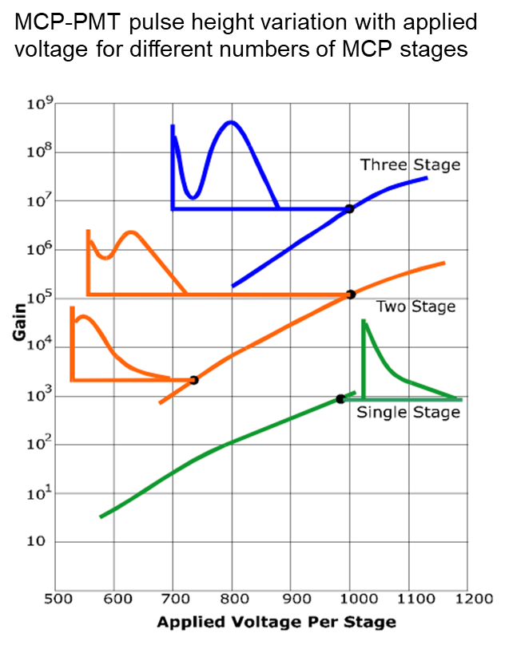
MCP-PMTs – the disadvantages
Gain Characteristics
Single photoelectron pulse height distribution
Characteristics of the microchannel plate design:
MCP glass has moderate secondary electron emission → large variance in gain per collision
Pore geometry and continuous dynode arrangement → varying electron trajectories
Varying gain per step and number of gain steps → high overall gain variance

Slide 5
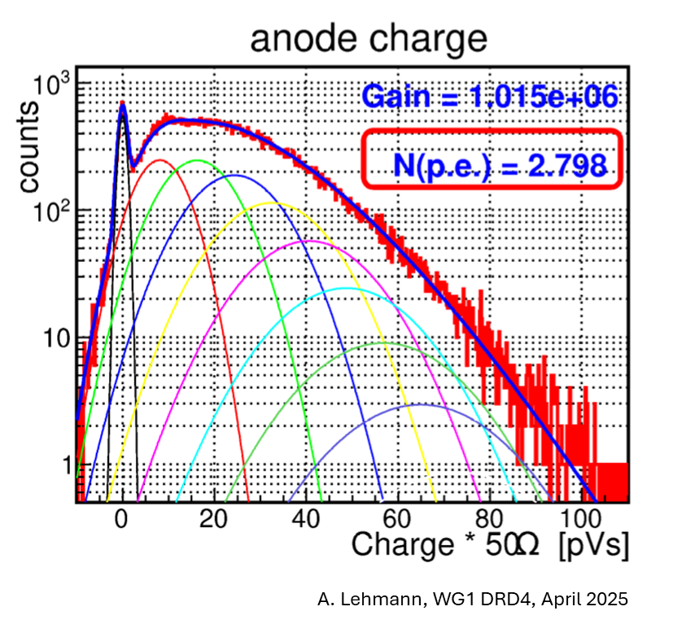
MCP-PMTs – the disadvantages
Gain Characteristics
Single MCP (~10³ gain) – negative exponential distribution
Two or more MCPs (10⁶ + gain) – pulse height saturation as gain increases
Pulse height saturation > 100% FWHM even at 10⁶ gain
poor single photoelectron resolution even at high gain
Compare with SiPM single photoelectron resolution!

Slide 6
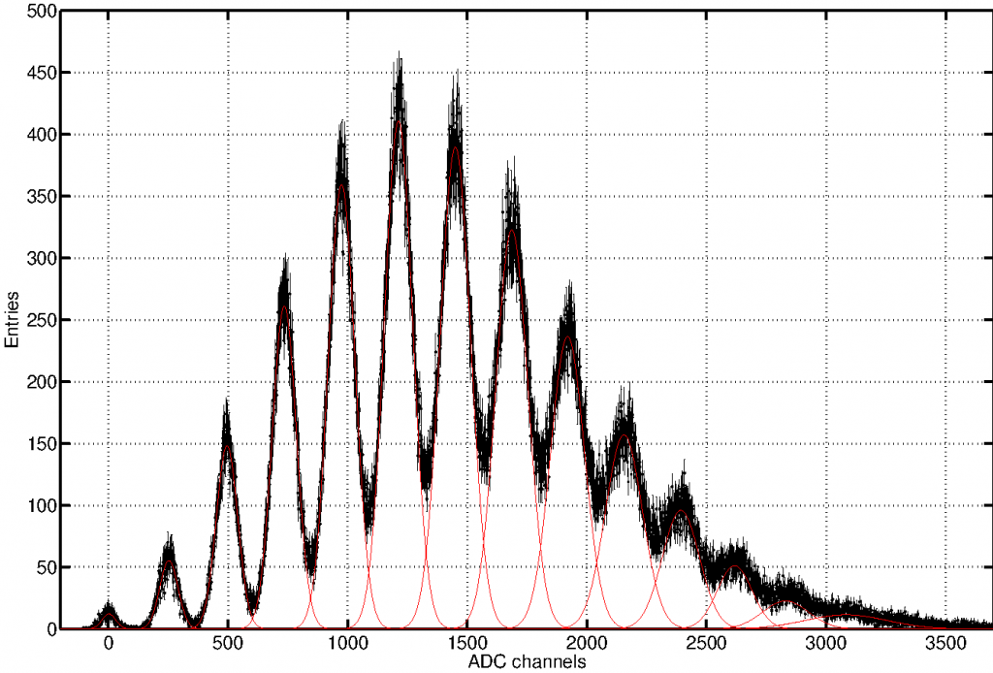
MCP-PMTs – the disadvantages
Gain Characteristics
Single MCP (~10³ gain) – negative exponential distribution
Two or more MCPs (10⁶ + gain) – pulse height saturation as gain increases
Pulse height saturation > 100% FWHM even at 10⁶ gain
poor single photoelectron resolution even at high gain
Compare with SiPM single photoelectron resolution!
Cf. SiPMs – can resolve single photoelectrons

Slide 7
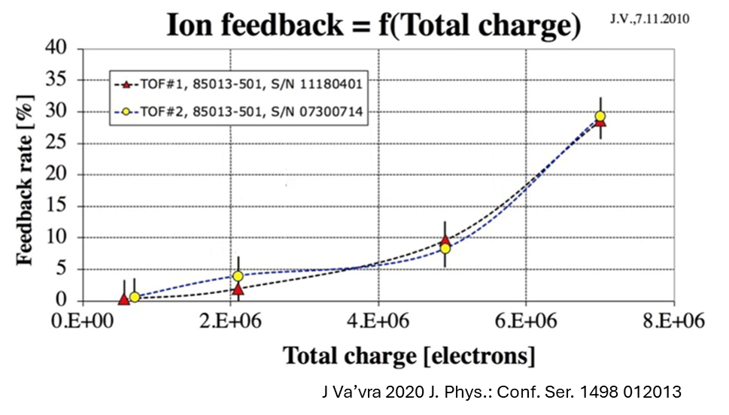
MCP-PMTs – the disadvantages
Lifetime Characteristics – negative effects of high gain
Electron avalanche in MCP mediates contaminant desorption
Desorption increases nonlinearly with MCP gain

Slide 8
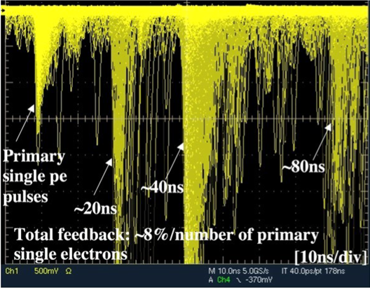
MCP-PMTs – the disadvantages
Lifetime Characteristics – negative effects of high gain
Electron avalanche in MCP mediates contaminant desorption
Desorption increases nonlinearly with MCP gain
Desorbed material ionized and drifts towards MCP input
→ Known as ion feedback
Ion collisions can instigate secondary event (afterpulsing)
J Va’vra 2020 J. Phys.: Conf. Ser. 1498 012013

Slide 9
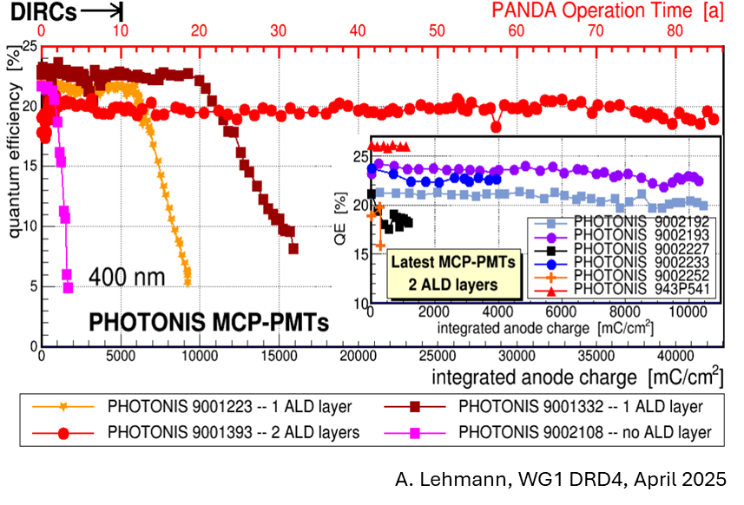
MCP-PMTs – the disadvantages
Lifetime Characteristics – negative effects of high gain
Ions which escape from MCP accelerate towards photocathode
Ion collision with photocathode damages photocathode
→ Degradation of photocathode quantum efficiency, QE (dependent on total extracted signal charge)
→ QE drops off faster at higher gain (for given detected event rate)

Slide 10
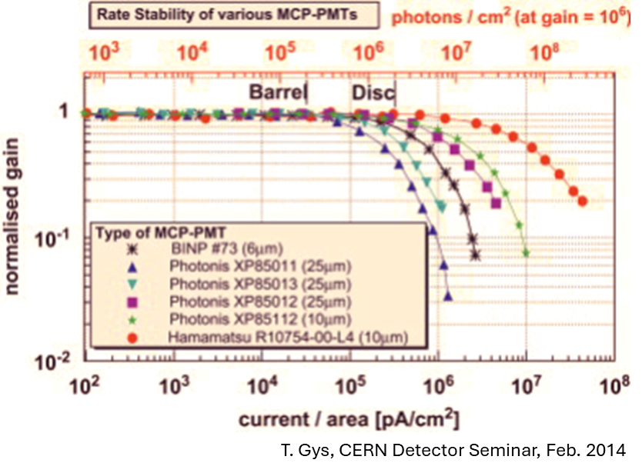
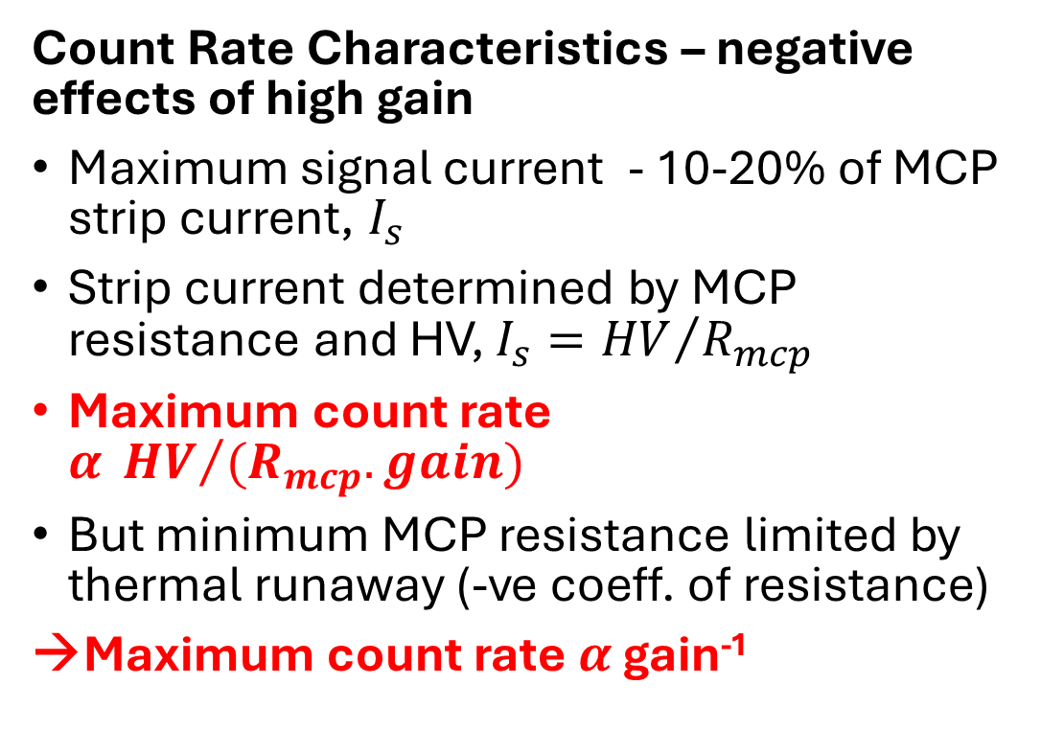
MCP-PMTs – the disadvantages
Count Rate Characteristics – negative effects of high gain
Maximum signal current - 10-20% of MCP strip current, $I_{s}$
Strip current determined by MCP resistance and HV, $I_{s}={HV}/{R_{mcp}}$
Maximum count rate $α {HV}/{{(R}_{mcp}.gain})$
But minimum MCP resistance limited by thermal runaway (-ve coeff. of resistance)
→Maximum count rate $α$ gain⁻¹

Slide 11
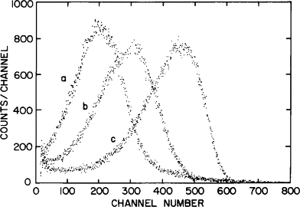
MCP-PMTs – the disadvantages
Count Rate Characteristics – negative effects of high gain
Saturated PHD with distinct valley required for thresholding and good photon counting statistics
Typically:
→ Minimum gain required >>10⁵

Slide 12
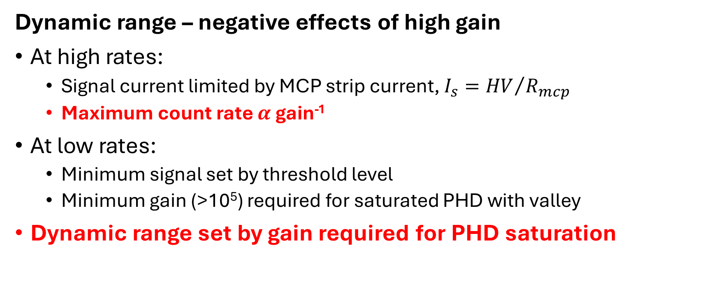
MCP-PMTs – the disadvantages
Dynamic range – negative effects of high gain
At high rates:
Signal current limited by MCP strip current, $I_{s}={HV}/{R_{mcp}}$
Maximum count rate $α$ gain⁻¹
At low rates:
Minimum signal set by threshold level
Minimum gain (>10⁵) required for saturated PHD with valley
Dynamic range set by gain required for PHD saturation

Slide 13
How do we escape MCP-PMT limitations?
Operation at reduced gain (without performance loss)
→ Increased lifetime, maximum count rate, dynamic range
Improve (narrow) pulse height distribution (without gain increase)
Possibility to run at lower overall gain
Lower gain increases maximum count rate
Lower gain also reduces ion feedback, increasing lifetime
Narrow PHD also improves SPE resolution and dynamic range
Physical technique to limit/prevent ion feedback to photocathode
Further improvement in lifetime
How to simultaneously achieve these objectives???

Slide 14
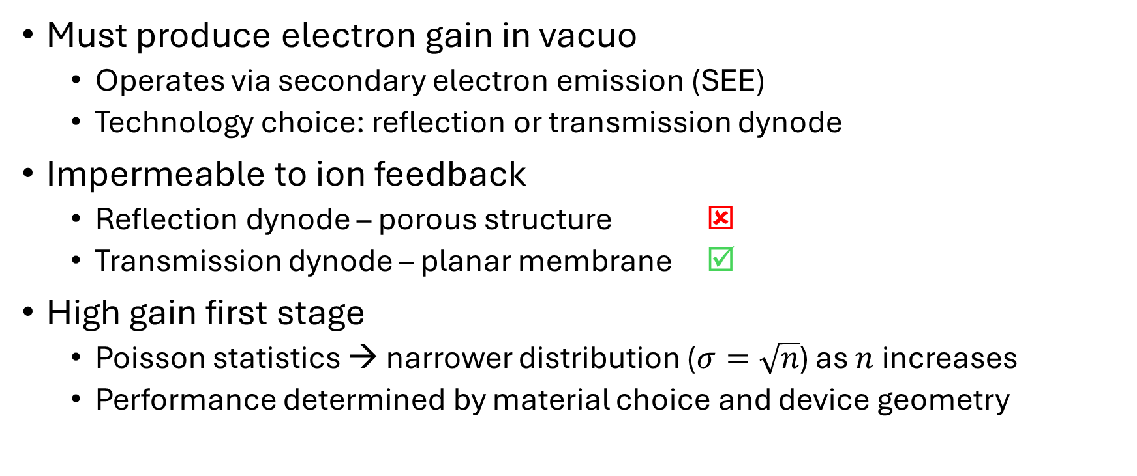
Technology Objectives
Must produce electron gain in vacuo
Operates via secondary electron emission (SEE)
Technology choice: reflection or transmission dynode
Impermeable to ion feedback
Reflection dynode – porous structure ☒
Transmission dynode – planar membrane ☑
High gain first stage
Poisson statistics → narrower distribution ($σ=\sqrt{n}$) as $n$ increases
Performance determined by material choice and device geometry

Slide 15
Recap: Secondary Electron Emission
Four processes:
Excitation – of energetic photoelectron
Thermalisation – to maximise # of secondary electrons
Transport – to dynode output
Emission – to vacuum

Slide 16
Recap: Secondary Electron Emission
Four processes:
Excitation – of energetic photoelectron
Generation of secondary electrons by interaction of primary electron
Absorption depth and number of secondaries related to primary electron energy and band gap
Thermalisation – to maximise # of secondary electrons
Thermalisation of initial energetic secondaries to ~conduction band minimum (CBM) energies
Transport – to dynode output
Transport efficiency dependent on scattering, trapping, and escape depth
Scattering: band gap influences number of conduction band electrons causing scatter
Trapping: dependent on crystallinity – defects cause traps, degrade efficient transport
Escape depth depends on primary energy and device geometry
Emission – to vacuum
Majority of secondary electrons thermalised – energies close to CBM
Dynode surface modification → Negative Electron affinity (NEA)
NEA allows electrons near CBM to be ejected into vacuum

Slide 17
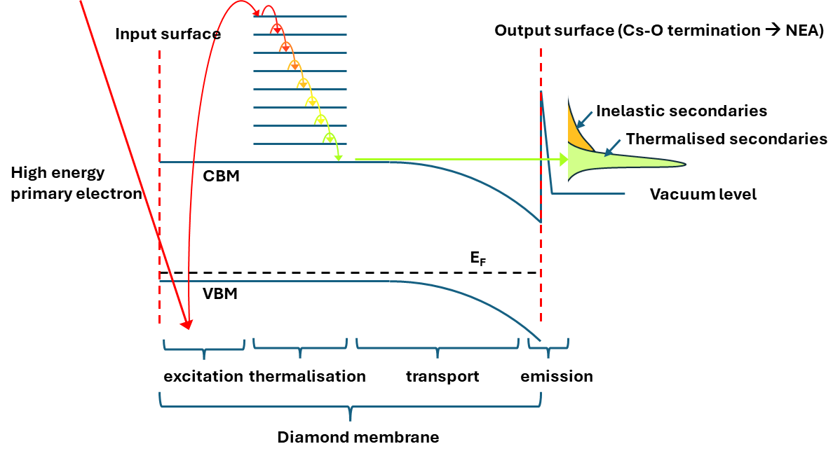
Band Structure of a Transmission Dynode

Slide 18
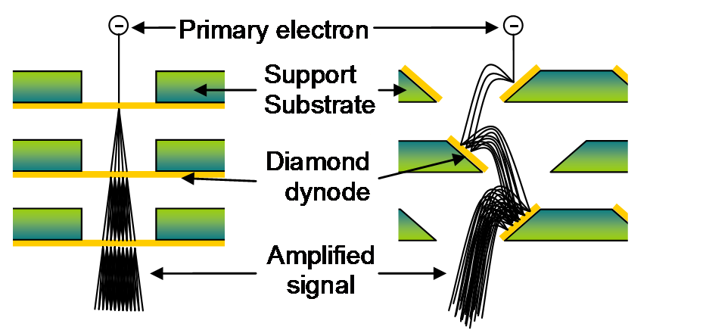
Reflection and Transmission Dynodes
Conventional PMTs
discrete dynodes in reflection mode
MCPs
continuous dynode in reflection mode
variable dynode length and number
large range of trajectories
Transmission dynode
Requires a thin membrane
Linear geometry – confined trajectories
Membrane is impermeable

Slide 19
How to improve the MCP-PMT?
Primary Design Goals
Prevent ion feedback reaching PC → overcome PC lifetime limitation
Reduce gain → maximise maximum count rate (MCP-limited)
Achieve tighter PHD → Better efficiency, counting statistics, electronics
How to achieve these simultaneously?
First gain stage impermeable to ion feedback
First gain stage achieves tight PHD by means of higher gain
Utilise discrete dynode in transmission mode (impermeable to ion feedback)
High gain by using high secondary electron yield material (diamond)
Implement a high gain diamond transmission dynode as first gain element

Slide 20
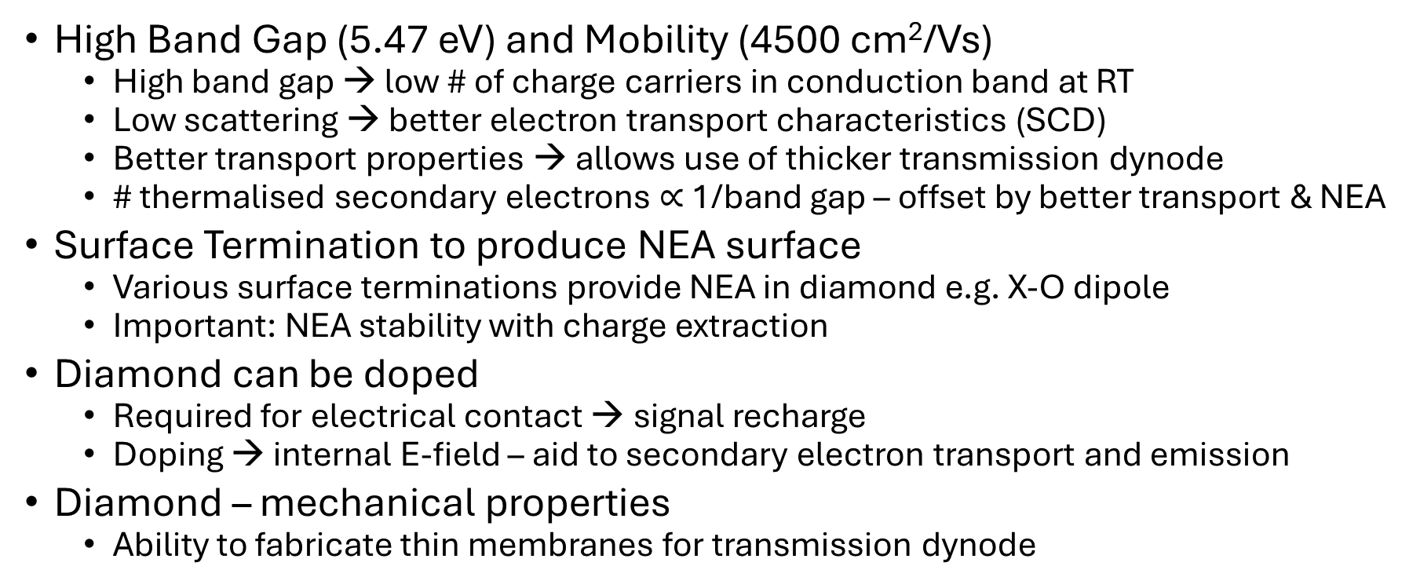
Diamond – a Suitable Dynode Material
High Band Gap (5.47 eV) and Mobility (4500 cm²/Vs)
High band gap → low # of charge carriers in conduction band at RT
Low scattering → better electron transport characteristics (SCD)
Better transport properties → allows use of thicker transmission dynode
# thermalised secondary electrons $∝$ 1/band gap – offset by better transport & NEA
Surface Termination to produce NEA surface
Various surface terminations provide NEA in diamond e.g. X-O dipole
Important: NEA stability with charge extraction
Diamond can be doped
Required for electrical contact → signal recharge
Doping → internal E-field – aid to secondary electron transport and emission
Diamond – mechanical properties
Ability to fabricate thin membranes for transmission dynode

Slide 21
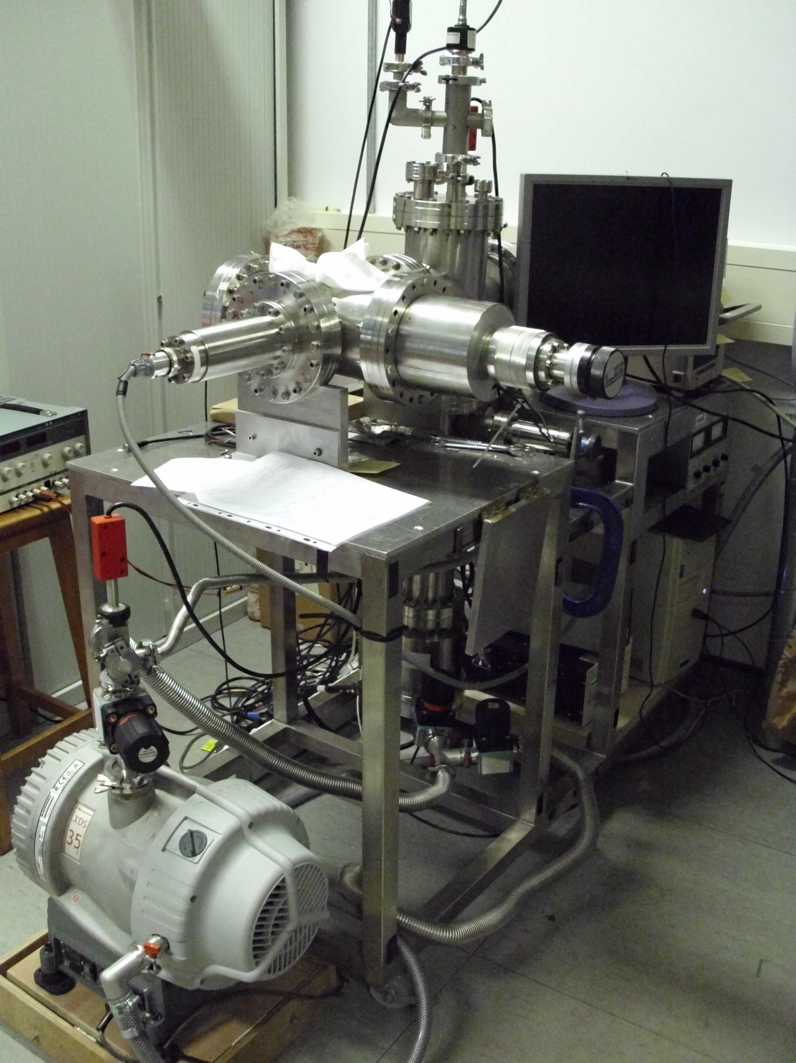
Previous work with diamond
Measured a high secondary electron yield – reflection mode only
Manufactured thin nanocrystalline diamond membranes– but transmission mode did not yield such good results
First tests using available polycrystalline diamond (PCD) material
Diamond SEE measurement

Slide 22
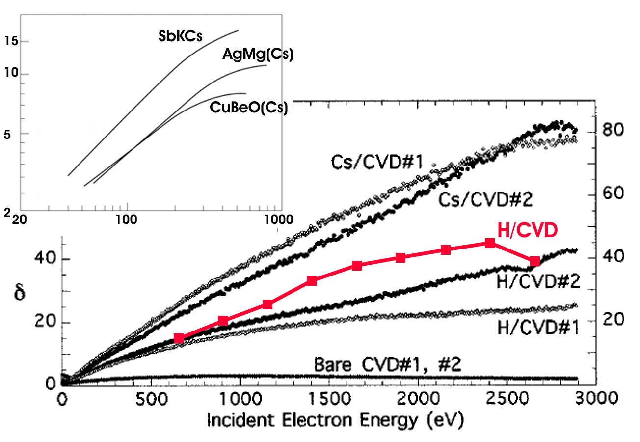
Previous work with diamond
PCD - graphitic grain boundaries which compromise electron transport
Problem for thin membranes
Transmission diamond dynodes require single crystal diamond (SCD)
No grain boundaries, defects, traps – large improvement in transport properties
SCD was not readily available
Gain Advantage of Diamond
Traditional dynode materials
Measured diamond secondary electron yield (reflection)

Slide 23
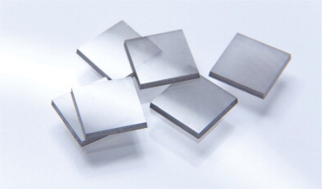
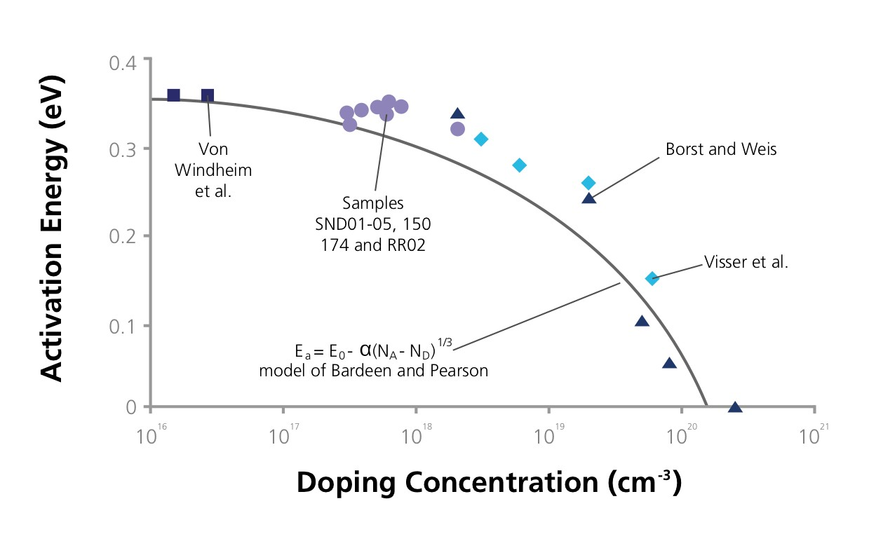
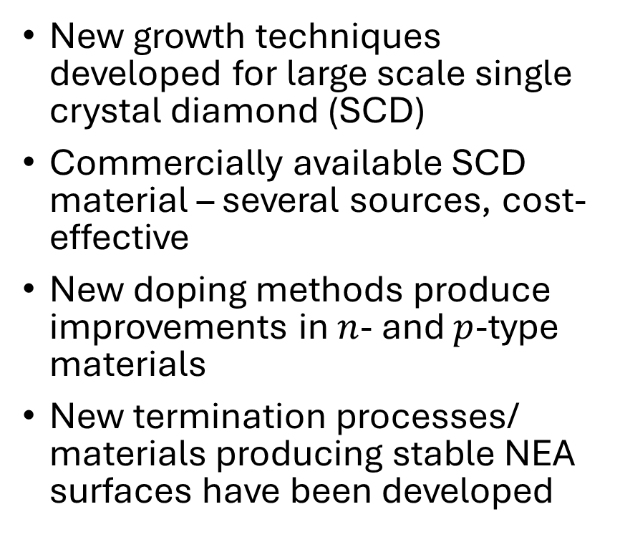
Recent Developments in Diamond
New growth techniques developed for large scale single crystal diamond (SCD)
Commercially available SCD material – several sources, cost-effective
New doping methods produce improvements in $n$- and $p$-type materials
New termination processes/ materials producing stable NEA surfaces have been developed
© Fraunhofer USA CMW

Slide 24
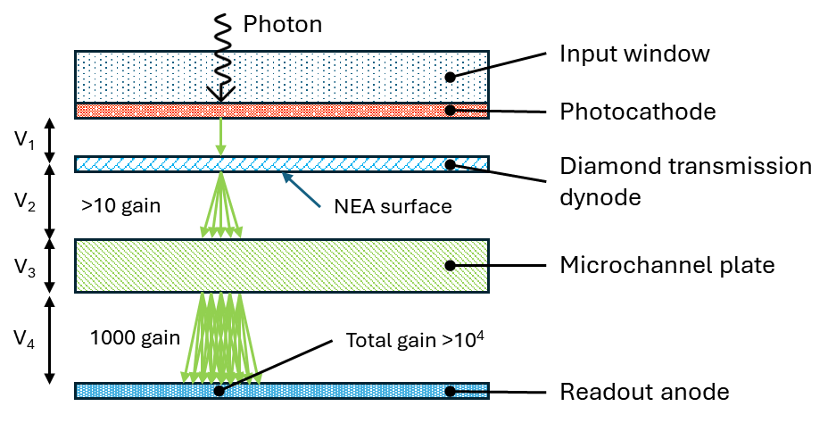
Proof-of-Concept Hybrid Detector

Slide 25
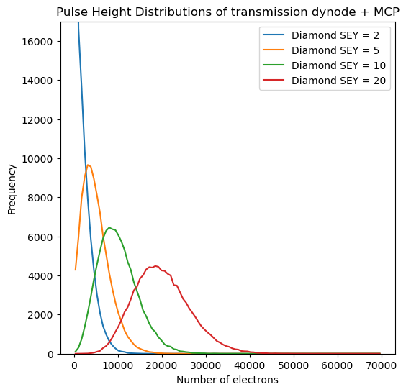
Proof-of-Concept Hybrid Detector
Initially trial a conservative approach
Transmission diamond dynode
→between photocathode and MCP
Provides a barrier for ion backflow
→ longer photocathode lifetime
Provides electron gain
→ Tight PHD at low gain
→ Higher maximum count rate
Thin diamond membrane
100’s nm – few μm thick
High OAR support structure
Diamond with NEA surface
Efficient charge extraction
Single MCP provides further amplification
→ but maintain overall low gain
Toy model of PHD for diamond-MCP-PMT for at range of diamond dynode gains

Slide 26
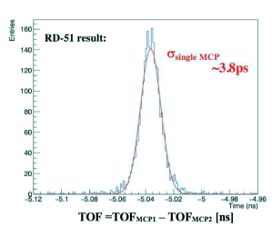
Proof-of-Concept Hybrid Detector
Initially trial a conservative approach
Transmission diamond dynode
→between photocathode and MCP
Provides a barrier for ion backflow
→ longer photocathode lifetime
Provides electron gain (10-20 gain)
→ Tight PHD at low gain
→ Higher maximum count rate
Thin diamond membrane
100’s nm – few μm thick
High OAR support structure
Diamond with NEA surface
Efficient charge extraction
Single MCP provides further amplification
→ but maintain overall low gain and timing
Va’vra 2020 J. Phys.: Conf. Ser. 1498 012013
A single MCP can achieve excellent time resolution in multi-photon mode – analogous to operation in hybrid detector

Slide 27
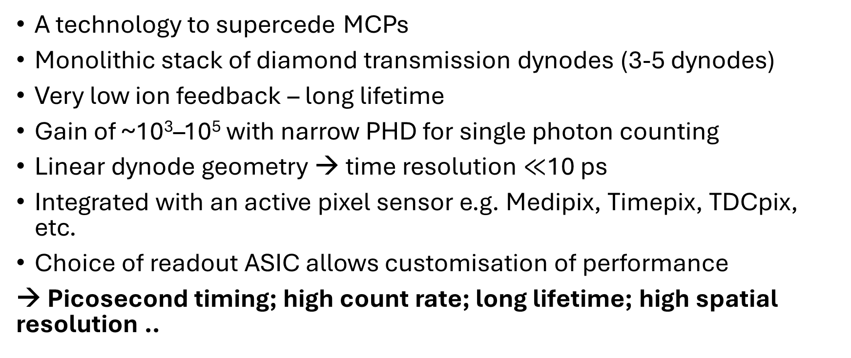
Long Term Vision
A technology to supercede MCPs
Monolithic stack of diamond transmission dynodes (3-5 dynodes)
Very low ion feedback – long lifetime
Gain of ~10³–10⁵ with narrow PHD for single photon counting
Linear dynode geometry → time resolution $≪$10 ps
Integrated with an active pixel sensor e.g. Medipix, Timepix, TDCpix, etc.
Choice of readout ASIC allows customisation of performance
→ Picosecond timing; high count rate; long lifetime; high spatial resolution ..

Slide 28
Project Team
University of Leicester – long heritage in space science inc. MCP-PMTs, development of alternative detector technologies inc. diamond dynodes
University of Bristol - expertise in diamond manufacture and use in energy applications, and detector development for high energy physics
University of Warwick - expertise in detector development for high energy physics with focus on photo-detector characterisation
University of Birmingham - expertise in detector development, characterisa-tion, technology survey, and comparison with state-of-the-art MCP-PMTs
Photek - one of the leading worldwide manufacturers of vacuum tube devices with more than 25 years of custom detector design and fabrication expertise
This project is part of the Vacuum-based Photodetectors programme within DRD4 WP4.2

Slide 29
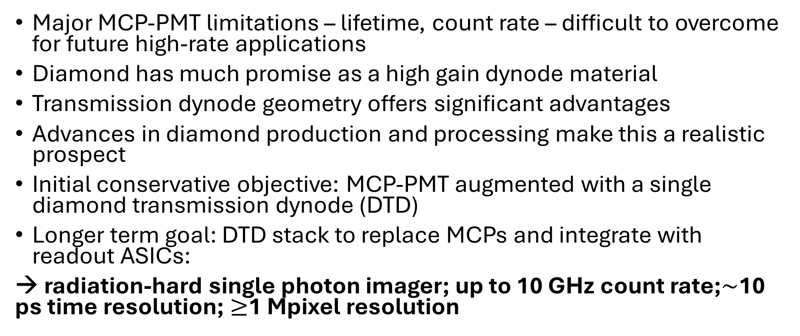
Summary
Major MCP-PMT limitations – lifetime, count rate – difficult to overcome for future high-rate applications
Diamond has much promise as a high gain dynode material
Transmission dynode geometry offers significant advantages
Advances in diamond production and processing make this a realistic prospect
Initial conservative objective: MCP-PMT augmented with a single diamond transmission dynode (DTD)
Longer term goal: DTD stack to replace MCPs and integrate with readout ASICs:
→ radiation-hard single photon imager; up to 10 GHz count rate;$\sim$10 ps time resolution; $≥$1 Mpixel resolution

