Slide 1



A RICH detector for the ALADDIN experiment
Elisabetta Spadaro Norella
University and INFN Genova, Italy
On behalf of ALADDIN Collaboration
RICH25 - 18/09/25

Slide 2
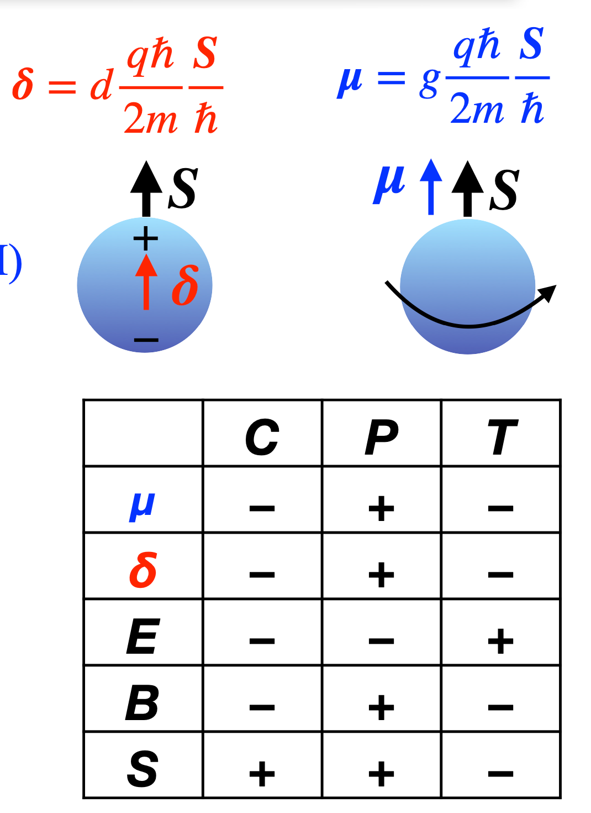

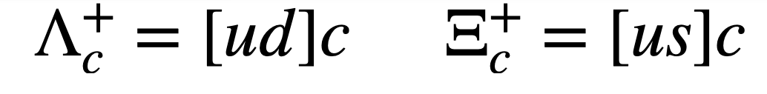
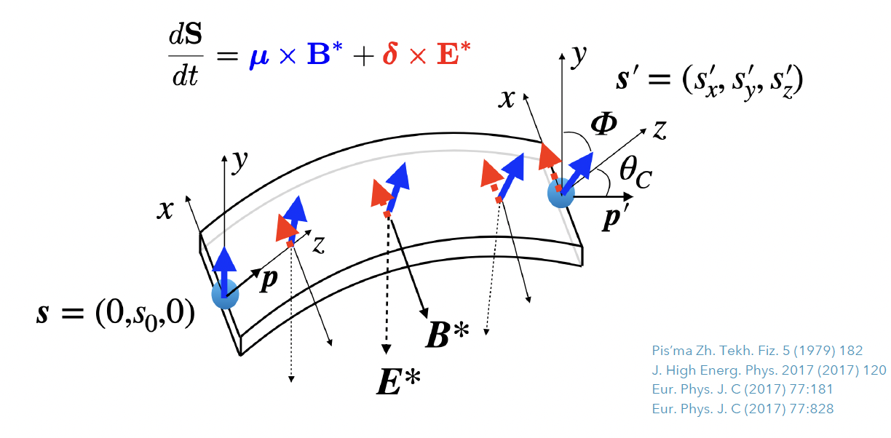

Electromagnetic dipole moments of charm baryons
MDM:
Naive quark model prediction:
Anchor point for low-energy QCD models
EDM:
If EDM ≠ 0: source of CPV beyond SM (EDM violates T, P and CP)
No measurement to date for short-lived charm baryons because of
Short lifetime:
Decay length:
$$cτ≈100 μm$$
$$γ≈500 γcτ≈5 cm$$
EDM/MDM measurement = spin precession induced by interaction with intense electromagnetic field
Channeling in Bent crystals:
Spin precession
thanks to intense fields
( E ~1 GeV/cm, B ~500 T)

Slide 3
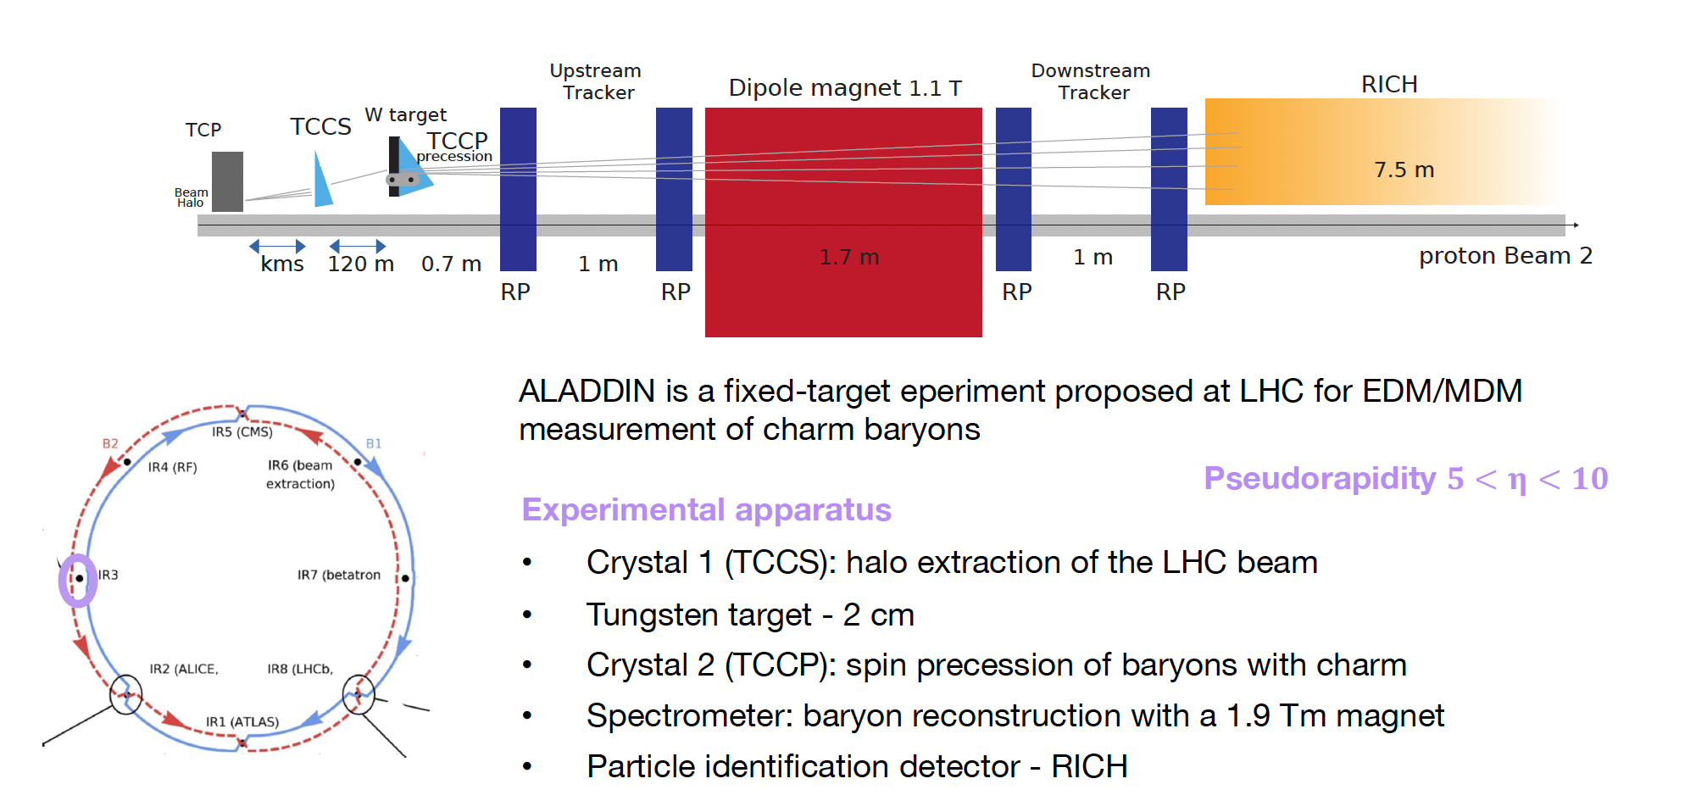
ALADDIN experiment
ALADDIN (An Lhc Apparatus for Direct Dipole moments INvestigation) is a fixed-target experiment proposed for EDM/MDM measurement of charm baryons
Experimental apparatus
Crystal 1 (TCCS): halo extraction of the LHC beam
Tungsten target – 2 cm
Crystal 2 (TCCP): spin precession of baryons with charm
Spectrometer: tracks reconstruction with a 1.9 Tm magnet
Particle identification with RICH
Pseudorapidity 5<y<10
Expected sensitivity for MDM of $2×{10}^{−2}μ_{N}$ and EDM of $3×{10}^{−16}ecm$ with ${10}^{13}$ PoT

Slide 4
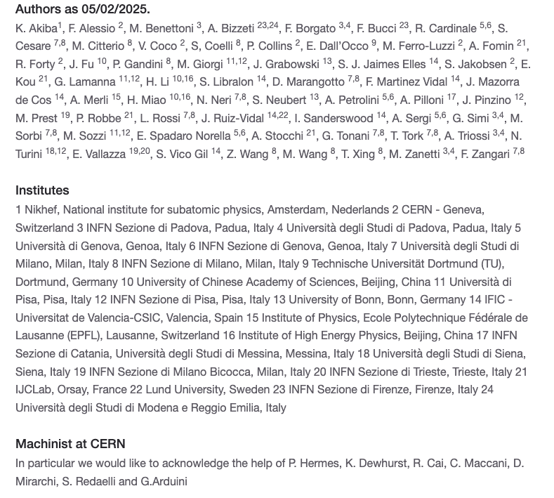
The ALADDIN Collaboration
Spokeperson: Nicola Neri
Physics Coordinator: Fernando Martinez Vidal
CB Chair: Roberta Cardinale
~70 members from 24 institutes in 8 countries
Website: https://aladdin.web.cern.ch/

Slide 5
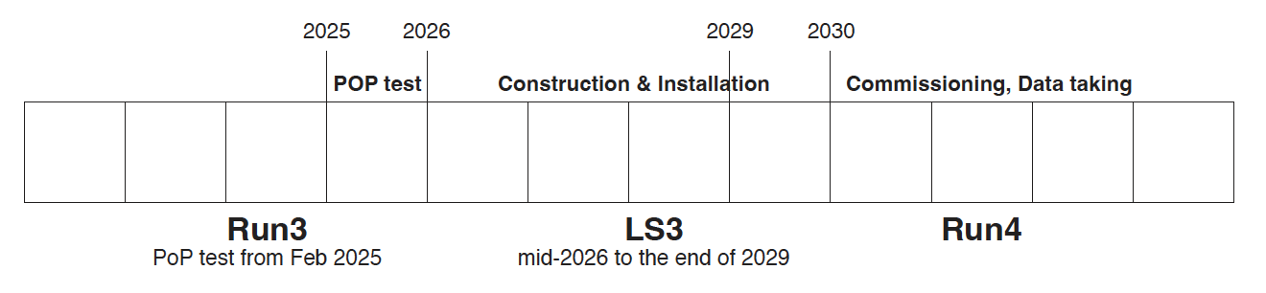
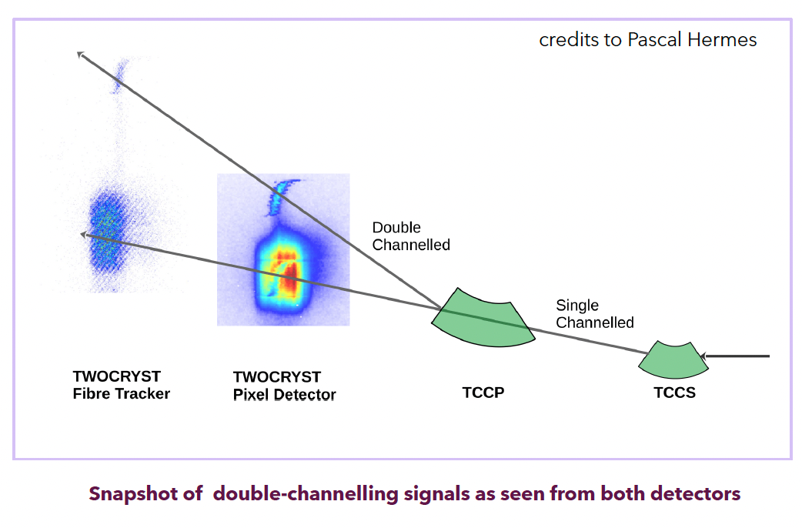
ALADDIN schedule and TWOCRYST
ALADDIN schedule:
Letter of Intent (LoI) was submitted in June 2024 → Very positive response from the LHCC committee
TDR is in preparation
Installation during a YETS in Run4
Data-taking in Run4
Result of June MD run
TWOCRYST is a proof-of-principle (PoP) test approved by the LMC committee and installed in March 2025
to demonstrate feasibility of double channeling at TeV energy
Preliminary results of double channeling: observed at 450 GeV, 1 and 2 TeV in MD tests but analyses are still in progress, especially at higher energies
Preliminary
See CERN bulletin

Slide 6
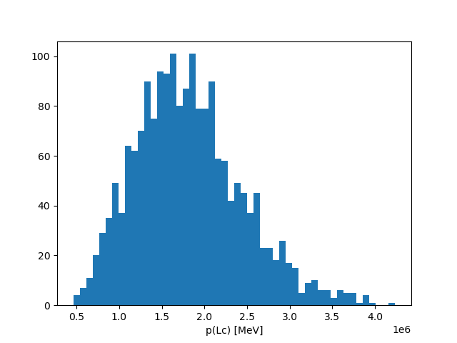
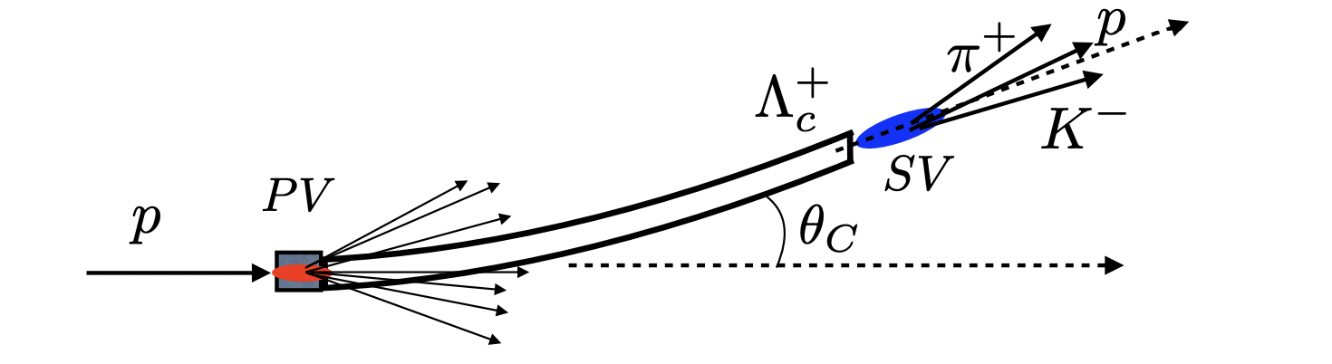
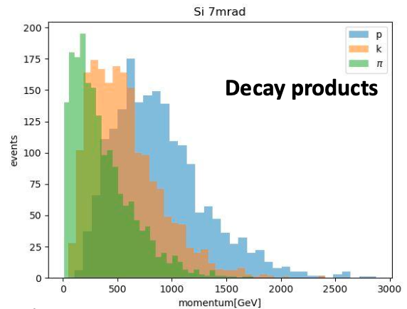
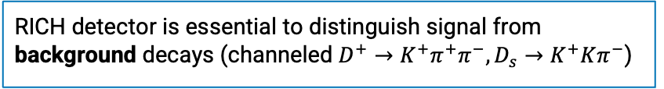
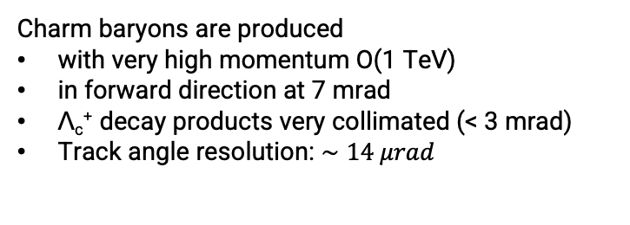
Λ_{c}⁺ signal and identification
Momentum of Λ_{c}⁺
Charm baryons are produced
with very high momentum O(1 TeV)
in forward direction at 7 mrad
Λ_{c}⁺ decay products very collimated (< 3 mrad)
Track angle resolution: $∼14 μrad$
RICH detector is essential to distinguish signal from background decays (channeled $D^{+}→K^{+}π^{+}π^{−}, D_{s}→K^{+}Kπ^{−}$)

Slide 7
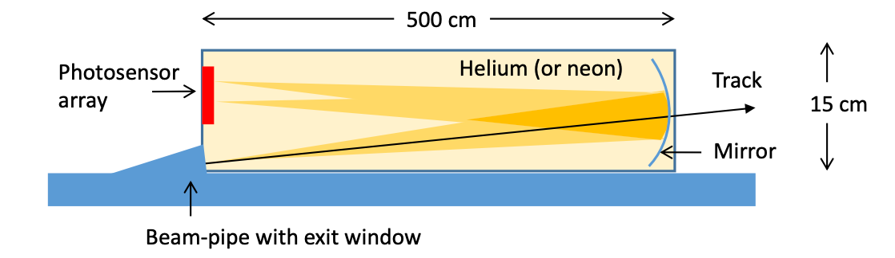
The ALADDIN RICH detector
Long vessel RICH radiator filled with He or Ne, originally proposed in LoI by R. Forty
Notes:
The original proposal made by Roger Forty consists of a long vessel radiator filled with He/Ne, low refractive index gases. An exit window is placed at the entrance of the RICH. And a simple layout of one spherical mirror is designed to deflect oparticles onto a photodetector plane.

Slide 8
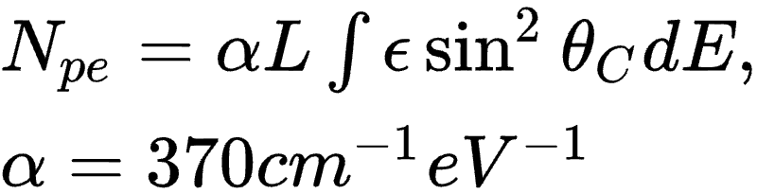
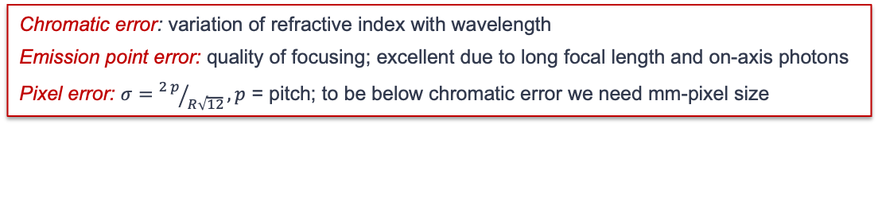

RICH requirements
The RICH layout is chosen in order to achieve:
Good separation for particles at O(1 TeV)
Maximum photon yield ➔ increasing the vessel length L
Small Cherenkov resolutions, currently limited by chromatic and pixel size error
Keep system compact: vertical direction (~70 cm) and along beam (~29 m max)
ε = quantum efficiency (PDE)
+ geom acceptance
+ mirror reflectivity
+ front-end efficiency
Chromatic error: variation of refractive index with wavelength
Emission point error: quality of focusing; excellent due to long focal length and on-axis photons
Pixel error: $σ={2 p}/{R\sqrt{12}}, p$ = pitch; to be below chromatic error we need mm-pixel size
$$σ_{tot}\sim 50 μrad$$
New space request
under consideration
Notes:
How can we build the best detector for our phycsi case? The choice of the layout is driven by these requirements.
The RICH need to satisfy these requirements which are driven the choice of the definite layout. The design of the RICH detector is a compromise btw efficiency in different requirements.1
Good separation up to 1 Te
Maximum photon yield → in order to increase the yield with respect to the original layout we want to increase the length. Npe is the integral of the sinthetac where the efficiency accounts for all sources of inefficiency, especially the sensor QE or PDE as illustrated in the fig. on the right for the MCCP of hamamatzu.
For building a good RICH detector we need to maintain small ckv angle uncertainty, currently limited by chromatic and pixel size error. We optimize the choice with various contributions

Slide 9
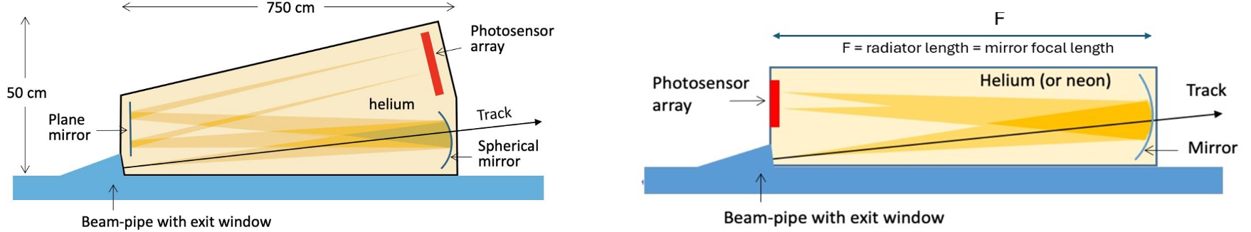

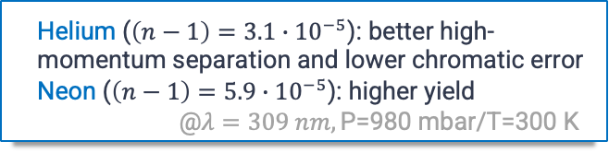
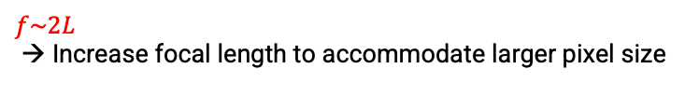
Detector options
Different geometries and gas options are under investigation:
Single reflection, 12-20 m long vessel
Double reflection, 7.5-12 m long vessel
Helium ($\left(n−1\right)=3.1{∙10}^{−5}$): better high-momentum separation and lower chromatic error
Neon ($\left(n−1\right)=5.9{∙10}^{−5}$): higher yield
@$λ=309 nm, \text{P}\text{=980 }\text{mbar}\text{/}\text{T}\text{=300 }\text{K}$
PDA
$$f\sim L$$
→ Optimal solution if sufficient space is available
$$f\sim 2L$$
→ Increase focal length to accommodate larger pixel size
Photodetector technology: SiPM or MCP of mm-pixel size

Slide 10
Layout studies & methods
OpticaEM [1], a customizable framework for optics (geometrical and wave) calculations, built on top of WOLFRAM Mathematica©; to define layout and performances.
Geant4 simulation to include realistic event generation, Cherenkov photon emission and detection, and background studies.
[1] https://www.opticasoft.com/support

Slide 11
Layout definition with OpticaEM

Slide 12
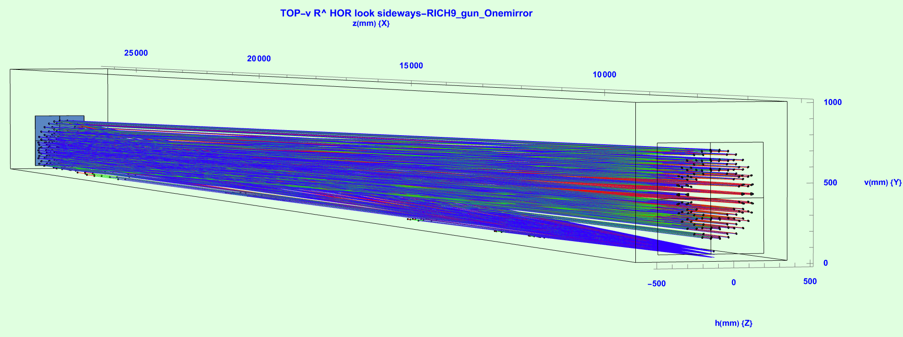
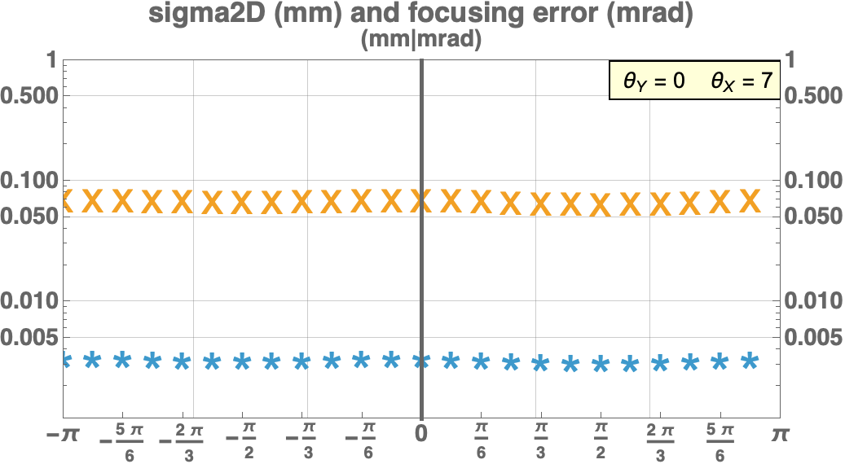


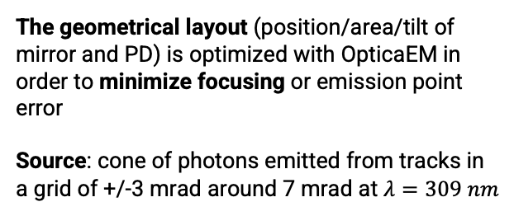
Geometrical layout with Optica
The geometrical layout (position/area/tilt of mirror and PD) is optimized with OpticaEM in order to minimize focusing or emission point error
Source: cone of photons emitted from tracks in a grid of +/-3 mrad around 7 mrad at $λ=309 nm$
Mirror
PD
Ne, 20m long, single reflection
Focusing/Emission point error:
Definition:= radial distance between first-last emitted photon on the PD $∙1/\sqrt{12}$(sigma2D)/$f_{eff}$,
where $f_{eff}$= track path length
Focusing is flat in $φ$and small (~3 $μrad$)
PD position can be further optimized to reduce focusing to 0, but already negligible
For a given track, as a function of $φ$

Slide 13
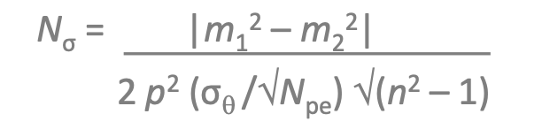
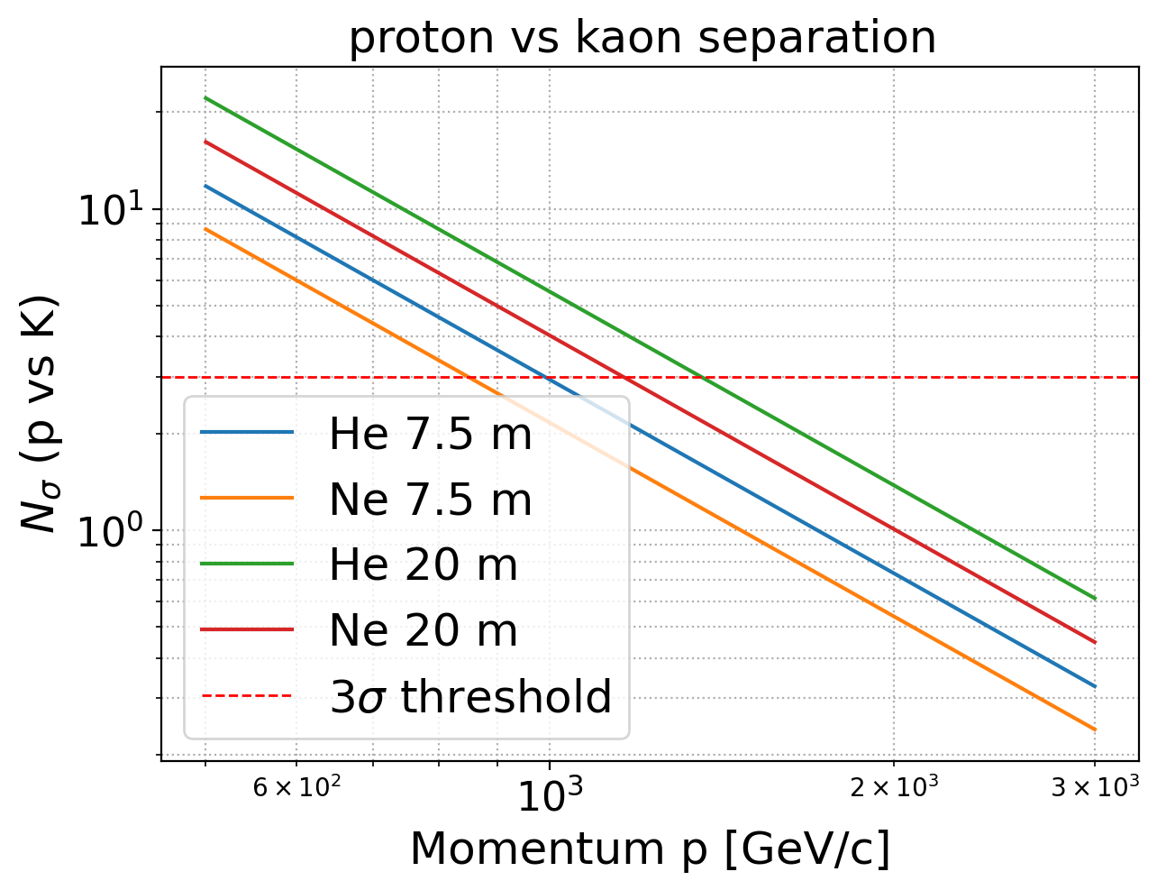
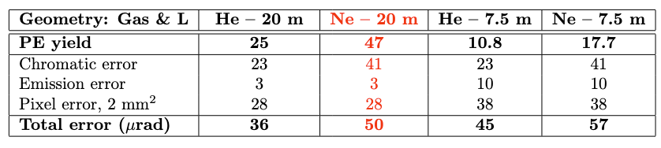
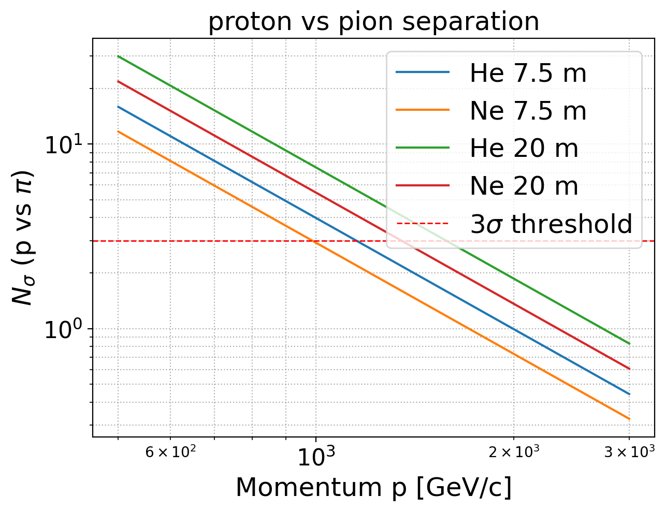

Results and PID separation
Preliminary PID Separation:
Performance for different layout comparisons @ P=980 mbar/ T=300 K and SiPM as photosensor
Single reflection
Double reflection
p/K
Geometry:
Single reflection with 20 m long radiator is preferable to increase photon yield
Double reflection as a backup solution in case space is not enough (up to results of beam dynamics simulations)
Gas: Ne = best gas radiator to increase photon yield
p/$π$
3$σ$ separation for Ne - 20m up to ~1.4/1.2 TeV for p/$π$ and p/K

Slide 14
Geant4 simulation

Slide 15
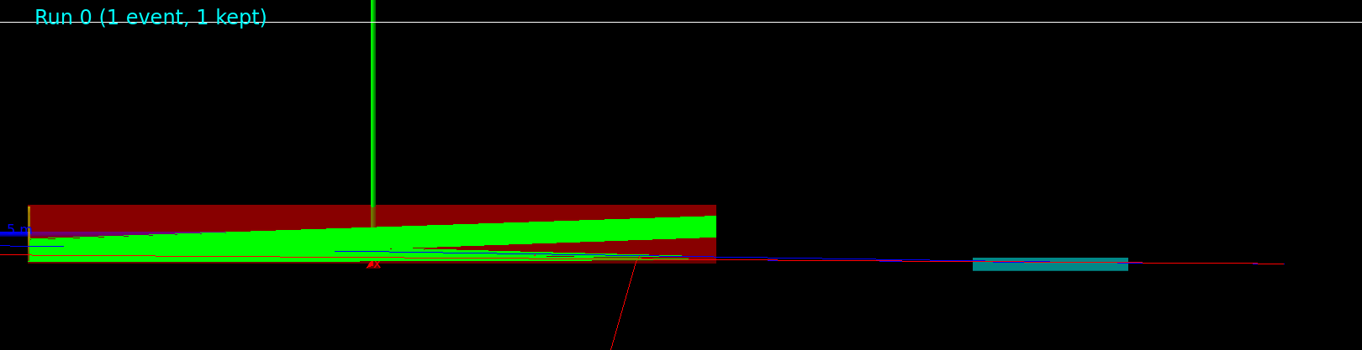
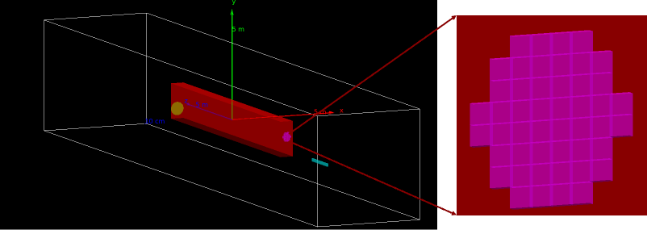
Full simulation with Geant4
Geometry: single reflection with length L=20 m,
RICH-TCCP distances varing assuming up to (29 m – L) available space
Origin: center of the RICH radiator
Mirror: R = 2L = 40 m
Photodetector: array of 53x53 mm² pixels
Ideal scenario: inefficiencies are not considered, i.e. QE/PDE, mirror reflectivity and gas absorption.
Event display
Optimization studies:
Position/dimensions of entrance window
RICH position to reduce photon losses
Choice of pixel granularity
Separation between signal & background tracks

Slide 16
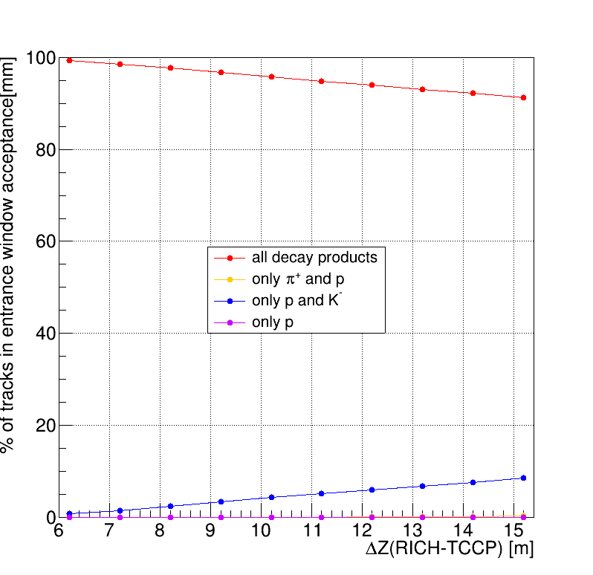
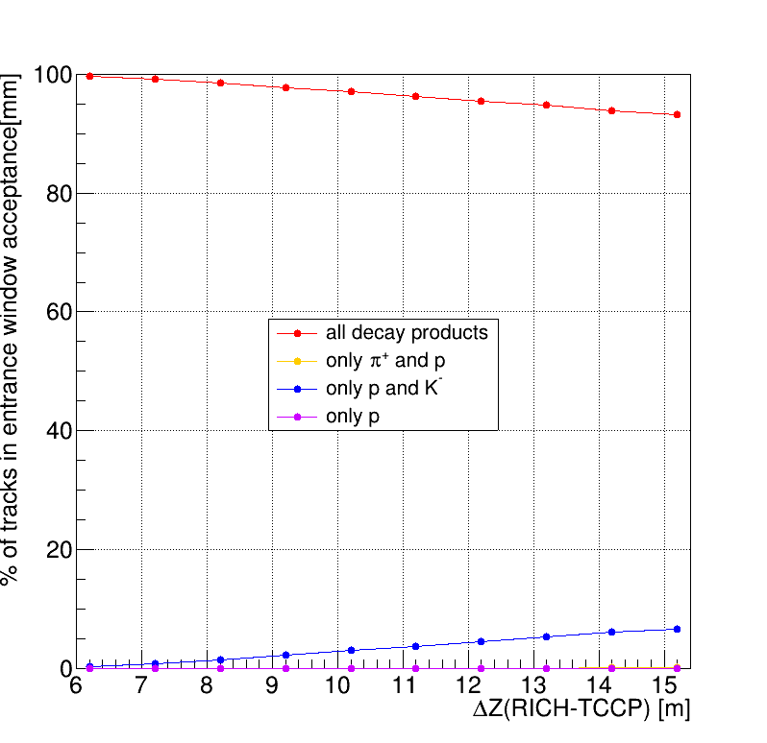
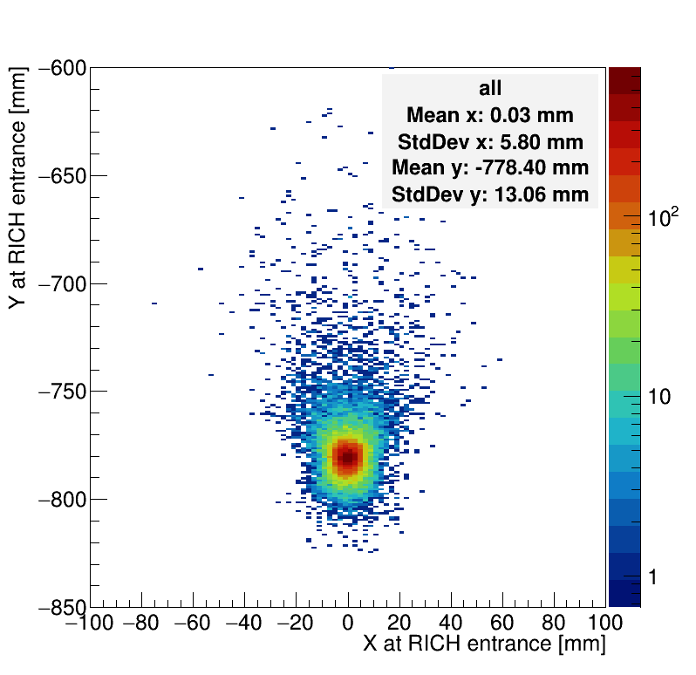


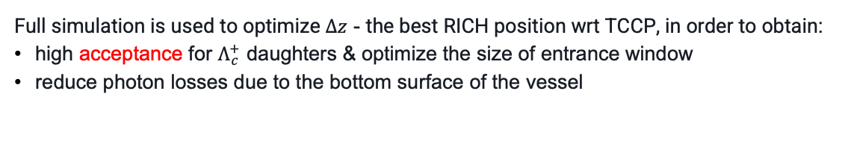


RICH position and photon losses
20 m long vessel
Full simulation is used to optimize $Δz$ - the best RICH position wrt TCCP, in order to obtain:
high acceptance for $Λ_{c}^{+}$ daughters & optimize the size of entrance window
reduce photon losses due to the bottom surface of the vessel
Distribution of tracks from $Λ_{c}^{+}→pK^{−}π^{+}$ at the RICH entrance for $Δz=6.2 m$
Track acceptance for different entrance window sizes as a function of $Δz$
$$80×100 mm^{2}$$
$$100×120 mm^{2}$$
Constraint due to the beam pipe
Notes:
First to keep high acceptance for Lc daughters. You can see the hit profiles at the RICH entrance on the left

Slide 17
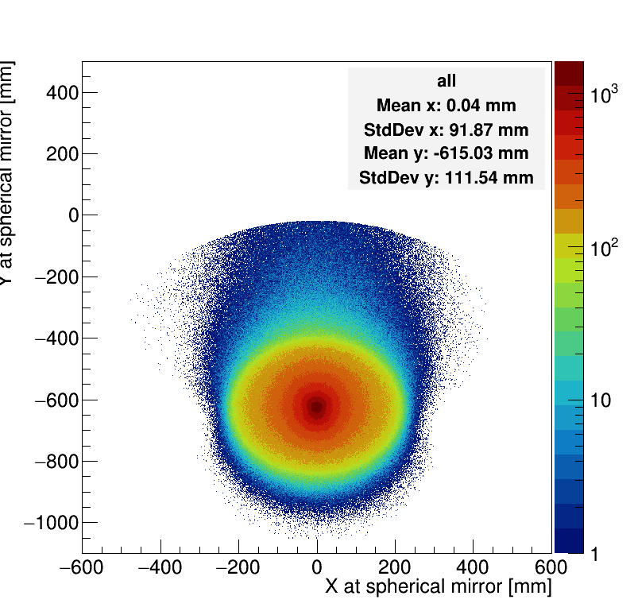
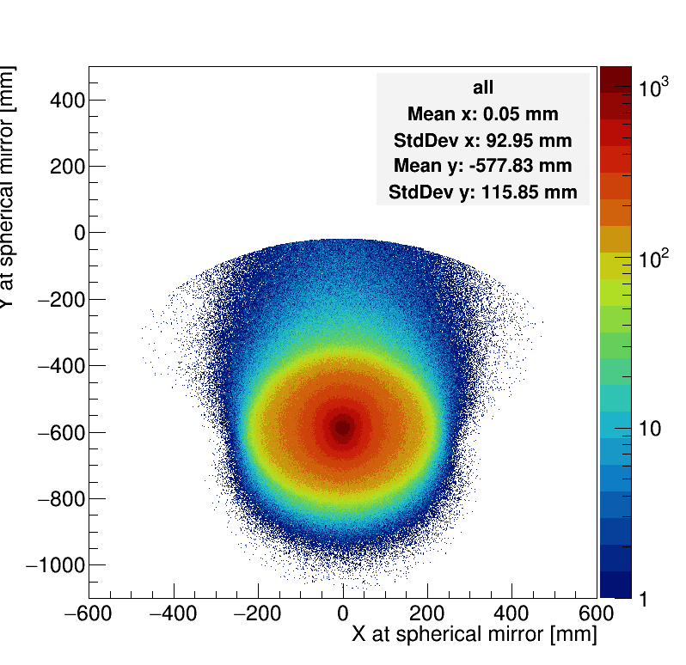




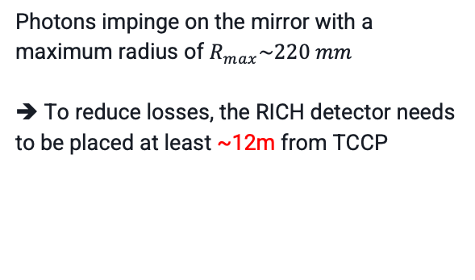

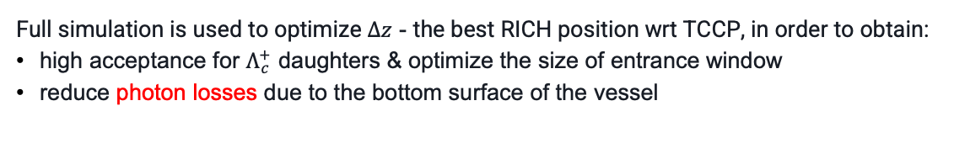

RICH position and photon losses
20 m long vessel
Full simulation is used to optimize $Δz$ - the best RICH position wrt TCCP, in order to obtain:
high acceptance for $Λ_{c}^{+}$ daughters & optimize the size of entrance window
reduce photon losses due to the bottom surface of the vessel
radiator
Photon distribution at the mirror
Photon cone
$Δz$ = $7.2 m$
$Δz$ = $12.2 m$
track
$pπ^{+}K^{−}$
$pπ^{+}K^{−}$
beampipe
Photon losses
Photons impinge on the mirror with a maximum radius of $R_{max}\sim 220 mm$
➔ To reduce losses, the RICH detector needs to be placed at least ~12m from TCCP
$$∼185 mm$$
$$∼222 mm$$
Constraint due to the beam pipe

Slide 18





p/K/$π$ separation and pixel granularity
p/K/$π$ separation needs to be evaluated as a function of the pixel size
Two possile solutions with MCPs/SiPM: $16×16$channels ($∼3$ mm pitch); $32×32$channels ($∼2$ mm pitch)
For each track, we compute:
Expected ring center position and ring radius, $R_{exp, m}$, under the 3 mass hypotheses: $m_{p}\left(blue\right), m_{K}\left(orange\right), m_{π }(green)$
16x16 segmentation
Kaon track
$${ΔR}_{Kaon}$$
$$R_{exp, K}$$
Expected ring center position
$${ΔR}_{proton}$$
$$σ∼1 mm$$
Separation between tracks if $ΔR_{mK}−{ΔR}_{mp}$ $>$ $σ ($ring resolution)
➔ Segmentation of 16x16 is already at the limit to distinguish between p-$π$ tracks in the ideal scenario
Notes:
We studied p/k/pi separation as a function of the pixel size with two different pixelization for MCPs/SipMs devised: 16x16 channels which correspond to 3mm pitch and 32x32 channels
For each track as re constructed by the tracker, as illustrated below for the case iof 16x16 segmentation, we compute the expected ring center position and the expected ring radius under the three mass hypo. And on the right you see the separation computed for a pion track as the difference btw the expected radius and the radius of each hit in the ring, where we defined the separation as the difference btw the spread the spread of the ring larger than the resolution. We obtained that a segmentation of 16x16 is already at the limit for a good separation.

Slide 19
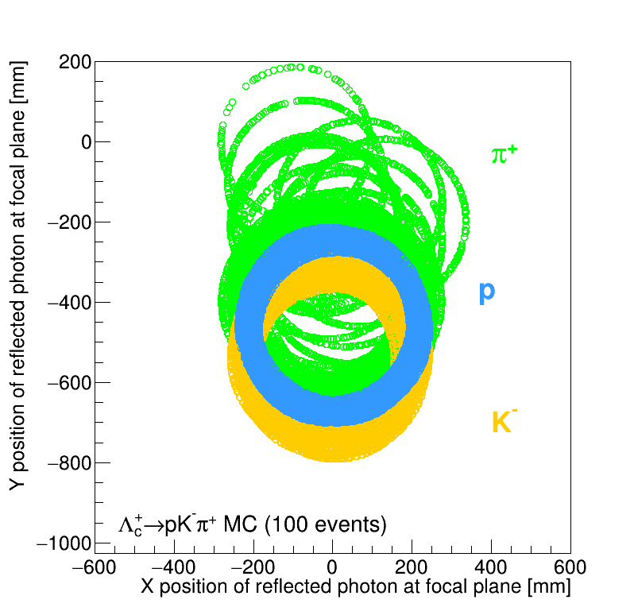
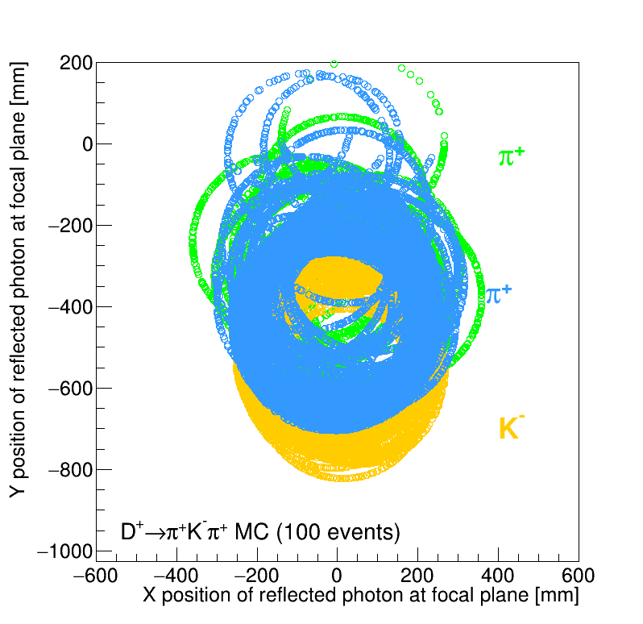
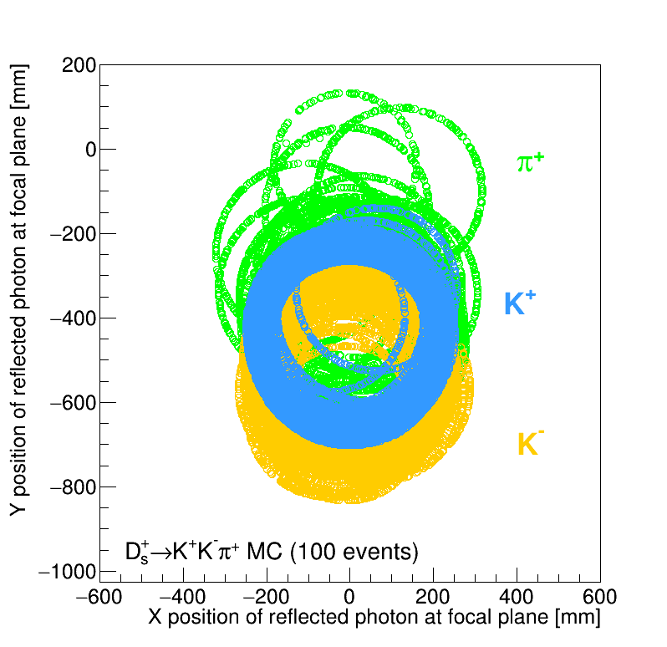


Signal separation from $D^{+}/D_{s}$ background
One of the background sources is from decays of channeled $D^{+}, D_{s}$charmed hadrons
Focal plane illumination plots for signal and background decays in single reflection 20 m vessel
$$π^{+}$$
$$K^{−}$$
signal
background
➔ To identify signal events wrt backgrounds: good separation between $p$of signal decay and $π^{+}/K^{+}$ of background decays
NEXT: The $π^{+}/p$ and $K^{+}/p$ separation needs to be evaluated as a function of the pixel size

Slide 20
R&D of photodetectors:
SiPM vs MCP

Slide 21
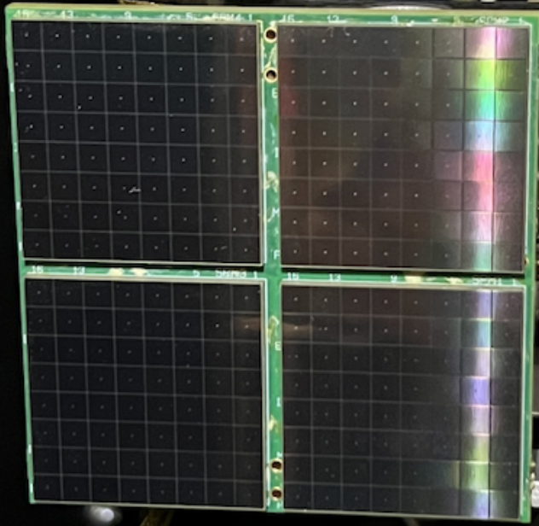
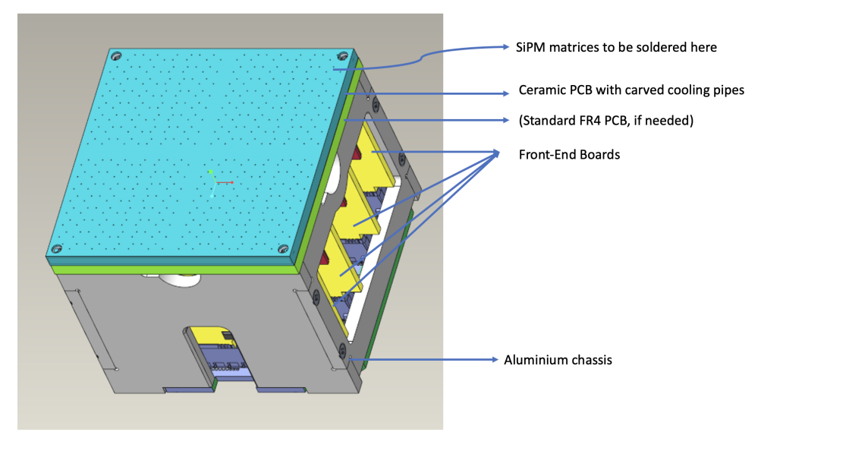
Photosensor option: SiPM
R&D from Genoa group
SiPM/MCCP: high detection efficiency and fine granularity.
It might need active cooling to control dark count rates
BaseBoard:
SiPM/MPPC matrixes,
8 x 8 pixel array of 3 mm
(Hamamatsu
S13361-3050NE-08)
Prototype module is designed to house SiPM/MPPCs, featuring integrated active cooling:
In collaboration with LHCb/RICH and within the DRD4-WP3 and WP4
Built on the Elementary Cell (EC) layout [1] which currently houses MaPMTs for the LHCb/RICH Upgrade I
Integrated active cooling using Ceramic PCB with fluid coolant circulation; to cool down a small region as low as −60 ℃/−80 ℃ (see R. Cardinale’s talk)
Readout by ALCOR v2.1 chip
[1] https://arxiv.org/pdf/2305.10515
EC with Ceramic PCB

Slide 22
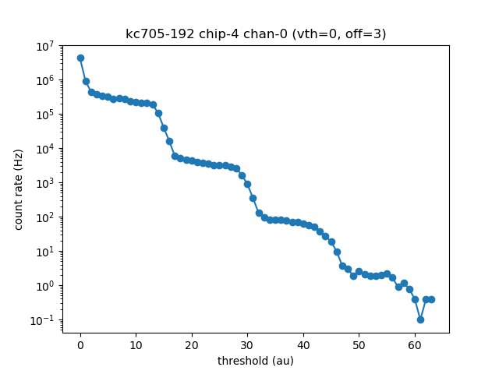
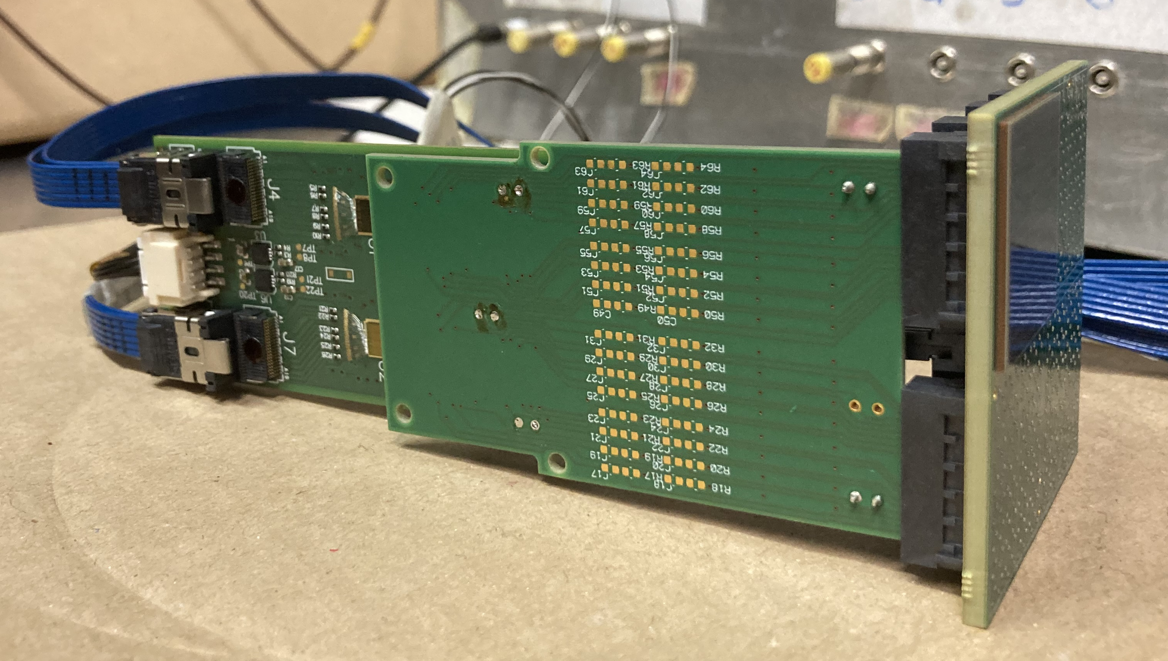
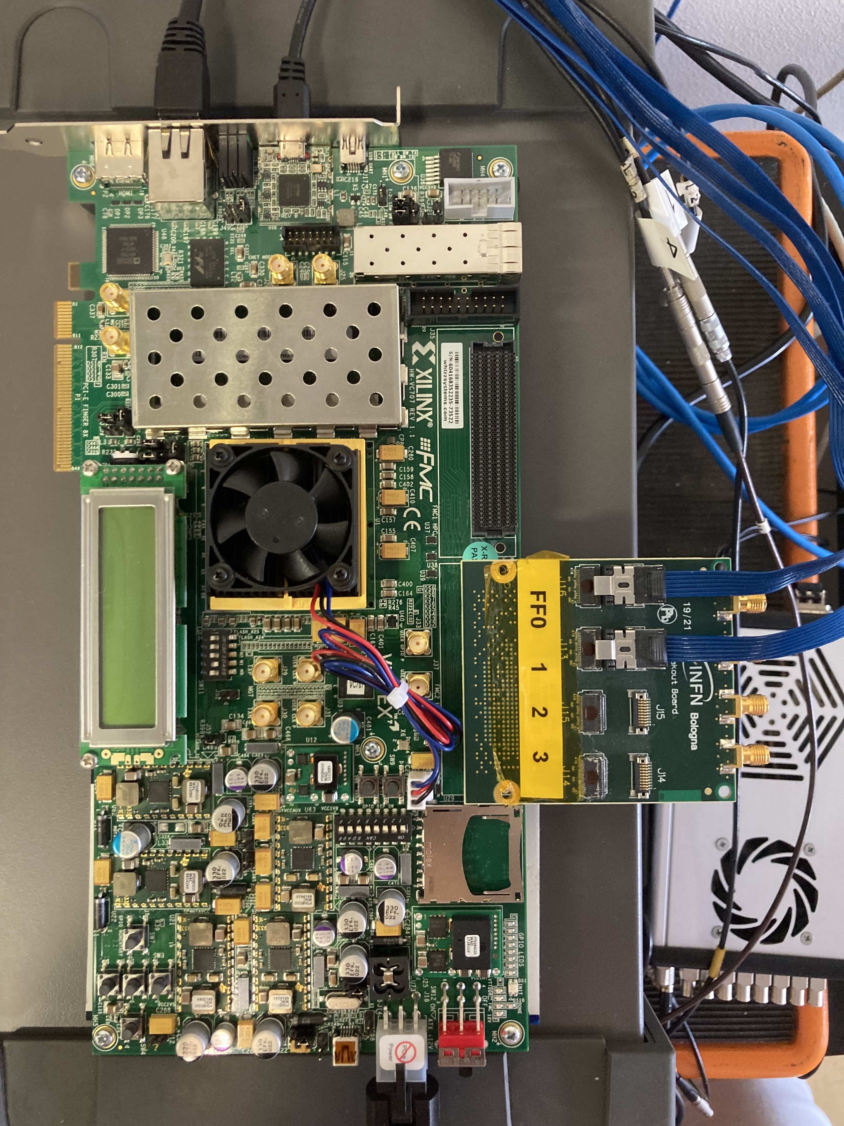
Setup with ALCOR chip
New front-end setup assembled in Genoa in collaboration with INFN-TO and INFN-BO under the DRD4 collaboration
FE electronics: ALCOR FE-DUAL + ALCOR v2.1 (32 channels) (INFN Torino)
PCB adapter to integrate the EC with ALCOR v2 & SiPM array (Genova)
DAQ/configuration: via IPbus ETH interface with Xilinx VC707 and FMC-Firefly link to ALCOR (Bologna)
New module with ALCOR v2.1
Readout board
Threshold scan
1 pe
S13360-3050
2 pe
3 pe
ALCOR chips
SiPM array
PCB adapter
Xilinx VC707 & FMC-FireFly
Notes:
New front-end setup is installed in Genoa, in collaboration with INFN torino and Bologna. As FE electronics we are using the ALOR-FE-DUAL board with 2 ALCOR chips installed at 32 channels each. Then we build an adapter to transport signal from the SiPM board to the FE board. And we are using an readout board with FPGA xiling VC707 and Firefly link provided by Bologna. The setup is functional as can be seen from the figure on the right of the threshold scan. Where clean signals can be observed from 1 to3 photoelectrons.

Slide 23
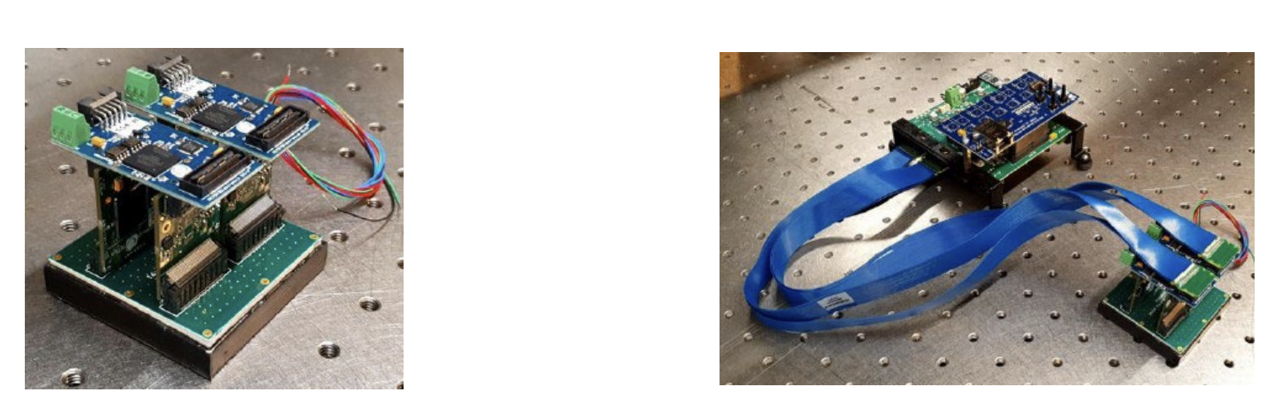
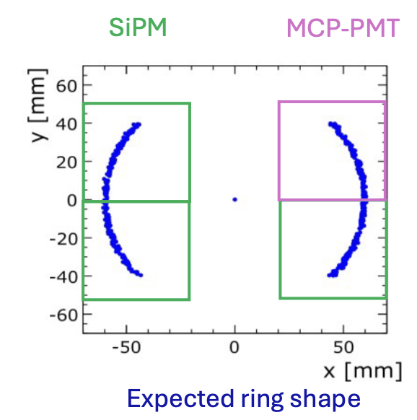
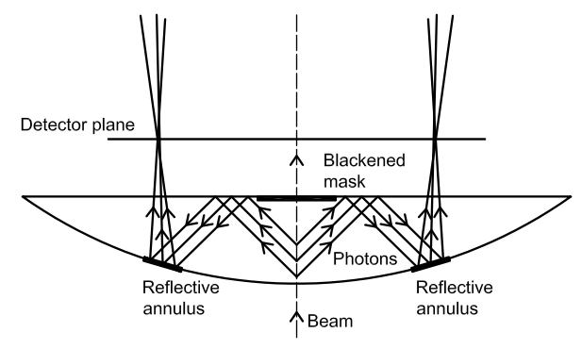
Photosensor option: MCP-PMT
R&D from Florence group
Microchannel Plate PMTs (MCP-PMTs) is another possible solution thanks to high granularity, good detection and no need for cooling.
→ Photek MCP-PMT (MAPMT253), 53x53 mm2 large, with 32x32 pixels (pixel size: 1.6x1.6 mm)
PETsysElectronics
Start to evaluate crosstalk and performance of the Photek MCP-PMT with 16x16 pixels
PETsysElectronics system, based on 4 PCBs with a TOFPET2 ASIC with 64 channels to perform lab tests
Check if SiPM readout used in Genoa is suitable for MCP-PMT
Test beam: use of a solid lens as radiator
[DOI:10.48550/arXiv.1610.10006]
Goal of 2026:
A test beam is foreseen to test the two photo-sensor technologies in June 26 at SPS
The choice of the optimal photodetector sensor and readout electronics will be made upon the test beam results
Notes:
Microchannels … and this developed in Florence group

Slide 24
Conclusions & outlook
Design and performance of a RICH detector for the ALADDIN experiment are presented:
                Geometrical layout is studied with OpticaEM simulation
    Preliminary results of full simulations for realistic detector condition and pattern recognition
    Geometry: 20 m – Ne
    Best solution is to use a long radiator with a single reflection
    Ne: to increase photon yield as used in other experiments such as NA62
    Final choice will be made based on the results of the discrimination between signal and background tracks obtained with the pattern recognition algorithm
    Photodetectors
    Two photodetector choices are under investigation: SiPM/MCP-PMT
    Decision is expected after test beam of June 26
    TDR is in preparation and will be submitted end of ‘25
Thanks for the attention!

Slide 25
Backup slides

Slide 26
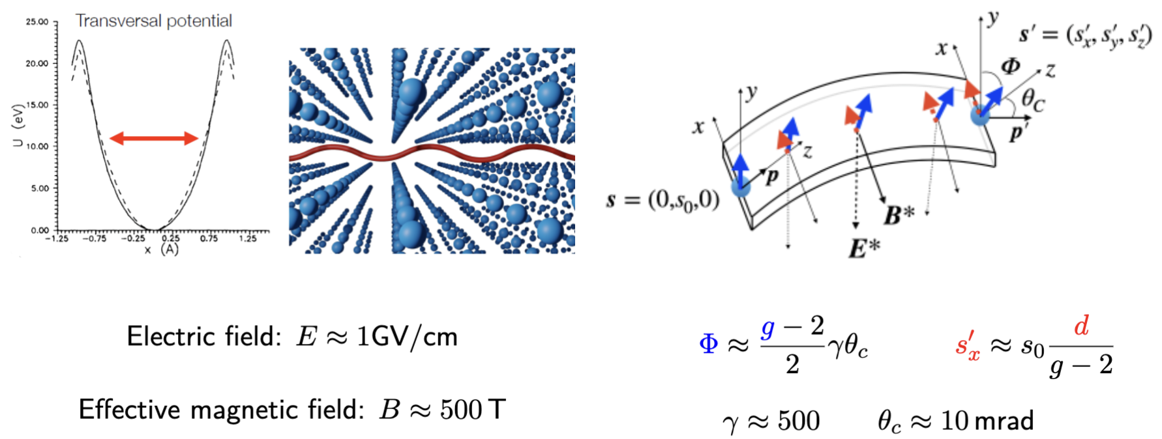
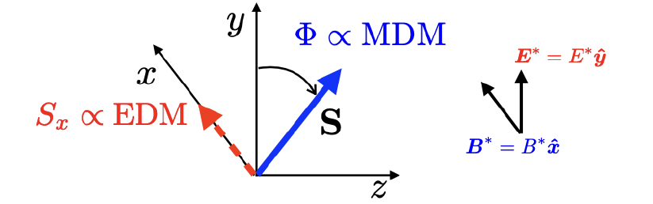
Channeling in bent crystals
For positive charged particles, bent crystals can be used to
In bent crystal we obtain:
Electric field: E ~1 GeV/cm
Effective magnetic field: B ~500 T
Steer particles at a given angle
Induce spin precession in short distance

Slide 27


QE/PDE of photosensors
QE of MCP-PMT
PDE for MCCP Hamamatsu

Slide 28


Proof-of-principle test: TWOCRYST
Proof of principle TWOCRYST approved by the LMC committee and installed in March 2025:
Demonstration of feasibility and measurement of double channeling at TeV energy
Results of MD in June 25
Roman Pots: allow tracker detectors to be placed in a secondary vacuum within beam pipe

Slide 29



Λ_{c}⁺ signal and identification
Momentum of Λ_{c}⁺ products
Charm baryons are produced
with very high momentum O(1 TeV)
in forward direction at 7 mrad and very collimated (<3mrad)
Spectrometer composed of 4 stations of pixel trackers (VeloPix) is used to reconstruct particle momentum:
p resolution ~ 2% at 1 TeV
RICH detector is essential to distinguish signal from background decays (channeled $D^{+}→Kππ, D_{s}→KKπ$)
PID based on momentum (highest momentum = p)
gives a signal efficiency of 60% with poor background rejection (~80%)
→ with RICH we can achieve a signal efficiency of 90% vs bkg rejection 95%

