Slide 1




Long-term performance of non-ALD MCP-PMTs in the high-radiation environment of ALICE
Yury Melikyan
on behalf of the ALICE Collaboration
Helsinki Institute of Physics, University of Helsinki
XII International Workshop
on Ring Imaging Cherenkov Detectors
17.09.2025

Slide 2
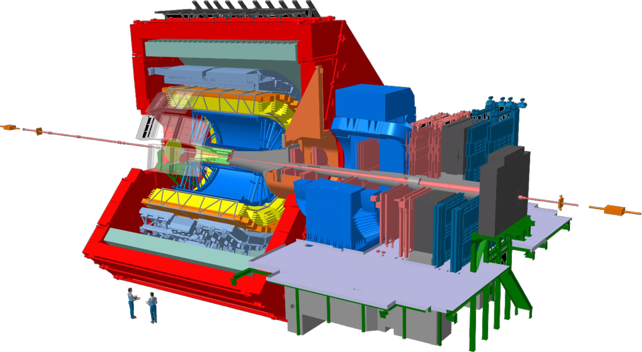
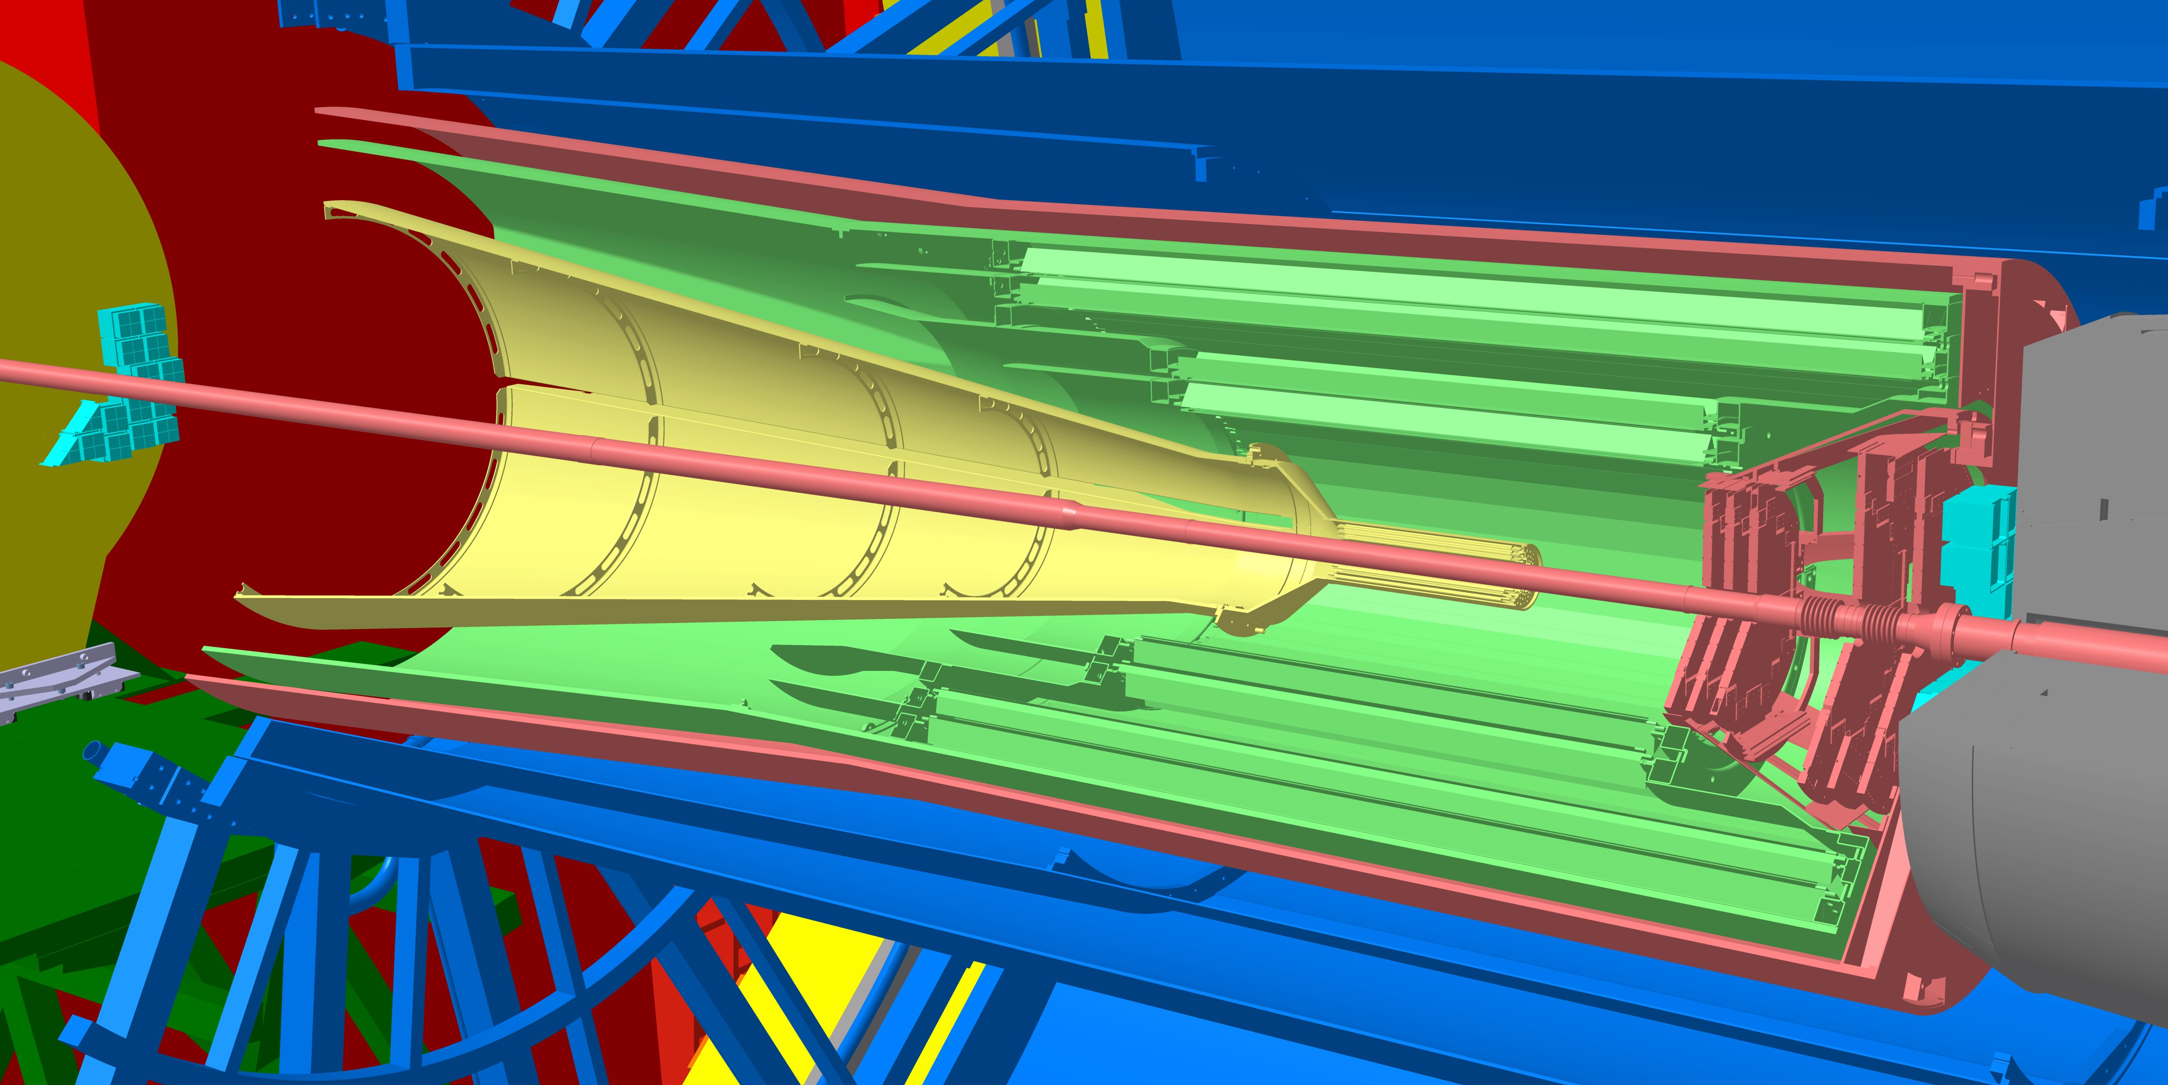
ALICE and FIT
Further reading on the ALICE FIT:
PoS(ICHEP2024)921
A Large Ion Collider Experiment (ALICE):
One of the four large LHC apparatus;
Fine-tuned to study heavy-ion collisions;
Undergone a major upgrade in 2018-2021: the Fast Interaction Trigger (FIT) detectors (including the FT0 Cherenkov detector) were installed.
FT0 physics purpose:
On-line trigger;
Precise time-zero detector for TOF;
Main luminometer & background monitor;
Centrality & multiplicity measurements.
FT0-A
IP
FT0-C

Slide 3
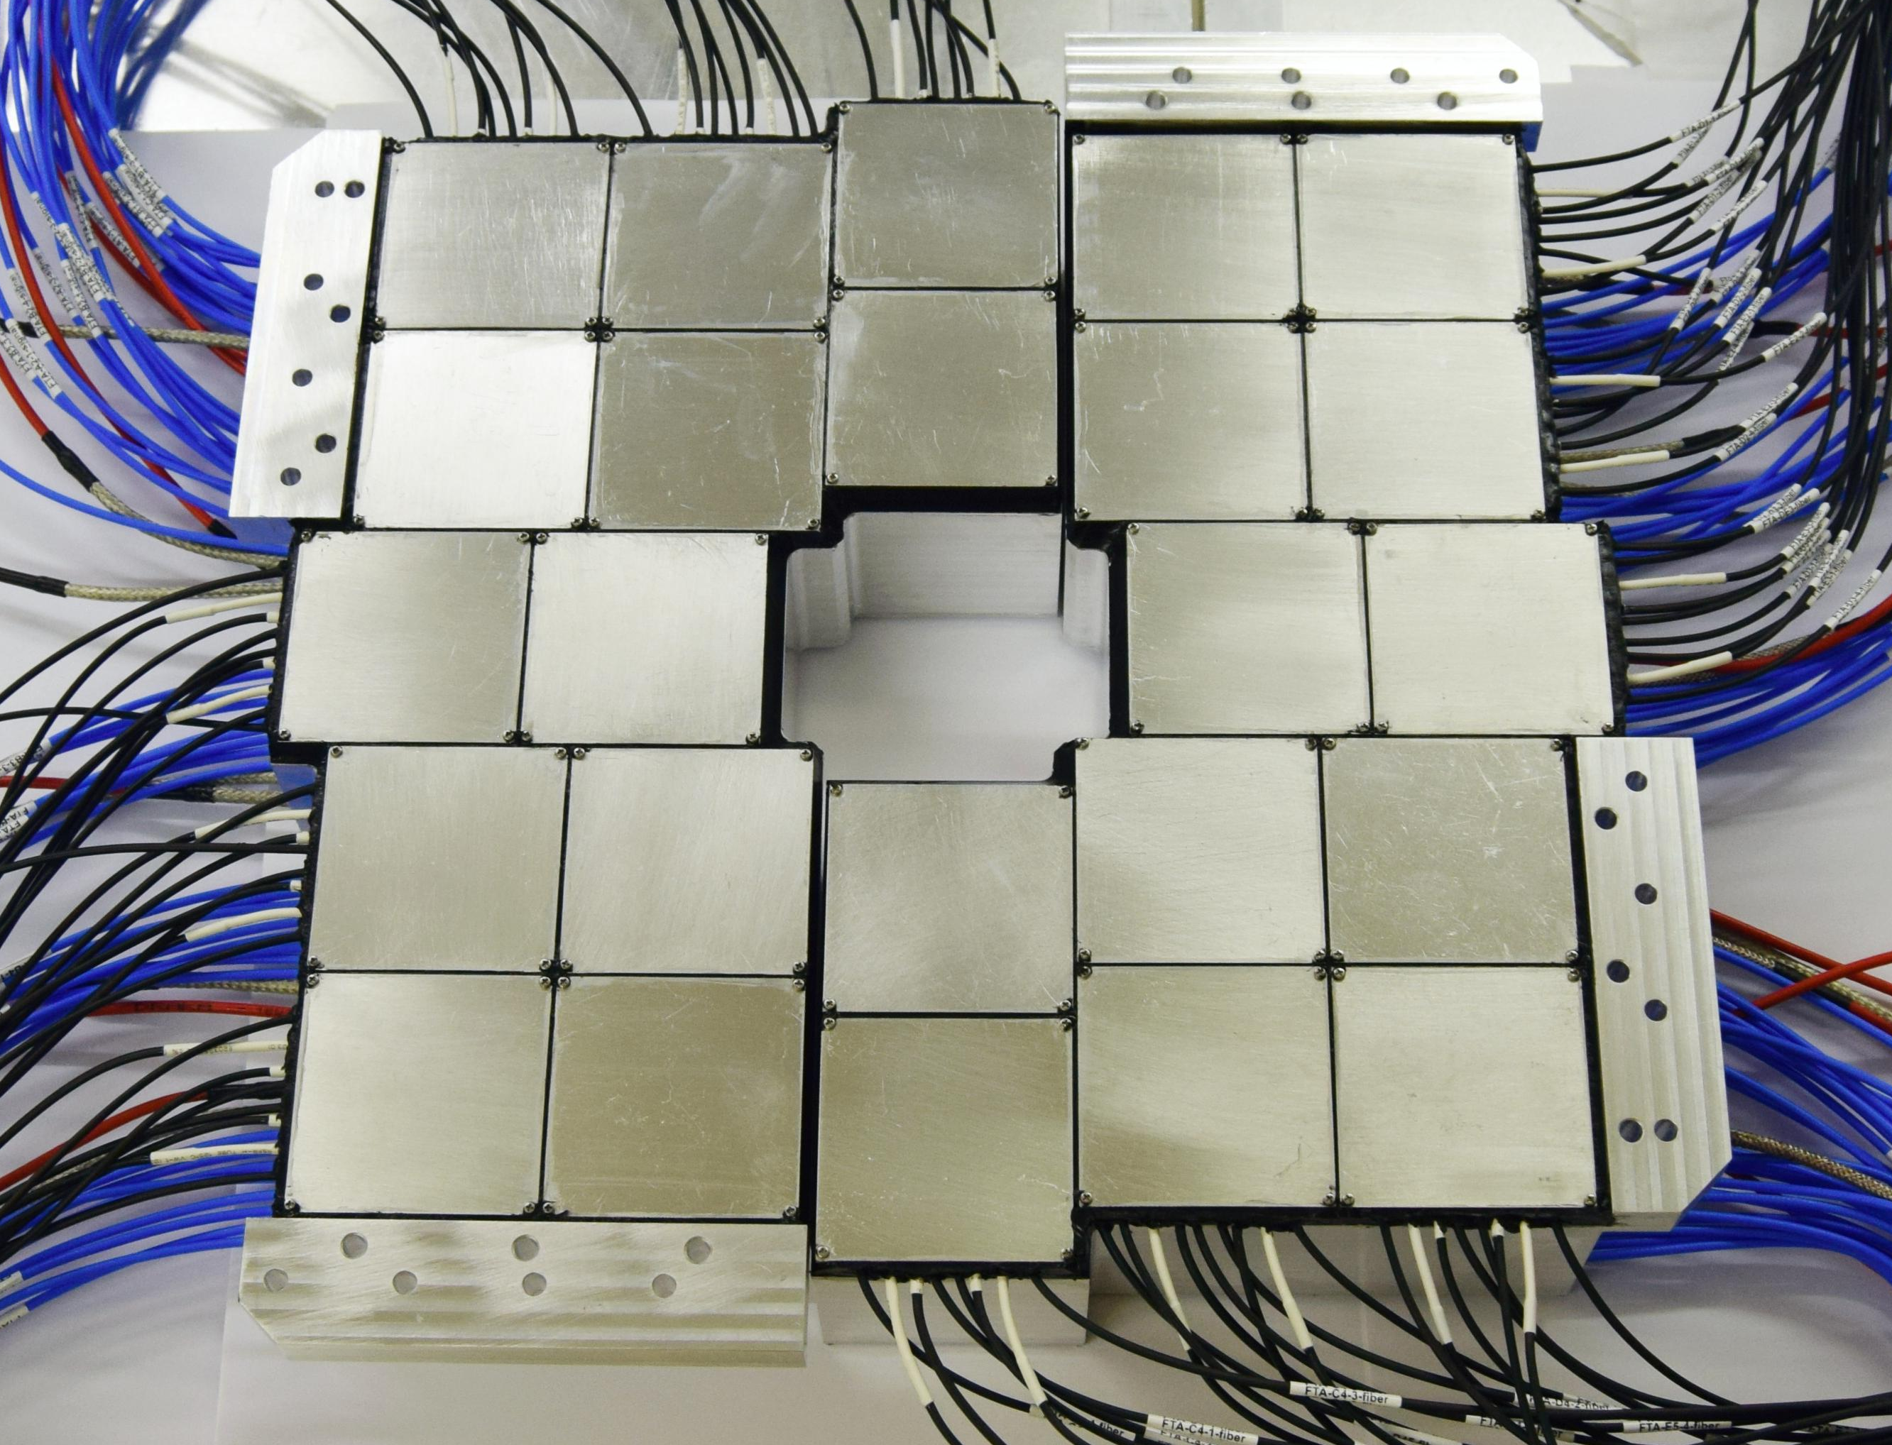
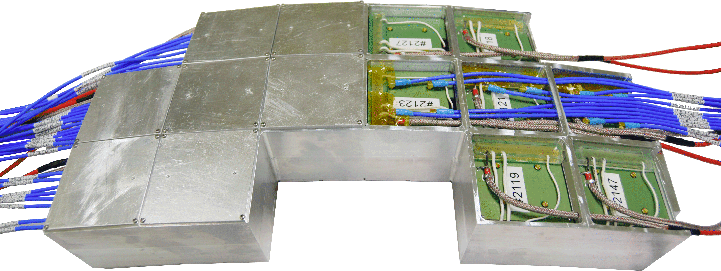
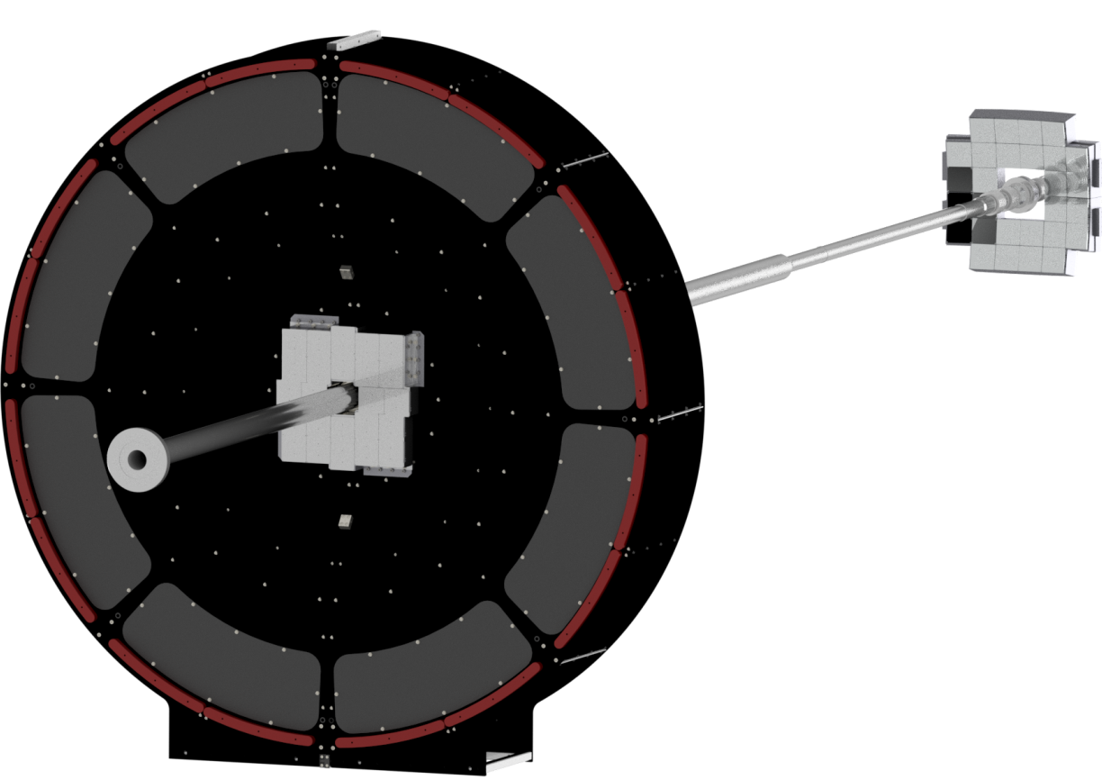
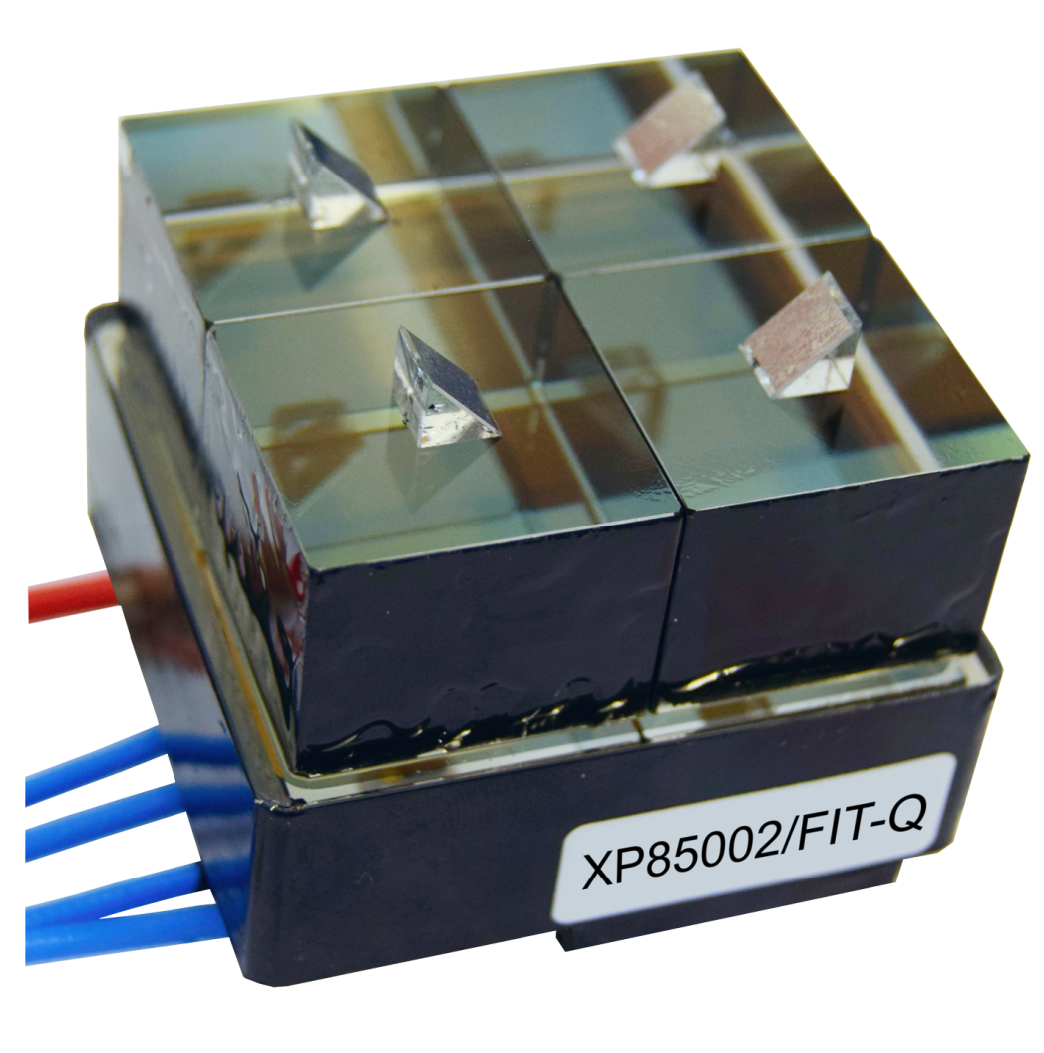
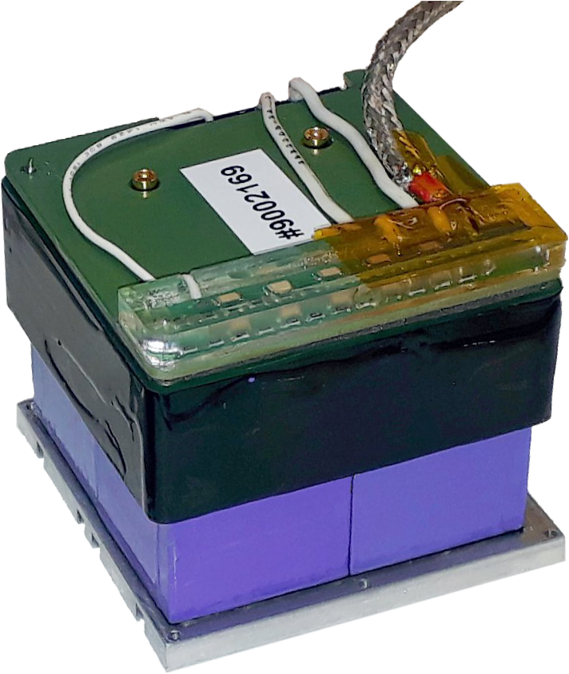

FT0 Cherenkov detector
← FT0-A fully-assembled
↓ FT0-C half – back view without covers
Two arrays of Cherenkov counters: 96 & 112 fused silica radiators coupled to 52 multianode Planacon XP85002/ FIT-Q MCP-PMTs (custom backplane).
Now completing its 4th year in operation:
First large-scale deployment of the Planacons in HEP;
First large-scale deployment of MCP-PMTs in a hadron collider experiment.
← 2-inch | 25 μm-pore → 8x8 anode | 2x2 ch.
non-ALD
IP
FT0-C
-3.3 < η < -2.1
-1m from IP
20 mm
quartz
← FT0 → Cherenkov module (4 channels)
FT0-A
3.5 < η < 4.9
3m from IP
FV0 sub-detector
3m from IP
2.2 < η < 5.1
Planacon upgrade for ALICE FIT – NIM A 952 (2020) 161689 (RICH-2018 proceedings)
Bench testing of the ALICE FIT Planacons – JINST 16 (2021) P12032
* Banana for scale

Slide 4
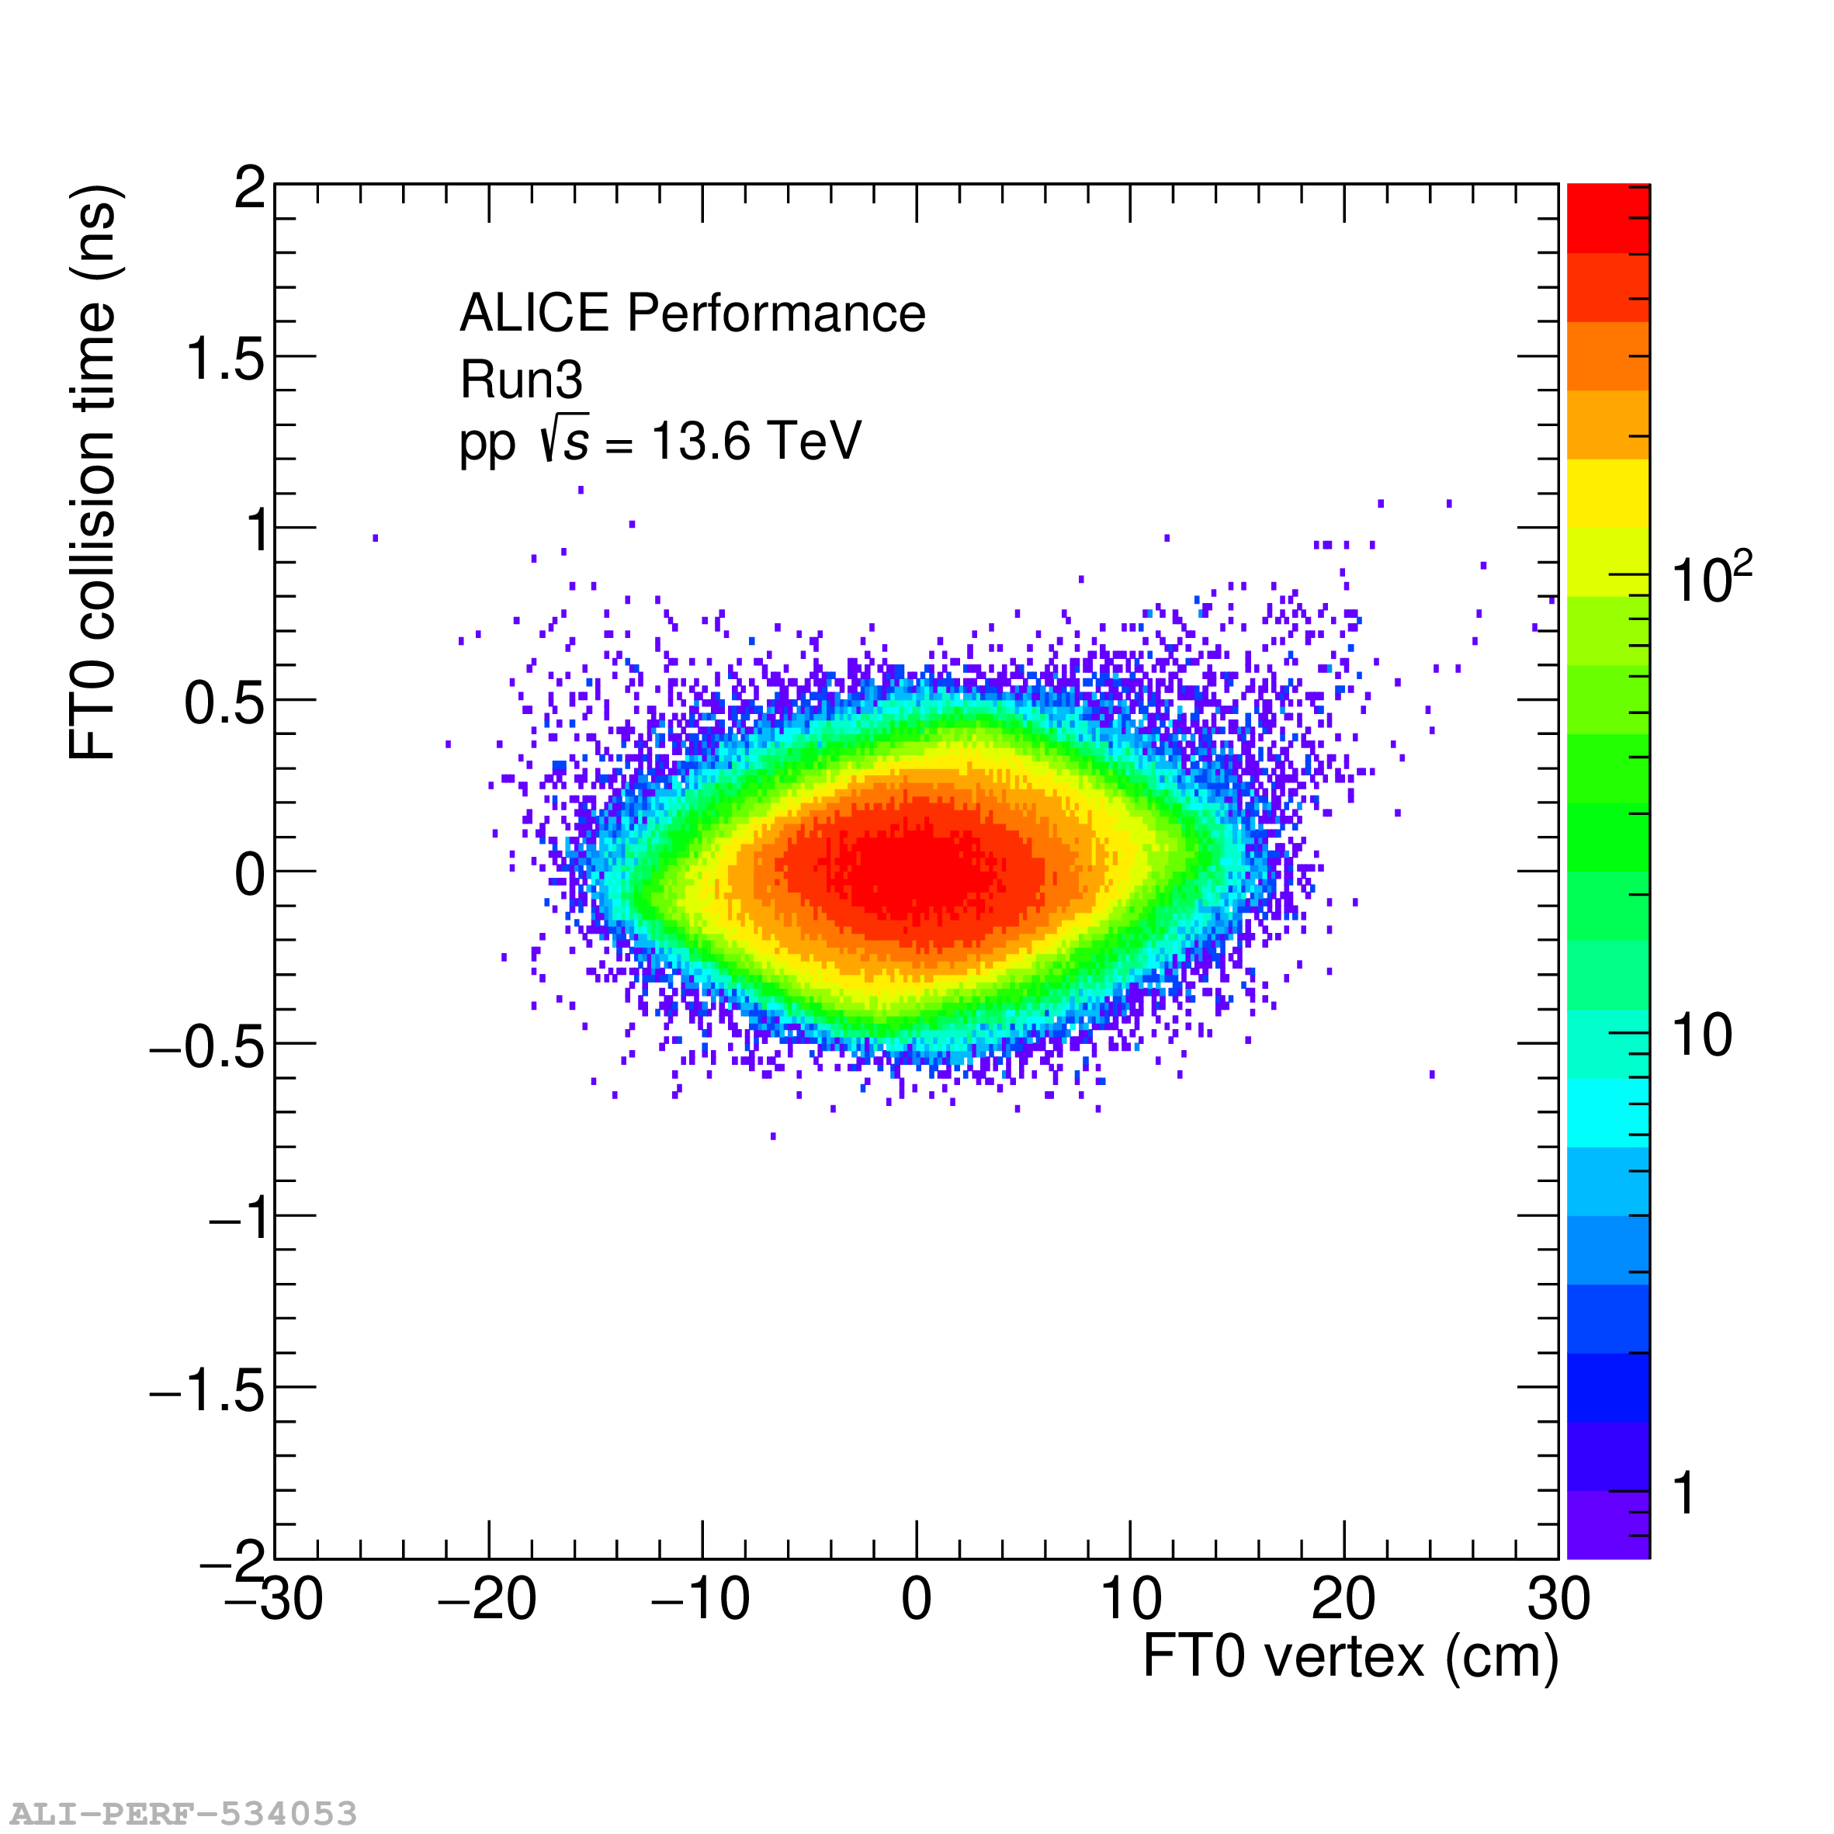
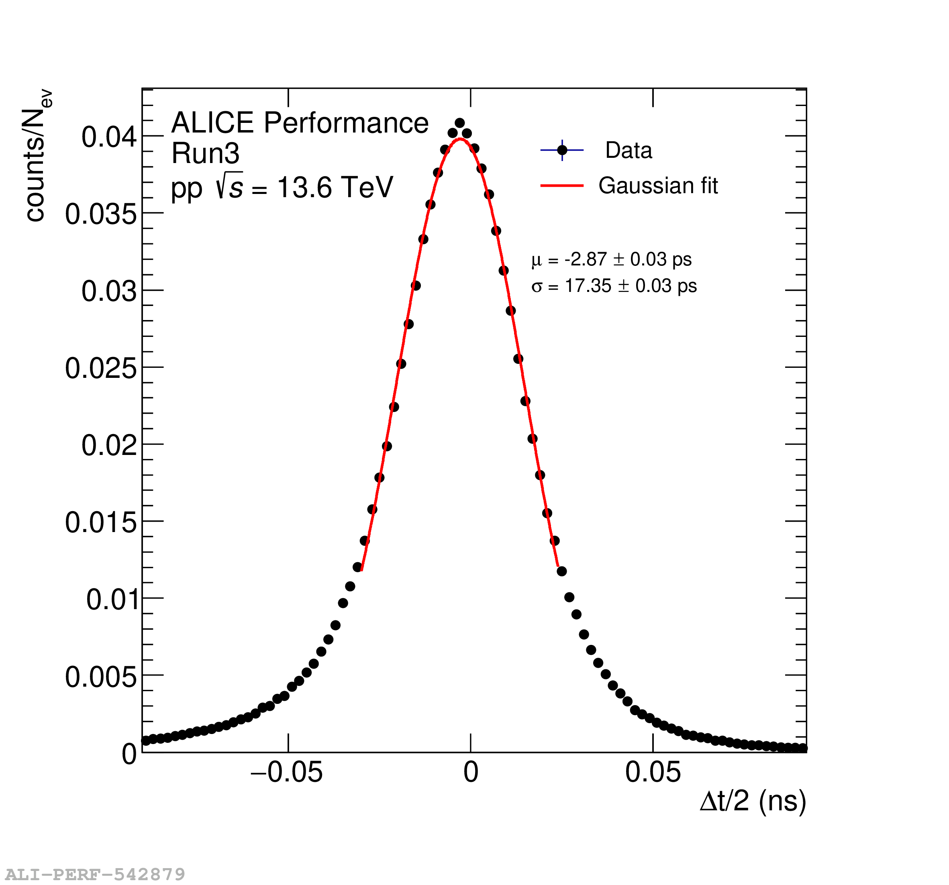
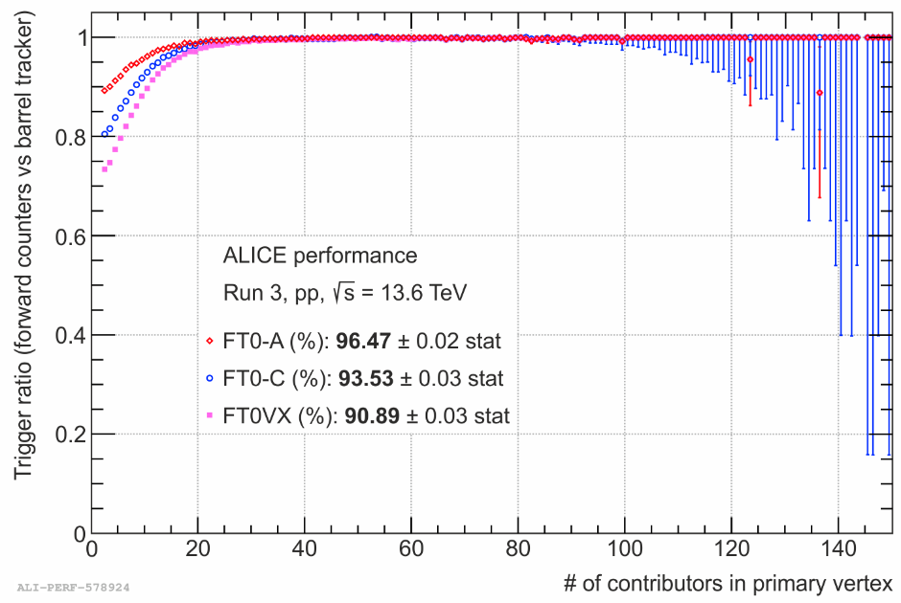
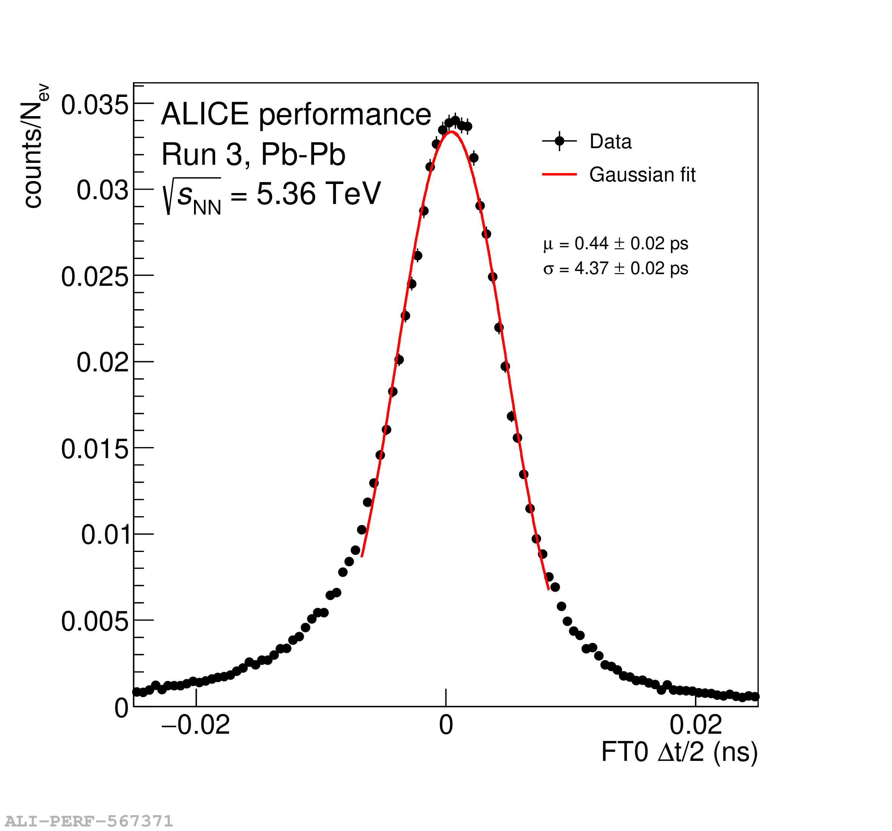
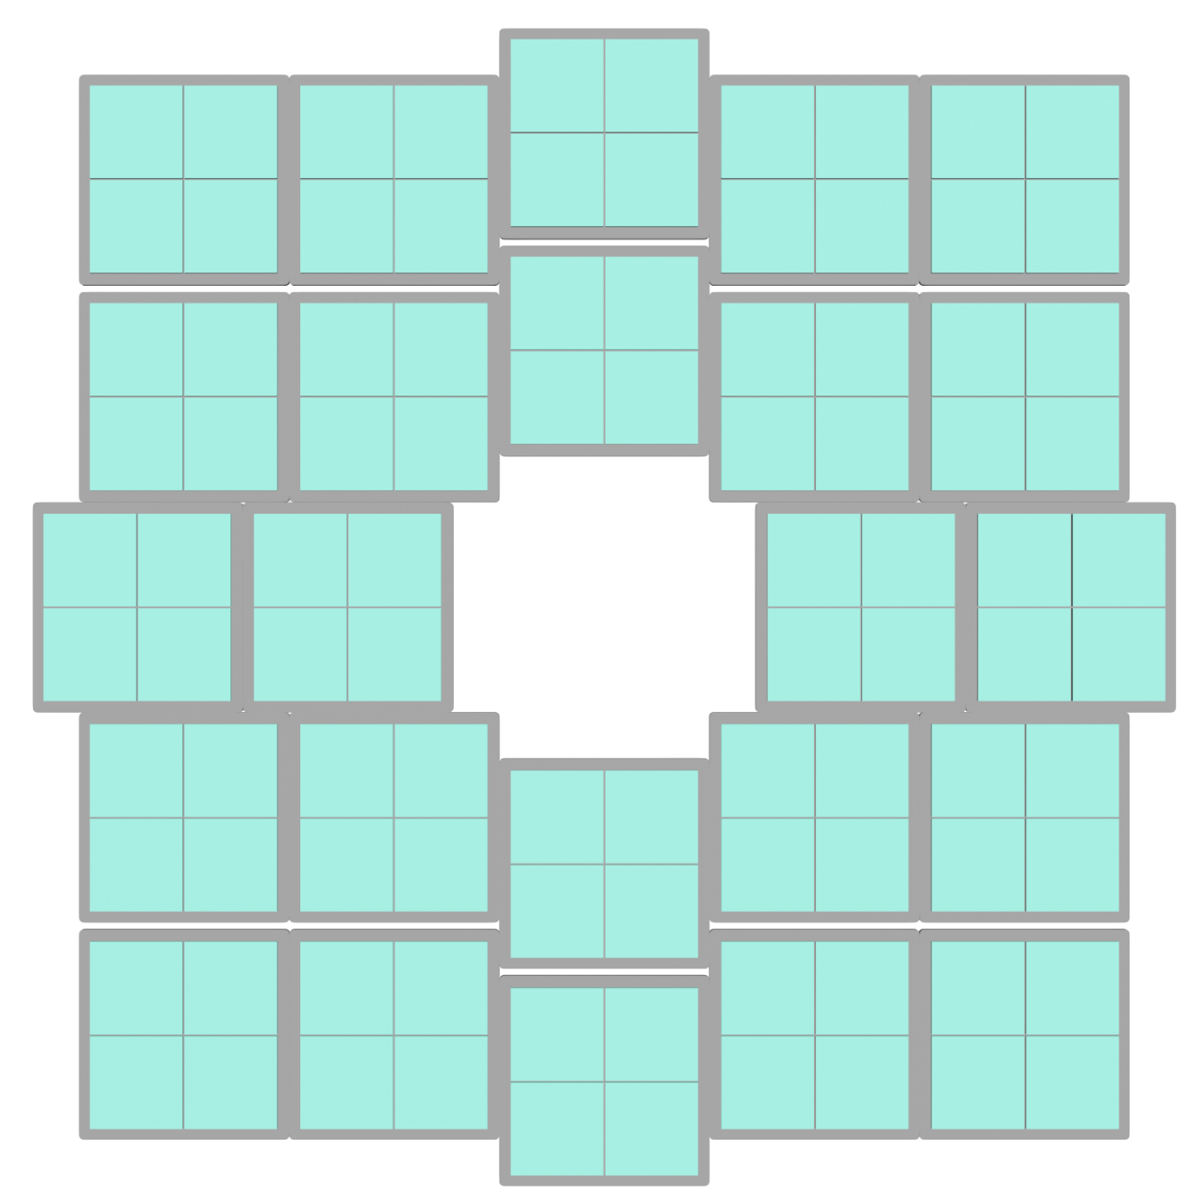
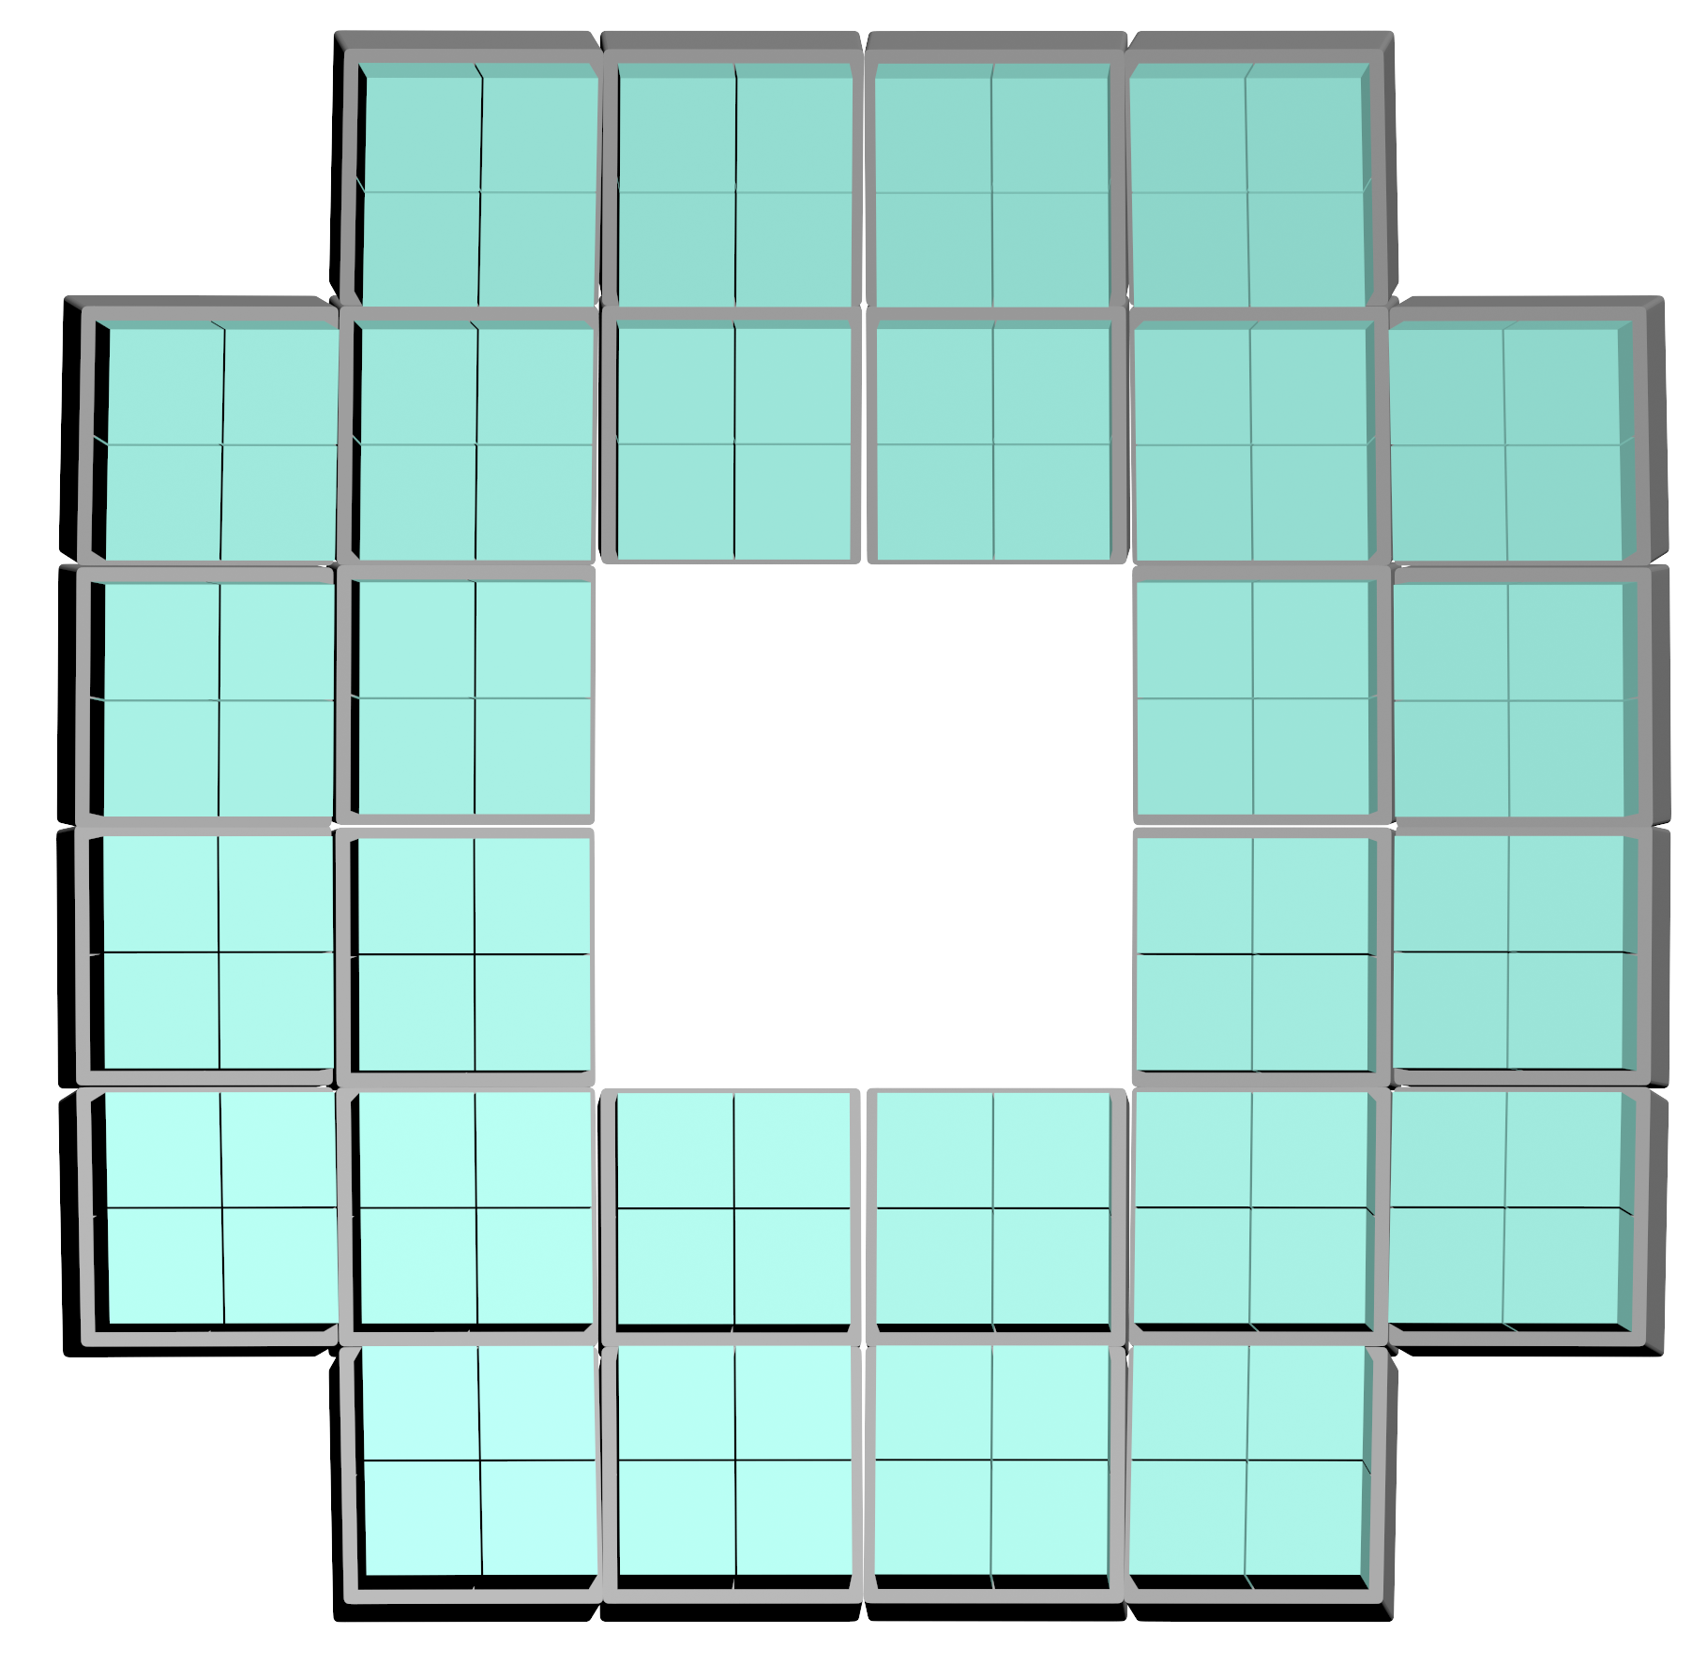
FT0 detector performance
Collision point of the LHC beams fluctuates within ±10 cm along the beam axis. FT0 resolves it with:
σ = 17 ps ≡ ±5.1 mm – precision in proton collisions (twice worse online);
σ = 4.4 ps ≡ ± 1.3 mm – precision for lead ion collisions (twice worse online);
FT0 trigger efficiency exceeds 90% in top-energy pp collisions – limited by the inter-PMT radiator gaps.
32 cm
35 cm

Slide 5
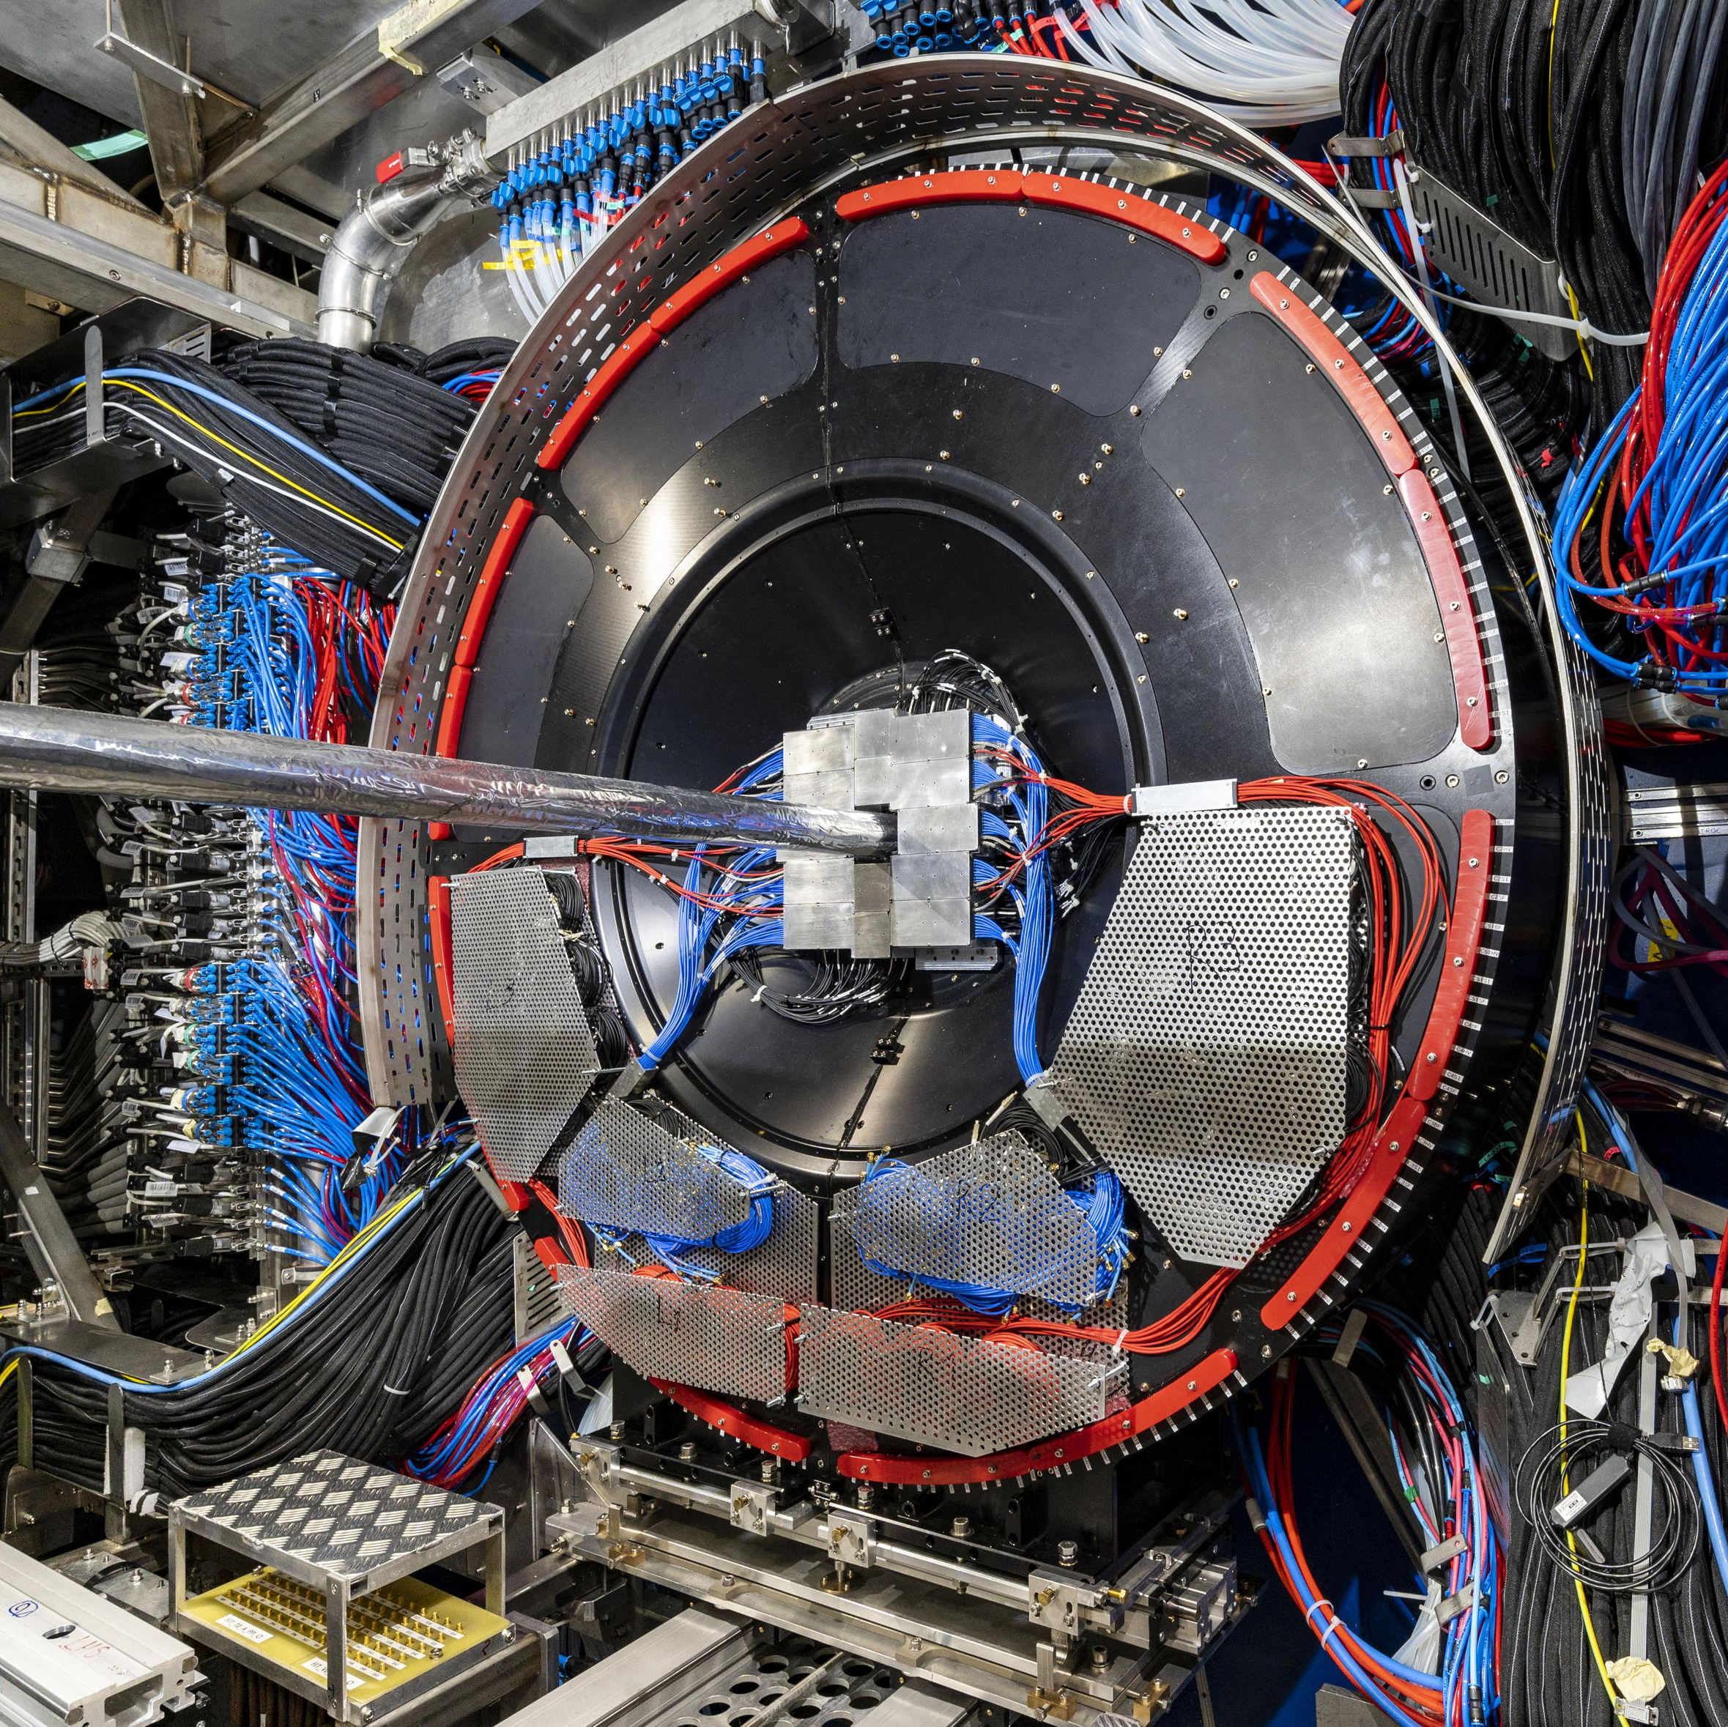
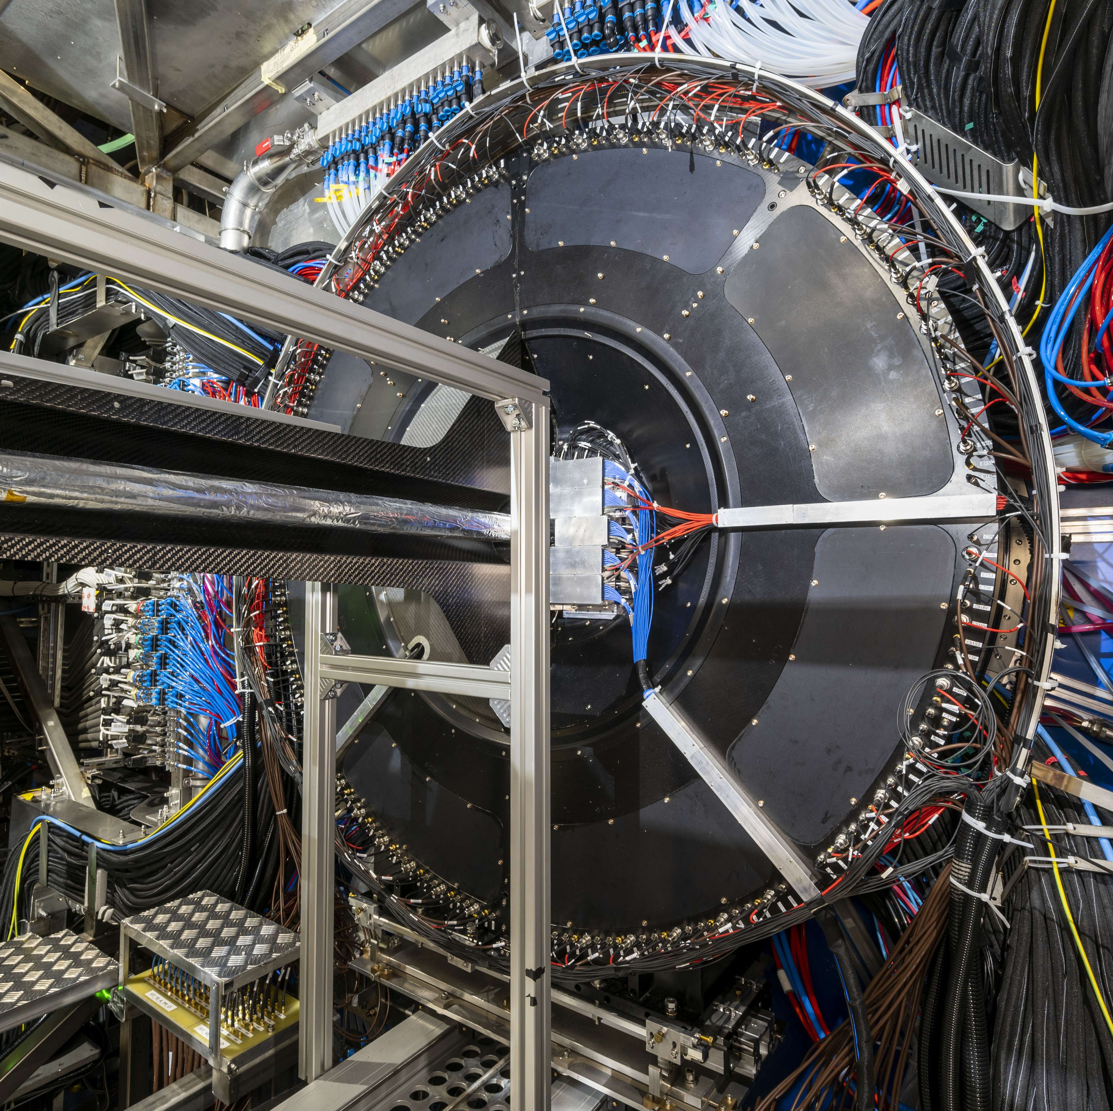
FT0 design constraints
Single-MIP time resolution ≲50 ps (the lower – the better);
BC*-per-BC readout capability (dead time ~15 ns);
No make-up view of FT0+FV0 (all cables connected) →
FT0+FV0 just after the installation in the cavern →
*BC – Bunch Crossing interval (25 ns)

Slide 6
FT0 design constraints
Single-MIP time resolution ≲50 ps (the lower – the better);
BC*-per-BC readout capability (dead time ~15 ns);
Harsh radiation conditions:
~3*10¹⁰ n_{eqv} / cm² / month (full program ≲ 3*10¹²)**;
~4 kRad / month (full program ≲ 0.5 MRad);
Non-axial magnetic field ≤ B = 0.5 T;
No make-up view of FT0+FV0 (all cables connected) →
**NIEL equivalent converted for 1 MeV neutrons as for silicon detectors

Slide 7
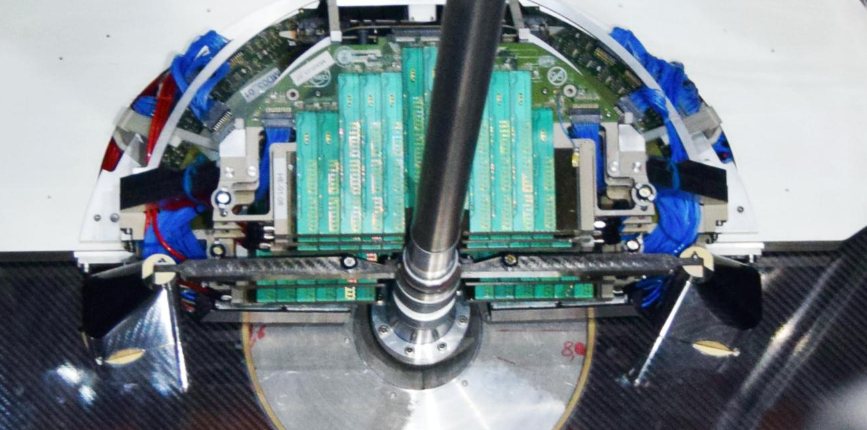
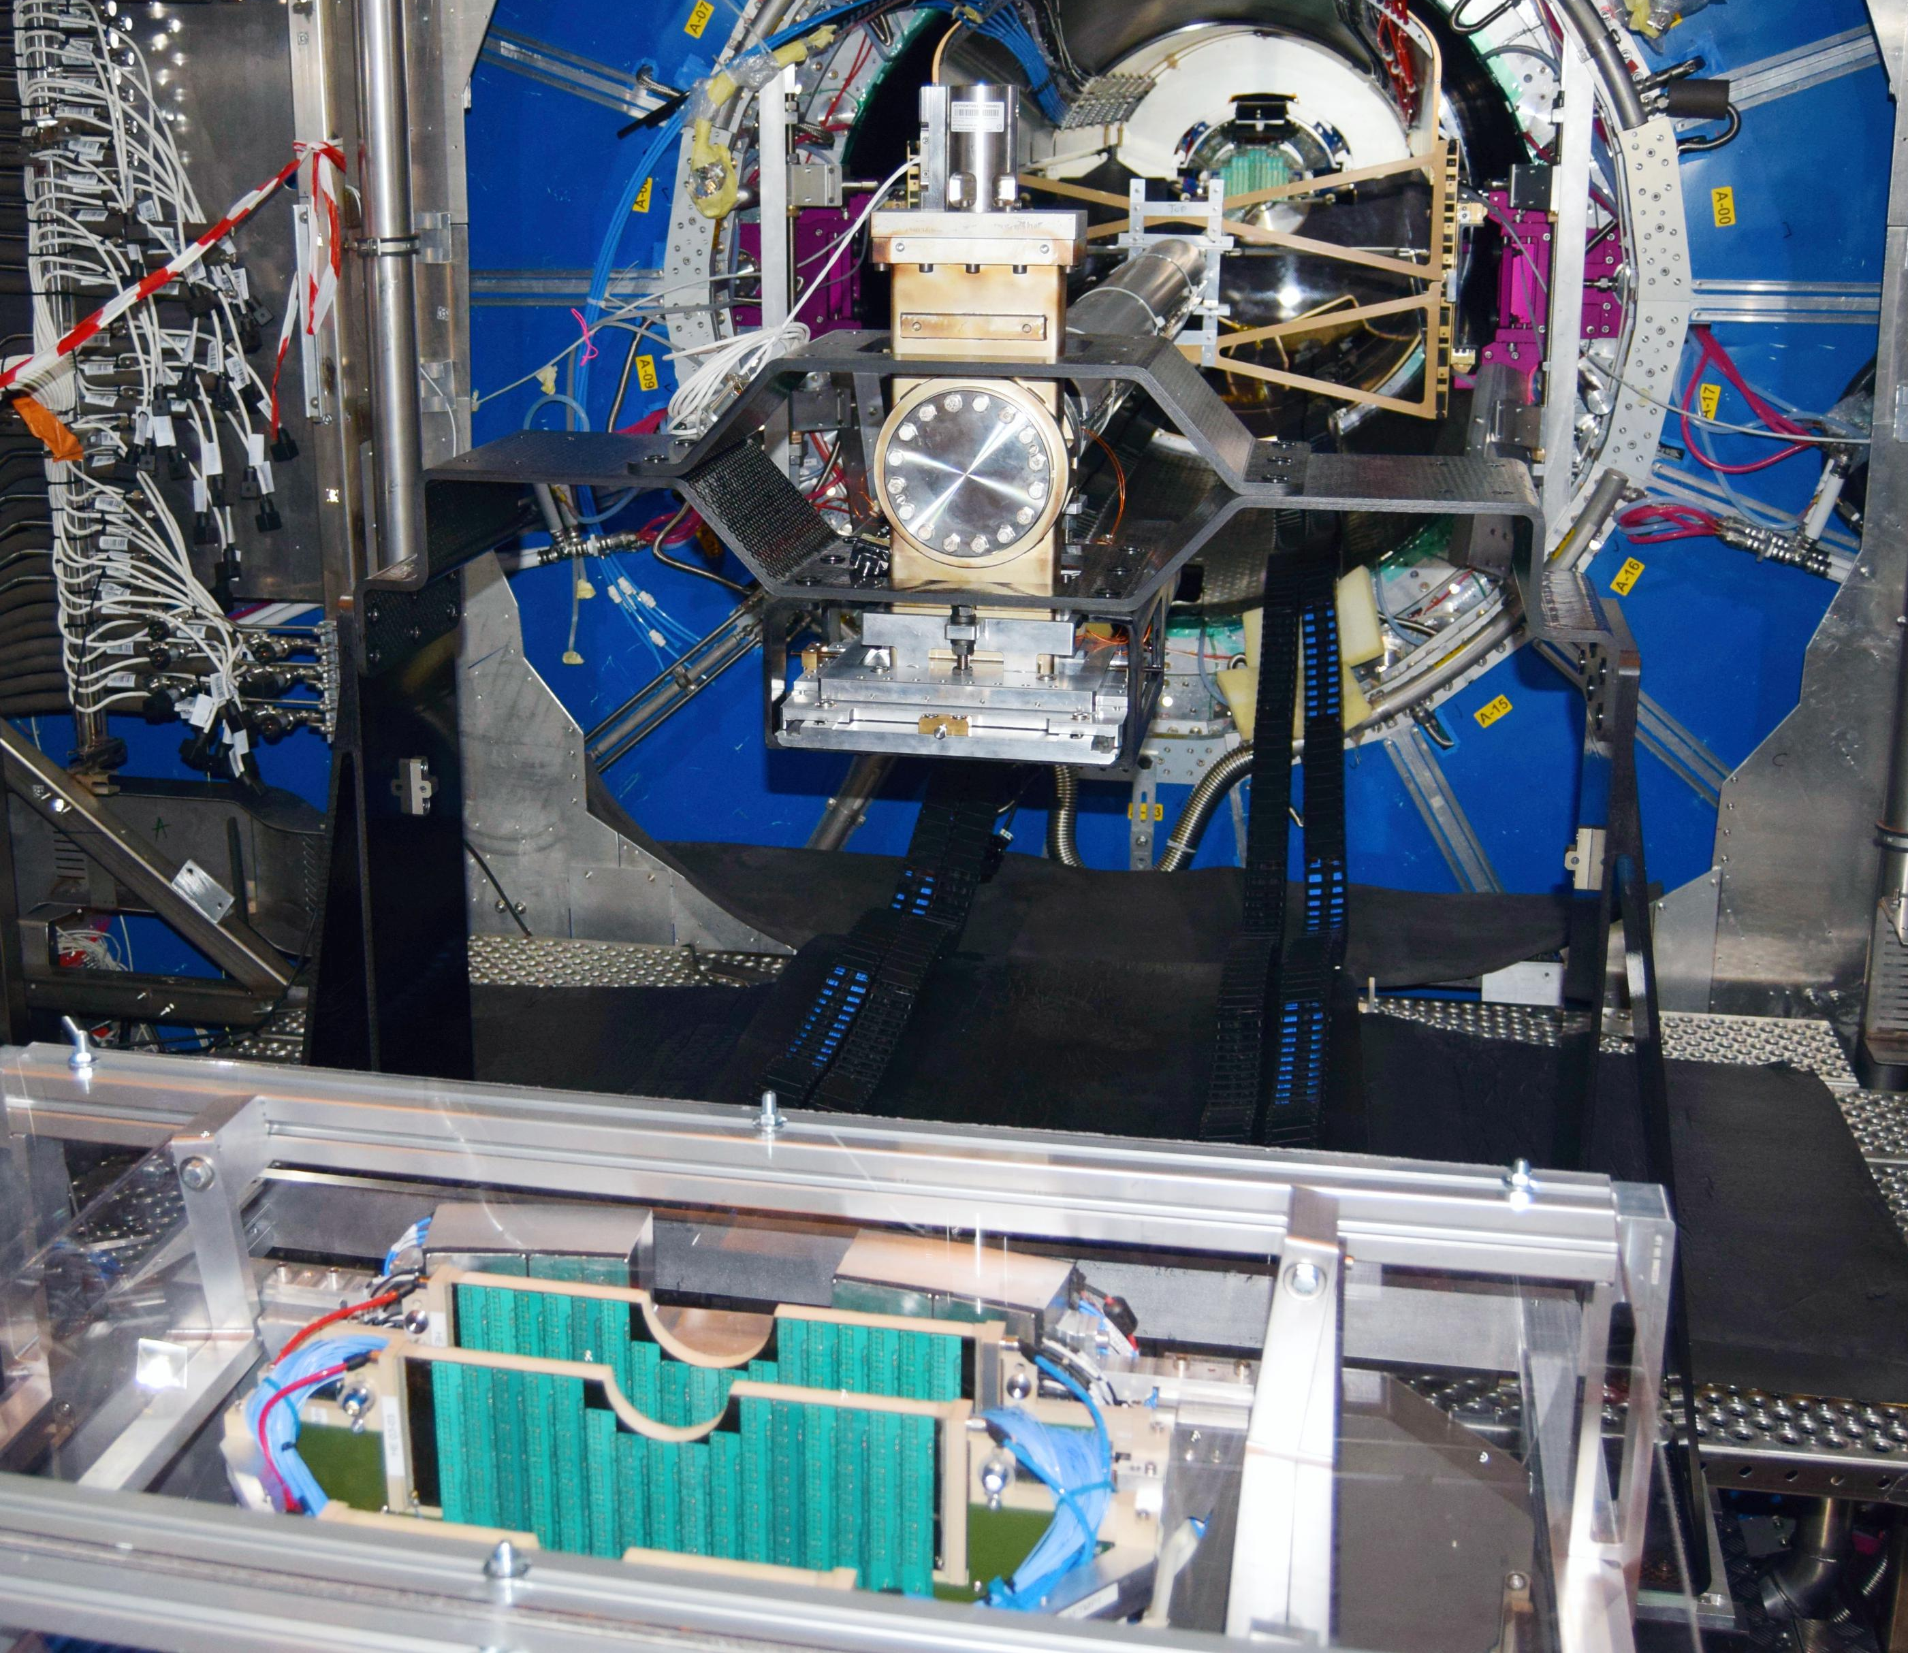
FT0 design constraints
Single-MIP time resolution ≲50 ps (the lower – the better);
BC*-per-BC readout capability (dead time ~15 ns);
Harsh radiation conditions:
~3*10¹⁰ n_{eqv} / cm² / month (full program ≲ 3*10¹²)**;
~4 kRad / month (full program ≲ 0.5 MRad);
Non-axial magnetic field ≤ B = 0.5 T;
Total thickness of the C-side array ≤ 9 cm.
Efficient running at nominal collision rates: (0.5 MHz for pp, 30-50 kHz for Pb-Pb) ≤ 10⁶ MIPs / cm² / s;
<9 cm
< 9 cm
Why we can’t use ALD-coated MCP-PMTs
*BC – Bunch Crossing interval (25 ns)
Congested spacing of FT0-C →
**NIEL equivalent converted for 1 MeV neutrons as for silicon detectors

Slide 8
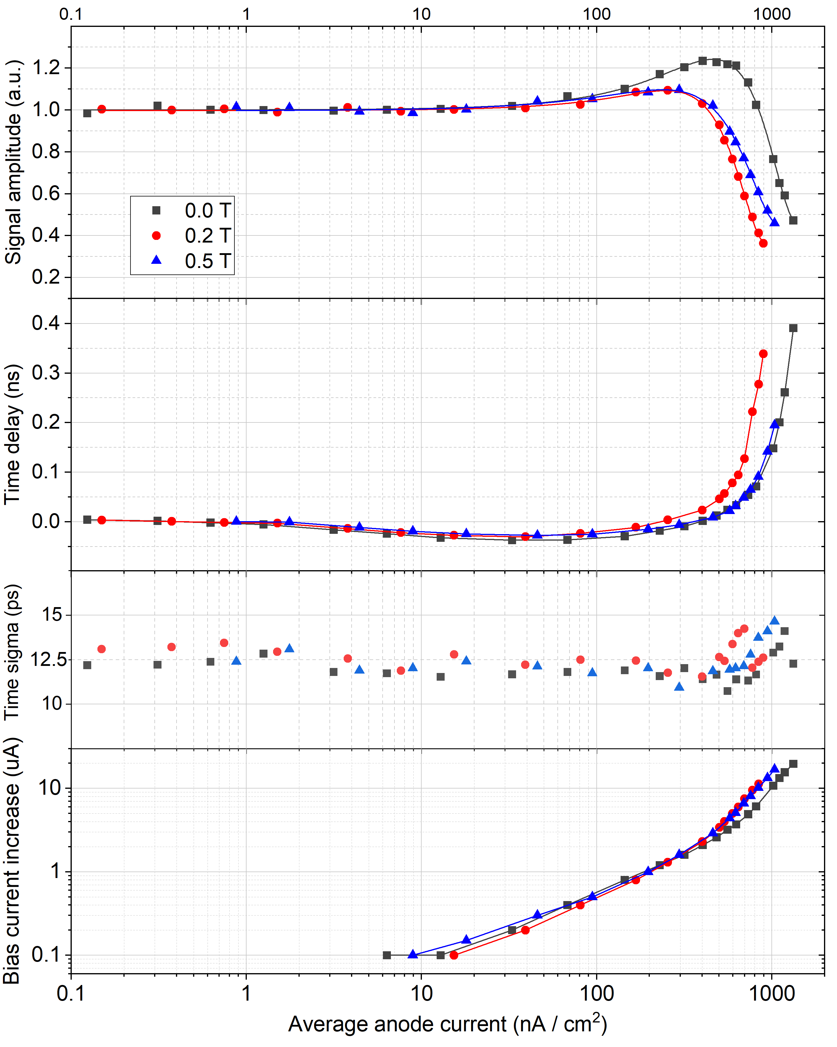
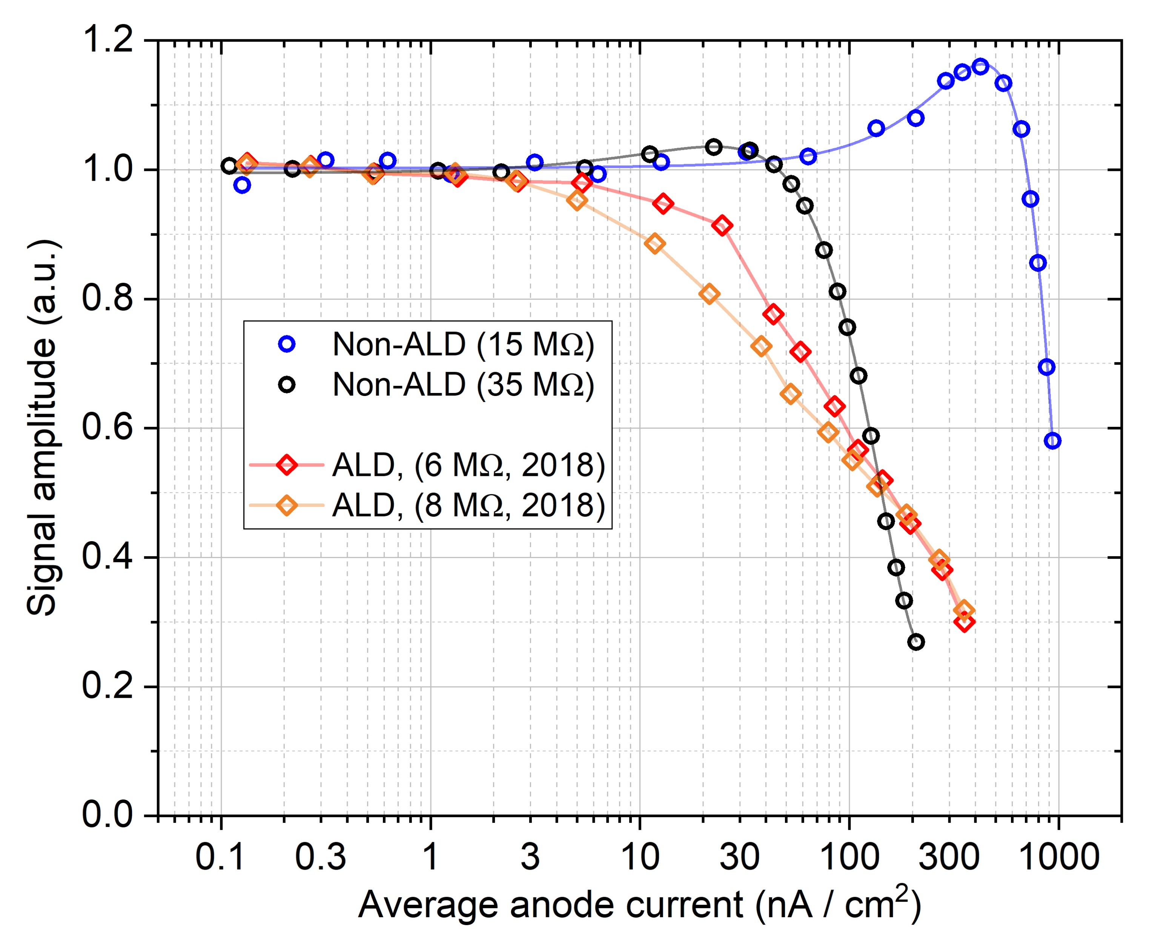
Average anode current saturation
Rate capability is naturally limited by the MCP RC:
~100 nA/cm² for standard non-ALD Planacons;
~800 nA/cm² for the low-resistance non-ALD Planacons;
(↑ gets further suppressed in 0.5 T B-field ↑)
~50 nA/cm² for the low-resistance ALD Planacons (in 2018).
500 kHz
protons
50 kHz
Pb-Pb
Innermost FIT Planacons see ~3x10⁸ p.e. / cm² / s ≈ 600 nA/cm².
B = 0.0 T
Our data on low AAC limit & long recovery of ALD MCPs published earlier in:
[JINST 13 (2018) T09001]
[NIM A 949 (2020) 162854]
FIT Planacon data published earlier in
[JINST 16 (2021) P12032]
B = 0.0 T

Slide 9
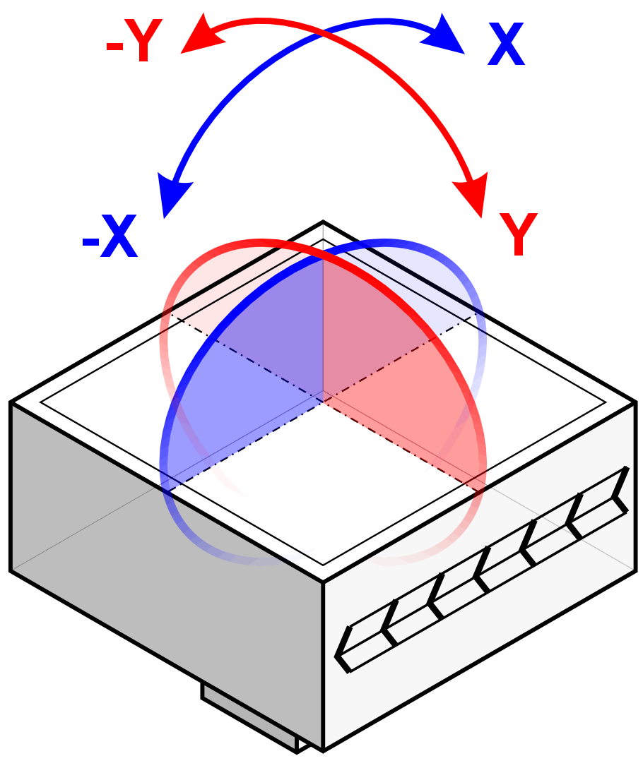
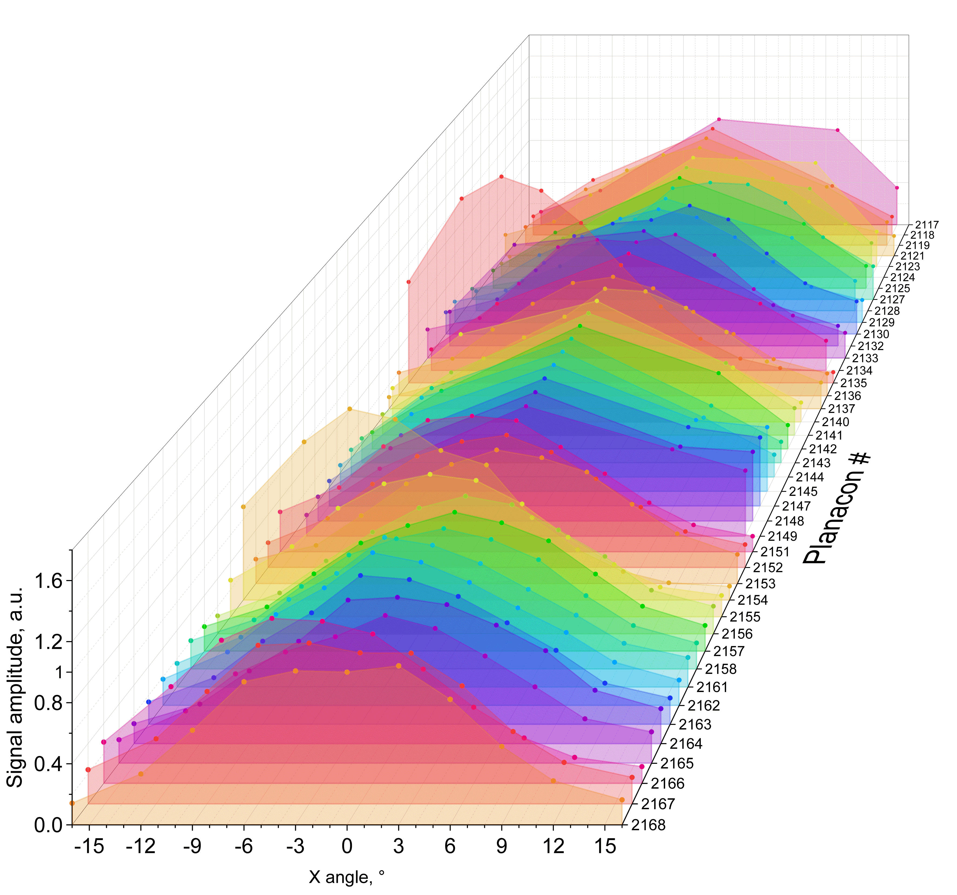
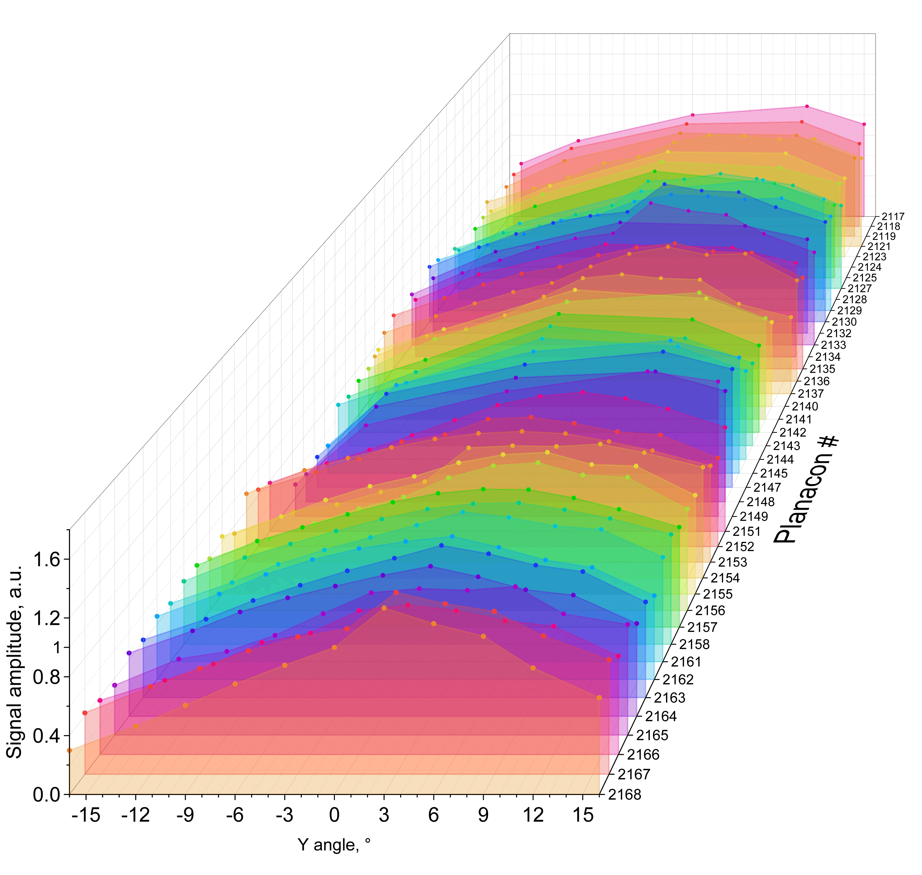

Effect of non-axial B-field
↓ B = 0.5 T
Along the chevron:
Perpendicular to chevron:
Gain vs angle dependencies for along-the-chevron tilts are Gaussian-like, with their centers scattered around 0°;
Centers of the gain vs angle dependencies of perpendicular tilts are consistently shifted to ~6°.

Slide 10
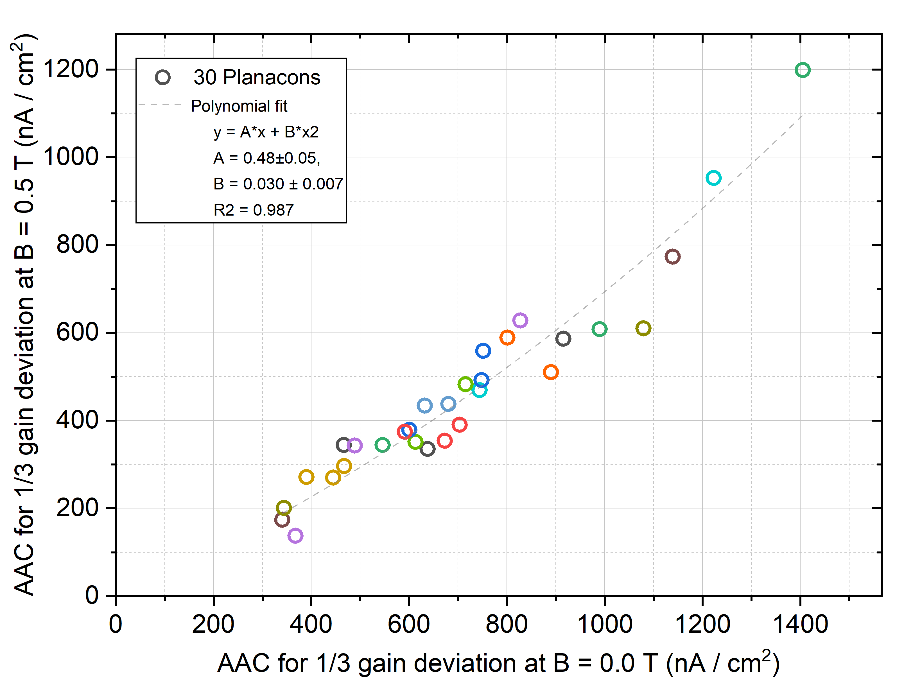
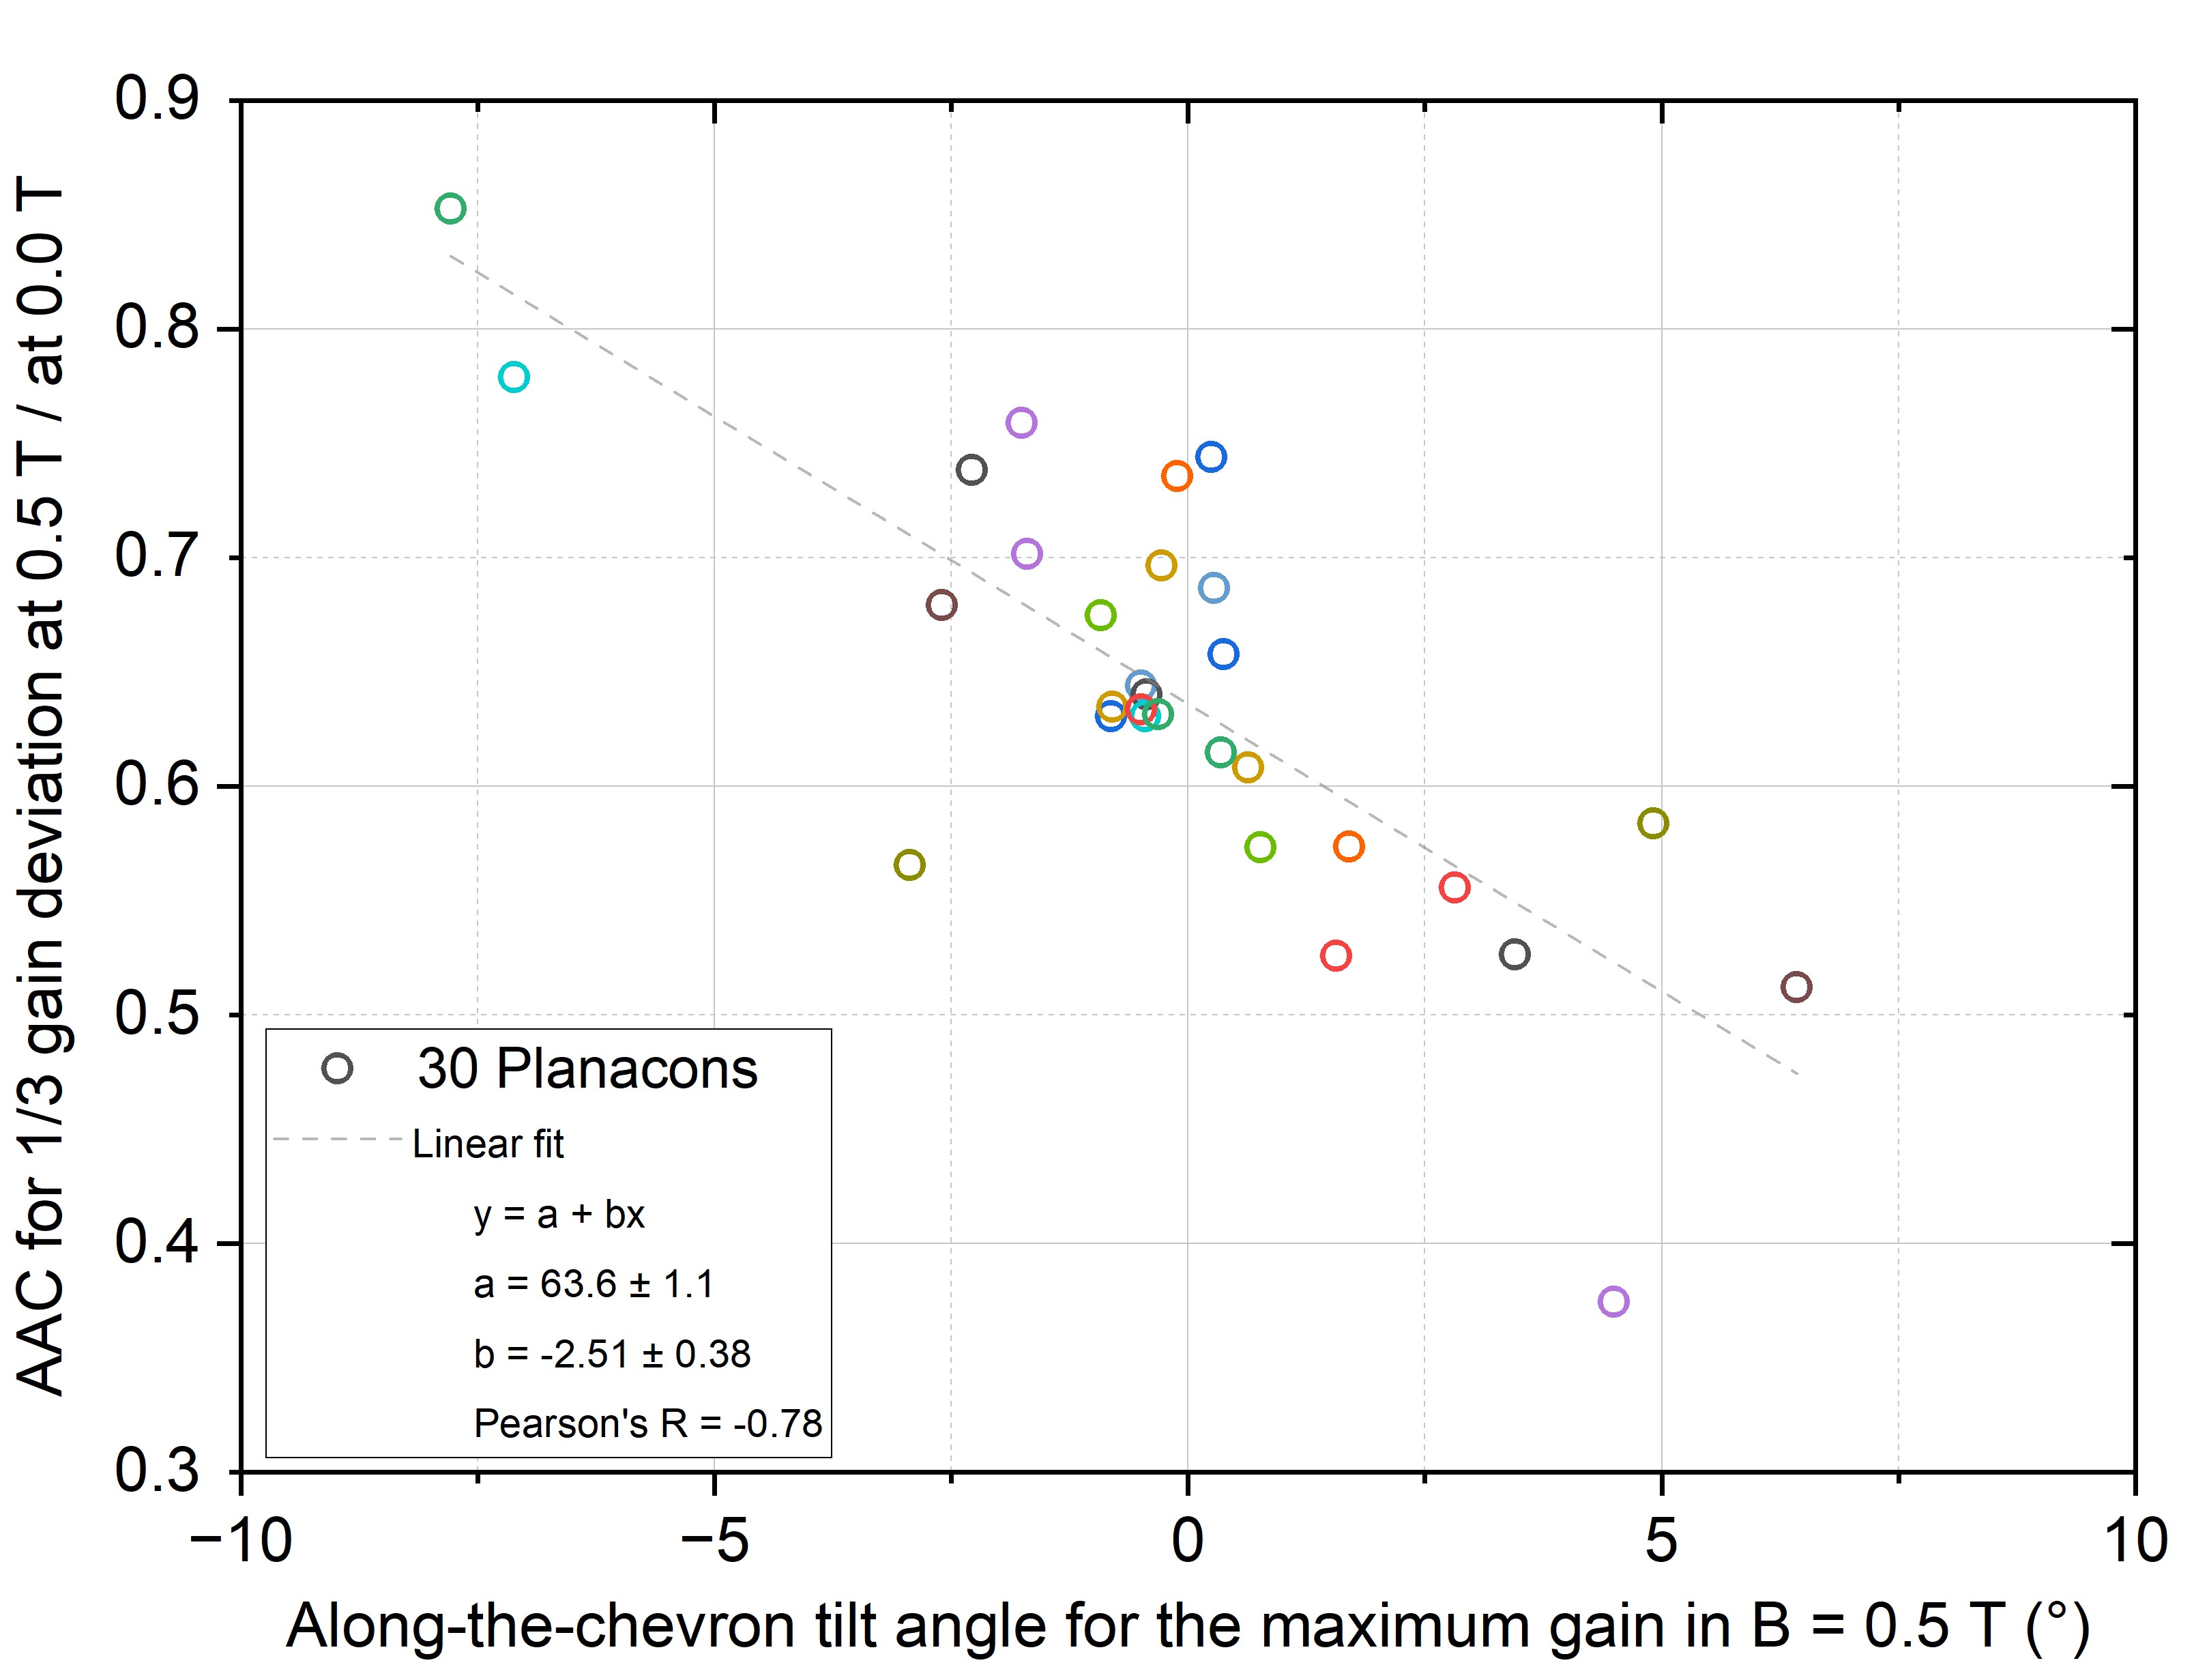
AAC limit in B-field
In B = 0.5 T AAC limit reduce to 0.4 … 0.9 of its value outside the magnetic field.
The reduction factor somehow looks correlated with the along-the-chevron tilt angle for maximum gain.

Slide 11
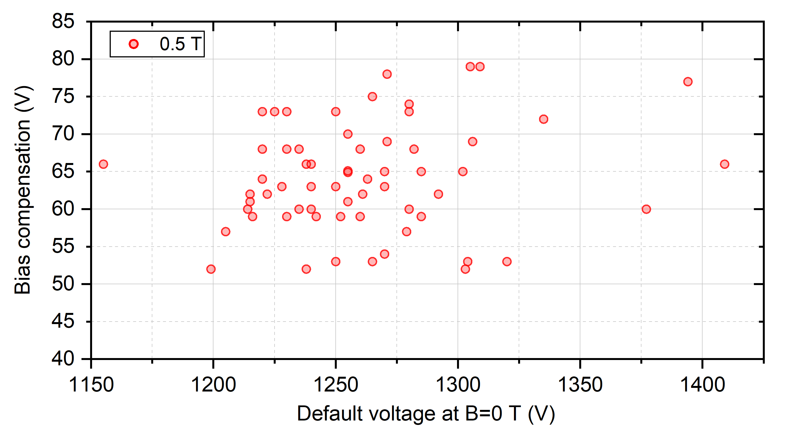
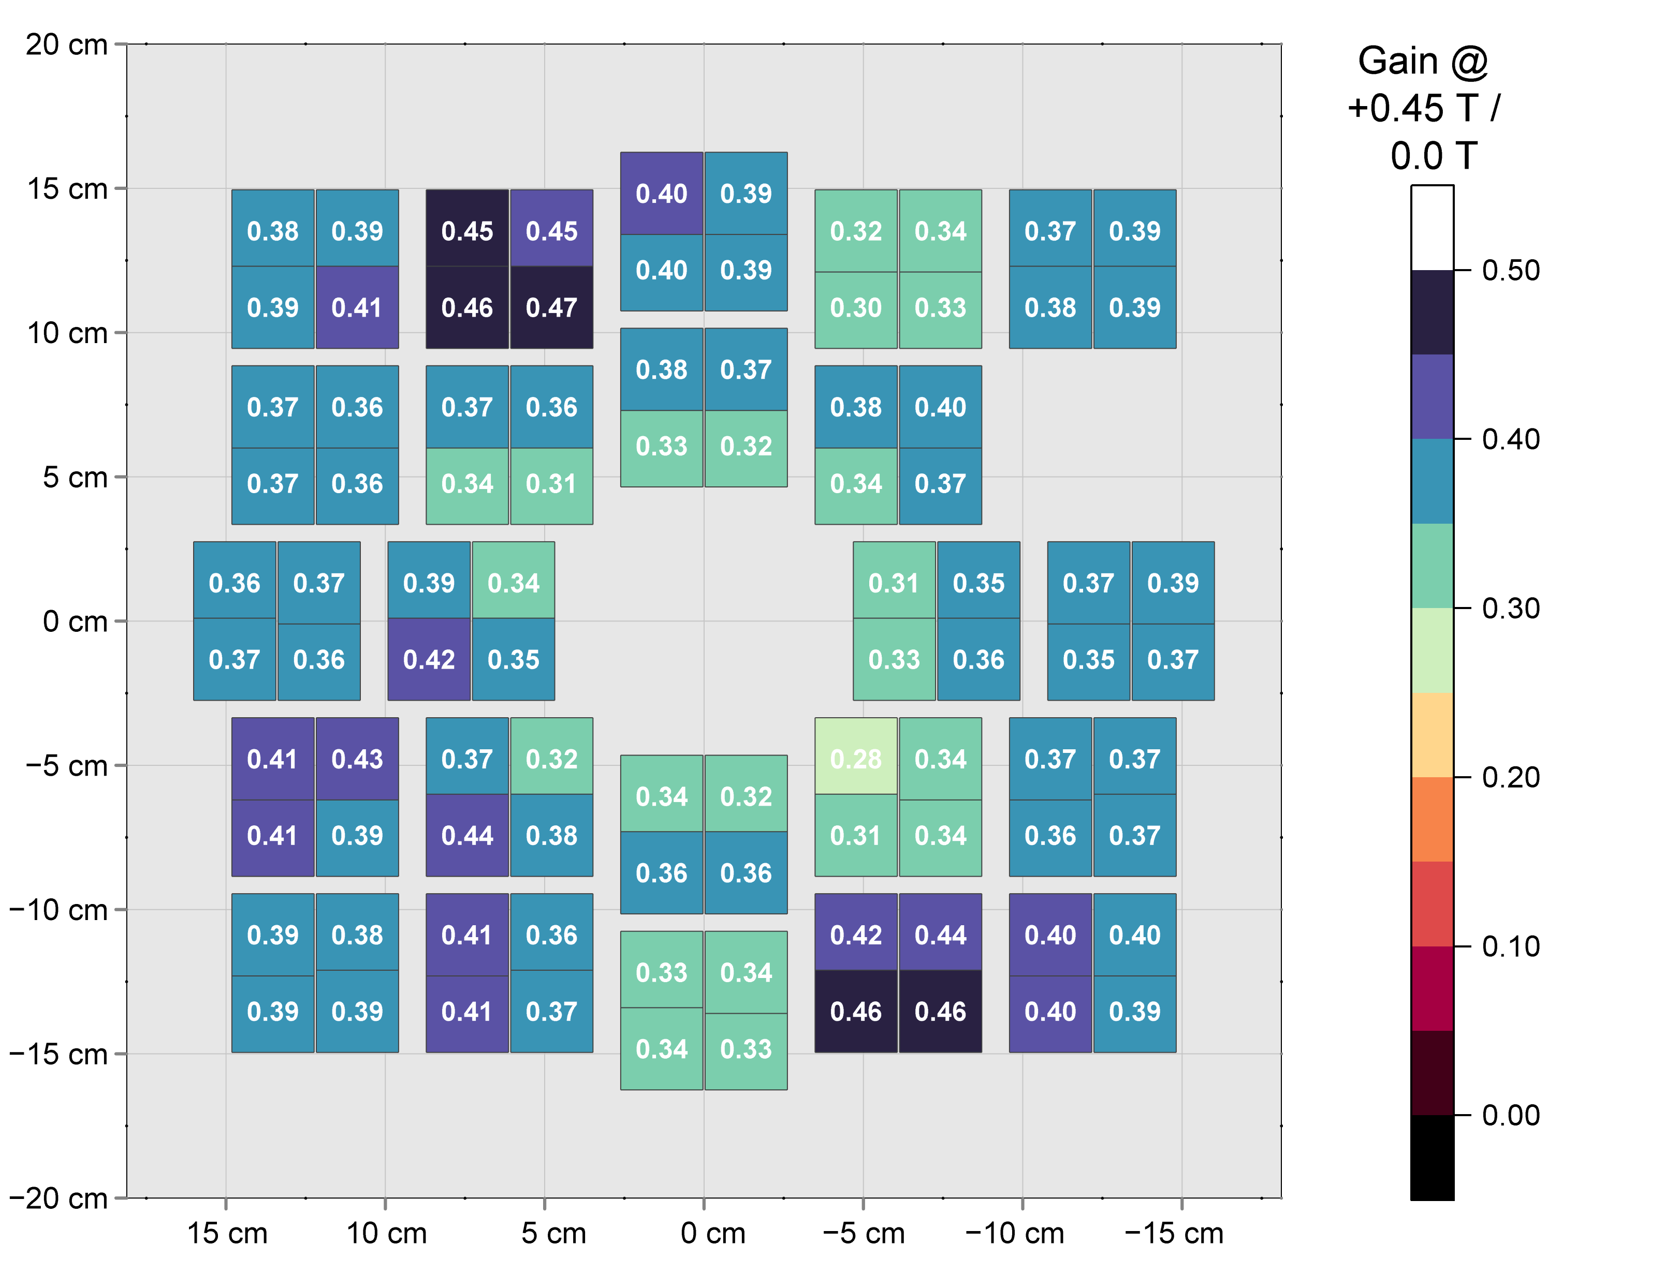
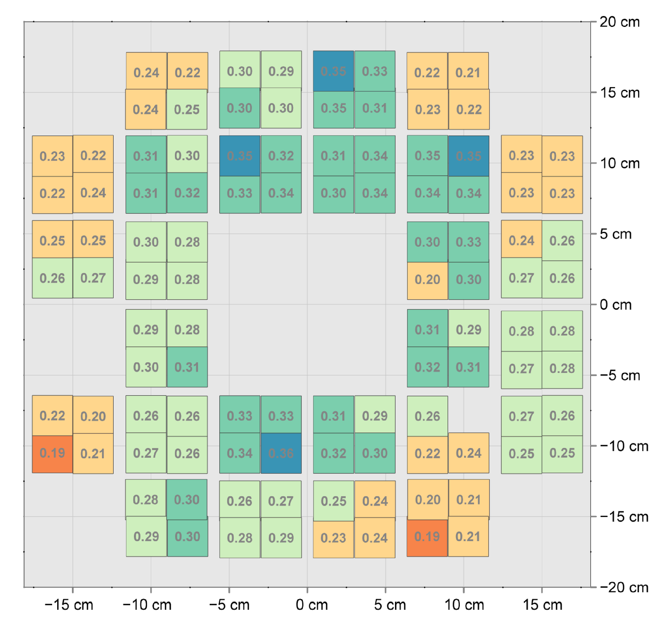
B-field effect on the detector
0.45 T B-field reduce gain x3 for the (flat) A-side, x5-x3 – for the (concave) C-side;
Easily compensated by + ~60 V; still average V_{bias} < 1.4 kV (<< V_{max} = 2.0 kV).
FIT B-field data published earlier in
[NIM A 983 (2020) 164591]
FT0-A
FT0-C

Slide 12
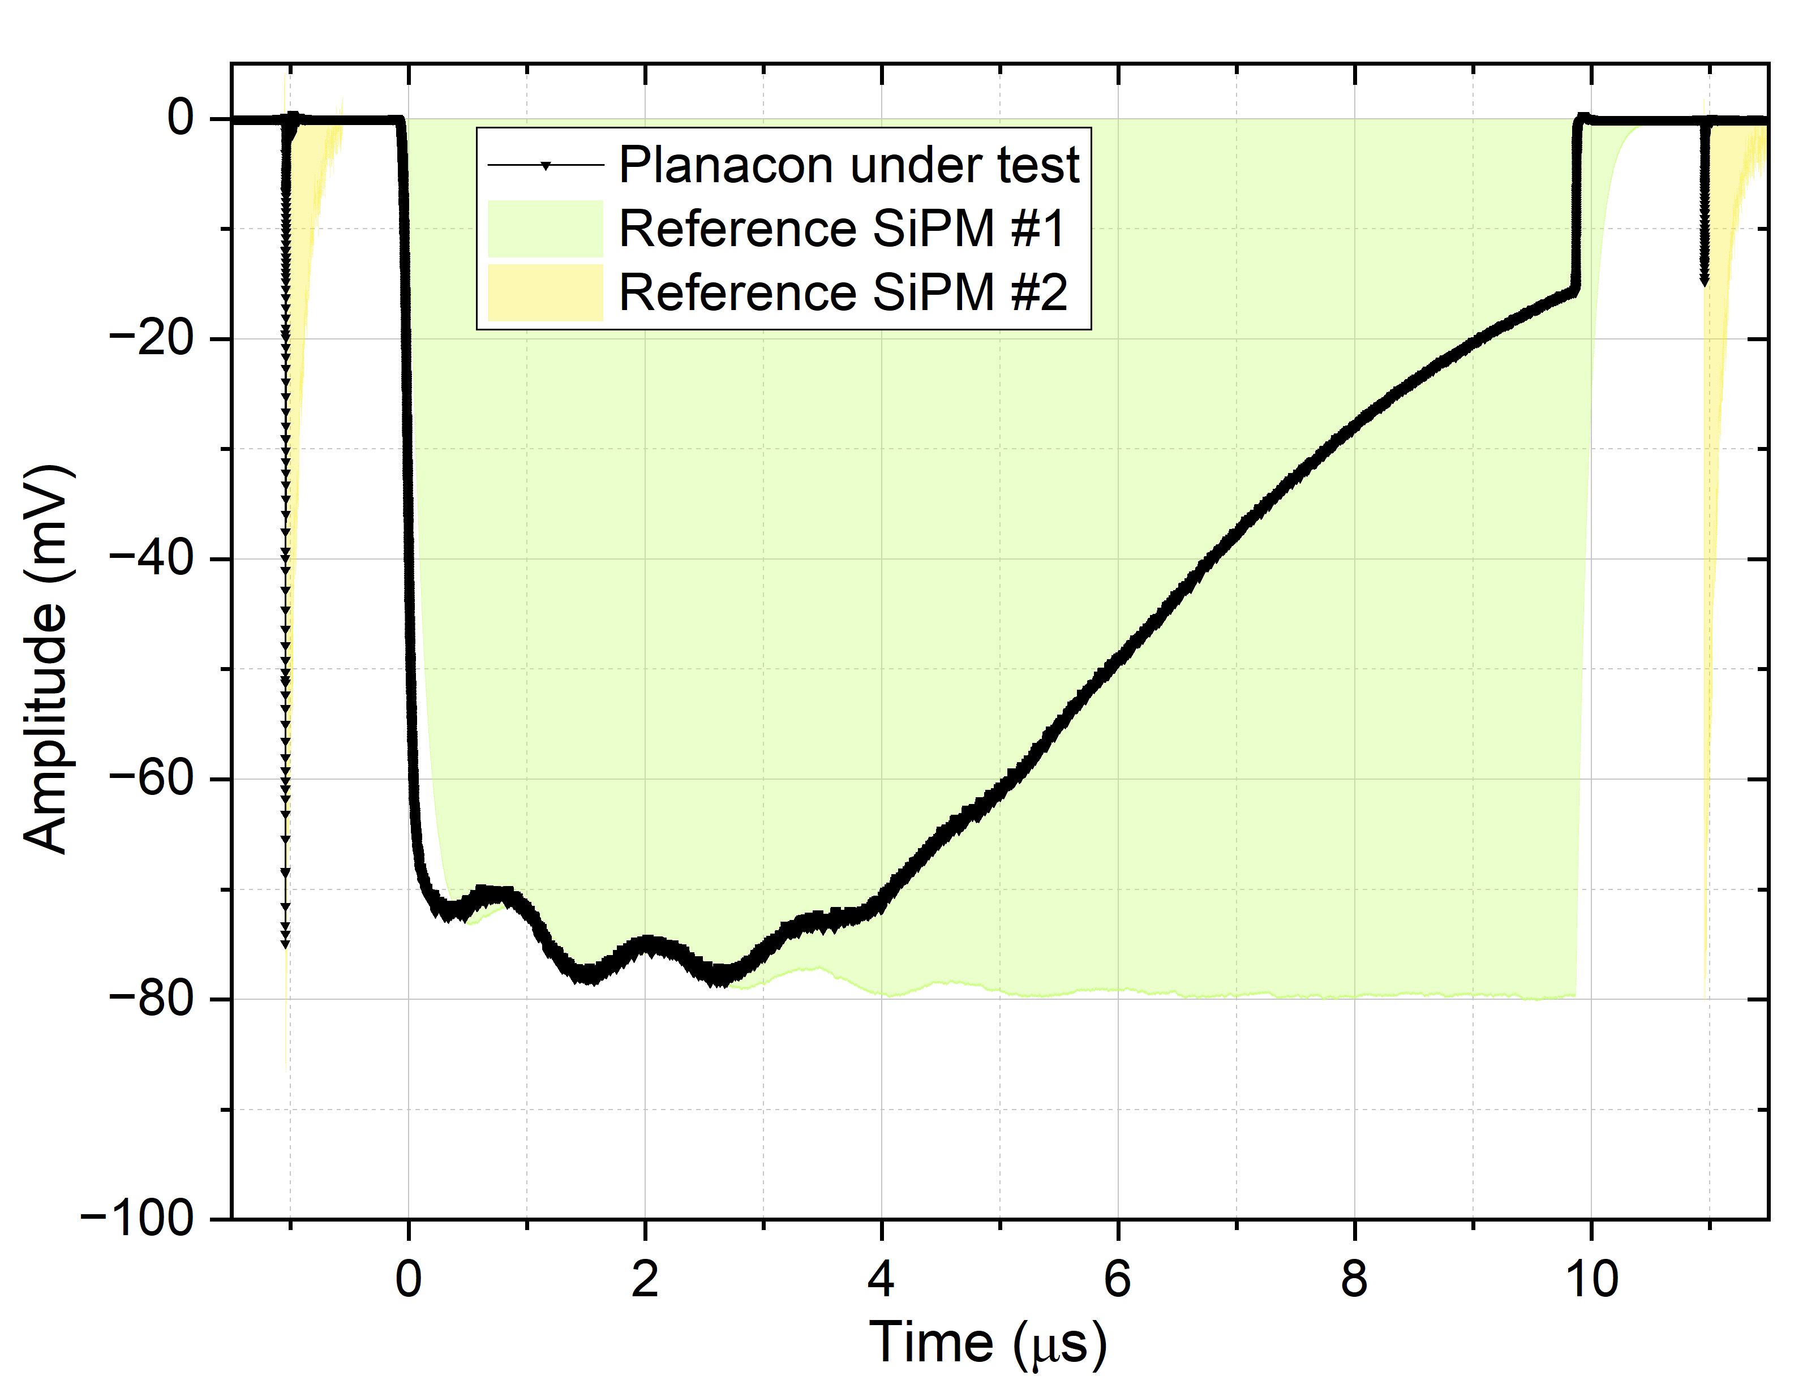
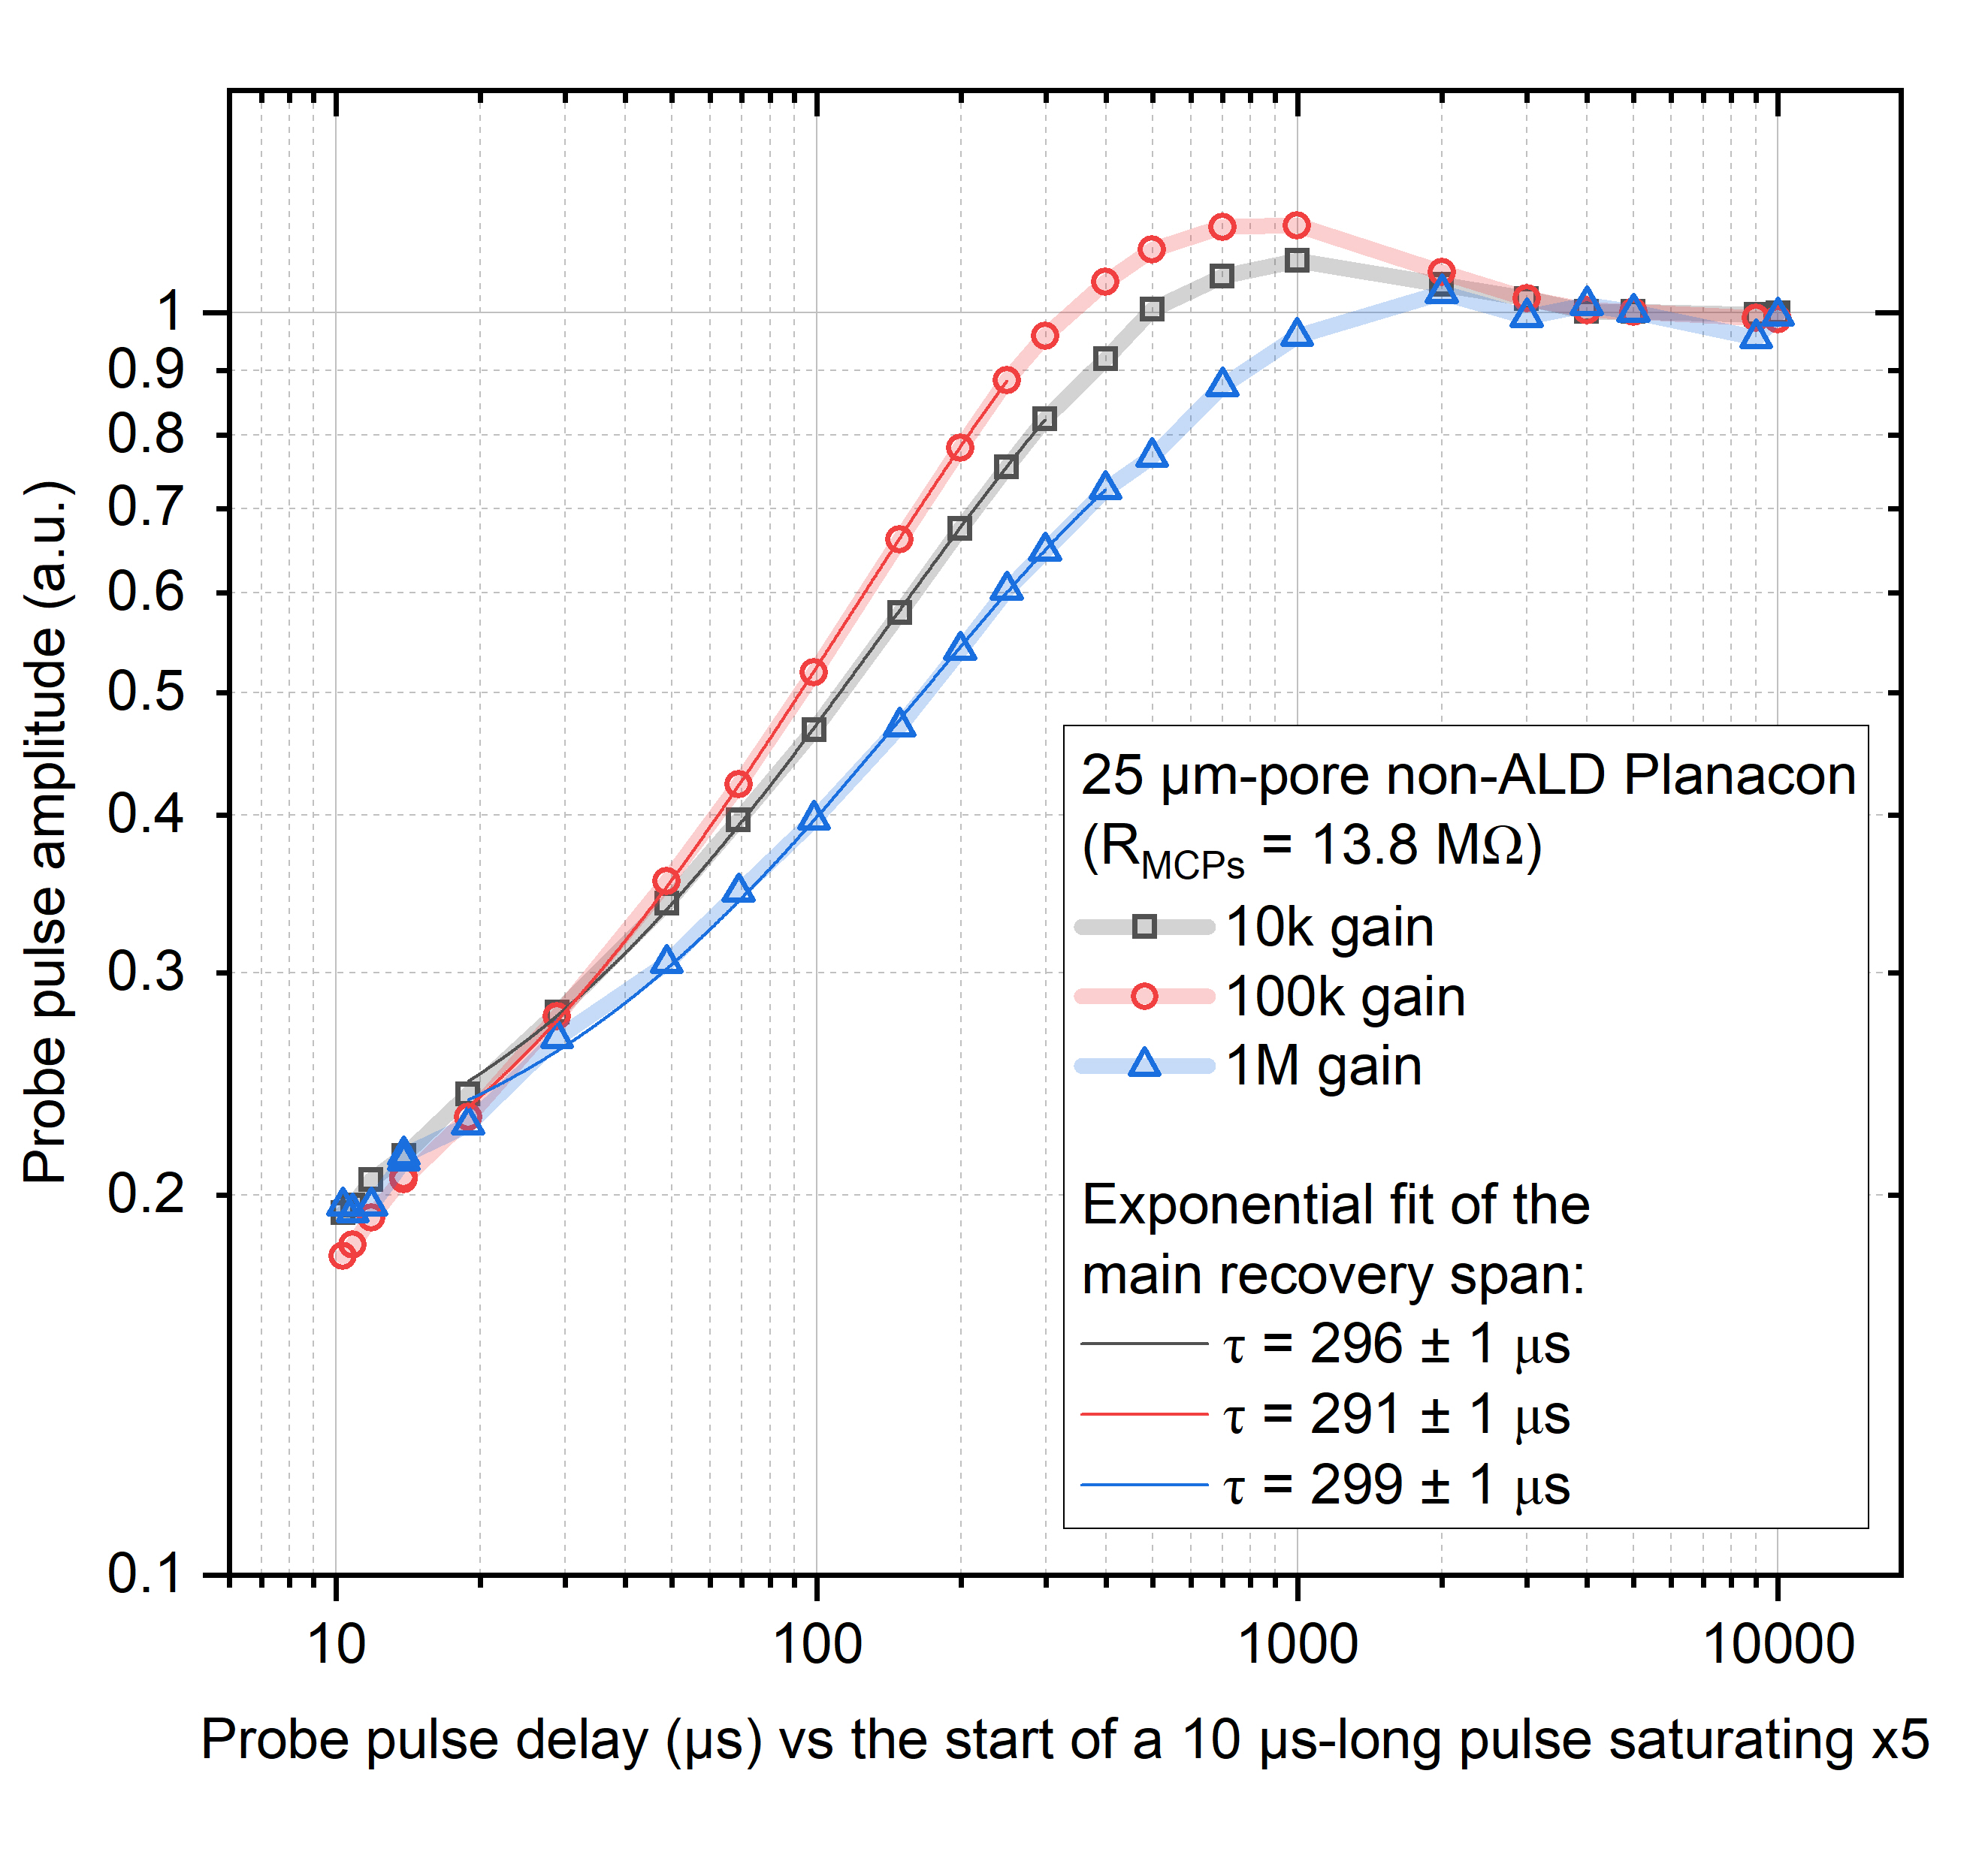
Characteristic MCP recovery time
Shape of the recovery curve is gain-dependent, but the typical τ = 300 μs (with R_{MCP stack} = 14 MΩ). Saturation is reached once 10 nC (~1.7*10⁴ MIPs) is detected within a time period notably shorter than that.
Illustration of the measurement technique and saturation conditions:

Slide 13
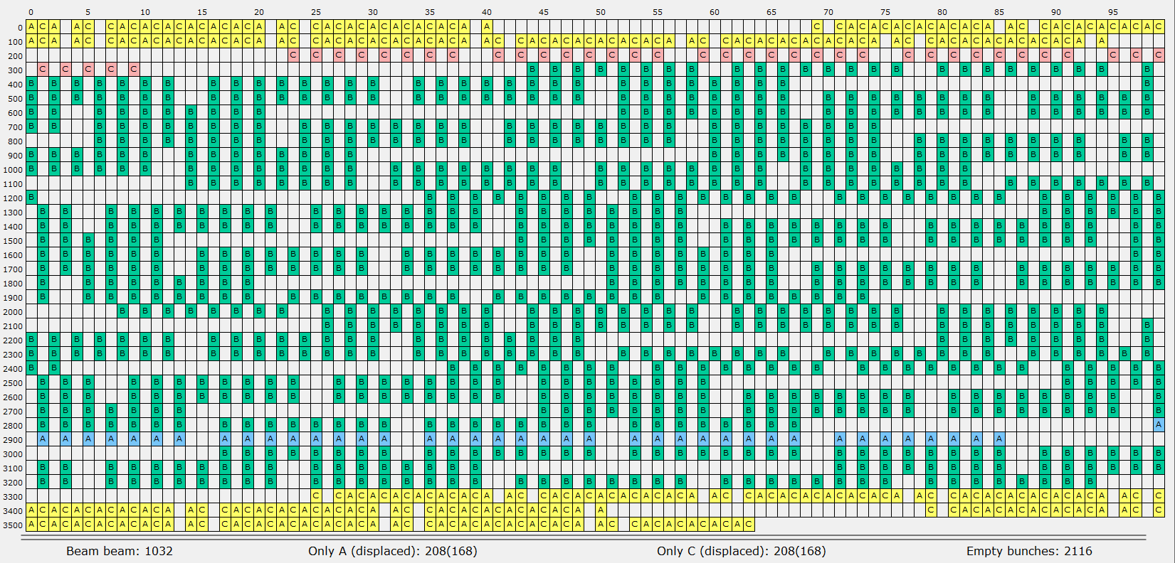
Characteristic MCP recovery time
Shape of the recovery curve is gain-dependent, but the typical τ = 300 μs (with R_{MCP stack} = 14 MΩ). Saturation is reached once 10 nC (~1.7*10⁴ MIPs) is detected within a time period notably shorter than that.
Load from the LHC collisions is distributed ~uniformly:
typical period < 2 μs in pp and <30 μs in Pb-Pb.
longest gap – 140 BC in pp (= 3.5 μs), 600 BC in Pb-Pb (=15 μs).
Visualization of a fully-packed LHC orbit. Green cells = colliding BCs. Number of cells = 3600 (27 km / 25 ns at the speed of light).

Slide 14
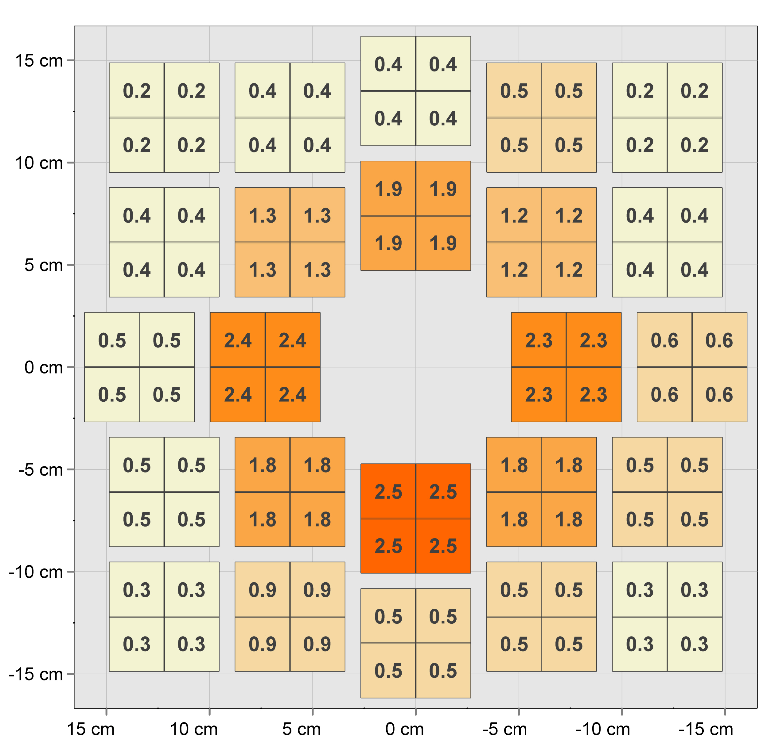
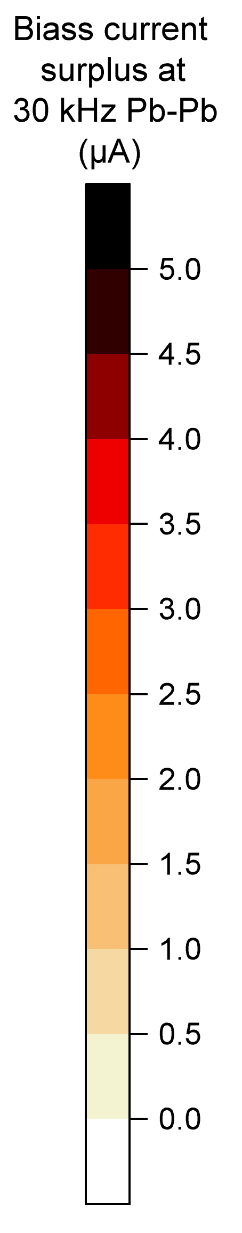
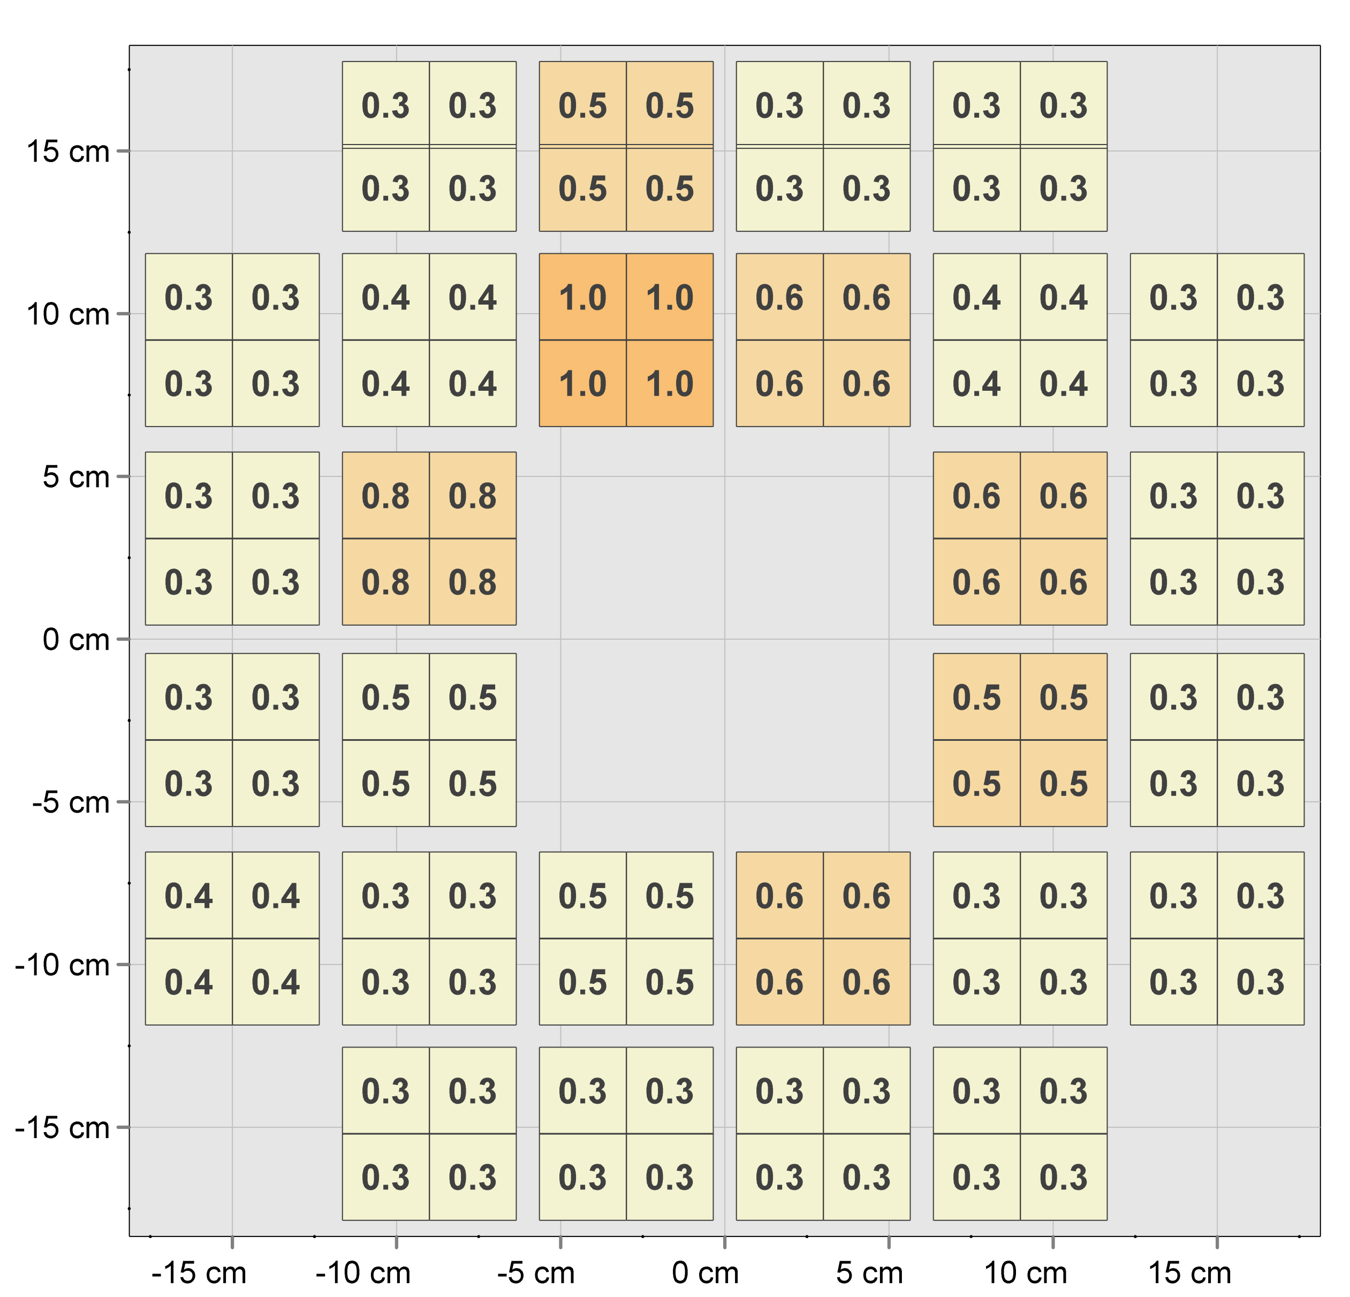
AAC saturation effect on the FT0 performance
Innermost FT0-A load is ~x6 of that for FT0-C (different pseudorapidity and material budget):
IP
7 cm of aluminium
1 cm of beryllium
FT0-A
FT0-C

Slide 15
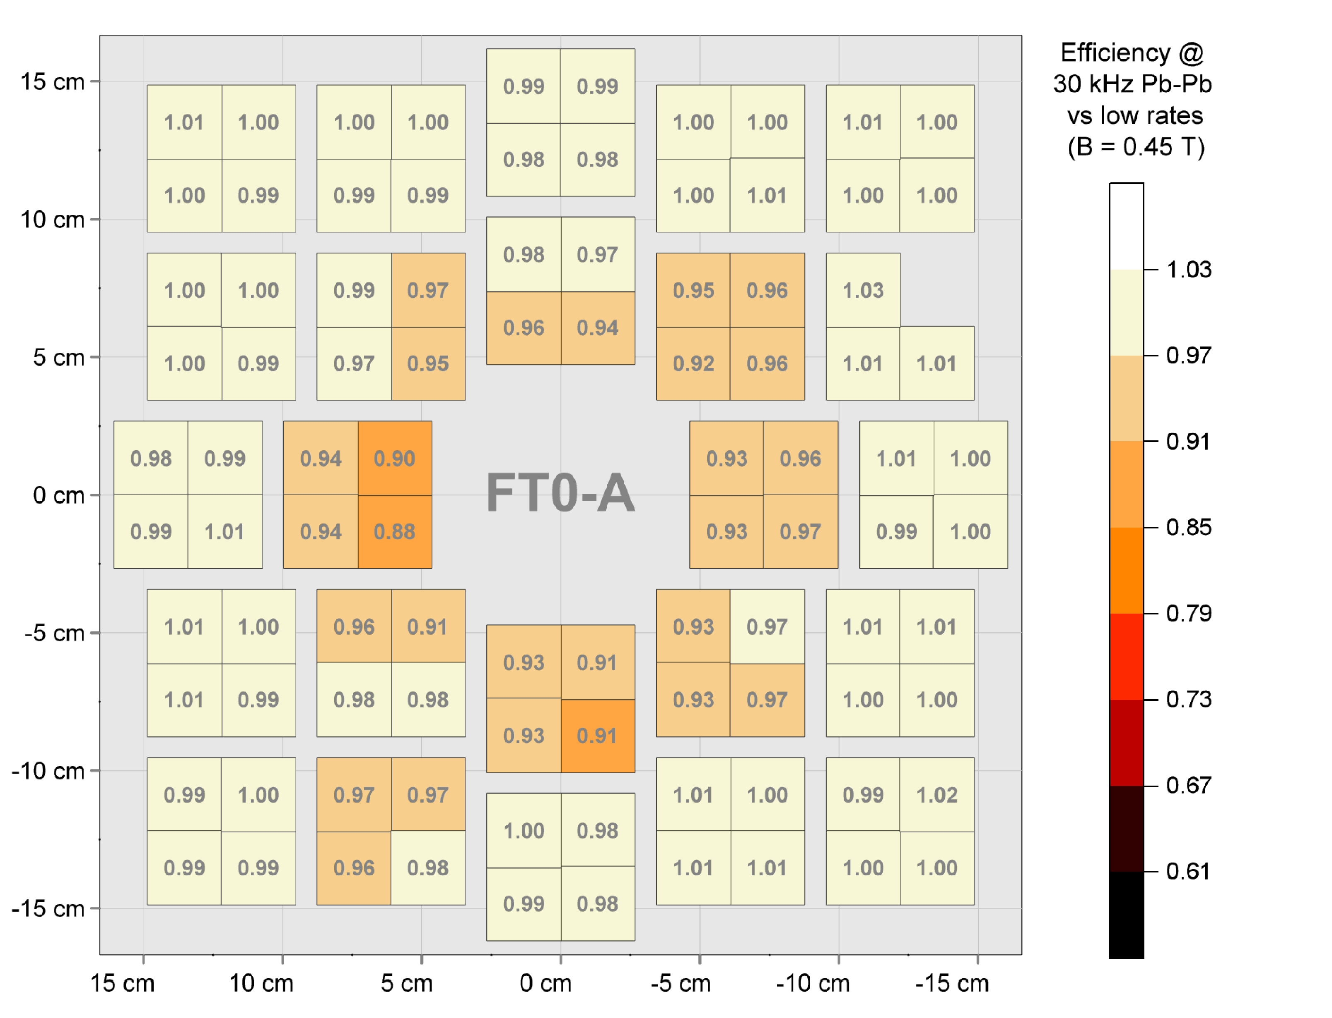
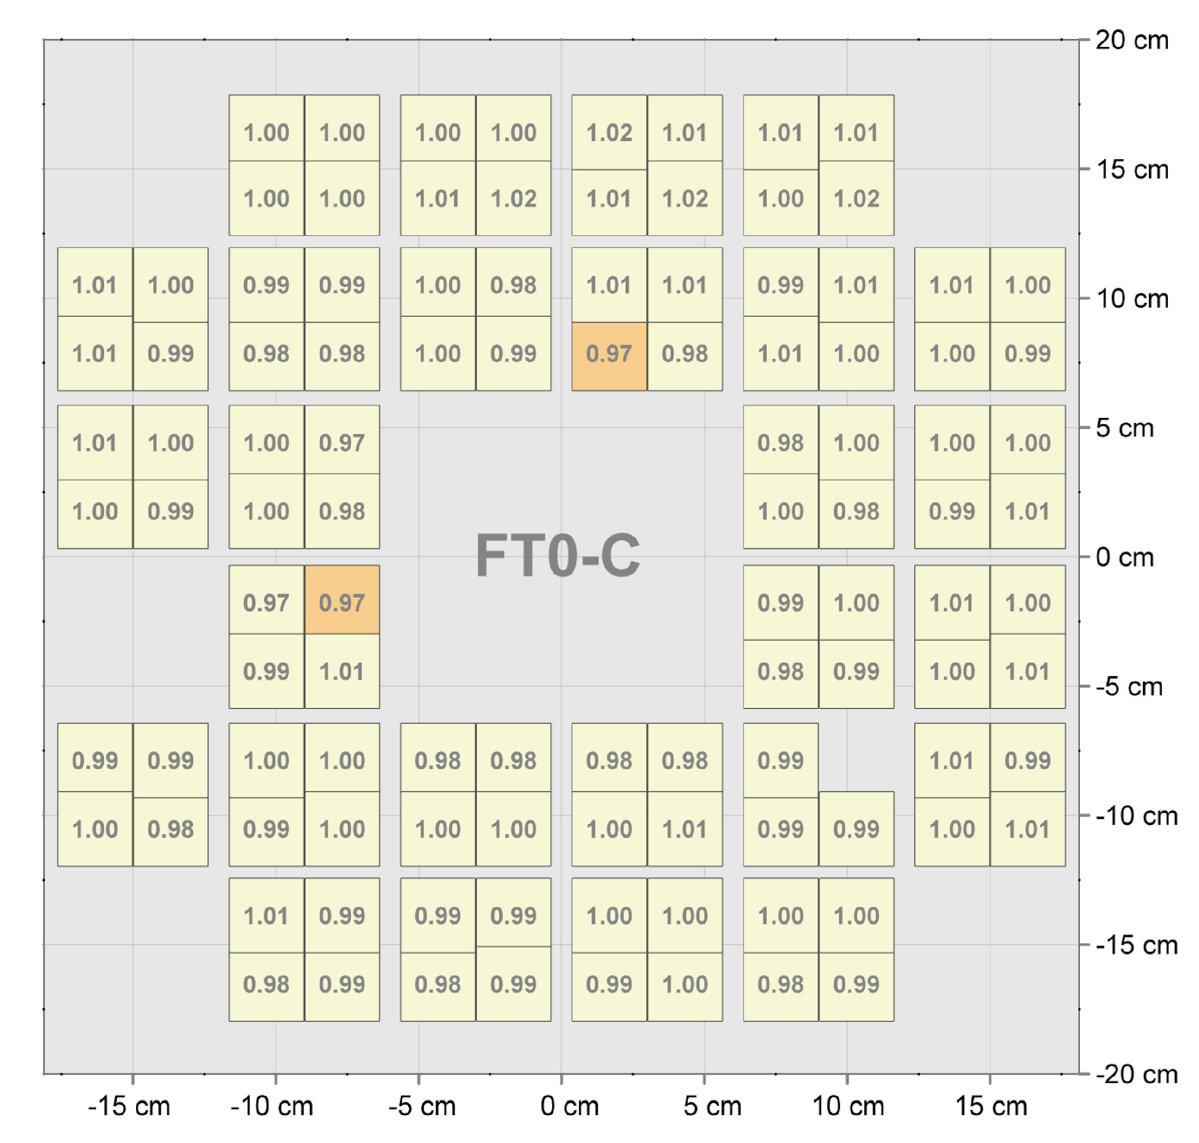
AAC saturation effect on the FT0 performance
So far LHC can run without a visible beam burnout at Pb-Pb rates ≤30 kHz;
30 kHz is also the preferred rate by ALICE to maximize the data taking efficiency;
Good stability of the FT0 Planacons’ response seen.

Slide 16
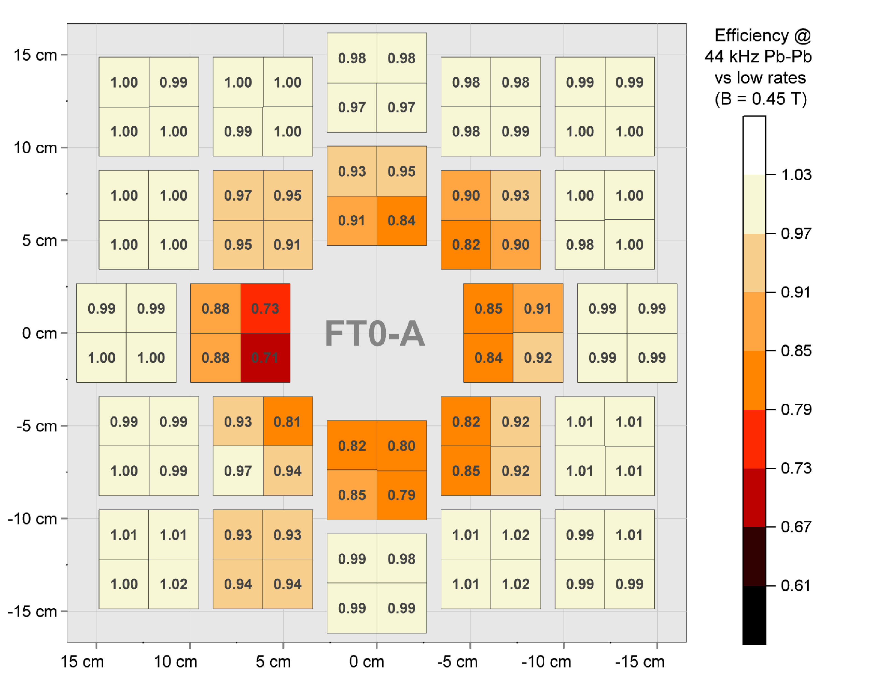
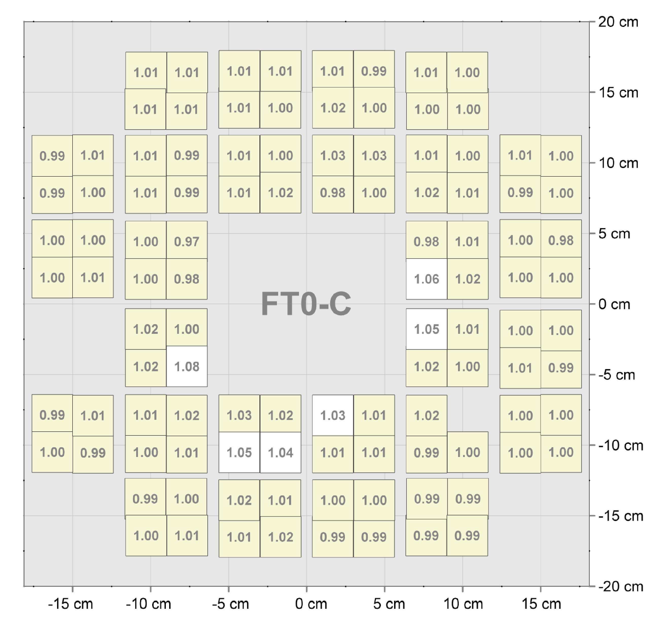
AAC saturation effect on the FT0 performance (worst case)
Stable response at highest rates, except the inner FT0-A ring (treated separately in the Pb-Pb data processing).
AAC saturation is correlated with an increased bias current consumption – can be corrected offline.

Slide 17
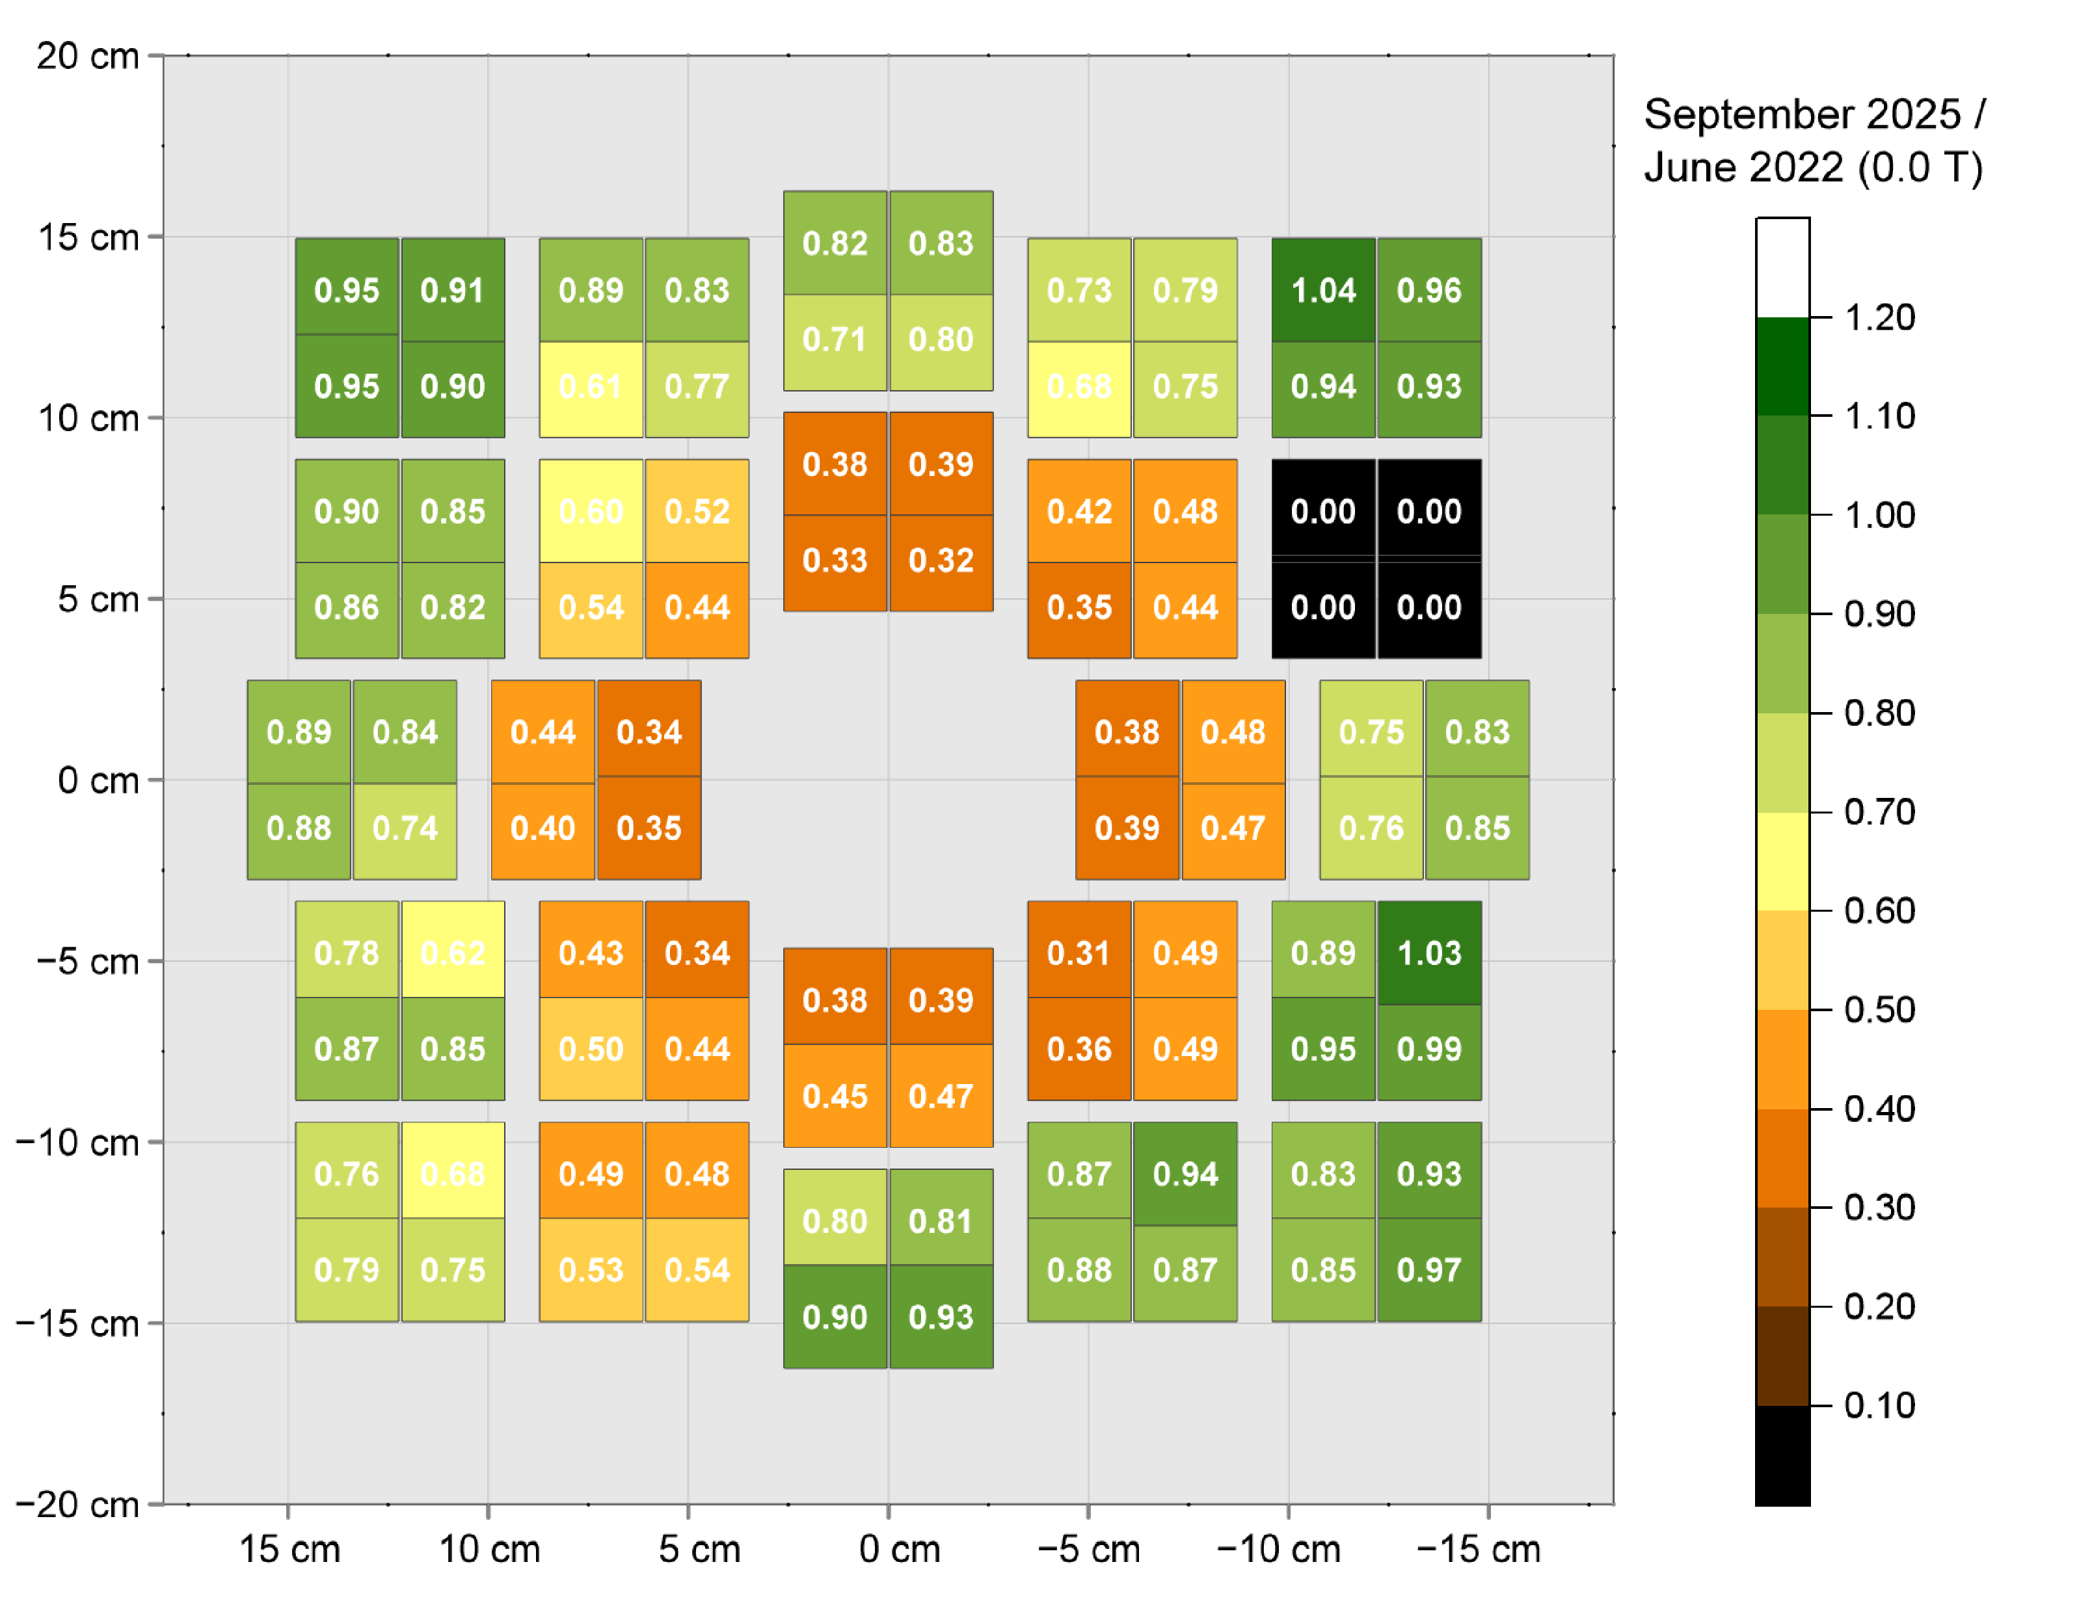
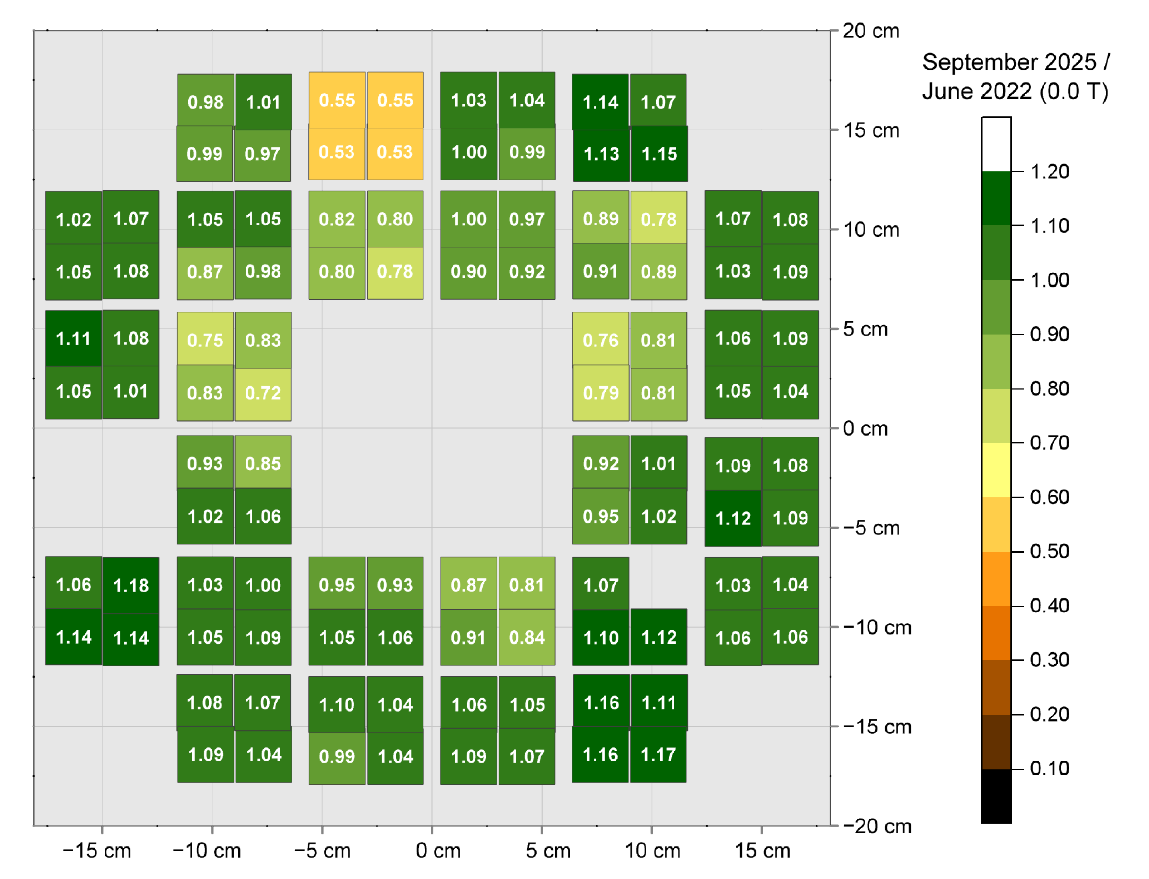
Ageing of the non-ALD Planacons
By September 2025, response of the inner FT0-A ring dropped by ~2/3 – compensated with HV increase;
< 100 V used, ~400 V of margin left – profit of the high yield / low gain strategy (~15 k gain @ ~1.3 kV typ.).
FT0-A
FT0-C

Slide 18
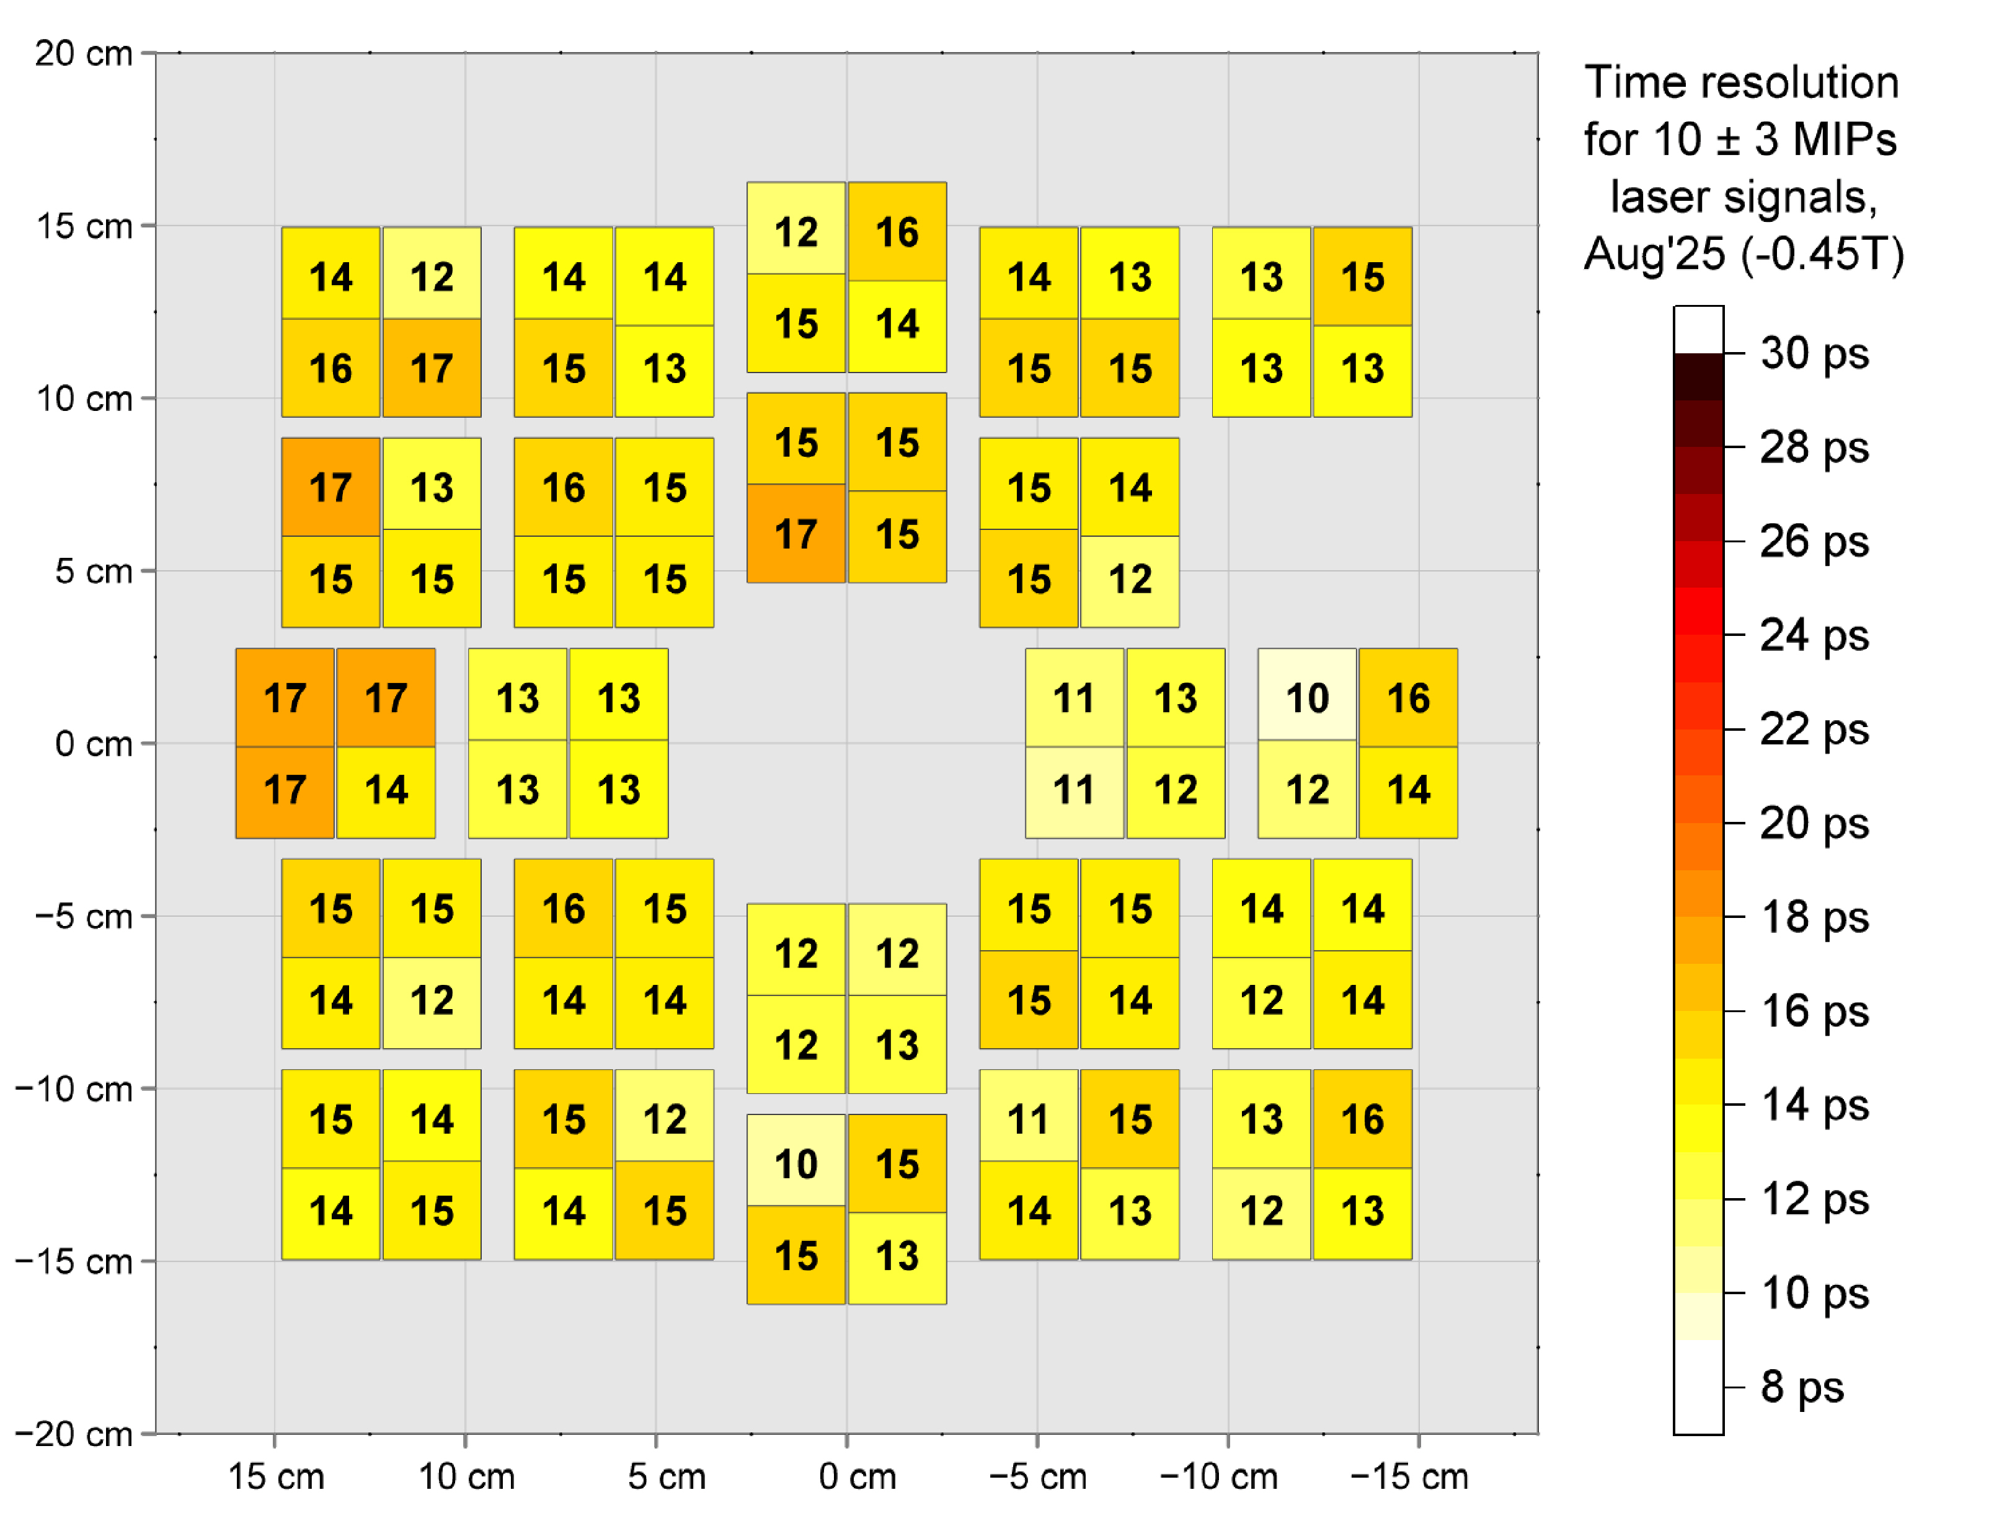
Ageing of the non-ALD Planacons
No visible deterioration of the (excellent) time resolution – no real side effects of ageing seen so far.
FT0-A
FT0-C

Slide 19
Ageing of the non-ALD Planacons
MCP-PMTs are (deservedly) considered rad-hard photosensors: FIT Planacons have been exposed to >100 kRad and ~7*10¹¹ 1-MeV-n_{eqv}/cm² without any clear correlation to ageing nor other effects.
Radiation conditions indicated in blue: NIEL (equivalent for silicon, 1-MeV-n_{eqv}/cm²) & TID (kRad):
1.1*10¹¹ n_{eqv}/cm² & 20 kRad
4*10¹¹
& 110
7*10¹¹
& 20

Slide 20
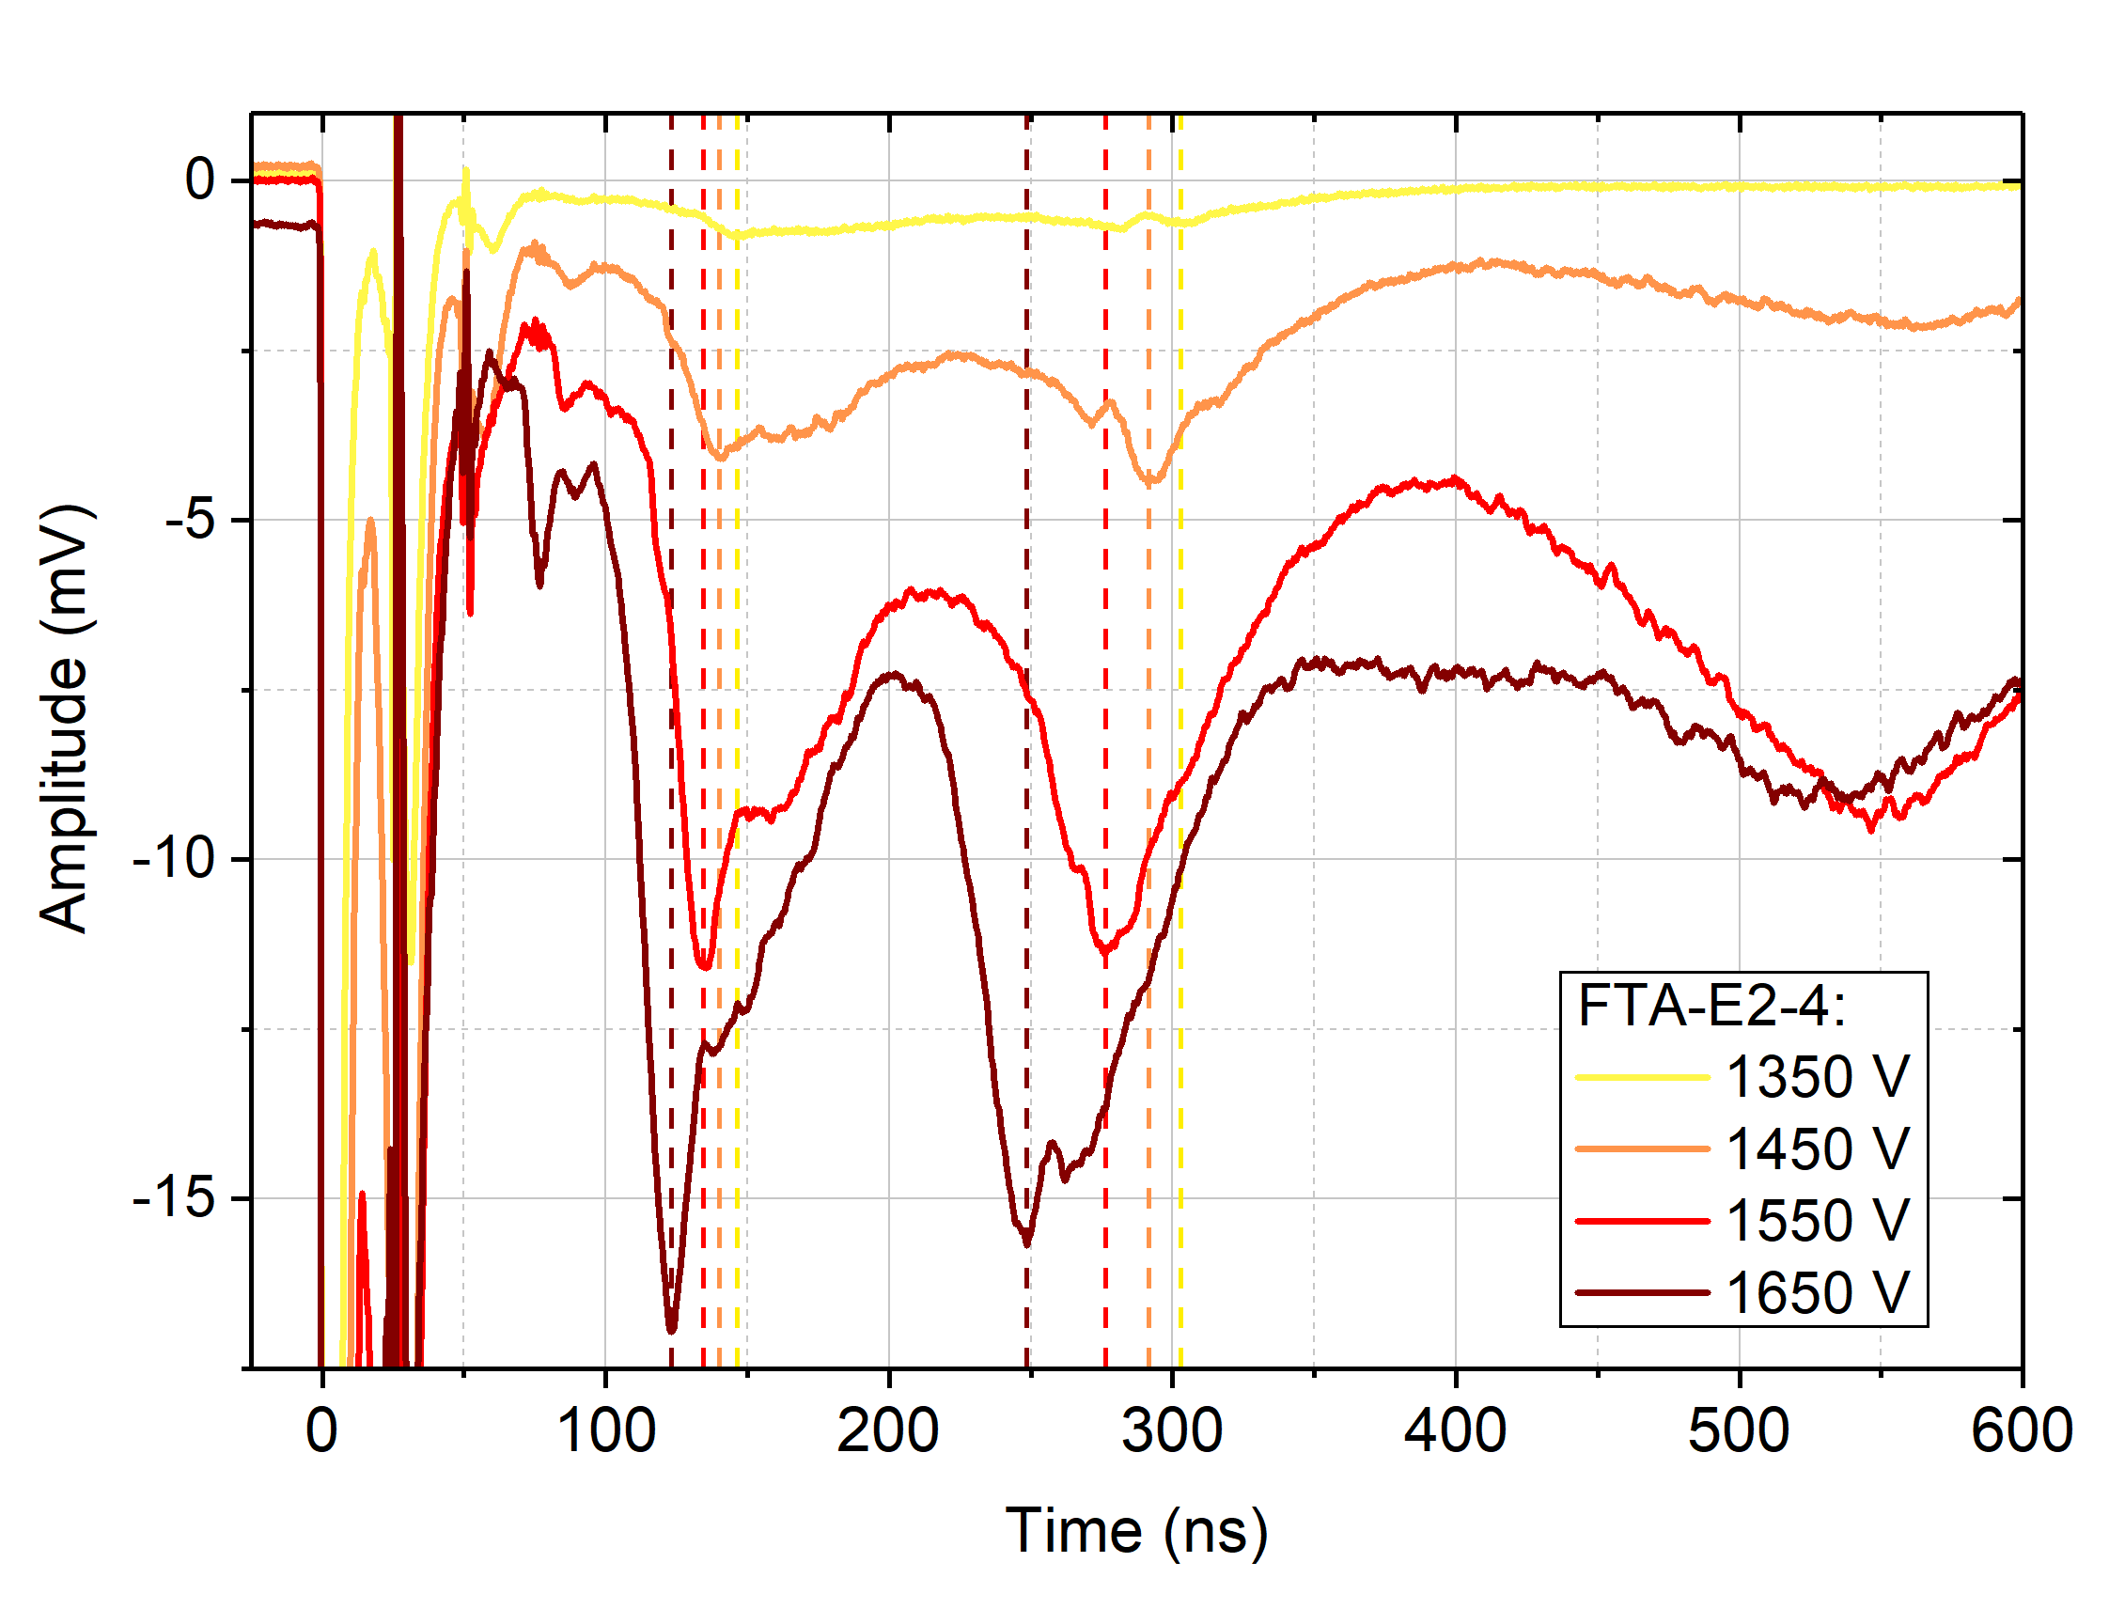
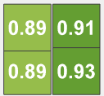
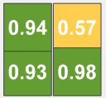
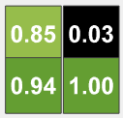
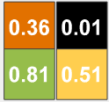
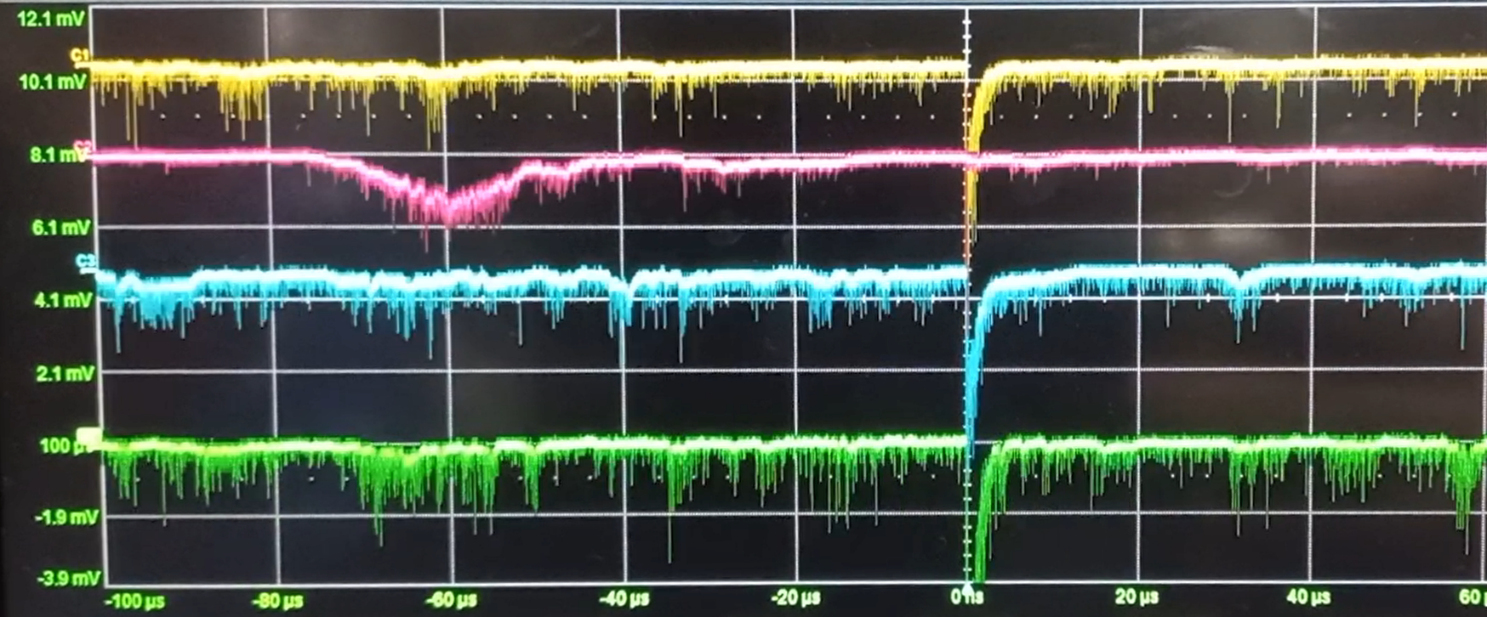
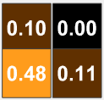
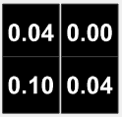
The blind spots
The only blind PMT suffered from a proven vacuum microleak.
Nov
2022
Apr
2023
FT0-A
Jun
2023
FT0-C
Oct
2023
Apr
2023
May
2024

Slide 21
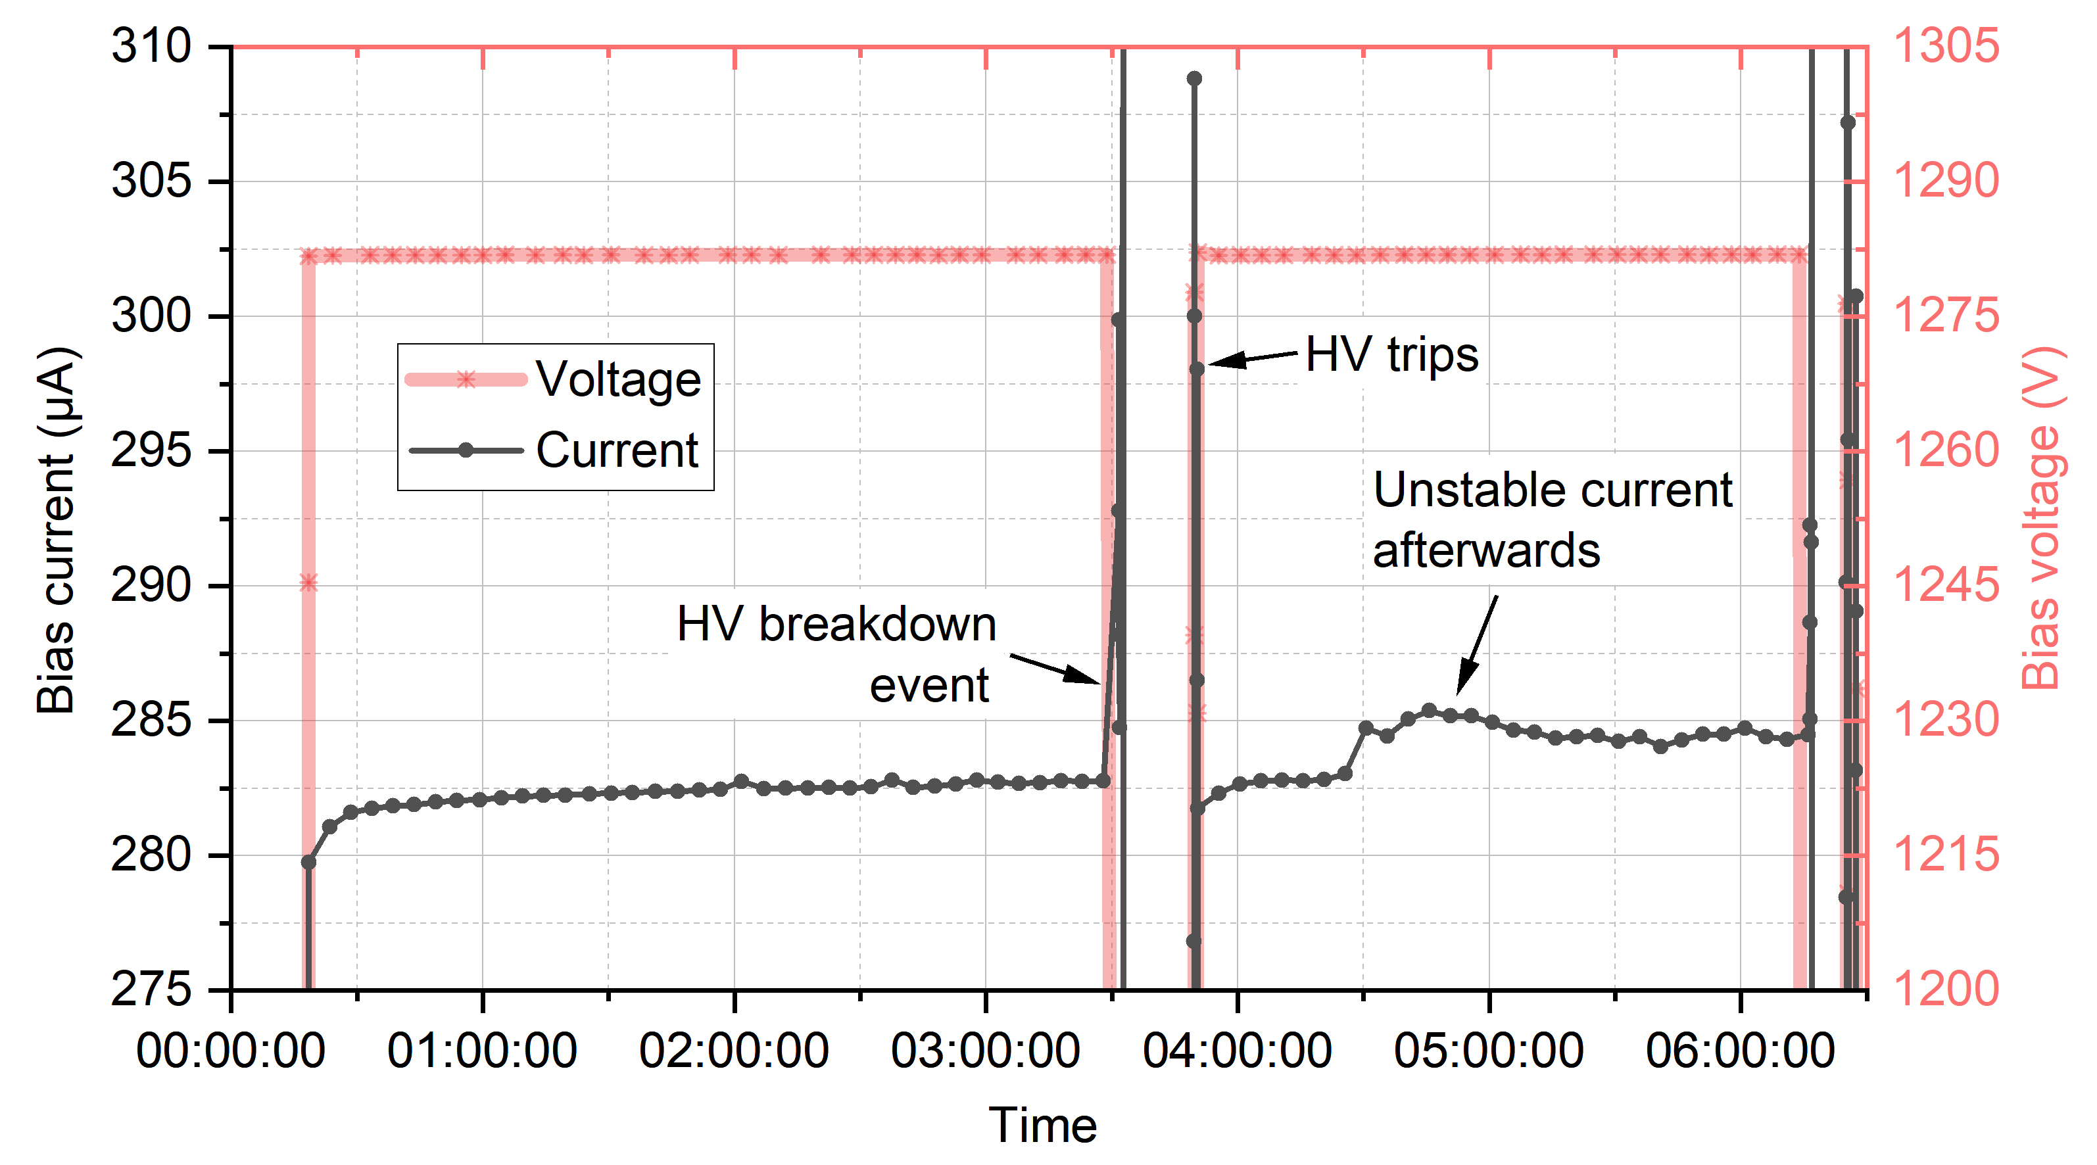

The blind spots
The only blind PMT suffered from a proven vacuum microleak.
HV breakdowns across the MCP: four cases over four years – three repairable, one ultimate
Nov
2022
Apr
2023
FT0-A
Jun
2023
FT0-C
Oct
2023
Apr
2023
May
2024

Slide 22
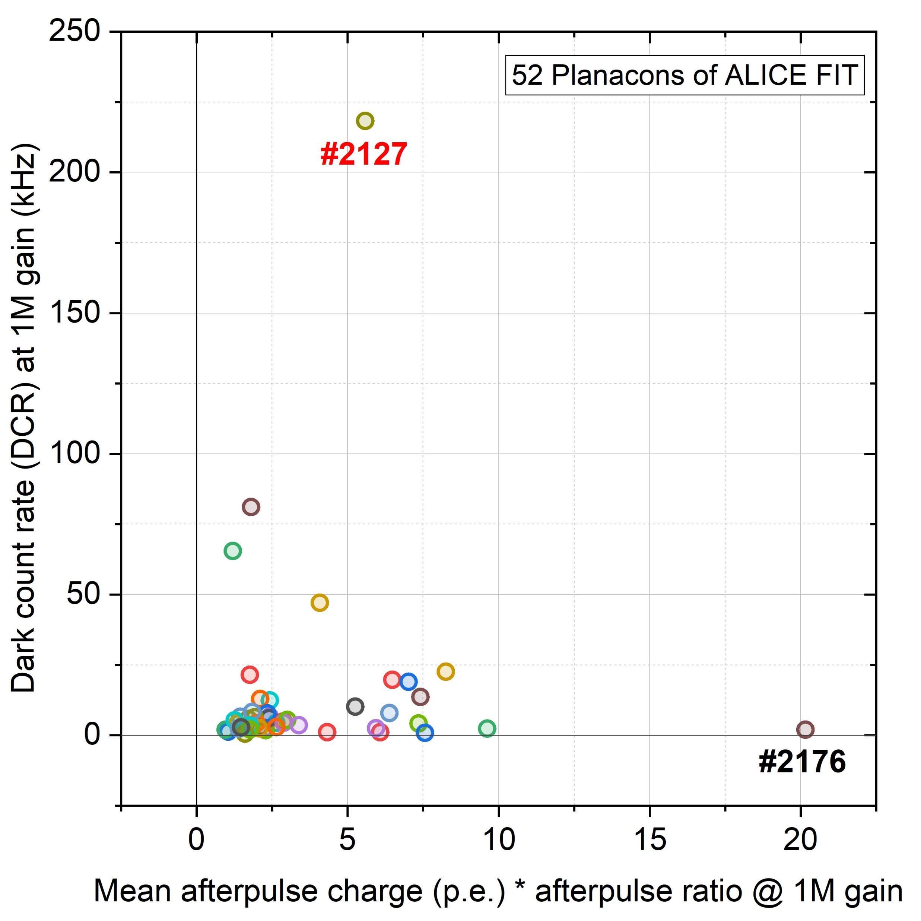

The ageing outliers
The only two outliers in terms of ageing speed are the only two outliers in terms of the intrinsic noise characteristics (DCR & afterpulsing).
#2127
FT0-A
FT0-C
#2176

Slide 23



Ageing development
Trends’ shapes ~repeatable across different MCP-PMTs;
Moderately-loaded Planacons age as fast as in the dedicated ageing test in lab (outside ALICE);
Ageing of the most loaded channels is slow enough to avoid any FT0 performance deterioration in LHC Run 3.
(B = 0.0 T)
collected at B = 0.45 T

Slide 24
Ageing development
Real effect – not errors
Trends’ shapes ~repeatable among different MCP-PMTs;
Moderately-loaded Planacons age as fast as expected from the dedicated ageing test in lab (outside ALICE);
Ageing of the most loaded channels is slow enough to avoid any FT0 performance deterioration in LHC Run 3.
(B = 0.0 T)
collected at B = 0.45 T

Slide 25

Self-recovery of the ageing effect
LHC normally runs for ~7 months in a row – then no collisions for ~5 month (“YETS” period);
Heavy-ion running results in faster ageing (x6 proton load) – proportional to IAC;
Notable self-recovery of the aged MCP-PMTs is observed throughout YETS (at room temperature).
collected at B = 0.45 T

Slide 26


Self-recovery of the ageing effect
Stronger ageing → stronger self-recovery
Change in the
MCP-PMT response
During
7 months
of running
During
5 months
of YETS
24.11.2024
07.05.2025

Slide 27




Self-recovery of the ageing effect
Stronger ageing → stronger self-recovery (true at moderate ageing);
No ageing → no recovery;
Very strong ageing → notable recovery.
160 days of YETS
2023 - 2024
2024 - 2025

Slide 28







FT0 laser calibration system
← “PMT view” of the radiators – black edge to suppress backward signals (> x20).
Essential tool to calibrate the detector and monitor the MCP-PMT response;
Light from a single laser delivered to 208 channels;
Dedicated fibers traced through both detectors to monitor for possible radiation damage;
“Non-invasive” solution to monitor and correct for laser light instability with the photon leakage via fiber walls.
1-to-64 optical splitter boxes custom-made to deliver 440 nm light from a single laser to 208 detector channels
↑ FT0 reference PMT module with a laser intensity monitoring loop and return inputs ↑

Slide 29


Stability of the laser calibration system
Fiber transparency is stable within ±1% over the 5 months-long YETS periods;
Sample rad-hard fiber degrades by <5% after 4*10¹² n_{eqv}/cm fluence, but on-detector fibers get ~x10 less.

Slide 30
Conclusions
The first large-scale Planacon application in HEP!
ALICE FIT-FT0 – success story of the using the cost-effective* MCP-PMTs
Key contributor to the remarkable time resolution for Pb-Pb collisions σ = 4.4 ps;
Handling high photon fluxes & AAC: ~10⁸ p.e./cm²/s | 600 nA/cm²
Profit of the low-resistance MCPs with τ = 0.3 ms;
AAC limit is B-field dependent, and peculiarly correlated to the tilt angle for the maximum gain.
Beyond 1.5 C/cm² IAC the strong ageing is balanced by HV increase without timing deterioration
Profit of the large Cherenkov yield (2 cm of quartz + VUV-sensitivity);
Outliers in terms of DCR and afterpulsing age notably faster;
Self-recovery of the aged MCP-PMTs – newly observed effect (to be scrutinized during the LS3).
Among the unpleasant surprises:
Vacuum microleak (1 case), non-repairable HV breakdown across the MCP (1 case).
(*25 µm pore size, non-ALD)

Slide 31

Thanks a lot for your attention!
More on the ALICE FIT on YouTube

Slide 32
Back-up slides

Slide 33
Our publications on the relevant topic
Yu. Melikyan, on behalf of ALICE. Status and performance of the ALICE Fast Interaction Trigger, PoS(ICHEP2024)921
Yu.A. Melikyan et al. Characteristic properties of Planacon MCP-PMTs, JINST 16 (2021) P12032
Yu. Melikyan et al. Load capacity and recovery behaviour of ALD-coated MCP-PMTs. NIM A 949 (2020)162854
Yu.A. Melikyan et al. Performance of the cost-effective Planacon® MCP-PMTs in strong magnetic fields, NIM A 983 (2020) 164591
Yu.A. Melikyan, on behalf of ALICE. Performance of Planacon MCP-PMT photosensors under extreme working conditions, NIM A 952 (2020) 161689
Yu. Melikyan, PhD thesis (2019) in Russian: Development of the Fast Interaction Trigger detecting system for the upgraded ALICE
E.V. Antamanova, et al. Anode current saturation of ALD-coated Planacon® MCP-PMTs. JINST 13 (2018) T09001
V.A. Grigoryev et al. Fast timing and trigger Cherenkov detector for collider experiments. J. Phys. Conf. Ser. (2016) 675(4):042015
V.A. Grigoryev et al., Study of the Planacon XP85012 photomultiplier characteristics for its use in a Cherenkov detector. J. Phys. Conf. Ser. (2016) 675 (042015)

Slide 34


Effective AAC saturation
Sufficient rate capability of all FT0 channels at 26 kHz.

Slide 35
Warm-up trends (11 MΩ ≤ R_{MCP stack} ≤ 20 MΩ)
FIT Planacon data published earlier in [JINST 16 (2021) P12032]

Slide 36


B-field effect on the detector
0.45 T B-field reduce gain x3 for the (flat) A-side, x5-x3 – for the (concave) C-side;
Easily compensated by + ~60 V; still average V_{bias} < 1.4 kV (<< V_{max} = 2.0 kV).
FIT B-field data published earlier in
[NIM A 983 (2020) 164591]

Slide 37



B-field effect on the detector
FIT B-field data published earlier in
[NIM A 983 (2020) 164591]
Reduced field vs no field

Slide 38


B-field effect on the detector
Full field – positive vs negative

Slide 39

Gain change vs tilt

Slide 40


Ageing of the non-ALD Planacons

Slide 41


C-side ageing & annealing maps
Partial ageing recovery during the year-end technical stops (160 days of no-lumi);

Slide 42

160 days of YETS
2023 - 2024

