Slide 1
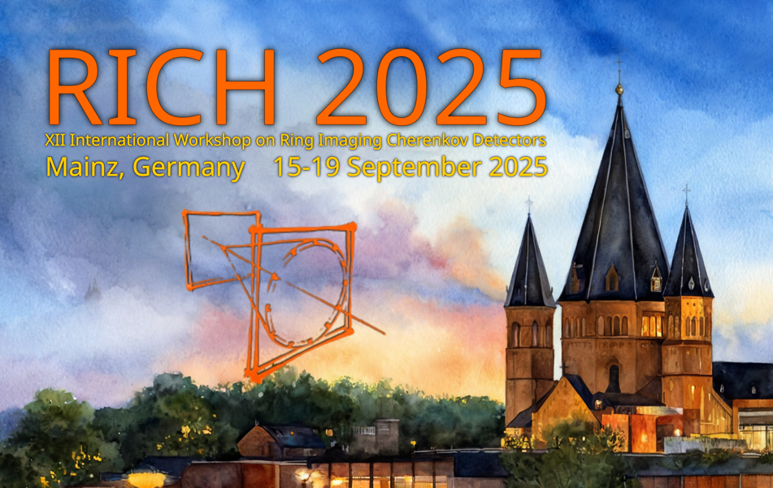
A DIRC-like TOF at STCF
R&D、beam test and future plan
Xuesen Lin On behalf of PID colleagues at STCF , USTC
1
Notes:
Hello everyone, I’m honored here to introduce the progress of the development of PID of STCF detector. This report focus on R&D, beam test and future plan of the DTOF.

Slide 2
Content
DTOF (DIRC-like TOF) @STCF: requirements
R&D: design ,reconstruction , simulation performance and cosmic ray test
Beam test @ CERN: experiment setup, result
Future plan: BTOF R&D and BTOF beam test preparation
2
Notes:
I list the content here. The report contains of the requirement of PID for STCF. The R&D including the Design, reconstruction, simulation performance and cosmicray test. Afterwards, the beam test of a 1/3 prototype was conducted in CERN T9 last summer.And I ‘ll show you the experiment setup and result. Final I would talk about the Barrel DTOF, which we call BTOF R&D and the beam test preparation.

Slide 3
DTOF@STCF: requirements
01
3

Slide 4
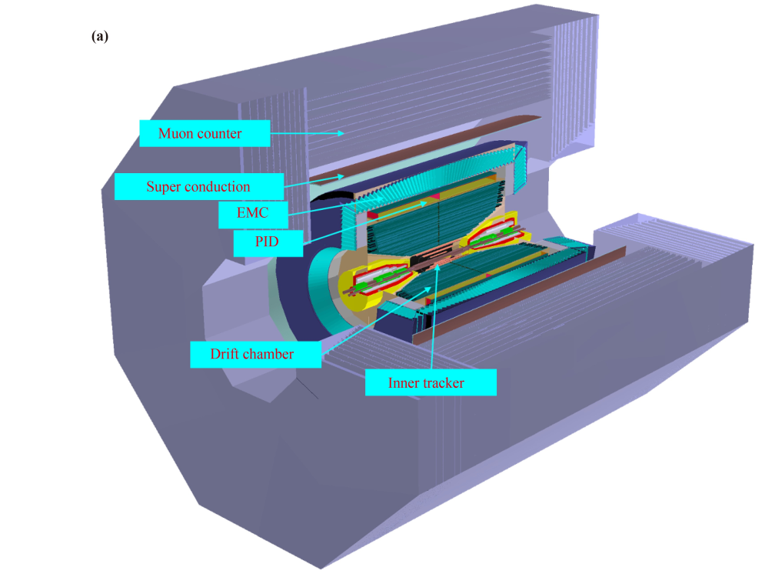
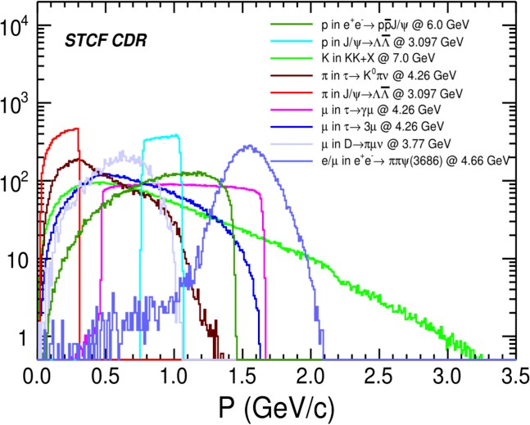
STCF introduction
The momenta of STCF final state particles
High luminosity frontier，focus on charm bottom quark and precise measurement of SM
Endcap PID detector requirements
>4σ 𝜋/Κ separation power at p≤2 GeV/c
Compact structure, thickness<20 cm
Low material budget (<0.3 X₀)
A polar angle coverage of 21°-36°
Super tau charm factory (STCF) in China
Maximum luminosity: >0.5×10³⁵ cm⁻²s⁻¹
Energy range: Ecm = 2-7 GeV
A DIRC detector !
Notes:
STCF, short for super tao charm facility, is a high luminosity frontier collider, focus on charm, bottom quark and precise measurement of SM. The maximum luminosity is ~ 10^35, energy range from 2-7GeV/c. Here’s the momentum distribution of the STCF final states particles, and you can see that almost every charged particle momentum < 2GeV, that is , we need to separate the particle , especially Pi K below 2 GeV. What’s more we want it to be more compact and lower material budget, so we choose the DIRC detector as the endcap PID detector.

Slide 5
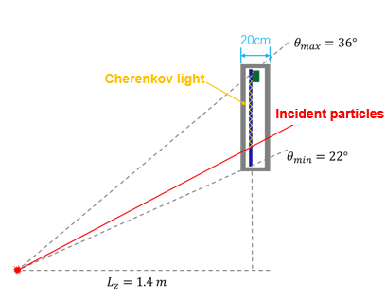
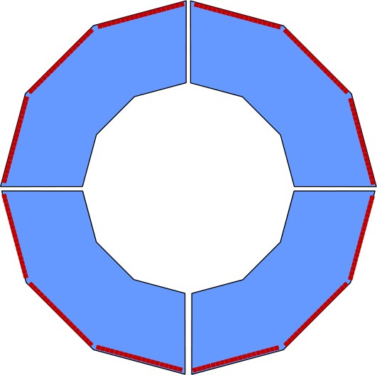
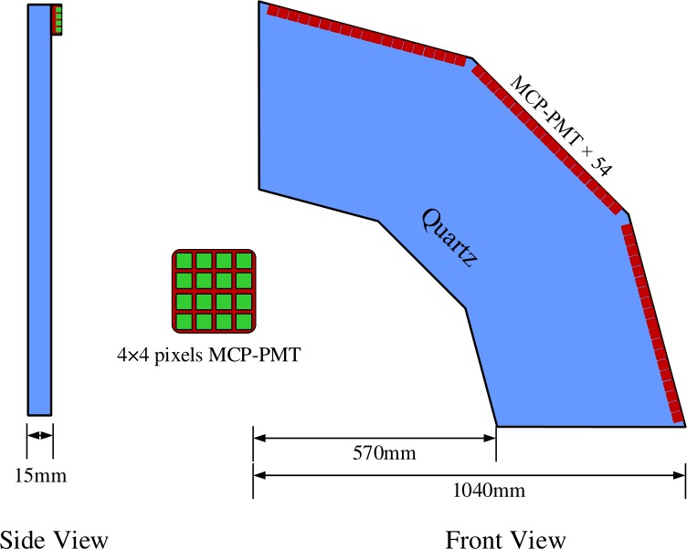
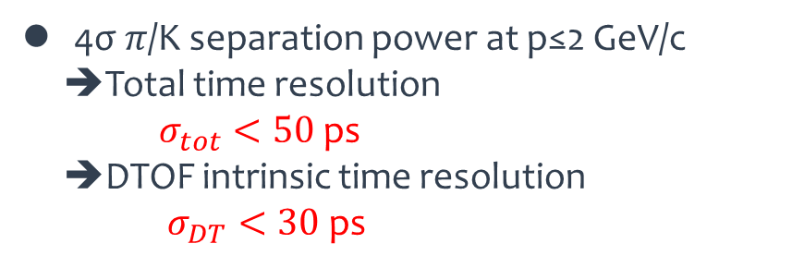
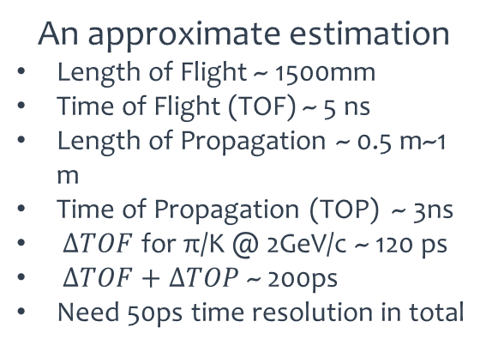

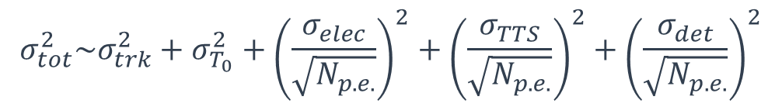
DTOF requirement
Absorber here
An approximate estimation
Length of Flight ~ 1500mm
Time of Flight (TOF) ~ 5 ns
Length of Propagation ~ 0.5 m~1 m
Time of Propagation (TOP) ~ 3ns
$∆TOF$ for π/K @ 2GeV/c ~ 120 ps
$∆TOF+∆TOP$ ~ 200ps
Need 50ps time resolution in total
Lateral
Front&back
Length of
Propagation
Length of Flight
Top&bottom
4σ 𝜋/Κ separation power at p≤2 GeV/c
➔Total time resolution
$σ_{tot}<50$ ps
➔DTOF intrinsic time resolution
$σ_{DT}<30$ ps
$$σ_{tot}^{2}\sim σ_{trk}^{2}+σ_{T_{0}}^{2}+{\left(\frac{σ_{elec}}{\sqrt{N_{p.e.}}}\right)}^{2}+{\left(\frac{σ_{TTS}}{\sqrt{N_{p.e.}}}\right)}^{2}+{\left(\frac{σ_{det}}{\sqrt{N_{p.e.}}}\right)}^{2}$$
$σ_{T_{0}}\sim$40 ps
Notes:
The basic design schematic picture lies on the left. Here is the one side of the endcap, consists of 4 quadrant parts.And each part consists of a piece of radiator, MCP-PMT coupled on the large edge of radiator, and electronics.The end of the radiator should be painted with absorber to avoid the confusion of the photons. The Length of flight is ~ 1.5 m and length of propagation ~ 0.5-1 m. The TOF difference ~ 120 ps for 2 GeV/c Pi K, and if add the TOP together , the difference ~ 200ps , much looser for the detector requirement for separation. T0 on STCF ~ 40 ps.

Slide 6
(DIRC-like TOF) DTOF R&D
02
Design: detector & electronics ,reconstruction and cosmic ray test
6

Slide 7
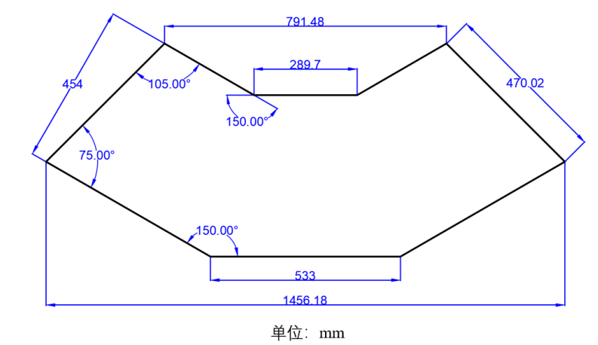
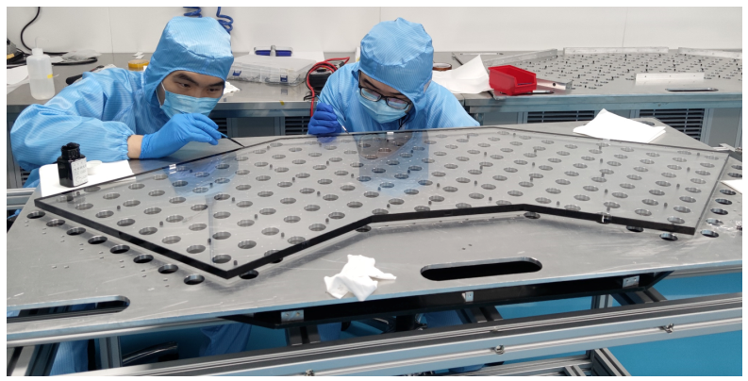
DTOF design
Radiator
Heraeus Suprasil 312 synthetic fused silica
  High purity, transparency>99%@200 nm
  High radiation tolerance
  Thickness=15 mm, area ≈ 0.56 m²
Surface roughness
  Front&Back RMS <1 nm (0.75 nm）
  Lateral Surfaces RMS~5nm
Thickness=15±0.1 mm, T_{max}-T_{min}<25 μm
Unit：mm
Precise parameter of the radiator
Apply matting paint to the sides of the radiator
Fused silica used in the cosmic-ray test
Notes:
We use heraues suprasil 312 synthetic fused silica. Below is the requirement of the parameters. It has a high purity transparency , and according to Panda data, it can tolerate high radiation.The surface roughness important because we want it to be very smooth to keep Cherenkov angle information. The radiator size is listed on the right.Here is the radiator we use in the cosmic ray test. My colleague was putting absorber on the side

Slide 8
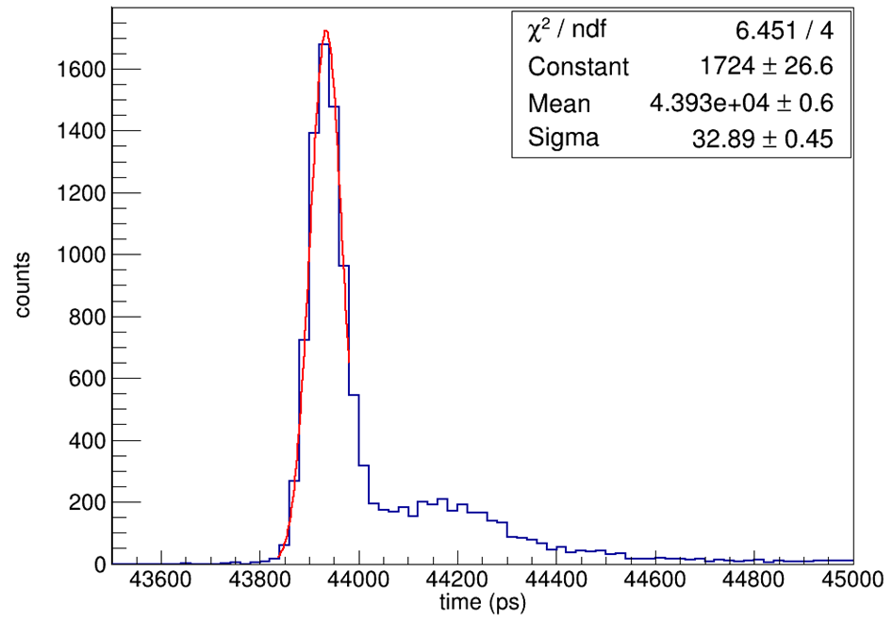
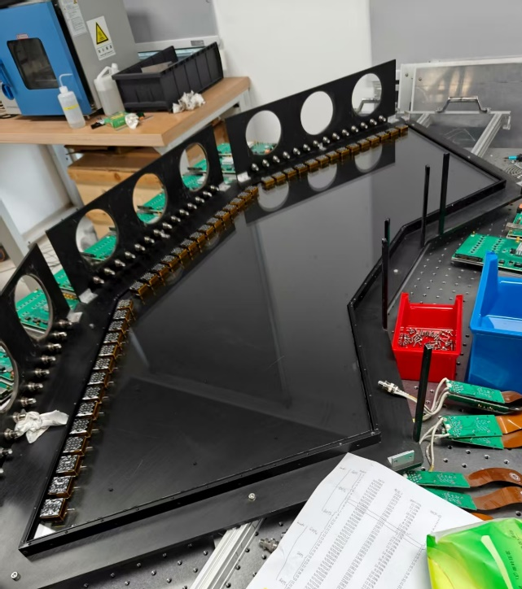
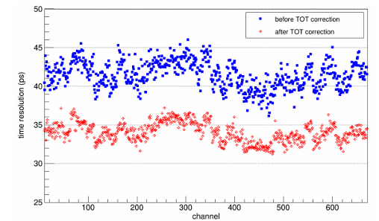
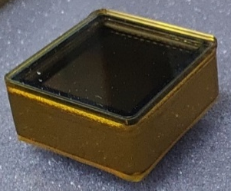
DTOF design
MCP-PMT
Hamamatsu R10754
  Sensitive area, 23×23 mm2
  4×4 pixels, 5.5×5.5 mm2 each
  spectral response range, 200-850 nm
  Quantum efficiency, ~25%@λ=400 nm
  Transit time spread(TTS):~28ps
Coupled to radiator by EJ550 silicon grease
σ = 33 ps
Recoiling electrons
Laser (width=60 ps) test performance
PMT coupled to radiator
(cosmic ray test prototype)
MCP-PMT time resolution after calibration
(including system error ~ 19 ps)
Hamamatsu R10754
Notes:
MCP-PMT we use it a Hamamatsu type. The parameters show here. It contains 16 pads, and each has an area of 5.5*5.5 mm2. .The time resolution of the MCP-PMT ~ 28ps . The systematic calibration of all MCP-PMT is finished and you can that the average time resolution ~ 35ps. MCP-PMT coupled to radiator by EJ550 silicon grease.

Slide 9
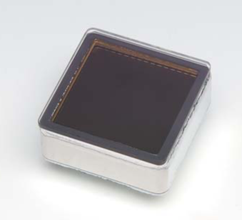
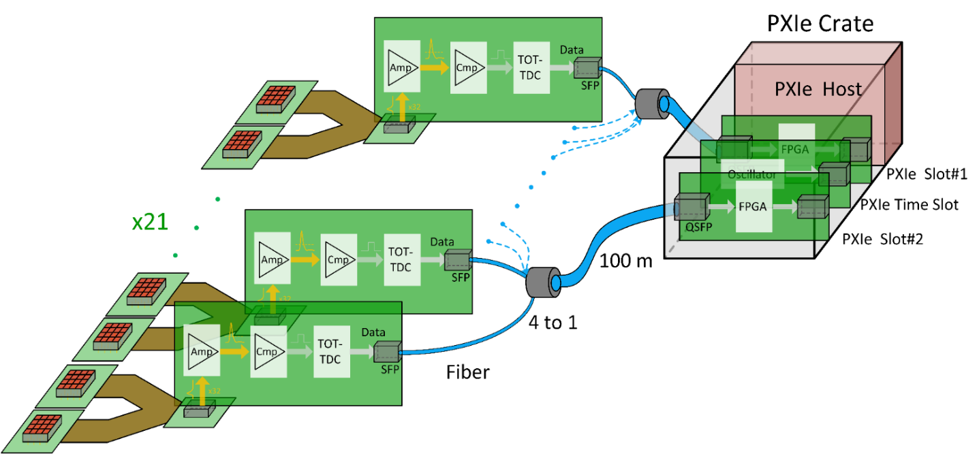
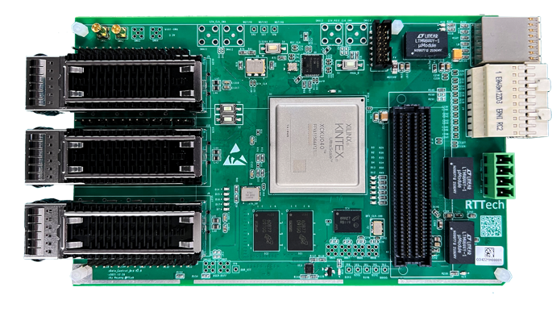
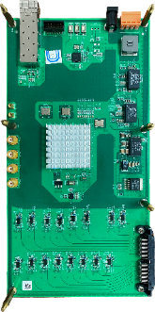
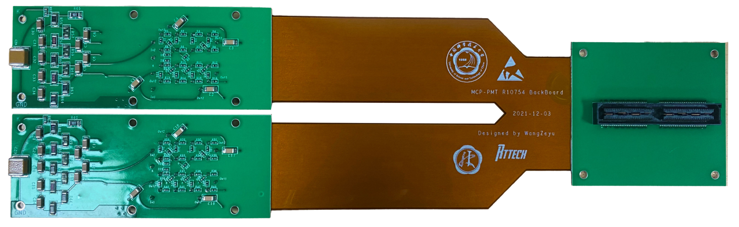
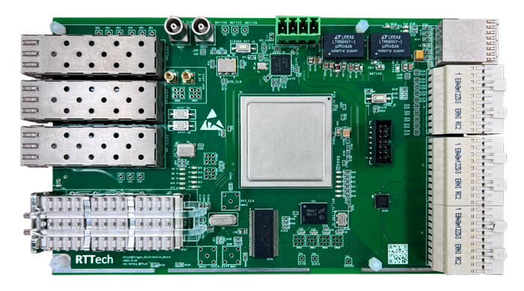
DTOF design
Electronics
  Time precision 10 ps
  Record TOA (Time of Arrival) and TOT (Time over threshold) of PMT
  Dead time < 10ns
MCP-PMT×42
Data collect board×2
Front-end readout board ×21
Flexible adapter board×21
Clock&Trigger distribute board×1
Notes:
Here’s the electronics structure , we have a TDC electronics , which can record TOA and TOT of PMT signal. The dead time ~ 10ns. MCP-PMT coupled to flexible adapter board and FEE finally to the Data collect board. We have a clock trigger distribution board.The total time resolution of electronics ~ 10 ps

Slide 10
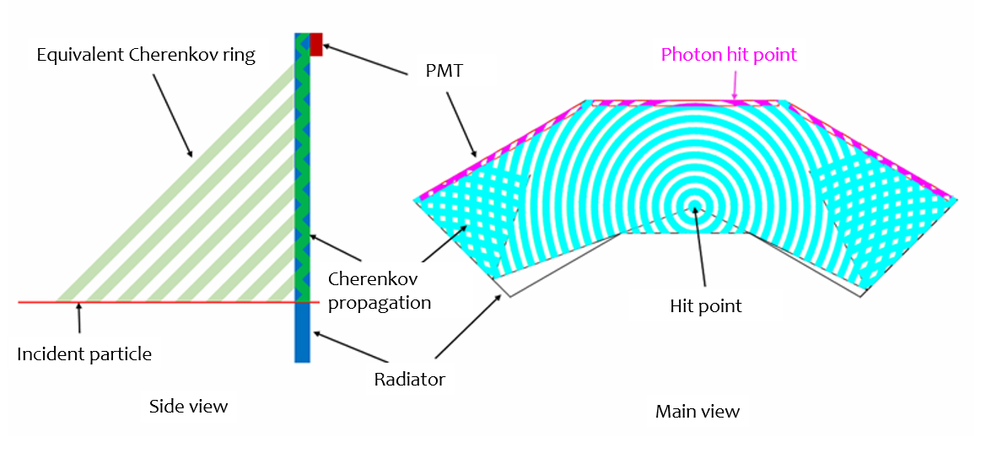
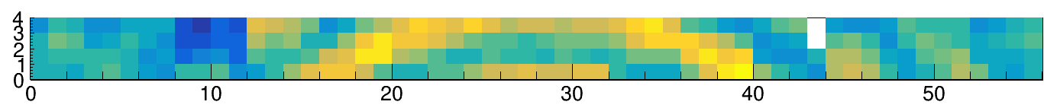
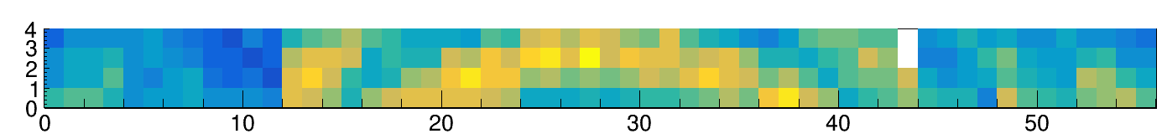
Basic conception of reconstruction
Absorber on the end side
What does pattern look like?
  Photons propagate like “water wave”
Reconstruction concept
  Calculate the photon propagation vector using hit point and the channel information
Cherenkov ring propagation in radiator
Cherenkov ring for π/p at 4GeV/c at beam test
Notes:
Now I ‘ll introduce the basics of the reconstruction. When a charged particle comes through radiator, the photons propagate like “water wave”. Some photons cannot hit the PMT channel, and will get absorbed at the end of radiator.Finally you can get the hit pattern like this. You can see that the pattern can be primarily used to separate particles. And combine the position information and the time informantion, we can do the separation much better.

Slide 11
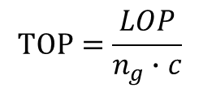

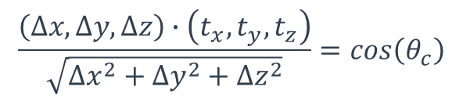


Basic conception of reconstruction
Δz
Reconstruction concept
  How to get Δz?
  Using reflective index to deduct the TOP
  Use average refractive index to reconstruct time=>Evaluate time performance
  Divide the index to make a hit pattern=>Fast imaging algorithm
$$\frac{\left(∆x,∆y,∆z\right)∙\left(t_{x},t_{y},t_{z}\right)}{\sqrt{{∆x}^{2}+{∆y}^{2}+{∆z}^{2}}}=cos\left(θ_{c}\right)$$
Photon detector
photon
Δy
Y
θc
Track , $\vec{t}$
$$LOP=\sqrt{{∆x}^{2}+{∆y}^{2}+{∆z}^{2}}$$
Quartz plate
Z
Photon detector
Δx
Δy
$$TOP=\frac{LOP}{n_{g}∙c}$$
Track
Quartz plate
$$Time=T_{ch}−TOP$$
Y
Imaging-based likelihood analysis for the STCF DTOF detector
X
Notes:
Here ‘s the reconstruction conception. Since we know the track information about its hit position and direction and the photon hit channel, We already know the all parameters except deltzZ here. By some mathematic calculation, you can get DeltaZ in this equation. And instantly all the information about the photon propagation vector and emission time. If you use average refractivity index to reconstruct the hit time, you will get a time performance evaluation. On the other hand, if you divide the index, you can calculate the hit pattern. More details please view the article below.

Slide 12
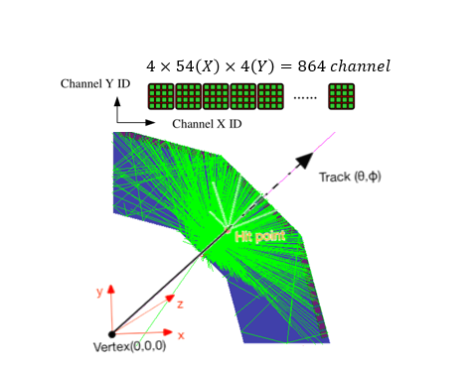
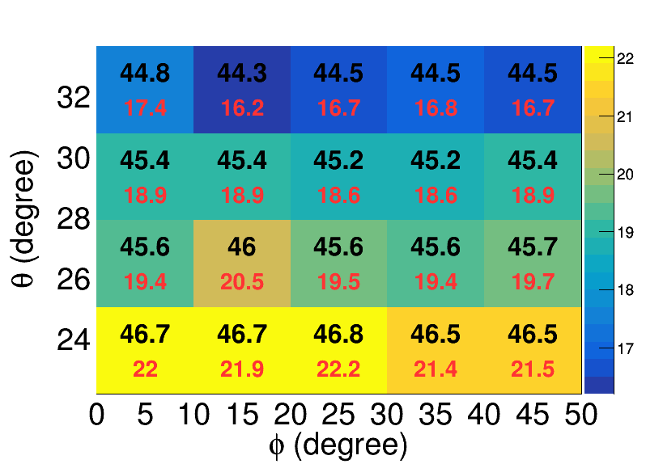
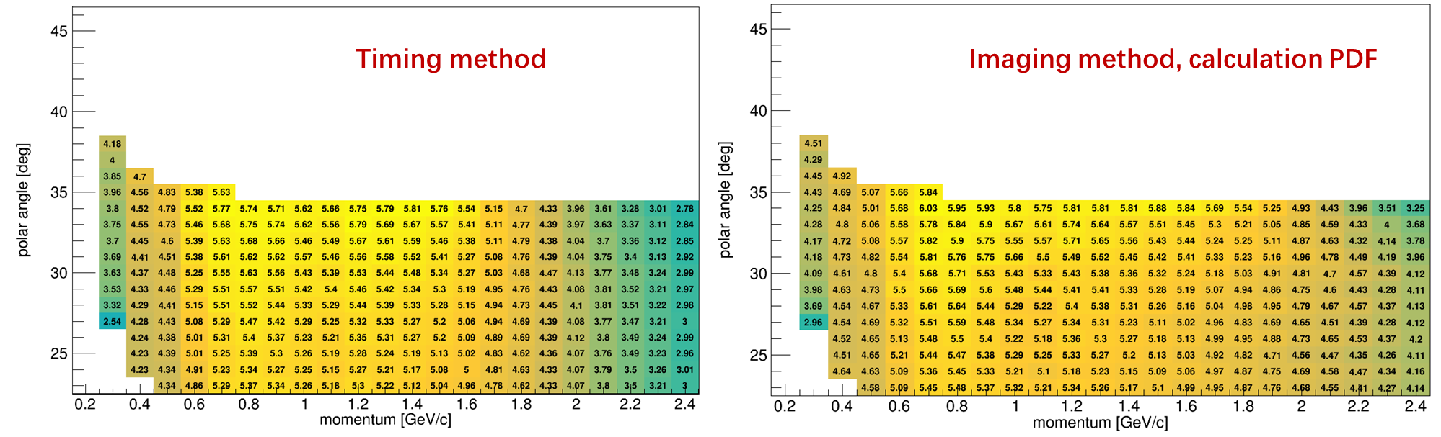


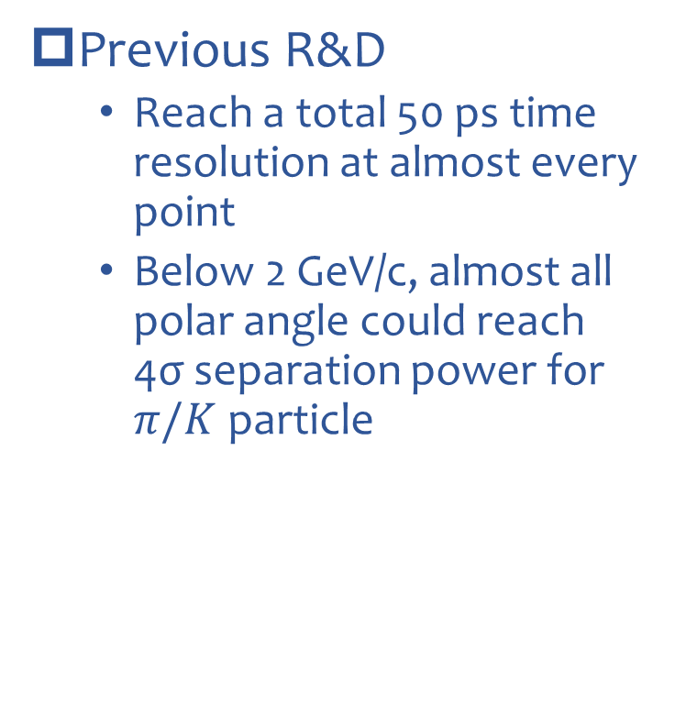
Previous R&D
Time resolution@2GeV/c
Previous R&D
  Reach a total 50 ps time resolution at almost every point
  Below 2 GeV/c, almost all polar angle could reach 4σ separation power for $π/K$ particle
σ_{total} or σ_{det} (ps)
σ_{total} <50 ps, σ_{DTOF} <30 ps
Geant4 Simulation
$π/Κ$ separation power
N_{σ} = $\sqrt{2}$ [erfc⁻¹(2η_{mis}) - erfc⁻¹(2ε_{id})]
Notes:
Now here’s the result of previous R&D, we reach a total 50 ps time resolution at all the phase point of phi and theta @2GeV for PiK. And below 2GeV, almost all polar angle could reach 4 sigma separation.

Slide 13
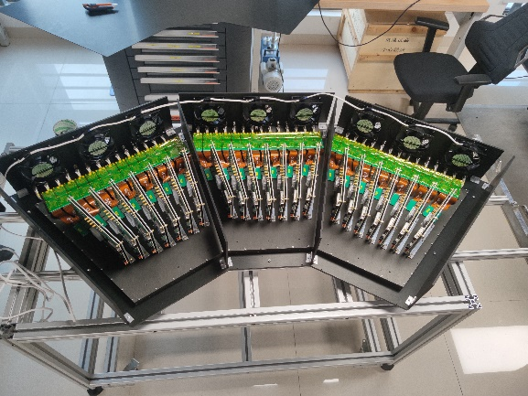
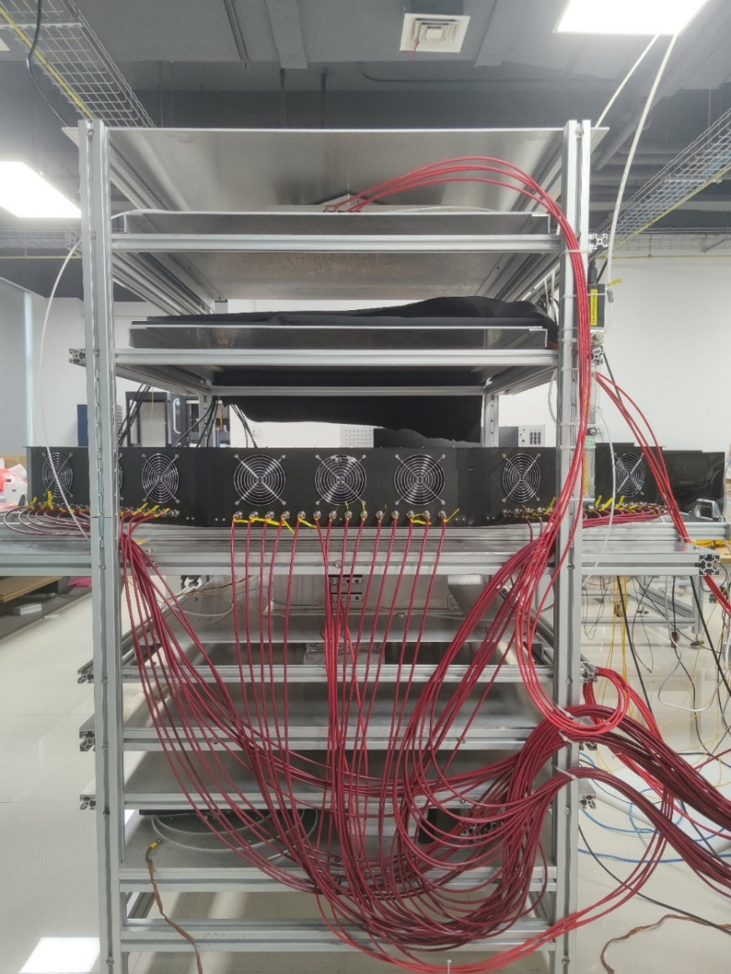
Cosmic ray test and result
Trigger counters
  Plastic scintillator + PMT, 220 × 220 mm²
  Coincidence of two trigger counters
Trackers
  4 × MicroMegas, 150×150 mm²
  Efficiency ~90%, σ_{pos} < 200 μm
Reference time detector (T0)
  180×180×10 mm³ fused silica
  4 × MCP-PMT，Φ = 10 mm
  σ_{T0} ≈ 20 ps
5 cm lead absorber
  Remove soft muons (p < 200 MeV/c)
Front-end readout board
Trigger
Radiator
(in dark box)
>1.5 m
2 × Trackers
T0
DTOF
2 × Trackers
Lead brick
Trigger
Z
X
Cosmic ray test of a full-sized DTOF detector prototype for the STCF experiment
Y
Notes:
We perform a cosmic ray test for the whole size DTOF prototype to test its time performance. The cosmic ray platform consists of 2 triggers, 4 trackers, a reference time detector~20ps and a lead absorber.

Slide 14
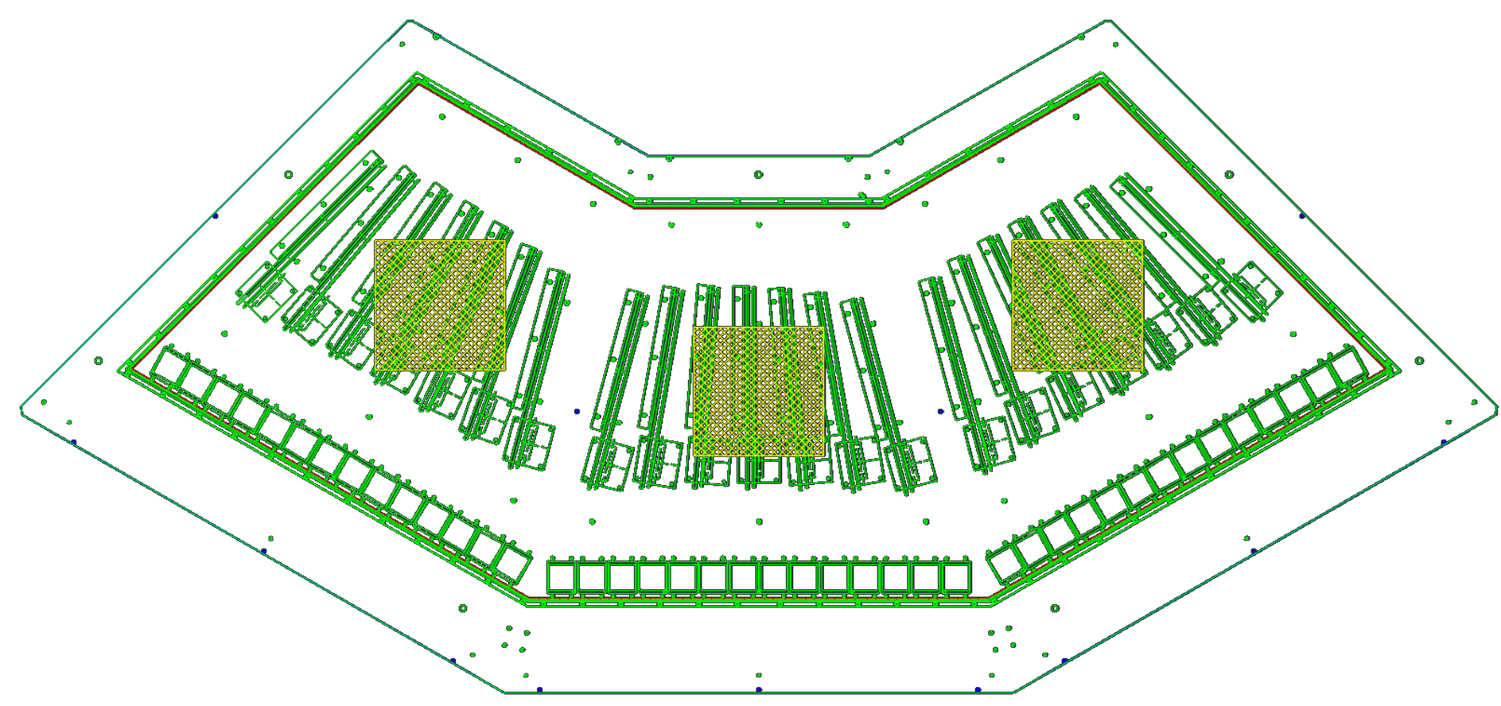
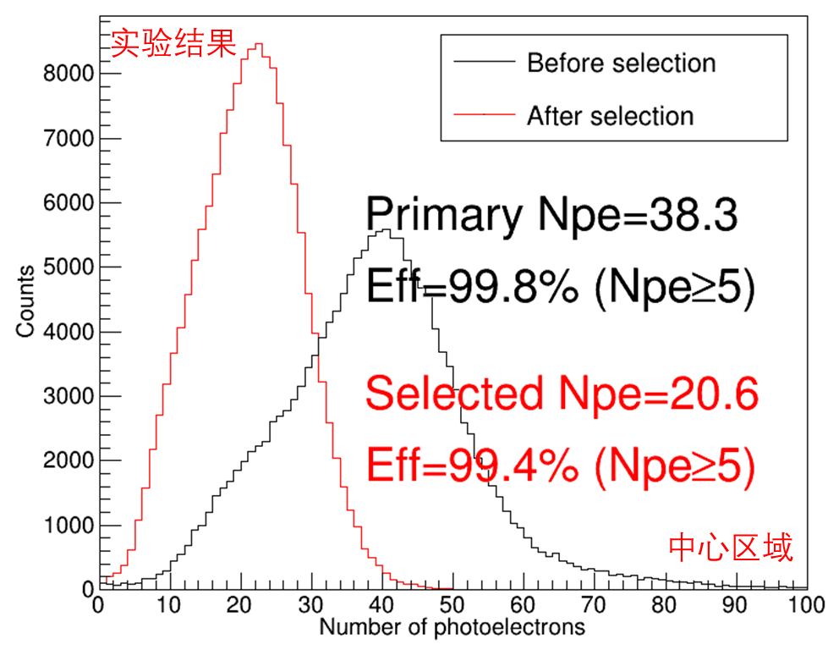
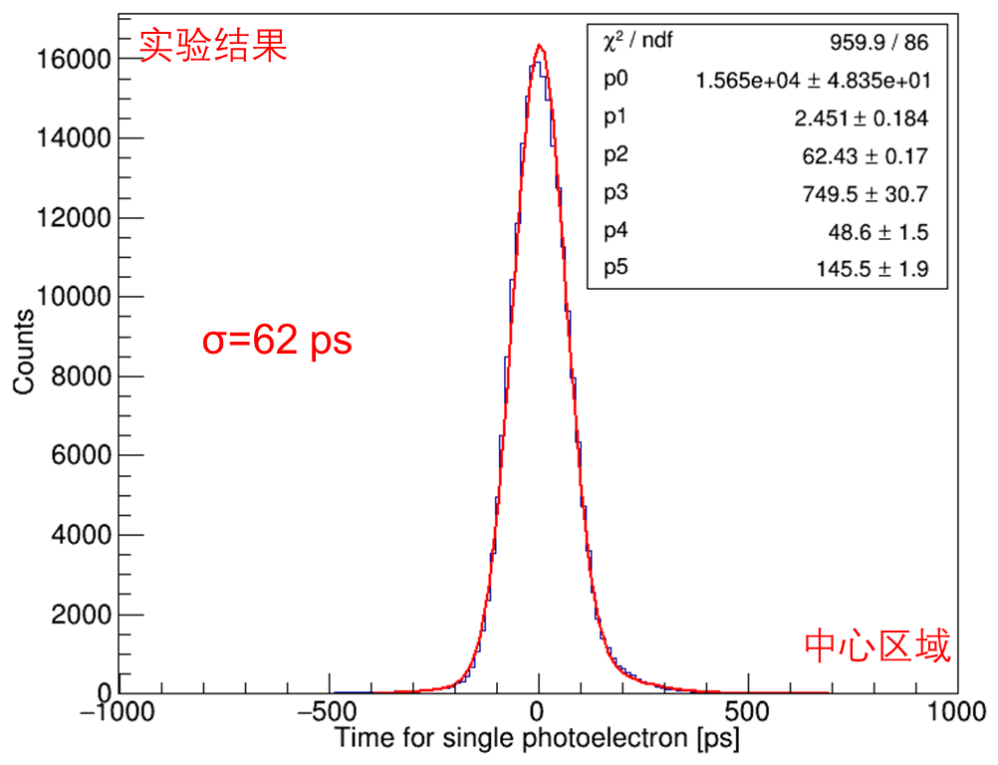
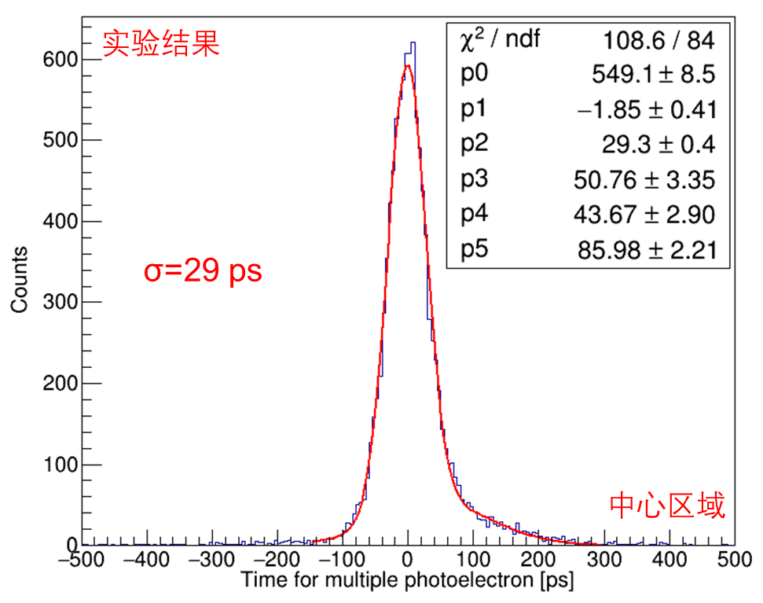
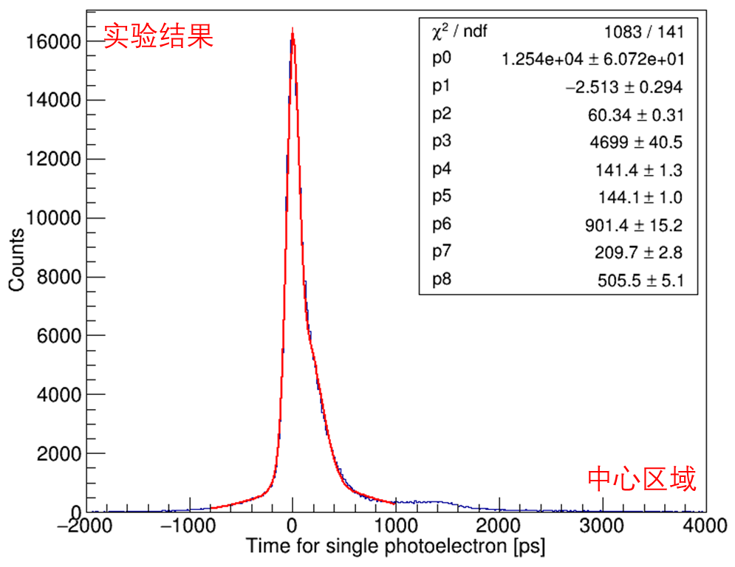
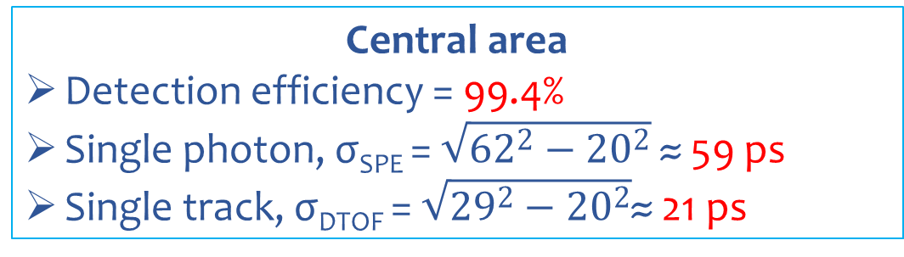
Cosmic ray test and result
Peripheral area
DATA
Central area
Central area
Detection efficiency = 99.4%
Single photon, σ_{SPE} = $\sqrt{{62}^{2}−{20}^{2}}$ ≈ 59 ps
Single track, σ_{DTOF} = $\sqrt{{29}^{2}−{20}^{2}}$≈ 21 ps
Central
DATA
DATA
DATA
Signals
Recoiling electrons
Single photon
(after selection)
Single track
BKG: δ-electrons, scattering photons and dark noise, et al.
Single photon
(before selection)
Central
Central
Central
Notes:
And the result of the cosmicray test : we get 38 photons on average, and this is the single photon time distribution. You can see there’s some tails, and we use a selected algorithm to cut the tail, and get a 62 ps time resolution for single photon, average them afterwards , a 29 ps time resolution for single track could be achieved.the Npe ~ 20. Detection effieciency ~ 99%,.

Slide 15
Summary of cosmic-ray test
Peripheral area
Test areas |  |  | Central area | Peripheral area
Number of photon electrons |  | DATA | 20.6 | 17.8
 |  | MC | 20.3 | 17.6
Time resolution of the DTOF prototype | DATA | Single photon | 59 ps | 60 ps
 |  | Single track | 21 ps | 22 ps
 | MC | Single photon | 54 ps | 57 ps
 |  | Single track | 18 ps | 22 ps
Central area
A Geant4-based simulation has been done to check the experimental results.
The experimental DATA are consistent with the MC results.
The time resolution of the DTOF prototype is ~22 ps, which meets the performance requirements of the DTOF detector (σ_{DTOF} < 30 ps).
Notes:
We also do the G4 simulation on the cosmic ray test. Here’s the result you can see that the

Slide 16
Beam test at CERN PS-T9
03
Setup and result
16
16

Slide 17
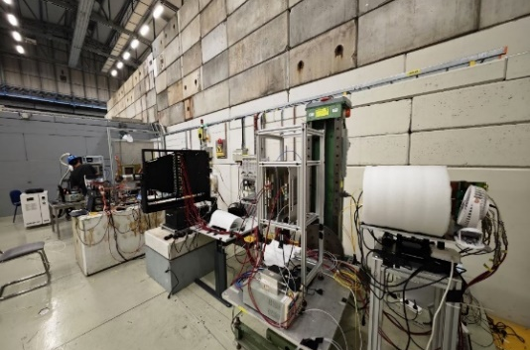
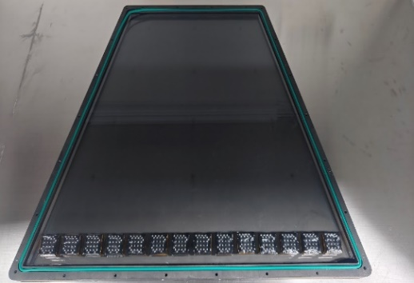
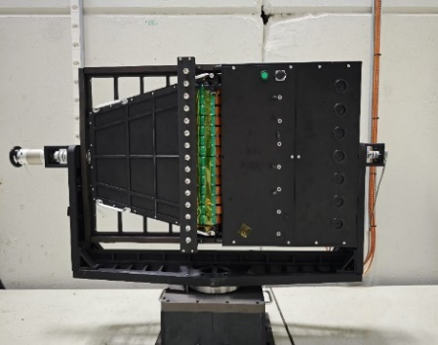
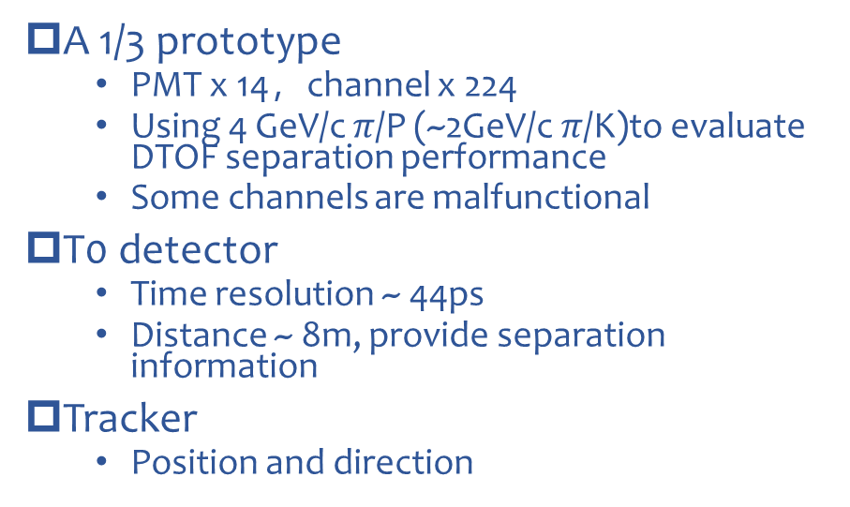
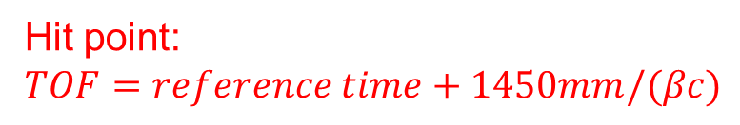
Beam test setup
Tracker
T0
Reference point:
1450mm to DTOF
Hit point:
$$TOF=reference time+1450mm/(βc)$$
DTOF
Tracker
Tracker
T0
DTOF
T0
Micromegas
Micromegas
A 1/3 prototype
  PMT x 14，channel x 224
  Using 4 GeV/c $π$/P (~2GeV/c $π$/K)to evaluate DTOF separation performance
  Some channels are malfunctional
T0 detector
  Time resolution ~ 44ps
  Distance ~ 8m, provide separation information
Tracker
  Position and direction
Electronics
cabinet
Fused silica (radiator)
radiator
MCP-PMT
1/3 prototype detector and mechanical structure
Applied matting painting

Slide 18
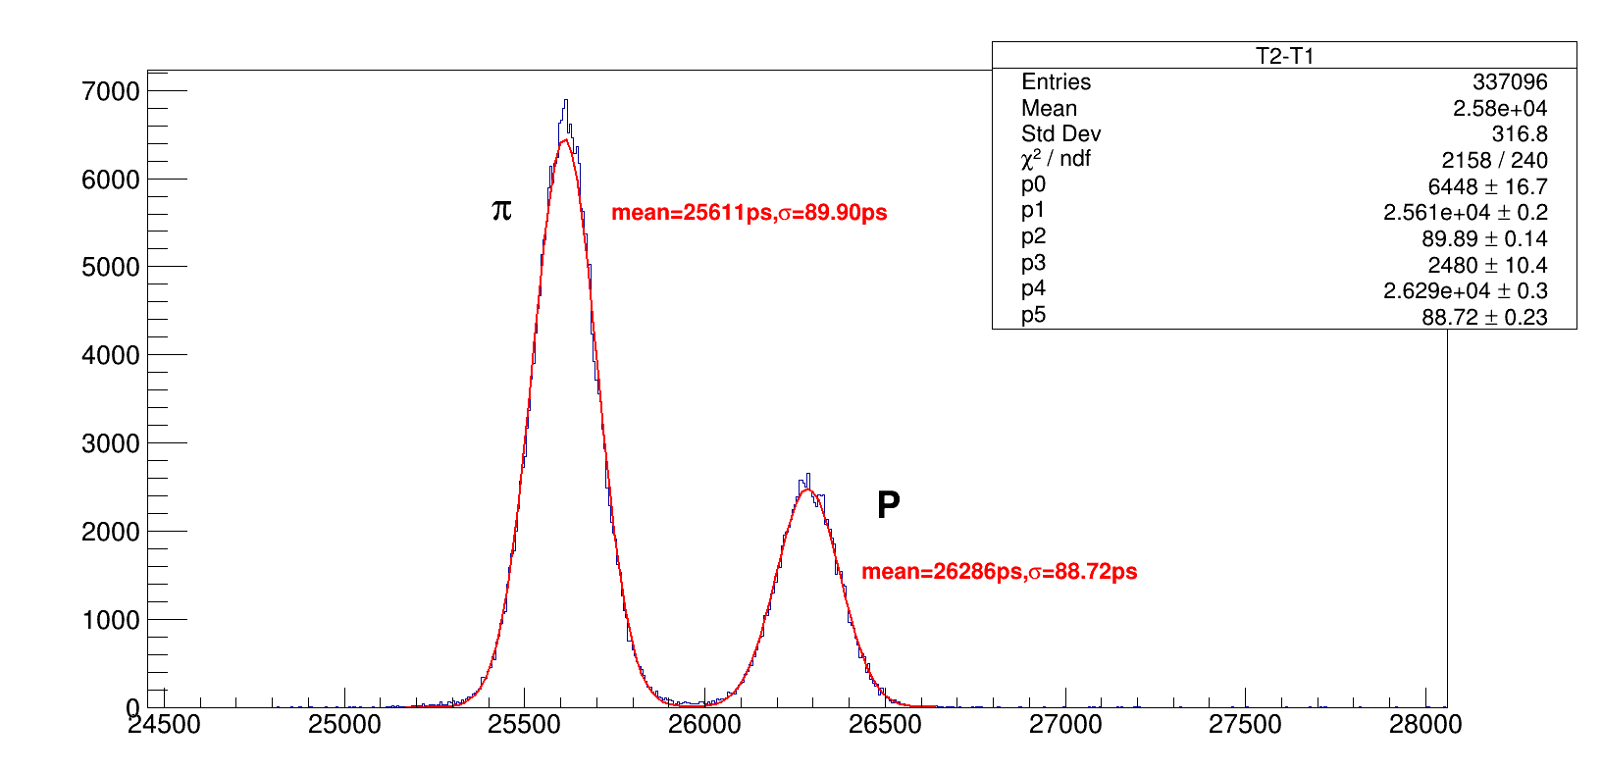

Beam test setup
Tracker
T0
Reference point:
1450mm to DTOF
Hit point:
$$TOF=reference time+1450mm/(βc)$$
DTOF
Tracker
Tracker
T0
DTOF
T0
Micromegas
Micromegas
A 1/3 prototype
  PMT x 14，channel x 224
  Using 4 GeV/c $π$/P (~2GeV/c $π$/K)to evaluate DTOF separation performance
  Some channels are malfunctional
T0 detector
  Time resolution ~ 44ps
  Distance ~ 8m, provide separation information
Tracker
  Position and direction
$$∆t=678ps,L_{flight}=7670mm$$
T0 performance @ 4GeV/c

Slide 19
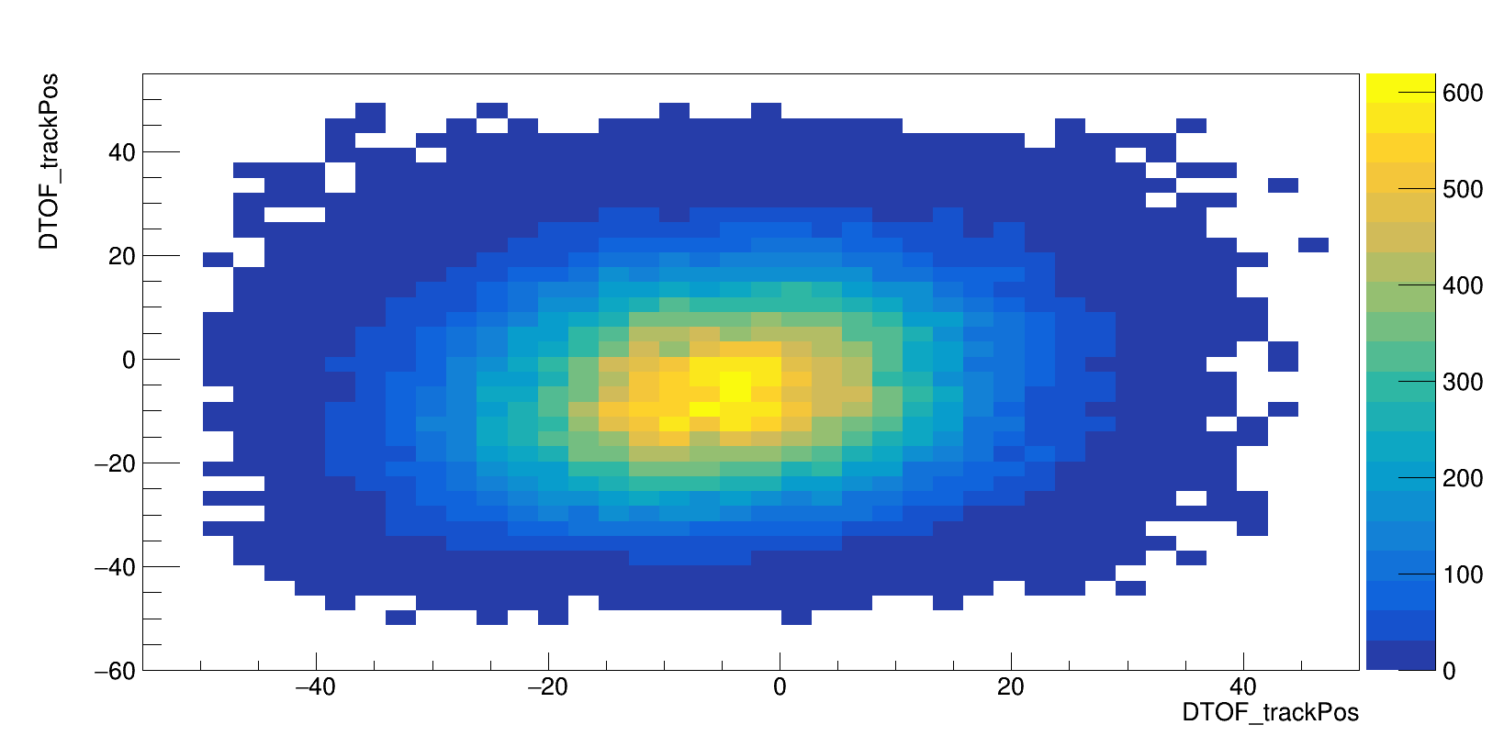
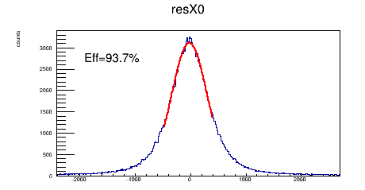
Beam test setup
Tracker
T0
Reference point:
1450mm to DTOF
Hit point:
$$TOF=reference time+1450mm/(βc)$$
DTOF
Tracker
Tracker
T0
DTOF
T0
Micromegas
Micromegas
A 1/3 prototype
  PMT x 14，channel x 224
  Using 4 GeV/c $π$/P (~2GeV/c $π$/K)to evaluate DTOF separation performance
  Some channels are malfunctional
T0 detector
  Time resolution ~ 44ps
  Distance ~ 8m, provide separation information
Tracker
  Position and direction
Tracker space resolution σ~323um
Beam hit size ~ 2cm

Slide 20
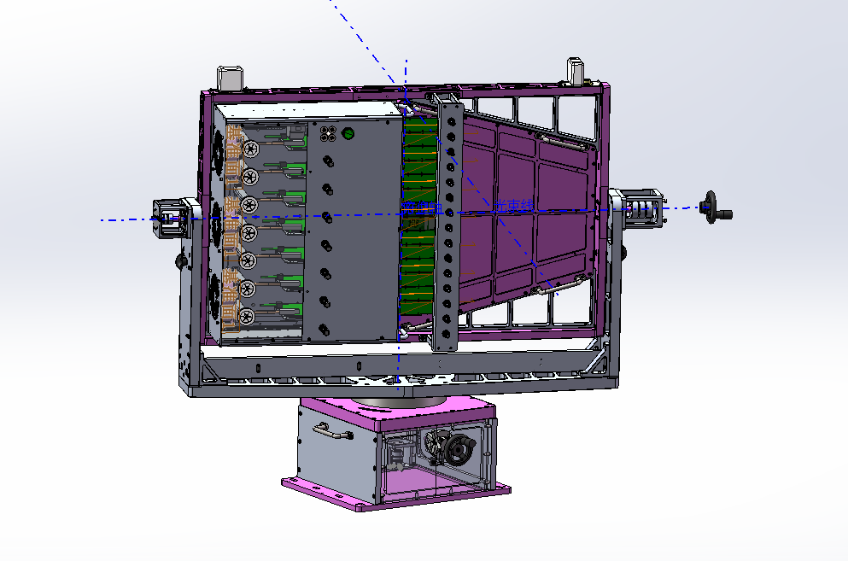
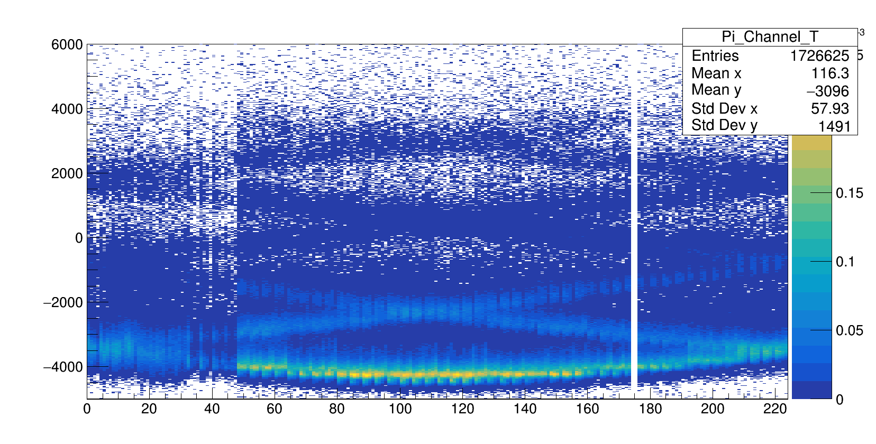

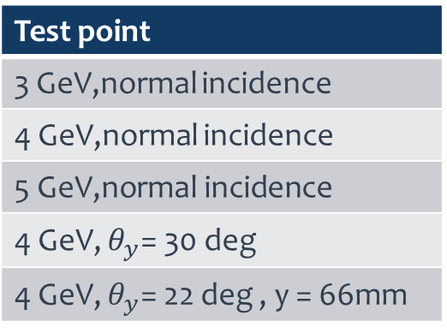

Data analysis
Vertical Axis, $θ_{y}$
Axis y
Test point
  Mark the vertical and horizontal angle are zero at normal incidence
Horizontal Axis, $θ_{x}$
Axis x
1/3 prototype schematic
Test point
3 GeV,normal incidence
4 GeV,normal incidence
5 GeV,normal incidence
4 GeV, $θ_{y}$= 30 deg
4 GeV, $θ_{y}$= 22 deg , y = 66mm
Typical hit pattern
Electronics channel malfunction

Slide 21
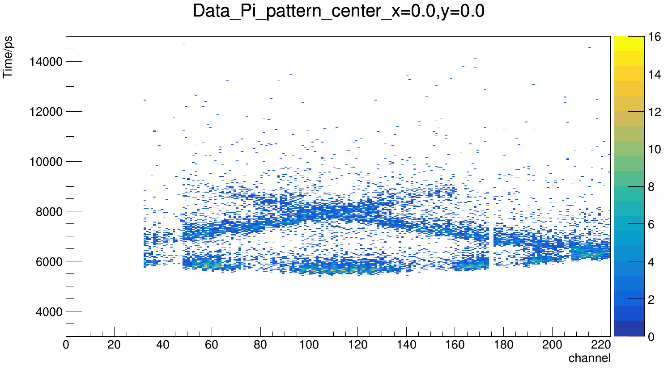





Data analysis-alignment-Kullback-Leibler Divergence
$π$ 4GeV/c 30 deg
KL divergence alignment
  KL divergence
    Evaluate discrepancy between 2 distributions
    Non negative
  Minimum of KL divergence point is the alignment point
hit pattern from
beam test | fast pattern algorithm
Scanning $θ_{x}$ & $θ_{y}$
$$\left\{\begin{aligned}KL=\sum{\int{p(ch,T)ln\left(\frac{p(ch,T)}{q\left(ch,T|θ\right)}\right)dT}} \\ \iint{p(x,y)dxdy=1} \\ \iint{q\left(x,y|θ\right)dxdy=1}\end{aligned}\right.$$
alignment point

Slide 22





Result and simulation
1.7%|98.3%
98.4%|1.6%
$$f_{h}\left(ch,t\right)=S_{h}\left(ch,t\right)+B$$
$$ℒ_{h}^{IL}=p_{h}\left(N\right)\prod_{i=0}^{N}{f_{h}\left({ch}_{i},t_{i}\right)}$$
p
π
Separation power reach ~4 σ below 4 GeV/c momentum
$$∆Log(likelihood)$$
Separation power ~4.4 σ @ 4 GeV/c normal incidence
Test point | Separation/σ | Npe
3 GeV/c normal | 5.9 | 31.7
4 GeV/c normal | 4.4 | 40.6
5 GeV/c normal | 2.7 | 41.2
4 GeV/c $θ_{y}=30 deg$ | 3.98 | 28.3
4 GeV/c $θ_{y}=22 deg$ y=+66mm | 3.93 | 31.6
Number of Photo-electrons detected ~ 40.6 @ 4 GeV/c normal incidence
Include secondary particles

Slide 23





Result and simulation
Simulation set up
  MCP-PMT response
  4 GeV π/p from
  $$z=−1450 mm$$
  Wavelength:280-600 nm
  Two 8mm thickness aluminum shell to simulate black box
  Surface roughness
  main ~ 1 nm , lateral~ 20 nm
  Track hit point ~ 2D
  Gaus (mean=0, sigma=14 mm)
Geant4 simulation
Hit pattern
Hit x-y@sim
PMT response Time distribution

Slide 24



Result and simulation
1.4%|98.6%
98.5%|1.5%
Simulation result
  The number of photons ~ 45
  Separation power ~ 4.8σ
  Consists well with beam test
  More simulation is ongoing for other test points
p
π
$$∆Log(likelihood)$$
Simulation Separation power ~4.8 σ @ 4GeV/c normal incidence
Number of Photons ~ 45
Simulation for Separation power of Pi/P

Slide 25





Future plan for barrel PID using DTOF
Consists of 12 modules of Barrel DTOF (BTOF)
Meet the STCF requirement < 2GeV/c, but need to be optimized
Plan to do beam test Oct. 2025 @ CERN PS-T9
$$θ_{max}=90°$$
860mm
MCP-PMT
$$θ_{min}=32°$$
1350mm

Slide 26
Conclusion
DIRC-like TOF at STCF focuses on separation of hadron whose momentum below 2GeV/c
A reconstruction method was developed
Simulation shows the DTOF could meet the requirements of STCF(4σ@2 πGeV/c π/K)
Cosmic ray test was made and the result shows that the intrinsic time resolution < 25 ps
Beam test indicates that the separation power ~ 4σ @ 4GeV/c π/p which equivalent to 2GeV/c π/K
More to do on barrel DTOF ……

Slide 27
Thank you！
ds1997@mail.ustc.edu.cn

Slide 28


Slide 29


Horizontal angle = -3.8 deg | KL divergence = 0.58
$θ_{x}$= -3.8 deg | KL = 0.58

Slide 30



Horizontal angle = -2.2 deg | KL divergence = 0.46
$θ_{x}$= -2.2 deg | KL = 0.46
KL = 0.46

Slide 31


Horizontal angle = -0.59 deg | KL divergence = 0.24
$θ_{x}$= -0.59 deg | KL = 0.24
KL = 0.24

Slide 32


Horizontal angle = 1.01 deg | KL divergence = 0.29
$θ_{x}$= -1.01 deg | KL = 0.29
KL = 0.29

Slide 33


Horizontal angle = 2.6 deg | KL divergence = 0.43
$θ_{x}$= 2.6 deg | KL = 0.43
KL = 0.43

Slide 34


Horizontal angle = 4.2 deg | KL divergence = 0.64
$θ_{x}$= 4.2deg | KL = 0.64
KL = 0.64

Slide 35



Surface roughness
Sim-20nm
Sim-30nm
Sim-50nm

Slide 36

ParticleType/L=1450mm | TOF/DeltaTOF:ps | Beta
Pi@2GeV | 4839.6 | 0.9975
K@2GeV | 4967.9 | 0.9709
TOF Difference Pi/K@2GeV | 128.3
Pi@4GeV | 4848.4 | 0.9994
P@4GeV | 4981.4 | 0.9736
TOF Difference Pi/P@4GeV | 133.0

Slide 37


thetaX=0.5
thetaY=1.5
x=(-2.5,2.5)
y=(-2.5,2.5)
x=(-2.5,2.5)
y=(-2.5,2.5)
图案生成算法数据
实验数据

Slide 38


Before selection
SPE signals of one track
DT₁ , DT₂ , … , DT_{N}
DATA
Signals
Calculated DTmax , DTmin and DTmean
Recoiling electrons
BKG: δ-electrons, scattering photons and dark noise, et al.
Eliminate DTmin
YES
Eliminate DTmax
DTmax -DTmin<ΔT ？
After selection
NO
DATA
YES
NO
(DTmax -DTmean)×w<DTmean -DTmin ？
σ = 62 ps
ΔT = 200 ps
w = 1.3
Output DT₁ , DT₂ , … , DT_{N}
And DTmean
Two parameters, Δt and w

Slide 39




Radiator thickness (10, 15, 20 mm)
Some conclusions
Thick radiator increases material, and thin radiator degreases performance ➔ a right thickness is better
Large area radiator reduces the number of lateral reflections, causing less hit map’s overlaps and better π/K separation power
Adding mirror on the top surface will increase Np.e., but cause more overlaps on the photon hit maps. As results, no obvious performance improvement and great attenuation of MCP-PMT’s lifetime ➔ Reducing the misidentification of photon paths is more important than increasing the number of photons
Absorber or mirror
Radiator shape (4, 12, 24 sectors)
Optimal design: Large area (4 sectors)，15 mm radiator, with absorber on top and button surfaces

Slide 40





Slide 41


Roughness /nm | Reflectivity
0 | 1
1 | 0.999
2 | 0.998
3 | 0.995
preliminary
roughness/nm | Reflectivity
0 | 1
5 | 0.99
10 | 0.95
15 | 0.89
20 | 0.81
25 | 0.72
30 | 0.63

Slide 42




T0探测器性能分析
Timing reconstruction principle
Photon TOP
  Reconstructed like DTOF出
Photon detected timeST0
T0 reconstruction：$T0=ST0−TOP$；Multiple photons：$\overline{T0}=\frac{\sum_{i=0}^{N_{p.e.}}{{T0}_{i}}}{N_{p.e.}}$
${T0}_{diff}=\frac{{T0}_{i}−{T0}_{j}}{2}$，evaluate Timing performance（when Np.e.=2）
T0
  180×180×10 mm³ fused silica
  4 R3809U single channel MCP-PMT
T0diff
T0
TOP
ST0
σ = 20.3 ps
TOP重建值分布

Slide 43






2D likelihood:
Project the channel into the R-PhiC phase district
Divide the channel into multiple cells，calculate the propagation vector for different cells, and area ~ intensity
$$\vec{t}=\left\{\begin{aligned}&t_{x}=\sin{θ}\cos{φ} \\ &t_{y}=\sin{θ}\sin{φ} \\ &t_{z}=\cos{θ}\end{aligned}\right..$$
$$\vec{t}$$
$$\vec{k}$$
Cherenkov photons are uniformly distributed in phiC and transportation dimension!

Slide 44









Slide 45


Prototype Test with laser input
Average measurement precision of 672 channels is 6.19 ps
Single photon time resolutions of DTOF prototype before and after corrections
Notes:
Finally, We tests performance of the electronics system. the time resolution of 672 channels is shown in the figure, the total timing accuracy of electronics, including the uncertainty of clock distribution, is less than 15ps, and most of them are between 5-8ps. And we tested the MCPPMT single photon signal, The figure on the right shows the single-photon timing resolution after TOT and temperature calibration of 672 channels. It can be seen that after correction, the single-photon resolution is concentrated in the range of 32-37ps, which is is consistent with the typical Transit Time Spread (TTS) value of MCPPMT itself.We can conclude that the performance of the DTOF electronics system meets the requirements we set out at the beginning of the design.

Slide 46
Performance Summary
 | value
Channel number | 672
Time resolution of electronics | < 10 ps
Single-photon time resolution | 34.5 ps (Contribution of MCP-PMT is about 32 ps)
Signal timing method | Leading edge timing + FPGA-based TDC + TOT correction
Measurement Dead time | < 10 ns
DAQ transmission bandwidth | ~ 6 GB/s
Maximum event rate | < 400 kHz/ch
Power consumption | 600 mW/ch
Notes:
This is the overall performance of the DTOF electronics system

