Slide 1
Welcome from GSI/FAIR
Thomas Nilsson
Scientific Managing Director GSI/FAIR

Slide 2
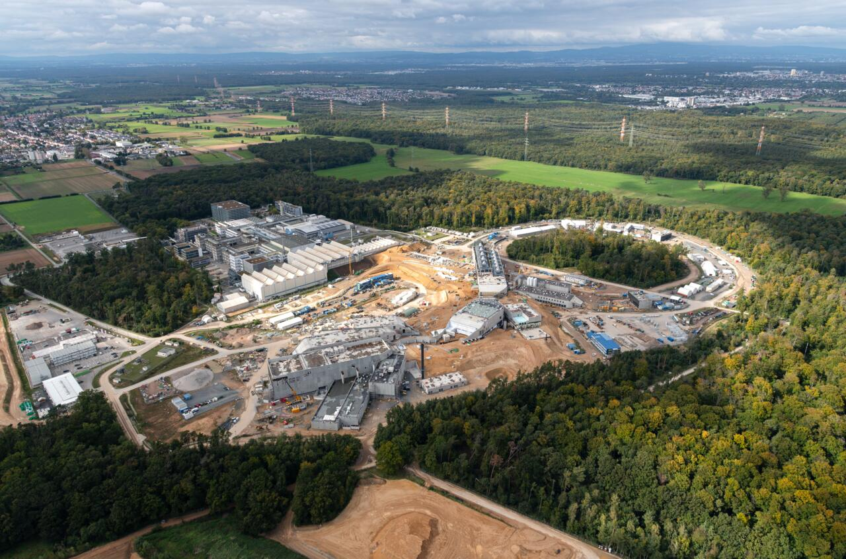
GSI – Facts and Numbers
GSI Helmholtzzentrum für Schwerionenforschung
Founded in 1969
Campus Darmstadt
Budget (core-financed, 2023): 153.3 Mio €
Employees (2023): 1,550 (thereof 1,150 scientific personnel)
Users of the GSI facilities: more than 1,500 per year
Mission:
Fundamental and applied research with heavy ions.
Development, construction and operation of heavy-ion accelerators and experimental facilities.
Research in hadron, nuclear, atomic, plasma physics, materials research, biophysics and heavy-ion therapy
Forefront developments and innovations in accelerator, laser, detector and IT technologies
Two outposts: Helmholtz Institute Jena and Mainz

Slide 3
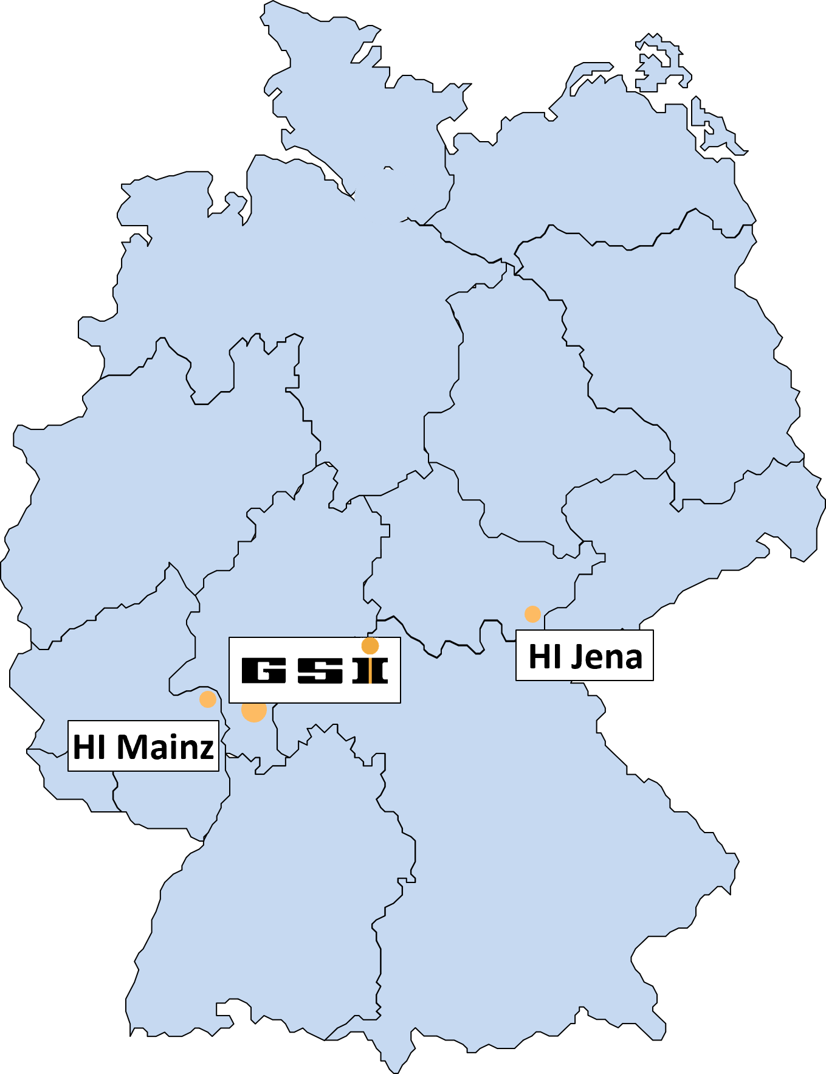
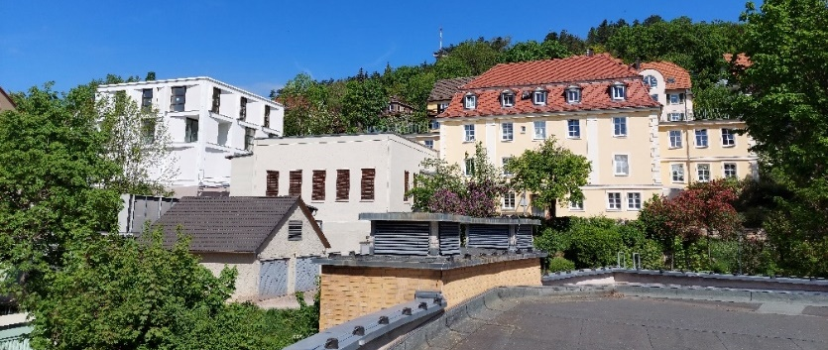
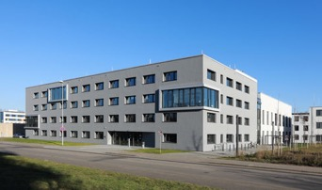
GSI – Facts and Numbers
Helmholtz Institute Jena (HI Jena)
Founded in June 2009
Affiliated to Friedrich
Schiller University Jena
Budget (2023): 6.9 Mio €
Employees (2023): 65
Expertise: fundamental physics, high-power lasers, laser-particle acceleration, X-ray technologies
Helmholtz Institute Mainz (HIM)
Founded in June 2009
Affiliated to Johannes
Gutenberg University Mainz
Budget (2023): 6.9 Mio €
Employees (2023): 50
Expertise: fundamental physics, strong interaction, superheavies, s.c. accelerators and detector technology

Slide 4
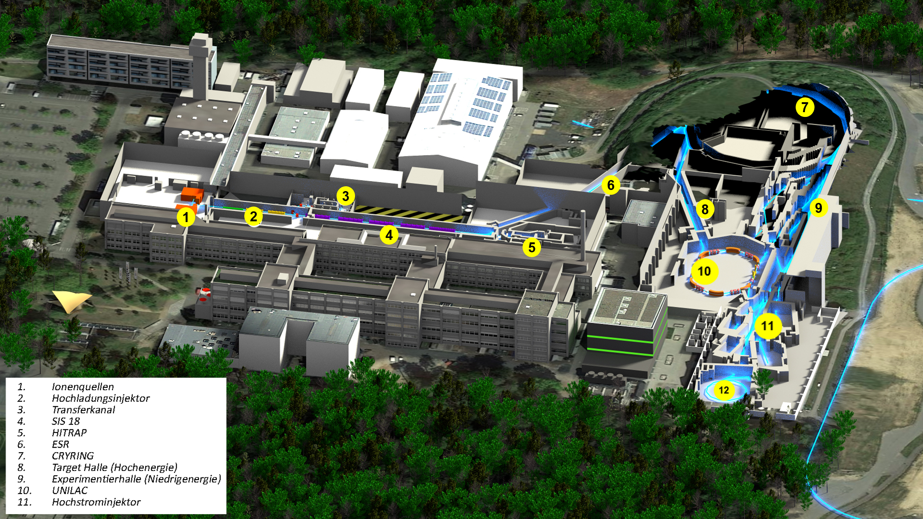
GSI: Unique Accelerator Complex for Heavy Ions
SIS18: 1 – 2 GeV/u for ions, 4.5 GeV for p
Highest heavy-ion intensities
Ions: proton – uranium
UNILAC: 3.6 – 11.4 MeV/u
Ion Sources
High-Current Injector
High-Charge Injector
UNILAC
Low-Energy Exp. Hall
Transfer Channel
SIS18
HITRAP
FRS
ESR
High-Energy Exp. Hall
Cryring @ ESR
Coupling: Fragment Separator – Storage & Cooling Rings

Slide 5
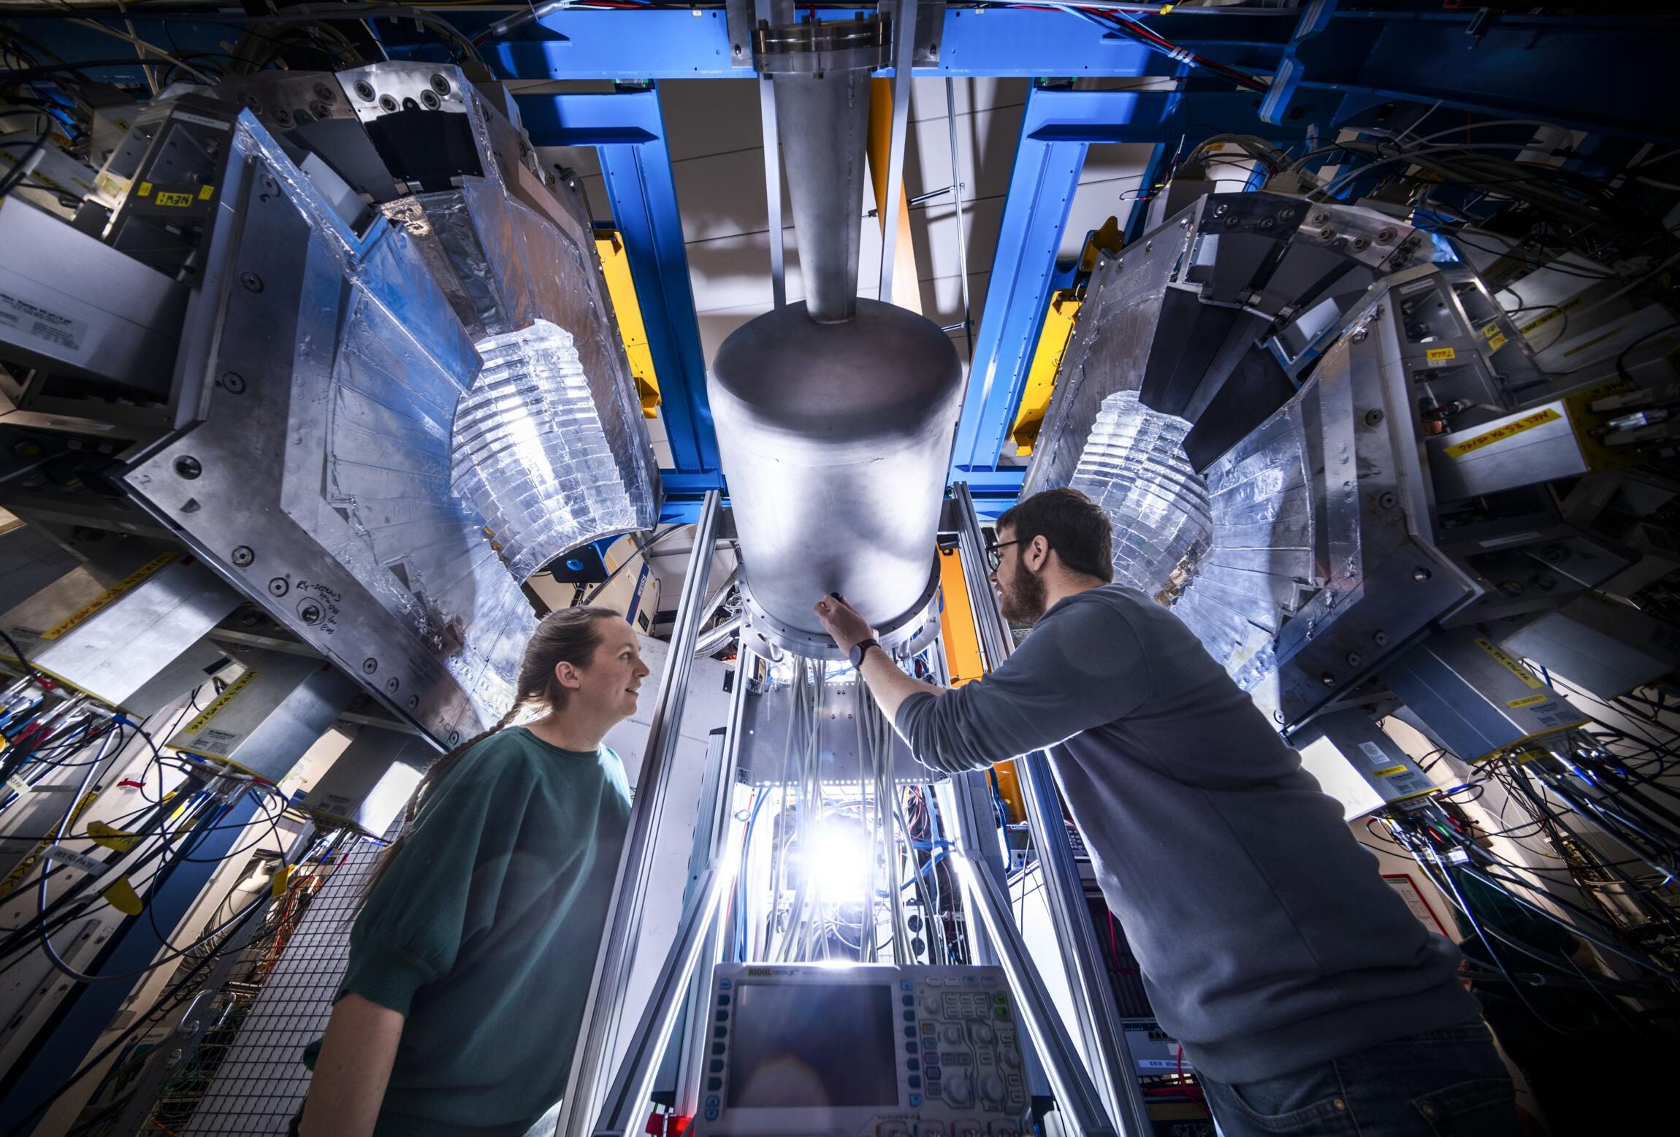
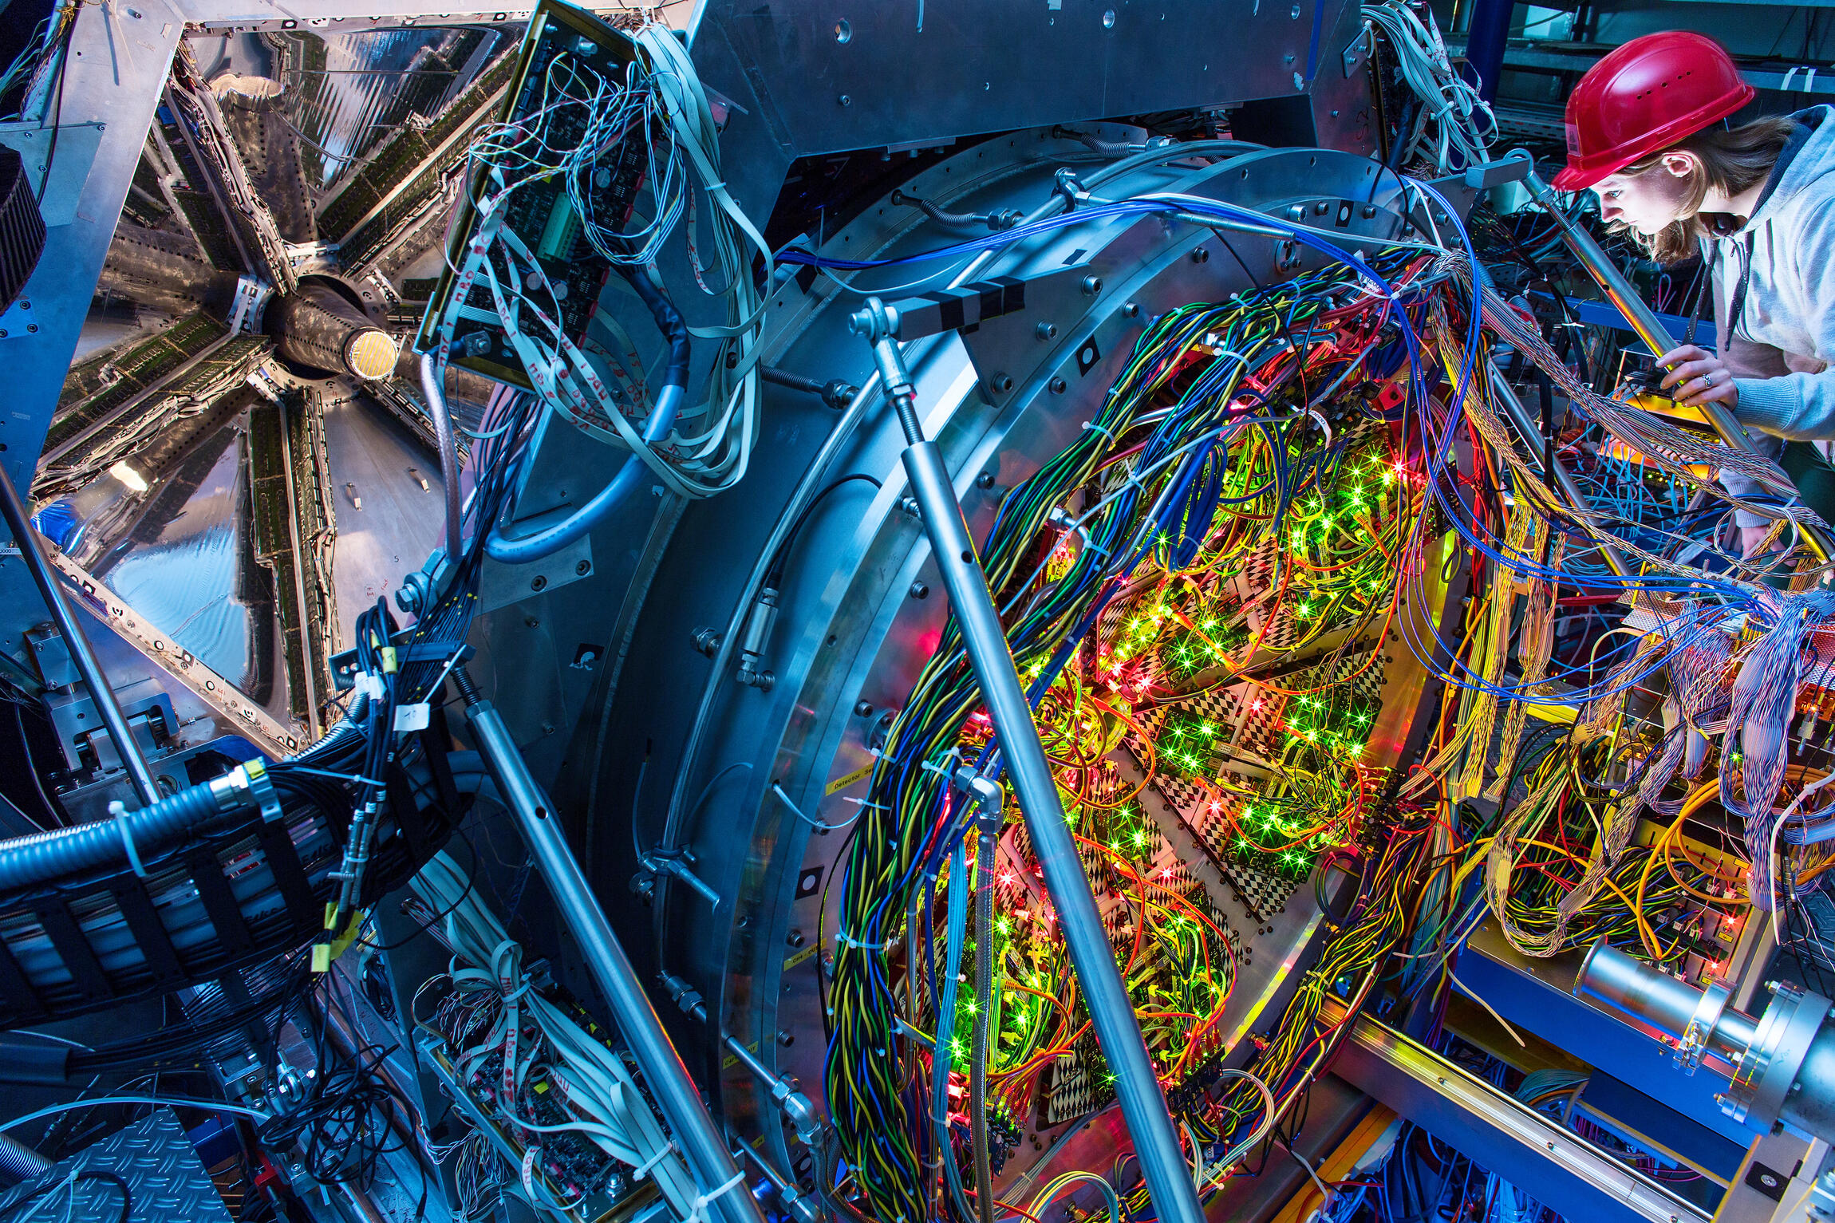
… with cutting-edge instrumentation
CALIFA@R³B
HADES

Slide 6

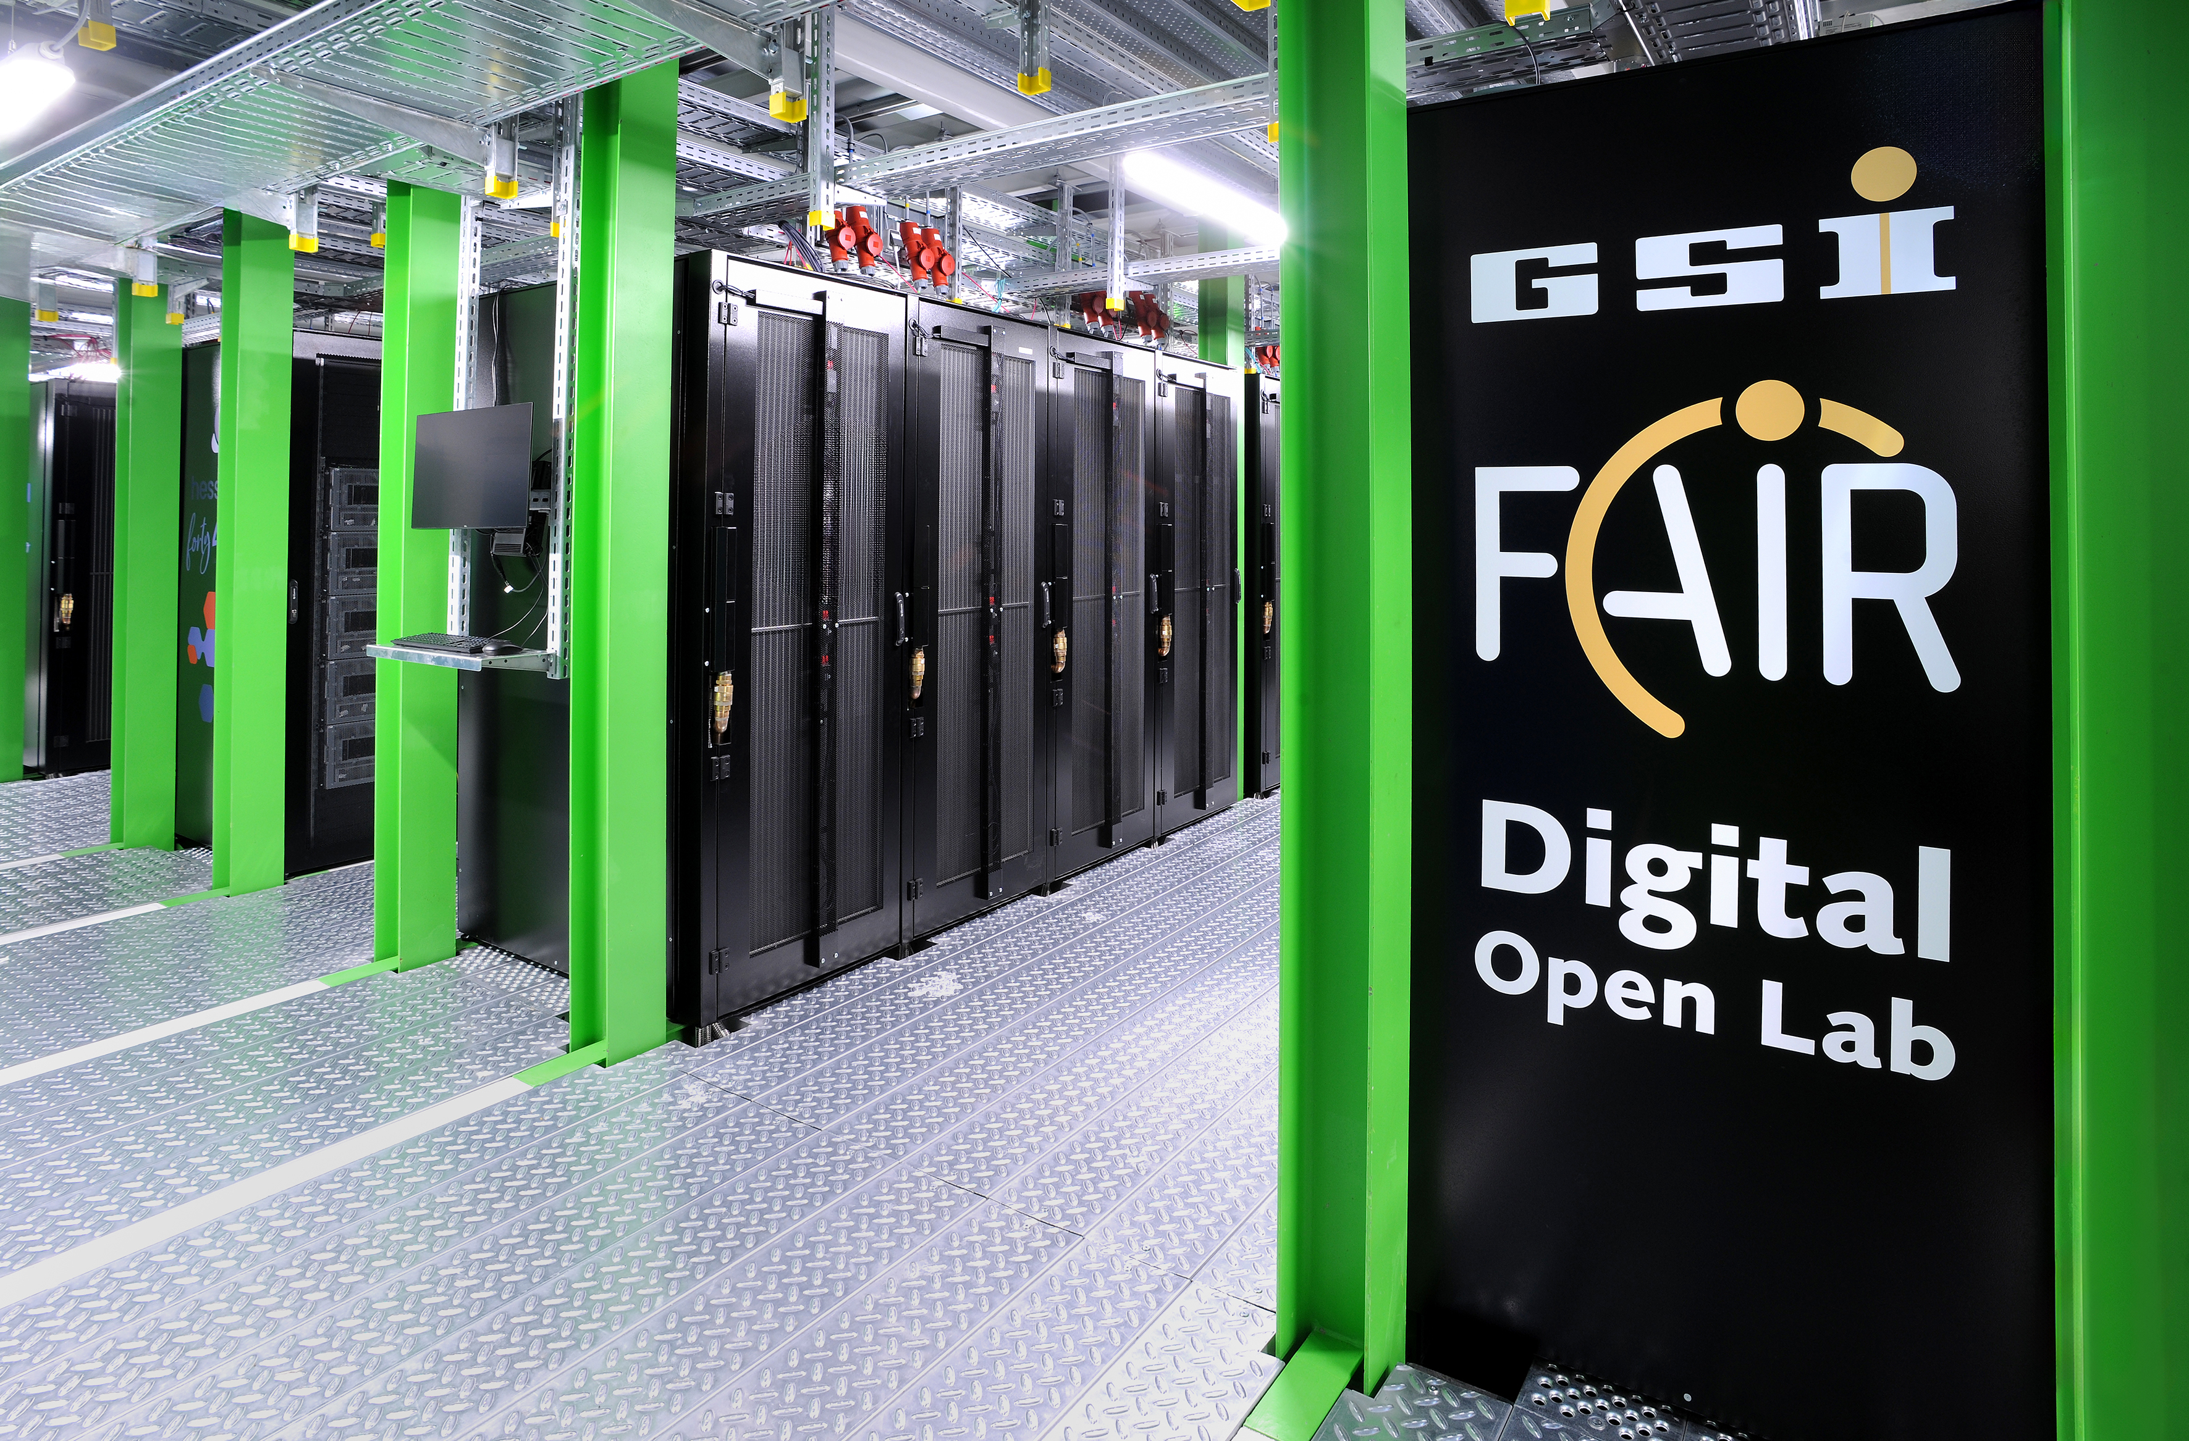
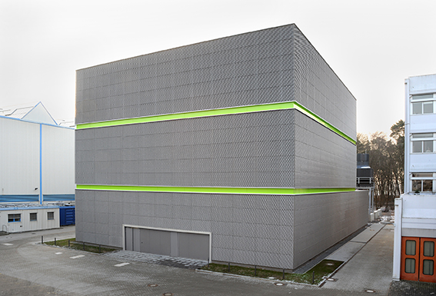
Forefront IT Developments
Green IT & Big Data
Energy-efficient high-performance computing
AI innovation lab of the Hessian Center for Artificial Intelligence (hessian.AI)
600 nodes/54.000 cores/400 GPUs (2023)

Slide 7
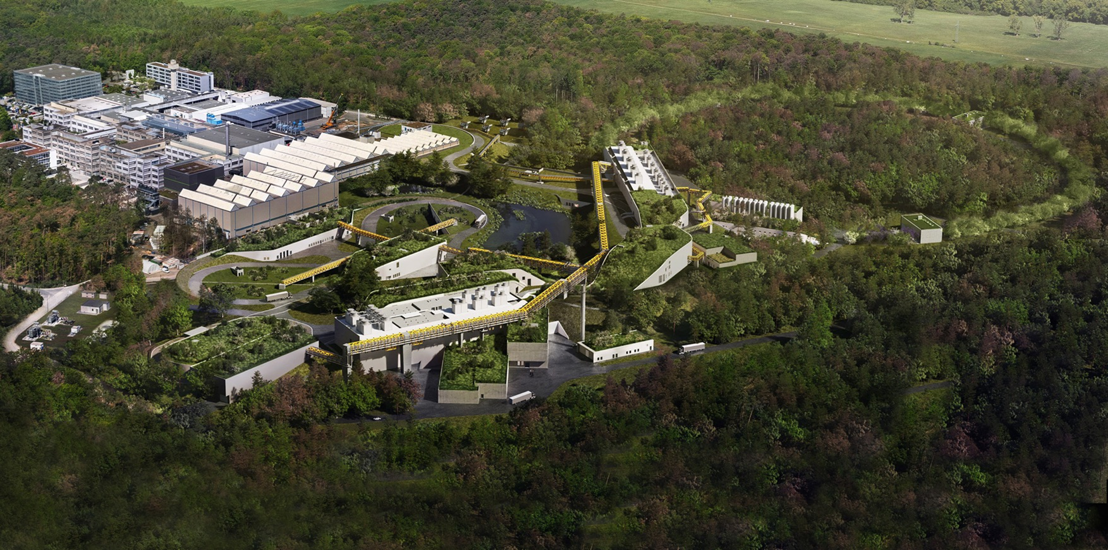



World-leading accelerator laboratory for nuclear and heavy-ion physics
Major scientific results and technical developments for decades
Landmark for the European Research Infrastructure (ESFRI)
Top priority for European Nuclear Physics Community
Unique scientific program

Slide 8
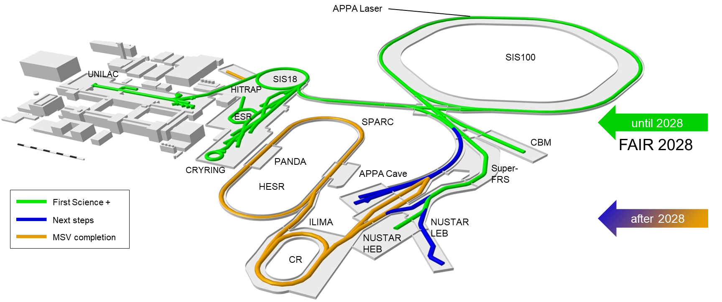











FAIR – Facility for Antiproton and Ion Research
FAIR international facility
9 shareholders
+ 1 associated partner
+ 1 aspirant partner

Slide 9
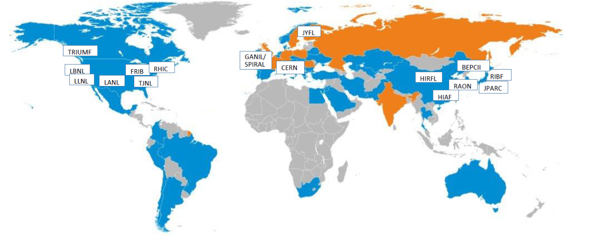




















Worldwide Collaboration & Competition
IHEP
With major research facilities / institutions / projects from all over the world
With Scientists from more than 200 institutions from 53 countries (Orange + Blue)
Orange: countries, which are shareholders of FAIR
Blue: countries contributing to research and technical development projects at GSI and FAIR
In total more than 3000 scientists and engineers are involved in R&D for GSI and FAIR

Slide 10
FAIR Project Progress – Civil Construction - Construction site view
FCC
SIS100
CRYO PLANT
APPA Cave
NUSTAR HEB
CBM
S-FRS
NUSTAR LEB

Slide 11
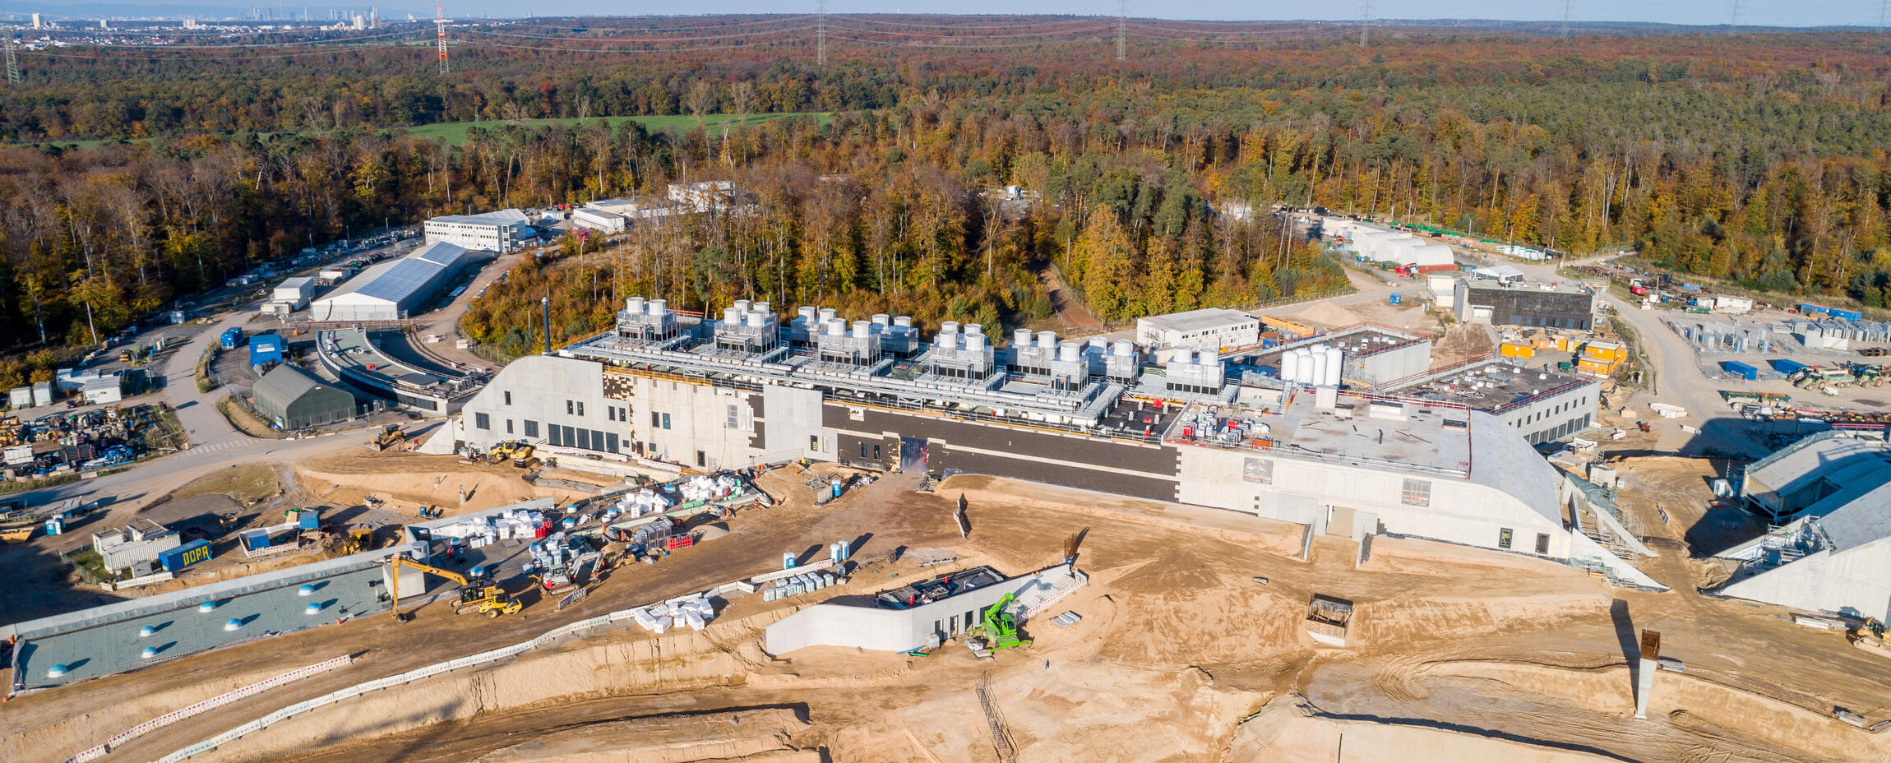
FAIR Project Progress – Civil Construction
View of north area (SIS100) with all buildings completed

Slide 12
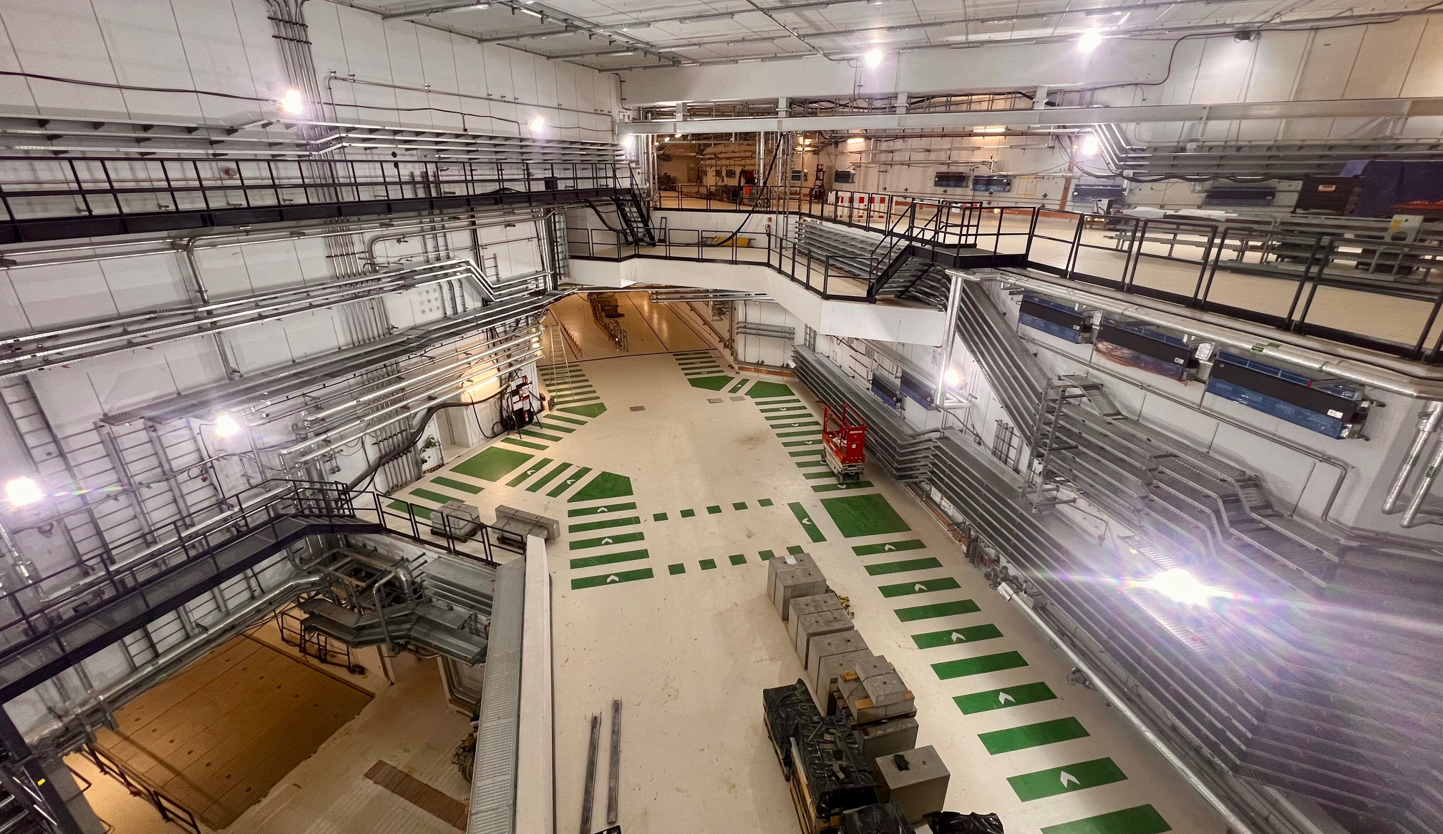
FAIR Project Progress – Civil Construction
- Central Transfer building

Slide 13
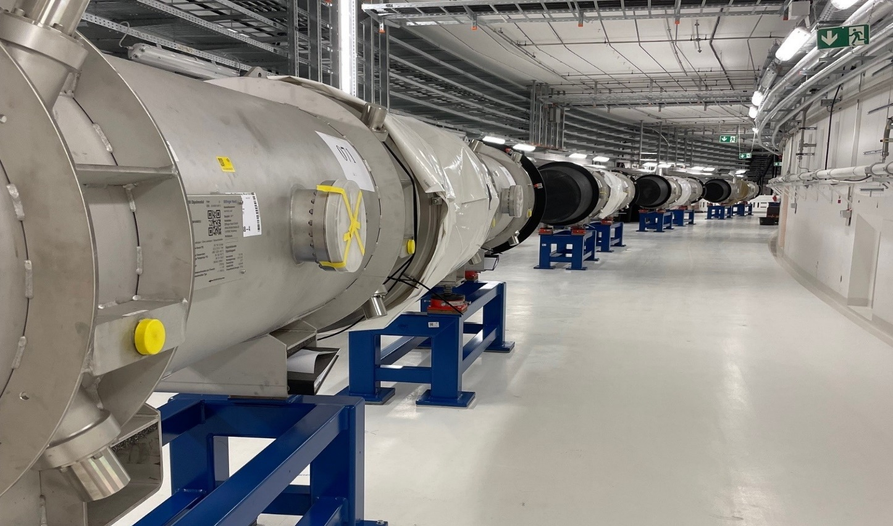
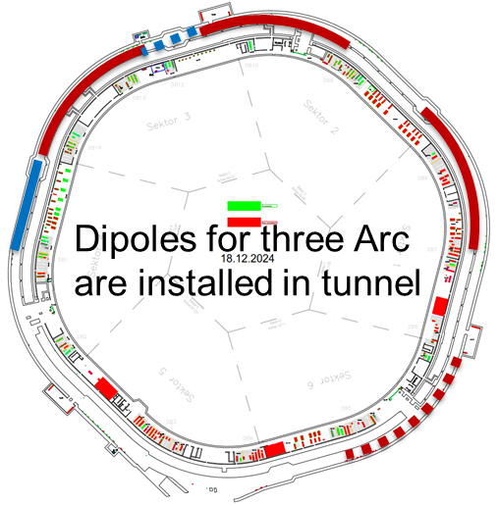
FAIR Project Progress – Accelerator - Accelerator Installation - SIS100

Slide 14

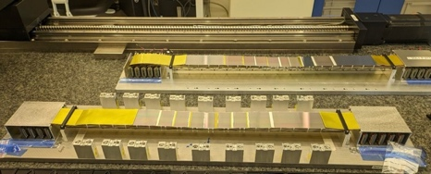
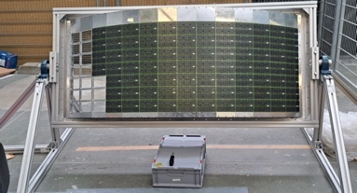



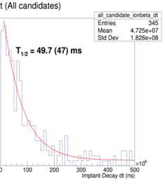

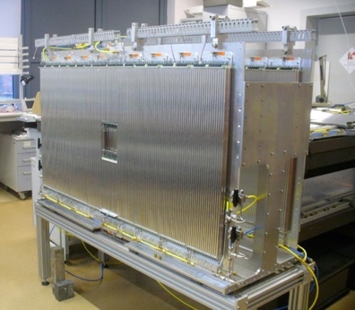
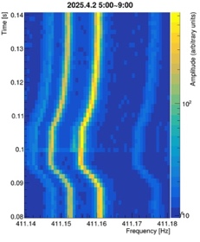
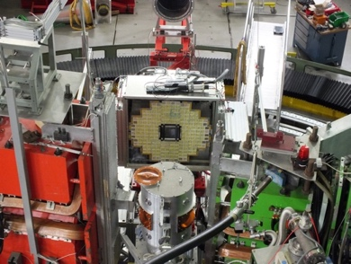
Experimental Progress
APPA
CBM
1st User Experiment at HITRAP
Series production
- STS modules/ladders
- TOF MRPC counters - RICH cameras
STS
TOF
Effort to best use the part of FAIR which will be available by 2028
RICH
NUSTAR
PANDA
CALIFA
Forward Tracker at JU Krakow
lifetime measurement with AIDA
EMC Backw. Endcap at MAMI
Isomer in
¹⁸⁴Pt⁷⁸⁺
T_{1/2}~1 ms
fission measurement, published in Nature (2025)

Slide 15
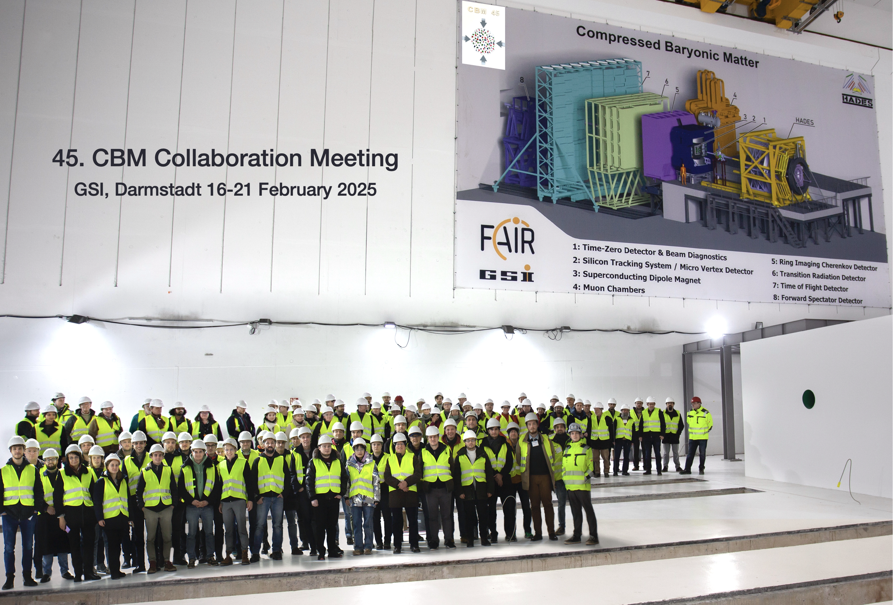

Slide 16
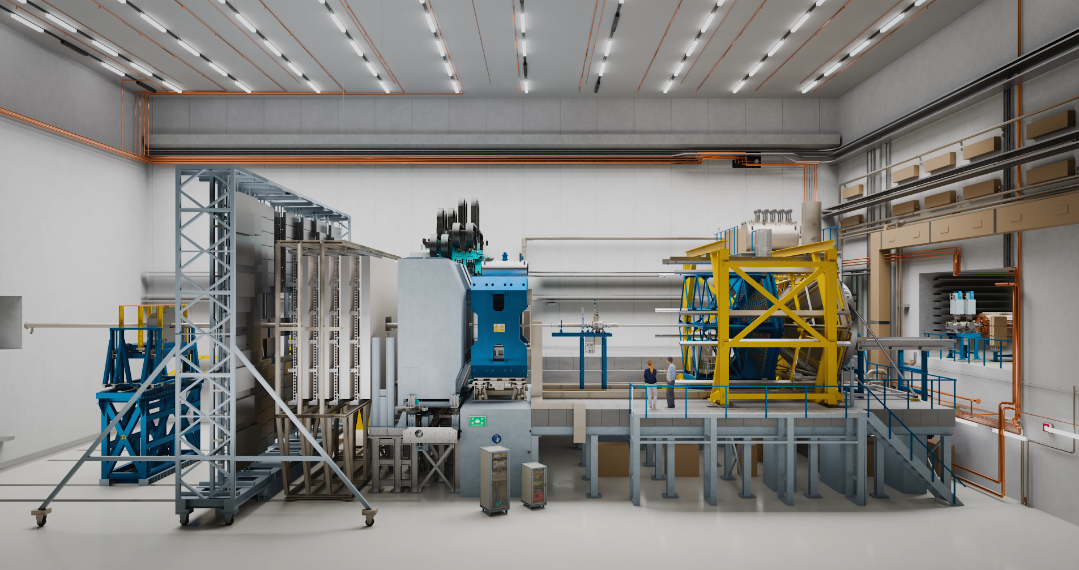
CBM final setup including HADES

Slide 17
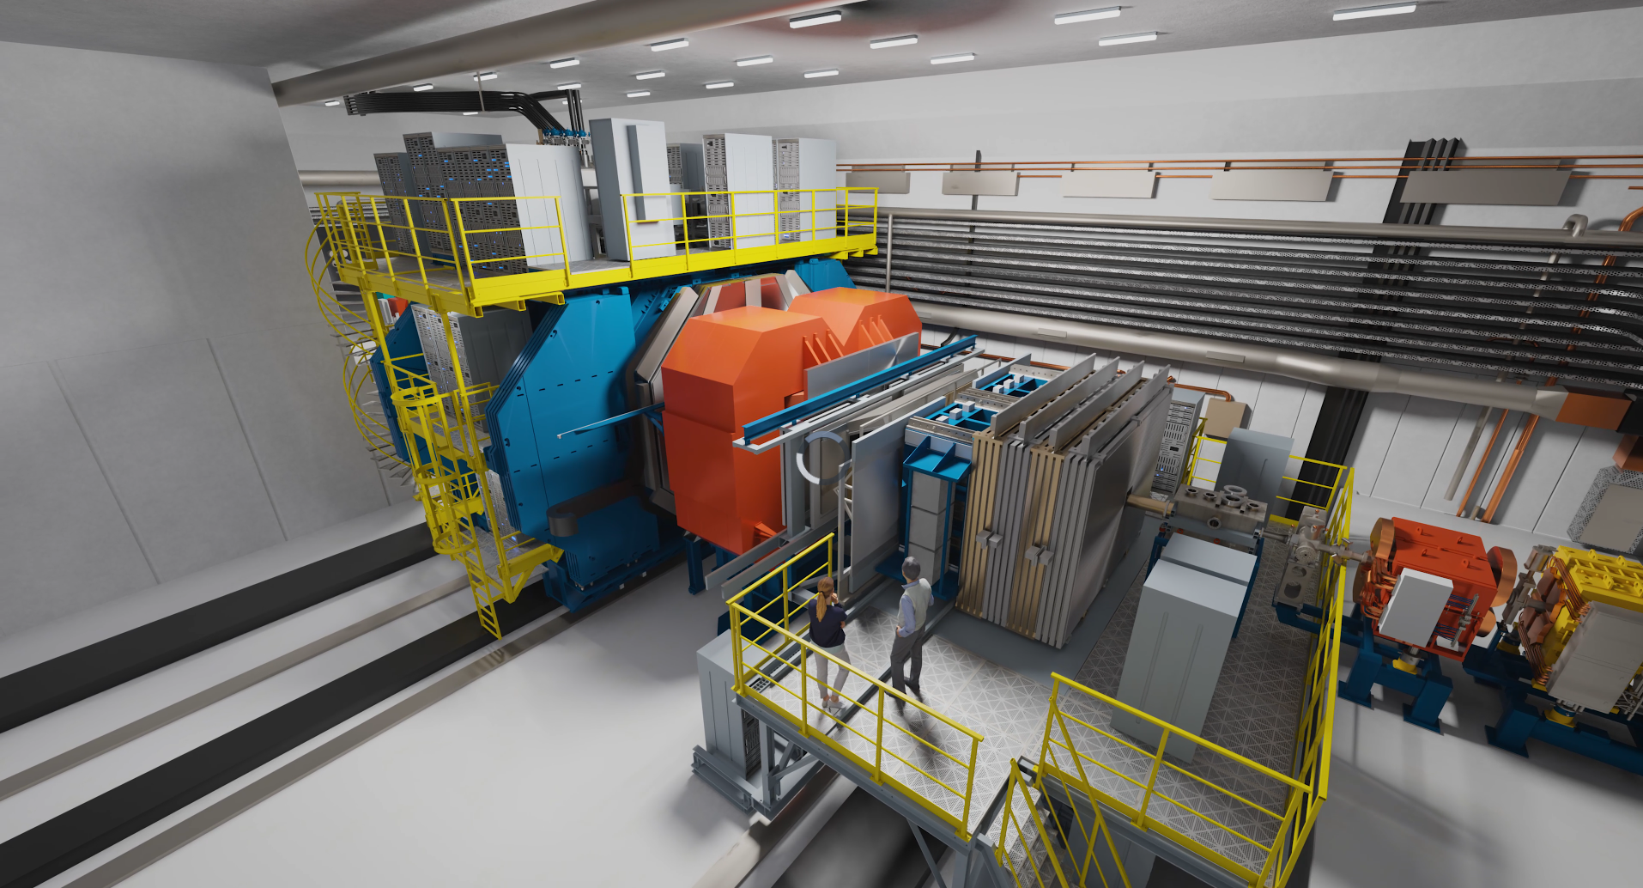
PANDA@MSV visualization

Slide 18
Our vision for the future: FAIR 2028
FAIR in 2028 will feature the most valuable science program which can be hosted in the FS+ infrastructure.
The „FAIR 2028“ science program will include:
APPA experiments at the low-energy rings, at SIS100, at the caves at SIS18 and UNILAC with and at PHELIX and a limited set of experiments which could be hosted at all the caves served by SIS100
NUSTAR at the Super FRS with SIS100 beams, plus SHE and MATS experiments at UNILAC and ILIMA at the low-energy rings
CBM at the new cave with SIS100 beams, and HADES at SIS18
PANDA is developing a hadron physics program to be carried as bridge towards the program with antiprotons, when possible using the caves and beams available at GSI/FAIR and synergies with other experiments.
Given the limits of financial and human resources, other activities will be downscaled, delayed or even discontinued.
FAIR2028
Early Science (ES)
First Science/+ (FS/FS+)
200 days/y
>5 y SIS100
UNILAC/Rings

Slide 19
FAIR & GSI Integrated Schedule
2024 2025 2026 2027 2028
Beam Time
Beam Time
Beam Time
Beam Time
Beam Time
Beam Time
FCC Construction & Procurement of Interior equipment
Equipment
Installation
Commissioning
ACC operation
from new FCC
Injector Controls Upgrade: 1st version of new production system
Injector Controls Upgrade: finalization
Controls & BI Digitization UNILAC, SIS18, ESR, Cryring, HEBT
Civil Construction
FAIR Tech. Buildings Infrastructure
FAIR Buildings Testing & Commissioning
HBO
Regular Operation of Tech. Buildings Infrastructure
FAIR Accelerator / Experiments Procurement & Manufacturing
SFRS-ES
SIS100-FS
FAIR Accelerator / Experiments Installation
HEBT/SFRS-ES
SIS100-FS
Cryo 2 Commissioning
HEBT-ES Hardware-Commissioning
Dry-Runs
Start of ES
science program
SFRS Hardware-Commissioning
ES Beam Commissioning
Start of FS science program
Dry-Runs
SFRS Cooldown
HEBT & SIS100 -FS Hardware-Commissioning
FS Beam Commissioning
Dry-Runs
SIS100 Cooldown
Version Q2 2025
Notes:
Version 1.3 Data Date 27.02.2025

Slide 20
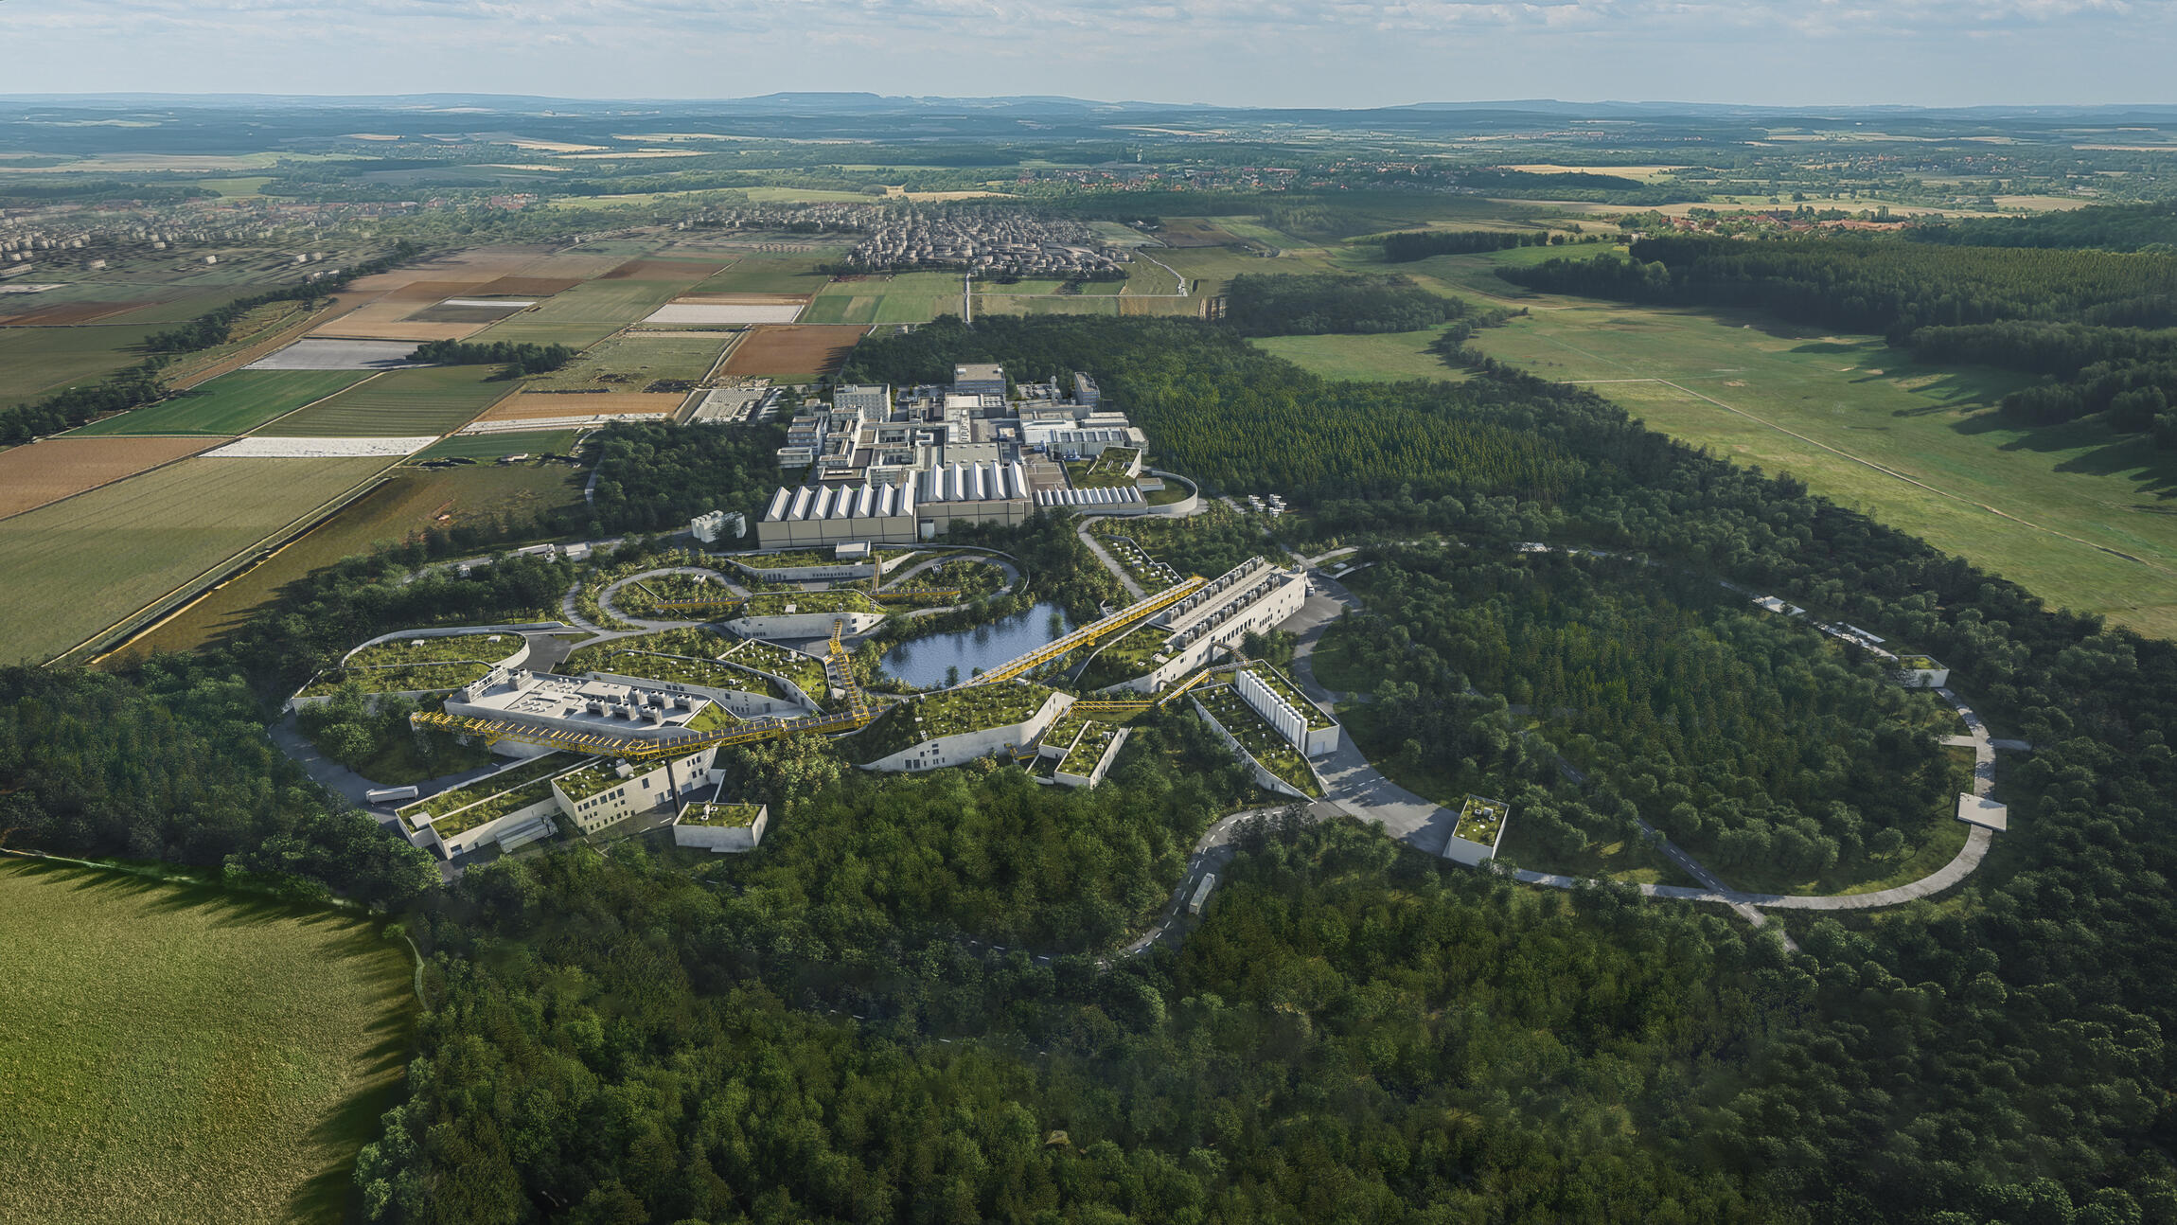
Thank you for your attention, wishing you a productive workshop!
Grafik: ion42/D. Fehrenz, GSI/FAIR

Slide 21
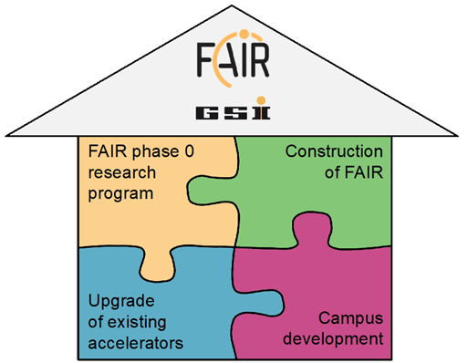
GSI/FAIR – Common Strategic Goals
Construction, installation and commissioning of FAIR
and start operation of the new facilities in 2028.
GSI ready for FAIR
Perform a world-class scientific FAIR Phase-0 program through:
Early physics experiments with FAIR equipment at GSI
combined with:
Testing and commissioning of new accelerators and detector instrumentation
Preserving and extending the FAIR science community
Upgrade of existing GSI facilities for the FAIR operation
Build a modern campus with appropriate infrastructure for the employees and international users

Slide 22
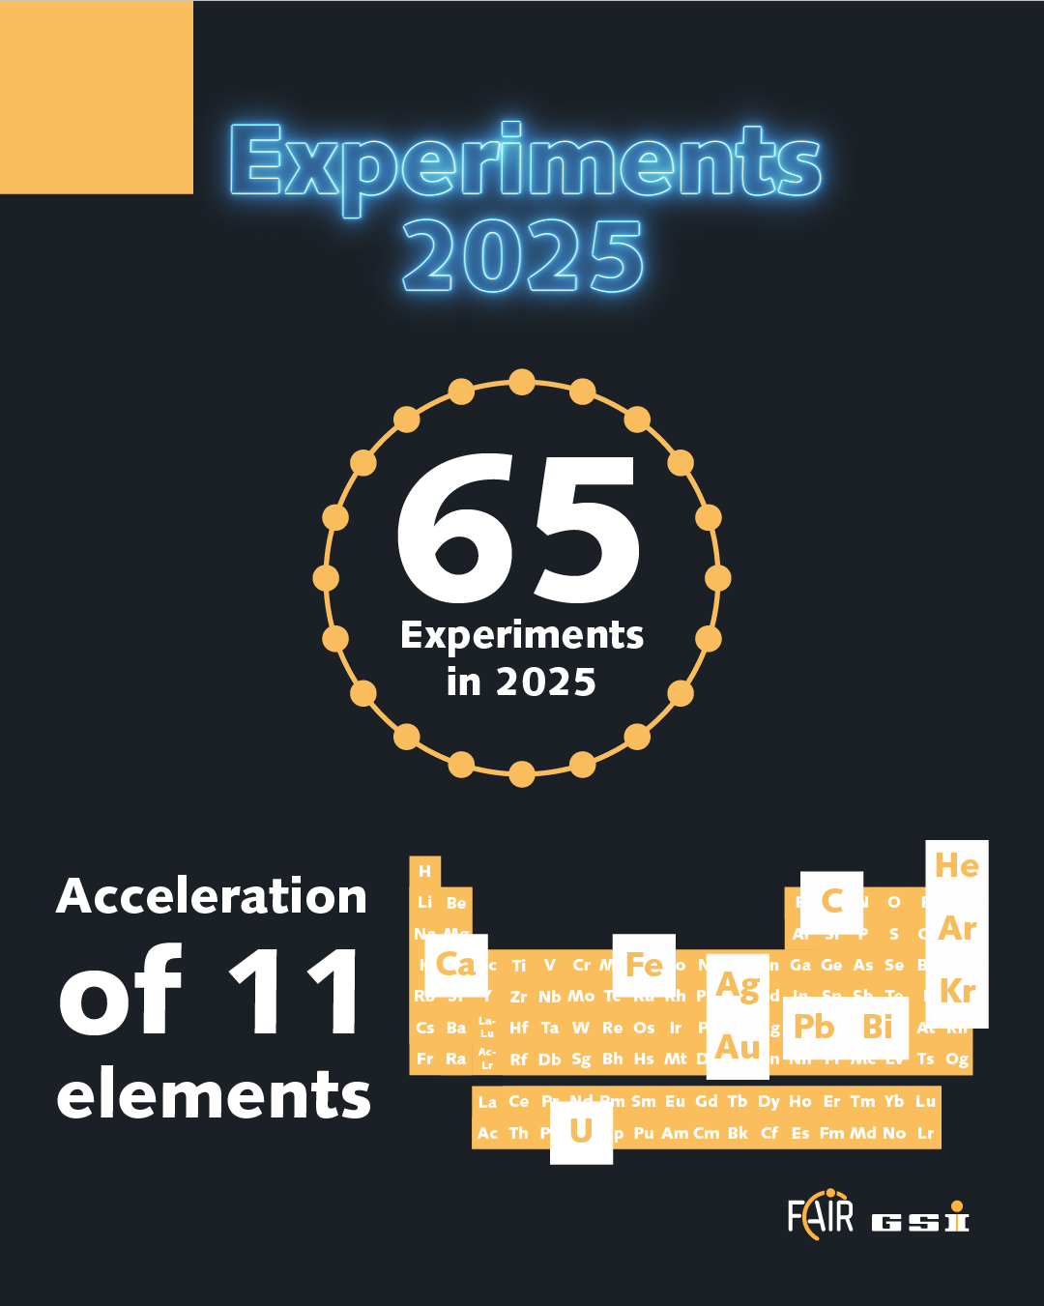
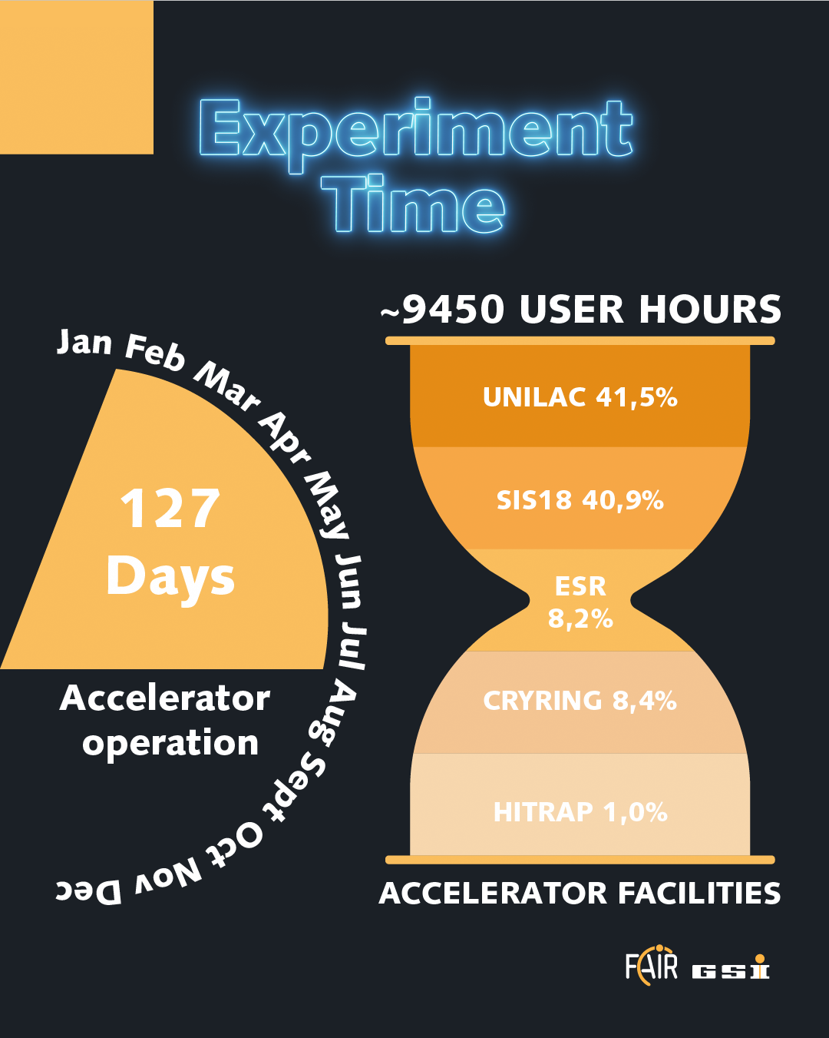
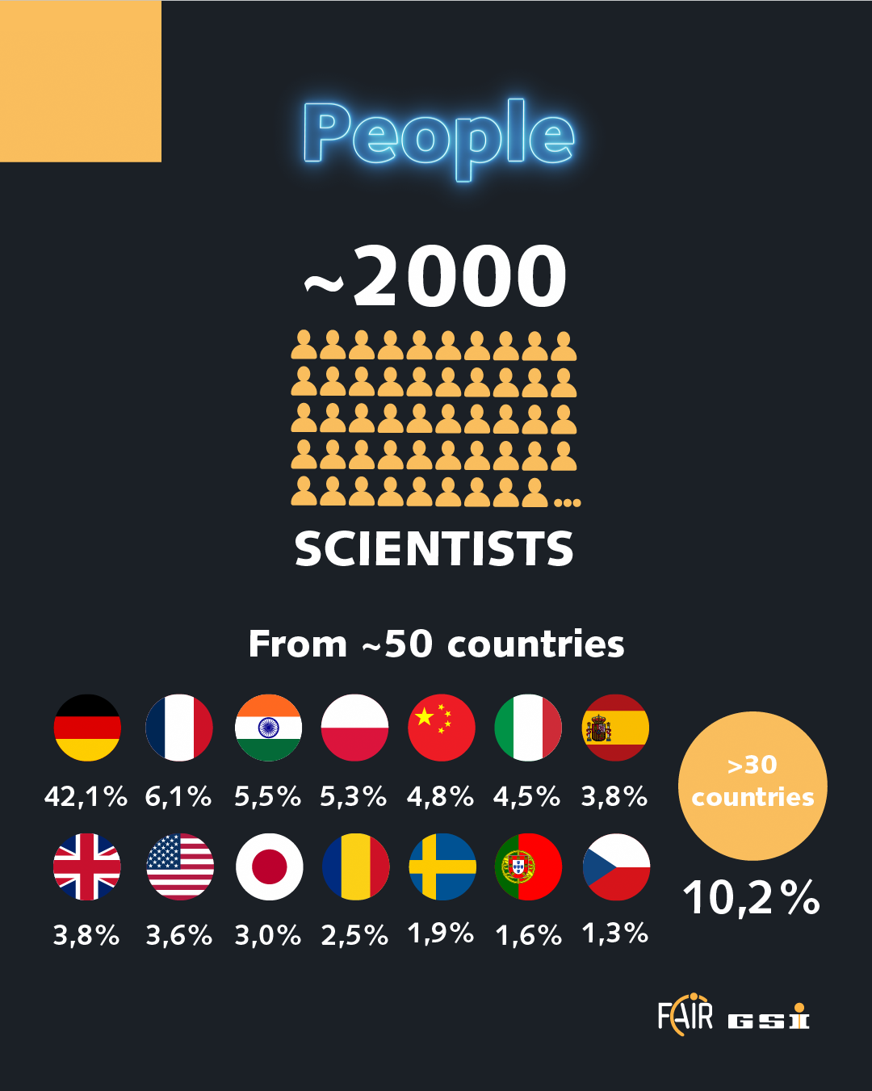
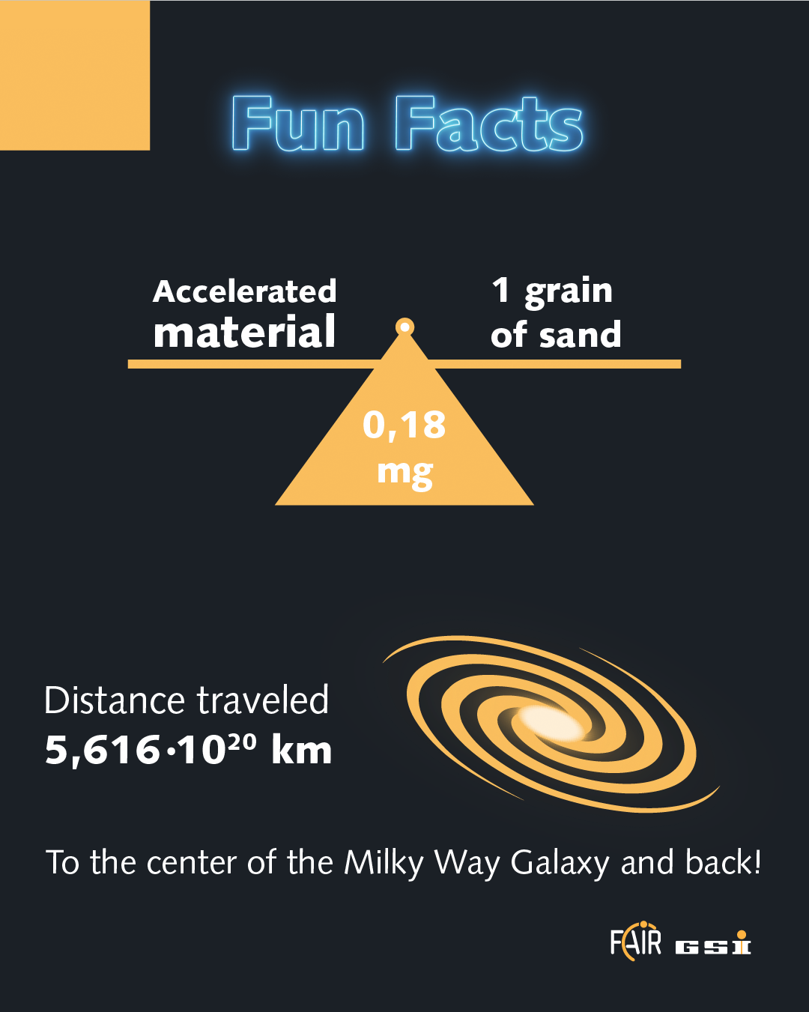
Beamtime 2025

