Slide 1
M/J Pellet Target
Recent developments
11 December 2012 | Markus Büscher
A.Boukharov, V.Chernetsky, P.Fedorets, A.Gerasimov, A.Dolgolenko,V.Balanutsa, A.Balashov, L.Gusev, S.Podchasky, D.Spölgen, A.Demekhin, I.Tarasenko

Slide 2
Towards smaller pellet diameters
PHL mode from TDR: pellet Ø < 15 µm
Requires small nozzle Ø & high jet velocity
Problem: too high driving pressure (max. ~1.5 bar)
Ansatz: optimized nozzle geometry (smaller C_{d} parameter)
old
new

Slide 3
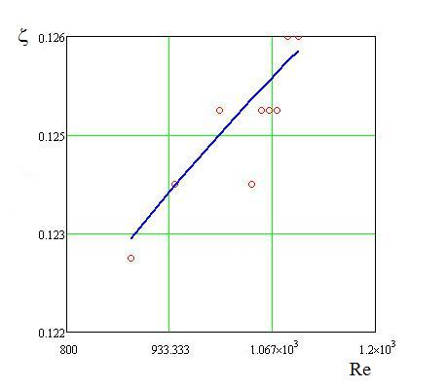
Discharge coefficient C_{d}
→ Measured mass flow rate relative to that of an ideal nozzle
$$C_{d}$$
$$v_{jet}=C_{d}∙\sqrt{2∙∆p/ρ}<0,13∙\sqrt{2∙∆p/ρ}$$
PTR mode from TDR:
$$v_{jet}=3\frac{m}{s}$$
‒ Theory for water
○ Our data for H₂
$$C_{d}=1$$
$∆p=340 Pa$
$$C_{d}=0.13$$
$∆p=0.2 mbar$
$$Re= \frac{ρvd}{η}∝v$$
Notes:
Re = rho v d / eta = Verhältnis von Trägheits- zu Zähigkeitskräften

Slide 4
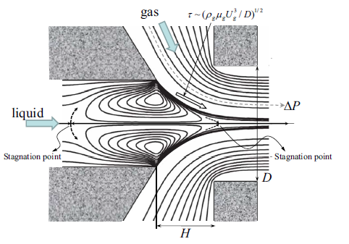
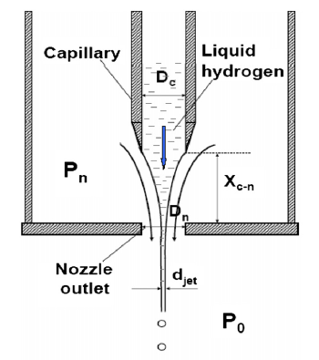
Towards smaller pellet diameters
PHL mode from TDR: pellet Ø < 15 µm
Requires small nozzle Ø
Problem: frequent nozzle blocking
Ansatz: reduction of jet Ø by “flow focussing”
A. M. Gañán-Calvo, PRE 79, 066305 (2009)
V.Varentsov, NIM A 646, 12 (2011)

Slide 5
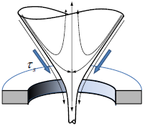
Towards smaller pellet diameters
A. M. Gañán-Calvo, PRE 79, 066305 (2009)
Jülich Dec. 2012

Slide 6
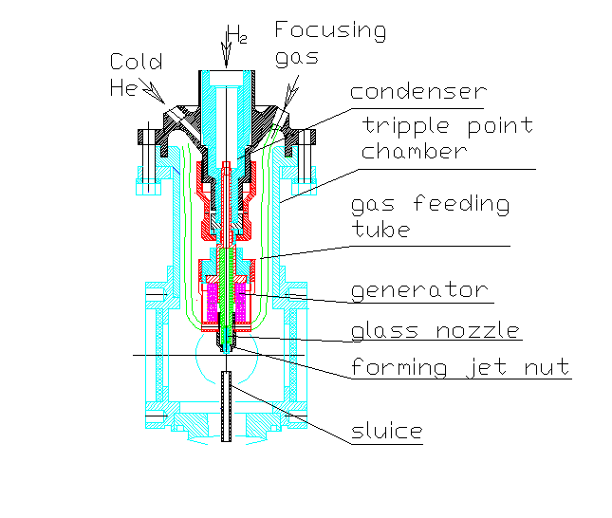
Avoid nozzle blockings
New condensor layout

Slide 7
New experimental hall @ITEP
Large experimental hall from ITEP directorate
Money & manpower for renovation
Equipment ordered, support frame in production
Ready in spring 2013

