Slide 1
PANDA Magnet Iron Yoke
Strength Analysis
Status report
Presented by E. Koshurnikov
December 11, 2012

Slide 2
Initial Data
All main dimensions of the yoke FE model are in accordance with CAD model https://edms.cern.ch FAIR Project, PANDA, Magnets, Solenoid yoke ID = 1064509
Cryostat FE model (dimensions, loads and points of their application) is in accordance :
  http://panda-wiki.gsi.de/pub/Magnet/Internal/keep_away_25_02_2011.zip
  http://panda-wiki.gsi.de/pub/Magnet/Internal/pandaTS_spectrometer_25_02_2011.zip
  http://panda-wiki.gsi.de/pub/Magnet/Internal/panda_coil_25_02_2011.zip,
  (Letter from R.Parodi of 30.11.11)
Material properties of the cryostat shells are from presentation «Panda TS Aluminium Cryostat» (letter from R.Parodi of 12.05.12).

Slide 3
Gravity loads, Magnetic and seismic forces
New load table of R. Parodi and H. Orth, May 8, 2012
 | m∙10³ (kg) | Z_{g} (mm)
SC coil and cryostat | 10 | 355
Inner detectors | 22 | 220
 | F_{x} (kN) | F_{y} (kN) | F_{z} (kN) | Z_{g} (mm)
Magnetic forces in nominal position | - | - | -40
Magnetic decentering forces | ±45 | ±45 | ±100 | 355
Horizontal seismic forces | ±24 |  | ±24 | 264

Slide 4
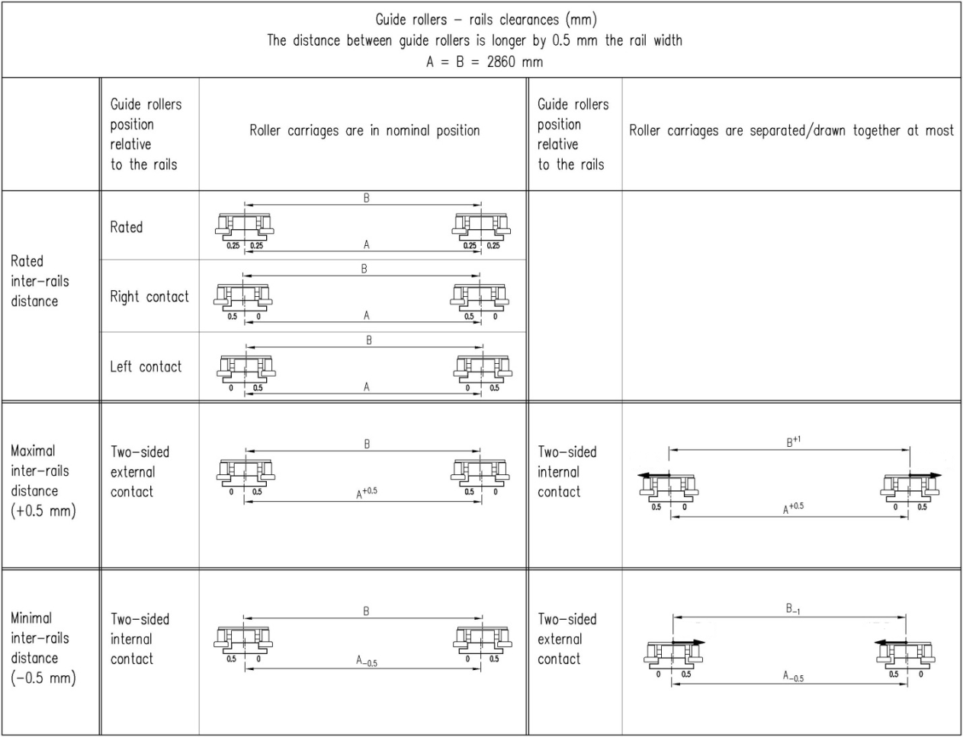
Requirements for the Rail Track
Distance between the rails: 2860 ±0.5 mm
Rail nonparallelism <0.2 mrad (1 mm/5 m)
Rail dimensions 325_{-0.14} x 70 mm
Gap between cam followers and rail +0.5 mm.

Slide 5
Allowable Deviations Inclination of the Cryostat Axis
Cryostat axis inclination under action of magnetic forces has to be limited Δα ≤ 0.3 mrad
Herbert Orth letter of 31.10.12.

Slide 6
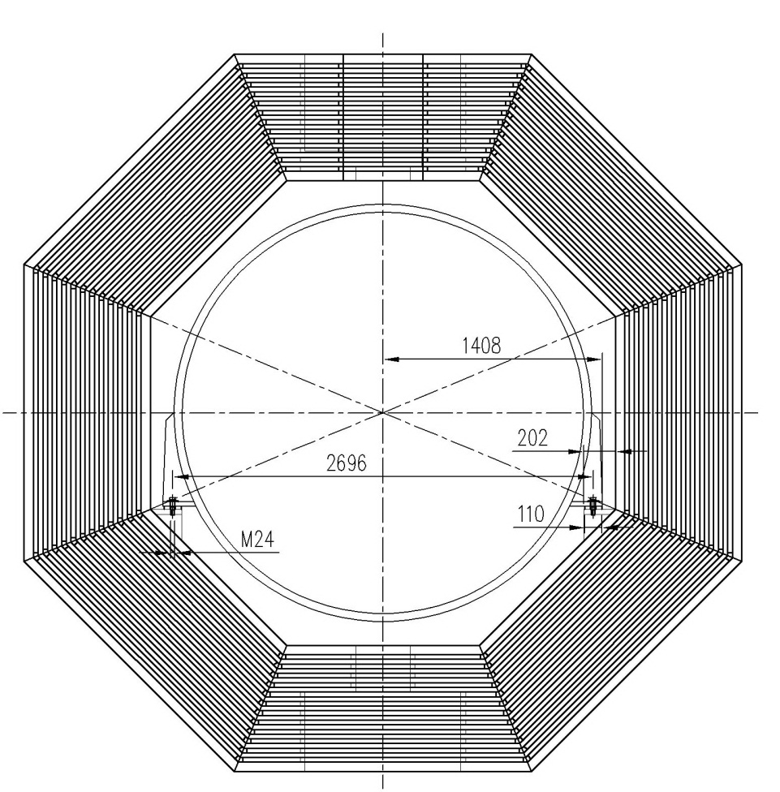
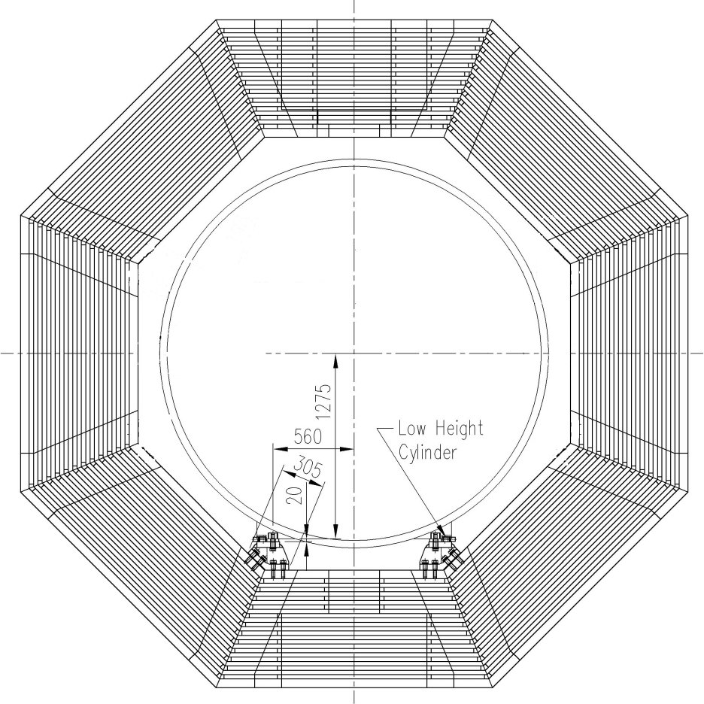
Cryostat fixation units
Option 1. Bottom beam fixation
Option 2. Inclined beam fixation

Slide 7
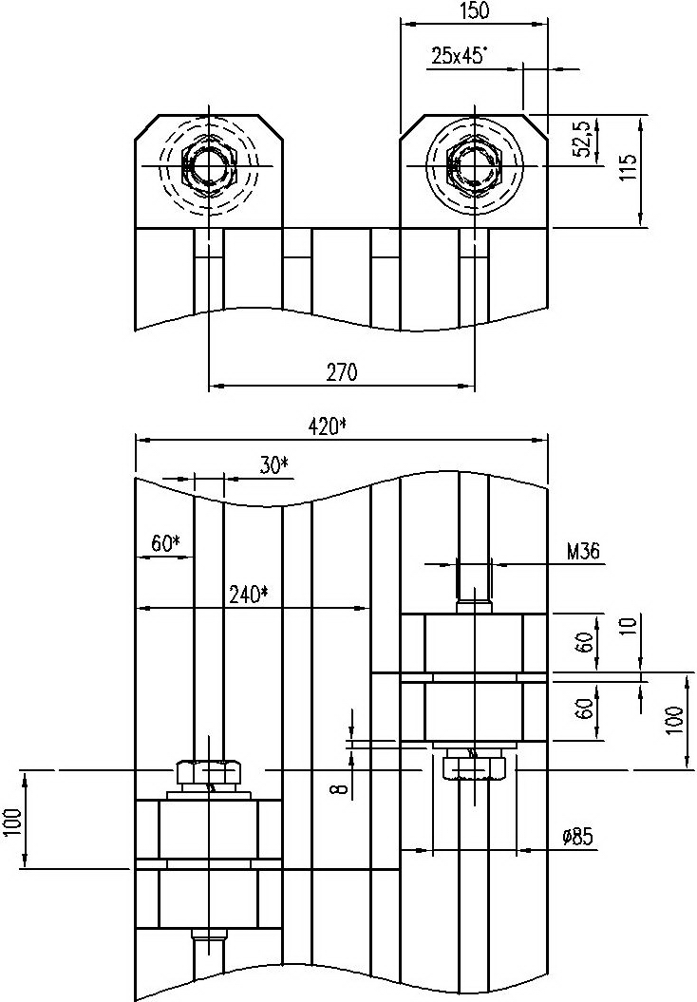
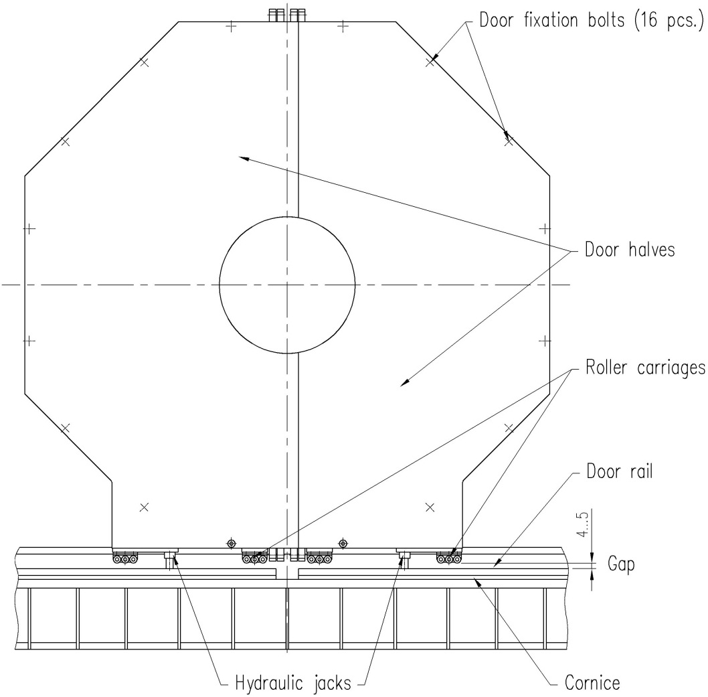
Magnet door component arrangement

Slide 8
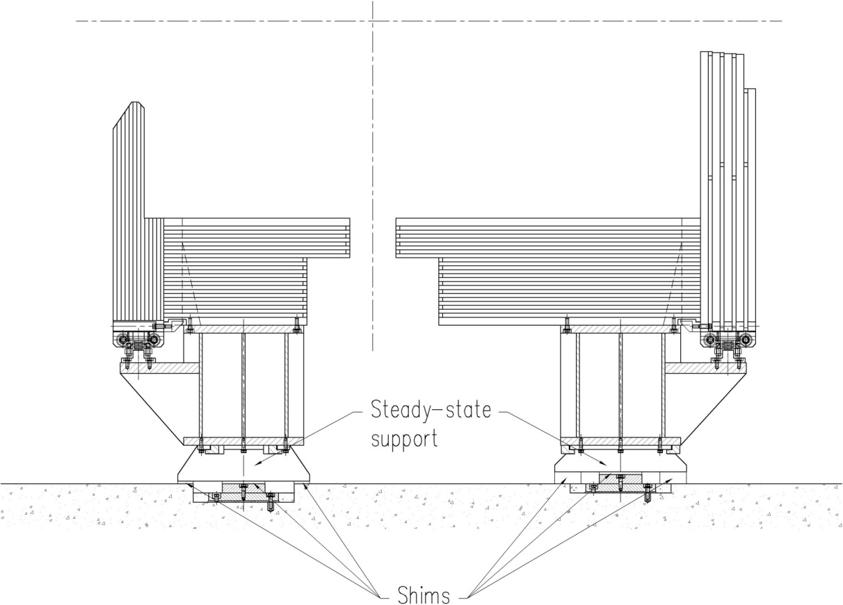
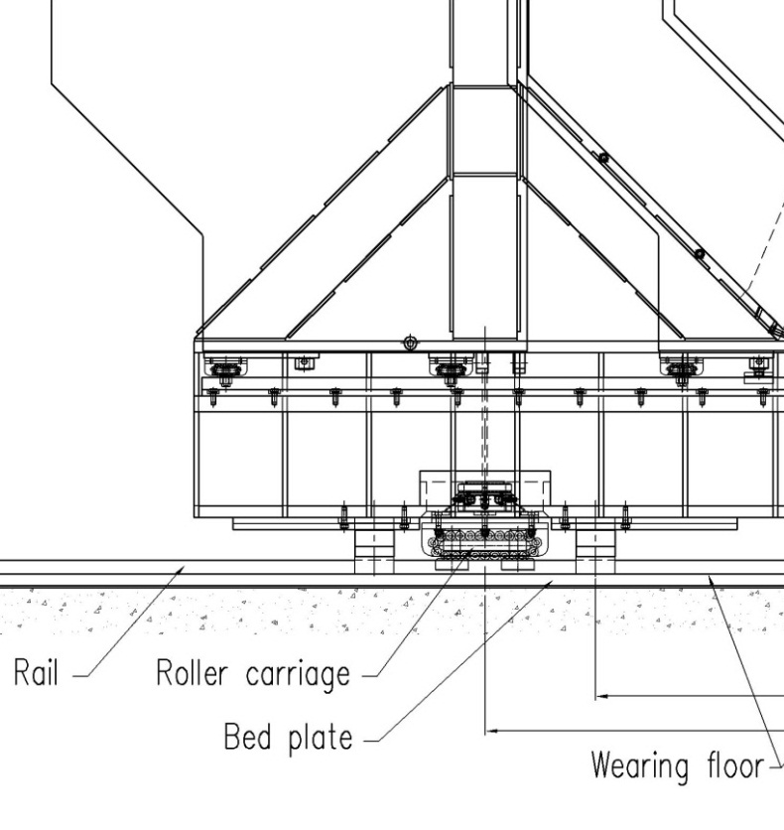
Magnet supports

Slide 9
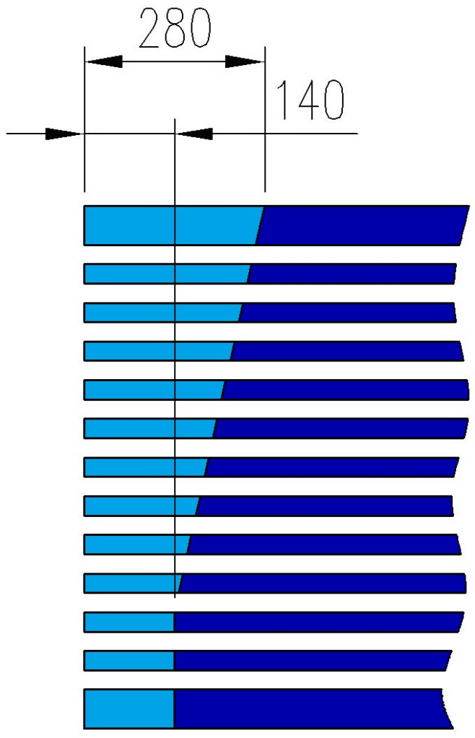
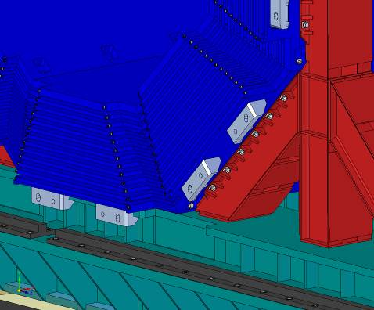
Passages for tubing and cabling
Additional space requested for muon cabling

Slide 10
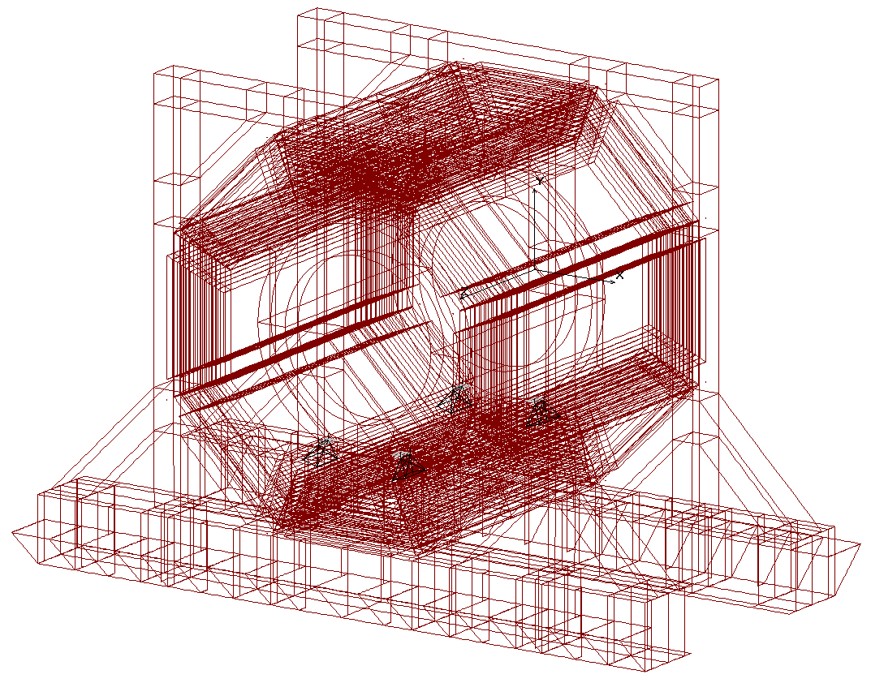
FE model of the Magnet
Model - Shell and beam finite elements
Number of elements ~260 000
Computation time of a basic load case ~30 minutes
Data base volume for one computation case -1.5Gb

Slide 11
List of Load Cases
LC# | Support scheme |  | Door position and fixation type^{*)} |  |  | Gravity load |  |  | Magnetic forces are applied to the yoke and to the coil at maximal current and for nominal position of the cryostat | Magnetic forces applied to the cryostat and to the yoke at maximal current due to tolerable misalignments of the cryostat |  |  | Horizontal seismic forces (acceleration) applied to the yoke parts and to the cryostat |  | Run over an on-path irregularity of 1 mm in height | Separation of platform beams due to misalignment of the rails
 |  |  | Doors at the cornices | Doors weight is applied to the barrel (without stiffness) | Doors stiffness is applied (without weight) |  |  |  |  | F_{X} = -45 kN | F_{Y} = +45 kN | F_{Z} = -100 kN | a_{X} = -0.75 m\s² | a_{Z} = -0.75 m\s²
 | Two supports for every platform beam (magnet transportation) | Fifteen steady-state supports for every platform beam (magnet assembly and magnet operation) |  |  |  | Gravity of the yoke | Gravity of cryostat | Gravity of the inner detectors |  |  |  |  |  |  |  | Δ₁₁ = +1mm | Δ₁₁= -1mm | Δ₁₂ = +1mm | Δ₁₂ = -1mm
51 |  | x |  |  |  | x
52** |  | x | x |  |  | x | x | x
53** |  | x | x |  |  | x | x | x
54 |  | x |  | x |  | x | x | x
55** |  | x | x |  |  | x | x | x
61 | x |  |  | x |  | x | x | x
62 | x |  |  | x |  | x | x | x |  |  |  |  |  |  | x
63 | x |  | x |  |  | x | x | x
64 | x |  |  | x | x | x | x | x |  |  |  |  |  |  | x
65 | x |  |  | x | x | x | x | x |  |  |  |  |  |  |  | x
66 | x |  |  | x | x | x | x | x |  |  |  |  |  |  |  |  | x
67 | x |  |  | x | x | x | x | x |  |  |  |  |  |  |  | x |  | x
68 | x |  |  | x | x | x | x | x |  |  |  |  |  |  |  |  | x |  | x
69 | x |  |  | x | x | x | x | x |  |  |  |  |  |  |  | x |  |  | x
71 |  | x |  | x |  | x | x | x | x
72 |  | x |  | x | x | x | x | x |  |  |  |  |  | x
73 |  | x |  | x | x | x | x | x | x | x |  | x |  | x
74 |  | x | x |  |  | x | x
75 |  | x |  | x | x | x | x |  | x | x | x | x
76 |  | x |  | x | x | x | x | x |  |  |  |  | x
77 |  | x |  | x | x | x | x | x | x | x |  | x | x
78 |  | x |  | x | x | x | x | x | x | x |  | x
81*** |  | x |  | x |  | x | x | x
82**** |  | x |  | x |  | x | x | x
83 | x |  |  | x |  | x | x | x
84 | x |  |  | x | x | x | x | x |  |  |  |  |  |  | x
85 |  | x |  | x | x | x | x | x | x | x |  | x
86 |  | x |  | x | x | x | x | x | x | x |  | x | x
87 |  | x |  | x |  | x | x | x | x | x |  | x

Slide 12
Vertical characteristics of the magnet supports
Maximal vertical load on a support (roller carriage) in the process of movement 1221 kN
Torsion stiffness of the yoke
rigid fixation of the door 387 kN/mm
nonrigid fixation of the door 225 kN/mm
Separation on rail/roller interface
rigid fixation of the door 2.1 mm
nonrigid fixation of the door 3.7 mm

Slide 13
Axial characteristics of the magnet supports
Axial stiffness of the yoke platform beam arrangement
152 kN/mm
The friction force between the roller carriage and the rails in lateral direction (friction factor is 0.1)
1221 kN x 0.1 = 122 kN
Maximal possible separation of the platform beams before roller carriage starts slipping
122/152=0.8 mm
The roller carriages will start slipping before cam followers at the roller carriages interact with the rails because of platform beam separation in the process of movement
0.8<1 mm

Slide 14
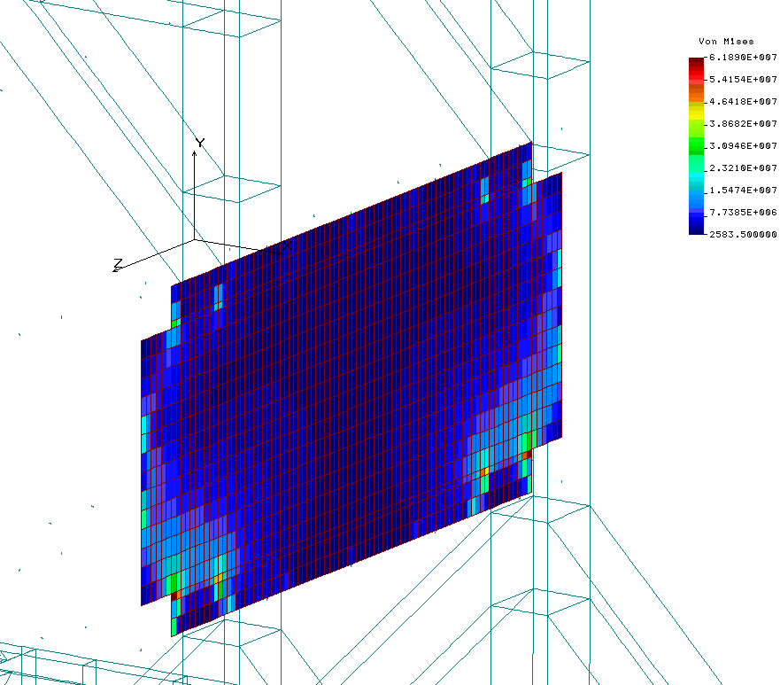
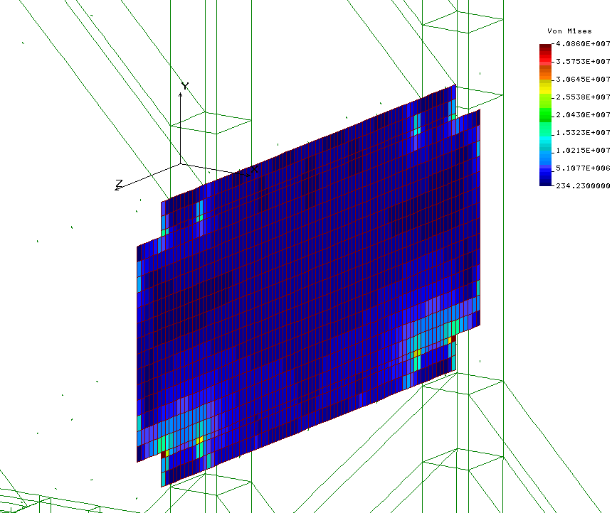
Equivalent stress (Von Mises) in the plate L13 of the beam W7 (LC64)
62+40=102MPa
η = 140/102 ≈1.4
LC61 (transportation position on four rollers)
Run into on-path irregularity 1 mm in height

Slide 15
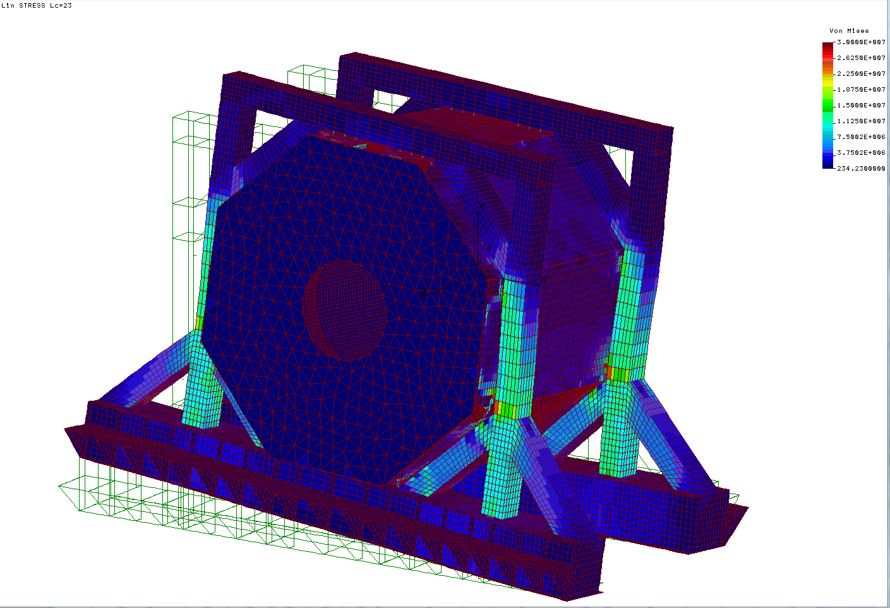
Deformity and Equivalent stress (Von Mises) for a run into on-path irregularity 1 mm in height (without gravity load)

Slide 16
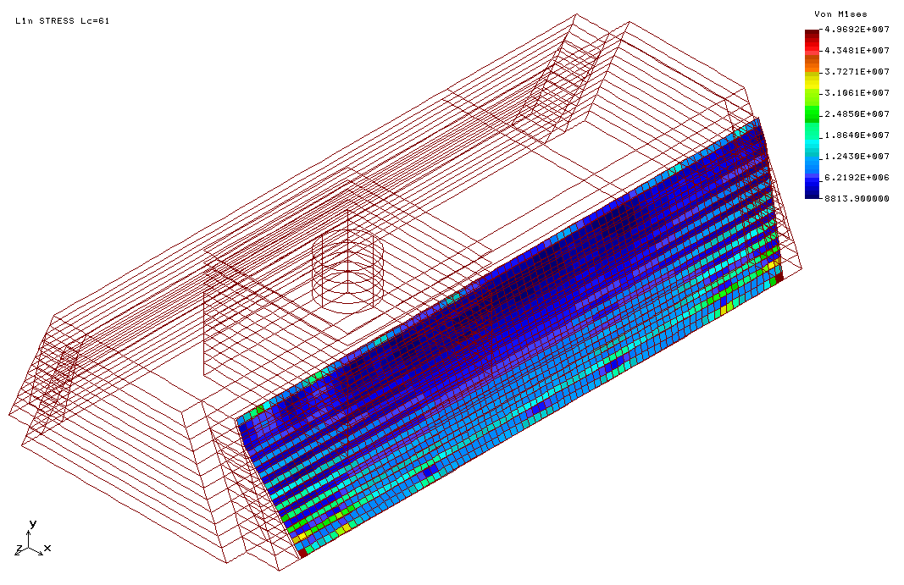
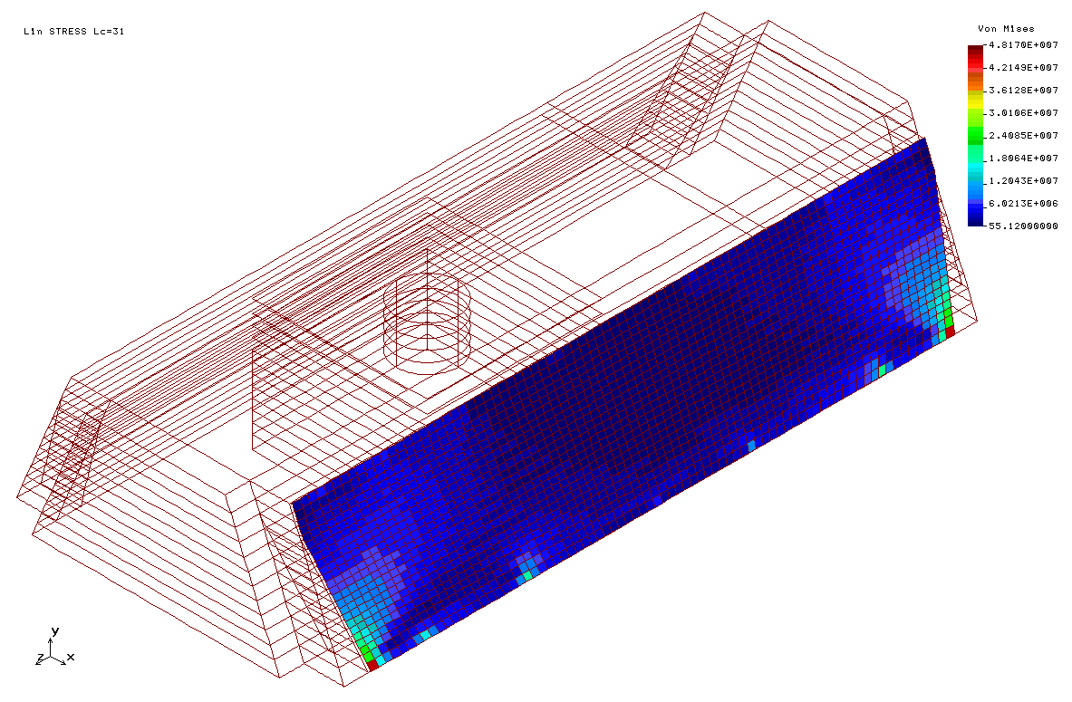
Equivalent stress (Von Mises) in the side plate (W8/W1 junction)
50MPa+45MPa = 94 MPa
LC61 (transportation position on four rollers)
Widening of the roller track up to +1mm
η = 140/94 ≈1.5 LC67

Slide 17
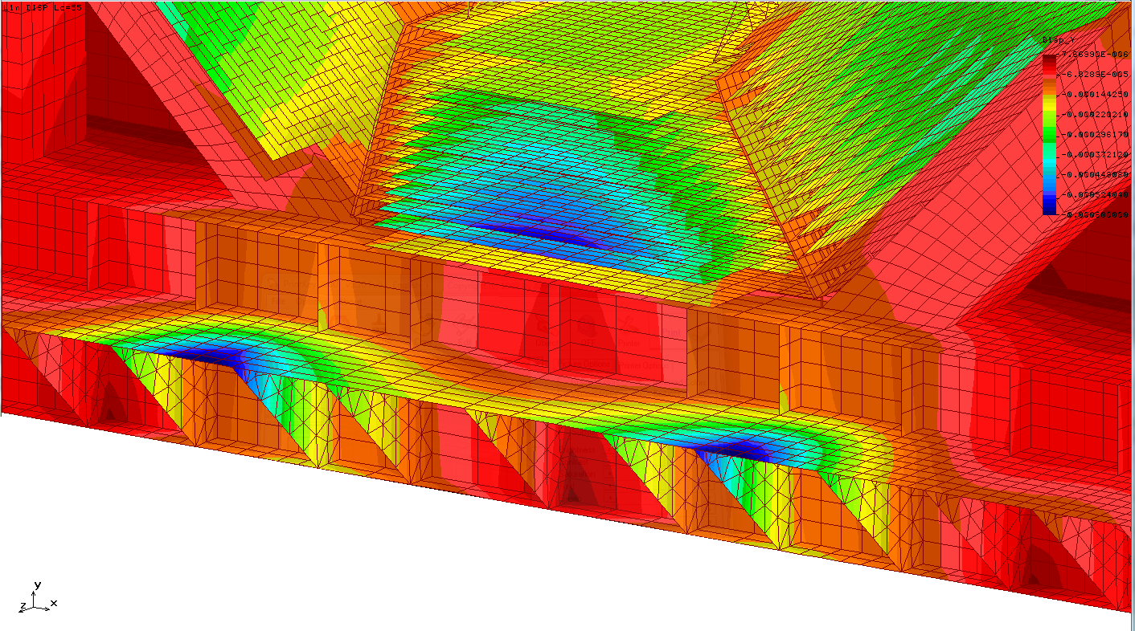
Vertical deformation of the cornices under action of the door jacks
Vertical sag up to 0.6mm

Slide 18
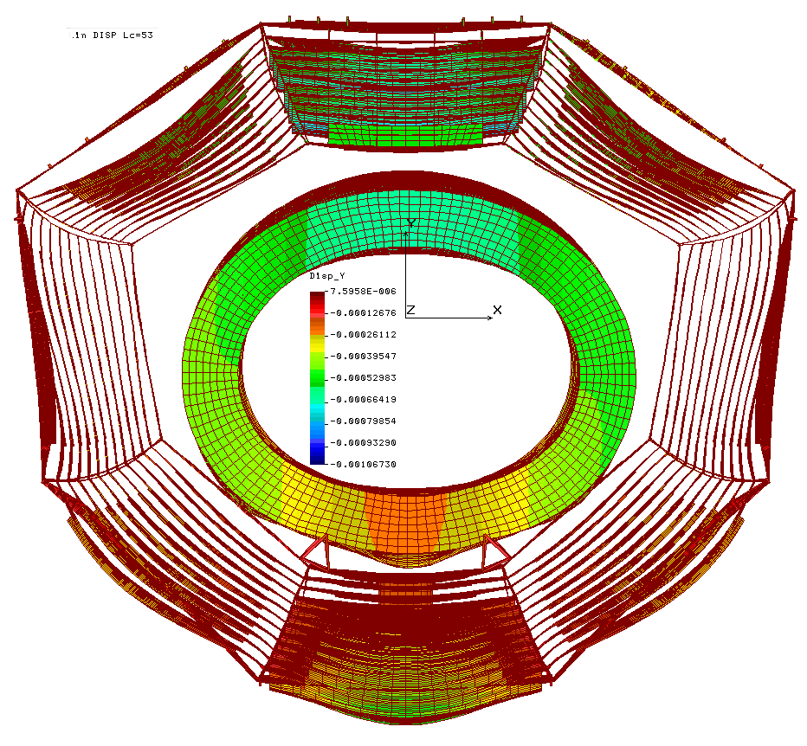
Vertical deformity of the yoke barrel beams
Maximal variation of the slots for muon panels ±0.5mm

Slide 19
Deformity and Equivalent stress (Von Mises) for barrel beam plate L1W1 with “b” and without “a” gravity of the disc calorimeter
Maximal sag ≈0.7mm

Slide 20
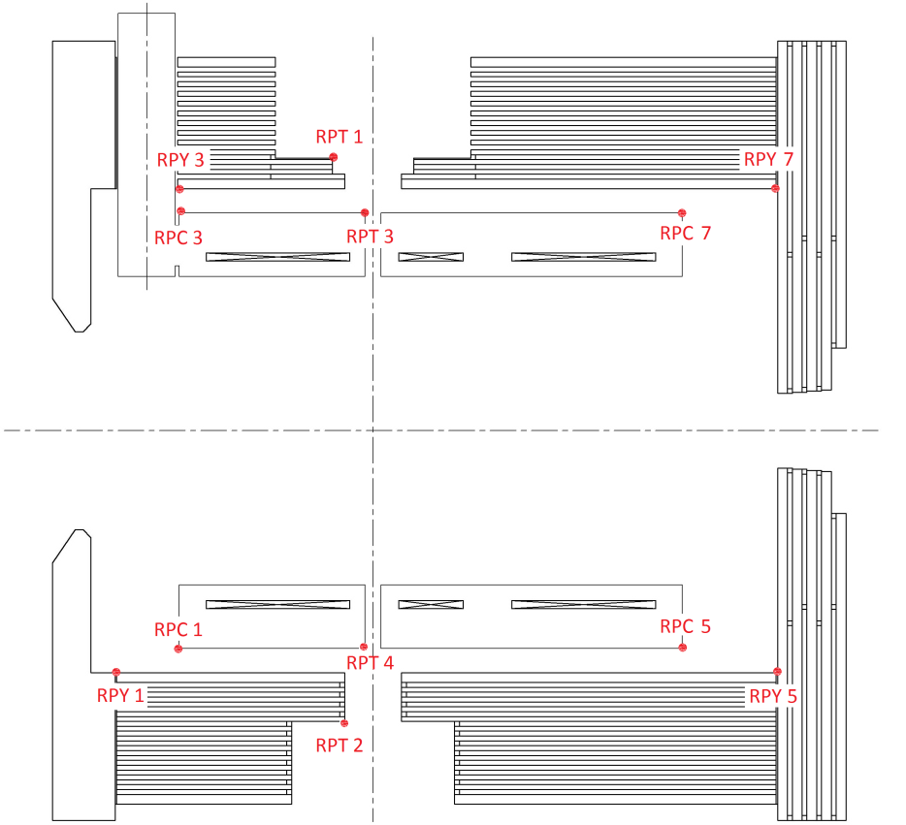
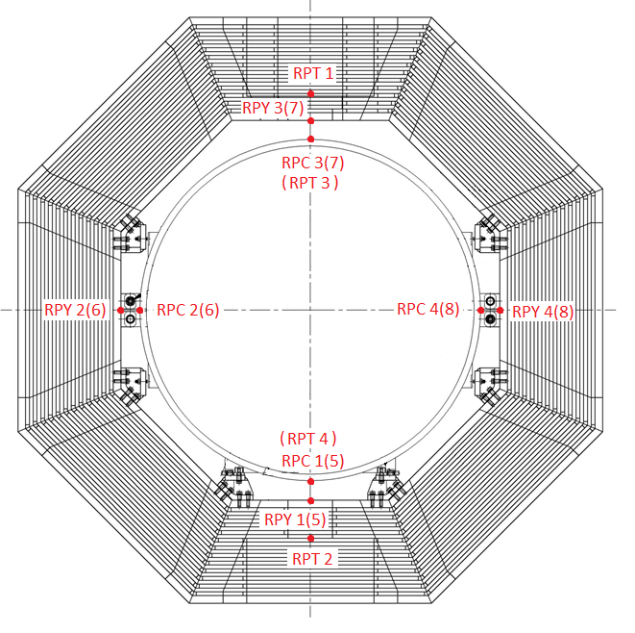
Reference points of the yoke and cryostat

Slide 21
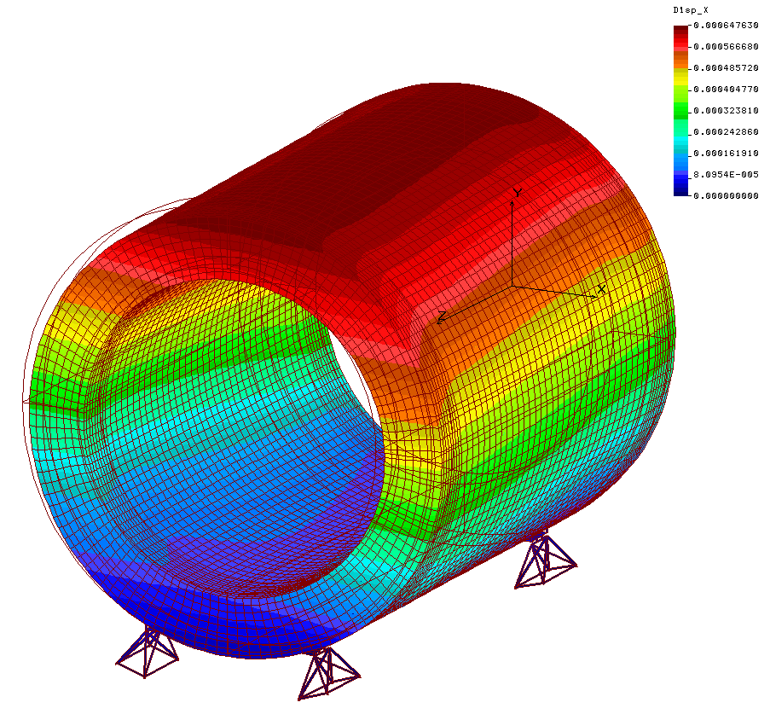
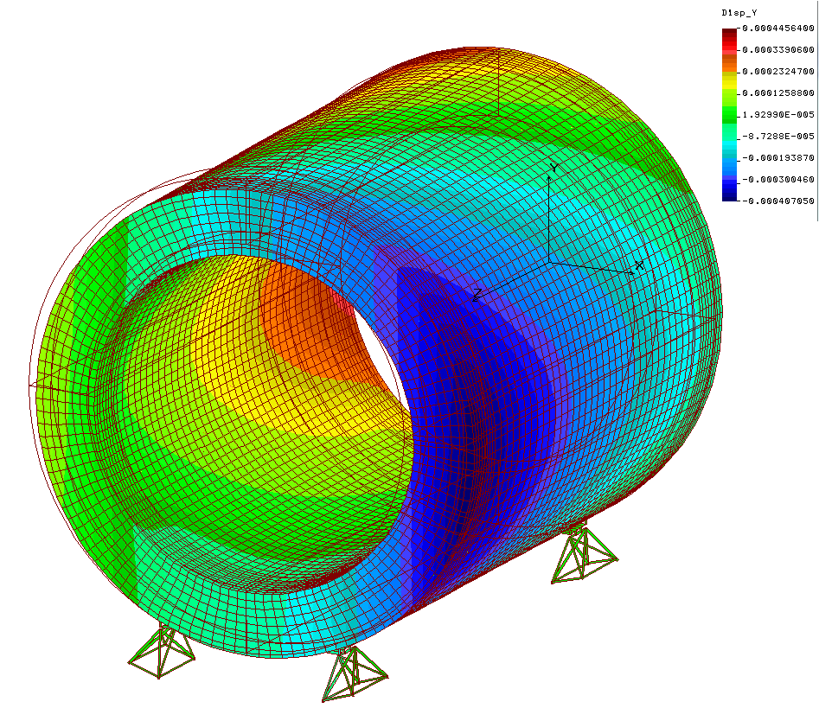
Cryostat deformity under action of magnetic forces Fx=45kN + Fz=140kN
Cryostat Support Option 1
Deformity in X direction
Deformity in Y direction
0.64
0.22
0.65
-0.18
0.23
-0.07
0.41
0.44
0.3
0.41
0.12
-0.41
0.03
0.13
0.04
-0.09
Δαmax = 0.137 mrad < [0.3 ] mrad

Slide 22
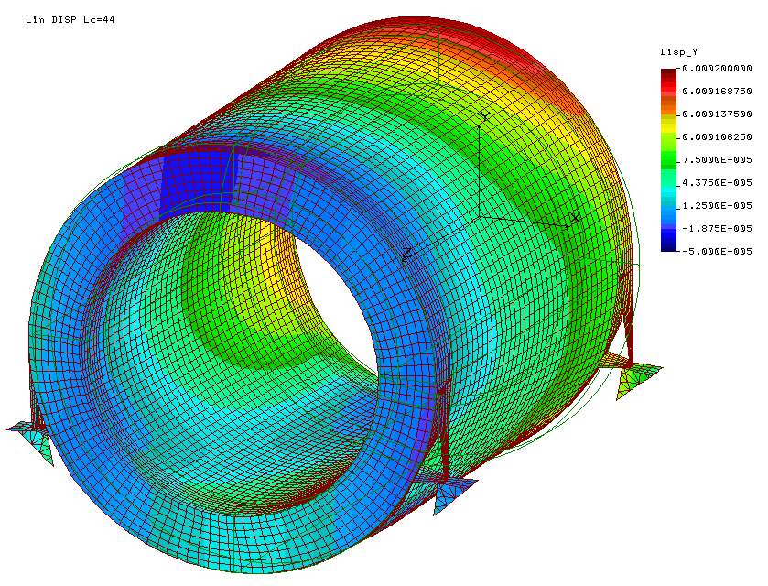
Cryostat deformity under action of magnetic forces Fx=45kN + Fz=140kN
Deformity in Y direction
Cryostat Support Option 2
0.18
-0.02
0.11
0.02
0.14
-0.01
Δαmax = 0.07 mrad
0.05
0.03

Slide 23
Cryostat support characteristics
Maximal reactions in cryostat supports (option 1)
Vertical Ry=-151kN/+47kN
Axial Rz=70kN
Lateral Rx=27kN
Maximal reactions in cryostat supports (option 2)
Vertical Ry=-105kN
Axial Rz=74kN
Lateral Rx=46kN

Slide 24
Safety Margins of the Fixation Units
 |  | η_{tension} | η_{shear} | Position | Load case
1. | Barrel bolts M24x2 | 1.7 |  | B5(W8/W1) | LC67
2. | Platform bolts M24x2 | 1.4 |  | B8P2 | LC63
3. | Cryostat support boltsM24x2 | 2.1 |  | B6CR | LC75
4. | Space frame bolts M24x2 |  | 1.9 | B7(W2/F2PL2) | LC85
5. | Door/barrel bolts M36x3 |  | 4 | B1(D1/W3) | LC64
6. | Door wings bolts M36x3 |  | 9 | B1(D11/D12) | LC83
 | η_{min=} | 1.4 |  | B8P2 | LC63

Slide 25
Main Results of Computations
The strength of the iron yoke is on a sufficient level. The yoke is able to bear loads in all regimes with minimal safety margin 1.4.
The request of muon group for increased passages for cabling has been met.
The both cryostat support design options meet the demand of the GSI/INFN colleagues. From yoke strength point of view they are virtually identical.
Main characteristics of the yoke supports are prepared for GSI Technical Specification for the rail track.

Slide 26
Design modifications based on the results of calculations
It takes to prepare design of the yoke support arrangements on the base of discussion with Boerkey people.
Door opener system has to be designed
It takes to complete design of the selected option of the cryostat support.
Barrel connection bolts are loaded by essential shear forces. Since it is difficult to provide their gapless mounting it takes some addition dowel pins to bear the shear forces in radial and axial directions.
8 bolts in barrel/platform interface bear tension/compression loads but other 12 bolts are always compressed. All bolts accept large shear forces. It takes to remove bolts which doesn’t bear tension loads and to use addition rests for shear.
Some bolts in the cryostat supports (first option of the cryostat fixation) are loaded by a small part of the vertical tension load. So it takes to remove them and to take special measures to exclude shear load on these bolts.
Vertical sag of the beam plate under action of the disc calorimeter gravity is 0.7 mm. To constrain deflection of the plate it takes a steel pad rigidly fixated to the beam plate.

Slide 27
List of interface problems to be fixed for yoke TDR finalizing
Solenoid coil tolerances v.r.t. the yoke
Attachment of the cryostat to the yoke:
  positions (coordinates) of the support points
  engineering design of the attachment units (part of the unit connected to the yoke)
  estimates of maximal loads (components of force and momentum) acting on the attachment units
Engineering design of the attachment units, loads on them (components of force and momentum) and their geometrical characteristics for fixation to the yoke:
  target production system
  target dump (also shape and dimensions of the recess for it in the lower barrel beam)
  forward EMC and disc DIRC (information taken from presentation by H.Löhner, 2009)
  backward EMC (possible interference with the door and its rails)
  cryogenic system on top of the magnet (chimney, bucket)
Additional equipment attached to the magnet from outside (fixation points, masses, possible loads and acceptable deformations):
  on the upper barrel beam (pumps, …?)
  on the lower barrel beam (optical system for the target dump control, …?)
  at the magnet side, on the platform (boxes with electronics, …?) – possible interference with the support frame that includes outer inclined beams
  muon filter – distance to the upstream magnet end cap, possibility of door opening: access to the units of the door halves fixation to each other is necessary
Final positions, shape and dimensions of recesses in the yoke for the cable passages
Limitations for the yoke parts displacements???

Slide 28
What should be done before announce the tender for the yoke
It takes:
to complete and to coordinate interfaces;
to make some design modifications based on the results of mechanical calculations and to release the final drawings;
to prepare technical specification and test manual for the yoke

