Slide 1
Roller/rail - System for PANDA
slides
View to the total PANDA-Detector
View to the iron yoke to be moved(4000 kN)
Cross-section throuht the laminated Yoke with support structure
Some details of the platform, rigid beams and roller carriage
Requirements to rails
Preliminary thoughts on rails and rollers
Sketch of a rails system
Static support system for long term position
Darmstadt, 29. August 2012, Herbert Orth

Slide 2
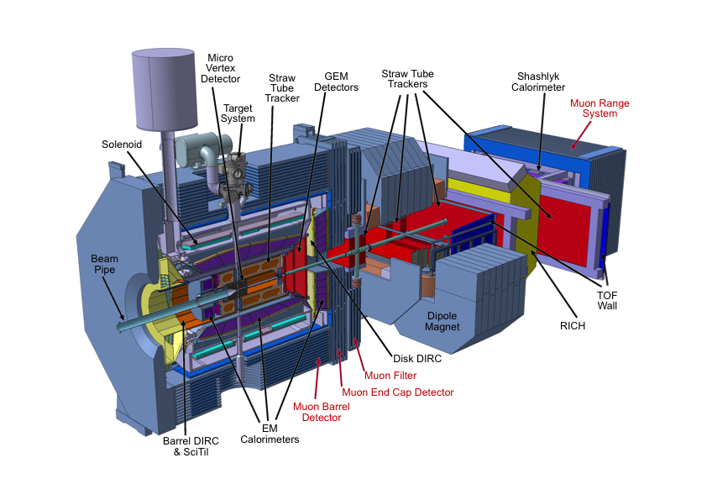
The PANDA Detector at FAIR
This solenoid needs to be moved
‘Target Spectrometer’

Slide 3
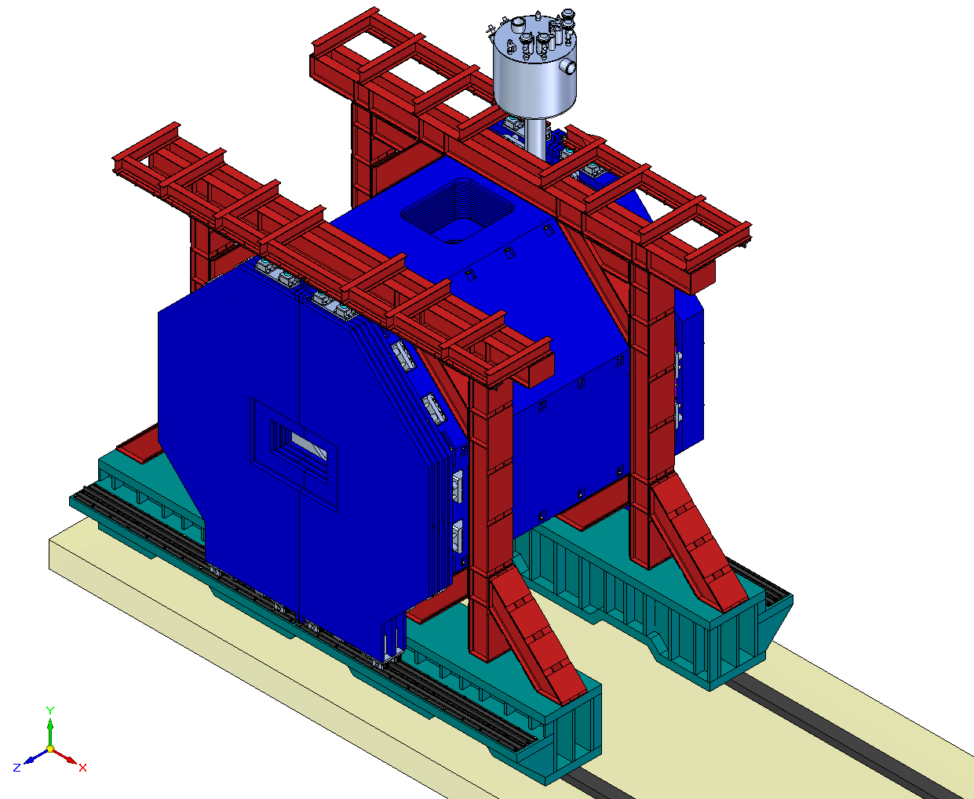
Design of the iron yoke for the Target Spectrometer (appr. 400 tons)
2 rigid beams as structural component of the yoke
Rail system based on Börkey rollers

Slide 4
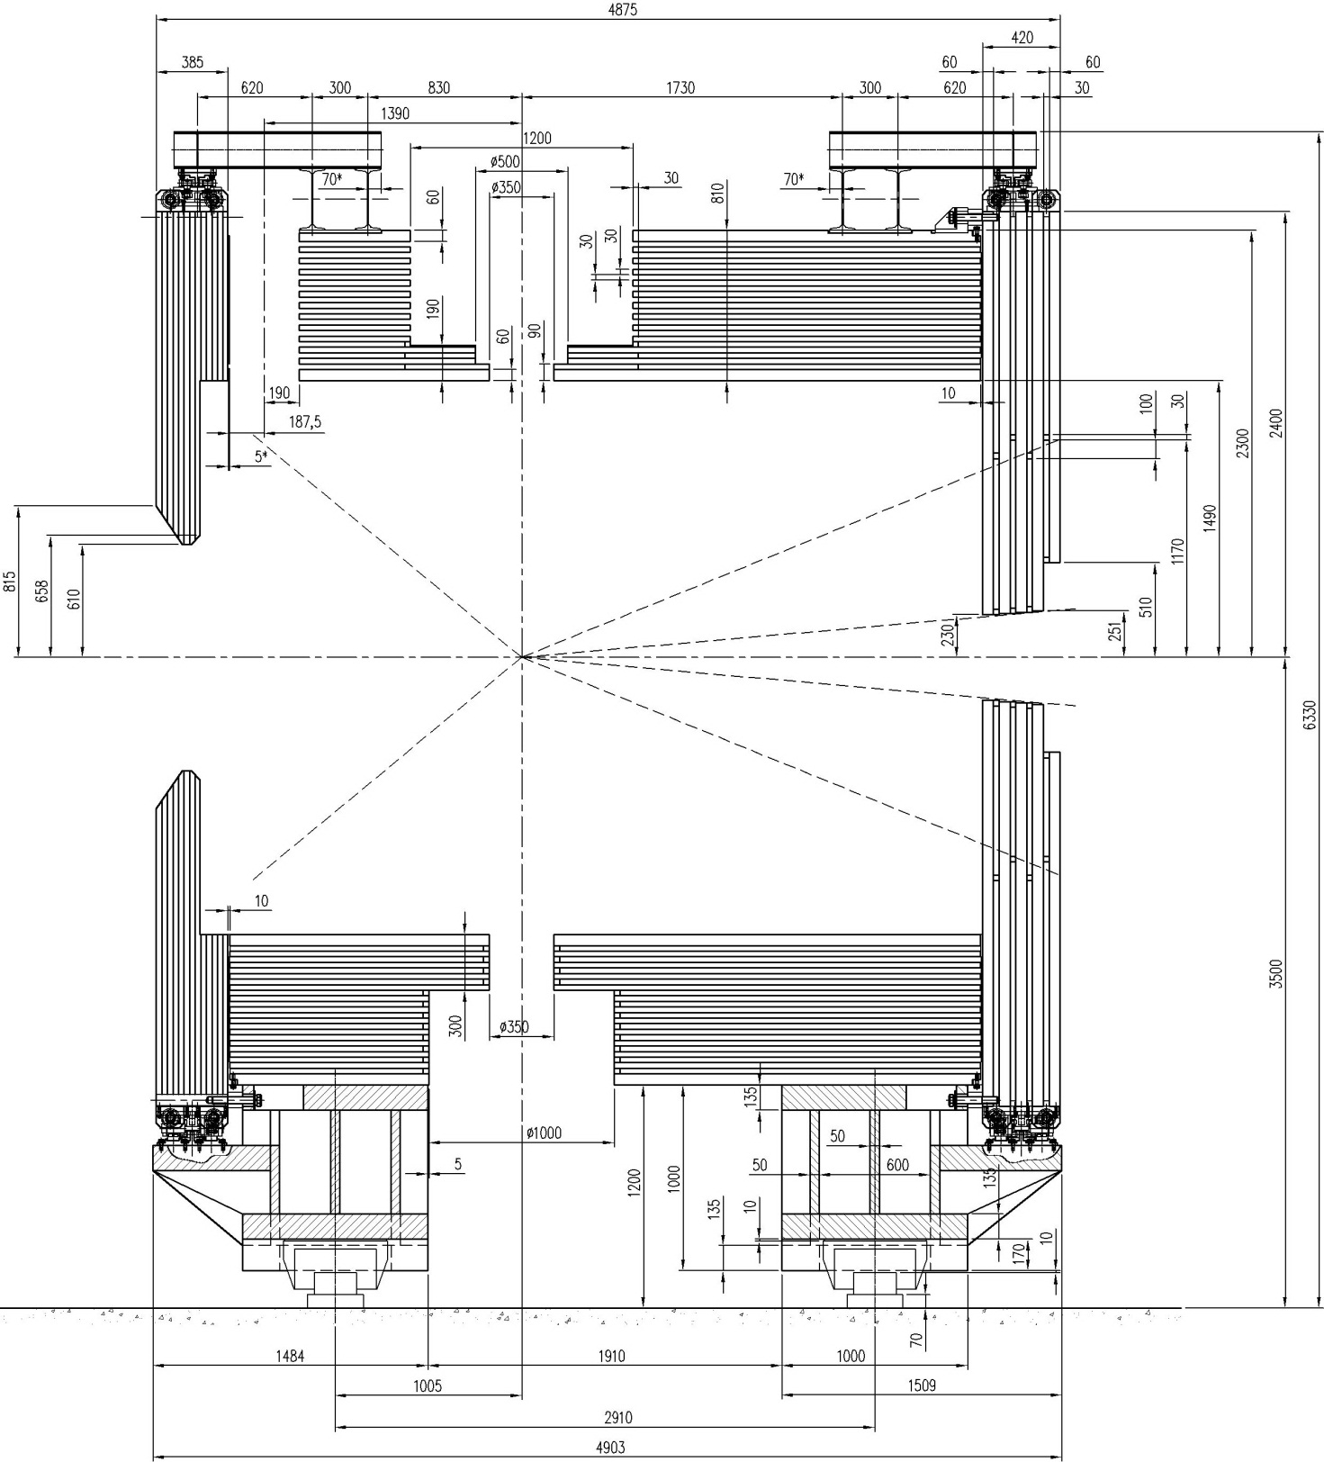
Cross-section through the laminated yoke
Rigid support beam
Roller
Rails (base plate + precision rail)

Slide 5
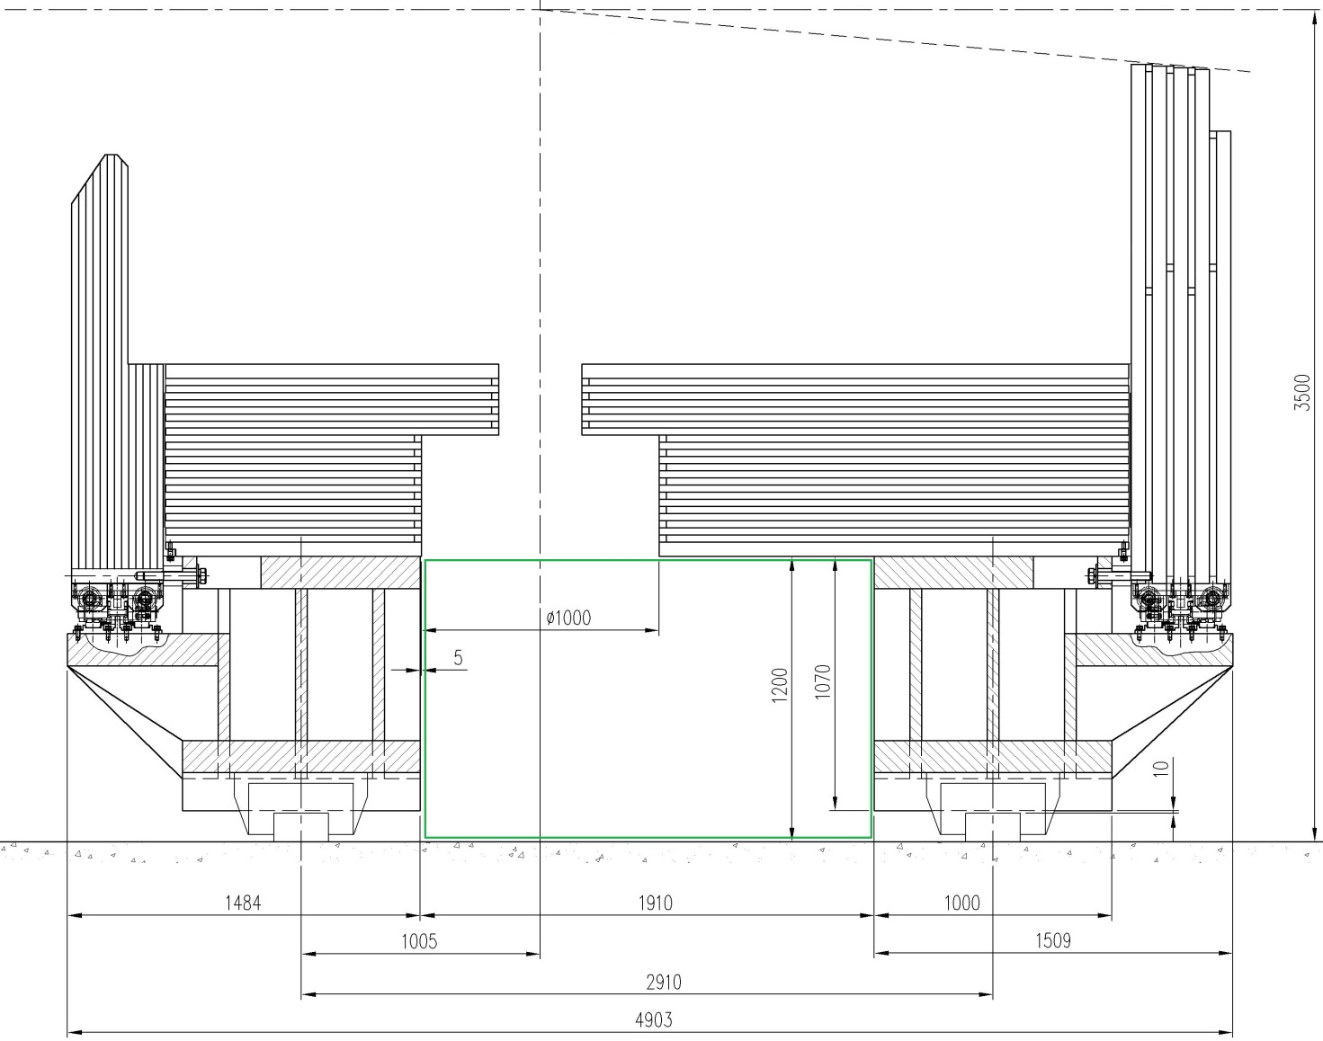
Some details of the platform, rigid beams and roller carriage

Slide 6
Requirements to the PANDA magnet transportation rails
The PANDA magnet will be transported into beam position after completion of assembly on four track-guided roller carriages placed below the platform beams. Typically once a year, a return move into parking position for detector repair/upgrade should be foreseen. The accuracy for positioning of the magnet in the beam line should be about 1 mm.
Deformations of the magnet and stresses in the detector components during the process of magnet movement should be minimized. This will be provided by keeping the magnet support beams parallel in the horizontal (XZ) and vertical (XY) planes, which sets requirements on the mutual alignment of the rails (parallelism of the rails in the both planes).
The forces for detector movement will be provided by two hydraulic cylinders attached to the platform beams on one side and to the rails on the other side by means of displaceable fixation units. The cylinders are aligned along the rail axes. The size of one step of movement will be 1.5 m at maximum. The total distance between parking position and beam position will be about 12 m. The repositioning/travel time should not exceed 10 h.

Slide 7
Preliminary thoughts on the rails and rollers
Preliminary chosen roller carriage type is Boerkey ZAS-H-FR-E Mod.Vv 300 tons (www.boerkey.com ). One carriage of this type is able to bear the loads up to 300 ton. The type of the carriages can be changed later on – it will be defined after discussions of the safety factors with the roller producer.
Dimensions of the rails are shown in fig. 1. They have been defined by the geometry of the roller carriages and their guidance rollers. The requirements to the rail surface treatment will be formulated later after discussions with the roller carriages producer.
The dimensions of the carriage roller chain footprint for mechanical computation of the rails and their fixation units are indicated in the fig.
The deviation of the vertical load on a magnet support (roller carriage) from the average (magnet weight divided on four supports) depends on the parallelism of the platform beams, which is defined by the rail track quality. When a roller carriage runs into an on-path irregularity the vertical reaction will increase up to 240 ÷ 420 kN per 1 mm of irregularity. The spread of values is defined by the uncertainty of the contact properties of the yoke barrel/doors fixation. An irregularity of 1.9 mm in height could lead to doubling of the initial load of two diagonal supports and a rail contact loss in the two other supports. The acceptable non-parallelism of the rails projected on the YX plane can be at maximum 0.2 mrad over the length of the magnet road. So maximum vertical deflection is 1 mm over 5m in any position of the rail surface.
The maximal acceptable inter-rail distance deviation in the XZ-plane is ±0.5 mm. In view of the guidance rollers/rail gaps this value corresponds to the maximal deviation of the inter-platform beam distance ±1 mm. This deviation of the inter-platform beam distance can create a maximal local load of ±175 kN applied to the rails in Z direction. This load is applied to the rails by means of guidance rollers.
The nominal distance between the rails is 2860 mm. This is the distance between the center of the roller carriages as well.
The drag force for the yoke movement will be applied to both platform beams and to both rails (we consider to have two hydraulic cylinders for magnet transportation). The maximal longitudinal force applied to a rail will be up to 5% of the detector weight. The simultaneously applied moments in the XY plane will be defined when a fixation unit of the cylinder/rail is designed.
The locations of the steady support points (2 x5 =10 pcs.) for assembly as well as in beam position are shown a fig.. We tentatively assume 5 supports under each platform beam being 10 feet altogether for the PANDA Target Spectrometer.

Slide 8
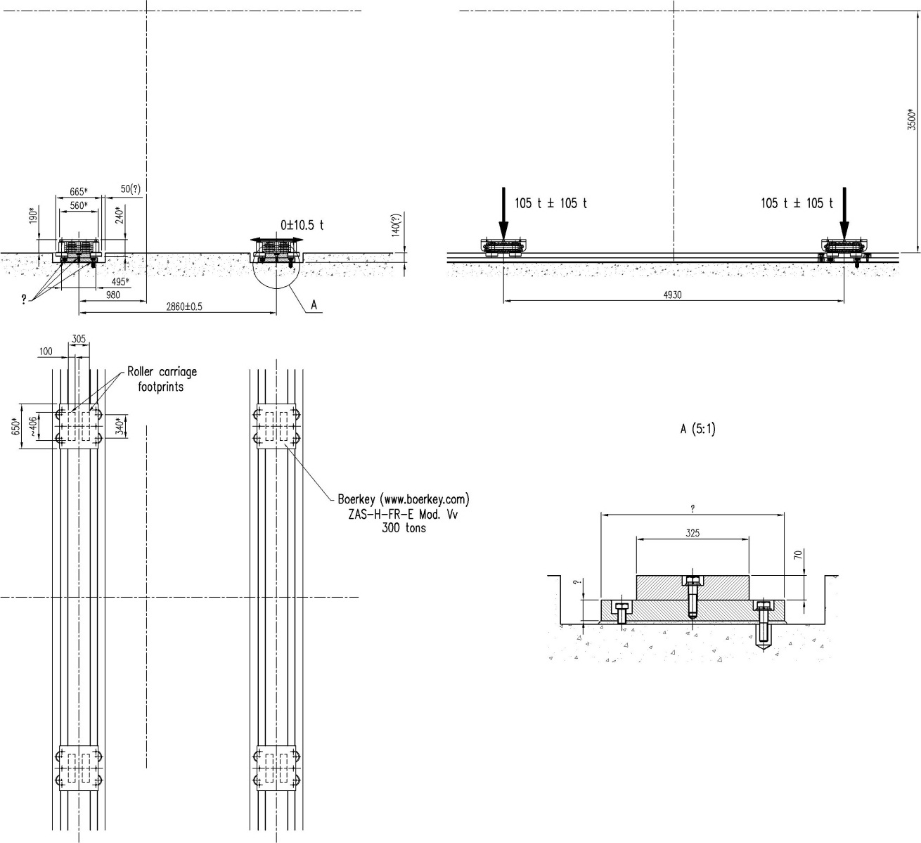
Sketch of the rail sytem
Cross-section of rails ambedded in the concrete floor

Slide 9
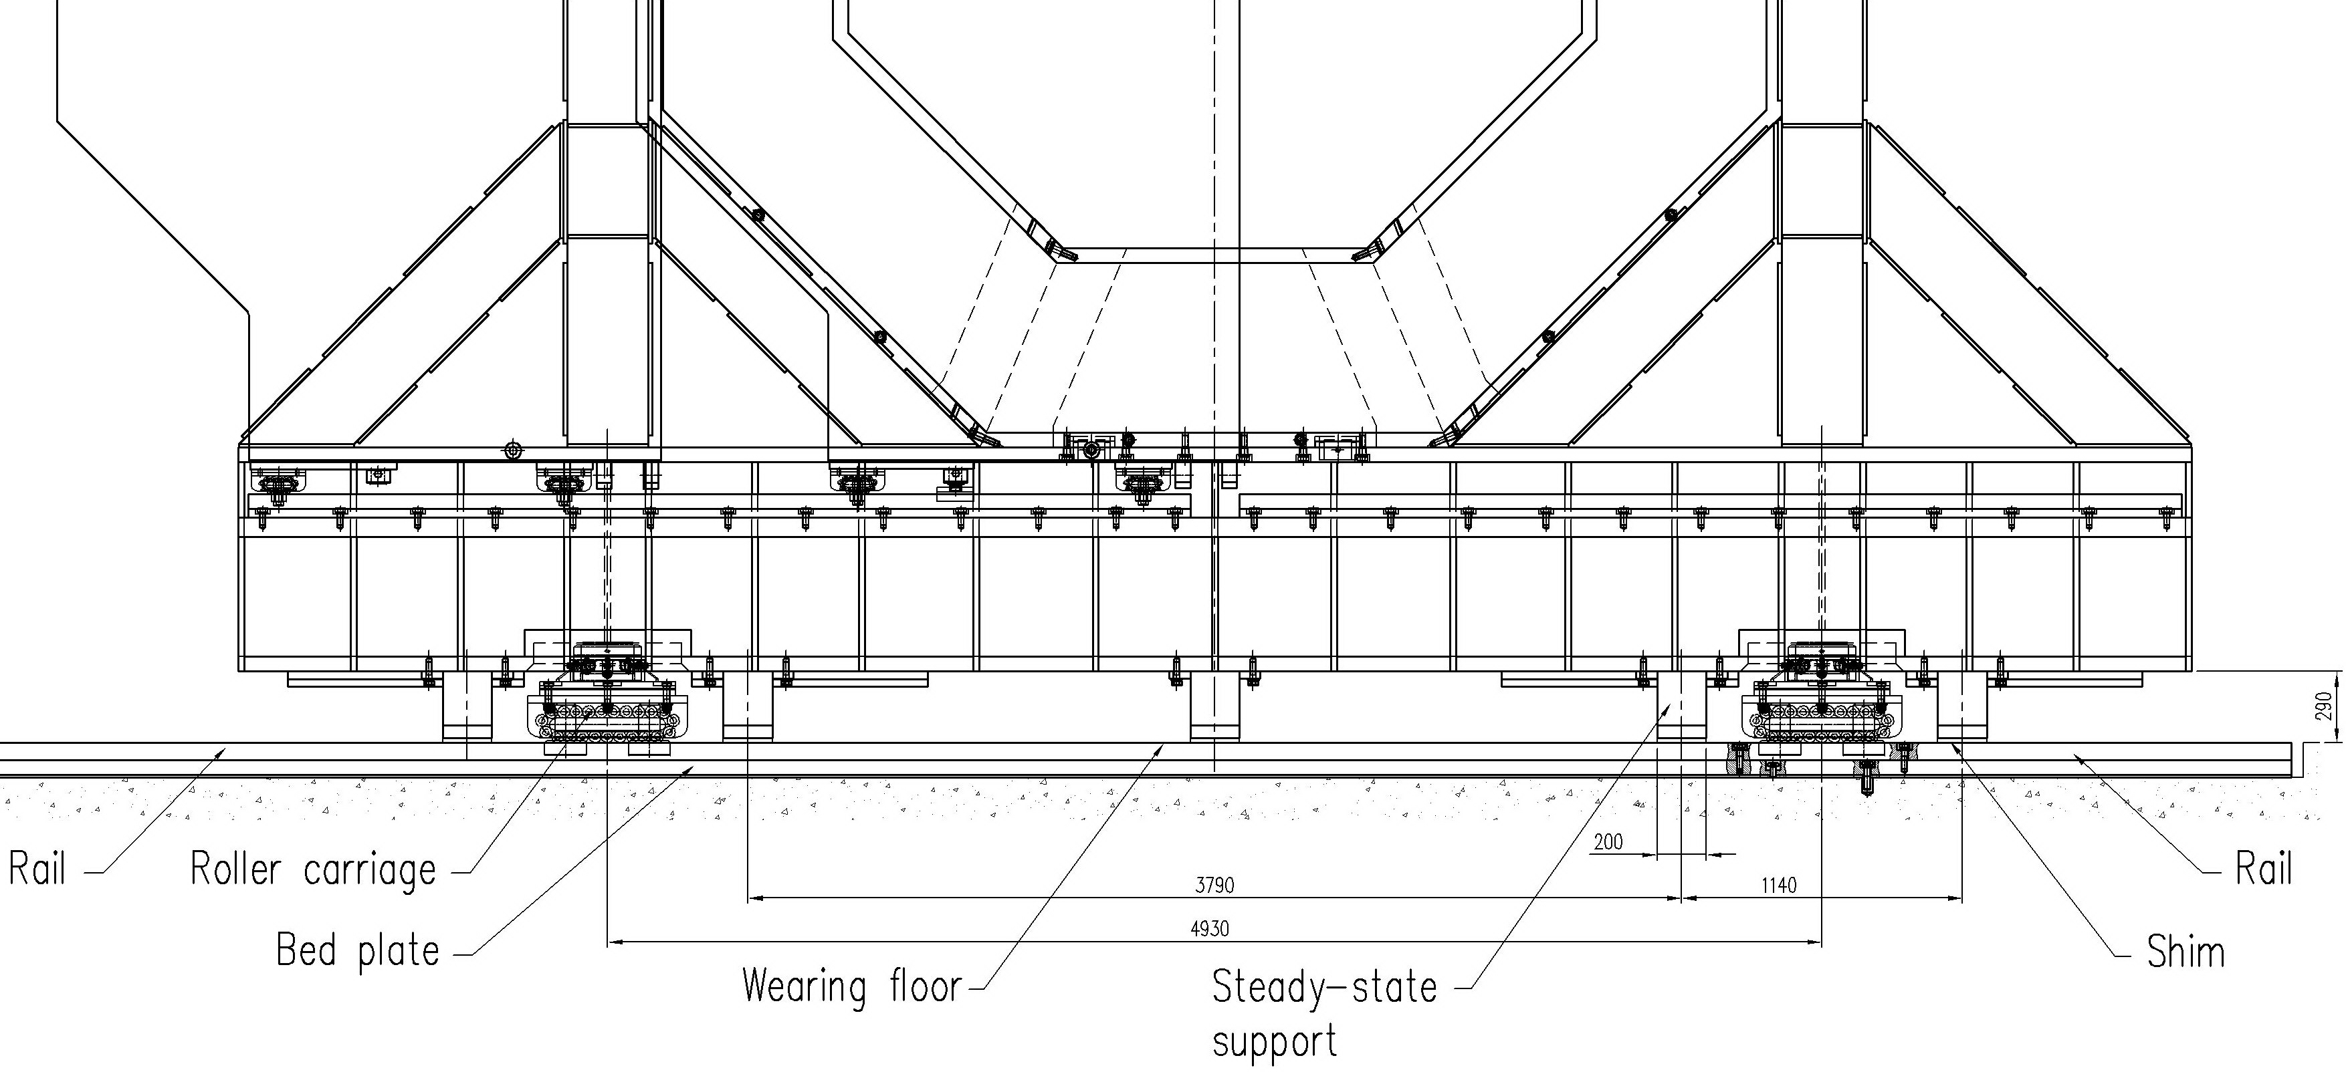

Slide 10
Rails for the Movement of the PANDA Target Spectrometer

Slide 11
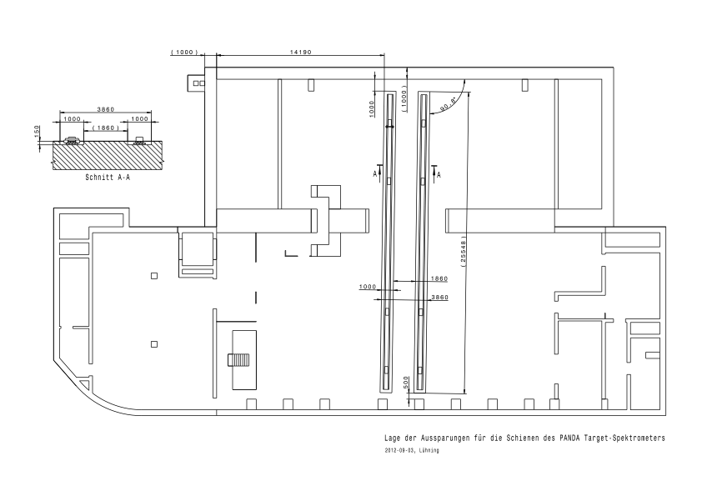
Floor Plan with TS-Tracks

Slide 12
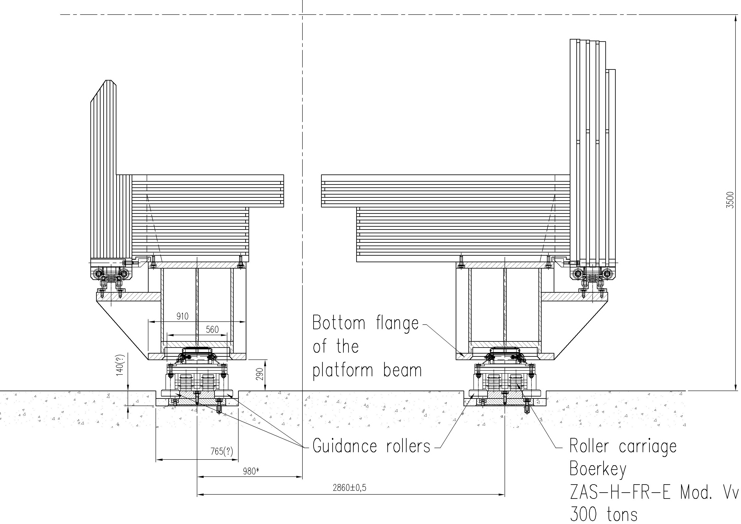

Slide 13
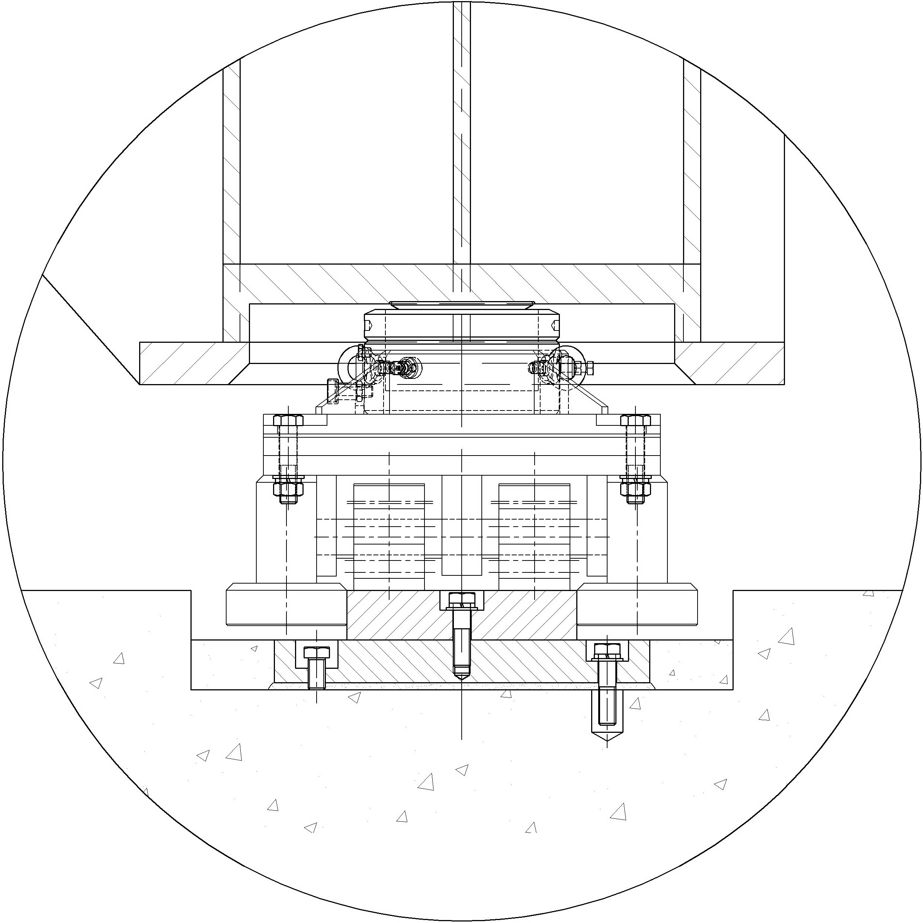
Draft design of a Roller Leg

Slide 14
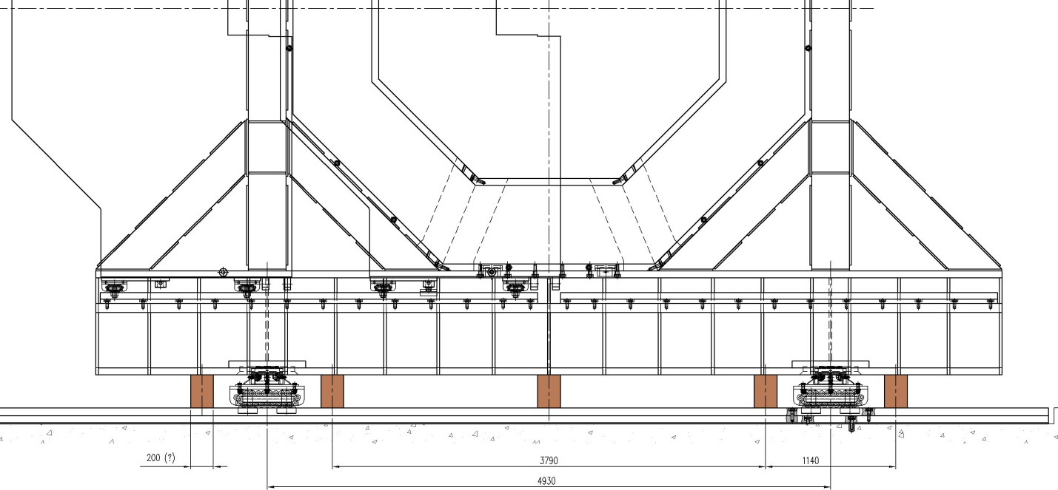
Steady supports 2 x 5 = 10 pcs. (indicated in brown)

Slide 15
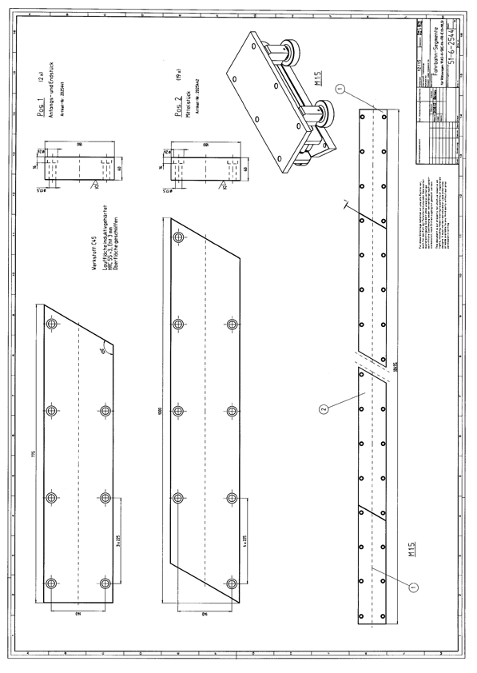

Slide 16
