Slide 1


Grant no. 12135007
Craig Roberts … http://inp.nju.edu.cn/
Insights into EHM from Studies of Hadron Structure
Notes:
25+5

Slide 2

Basic Questions in Nature …

Slide 3

Basic Questions in Nature …
… that physics might answer in the foreseeable future
What is the origin of the nuclear-physics mass scale
$m_{p}=$ proton mass
that characterises all visible matter?
Whatever it is, why is the pion seemingly oblivious?
How is this phenomenon expressed in measurable quantities?
  The expressions are (almost) certainly system specific!

Slide 4
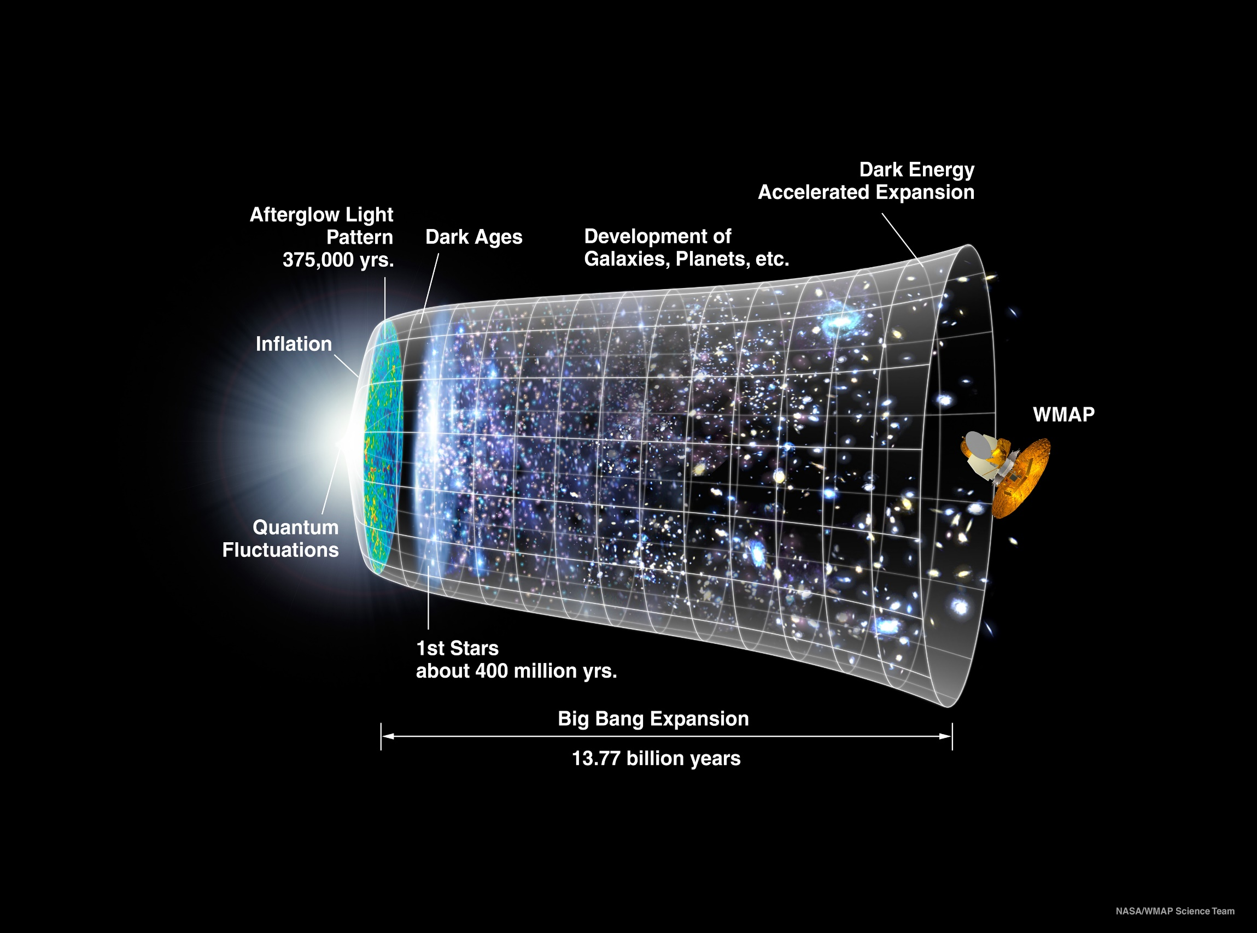
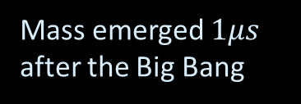
Our Universe
Mass emerged $1μs$ after the Big Bang
Its appearance was crucial to the formation of the Universe as we know it

Slide 5
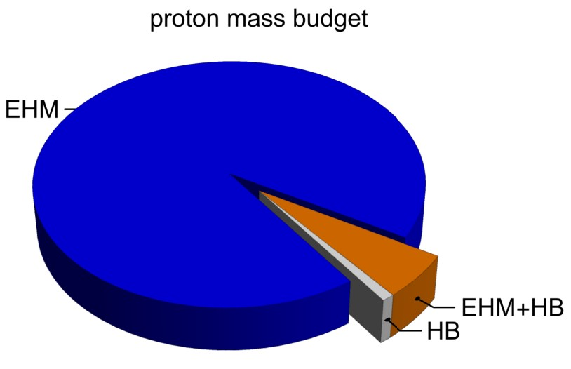
Emergence of Hadron Mass
Standard Model of Particle Physics has one obvious mass-generating mechanism
= Higgs Boson … impacts are critical to evolution of Universe as we know it
However, Higgs boson alone is responsible for just ∼ 1% of the visible mass in the Universe
Proton mass budget … only 9 MeV/939 MeV is directly from Higgs
Decomposition is
gauge invariant
Poincaré invariant
scale invariant
Evidently, Nature has another very effective mechanism for producing mass:
Emergent Hadron Mass (EHM)
  Alone, it produces 94% of the proton’s mass
  Remaining 5% is generated by constructive interference between EHM and Higgs-boson
What is the origin of EHM?

Slide 6
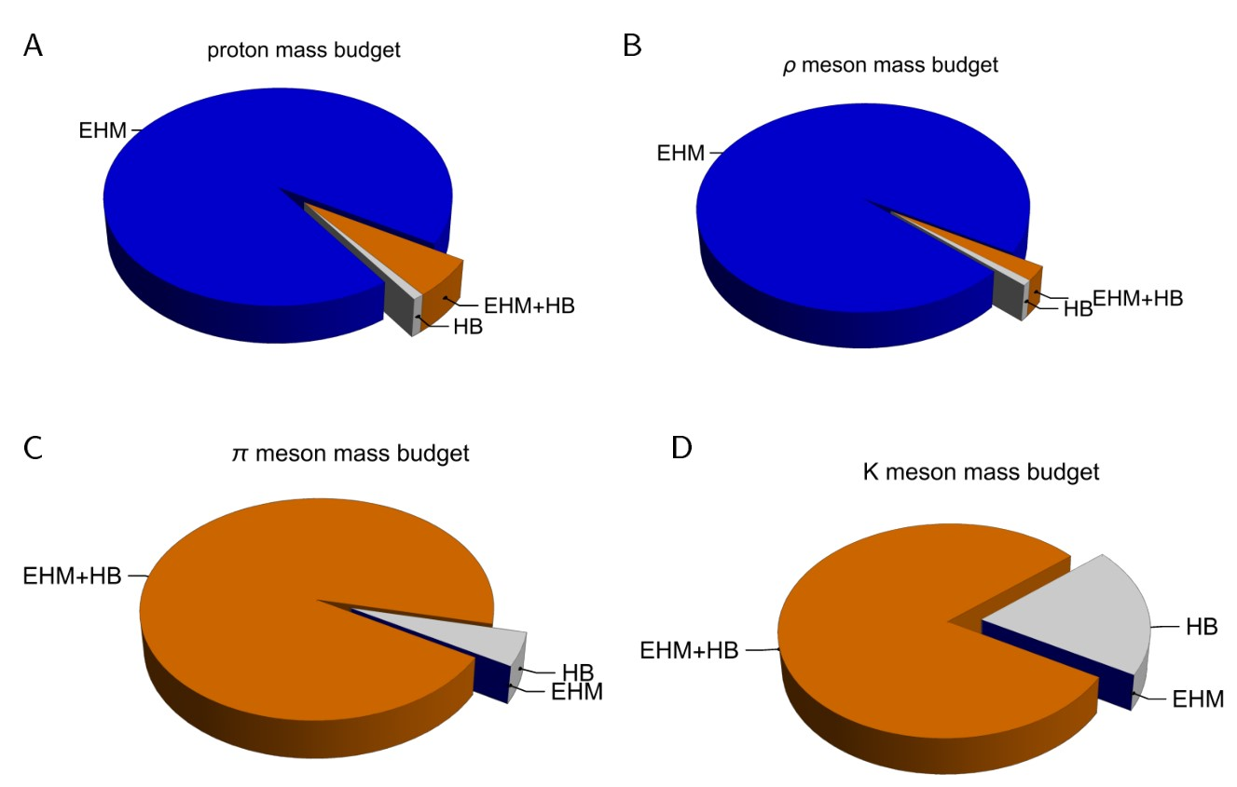
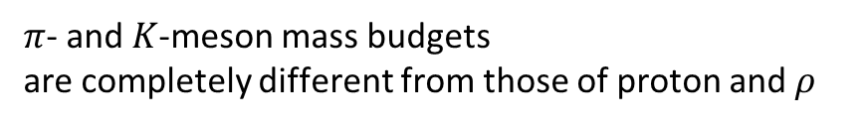
Emergence of Hadron Mass - Basic Questions
Decompositions are
gauge invariant
Poincaré invariant
scale invariant
What is the origin of EHM?
Does QCD explain EHM?
What are EHM’s connections with …
  Gluon and quark confinement?
  Dynamical chiral symmetry breaking (DCSB)?
  Nambu-Goldstone modes = π & K?
What is the role of Higgs in modulating EHM expressions in observable properties of hadrons?
  Without Higgs mechanism of mass generation, π and K would be indistinguishable
What and wherefrom is mass?
Proton and $ρ$-meson mass budgets are practically identical
$π$- and $K$-meson mass budgets
are completely different from those of proton and $ρ$

Slide 7
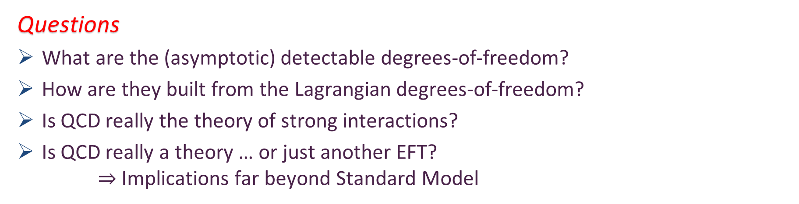
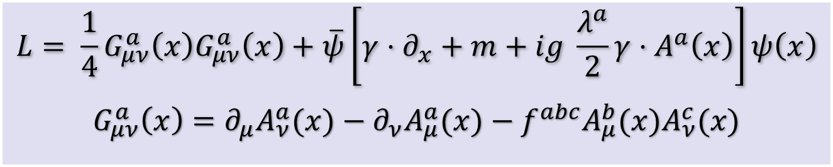
Quantum Chromodynamics
$$L= \frac{1}{4}G_{μν}^{a}\left(x\right)G_{μν}^{a}\left(x\right)+\overline{ψ}\left[γ⋅∂_{x}+m+ig \frac{λ^{a}}{2}γ⋅A^{a}\left(x\right)\right]ψ\left(x\right)$$
$$G_{μν}^{a}\left(x\right)=∂_{μ}A_{ν}^{a}(x)−∂_{ν}A_{μ}^{a}(x)−f^{abc}A_{μ}^{b}{(x)A}_{ν}^{c}(x)$$
One-line Lagrangian – expressed in terms of gluon and quark partons
Which are NOT the degrees-of-freedom measured in detectors
Questions
What are the (asymptotic) detectable degrees-of-freedom?
How are they built from the Lagrangian degrees-of-freedom?
Is QCD really the theory of strong interactions?
Is QCD really a theory … or just another EFT?
$⇒$ Implications far beyond Standard Model

Slide 8


In the Beginning…

Slide 9
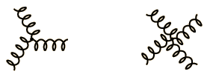
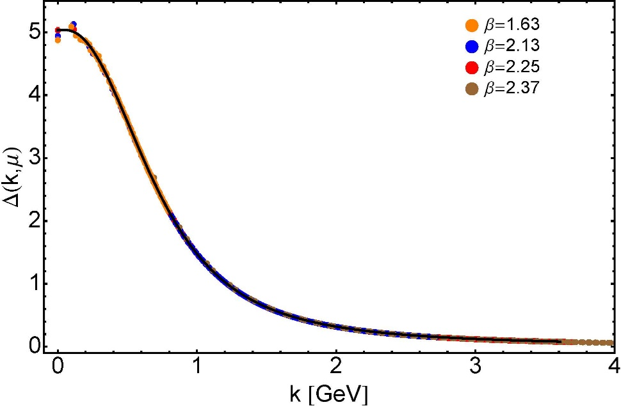


Modern Understanding
Grew Slowly from Ancient Origins
$≈$ 45 years ago
  Dynamical mass generation in continuum quantum chromodynamics,
  J.M. Cornwall, Phys. Rev. D 26 (1981) 1453 … $>1100$ citations
Owing to strong self-interactions, gluon partons $⇒$ gluon quasiparticles,
described by a mass function that is large at infrared momenta
3-gluon vertex
4-gluon vertex
$$\frac{1}{m_{g}^{2}}$$
Truly mass from nothing
An interacting theory, written in terms of massless gluon fields, produces dressed gluon fields that are characterised by a mass function that is large at infrared momenta
Gluon propagator … continuum and lattice QCD agree
QCD fact
Continuum theory and lattice simulations agree
Empirical verification?

Slide 10


Modern Understanding
Grew Slowly from Ancient Origins
D. Binosi, Emergent Hadron Mass in Strong Dynamics, Few Body Syst. 63 (2022) 42.
M. N. Ferreira, J. Papavassiliou, Gauge Sector Dynamics in QCD, Particles 6 (1) (2023) 312–363.
EHM means
Gluons are massive via Schwinger Mechanism
More than 40 years ago
  Dynamical mass generation in continuum quantum chromodynamics,
  J.M. Cornwall, Phys. Rev. D 26 (1981) 1453 … $∼1050$ citations
Owing to strong self-interactions, gluon partons $⇒$ gluon quasiparticles,
described by a mass function that is large at infrared momenta
3-gluon vertex
4-gluon vertex
$$\frac{1}{m_{g}^{2}}$$
Truly mass from nothing
An interacting theory, written in terms of massless gluon fields, produces dressed gluon fields that are characterised by a mass function that is large at infrared momenta
Gluon propagator … continuum and lattice QCD agree
QCD fact
Continuum theory and lattice simulations agree
Empirical verification?

Slide 11

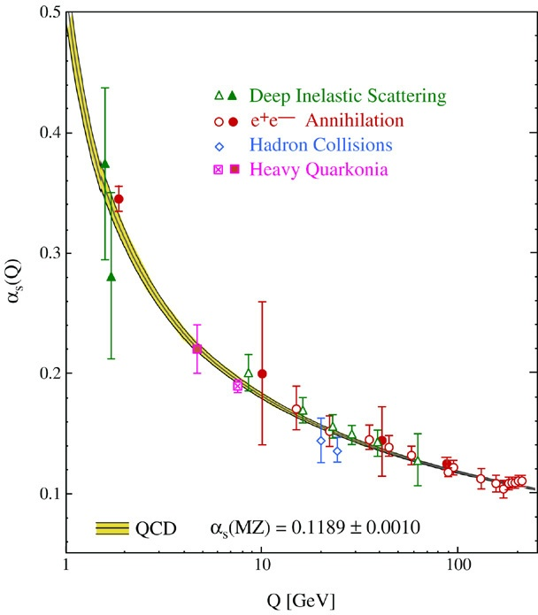
QCD’s Running Coupling
This is where we live
Asymptotic Freedom
Interaction becomes weaker
as energy grows
(as charges get closer together)
⇐
What’s happening
out here?!

Slide 12
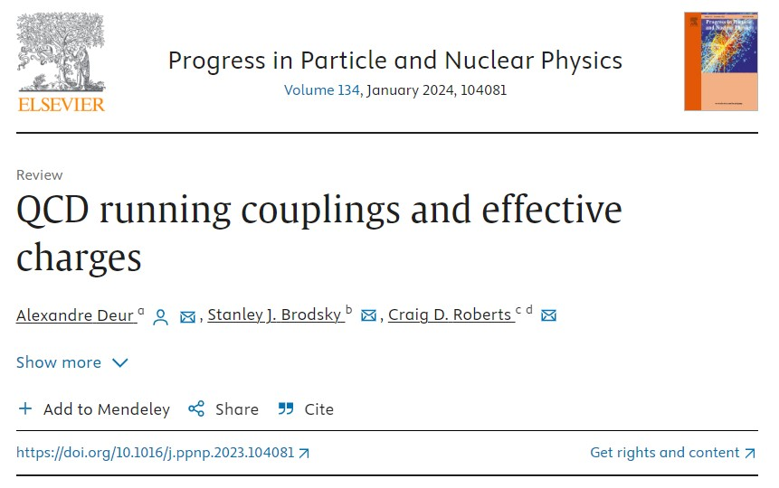
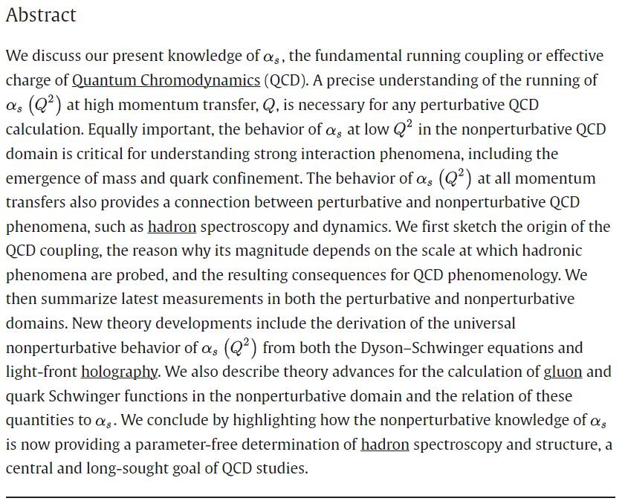

Slide 13

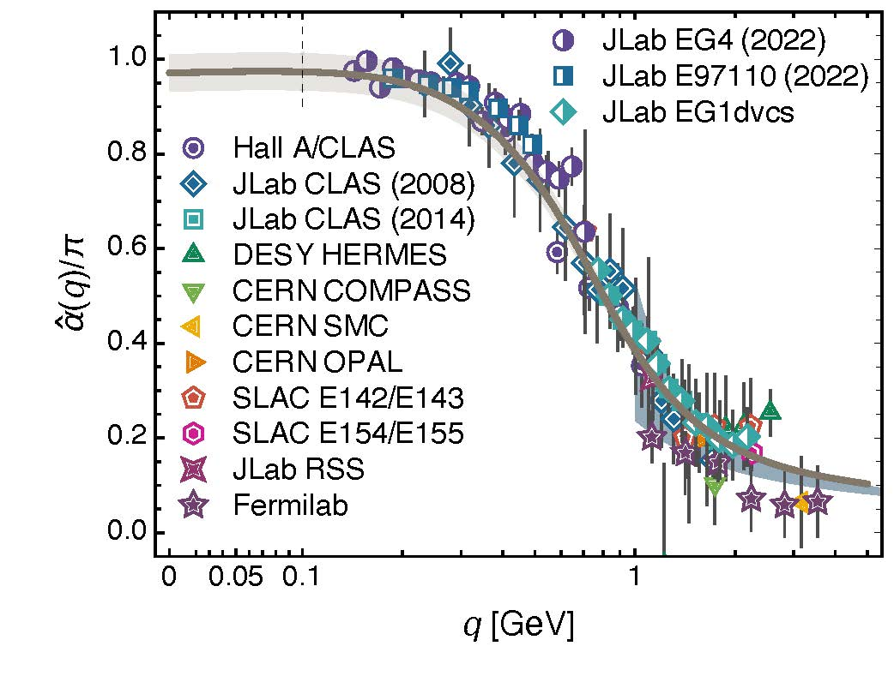
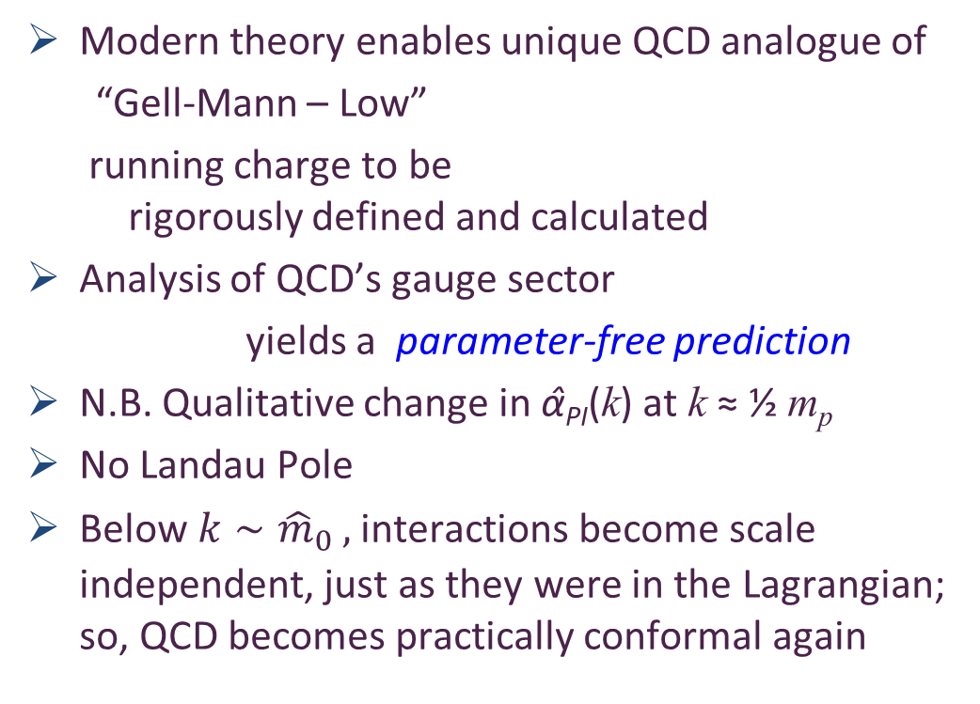

Process independent effective charge = running coupling
W orkshop on Dyson-Schwinger Equations in Modern Mathematics
and Physics (DSEMP2014) Trento, Italy, September 22-26, 2014
Effective charge from lattice QCD, Zhu-Fang Cui, Jin-Li Zhang et al.,
NJU-INP 014/19, arXiv:1912.08232 [hep-ph], Chin. Phys. C 44 (2020) 083102/1-10
$2560$ total downloads
Modern theory enables unique QCD analogue of
“Gell-Mann – Low”
  running charge to be
  rigorously defined and calculated
Analysis of QCD’s gauge sector
  yields a parameter-free prediction
N.B. Qualitative change in α̂_{PI}(k) at k ≈ ½ m_{p}
No Landau Pole
Below $k∼{{\hat{m}}_{0}}_{ },$interactions become scale independent, just as they were in the Lagrangian; so, QCD becomes practically conformal again
Process independent strong running coupling
Daniele Binosi et al., arXiv:1612.04835 [nucl-th], Phys. Rev. D 96 (2017) 054026/1-7
Experimental determination of the QCD effective charge α_{g1}(Q).
A. Deur; V. Burkert; J.-P. Chen; W. Korsch, Particles 5 (2022) 171
QCD Running Couplings and Effective Charges, Alexandre Deur, Stanley J. Brodsky and Craig Roberts, e-Print: 2303.00723 [hep-ph], Prog. Part. Nucl. Phys. 134 (2024) 104081

Slide 14
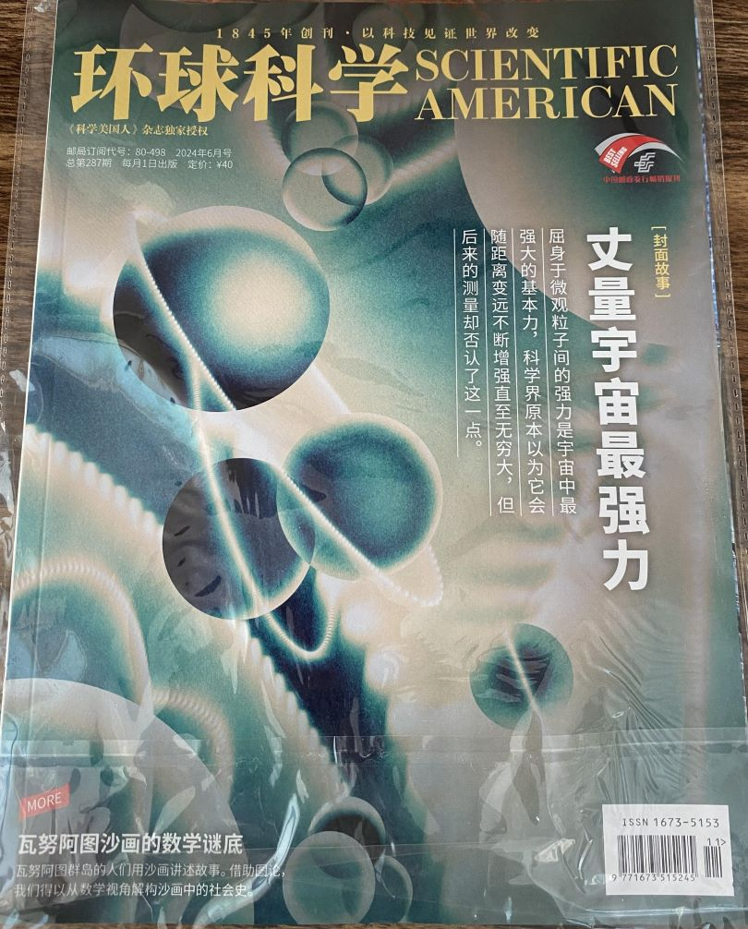

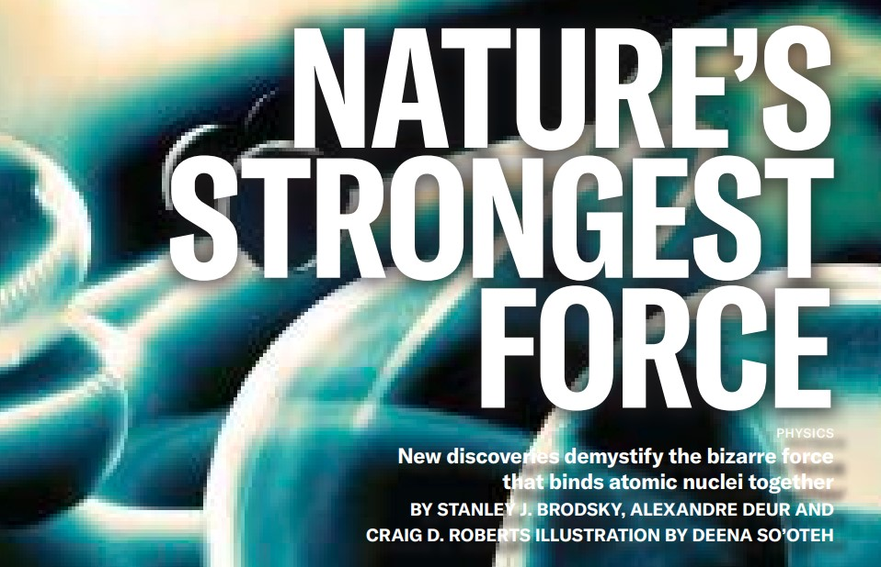

Process independent effective charge = running coupling
W orkshop on Dyson-Schwinger Equations in Modern Mathematics
and Physics (DSEMP2014) Trento, Italy, September 22-26, 2014
Effective charge from lattice QCD, Zhu-Fang Cui, Jin-Li Zhang et al.,
NJU-INP 014/19, arXiv:1912.08232 [hep-ph], Chin. Phys. C 44 (2020) 083102/1-10
$2560$ total downloads
Modern theory enables unique QCD analogue of
“Gell-Mann – Low”
  running charge to be
  rigorously defined and calculated
Analysis of QCD’s gauge sector
  yields a parameter-free prediction
N.B. Qualitative change in α̂_{PI}(k) at k ≈ ½ m_{p}
No Landau Pole
Below $k∼{{\hat{m}}_{0}}_{ },$interactions become scale independent, just as they were in the Lagrangian; so, QCD becomes practically conformal again
May 2024
Process independent strong running coupling
Daniele Binosi et al., arXiv:1612.04835 [nucl-th], Phys. Rev. D 96 (2017) 054026/1-7
Experimental determination of the QCD effective charge α_{g1}(Q).
A. Deur; V. Burkert; J.-P. Chen; W. Korsch, Particles 5 (2022) 171
QCD Running Couplings and Effective Charges, Alexandre Deur, Stanley J. Brodsky and Craig Roberts, e-Print: 2303.00723 [hep-ph], Prog. Part. Nucl. Phys. 134 (2024) 104081

Slide 15
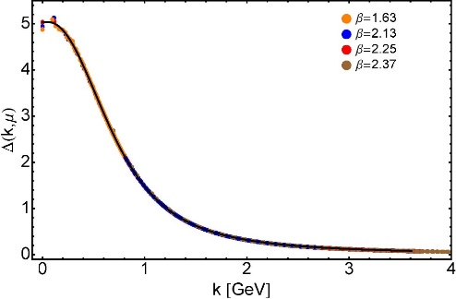

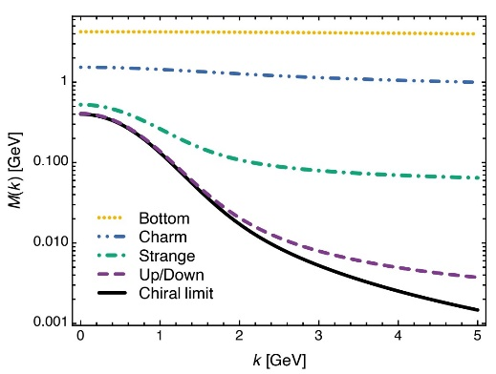
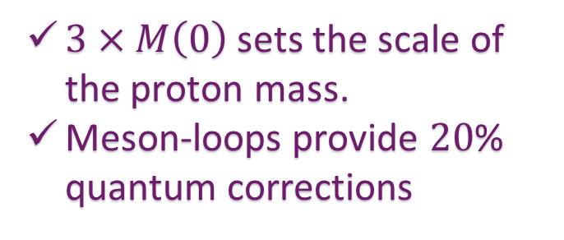
EHM Basics
Can’t build a Theory of Everything
before status of QCD is decided
Absent Higgs boson couplings, QCD Lagrangian is scale invariant
Yet …
  Massless gluons become massive
  A momentum-dependent charge is produced
  Massless quarks become massive
EHM is expressed in
    EVERY strong interaction observable
Challenge to Theory =
    Elucidate all observable consequences of these phenomena
    and highlight the paths to measuring them
Challenge to Experiment =
    Test the theory predictions so that
    the boundaries of the Standard Model can finally be drawn
Three pillars of EHM
$3×M\left(0\right)$ sets the scale of the proton mass.
Meson-loops provide $20$% quantum corrections

Slide 16






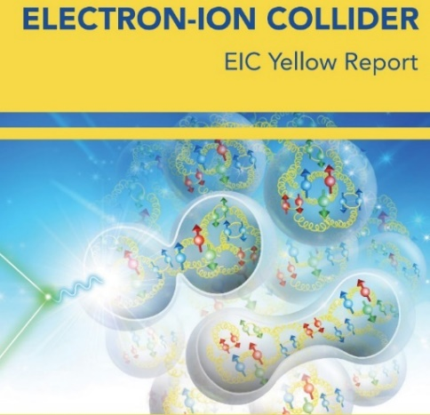

Charting EHM using
High Intensity, High Luminosity Facilities

Slide 17


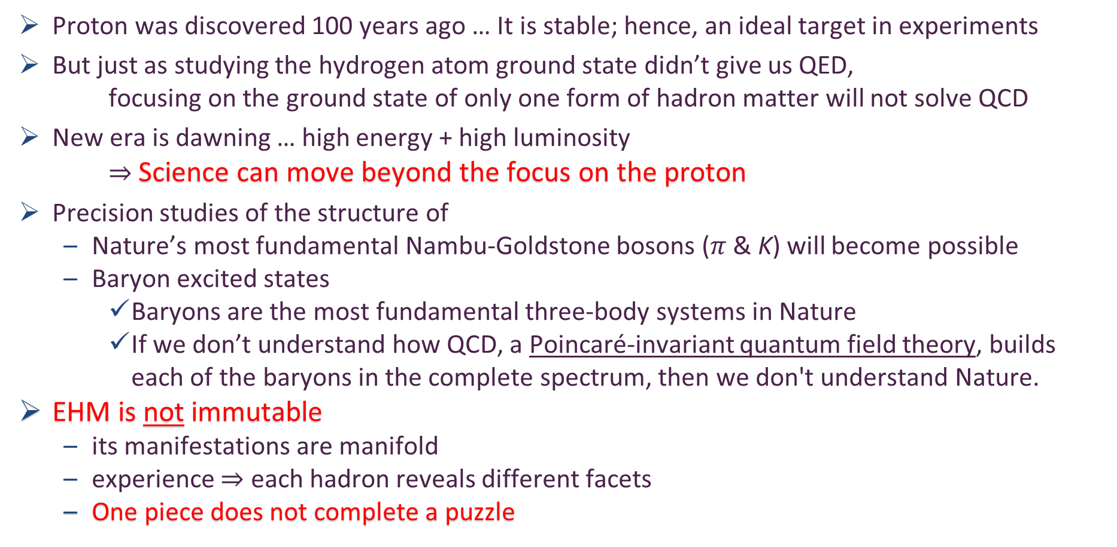
Charting EHM
Proton was discovered 100 years ago … It is stable; hence, an ideal target in experiments
But just as studying the hydrogen atom ground state didn’t give us QED,
focusing on the ground state of only one form of hadron matter will not solve QCD
New era is dawning … high energy + high luminosity
$⇒$ Science can move beyond the focus on the proton
Precision studies of the structure of
  Nature’s most fundamental Nambu-Goldstone bosons ($π$ & K) will become possible
  Baryon excited states
    Baryons are the most fundamental three-body systems in Nature
    If we don’t understand how QCD, a Poincaré-invariant quantum field theory, builds each of the baryons in the complete spectrum, then we don't understand Nature.
EHM is not immutable
  its manifestations are manifold
  experience $⇒$ each hadron reveals different facets
  One piece does not complete a puzzle
QCD @ FAIR
AMBER @ CERN
EIC
EicC & SCT & CEPC
JLab12 & JLab20+

Slide 18
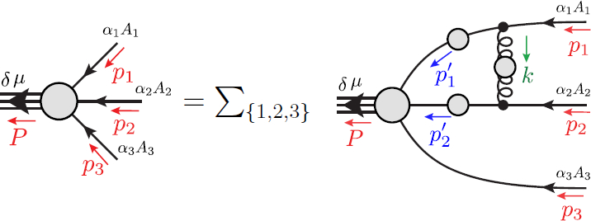
Faddeev Equation for Baryons
Nucleon mass from a covariant three-quark Faddeev equation, G. Eichmann et al., Phys. Rev. Lett. 104 (2010) 201601
Nucleon charge and magnetisation distributions: flavour separation and zeroes, Zhao-Qian Yao et al., e-Print: 2403.08088 [hep-ph]
Nucleon Gravitational Form Factors, Z.-Q. Yao et al., NJU-INP 091/24, e-Print: 2409.15547 [hep-ph]

Slide 19
Structure of Baryons
Poincaré covariant Faddeev equation sums all possible exchanges and interactions that can take place between three dressed-quarks
Direct solution of Faddeev equation using rainbow-ladder truncation is now possible … remains a challenging numerical problem

Slide 20
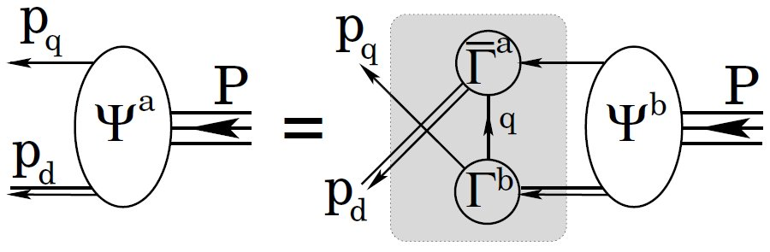
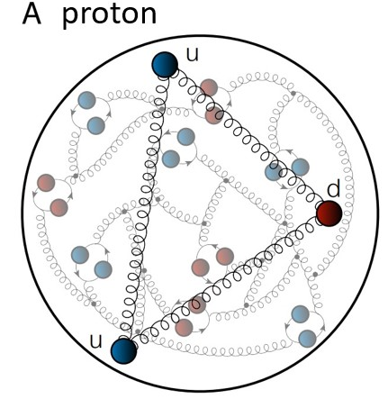
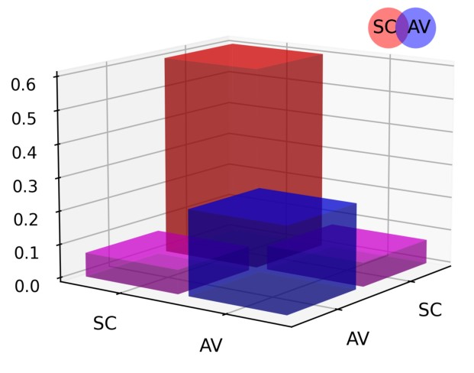
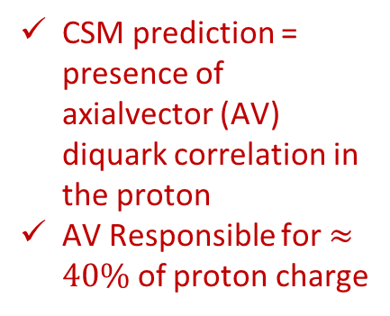
Structure of Baryons
Solution delivers
Poincaré-covariant
proton wave function
Poincaré covariant Faddeev equation sums all possible exchanges and interactions that can take place between three dressed-quarks
Evidently, direct solution of Faddeev equation using rainbow-ladder truncation is now possible … remains a challenging numerical problem
For many applications, diquark approximation to quark + quark scattering kernel is used
Prediction: owing to EHM phenomena, strong diquark correlations exist within baryons
  proton and neutron … both scalar and axial-vector diquarks are present
CSM prediction = presence of axialvector (AV) diquark correlation in the proton
AV Responsible for $≈40\%$ of proton charge

Slide 21
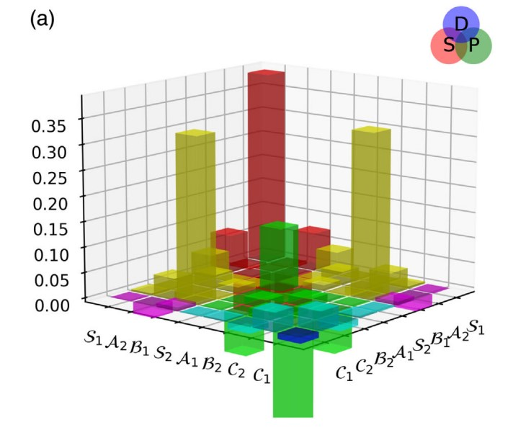

Structure of Baryons
Solution delivers
Poincaré-covariant
proton wave function
Poincaré covariant Faddeev equation sums all possible exchanges and interactions that can take place between three dressed-quarks
Direct solution of Faddeev equation using rainbow-ladder truncation is now possible, but numerical challenges remain
For many applications, diquark approximation to quark+quark scattering kernel is used
Prediction: owing to EHM:
proton wave function is not just S-wave, but contains strong P-wave contributions
baryon wave functions
necessarily contain
orbital angular momentum
CSM prediction = canonical normalization dominated by $S⊗S$, but receives large $S⊗P$ and $P⊗P$
contributions
Non-$S⊗S$make-up 6$0\%$ of proton charge

Slide 22
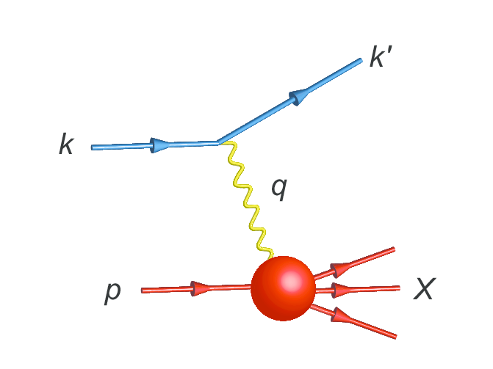
Parton Distribution Functions

Slide 23
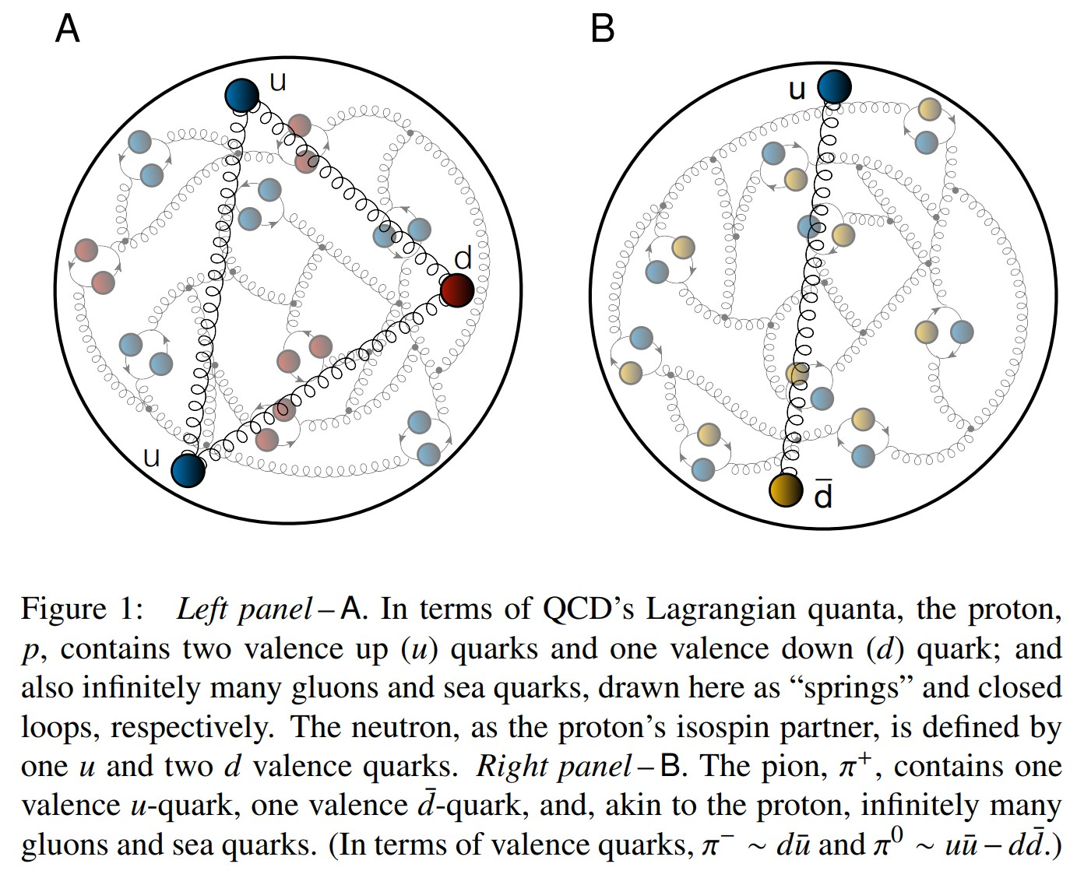
Proton and pion distribution functions in counterpoint
massive
almost massless
Today, despite enormous expense of time and effort, much must still be learnt before proton and pion structure may be considered understood in terms of DFs
Most simply –
  What are the differences, if any, between the distributions of partons within the proton and the pion?
The question of similarity/difference between proton and pion DFs has particular resonance today as science seeks to explain EHM
How are obvious macroscopic differences between protons and pions expressed in the structural features of these two bound-states?
proton
pion

Slide 24
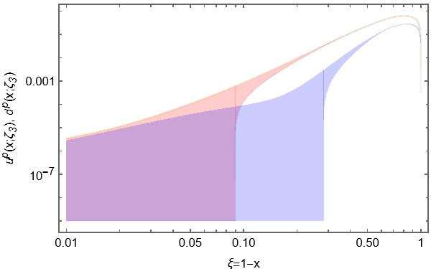
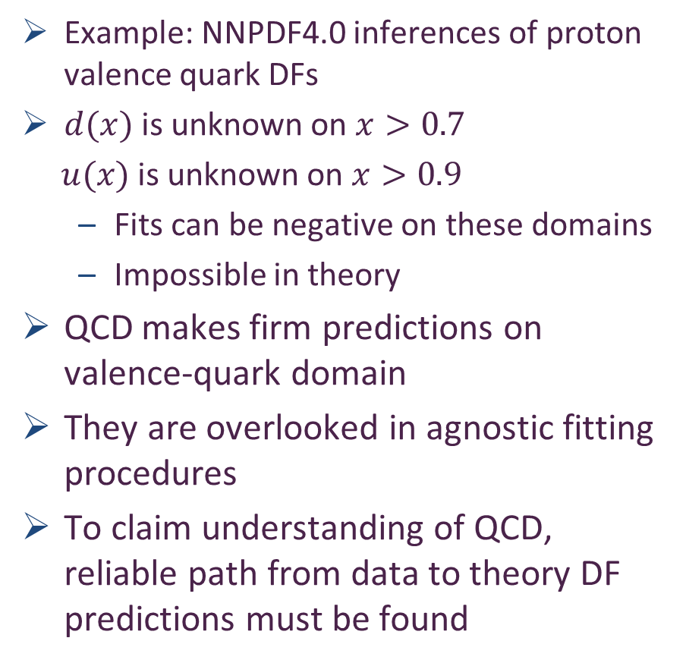
Phenomenology – global fits – of proton valence quark DFs
Example: NNPDF4.0 inferences of proton valence quark DFs
$d(x)$ is unknown on $x>0.7$
$u(x)$ is unknown on $x>0.9$
  Fits can be negative on these domains
  Impossible in theory
QCD makes firm predictions on valence-quark domain
They are overlooked in agnostic fitting procedures
To claim understanding of QCD, reliable path from data to theory DF predictions must be found
Far valence domain

Slide 25
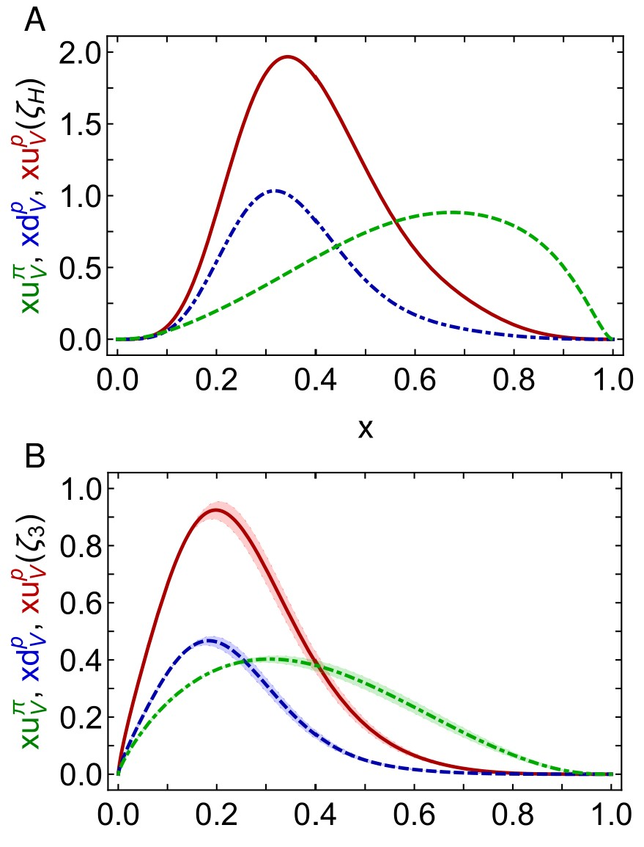

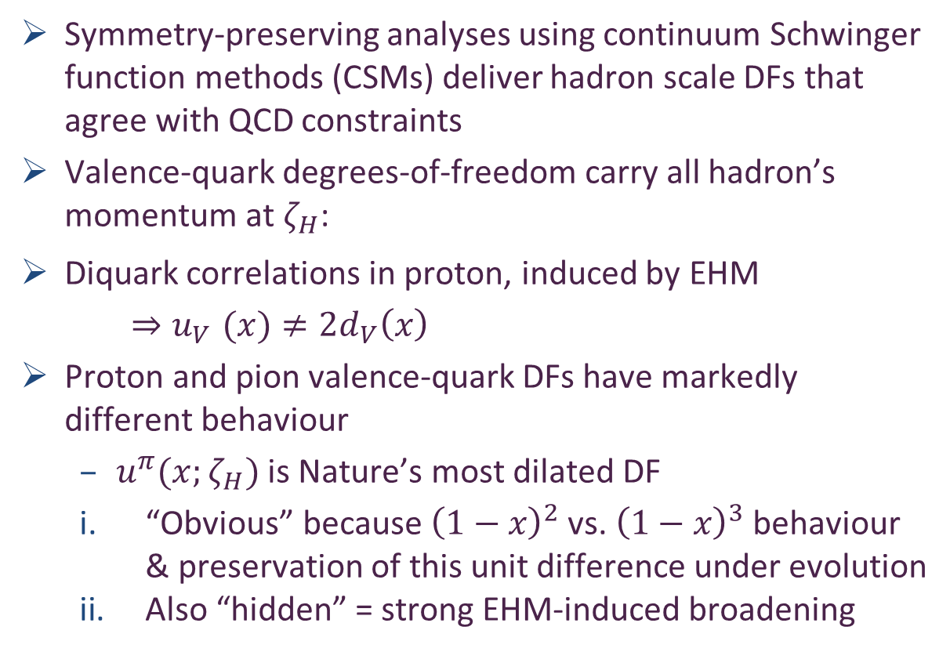
Proton and pion distribution functions in counterpoint
Proton and pion distribution functions in counterpoint, Ya Lu (陆亚) et al.,
NJU-INP 056/22, e-Print: 2203.00753 [hep-ph], Phys. Lett. B 830 (2022) 137130
Symmetry-preserving analyses using continuum Schwinger function methods (CSMs) deliver hadron scale DFs that agree with QCD constraints
Valence-quark degrees-of-freedom carry all hadron’s momentum at $ζ_{H}$:
Diquark correlations in proton, induced by EHM
    ${⇒u}_{V}(x)≠2d_{V}\left(x\right)$
Proton and pion valence-quark DFs have markedly different behaviour
  $u^{π}(x;ζ_{H})$ is Nature’s most dilated DF
  “Obvious” because ${\left(1−x\right)}^{2}$ vs. ${\left(1−x\right)}^{3}$ behaviour & preservation of this unit difference under evolution
  Also “hidden” = strong EHM-induced broadening
dilation
u in proton
d in proton
u in pion
dilation

Slide 26
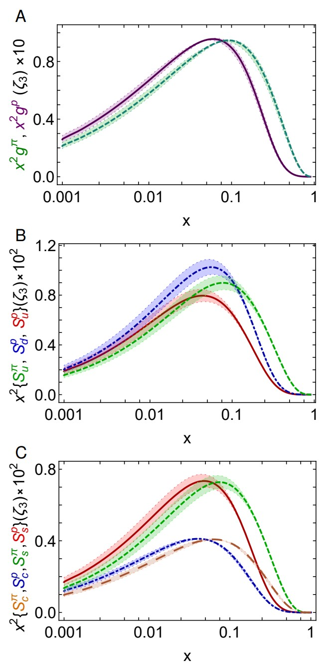
Proton and pion distribution functions in counterpoint
– glue and sea
Predicted glue-in-pion DF is confirmed by recent lQCD calculation
    [Regarding the distribution of glue in the pion, Lei Chang (常雷) and Craig D Roberts, e-Print: 2106.08451 [hep-ph], Chin. Phys. Lett. 38 (8) (2021) 081101/1-6]
Glue-in-π DF possess significantly more support on the valence domain than the glue-in-p DF
Sea-in-π DF possess significantly more support on the valence domain than sea-in-p DFs.
s and c sea DFs are commensurate in size with those of the light-quark sea DFs
For s-and c-quarks, too, the pion DFs possess significantly greater support on the valence domain than the kindred proton DFs.
These outcomes are measurable expressions of EHM

Slide 27
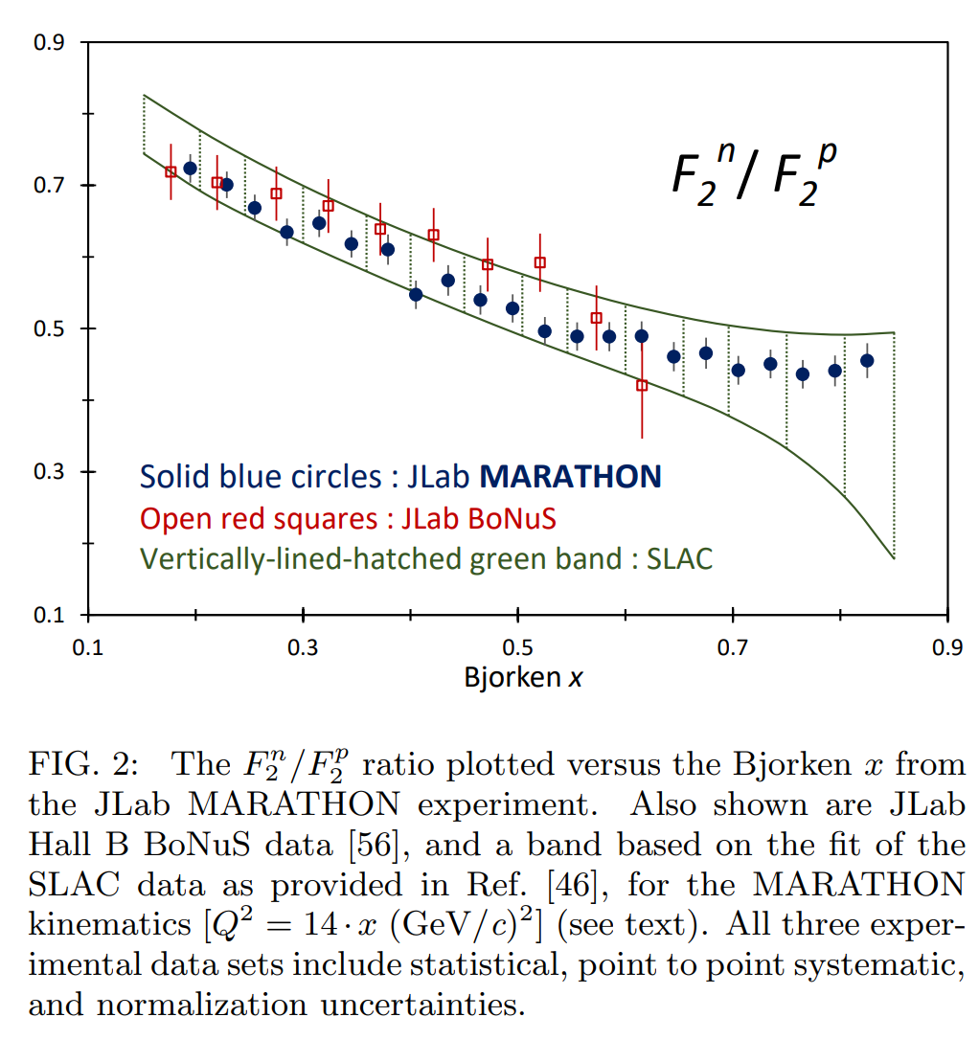
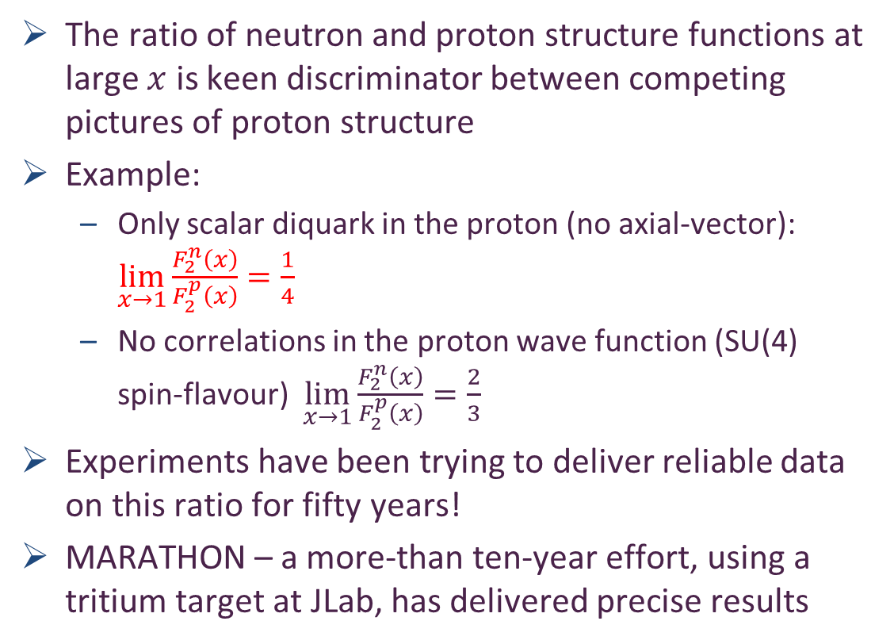

Diquarks & Deep Inelastic Scattering
The ratio of neutron and proton structure functions at large $x$ is keen discriminator between competing pictures of proton structure
Example:
  Only scalar diquark in the proton (no axial-vector): ${\lim_{x→1}{\frac{F_{2}^{n}\left(x\right)}{F_{2}^{p}\left(x\right)}=\frac{1}{4}} }_{ }^{ }$
  No correlations in the proton wave function (SU(4) spin-flavour) $\lim_{x→1}{\frac{F_{2}^{n}\left(x\right)}{F_{2}^{p}\left(x\right)}=\frac{2}{3}}$
Experiments have been trying to deliver reliable data on this ratio for fifty years!
MARATHON – a more-than ten-year effort, using a tritium target at JLab, has delivered precise results
$0^{+}$only
D. Abrams, et al., Measurement of the Nucleon Fn2/Fp2 Structure Function Ratio by the Jefferson Lab MARATHON Tritium/Helium-3 Deep Inelastic Scattering Experiment – arXiv:2104.05850 [hep-ex],
Phys. Rev. Lett. (2022) in press.

Slide 28
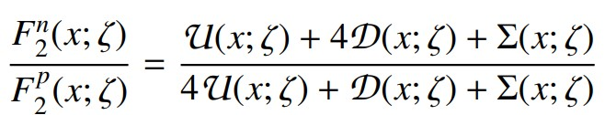
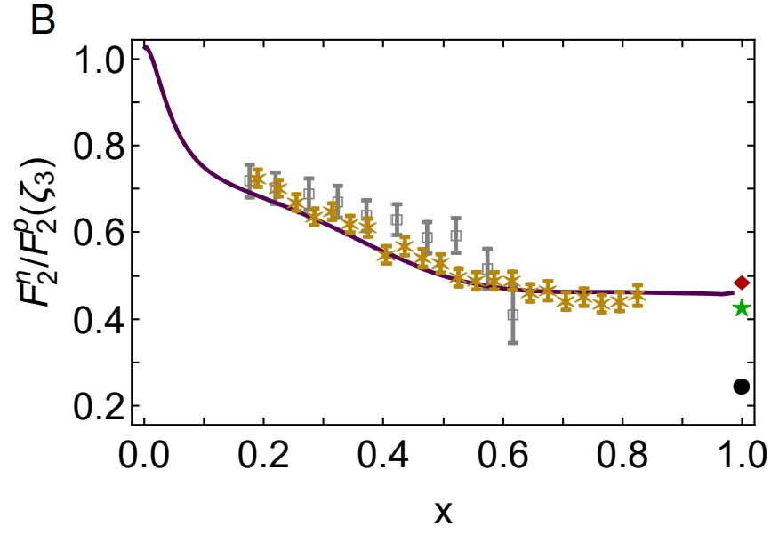
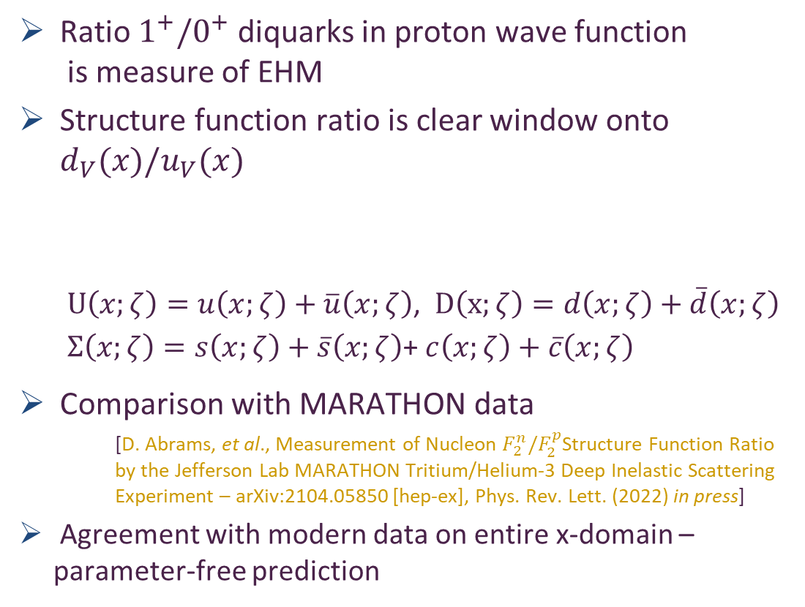
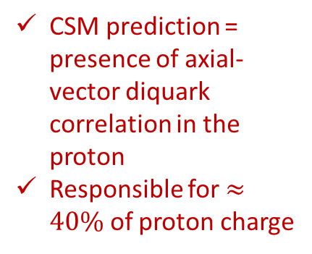
Neutron/Proton structure function ratio
CSM prediction = presence of axial-vector diquark correlation in the proton
Responsible for $≈40\%$ of proton charge
Ratio $1^{+}/0^{+}$ diquarks in proton wave function
  is measure of EHM
Structure function ratio is clear window onto $d_{V}(x)/u_{V}(x)$
  $U\left(x;ζ\right)=u\left(x;ζ\right)+\overline{u}\left(x;ζ\right)$, $D\left(x;ζ\right)=d\left(x;ζ\right)+\overline{d}\left(x;ζ\right)$
  $Σ\left(x;ζ\right)=s\left(x;ζ\right)+\overline{s}\left(x;ζ\right)$+ $c\left(x;ζ\right)+\overline{c}\left(x;ζ\right)$
Comparison with MARATHON data
    [D. Abrams, et al., Measurement of Nucleon $F_{2}^{n}/F_{2}^{p}$Structure Function Ratio by the Jefferson Lab MARATHON Tritium/Helium-3 Deep Inelastic Scattering Experiment – arXiv:2104.05850 [hep-ex], Phys. Rev. Lett. (2022) in press]
Agreement with modern data on entire x-domain – parameter-free prediction
Sea quark dominance on x<0.2
Valence quark dominance on x>0.2
🎆 Valence quark ratio in the proton, Zhu-Fang Cui, (崔著钫), Fei Gao (高飞), Daniele Binosi, Lei Chang (常雷), Craig D. Roberts and Sebastian M. Schmidt, NJU-INP 049/21, e-print: 2108.11493 [hep-ph], Chin. Phys. Lett. Express 39 (04) (2022) 041401/1-5: Express Letter
Probability that scalar diquark only models of nucleon might be consistent with available data is 1/141,000

Slide 29
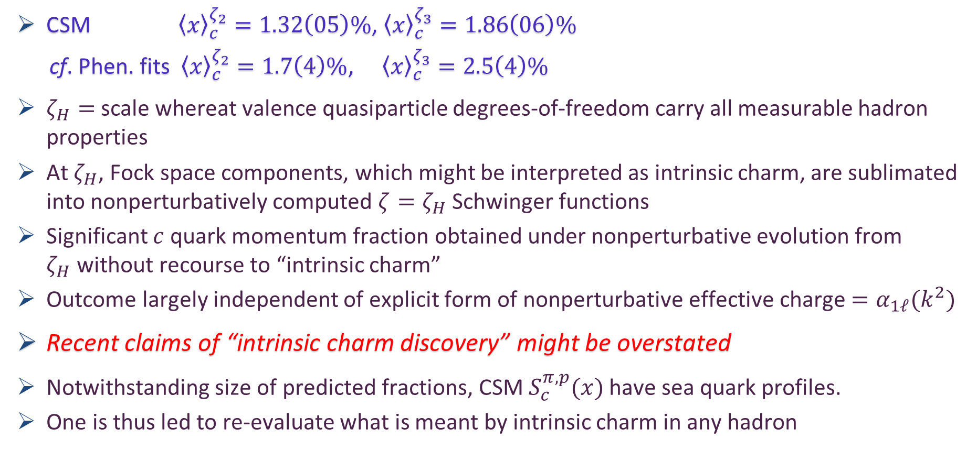
“Intrinsic” Charm
Proton and pion distribution functions in counterpoint, Ya Lu (陆亚) et al.,
NJU-INP 056/22, e-Print: 2203.00753 [hep-ph], Phys. Lett. B 830 (2022) 137130
CSM ${\left\langle x\right\rangle }_{c}^{ζ_{2}}=1.32\left(05\right)\%$, ${\left\langle x\right\rangle }_{c}^{ζ_{3}}=1.86\left(06\right)\%$
cf. Phen. fits ${\left\langle x\right\rangle }_{c}^{ζ_{2}}=1.7\left(4\right)\%$, ${\left\langle x\right\rangle }_{c}^{ζ_{3}}=2.5\left(4\right)\%$
$ζ_{H}=$ scale whereat valence quasiparticle degrees-of-freedom carry all measurable hadron properties
At $ζ_{H}$, Fock space components, which might be interpreted as intrinsic charm, are sublimated into nonperturbatively computed $ζ=ζ_{H}$ Schwinger functions
Significant $c$ quark momentum fraction obtained under nonperturbative evolution from $ζ_{H}$without recourse to “intrinsic charm”
Outcome largely independent of explicit form of nonperturbative effective charge $=α_{1ℓ}(k^{2})$
Recent claims of “intrinsic charm discovery” might be overstated
Notwithstanding size of predicted fractions, CSM $S_{c}^{π,p}(x)$ have sea quark profiles.
One is thus led to re-evaluate what is meant by intrinsic charm in any hadron

Slide 30
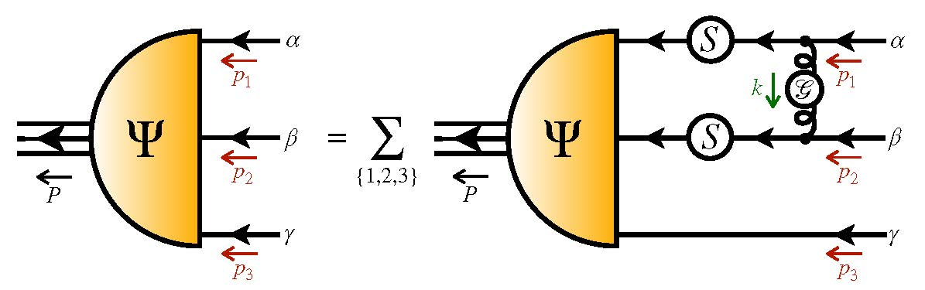
Proton Gravitational Form Factors

Slide 31
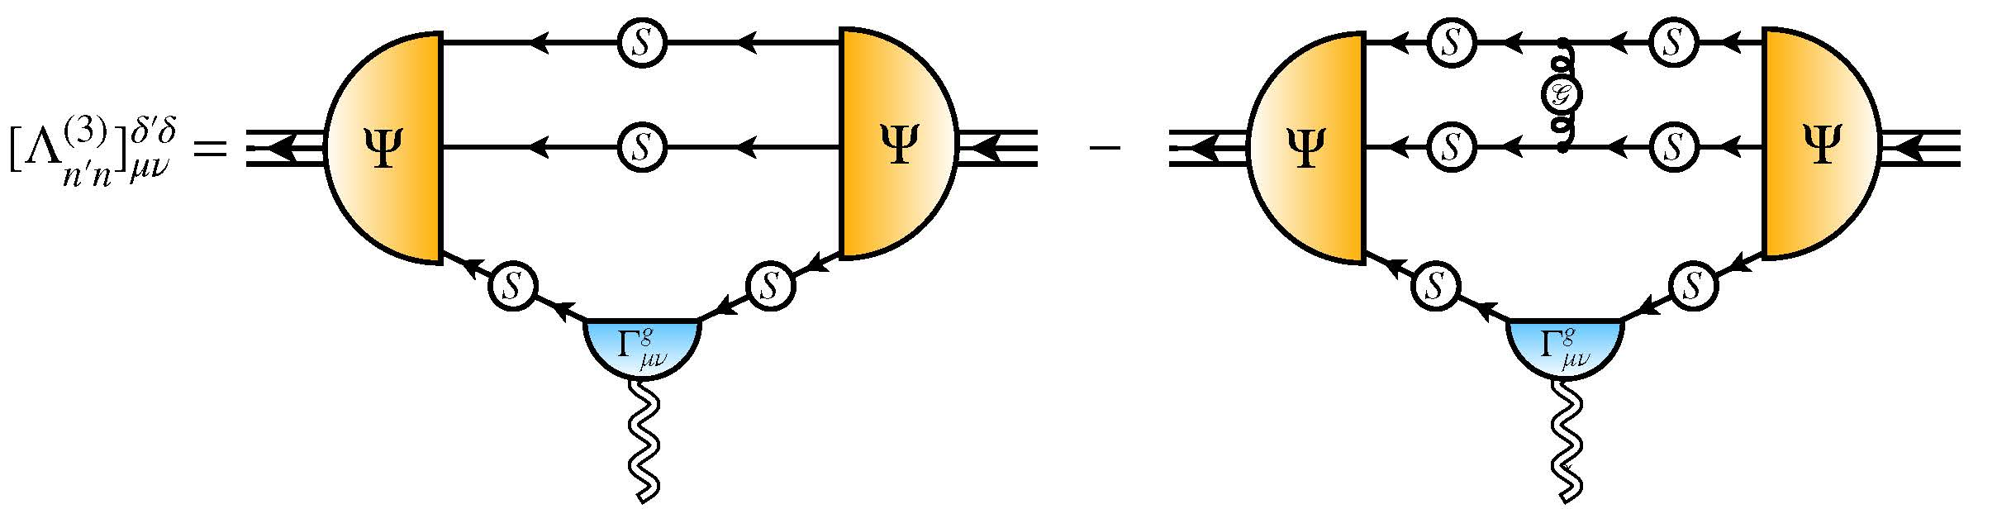
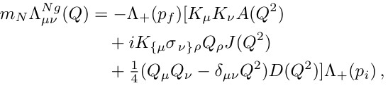

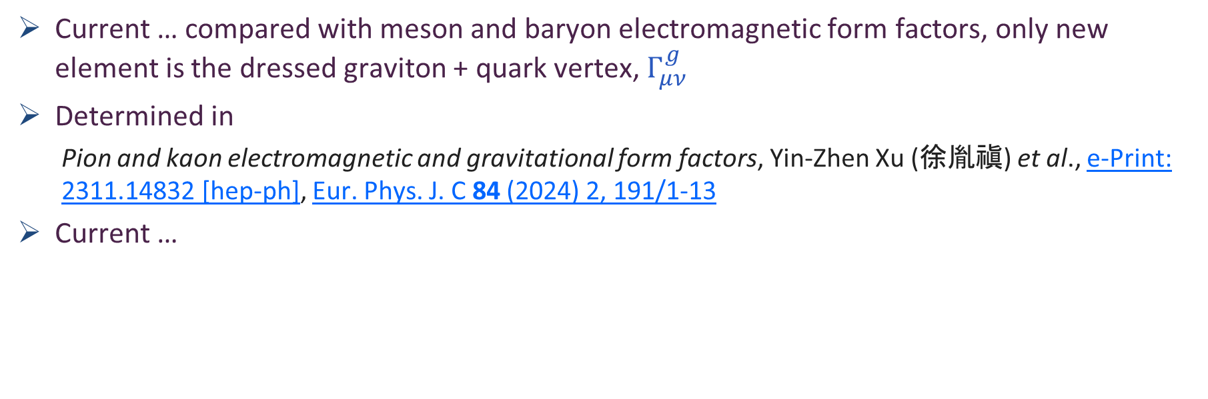
Nucleon Gravitational Form Factors
Current … compared with meson and baryon electromagnetic form factors, only new element is the dressed graviton + quark vertex, $Γ_{μν}^{g}$
Determined in
  Pion and kaon electromagnetic and gravitational form factors, Yin-Zhen Xu (徐胤禛) et al., e-Print: 2311.14832 [hep-ph], Eur. Phys. J. C 84 (2024) 2, 191/1-13
Current …
$A(Q^{2})$ mass distribution form factor
$$A\left(Q^{2}=0\right)=1$$
$J(Q^{2})$ spin distribution form factor
$$J\left(Q^{2}=0\right)=1/2$$
$D(Q^{2})$ pressure distribution form factor
$$D\left(Q^{2}=0\right)=?$$
GFFs Accessible via GPDs
Last unknown/unmeasured global property of nucleon

Slide 32


Predicted GFFs
Solid curves … CSM predicitions
Points lQCD results [Hackett:2023rif]
  Agreement within (large) lattice uncertainties
Symmetry-preserving character of CSM analysis is evident in values of
  $A\left(0\right)=1$
  $J\left(0\right)=1/2$
With $J\left(0\right)=1/2$, confirm that the anomalous gravitomagnetic moment of a spin-$1/2$ system is zero [Kobzarev:1962wt, Teryaev:1999su, Brodsky:2000ii].
nucleon “D-term” … prediction $D\left(0\right)=−3.11(1)$

Slide 33



GFF Species Decomposition (scale dependent, $ζ_{2}=2GeV$)
Considering light quarks alone:
$$D^{u+d}\left(0;ζ_{2}\right)=−1.73(5)$$
Inference from available DVCS data
$$D_{DVCS}^{u+d}\left(0;ζ_{2}\right)=−1.63(29)$$
CSM prediction is also in pointwise agreement with curve inferred from that data … see figure
BEG: Inference from existing DVCS data
V. D. Burkert, L. Elouadrhiri, F.-X. Girod, The pressure
distribution inside the proton, Nature 557 (7705) (2018) pp. 396–399.

Slide 34


GFF Species Decomposition (scale dependent, $ζ_{2}=2GeV$)
CSM prediction – species decomposition,
for each form factor:
$$\frac{F^{glue}\left(Q^{2};ζ\right)}{F^{quark}\left(Q^{2};ζ\right)}=constant(ζ)$$
$constant\left(ζ_{2}\right)=0.71(4)$
namely, the ratio of glue:quark contributions is the same
$Q^{2}$-independent number for each form factor
lQCD results … see figure
  Consistent with prediction
  ${constant}_{lQCD}\left(ζ_{2}\right)=0.82(18)$

Slide 35


Proton Pressure Profiles
Pressure and shear-force density profiles
Pion (green) peak values are roughly twice those in the proton
  Expected because
    pressures $∼Ψ^{2}$
    similar interior QCD dynamics + more compact object
    $⇒\frac{p_{π}}{r_{π}^{2}}≈p_{p}/r_{p}^{2}$ & $r_{p}^{2}≈2{ r}_{π}^{2}$
Scale is order-of-magnitude greater than neutron star core
$r_{mass}=0.81\left(5\right)r_{ch}$ $>$ $r_{mech}=0.72\left(2\right)r_{ch}$
Species decomposition ($ζ_{2}$)
  $r_{mass}^{q}=0.62\left(4\right)r_{ch}$ $>$ $r_{mass}^{g}=0.52\left(3\right)r_{ch}$
  $r_{mech}^{q}=0.55\left(4\right)r_{ch}$ $>$ $r_{mech}^{g}=0.47\left(3\right)r_{ch}$
Contrary to practitioner desires … no existing experiment provides information on glue contributions to proton GFFs

Slide 36


Synergy of Experiment, Phenomenology, Theory
Gather all pieces of the puzzle … Reveal the source of Nature’s basic mass-scale
Strong interaction theory is maturing
  Expanding array of parameter-free predictions for the nucleon – yes
  And all the other hadrons whose properties express the full meaning of QCD
    Structure of Nature’s most fundamental Nambu-Goldstone bosons
    Structure of baryons, e.g.,
    $Q^{2}$-dependence of nucleon resonance transition form factors
      Spectrum is insufficient – many models give same spectrum, but transition form factors discriminate between pictures.
Understanding how QCD’s simplicity explains the emergence of hadron mass and structure requires investment in facilities that can deliver precision data on much more than one of Nature’s hadrons.
AMBER@CERN, EIC, EicC, STCF, CEPC, JLab22, LHeC, QCD@FAIR could …
  Deliver precise structure data on a wide range of hadrons with distinctly different quantum numbers
  Thereby move Science into a new realm of understanding.

Slide 37
Emergent Hadron Mass
Grant no. 12135007
QCD is unique amongst known fundamental theories of natural phenomena
  The degrees-of-freedom used to express the scale-free Lagrangian are not directly observable
  Massless gauge bosons become massive, with no “human” interference
  Gluon mass ensures a stable, infrared completion of the theory through the appearance of a running coupling that saturates at infrared momenta, being everywhere finite
  Massless fermions become massive, producing
    Massive baryons and simultaneously Massless mesons
These emergent features of QCD are expressed in every strong interaction observable
They can also be revealed via
EHM interference with Nature’s other known source of mass = Higgs
We are capable of building facilities that can validate these concepts, proving QCD to be
the 1st well-defined four-dimensional quantum field theory ever contemplated
This may open doors that lead far beyond the Standard Model

Slide 38


$${\text{L}}_{Nature}= ?$$
There are theories of many things,
But is there a theory of everything?
Thankyou

Slide 40




All-orders evolution
All-Orders Evolution of Parton Distributions: Principle, Practice, and Predictions
Pei-Lin Yin (尹佩林), NJU-INP 075/23, e-Print: 2306.03274 [hep-ph]
P1 – In the context of Refs. [73, 74], there exists at least one effective charge, $α_{1ℓ}(k^{2})$, which, when used to integrate the leading-order perturbative DGLAP equations, defines an evolution scheme for parton DFs that is all-orders exact.
CSM Process-Independent charge serves this purpose
Hadron scale, $ζ_{H}$
  Scale at which all properties of a given hadron are carried by valence degrees-of-freedom

Slide 41

Summary: Nucleon Gravitational Form Factors
Last unknown global property of nucleon: prediction $D\left(0\right)=−3.11(1)$
Species decompositions: CSMs predict that glue/quark ratio = constant, independent of $Q^{2}$
Near-core pressure in pion is roughly twice that in proton
so both are at least an order of magnitude greater than that of a neutron star.
Nucleon's mechanical radius $<$ than its mass radius … in turn $<$than its charge radius.
At standard scale, glue contributions to both radii are 15% $<$than total quark contributions.
Within uncertainties, continuum predictions are consistent with phenomenological inferences from available data on deeply virtual Compton scattering.

Slide 42

Photoproduction of heavy vector mesons

Slide 43

EHM Measurements
How does the mass of the nucleon arise?
Once considered viable …
    Electromagnetic process ($V=J/ψ, Υ$) … $e+p→e^{′}+V+p$
    to access purely hadronic process … $V+p→V+p$
But …
  Deciphering the mechanism of near-threshold J/ψ photoproduction, M.-L. Du, V. Baru, F.-K. Guo et al., Eur. Phys. J. C 80, 1053 (2020)
  Vector-meson production and vector meson dominance, Yin-Zhen Xu, Si-Yang Chen, Zhao-Qian Yao et al., Eur. Phys. J. C 81 (2021) 895/1-11
  Near threshold heavy quarkonium photoproduction at large momentum transfer, P. Sun, X.-B. Tong, F. Yuan, Phys. Rev. D 105 (2022) 5, 054032
There is no objective, model-independent means by which to connect $e+p→e^{′}+V+p$ with $V+p→V+p$
Hence, vector meson photoproduction
    does not provide a path to the QCD trace anomaly
    (or anything else)

Slide 44




$J/ψ$ photoproduction: from threshold to very high energies
J/ψ photoproduction: threshold to very high energy, Lin Tang (唐淋), Yi-Xuan Yang (杨逸轩), Zhu-Fang Cui (崔著钫) and Craig D. Roberts, NJU-INP 089/24, e-Print: 2405.17675 [hep-ph], Phys. Lett. B 856 (2024) 138904/1-7
If GPD scheme valid at all, then only very near threshold.
All $W$ unification impossible
Some modern proposals for reaction model:
  GPD treatment – gain access to in-proton gluon gravitational form factors
  Coupled channels treatment – $P+ J/ψ p rescattering$
    S. Sakinah, T. S. H. Lee, H.-M. Choi, Dynamical Model of J/Ψ photoproduction on the nucleon – arXiv:2403.01958 [nucl-th] Phys. Rev. C 109 (2024) 6, 065204
    Suggestion = Final state interactions dominate cross-section near-threshold, so obscuring any connection with in-proton gluon distributions and/or gluon gravitational form factors.
  $γ+p→c+\overline{c}+P+p→J/ψ+p$
    Lin Tang (唐淋) et al. NJU-INP 089/24
    Exposes $c+\overline{c}$ content of the dressed photon
    Couples the intermediate $c+\overline{c}$system to
    proton’s valence quarks via Pomeron exchange

Slide 45



$J/ψ$ photoproduction: threshold differential cross-section
GPD model (dotted blue)
  overfitting issue
  concave differential cross-section with max. at low $\left|t\right|$
  trying to reconcile GlueX and $J/ψ$-007 data (some tension)
  all other reaction models produce convex $\frac{dσ}{dt}$
$P+J/ψp$ rescattering
  dashed green – $χ_{dof}^{2}=8$
$P+quark loop$
  solid purple – $χ_{dof}^{2}=7$

Slide 46




$J/ψ$ photoproduction: total cross-section, threshold to high-$W$
Reported ZEUS uncertainty in W is large, but uncertainty in $σ$ is small
Distorts $χ^{2}$
GPD model (dotted blue)
  Inapplicable on $W>5$ GeV
  $χ_{dof}^{2}$ undefined
$P+J/ψp$ rescattering
  dashed green
    ZEUS+H1 $χ_{dof}^{2}=2.1$
    H1 $χ_{dof}^{2}=1.6$
$P+quark loop$
  solid purple
    ZEUS +H1 $χ_{dof}^{2}=3.5$
    H1 $χ_{dof}^{2}=1.0$

Slide 47

$J/ψ$ photoproduction: from threshold to very high energies
Two reaction models provide viable unification
  differential and total cross-section data
GPD model does NOT
  Premature to connect γ + p → J/ψ + p photoproduction data with anything derived from/connected with GPDs
  Theory predicts that proton mass radius < proton charge radius – see Empirical Determination of the Pion Mass Distribution, Y-Z. Xu (徐胤禛) et al., NJU-INP 070/23, e-Print: 2302.07361 [hep-ph], Chin. Phys. Lett. Express 40 (2023) 041201/1-7.
Best description of data is provided by CSM reaction model
  $(W,t)$ dependence of quark loop is important to differential cross-section near threshold
  Photoproduction probes quark structure of $γ→J/ψ$ not glue in proton

