Slide 1
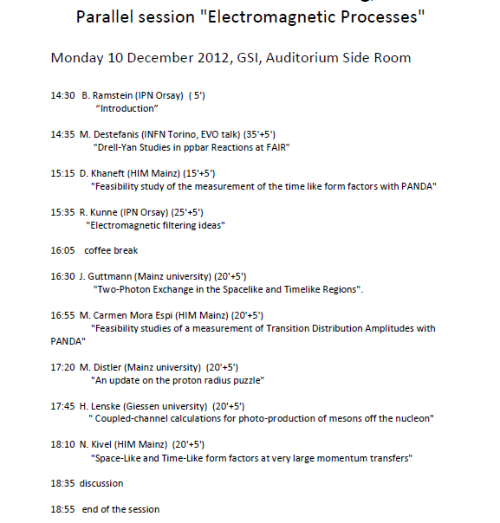
Feasibility studies for PANDA
Theoretical talks (TAG)
Opening to other nucleon
structure experiments

