Slide 1
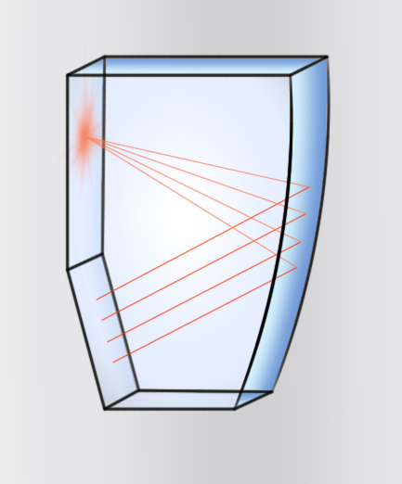
Results of the Disc DIRC test beam campaign at DESY
AG Düren
JLU Gießen

Slide 2
Contents
Experimental Setup
Calibration
Results and Comparison to MC-Data
First Conclusions

Slide 3
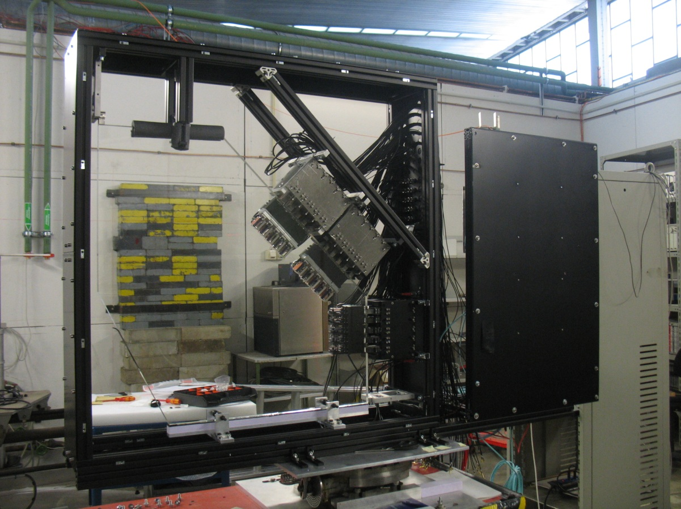
Experimental Setup
Location: DESY, Hamburg
Beam-Dump
Radiator
3 sensor batteries
equipped with 5 PMTs each
Pivotable and linearily movable mounting device

Slide 4
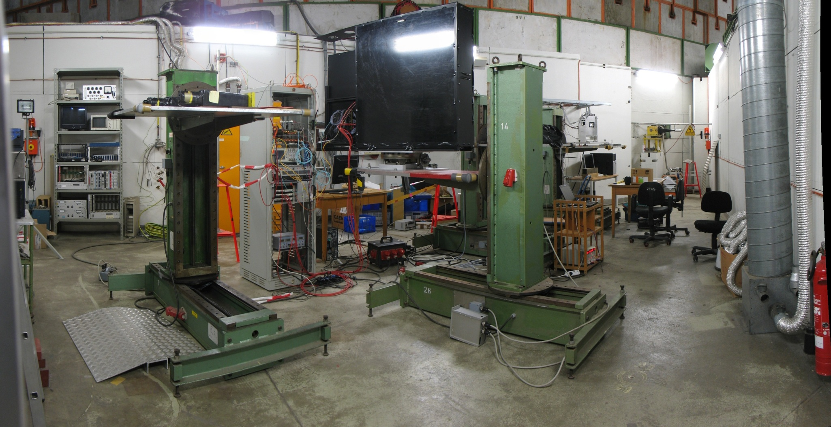
Experimental Setup
Ready to Go

Slide 5
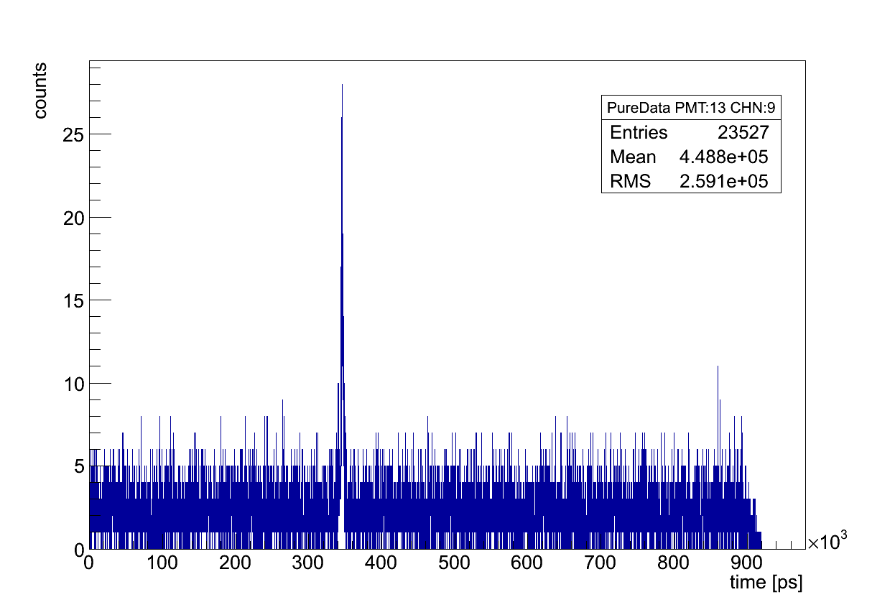
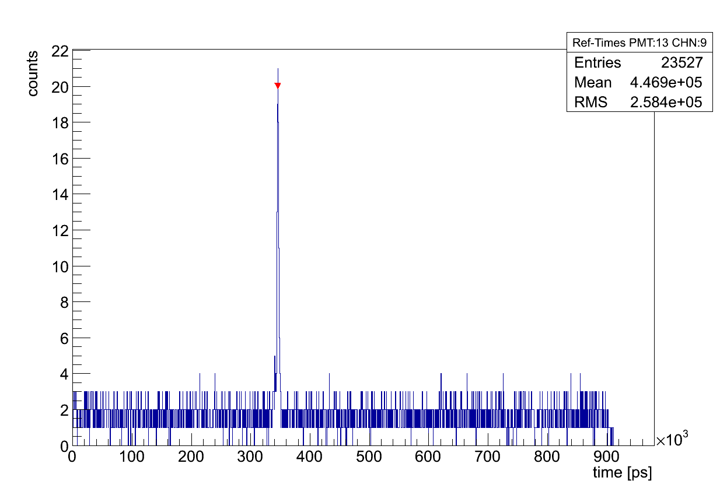
Selection Criteria
Time spectra are smoothed out. Then a peak-finding-algorithm scans the spectra.
The highest peak is used to center a ± 10 ns window
No energy cuts applied.
Just the direct hits are kept!
Smoothing and peak detection

Slide 6
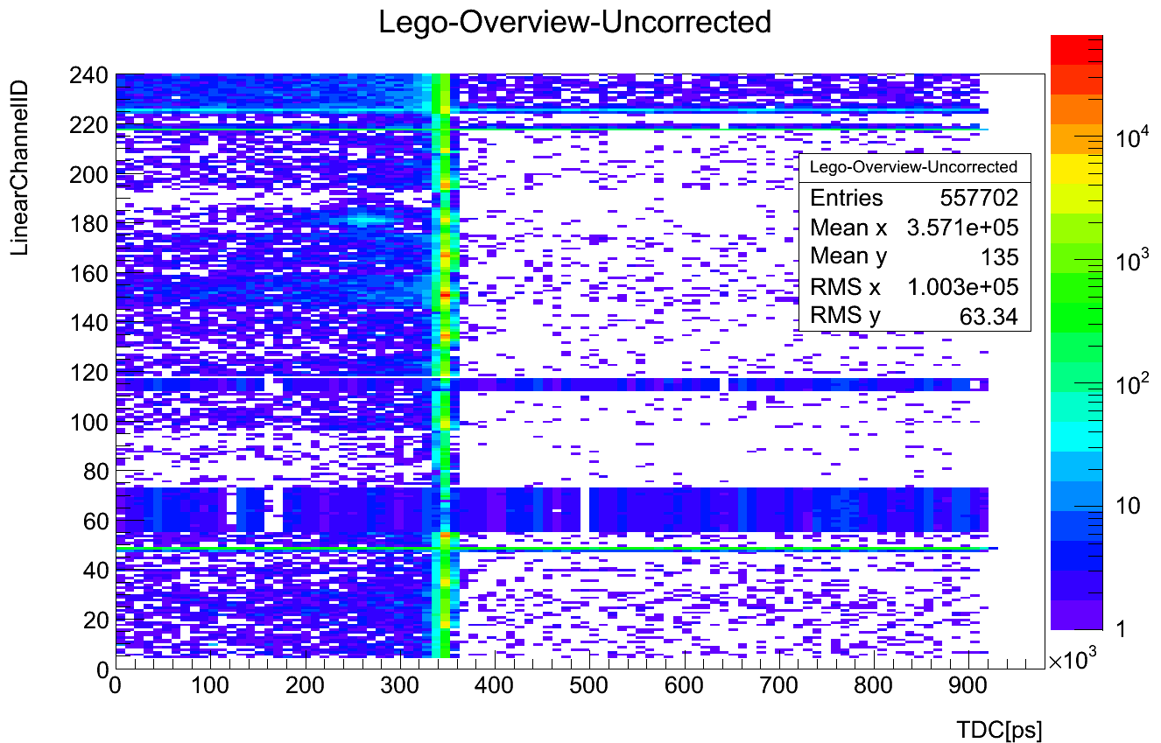
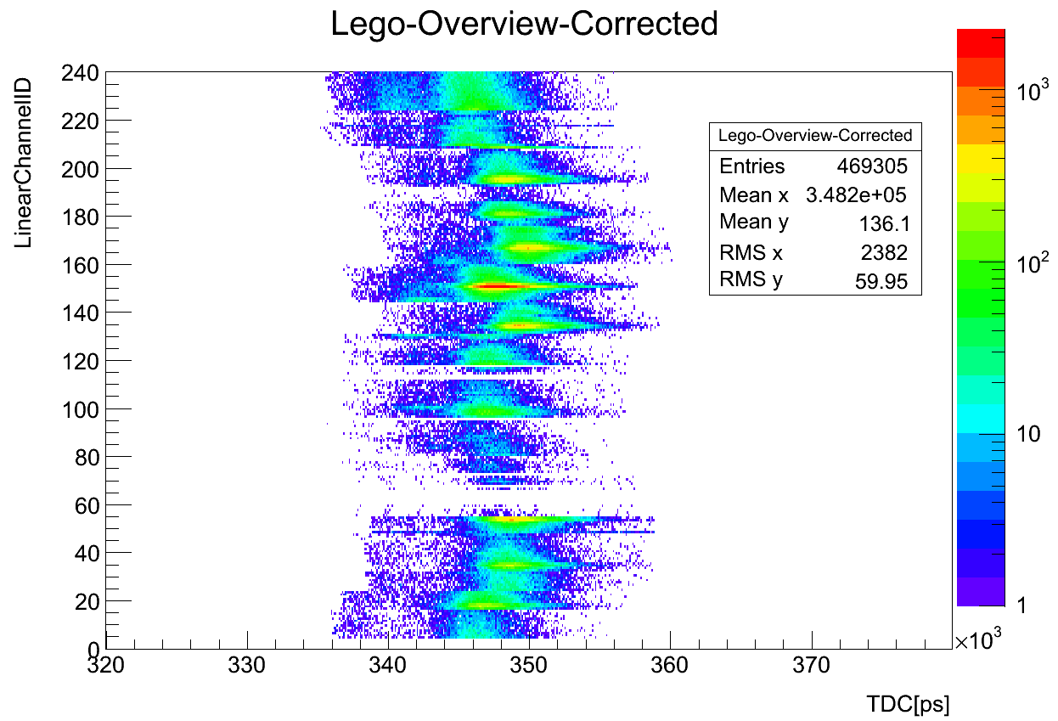
Selection Criteria
LinearChannelID = 16 * PmtID + ChnID
Time Cut

Slide 7
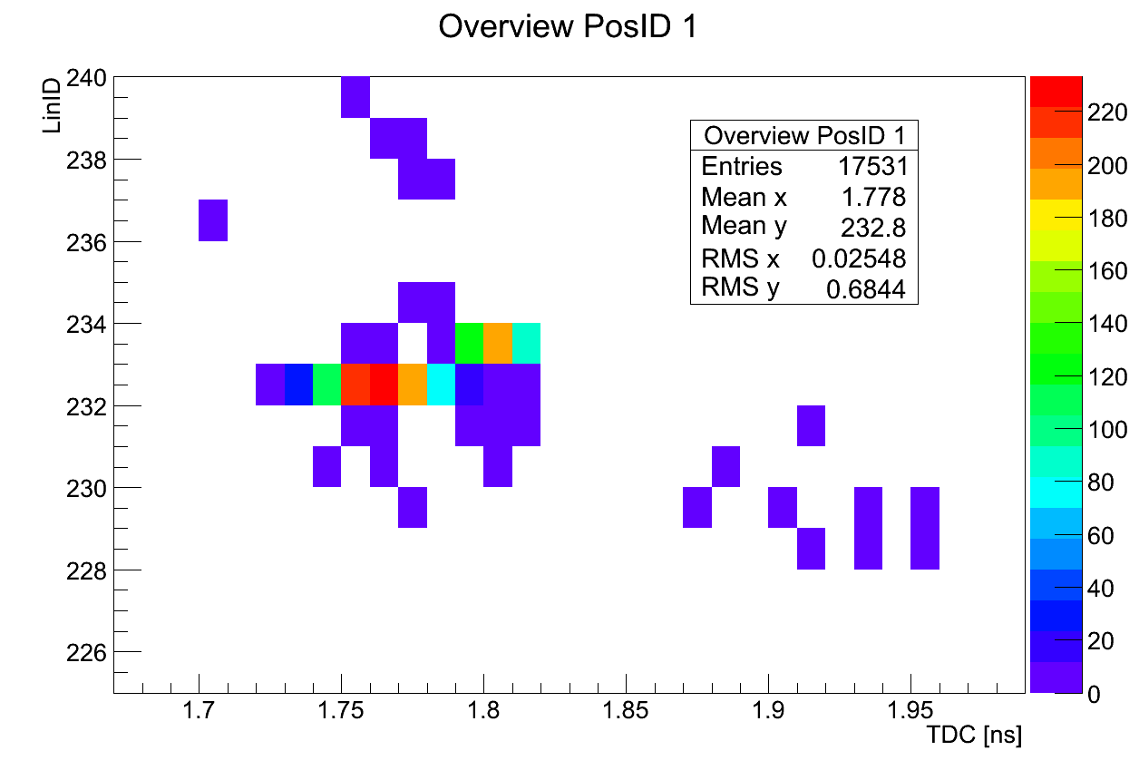
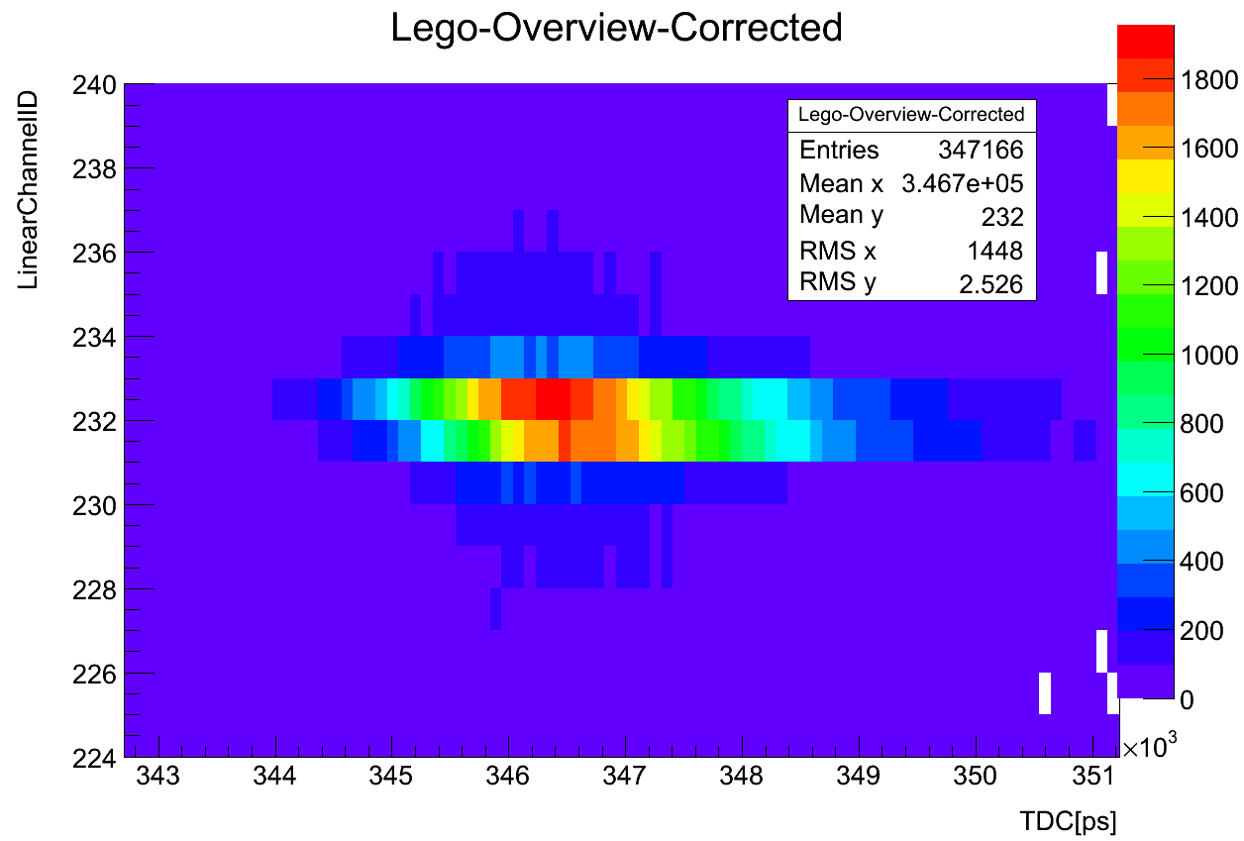
Time Resolution
Example: Direct hit peak in time spectrum
(Calibration Run)
Monte Carlo (no normalization)
Real Data (noise corrected)

Slide 8
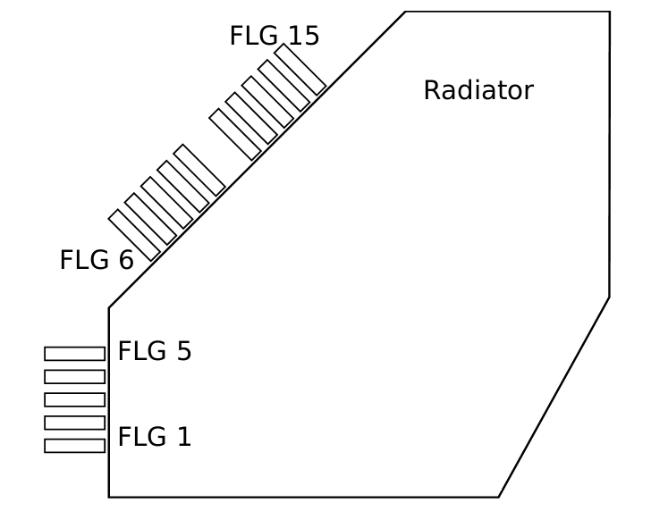
Calibration
The detector was calibrated by shooting the electron beam 15 cm away from every single lightguide (200k events) .
The same positions are used in a MC-simulation of the experiment (Geant 4) done by O. Merle.
The centers of gravity are computed for each sensor for MC and for the data.

Slide 9
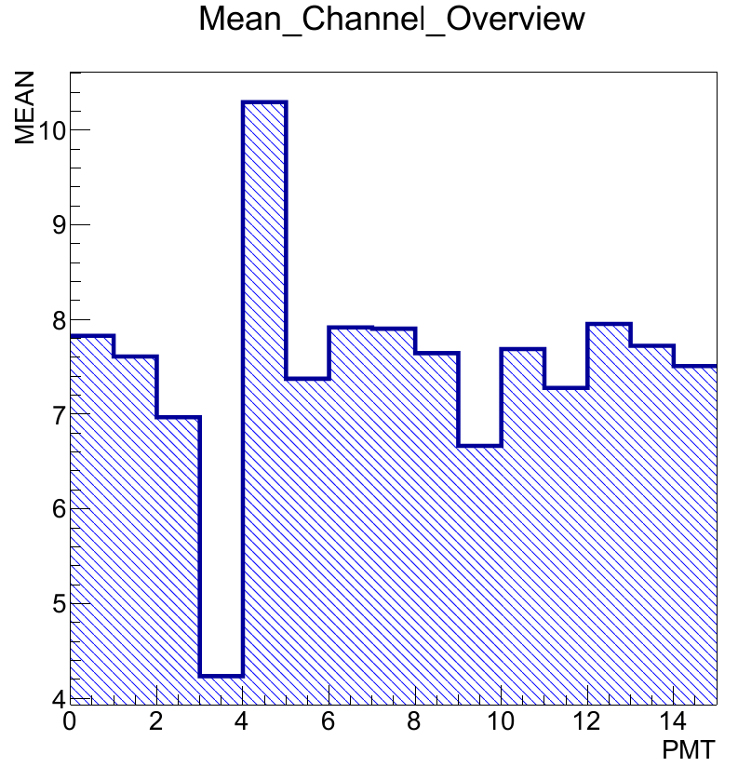
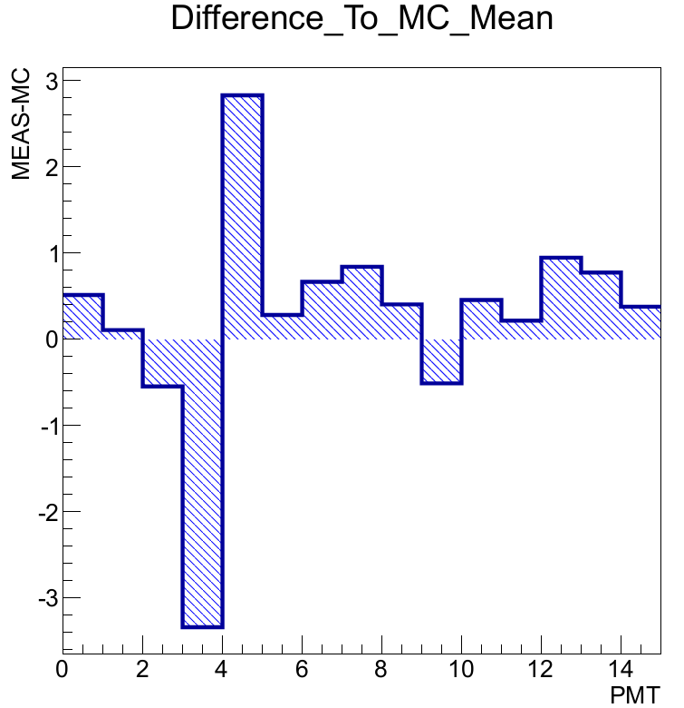
Calibration
Discrepancies between MC and data are used to correct for misalignment of the sensors. The sensor positions in the MC were iteratively shifted to minimize the differences.
Electronics related
malfunction of TOF board
Initial Situation

Slide 10
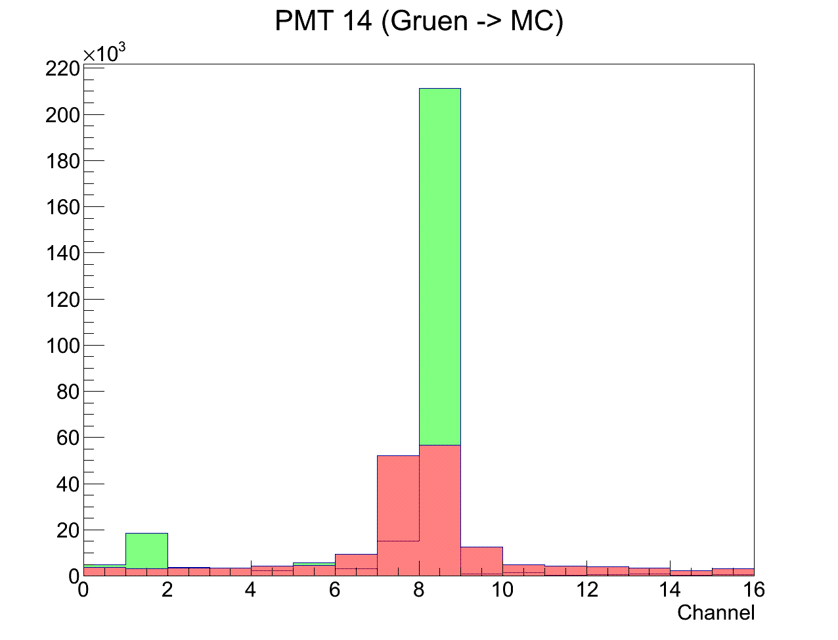
Calibration
Question: How do we shift the sensors?
A) match peaks in both spectra
B) maximize sensor efficency
C) match centers of gravity
From now unbinned MC-data is used including dead space between pixels to obtain the center of gravity.
Measured Data (red) and ‘Event-Normalized‘ predictive MC (Green)

Slide 11
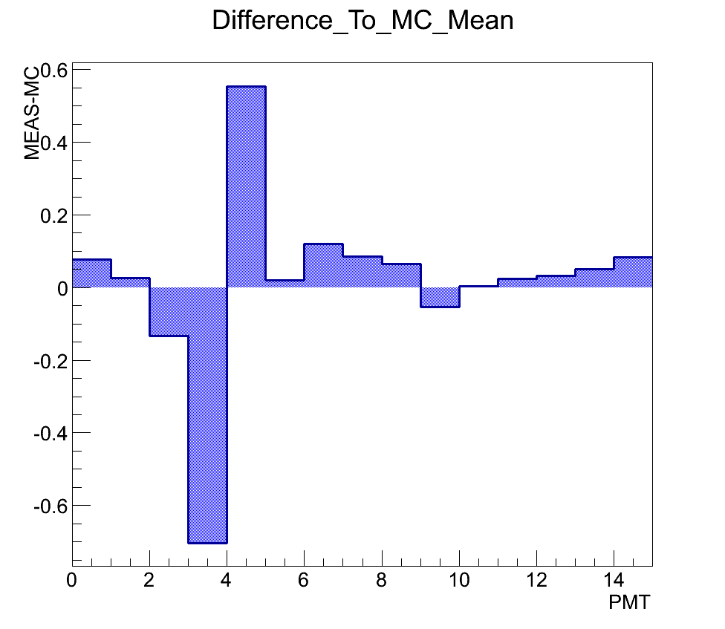
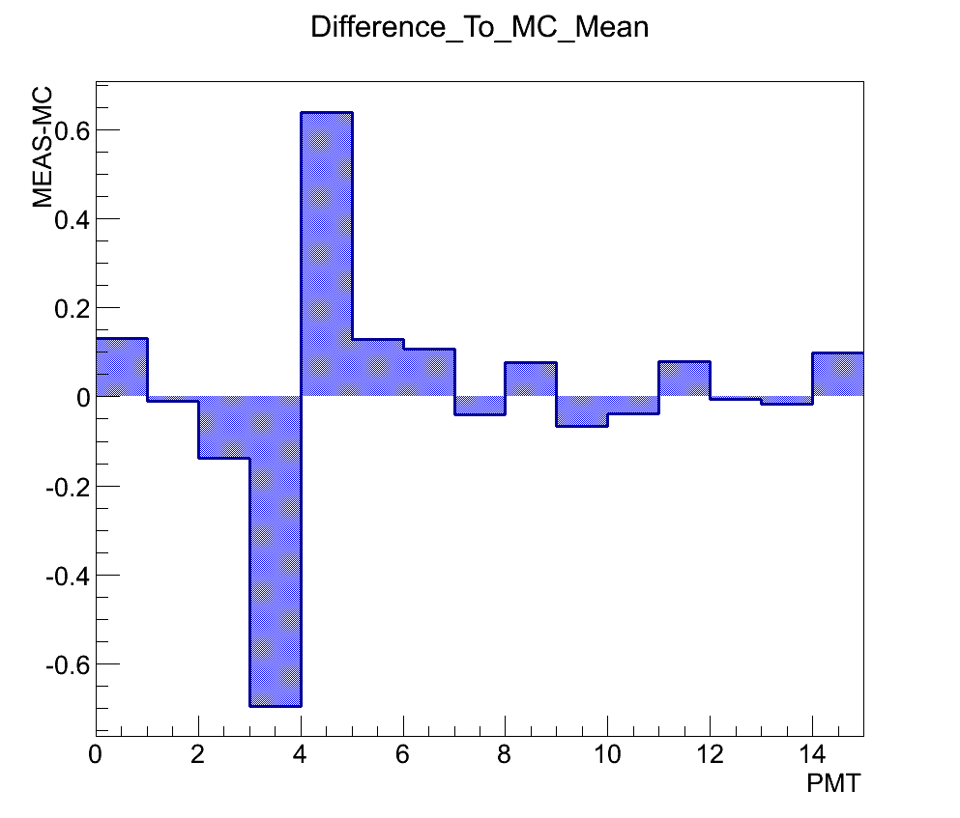
Calibration
Deviations after calibration
Unbinned MC
Fake Data

Slide 12
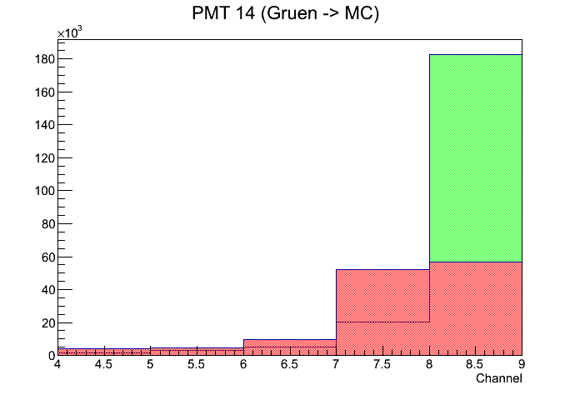
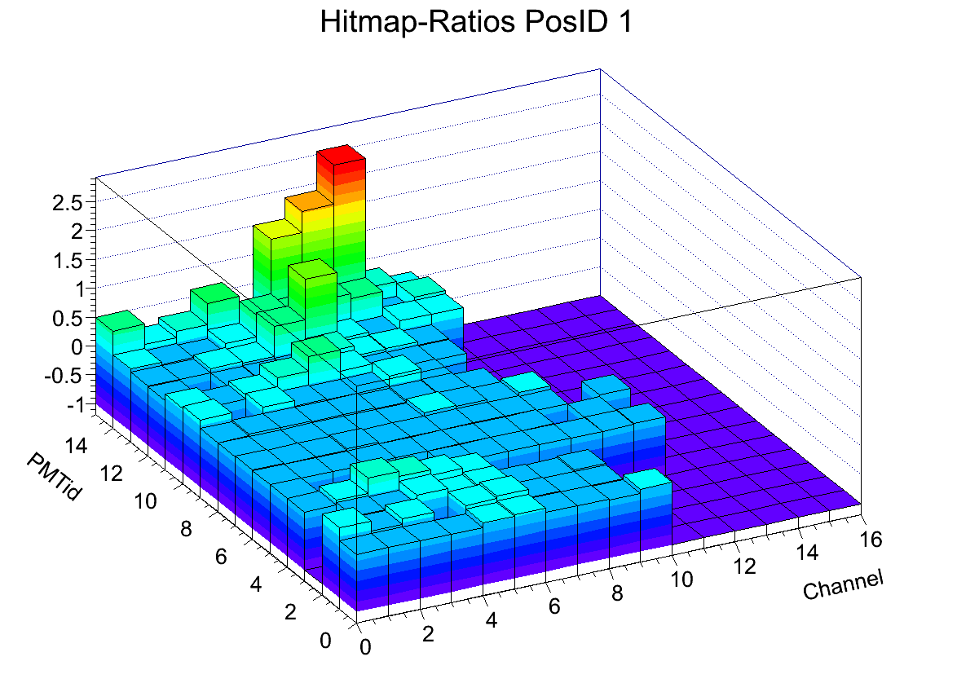
Calibration
Measured / MC
Threshold: 0.01 hits/event
Efficencies can be analysed
for entire runs:

Slide 13
Results
Angle Scan
1M Events per position
16 Runs
Angles from -8° to +8° scanned
Results
Hitmaps (MC and Data)
MC-Ratio-Maps
Multi-Hit Events
Hitmaps (Data)
341 mm
341 mm

Slide 14
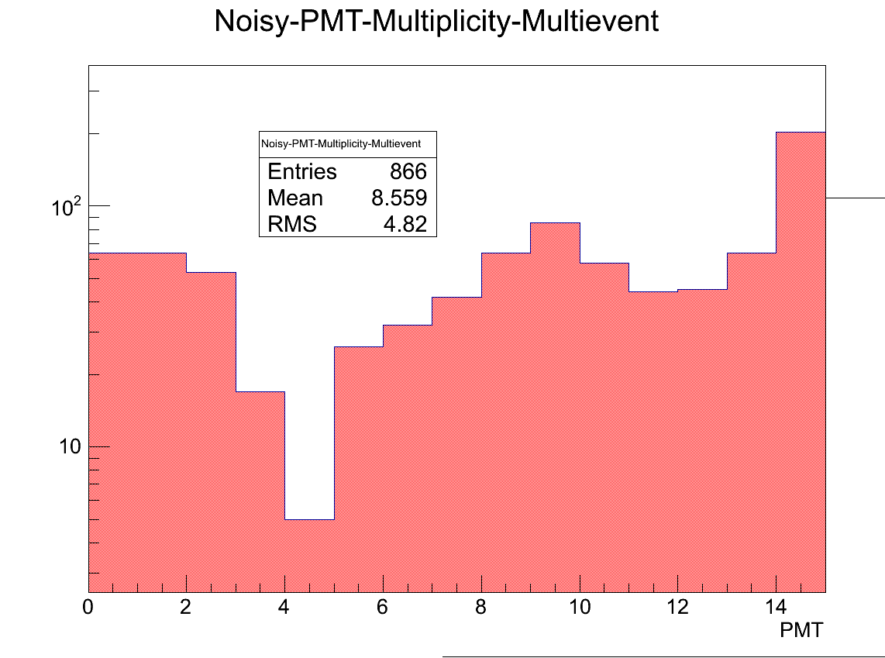
Multi-Hit Events
An event is considered a multi-hit event if more than 10 hits are detected.
It is discarded however if one sensor fired more than 5 of its pixels (which happened quite frequently and we don‘t really now why).
Taken from angle scan at -8°

Slide 15
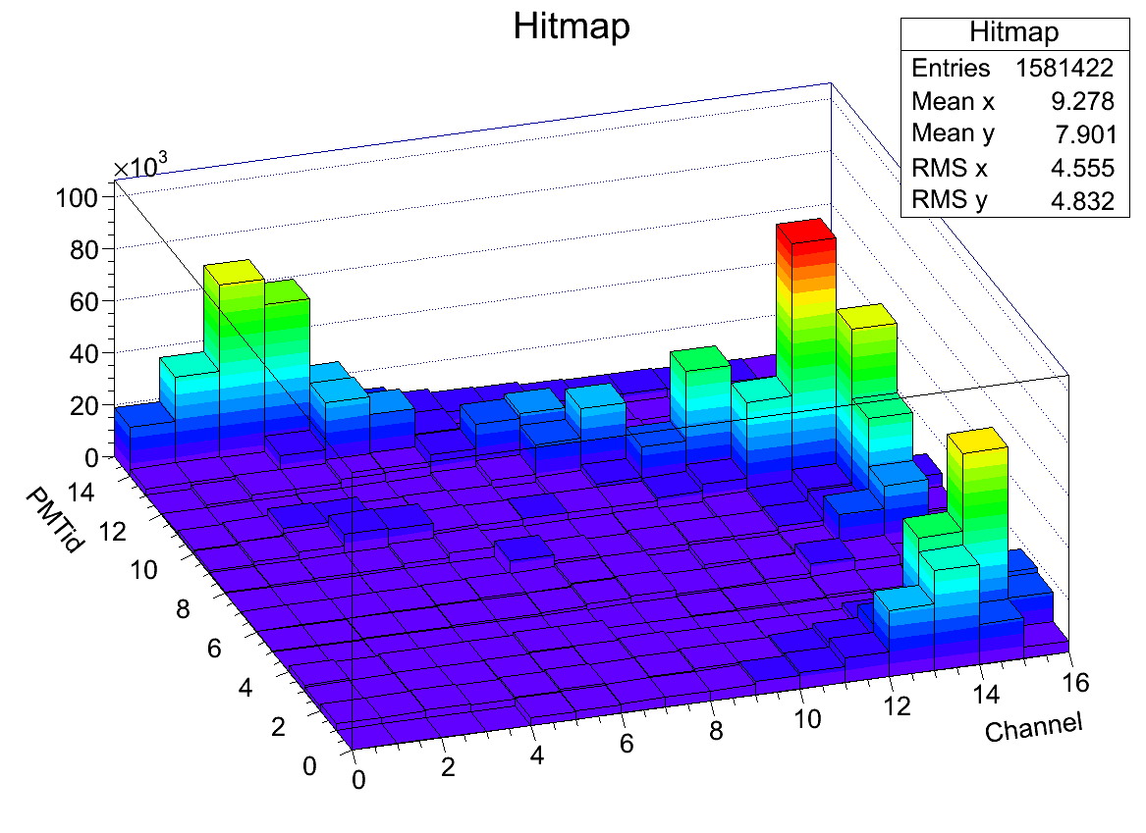
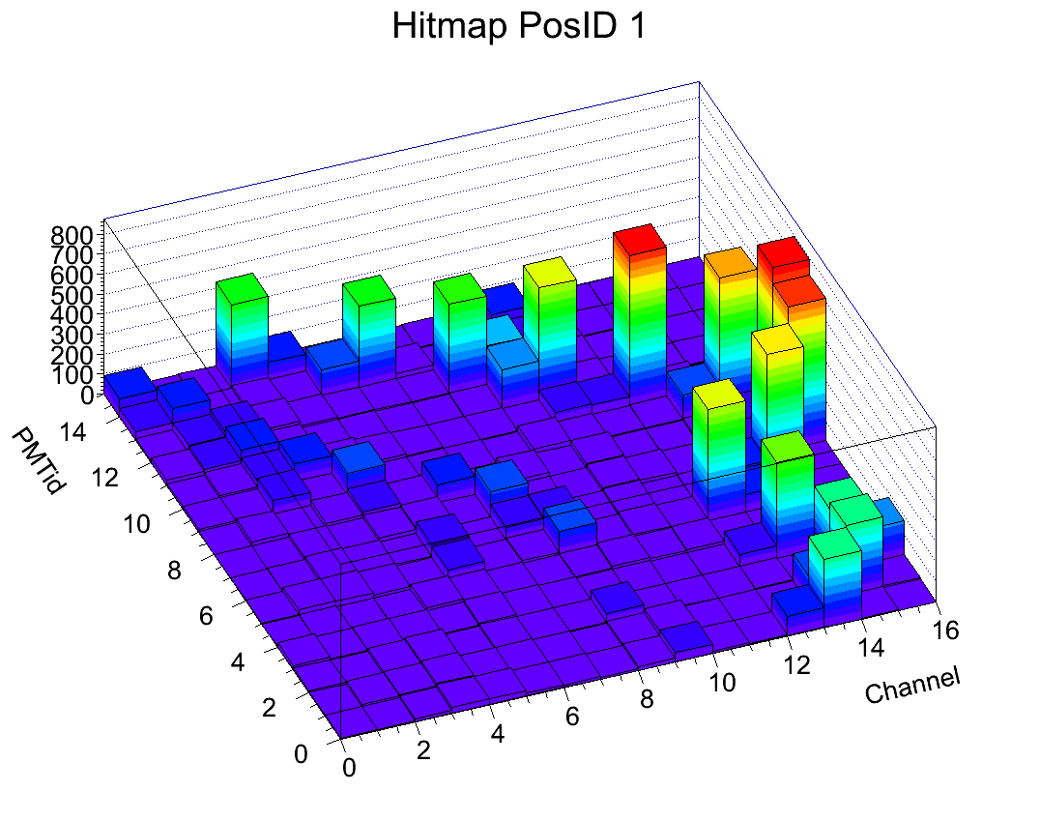
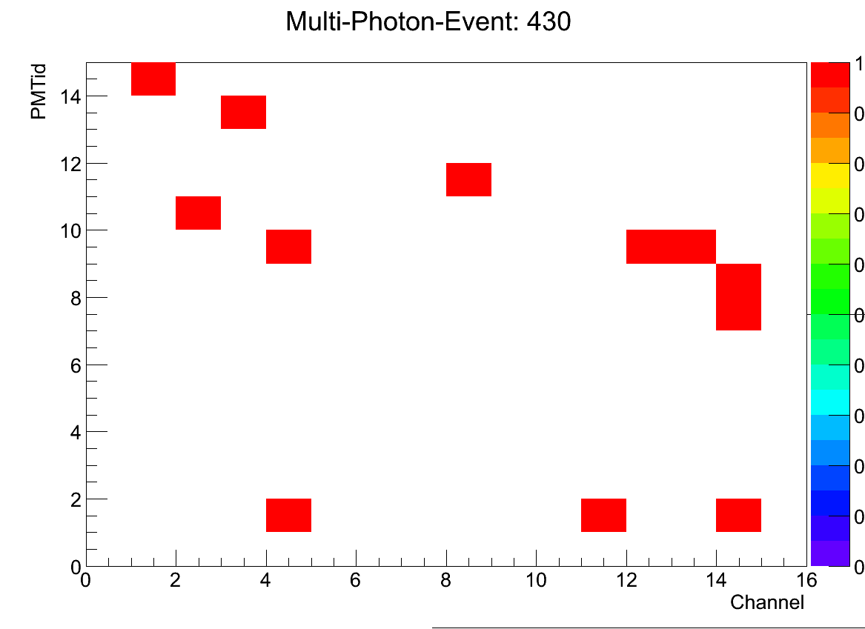
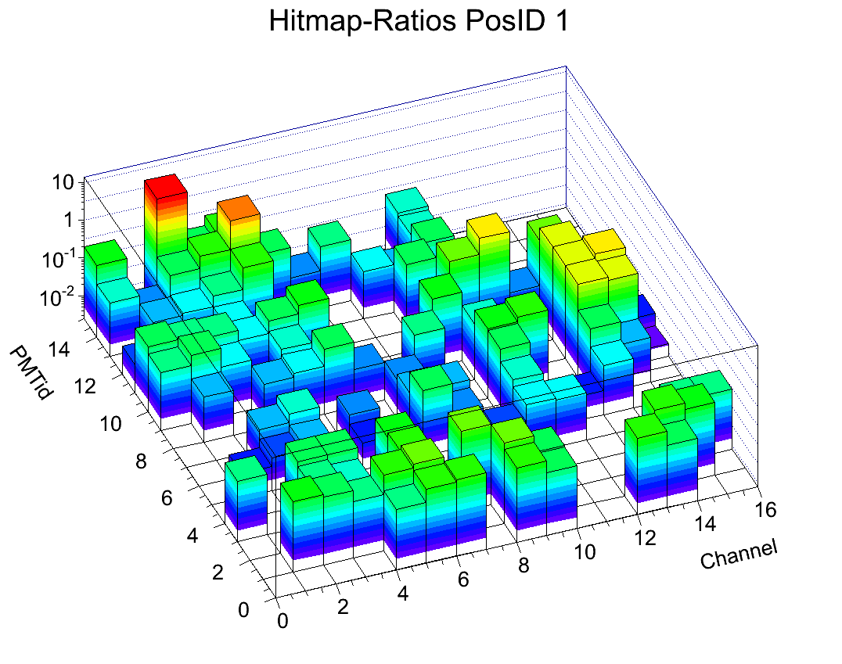
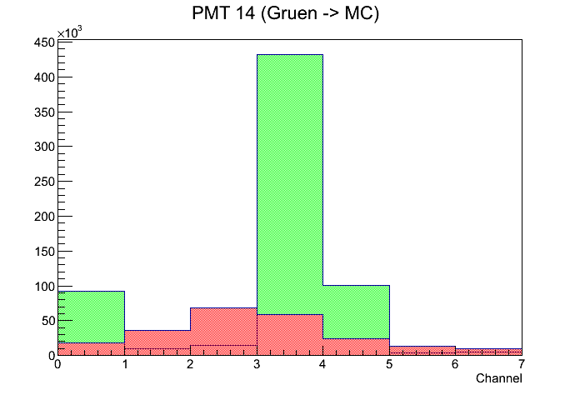
Angle Scan
-8°
Data
MC

Slide 16
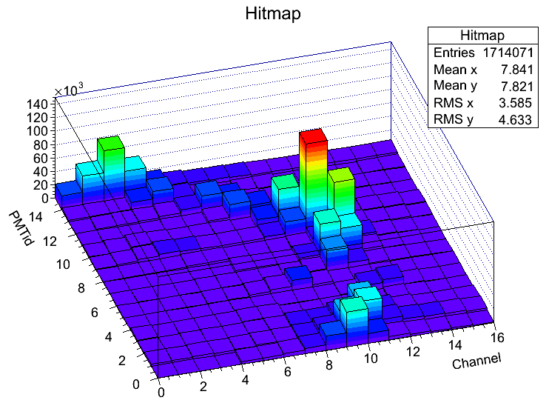
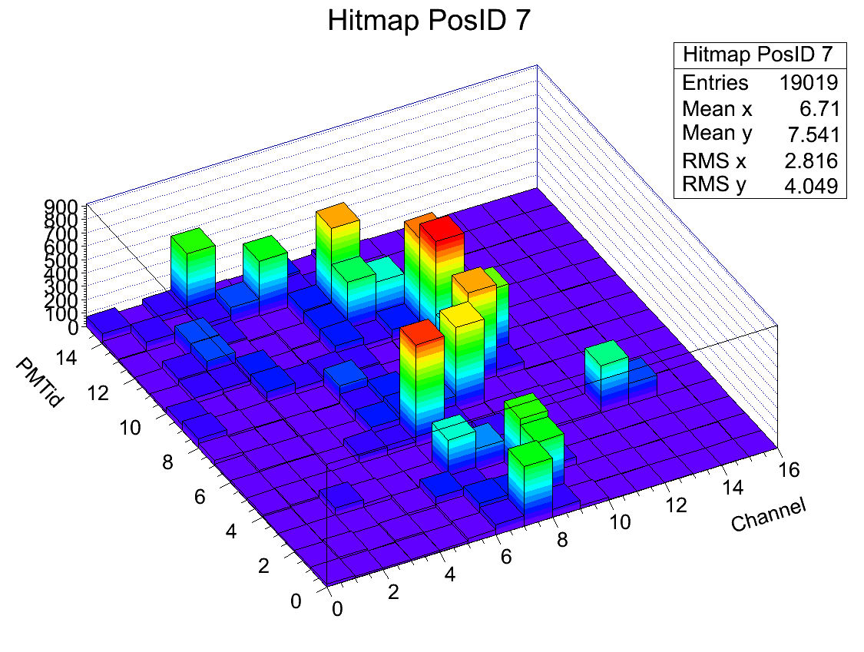
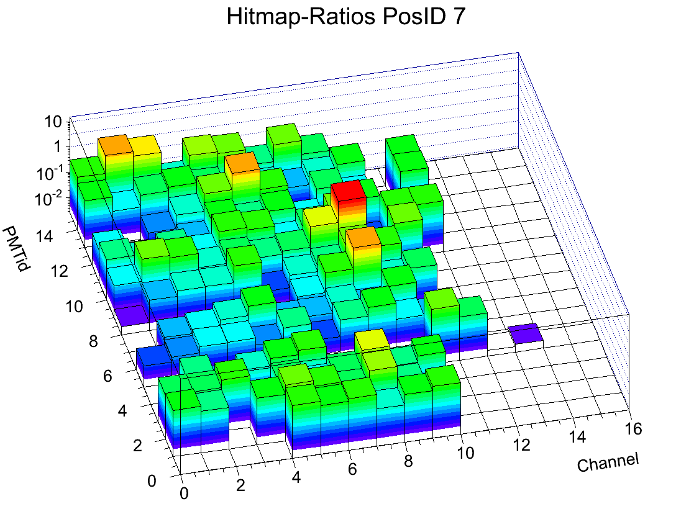
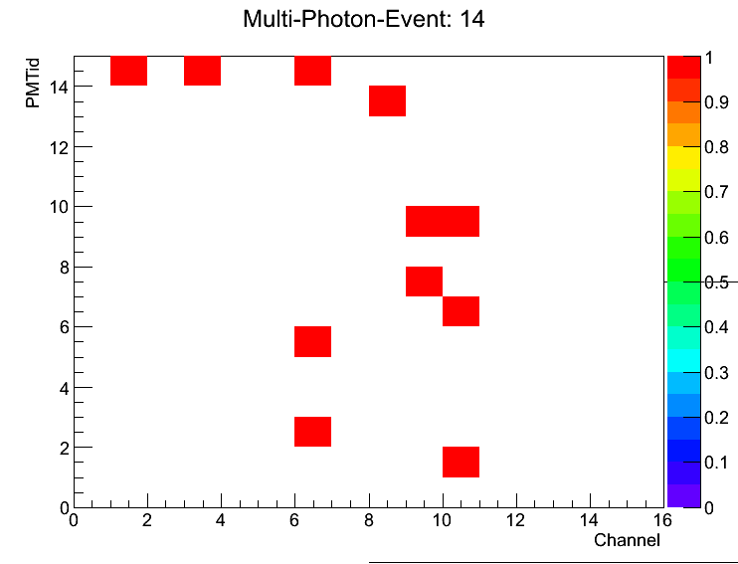
Angle Scan
-4°
Data
MC

Slide 17
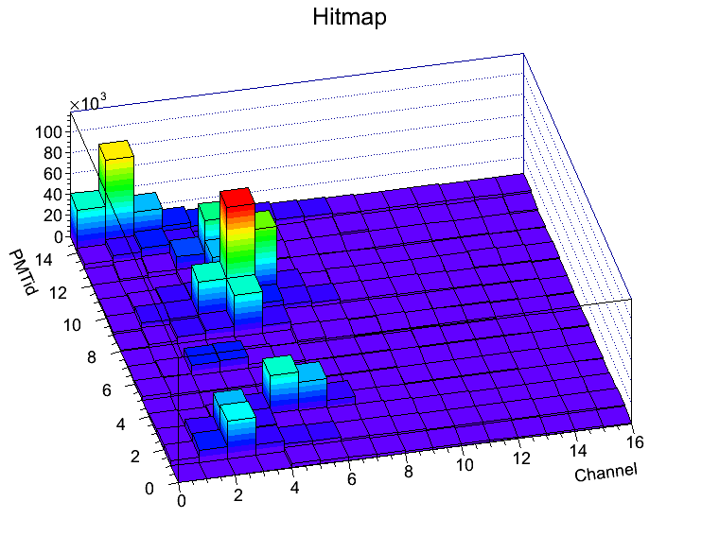
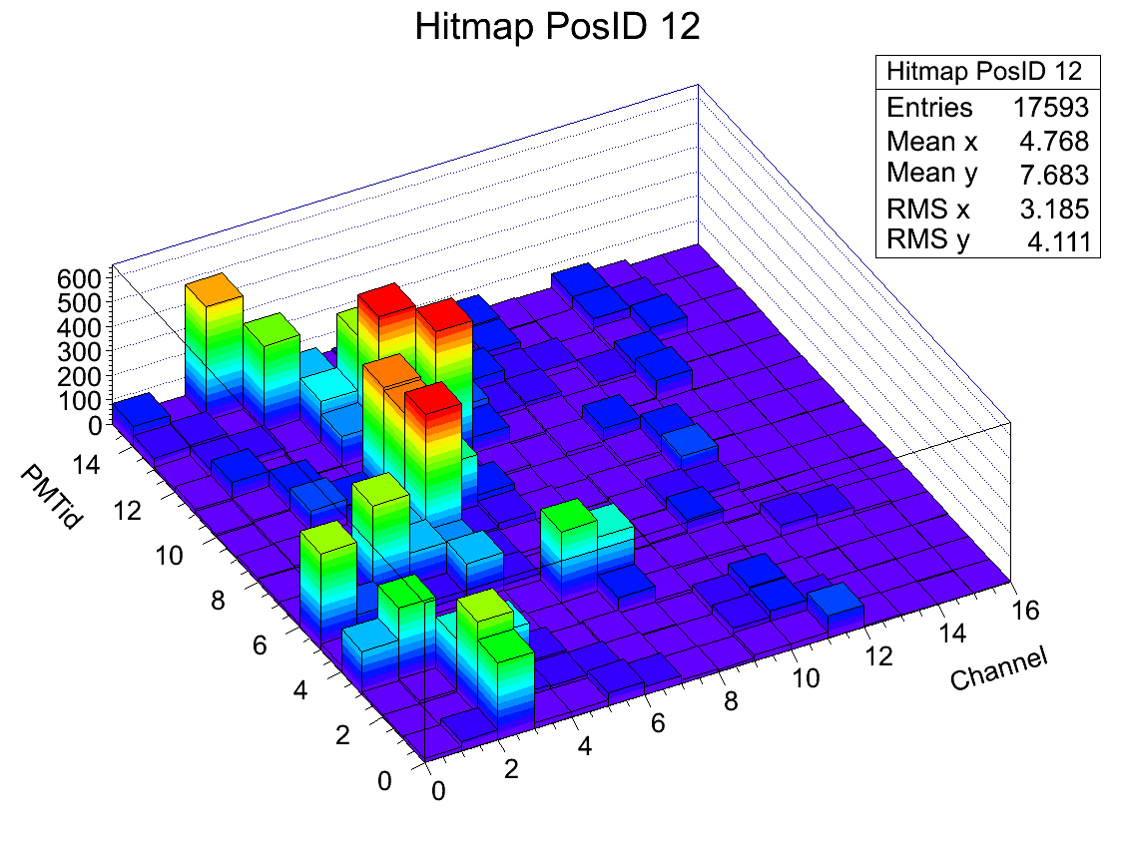
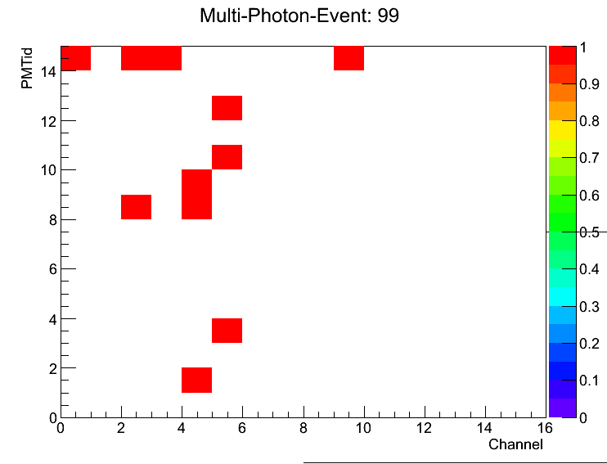
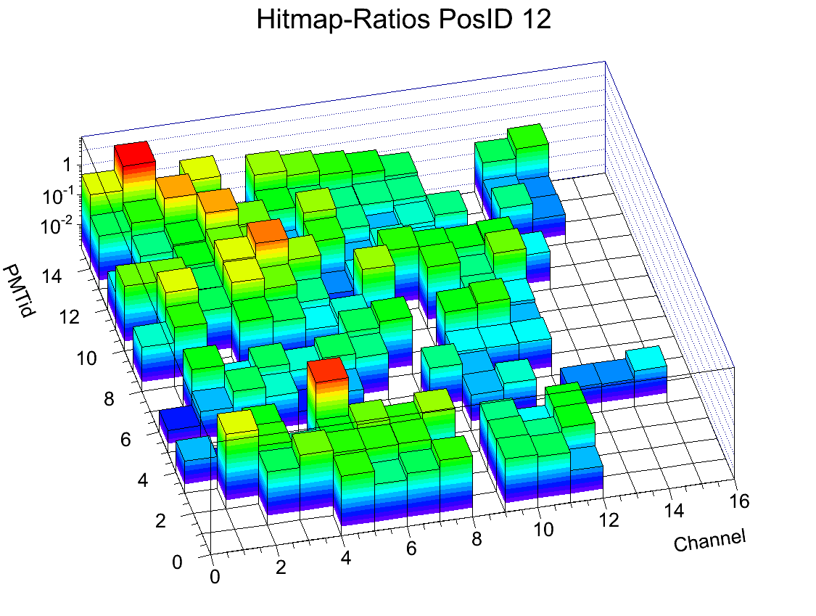
Angle Scan
4°
Data
MC

Slide 18
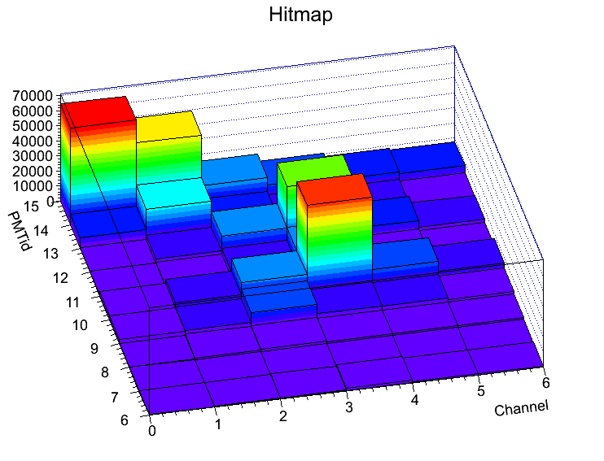
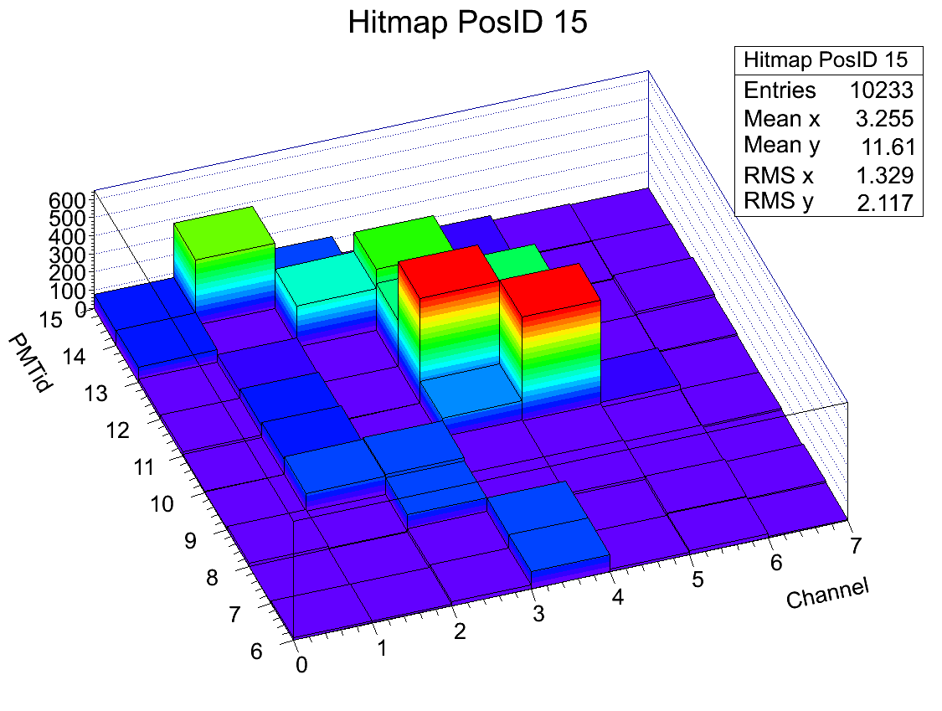
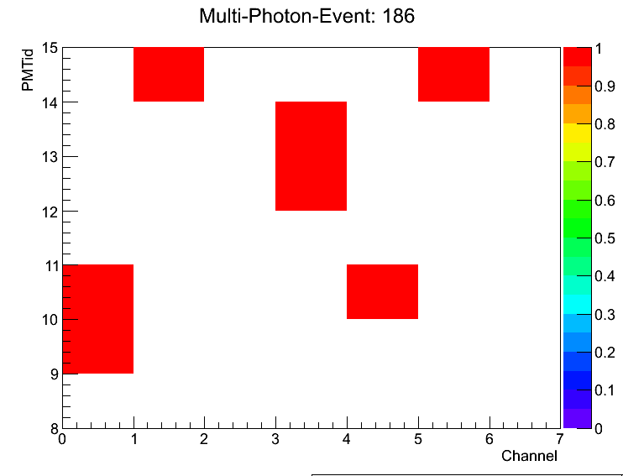
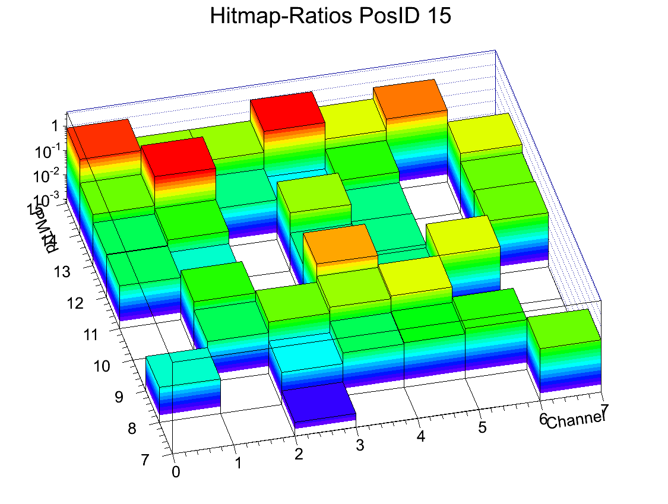
Angle Scan
7°
Data
MC

Slide 19
Results
Distance Scan
300k Events per position
14 Runs
Results
Hitmaps
MC-Ratio-Maps
Multi Events
Multiplicities
Hitmaps
MC Multi Events
Attenuation map
15 cm
2 cm
14 runs

Slide 20
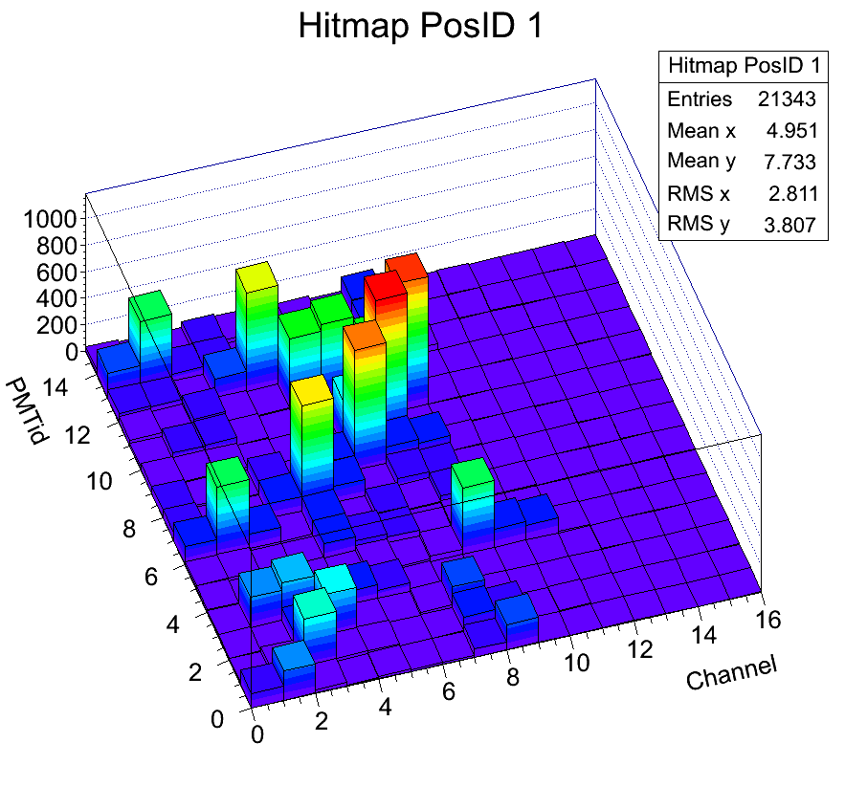
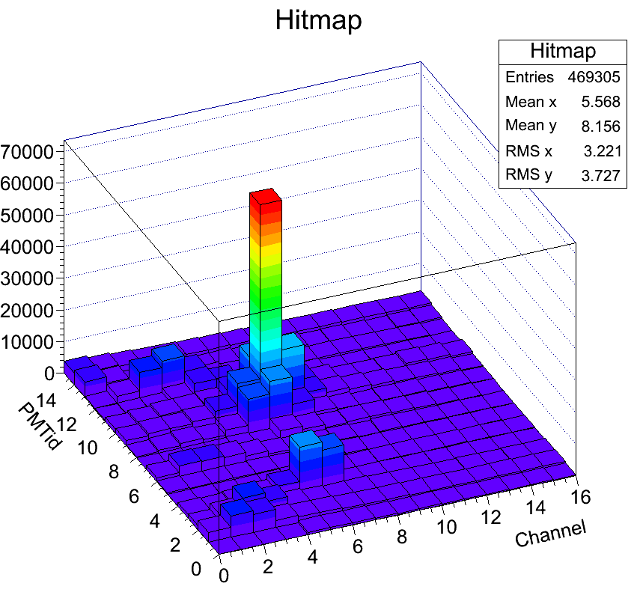
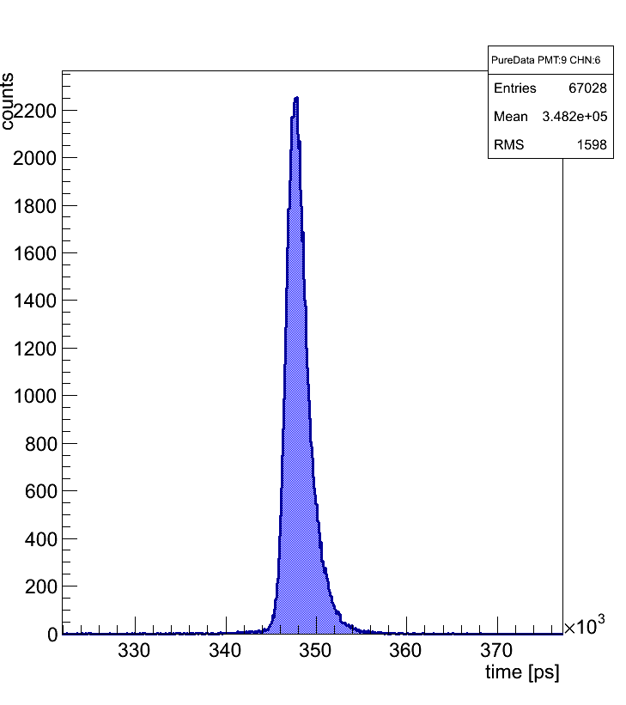
Distance Scan
15 cm
Data
MC (not normalized)
Did we hit the FLG??

Slide 21
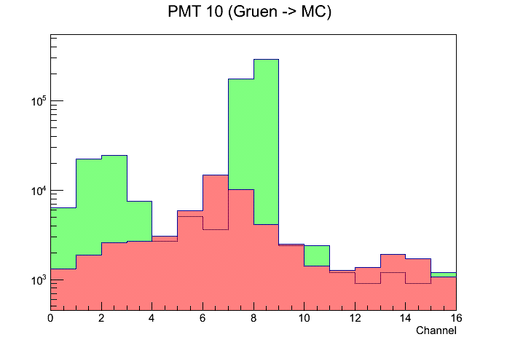
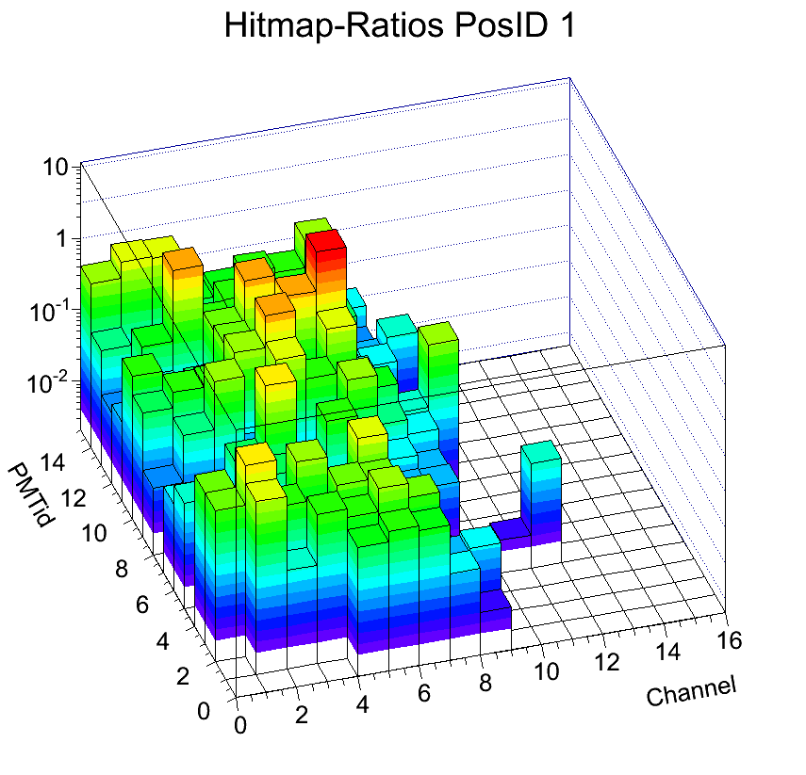
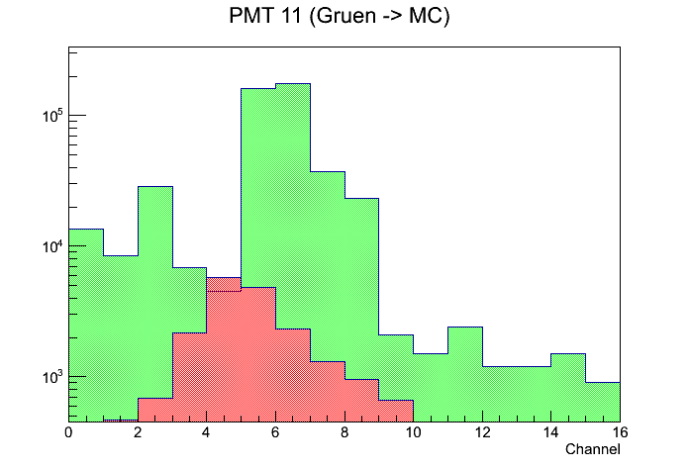
Distance Scan
15 cm

Slide 22
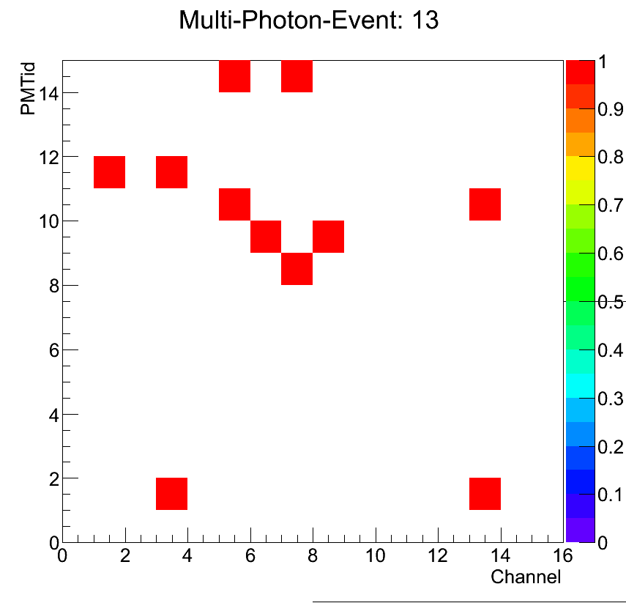
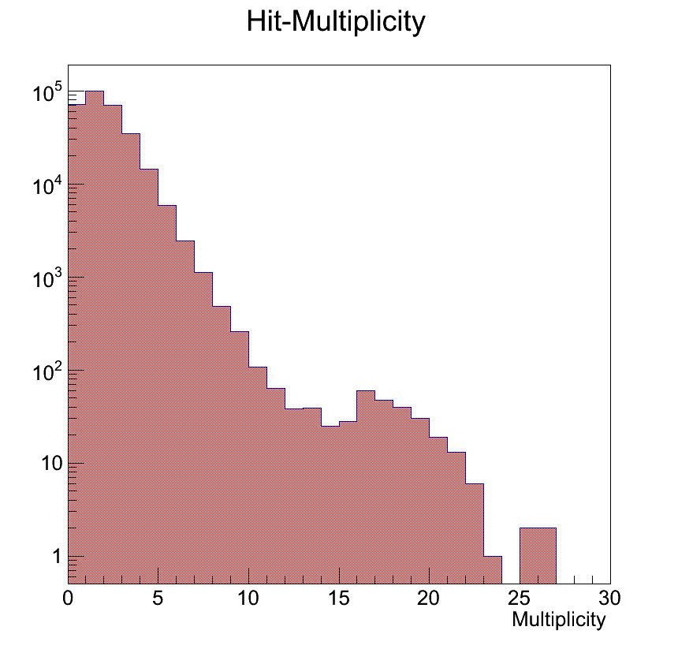
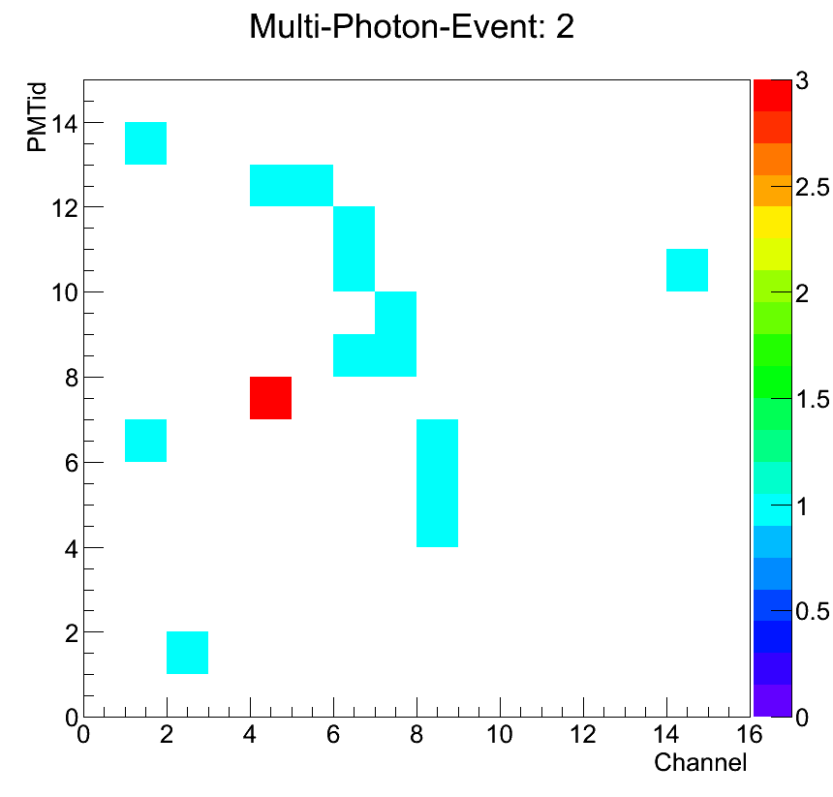
Distance Scan
15 cm
Why the increase?
Data
MC

Slide 23
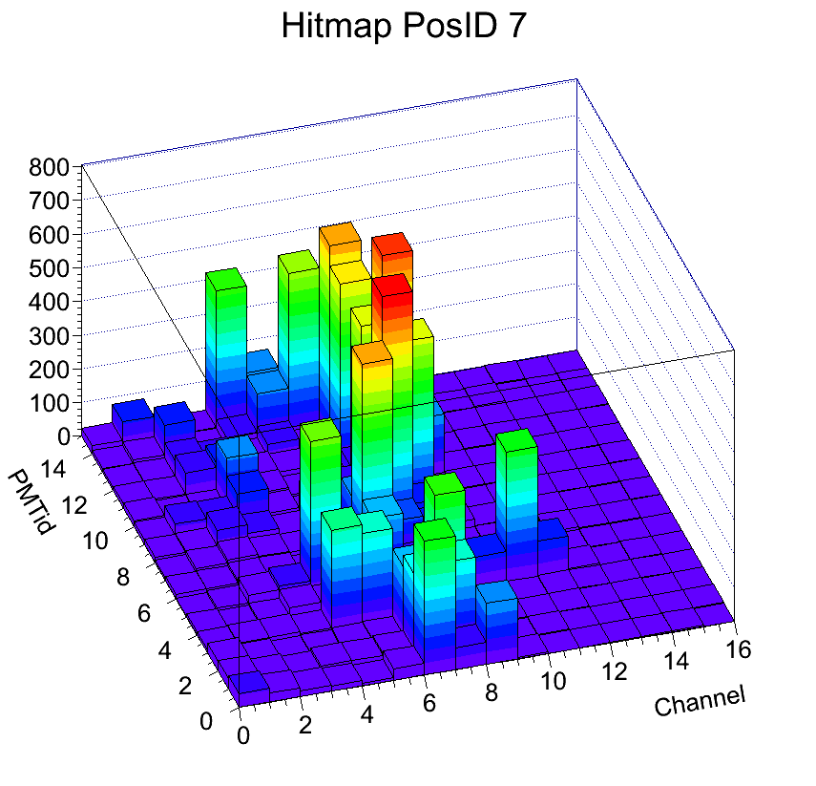
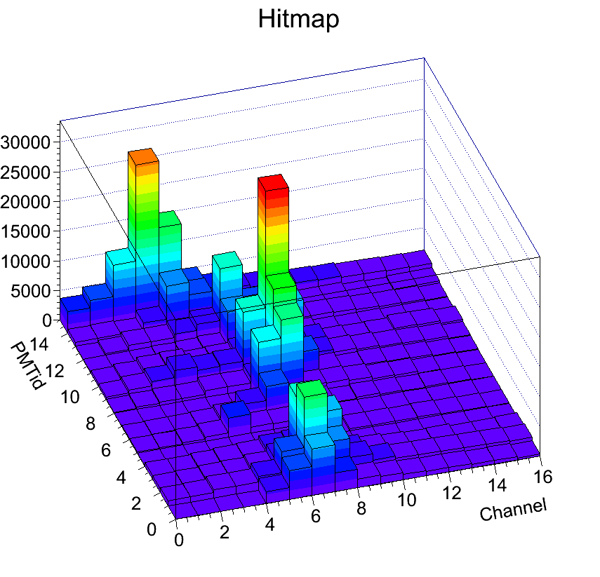
Distance Scan
27 cm
Data
MC (not normalized)

Slide 24
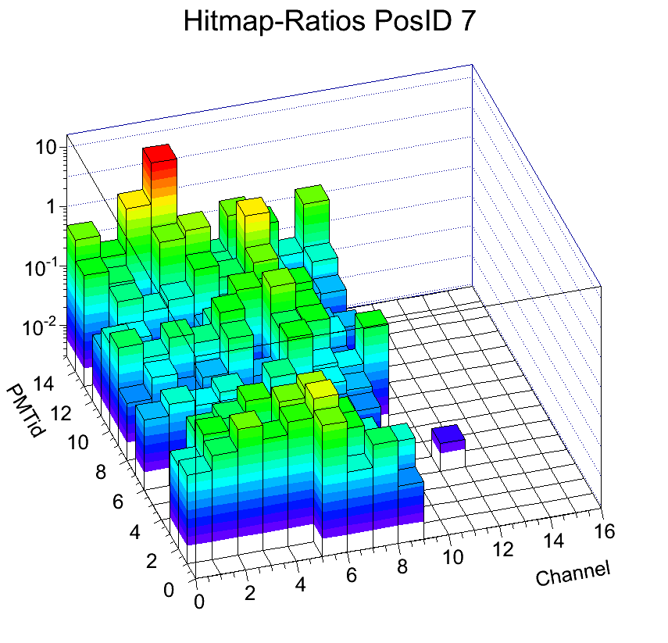
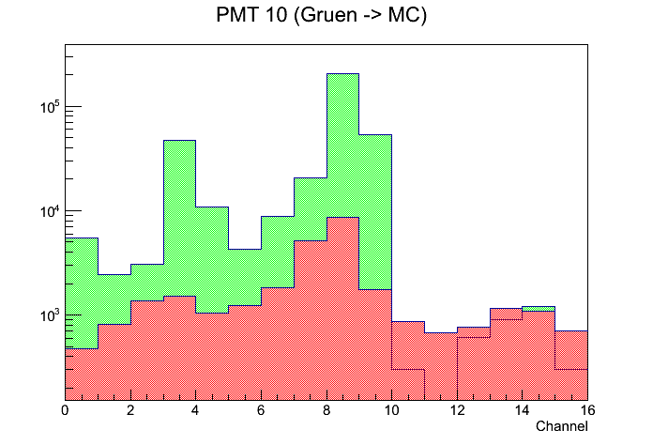
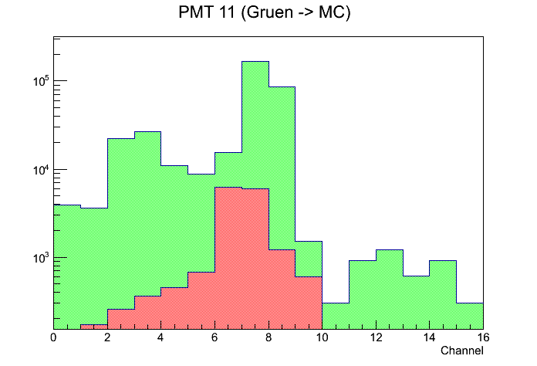
Distance Scan
27 cm

Slide 25
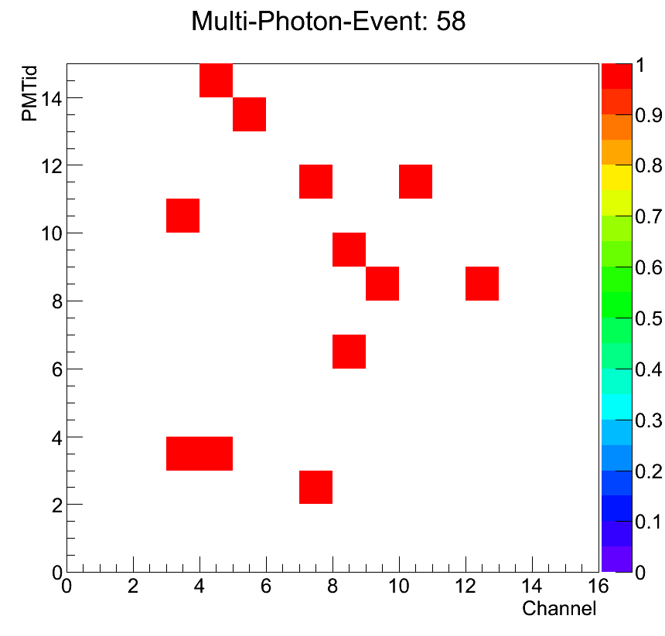
Distance Scan
27 cm
Data
MC

Slide 26
Distance Scan
41 cm
Data
MC (not normalized)

Slide 27
Distance Scan
41 cm

Slide 28
Distance Scan
41 cm
Data
MC

Slide 29
Distance Scan
How do entries vary over distance?

Slide 30
First Conclusions
The data shows obvious qualitative similarity to MC in all aspects.
There are however some issues that cause (massive) quantitative discrepancies between the two.
Electronics
Threshold on TOF-addon boards
Noisy PMTs fire all their pixels in one event (HV supply?)
Optical imperfections
Different transparencies of optical interfaces
Surface imperfections worsen reflectivity
Focusing quality of FLG
Mechanical misalignment
Sensor and FLG misalingment
Beam impact position

Slide 31
First Conclusions
My personal (somehow educated) guesses from looking at the data: 2 main problems
Missing photons: Electronics and Optics
Malfunction of TOF boards and threshold issue
Absorption of photons due to ‘photon-drains‘ along the paths (interfaces, rough surfaces etc.)
Unexpected impact positions of photons: Mechanics and Optics
Sensor misalignment
Electron impact position misalignment
Focusing properties
Please don‘t get me wrong: These are just guesses!
To really disentangle all of the possible effects more effort is inevitable!

Slide 32
Backup Slides

Slide 33
Experimental Setup
Lengths in mm

Slide 34
Experimental Setup
Readout Electronics
Rack (HV-Supply, Network Hub, Trigger-Logic)
Benno
DAQ-PC
Hodoscope (Trigger)

Slide 35
Experimental Setup

Slide 36
Experimental Setup

Slide 37
Experimental Setup
Electron energy recorded by EM-Calorimeter (TOT)
Triple coincidence required to trigger readout

Slide 38
Experimental Setup

Slide 39
Experimental Setup
PMT Signal Sockets
(4 x 32 TOF board)
Front board (TOF-addon) holds:
Pre-Amplification and Discrimination (NINO)
Conversion into LVDS signal
Back board (TRB-board) holds:
HP-TDC (Time measurement)
Network Connection

Slide 40
Conversion of Data
Let‘s do some semantics first...
Experiment
Scan
Run
Event
Hit
e.g. ‘Angle Scan‘: Includes measurements at 16 different angles
each of which has roughly 1M electrons that fired the trigger and caused
roughly 2 photons per electron to strike the sensors.

Slide 41
Conversion of Data
The big picture
Readout generates *.hld rawdata files consisting of 32 bit sequences (binary files)
Resulting files are first treated with the “Grzegorzkorcyl-Unpacker“ which converts the rawdata into root trees (Let‘s call them “Greg-Trees“) making the data easily accessible
Greg-trees were examined directly after the data was taken with Daniel Mühlheim‘s “Online Tool“ in order to check if the measurement was meaningful
The offline analysis (the main focus of this work) takes the Greg-Trees as lowest level input.

Slide 42
Conversion of Data
Greg-Tree
Contains unsorted rawdata of one run.
AGD-Tree
Cointains entire data sorted into data-classes so that all the information can be accessed directly and quickly (rather than having to read out the raw data over and over again). Time and energy spectra are computed and peaks in the spectra are automatically found. So from looking at the data a human being can decide if the selection criteria make sense and should be applied.
Cut-AGD-Tree
Event and hit selections can be applied to convert each AGD-Tree into its “Cut-Counterpart“. This tree is the same as the above but all events and hits that don‘t fulfill the selection conditions are no longer there. This tree contains the refined data and can be used to easily draw conclusions from the measurement.
Plots, Images, MC-Comparisons, Data -Sections etc.
Cut-AGD-Tree-Chain
To examine properties of a SCAN rather than isolated RUNS the trees corresponding to various runs of one and the same scan can be ‘thrown together‘ into a ‘chain‘ to be able to quickly loop an entire scan.
Every (graphical) representation of the data can be taken from the Cut-AGD-Tree or the Cut-AGD-Tree-Chain and can be shown or analysed.

Slide 43
Conversion of Data
Greg-Tree
n Events (ordered chronologically)
m Hits (ordered through TRB-Channels)
Pixel, ECAL, Reference Channel
Leading Edge
Trailing Edge
TRB-Channel
...
TDC
...
Structure of Greg Trees

Slide 44
Conversion of Data
AGD-Tree
AGD-run
k AGD-Hits
Run-ID
Electron Impact Position
n AGD-Events
ECAL TOT
Leading Edge (un)referenced
Trailing Edge
(un)referenced
Leading Edge
of Ref-Chan
Trailing Edge
of Ref-Chan
TDC
PMT-ID
Pixel-ID
Validity Flag
Linear ID
= 16 * PMT-ID + Pixel-ID
TRB
Data-File
Number of valid hits
Structure of AGD-Trees

Slide 45
Calibration
Example shown for one Sensor (14)
Compare unbinned MC to DATA
(including dead space)
Shift to match centers of gravity
Compute ‘Fake Data‘ (rebinned & taking into account dead spaces & normalization)
to estimate efficiency for each channel

Slide 46
Time Spectra
Why can‘t we do more with the time spectra? MC looks very interesting!

Slide 47
Time Spectra
Very complicated structure!
Just one leading and one trailing edge written out for every pixel in every event
All the interesting ‘late‘ structure ‘drowned‘ in direct hits
No measurement of absolute time available
Could be done by calibrating the direct photon peaks
Signal-to-Noise-ratio
→ Very messy business
→ Time information mainly used to focus out the direct hits

