Slide 1
Hit Triplet Finding in the PANDA-STT
Marius C. Mertens¹
Sean Dobbs², Jim Ritman¹, Peter Wintz¹
¹ Forschungszentrum Jülich
² Northwestern University

Slide 2
Outline
Part I → Focus on Tracking
Triplet Finding and Tracking in Axial Straws
STT Geometry in PandaRoot
Track Verification
Hitstream Display
Triplet Finding in Skewed straws: Skewlets
Summary/Outlook I
Part II → Focus on OnlineManager/Implementation
Triplet / Skewlet Finding Overview
Implementation in OnlineManager
Track/Hit Quality Criteria
Output to Hitstream Display
Summary/Outlook II

Slide 3
Triplet Finding in Axial Straws
Basic properties:
Finds tracks originating from the interaction point
Works in xy projection
No isochrone information used → Does not require t₀ or isochrone-drifttime calibration
Results:
Track candidates
Associated hits
t₀ seed for selected tracks (hit timestamp constraints, matching with other detectors)
Carried out in three steps:
Identification of hit triplets (or n-lets) around pivot cells
3 point circle calculation: Origin + 2 Triplets
Hit association via circle proximity

Slide 4
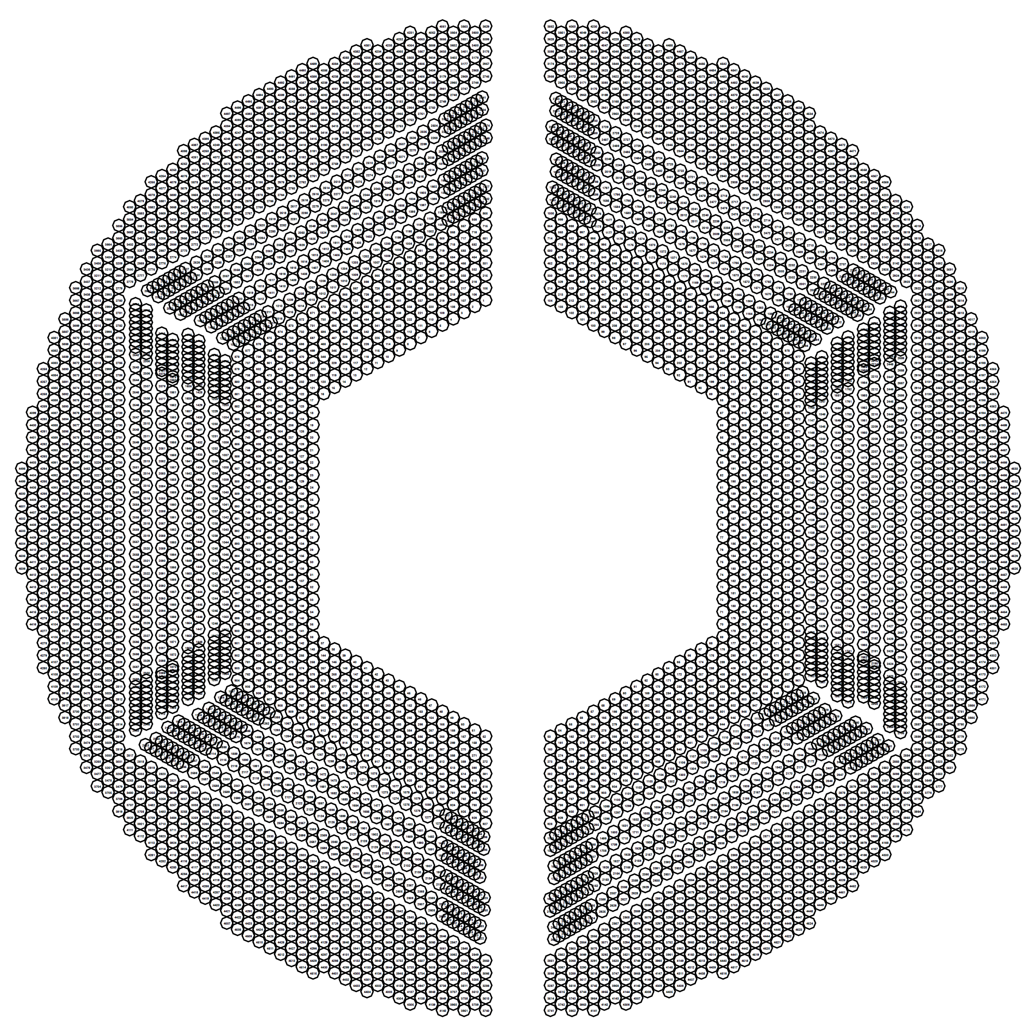
STT Geometry in PandaRoot
Axial pivot cells indicated
in one sector

Slide 5
Triplet Finding in Axial Straws
Pivot cell is checked for hit
Surrounding straws are checked for hits
Center of mass of fired straws is calculated (small number of combinations → suitable for lookup table)

Slide 6
Triplet Finding in Axial Straws
Once two triplets are found, calculate circle through origin
Associate nearby hits with track candidate
Track Verification:
Currently mix of curvature and associated hits
Lots of room for improvement
Further possibilites:
Distance sorting, Concurrent associations, Clutter veto, …
Missing straw compensation: Pivot Straw triggered by neighbor straws
Weight hits according to timestamp
Improved Triplet merging
Interaction Point

Slide 7
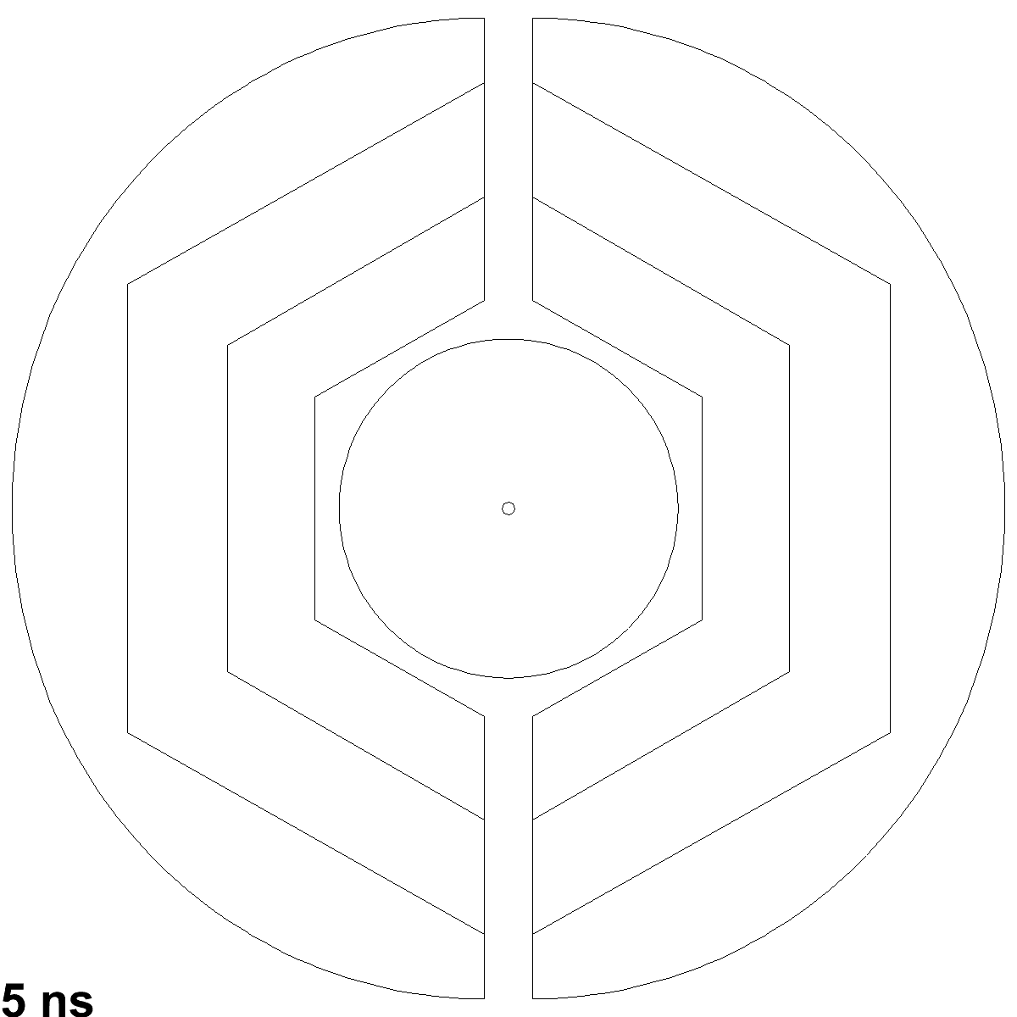
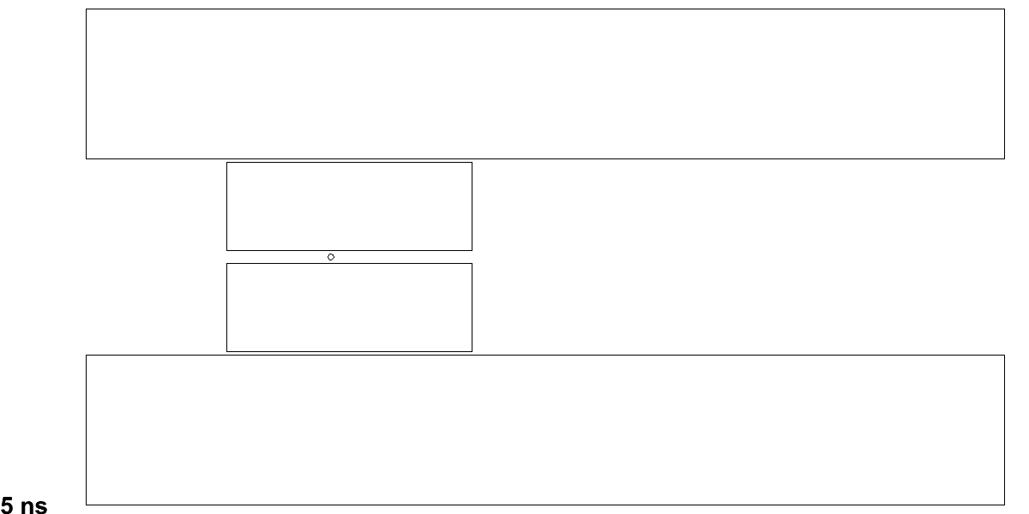
Hitstream Display: 15 GeV/c DPM, 50 ns mean time
RZ-View
XY-View
Black circles: Early isochrone
Blue circles: Early skewed isochrone
Green circles: Close isochrone
Red circles: Late isochrone
Black dots: MVD hits
Green dots: MVD hits r/z > 0.3
Black+Red dots: Triplets/Skewlets
Yellow tracks: Vetoed
Blue tracks: Accepted

Slide 8
Triplet Finding in Skewed Straws: Skewlets
Skewlet layers indicated
in one sector

Slide 9
Triplet Finding in Skewed Straws: Skewlets
Triplet search in individual skewed double layers
Combination of adjacent double layers‘ Triplets to Skewlets
Track matching in xy-projection
Extraction of z-information

Slide 10
Interlude Summary/Outlook
Part I
Proof of concept Triplet Finder tested with DPM input
Robust first-line algorithm independent of isochrone (t₀) information and drifttime calibration
Visual inspection yields promising results
Many (straightforward) tuning possibilites affecting efficiency, purity and robustness
Part II
Implementation within OnlineManager → Sean‘s talk
Triplet Finder runs as compiled code and uses OnlineManager‘s data flow
Animated visualization in HitstreamDisplay
Outlook:
Implementation of hit association quality property
Merge with canonical PandaRoot tools
Long term goal: Track-to-event association

Slide 11
Part II

Slide 12
Outline
Part I → Focus on Tracking
Triplet Finding and Tracking in Axial Straws
STT Geometry in PandaRoot
Track Verification
Hitstream Display
Triplet Finding in Skewed straws: Skewlets
Summary/Outlook I
Part II → Focus on OnlineManager/Implementation
Triplet / Skewlet Finding Overview
Implementation in OnlineManager
Track/Hit Quality Criteria
Output to Hitstream Display
Summary/Outlook II

Slide 13
STT Geometry in PandaRoot
Axial pivot cells indicated
in one sector (red)
Skewlet layer indicated
in one sector (orange)

Slide 14
Continuous Online Tracking: Status Sep. 2012
Cluster Finding
Hit Building
Sorting:
Arrival Time
→
Hit Time
Detector Hits
Detector Hits
Detector Hits
Digi
Reco
Digi/Reco
Hitstream Display

Slide 15
Continuous Online Tracking in OnlineManager
Detector Hits
Cluster Finding
Hit Building
Sorting:
Arrival Time →
Hit Time
Detector Hits
Detector Hits
Time Ordered Simulation
Hits
Tracklets
Tracks
Events
Functor Based Reader
Triplet
Finder
PndOnlineManager
Reconstruction Algorithms
Hitstream
Display
(FairTask)

Slide 16
Track/Hit Quality Criteria
Possible Extensions in Track Quality Measurement
Hit distance to track order should correspond to hit timestamp
Add extrapolations to other detectors
Concurrent hit association / clutter criterion
…
Implementation Sketch
Hits are assigned to tracks with their quality measure
Algorithms access and update the quality measure (may also reject processing if quality is already marked as very good)
Same principle: Association of tracks to events

Slide 17
Output to Hitstream Display
Analysis / Track Finding Part
OnlineManager provides hits
Triplet Finder processes hits and generates Triplet lists
Track candidates are sent to OnlineManager
Visualization Part
OnlineManager provides OnlineTracks
Display Macro has functions to draw the different objects stored in the lists for display

Slide 18
Hitstream Display: 15 GeV/c DPM, 50 ns mean time
RZ-View
XY-View
Black circles: Early isochrone
Blue circles: Early skewed isochrone
Green circles: Close isochrone
Red circles: Late isochrone
Black dots: MVD hits
Green dots: MVD hits r/z > 0.3
Black+Red dots: Triplets/Skewlets
Yellow tracks: Vetoed
Blue tracks: Accepted

Slide 19
Summary/Outlook
Part I
Proof of concept Triplet Finder tested with DPM input
Robust first-line algorithm independent of isochrone (t₀) information and drifttime calibration
Visual inspection yields promising results
Many (straightforward) tuning possibilites affecting efficiency, purity and robustness
Part II
Implementation within OnlineManager → Sean‘s talk
Triplet Finder runs as compiled code and uses OnlineManager‘s data flow
Animated visualization in HitstreamDisplay
Outlook:
Implementation of hit association quality property
Merge with canonical PandaRoot tools
Long term goal: Track-to-event association
Thank you for your attention

