Slide 1
Continuous Online Tracking FRAMEWORK
Sean Dobbs
(Northwestern U.)
M. Mertens, J. Ritman, P. Wintz
(FZ Jülich)

Slide 2
Motivation
PANDA is planned to run with a quasi-continuous beam and triggerless readout at high rate (up to 2x10⁷ events/s)
“Interesting” events are many orders of magnitude more rare than the “uninteresting” events, but often have similar topologies.
Software trigger needs well reconstructed tracks
This creates a demanding situation for online tracking
Needs to be robust against low-p_{T} tracks, displaced vertices, decays-in-flight, etc.
Need to determine which particles come from which event.

Slide 3
Setting the Scale of the Problem
LHCb
pp collisions, √s = 7(8) TeV @ 20 MHz
Hardware L0 triggers on muons, calorimeter energy, reduces event rate to 1 MHz (limited by FEE, upgrade plans to read out at full rate)
HLT runs offline algorithms (or slightly simplified versions) on >15000 processors (>25000 instances), reducing event rate to 3 kHz
Notes:
average 2.5 interactions per bunch crossing,

Slide 4
How does PANDA compare with LHCb?
PANDA: pp collisions, √s = 2.5 – 5 GeV
Event rate from FEE is an order of magnitude higher
PANDA: 20 MHz, LHCb 1 MHz
Individual channels in PANDA have < 1 MHz
Event complexity is an order of magnitude lower
Average number of tracks/event: PANDA ~5, LHCb ~70
Data rate for both experiments is comparable
PANDA has more complicated geometry
Target spectrometer in addition to forward spectrometer
No a priori knowledge of event timing
Comparable online processing resources

Slide 5
Continuous Online Tracking
The constraints on online tracking are:
Triggerless readout
High event rate
Continuous beam
Different track topologies
Various types of tracks must be reconstructed on a non-event-based, “continuous”, basis
Algorithms should be selected which maximize speed and reconstruction efficiency while using a reasonable amount of computing resources.
Notes:
Both track reconstruction and cost efficiency

Slide 6
Continuous Online Tracking Framework
Algorithms must be tested with time-based simulations and benchmarked against key physics channels
To this end, we have developed a prototype framework for running and evaluating tracking algorithms
Tests continuous tracking data flow
Development has focused on STT & MVD detectors

Slide 7
Framework for Algorithm Development
Reads in hits from time-based simulation
Runs series of algorithms and keeps running track of results
Hits → Tracks → Events
Standard classes are wrapped or extended to store online-specific information, e.g., t₀
FairRunAna handles ROOT I/O, geometry
Most detectors do local clustering, simple geometry needed for straw tubes due to long drift times
Simple event display to facilitate development
Example: Triplet finder

Slide 8
Detector Hits
Cluster Finding
Hit Building
Sorting:
Arrival Time →
Hit Time
Detector Hits
Detector Hits
Time Ordered Simulation
PndOnlineManager
Functor-based Reader
Hits
Tracklets
Tracks
Events
(FairTask)
Reconstruction Algorithms
Software Trigger
Event Display

Slide 9
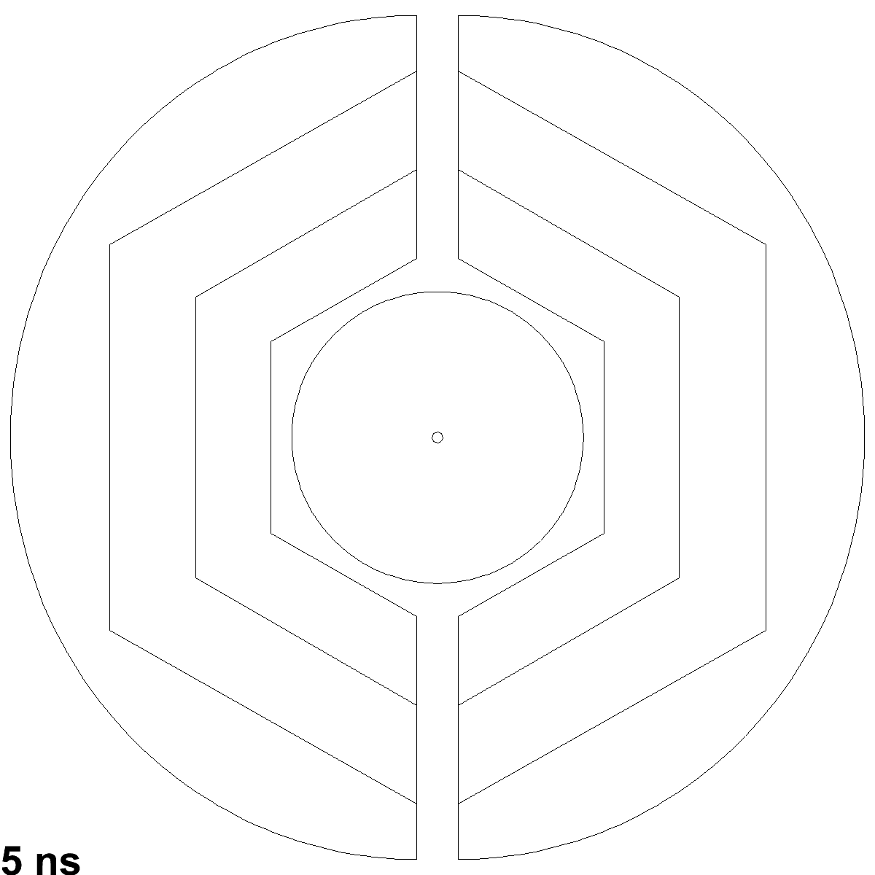

Slide 10
Summary
PANDA online tracking needs to reconstruct a variety of different track topologies in a demanding environment.
Algorithms must be tested with realistic, time-based simulations
A framework for running and evaluating these algorithms is under development
Short term: Standardize and make available in SVN
Future: Integration with other infrastructure (Event Dispatcher), execution on GPUs & Compute Nodes
Other detectors easily integrated (forward tracking?)
We look forward to contributions from many others!

