Slide 1
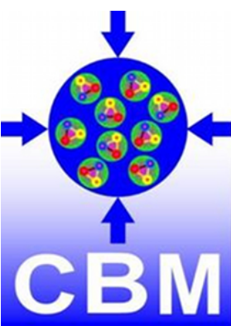
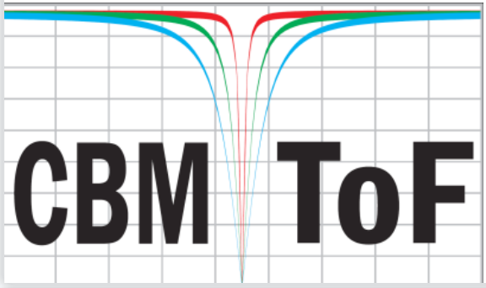
Counter Production Readiness Review (PRR) of MRPC2 Detector in CBM-TOF System
Kai Sun, Yi Wang, Ingo Deppner
Tsinghua University, Beijing, China
Notes:
】

Slide 2
Outline
Introduction
Description of MRPC2
Material preparation of MRPC2
Production of MRPC2
QA ＆ QC
Performance of MRPC2

Slide 3
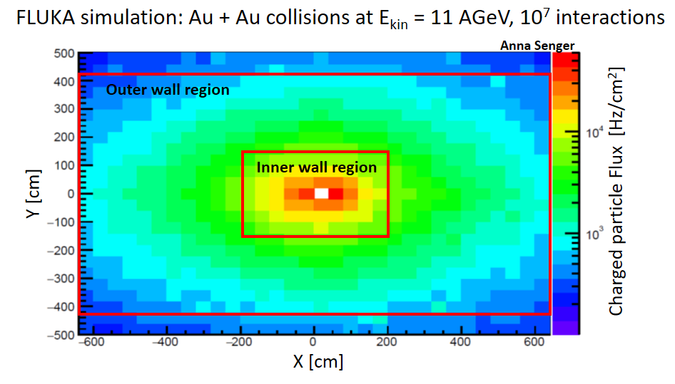
Introduction of CBM-TOF Wall
The CBM-TOF wall is subdivided into two parts called the inner wall and the outer wall:
Inner wall: charged particle fluxes range between 5 kHz/cm² and 30 kHz/cm².
Outer wall: charged particle fluxes range between 0.1 kHz/cm² and 5 kHz/cm².
MRPC2 detectors belong to the outer wall and cover the area where the charged particle fluxes range between 1 kHz/cm² and 5 kHz/cm².

Slide 4
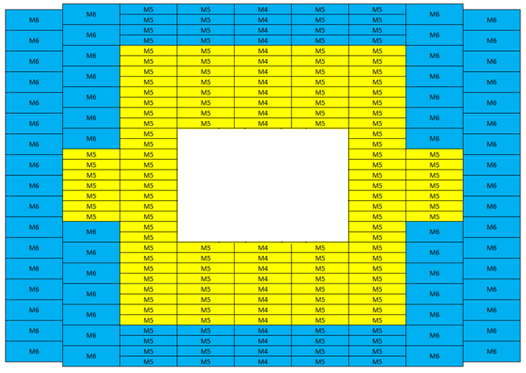
Introduction of CBM-TOF Wall
Requirements of MRPC2(Yellow Region) in CBM-TOF Wall:
Efficiency: > 95%
Time Resolution: better than 80 ps
Rate Capability: ＞ 5 kHz/cm²
Granularity: ＜ 30 cm²

Slide 5
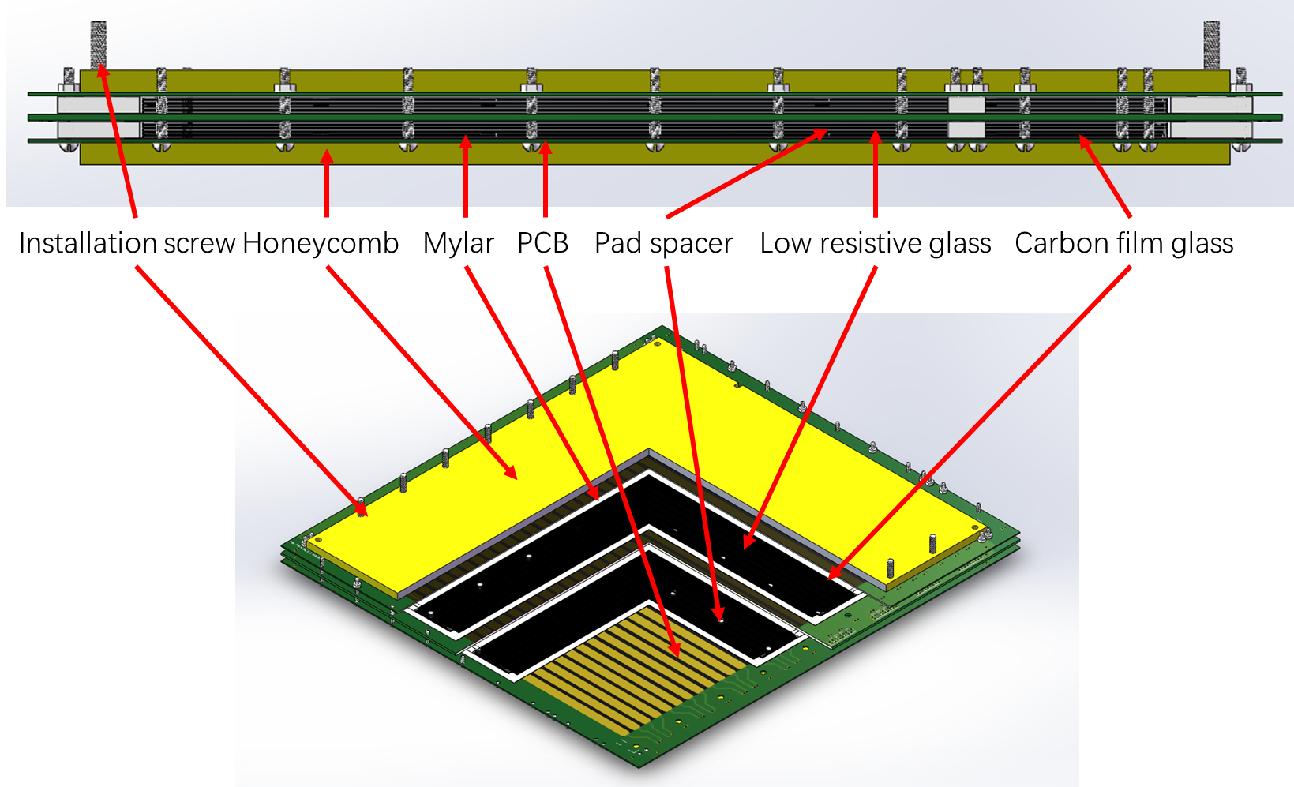
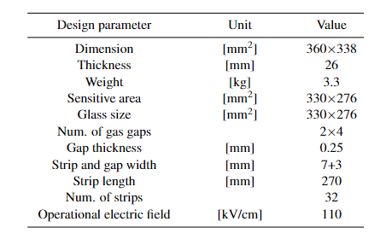
Description of MRPC2
Main design parameters of MRPC2
Section and structure view of MRPC2
Honeycomb
Top PCB
Mylar
Carbon film glass
Glass*3
Carbon film glass
Mylar
Mid PCB
Mylar
Carbon film glass
Glass*3
Carbon film glass
Mylar
Bot PCB
Honeycomb

Slide 6
Material preparation of MRPC2
Material | Length /[mm] | Width /[mm] | Thickness /[mm] | Amount | Others
Low-resistive glass | 330±0.2 | 276±0.2 | 0.7±0.02 | 10
Carbon film | 324±0.5 | 270±0.5 | 0.005 | 4
TOP PCB | 360±0.2 | 338±0.2 | 0.8±0.05 | 1
Mid PCB | 360±0.2 | 338±0.2 | 0.8±0.05 | 1
Bot PCB | 360±0.2 | 338±0.2 | 1.6±0.05 | 1
Honeycomb board | 333±1 | 310±1 | 6±0.2 | 2
Mylar | 340±0.2 | 286±0.2 | 0.25±0.02 | 8
Carbon film tape | 50 | 50 | 0.13±0.2 | /
A type fix block | 23±0.2 | 10±0.2 | 4±0.05 | 4 | 3D-Print
B type fix block | 14±0.2 | 10±0.2 | 4±0.05 | 2 | 3D-Print
Pad Spacer | Φ=4 | Φ=4 | 0.25±0.005 | 448 | Made of Mylar
M2.5 Screws | 40 | 2.5 | / | 32
M4 Screws | 40 | 4 | / | 16
Protection resistor | / | / | / | 128 | 0603
Fix pin | 19 | Φ=0.6 | / | 100
2×9 signal pin | / | / | / | 16

Slide 7
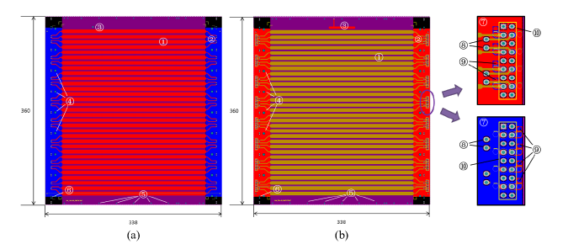
Material preparation of MRPC2

Slide 8
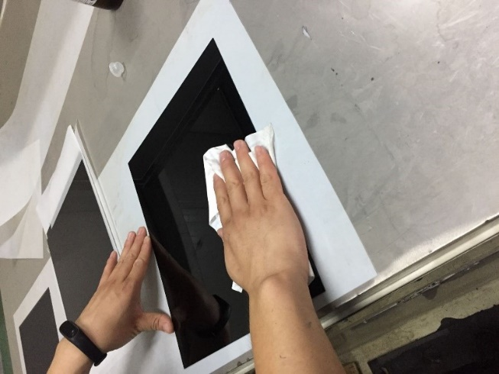
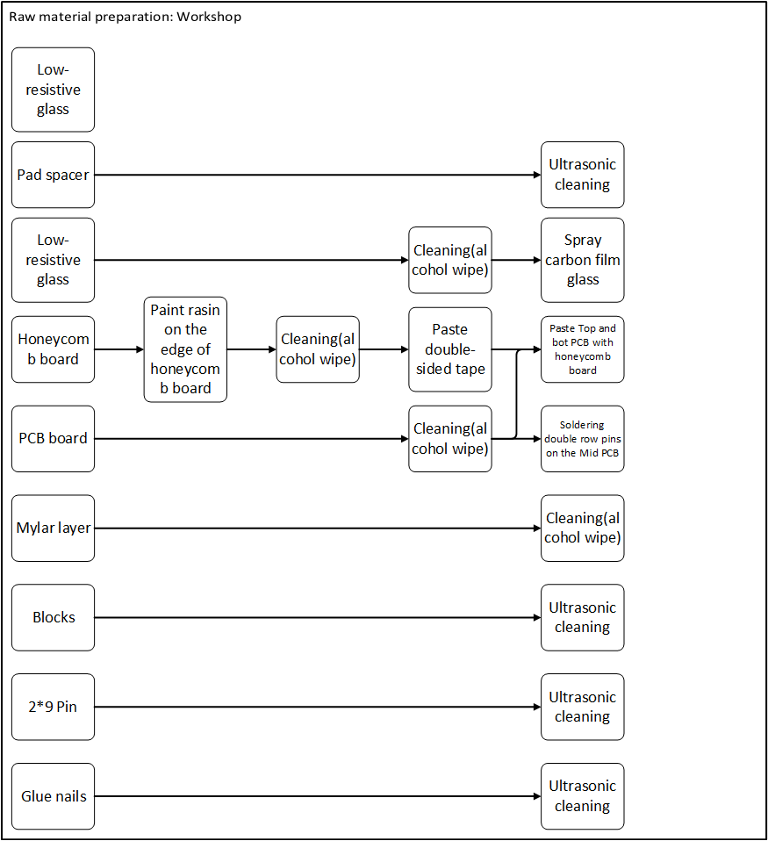
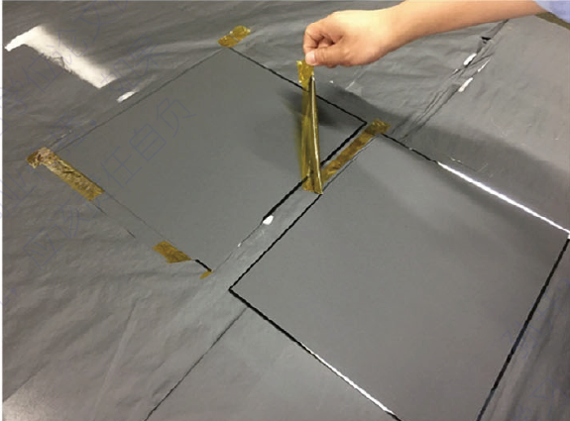
Material preparation workflow
Low resistive glass
  Clean
  Spray carbon film
  Glue pad spacer
PCB
  Soldering 2×9 signal pin
  Soldering protection resistor
Mylar
  Slotted for high voltage
Honeycomb
High voltage lines
Other fix pin and fix blocks
Cleaning glass
Spray machine
  Spray carbon film

Slide 9
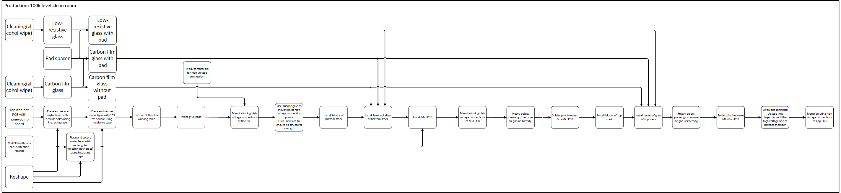
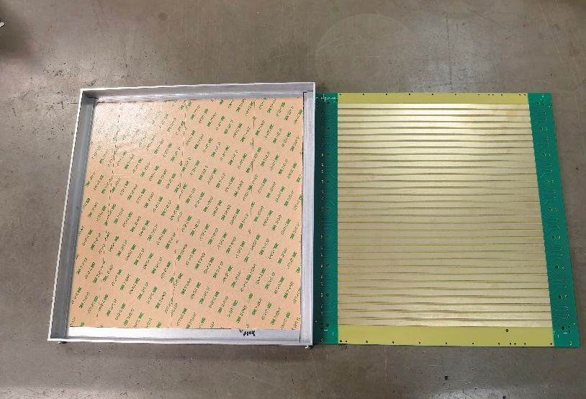
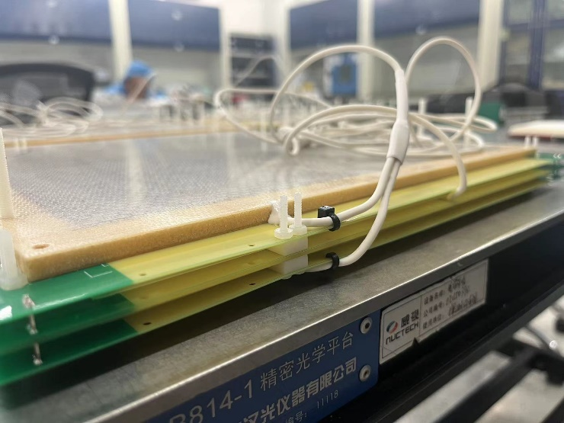
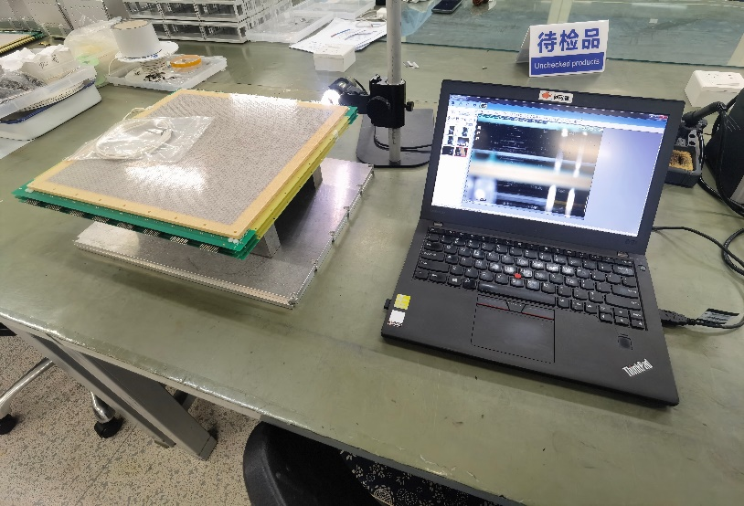
Production of MRPC2
Glue the honeycomb panel on the PCB
HV connection
Test of gap thickness

Slide 10
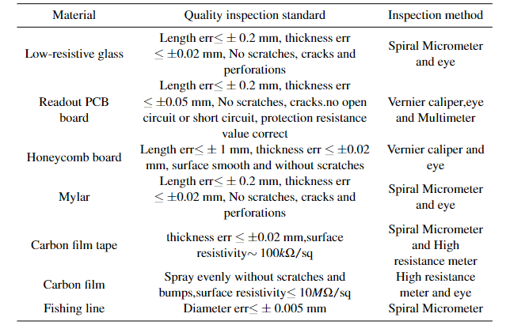
QA ＆ QC
Dimensional inspection of key materials

Slide 11
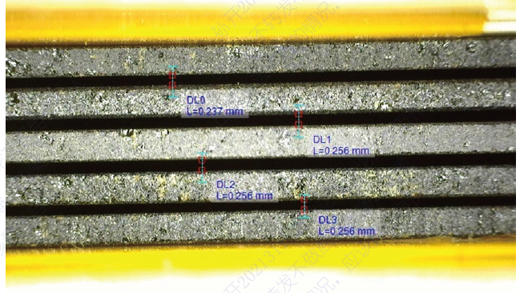
QA ＆ QC
Other inspections
Low resistive glass
  Dark current smaller than 80nA under ±6000 V (spot test for each batch of glass)
Uniformity of the detector gas gap
  directly observing gap with a digital microscope
Signal connection
  Use a multimeter to test circuit connection
HV test and cosmic test for MRPC2 produced
MRPC gap image

Slide 12
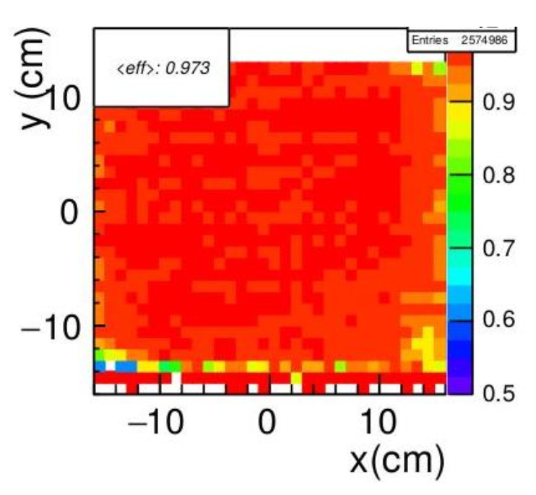
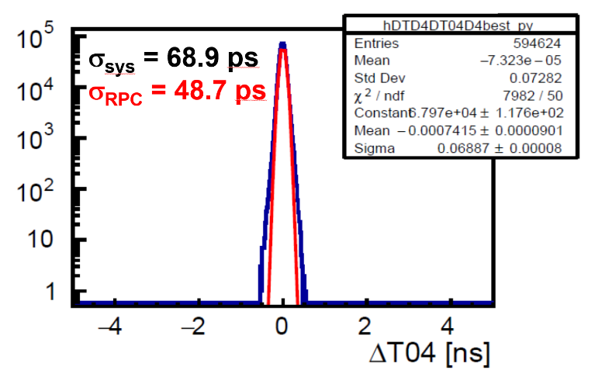
Performance of MRPC2
  Efficiency distribution of an MRPC2 at mTOF
Time resolution of MRPC2 at mTOF

Slide 13
The first batch of mass production of
75 MRPC2 has started.
Thank you!
yiwang@mail.tsinghua.edu.cn

