Slide 1



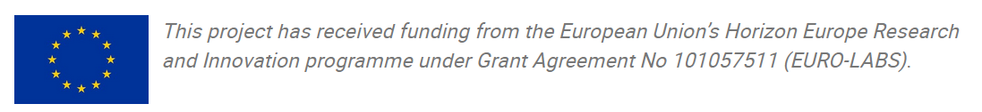

European Infrastructures for Open Science
… and other things
Andrew Mistry
EURO-LABS Advanced Training: Open Science and Data Management
CC-BY 4.0

Slide 2
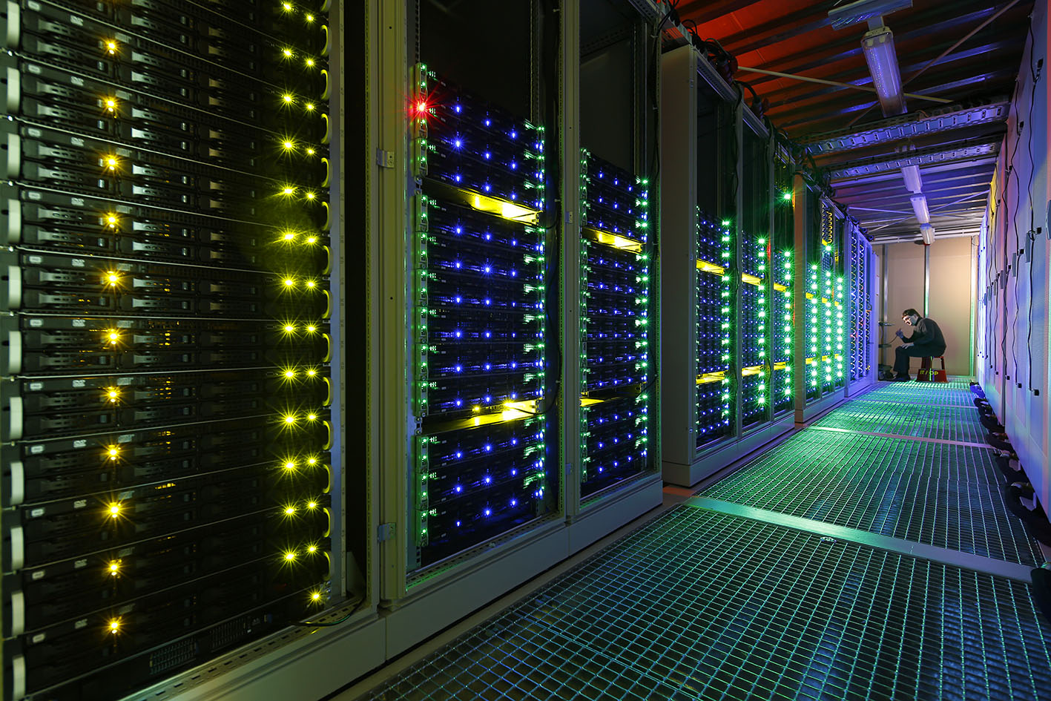
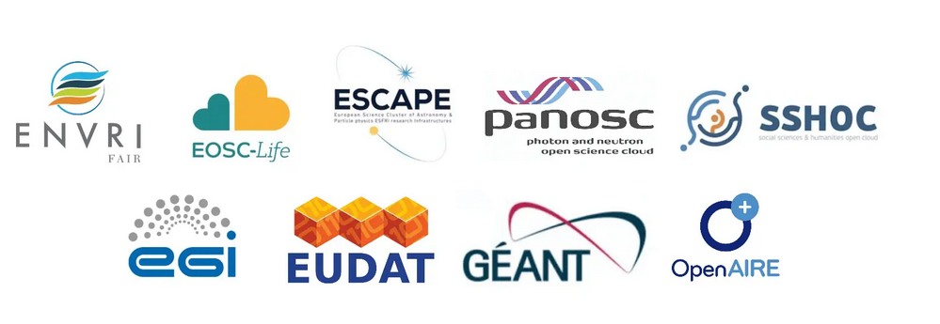
What Are European Infrastructures for Open Science?
A set of initiatives, services and platforms designed to drive Open Science across Europe:
Make research Outputs openly accessible and reusable while developing collaboration and innovation
Some Examples:
Infrastructure
EOSC
Zenodo and Data repositories
B2 Services by EUDAT
ESCAPE, PAnOSC…
Policies and Initiatives
Horizon Europe
Research Data Alliance
Training and Community Building
FAIRsFAIR
EUROLABS
…

Slide 3
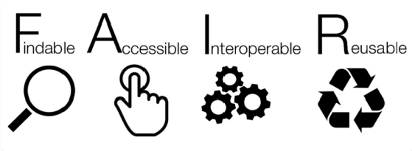
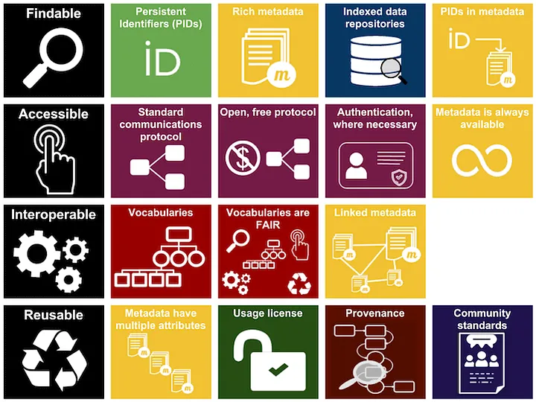
F.A.I.R. Principles outlines (briefly for info)
https://www.go-fair.org/fair-principles/
Findable
• Centrally orchestrated storage and access of data essential to enable the data/software to be findable.
• Usage of Persistent IDentifiers (PID), Digital Object Identifiers (DOI) -> Guarantee access to Digital Research Objects.
Generation of ‘data record’ in discipline specific repositories
Accessible
• Data and software produced/dedicated for F.A.I.R communities and publications centrally stored
• Common & “user-friendly” interface to store and retrieve data
Interoperable
• Common metadata formats
• F.A.I.R-produced data operable with other datasets
Reusable
• Ensure (as reasonably as possible) data stored long term
• Metadata should be retained indefinitely
Image credit: ARDC licensed under a Creative Commons Attribution 4.0 International License

Slide 4

European Open Science Cloud (EOSC)
https://eosc.eu/
The EOSC vision is to set up a ‘Web of FAIR Data and Services’ for science in Europe. Central to this ambition is the deployment of a trusted, virtual, federation of existing infrastructures in Europe to store, share and reuse FAIR research outputs across borders and scientific disciplines also called the “EOSC Federation”.
EOSC is:
a vision
a portal
a community
a partnership
a Horizon Europe funding programme
a work in progress…
EOSC is not:
a cloud infrastructure
a new research data repository
a new pan-European e-infrastructure
synonymous with Open Science
substituting existing e-infrastructures.…
owning any data
engaging directly with individual researchers

Slide 5























European Open Science Cloud
Nodes
“the EOSC Federation will consist of multiple EOSC Nodes that are interconnected and can collaborate to share and manage scientific data, knowledge, and resources within and across thematic and geographical research communities.
The EOSC Nodes will be entry points for users to the EOSC Federation, with each node offering its own and possibly third-party services, including data reposing and accessing services.”
Within Horizon Europe

Slide 6
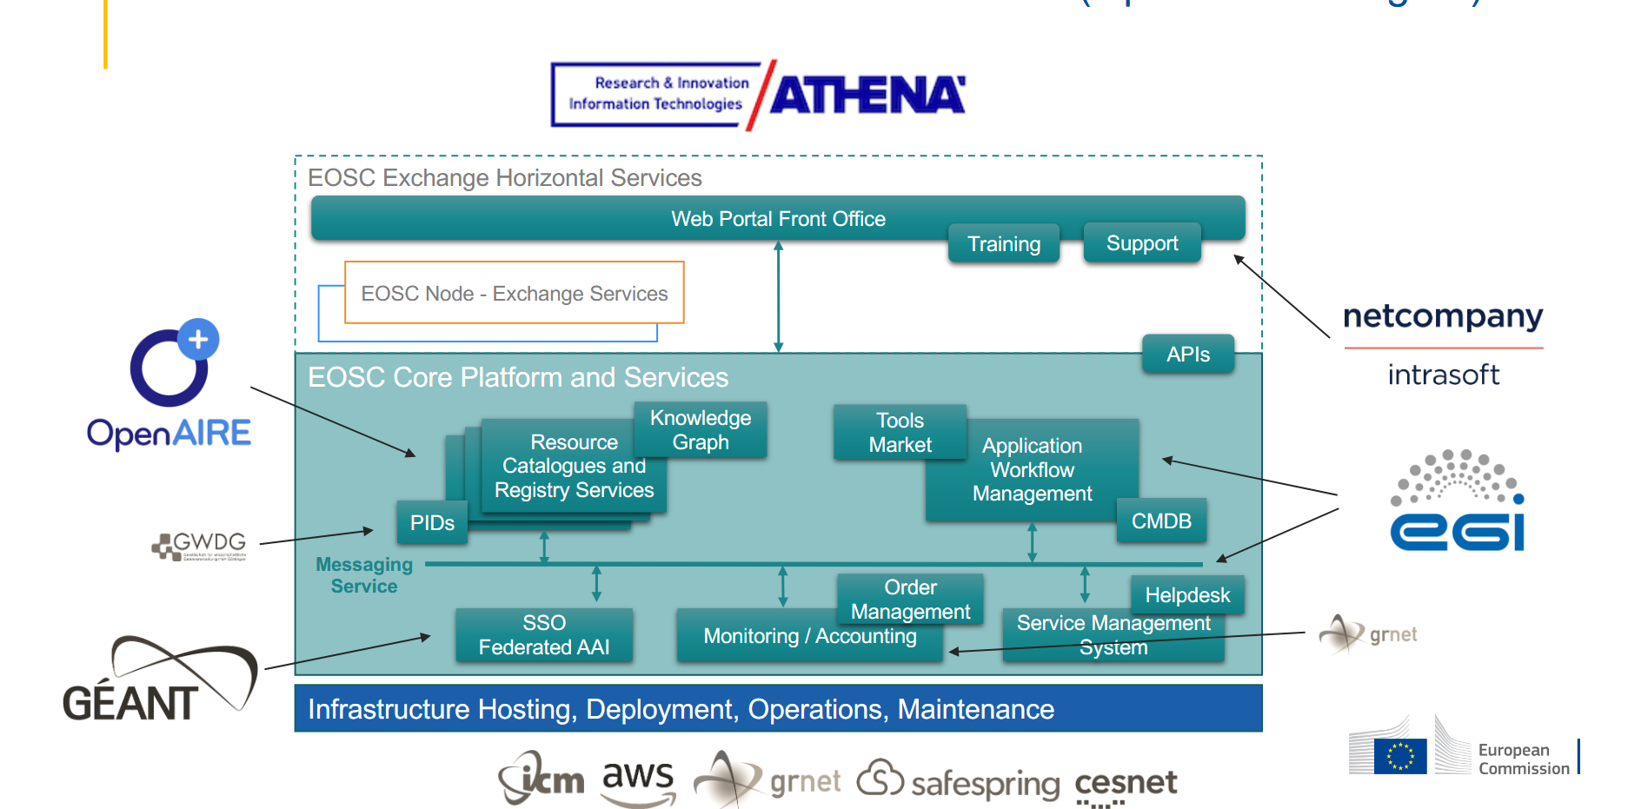
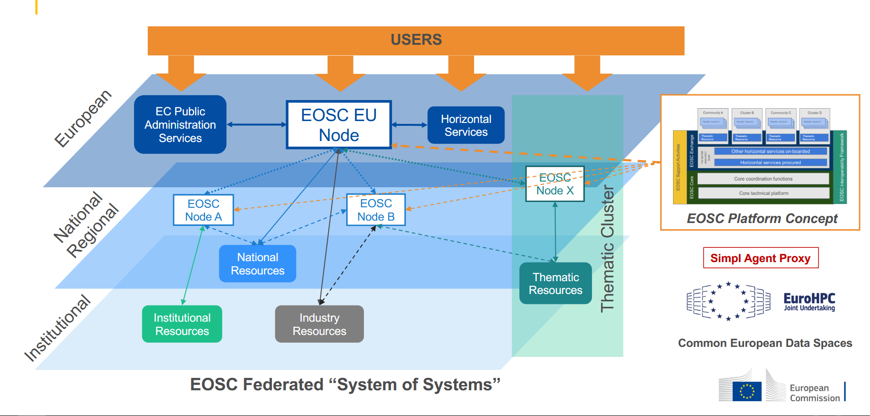
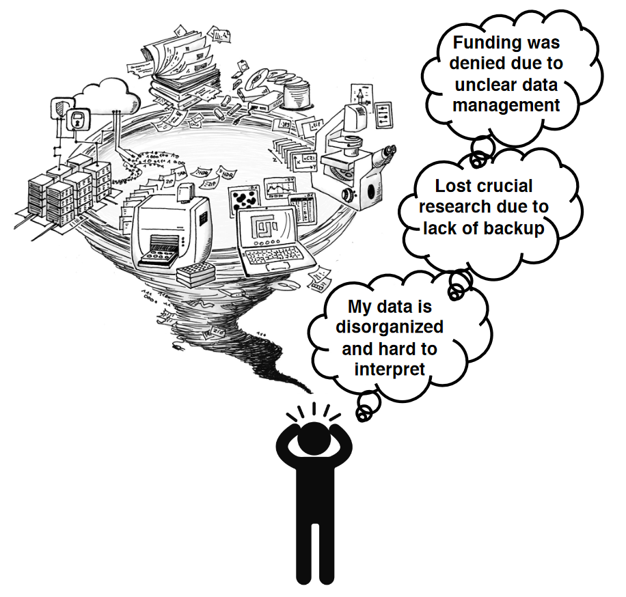
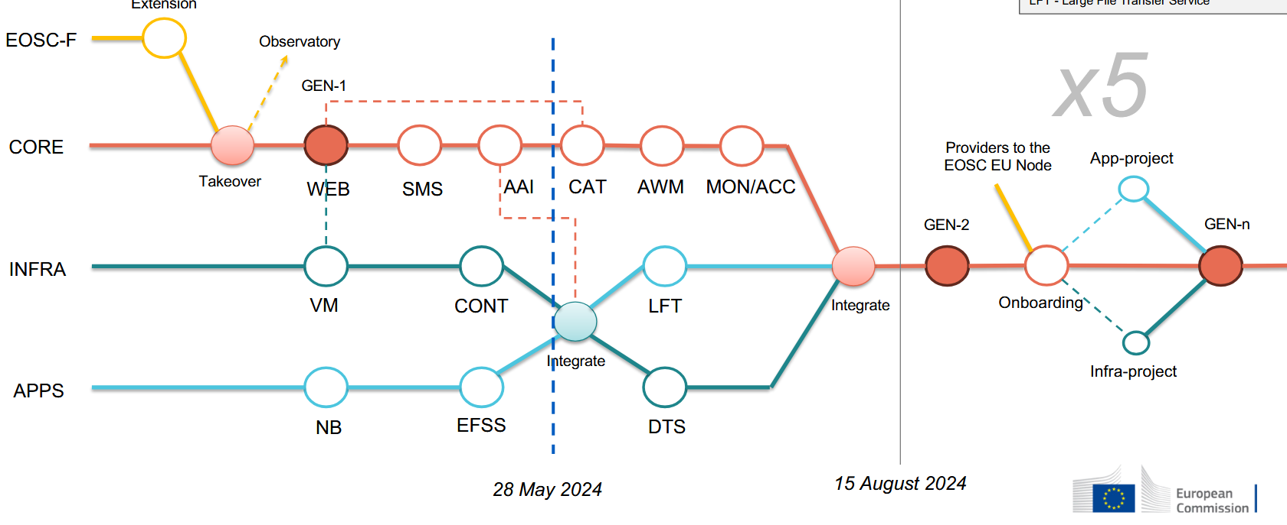
European Open Science Cloud Nodes

Slide 7
European Open Science Cloud Nodes
Feedback and making it useful for the researchers!

Slide 8
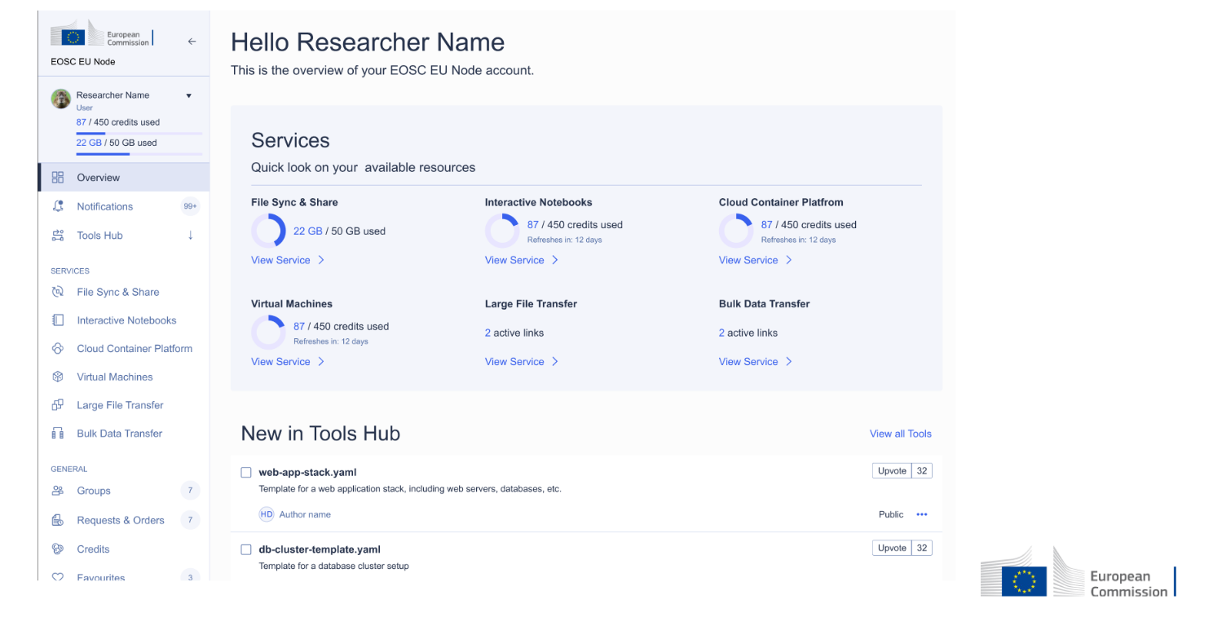

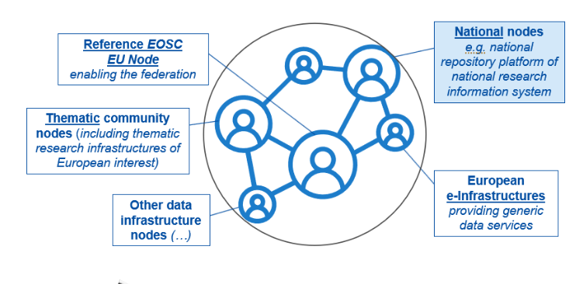





EOSC: How it all links together
Caveat: My interpretation - these are just some examples, most of these are unconfirmed!

Slide 9
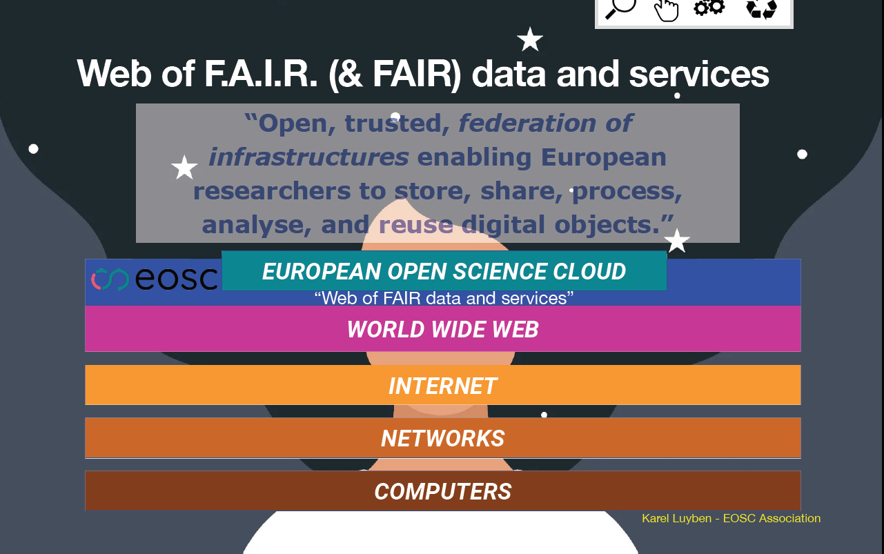
European Open Science Cloud

Slide 10
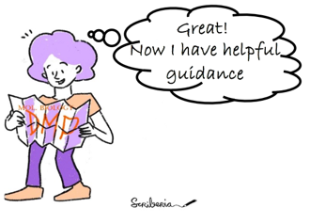
European Open Science Cloud: EU Node
How is this useful for me (in the long run)?
Enhancing scientific research by providing access to a wealth of data and research outputs from various fields and institutions
Fostering innovation by making it easier for researchers to share, collaborate and build on each other´s work
Improving transparency and reproducibility of research by making data and methods more open and accessible
Reducing data silos and duplication of efforts by promoting data sharing and reuse
Facilitating interdisciplinary research and cross-sectoral collaboration by making data and resources from different domains more easily available
https://open-science-cloud.ec.europa.eu/

Slide 11
European Level: Science Clusters
The Science Clusters build bridges between scientific communities, their infrastructures, and EOSC. The role of the clusters is to connect these communities by providing services that catalyse interdisciplinary research.
Working together, the Science Clusters create a cross-border open innovation environment for FAIR data, ensuring improved access to data, tools, and resources from less traditional disciplines, and catalysing new insights and innovation.

Slide 12





European Science Cluster of Astronomy & Particle physics ESFRI research infrastructures
https://projectescape.eu/
Establish a single collaborative cluster of next generation European Strategy Forum on Research Infrastructures (ESFRI) facilities in the area of astronomy- and accelerator-based particle physics in order to implement a functional link between the concerned ESFRI projects and European Open Science Cloud (EOSC).
Project ended in 2022 - (Prototype) Outcomes:
Understanding the lingo… ESCAPE ESAP
= ESCAPE ESFRI Science Analysis Platform
= "European Science Cluster of Astronomy and Particle physics European Strategy Forum on Research Infrastructures European Strategy Forum on Research Infrastructures Science Analysis Platform"
 | Open-access repository to share scientific software and services to the science community [https://purl.org/escape/ossr]
 | For astronomy: integrates distributed infrastructures into one single virtual astronomy facility… ensure that their high-level scientific products and big data sets are openly accessible
 | Platform-service gateway with the capability to access and combine data from multiple collections and stage for subsequent processing and analysis
 | Federated data infrastructure of open access data that enables large national research data centres to work together and build a robust cloud-like service to curate and scale up to multi-Exabyte needs
 | Astronomy and astroparticle physics programme of scientific and public engagement that trains and educates the community in the usage and implementation of the ESCAPE services

Slide 13


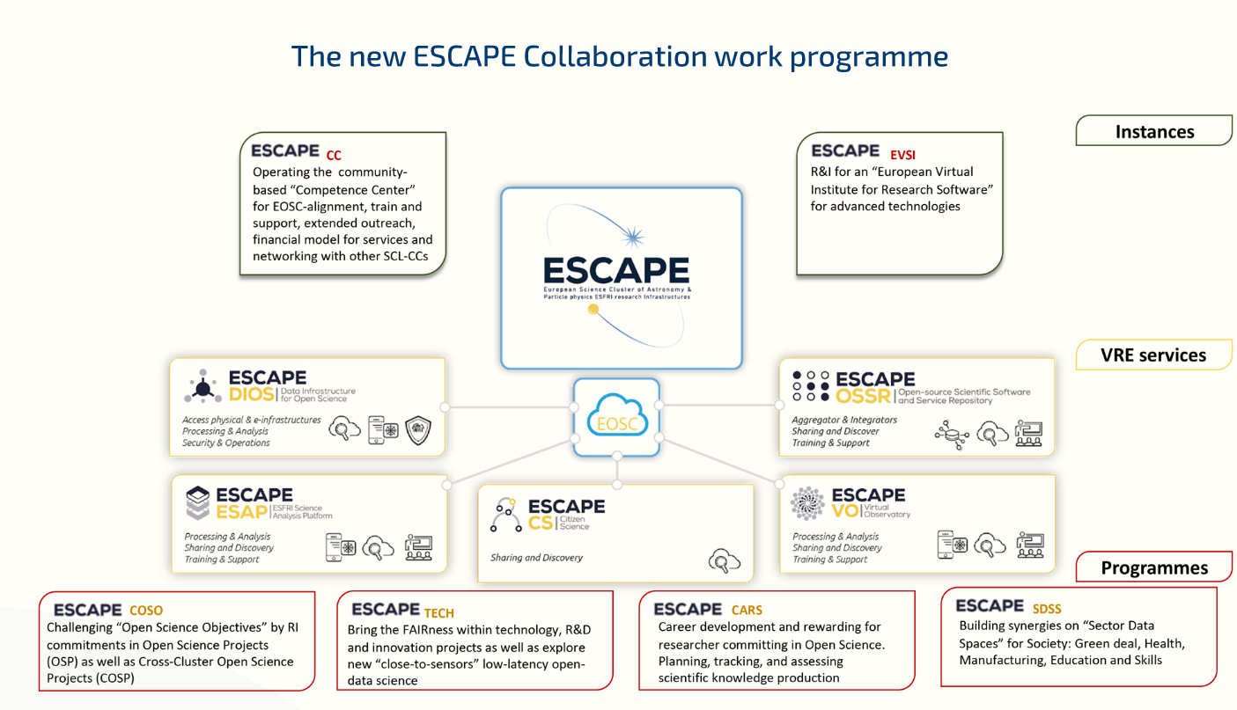



ESCAPE Future
Open Collaboration Agreement 2022:
Consolidate the benefit of Open Science within EOSC and establish new schemes
Funding models (e.g. OSCARS) to continue development of Open Science infrastructures and endeavours
https://oscars-project.eu/projects
…

Slide 14

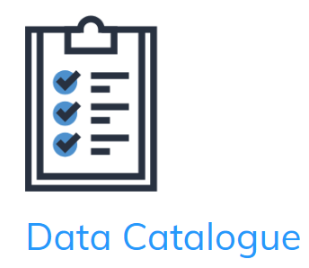

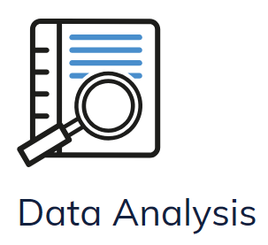
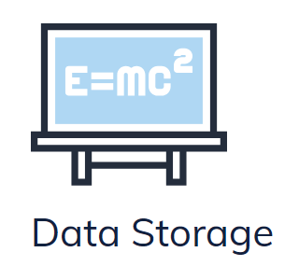
Photon and Neutron Open Science Cluster
The Photon and Neutron Open Science Cluster (PaNOSC) is the Science Cluster representing Photon and Neutron European Research Infrastructures (RIs), developing and providing services for its scientific community and connecting these to the European Open Science Cloud (EOSC).
Project ended in 2022 - (Prototype) Outcomes:
 | Easy access to the broadest sets of data from the diverse catalogues of European photon and neutron facilities, through the PaNOSC federated data catalogues using the federated search engine compatible with OpenAIRE.
 | Search, find and access data from PaN sources across the federated, cross-disciplinary and cross-border data catalogues infrastructure, and access scientific open data remotely.
 | Analyse, use and re-use raw data from PaN facilities, using Jupyter notebooks based data analysis services
 | Enter PaN cloud-based virtual facility and access the available simulation data services to rapidly prototype and execute (both experimental and simulation) data workflows from designing your beamline
 | Astronomy and astroparticle physics programme of scientific and public engagement that trains and educates the community in the usage and implementation of the ESCAPE services
https://www.panosc.eu/panosc-project/ (see also ExPaNDS project https://www.panosc.eu/expands-project/)

Slide 15
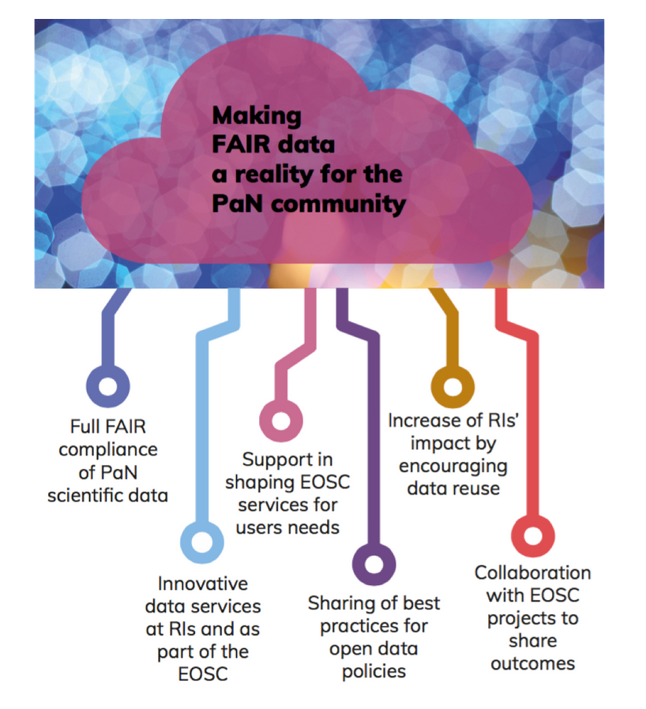



PaNOSC Future
The Photon and Neutron community efforts to contribute to the EOSC, FAIR data and Open Science will be structured around the PaNOSC science cluster.
Similar to ESCAPE, funding models and sub project developments
https://www.panosc.eu/
…

Slide 16
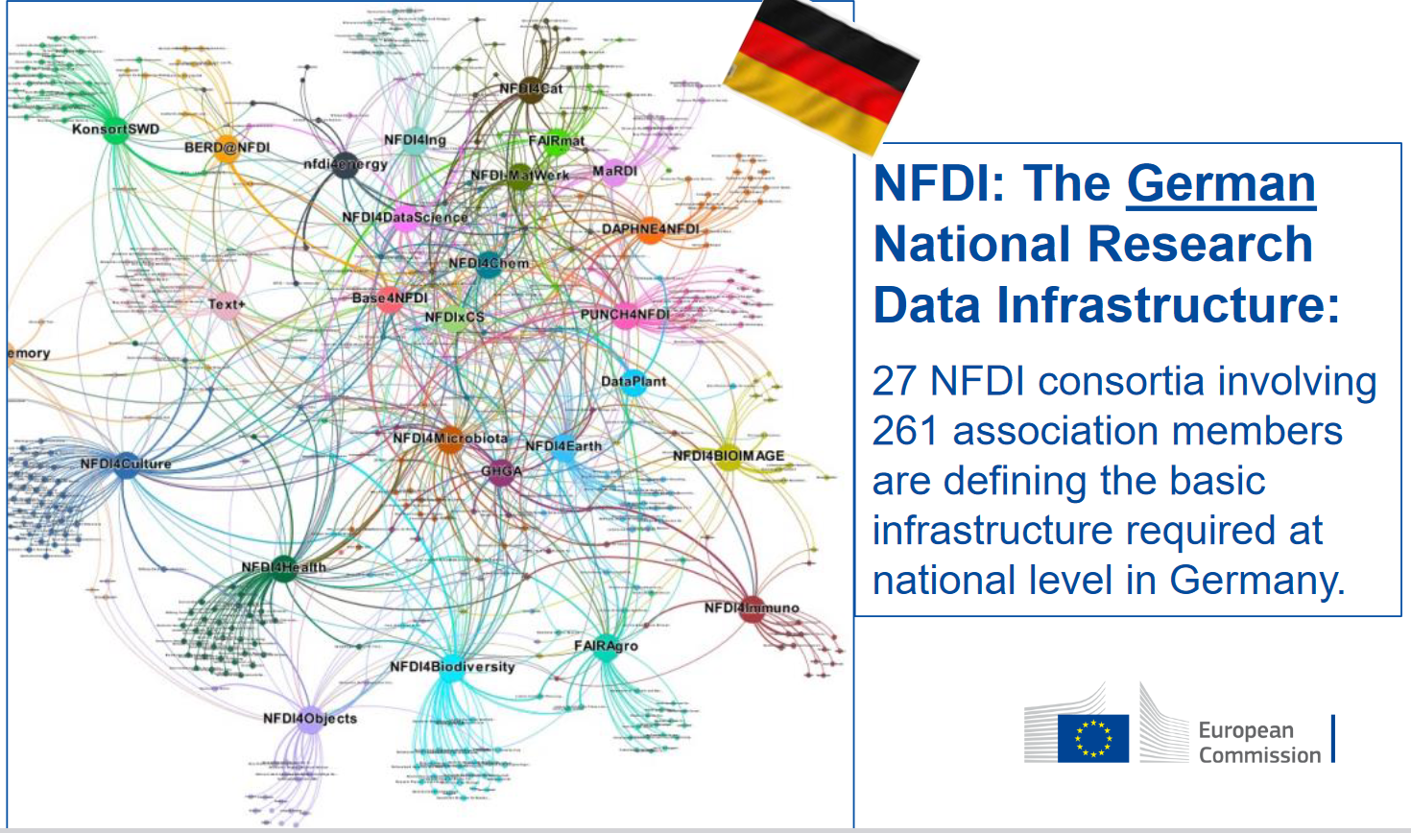
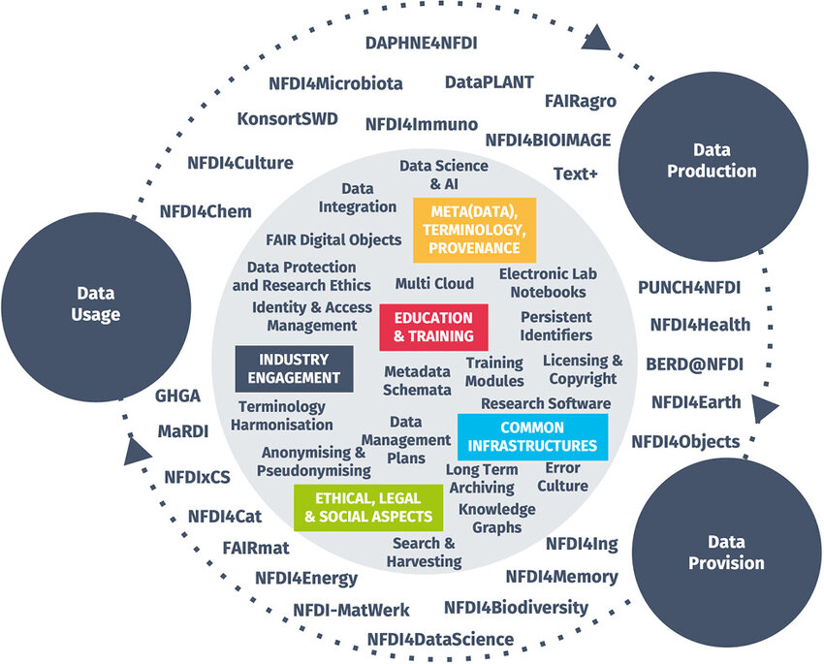
National Level: Example NFDI (Germany)
The NFDI aims to create a permanent digital repository of knowledge as an indispensable prerequisite for new research questions, findings and innovations.
The individual scientific disciplines are involved in the NFDI in consortia. In each of these, numerous institutions are organised and work together on internal and interdisciplinary topics.
Many topics are relevant for all or several consortia. These are jointly identified and addressed in sections. The network of consortia, Base4NFDI, develops basic services for NFDI.

Slide 17
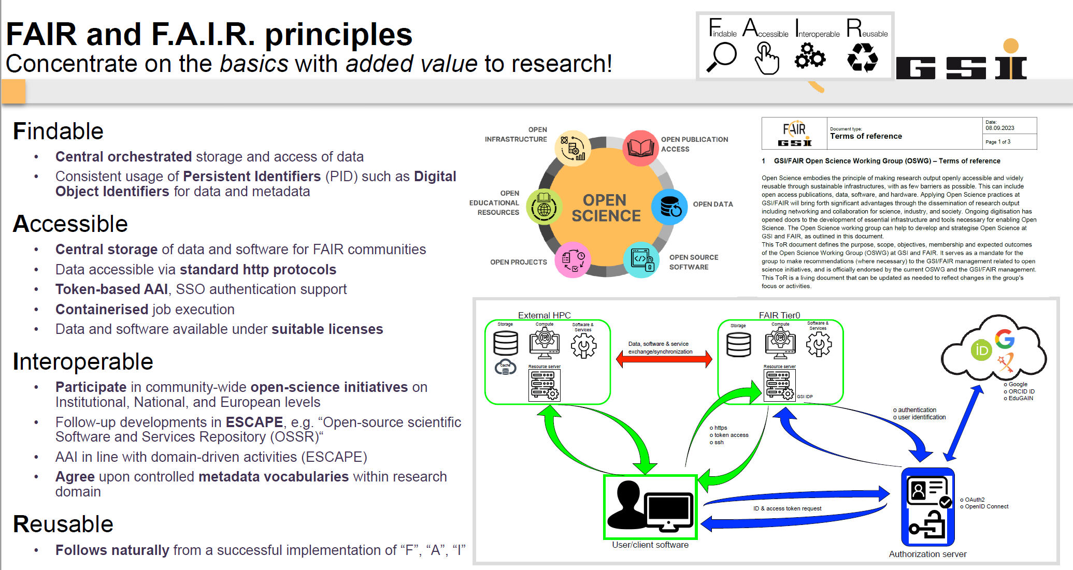
Institutional level
The complicated stuff!

Slide 18
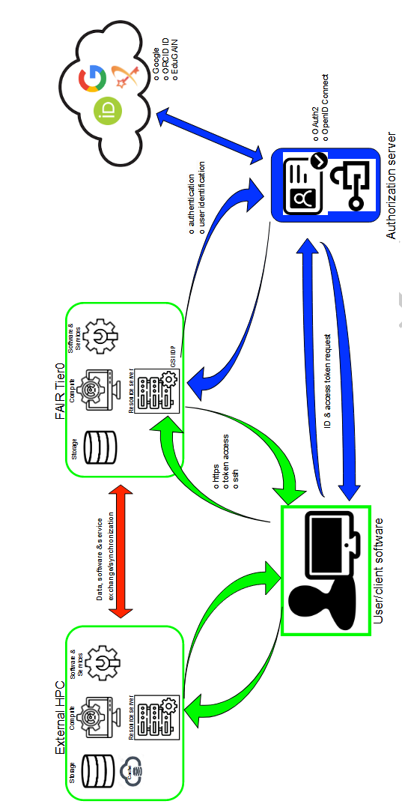
Institutional level
Feedback and making it useful for the researchers!

Slide 19
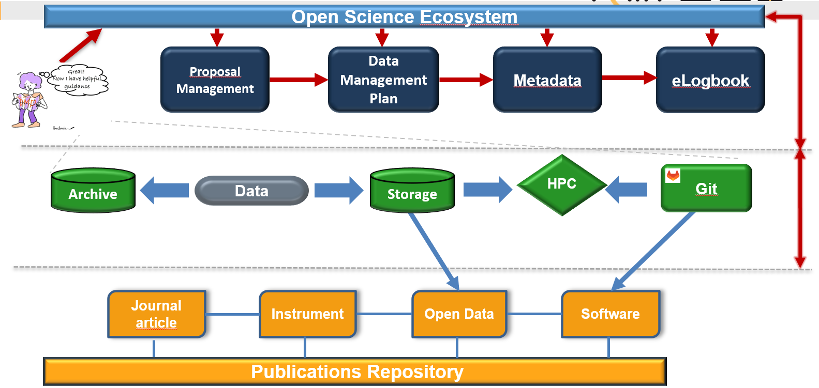
Institutional level

Slide 20

Example Infrastructures: Zenodo
Launched in 2013 by CERN as an OpenAIRE project
Catch-all repository for EC funded research
InvenioRDM architecture
Up to 50GB file uploads (more available upon request)
Zenodo is derived from Zenodotus, the first librarian of the Ancient Library of Alexandria and father of the first recorded use of metadata, a landmark in library history.
CERN Data Centre:
300 PB disk
400PB tape
110k Cores
Upload
Describe
Publish

Slide 21
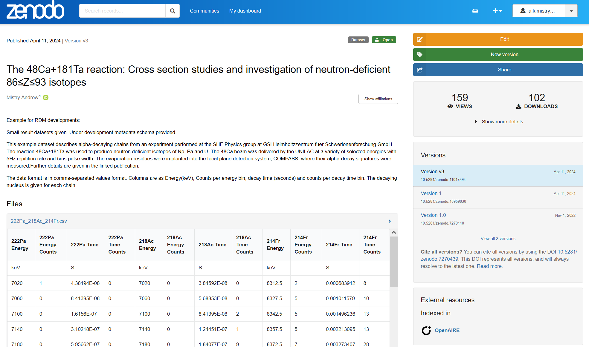
Is Zenodo F.A.I.R.?
Zenodo's metadata is compliant with DataCite's Metadata Schema minimum
Findable:
(Meta)data are assigned a globally unique and persistent identifier;
Data are described with rich metadata;
Metadata clearly and explicitly include the identifier of the data it describes;
(Meta)data are registered or indexed in a searchable resource
DOI is mandatory
Indexed

Slide 22
Is Zenodo F.A.I.R.?
Accessible:
(Meta)data are retrievable by their identifier using a standardized communications protocol
  Public REST API’s can be used to retrieve metadata
  Metadata are accessible and licensed public domain
Metadata are accessible, even when the data are no longer available
  Data and metadata will be retained for the lifetime of the repository.

Slide 23
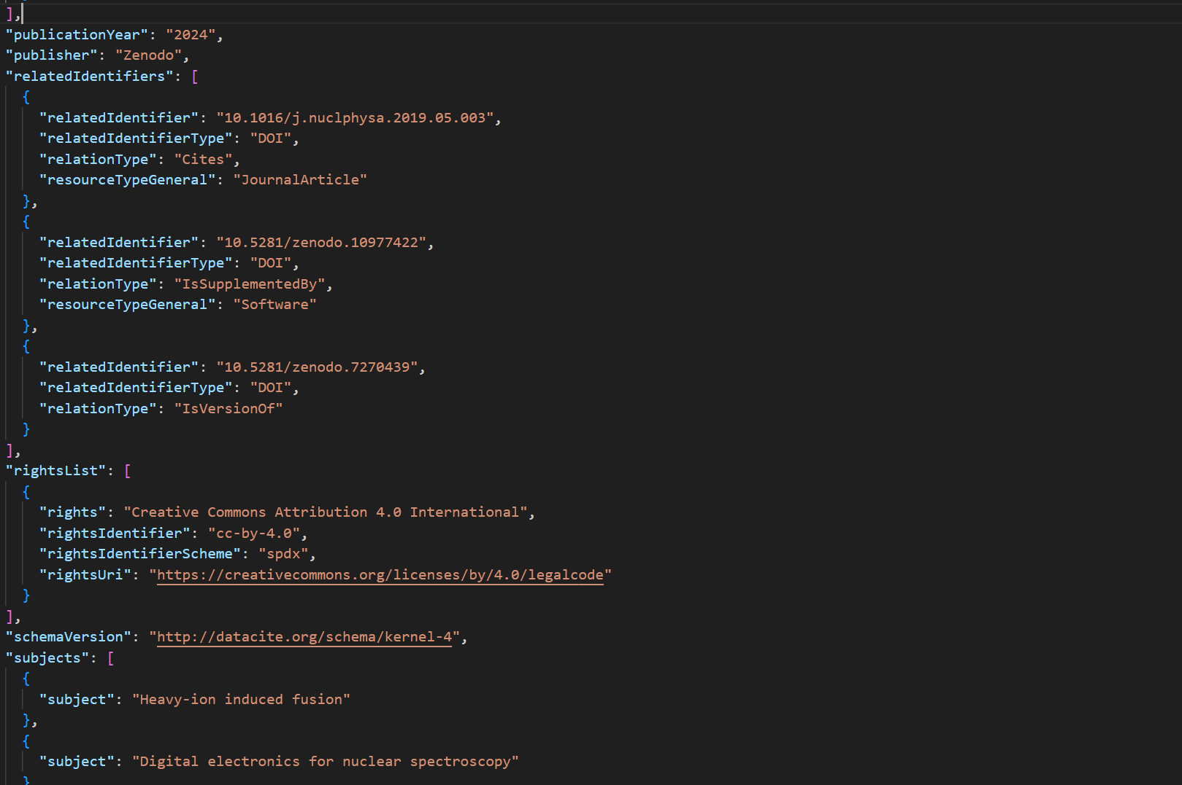
Is Zenodo F.A.I.R.?
Interoperable:
(Meta)data use a formal, accessible, shared, and broadly applicable language for knowledge representation
(Meta)data use vocabularies that follow FAIR principles
(Meta)data include qualified references to other (meta)data
Zenodo uses JSON Schema as internal representation of metadata
For certain terms Zenodo refers to open, external vocabularies, e.g.: license
Each referenced external piece of metadata is qualified by a resolvable URL.

Slide 24
Is Zenodo F.A.I.R.?
Reusable:
(Meta)data are richly described with a plurality of accurate and relevant attribute
(Meta)data are released with a clear and accessible data usage license
(Meta)data are associated with detailed provenance
(Meta)data meet domain-relevant community standards
Each record contains a minimum of DataCite's mandatory terms
License is one of the mandatory terms in Zenodo's metadata
All data and metadata uploaded is traceable to a registered Zenodo user
Zenodo is not a domain-specific repository, yet through compliance with DataCite's Metadata Schema

Slide 25
Is Zenodo F.A.I.R.? The metadata issue
However:
General specific vs. Discipline specific vs. ‘Experiment’ specific metadata
Project specific metadata
Project name, publication date, collaborations, researchers, institutions, journal references
1
Discipline specific metadata
Projectile data, target data, infrastructure, detector type, datasets, software repositories
2
Experiment specific metadata
Reaction data, gamma-ray energies, time of flight parameters, instrument records
3

Slide 26
Is Zenodo F.A.I.R.?
Conclusion: To some/a large extent, yes!
However be aware of:
A catch-all repository – not discipline specific
Metadata Quality: Limited support for Domain-specific standards
Dependence on user practices
No built in validation for deposits
…
https://about.zenodo.org/principles/

Slide 27


Other Repositories: Discipline Specific
HEPData: Discipline Specific Repository https://www.hepdata.net/
Discipline Specific Repository for the HEP community
Suitable for tabular high-level data
Developed at Uni Durham, hosted by CERN
Great for metadata, including validation
Not suitable for large datasets
NOMAD https://nomad-lab.eu/nomad-lab/
lets you manage and share materials science data

Slide 28
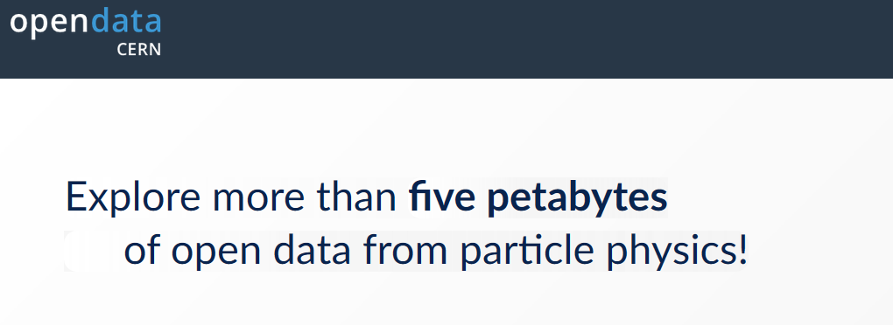

Other Data Repositories: Institutional
OpenData Portal CERN: https://opendata.cern.ch/
For CERN LHC Data
Access to large volume datasets
TUDatalib https://tudatalib.ulb.tu-darmstadt.de/
Technical University Darmstadt
Available for all research data generated or worked with at TU Darmstadt
Check and see if you have an institution data repository in your university or research centre!

Slide 29
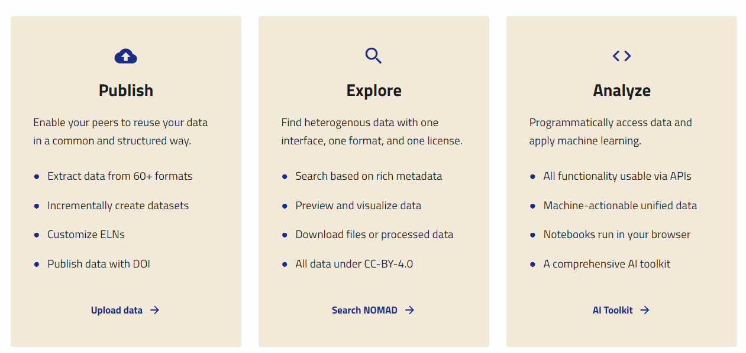
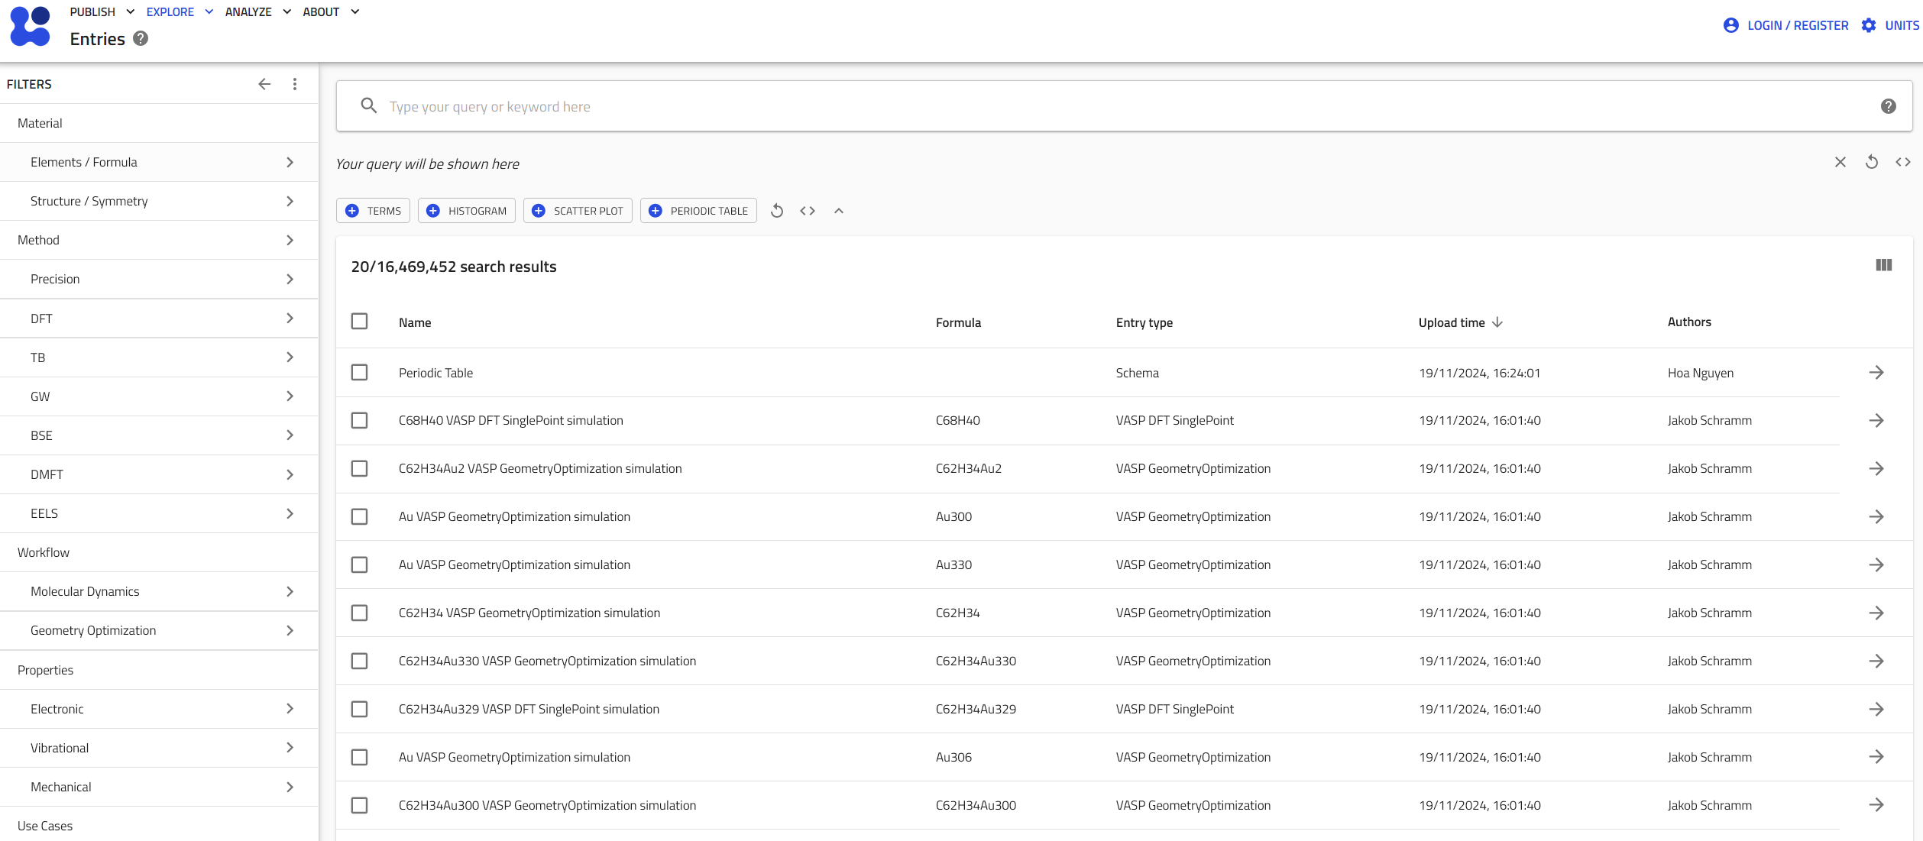
https://nomad-lab.eu/nomad-lab/
Materials science data managed and shared:
NOMAD lets you manage and share your materials science data in a way that makes it truly useful to you, your group, and the community.

Slide 30
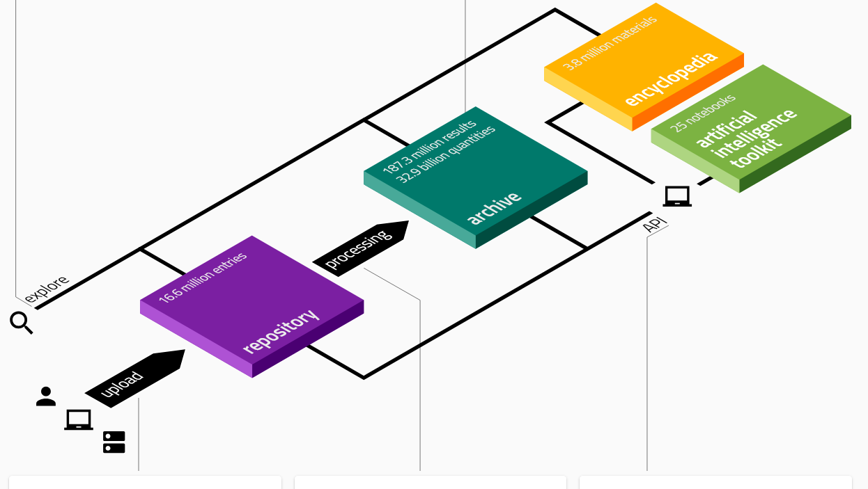
https://nomad-lab.eu/nomad-lab/
NOMAD extracts rich metadata from uploaded raw-data
create complex queries from interactive data visualizations of key properties, including the simulated composition/system, used method, upload metadata, as well as material classifications and available quantities
NOMAD provides data in processed and normalized form in a machine processable and common hierarchical format. This processed data, i.e. the NOMAD Archive
The NOMAD can also be accessed programmatically via ReST APIs.
Uploaded data is automatically processed and made available in the uploaded raw files or in its unified processed data form. NOMAD parsers convert raw files into NOMAD's common data format.
You provide your own data as is. Just zip your files as they are, including nested directory structures and potential auxiliary files, and upload up to 32GB in a single .zip or .tar(.gz) file

Slide 31

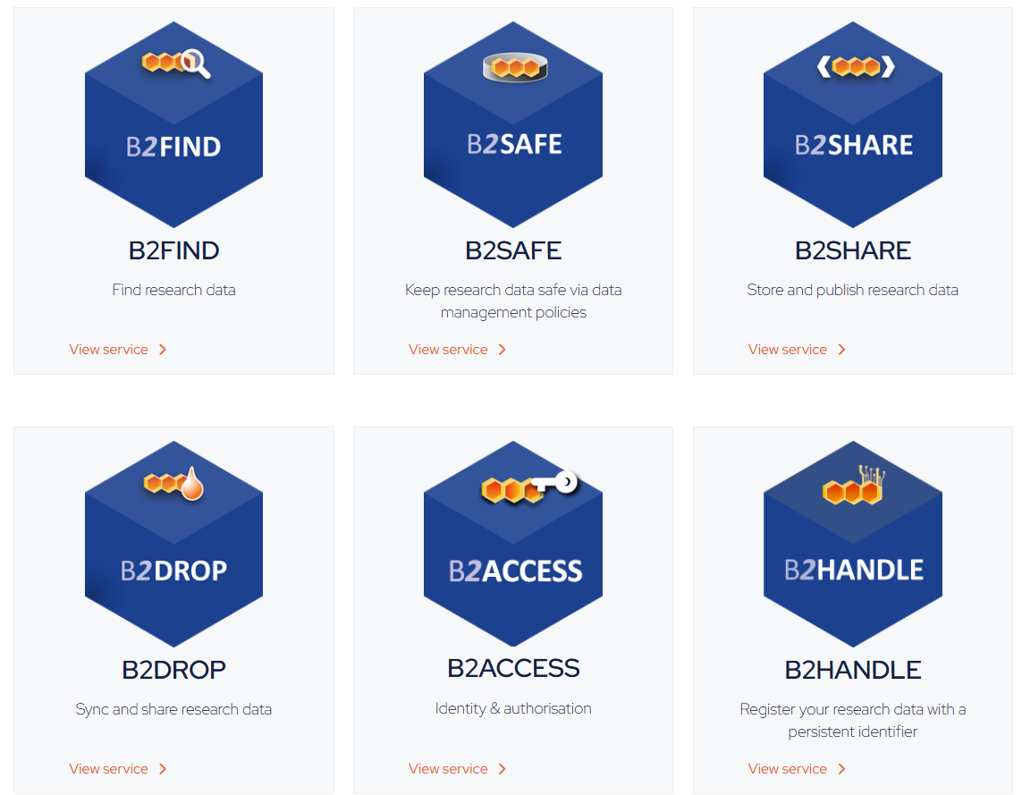
https://www.eudat.eu/
The EUDAT Collaborative Data Infrastructure (or EUDAT CDI) is one of the largest infrastructures of integrated data services and resources supporting research in Europe. It is sustained by a network of more than 20 European research organisations, data and computing centre
Any organisation can join as a service provider, as long as it satisfies a set of technical requirements. A service provider can join as an interoperable or an integrated node depending on the kind of integration the single organisation wants to pursue.
Each service provider is responsible of covering the costs of the CDI services it delivers and has to pay an annual fee.
These organisations stand together behind a long term sustainability plan and commit to develop, maintain and deploy pan-European research data services and to promote harmonization of research data management practices across centres

Slide 32


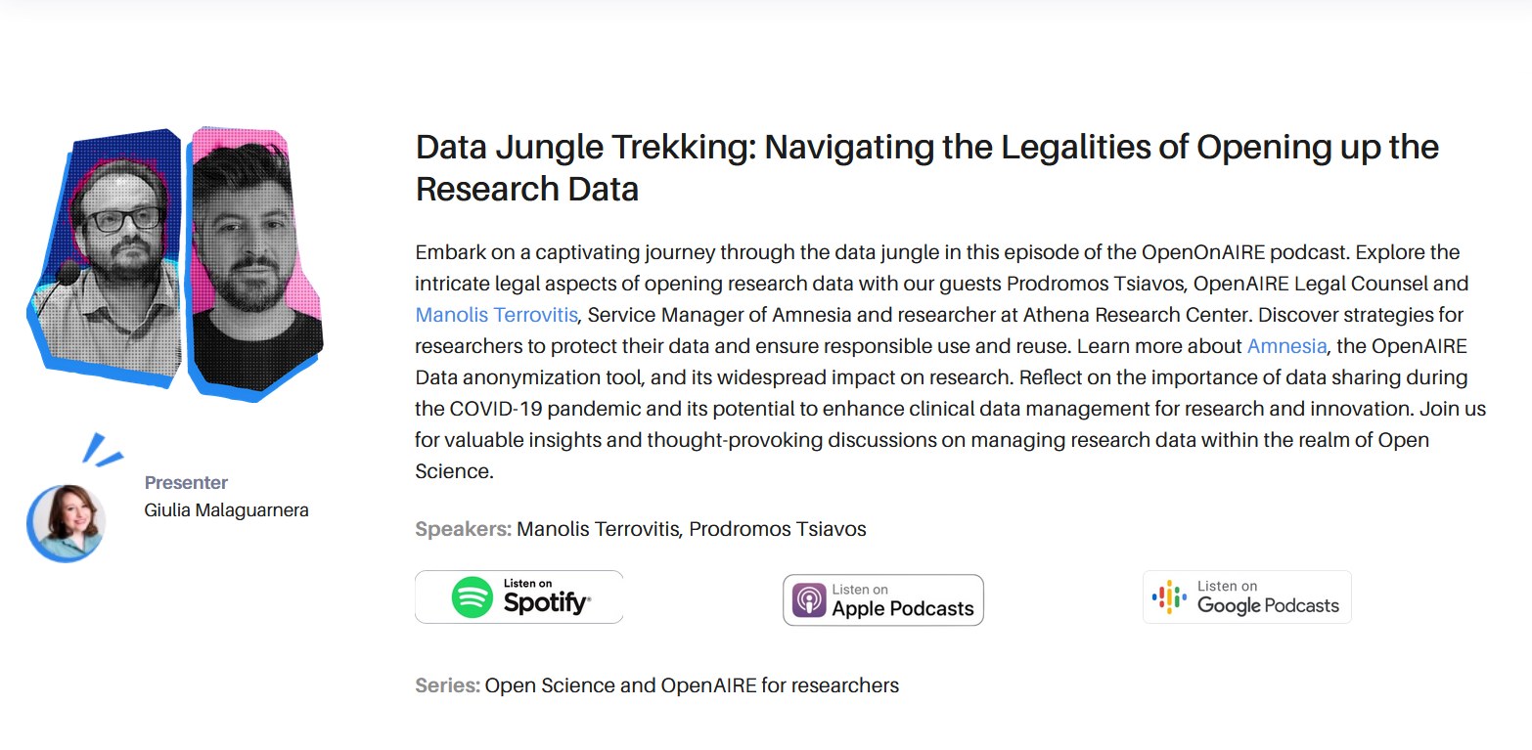
https://www.openaire.eu/
OpenAIRE AMKE is a non-profit organization of 50 members with a mission to promote open scholarship and improve discoverability, accessibility, shareability, reusability, reproducibility, and monitoring of data-driven research results, globally.
The organization operates a European e-infrastructure offering a diverse set of public services (catalogues, webinars, podcasts…) to accelerate the adoption of Open Science and is supported by a network of experts placed in key national organizations across European countries, the National Open Access Desk. OpenAIRE is a key implementer EOSC. Funded by Horizon Europe and members
Goals:
Align policies
Facilitate interoperability via guidelines and services that federate all types of scholarly works.
Link research to provide context and enable discoverability, transparency, reproducibility.
Monitor Open Science by bringing quality data for trusted metrics and consensus on indicators.
Train for Open Science researchers, content providers, policy makers, research managers, citizens for opening up and (re)using research outcomes.
Build global bridges to promote and share common practices, …towards a sustainable open global research ecosystem.
Facilitate open innovation for innovative scholarly communication and value-added services.

Slide 33

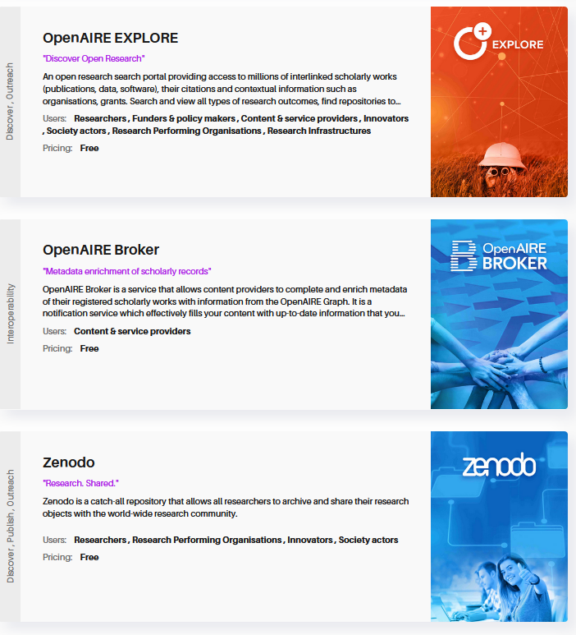
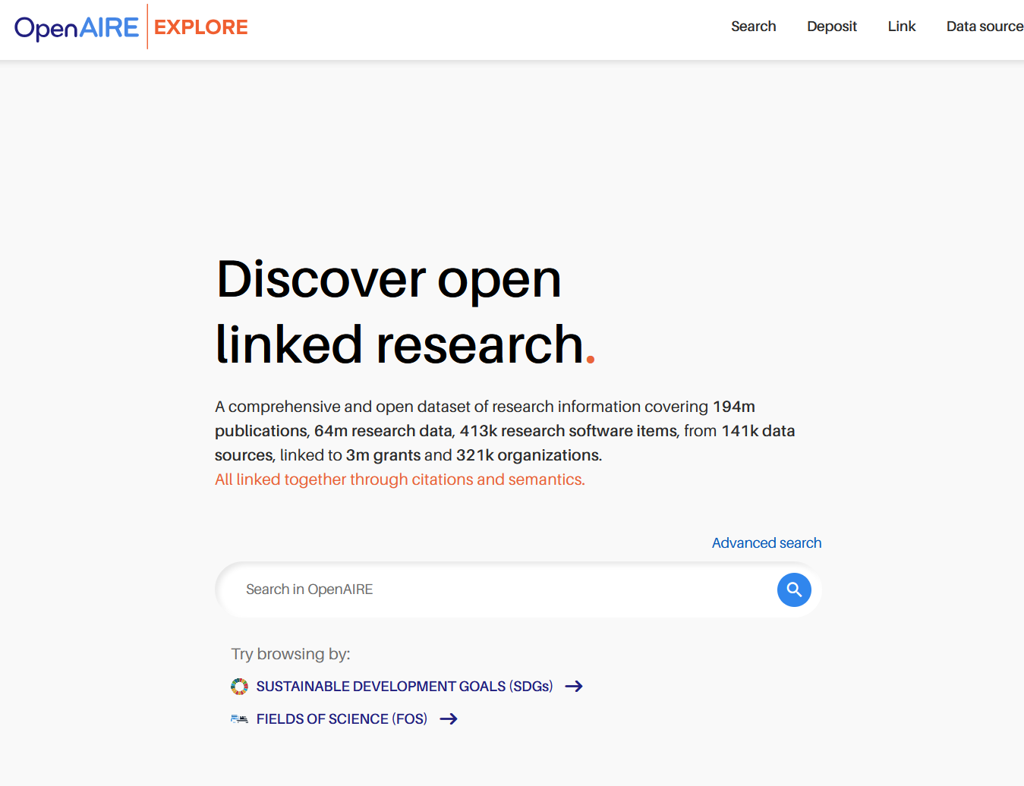
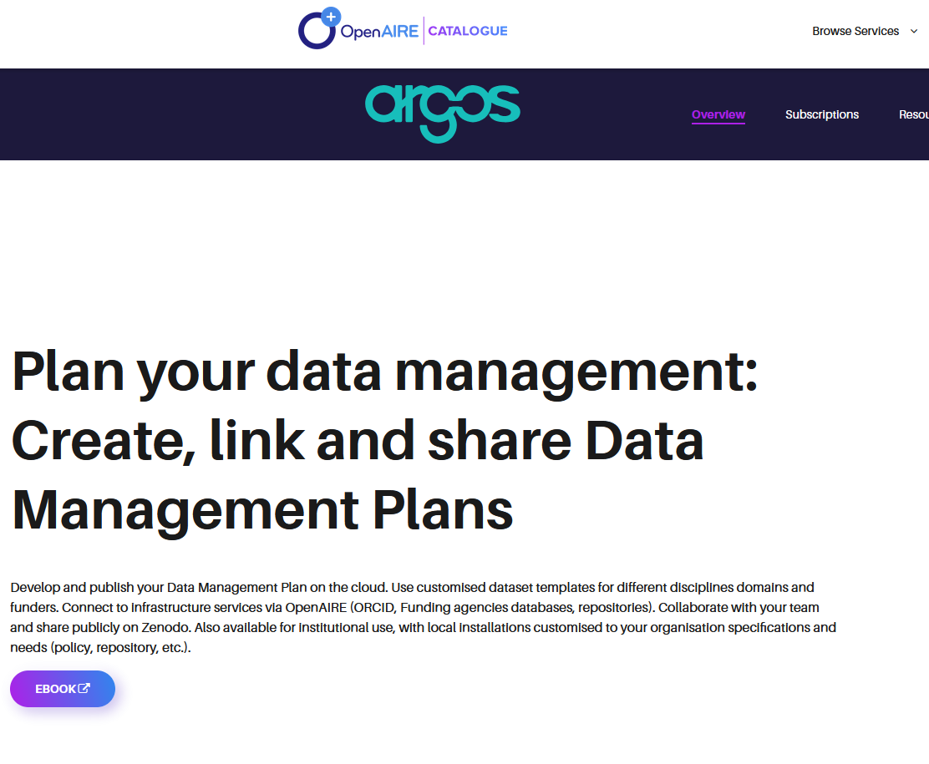
The OpenAIRE service catalogue is an on-demand online platform that presents a comprehensive list of services in support of Open Science.
The catalogue registers, hosts, and gives visibility to services operated by OpenAIRE and by third-party entities active in the Open Science scholarly communication domain.
.. intermediate service to third party Open Science stakeholders that wish to register their services to the EOSC ecosystem.
18 Different Services available (most free, some subscription based)
https://catalogue.openaire.eu/search

Slide 34
EOSC: How it all links together
These are just some examples: Many other initiatives and infrastructures under development or available!
My interpretation, nodes not confirmed!

Slide 35
Research Data Management (RDM) in practice: Data Publication, things to consider…
  What should I publish? -> Raw; Pre-processed; Result…
  What do I need to replicate my result? -> Software; Workflows…
  Where should I publish? -> Zenodo; HEPData…
  How do I ‘publish’ data? -> Uploading, linking
  How much time will it take? -> 1 day, 3 months…
  What Licence should I choose? -> CC-BY?
  How do I accurately describe my data? -> Metadata; Written Explanations…
  How do I ensure that the data is findable? -> Linking to article/software?...

Slide 36
RDM in practice: Data Publication, things to consider…
  What should I publish? -> Raw; Pre-processed; Result…
  What do I need to replicate my result? -> Software; Workflows…
  Where should I publish? -> Zenodo; HEPData…
  How do I ‘publish’ data? -> Uploading, linking
  How much time will it take? -> 1 day, 3 months…
  What Licence should I choose? -> CC-BY?
  How do I accurately describe my data? -> Metadata; Written Explanations…
  How do I ensure that the data is findable? -> Linking to article/software?...
  These you can answer in a Data Management Plan (DMP)

Slide 37
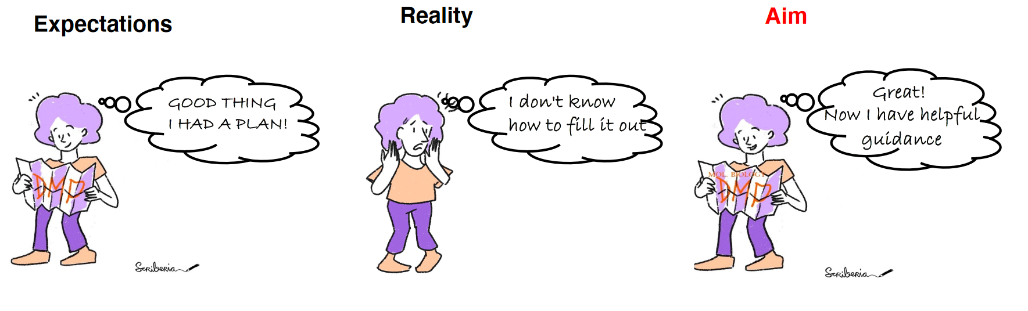
RDM in practice: Data Management Plans
Goal : Make RDM easy for users and encourage preparation
Henning Falk
The Turing Way Community
Modified by: Yasmin Demerdash & Sarah Wettermann; Bridging the Gap: Molecular Biology DMP catalog creation (2023)
https://www.forschungsdaten.uni-mainz.de/files/2023/11/Bridging_the_gap_Demerdash_Wettermann.pdf

Slide 38
RDM in practice: Data Management Plans
Living document
Prepared at the start and follows the research data (RD) lifecycle throughout
Data management plans
  Communication tool for researchers
  RDM project internal management
  Reuse of RD
  Useful for IT/Resource Cost estimates
  Funding body requirements
Contents include
  General data (Project name/PI, start and end of data taking…)
  RD information (Data type, size, scope, and generation method…)
  Overhead (Data protection, costs, project planning…)
  Achieving and reuse (repository selection, data to be published, metadata schema…)

Slide 39
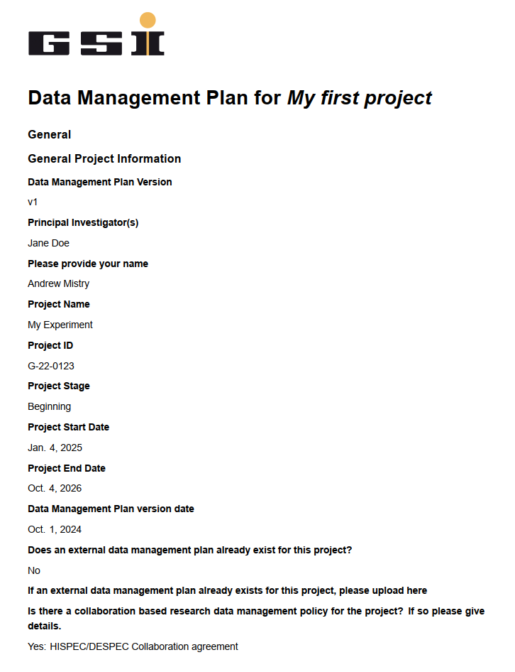
RDM in practice: Data Management Plans
Ask at your institution if they have a template!
Or create one with ideas from e.g. https://dmponline.dcc.ac.uk/plans
Template for GSI:
Open Office: https://wiki.gsi.de/pub/OpenScience/WebHome/GSI%20Template%20Data%20Management%20Plan.odt
Word:
https://wiki.gsi.de/pub/OpenScience/WebHome/GSI%20Template%20Data%20Management%20Plan.docx
Pdf: https://wiki.gsi.de/pub/OpenScience/WebHome/GSI%20Template%20Data%20Management%20Plan.pdf

Slide 40
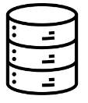
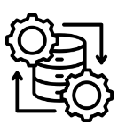



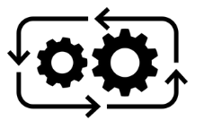
RDM in practice: What should I publish?
[What do I need to replicate the result(s)?]
  Raw -> Ideal FAIR data case? Often too large; difficult to process.
  Pre-processed -> Feasible option; needs some processing and analysis. Allows further examination of the data
  Result -> ‘Easiest’ case. Can be the data used to make plots etc.
  Others…. Simulation; Calibration…
  Software -> analysis scripts;
  Workflows -> Containers, Descriptions of processing procedures
Research Data

Slide 41
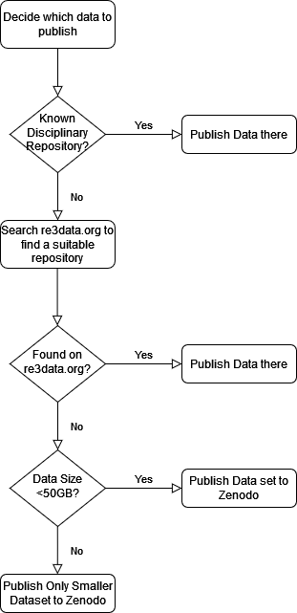
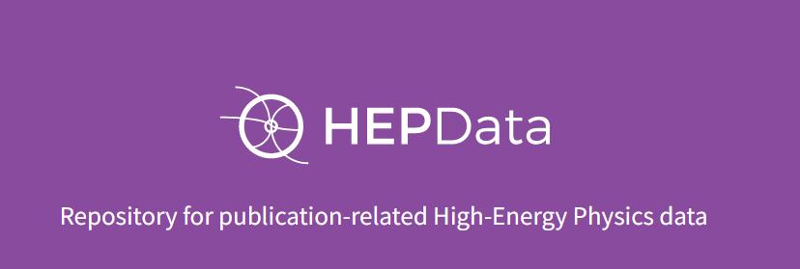
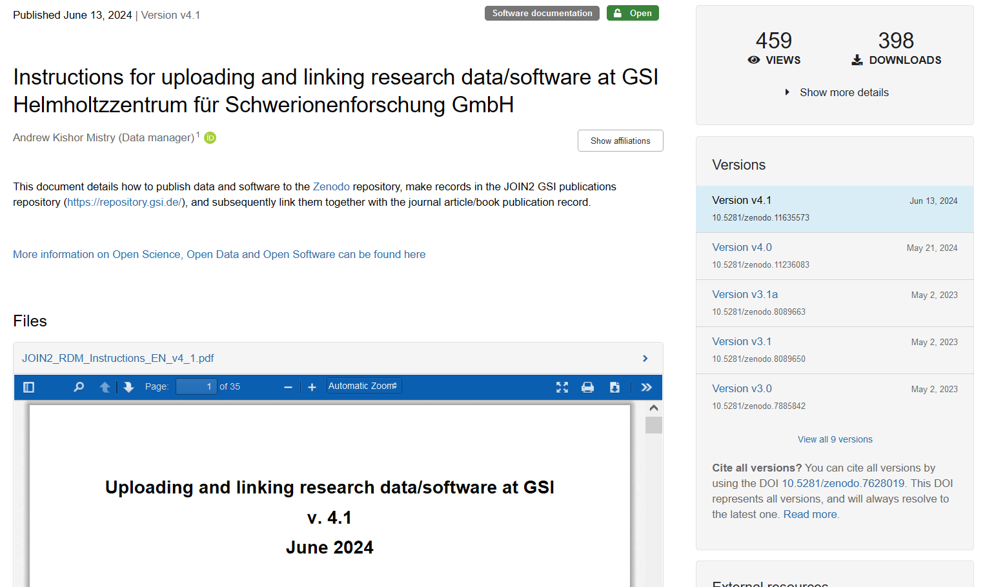


RDM in practice: Where/How do I publish?
Interim strategy
Publish in Zenodo/discipline specific repos
Instructions available on how to publish data at GSI
Up to 50GB (more on request)
https://doi.org/10.5281/zenodo.7628019

Slide 42









RDM in practice: Where/How do I publish? [Example]
[What do I need to replicate the result(s)?]
Starting out and keeping it simple: Result data + analysis scripts
Raw
Semi-derived
Result
Journal article
Unpack/Calibrate
Analyse
CC-BY 4.0
Archive/Store
Link
Publish
GPLv3
Link
Link

Slide 43

RDM in practice: Where/How do I publish? [Example]
[What do I need to replicate the result(s)?]
Step forward… Include metadata
Raw
Descriptive Metadata
Semi-derived
Result
Journal article
Unpack/Calibrate
Analyse
CC-BY 4.0
Archive/Store
Link
Publish
GPLv3
Link
Link

Slide 44
RDM in practice: Where/How do I publish? [Example]
[What do I need to replicate the result(s)?]
Another step forward: semi-derived data, software codes, result data and accompanying metadata
Raw
Descriptive Metadata
Semi-derived
Result
Journal article
Unpack/Calibrate
Analyse
CC-BY 4.0
CC-BY 4.0
Archive/Store
GPLv3
Link
Publish
GPLv3
Link
Link

Slide 45
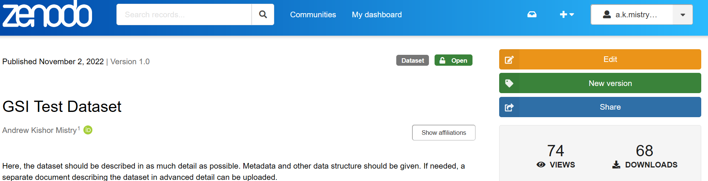
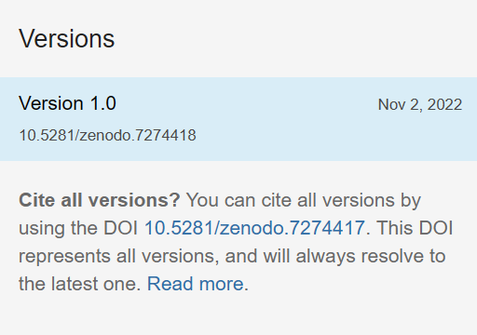
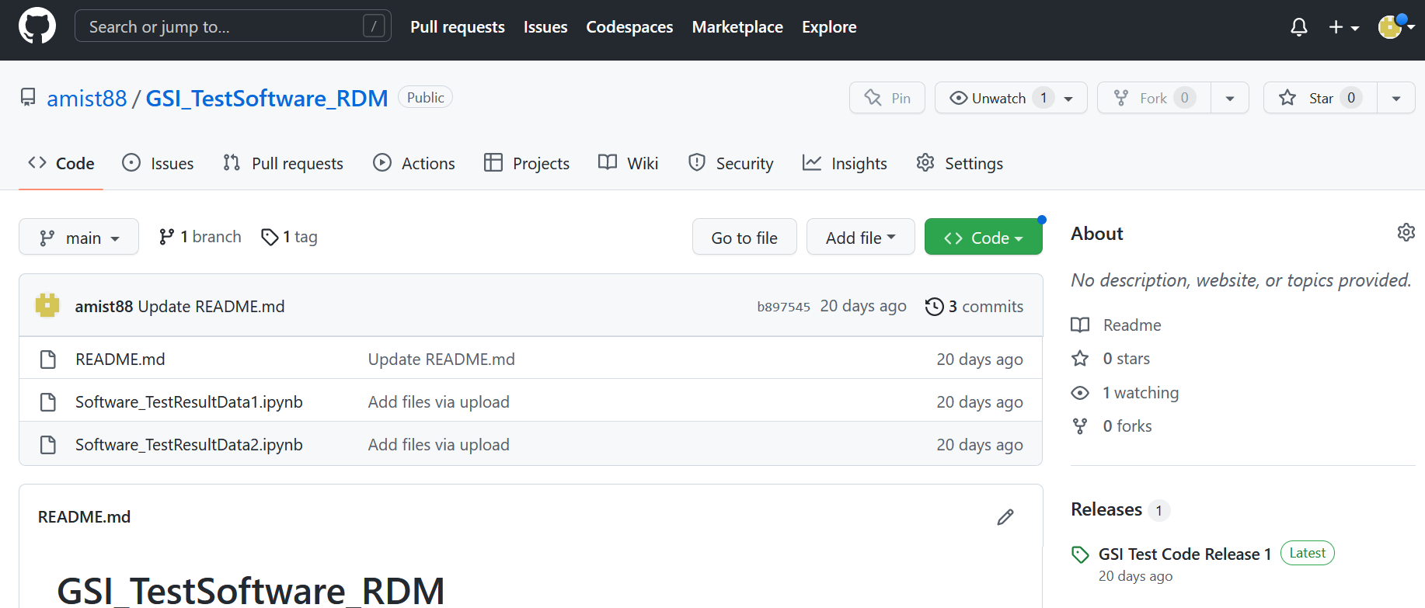
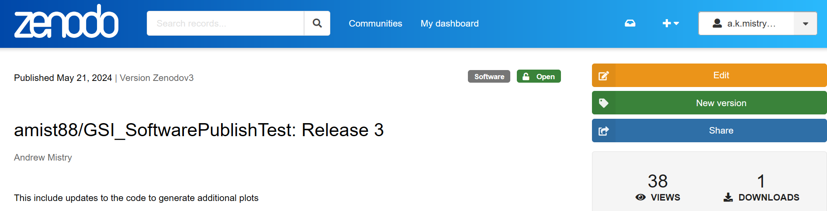
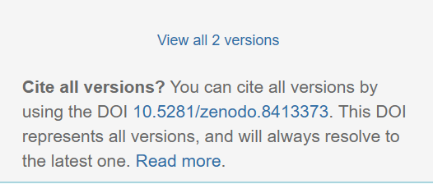
RDM in practice: How do I ensure that the data is findable?
Article -> Dataset -> Software linking
Zenodo: Dataset Record
Publications Repository: Journal Article Record
DOI
GitHub/Lab: Software
Zenodo: Software Record
DOI
Datasets/software records in GSI publications repository count towards POF IV

Slide 46
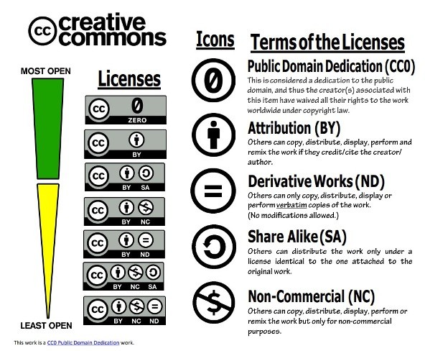
Links on Licensing: Open Data
For Data(bases)
CC BY 4.0 Deed | Attribution 4.0 International | Creative Commons
Database protection in the EU - Your Europe (europa.eu)

Slide 47
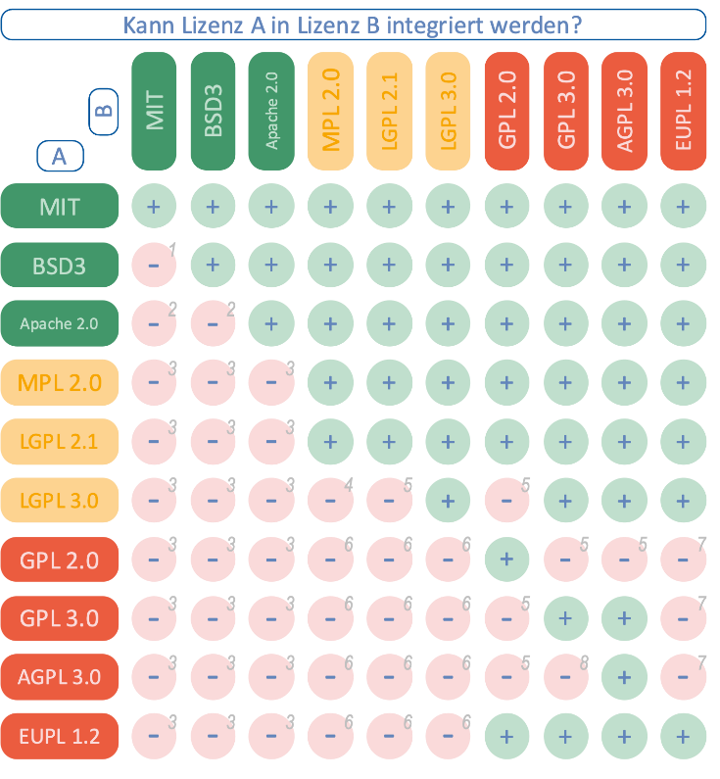
Links on Licensing: Open Software
Permissive -> minimal restrictions on the use, modification, and redistribution of the software
Apache Apache License, Version 2.0 – Open Source Initiative
FreeBSD The 2-Clause BSD License – Open Source Initiative
Modified BSD The 3-Clause BSD License – Open Source Initiative
MIT The MIT License – Open Source Initiative
Copyleft -> more restrictive licenses, require derivative works to also be distributed under the same license
GPL3 GNU General Public License version 3 – Open Source Initiative
LGPL GNU Lesser General Public License version 3 – Open Source Initiative

Slide 48
Links on Licensing (contin..)
Choosing a license
Non-Software Licenses | Choose a License Choose a non software license
Choose a License (creativecommons.org) CC LICENSE CHOOSER
Choose an open source license | Choose a License Choose an open source license
Licenses – Open Source Initiative OSI Approved Licenses
The Free-Libre / Open Source Software (FLOSS) License Slide (dwheeler.com) The Free-Libre / Open Source Software (FLOSS) License Slide by David A. Wheeler
Check at your institute Technology Transfer/Legal Department/Collaboration for license requirements

Slide 49



Summary: European Infrastructures for Open Science
Many different types of infrastructures available
Speak to your in-house IT/Open Science team to find which solution fits to your needs
Still ongoing developments and improvements to new and existing architecture
Long term goal of interconnected Open resources for a broad community: Federated approach within EOSC
…and many more!
Open Science at GSI/FAIR
open-science@gsi.de
https://www.gsi.de/open-science

