Slide 1


EURO-LABS Advanced Training
Open Science and Data Management
Castle Ebernburg: 24.11.24 – 29.11.24
This project has received funding from the European Union’s Horizon Europe Research and Innovation programme under Grant Agreement No 101057511.

Slide 2
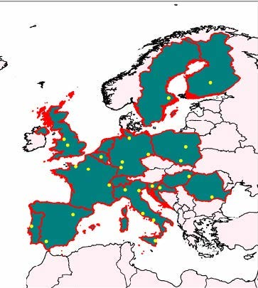
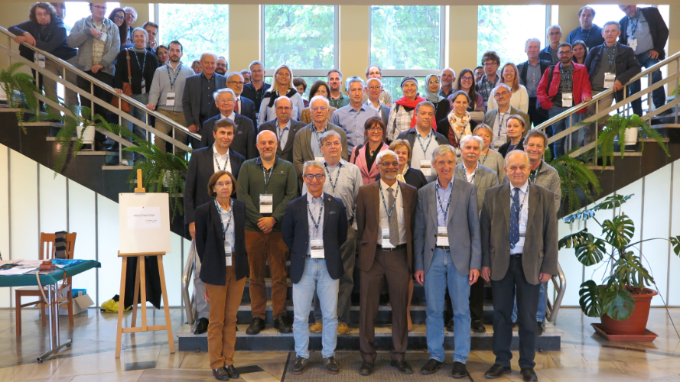
EURO-LABS
Goals:
  Providing efficient access to the available resources to a large fraction of EUROpean Laboratories for Accelerator Based Sciences (EURO-LABS)
  Bringing together the three communities engaged in Nuclear Physics, Accelerator and Detector technology for High Energy Physics
  Allowing a synergic implementation of best practices for data management and activities relating to targeted service improvements at these RIs
  Creating synergies and collaborations between the RIs of the Nuclear and High Energy communities
  Enhancing Europe's potential
https://web.infn.it/EURO-LABS/
This project has received funding from the European Union’s Horizon Europe Research and Innovation programme under Grant Agreement No 101057511.

Slide 3
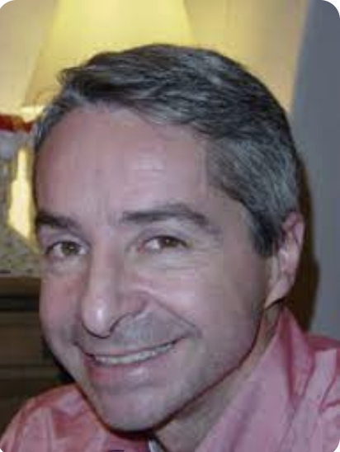
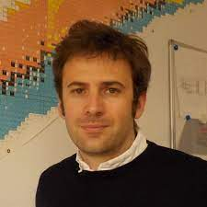
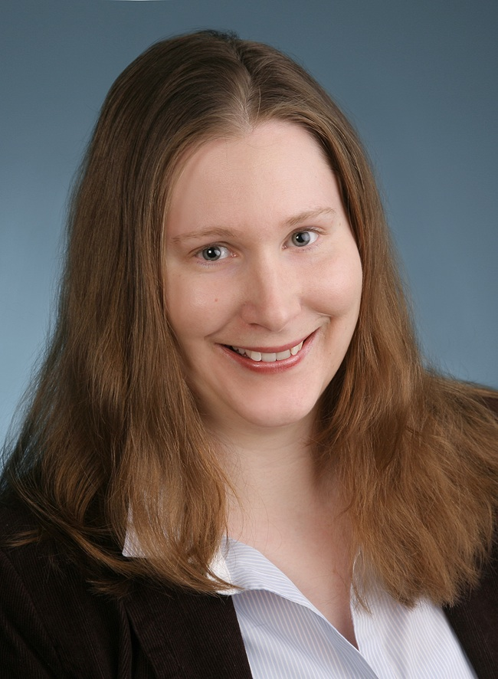
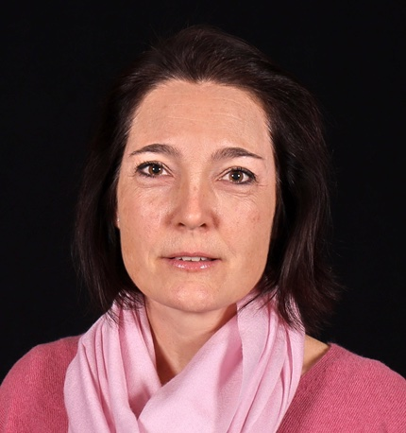
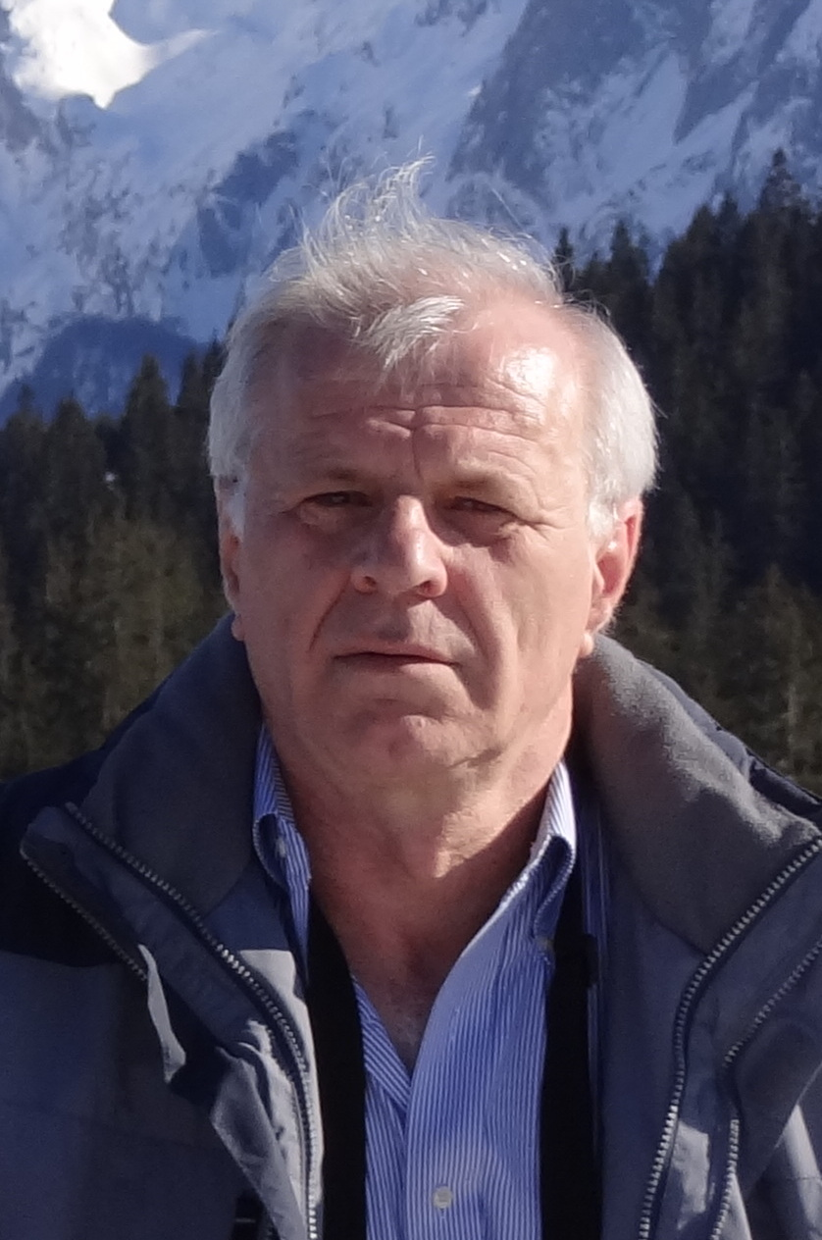
WP5: Open, Diverse and Inclusive Science
Task 1: Diversity and Dissemination
Enhancing diversity: Nacionality, Gender, Age, Level of expertise
Enhancing Dissemination: Web site, Videos of RI, Newsletters,…
Task 2: Open Science & Data Management
Promoting data management plans
Creating a portal for nuclear physics data tools
Task 3: Machine learning
Machine Learning used in beam control and optimization
Task 4: Training
Control of the source of laser driven accelerator
Hands-on training on the facilities: 4 events of basic training and 4 events of advanced training
Paolo Giacomelli
(IFIN)
Antoine Lemasson
(Ganil)
Livius Trache
IFIN-HH
Sabrina Appel Sandrine Dobosz
(GSI) (CEA)

Slide 4
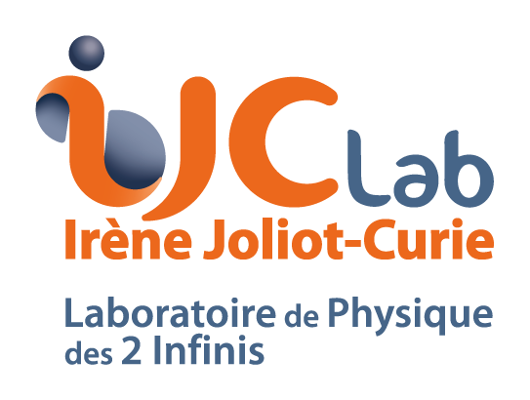





WP 5.2: Open Science and Data Management
Participants: CSIC, GANIL (Leading partners), INFN, CNRS, IJCLab, GSI
Task leader: A. Lemasson (Ganil); subtask leader: C. Hornung (GSI), A. Matta (CNRS), M. Jouvin (IJCLab)
Goals:
  Bringing the nuclear physics community into the EOSC (European Open Science Cloud) framework
  Developing services to enhance FAIR (Findable, Accessible, Interoperable and Reusable) data principles
  Integration of Nuclear Physics community to existing infrastructures/services of EOSC environment - using present experience from ESCAPE/HEP physics community

Slide 5
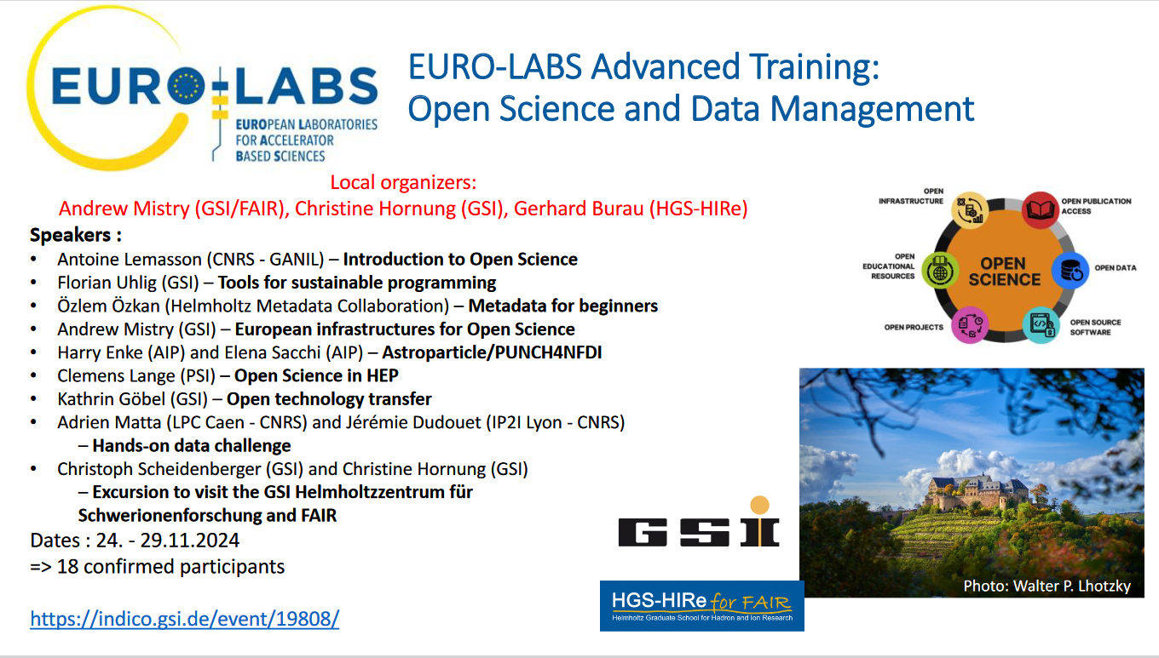

Slide 6
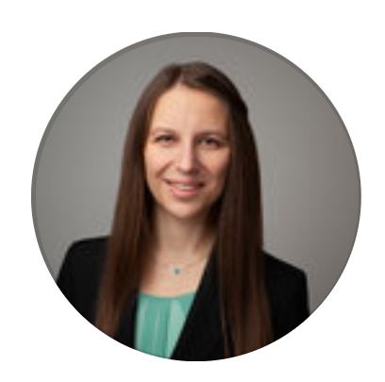
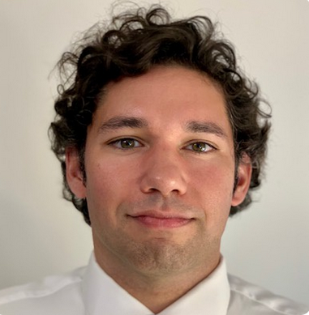
Contact Points
Andrew
Christine
Questions, comments, issues… Speak to us!

Slide 7
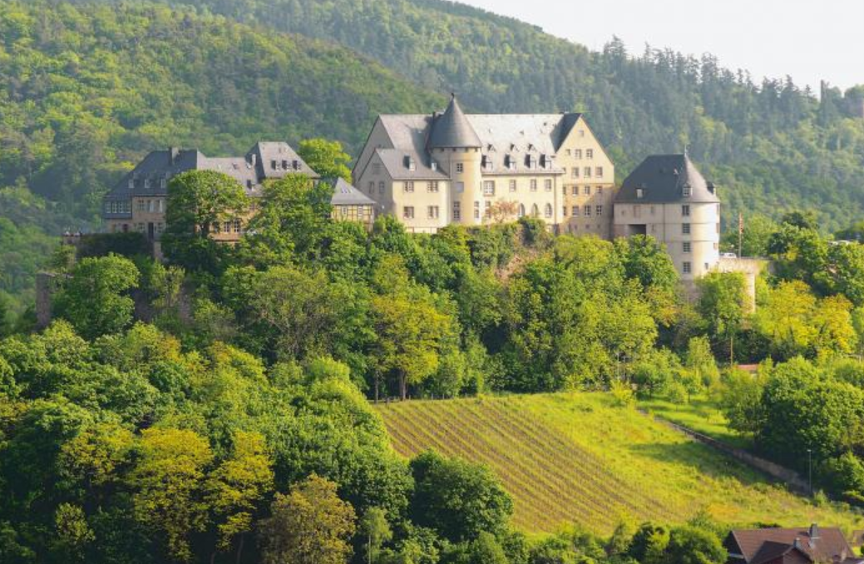
Where are we?
The ChatGPT answer…
Castle Ebernburg (German: Burg Ebernburg) is a medieval castle located near the town of Bad Münster am Stein-Ebernburg in Rhineland-Palatinate, Germany. It is situated on a hill above the Nahe River and offers a striking view of the surrounding region, including the Rotenfels cliffs.
Historical Significance
Origins: The castle was first mentioned in the 12th century. It has undergone numerous expansions and reconstructions over the centuries.
The "Refuge of Justice": Ebernburg gained historical prominence in the early 16th century when it became associated with Franz von Sickingen, a notable knight and supporter of Martin Luther and the Reformation. Sickingen used the castle as a base for his campaigns and offered it as a safe haven for reformers and thinkers, leading to its nickname, the "Refuge of Justice" (German: Herberge der Gerechtigkeit).
Destruction and Reconstruction: The castle was partially destroyed during conflicts in the 16th and 17th centuries, including the Thirty Years' War. It was rebuilt in later centuries and retains elements of its medieval architecture.
Modern Use
Today, Castle Ebernburg is a cultural and tourist site. It includes:
A youth hostel located within its premises.
Facilities for events, conferences, and seminars.
A museum and exhibition space that highlights its history and the era of Franz von Sickingen.
The castle is a popular destination for visitors interested in history, architecture, and scenic views of the Nahe region.

Slide 8
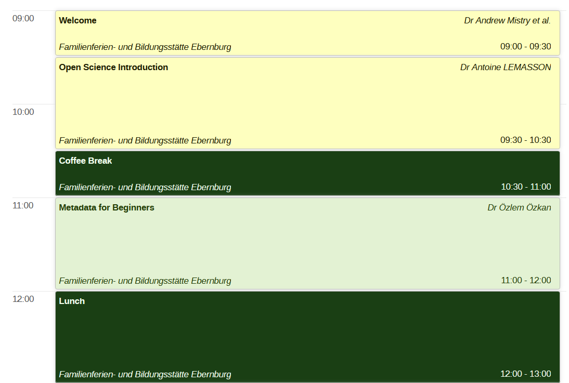
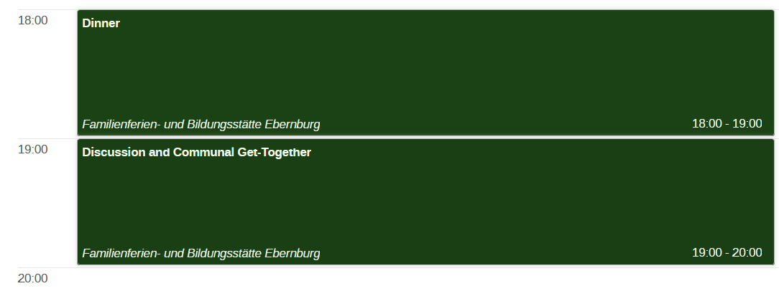
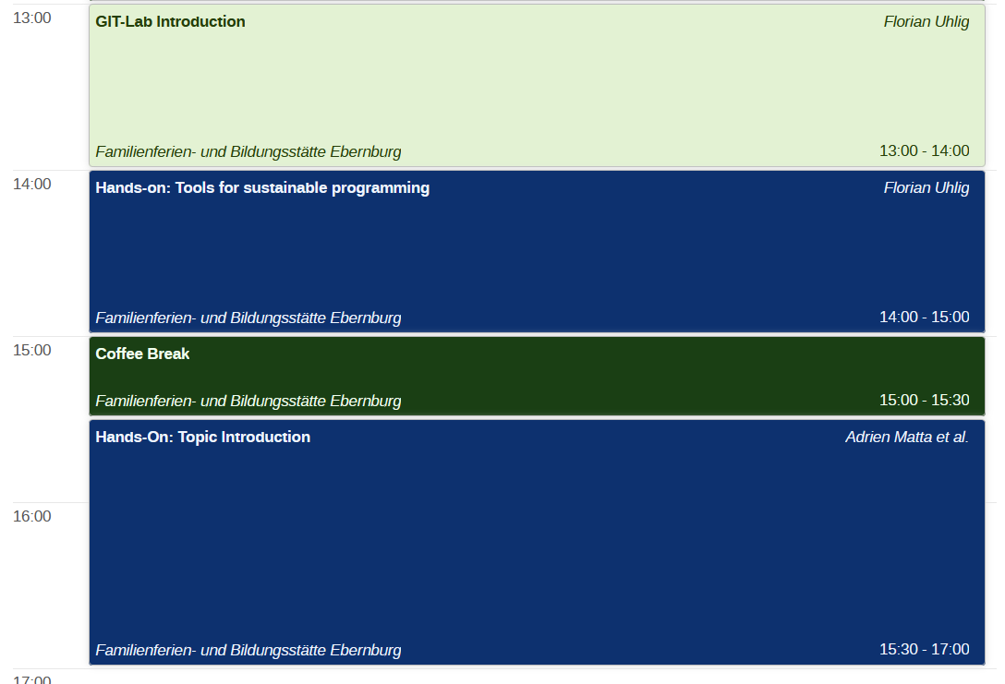
Monday 25th

Slide 9
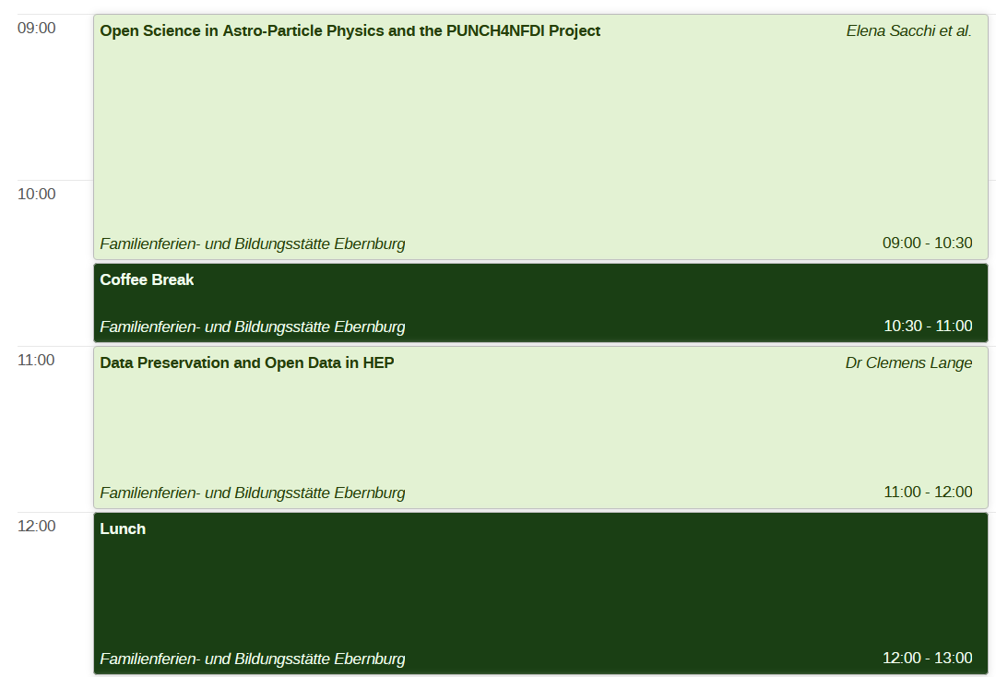
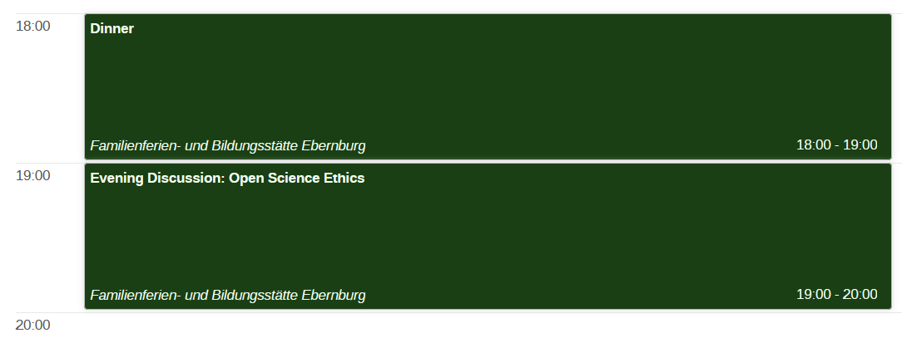
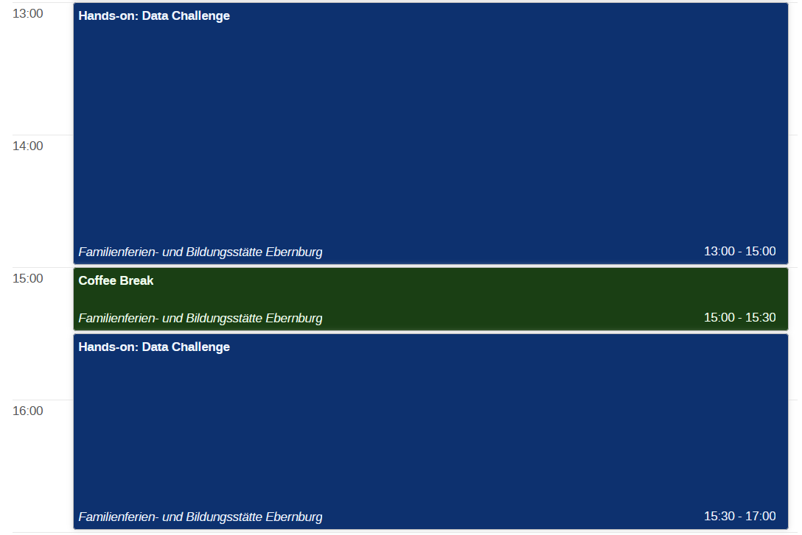
Tuesday 26th

Slide 10
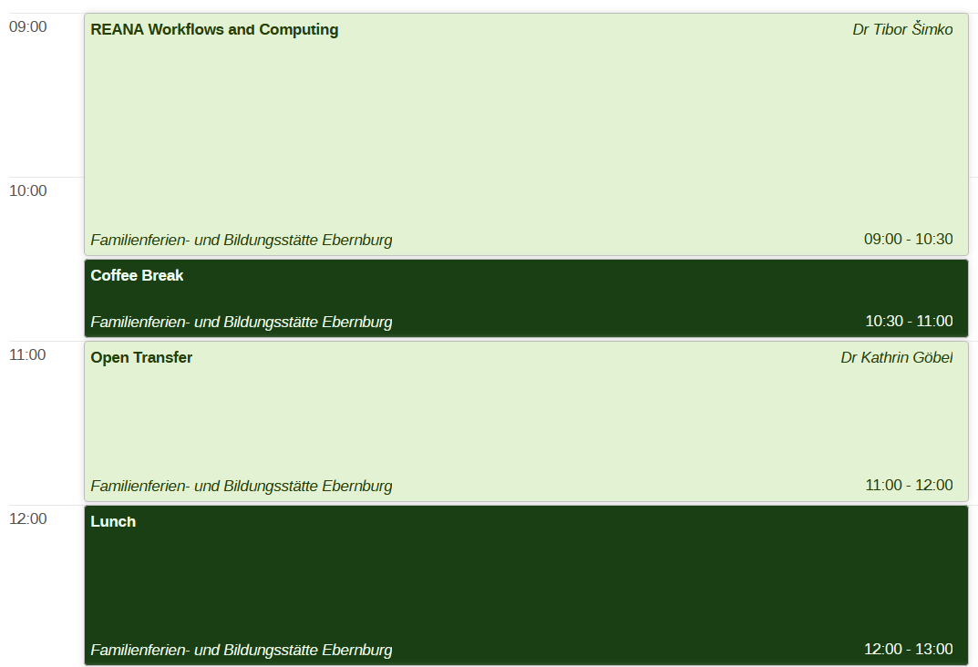
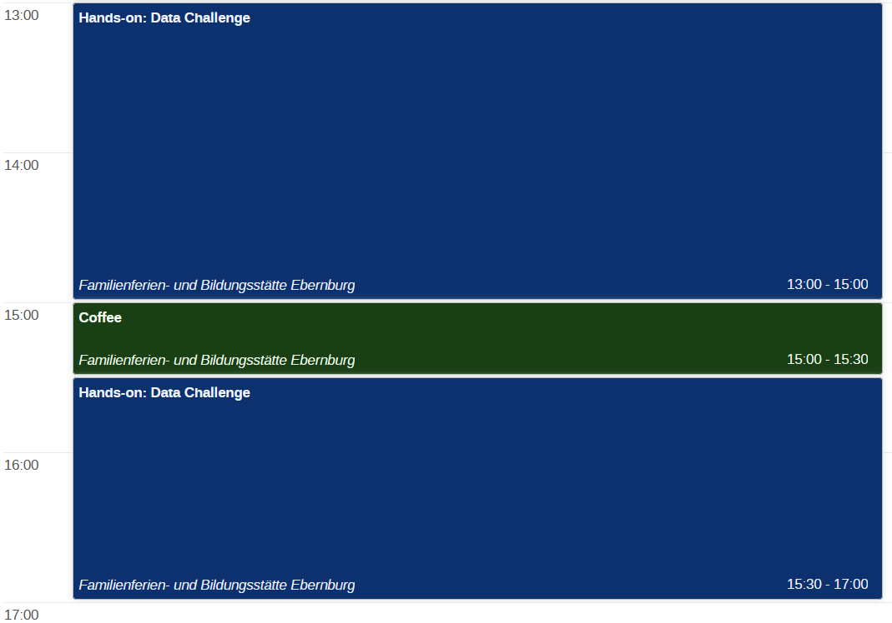
Wednesday 27th

Slide 11
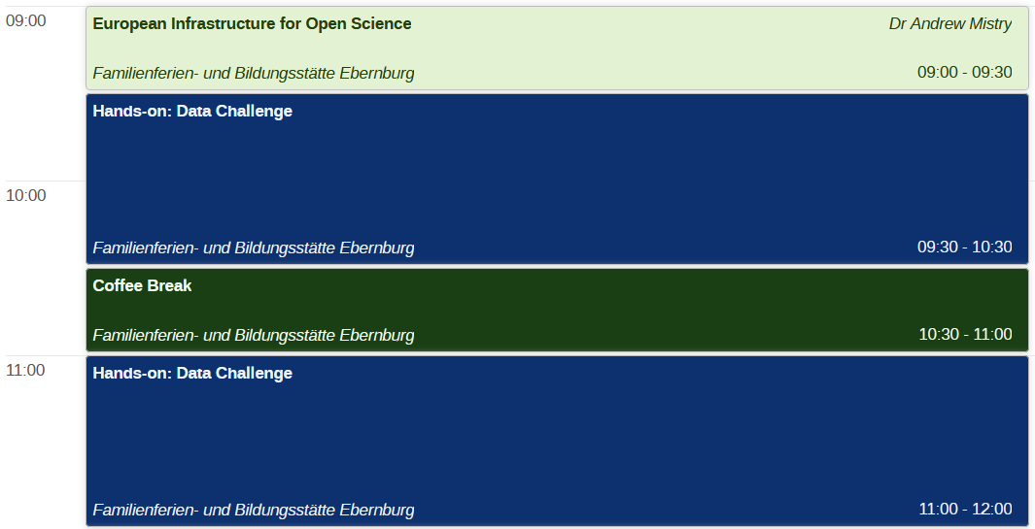
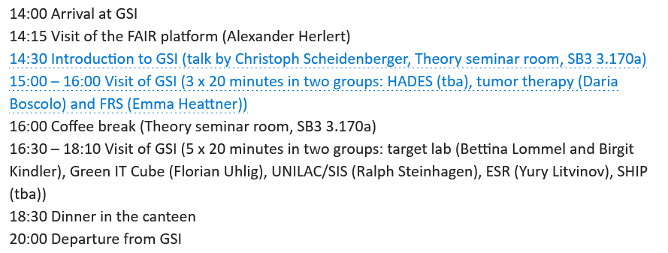

Thursday 28th
Bus departs Castle @ 12:30 -> We may need to climb down…
Arrival back at Castle ~21:30 -> We may need to climb back up…
There will be no lunch that day -> prepare a sandwich at breakfast?

Slide 12
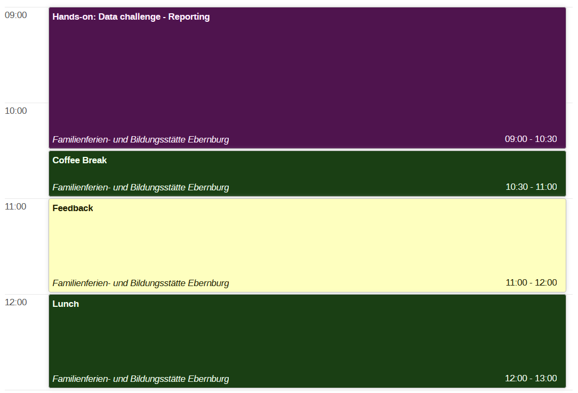
Friday 29th

Slide 13
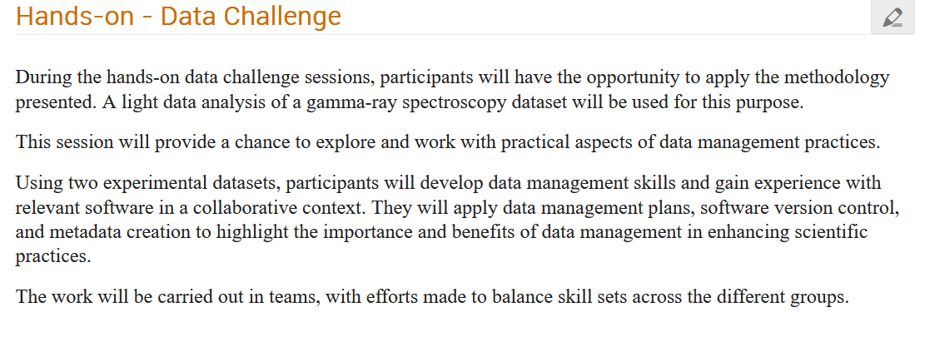
Antoine Lemasson; Adrien Matta; Jeremie Dudouet

Slide 14
Forms to Sign
Photo Consent Form – Do this now
Reimbursement forms – can be done until end of the week
Christine: Something I missed?

Slide 15
EURO-LABS Advanced Training
Open Science and Data Management
Castle Ebernburg: 24.11.24 – 29.11.24
Thanks to these guys!
Most importantly: Enjoy yourself!
Now: Shortly introduce yourselves

