Slide 1
GLAD status, upgrade &
R3B Collaboration Meeting
20240709
Darmstadt
H. Simon ●
GSI Darmstadt

Slide 2
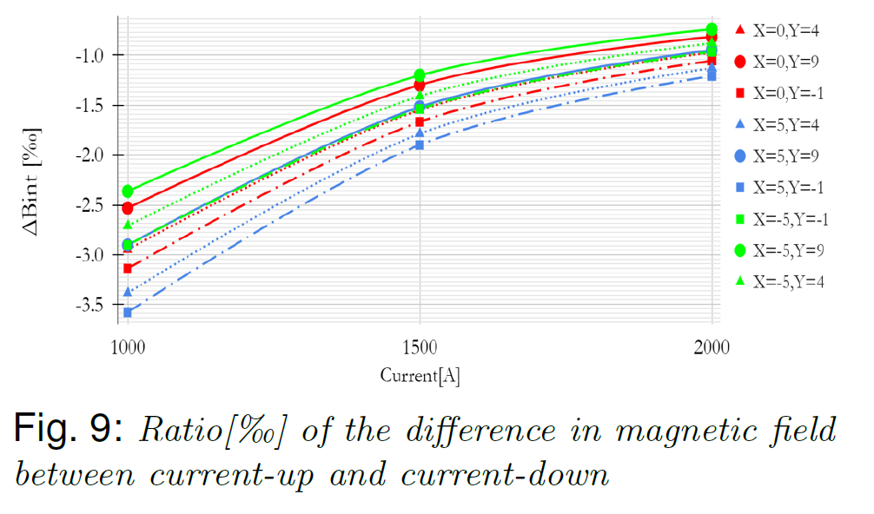
Remaining issues:
Field maps → Based on Valeriis field maps inconsistencies
with tracker have been found (M . Heil / A Kelic-Heil )
Analysis in progress (M. Kelic-Heil, M.Heil, V. Panin)
Decision on Mapping@FAIR for precision tracking based on findings
➔ Dedicated talk by Michael

Slide 3
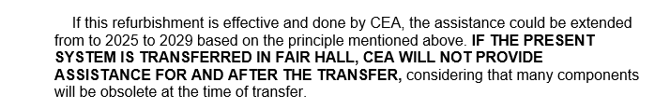
Contractual status - remaining issues:
In-kind accepted (France/Germany)
In-kind contracts closed
Maintenance contract closed
preventive maintenance and hot-line support (10k€/y)
Documentation received 05/2022 / approval by QA.
Common funds via NUSTAR → ECE/ECSG (193k€@2005) ok
FAIR budget allocated, Contract closed
Work on DAQ system (MSS) has started
open issue: PLC based magnet control system

Slide 4
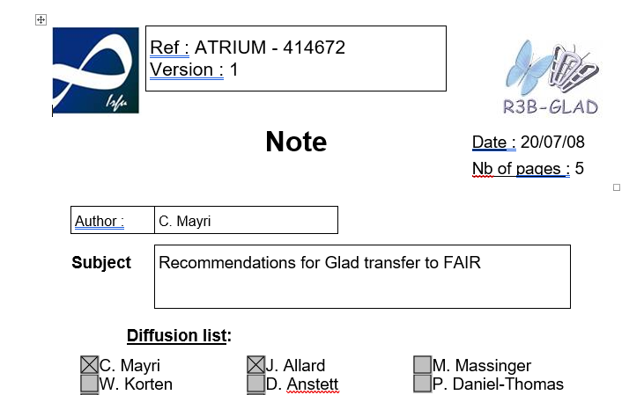
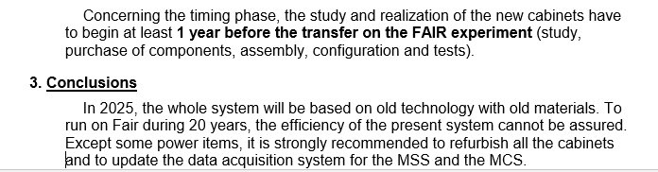
Scope:
Cabling, Magnet Control, Magnet Safety System, Software

Slide 5
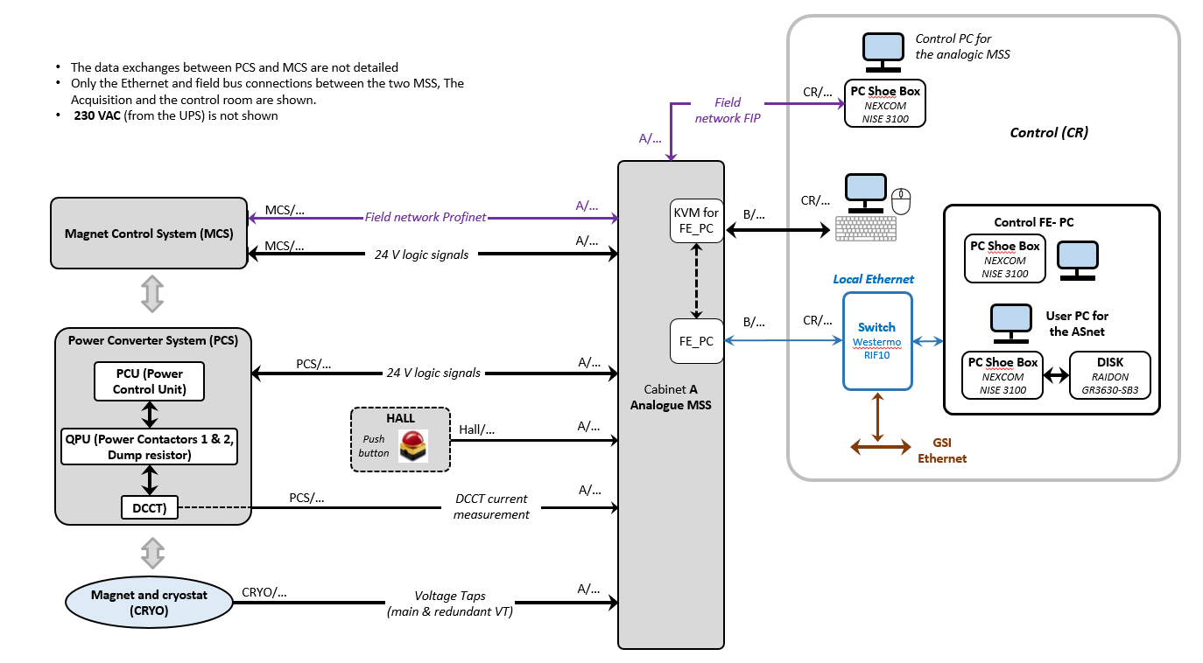
R3B - Analog MSS – current status

Slide 6
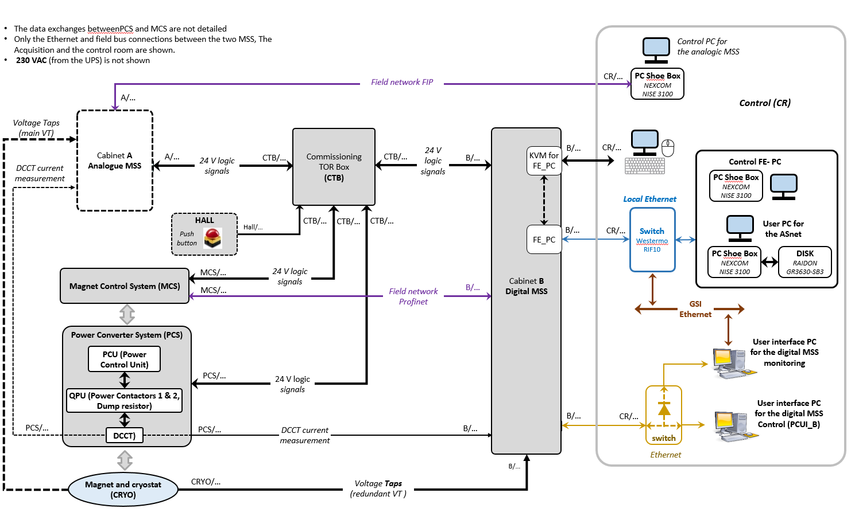
R3B - Analog + Digital MSS for commissionning from end of this year

Slide 7
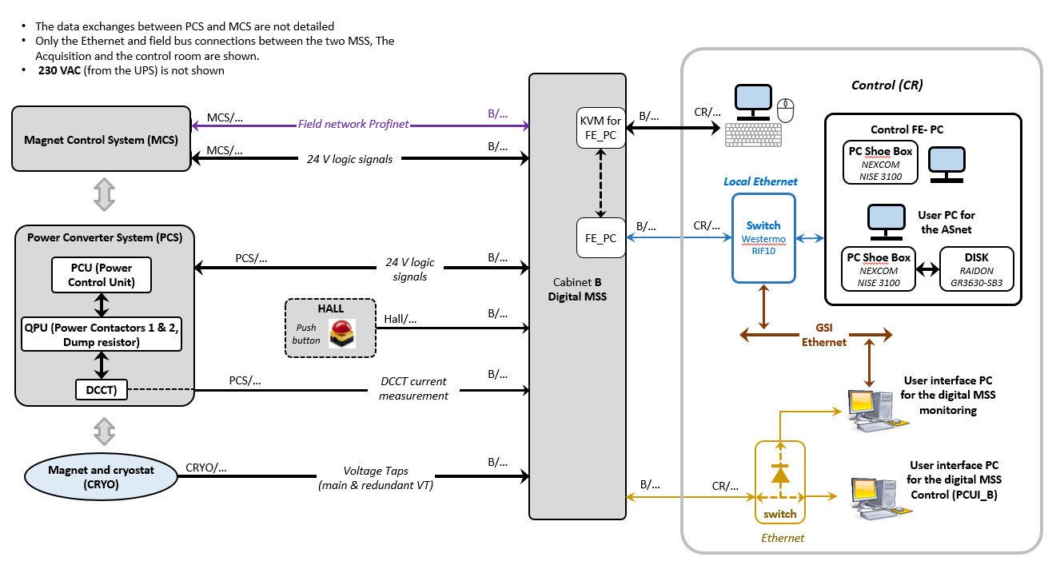
R3B - Digital MSS
(alone after the commissionning – new Cave)

Slide 8
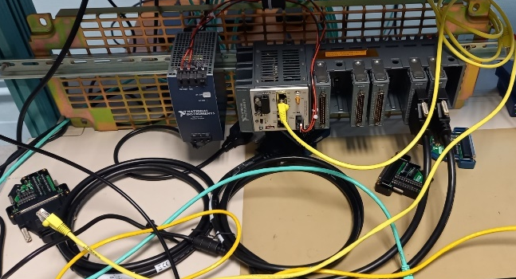
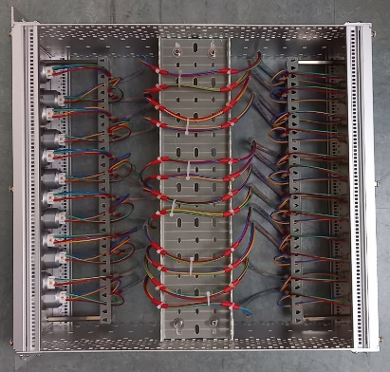
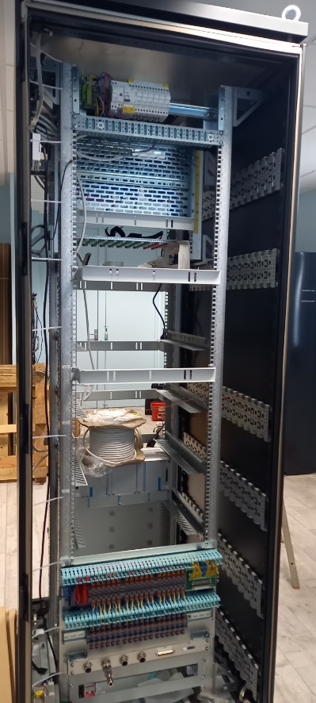
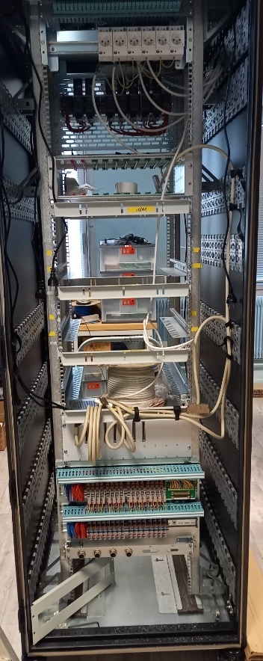
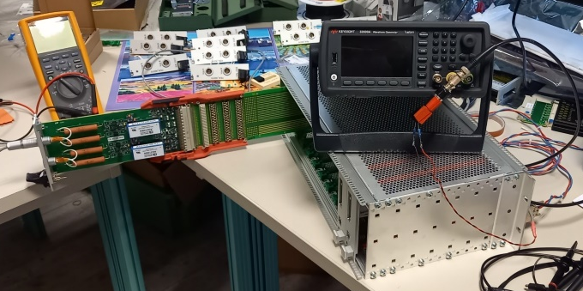
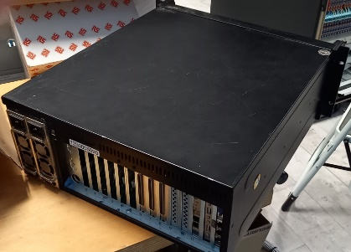
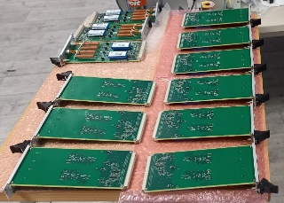
R3B- MSS cabinet – Work in Progress
Compact RIO (FPGA + µP)
Dispatching Chassis
MSS cabinet
Measurement boards
Acquisition FEPC

Slide 9
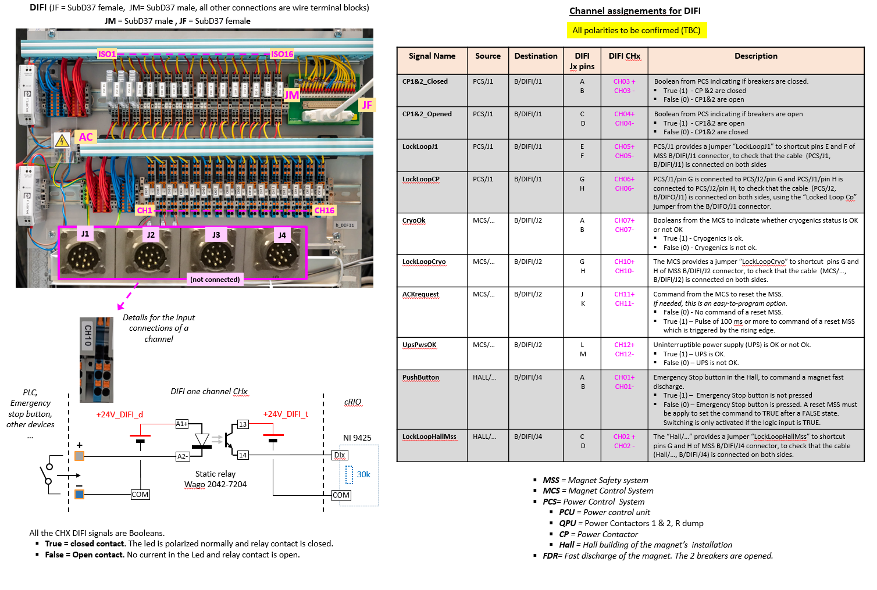
R3B - Digital Inputs

Slide 10
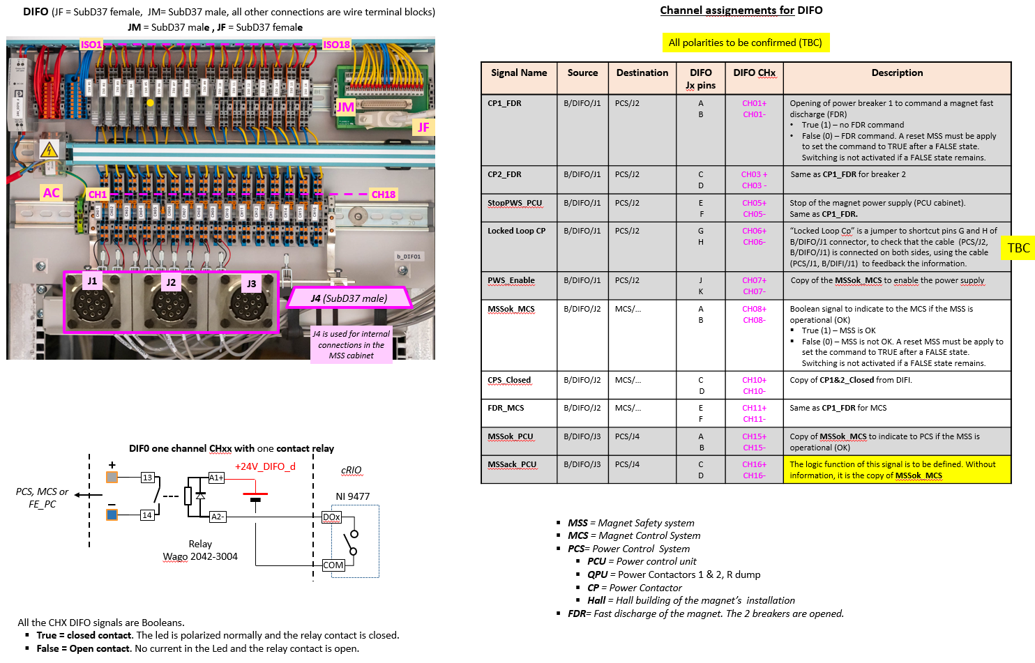
R3B - Digital Outputs

Slide 11
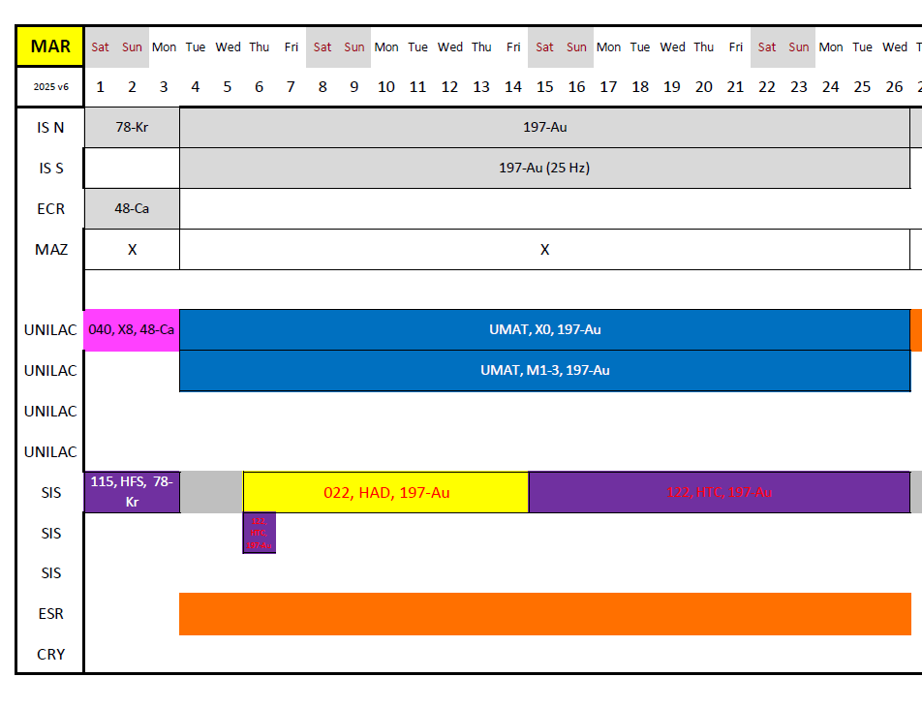
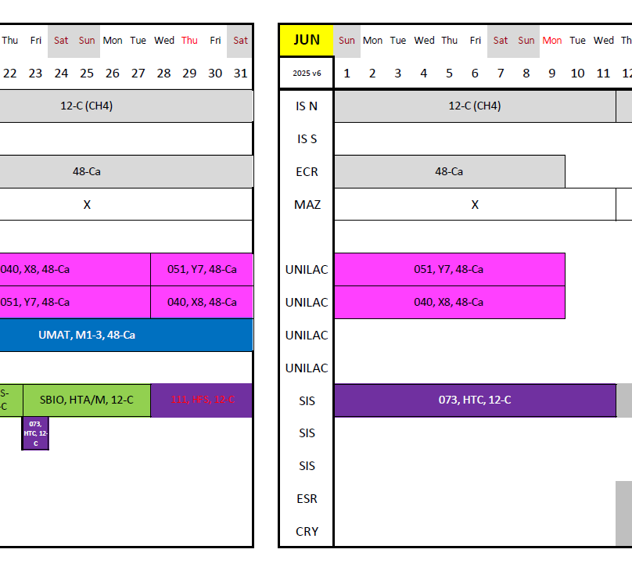
Parallel Operation of old an new MSS prepared (tentative plan – still preliminary (V6) )
S122 (ASYEOS, no GLAD)
- Nov/Dec 2024 Test (?)
S073 (Hypernuclei)
➔ Prepare for early operation 2025 with mirrored MSS
Super-FRS Detector tests (Beginning February & July, no GLAD)

Slide 12
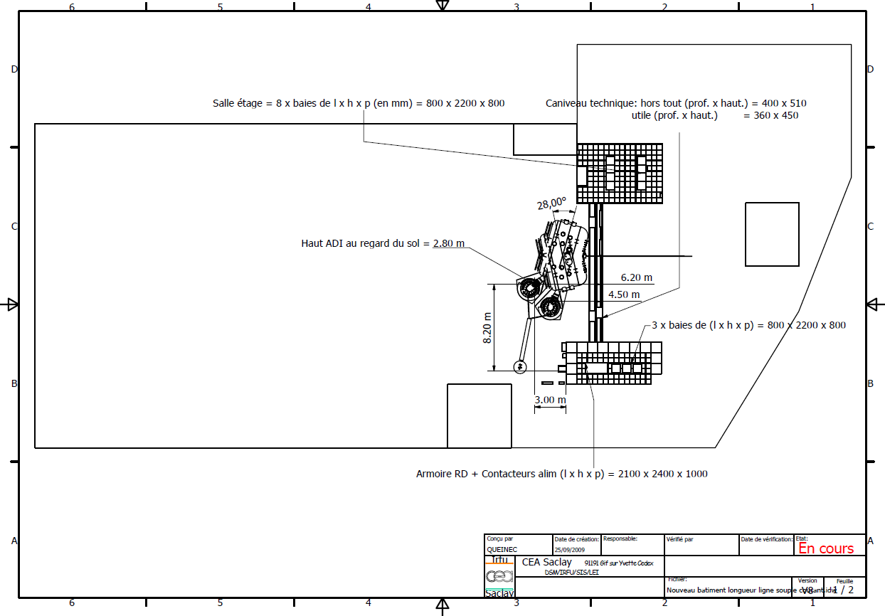
Further preparation
See Daniels talk

Slide 13
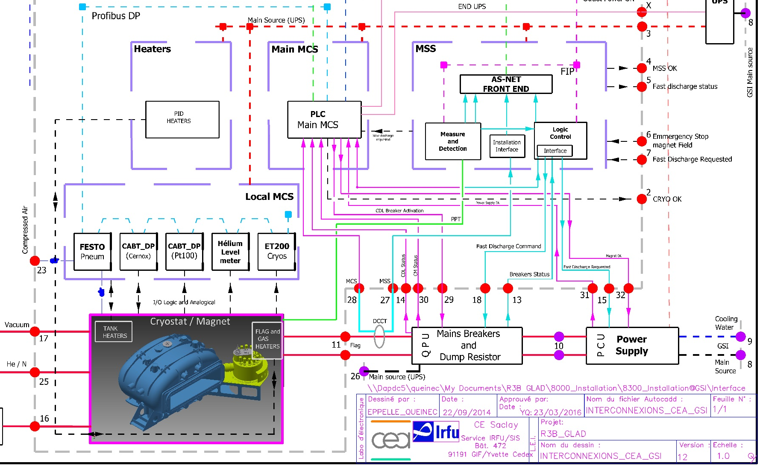
Remaining Issue
MCS – Heaters, Local MCS, Main MCS
Software received, analysis still to be contracted,
Meeting with ACC/IND end of March – possible COSYLab contact

Slide 14
Summary
MSS is on its way
MCS has just started, needs budget and study (Q3/2024)
Design of Foot holding structure discussed
Survey in Cave necessary (alignment, fiducialization)
Magnet Measurement campaingn @ FAIR (Michael)

Slide 16
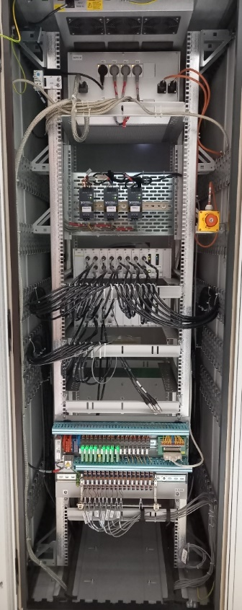
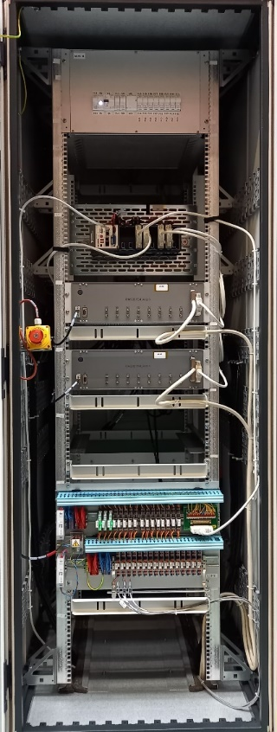


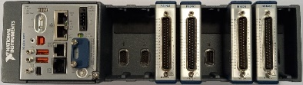
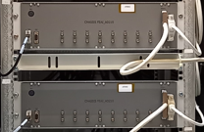

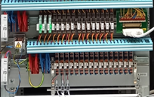
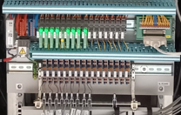
Example – STAARQ MSS – General synoptic
Magnet installation with Rdump only
Digital MSS cabinet
User interface
Configuration, exploitation, monitoring of the MSS cabinet
(Reset MSS)
Magnet General Control System
Rear view
Front view
Cryostat
Export MSS Data
VT
Magnet Dispatching System (MDS
Main supply distribution
Vrms = 230 V ; Irms= 1,15 A
From a UPS
Cyber security
Magnet
TCP
UDP
Current leads
Local Ethernet
network
24V Power supplies for
Compact RIO chassis
Measurement chassis
Compact RIO
cRIO 9039 Sync
cRIO 9049
Rdump
I dcct
TCP
UDP
V and I
Measurements
Breaker
Analog Front End chassis
with high voltage insulation
16 measurements per chassis
3 chassis max
48 measurements max
Logic modules
ADC
modules
Cmd Breaker
Power supply STOP
MPES
measurements
Logic I/O (24 V logic standard)
16 outputs max - scalable to 31 inputs with another chassis
16 inputs max - scalable to 31 inputs with another chassis
MCCS
CRYO_OK, others ..>>
<< Trigger if quench
<< MSS OK, others …
Command and control Logic
Trigger distribution if quench

Slide 17
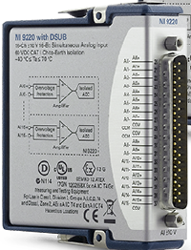
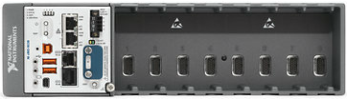

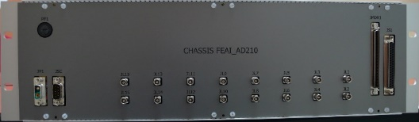
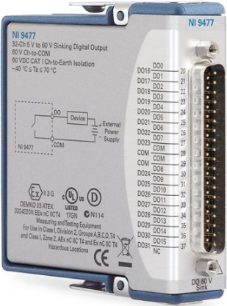
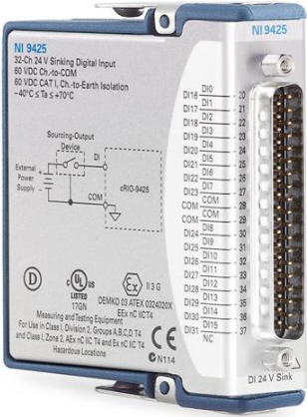
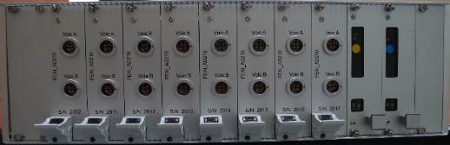
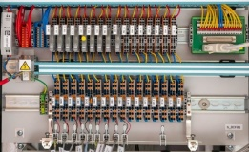
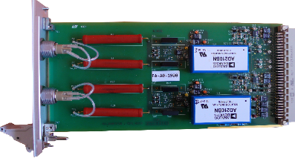
Example – STAARQ MSS - Detailed synoptic
Local Eth
network
    Analogue interface for other subsystems like the Magnet Command / Control System
NI 9220
TCP
UDP
MSS Digital processing
cRIO 9049
    +24V
± 10 V test points
Other subsystem
Spare
slots
16 channels
    Front side
NI 9477
NI 9425
16 channels
32 logic outputs (24V)
td = 8µS
32 logic inputs (24V)
td = 8µS
16 logic outputs
16 logic inputs
    Rear side
16 channels
NI 9220
16 ADC – 16 bits
+/- 10V
Fs = 100 kHz
Simultaneous sampling
  Magnet Power Electronic System
Cmd if Quench of Breaker, Heaters, CLIQ, Power supply STOP
  Magnet Data Acquisition System
  Trigger if quench
  Magnet Command Control System
  Trigger if quench and Logic
I dcct
    Two Channels
    Gain 1 to 500 (adjustable)
    Bandwith = 900 Hz (adjustable)
    ± 10 V differential or single end outputs
    Isolation working voltage = 3,5 kV
  Magnet Voltage Taps System
  48 Magnet analogue measurements
  One more chassis may be added to reach 64 measurements

Slide 18
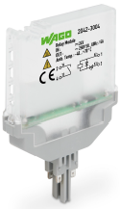
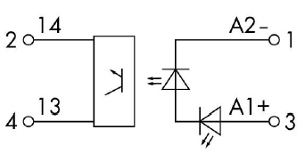
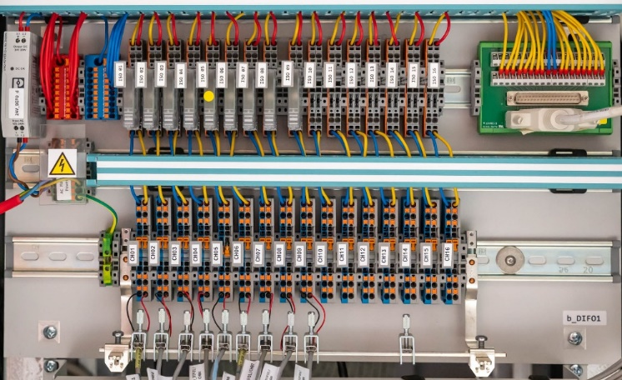
Example – STAARQ MSS - Digital I/O
Example: Interface subsystems for logic outputs
up to 16 channels (scalable to 32) - on the shelf devices
Low = active level for command/control for safety
Local Ethernet
network
TCP
UDP
MSS Digital processing
Compact RIO
NI 9220
for analogue inputs
Wago 2042-7204
Input 24V, 7mA
Output 24V , 100 mA max
Drop out-time ≤ 20 µS
Working Isolation = 250V
State led: green
Spare
slots
Pluggable static relay
NI 9477
NI 9425
32 logic outputs (24V)
td = 8µS
32 logic inputs (24V)
td = 8µS
Logic outputs
Logic inputs
    +24V for
    NI 9477
    AC main
    220 V
Terminal blocks
with no operation of connection or disconnection for maintenance
  Magnet Power Electronic System
Cmd if Quench of Breaker, Heaters, CLIQ, Power supply STOP
  Magnet Data Acquisition System
  Trigger if quench
  Magnet Command Control System
  Trigger if quench and Logic

Slide 19
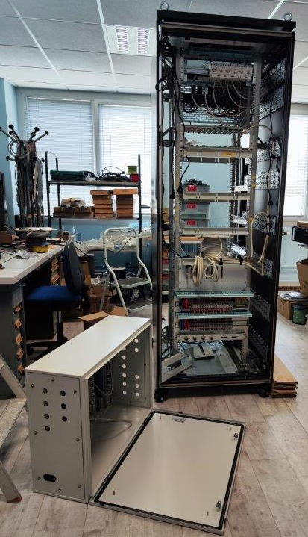
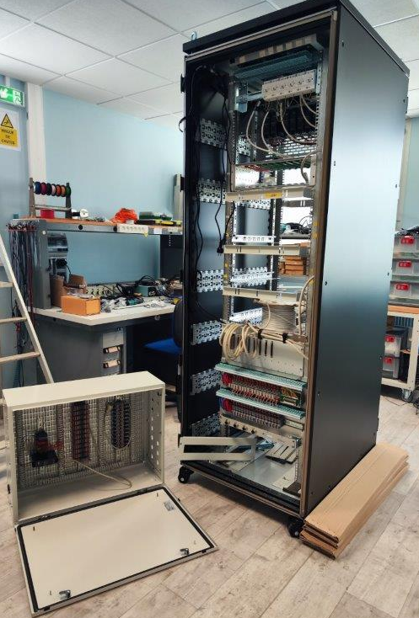
Digital MSS – Size of cabinet B and box CTB
4 lifting eyes
Cabinet B
Width = 800 mm
  812 mm if wheels are not aligned under the cabinet
Depth =1030mm
  +60 mm if wheels are not aligned under the cabinet
  Space is needed to open the doors
Height = 2400 mm
Space is needed to plug or unplug connectors on both sides
H
W
Box CTB
Width = 610 mm
Depth = 305 mm
Height = 805 mm

Slide 20
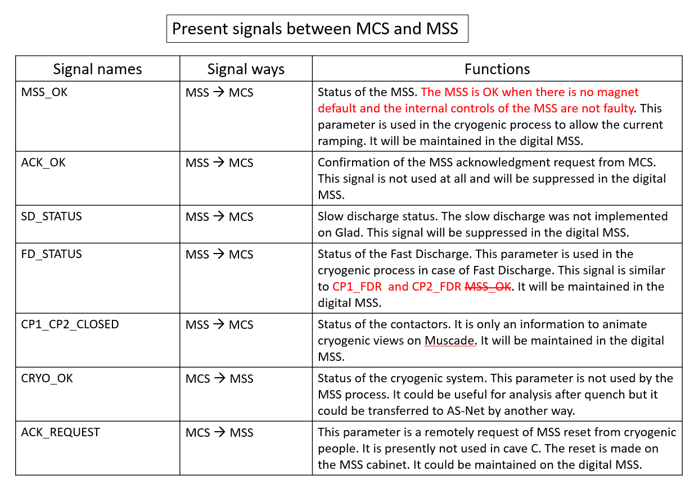
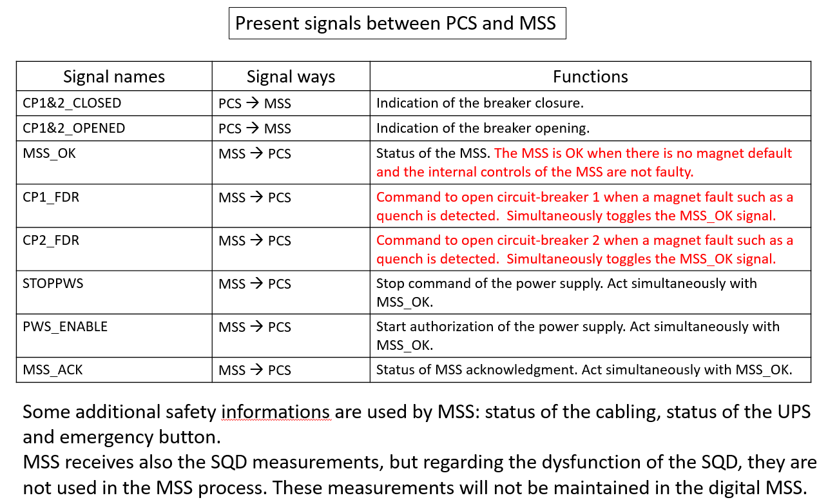
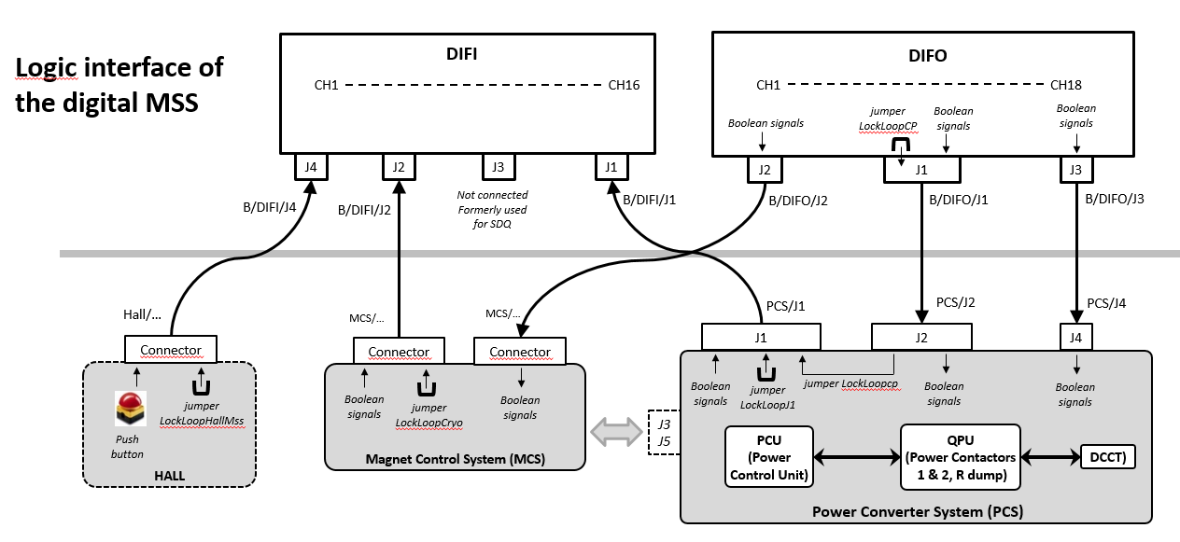
R3B - Logic I/O of MSS

