Slide 1
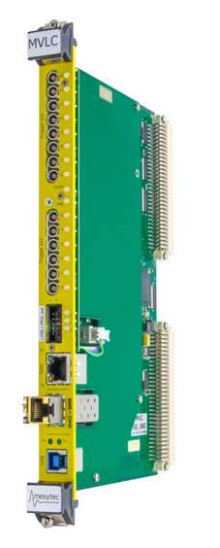
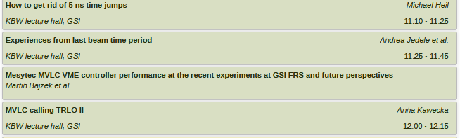
Intro DAQ
- Refilling of DAQ operator ongoing: interviews done → short list
- Developments CHT : SEP Rimfaxe/Heimdal → COTS
Talks on:
clock dist.
operations
high rate VME data readout

Slide 2
Future planning (last meeting)
Job offer for replacement (subject to full directorates’ approval)
approved and finalizing
DAQ operation by experienced core team
(proposal: 1 position at GSI + 1 via collaboration funds, on-site)
  overview & planning of complete experiment DAQ system
  quick intervention capability
  maintain / grow system knowledge
  DAQ training and support for detector groups
  system critical task
Control system maintenance (no volonteers)
  looking for engineer / physicist with EPICS background, e.g. accelerator context
  can be done off-site
Basti & Haik

Slide 3
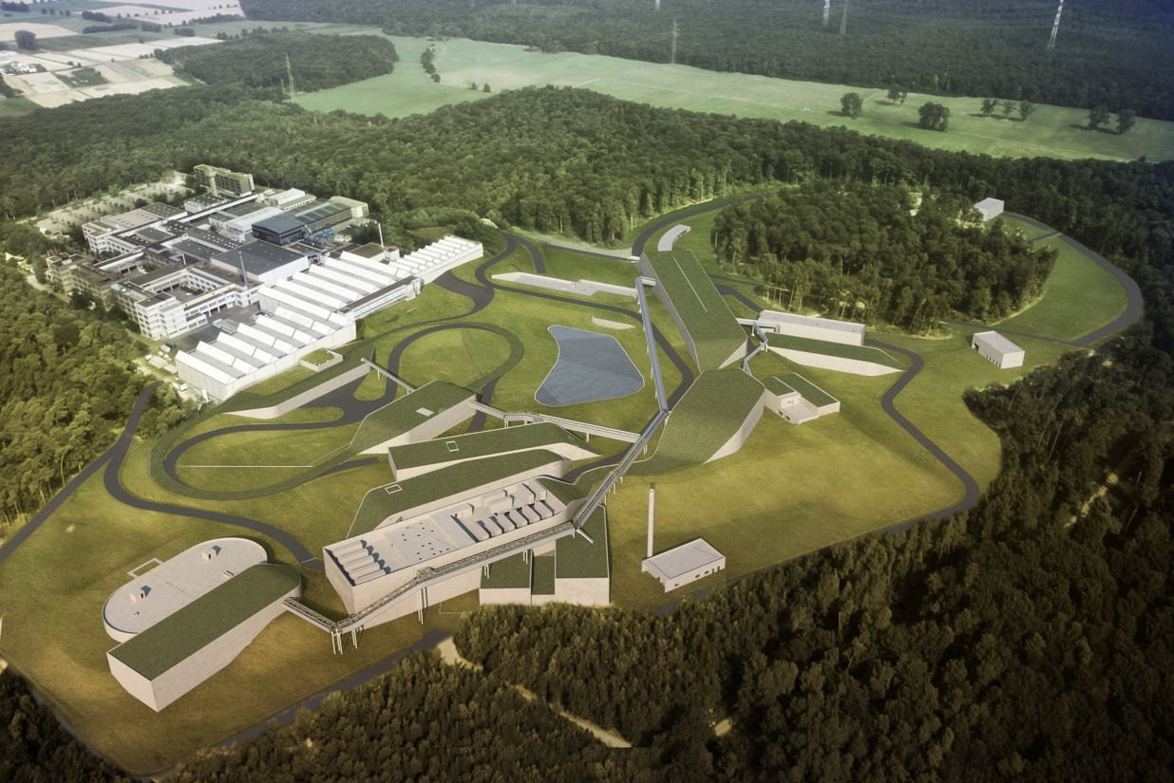

How can Sweden help GSI to develop a cost effective system design using COTS with dedicated interface adaptations for a high performant data acquisition system?
20240130-Lund
Haik Simon – GSI Darmstadt
in collaboration with

Slide 4
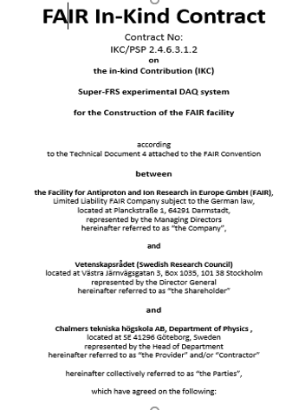
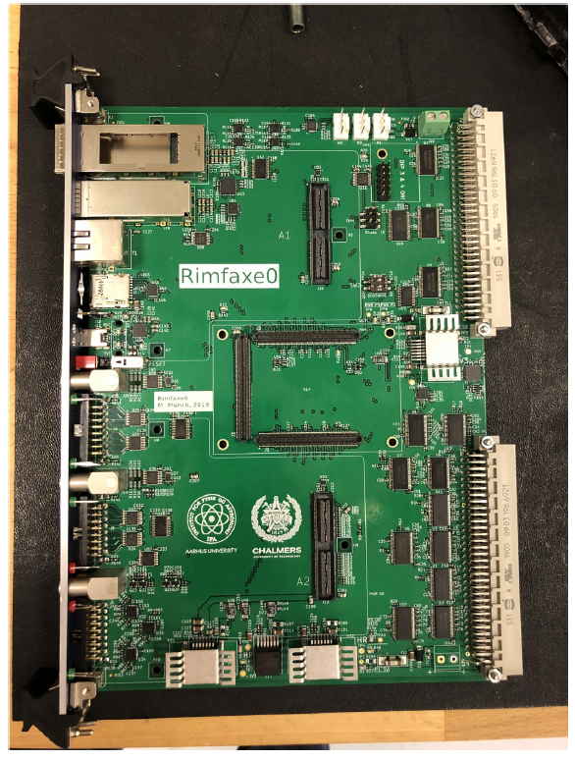
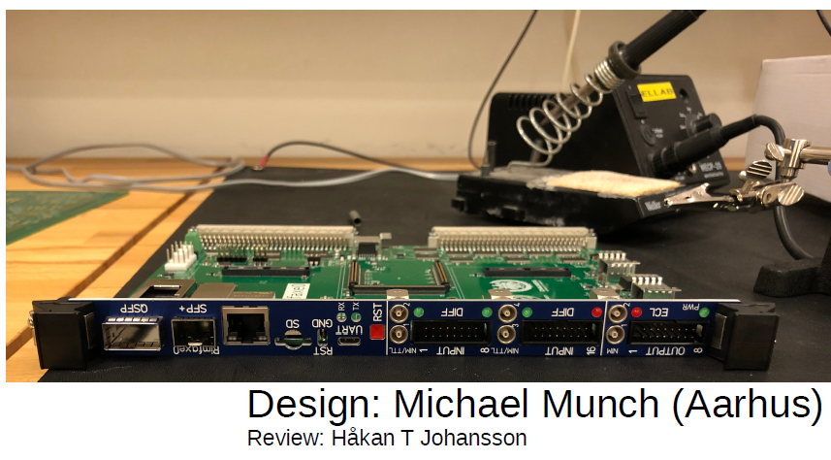
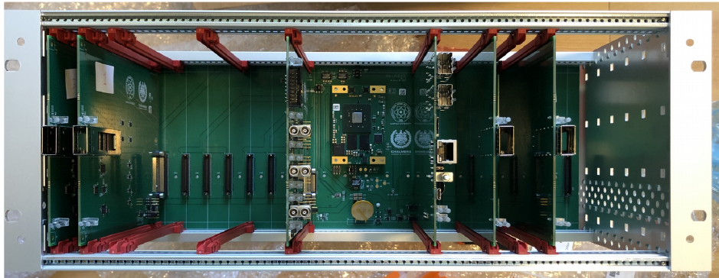
Status: Current Field of intense collaboration
Distributed high rate DAQ (km scale, few 10ps resolution time base)
Strong links
to experiment
Collaboration CTH-AAU-GSI
produced in SE
prototype:
Heimdal/Bifrost
fibre signal
exchange points
Building blocks
exist, final system design
and production to follow
Series production/testing to come

Slide 5
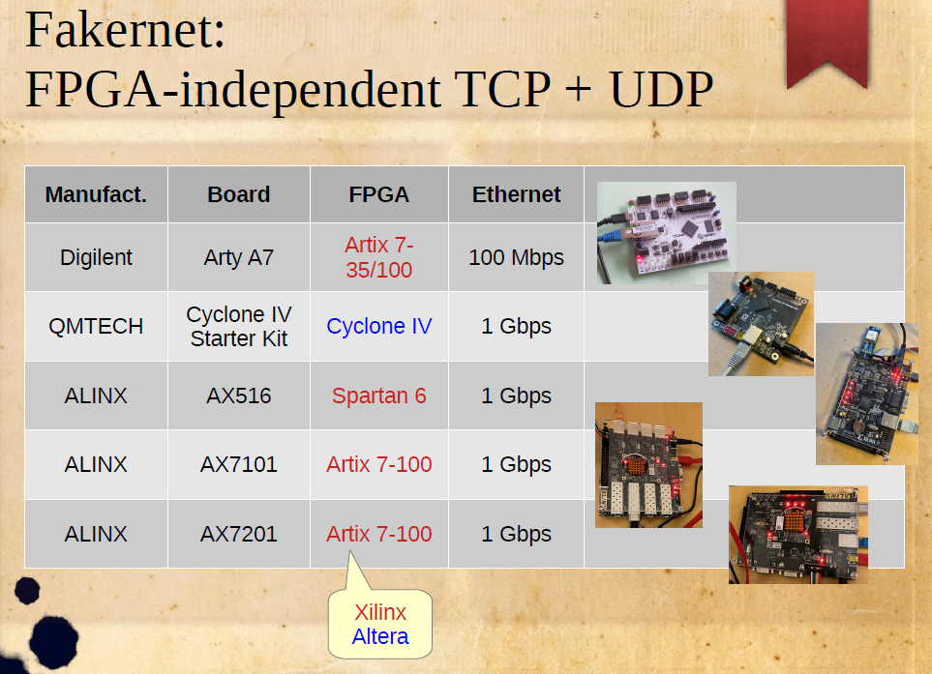
Idea is to replace
Heimdal by COTS
and adapter boards
→benefit from
industrial QM and
support
→possible split of
firmware
developments
→life cycles!
Courtesy: H. Johansson - Chalmers

Slide 6
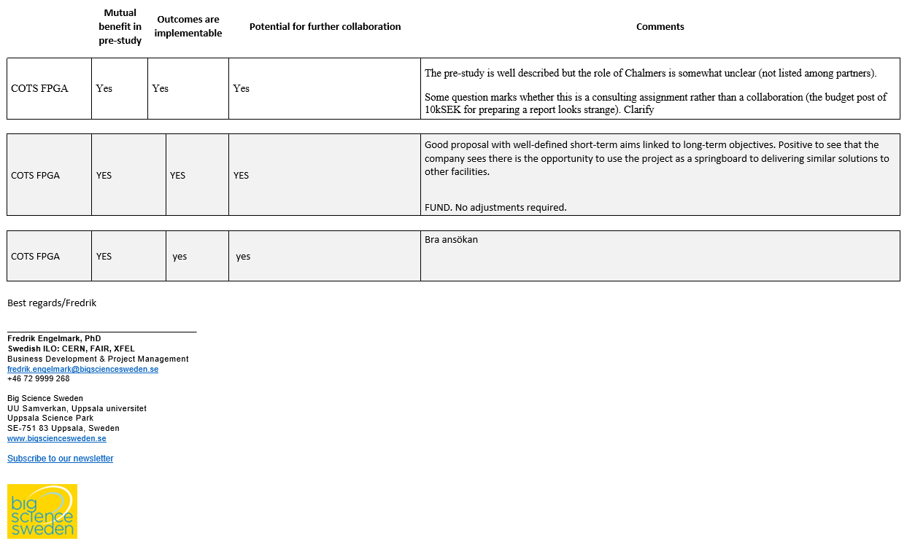
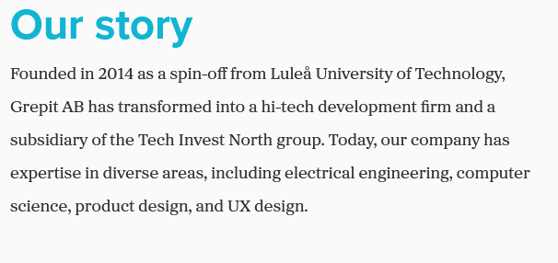
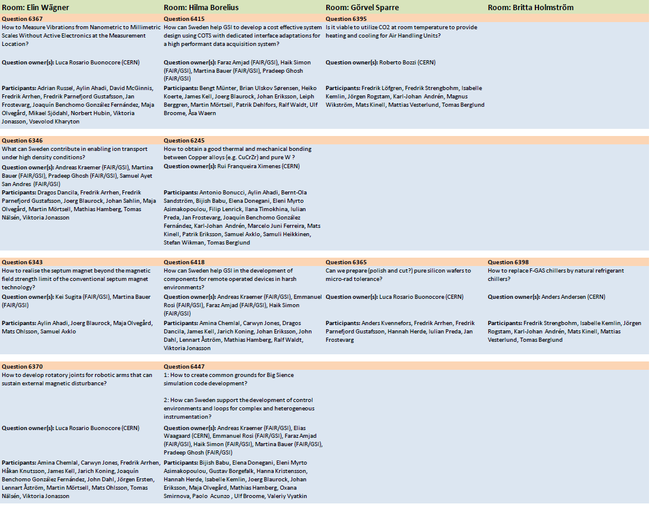
Grant application successful 20240405
Industry partner: grepit.se (Lulea/SE)
Several other applications (2 funded)
20240530
20240613
Identified low latency transfer of
signals via optical fibre interface.
COTS to be identified.

