Slide 1
Performance of the ALPIDE detectors for s091 & s118 experiments
By : Martin Bayzek && Luke Rose
Date: 09/07/2024

Slide 2
What worked

Slide 3
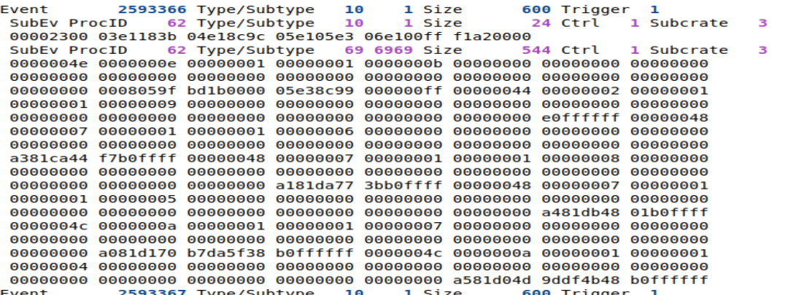
Data suppression
BEFORE
“Thats alot of nothing”

Slide 4
Data suppression
Reciver_id-1=3->Convert to chip
AFTER
Code word
# sensor fired
For this experiment ctrl=MOSAIC_ID
*Danke Martin

Slide 5
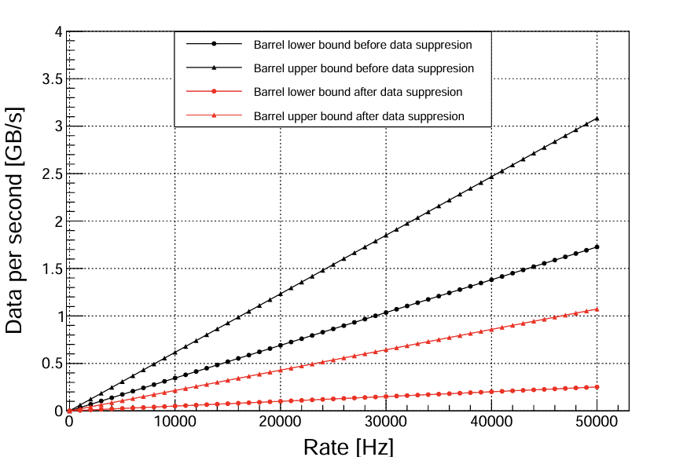
Data rates

Slide 6
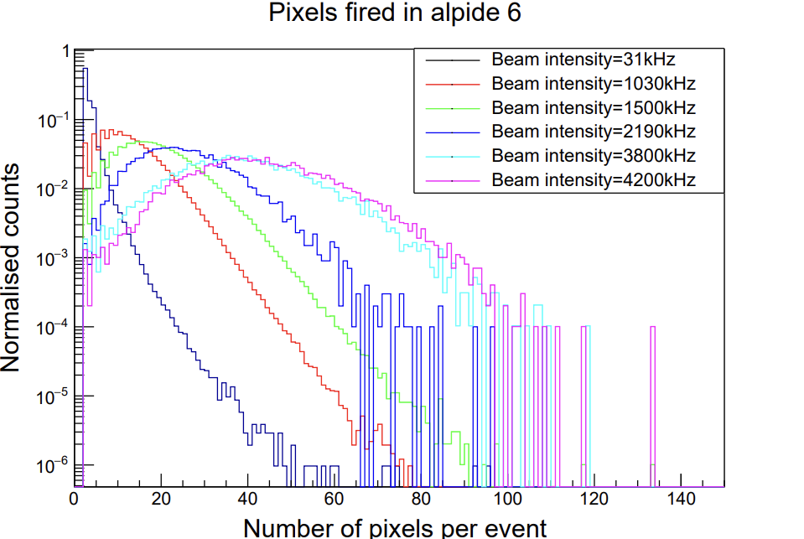
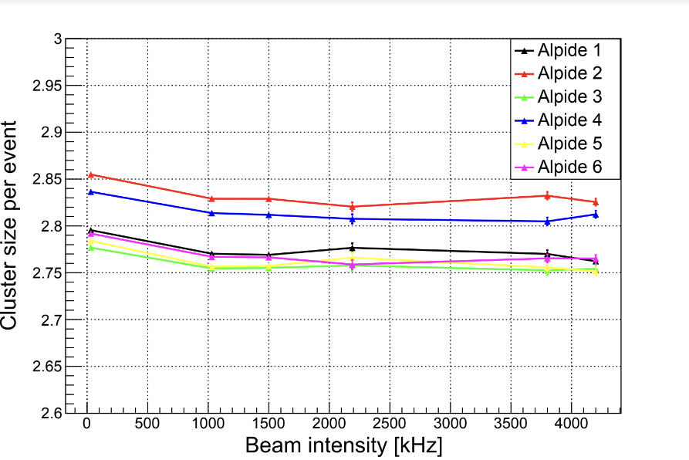
Measured cluster size stable as intensity increased.
Number of clusters/pixels fired increased with the beam rate.
Data rates
Cern 2020 Data

Slide 7
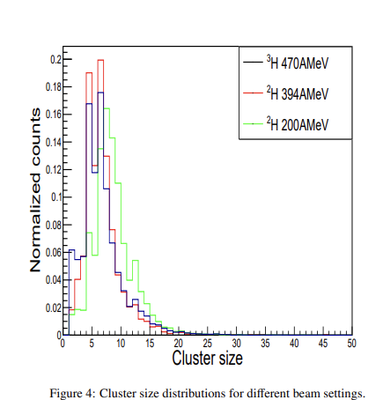
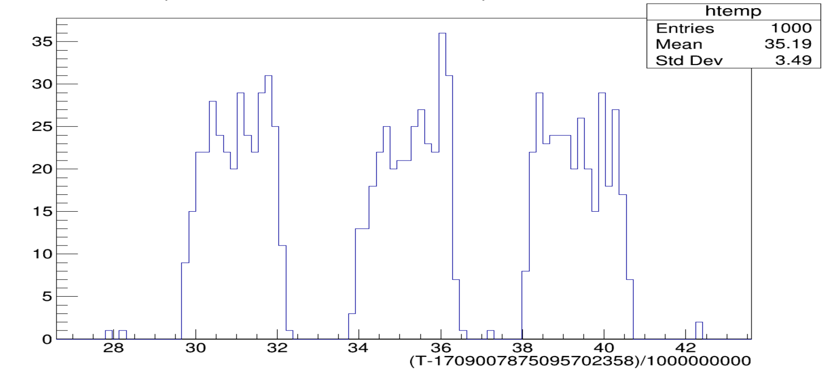
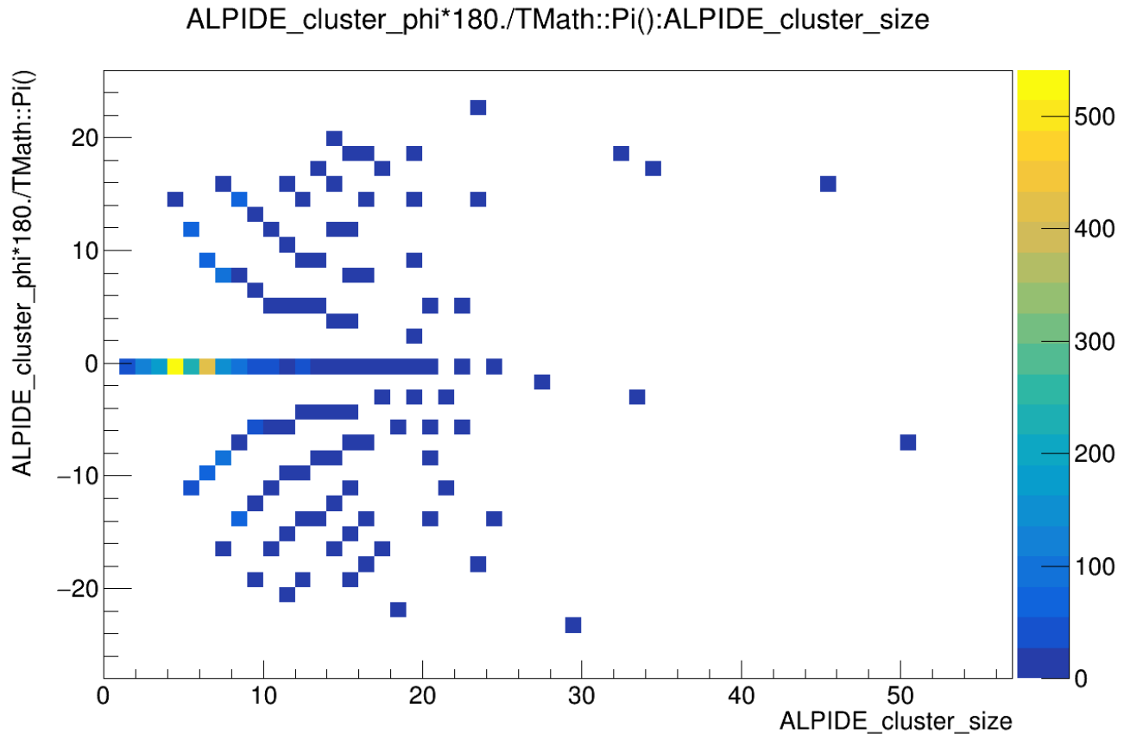
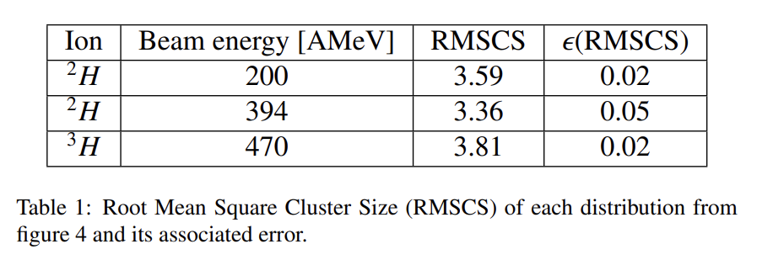
Clusters
Energy relation
Spill structure
Shape analysis
W
φ
L

Slide 8
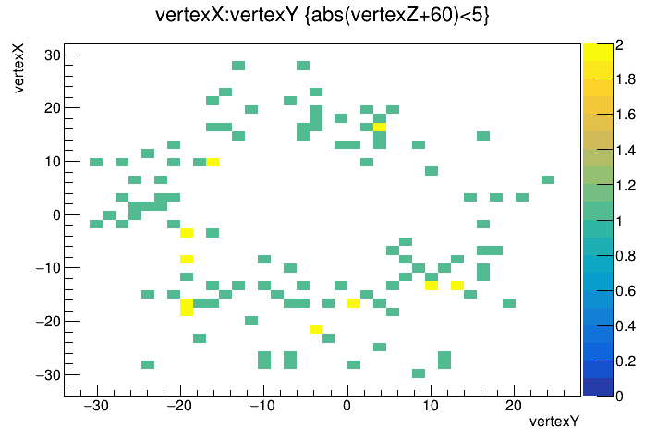
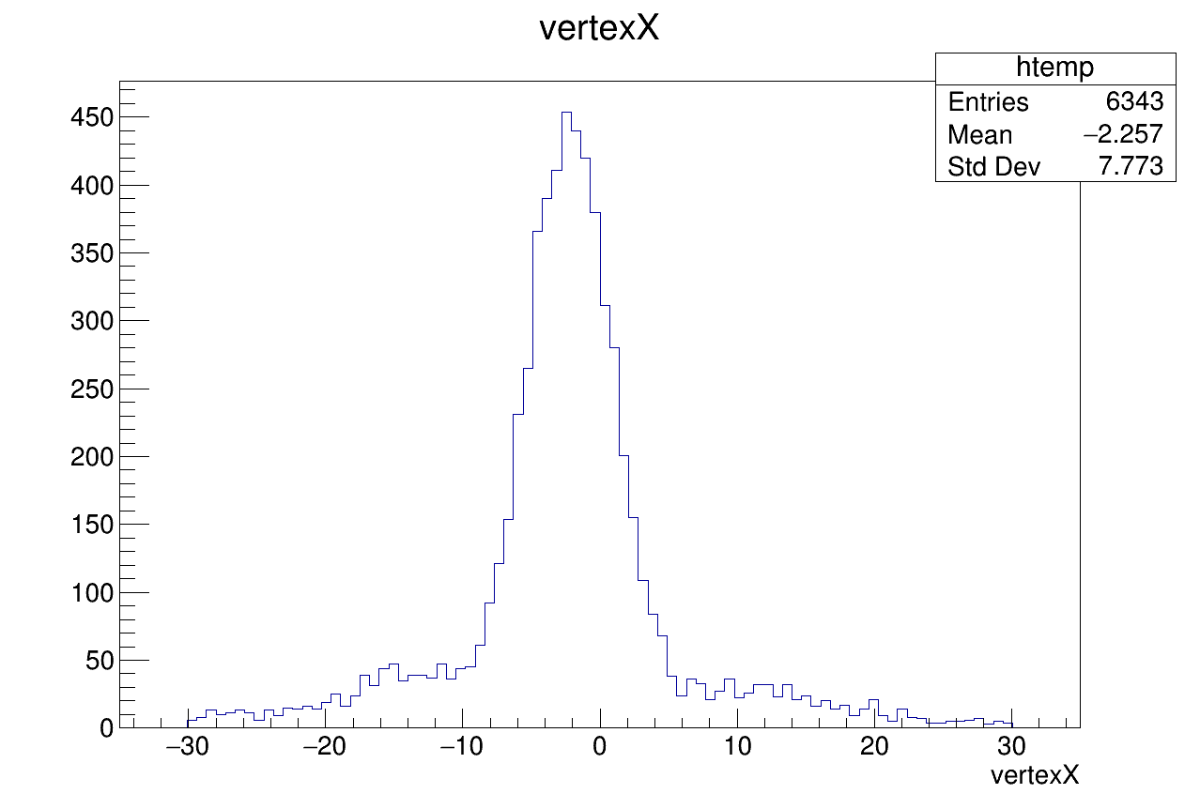
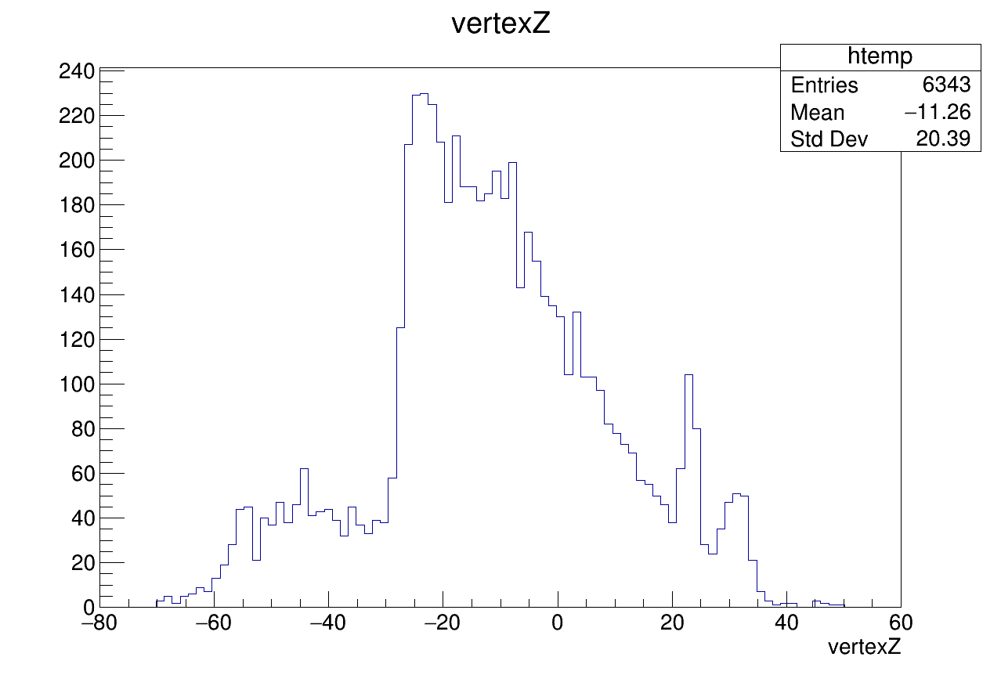
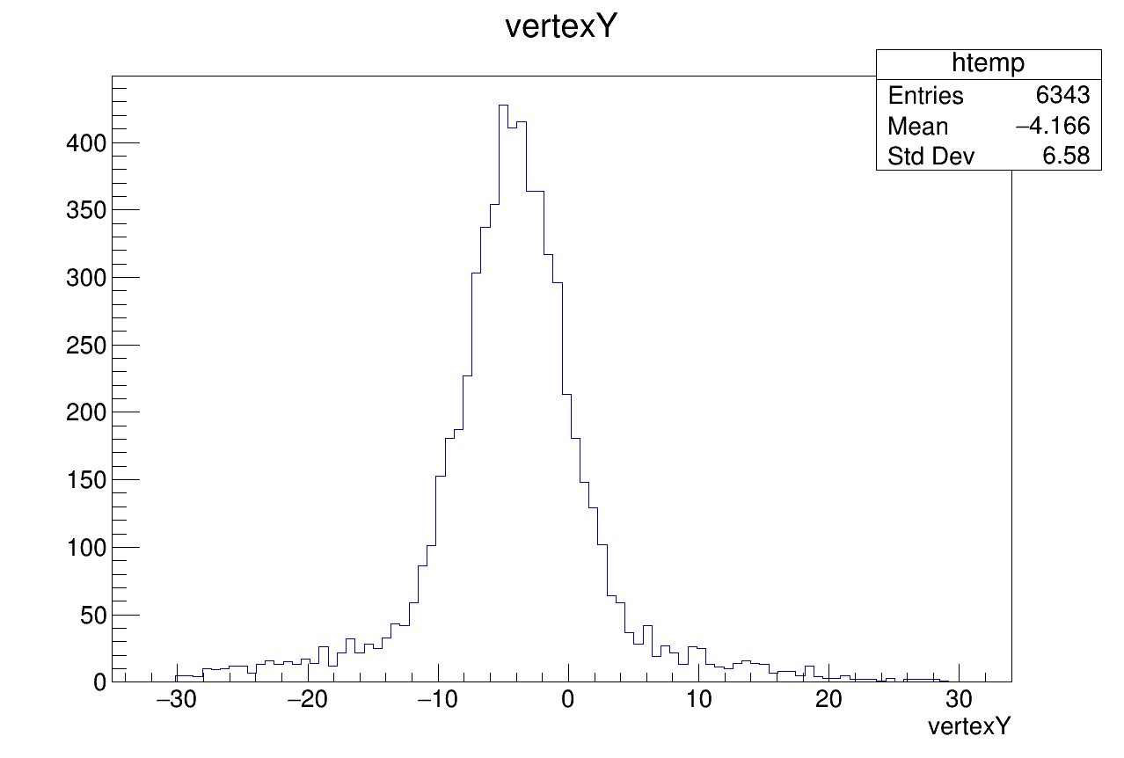
Vertexing

Slide 9
What was poor form

Slide 10
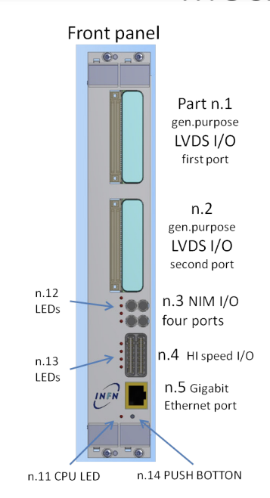
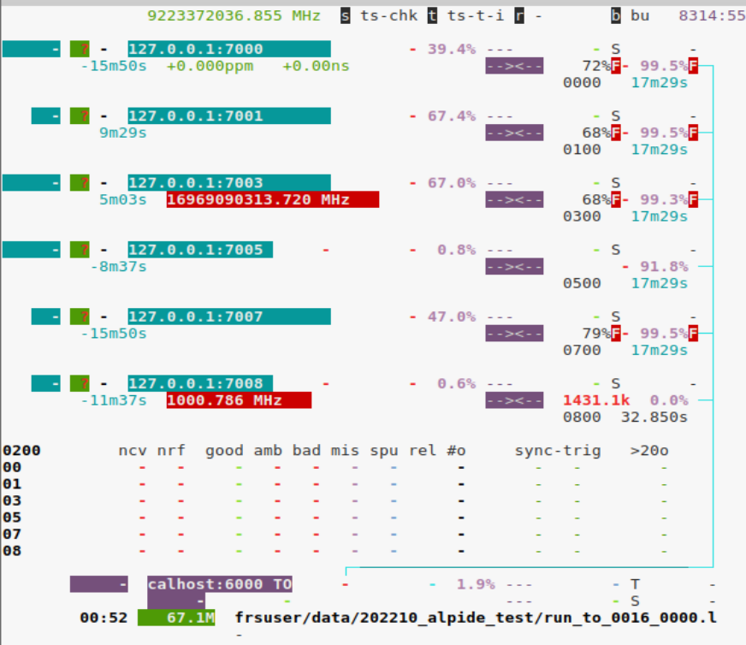
Time
Timing signals had to be perfect or would loose PPL lock.
(used slow rata clock 6.25 MhZ over lemo)
From CERN 2022

Slide 11
BUSY
Ohne BUSY (from CHIP)
->Use MOSAIC internal busy as compromise

Slide 12
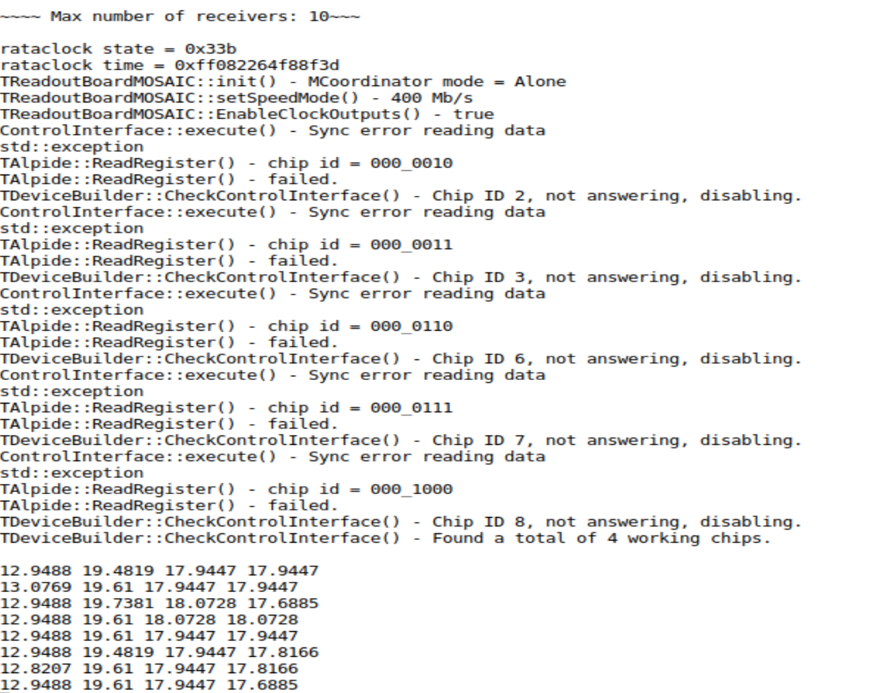
R/W register for Slow Control
Read the Analog voltage register and look at fluctuations.
Can check fluctuations->Hints at temperature increase.
Can add to readout cycle every cycle (++1-5us of deadtime for safety as takes time to read.)
Must be stability tested once configured if implemented.
Here linear translation to try reconstruct temperature.->Not accurate can just monitor register its easier! And probably more useful can be done per sensor!

