Slide 1
Ideas for determining and quantifying in-beam ALPIDEs rates and PID features
Martin Bajzek
M.Bajzek@gsi.de

Slide 2
Timestamp problems & ideas
Whiterabbit timestamp to MOSAIC’s supplied via slow (6.25 MHz) rataclock
Transmission over LEMO problematic, receiver side not always locked.
To compensate, used thick LEMO -> still unstable
To correlate with other systems, a <1us precise clock isn’t necessary.
White Rabbit = UNIX time in nanoseconds
Could we just poll unix system time?

Slide 3
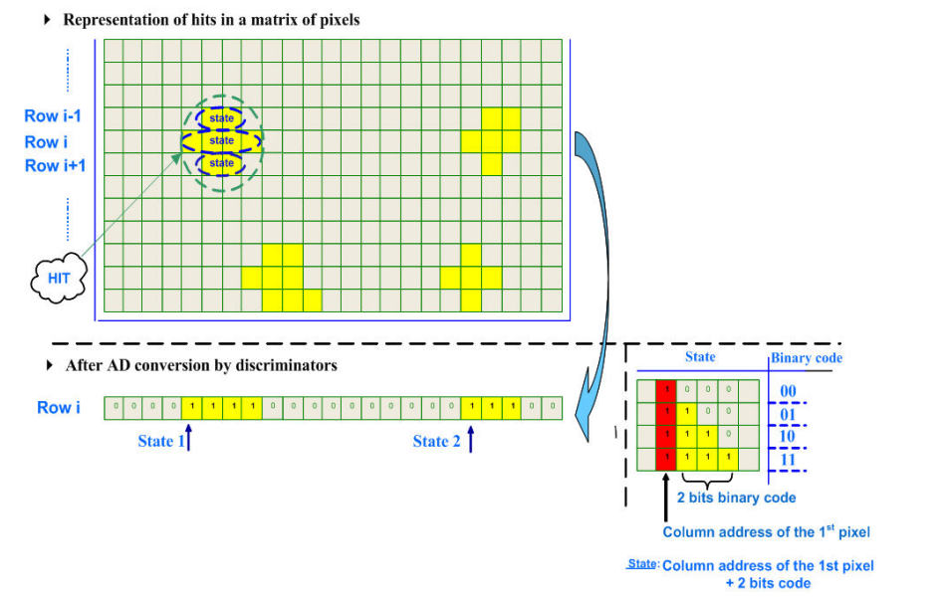
Data compression
S118 ALPIDE disk usage = ~ 1-5% of the payload data
For barrel mode, data rate drastically increases
Preliminary calculations 1-10 GBit/s just ALPIDE
Zero-suppression encoding for binary readout?
Encode full address of first hit, then 2-3 bits encoding of nearby pixels in the row
Can be done in the f_user.c [drasi] => might increase deadtime
Possible without FPGA implementation?
Figure taken from:
A. Himmi et al., A Zero Suppression Micro-Circuit for Binary Readout CMOS Monolithic Sensors

Slide 4
Understanding thresholds
Discriminator thresholds aren’t optimized
Right now: decreasing threshold parameter until noise
More correct optimization procedure:
Charge injection (R3BThresholdscan class)
S-curve analysis
Supported with ideas from ALICE GSI
GSI Summer Student programme topic: ALPIDE detectors for R3B/Super-FRS EC

