Slide 1
Status of the Active Target TPC
Oleg Kiselev GSI Darmstadt
Saúl Beceiro-Novo Universidade da Coruña
R3B collaboration meeting, GSI, July 2024

Slide 2
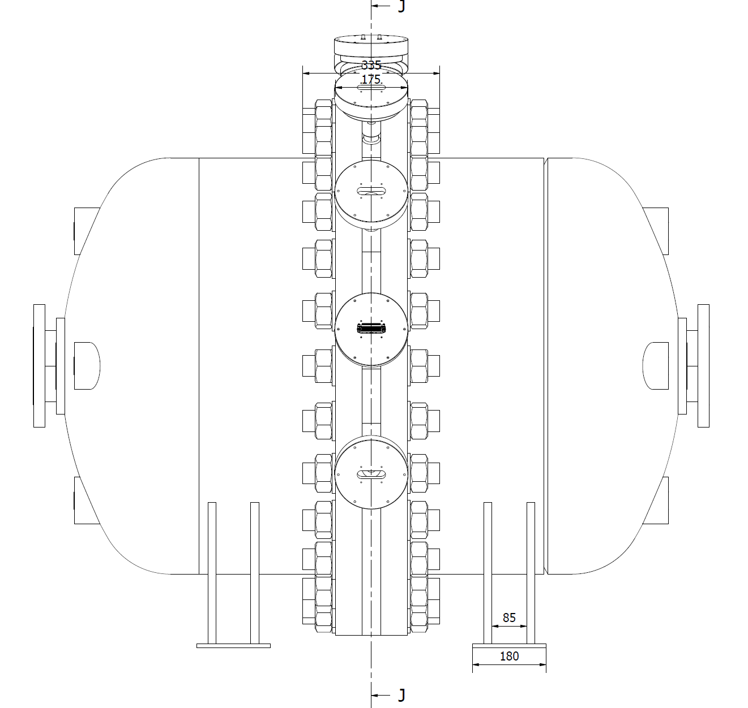
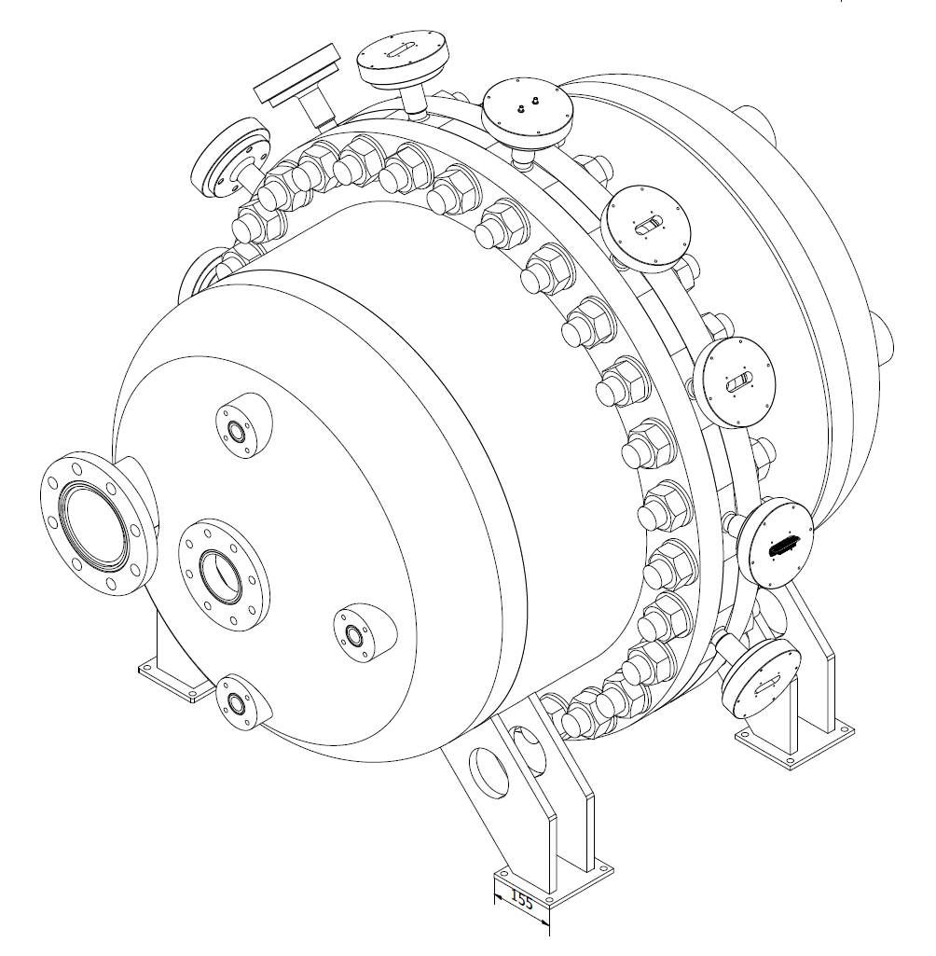
TPC pressure vessel
Pressure tank produced in autumn 2023
CE certified, tested by X-rays
Overpressure test in October 2023
Middle flange designed by the same company
on the basis of PNPI design
Produced in spring 2024

Slide 3
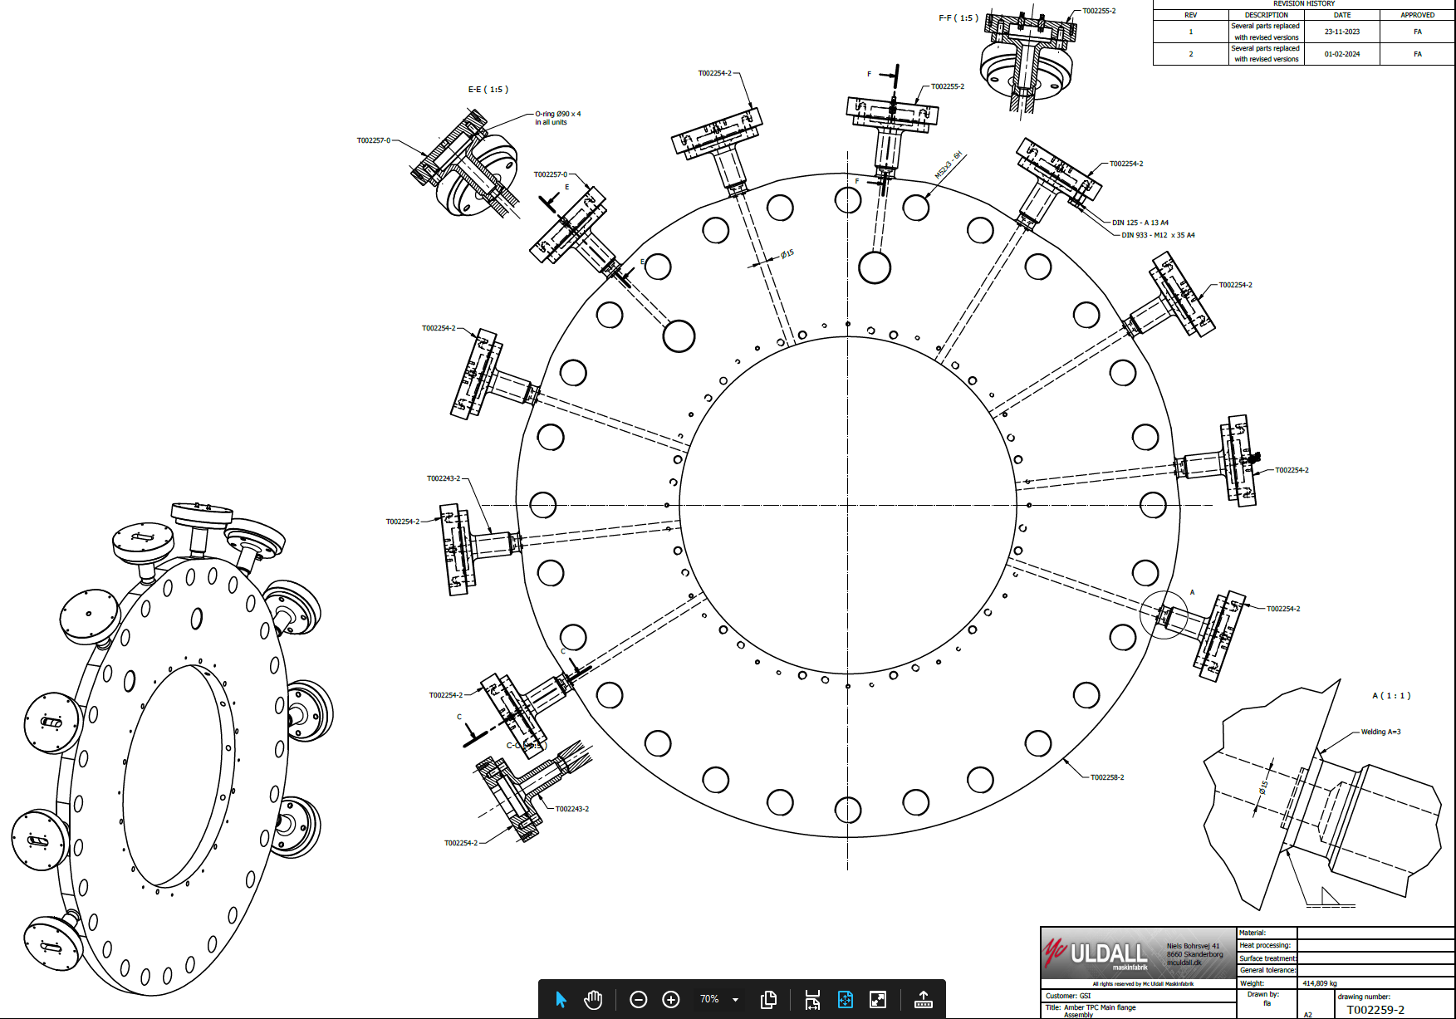
Middle flange
10 smaller flanges welded
Feedthroughs for HV, amplifiers,
temperature sensor

Slide 4
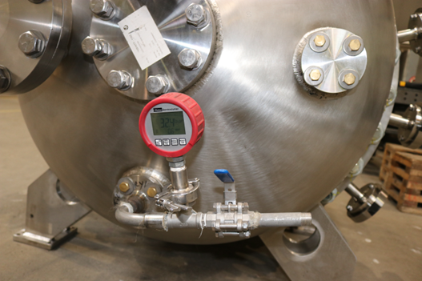
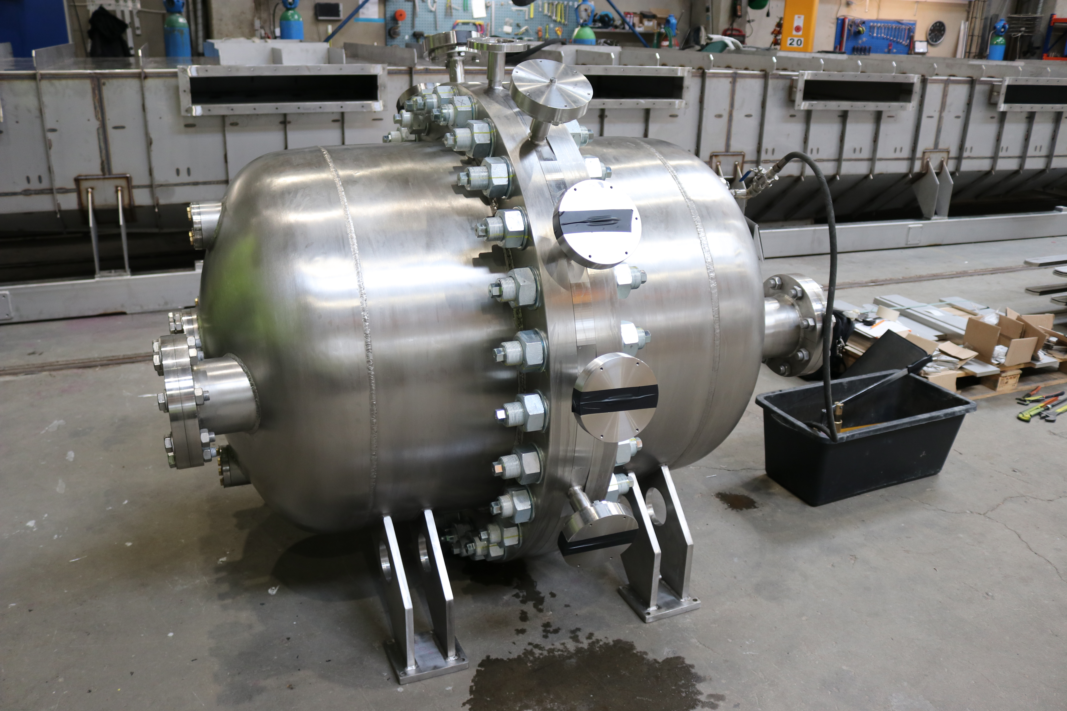
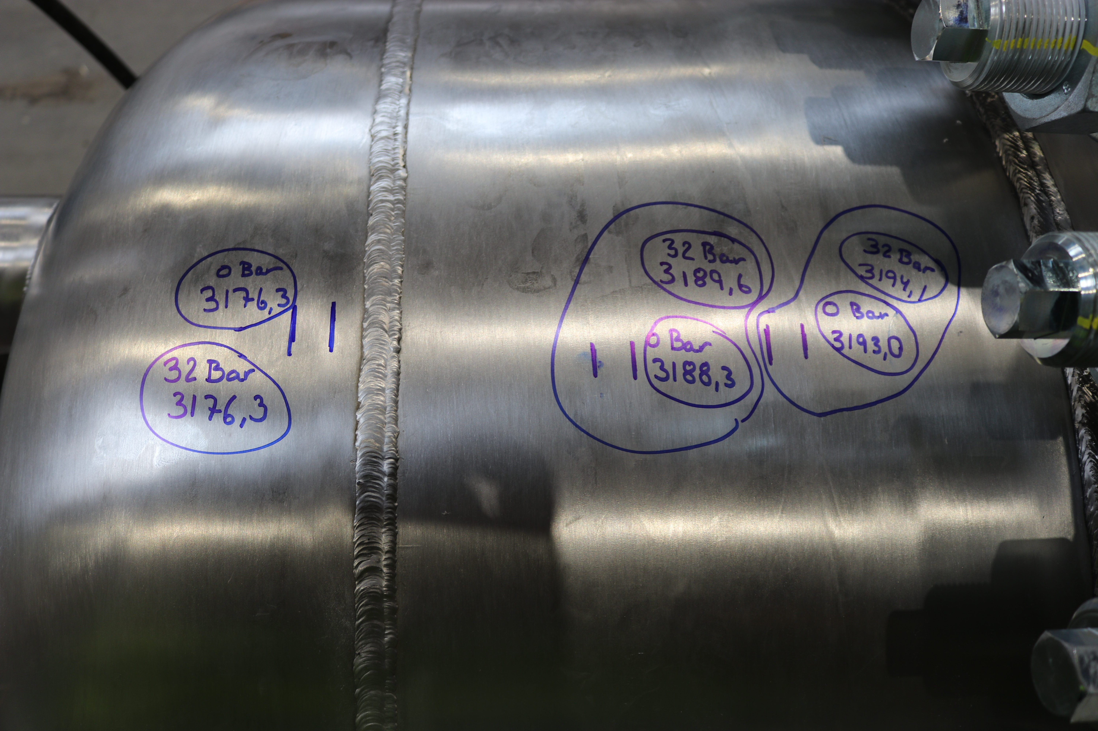
TPC with middle flange
Overpressure test (32 bar) on April 30 at the producer site in Denmark, report submitted
Volume change 6 / 990 liter
Circumstance change – 1.3 / 3188.3 mm
Plastic deformations, can be compared to the calculations

Slide 5
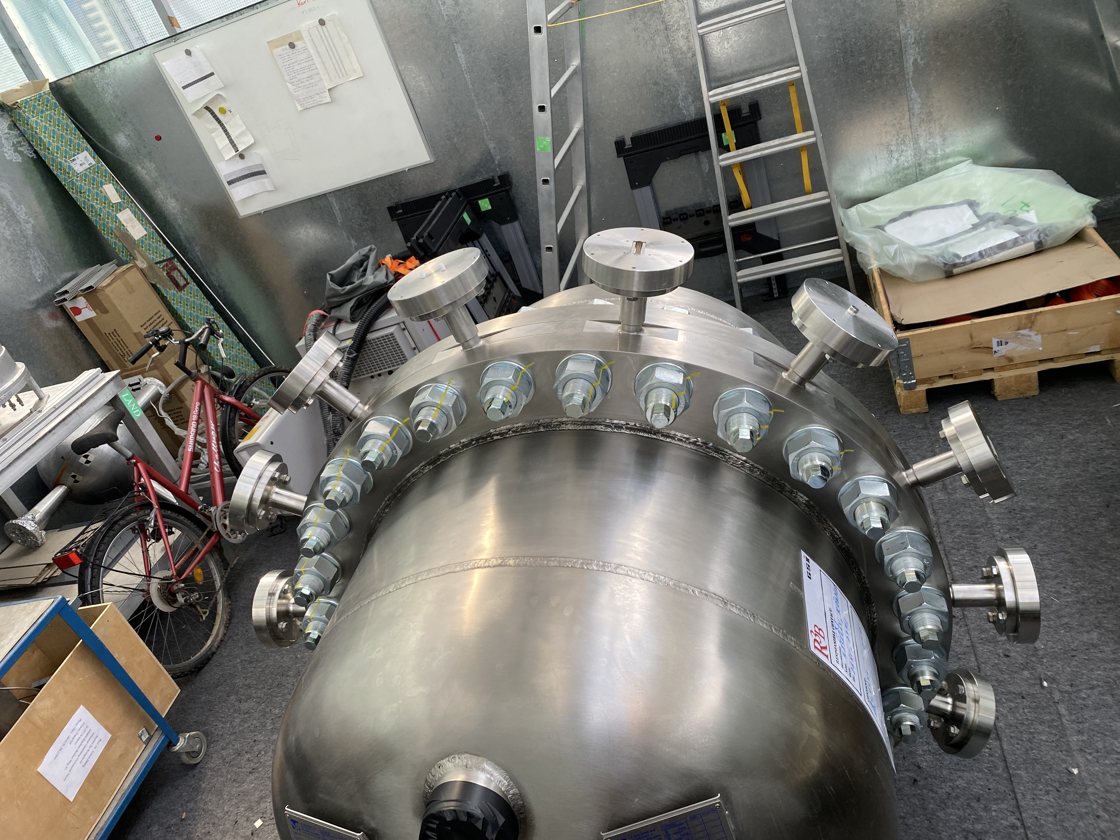
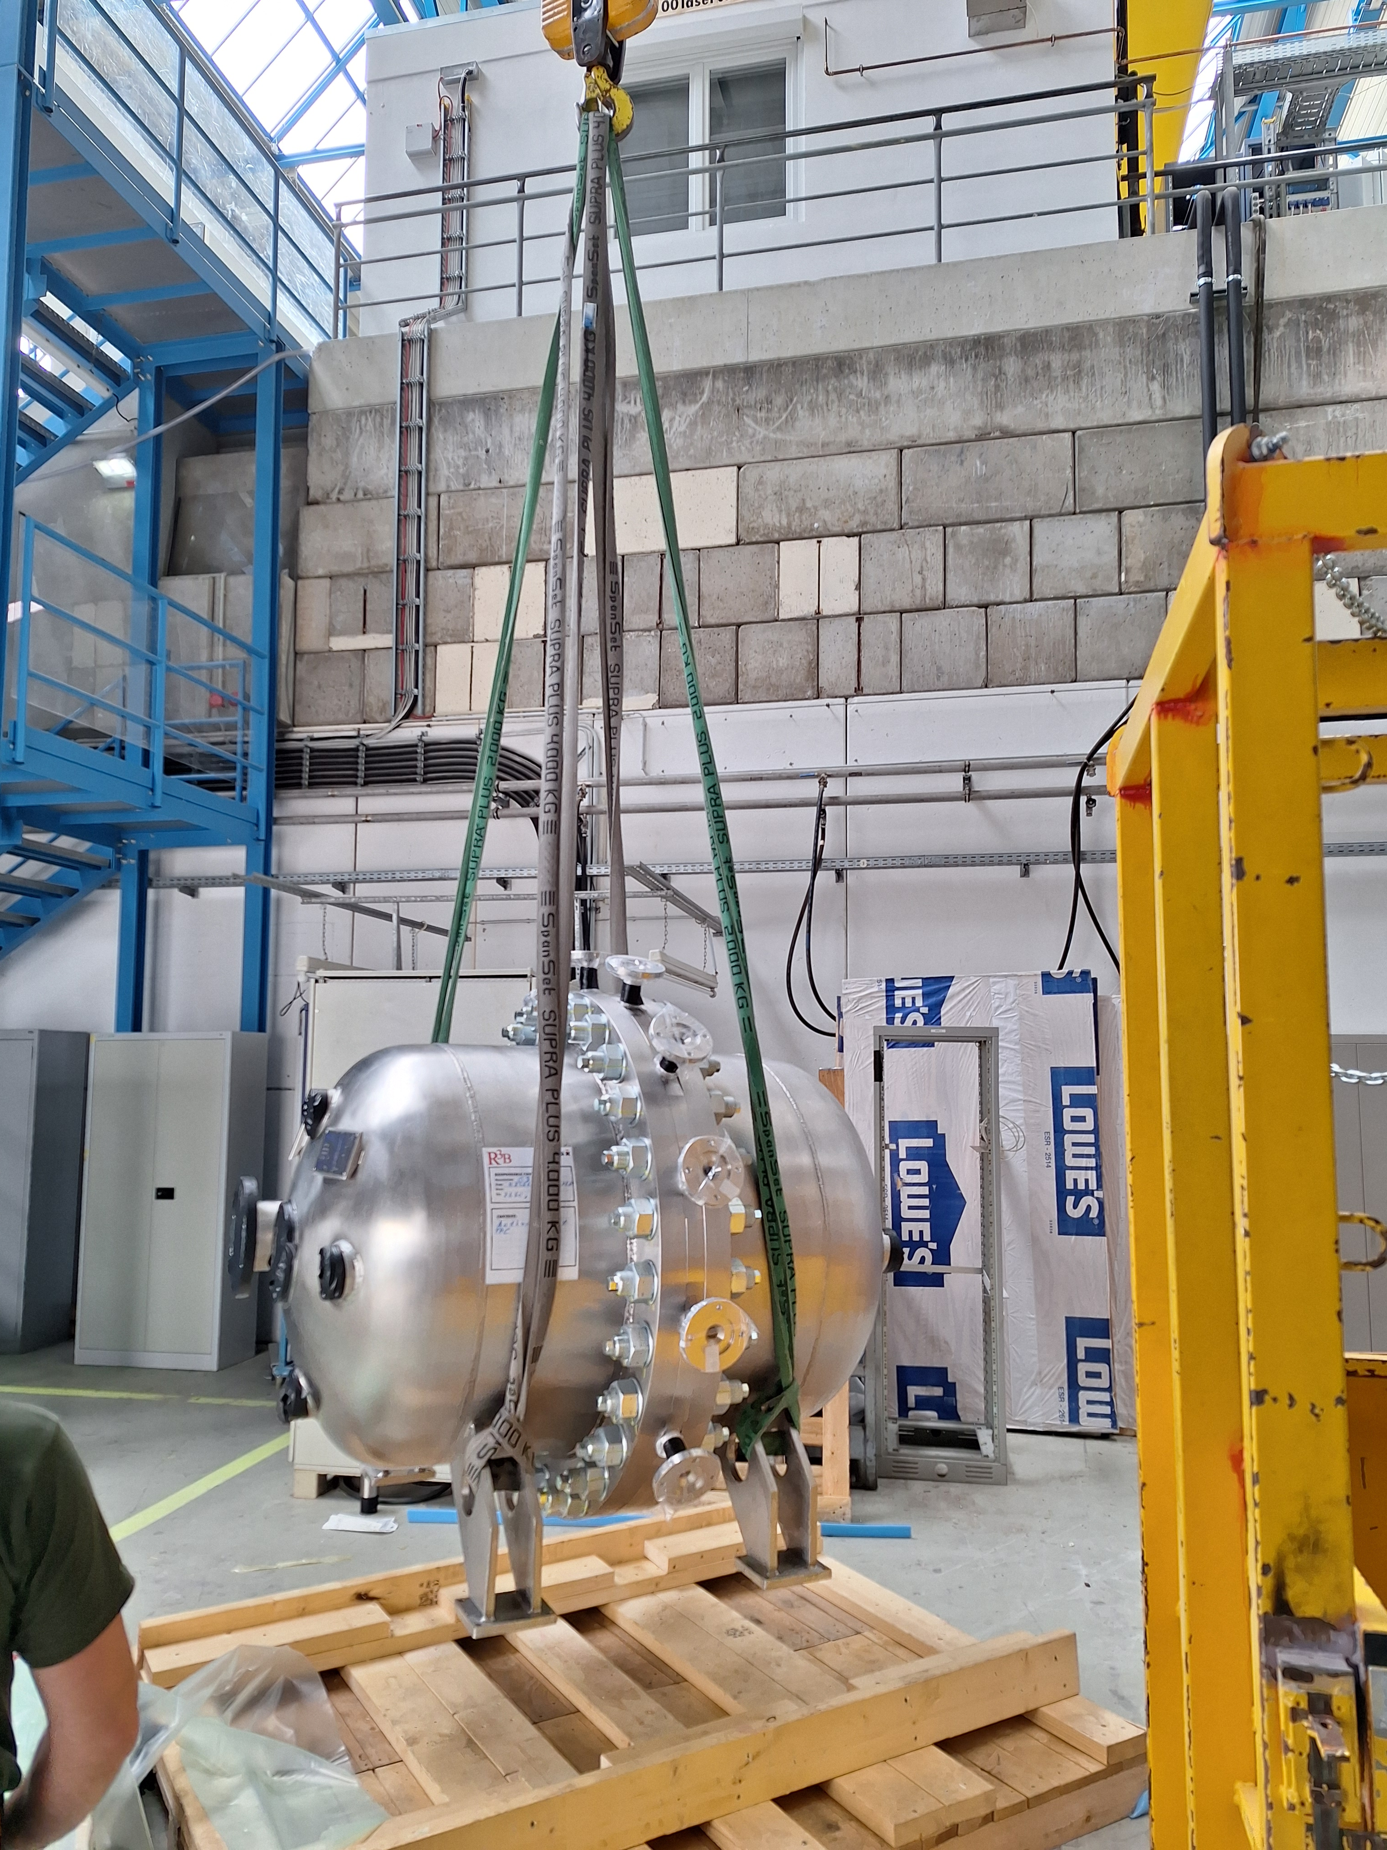
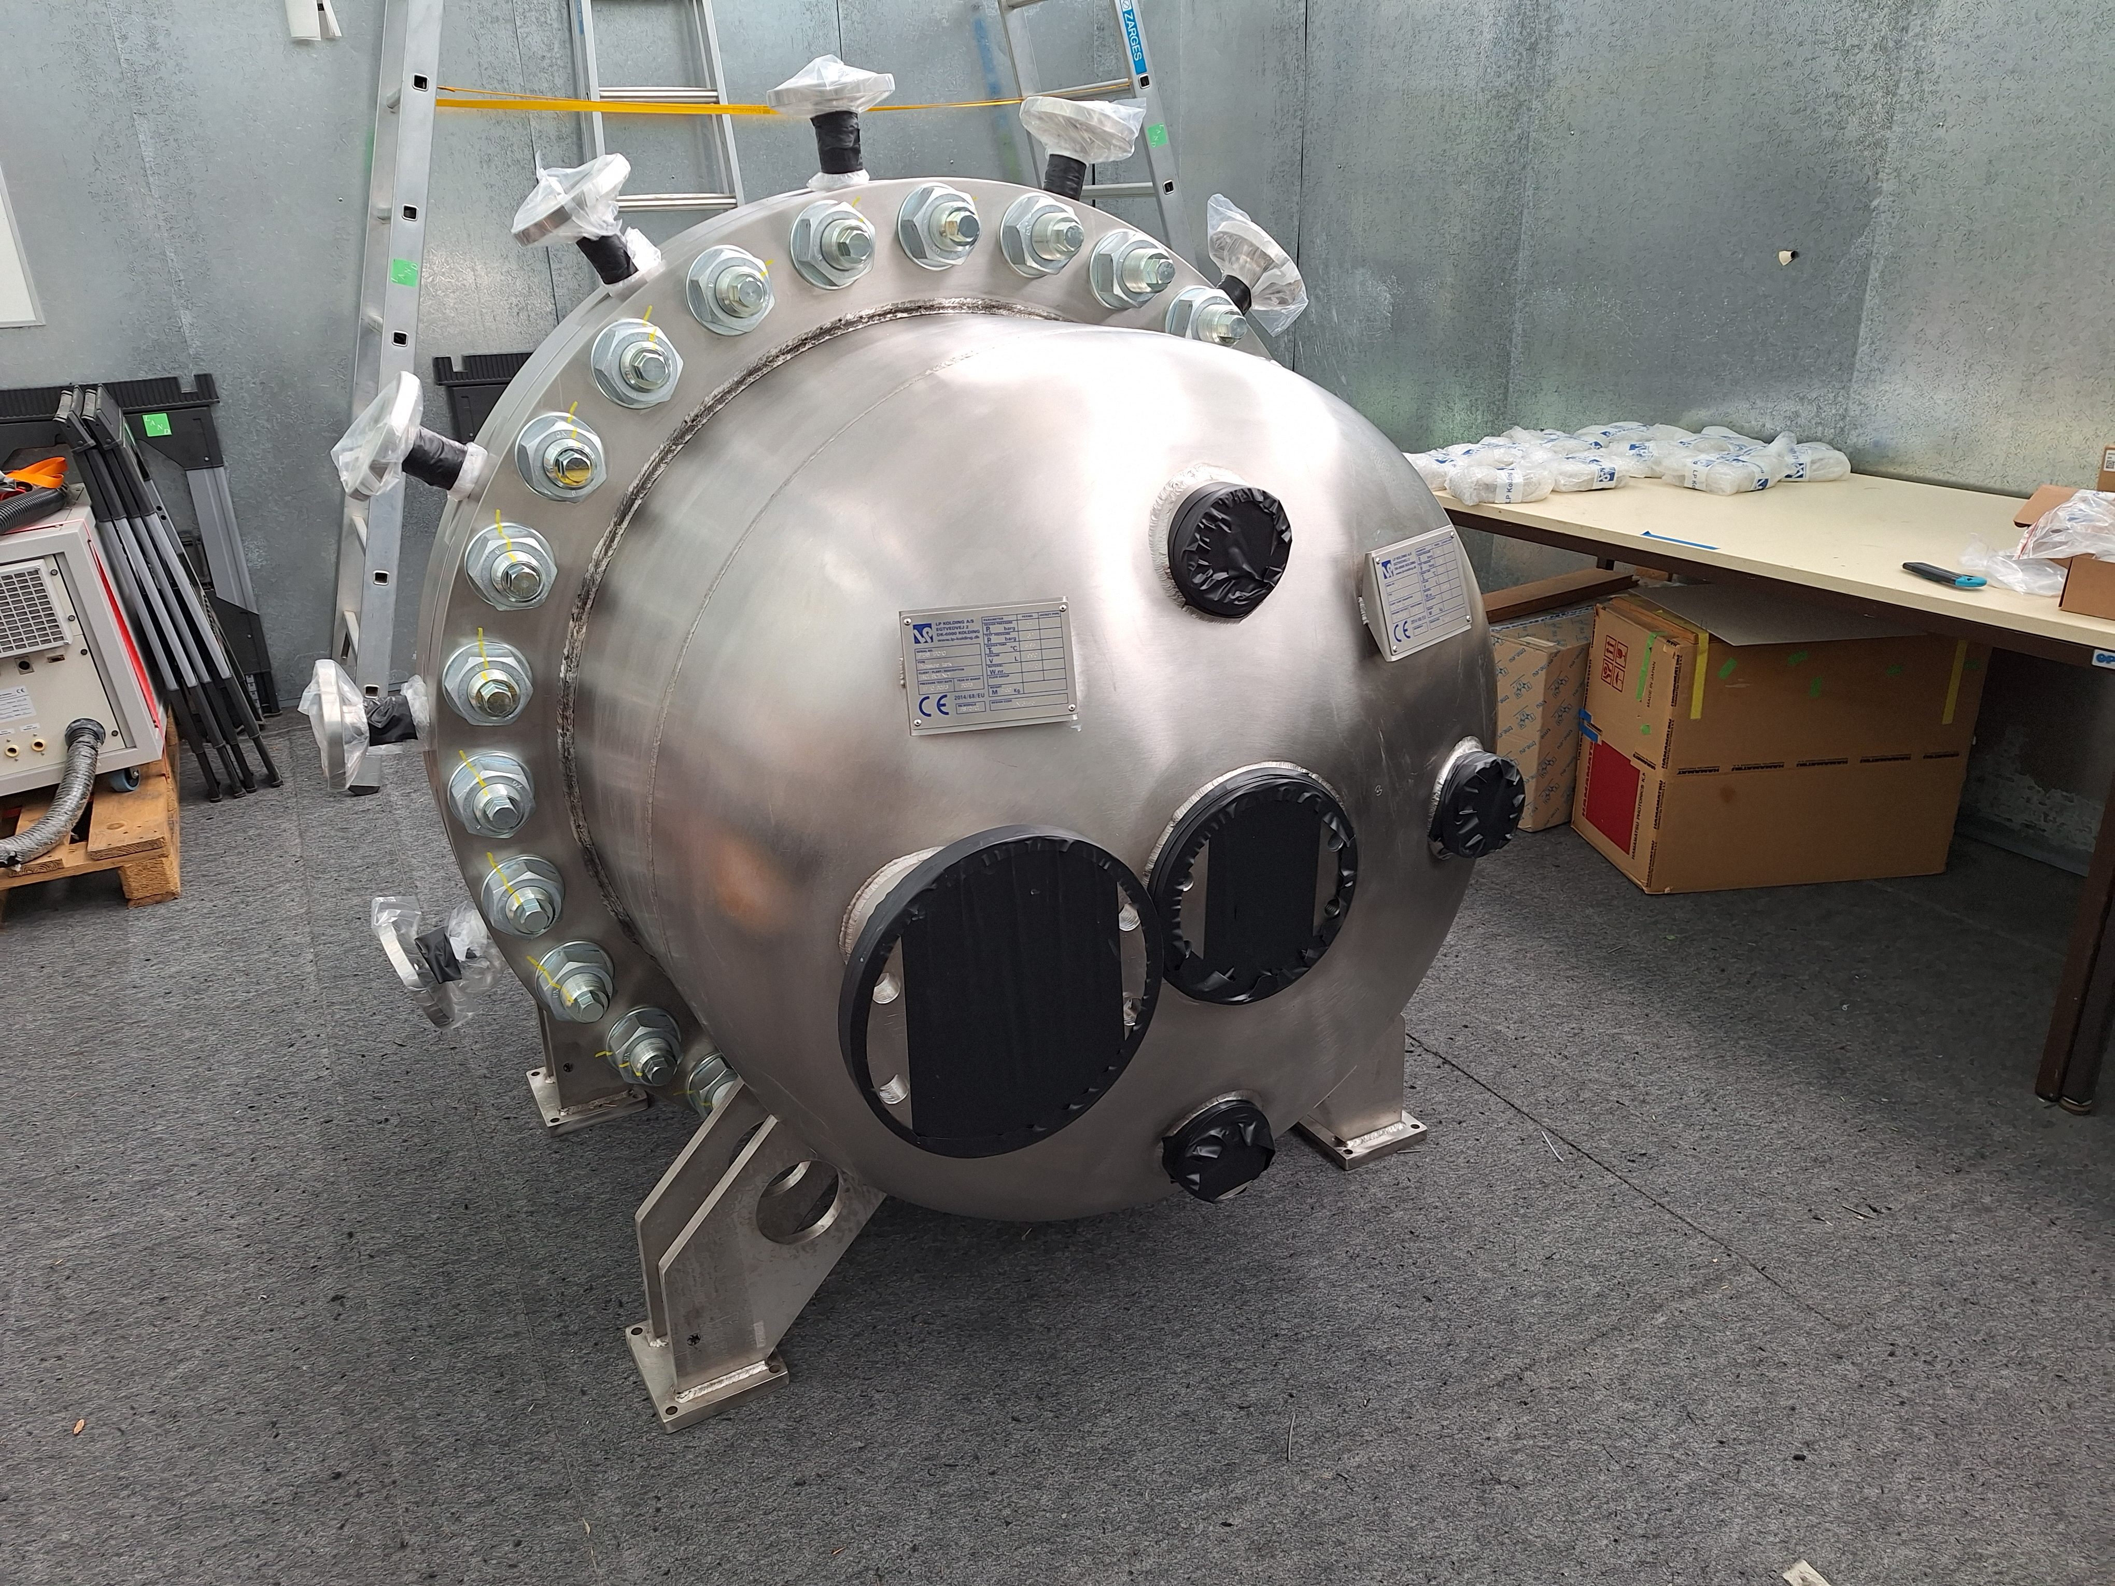
TPC vessel at GSI
June 2024

Slide 6
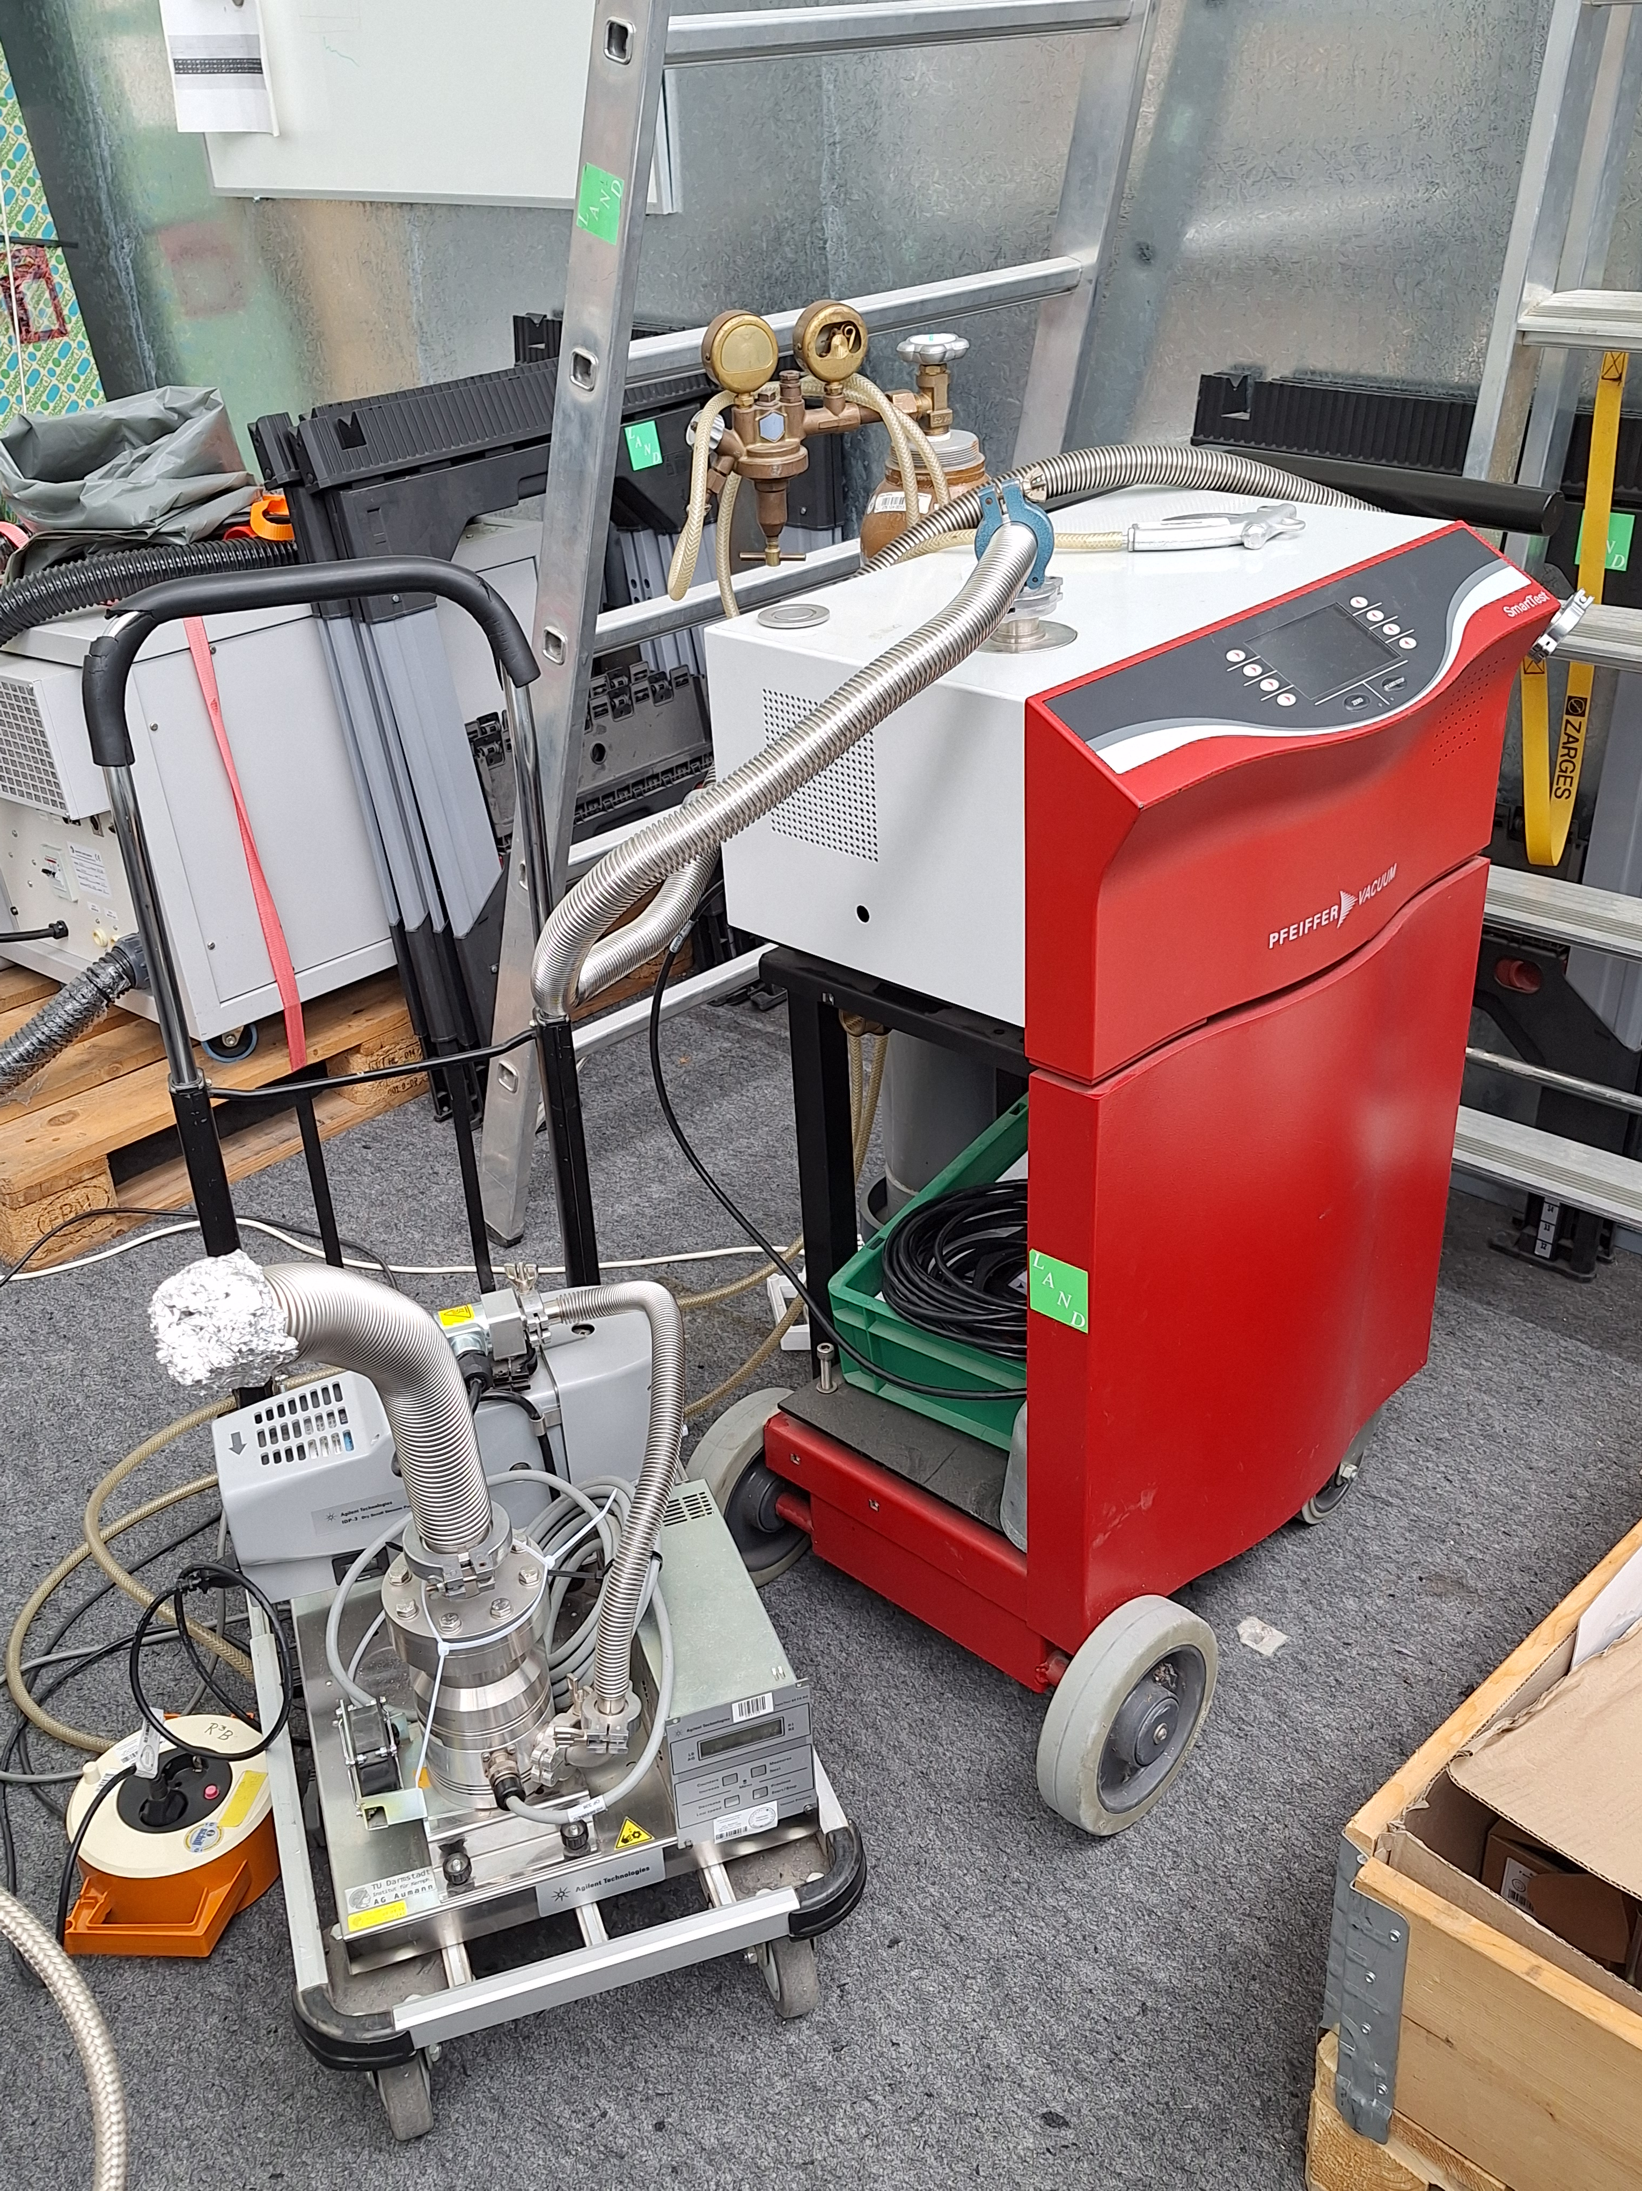
TPC vessel with middle flange, futher tests
TPC with middle flange delivered to GSI in May
All (18!) small flanges mounted
Optical inspection inside the vessel - done
Measurement of few sizes - done
Vacuum leak test of all flanges - done
Filling with gas (nitrogen), long-term pressure/temperature measurement
Leak tests completed
Only way to get leak rate values – relevant for the safety and gas regulation system

Slide 7
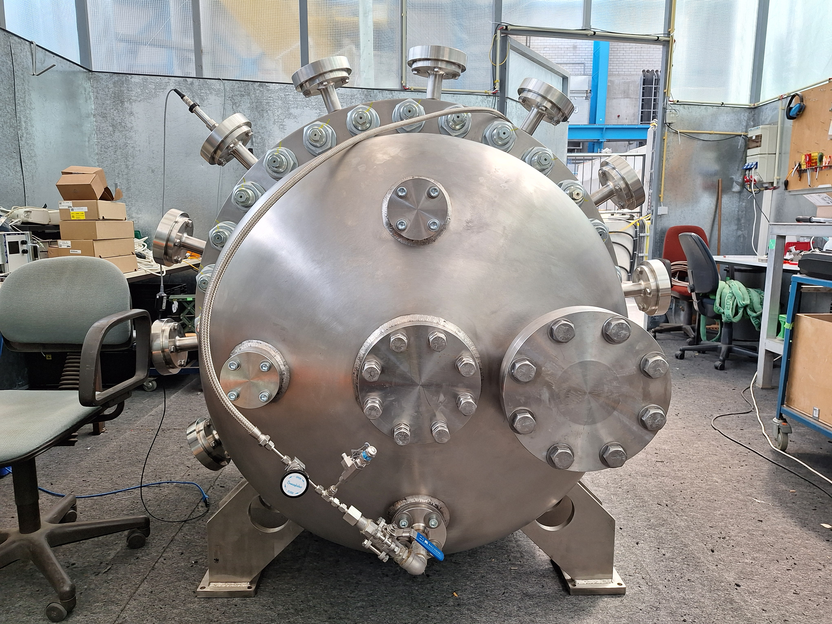
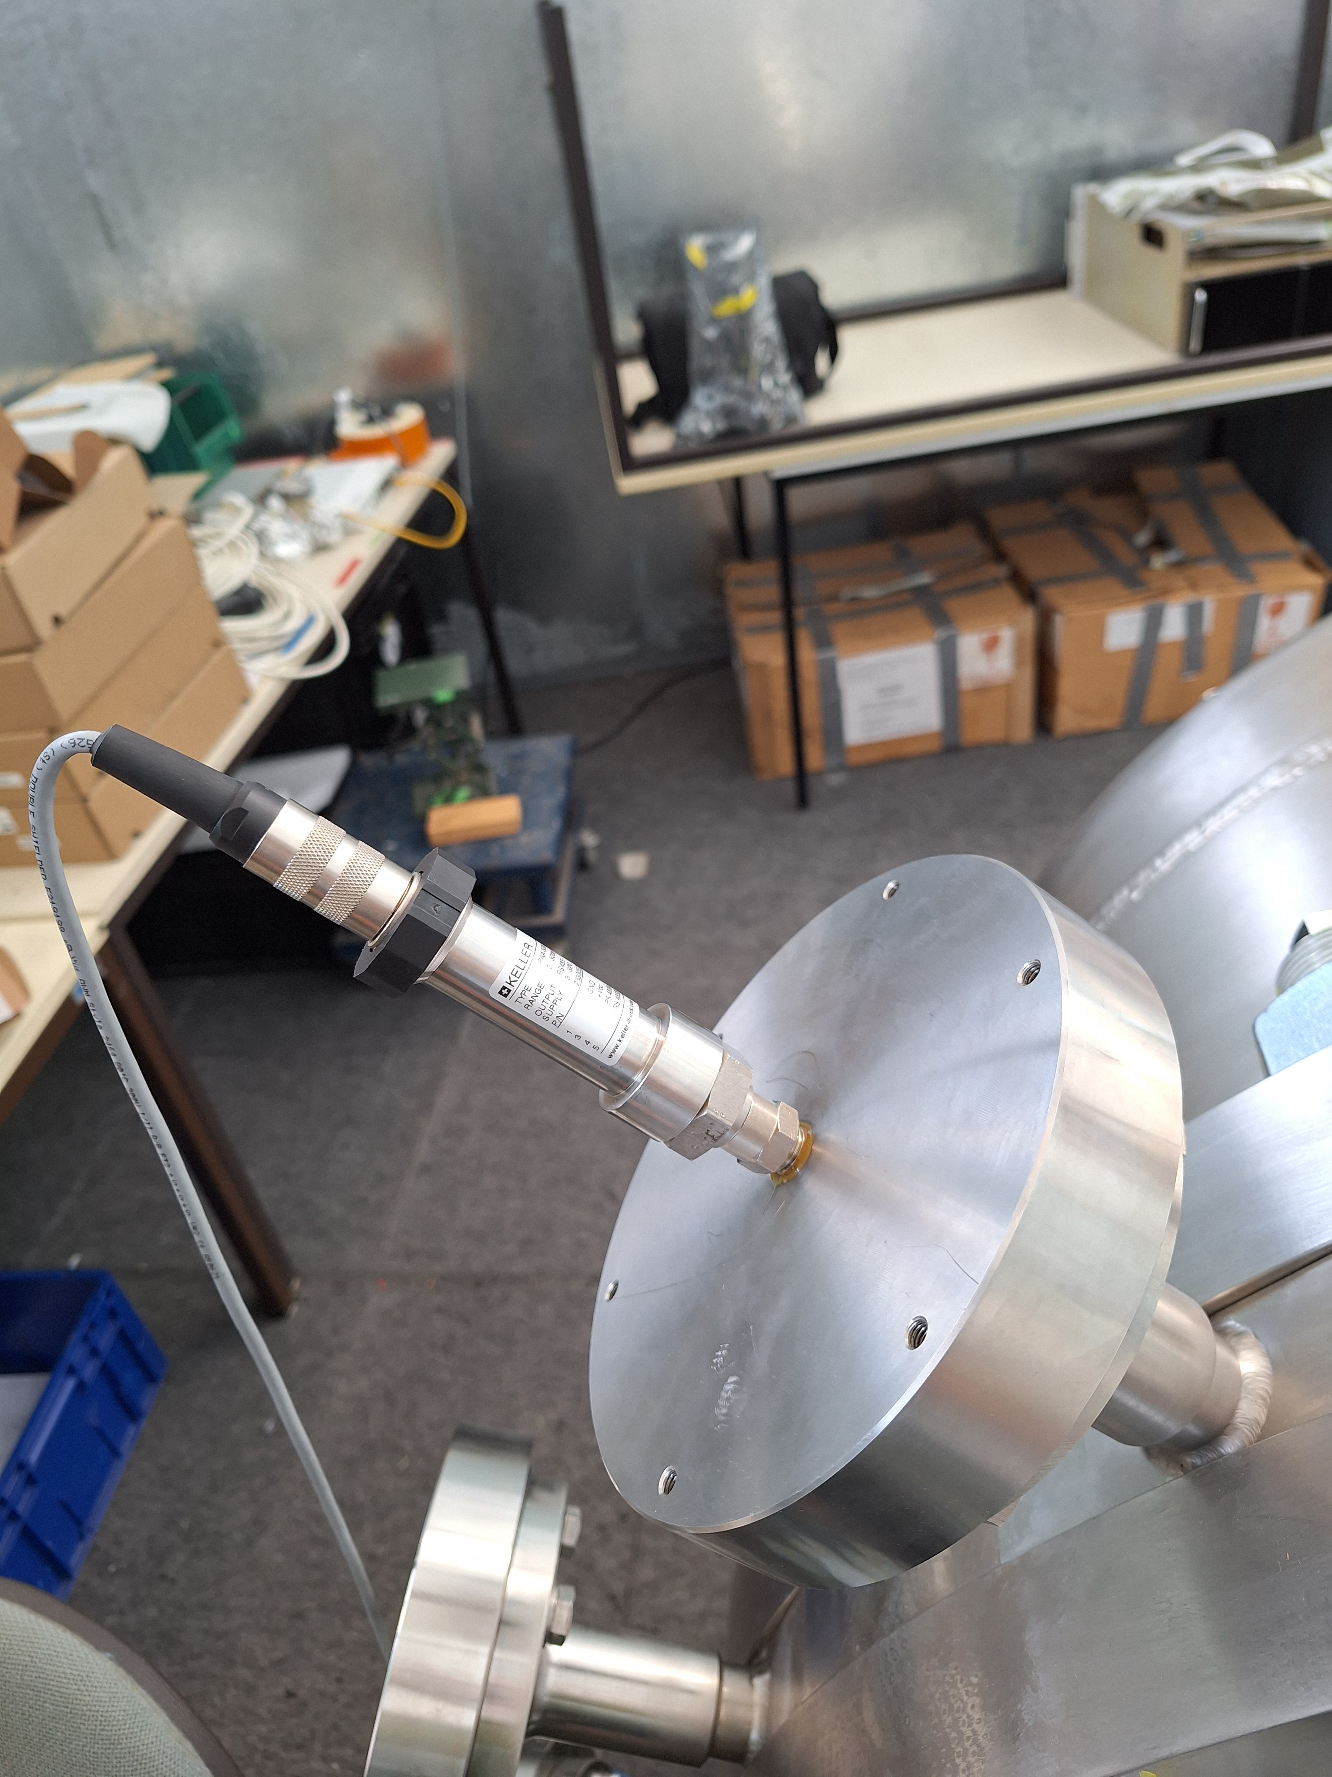
Leak and pressure tests at GSI
Standard helium leak checker
No detectable leaks found all around the flanges
Pressure sensors (same type as planned for the final system), PC with readout and logging software installed
Great help of Daniel and Sergei

Slide 8
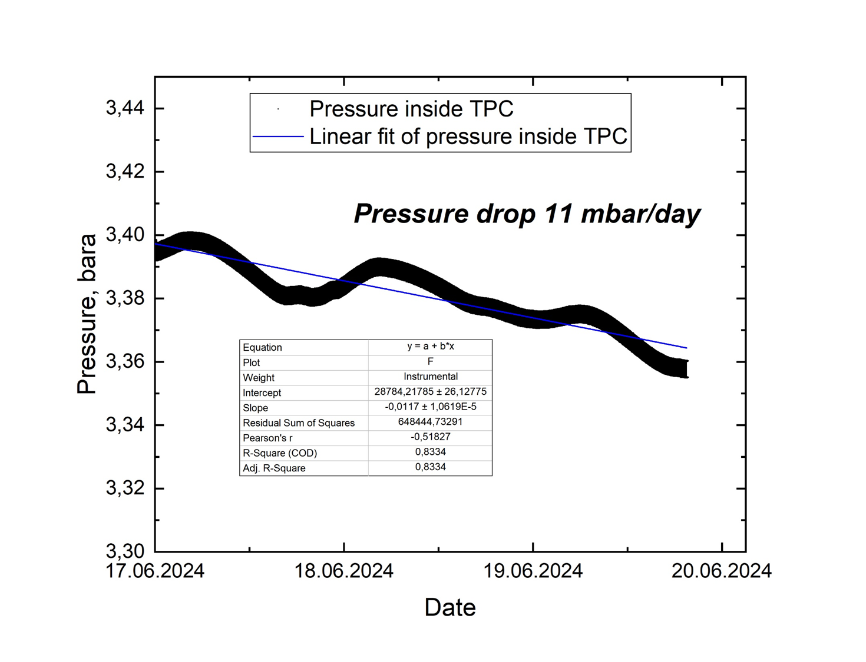
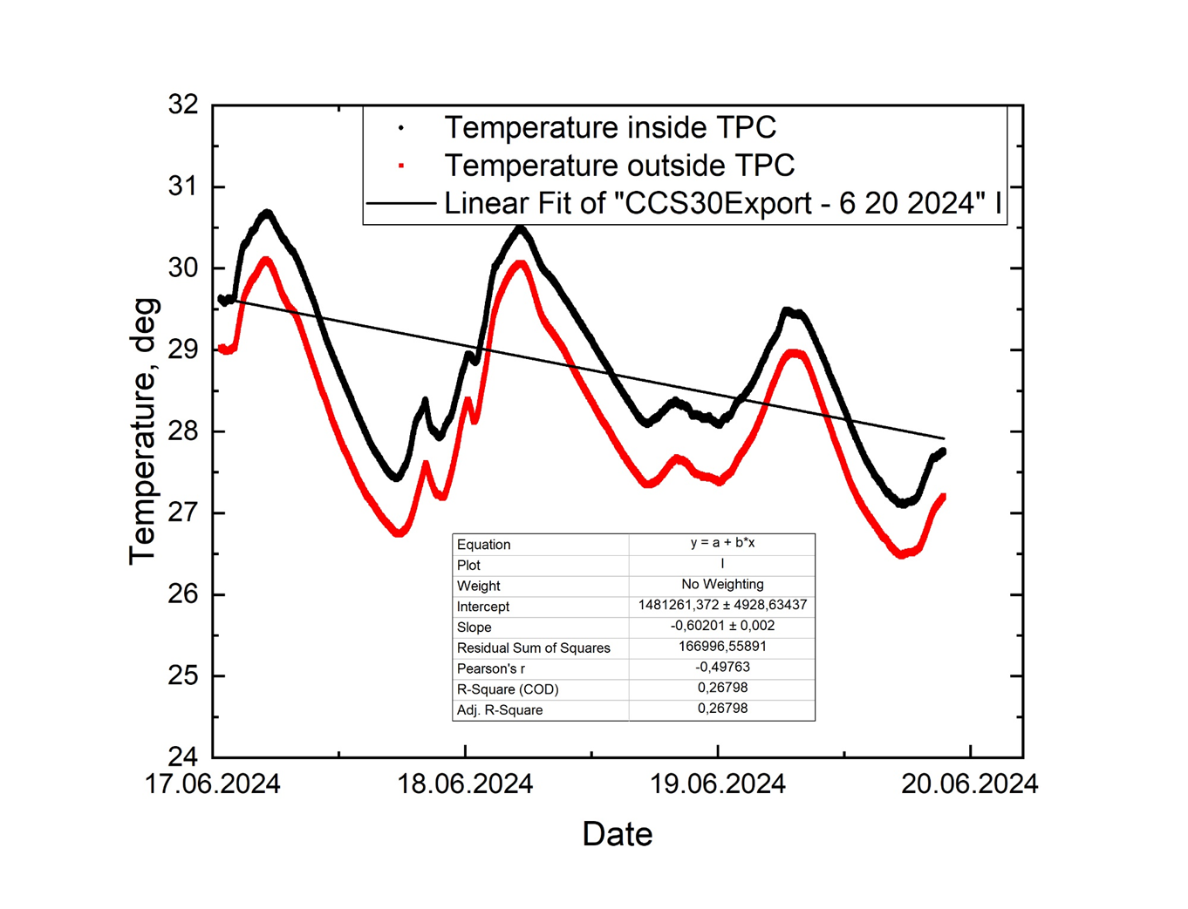
Leak and pressure tests at GSI
Two pressure/temperature sensors (precision 0.05% FS) are used, one measures inside, the other outside of the TPC
TPC is filled with nitrogen at 3.5 bars
Data (2 pressures, 2 temperatures) logged several days
Important values for the gas system steering

Slide 9
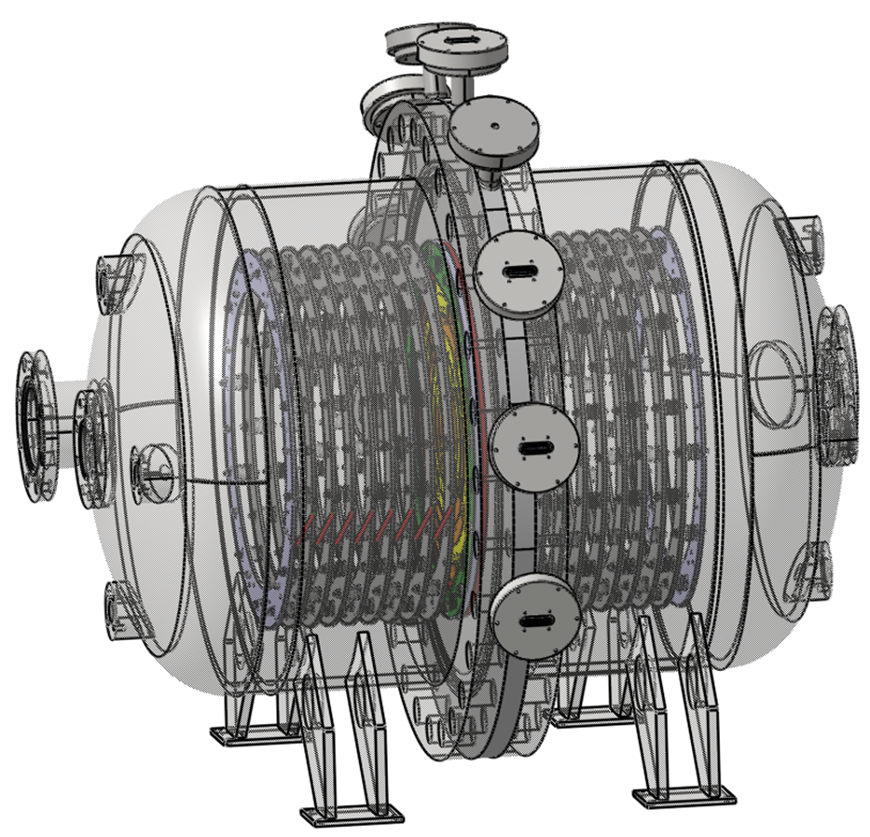
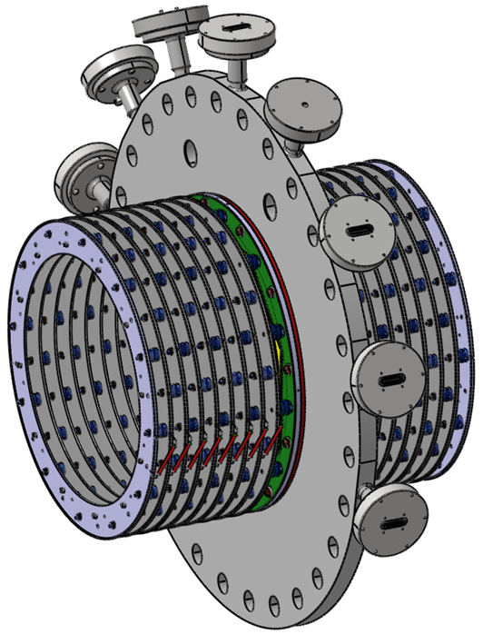
Electrodes inside the TPC
Basis - latest drawings from the company and PNPI
Checked for problems, some modifications done
Construction drawings for the field shaping rings, grid and anode rings made
Drawings for the isolators made
O. Vasyliev / GSI

Slide 10
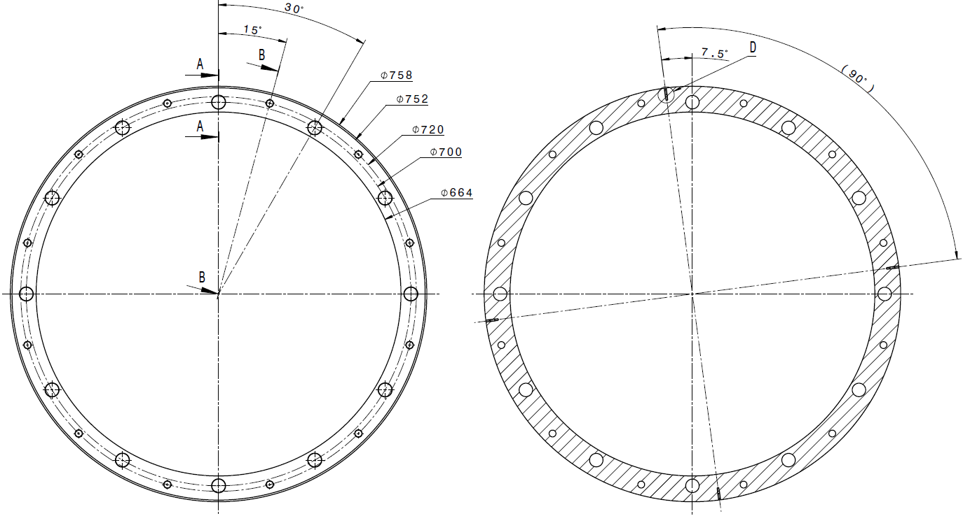
Grid support ring
Will be produced at GSI (mid June)
Specially treated stainless steel
3 units

Slide 11
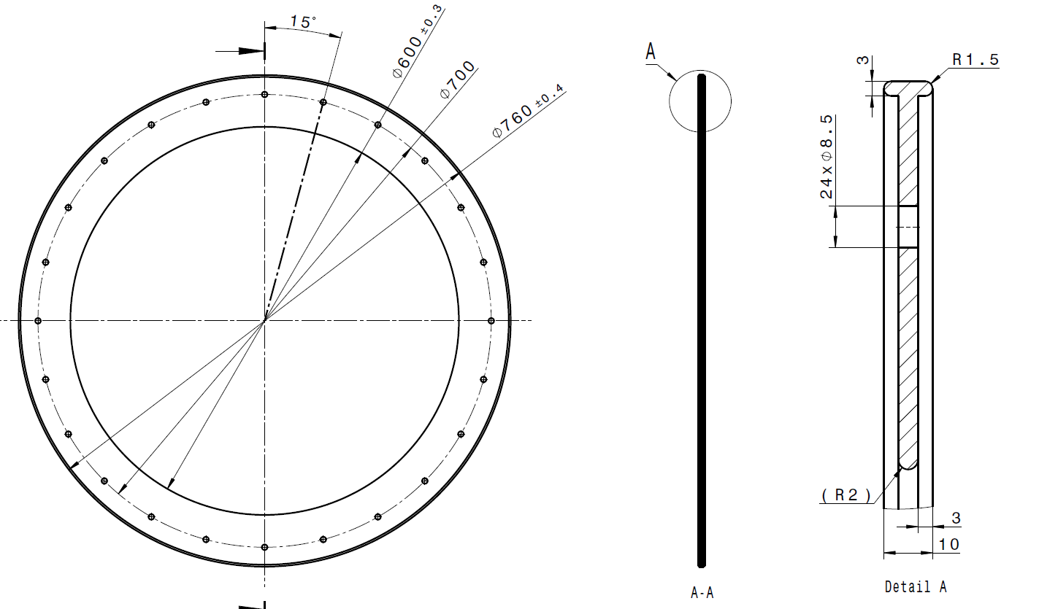
Field correction ring
Will be produced externally (mid July)
Specially treated stainless steel
16+1 units

Slide 12
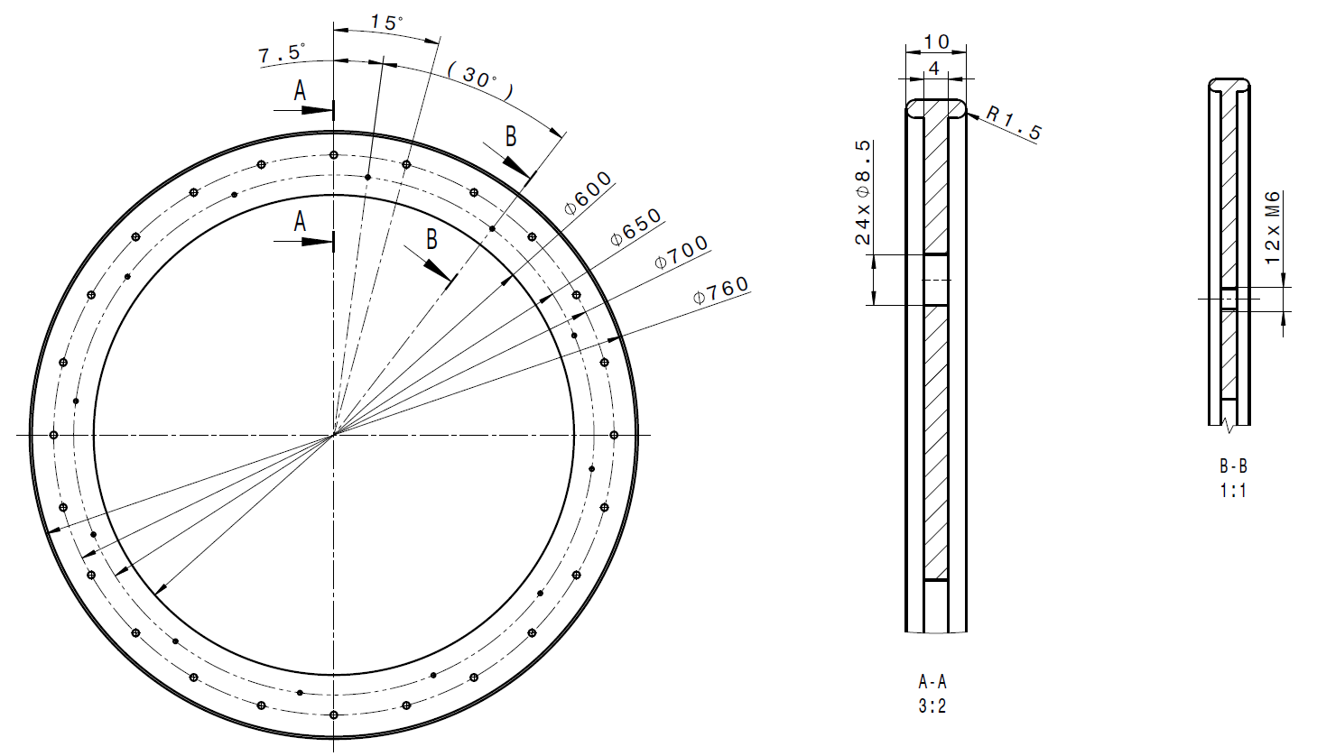
Cathode ring
Will be produced at GSI (mid Lune)
Specially treated stainless steel
2 units

Slide 13
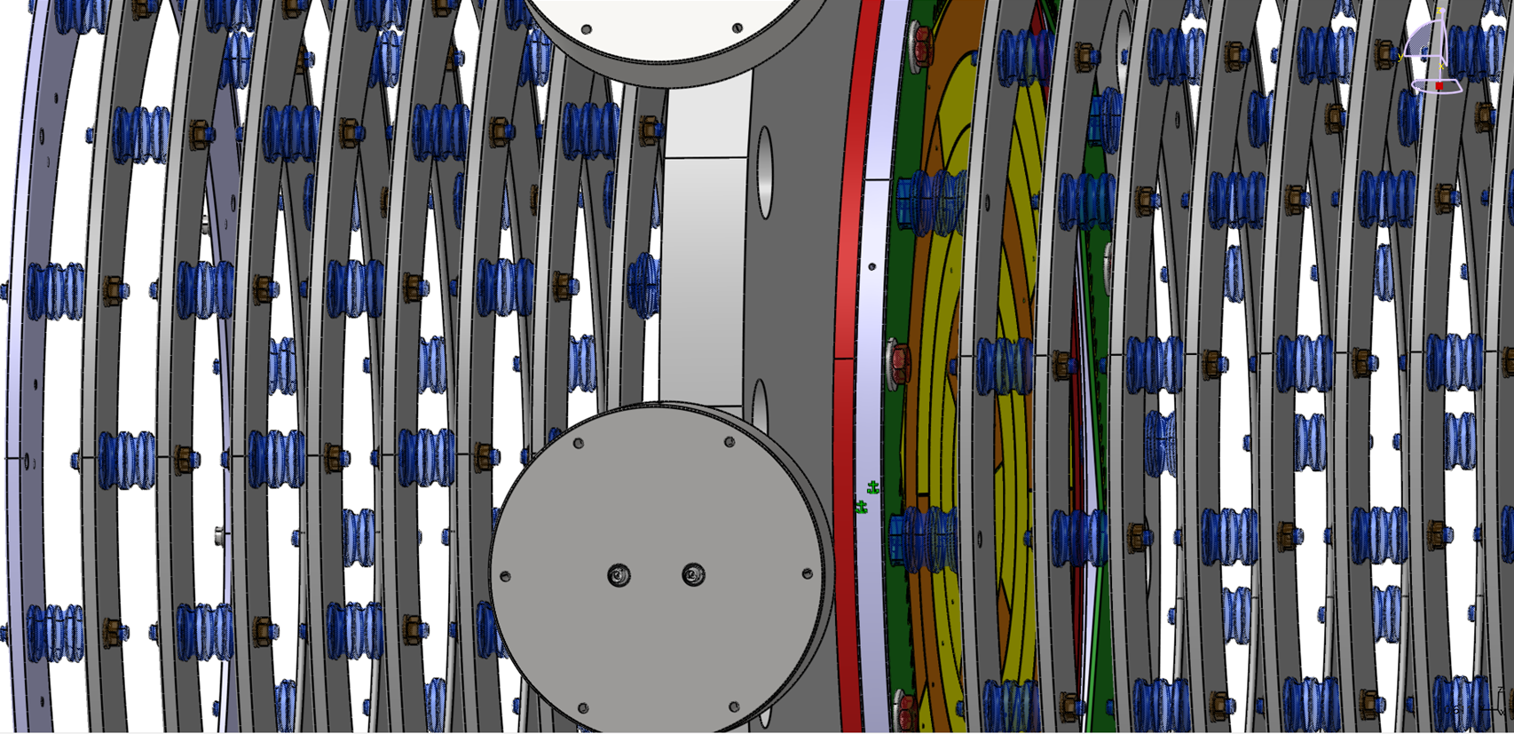
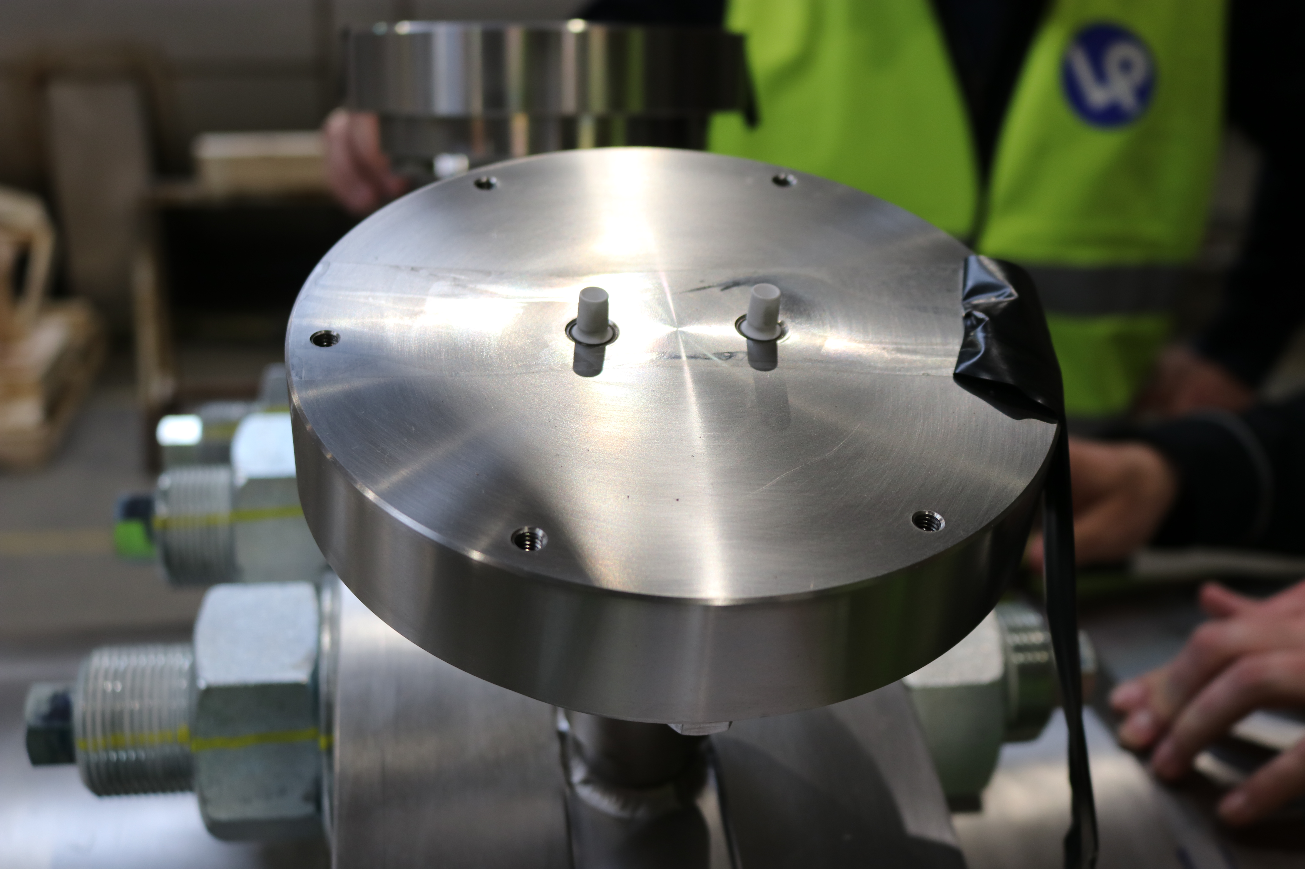
Electrodes inside the TPC
Grid and cathode support, field shaping rings are the basis of the construction
Source for controlling the gas quality needs to be placed on the rings
Isolating ring (red at the figure) needs to be designed and produced
PCBs for the grid and anode are being designed

Slide 14
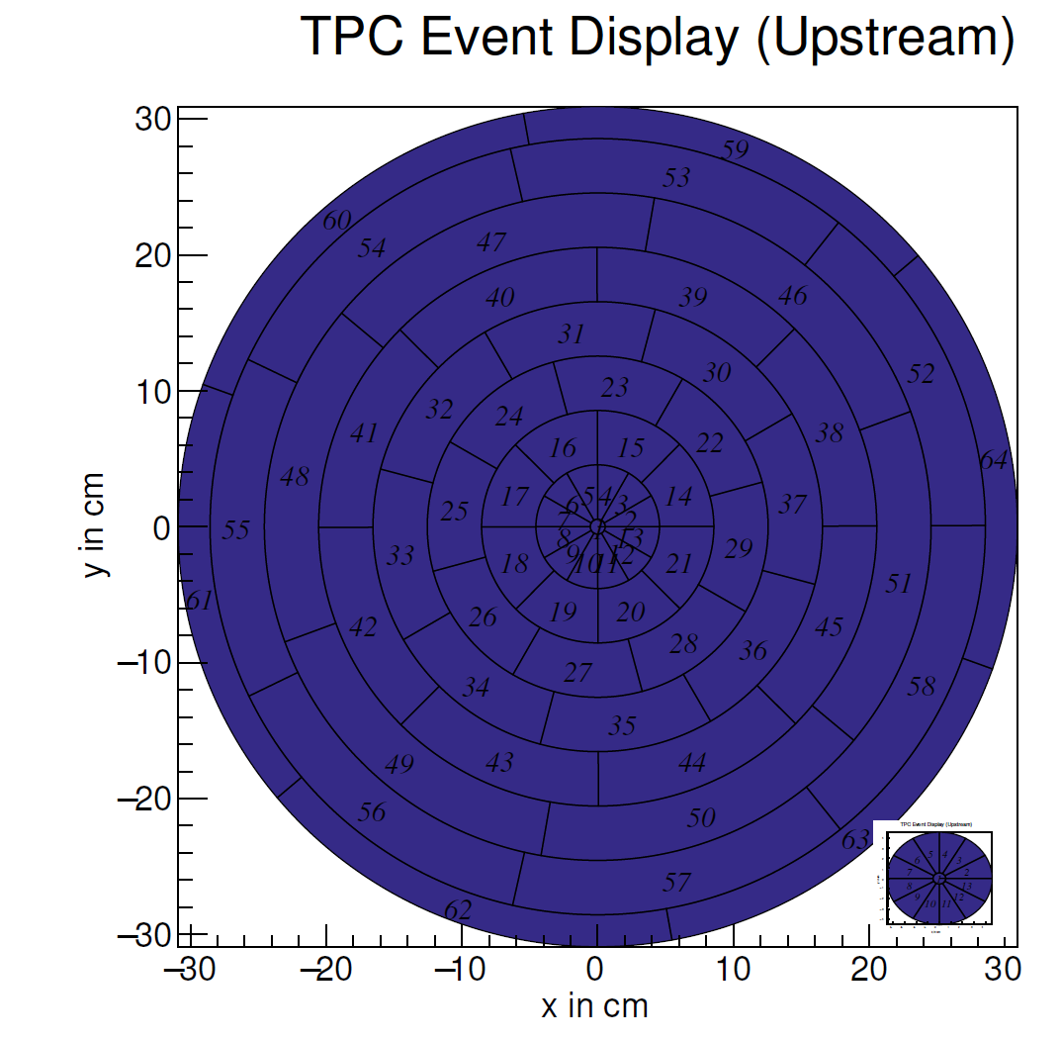
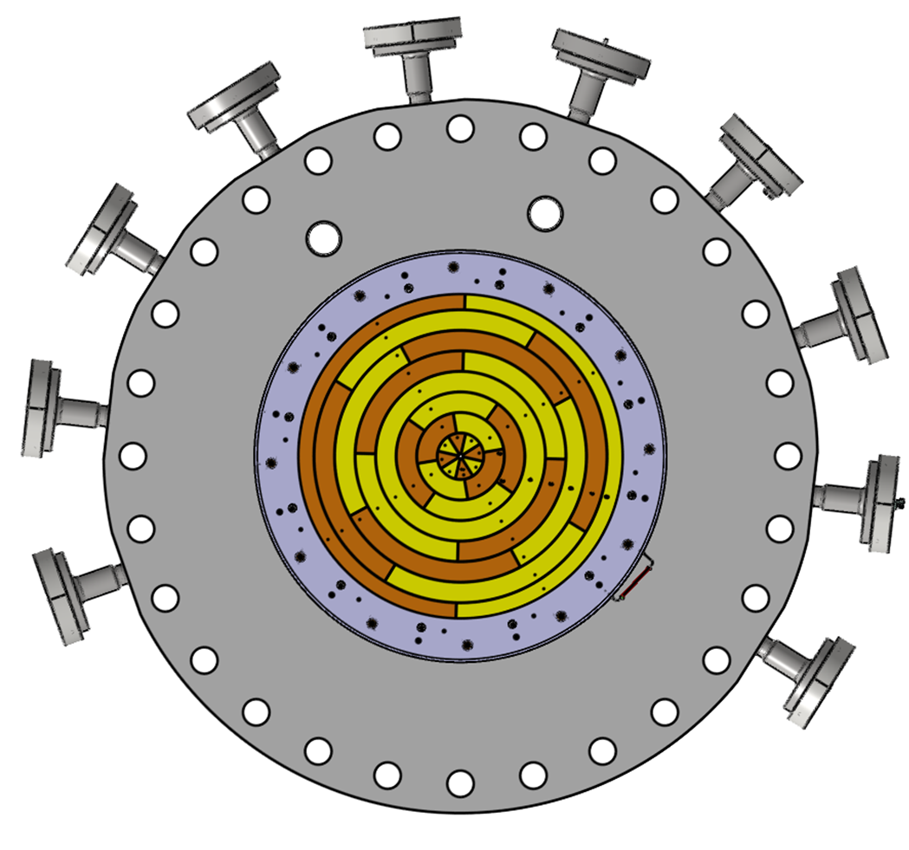
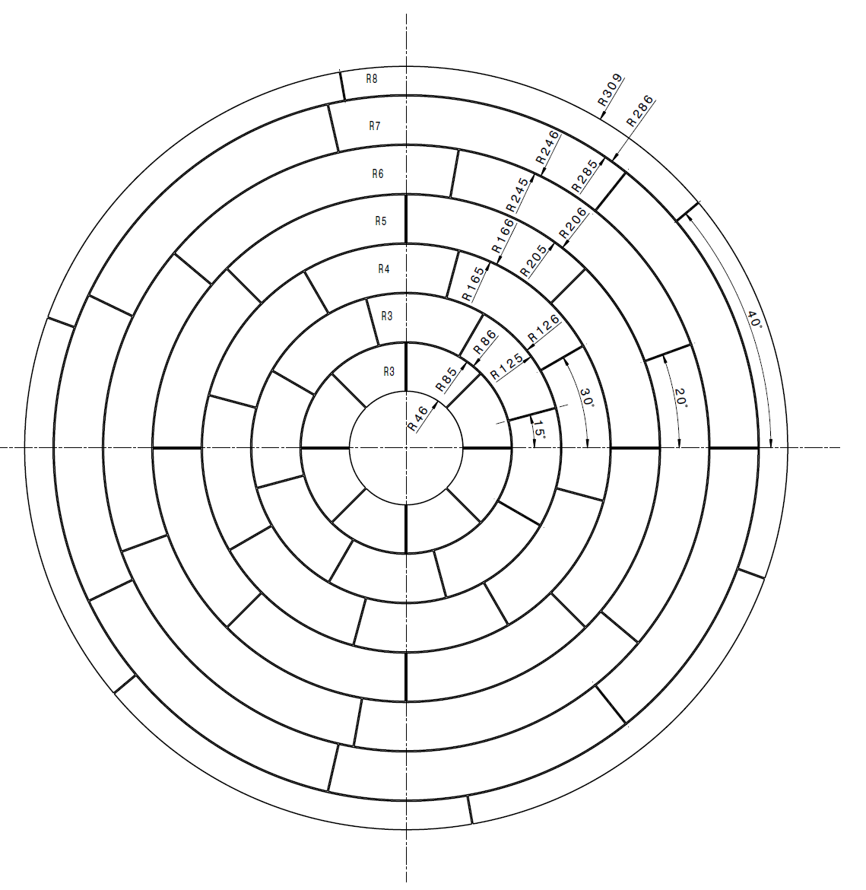
Electrodes inside the TPC
PCBs on material Rogers RO4000 Series (low outgassing)
3-4 times more expensive but easy to produce
Production of anode pad PCBs (2+1), grid PCBs (2+1) – August

Slide 15
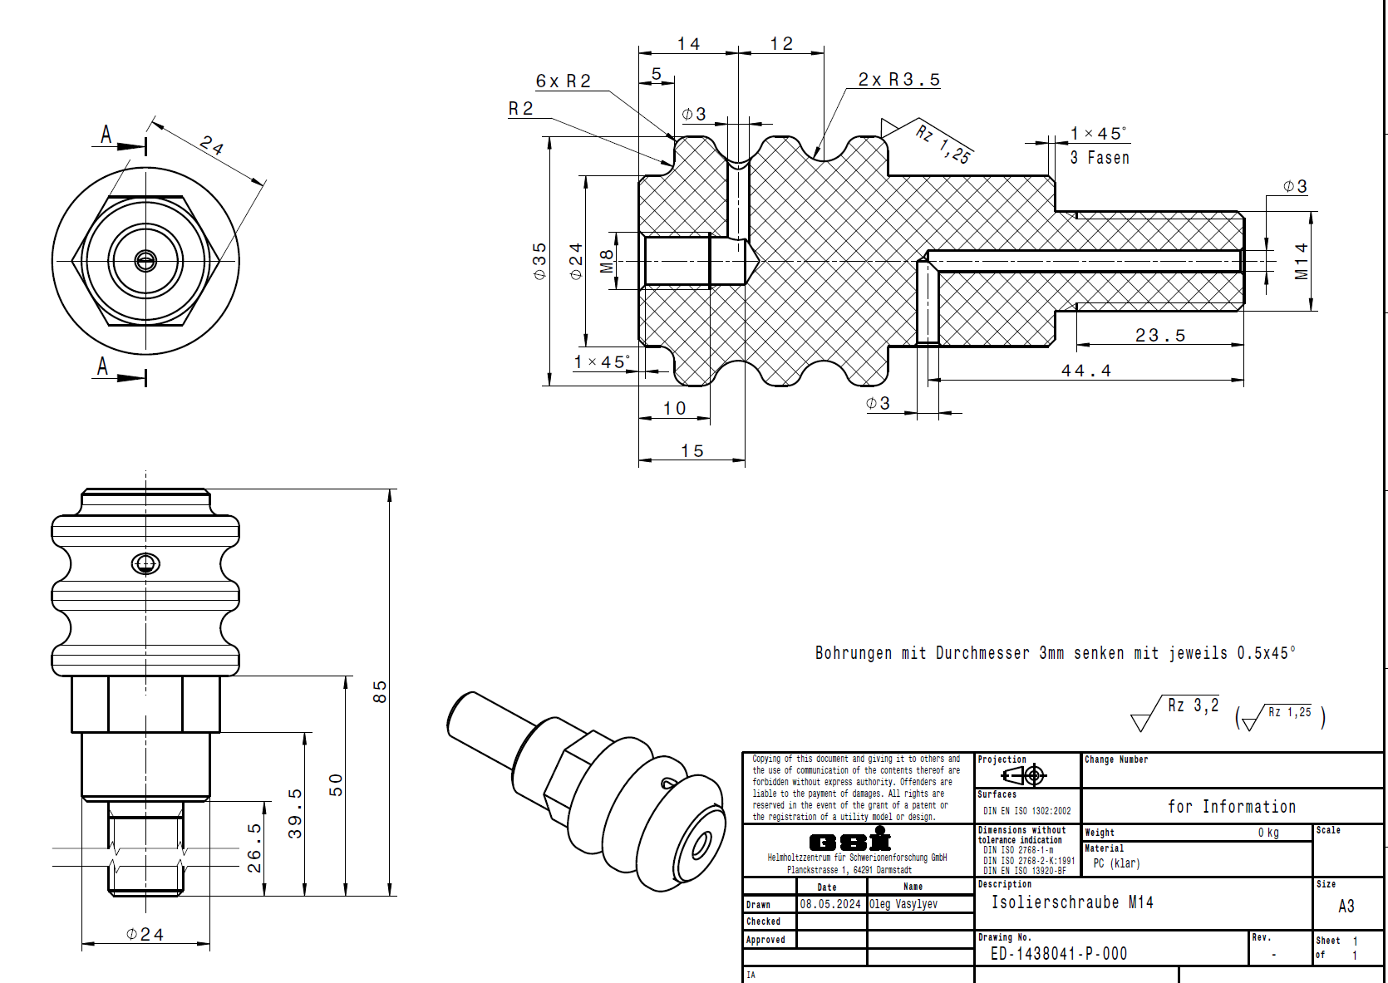
TPC electrodes/isolators
One out of 3 different
isolation screws
O. Vasyliev/GSI
All rings are kept together by the special screws
Anode, grid and field correction rings all under different HV
3 different types of the polycarbonate screws are designed
Total amount of the polycarbonate screws is 500 units, ordered, delivery – end of August

Slide 16
Calibration sources
Source for testing of gas quality
Check of the amplifiers, DAQ, analysis
Two sources deposited on different rings
²⁴¹Am, activity 5-10 Bq, open
Agreement with radiochemistry group at Institute for Nuclear Chemistry, University of Mainz
Setup available, some tools might be needed
Deposition end of July – beginning of August

Slide 17
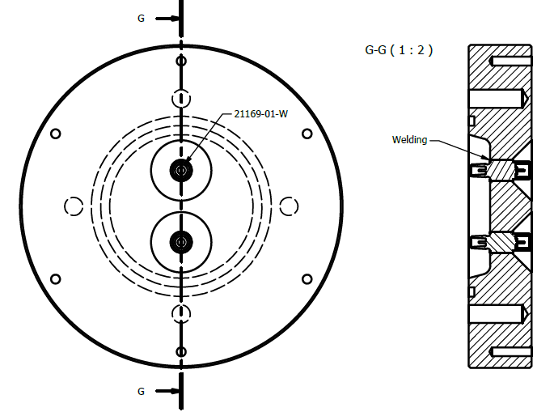
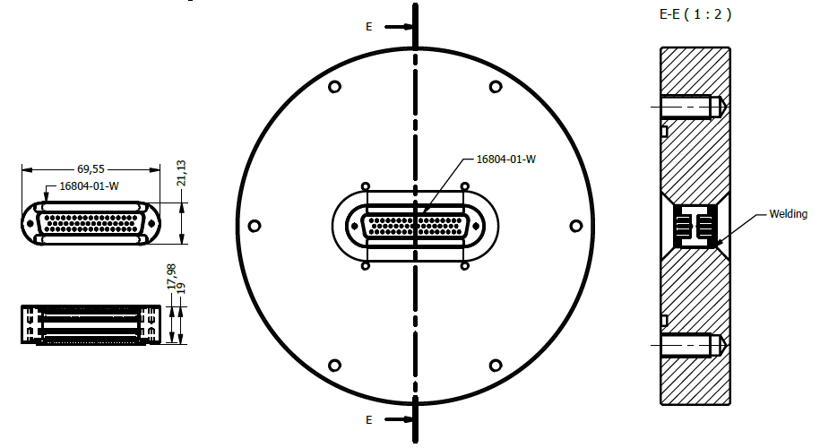
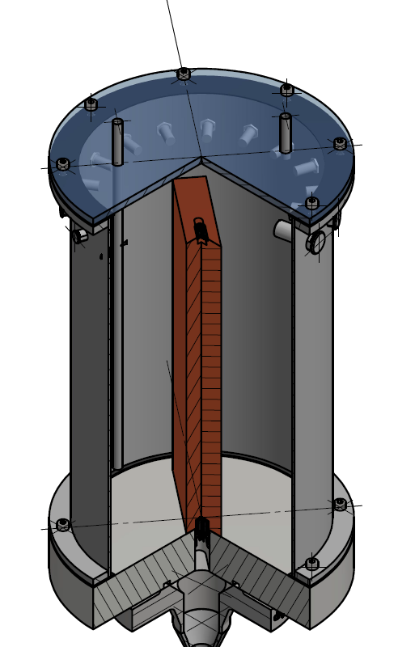
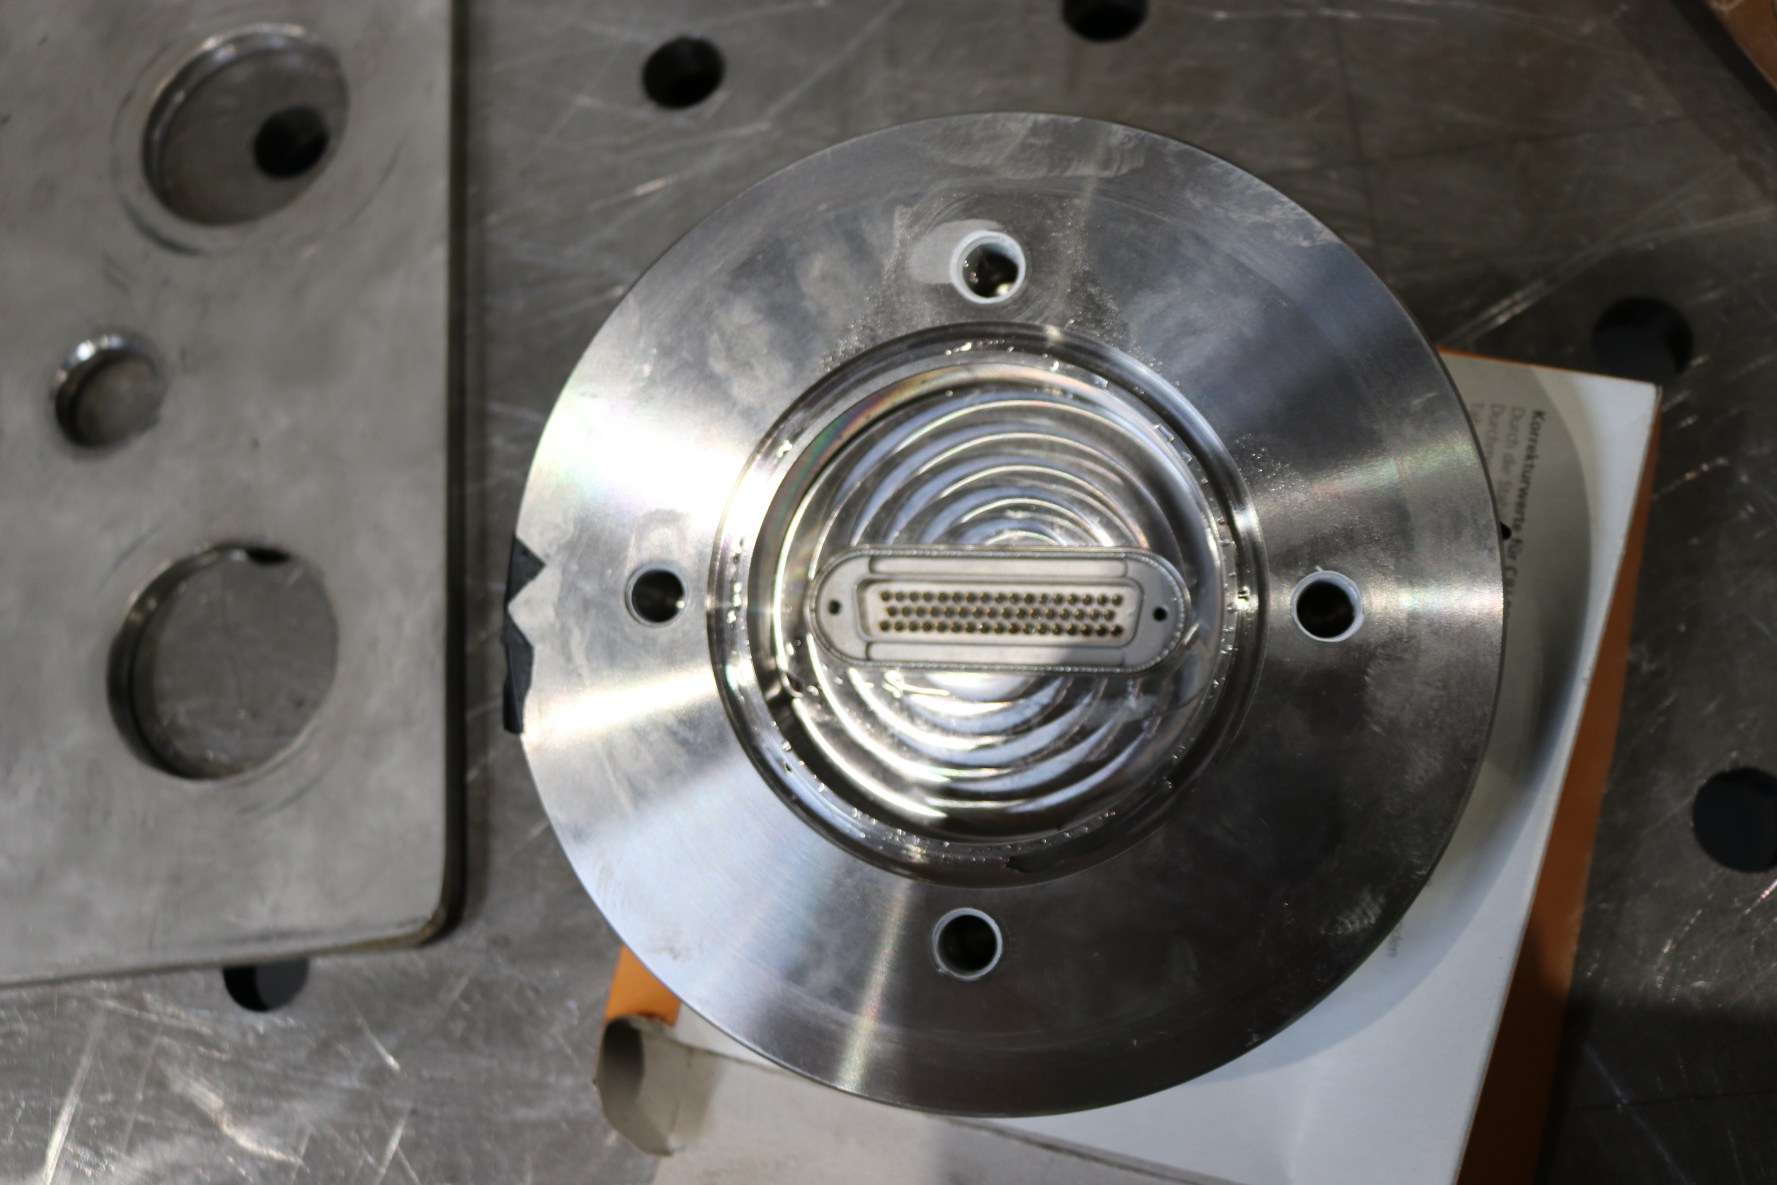
Middle flange
8 small flanges for preamps, welded SubD51 feedthroughs
1 small flange for 15 kV HV connectors, welded
1 small flange for temperature sensor
All small flanges covered by the
protection (N₂-filled) cylinders
Need to be designed (Spain?)

Slide 18
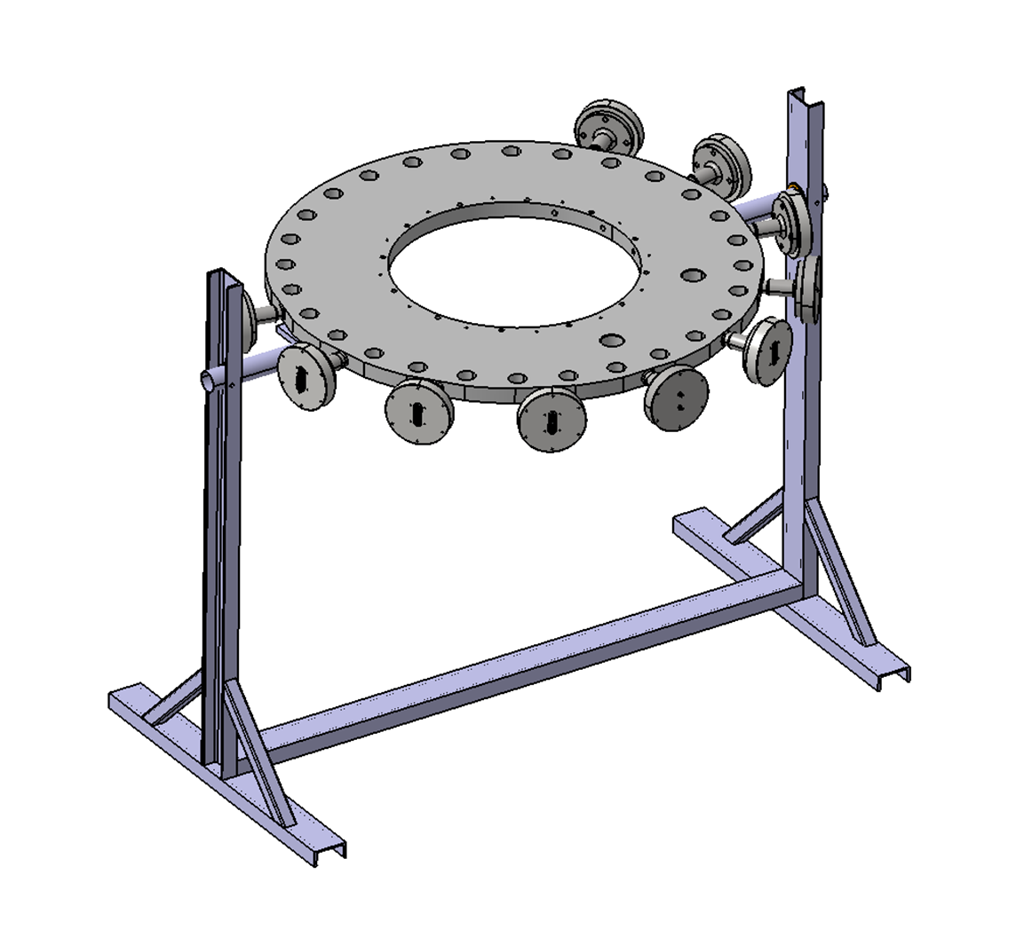
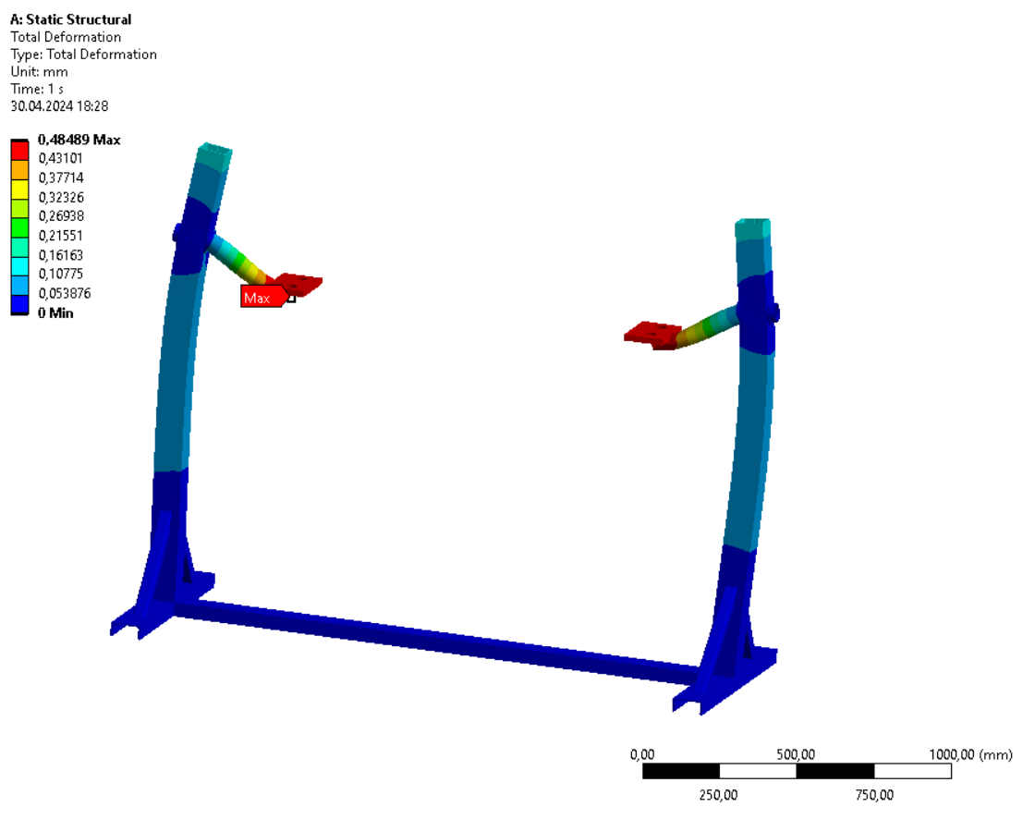
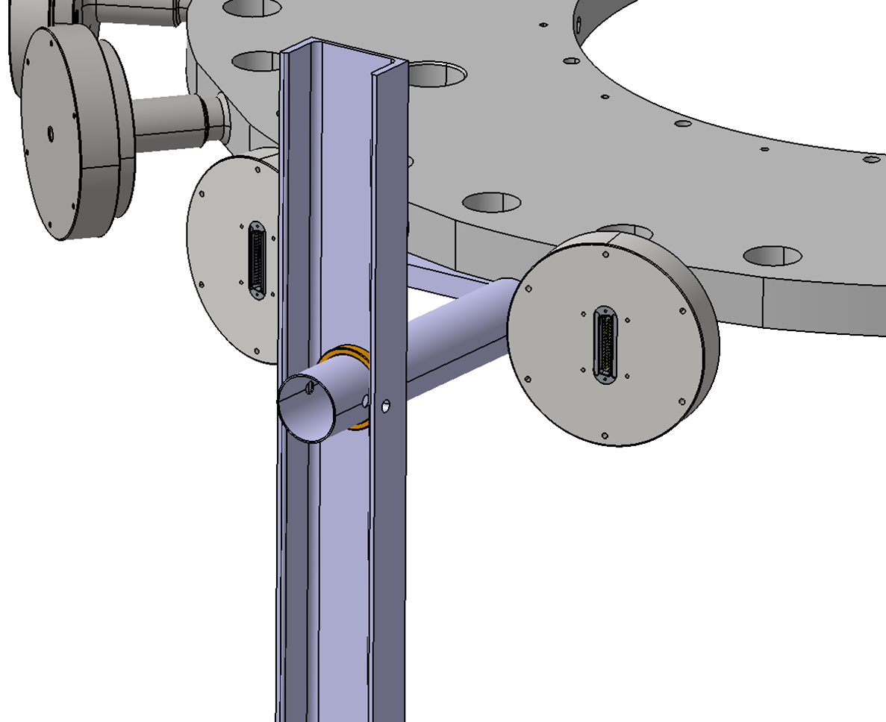
TPC mounting table, support
Shunko / JINR
A. Vasyliev / PNPI
Draft design of mounting table available, needs to be finalized
Parts of the mounting table need to be made - August-September, CERN?
Assembly of the mounting table – September?
Support, alignment table is needed

Slide 19
Amplifiers
Original design from PNPI
Not enough units + no production of few components → design revision (GSI)
Different input connector, different power connector, power regulators on board (better stability and lower noise)
Layout done, PCBs ordered
Components ordered, will be placed at GSI
1-2 units in August, whole set – September
Tests and calibration of the amplifiers – August-September
Calibration setup with CAEN Digital Detector Emulator (DT5810) and CAEN Signal Digitizer (DT5743) is available
Analysis package (python-based) for calibration of the amplifiers

Slide 20
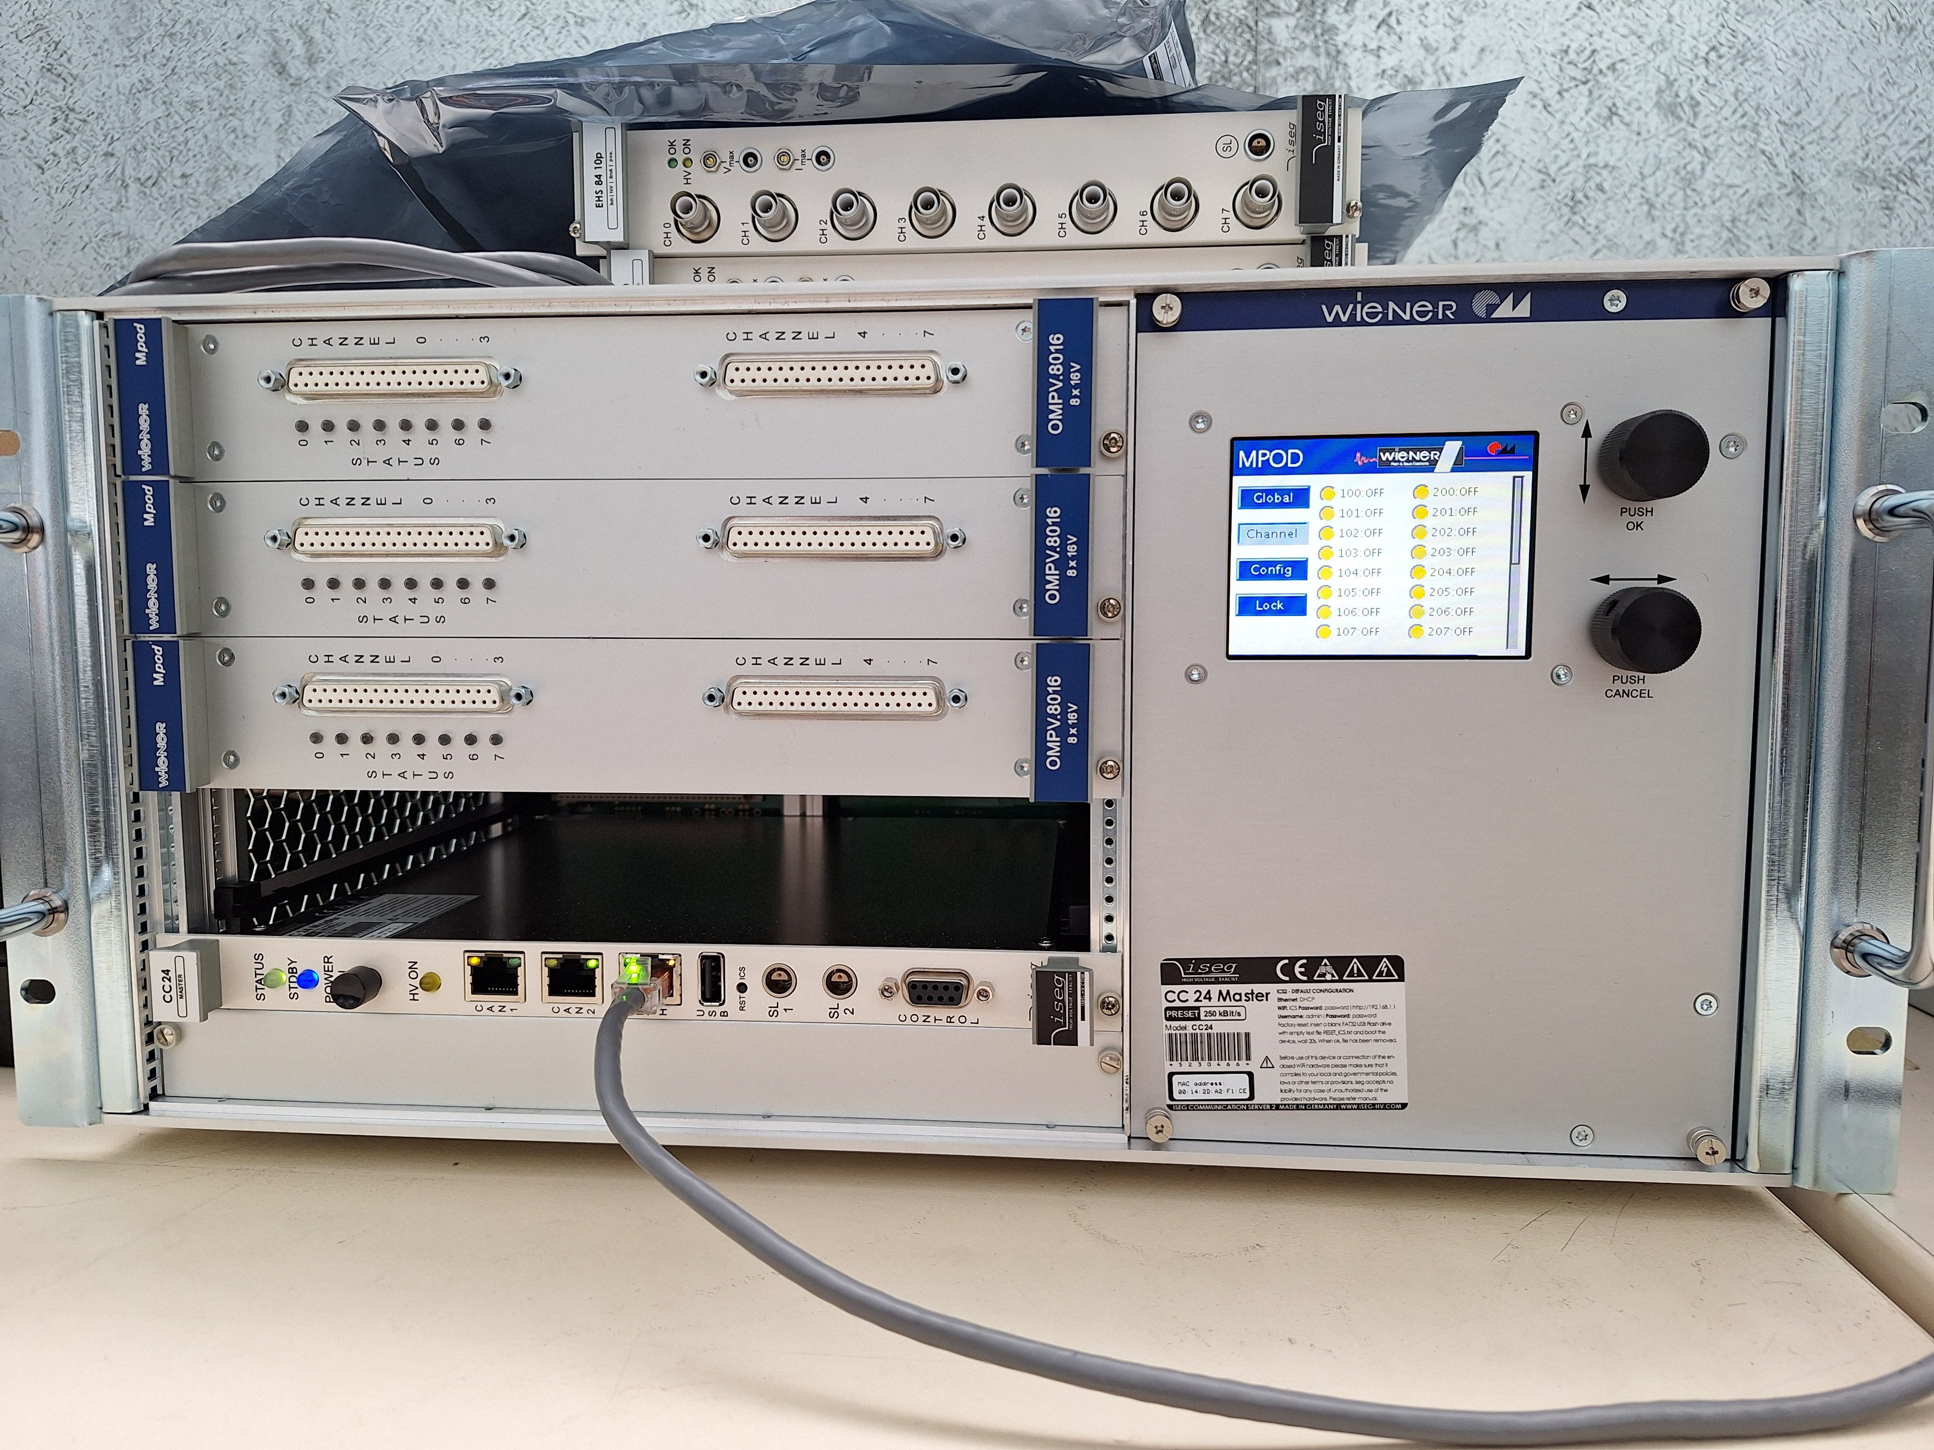
Power supply for the amplifiers
Each amplifier needs +6V and -6V, up to 1.5 A; 8 amplifiers – 16 LV channels (plus spares)
Wiener MPOD crate + low noise LV modules, 2 +1 units (2x8 + 8 channels) obtained and tested
Individual steering, monitoring via network (built-in Web server), other protocols available
Integration into the DSC needed?
Interlock per channel, per module (16 channels) and for all modules is possible
Cables from the LV modules to the feedthrough in the protection cylinders and from feedthrough to the amplifiers need to be made

Slide 21
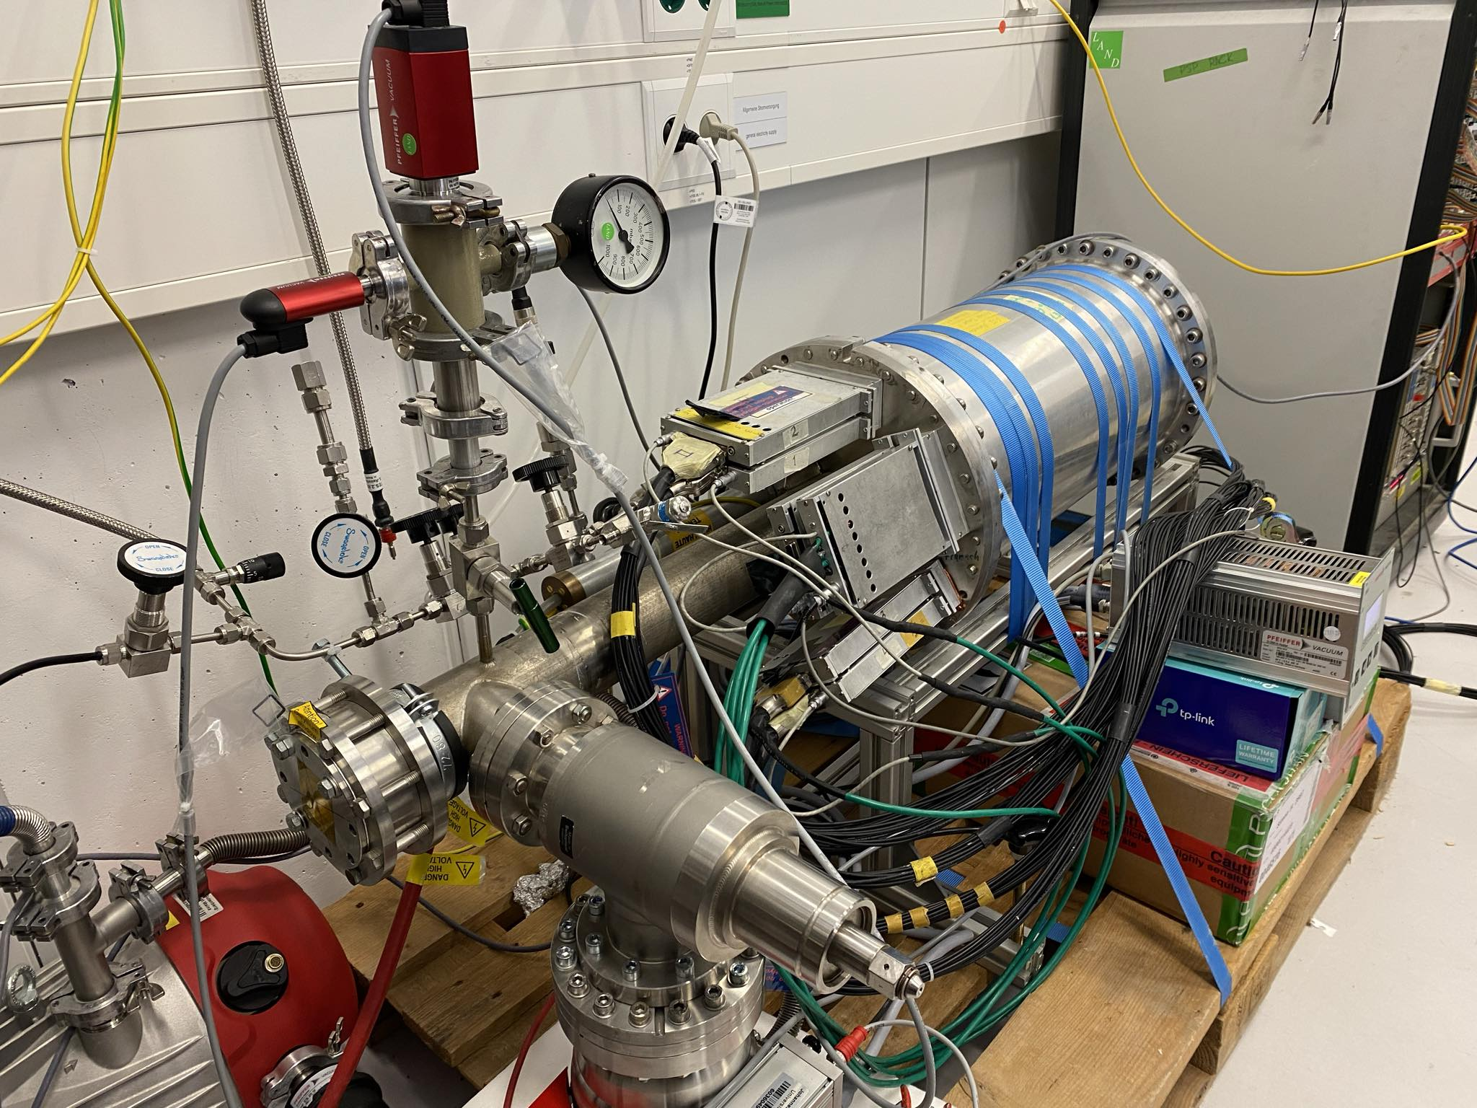
TPC ACTAF2 setup at GSI
Test bench for the
electronics/DAQ
Fully working detector

Slide 22
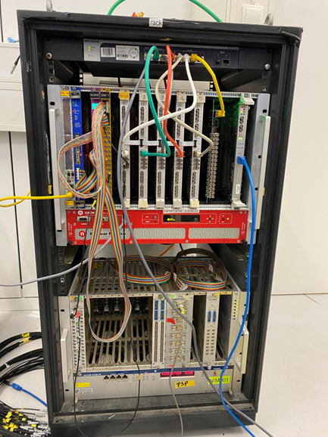
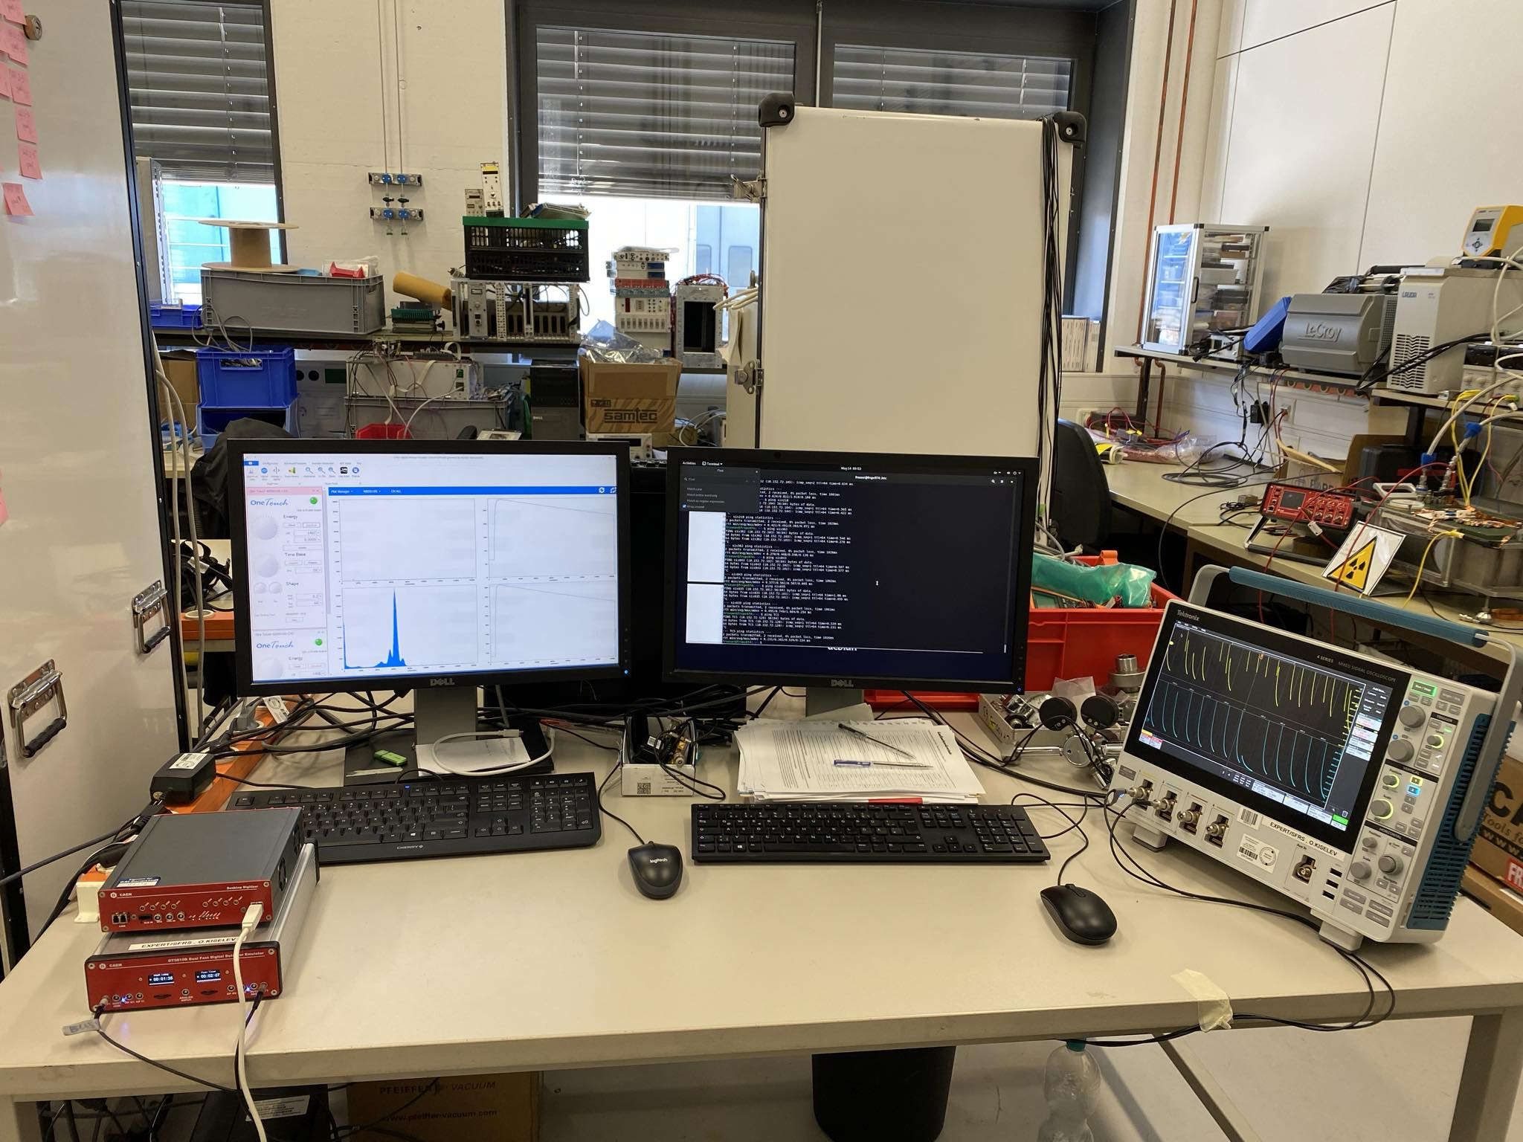
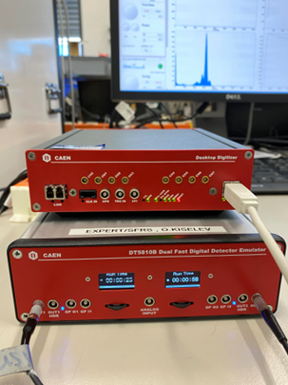
TPC ACTAF2 setup at GSI
Similar setup as at CERN, including TCS controller

Slide 23
TPC DAQ
VME and Ethernet-based readout possible
GSI DAQ environment on TPC AMD Supermicro server pcamtpc04 at CERN
Synchronisation via common clock, start/stop of spill, physics and sync trigger from TCS controller - September 2023
Contact with the Struck company - FADC FW upgrade (factor 3-4 of data compression) – project is frozen since a year
Setup at CERN is moved but up and running (except of TCS), tests are possible
TPC DAQ setup similar to the one at CERN is made at GSI (VME crate with FADCs, TCS controller, DAQ PC); VME readout is working, Ethernet readout is not yet working, help needed. Know-how is partly transferred, documentation at GSI R3B Wiki available
Support for DAQ is absolutely essential
Data analysis – University of Santiago de Compostella and Coruna
Merging of the TPC data into the main AMBER DAQ via software (event server) or FPGA card in the DAQ server (firmware needed) is still open issue

Slide 24
TPC gas system
EP-DT Gas Group agreed to develop and support the project
Several meetings – about the overall scheme, compressor, steering/PLC
Compressor, mass-flow controllers, valves et cet. need to be ordered soon. Many-many components
Part of the system (steering, PLC) is a part of the hall infrastructure plus
EP-DT Gas group uses Schneider PLC and GSI - Siemens PLC →
Top-level steering software UNICOS can be used for both PLC versions
Manpower from our side in September-October is needed. Gas expert from GSI ALICE group (Chilo Garabatos) will help.
ATEX risk assessment by external company at CERN – works but quite slow
ATEX risk assessment by external company at GSI – will be ordered soon

Slide 25
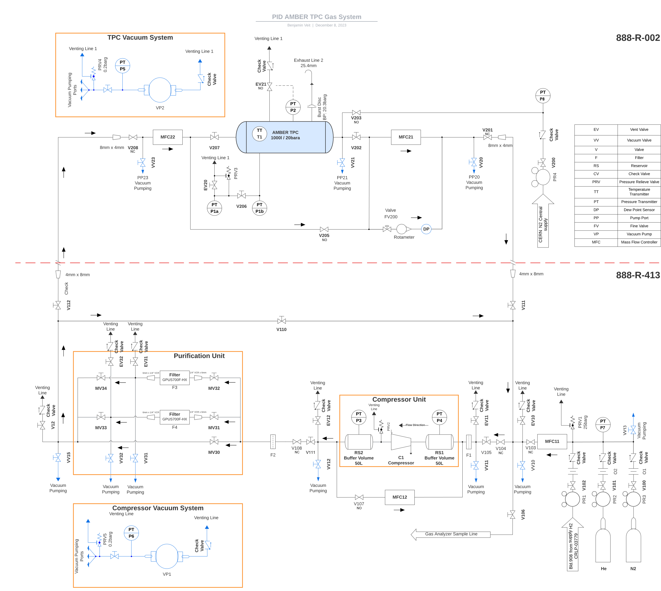
TPC gas system
Preliminary
Design for CERN,
needs to be modified for HEC

Slide 26
Plans
Transport of the pressure vessel/stainless steel rings to CERN – mid August?
Isolation screws – ready end of August
Grids, anodes – ready in September?
If mounting table and support table will be ready in September, TPC can be assembled in October
Additional flanges with beam windows ready (tested for overpressure) in August-September
100 kV units need to be finally designed and produced – September?
Components for gas system will be ordered soon, complete delivery – end of September
Gas system assembly – October?
Final detector and gas system ready – beginning of 2025, measurement at CERN up to the end of 2025

