Slide 1
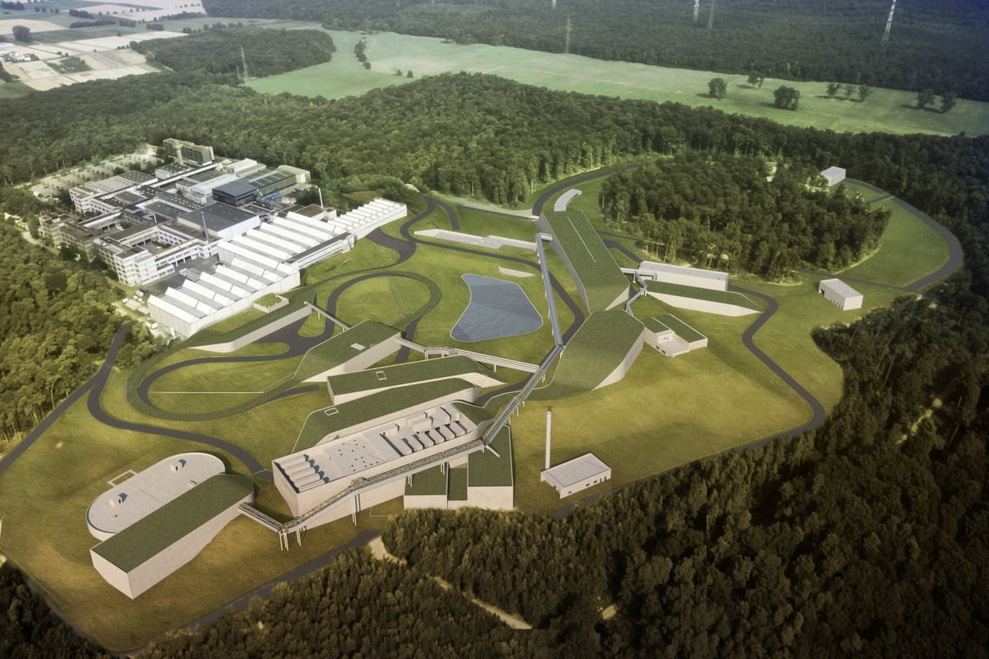


Status of FAIR and Super-FRS .
Haik Simon – GSI Darmstadt

Slide 2
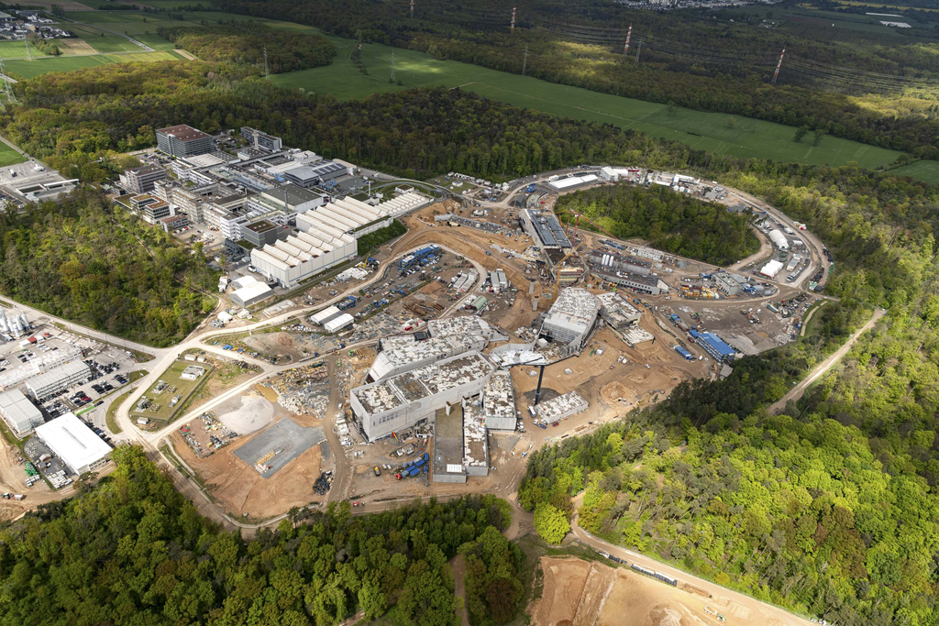
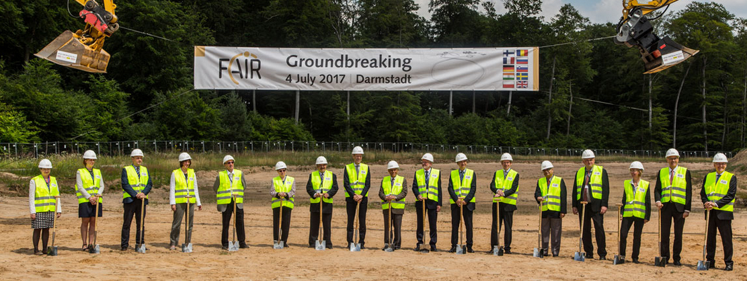
FAIR Construction Site
April 2024
April 2024 – Shell construction Finished – Groundbreaking July 2017

Slide 3
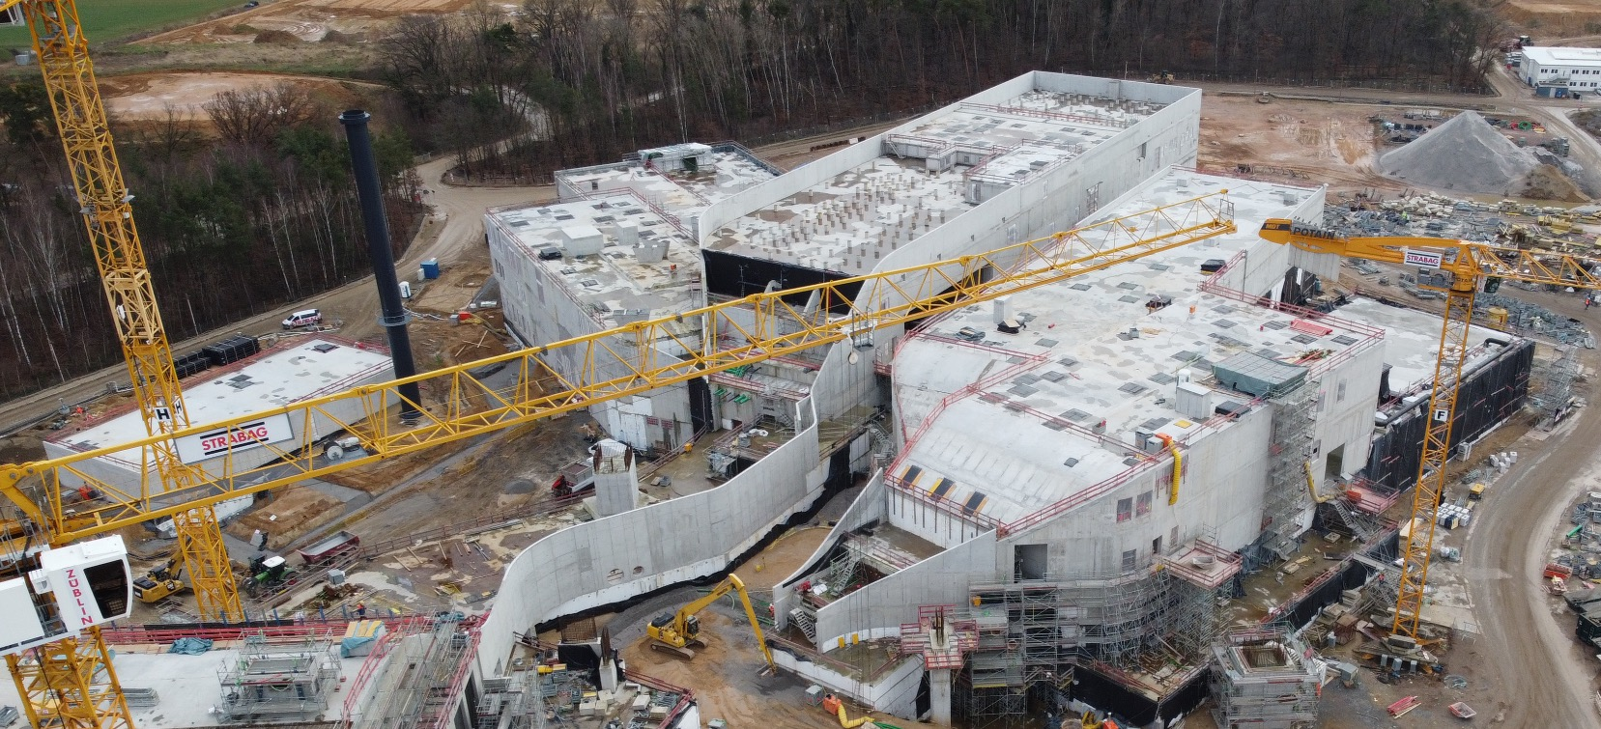
FAIR Project Progress – Civil Construction
Construction Area South – Only TBI and landscaping missing
May 2022
H.Simon - Halo Week '24

Slide 4
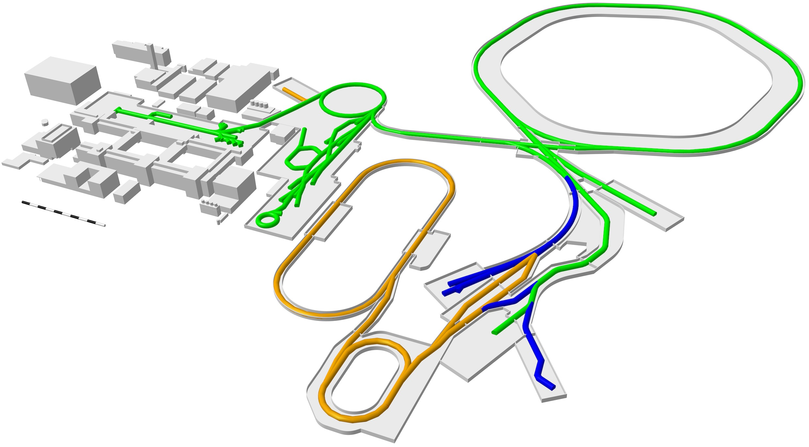
Fair-28: Main Objectives - NUSTAR
SIS100
Increase in primary
beam intensity
10-100
Super-FRS
Matched with acceptance
and selectivity of a versatile
Separator: Ion optics and
instrumentation …
➔ Experiments

Slide 5
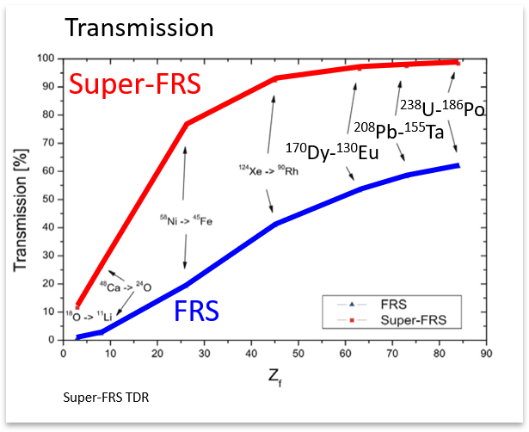
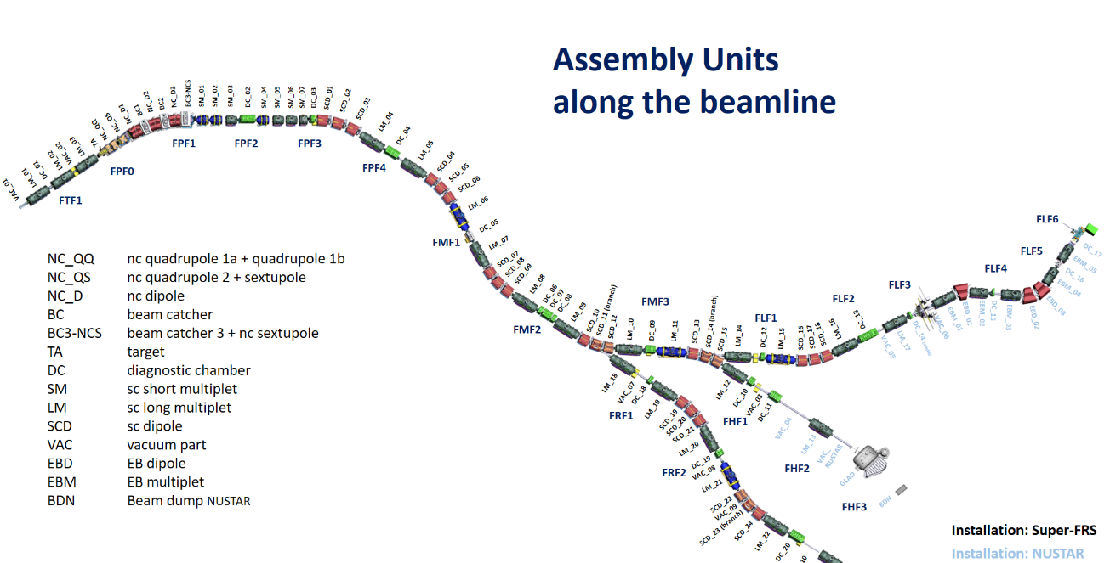
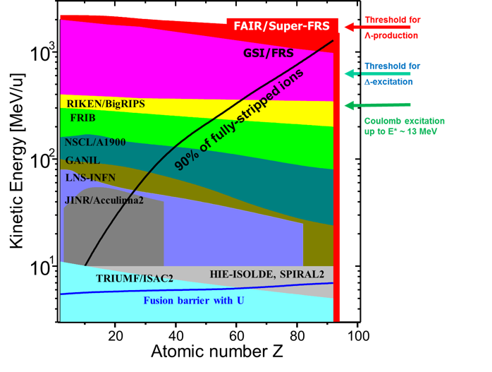
Super-FRS (@SIS18/SIS100) workhorse for
NUSTAR
Low energy
Branch with
Energy buncher
One of
worlds most
powerful
separators
for exotic
nuclei
High energy Branch
Λ prod.
Δ exc.
E* 13 MeV
Ring Branch
Target
Large acceptance
High rigidity, minimized losses
→ Thick production targets
Most effective use of
primary beam for experiments
Technical Design Report:
H. Geissel, M. Winkler, H. Weick,
et al. (2009)
H. Simon – Halo Week ‘24

Slide 6
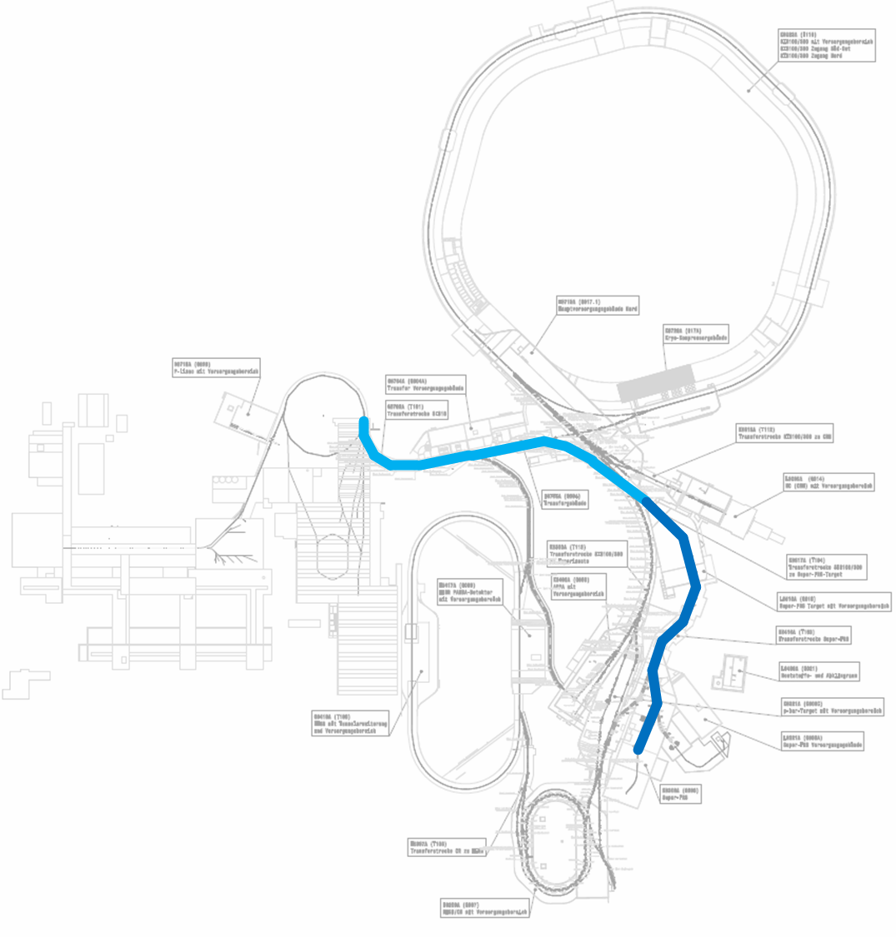
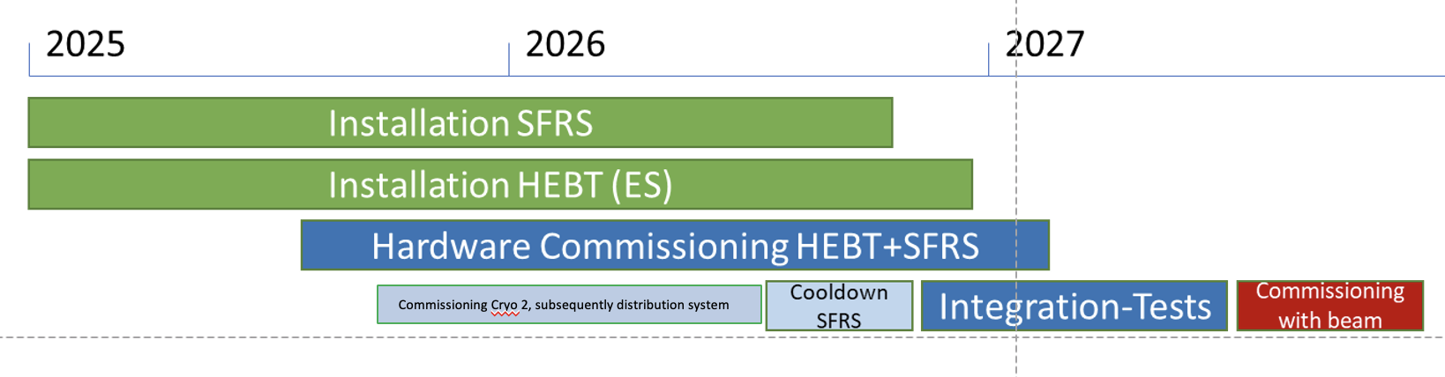
Early Science Objective
Start version taking beam from SIS18
via Super-FRS to the High Energy Branch
Beam intensity increase through optimized
beam transport and transmission from SIS18
FCC
commissioning

Slide 7
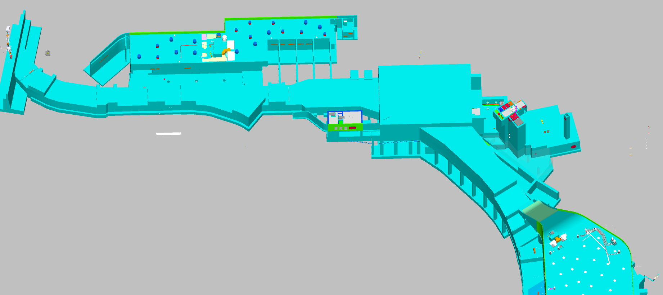
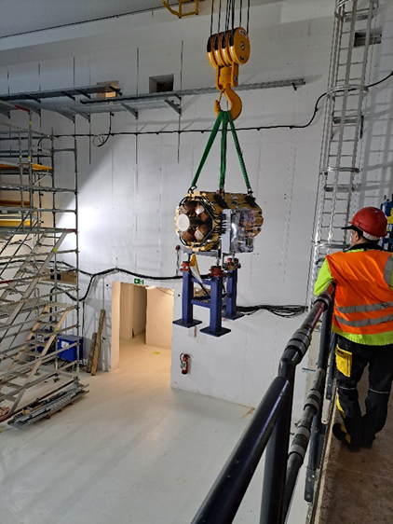
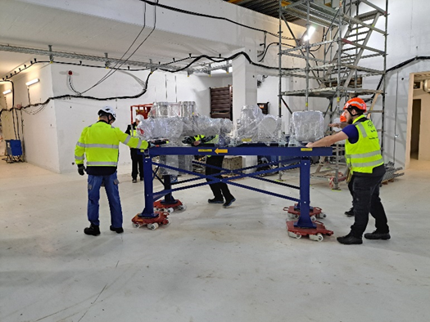
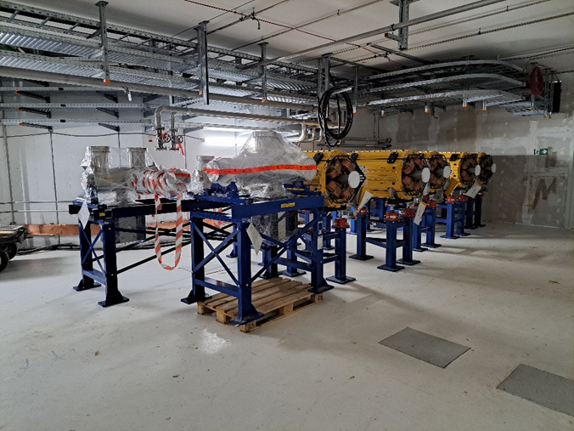
HE Beam Transport Early Science (SIS18 – Super-FRS)
SIS18
G0704A
G0702A
H0705A
K0617A
Installation start on 03.04.2024
Super-FRS

Slide 8
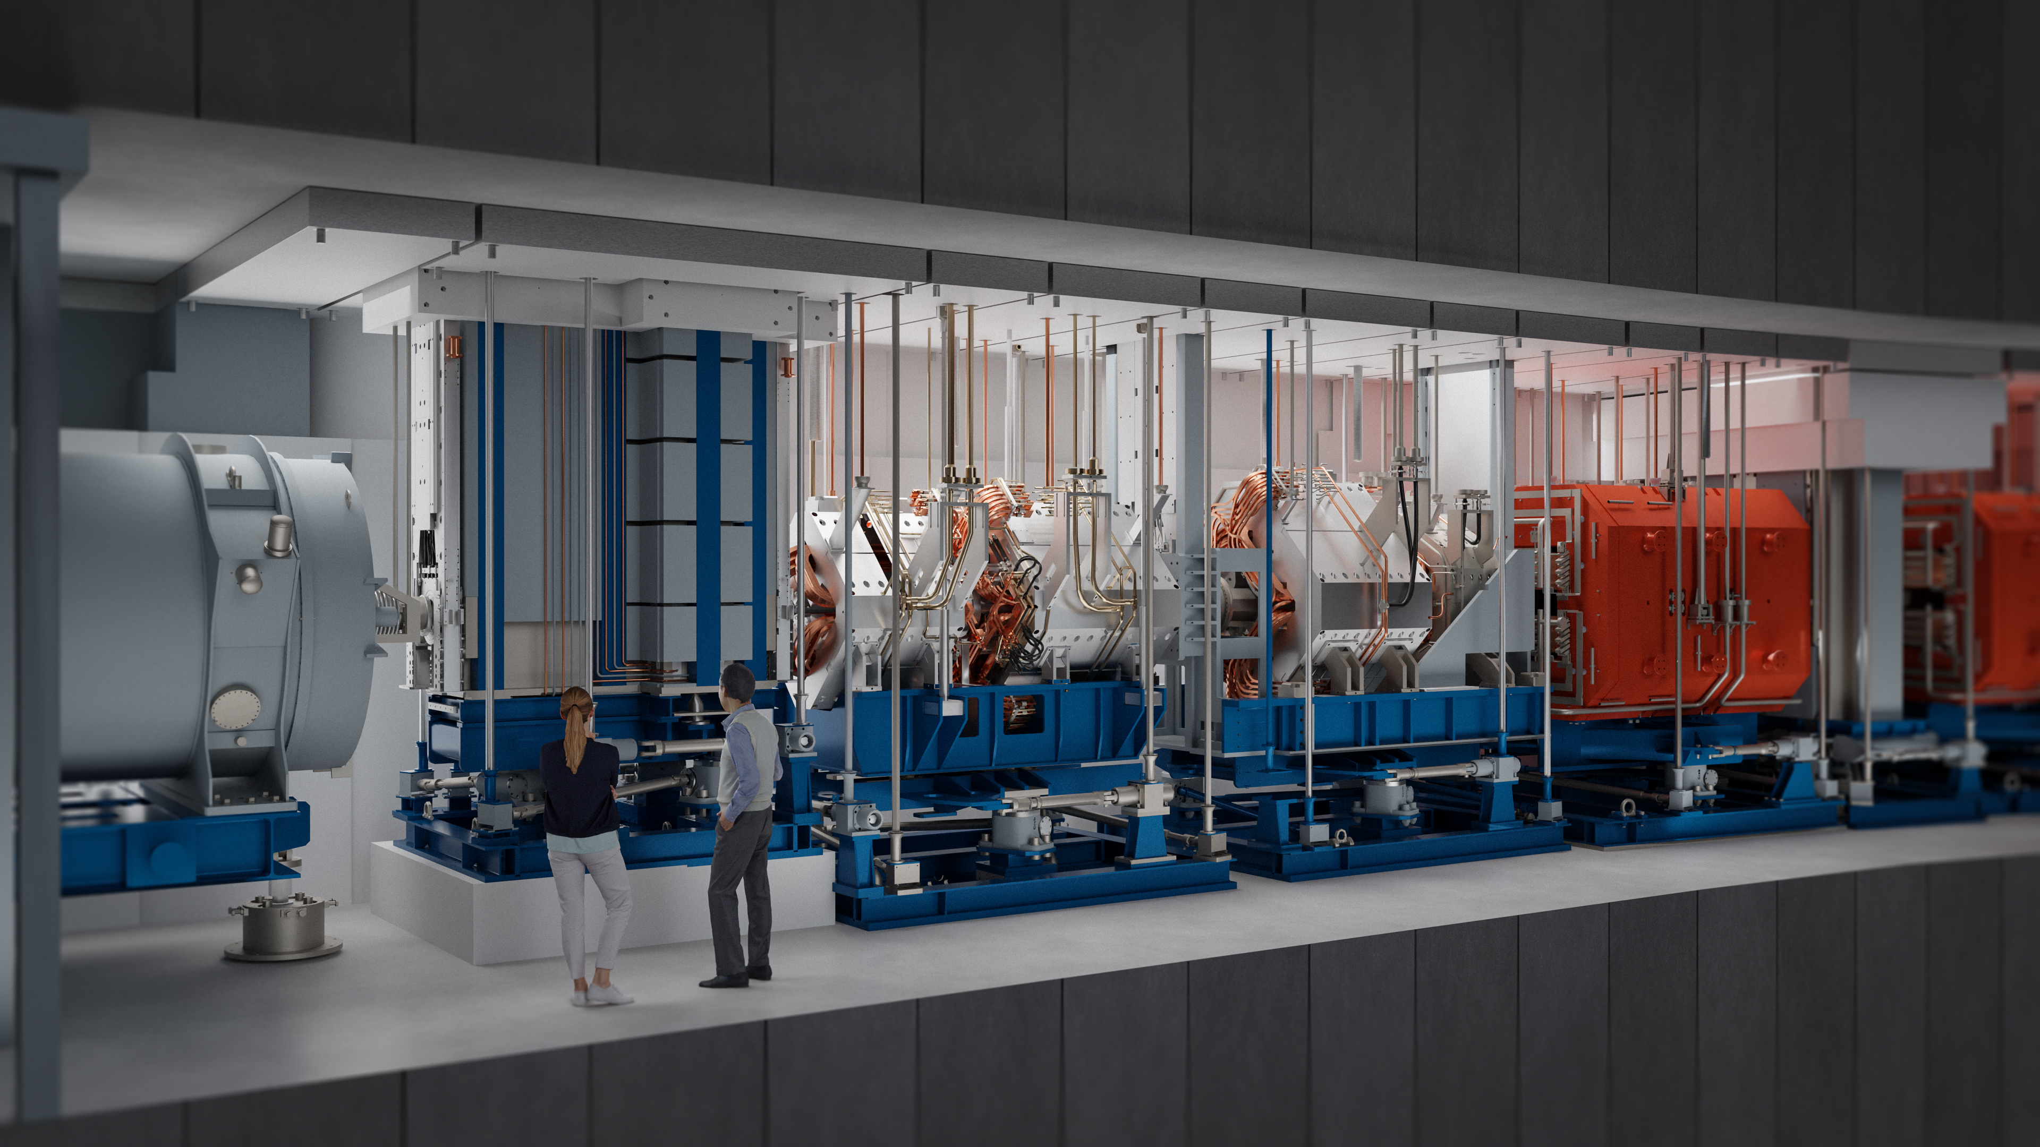
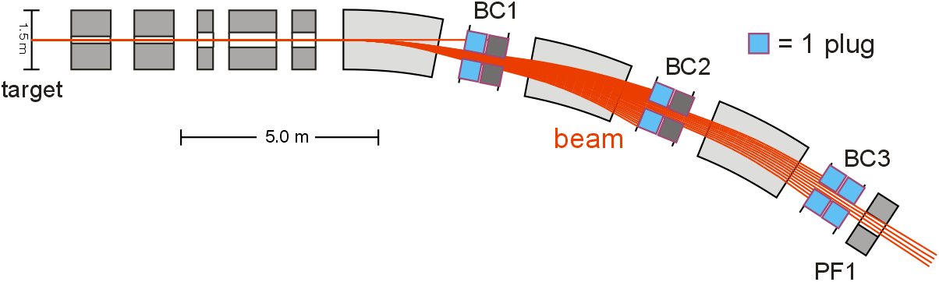
Super-FRS Target area (artists‘ view)
magnets
unreacted primary beam
wanted fragment beam
Preselection in
The pre-separator
allows to cope with
100-fold intensity from
SIS-100.
Technically challenging
Radiation area.

Slide 9
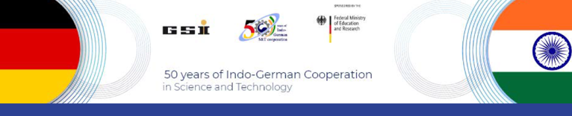

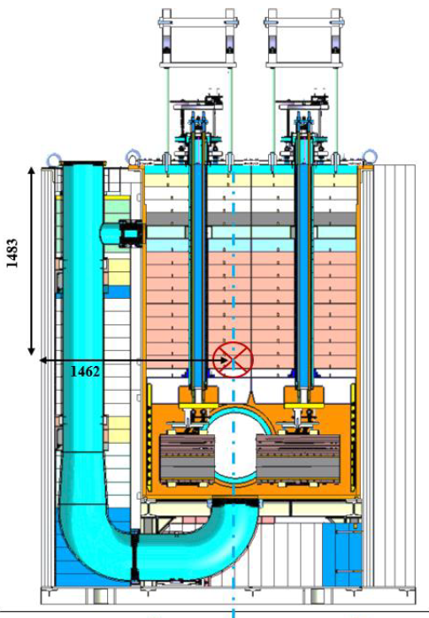
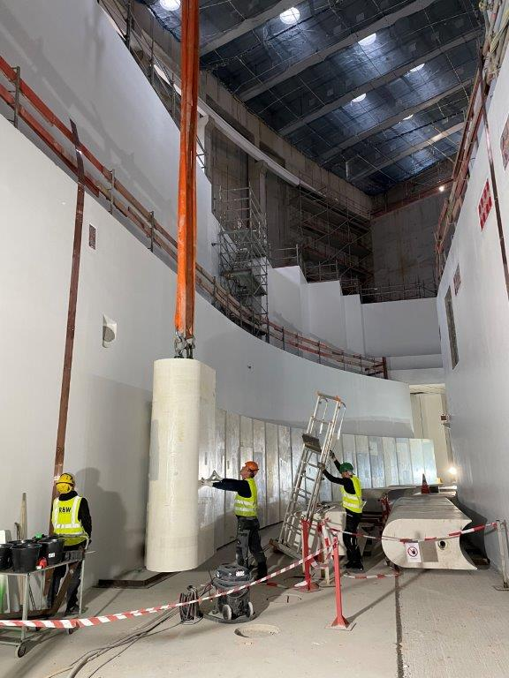
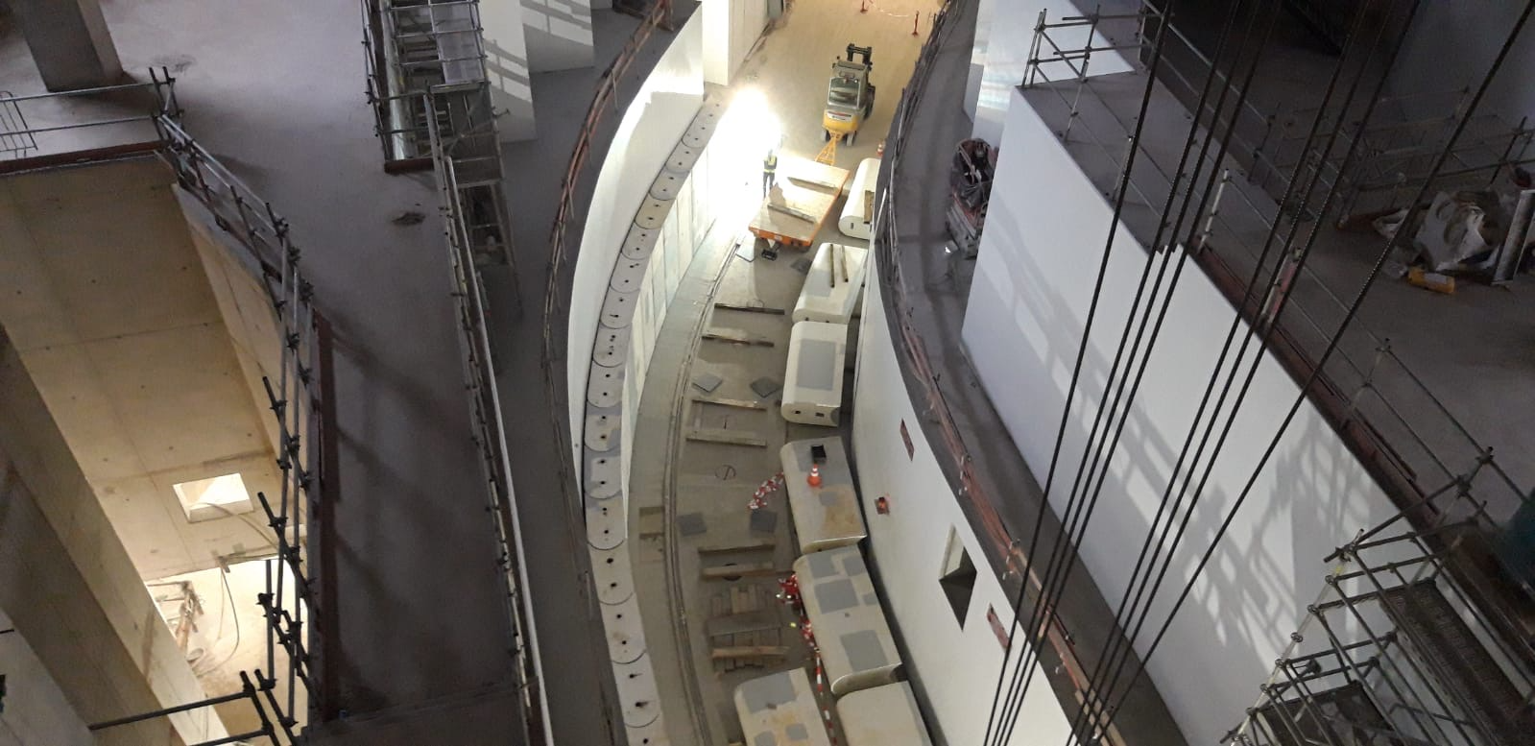
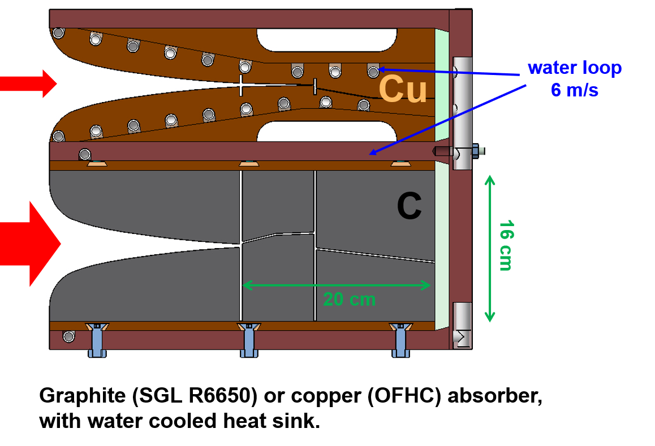
Target area components
iron and concrete shielding
Russian In-kind
contributions from
BINP (Novosibirsk)
IOFFE Institue (St Peterburg)
needed replacement !
Installation start of
lateral iron shielding
started 05/2024 as scheduled
target
Q1a
Q1b
Q2
S1
D1
BC1
D2
BC2
D3
BC3
S2

Slide 10
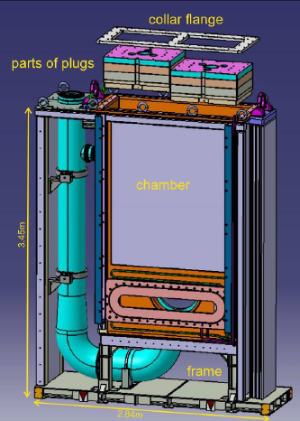
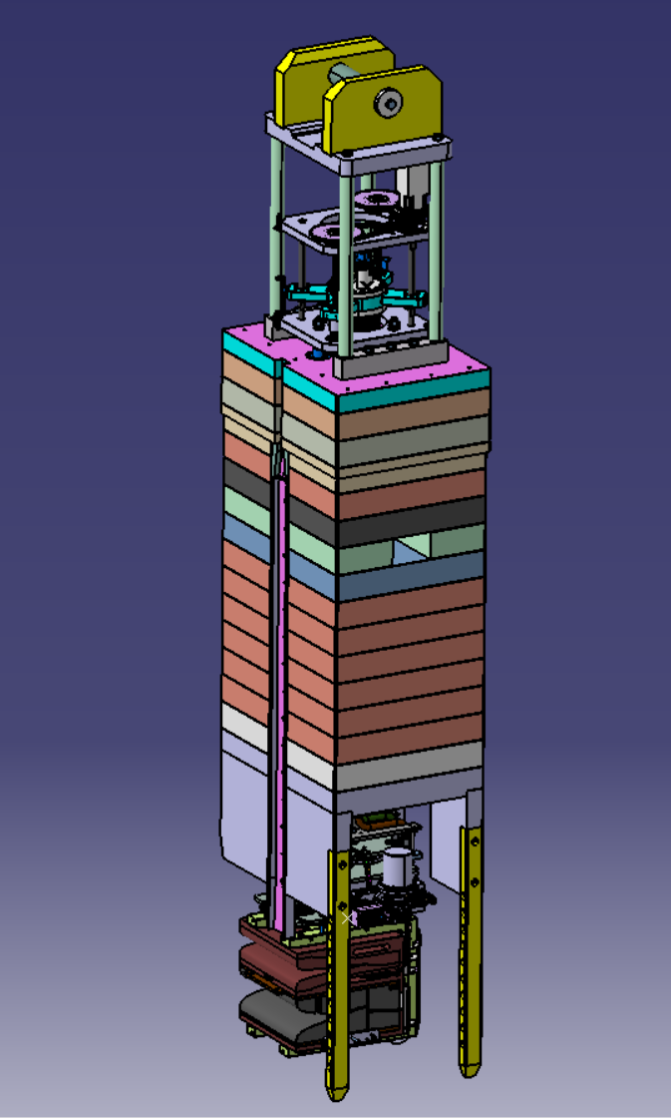
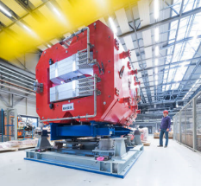
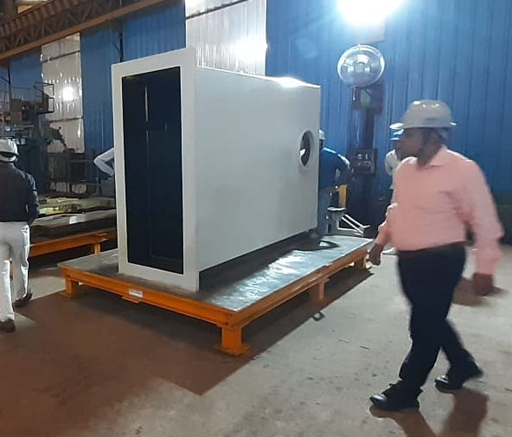
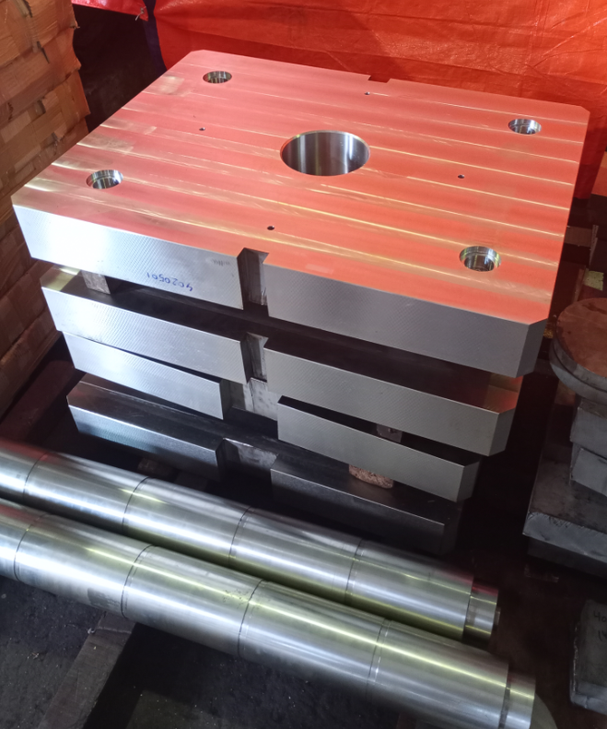

Area of success:
All target component entering production or running
7.5 t
3.6m
Ex Russian In-kind:
rad-hard Dipoles (2) and Multipoles (2) again in production (Buckley NZ, SigmaPhi F)
plug parts
Ex Russian
vacuum system
Local cryogenics components
detectors
Again in production !
Welding
test chamber 1:1 at Trident, Kanpur

Slide 11
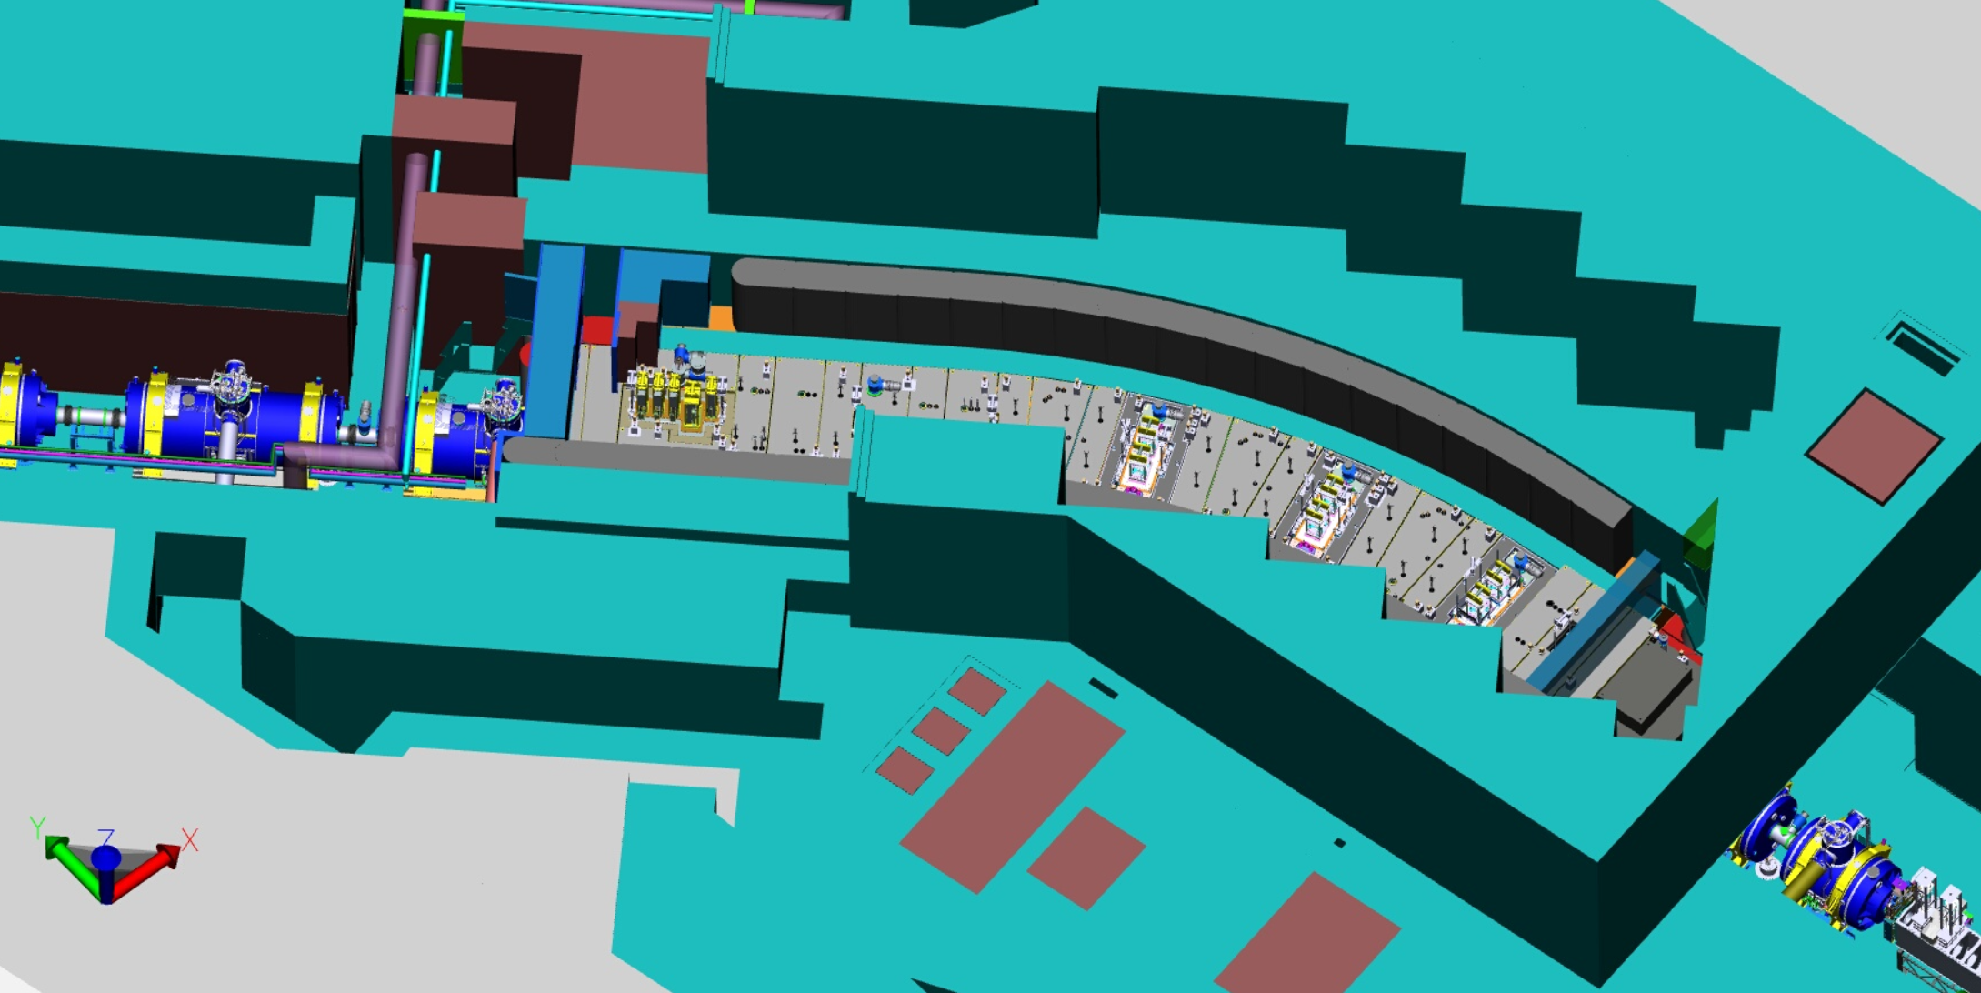
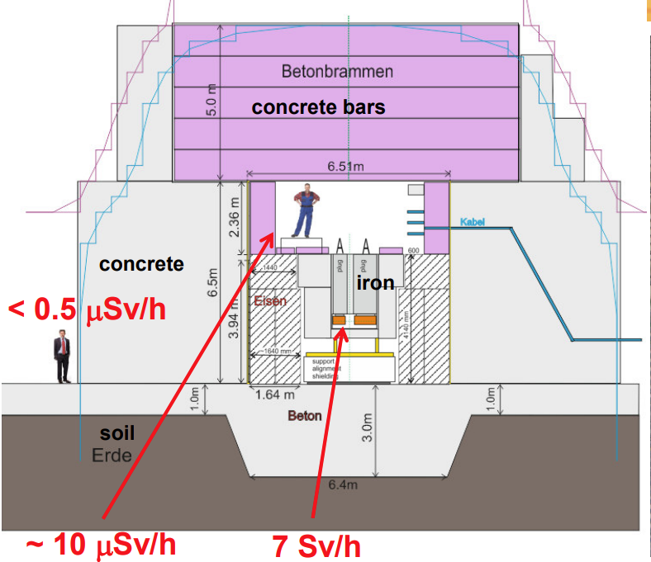
Target Area
-Remote handling and shielding
hall
maintenance
pillow seals
Target chamber
BC chambers
Pillow seal plugs
parking cell
Beam Plug interactions
Plugs parking cells
Hot cell slider
Hot and decay cell
E. Kozlova
Notes:
Here, one can observe the target area beamline enclosed from the top.
The target area beamline is situated near the hot cell where plugs are periodically repaired, including target plugs and beam catcher plugs.
A total of 21 plugs will be required depending on the phase of the facility's life cycle.
To facilitate maintenance, storage of both fresh and activated plugs must be considered, given that the hot cell is in use.
The plugs are activated and can reach a dose rate of up to 7 Sv/h.

Slide 12
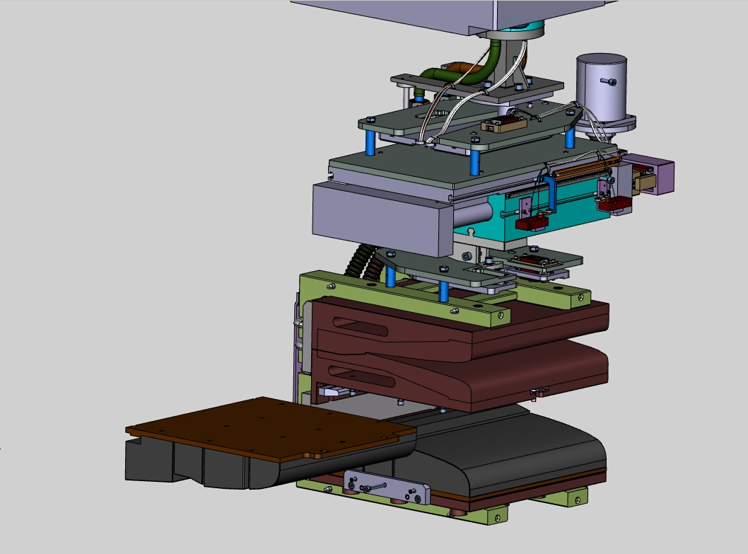
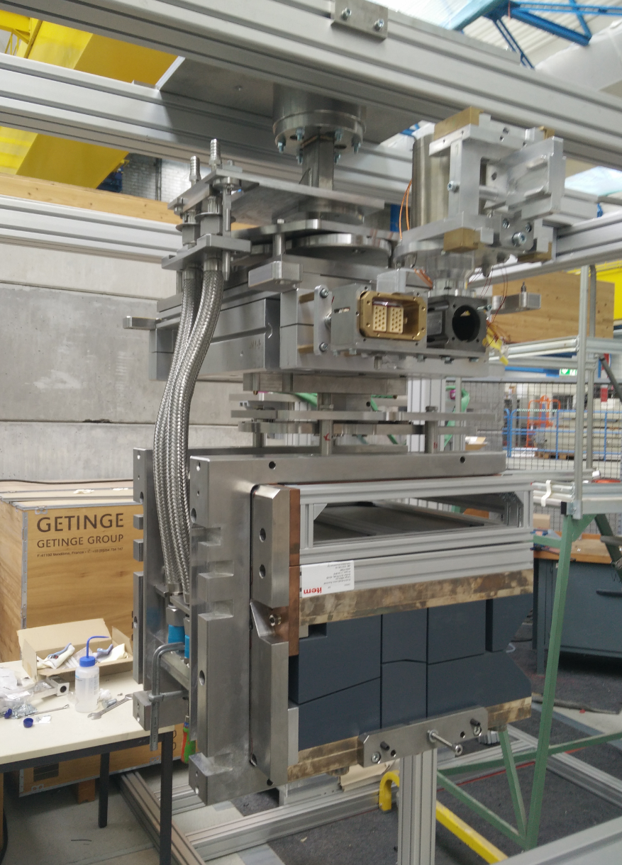
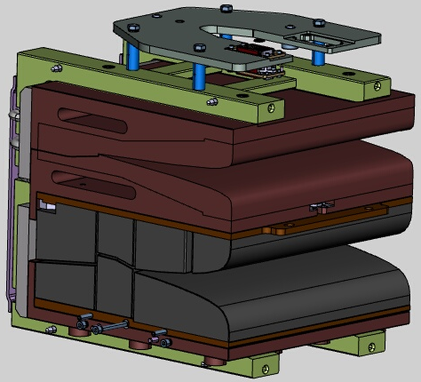
Final Absorber Block
motor
linear drive
steel
absorber block
~ 300 kg
Cu
graphite tile
C
490 mm
400 mm
Collaborative development,
optimization and technical implementation !
1:1 dummy

Slide 13
Area of success: 3 beam catchers in production
7.5 t
3 full beam catchers (IK India; CMERI Durgapur)
chambers plus absorber plugs
In-kind contract not yet signed, but…
Indian manufacturer already awarded (Trident Auto Components, IN)
Planned end of design (FDR): June 2024
Planned end of delivery to FAIR: October 2025
Planned installation: Q2-Q4 2025
3.6m
Welding
test chamber 1:1 at Trident, Kanpur
3 special alignment supports
FAIR contract award: February 2023 (Fantini Sud, IT)
FDR = December 2023
Planned delivery: November 2024
Planned installation: Q1 2025
plug parts

Slide 14

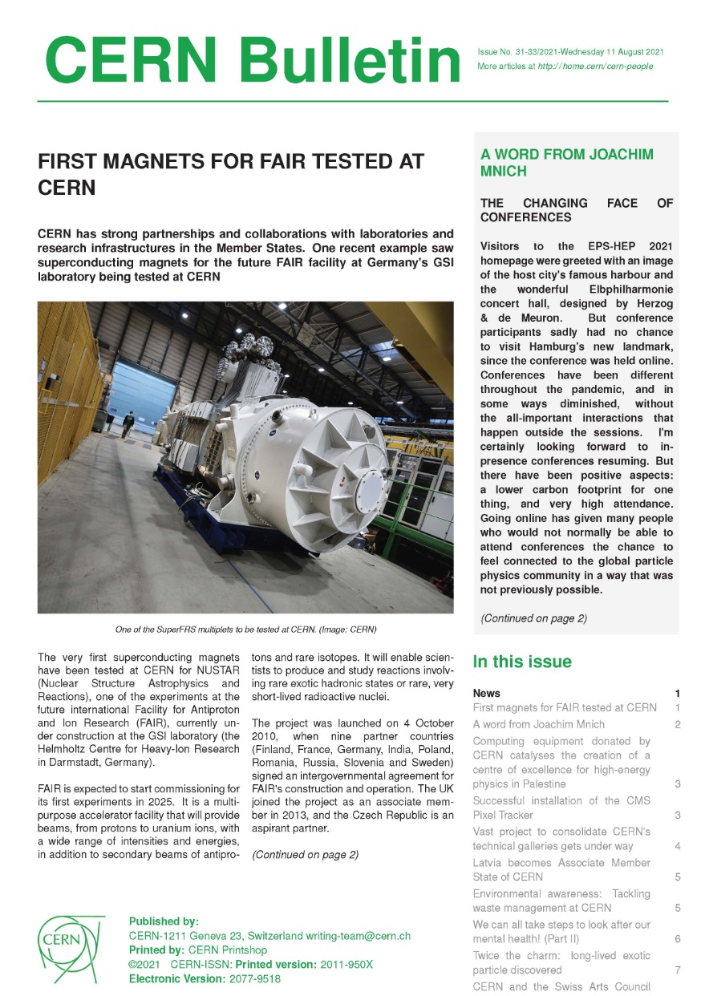
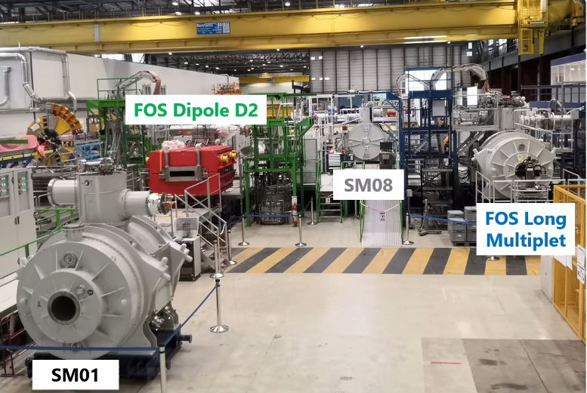
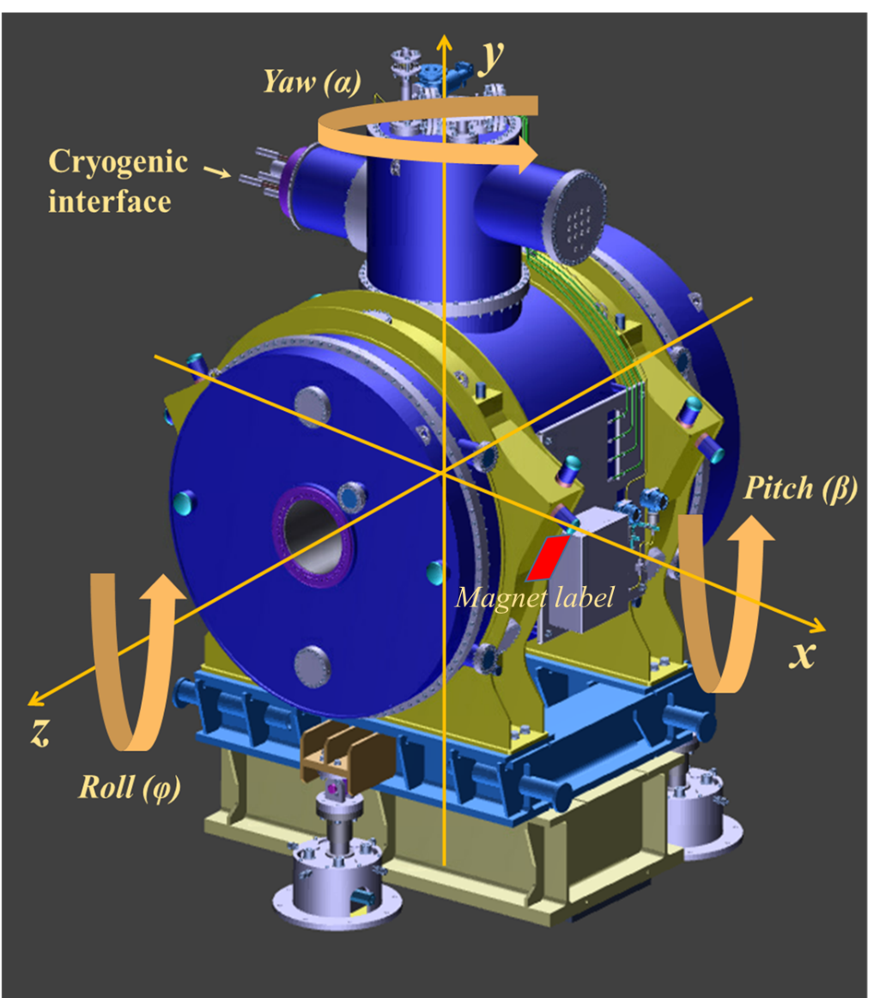
Sc Magnets are key components:
Testing at CERN of sc magnets
Very successful tests @ CERN
Ion optical performance well achieved ! (99% done ,,,)
But:
magnet leaks at cold observed
H. Simon – Halo Week ‘24

Slide 15
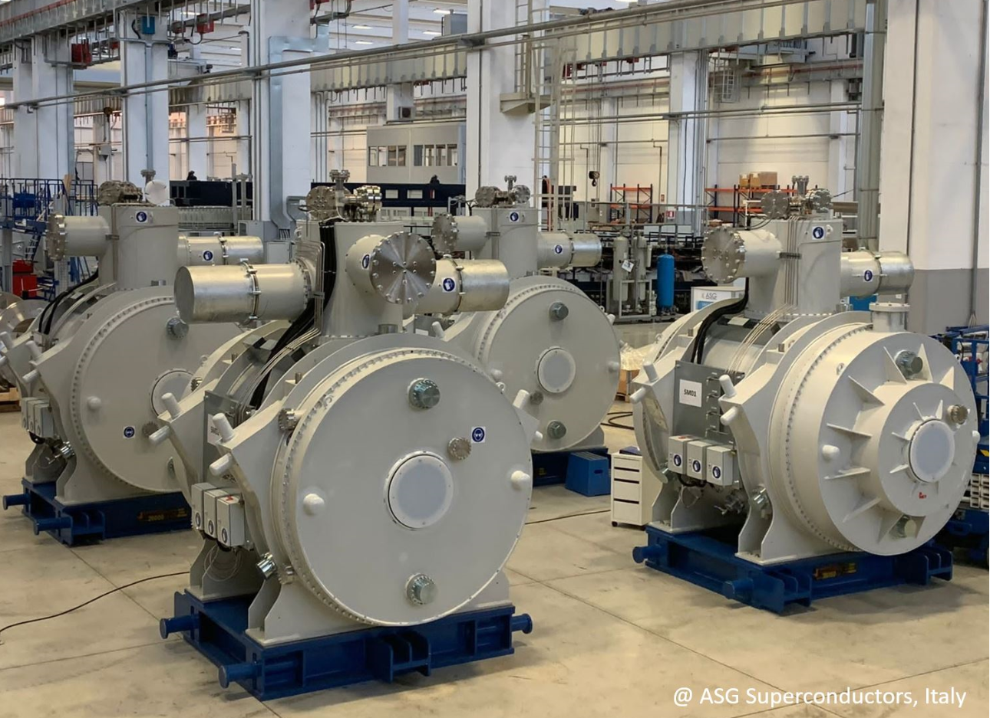
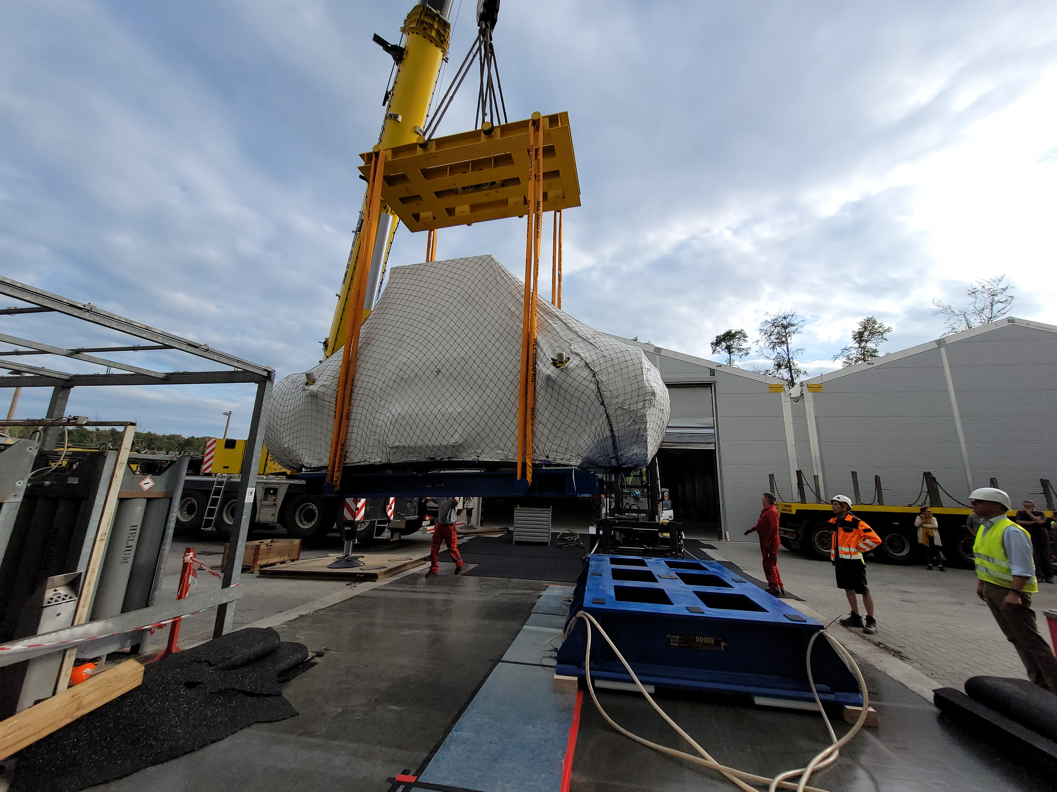

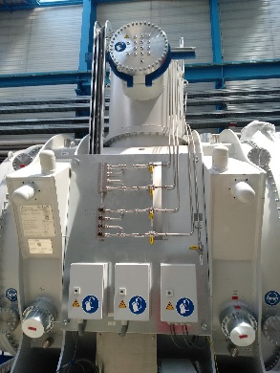
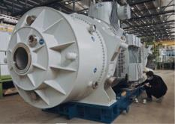
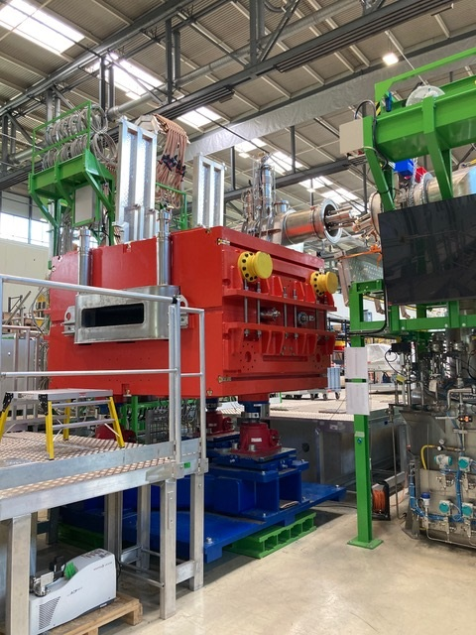
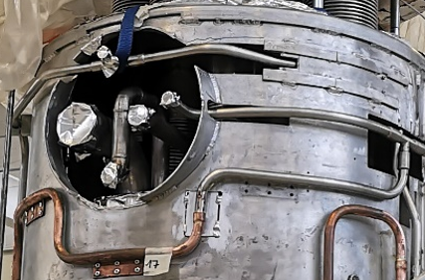
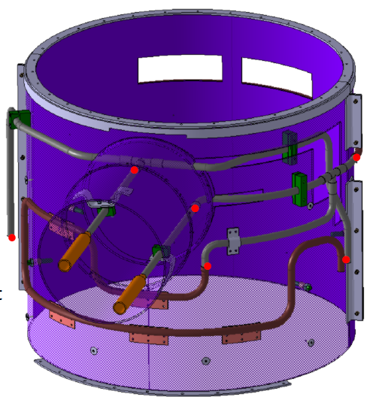
Superconducting Magnets
Re-Entering Series Production after Prototype testing and repair
Technical issues
with thermal shield
brazing connections
➔
Reworks and Design change
was neccessary
Intense ollaboration with
CERN to resolve the issue
with manufacturers.
Similar activity with Elytt (Dipoles)
➔ entering series testing if
running tests are successful

Slide 16
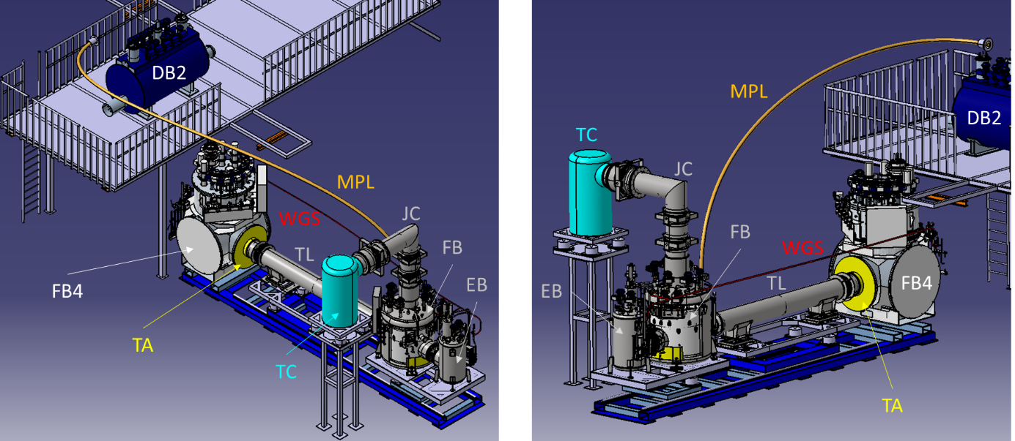
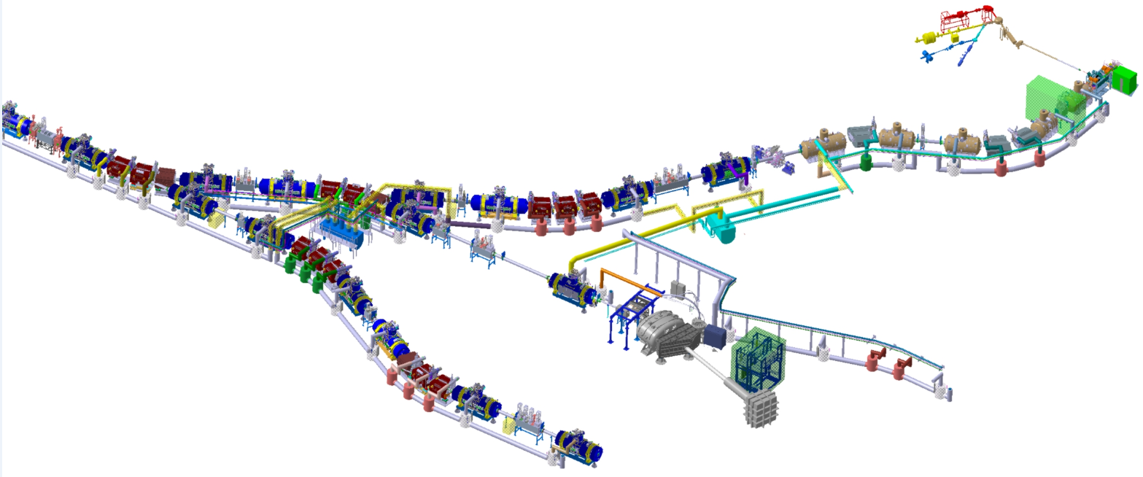
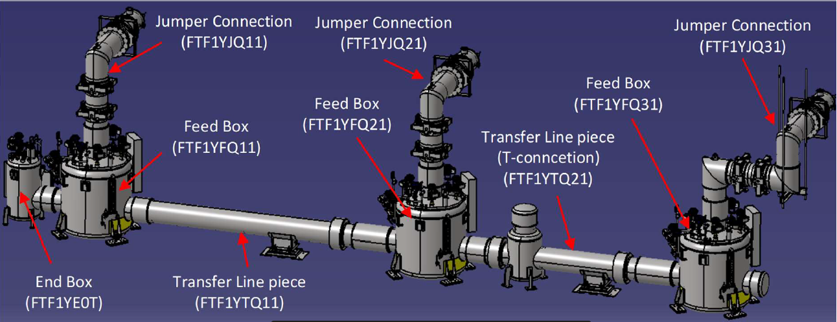

Example: Magnet Supplies as part of the Building
Local Cryogenics distribution system
Complex distribution system, long distances
Design in
collaboration with
WUST/Wroclaw
CDR phase just
finished
Tender of FoS Branch-T
running to be tested @GSI
Sharing of IK components
in Council 20240710-11
FoS tests @ STF/GSI

Slide 17
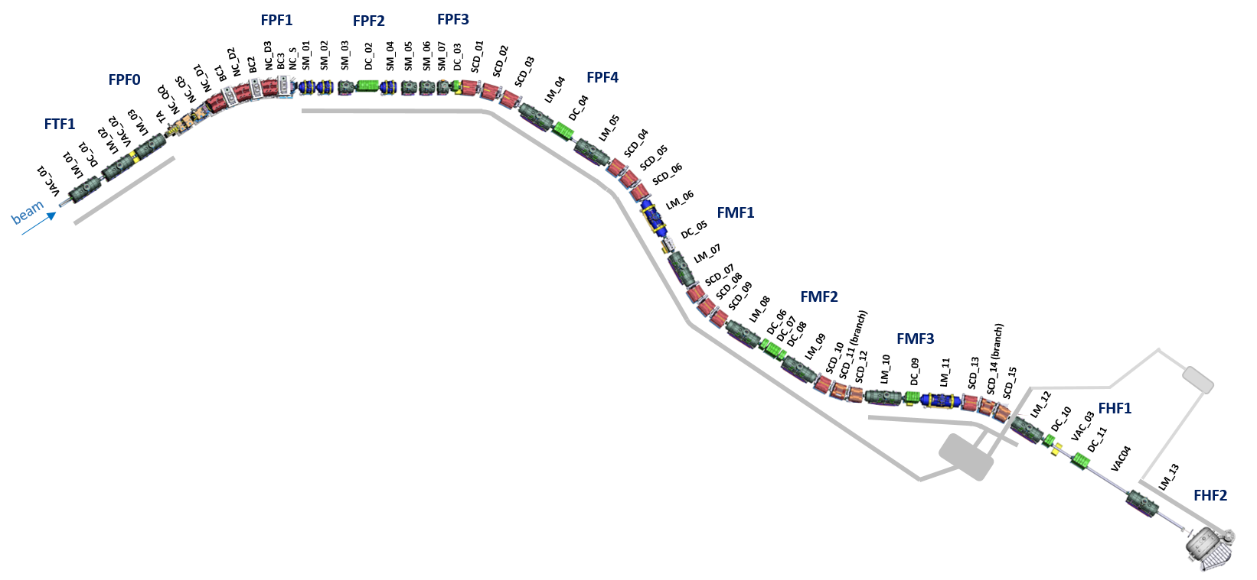
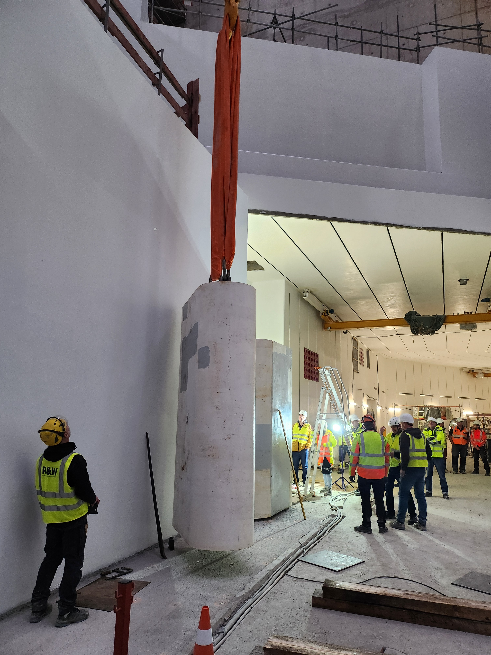
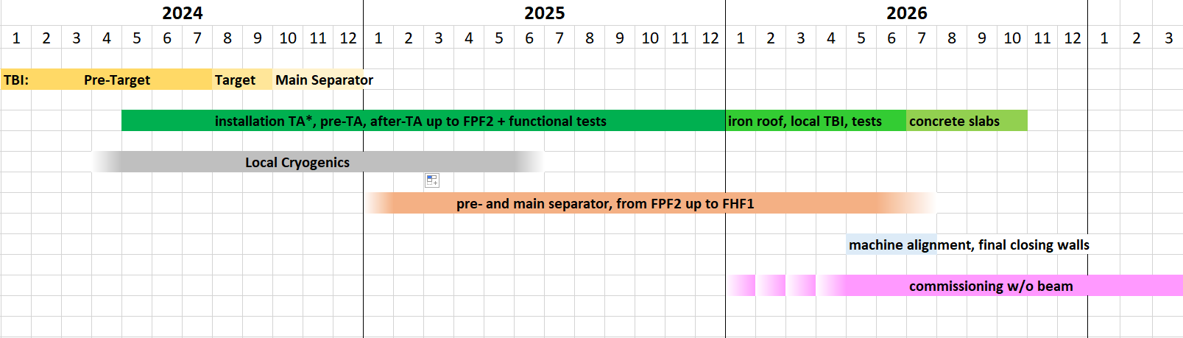
Overall installation schedule – entering 3 dense years after a lot of stride
May 2024
Dec 2025
Juni 2026
Oct 2026
Installation local cryogenics
Jan 2025 July 2026
Installation start 6.5.2024
BB
control system ready for test operations
cryo plant available
Many issues solved
But still some on the way !
* starts with lateral iron shielding

Slide 18
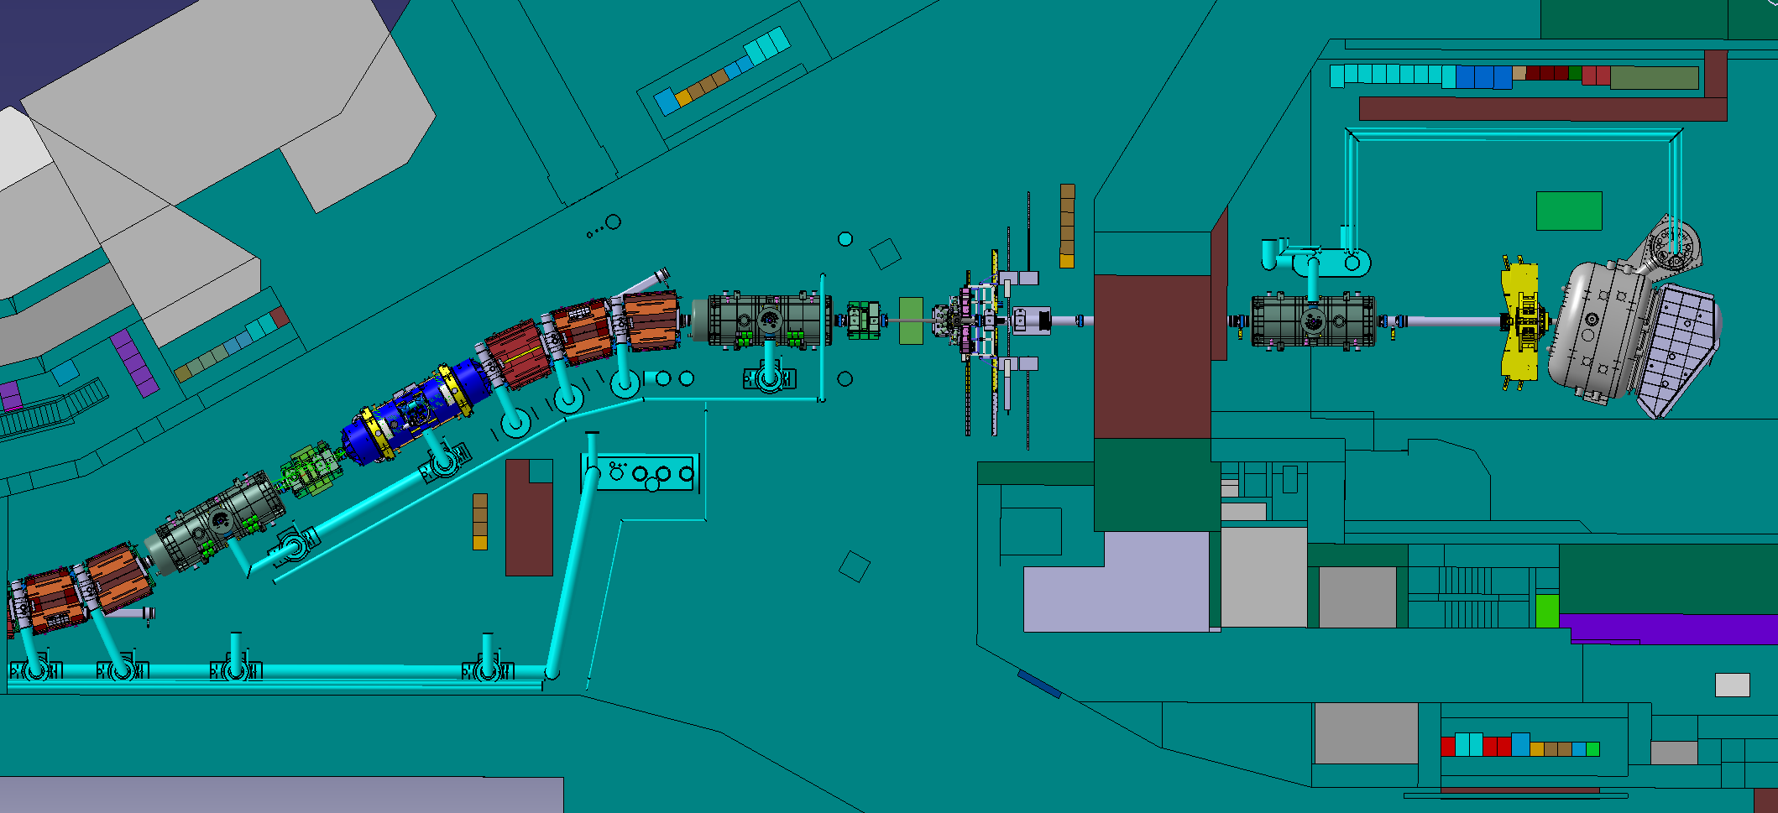
Prospects: First stage:
High energy branch R3B/GLAD (and setup @ FHF1)
HISPEC
DESPEC
Super-FRS Exp.
1st NUSTAR
→ R³B
15m
All NUSTAR Experiments possible
(some in start versions @ FHF1)
Exception: ring experiments &
MATS LASPEC @ Super-FRS

Slide 19
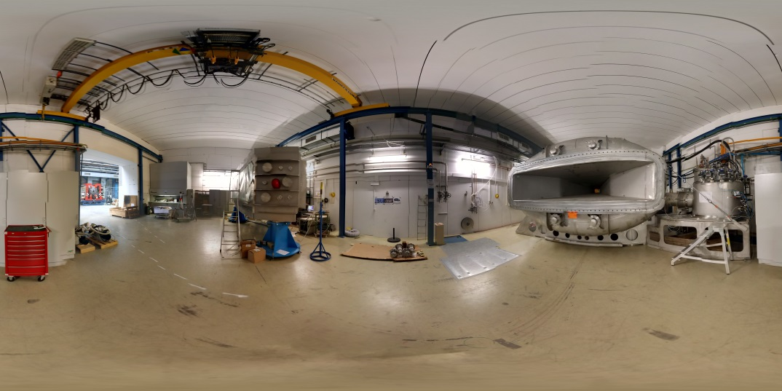
From R³B prototype to R³B precursor
Empty Cave with GLAD 2015/16

Slide 20
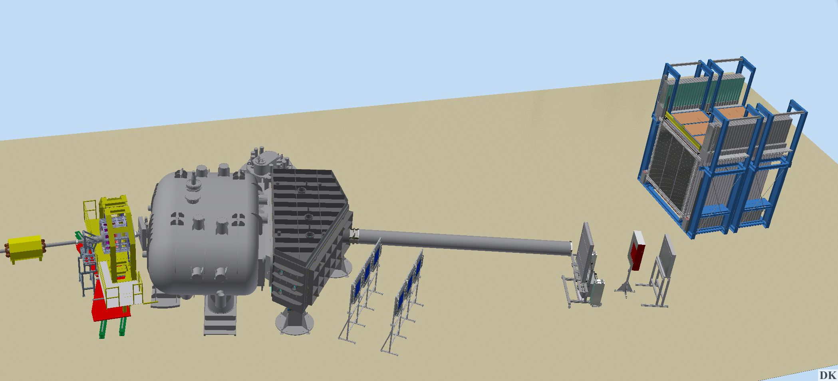
R³B setup ready
to move to FAIR in 2025/6
CALIFA (60-70%)
2528 detection units
CsI(Tl)-LAAPD
1.3 m³ and 2.5 tons
NeuLAND (50-60%)
250x250 cm²
3000 BC408 + 6000
PMTs ; 32 tons
Liquid - H₂ target
(100%)
Up to 15 m
2 m
3 m
ToF walls (100%)
Plastics walls 120x80 cm²
Plastics walls 84x60 cm² ⁽15 ps)
RPC system (protons)
TRT Si based
Technically challenging
still R&D ongoing based
e.g. ALPIDE pixel detectors
GLAD (100%)
Large aper. 80x100 cm
4,8 Tm ; 3,5 x7x4 m
50 tons first to move
Tracking detectors (100%)
Silicon/ Plastics
Fibers 80x80 cm², 500 mm MUSIC´s
MW´s 90x60 cm² , 200 mm
H.Simon - Halo Week '24
Notes:
20

Slide 21

R3B experiment
Reactions with Relativistic Radioactive Beams
NeuLAND
HI Beams @ 500– 1000 A MeV
neutrons
30 m
Heavy fragments
Tracking detectors
2 m
Target + Si-Tracker + CALIFA
Tracking detectors
protons
GLAD
Tracking detectors
beam from SIS18/FRS
© GSI/FAIR, Zeitrausch
Moving date to be decided – Beam time retreat 20240711-12
Notes:
21

Slide 22


Thanks
Super-FRS project group and
www.gsi.de/superfrs
www.gsi.de/r3b
www.r3b-nustar.de
collaboration

Slide 24




FAIR beams (with suitable intensities)
Up to 20Tm beam rigdity ➔ high energy coulomb excitation
GSI
FAIR
➔ high energy ~1 A GeV
(1998)
S. Bacca et al.
PRL 89 (2002) 052502
PRC 69 (2004) 057001
© ANL
@ 240 A MeV
Heavier systems !
clean separation
no charge states
Thesis:
C. Lehr – D17 (2022)
⁶He@185 A MeV
➔ RIKEN campaign
dσ/E_{fnn}
[mb/MeV]

Slide 25




FAIR beams (with suitable intensities)
Phil. Trans. R. Soc. Lond.
A356 (1998) 2063
Not only ¹¹Li but also
³_{Λ}H forms presumably a halo system !
➔ 1.57 A GeV threshold
A. Obertelli

Slide 26


Summary
Instrumentation suitable for halo and dripline physics constructed and commissioned within Phase-0 experiments of the R³B experiments, examples presented (Nikhil, Stefanos, …)
FAIR facility enables exclusively dedicated program especially suited for energetic intense secondary beams
in particular also for heavy nuclei (N=126)
Installation/(commissioning) schedule and scenario for NUSTAR experiments@FAIR presented
→ dedicated program during ramp up
"If you want to build a ship, don't drum up people to collect wood and don't assign them tasks and work, but rather teach them to long for the endless immensity of the sea."
- Antoine de Saint Exupéry

Slide 27





R³B in Cave C @ GSI ➔ preparing for FAIR
2015 - 2020
Lola Cortina

Slide 28






R³B in Cave C @ GSI ➔ preparing for FAIR
2020 - 2025
Lola Cortina

Slide 29





First ¹²C(p,2p) experiment @ 400AMeV
- „R³B prototype setup“
H. Simon – Halo Week ‘24

Slide 30




The ¹⁷Ne 2p halo quest (@500 AMeV)
¹⁵O core
excitations
CH₂ target !
Rather small
2s² - contribution 35(3) %
➔ Suppressed halo

Slide 31










⁷H ↓ and 4n →
Missing mass analysis
M. Duerr et al.
⁸He(p,pa)
@ 156 A MeV
K. Kisamori et al.
⁴He(⁸He; ⁸B)
@ 186 A MeV
PRL90(2003)082501
¹²C(⁸He,⁷⁻⁵H →³H + x)¹³N
15.4 A MeV
Direct study is
enabled by exclusive
measurements
PRL 99 (2007)
062502
PRL 116 (2016) 052501
p(⁸He,pp)⁷H
61.3 AMeV
4n@100keV
600 A MeV, 35m
>60% 4n recog.
²H(⁸He,³He )⁷H
42 A MeV
EPJA 32
(2007) 261
PRC81 (2010)
064606
➔ NeuLAND.

Slide 32



Neuland demonstrator @ RIKEN
NeuLAND demonstrator (40 cm depth with
4/30 double planes and 800 readout channels) at RIKEN 2014-2017, participation in various beam times
Several experiments performed and published
(e.g. M. Duerr et al., Nature 606 (2022) 678)
NEBULA
SAMURAI
NEULAND
4 double planes @ RIBF
March 2015

Slide 33




O-28 a first Landmark for fragment + 4n detection
Causallity cuts only 16% remaining background
ε(3n)=2% ε(4n)=0.4%
Very intense RIBF beams ➔ detection efficiency is key !

Slide 34






Novel Neutron Detector: NeuLAND
Fully active neutron detector based on
scintillators (calorimetry & tracking)
NIMA 1014 (2021) 165701
30 double planes
2 x 50 paddles each
5 x 5 x 250 cm³
RP408 / R8619ASSY
FPGA TDC readout
4n coincident
four-momentum detection
Split detector + causality cuts
could be added.
Previously < 50%
Previously <5% !
H.Simon - Halo Week '24

Slide 35





Steady State Thermal Simulation
Optimisation of Absorber Profile
Use Gaussian beam spot and 17 kW (1500 MeV/u ²³⁸U)
LS-DYNA
fresh SGL R6650
to copper heat sink
300 K
Apply radiation damage only
in inner regions of spot (c1..c3)
950 K
modified material
λ =15 W/m-K in center (c1-c3)
λ =15 W/m-K, shaped better
301 K
301 K
beam
2210 K
1504 K

Slide 36









Example for status of major components: sc multiplets in series production
FoS SM
FoS LM
Beam pipe
Apperture
400 mm
FoS SM
early science
(20 multiplets)
baseline
actual
ASG: 01/09/2021
First-of-Series Magnets readily prepared for tunnel installation
Weigth:
Several
10 tons

Slide 37


Replacement of ex-Russian in-kind components
Status and challenges
„closing all vacuum“ Q4
specs being rewritten
tender running
tender awarded
production completed
nc dipoles
nc dipoles
FoS sc dip. chambers
nc dip. chambers
nc dip. chambers
series sc dip. chambers Q3
nc dip. wires
nc dip. wires
nc dip. supports
nc dip. supports
sc branch dip. chambers
FoS diagnostic cambers
series diagn. chamb. Q2
early science
some detectors
(now in-house)
local cryogenics
branch box
LC branch B transfer lines
new PolishIK
LC warm gas pipes Q4
ex RU in-kind
All components on track to be ready for early science

Slide 38





... with direct applications
High-performance and scientific computing, big data, green IT, AI (host of Hessian AI)
Space radiation protection, unique facility for simulation, collaboration with ESA
100 %
Tumor
Schädigung
harte Röntgenstrahlung
Ionen-strahl
50 %
0 %
2
6
10
14
18
Eindringtiefe [cm]
Development of a high precision nuclear clock: Promising candidate thorium-229
Innovation in
Cancer Treatement
38

Slide 39

FAIR in construction
First Runs expected 2026/27

Slide 40

A new vertex tracker for R³B assembled for FAIR Phase-0 2022
Si microstrip vertex tracker assembled for 2022
FAIR Phase-0 beam time

Slide 41

Si vertex detector developments
Measurements at
FZ Jülich
ALPIDE pixel detector station (area 100 cm², position resolution 5 µm, rate up to 100 kHz)
Developed for MIPs, possibility to measure heavy ions is proved
Holding/mounting frame is developed, production started
Cooling carbon-fiber plate is developed and produced at CERN
Beam tests:
CERN, relativistic muons
FZ Jülich, deuterons @300 MeV, 800 MeV
and 1 GeV
Investigation of efficiency,
maximum trigger / data rate,
PID (via cluster size),
synchronous readout
of many detectors
MOSAIC FPGA readout boards
Cluster size and hit occupancy
measurements at Jülich
Courtesy: W. Korten
Notes:
Recent results from tests at CERN and Jülich

Slide 42
From precursor to (almost) final
2018-2019
2020-2022
20 % detector setup
Stable beams
60-70 % detector setup
Fragmentation beams@ cave C
Fission beams @ cave C
Notes:
42

Slide 43


History of RIBF commissioning
TOF
Dec. 28th , 2006
First Beam ²⁷Al¹⁰⁺ 345 MeV/u at RIBF-SRC
March, 2007
12th ⁸⁶Kr³¹⁺ beam at 345 MeV/u several pnA.
13th First production of RI beams with ⁸⁶Kr beam
23rd First successful acceleration of ²³⁸U⁸⁶⁺
beam at 345 MeV/u and 0.002 pnA
27th First production of RI beams with ²³⁸U beam
May-June, 2007 (without ZDS)
with ²³⁸U beam at 345 MeV/u and 0.02 pnA max
May 16th-23th BigRIPS commissioning experiment
May 24th – June 3rd Search for new isotopes
End of June(a few days) detector testing
Nov. 2007 acceleration test with ⁸⁶Kr beams, 30 pnA
ΔE
Break at the facility !
ΔE
(~1x10⁸ pps)
T. Kubo RIKEN / Separator Expert Meeting

Slide 44



Z
Searching for new isotopes
May 2007
Bρ: 7.438 Tm
Total dose: 3.6×10¹²
Total time: 25.4 hour
Z=46
¹²⁵Pd
A/Q
Z
A/Q
T. Kubo RIKEN

Slide 45


R³B experiments in 2018/19
Modular and versatile experimental setup with unprecedented efficiency, acceptance, and resolution for kinematical complete measurements of reactions with high-energy radioactive beams ➔ first experiments
2017
GLAD Installation
HTD detector commiss.
2016 GLAD @ GSI
Cave refurbishment
2015
Cave C empty
2018/19
GLAD + Big chamber
CALIFA and NeuLAND
Demonstrator
2017-2018
Stable beams
S444 Main detection system commissioning
S454 Studying the astrophysical reaction rate of C(alpha,gamma)
S473 Constraining energy‐density functionals and the
density‐dependence of the symmetry energy (i)
Notes:
45

Slide 46







R³B experiments in 2020/21
2020
CALIFA Barrel (P-39, Han-Bum Rhee)
NeuLAND 8 DP
SOFIA tracking detectors
R3BMusic
2021
+ LH2 +
CALIFA iPHOS
NeuLAND 12 DP
2022
+ Proton arm
behind GLAD
& LH₂ target
preparation
New Fiber
Detectors
S444 Detection system commissioning
S467 Single‐particle structure of neutron‐rich Ca isotopes
S455 Fission studies @R3B - → talk by Jose Luis Rodríguez-Sánchez
S515 Constraining energy‐density functionals
and the density‐dependence of the symmetry energy (ii)
S494 Coulomb dissociation of ​¹⁶​O into ​^{12​}C and ​^{4​}He.
Notes:
46

Slide 47




R³B experiments in 2022
S522 First characterization of
Short-Range Correlations in exotic
nuclei at R³B (¹⁶C)
S509 Study of multi-neutron
configurations in atomic nuclei
& Dedicated field mapping
for precision tracking
Ended few weeks ago!
AIR
VACUUM
R3B
Music
LH2
FOOT x4
GLAD
Neuland
ROLU
FOOT x 2
FOOT
FIB
x, y
FIB
LOSS
FOOT x4
TOFD
MW
MW
CALIFA
RPC
LH2 + FOOT + CALIFA + NeuLAND (13 DP) + Fiber tracking + Proton arm
behind GLAD
S522
14°
S494
Cocotier LH2 target FOOT Si-trackers
CALIFA calorimeter
GLAD
RPC & FIBER
TOFD
Notes:
For 2022 there are several important additions in preparation, most notably the FOOT Si detector array, which is an intermediate solution but increasing the efficiency for two-proton detection in (p,2p) reactions to 20-30% running at rates up to 10kHz.

Slide 48

GSI FRS → FAIR Super-FRS
(key parameters and enhancement)
Super-FRS
FRS
1000 7500

Slide 49


GSI and FAIR – The Facility
GSI, existing (upgraded to integrate with FAIR)
UNILAC
SIS 100
SIS18
HITRAP
FRS
FAIR,
under construction
ESR
100 m
HESR
CRYRING
FAIR-Phase 0 –
Start in 2018!
Super FRS
CR
FAIR key features
intensity for wide range of ions
storage rings
antiproton beams
ESR, CRYRING, & HITRAP are part of the FAIR MSV
49

Slide 50


𝛬 hypernuclei @ R3B
Study of Hyperhalos, determination of binding energies and lifetimes
Program at R3B based on a new high-resolution pion tracker (TPC) , HYDRA, inside GLAD
➔ Halo properties can be probed

Slide 51









Target area: remote handling in highly radioactive environment
Shielded Flask for transport
to hot cell for maintenance
Automatic media board disconnection
Customized
environment
for handling of
activated
materials
Robot tools
Remote Handling of beamline inserts
(X and Y slits) using industrial robots

Slide 52



Main components for early science aiming for Q4/2026
production target
iron shielding
sc short multiplets
sc long multiplets
power converters
nc dipoles
sc dipoles
beam catchers
nc multipoles
early science
HISPEC DESPEC
Super-FRS Exp.
focal plane chambers
+
detectors
local cryogenics
early science at R3B
power converters
Reduced scope, in line with building infrastructure
Major components in production

Slide 53

Example:
R³B at the High energy Branch of the Super-FRS
From Past experiments (FRS + ALADiN-LAND setup)
to future (Super-FRS – R³B setup)
Evolutionary steps towards R³B setup
Why do we need FAIR beams
(SIS-100 & Super-FRS)
Status of the new facility
R³B collaboration meeting
June 2022

