Slide 1
S522 Status Report : part 1
July 10th, 2024
Manuel Xarepe for the s522 analysis Group

Slide 2
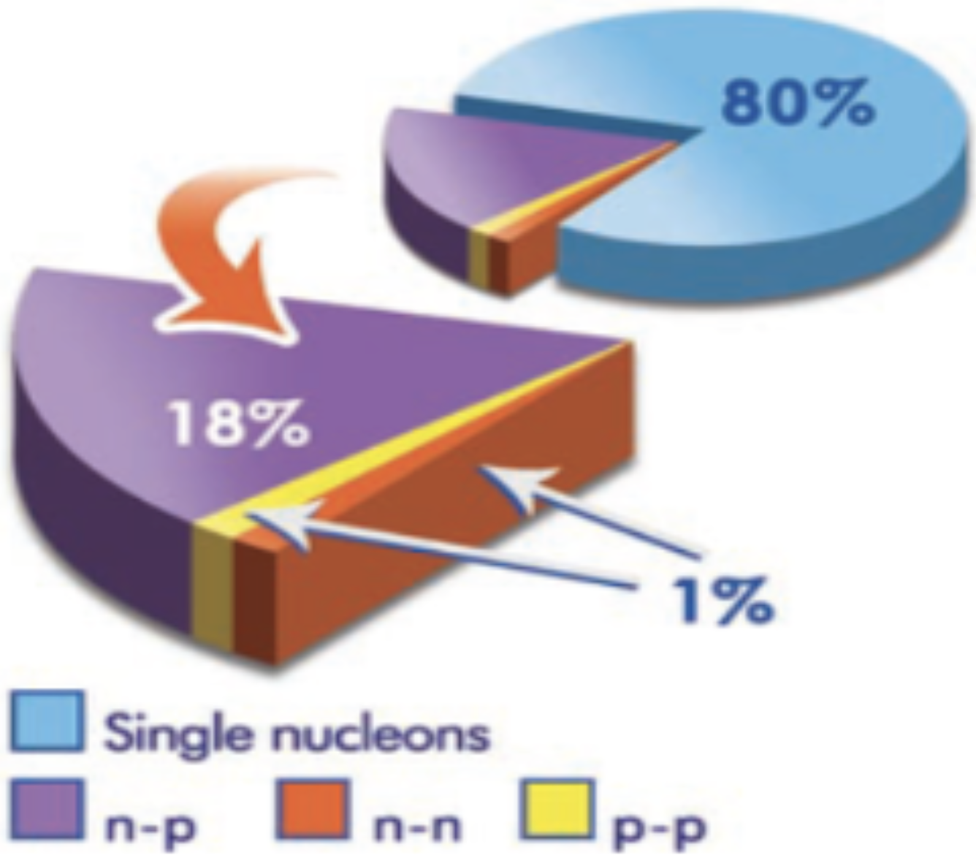
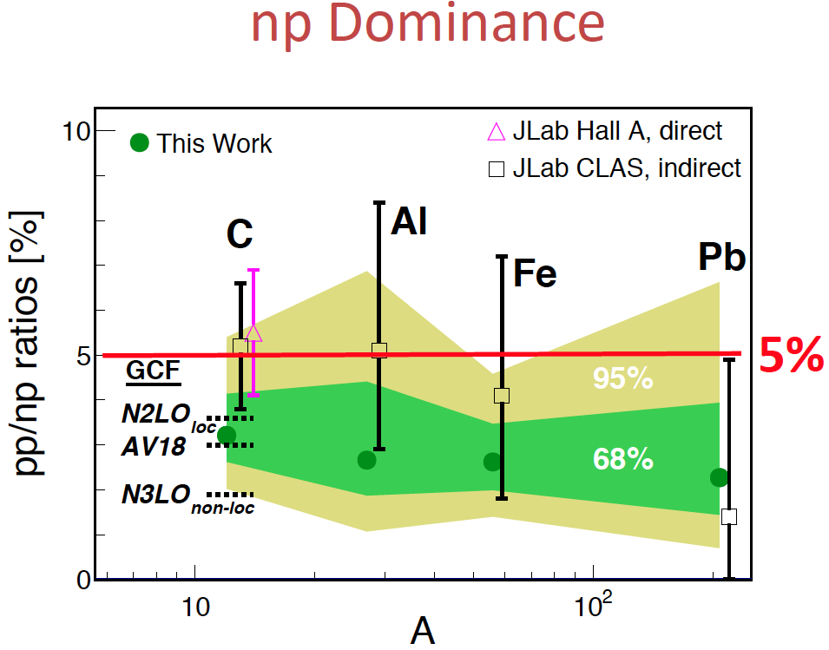
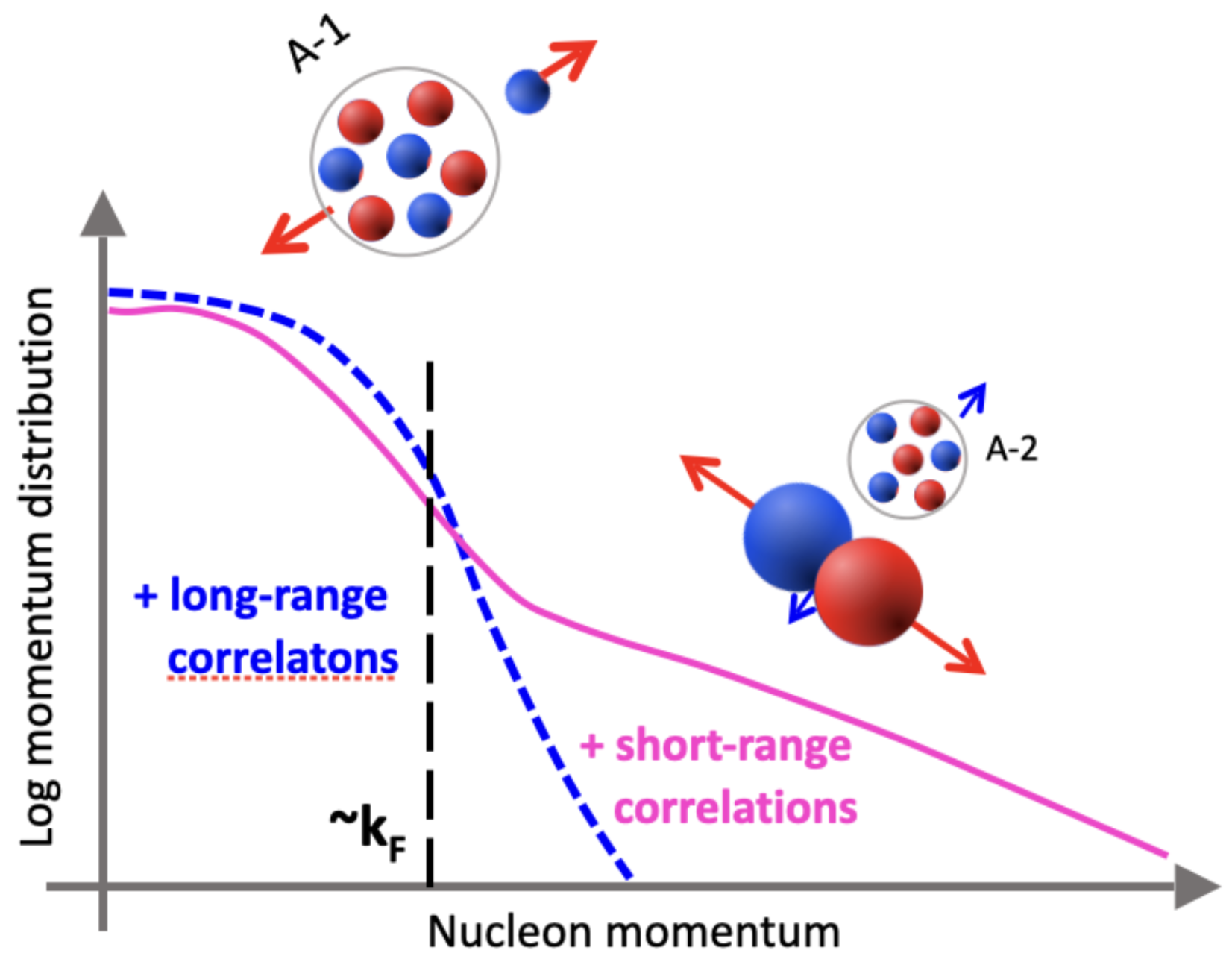
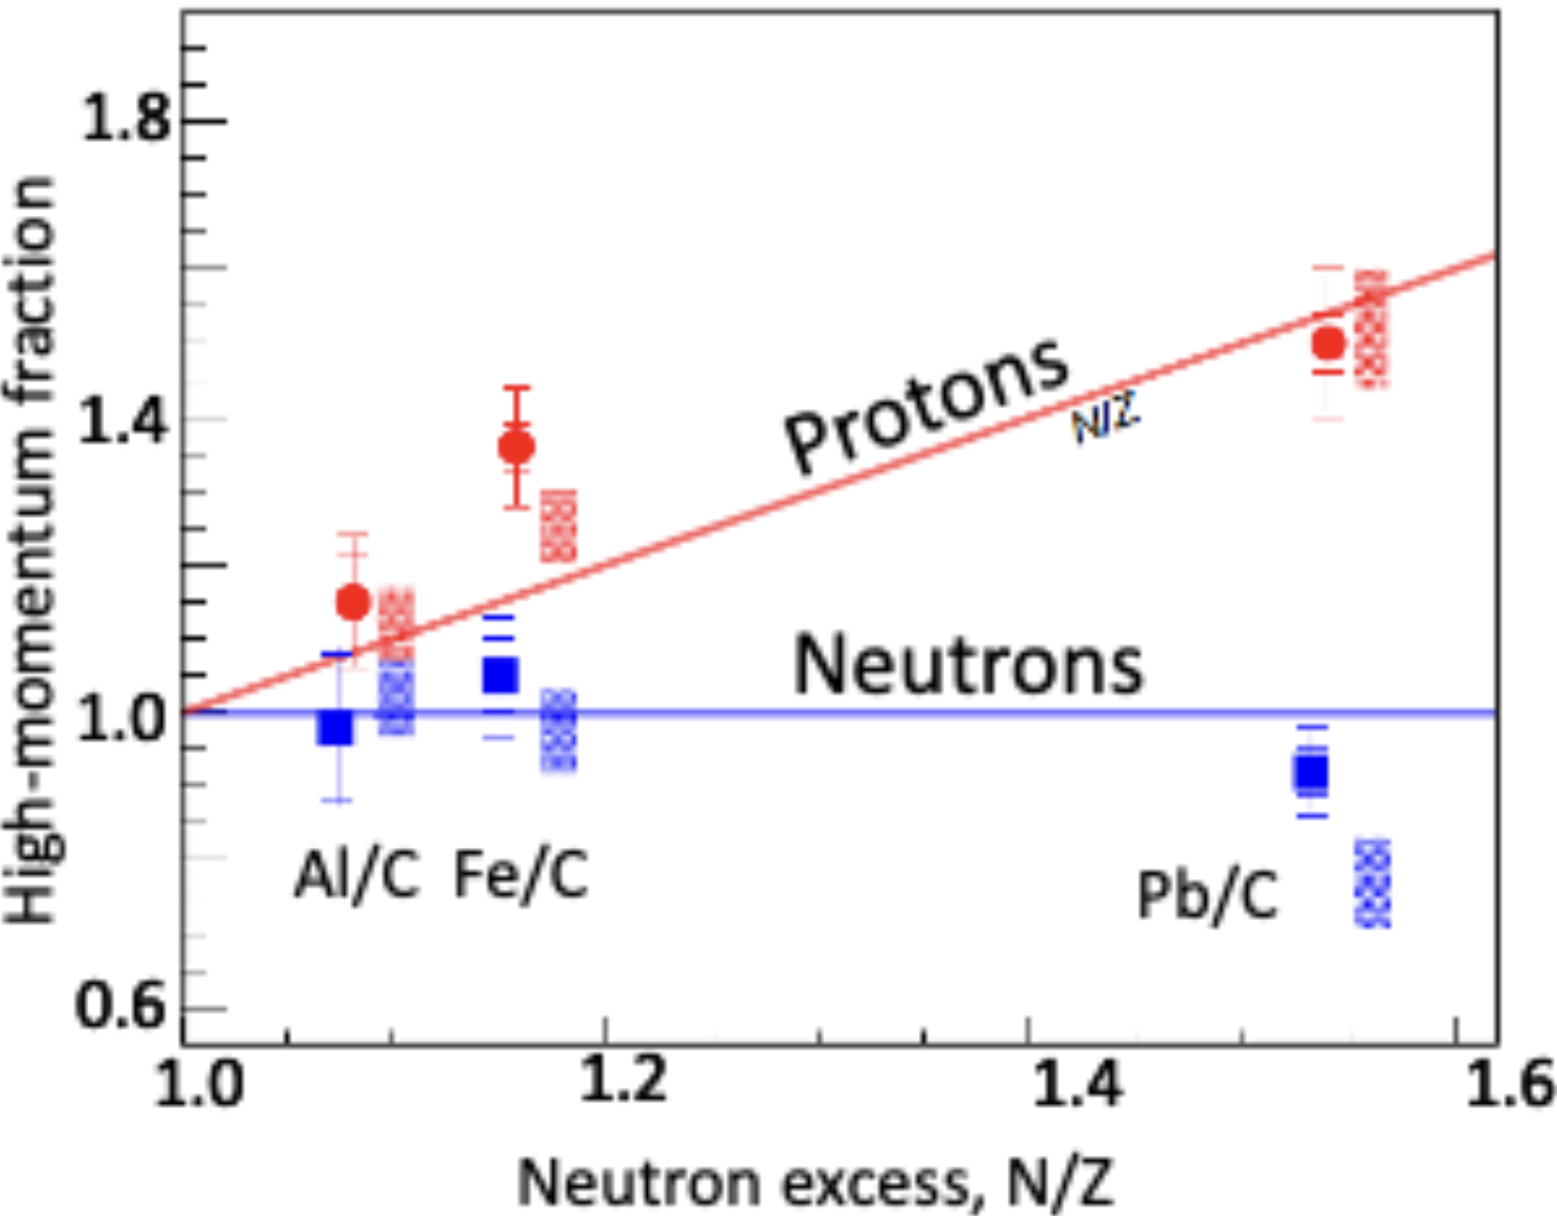
SRC introduction
High relative momentum and low centre of mass (c.m.) momentum pairs;
mainly proton-neutron (pn) pairs;
pp/pn ratio does not change with A;
The fraction of high momentum protons increases with N/Z.
R.Subedi,Science,Vol 320, (2008)
O. Hen et al. (CLAS Collaboration), Science, 346 (6209):614, 2014.
Duer, PRL (2019); Duer, Nature (2018); Hen, Science (2014); Korover, PRL (2014); Subedi, Science
(2008); Shneor, PRL (2007); Piasetzky, PRL (2006); Tang, PRL (2003);
M. Duer et al. (CLAS Collaboration), Nature, 560:617, 2018.

Slide 3
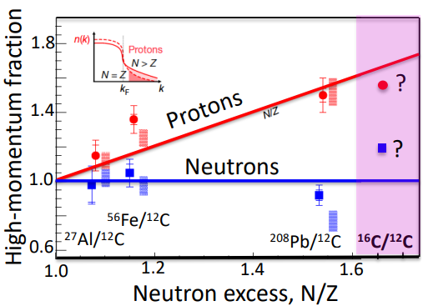
Motivation and goals
Understand SRC interaction and NN pairs in n-rich environment
Existing trend based on a few points;
mass and N/Z excess cannot be disentangled with stable nuclei.
Necessary to measure in Inverse kinematics
New measurement at N/Z = 1.67, above the largest available N/Z and at a much smaller mass.
?
Adapted from M. Duer et al. (CLAS Collaboration), Nature, 560:617, 2018.

Slide 4
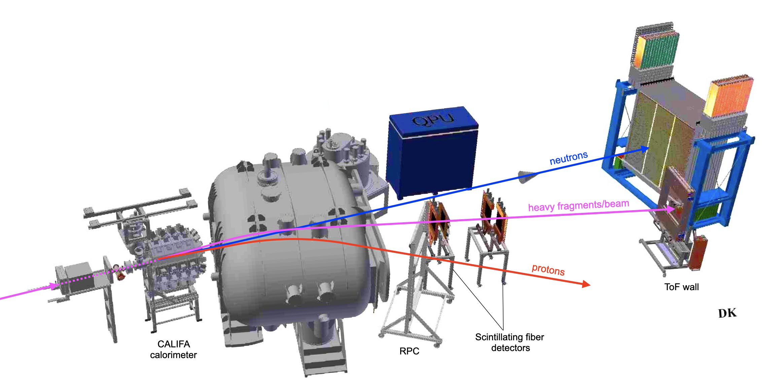
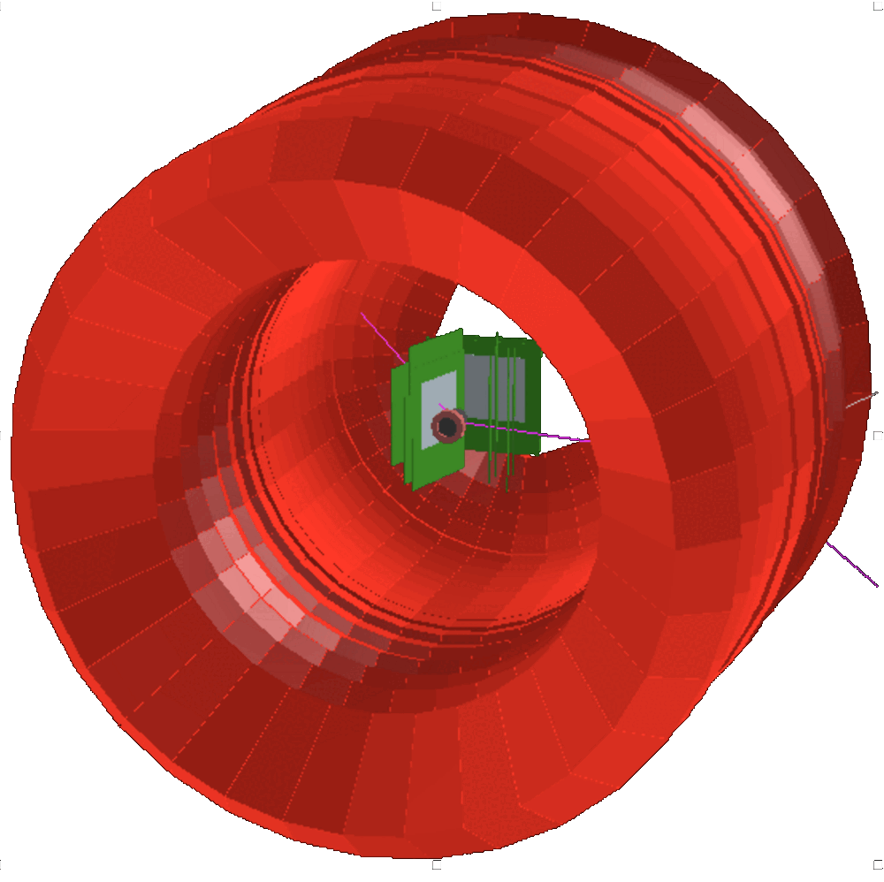
Experimental setup
^{16,12}C (p,p2pN) A-2
Beam @ 1.25 GeV/u and 10⁵ pps
n SRC partner
n SRC partner
LiH
(CEA Saclay)
LiH
(CEA Saclay)
p SRC partner
p SRC partner

Slide 5
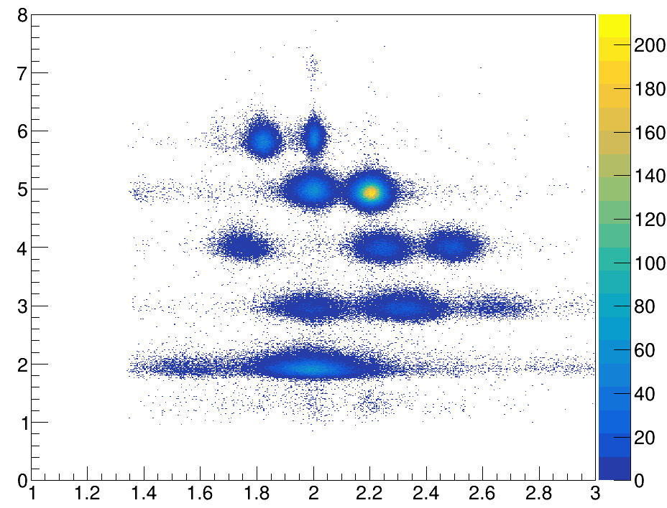
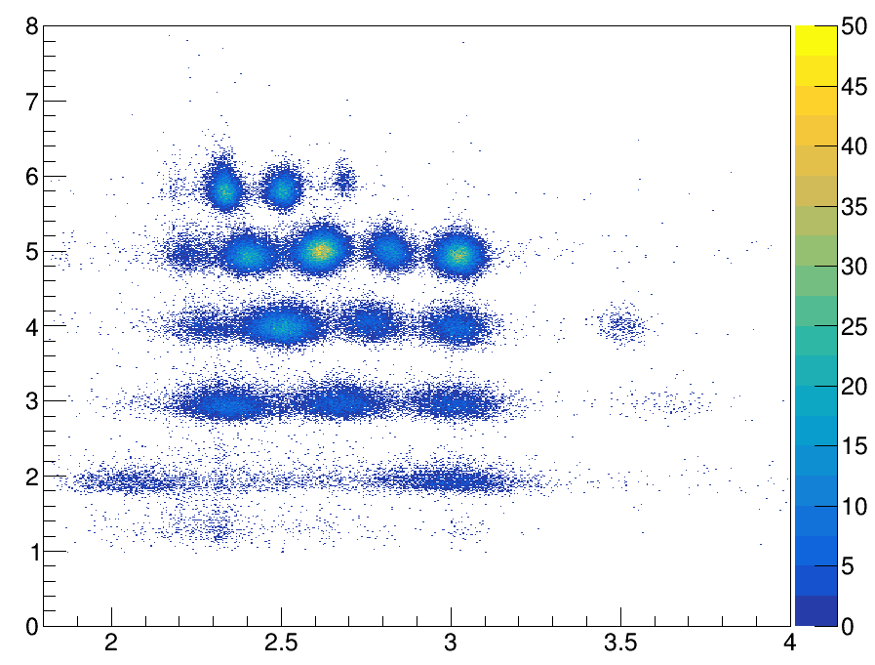
PID plots (with p2p condition)
Z
¹²C
¹⁶C
Z
¹⁰B
¹¹B
¹⁴B
¹⁵B
¹⁰Be
¹⁴Be
56% lost due to acceptance
A/Z
A/Z

Slide 6
Where we left off
Outlook from last meeting:
Open technical issues:
Vertex efficiency;
FOOT multiplicity;
CALIFA punch-through ID and energy reconstruction.
Next:
QE in 16C setting;
SRC ID.
FOOTs are not used anymore

Slide 7
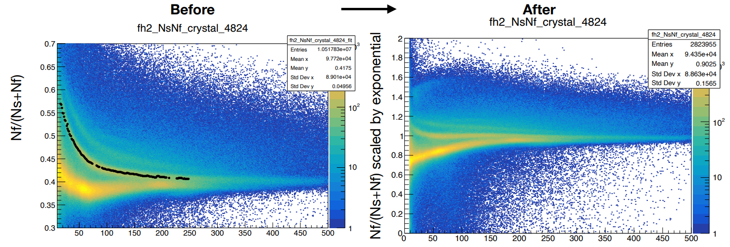
CALIFA punch-through ID
Stopped proton
Stopped proton
γ, punch-through proton
γ, punch-through proton
Ns+Nf [MeV]
Ns+Nf [MeV]
Ns+Nf [MeV]
Ns+Nf [MeV]

Slide 8
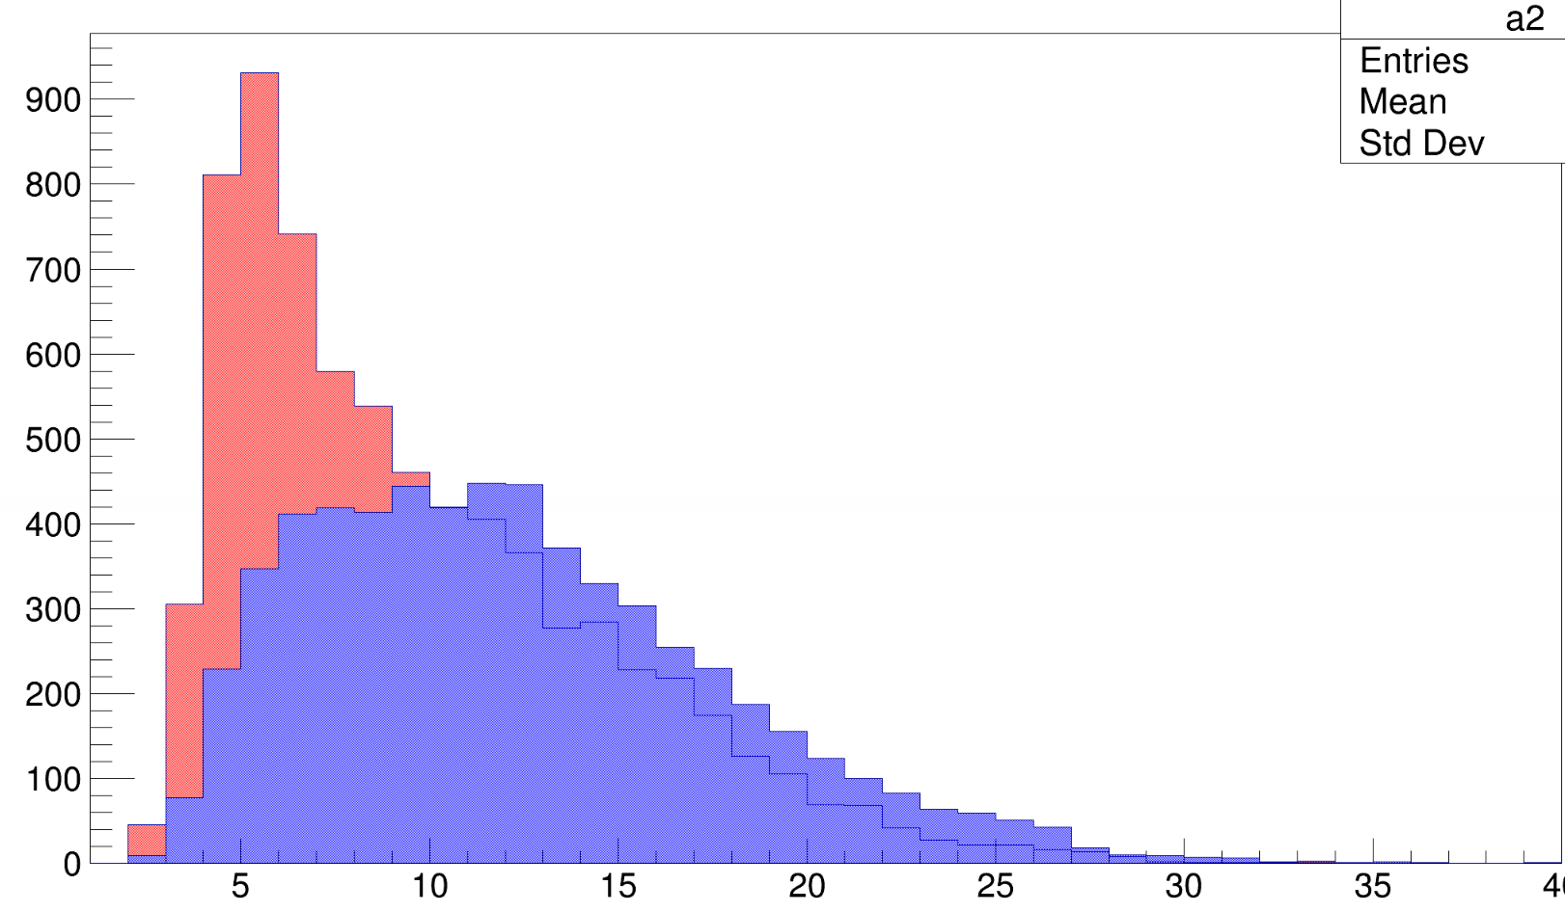
Improve p2p cut in Califa
High t and u -> high momentum transfer
t = (ptg - p1)^2 and u = (ptg - p2)^2
Cluster size
Foots are not used
Aiming at improving p2p selection1
11B
11C
cl_size 1 + cl_size2

Slide 9
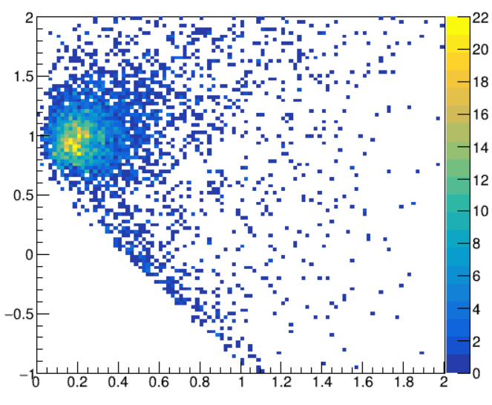
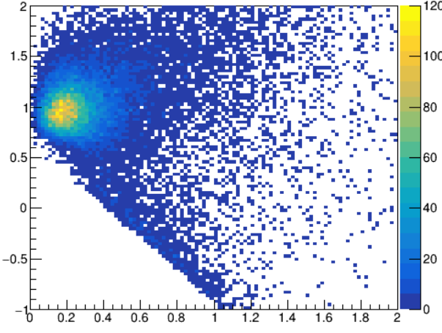
QE event identification with t and u cut
¹²C(p,2p) ¹¹B
¹⁶C(p,2p) ¹⁵B
Mmiss² [GeV²/c⁴]
Mmiss² [GeV²/c⁴]
QE
QE
QE
QE
IE
IE
IE
IE
p_{miss} [GeV/c]
p_{miss} [GeV/c]

Slide 10
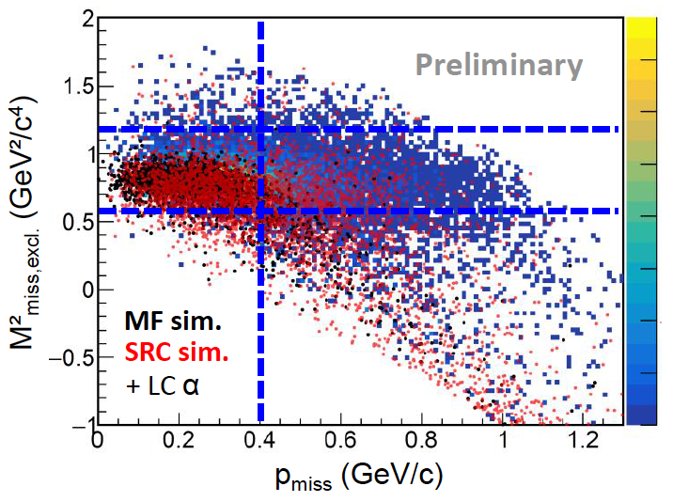
SRC selection
High mandelstam t and u
abs() > 0.8 GeV²/c⁴
Cluster size < 5
Only 2 clusters
Frag multiplicity 1
p_{miss} > 0.4 GeV/c
M²_{miss} and E_{miss} cuts guided by simulation
Light Cone variable also guided by simulation

Slide 11
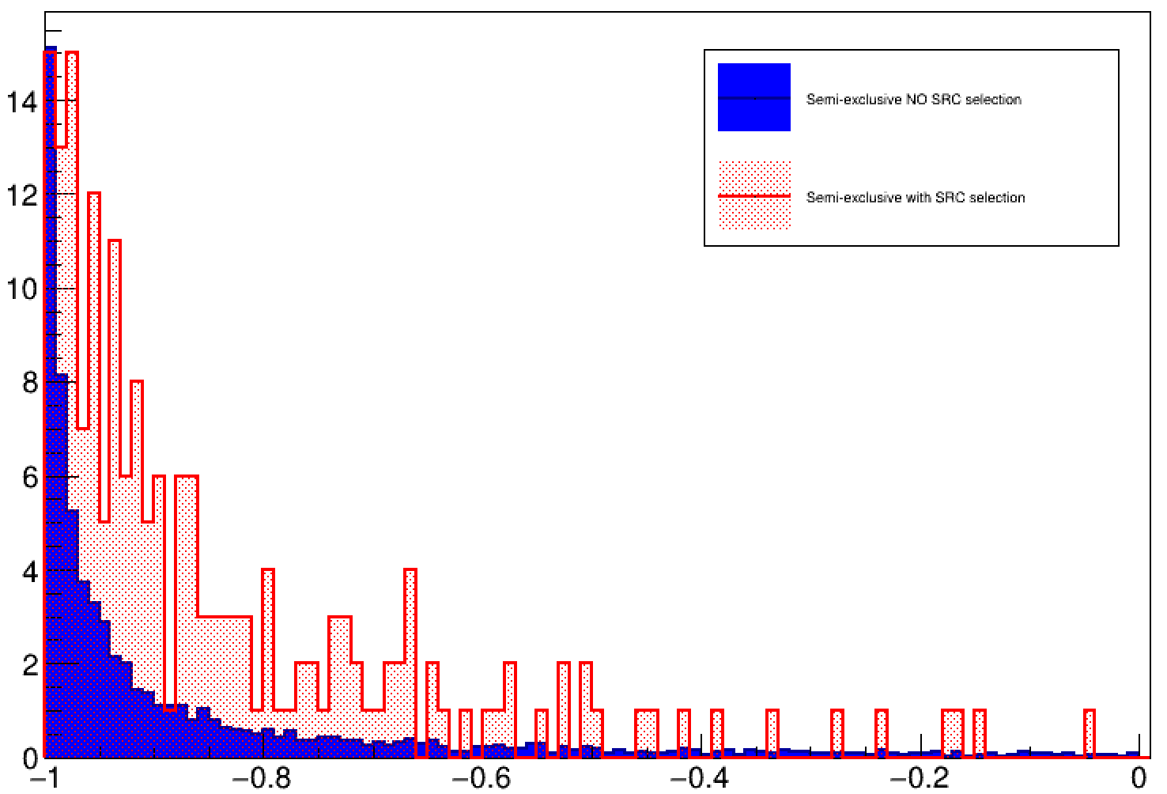
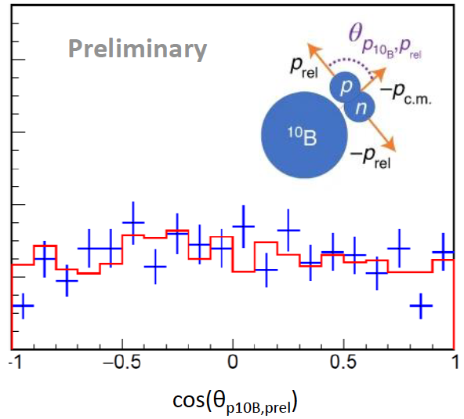
Indications of SRC ?
Patsyuk, M., et al. "Unperturbed inverse kinematics nucleon knockout measurements with a carbon beam." Nature Physics 17.6 (2021): 693-699
Semi exclusive
p_{n} = pbeam - pmiss - pfrag
cos(Ө(p_{n},p_{miss}))

Slide 12
Fully exclusive

Slide 13
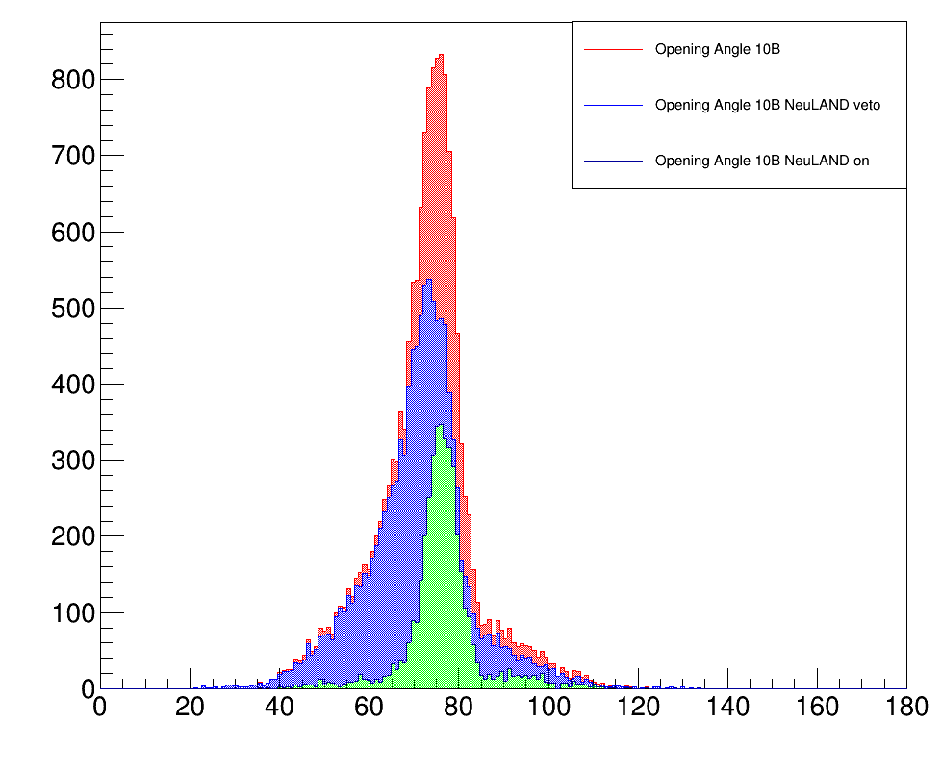
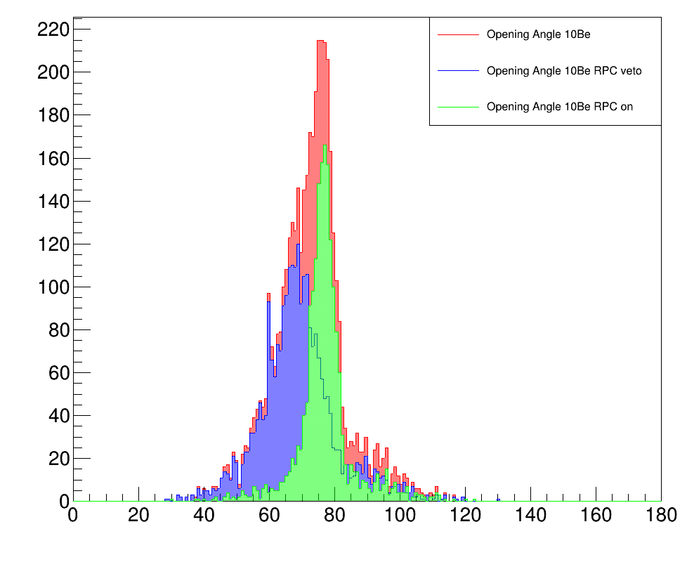
Opening angle (semi excl. vs fully excl.)
¹²C(p,2p)¹⁰B + n
¹²C(p,2p)¹⁰Be + p
Opening angle [º]
Opening angle [º]

Slide 14
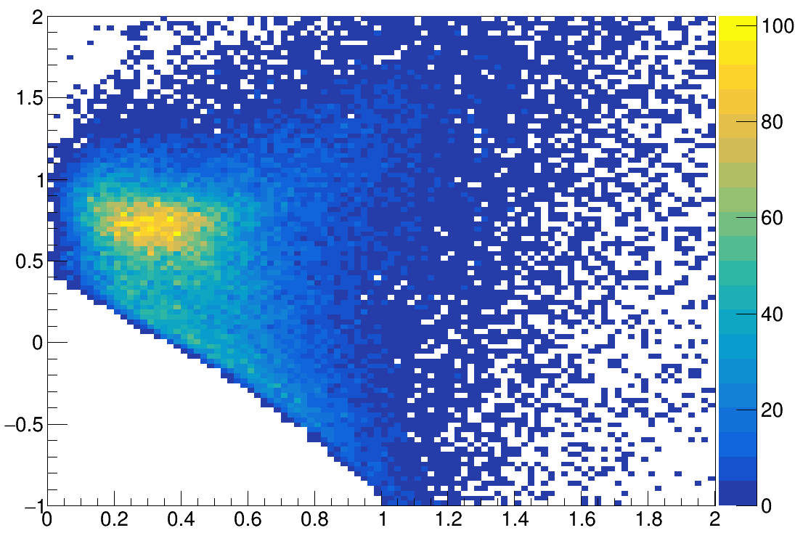
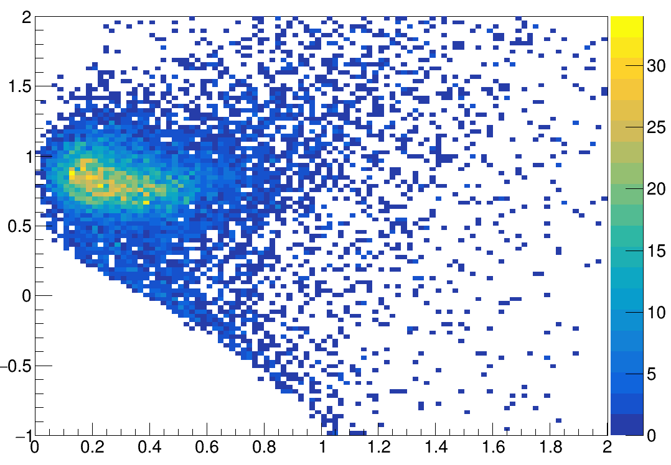
QE identification ¹⁰B (semi excl. vs excl)
¹²C(p,2p)¹⁰B
¹²C(p,2p)¹⁰B + n
M_{miss}² [GeV²/c⁴]
M_{miss}² [GeV²/c⁴]
QE
IE
p_{miss} [GeV/c]
p_{miss} [GeV/c]

Slide 15
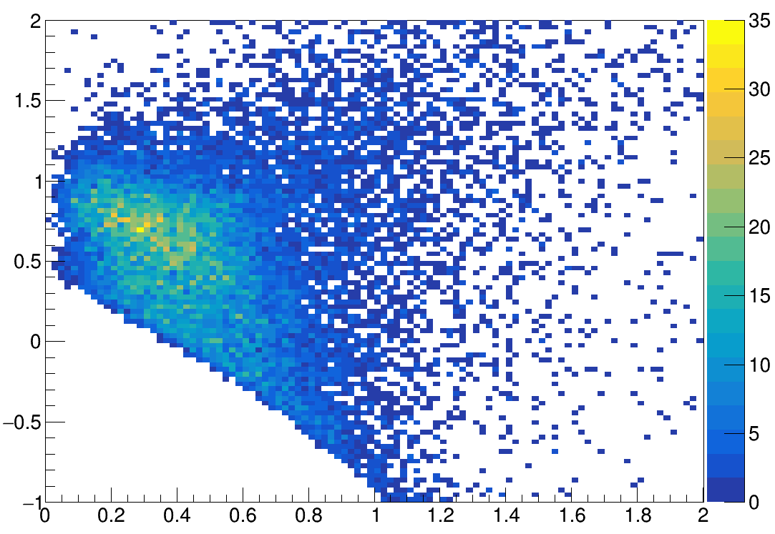
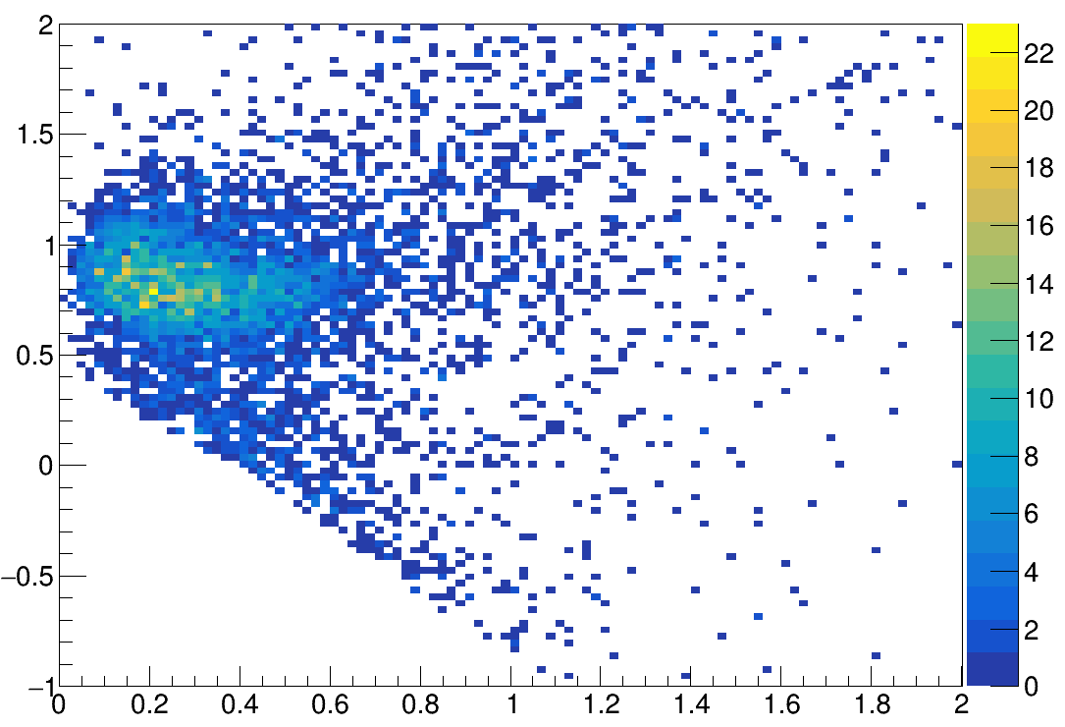
QE identification ¹⁰Be (semi excl. vs excl)
¹²C(p,2p)¹⁰Be
¹²C(p,2p)¹⁰Be + p
M_{miss}² [GeV²/c⁴]
M_{miss}² [GeV²/c⁴]
QE
IE
p_{miss} [GeV/c]
p_{miss} [GeV/c]

Slide 16
Fully exclusive measurement of SRC
Pros:
Complete Kinematics
Cleaner reactions
Accurate measurement
Cons:
Very low statistics
Detector efficiencies and acceptance are not the same for pp and pn pairs
SRC events mainly outside detector acceptance

Slide 17
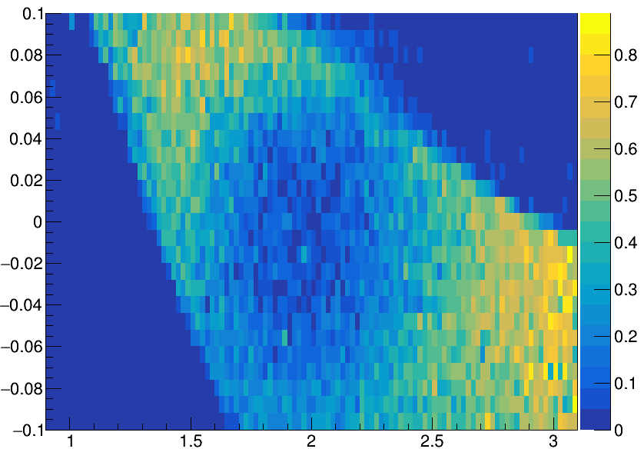
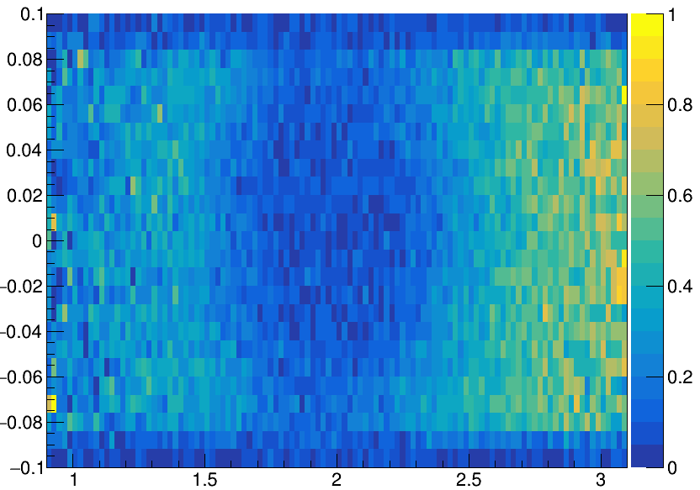
Acceptance for SRC
RPC acceptance
NeuLAND acceptance
TX
TX
P [GeV/c]
P [GeV/c]

Slide 18
Fully exclusive measurement of SRC
Pros:
Complete Kinematics
Cleaner reactions
Accurate measurement
Cons:
Very low statistics
Detector efficiencies and acceptance are not the same for pp and pn pairs
SRC events mainly outside detector acceptance -> Veto?

Slide 19
Summary and Outlook
Summary
A preliminary set of cuts aiming at reducing FSI and seeing SRC as been found for semi-exclusive ¹²C (under investigation for ¹⁶C)
The jump to fully exclusive shows improvements for the reaction selection, but with a severe drop in statistics.
Next:
pn/pp ratio estimation for ¹²C and ¹⁶C
Attempt fully exclusive even with the lack in statistics
Understand better why the back to back signature is always present
Investigate how ratios evolve when Detector veto are used
Understand the effect of acceptance and efficiency in this ratios

Slide 20
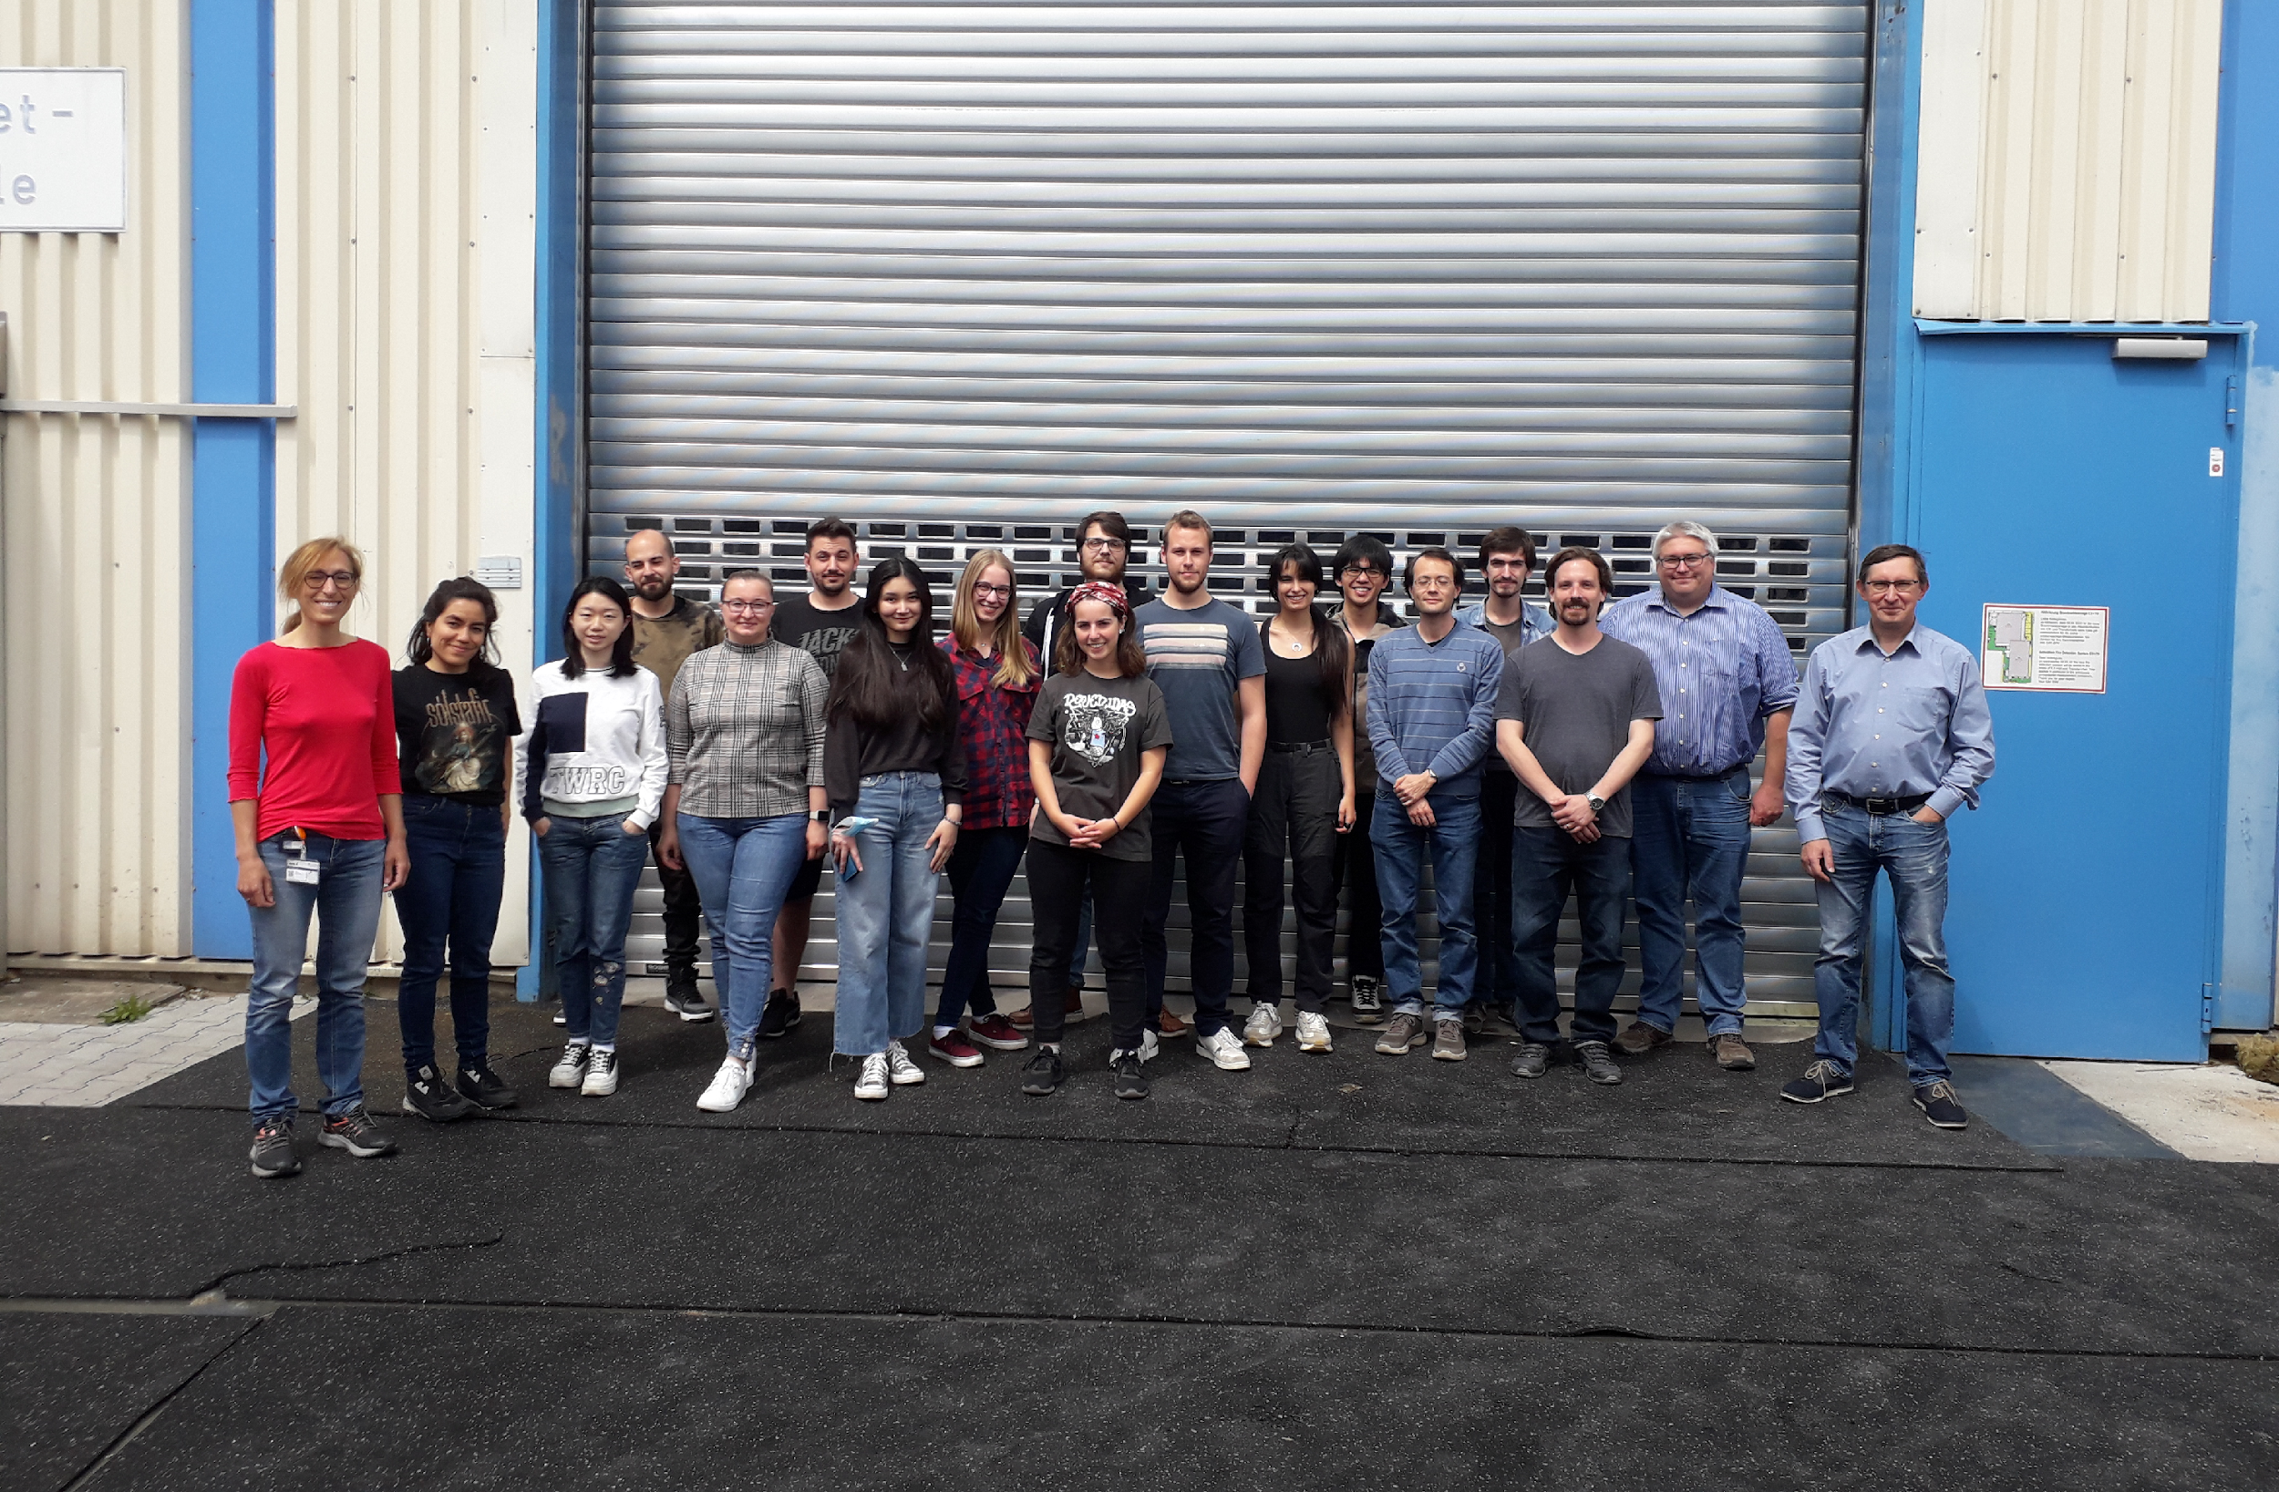
Thank you for your attention!

Slide 21
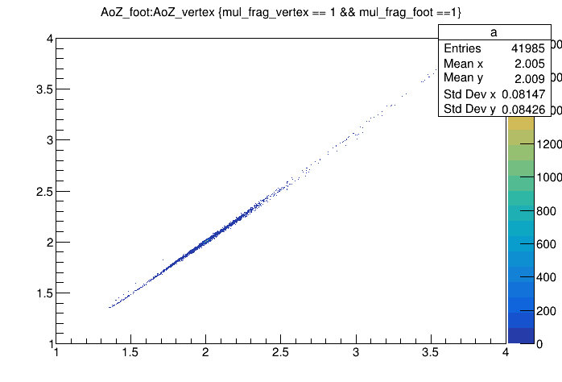
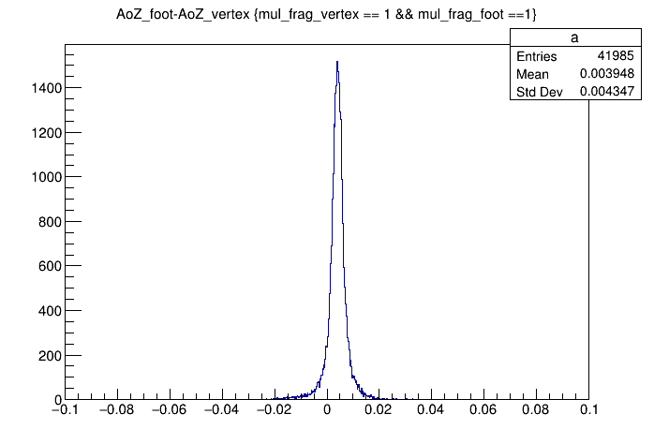
Tracking with foot or tracking with mwpc

Slide 22
Fragment ratios
For mwpc tracking
11B/11C | 1,819 | 0,004
11B/10B | 1,850 | 0,004
11B/10Be | 7,26 | 0,03
11B/9Be | 5,05 | 0,02
10B/10Be | 3,92 | 0,02
10Be/9Be | 0,696 | 0,003
For mwpc tracking with foot on
11B/11C | 1,199 | 0,007
11B/10B | 2,03 | 0,02
11B/10Be | 35 | 1
11B/9Be | 23,5 | 0,5
10B/10Be | 17,5 | 0,5
10Be/9Be | 0,66 | 0,02

Slide 23
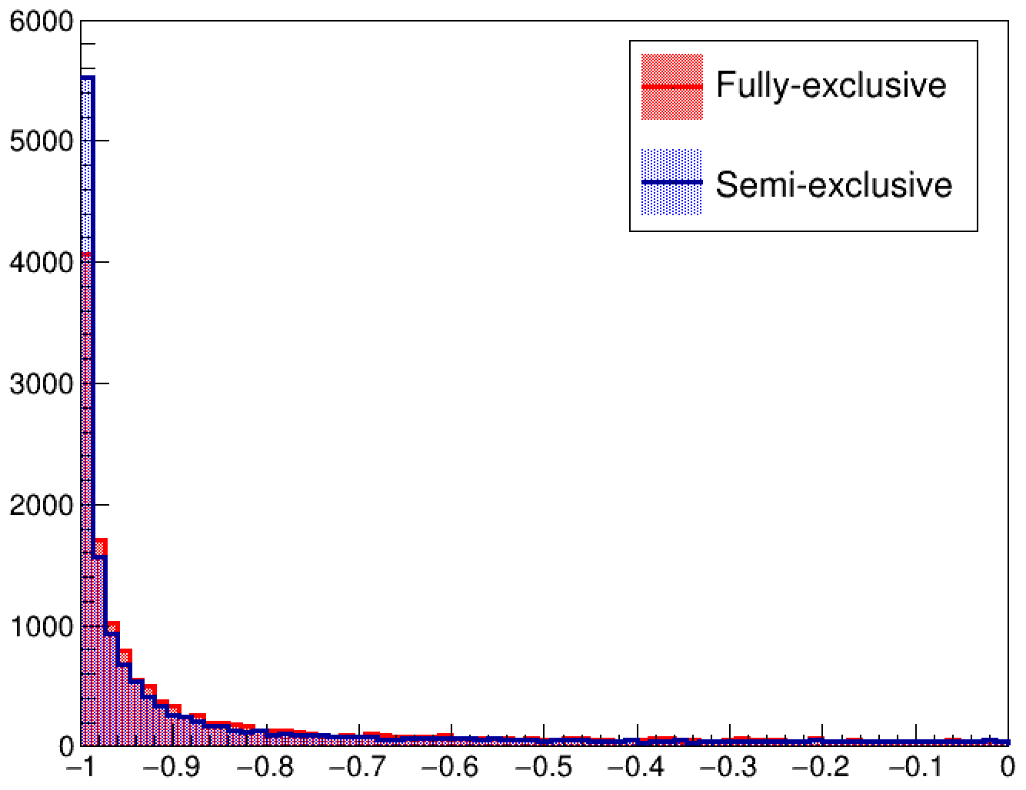
INCL opening angle
Semi-exclusive
pn = pbeam - pmiss - pfrag
Fully-exclusive
reconstructed using NeuLAND
Directly from INCL generator
Perfect resolution;
In INCL no SRC
(IE+Evaporation+rescattering)
Both angle peaked at -1;
cos(Ө(p_{n},p_{miss}))

Slide 24
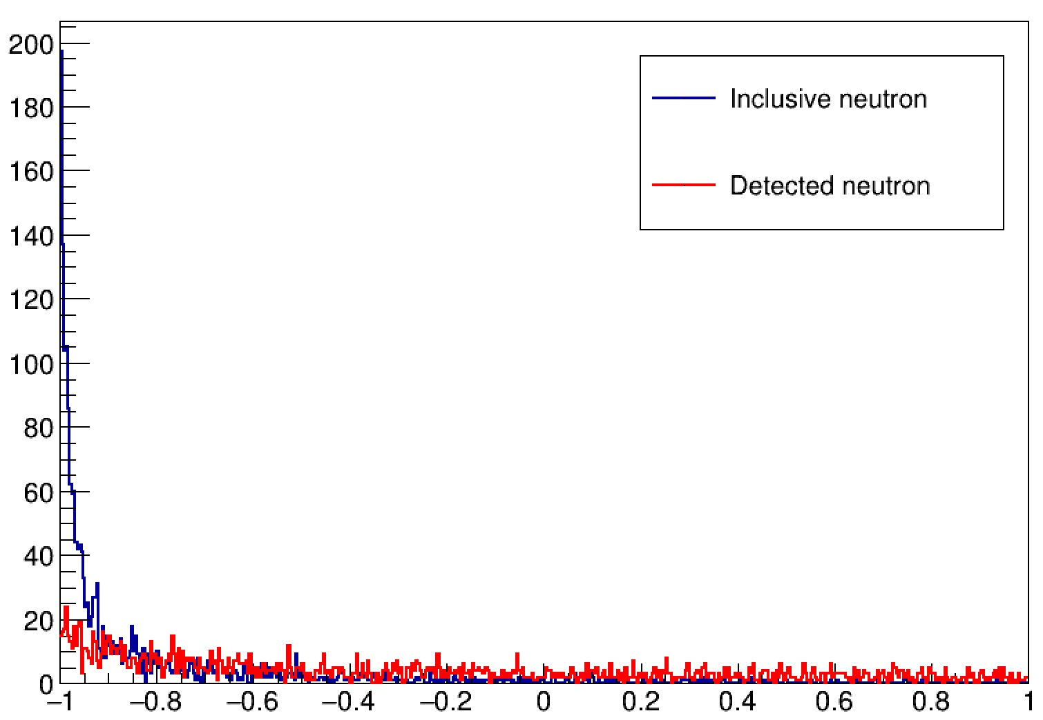
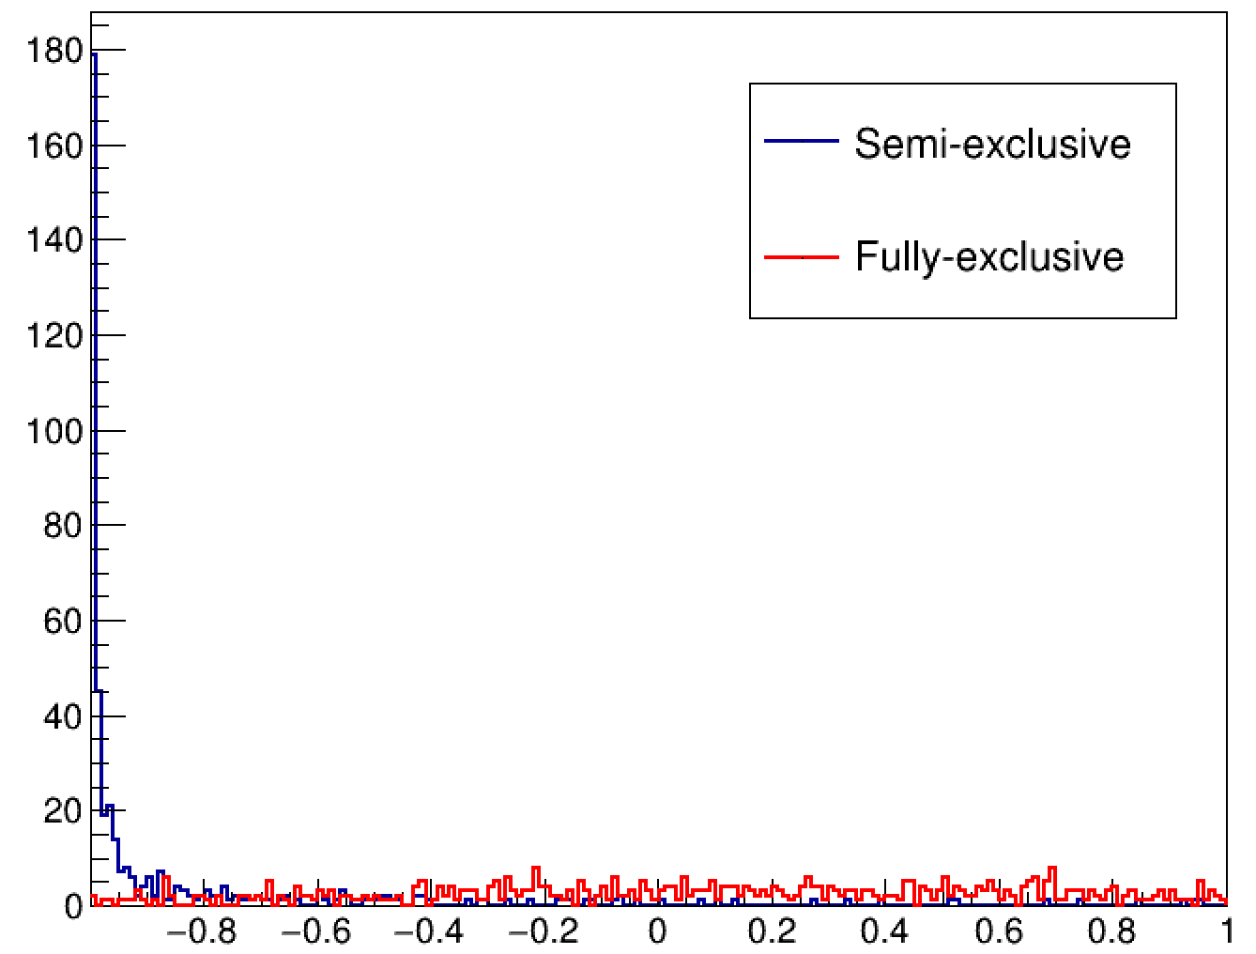
Back to Back in Fully exclusive measurement
cos(Ө(p_{n},p_{miss}))
cos(Ө(p_{n},p_{miss}))
¹²C(p,2p)¹⁰B + n (data)
¹²C(p,2p)¹⁰B + n (INCL simulation)
CALIFA coverage

Slide 25
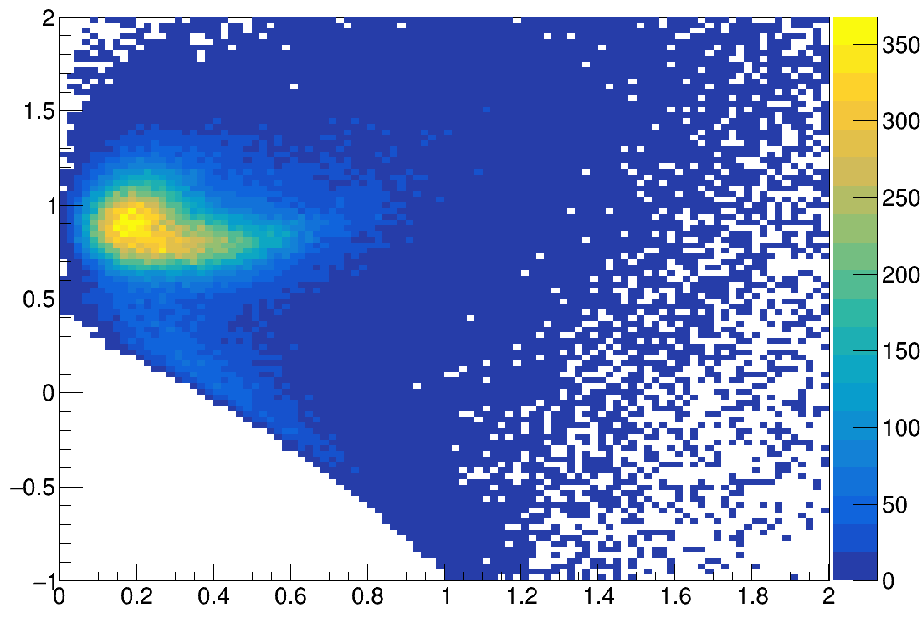
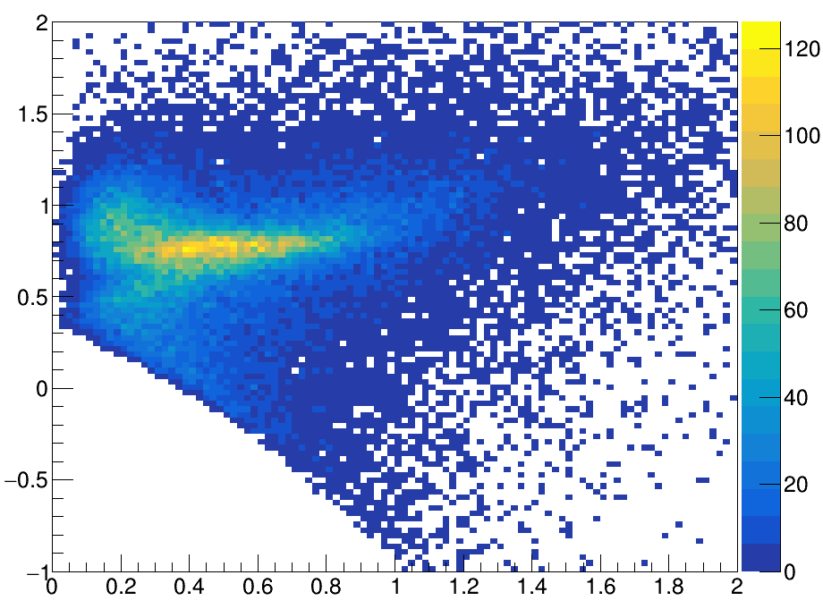
QE event identification using new QPID
¹²C(p,2p) ¹¹B
¹⁶C(p,2p) ¹⁵B
Mmiss² [GeV²/c⁴]
Mmiss² [GeV²/c⁴]
QE
QE
IE
IE
p_{miss} [GeV/c]
p_{miss} [GeV/c]

Slide 26
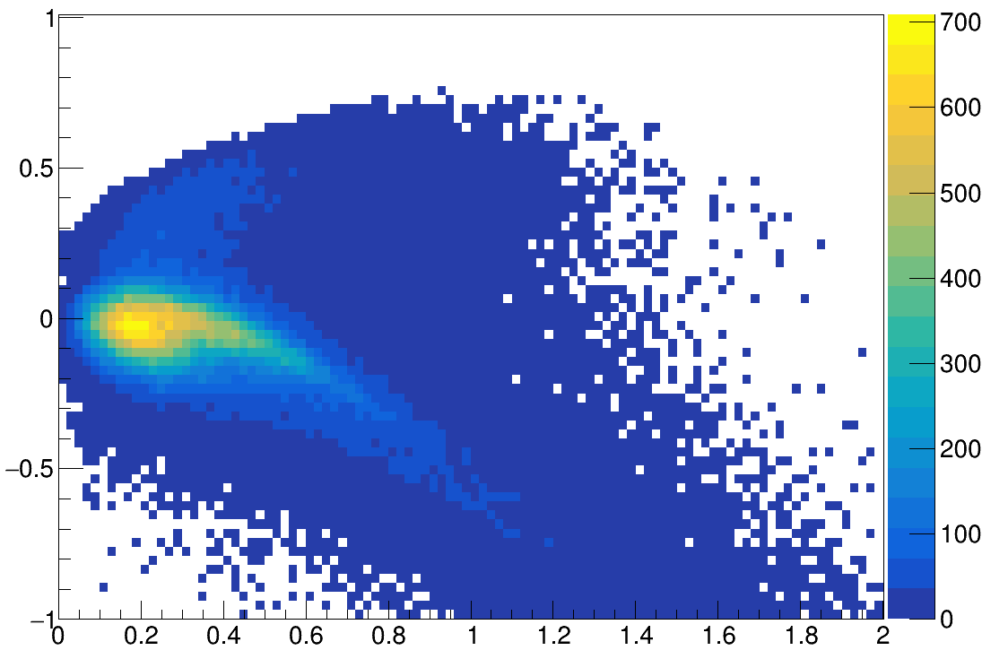
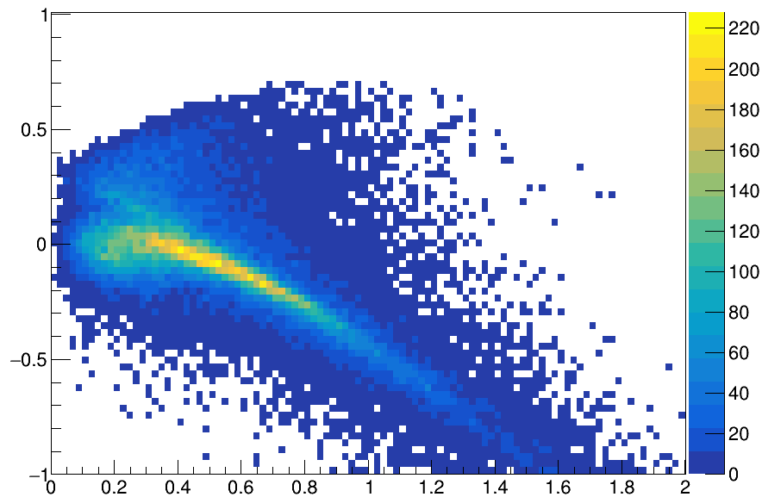
QE event identification using new QPID
¹²C(p,2p) ¹¹B
¹⁶C(p,2p) ¹⁵B
E miss [GeV]
E miss [GeV]
E miss [GeV]
p_miss [GeV/c]
p_miss [GeV/c]

Slide 27
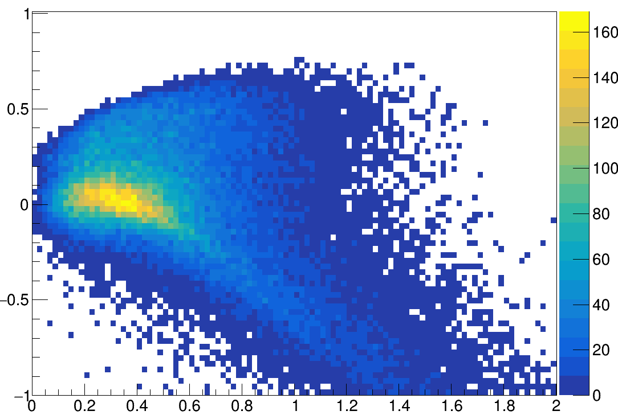
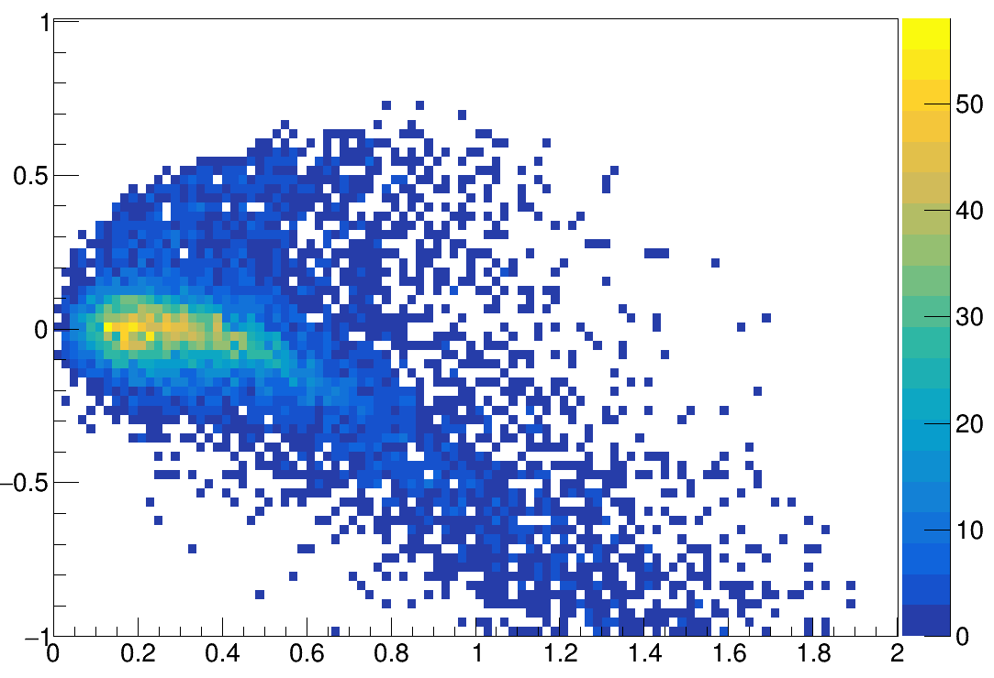
QE identification ¹⁰B (semi excl. vs excl)
¹²C(p,2p)¹⁰B
¹²C(p,2p)¹⁰B + n
E miss [GeV]
E miss [GeV]
p_miss [GeV/c]
p_miss [GeV/c]

Slide 28
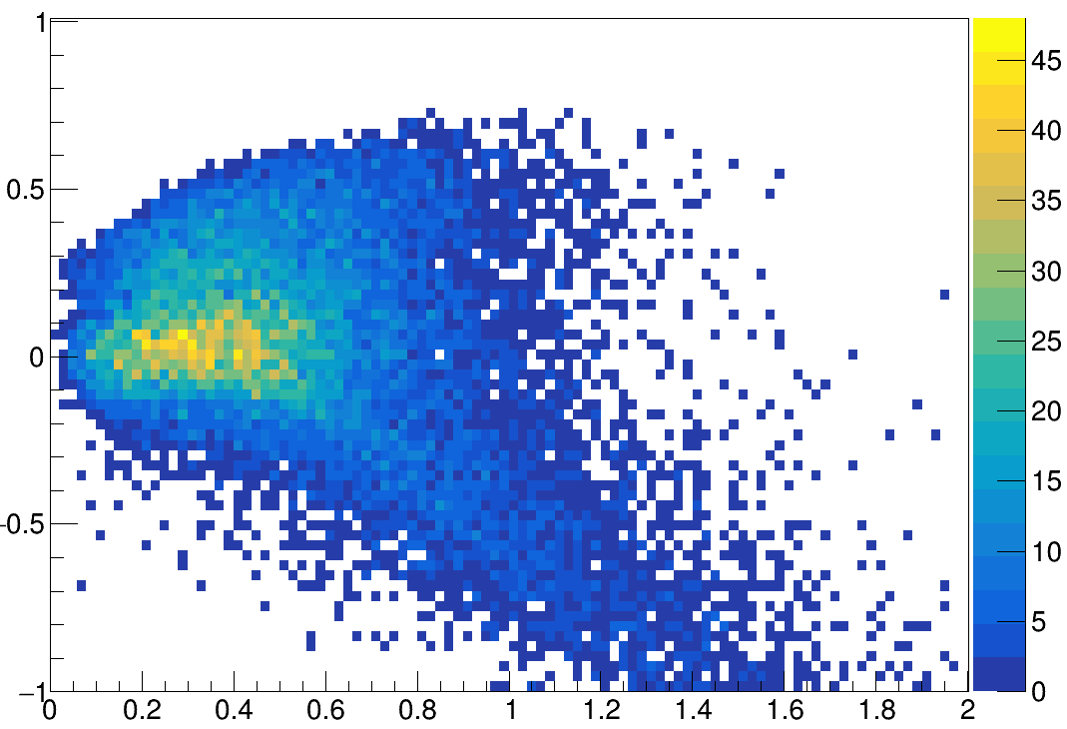
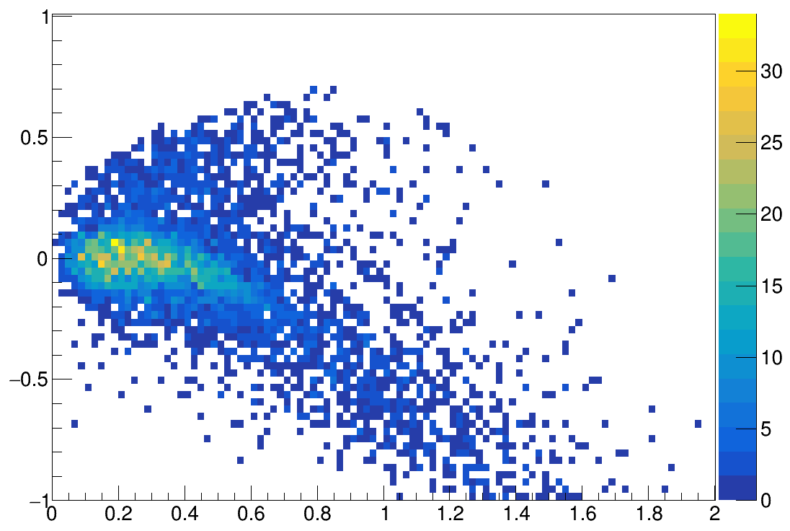
QE identification ¹⁰Be (semi excl. vs excl)
¹²C(p,2p)¹⁰Be
¹²C(p,2p)¹⁰Be + p
E miss [GeV]
E miss [GeV]
p_miss [GeV/c]
p_miss [GeV/c]

Slide 29
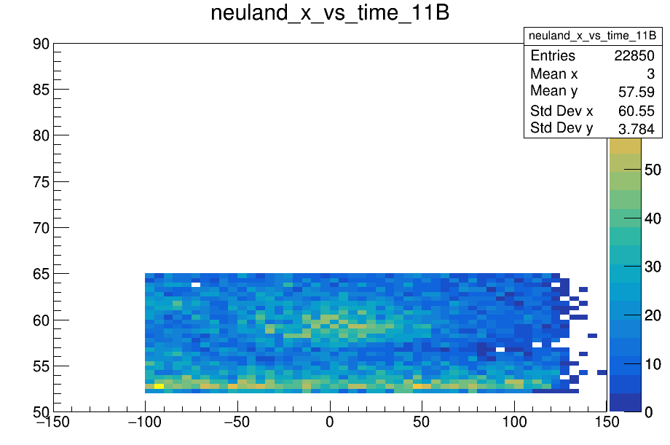
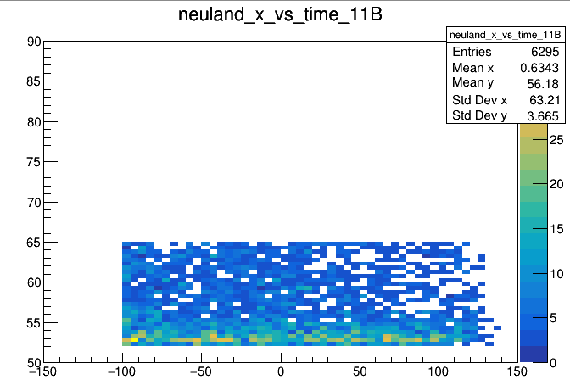
Importance of Mandelstam t and u cut
¹²C(p,2p)¹¹B no t or u cut
¹²C(p,2p)¹¹B with abs(t)>0.5 and abs(u)>0.5
Neuland t [ns]
Neuland t [ns]
Neuland_x [cm]
Neuland_x [cm]

Slide 30
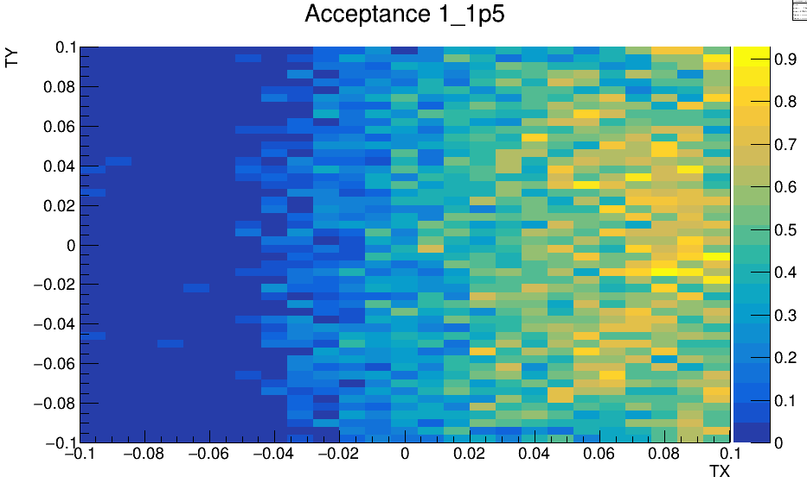
Acceptance hist

Slide 31
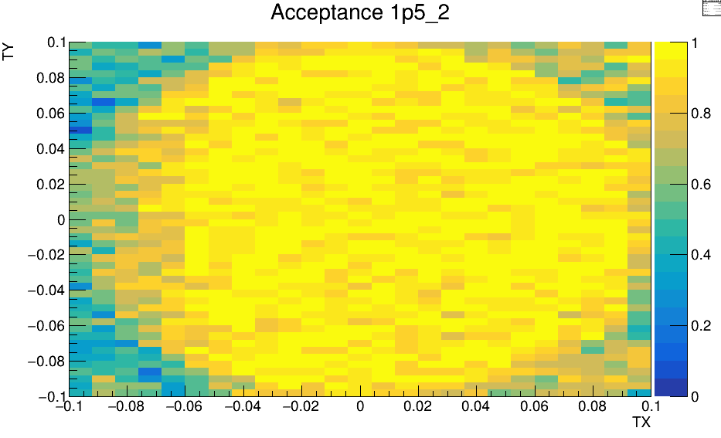
Acceptance hist

Slide 32
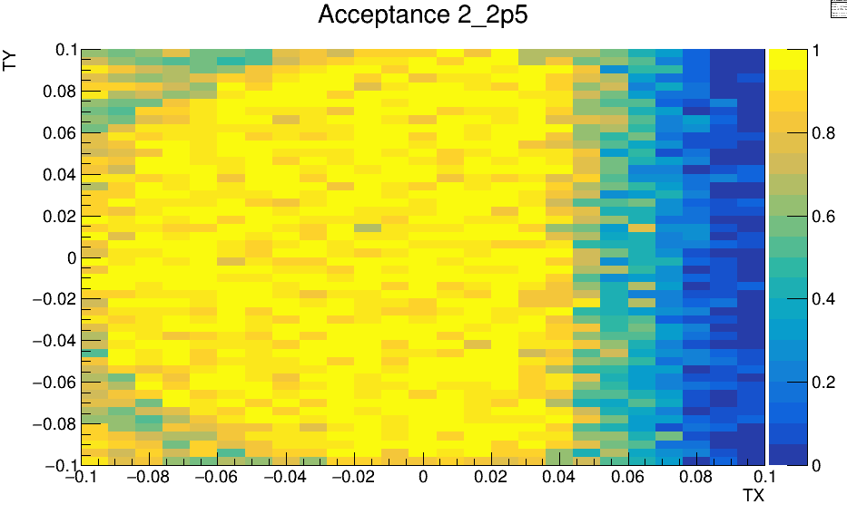
Acceptance hist

Slide 33
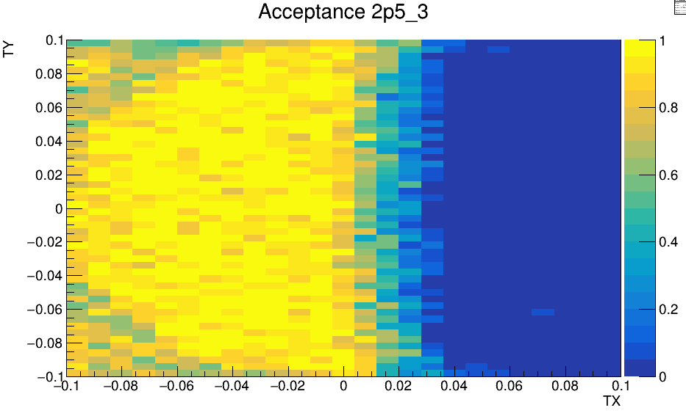
Acceptance hist

Slide 34
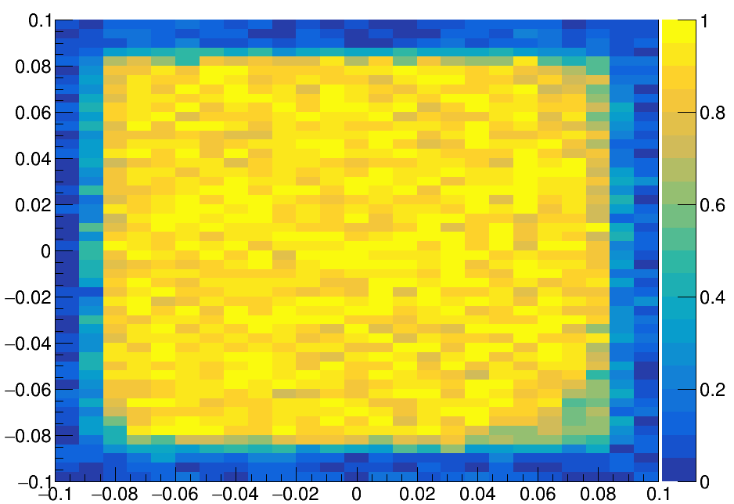
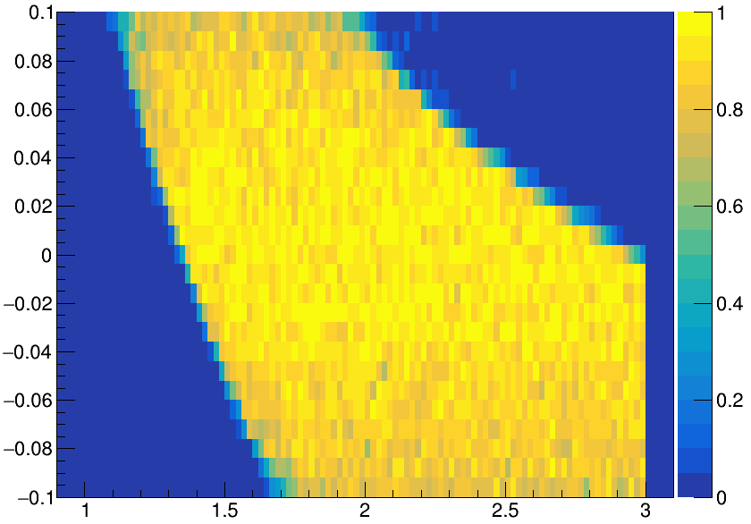
Acceptances RPC and NeuLAND
TY
TX
TX
P [GeV/c]

Slide 35
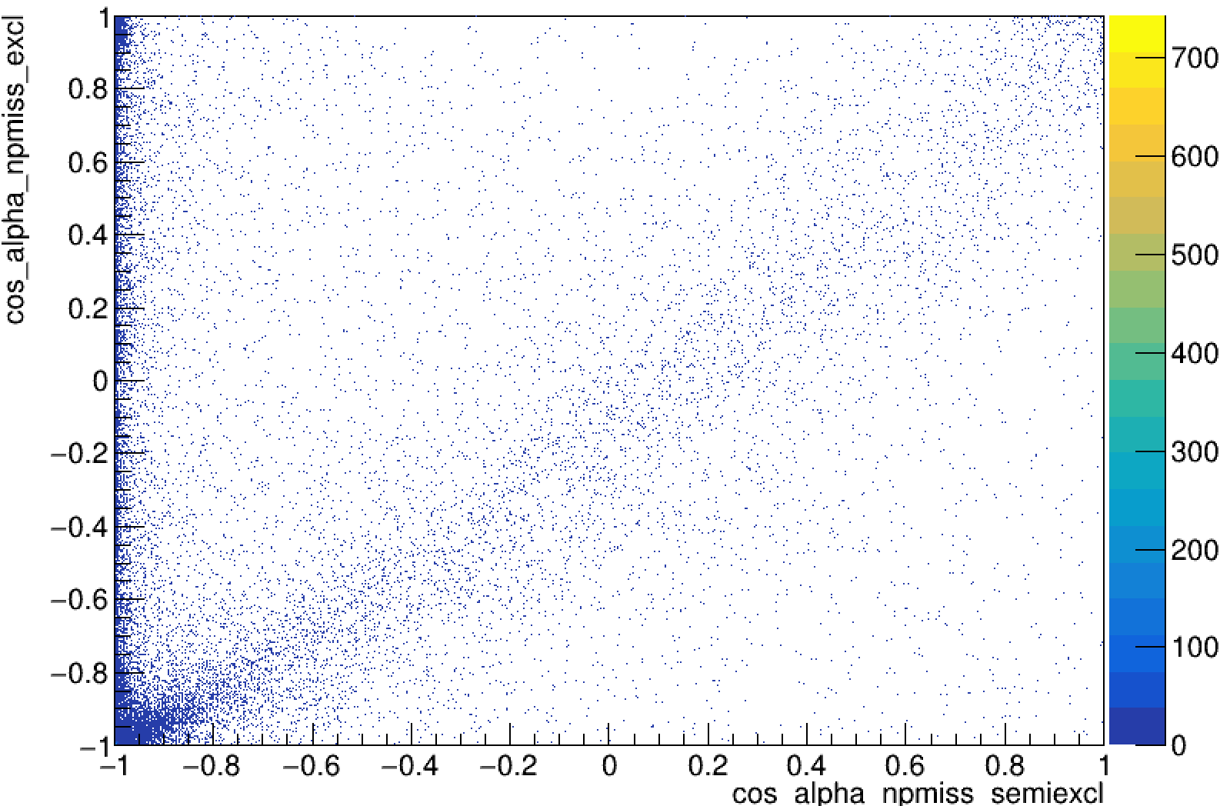
DATA
INCL
cos(Ө(p_{n},p_{miss}))

Slide 36
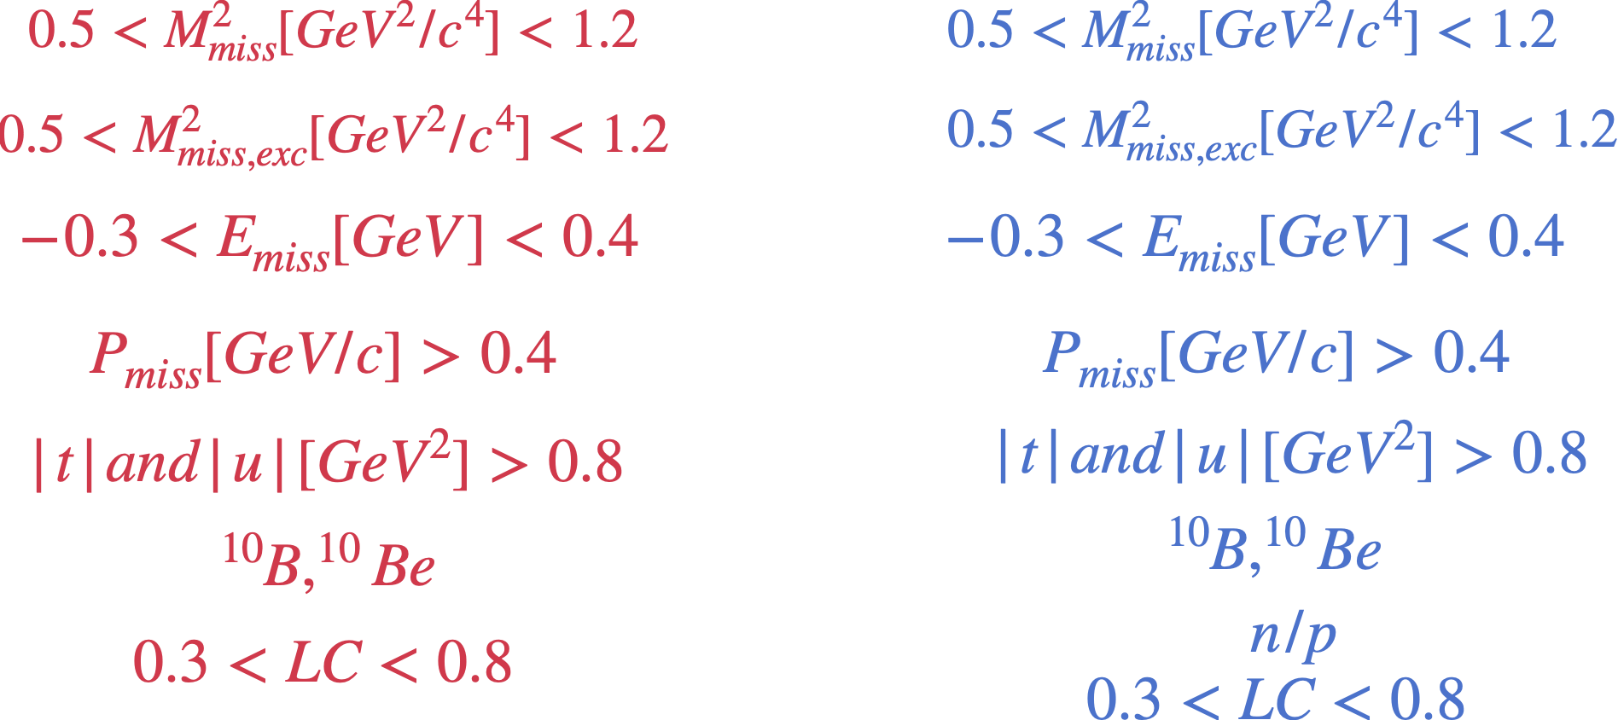
Semi-exclusive SRC conditions
Fully-exclusive SRC conditions

