Slide 1
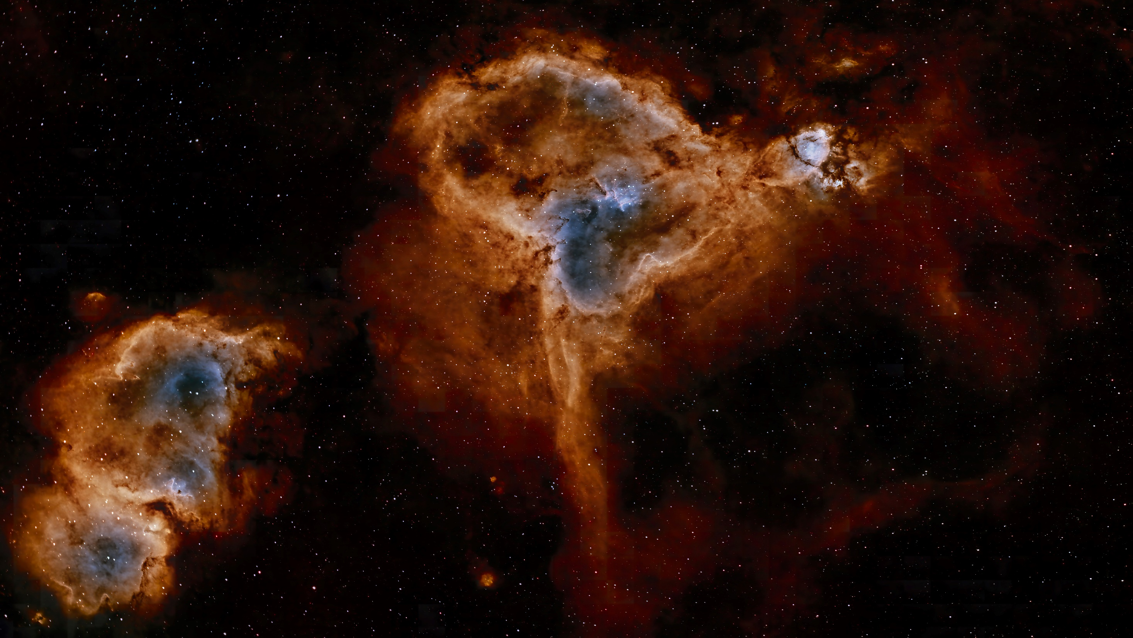
Accelerator Based Neutron Sources
June 13th 2025
GSI Accelerator Seminar
Holger Podlech
Institute for Applied Physics (IAP), Goethe University Frankfurt &
Helmholtz Research Academy Hesse for FAIR (HFHF)

Slide 2
Outline
Use of
Neutrons
Neutron Sources and neutron generation
Accelerator Based Neutron Sources
HiCANS

Slide 3
Use of Neutrons
Neutrons are subatomic particles with unique properties that allow scientists to non-destructive study and understand matter at the atomic and molecular level.
Neutrons have become one of the most important analytical tools in the toolbox of countless branches of science and technology.
The unique properties of neutrons to study and interact with matter apply to almost all scientific and societal topics such as energy, transportation, information technology, environment, engineering, security and health.

Slide 4
Use of Neutrons
Neutron Imaging and Tomography: Attenuation of neutrons depends on material and cross section
Neutron Elastic Scattering (Neutron Diffraction): Neutron are scattered in the crystal lattice
Neutron Spectroscopy: Vibrational spectroscopy technique, where a neutron loses energy by interacting with molecules or the lattice.
(n,γ)-Based Techniques (Radiative-Capture Techniques): Based on nuclear reactions that take place when a nucleus absorbs a neutron. The nucleus is in an excited state and decays to its ground state in 10⁻⁹−10⁻¹² s emitting 2–4 γ. Can be used to identify the isotopic fingerprint of a sample.

Slide 5
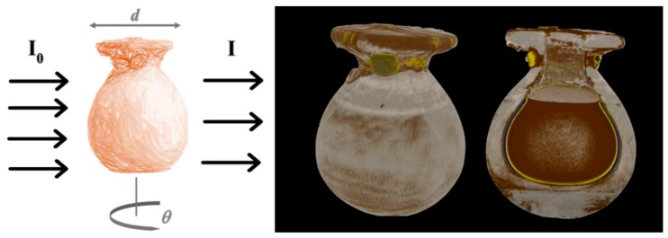
Use of Neutrons
Neutron Imaging and tomography of an acent sealed egyptian vase

Slide 6
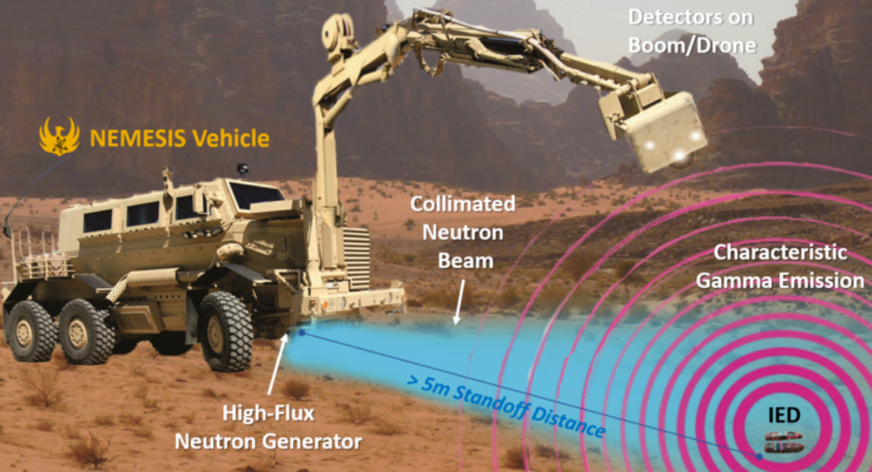
Use of Neutrons
Detection of explosives using radiative capture method

Slide 7
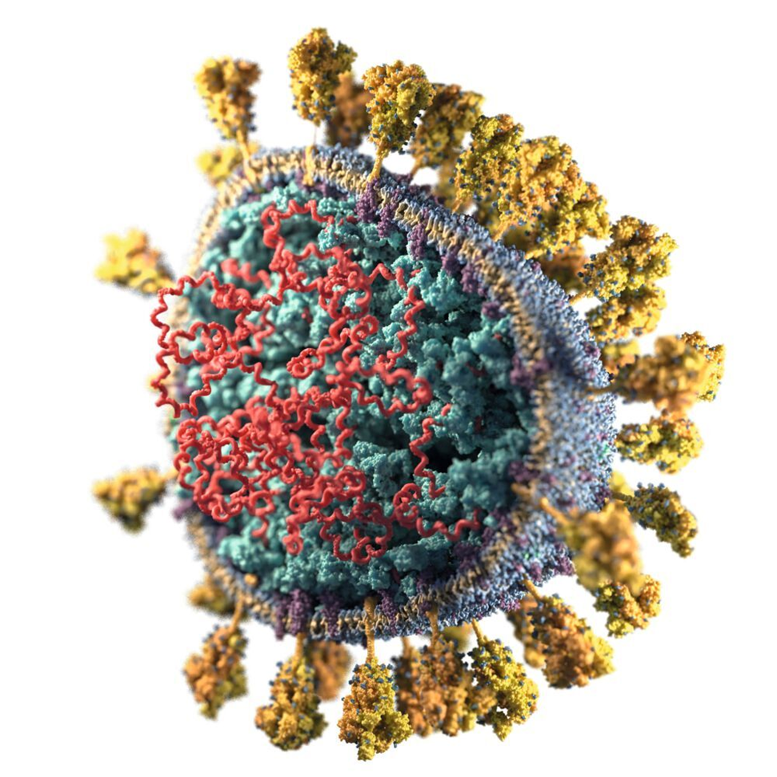
Use of Neutrons
Structure of the Corona Virus with neutron diffraction

Slide 8
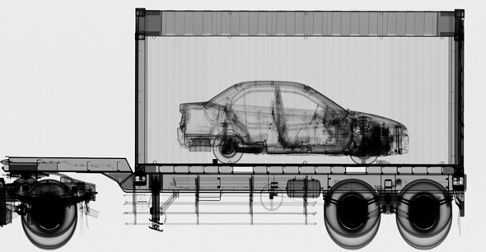

Use of Neutrons
Scanning of cars, trucks container… to identify explosives, drugs, …

Slide 9
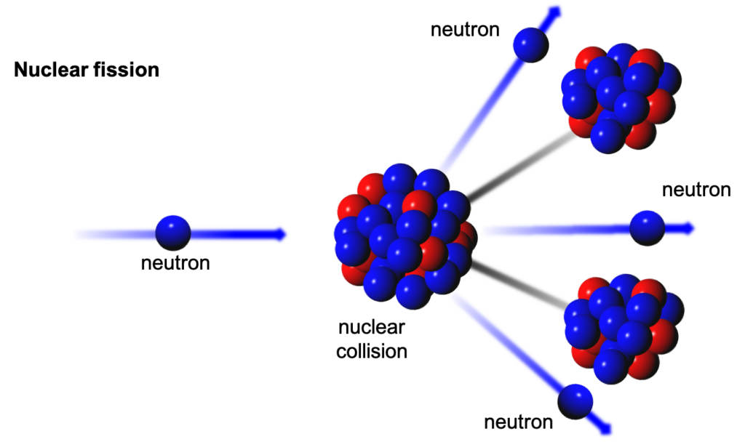
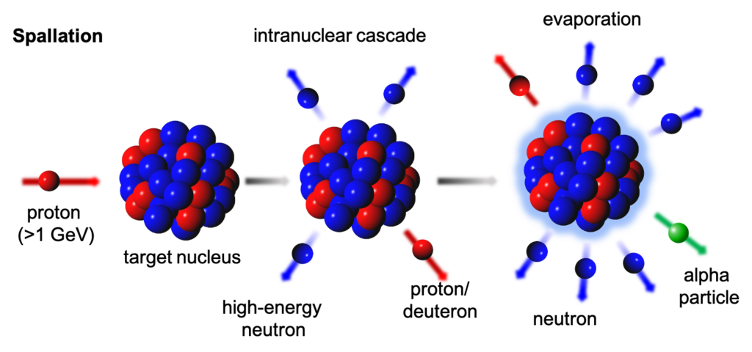
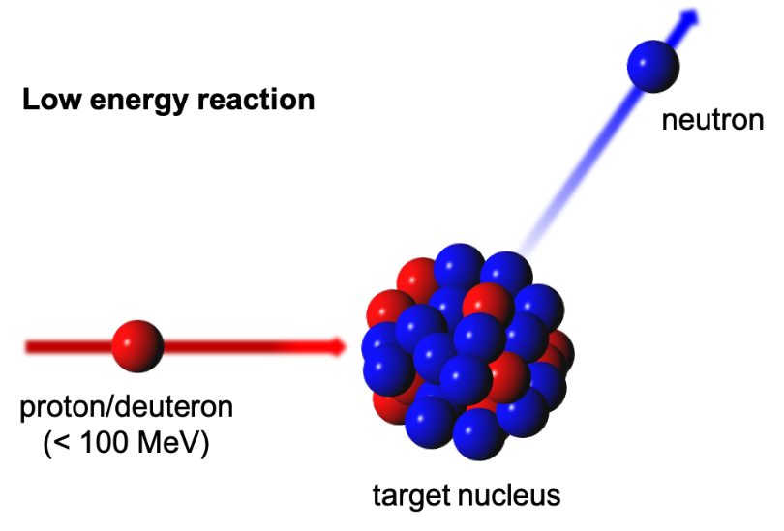
Production of Free Neutrons
Additionally:
Fusion (D-T od D-D) → Neutron Generators
Photodesintegration

Slide 10
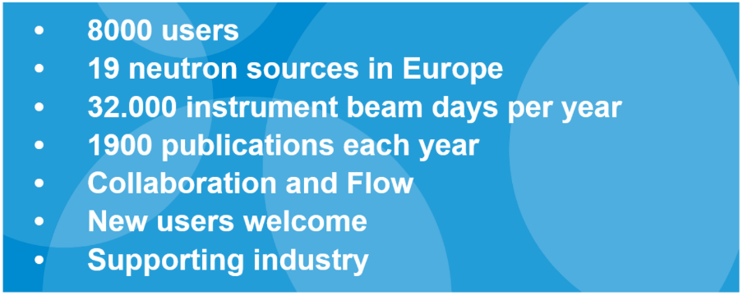
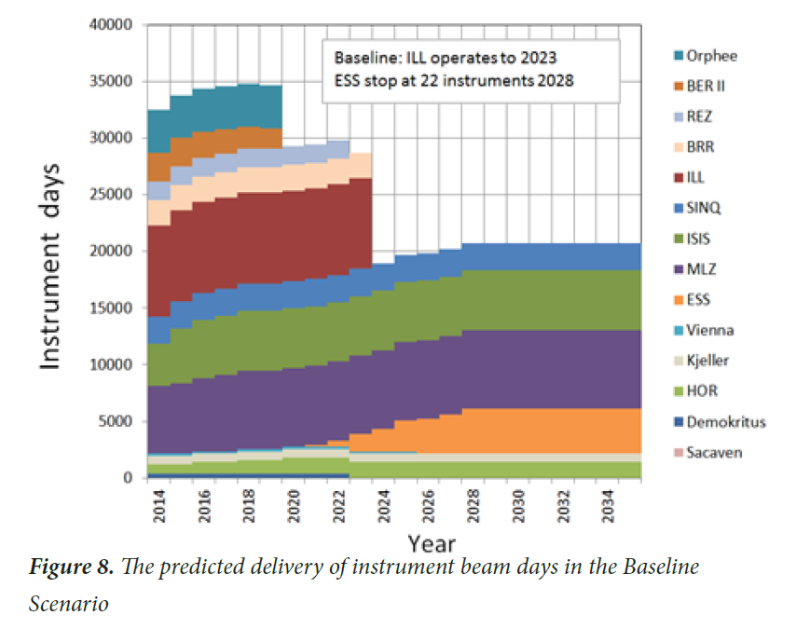
Neutrons Availability
+
Orphee
+
+
BER II
Rez
+
BRR
+
ILL
SINQ
ISIS
MLZ
New (accelerator based) neutron sources are required
ESS
HOR

Slide 11
Spallation Neutron Sources
Pulsed high energy proton accelerator
Energy: ≈ 1 GeV
Average beam power 100 kW to several MW
Heavy elements targets (solid/liquid): Hg, Bi, W, Pb
SINQ (PSI, Cyclotron)
SNS (ORNL, Linac)
ISIS (Rutherford Lab, Linac/Synchrotron)
J-PARC (Linac/Synchrotron)
CSNS (Linac/Synchrotron)
ESS (Linac)
MYRRHA (Linac)

Slide 12
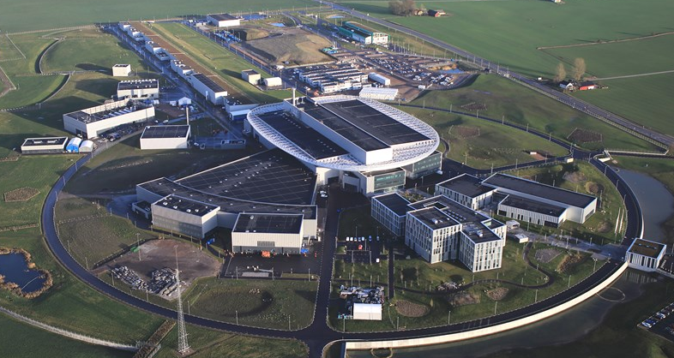
Spallation Neutron Sources
Spallation Neutron Sources are big and expensive (p-energy, price tag > 1 billion €)
ESS

Slide 13
High Current Compact Accelerator Based Neutron Sources
High Current Accelerator based Neutron Sources (HiCANS) are using low energy proton accelerators (<100MeV)
Flexible pulse scheme depending on requirements
Average beam power from 1 kW up to MW
Presently, a new class of scalable HiCANS is being developed
Frankfurt Neutron Source FRANZ
High Brilliance Neutron Source HBS

Slide 14
FRANZ
The Frankfurt Neutron Source FRANZ is based on a high current, low energy proton Linac originally designed for nuclear astro-physics experiments (s-process)
The RF Linacs consists of a coupled RFQ-IH combination
It can provide cw beams or pulsed beams with arbitray pulse schemes with repetition rates up to 250 kHz (100 ns pulsed).
The beam energy can be varied between 1.8 and 2.2 MeV
The beam current (present) is 30 mA (beam power up to 60 kW)

Slide 15
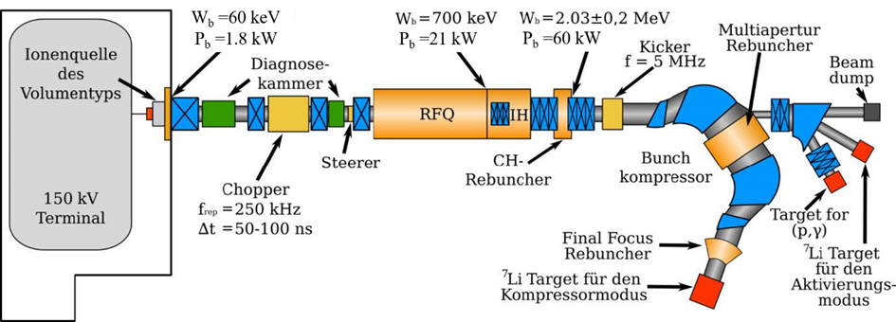
FRANZ

Slide 16
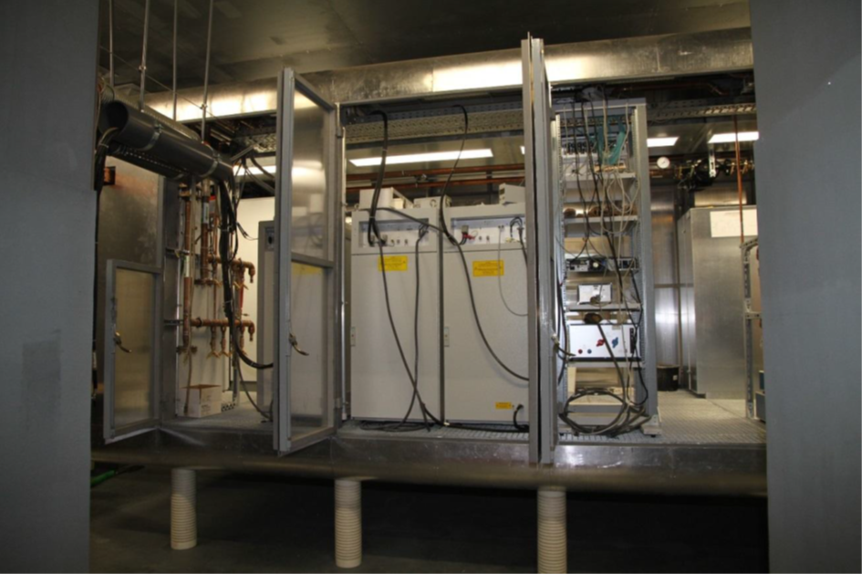
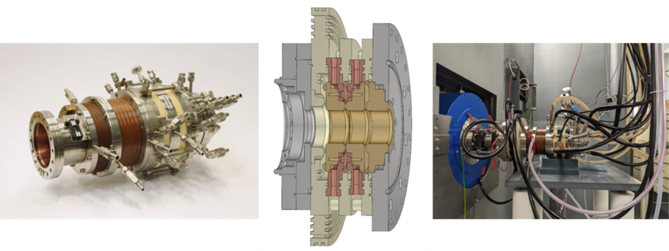
FRANZ
150 kV Terminal with power supplies
CHORDIS source form GSI (thanks to R. Hollinger)
A new volume source has been developed and recently tested (80 mA DC)

Slide 17
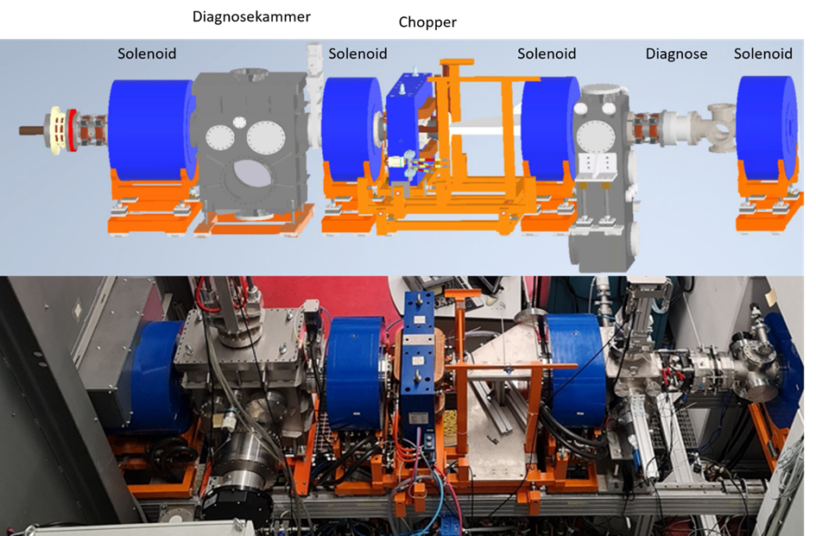
FRANZ
The LEBT section is operational since 2022
Beside focusing and matching it used to create the required pulses with an E x B chopper.

Slide 18
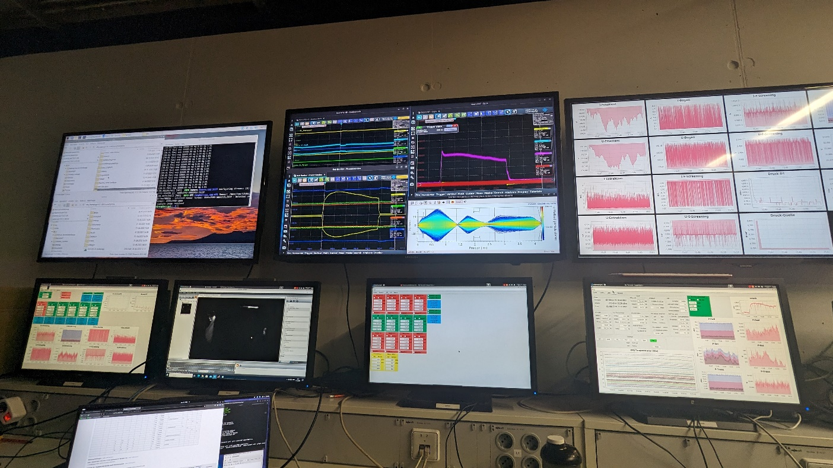
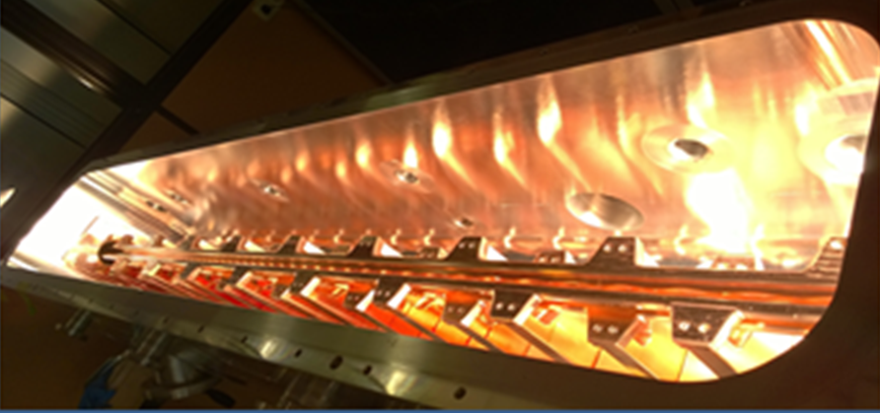
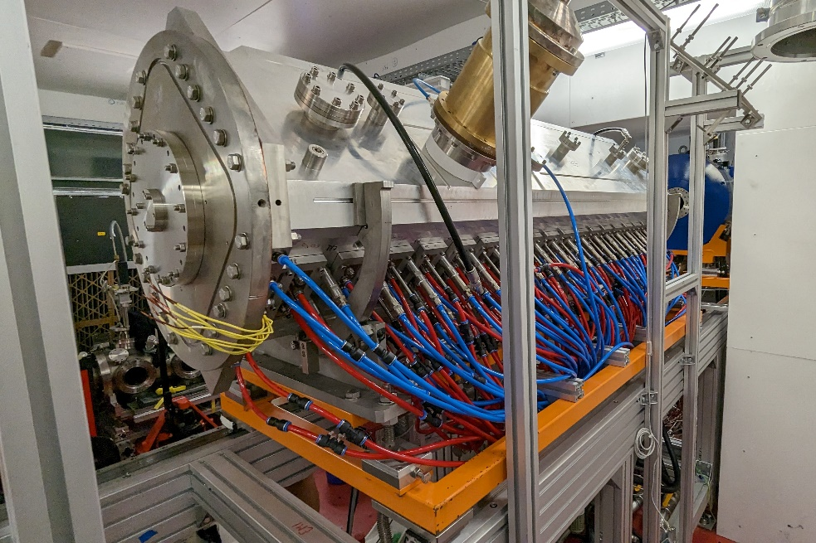
FRANZ-RFQ
Beam Dynamics Design by Chuan Zhang
Stable beam operation with > 10 mA
Tested up to 80 kW cw (RF)

Slide 19
FRANZ – Status & Roadmap
Proton source (CHORDIS)
150 kV Terminal
Low Energy Beam Transport
RFQ (700 keV)
RF Supply
Preparation IH-Structure: 09/2024
Pre-conditioning IH: 10/2024
Coupling RFQ-IH with Tuning: 12/2024
Conditionierung RFQ-IH-System: 04/2025
1. Beam test 2 MeV: 05/2025
Beam test mit CH-Structure: 06/2025
First neutrons: 07/2025
Special thanks to H. Hähnel, A. Ates and J. Kaiser

Slide 20
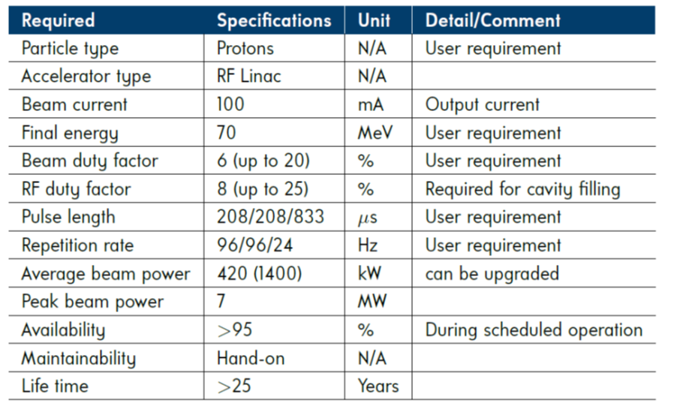
HBS – High Brilliance Neutron Source
HBS will be the flagship project for a new class of HiCANS Facilities

Slide 21
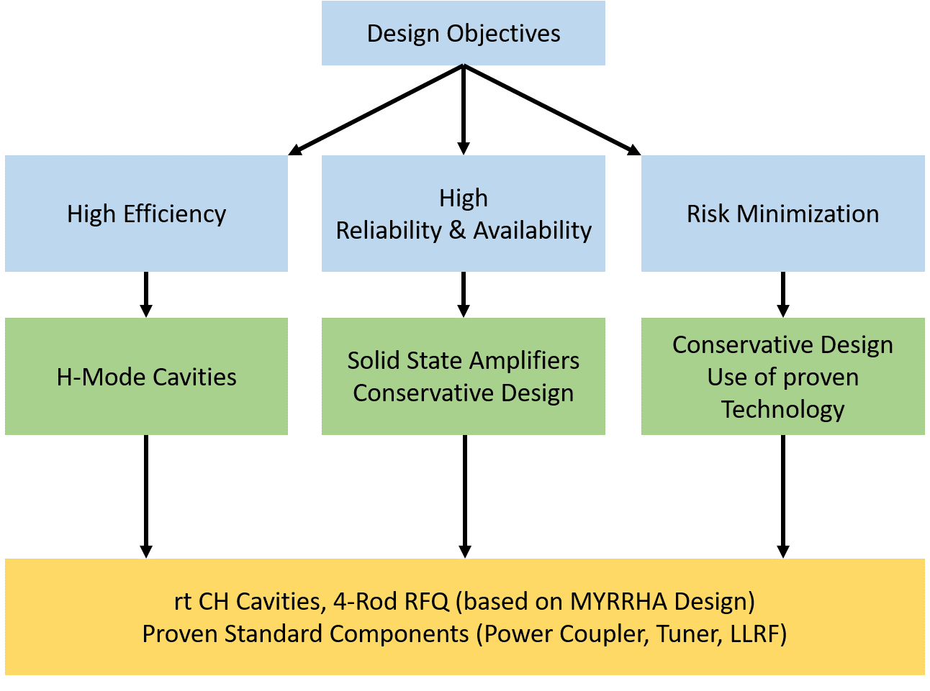
Design Philosophy HBS-Accelerator

Slide 22
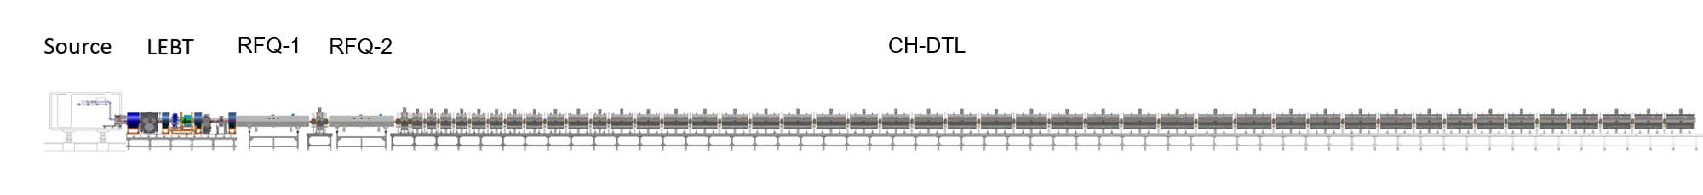
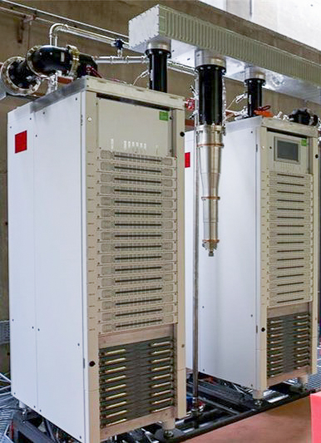
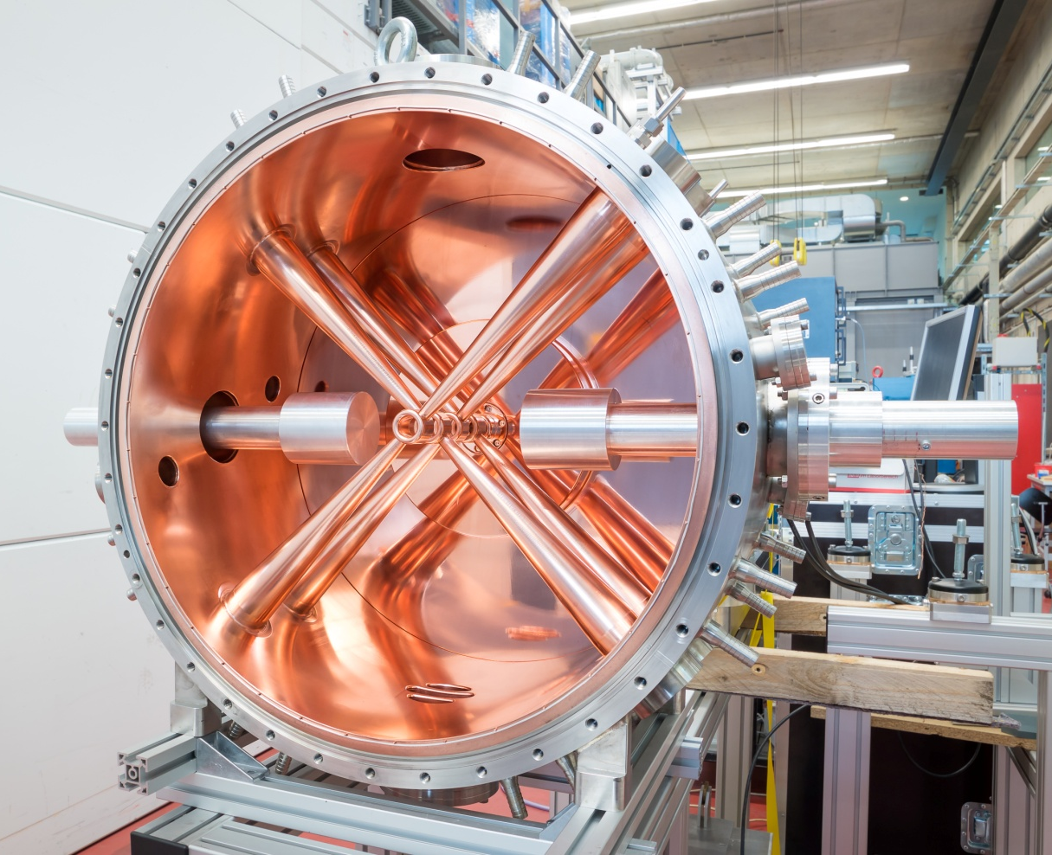
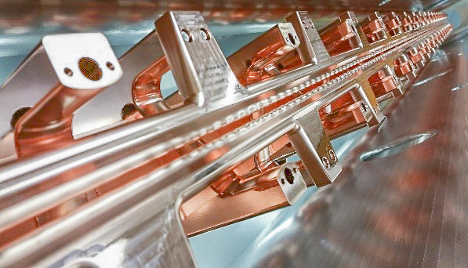
High Brilliance Neutron Source (HBS)
100 keV
1.25 MeV
2.5 MeV
70 MeV
176 MHz, 200 kW cw SSA
Use of state-of-the-art proven technology
176 MHz cw CH-Cavities
176 MHz cw RFQ
Courtesy SCK • CEN

Slide 23
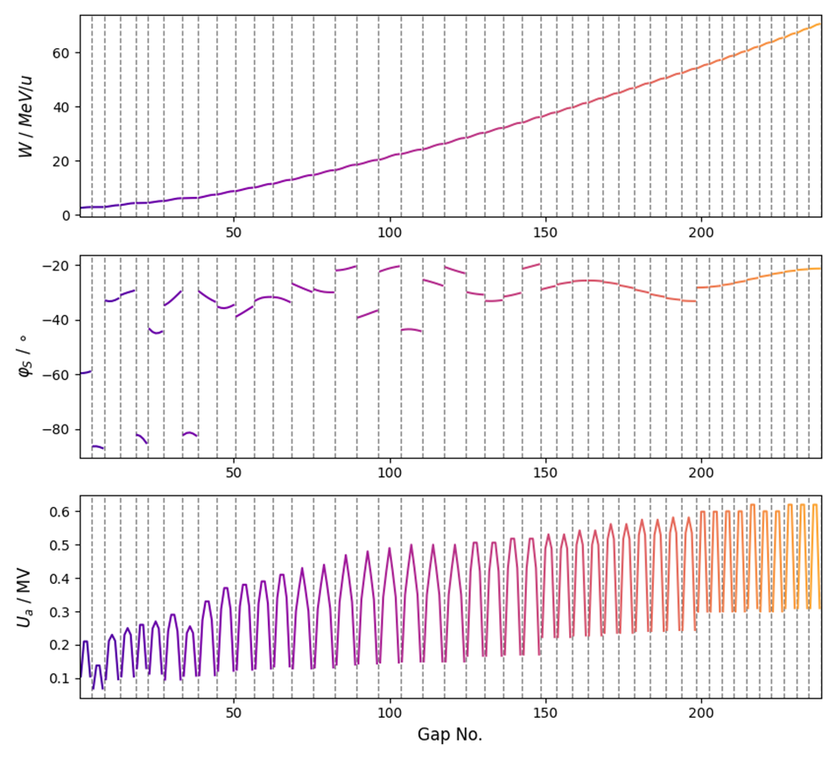
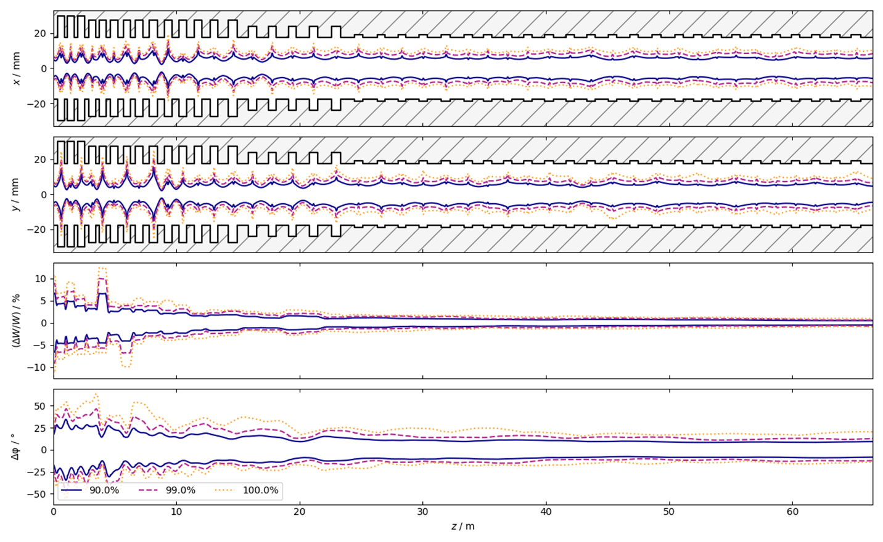
High Brilliance Neutron Source (HBS)
Most critical issue of the HBS Linac: Beam Dynamics
S. Lamprecht, IAP

Slide 24
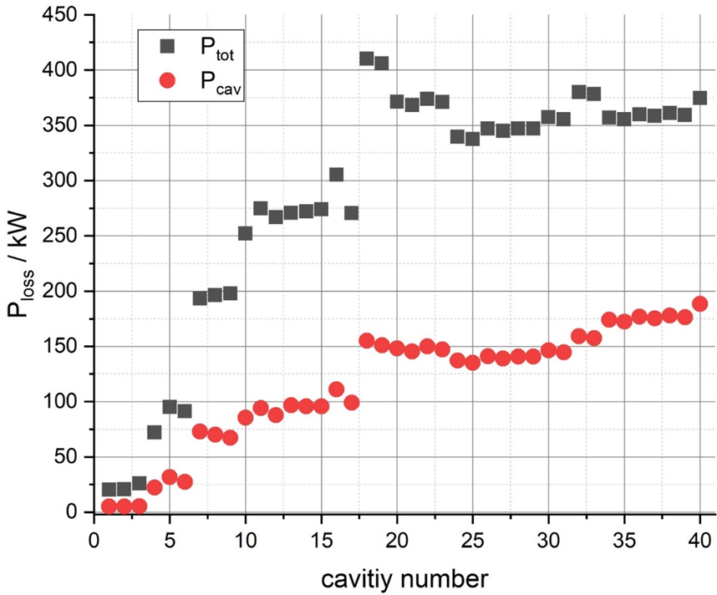
High Brilliance Neutron Source (HBS)
40 CH-cavities
SSA Amplifier 100-500 kW
Peak loss 100 kW/m
Thermal loss 25 kW/m

Slide 25
Technical Design Report

Slide 26

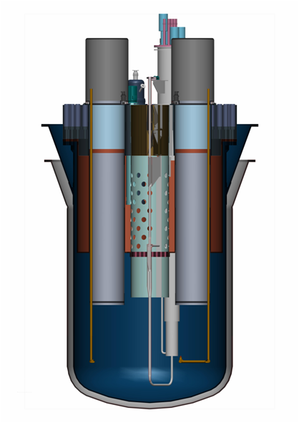
The MYRRHA Project
Fast Reactor
subcritical mode (50-100 MW_{th})
critical mode (~100 MW_{th})
Accelerator
(600 MeV – 4 mA proton)
Aims to demonstrate the large scale feasibility of nuclear waste transmutation
Provides neutrons for various other applications
Spallation source
Fast
neutron
source
Multipurpose flexible
Irradiation facility
Lead-Bismuth
coolant

Slide 27
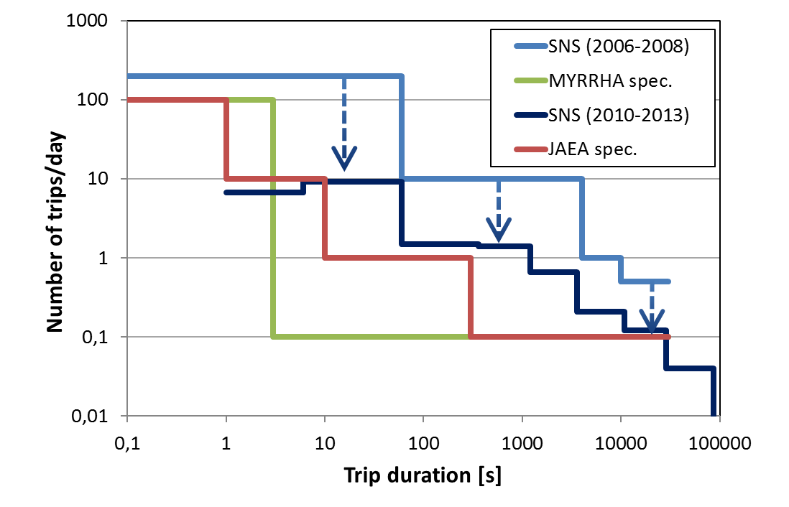
Reliability
Beam trips longer than 3 sec must be very rare:
To minimize thermal stress & fatigue on reactor
structures & fuel assemblies
To ensure an 80% availability: determined by the foreseen reactor start-up procedures
The overall availability (Linac+Reactor) is given by the reliability of the accelerator not by its availability
Conservative design & redundancy

Slide 28
Reliability
Goal: High Reliability
Measures to reach reliability goal:
Conservative Design
Plenty of margin for components
(PS, SSA, cavitiy gradients …)
Beam dynamics
Advanced Control
Plenty of diagnostics
(beam properties, detection of failures and beam loss)
Fault Tolerance
Redundancy
Parallel
Serial

Slide 29
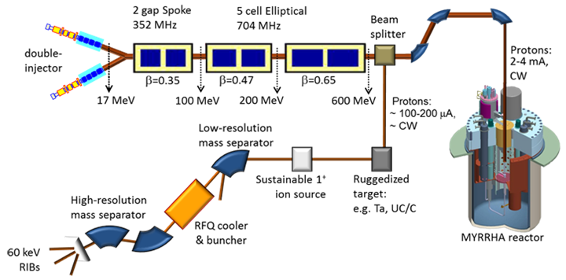
Redundancy
Parallel redundancy: one or more independent systems can provide the requested functionality.
→ Two injectors
Parallel Redundancy
Serial
Redundancy
sc Linac
Serial redundancy: the requested functionality of a given element is ensured by means of dynamic fault compensation by non-failed elements, taking over the load of the failed one.
→ This implies that all elements must be operated well below their nominal performance

Slide 30
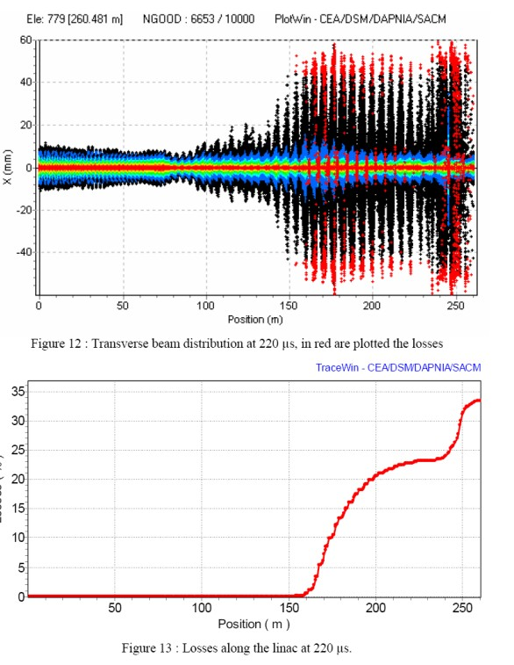
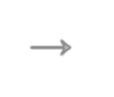





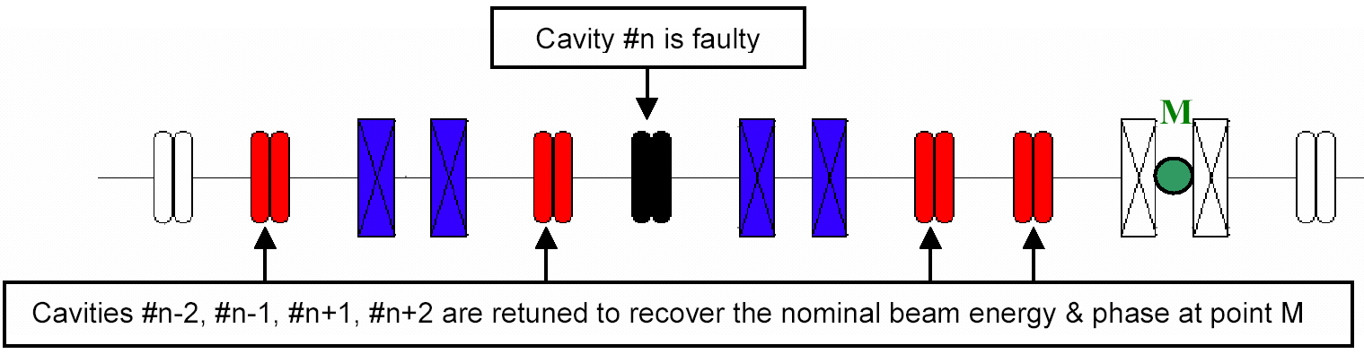
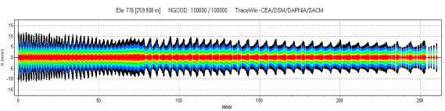
Dynamic Fault Compensation
 New V/φ set-point
cavities adjacent to t
→ Set-points determined application and/or at the c
Failed cavity position
1. A failure is detected anywhere
→ Beam is stopped by the MPS in injector at t₀
→ Need for an efficient fault diagnostic system
2. The fault is localized in a sc cavity RF loop
→ The failed cavity is detuned (to avoid beam loading effect)
3. Neighbouring cavities are retuned (amplitude and phase)
→ Need enough margin for amplifiers
→ Need enough margin for cavity gradients
After fault compensation
4. Once steady state is reached, beam is resumed at t₁ < t₀+3 sec

Slide 31
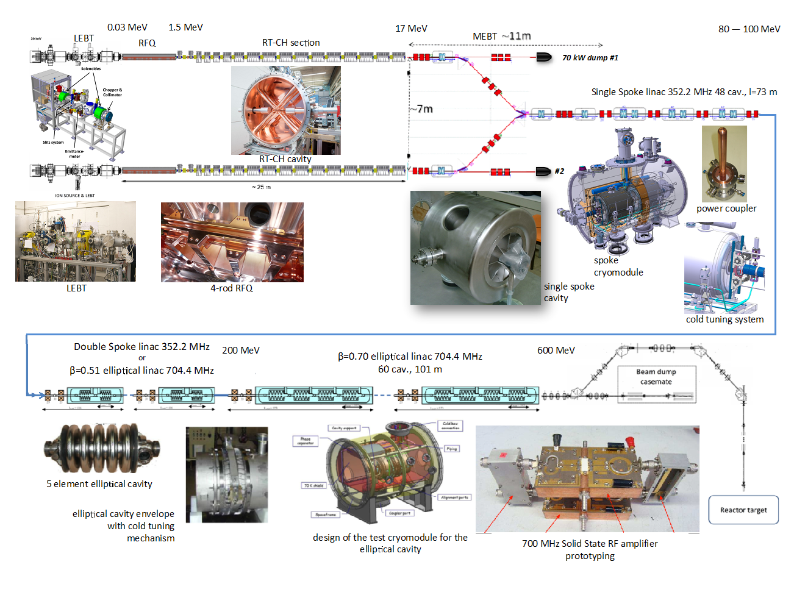
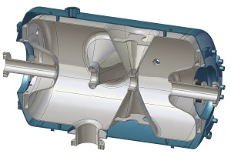
Detailed Overview MYRRHA Linac
Double Spoke Linac
352.2 MHz
ESS type Double Spoke cavity

Slide 32
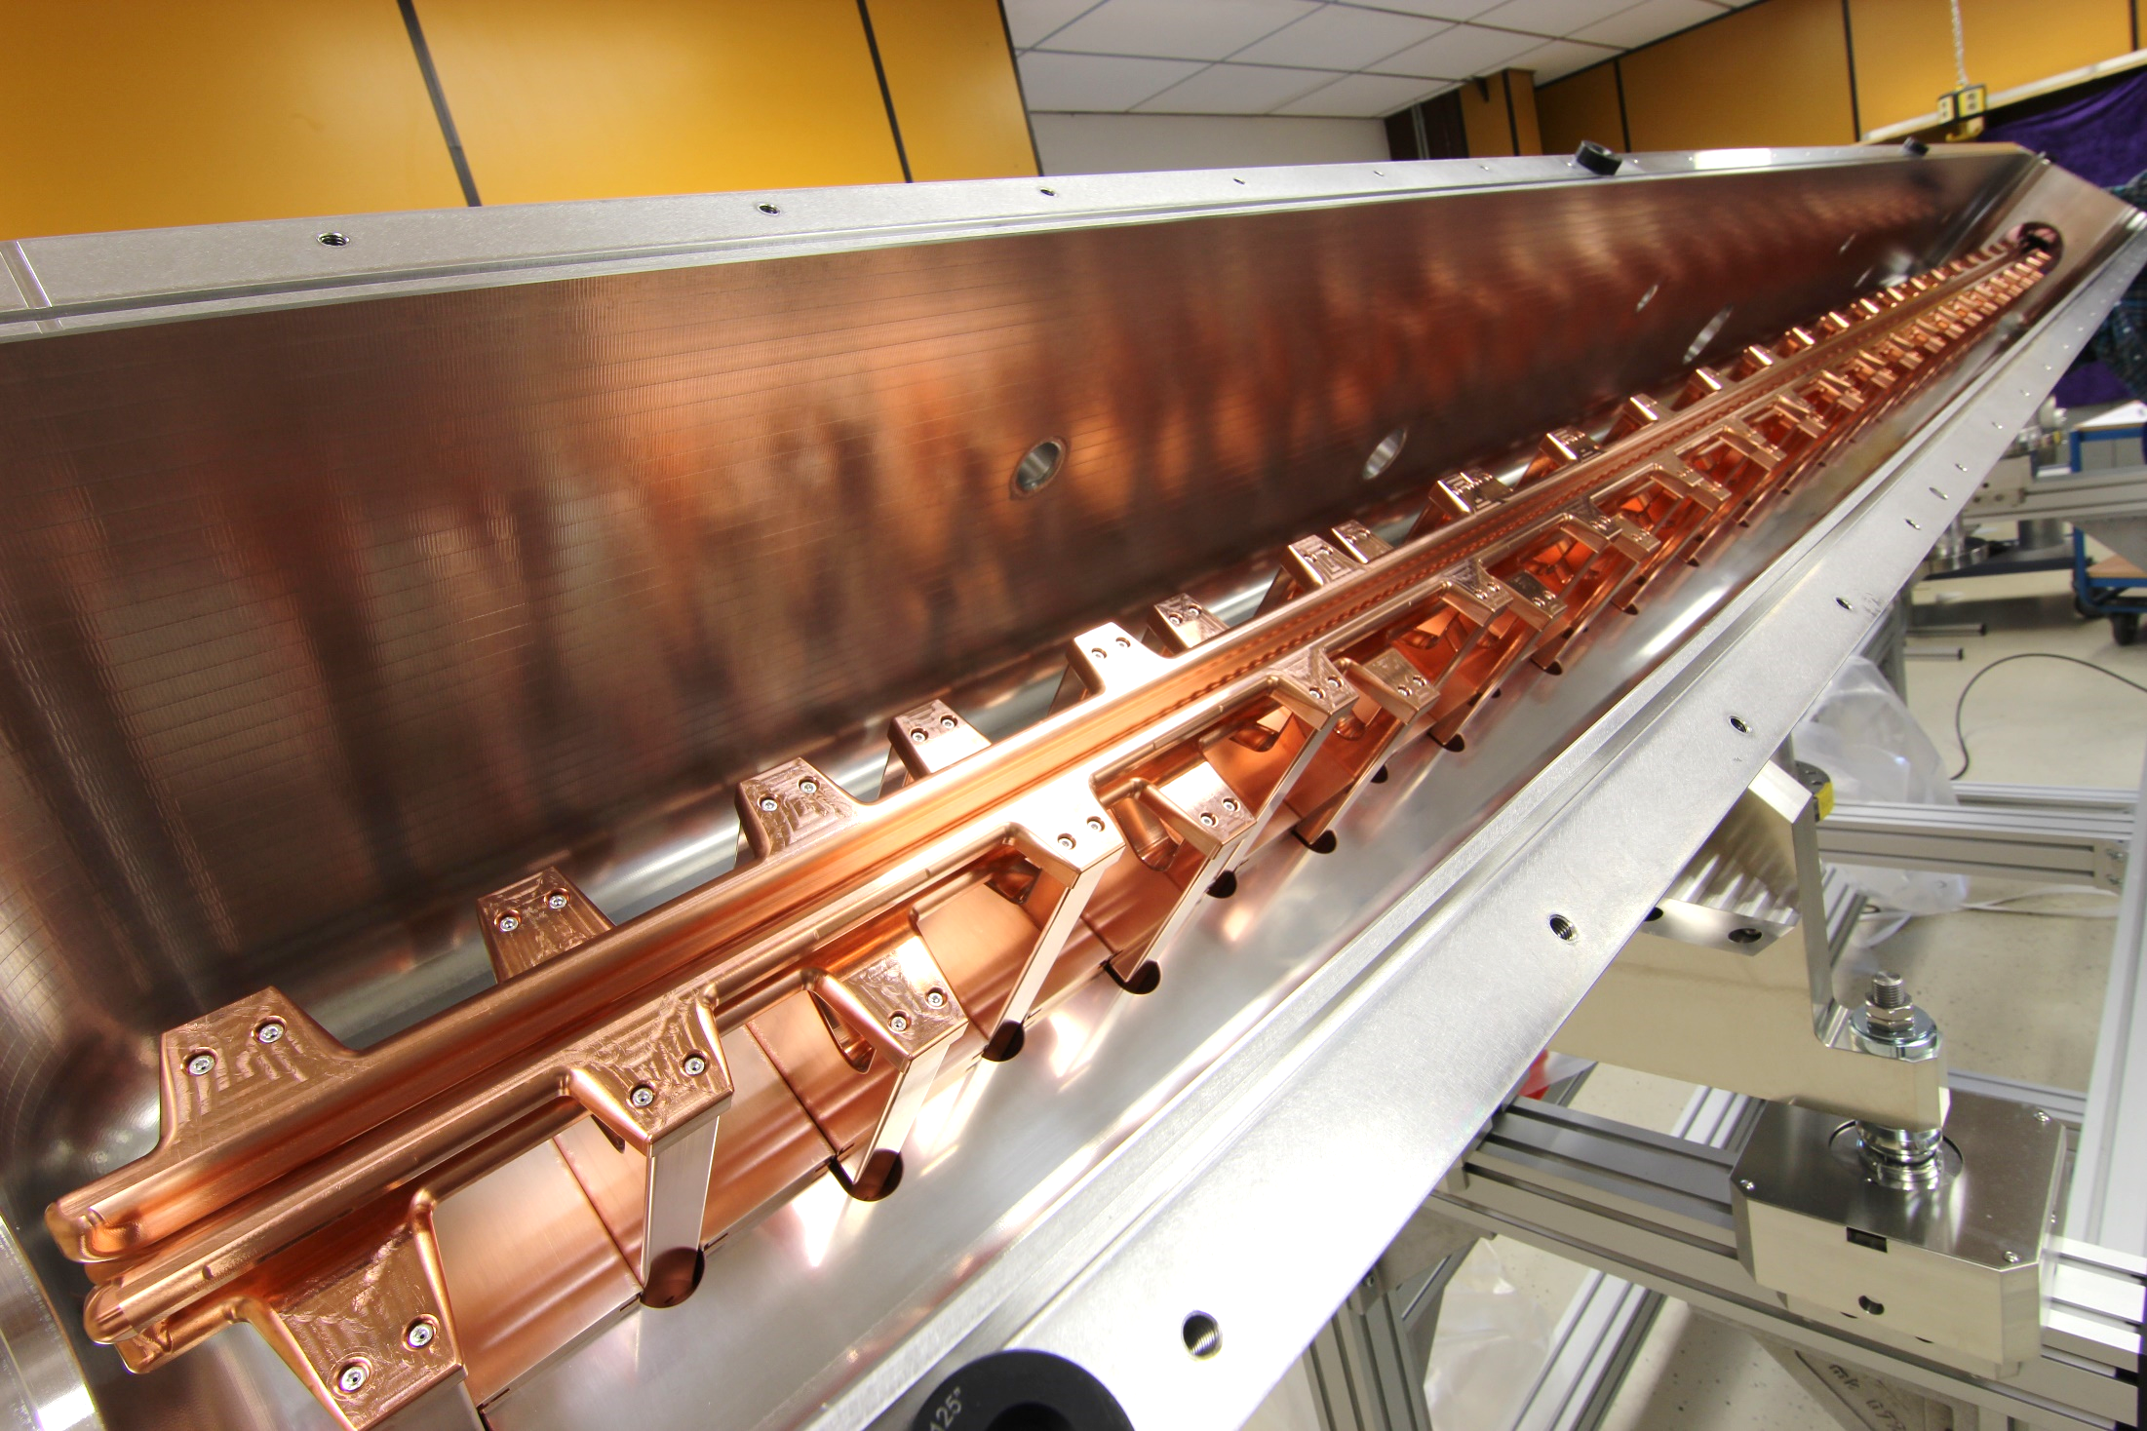
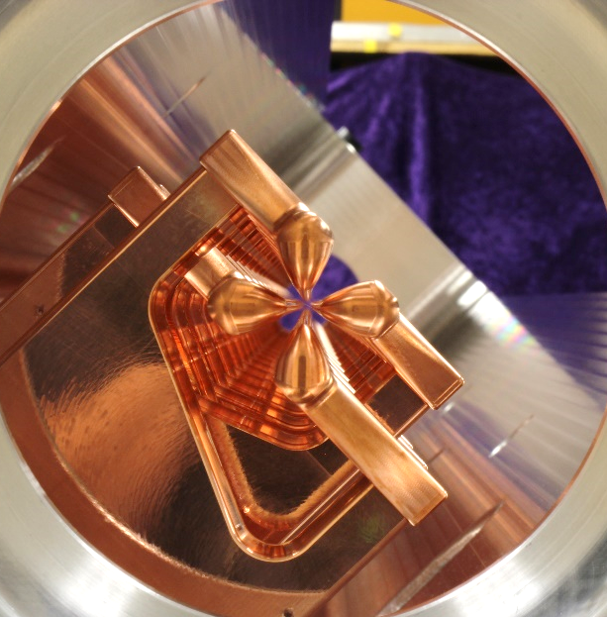
MYRRHA RFQ
Parameter | Value | Unit
RF Structure | 4.Rod | ---
Frequency | 176.1 | MHz
Beam current | 5 | mA
Duty factor | 100 | %
E_{out} | 1.5 | MeV
R_{p} | 72 | kΩm
RF Power with beam | 113 | kW
Specific power loss | 26.5 | kW/m
Voltage | 44 | kV
Length | 4 | m

Slide 33
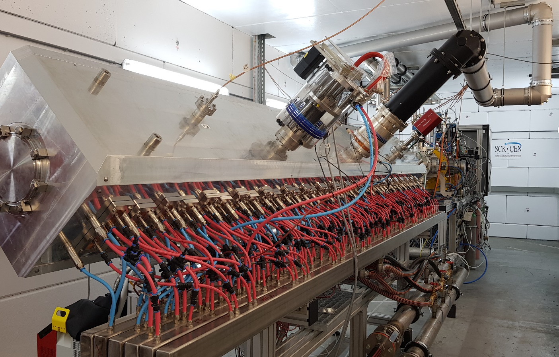
MYRRHA RFQ
First 4-Rod RFQ with full dipole compensation
Beam Dynamics Design C. Zhang

Slide 34
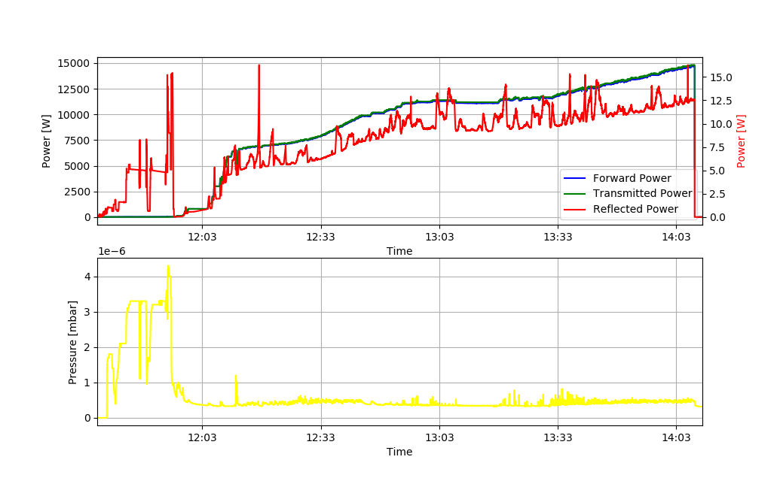
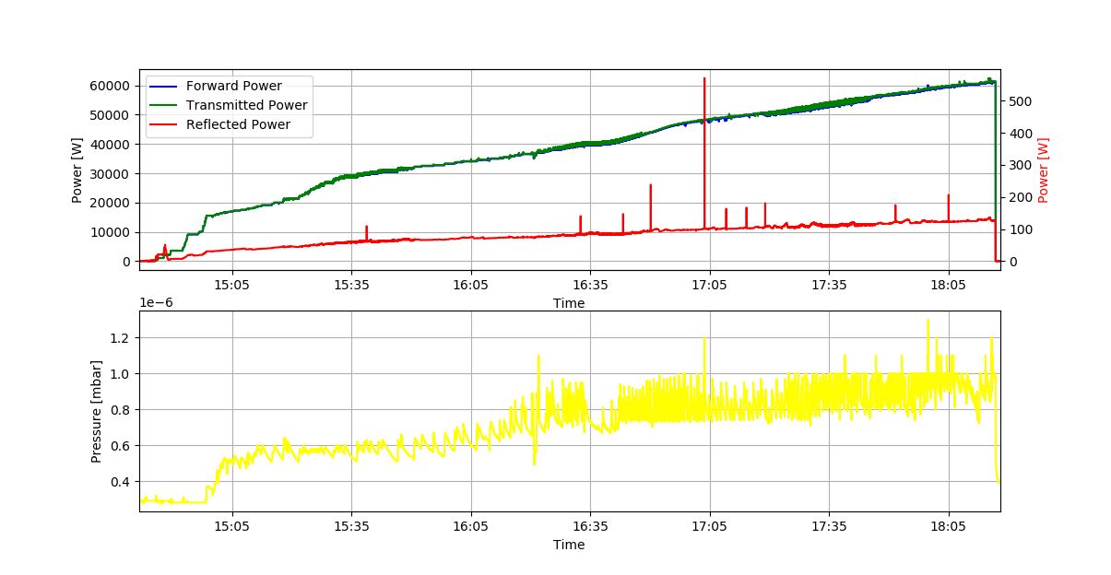
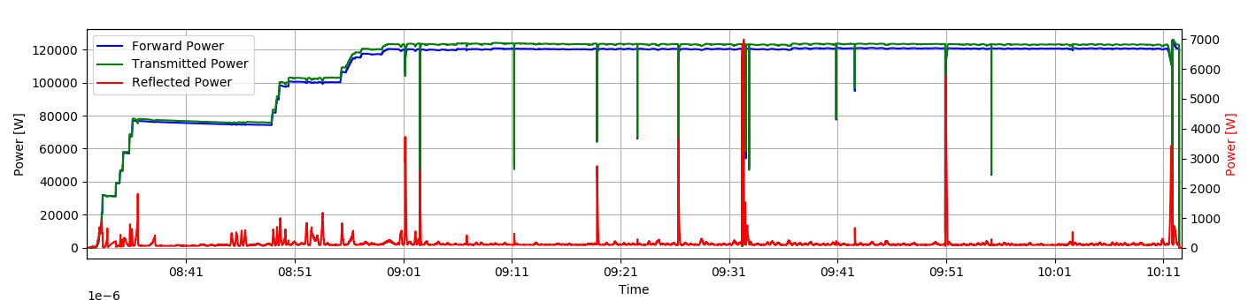
Conditioning of the MYRRHA RFQ
The RFQ requires about 108 kW RF power (losses)
Conditioned up to 145 kW cw
Conditioning time about 10 work days
Transmission: 99%

Slide 35
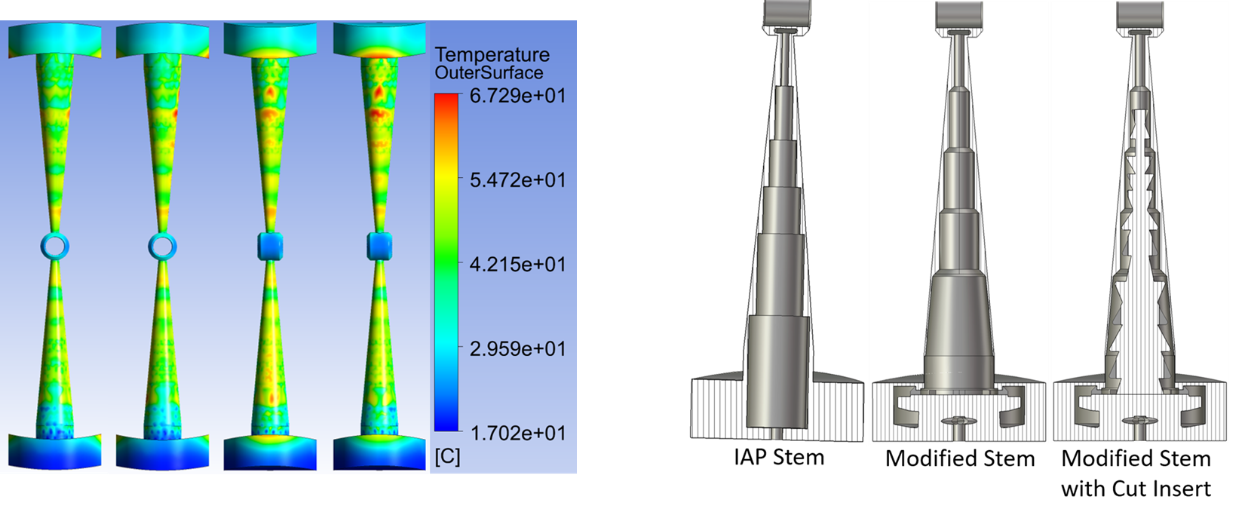
CH-Cavity Development
CH-1 and CH-2 already fabricated and conditioned
Production of CH-3 – CH-17 starts in August 2024
Cavities will be conditioned at IAP
A dedicated test stand has been established
MYRRHA ground breaking
June, 25th 2024

Slide 36
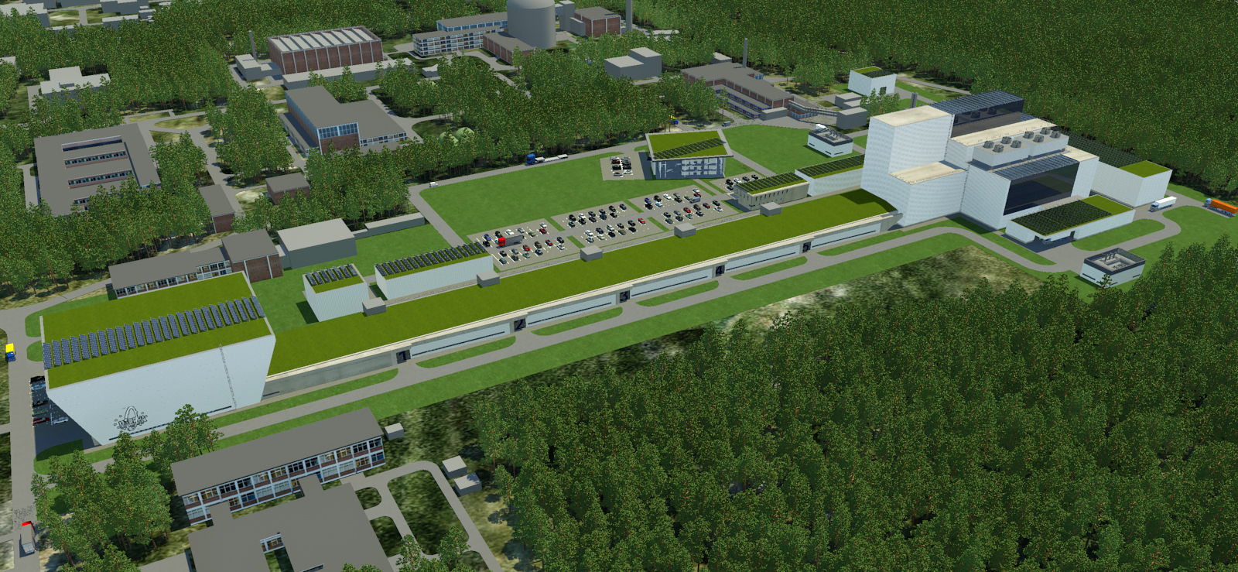
A view into the future
Courtesy SCK • CEN

Slide 37
BNCT Linacs
BNCT is a treatment for tumors
n+¹⁰B → ⁷Li + α
High cross section
10B is brought exclusively to tumor cells
Boron-Neutron Capture Therapy
Energy 5-10 MeV (Linacs)
Average Beam Current 10-20 mA
Average Beam Power 100-200 kW

Slide 38
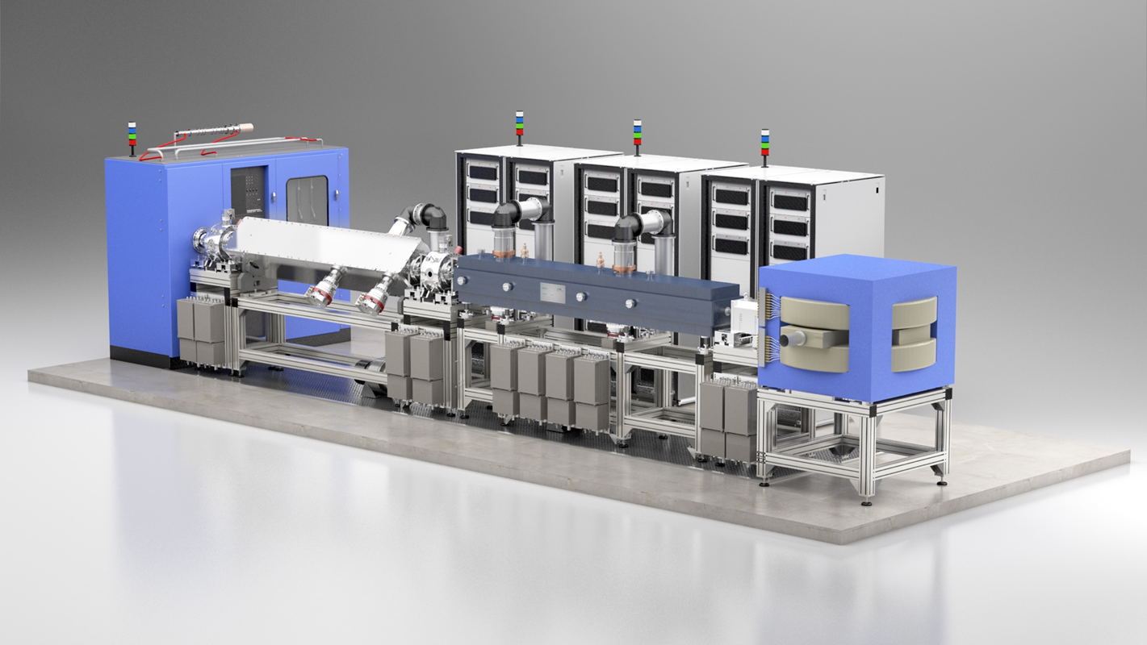
BNCT Linacs

Slide 39
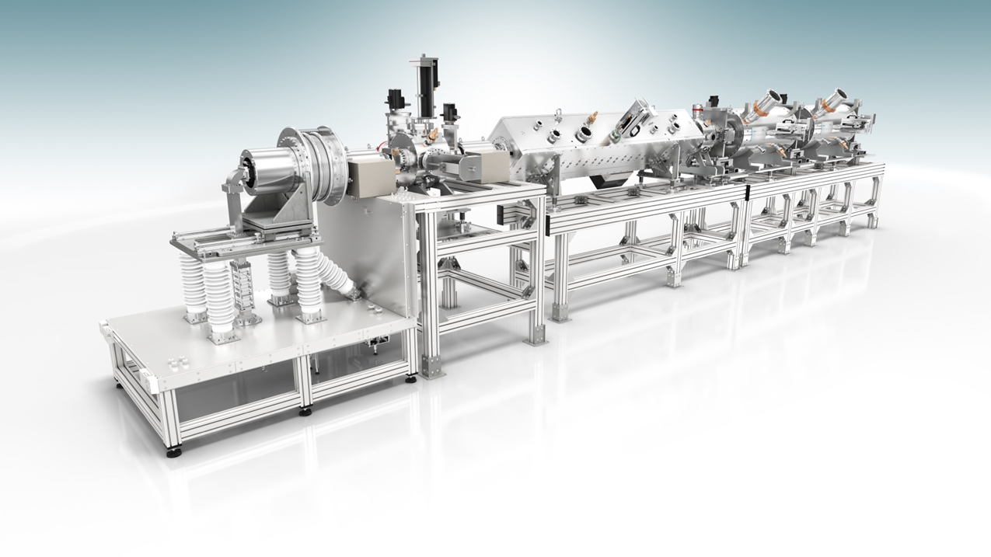



BNCT Linacs

Slide 40


Summary
Neutrons are an essential tool in many areas of science and technology
There is a demand for new accelerator based neutron sources
HiCANS facilities provide an flexible possibility to deliver neutrons
Projects
  FRANZ
  HBS
  MYRRHA
  BNCT

Slide 41
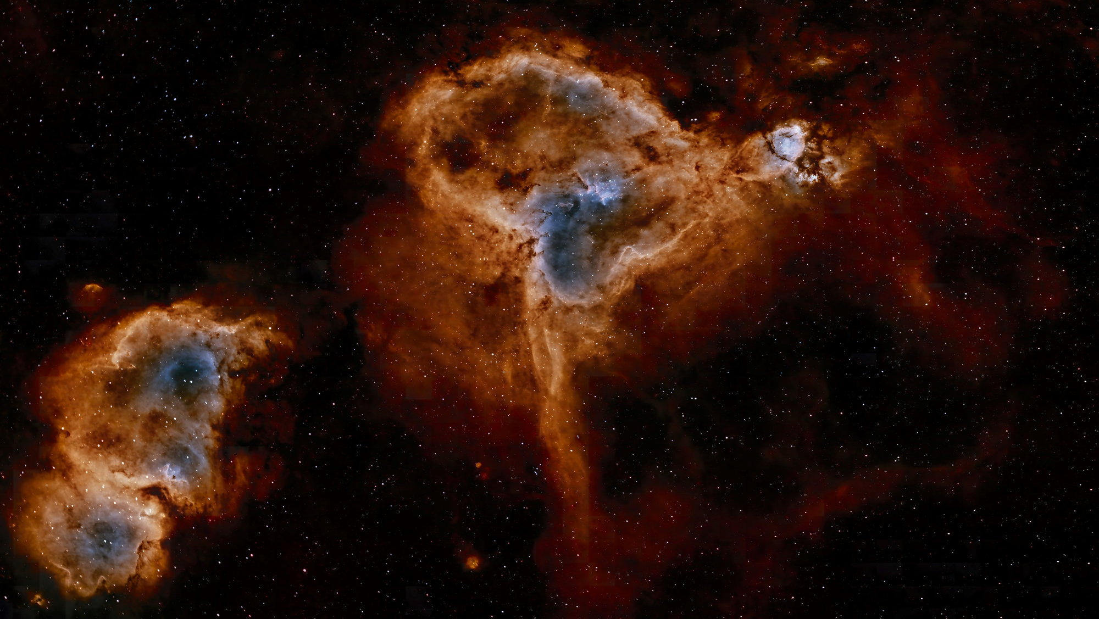
Backup

Slide 42
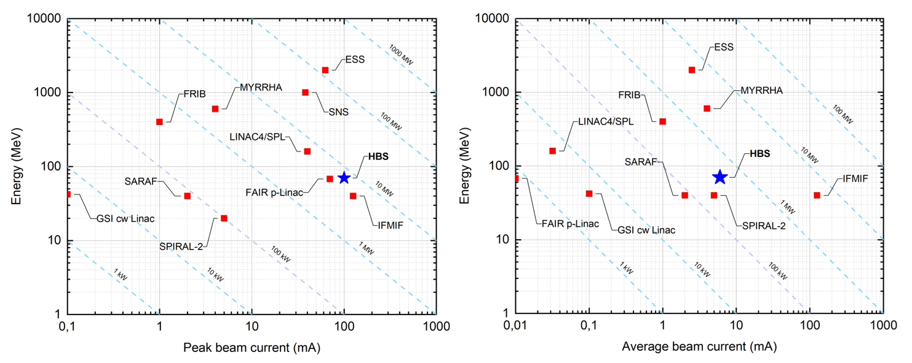
Peak and Average Beam Power of Modern Hadron Linacs

Slide 43
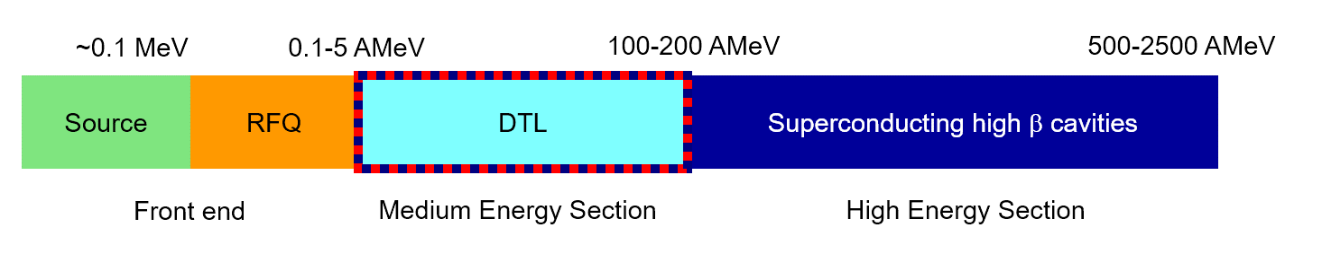
Schematic Layout of Modern Proton Linacs
HBS
ECR-source
RFQ
sc high β-cavities
Situation for medium energy section is not that clear wrt choice of technology (rt vs sc)
clear

Slide 44
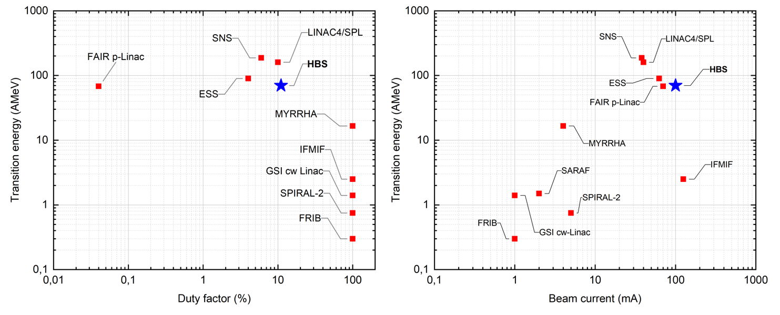
Transition Energy RT-SC

Slide 45
HBS-Accelerator
Choice of Technology
Normal Conducting
Superconducting
Low Energy High Energy
HBS
High Beam Power Low Beam Power
HBS
Low Duty Factor High Duty Factor
HBS

Slide 46
Room Temperature HBS-Accelerator
Peak beam power: 7 MW
Peak RF power: ≈12 MW
Much simpler technology
Easy access to all components
No cryo-plant
No cryo-modules
Beam losses less severe (quenches): more reliable...
Easier beam dynamics
(no additional drifts due to cold-warm-transitions)
A room temperature linac is the most reasonable and safe solution

Slide 47

LLRF
S. Lamprecht, IAP

