Slide 1
Recent Technical Advances in Penning Trap Mass Spectrometry
Sebastian George
Max-Planck-Institut für Kernphysik
Bad Honnef 2013

Slide 2
Outline
Motivation / Introduction
Ion Production
In-trap Decay
Cleaning Procedure
SIMCO Excitation
Ramsey-type Dipolar Cleaning
Mass Determination
Ramsey Excitation
Octupolar Excitation Scheme
Phase-Imaging Ion-Cyclotron Resonance

Slide 3
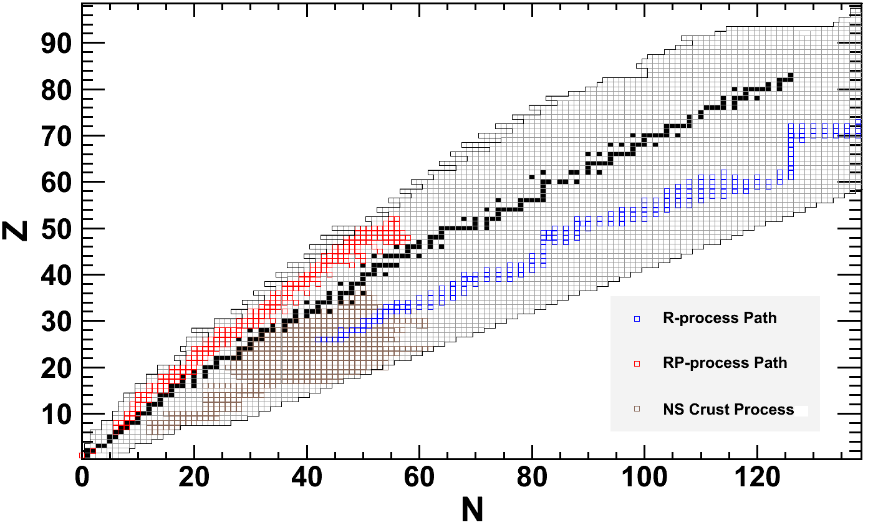
Masses for Nuclear Astrophysics
Masses, Half-lifes, Reaction Rates

Slide 4
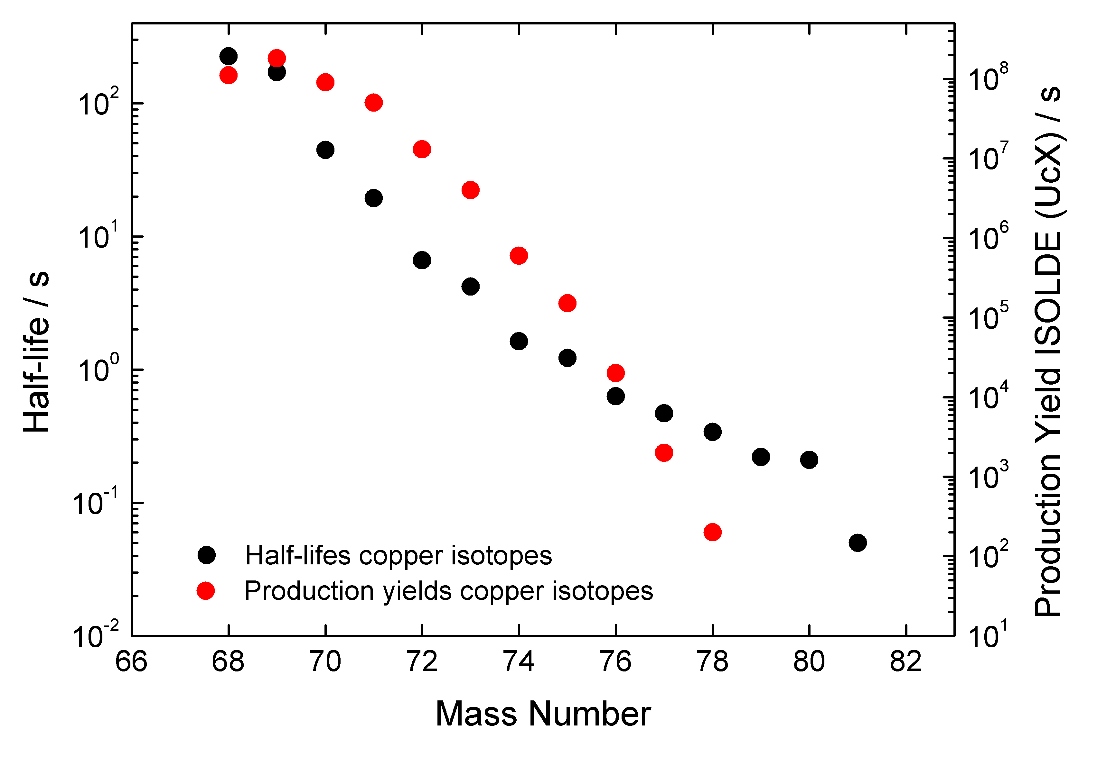
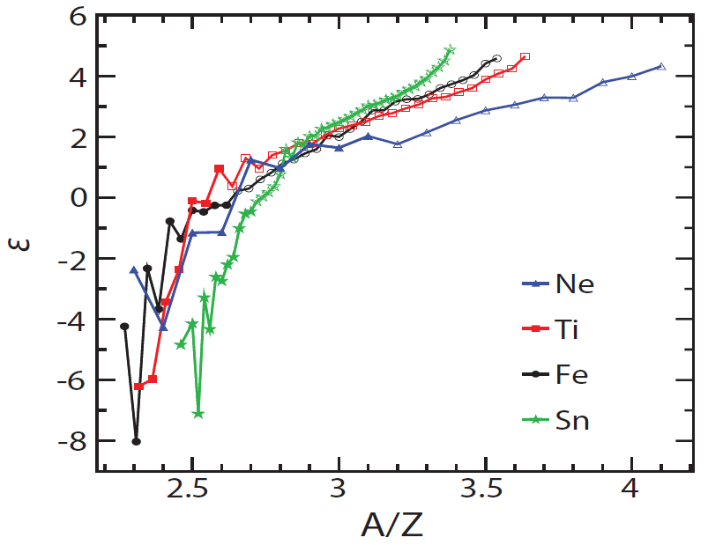
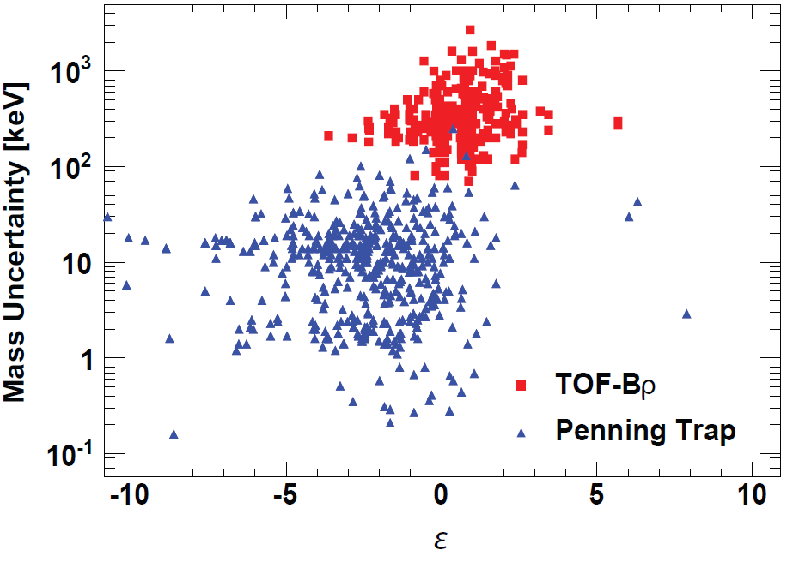
“Exotic” Nuclei
D. Lunney et al., Review of Modern Physics 75 (2003) 1021.
P. Möller, et al., Physical Review C 67 (2003) 055802.

Slide 5
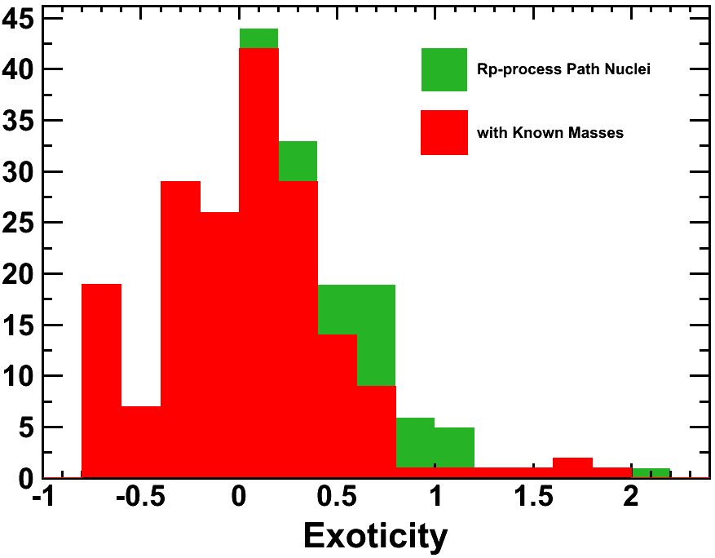
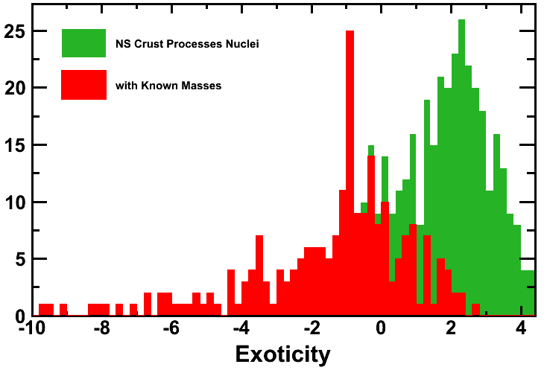
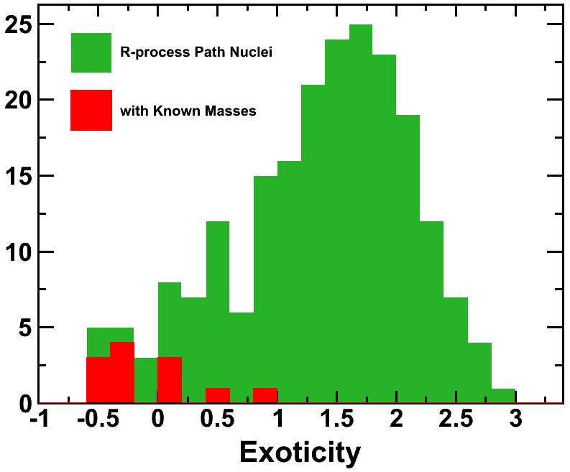
Exotic Nuclei in the rp-Process

Slide 6
Exotic Nuclei in Neutron Star Crust

Slide 7
Exotic Nuclei in the r-Process

Slide 8
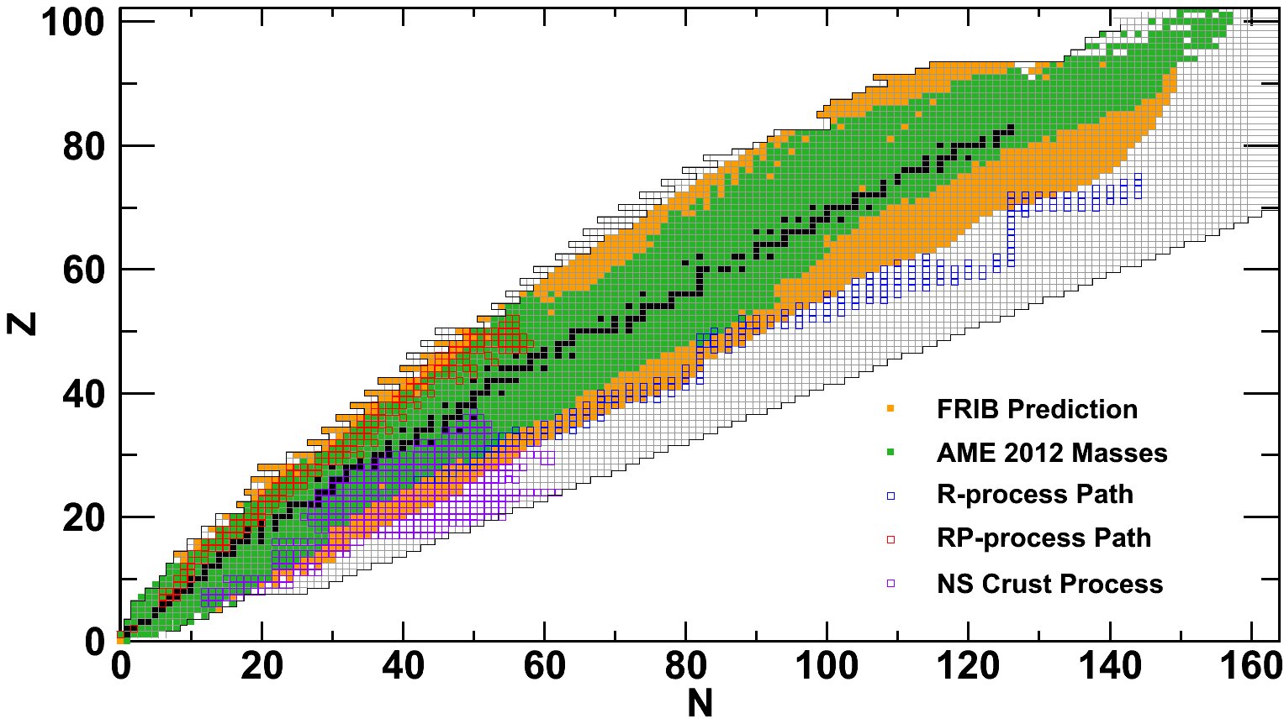
Accessibility of Isotopes
Predicted Production of at least 1000 / day

Slide 9
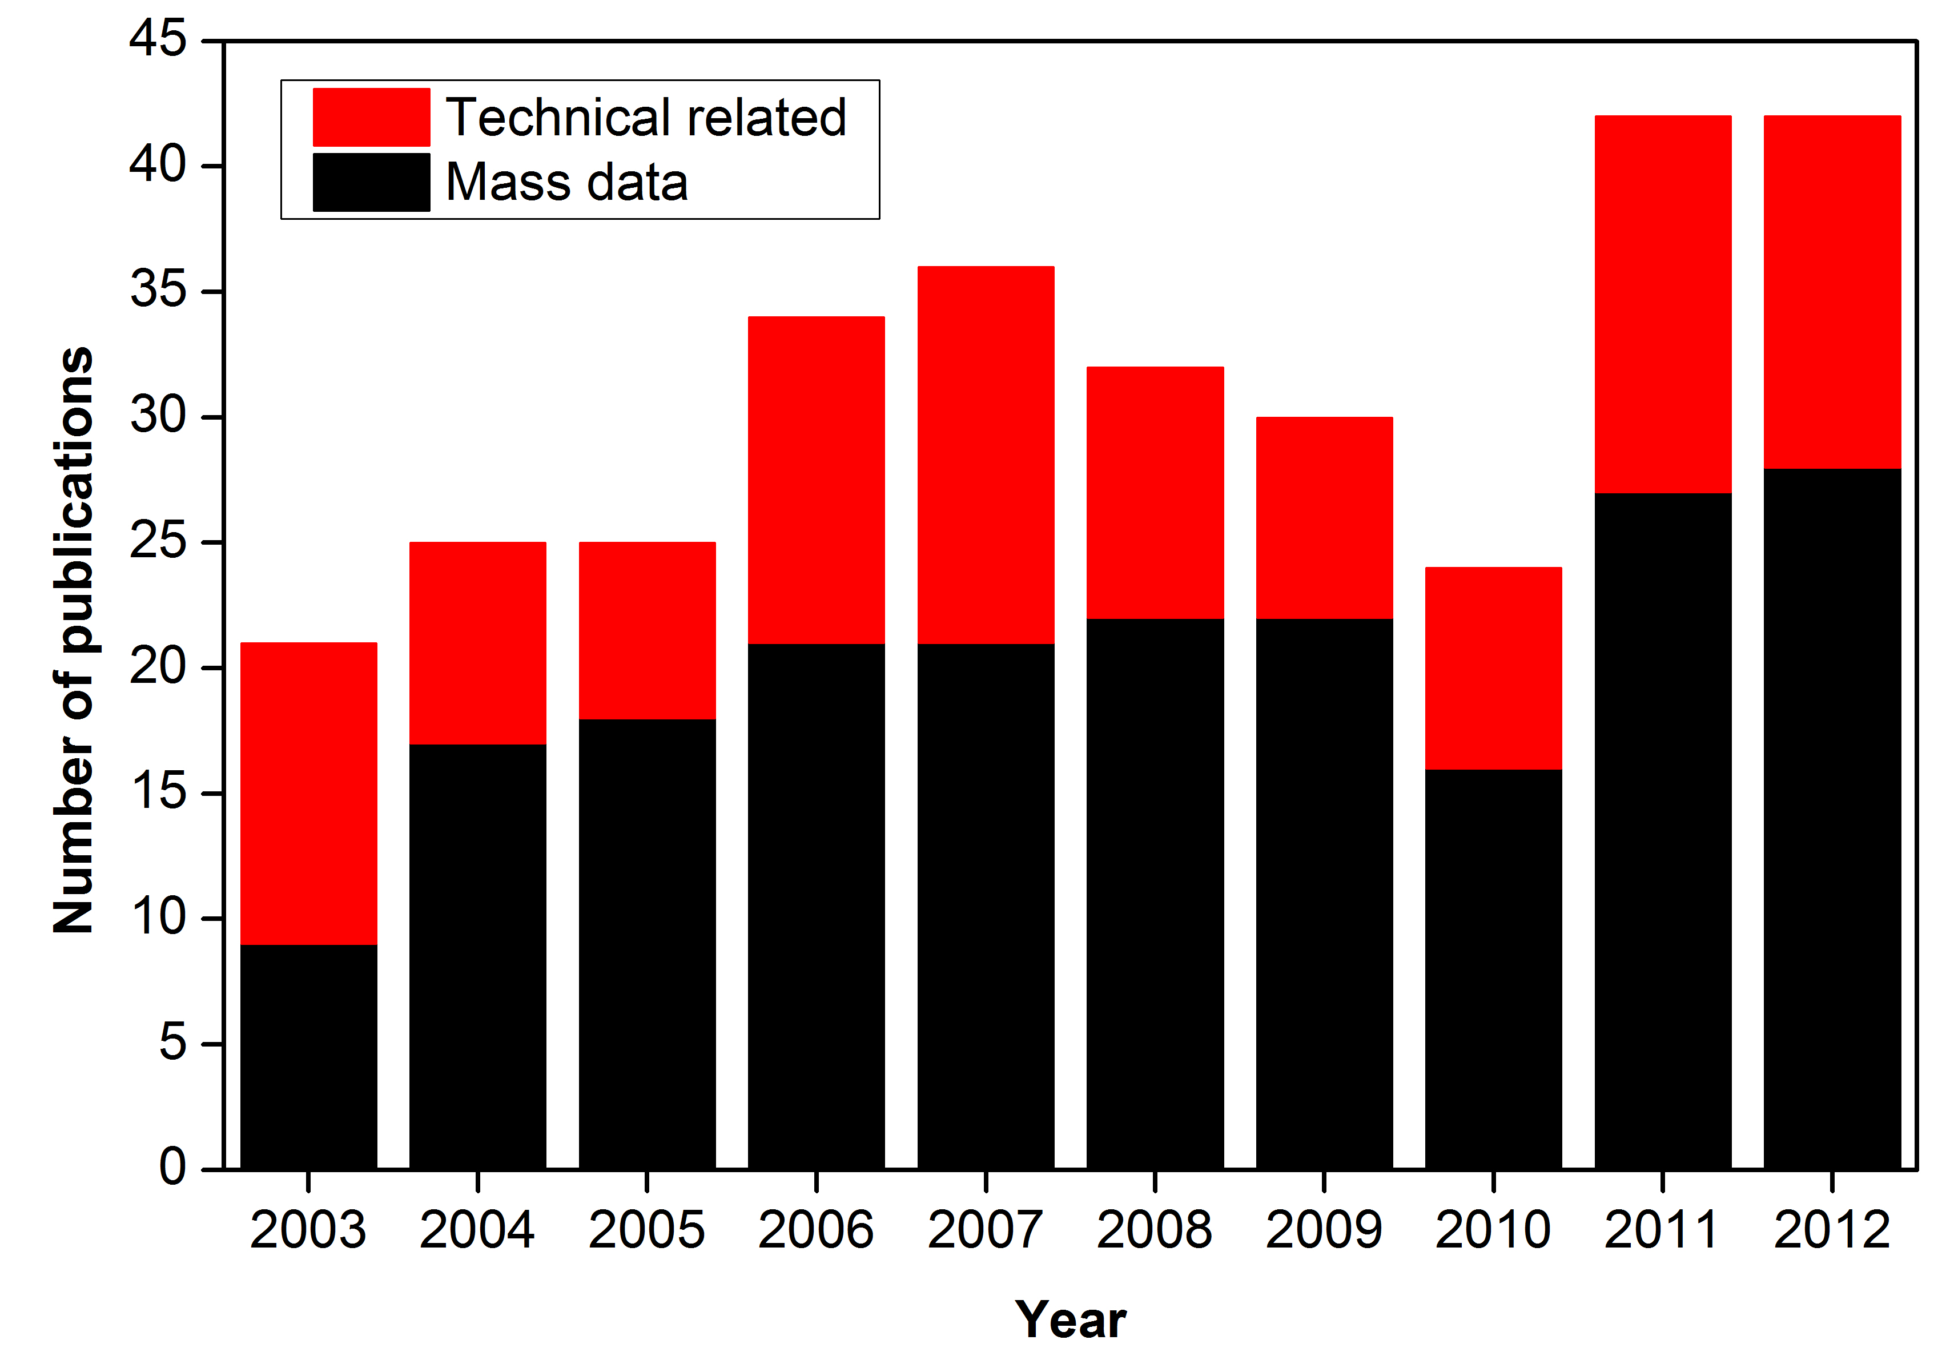
Technical Publications
≈ 40% technical related publications
(Penning trap mass spectrometer)

Slide 10
Penning Traps at Radioactive Ion Beam Facilities
Detection System
Microchannel Plate Detector, Channeltron
Precision Penning Trap
Mass determination
Preparation Penning Trap
Buffer-gas Cooling
Stopping and Accumulation
Radiofrequency Quadrupole Trap, Gas Cell

Slide 11
Ion Preparation / Cooling
Buffer-gas (He) in preparation trap
Motional amplitudes are reduced
Well-controlled conditions
Ion beam cocktail: R=10²-10³ (Selection by dipole magnets)

Slide 12
Mass Selective Buffer-gas Cooling
Resolving Power R=10⁵
Cooled ions
Dipolar excitation at
magnetron frequency
(≈ mass independent)
Quadrupolar excitation at
the cyclotron frequency
(mass selective recentering)
G. Savard et al., Phys. Lett. A 158 (1991) 247.

Slide 13
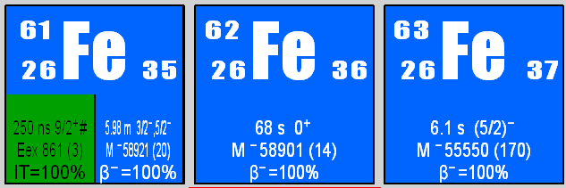
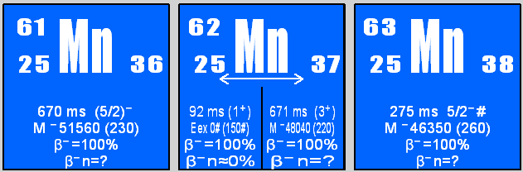
In-Trap Decay
produced
A. Herlert
e⁺
⁴He
_{A}
_{A}
e⁺
_{Z}X
_{Z-1}Y
+
e⁺
⁴He
_{A}
_{Z}X
not produced
⁴He
_{A}
_{Z}X
A. Herlert et al., New J. Phys. 44 (2005) 1021.
_{A}
_{Z-1}Y
⁴He
e⁺
⁴He
_{A}
_{A}
_{Z-1}Y
_{Z}X
⁴He
_{A}
_{Z-1}Y
_{A}
_{Z}X
⁴He
e⁺
⁴He
⁴He
_{A}
_{Z}X
e⁺
⁴He
Herlert et al., Eur. Phys.J. A 48 (2012) 97.

Slide 14
ISOLDE Yields (2006)
Release suppression due to
chemical properties of targets
and elements of interest
e⁺
⁴He
⁴He
e⁺
_{A}
_{Z}X
⁴He
_{A}
_{Z}X
_{A}
_{Z-1}Y
⁴He
e⁺
⁴He
_{A}
_{A}
_{Z-1}Y
_{Z}X
⁴He
_{A}
_{Z-1}Y
_{A}
_{Z}X
⁴He
e⁺
⁴He
⁴He
_{A}
_{Z}X
e⁺
⁴He
A. Herlert
2006:
70 elements 800 nuclides

Slide 15
Dipolar Cleaning
Dipolar excitation at reduced
cyclotron frequency
(mass dependent)
Known contamination
SWIFT cleaning
Unwanted excitation of
species of interest
Resolving power R=10⁶

Slide 16
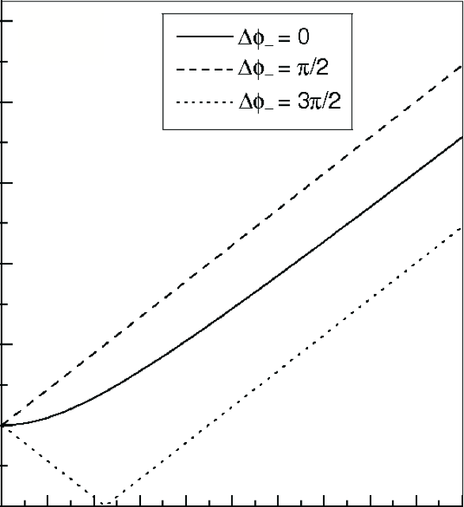
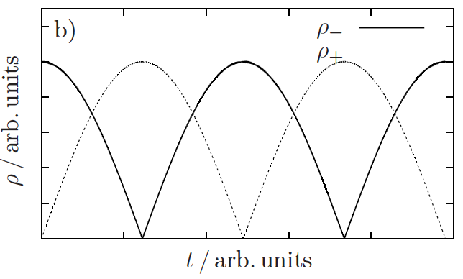
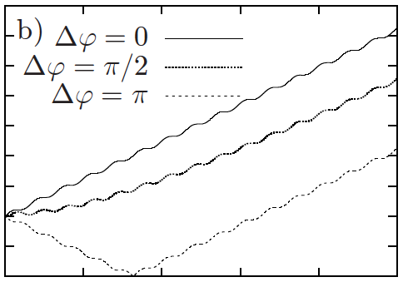


SIMCO
SImultaneous application of a dipolar excitation at Magnetron
frequency and resonant COnversion at cyclotron frequency
Dipolar
Excitation
Quadrupolar
Excitation
M. Rosenbusch et al., Int. J. Mass Spectrom. 325 (2012) 51.
M. Kretzschmar et al., Int. J. Mass Spectrom. 325 (2012) 30.
M. Rosenbusch

Slide 17
Theory
Simplest case: Ion starts in center, on-resonant excitation for both excitation
schemes
No buffer-gas
Simple equation for the evolution
of the radii
Ion returns to center periodically
→ dipolar field strength
→ quadrupolar field strength
M. Rosenbusch et al., Int. J. Mass Spectrom. 325 (2012) 51.
M. Kretzschmar et al., Int. J. Mass Spectrom. 325 (2012) 30.
M. Rosenbusch

Slide 18
Experimental Tests
Excitation time: 92 ms, FWHM: ≈ 3.5 Hz
Efficiency: 100%
Excitation time: 185 ms, FWHM: ≈ 2.5 Hz
Dipolar Cleaning:
Excitation time: 1000 ms, FWHM: ≈ 3 Hz
Resolving Power R=8*10⁵
Well-suited for highly-charged ions
requiring superb vacuum conditions
M. Rosenbusch

Slide 19
Higher Precision – Lower Statistics?
Nuclear Physics
mass formula, models, halo
Titan (Jens Dilling et al.)
LEBIT (Georg Bollen et al.)
Advanced Measurement Schemes
  Ramsey Excitation
  Octupolar Excitation (higher harmonics)
  Phase-Imaging Ion-Cyclotron-Resonance
δm/m ≈ 10⁻⁶-10⁻⁷
Astrophysics
nuclear synthesis,
r-, rp-process
Octupolar
Quadrupolar
δm/m < 1·10⁻⁷
3 times higher precision ≅ 9 times lower statistics ≅ 1 isotope further out
4/26/13

Slide 20
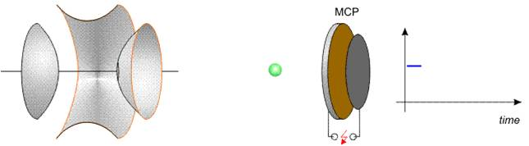
TOF-ICR
7 T
Scan QP-excitation freq. ν_{rf} about ν_{c}
0
Magnetron excitation
Quadrupole excitation ν_{rf}
radial ⇒ axial energy
Time-of-flight (TOF)

Slide 21
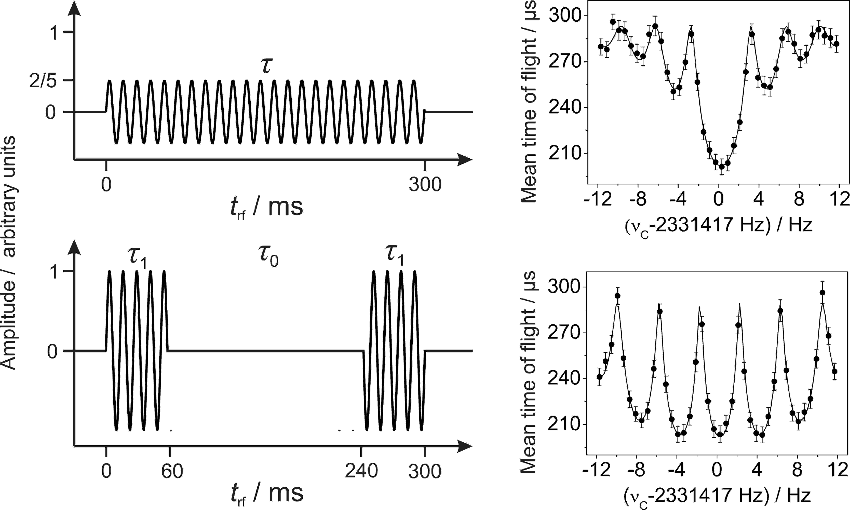
Ramsey Excitation
1/10 of the statistics required by conventional excitation
S. George et al., Phys. Rev. Lett. 98 (2007) 162501.
M. Kretzschmar, Int. J. Mass Spectrom. 264 (2007) 122.
S. George et al., Int. J. Mass Spectrom. 264 (2007) 110.
G. Bollen et al., NIMB 70 (1992) 490.

Slide 22
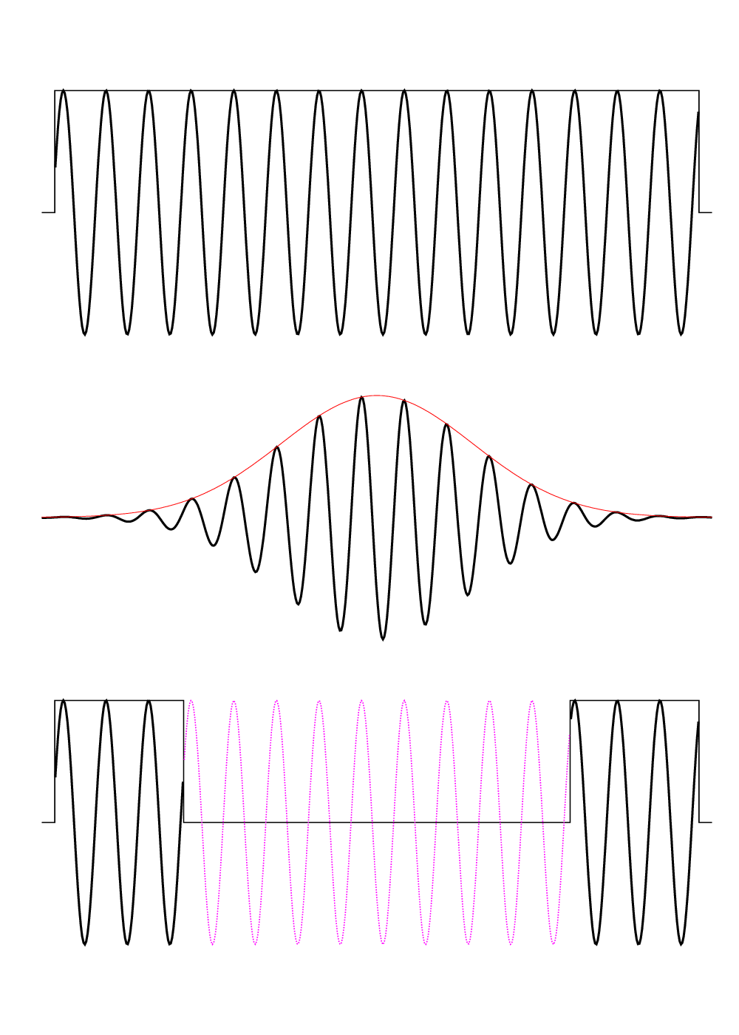
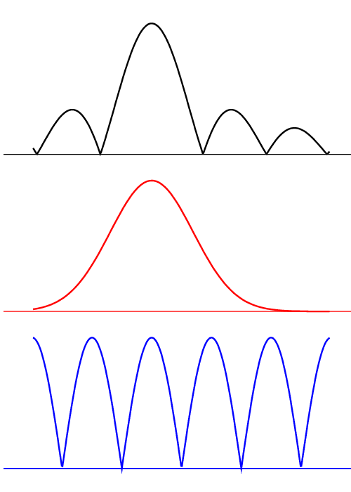
Ramsey Cleaning
A_{RF}
Radius
Constant RF amplitude
0.9*T_{RF} [Hz]
time
frequency
Gauss-modulated
> 2*T_{RF} [Hz]
Time-separated - Ramsey
0.4*T_{RF} [Hz]
T. Eronen et al., NIMB 266 (2008) 4527.
T. Eronen

Slide 23
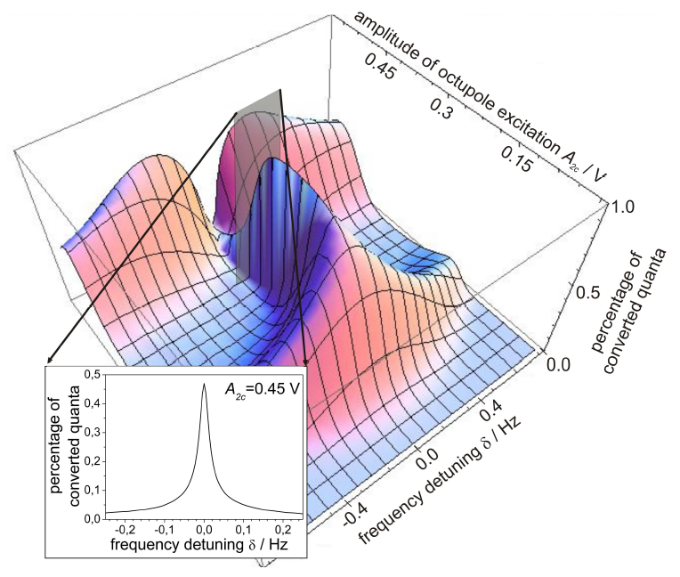
Octupolar Excitation
Quadrupolar
Octupolar
LEBIT: R. Ringle et al., Int. J. Mass Spectrom. 261 (2007) 33.
SHIPTRAP: S. Eliseev et al., Int. J. Mass Spectrom. 261 (2007) 45.
No theoretical description available
Different line shapes compared
to quadrupolar excitation
Very sensitive to initial conditions:
  Radii
  Phases
  Excitation amplitudes
At least 20 folds improvement in
resolving power!

Slide 24
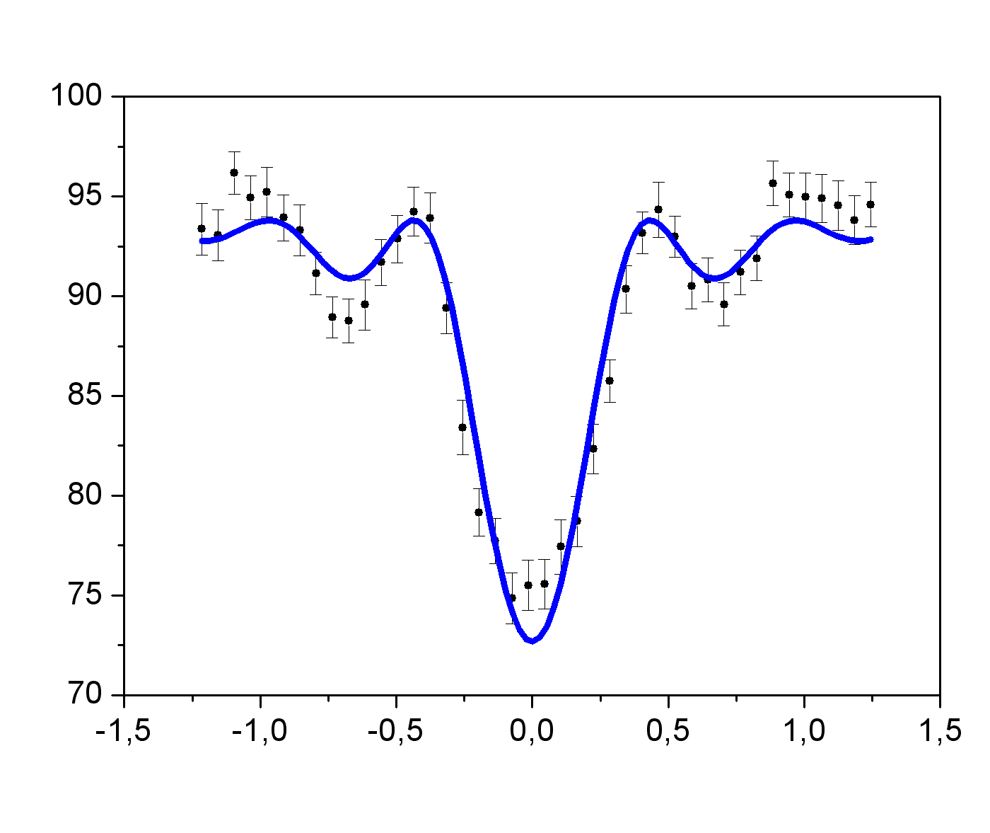
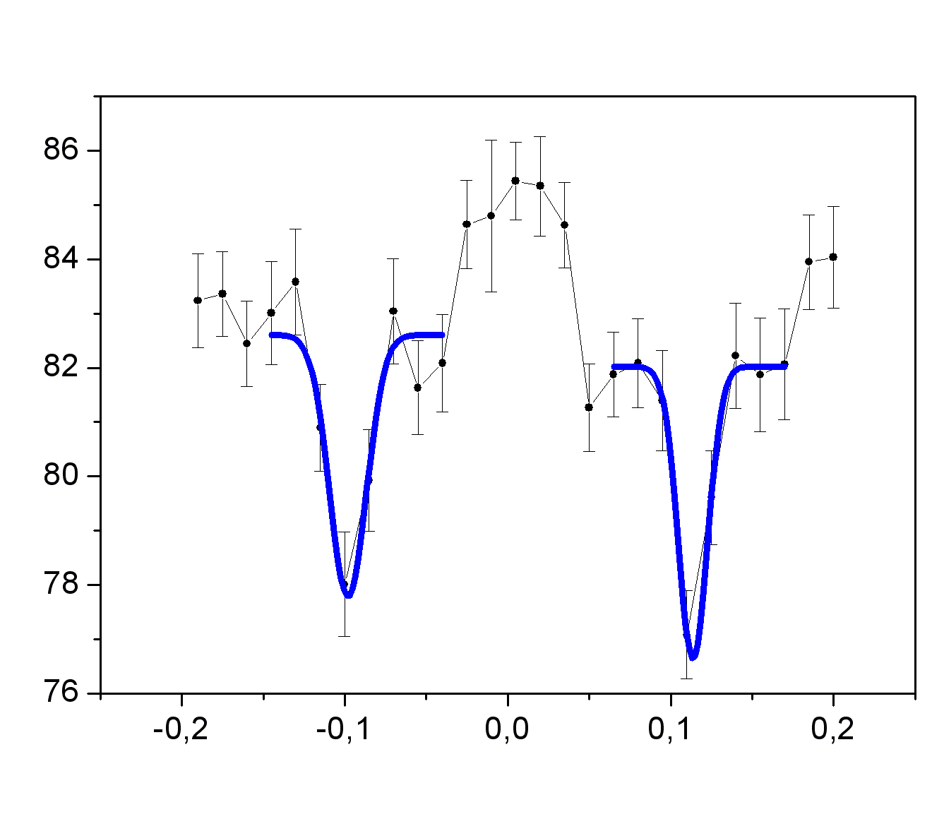
¹⁶⁴Er and ¹⁶⁴Dy
Quadrupolar
Octupolar
¹⁶⁴Er and ¹⁶⁴Dy are not resolved
¹⁶⁴Er and ¹⁶⁴Dy are resolved
70 keV
TOF / μs
2.5 keV
23 keV
Δf / Hz
Δf / Hz
A resolving power of 10⁸ has been demonstrated in a Penning trap.
S. Eliseev et al., Phys. Rev. Lett. 107, 152501 (2011).

Slide 25
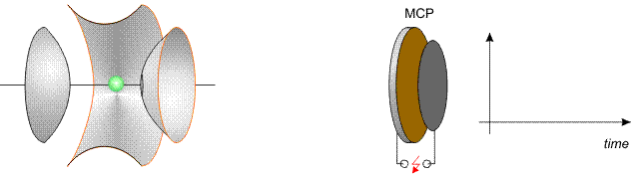
From Counting to Position Sensitivity
Destructive
time-of-flight
detection

Slide 26
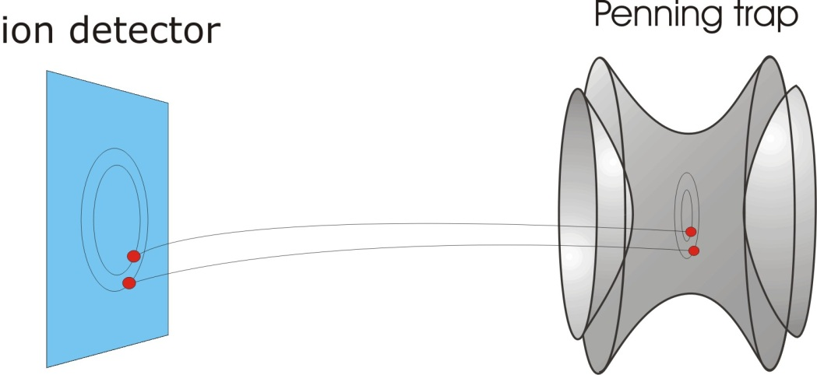
From Counting to Position Sensitivity
Destructive
time-of-flight
detection
Space
resolving
detection

Slide 27
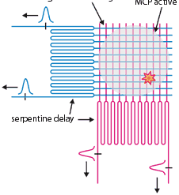
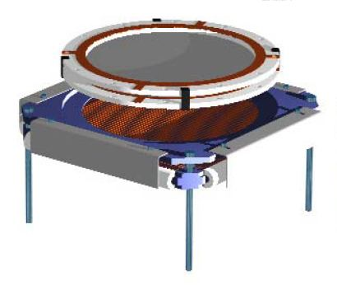
From Counting to Position Sensitivity
Destructive
time-of-flight
detection
MCP Active Area
Space
resolving
detection
Serpentine Delay
Delay-line
detector

Slide 28
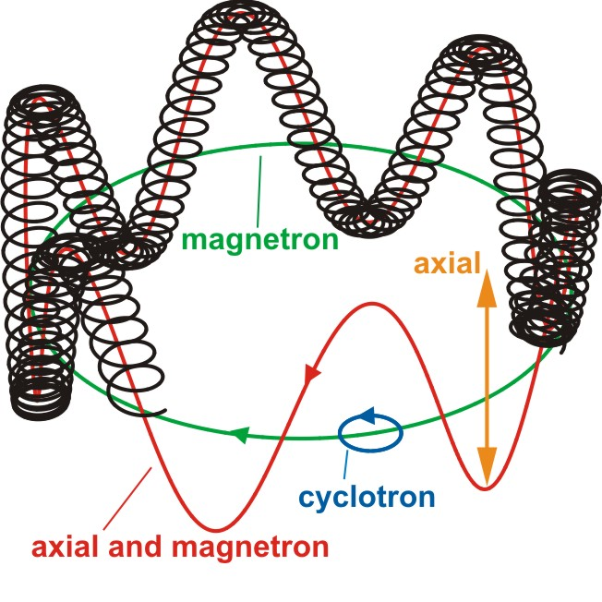
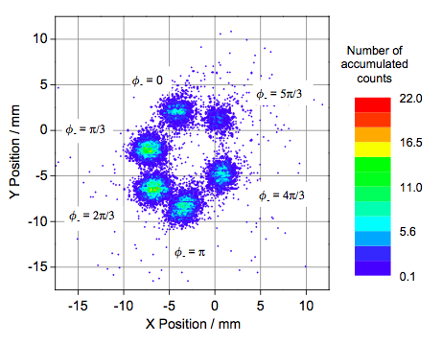
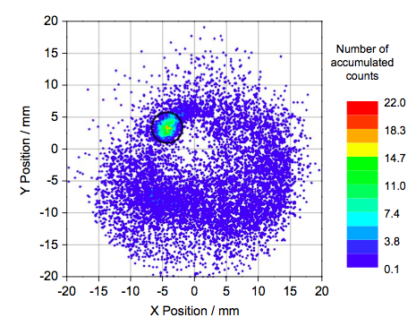
Visualizing the Ion Motion
G. Eitel et al., NIMA 606 (2009) 475.
Typical frequencies:
q = e, m = 100 u,
B = 6 T, U₀=10 V:
⇒ f₋ ≈ 1 kHz
f_{z} ≈ 50 kHz
f₊ ≈ 1 MHz

Slide 29
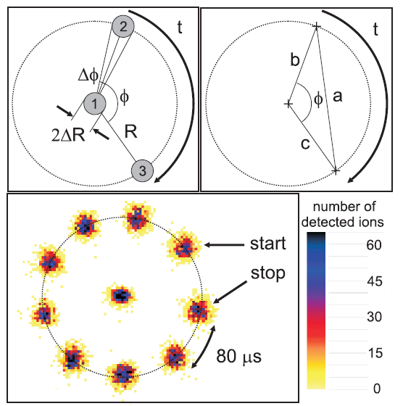
Phase-Imaging Magnetron Measurement
S. Eliseev
S. Eliseev et al., Phys. Rev. Lett., 110 (2013) 082501.

Slide 30
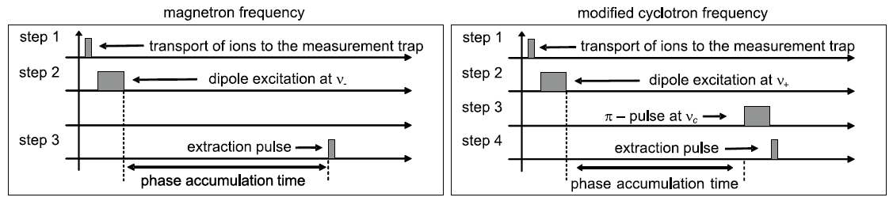
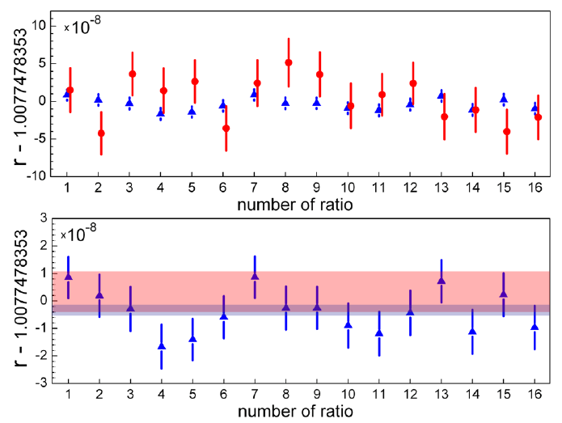
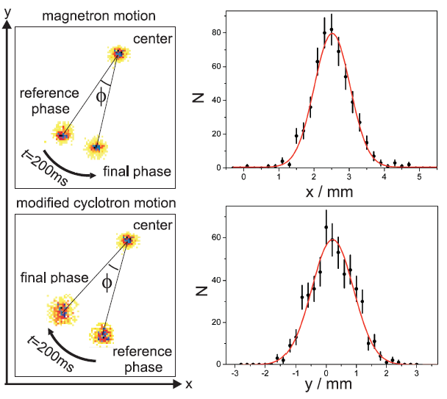
Phase-Imaging Cyclotron Measurement
Gain of a factor of 10 in precision
and a factor of 100 in resolution.
S. Eliseev

Slide 31
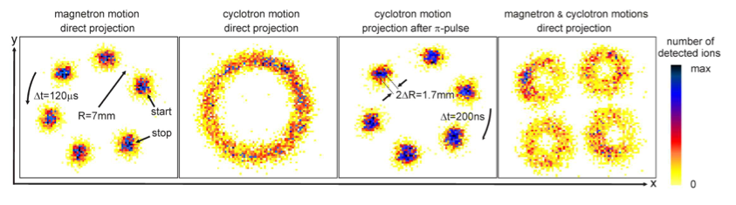
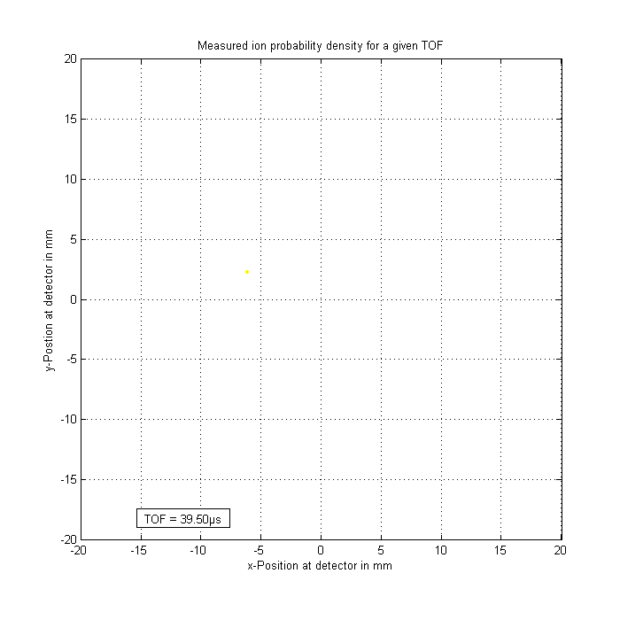
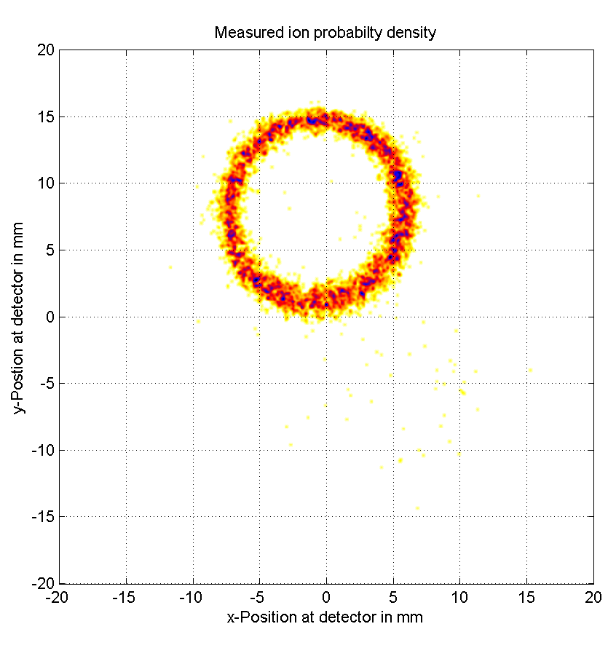
On the Way to Mass Measurements

Slide 32
Outlook
Phase-Imaging ICR (SHIPTRAP)
Fourier-Transform ICR (LEBIT, TRIGA)
MR-TOF (ISOLTRAP)
Highly-charged Ions (TITAN)

Slide 33
The End
Thank you for your attention
Special thanks to the ISOLTRAP collaboration
and
Klaus Blaum, Tommi Eronen, Sergey Eliseev,
Alexander Herlert, and Marco Rosenbusch

