Slide 1
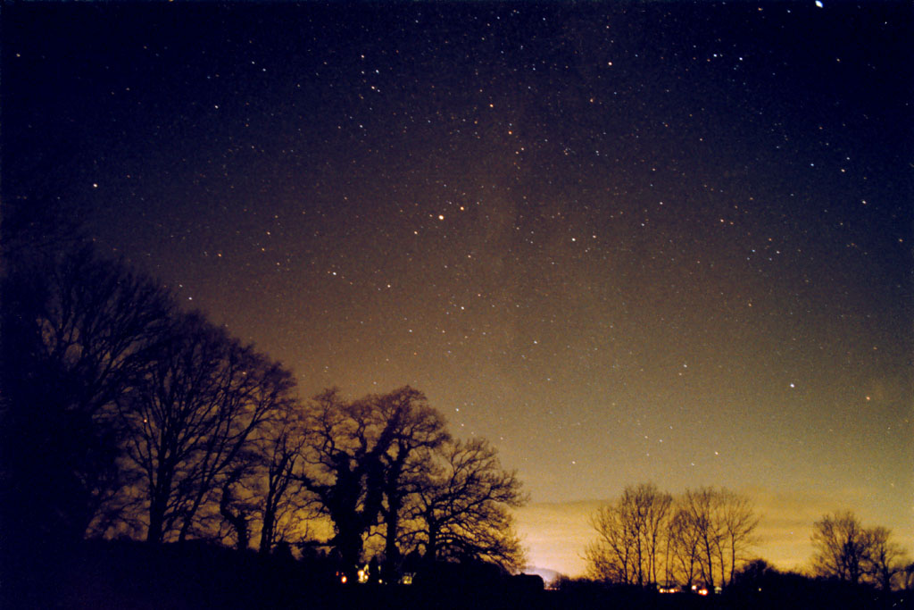
Nuclear masses in astrophysics
Hendrik Schatz
Michigan State University
Dept. of Physics and Astronomy
National Superconducting Cyclotron Laboratory
Joint Institute for Nuclear Astrophysics

Slide 2
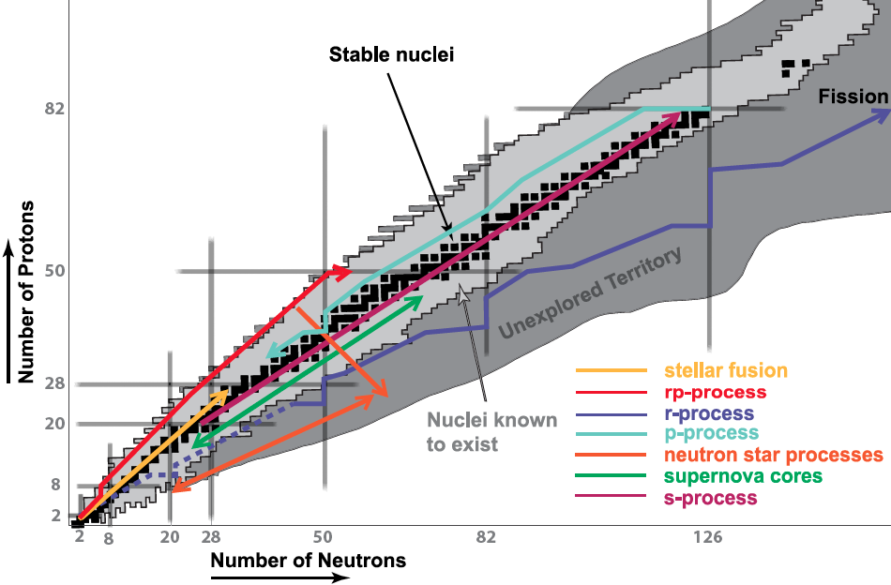
Astrophysical processes
rp-process
(X-ray bursts)
νp-process
r-process
Crust process
Masses far from stability still unknown → rp, νp, r, crust processes

Slide 3



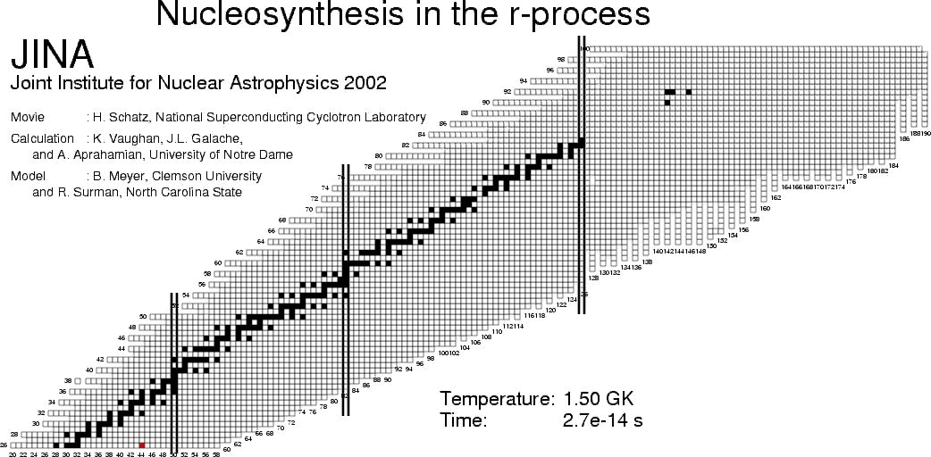
A possible pathway of the r-process
Compare calculated results with many precision abundance observations ?
→ Masses and half-lives of very unstable, exotic nuclei need to be known

Slide 4
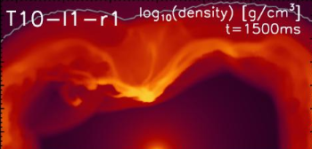
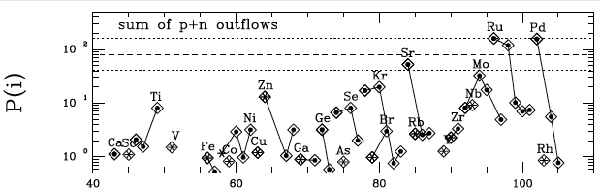
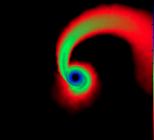
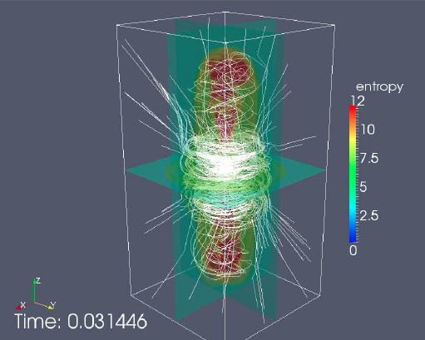
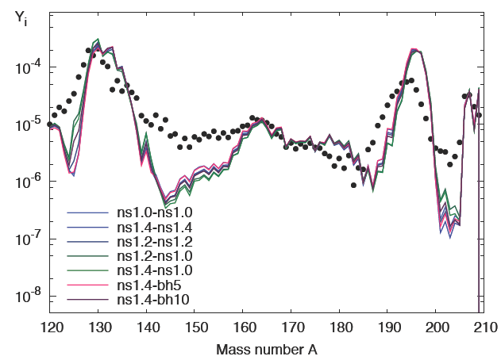
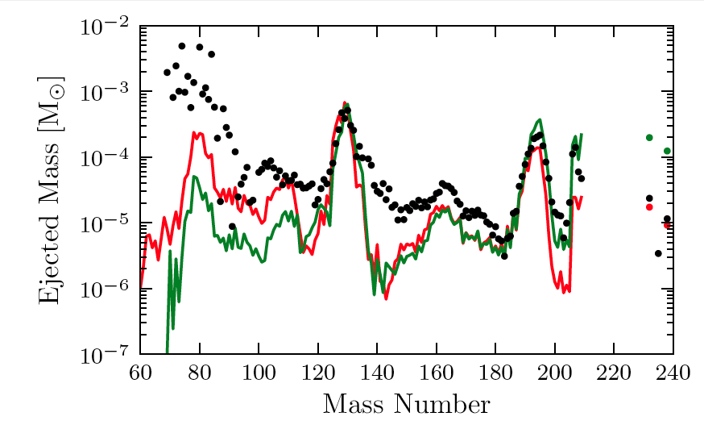
Advances in Theoretical Astrophysics
Neutrino driven wind
Hoffman et al. 2008
Overproduction
Winteler et al. 2012
Mass Number
Korobkin et al. 2012
Neutron
star mergers
MHD Supernova Jets
Abundance
We now have several robust, rather self-consistent r-process models
To test them against observations → Need nuclear data now!
Goal: reveal model deficiencies and site physics signatures
Provide data for specific models

Slide 5
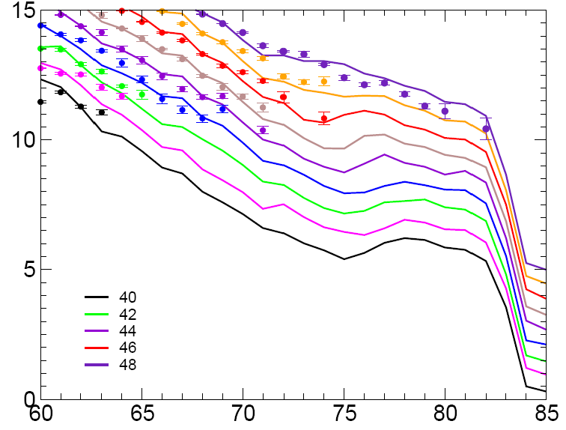
Trends of the mass surface do matter
Ru
Pd
Cd
Mo
Zr
S2n (MeV)
r-process path
ETFSI-1
From isotopic Sn difference: need mass uncertainty << 200 keV
Neutron number

Slide 6
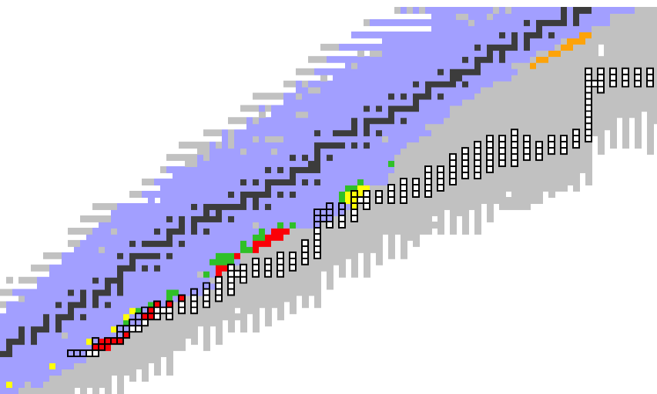
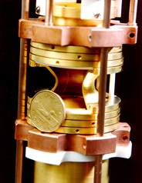
Recent r-process related experiments
Mass measurements (need 1:10⁶)
Penning Traps
TOF
(spectrometers,
storage rings)
N=126
N=82
ANL Trap
Jyvaskyla
Trap
GSI
ESR Ring
TRIUMF Trap
CERN/ISOLDE
Trap
NSCL
TOF
N=50

Slide 7
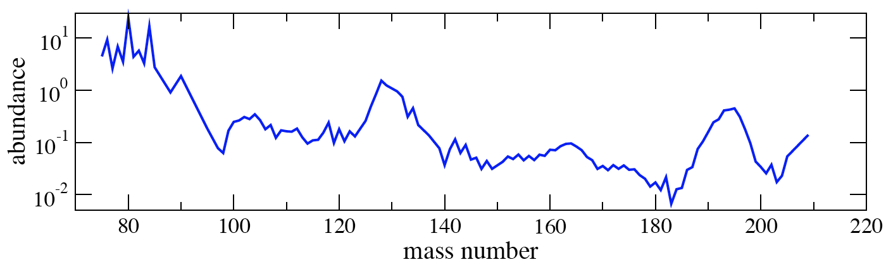
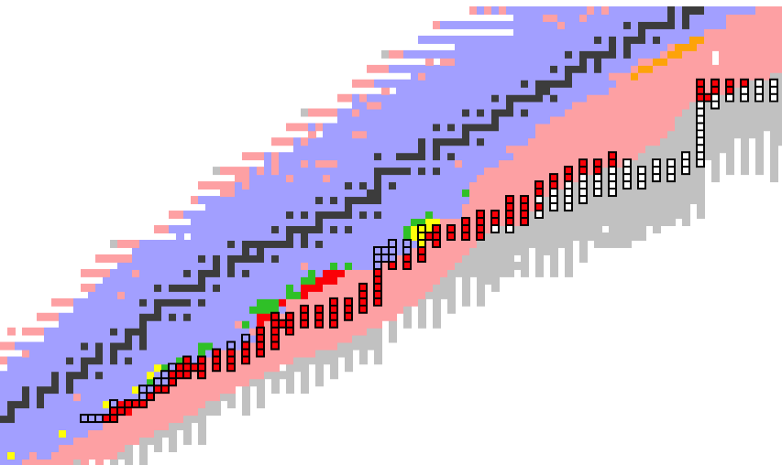
FRIB: Breakthrough in Nuclear Physics
Different key-regions probe
different model aspects
when compared to
observations
FRIB reach for T_{1/2}, masses
N=126
FRIB reach
for (d,p)
N=82
Critical region probes:
Main r-process parameters
Production of actinides
Critical region:
Disentangle
r-processes
Critical region probes:
r-process freezeout behavior
(Mumpower et al. 2012)
Critical region probes:
Main r-process parameters
Critical region probes:
Neutrino fluence

Slide 8
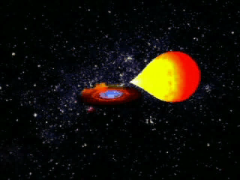
rp-process on Accreting neutron stars

Slide 9
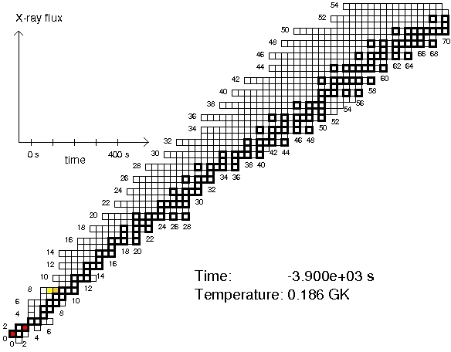
Deepest zone of first burst (model zM of Woosley et al. 2007)
Model by Heger, Woosley et al.; Similar to others: Fisker et al. and Jose et al.
Notes:
5% of solar metallicity;
INTERESTING NUCLEOSYNTHESIS: p-nuclei !!!!

Slide 10
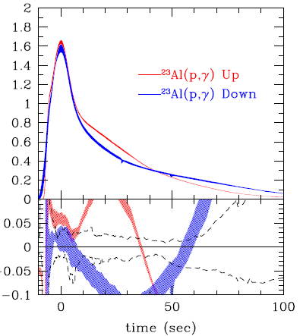
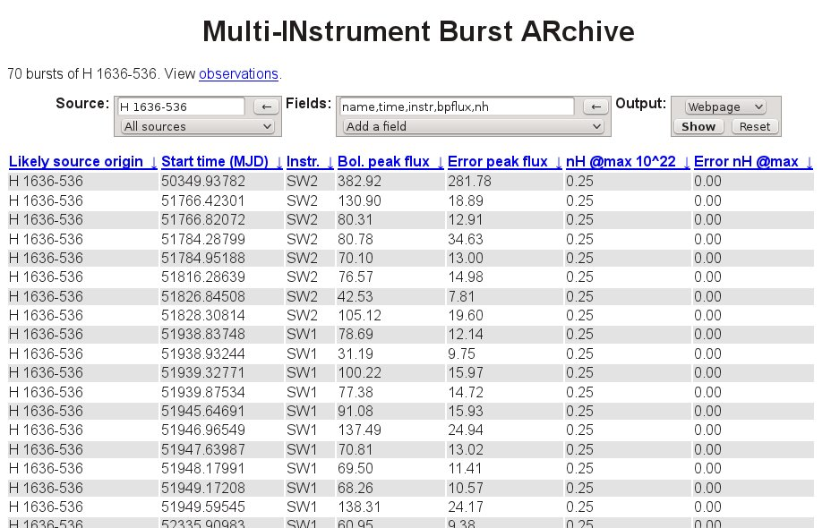
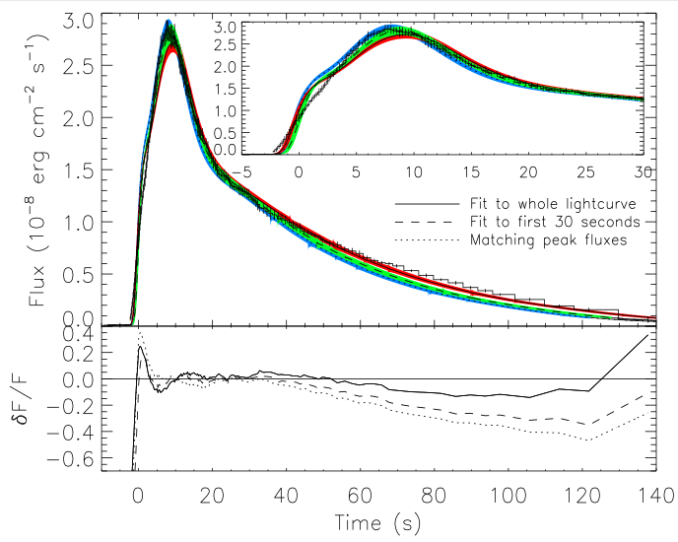
Interpretation of X-ray Burst Observations
Major progress in observations
MINBAR archive ~5000 widely varying bursts
Lightcurves depend on nuclear data
Amthor, Cyburt, Keek et al. 2012
Galloway
GS 1826-24
Example Template Analysis:
Determine surface redshift
Neutron star compactness
Also: brightness, distance,
accretion rate, accreted comp.
Redshift
variation
Data
Zamfir et al. 2012
Need nuclear data to create set of model templates for matching
to wide variety of specific bursts to analyze observations

Slide 11
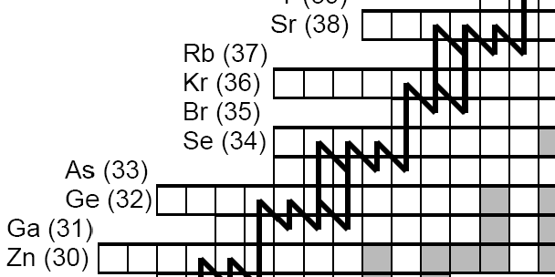

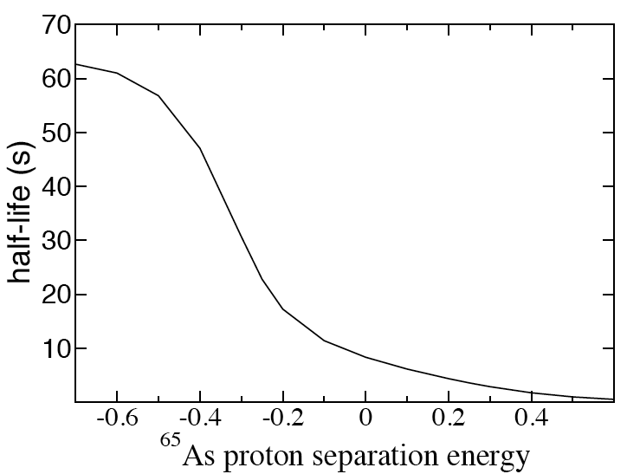
Direct mass measurements for p,γ-γ,p equilibrium
Waiting point masses:
Penning Trap precision
measurements:
ISOLTRAP, CPT, LEBIT
Need masses
What about these?
⁶⁴Ge lifetime in X-ray burst
p,γ-γ,p equilibrium
Estimate from
β-decay observation
Recent NSCL
experiments
measured
Measurement of ⁶⁵As mass
at Cooler Storage Ring in Lanzhou
(Tu et al. 2011) S_{p}(⁶⁵As)=-90(85) keV

Slide 12
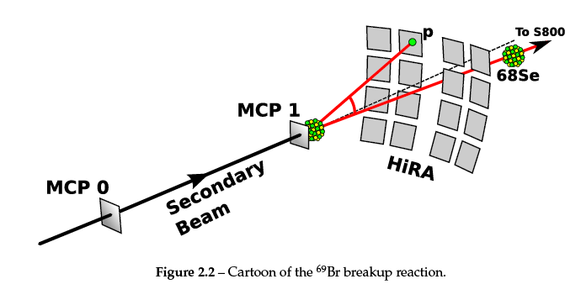
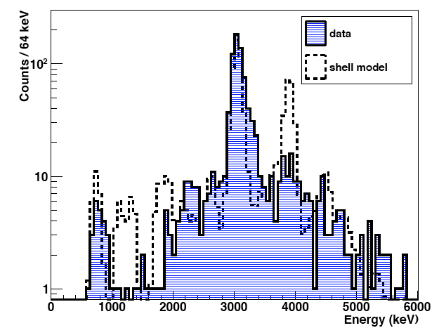
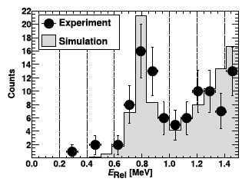
Populate ⁶⁹Br and detect p-decay at NSCL with fast radioactive beams
Reactions of ⁷⁰Se beam with ¹²C
(polypropylene target)
(A. Rogers et al. 2010)
β-delayed proton emission of ⁶⁹Kr
(M. Del Santo, Crawford, Gryner, Meisel 2013)
40x40 DSSSDs
⁶⁹Kr beam
NSCL Beta
Counting System
(detects ⁶⁹Kr and p)
Si PINs
-640(40) keV
-785(40) keV
→ 13% via ⁶⁸Se+2p
in the rp-process
Notes:
Note: parent 5/2- (from IAS going mainly to 2+). So populate 3/2- or 5/2-. Mirror suggests 5/2 gs, 3/2 close (100 keV), ½ a bit higher. 5/2
A bit longer lived as l=3
Decays must go to gs, as otherwise one would expect second peak for gs …

Slide 13
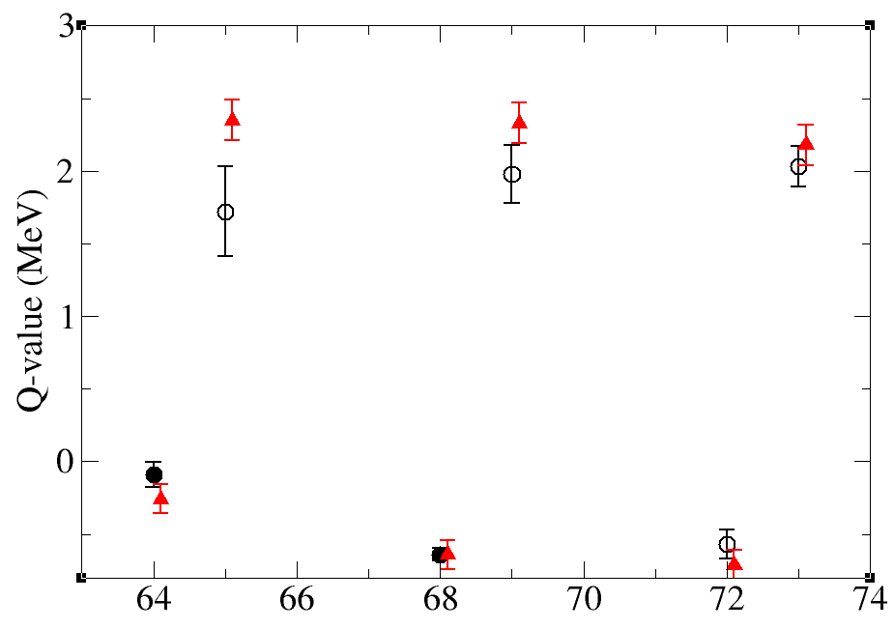
Use of Coulomb Displacement
Energies (CDE)
Brown et al. 2002
Proton capture Q-values
Discrepancy
between CDE
and AME12
extrapolation
for ⁶⁶Se
CDE: - 41.832 ± 0.1
AME11: - 41.722 ± 0.298
AME12: - 41.368 ± 0.298
CDE
AME12
Ge
As
Se
Br
Kr
Rb

Slide 14
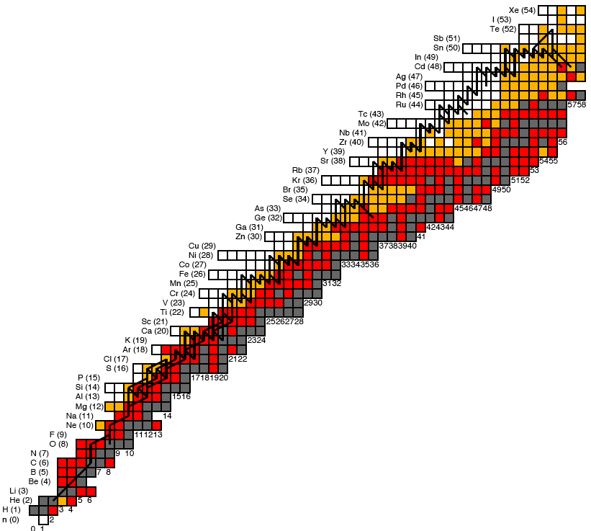
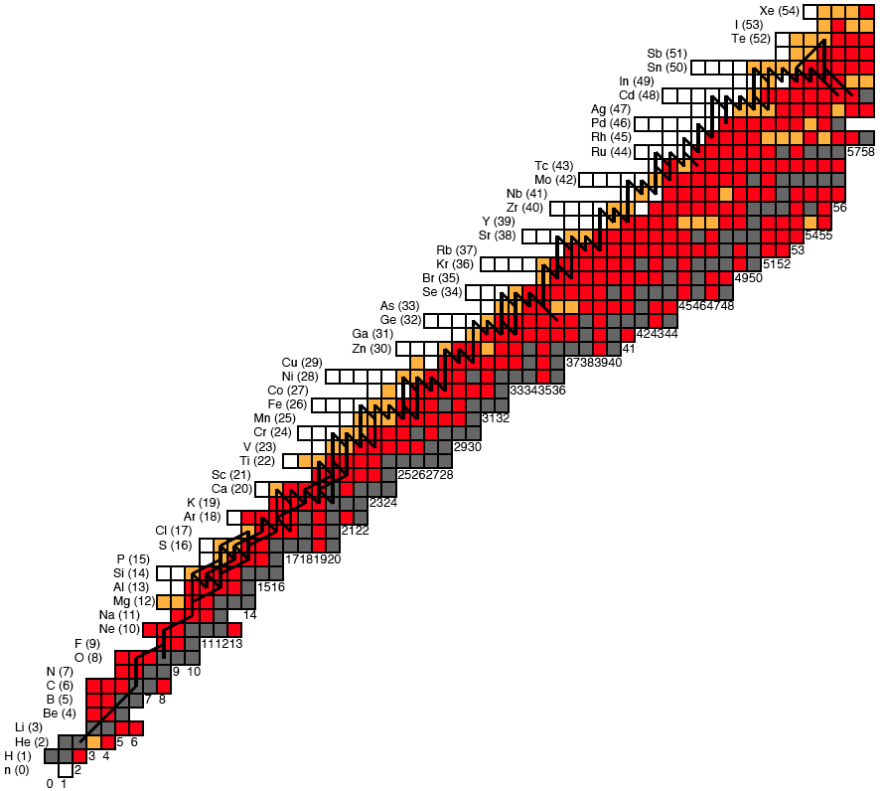

ORNL α-decay
JYFLTRAP - SnSbTe Cycle
JYFLTRAP
SHIPTRAP
CPT
ISOLTRAP
Final composition
Lanzhou CSR
burst light cuves
(⁴⁵Cr → no CaSc cycle)
CPT, ISOLTRAP, LEBIT
Lanzhou CSR
burst light cuves
Coulomb shift
calculations
(Brown et al.)
important masses identified Parikh et al. 2009
(for effect on final composition)
Mass known <10 keV
Mass known

Slide 15
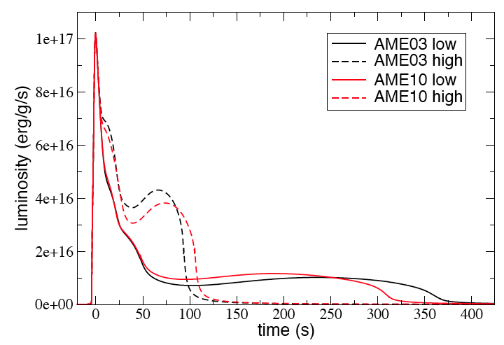
Maximum impact of mass uncertainties: (3σ, fully correlated)
Kankainen, Novikov, Schatz, Weber 2011

Slide 16
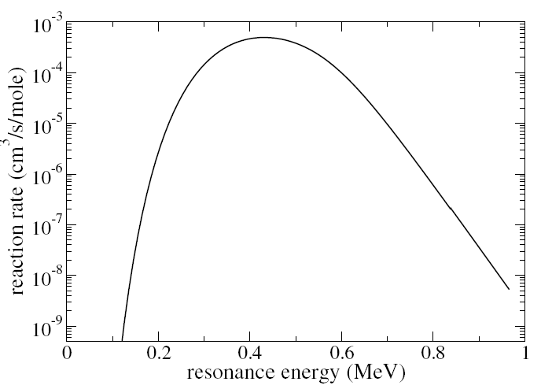
Masses for rates with isolated narrow resonances
³²Cl+p ³³Ar Reaction rate for T=0.4 x 10⁹ K
Coulomb penetrability
Often < 10 keV
(for x2 uncertainty)
Boltzmann e^{-E/kT}
For higher energy
resonances δQ < kT
in keV
E_{p}
³²Cl+p
Q
³³Ar
E_{r} = E_{x} - Q
Mass uncertainties translate into rate uncertainties if E_{r} calculated from E_{x}
Note: keV mass precision also needed to plan direct measurements

Slide 17
rp-process reaction rate measurements
⁵⁷Cu(p,γ)⁵⁸Zn reaction rate
Preliminary …
F. Montes, C. Langer
Remaining resonance energy uncertainty
dominated by ⁵⁸Zn mass (50 keV)
200 keV resonance energy uncertainty
(Forstner et al. )

Slide 18

Surface of accreting neutron stars
Neutron star surface
Radiative
cooling
Nuclear
reactions
H,He
gas
Thermonuclear
rp-process
ashes
ocean
Thermonuclear
C-burning
outer
crust
Electron
capture
Inner
crust
pycnonuclear
ν cooling
D. Page
All processes are connected:
composition (ashes = seed for next process)
heat release → thermal conditions everywhere
Notes:
Example: superbursts probe cooling

Slide 19
Crustal heating
25% heat, 75% ν-loss
E_{F}
Threshold difference
Released as energy
(neutrinos and
crust heating)
E_{F}
E_{F}
Z-2,N+2
even-even
E_{F}
e⁻
Z-1,N+1
odd-odd
E_{F}
E_{F}
e⁻
Z,N
even-even

Slide 20
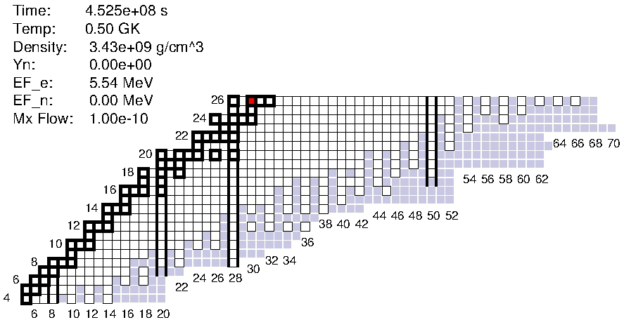
Crust processes: Electron capture and neutron emission
Masses: FRDM
Electron capture/β-decay: QRPA (P. Moeller, S. Gupta)
Neutron capture: TALYS,
degeneracy and plasma corrections (Shternin et al. 2012)
Equilibrium nucleus: N=82 (¹²⁰Sr)
(Steiner 2012) reached? (Jones 2005)
EC possible
Q_{EC} = −30 MeV
Unlike simple 1 component minimization models:
Super Electron Capture Cascades
instead of stepwise EC and n-emission
(Gupta et al. 2008)
Neutrons get captured on abundant nuclei
path splits, multi isotope composition
EC, (n,γ)
β-decay, (γ,n), fusion

Slide 21
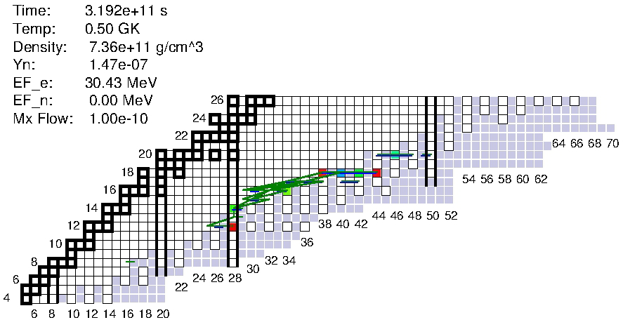
Crust processes: Pycnonuclear fusion cycles
Pycnonuclear fusion rates: M. Beard, D. Yakovlev, et al. 2010
⁴⁰Mg+⁴⁰Mg→⁴⁰Mg+⁴⁰n
Unlike simple 1 component minimization models:
Rapid fusion cycles because of EC Cascades
each cycle converts one ⁴⁰Mg into 40 neutrons
EC cascades can proceed to C before fusion wins
Multiple ion composition → many fusion reactions
⁴⁰Mg+²⁵N, ⁴⁰Mg+⁴⁰Mg, ⁴⁰Mg+²⁸O, ⁴⁰Mg+²⁰C, …
No path to equilibrium (Jones 2005)
EC, (n,γ)
β-decay, (γ,n), fusion
Notes:
21
Sqaures < 100 keV
Circles < 400 keV

Slide 22
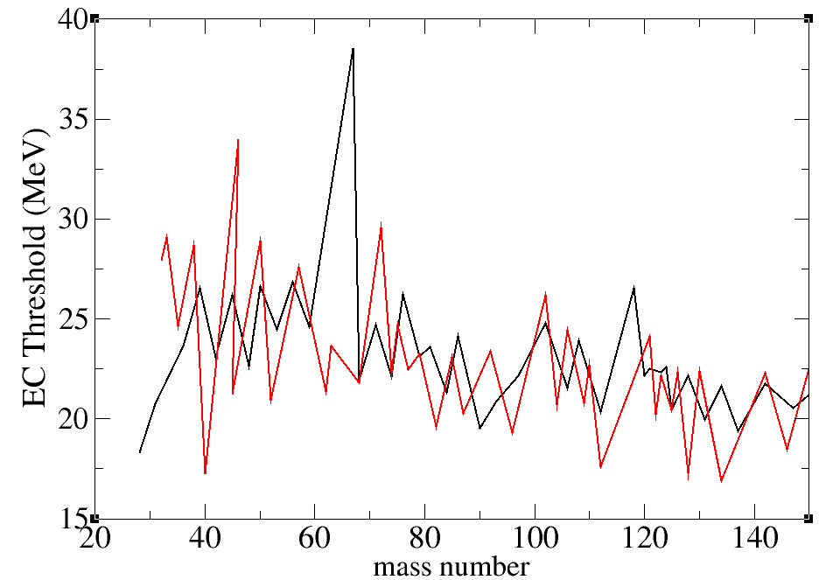
Importance of the mass surface
Increasing A along S_{n}=const
→ Decreasing |Q_{EC}|
→ Prevents heavy element buildup
Z
S_{n}=const
EC
EC sequence
|Q_{EC}| =const =E_{F}
EC Threshold for S_{n}~1 MeV
β⁻ sequence
β⁻ decay
N
HFB-21
Z
|Q_{EC}| =const =E_{F}
EC
S_{n}=const
FRDM
β⁻ sequence
Increasing A
Increasing |Q_{EC}|
EC sequence
β⁻ decay
N
Note: we are not comparing the same nuclei

Slide 23
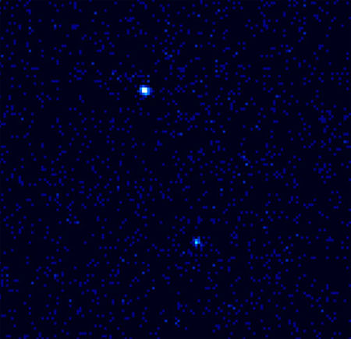
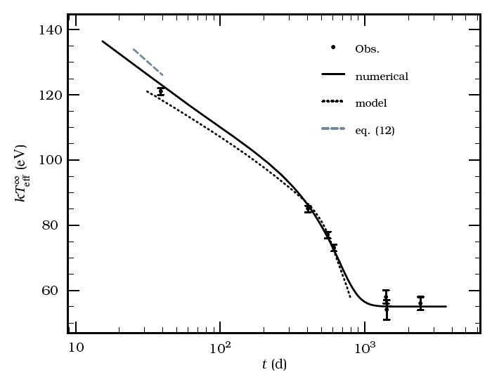
Neutron star crusts in X-ray transients
KS 1731-260
Unknown heat source
was added
Bright X-ray burster for ~12 yr
Accretion shut off early 2001
Superfluid
neutrons?
Core?
MXB 1659-29
Brown & Cumming 2009
Brown&Cumming 2009
NASA/Chandra/Wijnands et al.

Slide 24
Composition does matter
Impurity parameter
Q=100
(rp-ashes)
Q=2.5
everywhere

Slide 25
Summary
Field has come a long way
→ Techniques for precision measurements (Penning Traps)
and lots of new results
→ Techniques for large scale mapping of mass surface
and lots of new results
→ no mass models needed anymore in rp-process (just local
extrapolations or mirror symmetry)
→ New facilities on horizon: FRIB, FAIR, RIBF, ….
Many of the masses needed to model the r, νp, rp-processes
are not known → lots of work to be done (experiment and theory)
Accuracy needs vary:
→ Typical ~kT for mass differences (Q-values) (10-100 keV)
→ for important single resonant p-capture rates: keV Q-values
→ Need sensitivity studies
→ Need also accurate trends (not easy to include in sensitivity)

Slide 26
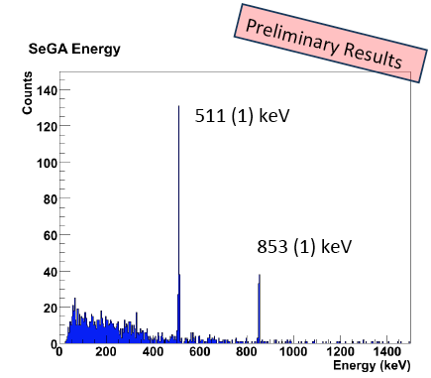
⁶⁹Kr beta delayed proton decay
(5/2⁻)
⁶⁹Kr
β⁺
IAS
p
β⁺
854 keV
2⁺
(129 keV 3/2⁻)
(40 keV 5/2⁻)
γ
1/2⁻
⁶⁹Br
p
0⁺
⁶⁸Se

Slide 27
⁶⁹Kr beta delayed proton decay
(5/2⁻)
⁶⁹Kr
β⁺
IAS
p
β⁺
854 keV
2⁺
(129 keV 3/2⁻)
(40 keV 1/2⁻)
γ
5/2⁻
⁶⁹Br
p
0⁺
⁶⁸Se

Slide 28
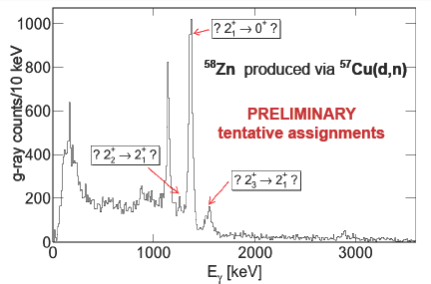
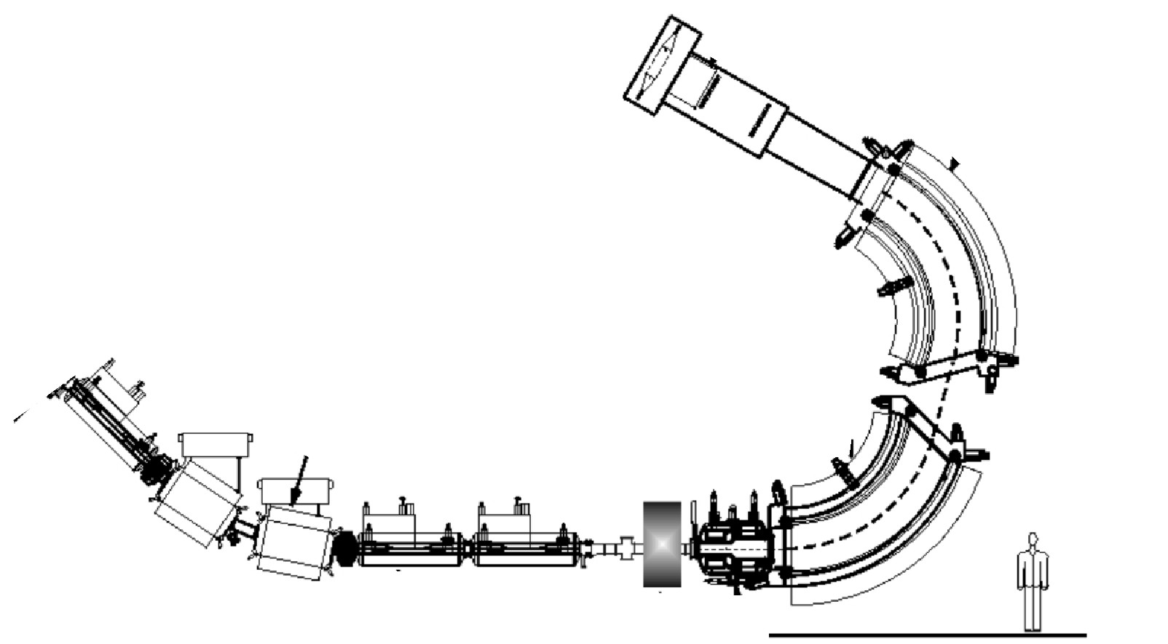
rp-process reaction rate measurements
First GRETINA@NSCL science experiment by JINA for ⁵⁷Cu(p,γ)⁵⁸Zn
(C. Langer, F. Montes)
γ-rays from ⁵⁸Zn populated by ⁵⁷Cu(d,n)
Focal plane:
identify ⁵⁸Zn
Beam
blocker
⁵⁸Zn
⁵⁷Cu
GRETINA
Radioactive ⁵⁷Cu beam
CD₂ target – transfers proton to beam

Slide 29
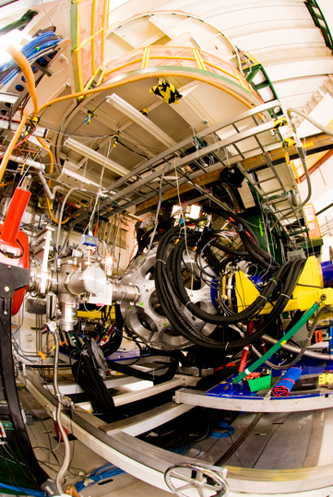
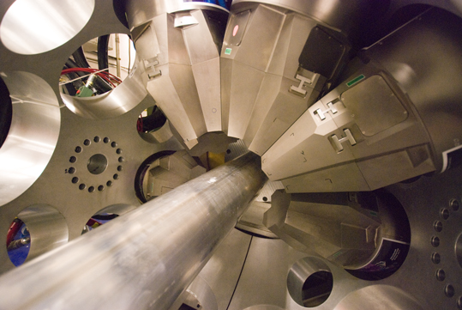
GRETINA
Moving to ANL next …

