Slide 1


Stellar Processes Viewed through Mass Measurements with ISOLTRAP
Susanne Kreim
April 26th 2013
530. WEH Seminar
CERN, Geneva, Switzerland
Max-Planck-Institut für Kernphysik, Heidelberg, Germany

Slide 2
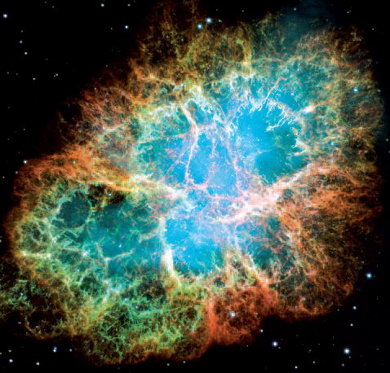
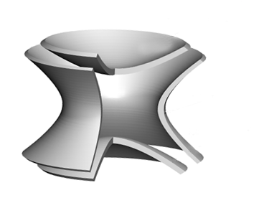

Nuclear Astrophysics
Laboratory: experiments on symmetric matter
Valley of stability along N≈Z
Structure of nuclei
Universe: extreme environment
Scarce data, large uncertainties
Rely on astrophyical and nuclear models
?

Slide 3
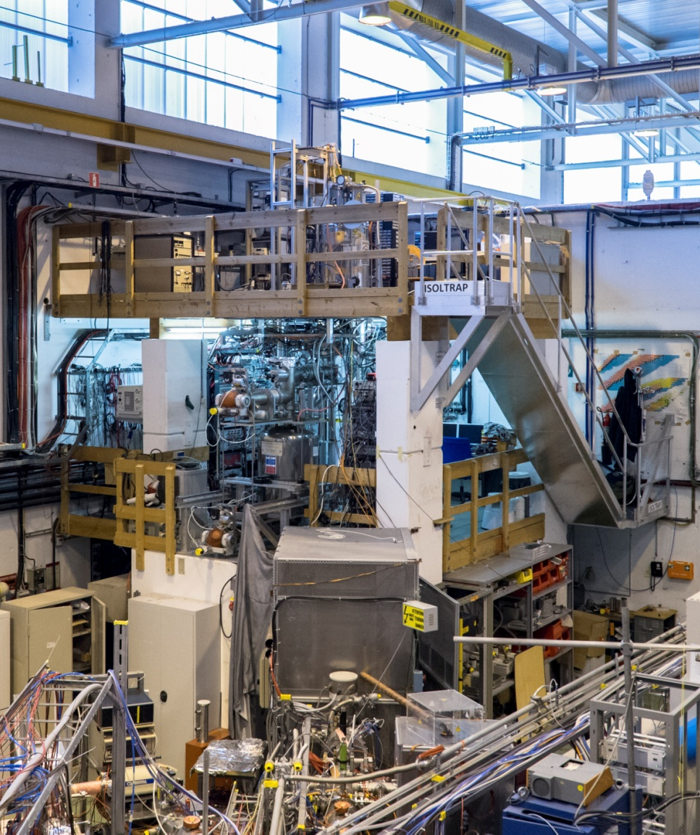
Overview
Introduction
Stellar Processes and Masses
  rp-process
  r-process
  Neutron stars
Measurement techniques
  Penning traps
Future possibilities
Summary
Picture credit: CERN

Slide 4
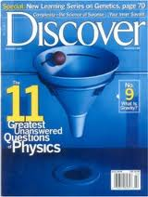
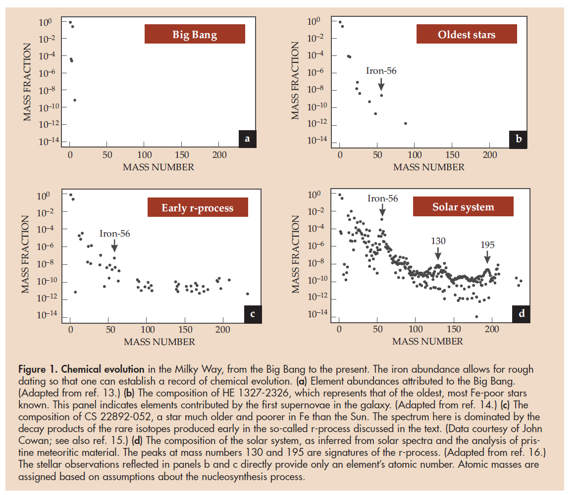
Creation of Heavy Elements
  Age of the Universe
H. Schatz, Physics Today 61, 40 (2008)

Slide 5
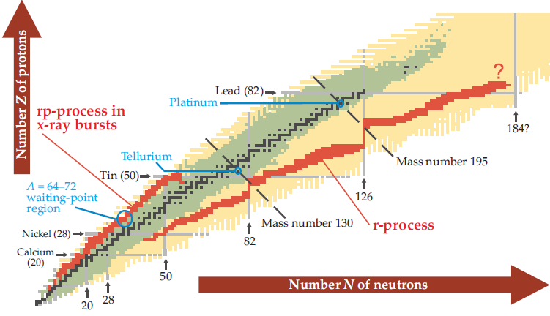
Possible Nuclear Processes
  Masses (together with other observables) play a key role in the modeling of astropyhsical processes since they affect rates and probabilities of nuclear processes
  Precise masses needed to constrain nuclear models
  Creation of the heavy elements in neutron stars?
H. Schatz, Physics Today 61, 40 (2008)
M. Arnould et al., Phys. Rep. 450, 97 (2007)

Slide 6
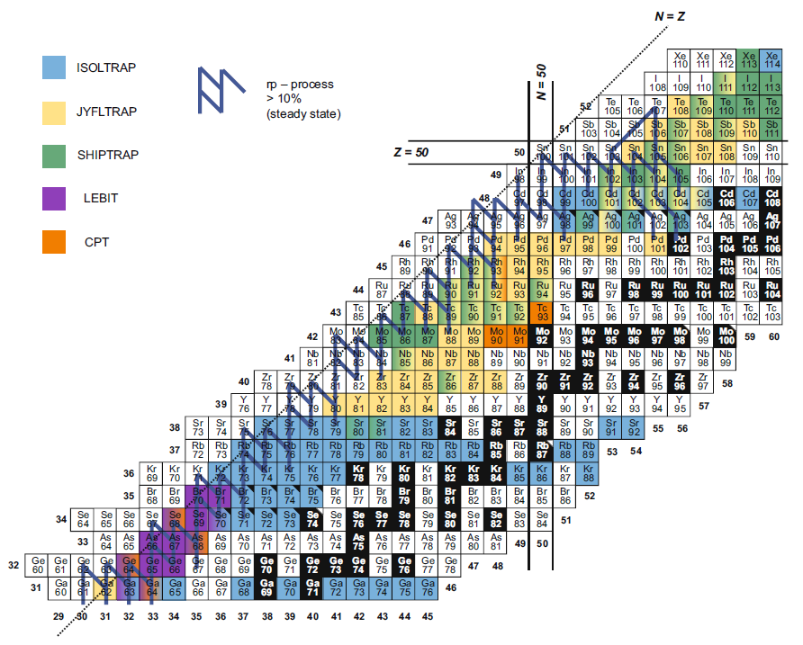
RP-Process above Z=32
Precise masses used to calculate possible rp-process path using nuclear reaction networks
International effort to improve calculation on element synthesis
Well-known masses allow for an extrapolation towards the proton dripline
Understanding of nuclear physics helps to assess amount of hydrogen in x-ray burst
F. Herfurth et al., EPJA 47, 75 (2011)

Slide 7
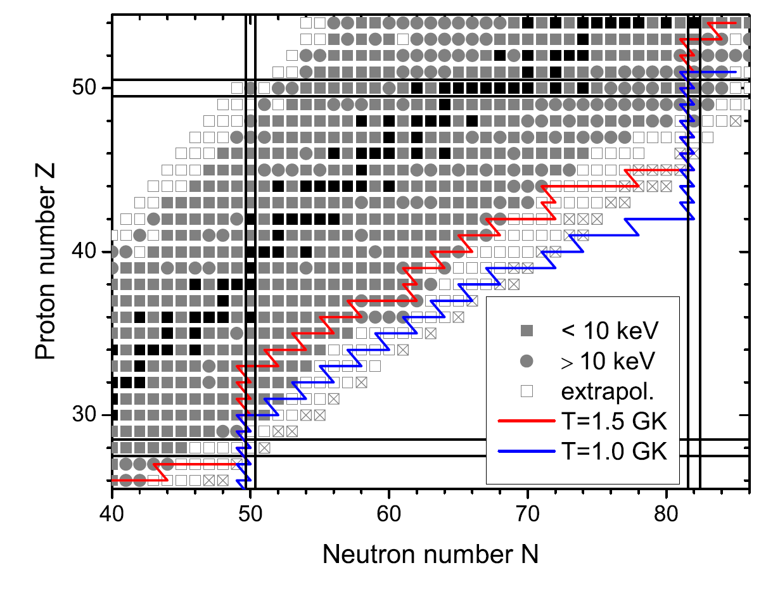
The R-Process at Magic Numbers
N_{n} = 10²⁴ cm⁻³
Accurate mass measurements needed to reliably compare the calculated r-process abundances to observations
The r-process path depends strongly on the used astrophysical model and the environment (temperature and neutron density)
Penning-trap mass measurements have reached the r-process path for nuclides around ⁸⁰Zn₅₀ and ¹³²Sn₈₂
Masses of JYFLTRAP or ISOLTRAP shown help in constructing more reliable mass extrapolations and models to be used for r-process studies
A. Kankainen et al., J. Phys. G 39, 093101 (2012)

Slide 8
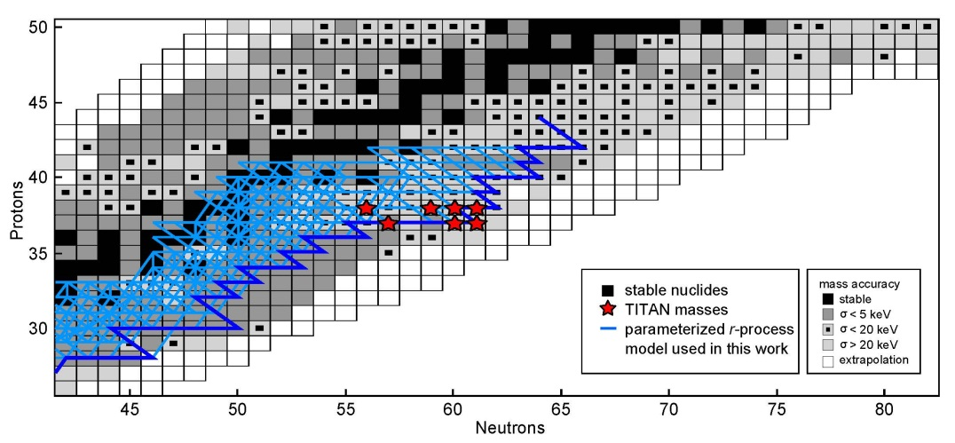
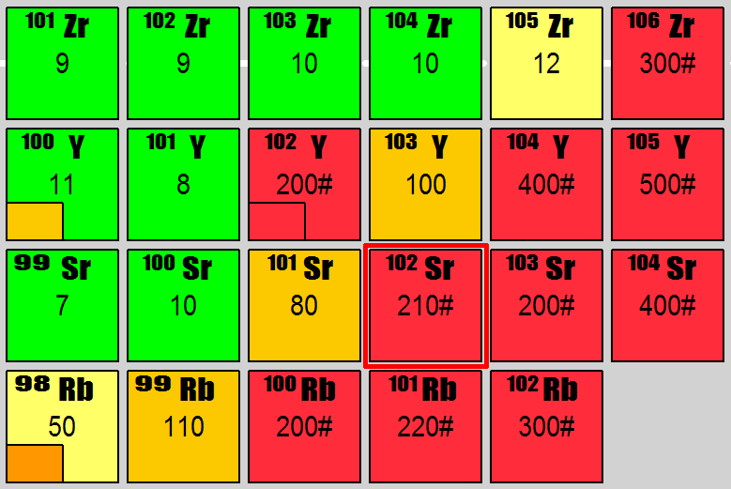
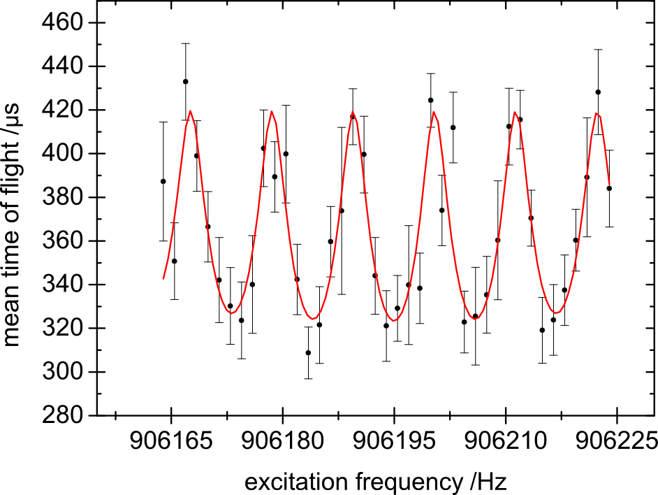
N-Rich Rb Isotopes
^{97,98}Rb measurements of TITAN for network calculations by H. Schatz
model inspired by conditions in high entropy winds from neutron stars in core collapse supernovae
^{99,100}Rb measured by ISOLTRAP
100Rb⁺
48ms!!
V.V. Simon et al., PRC 85, 064308 (2012)

Slide 9
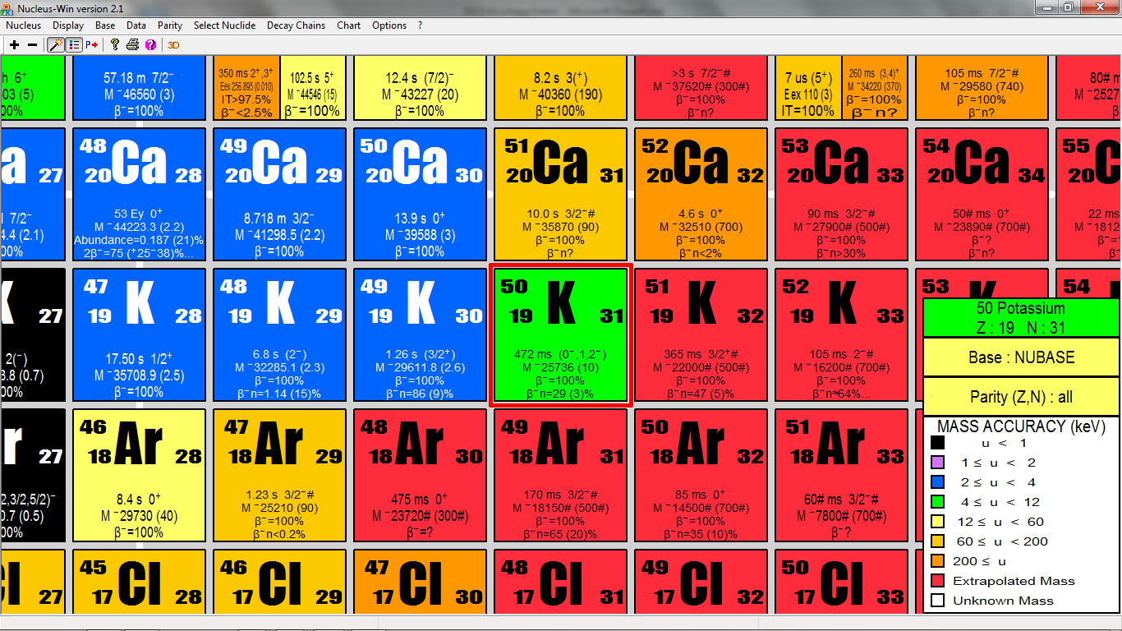
Calcium Isotopes at N=32
Ground-state properties (masses, radii) at N=32 missing
ISOLTRAP measurements of ^{53,54}Ca
No protons on target
Lasers off
⁵⁴Cr
⁵⁴Ti
⁵⁴Ca
time / arb. units
time of flight / arb. units
F. Wienholtz et al., accepted for publication
S. Kreim et al., INTC-P-317 (2011)

Slide 10
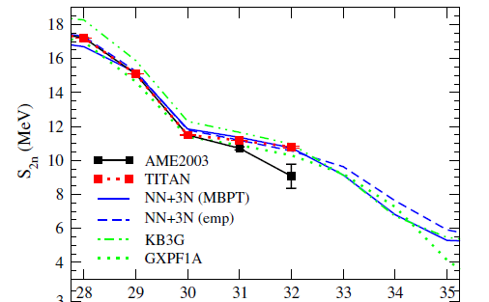
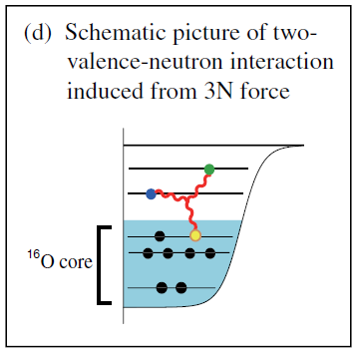
3-Body Forces in Ca
TITAN measurements of ^{51,52}Ca
Calculations including 3-body forces from chiral effective field theory
  Agreement with phenomenological approaches and experimental data
  Prediction of Ca masses beyond ⁵²Ca -> nuclear structure toward neutron dripline?
Mass of ⁵⁴Ca ideal test bench for predictive power of 3-body forces
?
Neutron Number N
A. T. Gallant et al., PRL 109, 032506 (2012)
T. Otsuka et al., PRL 105, 032501 (2010)

Slide 11
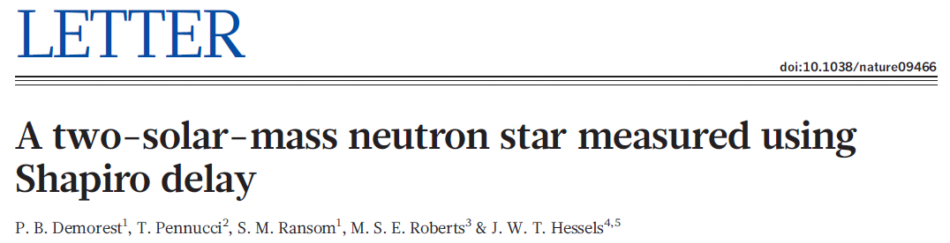
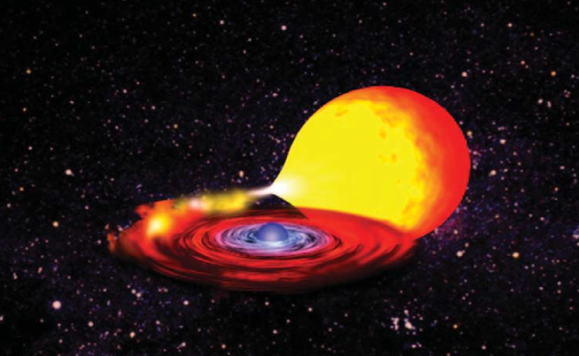
Nuclear Stability and Neutron Star
ISOLTRAP measurements illustrate importance of 3-body forces for nuclear interaction
Link the mass measurement of ⁵⁴Ca to advances in the description of neutron matter, including potentials based on chiral effective field theory
Neutron star and companion (Courtesy of NASA)
Heaviest neutron star with 1.97±0.04M_{sun}
Puts constraints on equation of state

Slide 12
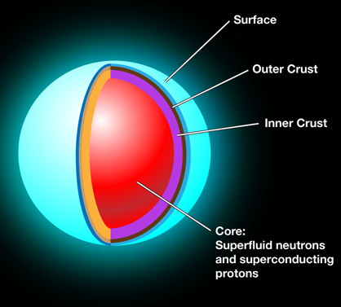
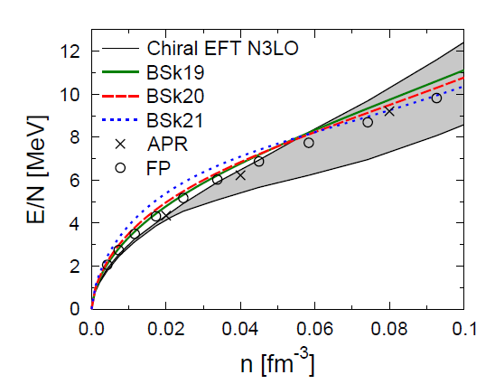
Equation of State
Important for the equation of state of neutron stars
Ab-inition methods limited to A~60
Effective Skyrme forces provide consistently EOS and nuclear mass tables
HFB19-21 predict composition of outer crurst of neutron stars
J. M Pearson et al, PRC 85, 065803 (2012)
I. Tews et al., PRL 110, 032504 (2013)
B. Friedman, V. R. Pandharipande, Nucl. Phys. A 361, 502 (1981)
A. Akmal et al., Phys. Rev. C 58, 1804 (1998)
S. Kreim et al., DOI:10.1016/j.ijms.2013.02.015 (2013)

Slide 13
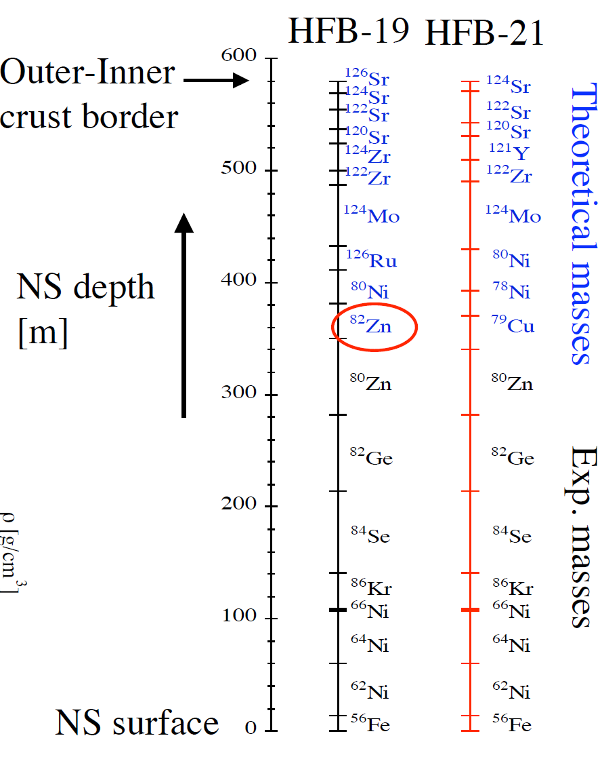
Modelling of Neutron-Star Crust
Outer crust of neutron stars is a possible birthplace of the heavy elements
For a given pressure, modeling the composition depends mainly on the binding energy of the nucleus!
Depth profile of a neutron star by using experimental masses and mass models as input for equation of state
J. M. Pearson et al., Phys. Rev. C 83 (2011)

Slide 14
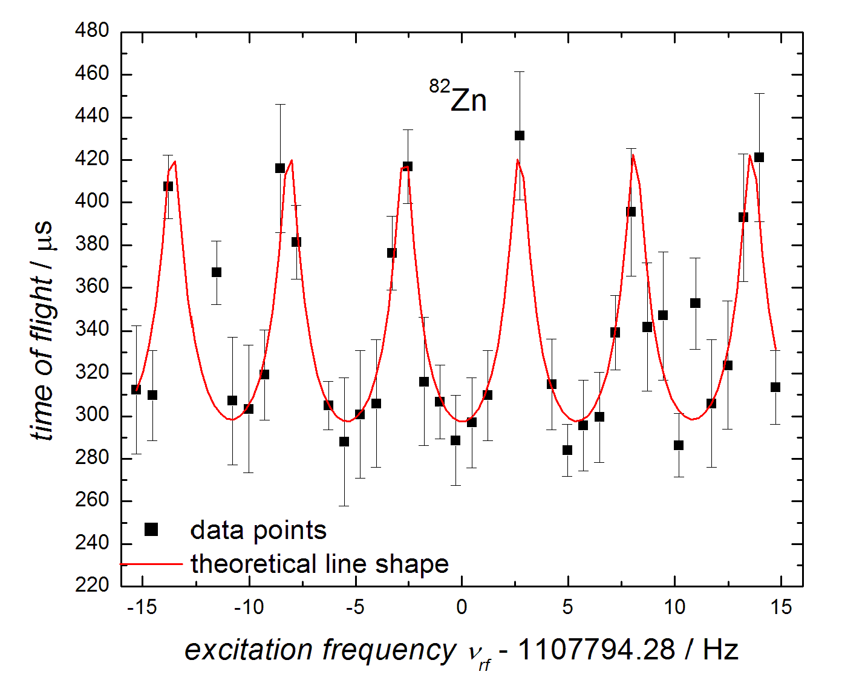
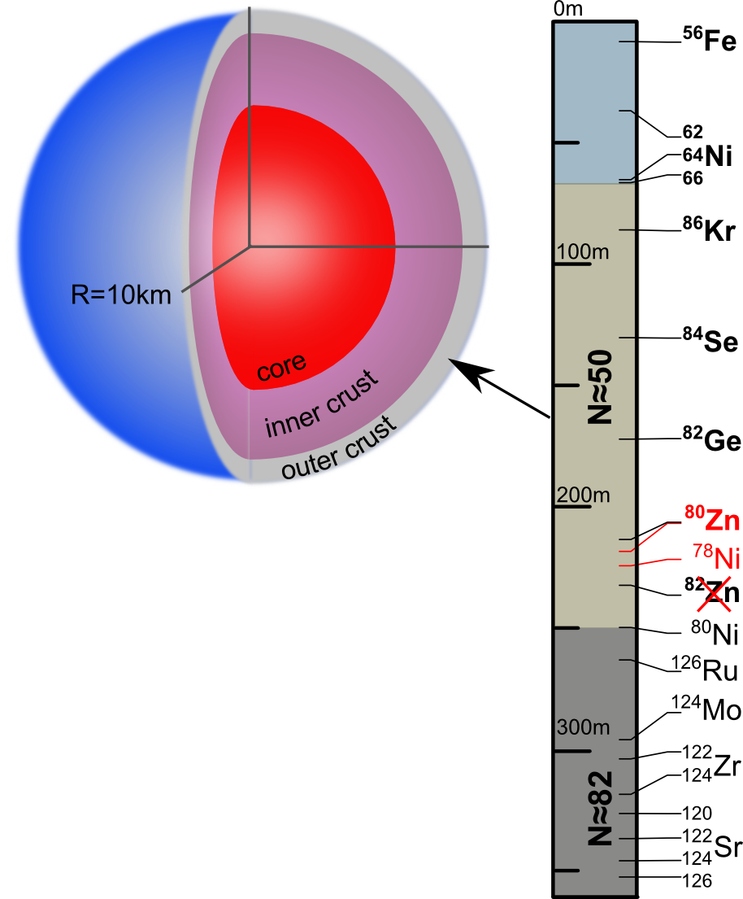
Mass Measurement of ⁸²Zn
80 ions in 35 minutes!
Before only AME extrapolation with 400keV uncertainty
Mass excess ME(⁸²Zn) = m – Au = -42.314(3) MeV/c²
  Uncertainty δm/m = 4•10⁻⁸
Most exotic nuclei measured for neutron-star crustal composition
PhD thesis R. Wolf
R. N. Wolf et al., PRL 110, 041101 (2013)

Slide 15
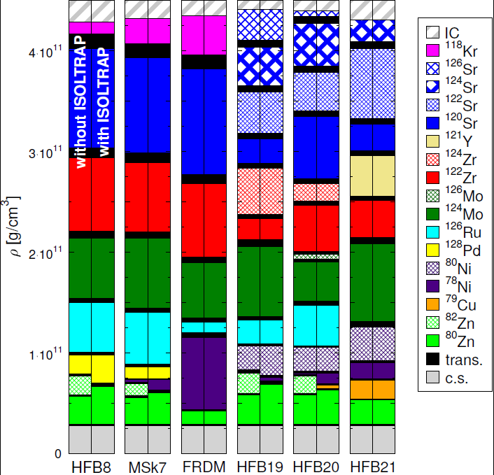
Crustal Composition
25 different nuclear mass models have been tested and all now exclude ⁸²Zn
Validate that up to a density of 5*10¹⁰ g/cm³, the crustal composition is determined only by experimental data with ⁸⁰Zn being the corresponding nucleus
Magic neutron shells N=50 and N=82 are the dominating effect of nuclear structure
Masses for crustal heating
  A. Estradé et al., PRL 107, 172503 (2011)
S. Kreim et al., DOI:10.1016/j.ijms.2013.02.015 (2013)

Slide 16
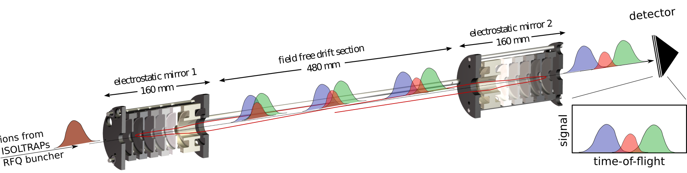
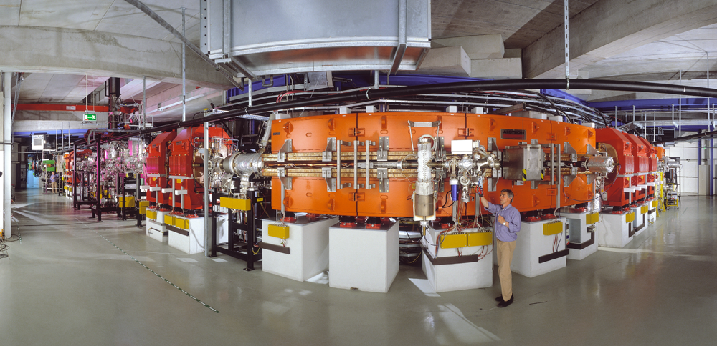
High-Accuracy Mass Measurements
Requirement for astrophysics: σ ≈ 10⁻⁶
Time-of-flight mass spectrometry
  Multi-reflection time-of-flight mass spectrometer
  NSCL at MSU
Storage ring
  Schottky mass spectrometry
  Isochronous mass spectrometry
Penning traps
  Time-of-flight ion-cyclotron-resonance technique

Slide 17
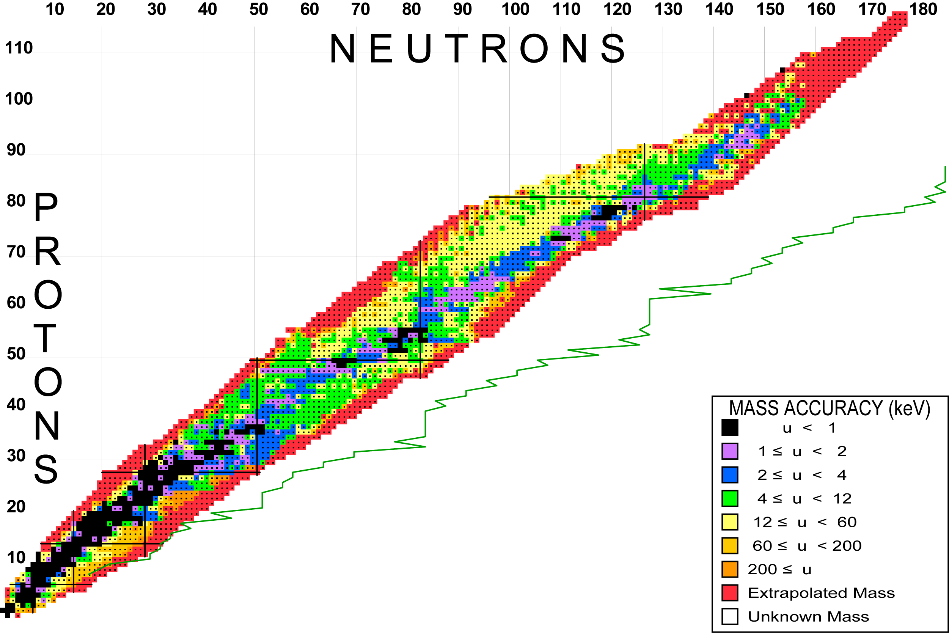
Challenges for PTMS
Challenges at the outskirts of the nuclear chart:
  Half-lives tens of ms
  Minute production rates
  High yield of contaminating ions
3290 nuclides
Data from: AME 2011 preview (28.04.2011)
G. Audi, M. Wang,
private communication

Slide 18
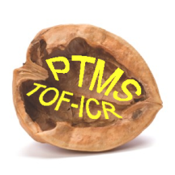

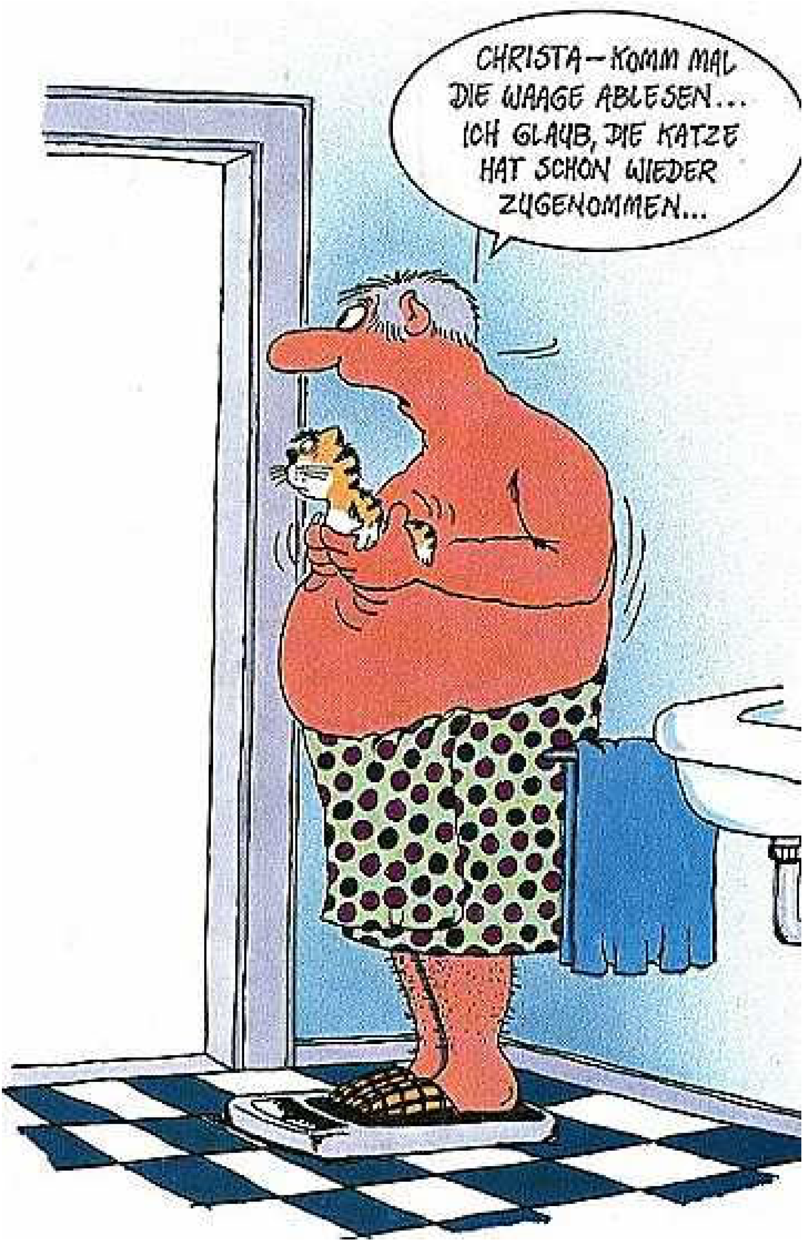
Penning alone in New York
8 million inhabitants
many with the similar weight
Goal: identify the few with exactly the same mass, evacuate all others
Measure their mass with high precision

Slide 19
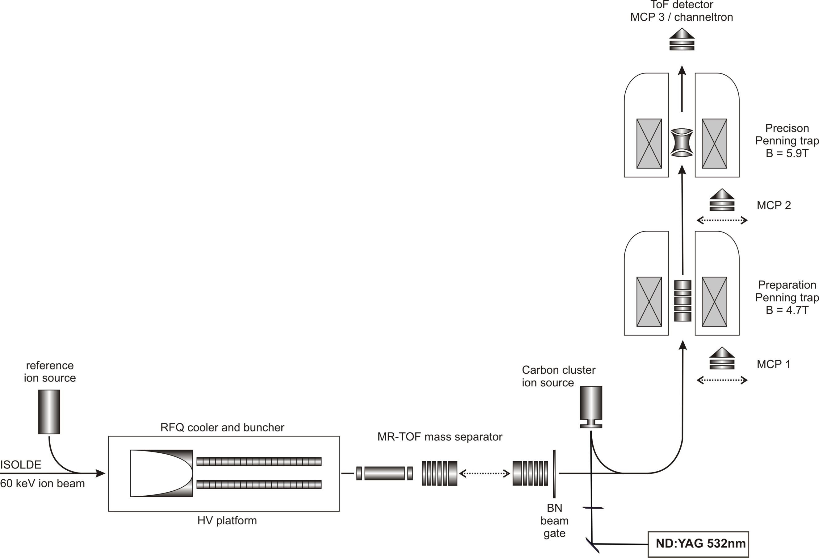

The ISOLTRAP Experiment
M. Mukherjee et al., Eur. Phys. J A 35, 1 (2008)
R. N. Wolf et al., NIM A 686, 82 (2012)
preparation
measurement

Slide 20
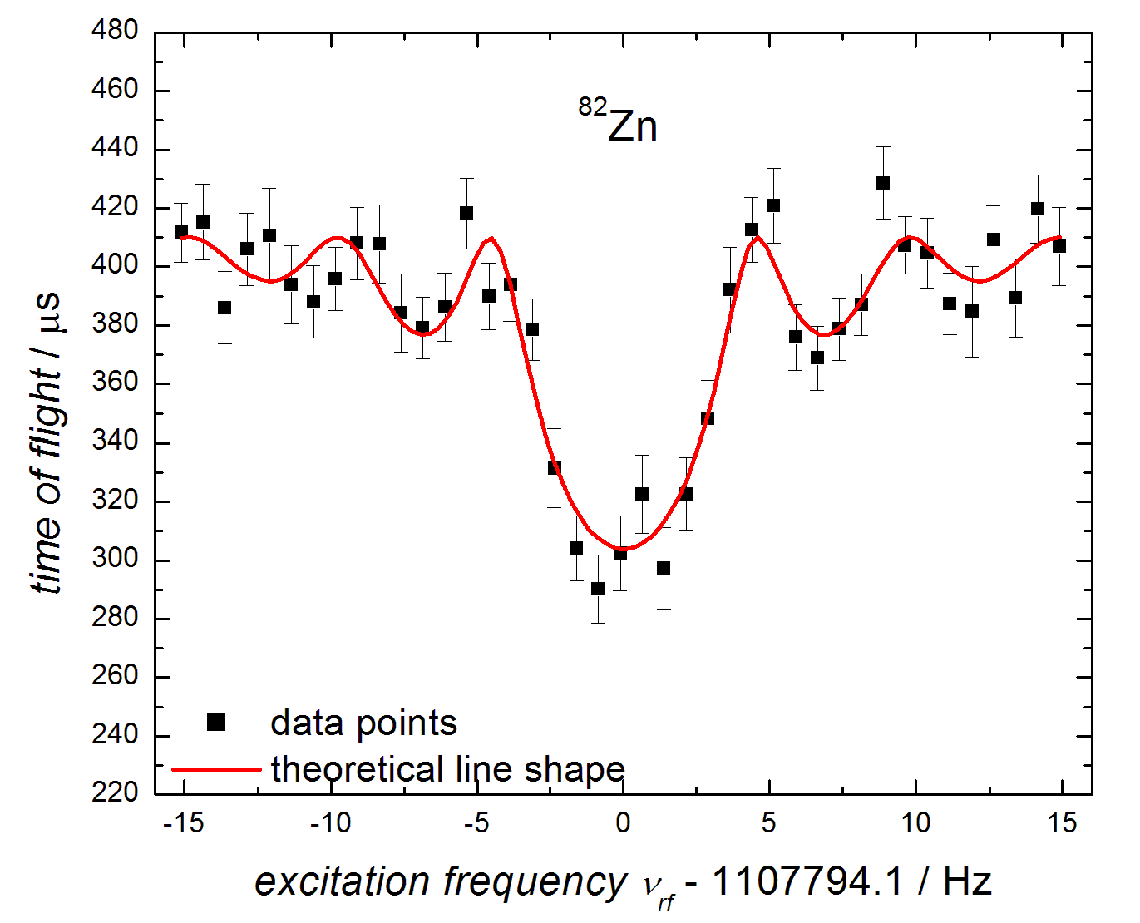
Detection Principle PT
Charged particle stored by superposition of strong homogeneous magnetic field in z direction and weak, electrostatic potential for axial confinement
  Frequency measurement
  Long storage times
  Single-ion sensitivity
  High precision
Frequency measurement: eigenmotion in the trap can be used to determine mass
B
L. S. Brown and G. Gabrielse , Rev. Mod. Phys. 58, 233 (1986)
M. König et al., Int. J. Mass Spectrom. 142, 95 (1995)
Notes:
Fill the trap with a big sample of 35Ar+ ions. Then, make the measuremet. The envelope exponential decay is due to the half-life. The recoil ions have enough energy to overcome the trapping potential of the Penning trap. The voltage of the retardation electrodes defines what particles make it to the detector. In addition, a weak magnetic field is added behind the trap to create a strong magnetic field gradient to convert the particle‘s radial into axial energy. Thus forcing a larger angular distribtuon to reach the detector.

Slide 21

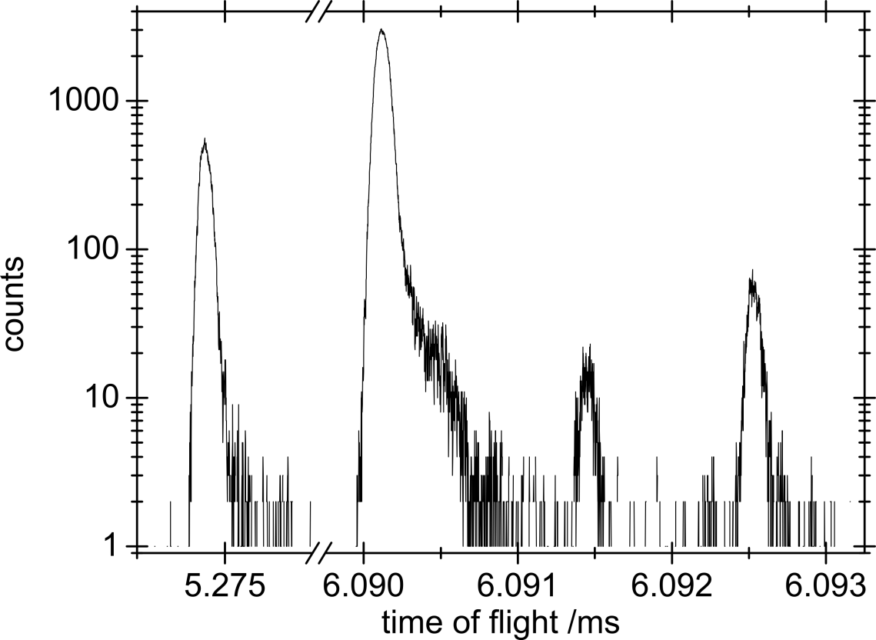
MR-TOF Mass Measurement
Direct time-of-flight mass measurements with one well-known isobaric reference in the spectrum
  Determine a,b from two well-known references
Time scale: tens of ms
  An order of magnitude faster than Penning-trap measurements
39K
52Cr
350 rev.
52K
52Ca
S. Kreim et al., INTC-P-317, IS 532 (2011)
F. Wienholtz, accepted for publication ( 2013)

Slide 22
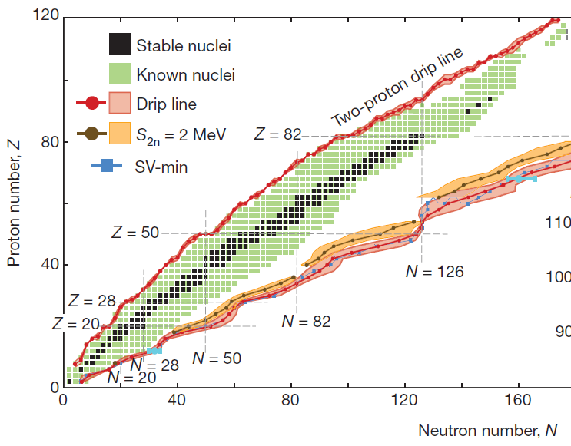
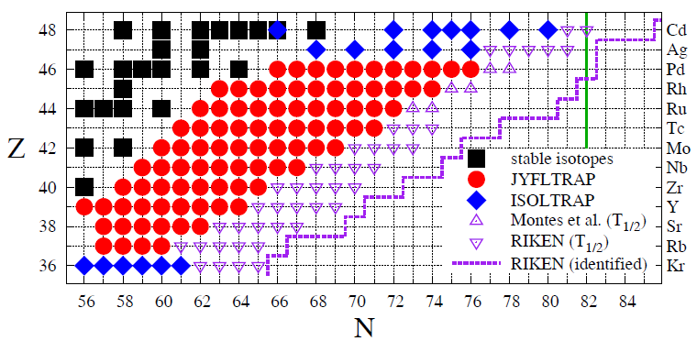

Future Possibilities
Explore N=50,82 nuclei constituting the outer crust of neutron stars
Challenging case: ⁴⁶Pd could be provided by upgrades of radioactive-beam facilities
Eploring the neutron drip line will help constraining nuclear mass models which serve as input to stellar processes
Sensitivity studies for r-process provide list of „most wanted nuclei“
J. Hakala et al., EPJA 47, 129 (2011)
S. Brett et al., EPJA 48, 184 (2012)
J. Erler et al., Nature 486, 509 (2012)

Slide 23




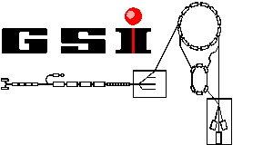


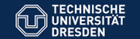


G. Audi, D. Beck,
P. Ascher, D. Atanasov,
Ch. Borgmann,
T. E. Cocolios, S. Eliseev,
F. Herfurth, A. Herlert,
Yu. Litvinov, D. Lunney,
V. Manea, S. Naimi,
S. Schwarz, L. Schweikhard,
K. Blaum, Ch. Böhm, G. Bollen
M. Breitenfeldt, R. B. Cakirli,
T. Eronen, S. George
J. Kluge, M. Kowalska, S. Kreim,
E. Minaya Ramirez,
D. Neidherr, M. Rosenbusch,
F. Wienholtz, R. Wolf, K. Zuber
J. Stanja, M. Wang,

Slide 24
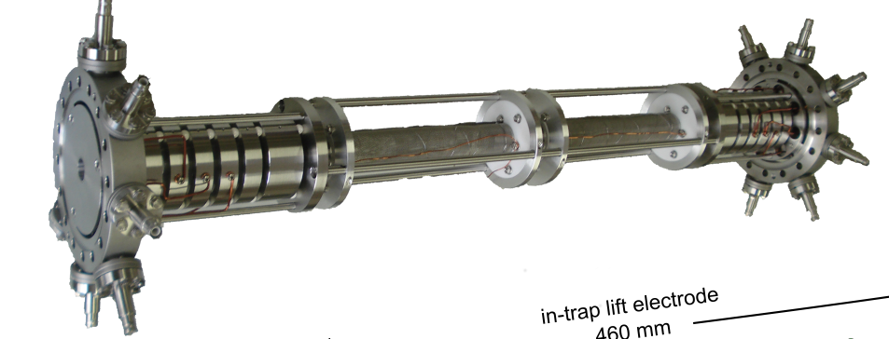
Summary
High-accuracy mass measurements are important for astrophysics
  Masses at proton dripline for rp-process
  Masses at neutron dripline for r-process
  ⁵⁴Ca - as test bench for calculations using 3-body forces
  ⁸²Zn - one mass value changes crustal composition as
  compared to core-collapse supernovae r-process scenarios
High-accuracy mass measurments provided by different techniques
  Multi-reflection time-of-flight mass spectrometer versatile device for astrophysics
Future possibilities
  Masses of exotic, neutron-rich nuclei at magic neutron numbers needed
  Required to probe limits of nuclear stability for improving model predictions
T. Otsuka et al., PRL 105, 032501 (2010)

