Slide 1
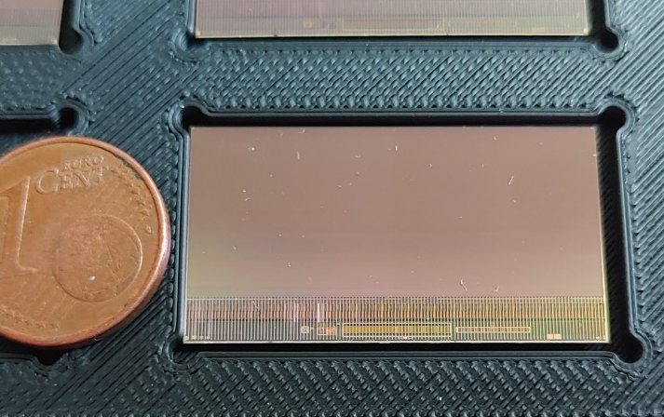


Status of MIMOSIS
$=∑$( )
?
MIMOSIS-1, 60µm thick
M. Deveaux, GSI detector laboratory

Slide 2
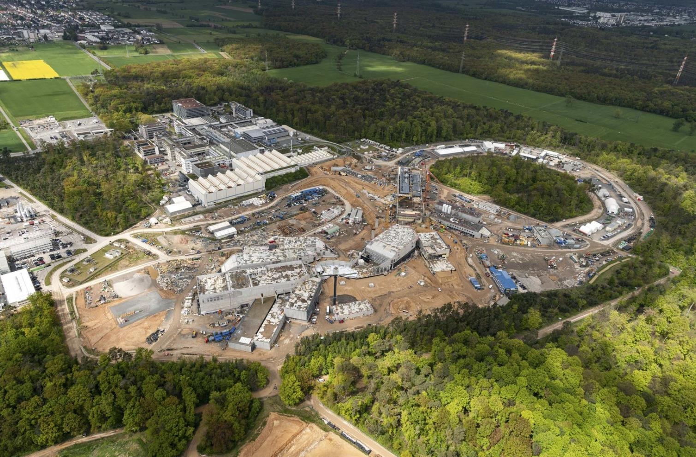
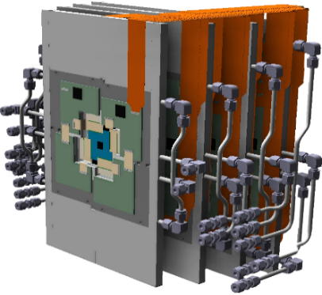
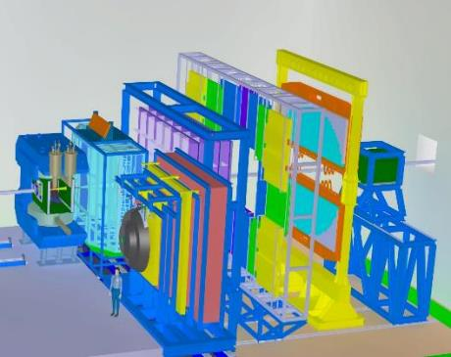
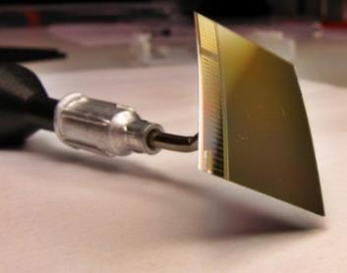
The Micro Vertex Detector (MVD) of CBM
CBM Detector
Main requirements:
  ~5 µm spatial resolution.
  70 MHz/cm² (peak)
  0.5 cm from the beam axis.
  0.3-0.5% X₀ In vacuum.
CMOS MAPS
called MIMOSIS
DRD3 Week, CERN, 17 June 2024

Slide 3
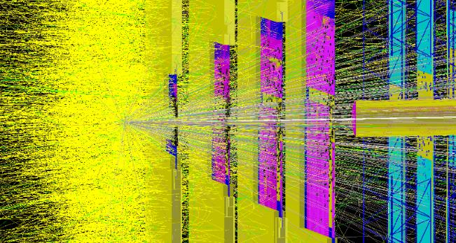
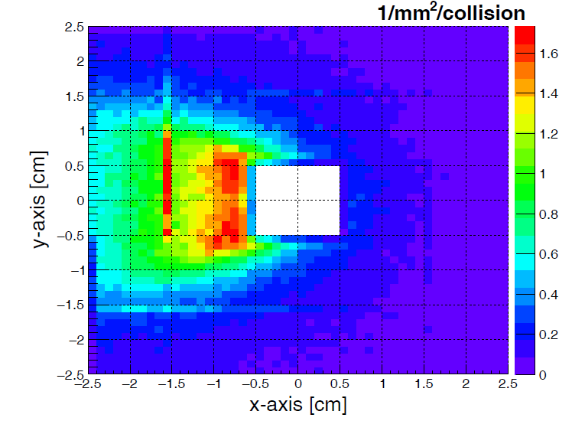
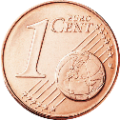
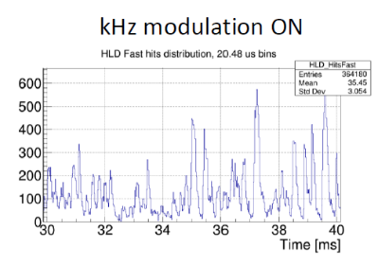
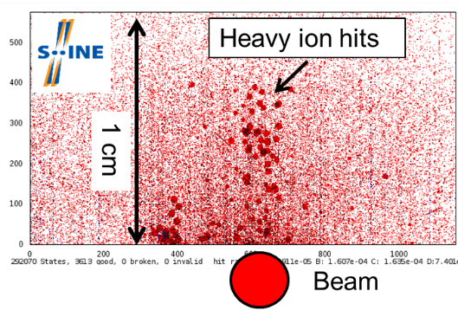
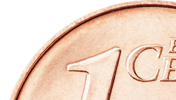
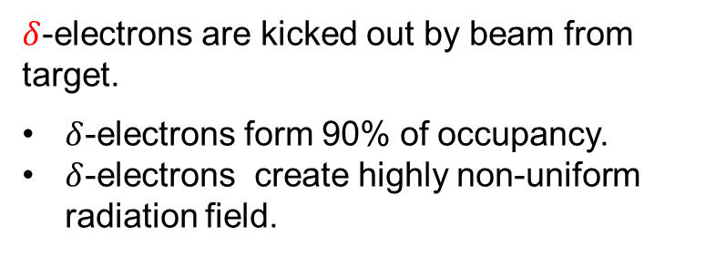
Requirements for sensors in fixed target HI-experiments.
$δ$-electrons are kicked out by beam from target.
$δ$-electrons form 90% of occupancy.
$δ$-electrons create highly non-uniform radiation field.
Nominal acceptance
Beam intensity (SIS18-measured)
Target
Size of MIMOSIS-1
No Trigger signature => Continuous readout
“Slow extraction” of beam on target creates beam fluctuations.
Detector must handle significant rate peaks.
Operation very close to the beam => Tolerate ions
Significant beam halo => Need to understand integrated radiation damage
Manage Single Event Effects up to highest LET (dE/dx >>10⁴ m.i.p).
M. Deveaux, SQM 2017
Utrecht/Netherlands
HI-physics is low momentum physics – Material budget really matters!
DRD3 Week, CERN, 17 June 2024

Slide 4
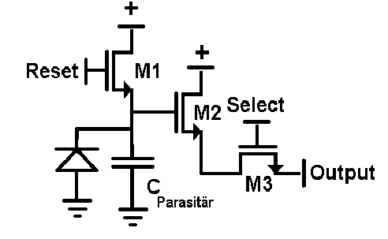
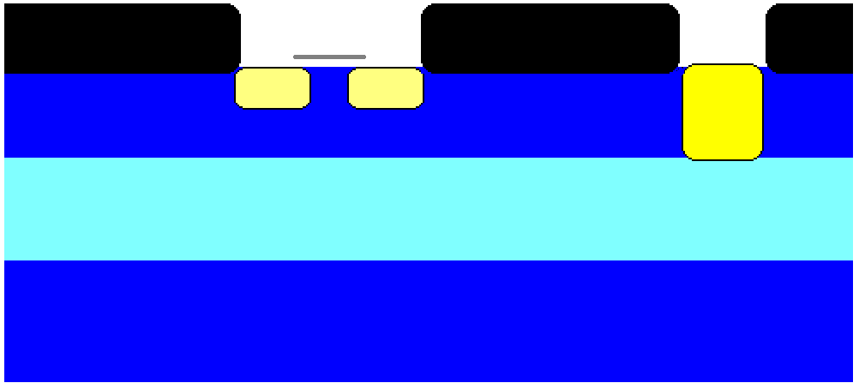
The operation principle of MAPS
+3.3V
Reset
+3.3V
Output
SiO₂
SiO₂
SiO₂
N++
N++
N+
P+
P-
P+
Digital camera: ~1000 photons produce one electron each.
Particle detector: One particle produces ~1000 electrons.

Slide 5
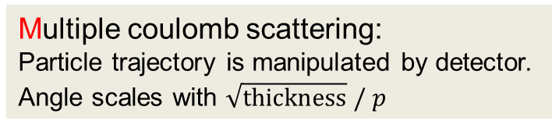
MAPS vs. Hybrid pixels
CMS @ LHC – Hybrid Pixel
MAPS:
~0.05 µm
Si equivalent
Readout - chip
Hybrid:
0.5mm Si
equivalent
~100 µm
Pixel
Pixel
Pixel
~120 µm
Multiple coulomb scattering:
Particle trajectory is manipulated by detector.
Angle scales with $\sqrt{thickness} / p$

Slide 6




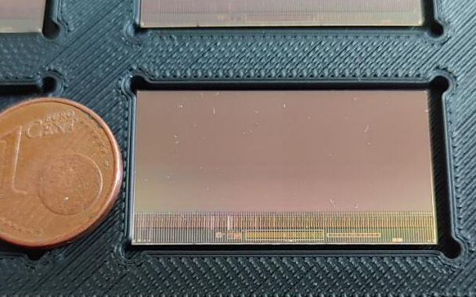

MIMOSIS – A sensor for CBM
MIMOSIS-0 (2018)
Demonstrate pixel concept.
Demonstrate zero suppression.
Demonstrate readout concept.
In synergy with:
MIMOSIS-1 (2020)
Full dimension sensor
Add buffer structure.
SEE hardening 1/2
MIMOSIS-2.1 (Q2/2024)
On-chip pixel grouping.
Final pixels.
SEE hardening 2/2
Work in progress
MIMOSIS-1, 60µm thick
MIMOSIS-1
MIMOSIS-3 (~2025)
Final sensor for mass production
All submissions:
Additional CE18 test structures to study specific design questions.
13th POS conference, Oxford, Sept 2023

Slide 7
Micro Vertex Detector – Sensor requirements
 | PANDA MVD | MIMOSIS
Spatial resolution [µm] | 28 | 5-7
Material budget [X0/layer] | ~1% | 0.05%
Power [mW/cm²] | <800 | <100
Rate [MHz/cm²] | > 6 | 20
Ionizing dose [Mrad/10 years] | 10 | > 5 Mrad
Non-ion dose [n_{eq}/cm²/10 years] | ~ 10¹⁴ | ~3 x 10¹⁴
Operation temperature | Liquid cooled, 35°C | Air cooled? 15°C
Readout | Self-triggered, GBTx | Self-triggered, GBTx
Time binning | <10 ns | 5 µs
dE/dx | Yes | Somewhat*
Better than required
As required
Use strip information instead?

Slide 8
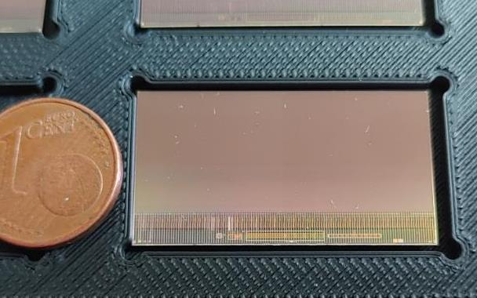

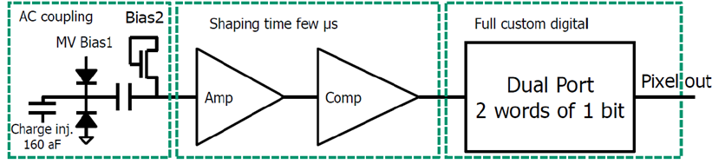
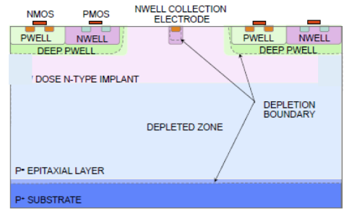
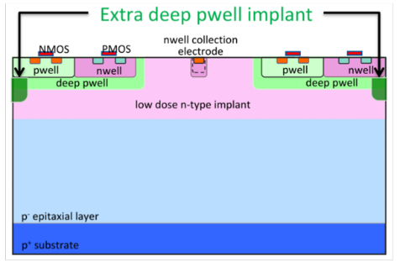
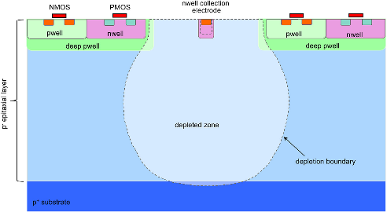

The state of the art: MIMOSIS-1 (inspired by ALPIDE)
Size: 504 x 1024 pixels (27x30µm²), 5µs time binning
Full integrated: 20 MHz/cm² (80 MHz/cm² for 35µs), ~70mW/cm²
Fully depleted: >20V top bias
A
B
C
D
>20V HV top bias
MIMOSIS-1, 60µm thick
Back bias possible.
P-Well bias (ALPIDE) possible
Most likely Fully Depleted
Capacitor blocks HV
First proposed by W. Snoeys et al.
H. Pernegger et al., 2017 JINST 12 P06008
n-gap
p-stop
standard
Standard
Rad. hard, candidate 2
Rad. hard, candidate 1
MIMOSIS-1: 25 µm epitaxial layer. MIMOSIS-2.1: 25µm + 50µm epitaxial layer => stay tuned.
DRD3 Week, CERN, 17 June 2024

Slide 9
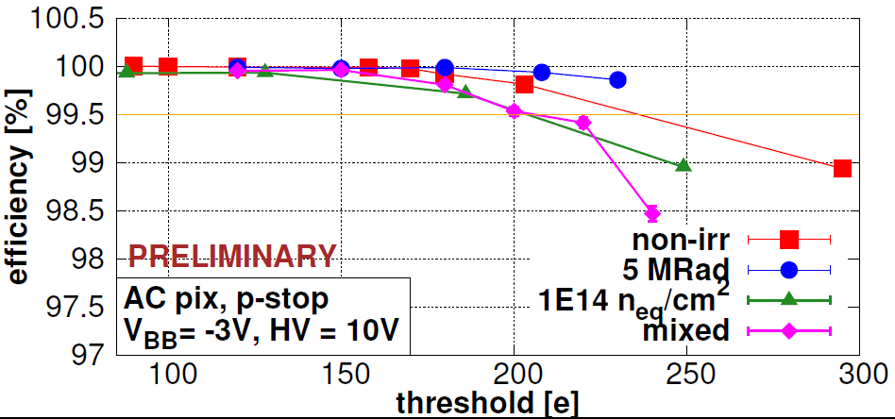
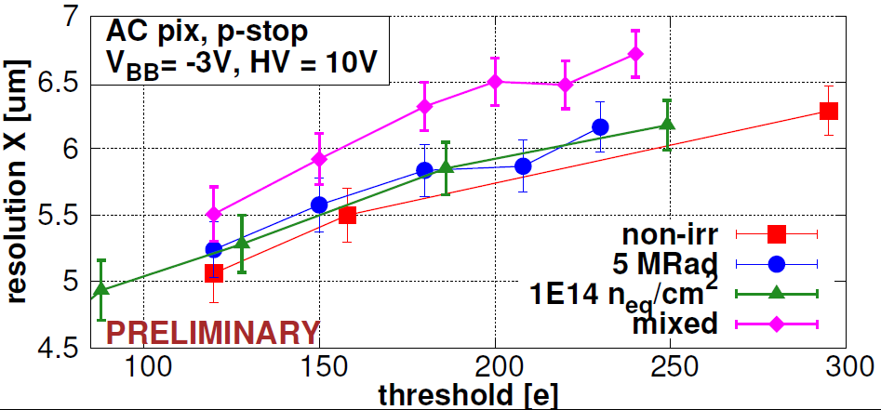
Sensor performance: New and after 5 MRad + 10¹⁴n_{eq}/cm²
CBM
Best performing pixel: AC P-stop
Efficiency >99% (end of life-time).
Spatial resolution: ~6 µm
Dark rate (not shown, see backup):
  Marginal before irradiation.
  <10⁻⁶ after irradiation.
Short dimension
of 27x30µm² pixel.
Plots: Curtesy CBM-MVD collaboration
Conclusion on sensor performance:
All pixels work excellent before irradiation.
Standard pixels show best spatial resolution. (see backup)
P-stop AC pixel most radiation hard, matches requirements of CBM.
13th POS conference, Oxford, Sept 2023

Slide 10
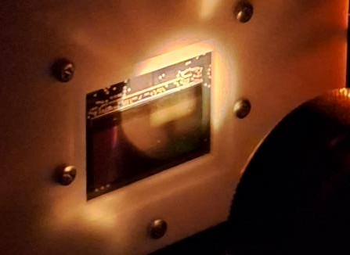


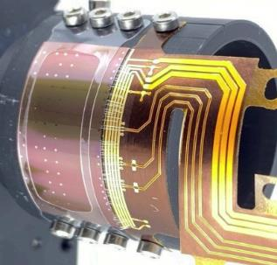

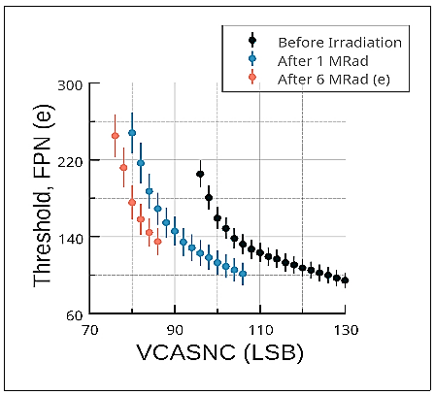
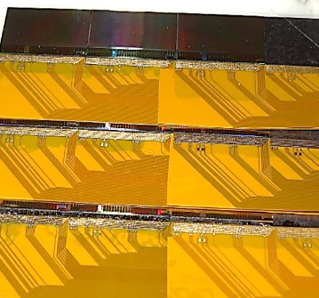

Test and integration work at GSI/Uni-Frankfurt
MIMOSIS-2 SEE tests with ~5 AMeV heavy ion beam.
Working bit-flip recovery.
No latch-up <50 MeV cm²/mg.
  (work in progress)
Test of bent ALICE and
65nm TPSCo prototypes:
The GSI ALICE group.
Test of differential rad. damage:
Issues finding common working point at differential rad. damage.
Effect saturates: Pre-condition by irradiating with ~1 MRad.
  (work in progress)
Integration :
Vacuum compatible detector stations with 0.3 - 0.5% X₀.
High speed DAQ (CBM)
DRD3 Week, CERN, 17 June 2024

Slide 11


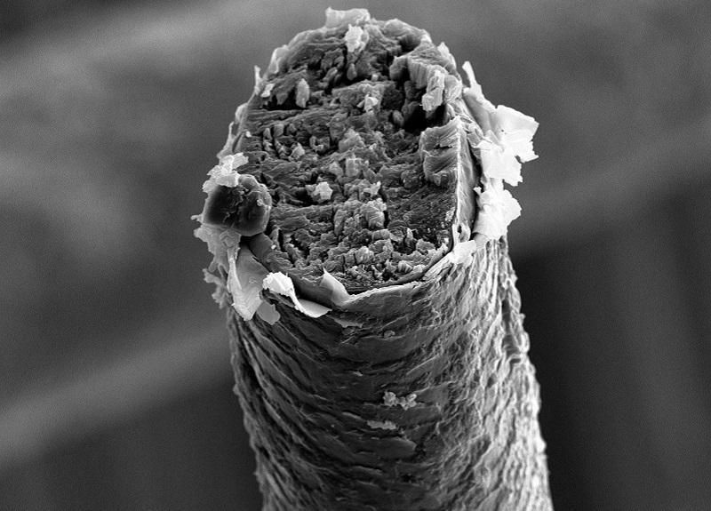
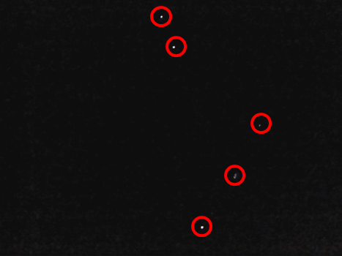
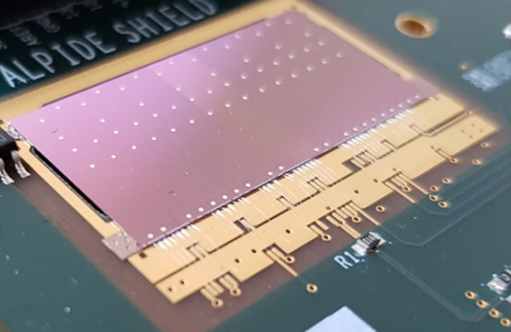
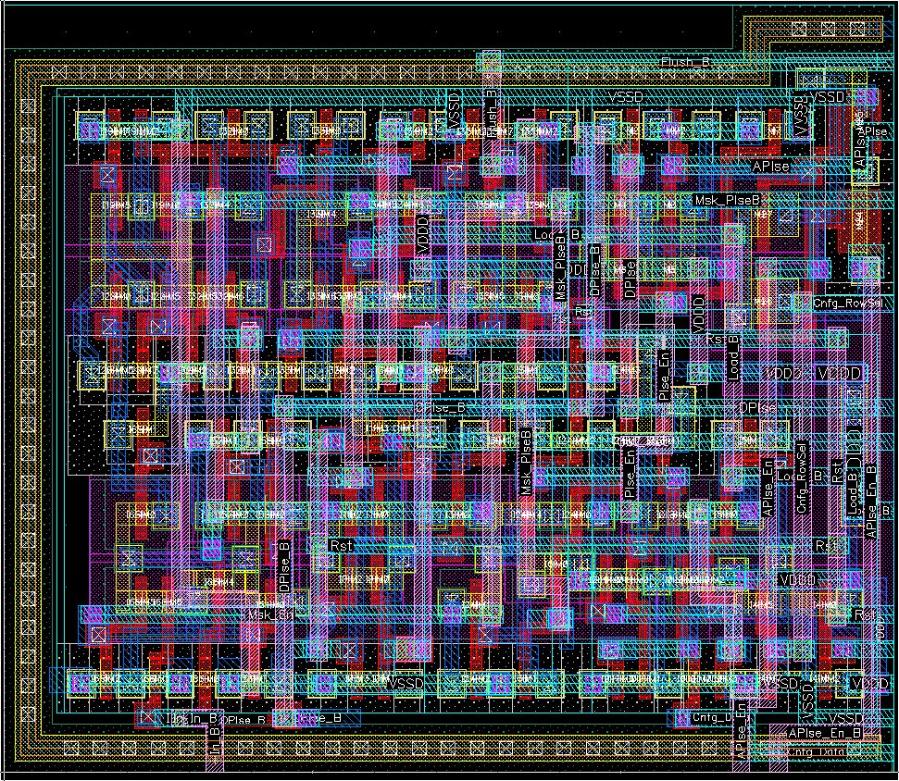



How to get the data out?
~30µm
~30µm
Priority encoder
Human hair (to scale)
14.5µm
ALPIDE Sensor.
~ 50 mW/cm²
01001010010
01001010110
Mimosis Pixel Logic Layout (106 Transistors)
01001011000
Data-Buffer
On-chip
Off-chip

Slide 12
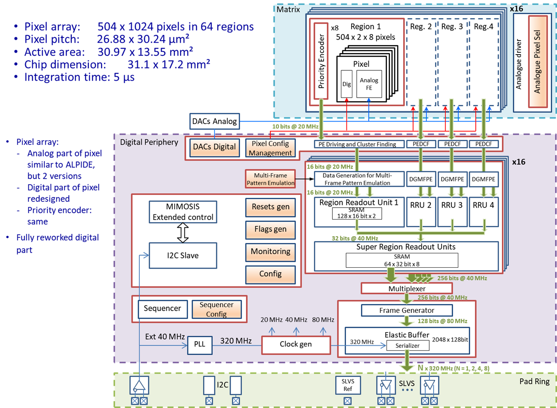
MIMOSIS – Internal structure
Double column:
2 x 504 pixel
Common priority encoder
Region (64x):
Concentrated data from 8 double col.
Max. 100 hit pixel/frame
Super Region (16x):
Further data concentration
Elastic buffer:
Input 10.24 Gbps, output 2.4 Gbps.
Stores 80 MHz/cm² peaks for max 35µs.
Output:
1x, 2x, 4x or 8x 320 Mbps DDR SLVS.
GBTx compatible
MIMOSIS-data arrives with defined time stamp but a typical delay of few 10 µs due to buffers.

Slide 13
Data format (slightly simplified)
Data words length: 16 bit
Meaning | 15 8 |  |  | 7 | 6 | 5 | 4 | 3 | 2 | 1 | 0
Pixel Data | Pixel Address (N-Pix) |  |  |  |  | N-Col |  |  | Pattern
Idle | FC | 0 | 0 | 1 | 0 | 1 | 0 | 1 | 0 | 1 | 0
Frame header | FC | 1 | 0 | Payload (N-Frame…)
Frame trailer | FC | 1 | 1 | Flags
Region header | FC | 0 | 1 |  | N-Region
Spare | FC | 0 | 0 | 0
Spare | FC | 0 | 1 | 1
O
V
O = Overflow flag, Pattern: Status of consecutive pixels
V
Data train
Frame header (8 words) | Region header (1 word) | Pixel data (<100 words) | Region header (1 word) | Pixel data (<100 words) | Frame trailer (1 word) | Checksum (1 word) | Idle
Highly efficient data format – mostly no post-compressing required.

Slide 14
Readout chain (work in progress)
In vacuum
In air
Common Readout Board
Common Readout Interface
8x 320 Mbps
GBTx
Cri-Board (PXIe-board)
clk (40 MHz)
GBTx
GBTx
5 Gbps (optical)
Slow control: I²C
SCA
MIMOSIS-1, 60µm thick
CROB
HV (+10V)
Green Cube
VDD (1.8V)
GND
See talk of D. Emschermann (tomorrow)
VBB (-1V)

Slide 15


Summary and conclusion
GSI, IPHC and Goethe University Frankfurt are developing MIMOSIS:
  Fully depleted, >10¹⁴n_{eq}/cm².
  5 µm spatial resolution.
  5 µs time binning.
  20 MHz/cm² (80 MHz/cm² peak).
  Proven tolerance to heavy ion impacts.
Sensor design far advanced, expect final sensor within 2 years.
Thanks to:
IPHC, Uni-Frankfurt, GSI (CBM-MVD) collaboration:
Julio Andary¹, Benedict Arnoldi-Meadows¹, Ole Artz¹, Jérôme
Baudot², Grégory Bertolone², Auguste Besson², Norbert Bialas¹,
Roma Bugiel², Gilles Claus², Claude Colledani², Hasan
Darwish^{1,2,3}, Michael Deveaux³, Andrei Dorokhov², Guy Dozière²,
Ziad El Bitar², Ingo Fröhlich^{1,3}, Mathieu Goffe², Fabian
Hebermehl¹, Abdelkader Himmi², Christine Hu-Guo², Kimmo
Jaaskelainen², Oliver Michael Keller⁶, Michal Koziel¹, Franz
Matejcek¹, Jan Michel¹, Frédéric Morel², Christian Müntz¹, Hung
Pham², Christian Joachim Schmidt³, Stefan Schreiber¹, Matthieu
Specht², Dennis Spicker¹, Joachim Stroth^{1,3,4}, Isabelle Valin², Yue
Zhao², Roland Weirich¹ and Marc Winter^{2,5}
¹Goethe-Universität Frankfurt, Germany, ²Université de Strasbourg, CNRS, IPHC UMR 7178, Strasbourg, France
³GSI Helmholtzzentrum für Schwerionenforschung GmbH, ⁴Helmholtz Forschungsakademie Hessen für FAIR,
⁵IJCLab, UMR9012 – CNRS / Université Paris-Saclay / Université de Paris, France, ⁶ FIAR GmbH,Germany
ALICE@GSI: Silvia Masciocchi et al.
MIMOSIS readout and FEE:
1x, 2x, 4x, 8x 320 Mbps DDR data links.
Compatible with GBTx/SCA and the CBM readout chain.
Voltages: 1.8V (power), GND, Pixel HV (10V, -1V)
Integration into the CBM standard readout system is in progress.
DRD3 Week, CERN, 17 June 2024

