Slide 1

A high time resolution and high dynamic range ASIC for the micro vertex detector in the PANDA experiment
Hui Zhang, Toko Hirono, Ivan Peric
Karlsruhe Institute of Technology, ASIC and Detector Lab

Slide 2
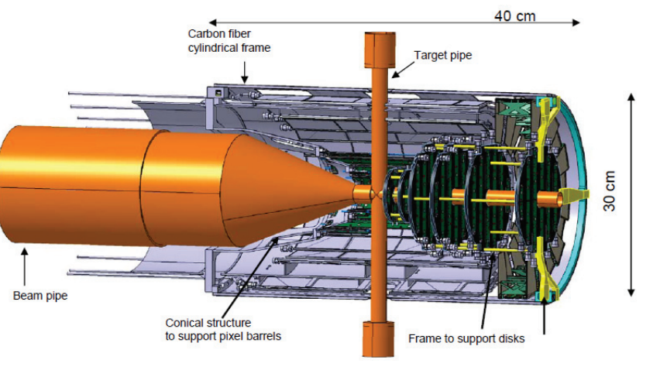
PANDA Micro Vertex Detector
The PANDA detector is composed of several subdetectors
The Micro Vertex Detector (MVD) is a tracking device for charged particles. It is the innermost sub-detector system of the target spectrometer
Main tasks of the MVD are:
  High vertex resolution for primary and secondary vertices of short-lived particles
  Improvement of momentum resolution
  Additional input for particle identification
High time resolution of 1ns RMS enables efficient track reconstruction and possibly particle identification by time of flight
Energy resolution in wide dynamic range 100ke with 100e noise for dE/dX measurements and particle identification
Pixel size: 80 µm x 80 µm
Chip size: 1 cm x 2 cm

Slide 3
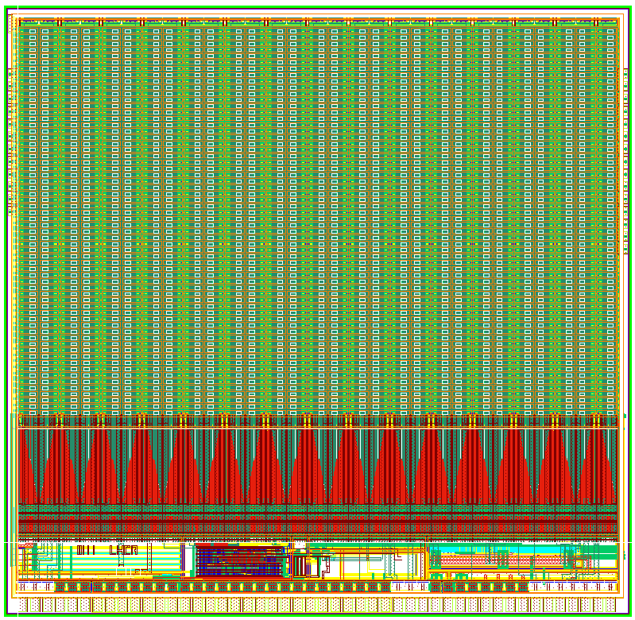
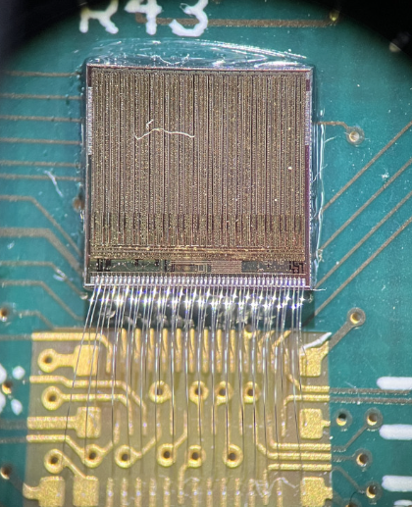
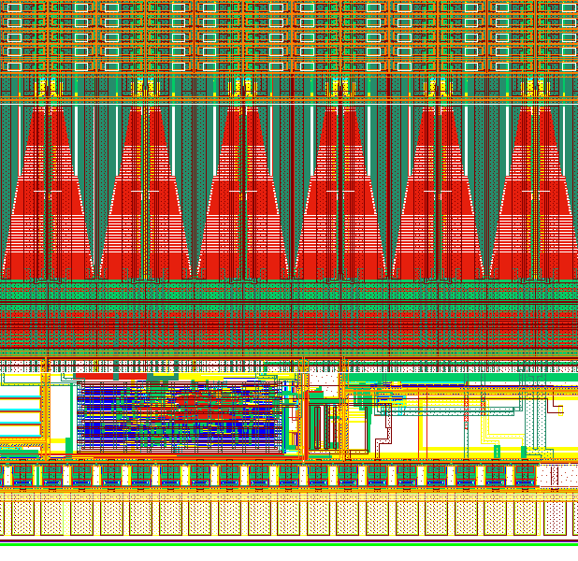
Chip Architecture
HVCMOS 180 nm technology with MPW run
Chip Size: ~ 5 mm x 5 mm
Pixel Matrix: 29 columns x 62 rows
Pixel Size: 50 µm x 165 µm
Configuration register
Readout Cell
End of Column
Synthesized Digital
Bias Block
Pads
Pixel Matrix
Configuration
+Hit Buffer
TDC
End of Column
Synthesized Digital
+ Bias Block
Pads

Slide 4
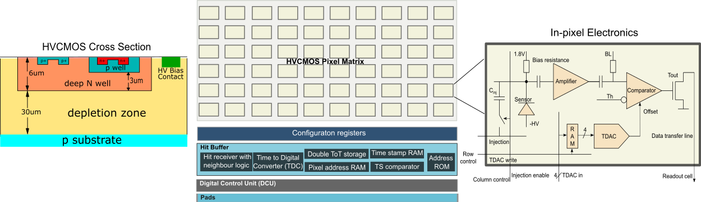
HVCMOS Technology
HVCMOS Sensor, a new generation of particle detectors
Commercial technology, not expensive
The sensor and readout electronics in the same die
Use external negative bias voltage
Pixel is based on a deep n well with electronics inside, isolated against HV
Charge collection by drift
Substrates from 300Ωcm to ~20kΩcm
Good time resolution, detection efficiency and radiation tolerance
Can be thin
Radiation tolerant technology, further increased by special design
  Radiation tolerant PMOS transistors
  Deep submicron
  Guard Ring
  Shielding

Slide 5
Pixel Electronics
Charge sensitive amplifier with variable gain
Feedback circuit
Two comparators
  Fast comparator: enable accurate time measurement
  Slow comparator: enable precise amplitude measurement
1.8V
AlwaysEnB
BL
Pixel
Bias resistance
Disable
Amplifier
Comparator
Sensor
AnalogOut
Th
C_{inj}
EnInjection_row_i
Disable=Q(3)
Offset
-HV
RAM
Q(0:2)
TDAC
Data transfer line
Injection
WrRAM(0:3)_row_i
4
Injection
RAM in
AmpOut
row control (in CRB)
column control (in CRB)
Hit buffer

Slide 6
Pixel Electronics
The first stage is a standard folded cascode amplifier
  Implement variable gain
The second stage are the two source followers
  It provides fast time constant and voltage level shifting
  The bias current of the second source follower is smaller than that of the first
  The second source follower acts as a low pass filter
Each pixel has two comparators and two readout channels

Slide 7
Readout control unit
Hit Buffer, End of Column, Readout Control Unit
row control (in pixel control reg)
column control (in pixel control reg)
RCU
pd
From Pixel
Hit buffer
PD1
RAMIn<0:3>
Regulated
cascode
Scan In
PD2
RAM Wr
m1
m2
TDC
LdCol1
Ld column
TDAC
+
edge
h1
&
h2
L
&
LdCol2
RAM
Ld pixel
EnB
LdPix1
TS
TS2
TS3
TSCk
LdPix2
Ld pixel
Scan Out
Rd Pixel
RdCol1
Rd column
EOC
RdCol2
Ld column
h1
meoc
RdCol3
Rd column
RdCol4
Scan Out
Scan In
L
Rd column
&
Serializer
DataOut

Slide 8
Hit buffer
Hit buffer logic
  RAM cell
  4-bit Tune DAC
  Regulated cascode receiver
  Time to digital converter
  Main hit buffer logic
Hit from pixel
LE
RAM
RAMIn<0:3>
RAM Wr
TDAC
+
Main hit buffer logic
LE
RAM
RAM
EnB
Addr
ROM
LE
RAM
TS2
TS1
TS3
Data Bus
TDC

Slide 9
Hit buffer
Main hit buffer
  Edge detector
  Priority logic
  Address ROM cells
  Time stamp RAM cells
LE
RAM
Scan In
Priority Logic
Hit
1st hit flag
2nd hit flag
Enable
Enable*
LE
RAM
+
S
S
EnB
R
R
RdInt
Addr
ROM
SR latch
LE
RAM
LdPix & !Hit
Scan Out
RdPix
TS2
TS1
TS3
Data Bus

Slide 10
Time to Digital Converter
Time to digital converter
The hit time is measured by storing two time stamp values
Two time stamp counters run with the same period of 10ns and could be reset synchronously
TS coarse
0
1
2
3
4
5
6
7
Clk
Particle hit
HitSync
time stretching circuit
TS fine
0
1
2
3
4
5
6
7

Slide 11
Time to Digital Converter
Our circuit
Ibig
hit
hitSync
Ismall
hit
Clk
FF
vcap
Vth
comp
hitSync
hit
Amplified time = (
TDCfine
–
TDCcoarse
) x
Tclk
vcap
comp
Clk
1
6
TS
coarse
TS
fine
Amplified
time
TS
coarse
0
1
2
3
4
5
6
7
TS
fine
0
1
2
3
4
5
6
7

Slide 12
End of Column
Data for each event has 55 bits
  Coarse time stamp (20 bits TS1)
  Energy measurement (10 bits TS2)
  Fine time stamp (7 bits TS3)
  Row Address (10 bits)
  Column Address (8 bits)
The time stamp frequency: 100MHz
TS1 uses two 10-bit counters, one clocked with positive edge and the other with the negative edge
Column control line 0
Row2
Column control line 28
Row1
Row0
Config. reg block
Config. reg block
col
row
row
row
col
row
row
row
124 Hit buffers
Hit buffers
(…)
EoC
EoC

Slide 13
Readout control unit
Readout block, data formatting block, time stamp counter, Phase locked loop
Readout block comprises a state machine
Data formatting block performs 8-bit to 10-bit conversion and transmits the data serially
Serializer is based on a binary tree, and transmits a bit on the rising and falling output clock edge
PLL input clock of 250 MHz and output clock of maximal 800 MHz
Maximal data rate: 1.6Gbps
RCU
Readout block
Data formatting block
State machine
Serializer
Time stamp counter
Phase locked loop

Slide 14
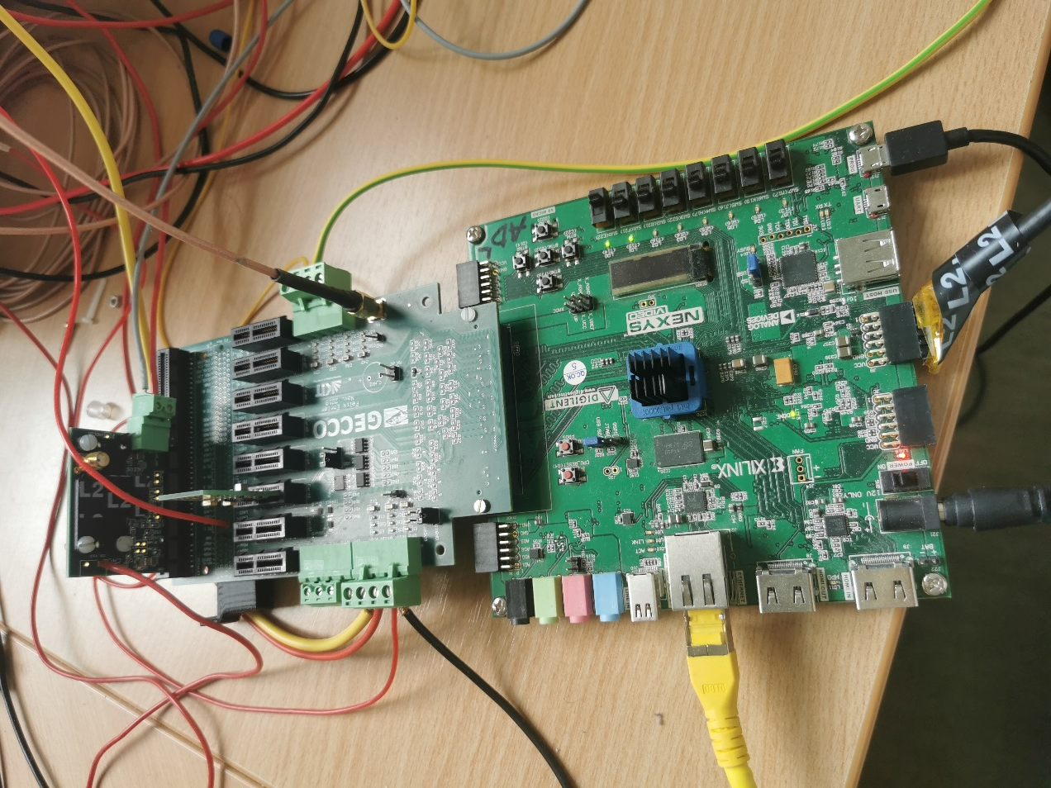
Measurement system
Test system
Signal source for measurements is a test signal circuit – a capacitor placed in every pixel
The test circuit is calibrated with radioactive source

Slide 15
Measurements
Pulse width measurement
The pulse width of slow signal is larger than the fast signal. The sigma value for slow channel is smaller, leading to significantly larger SNR.
Energy resolution with SNR>1000 possible, the maximum signal limited by the injection circuit
- For 32ke amplifier does not saturate, maximum signal limited by injection circuit
- The average ToT noise is about 48 ns for slow comparator. Its gain can be obtained by fit and it is 0.413 ns/e. If we divide the ToT by gain, we obtain the noise in electrons as 116 e.

Slide 16
Measurements
Comparator response time and pulse width
The time of threshold crossing is smaller when measured ToT is larger. Exponential function has been fitted to the data and it is used for the time walk correction.
Time resolution <1ns should be possible

Slide 17
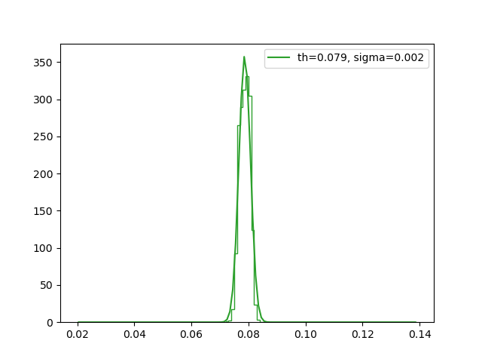
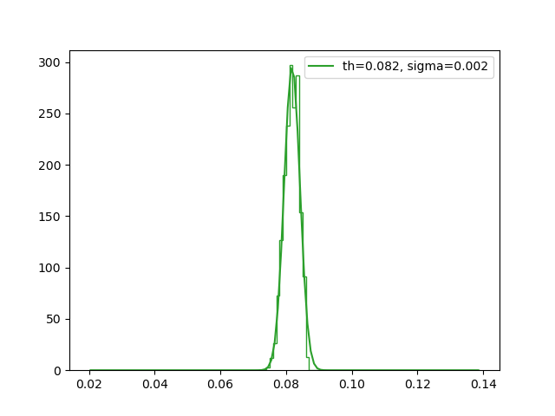
Measurements
Threshold dispersion is <60e, both comparators can be tuned

Slide 18
Outlook
Planned design improvements include:
  reduce detector capacitance, reduce noise
  optimize layout design
Next prototype (named MiniPANDA), with 80 μm x 80 μm pixel size has been completed.
  Uses two stage amplifier and one comparator
  Second amplifier improves energy resolution by TOT
  Uses deep p-well and isolated amplifier
  Test system ready, results soon
Following testing of the MiniPANDA ASIC, the full-size sensor will be designed.
25pA
200pA
2.5fF
10fF
20fF

Slide 19


