Slide 1

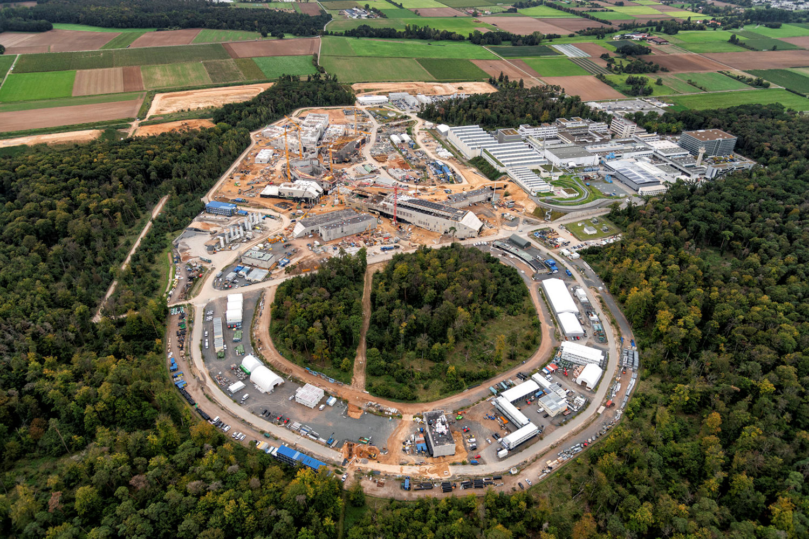
Status Funding
CBM and HADES experiment
13th CBM Resource Review Board meeting – 16th May 2024
Report CBM and HADES Resource Coordinator, Jürgen Eschke
Content:
CBM Collaboration without Russian participation
Consequences of the termination of all In-Kind contracts with Russian institutes (strategy for re-procurement)
Status funding of the CBM day 1 setup and of the CBM start version
Status IKCs
CBM construction timeline and funding strategy
Status Funding of HADES@SIS18 (FAIR Phase 0)
and of HADES@SIS100 (FAIR Phase 1)
HADES MoUs

Slide 2
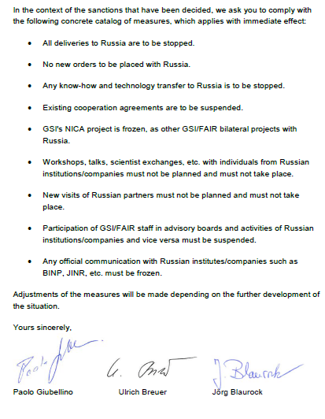
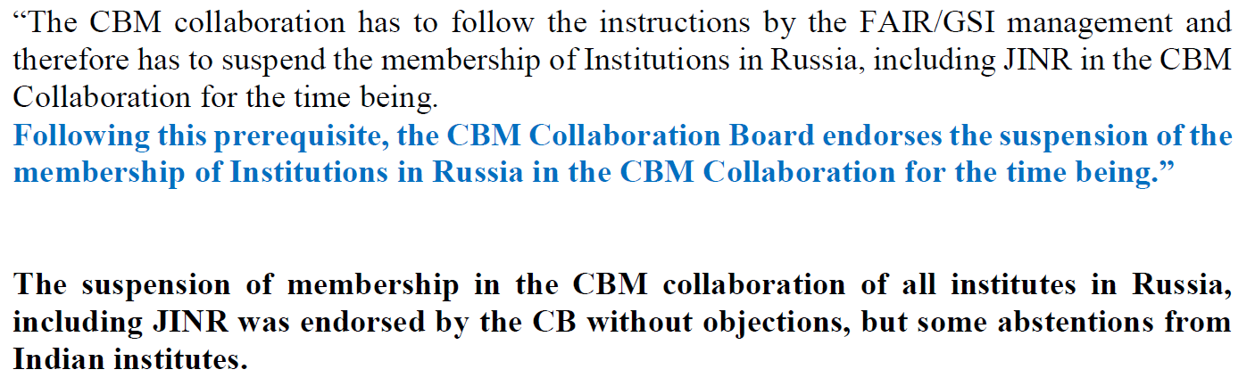
March 2022
Stop of communication and
cooperation with Russian Institutes
in CBM Collaboration
28. Februar 2022
CBM CB decision 18.05.2022
Termination (6.12.2022) of all collaboration contracts with Russian institutions by Council → executed by FAIR management
CBM CB decision 04.04.2023 (by e-voting)
CBM CB has decided to terminate the membership of institutions in Russia (this includes JINR) in the CBM collaboration.

Slide 3
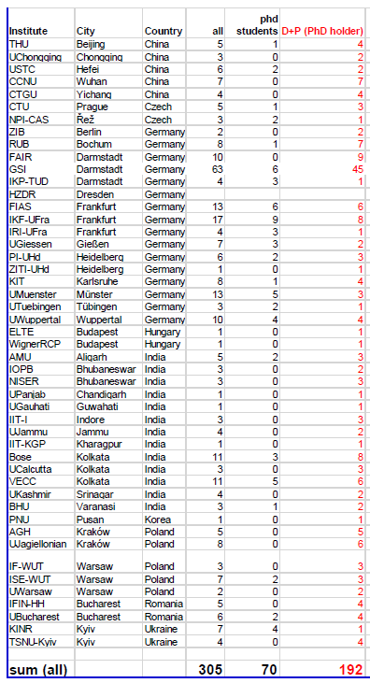
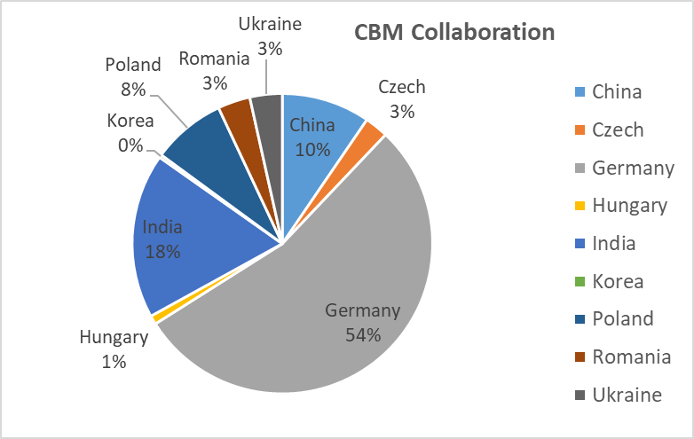
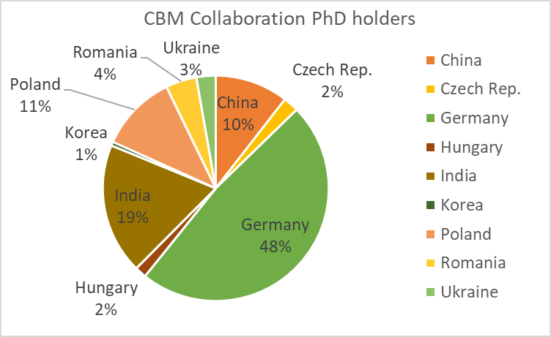
Composition of CBM Collaboration (December 2023)
CBM without Russia (06.12.2023)
47 full member institutions
10 associated member institutions
from 10 countries
~400 full member – ~22% from Russia = 305

Slide 4
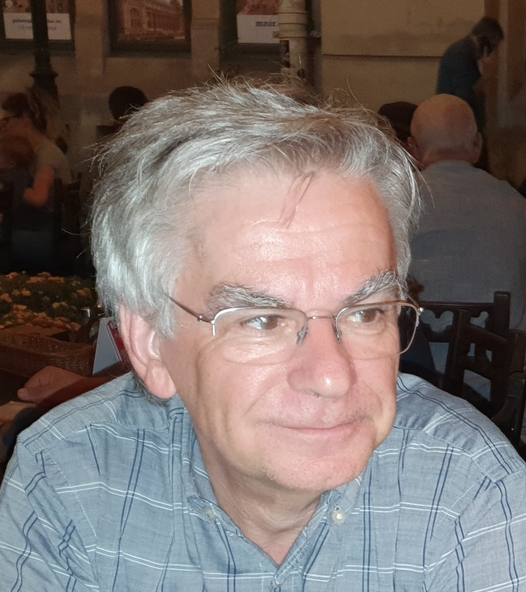
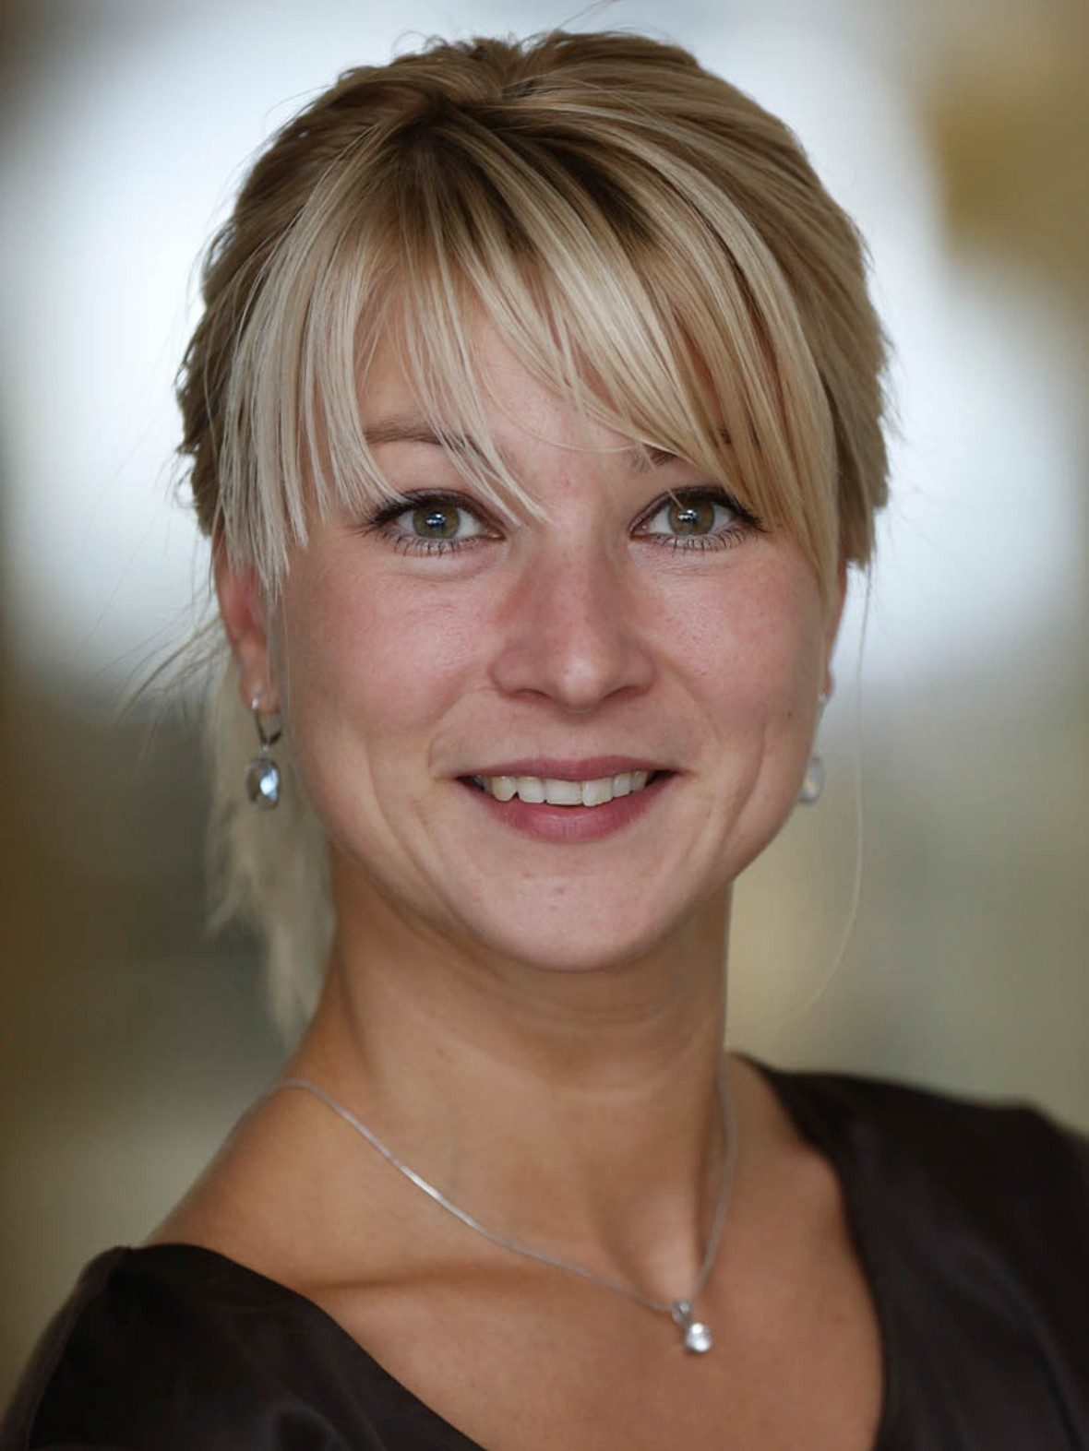
new CBM spokesperson
Prof. Norbert Herrmann
(University Heidelberg)
CBM spokesperson
(April 2017 – April 2024)
Prof. Tetyana Galatyuk
(University Darmstadt)
elected on 12th April 2024
as new CBM spokesperson

Slide 5
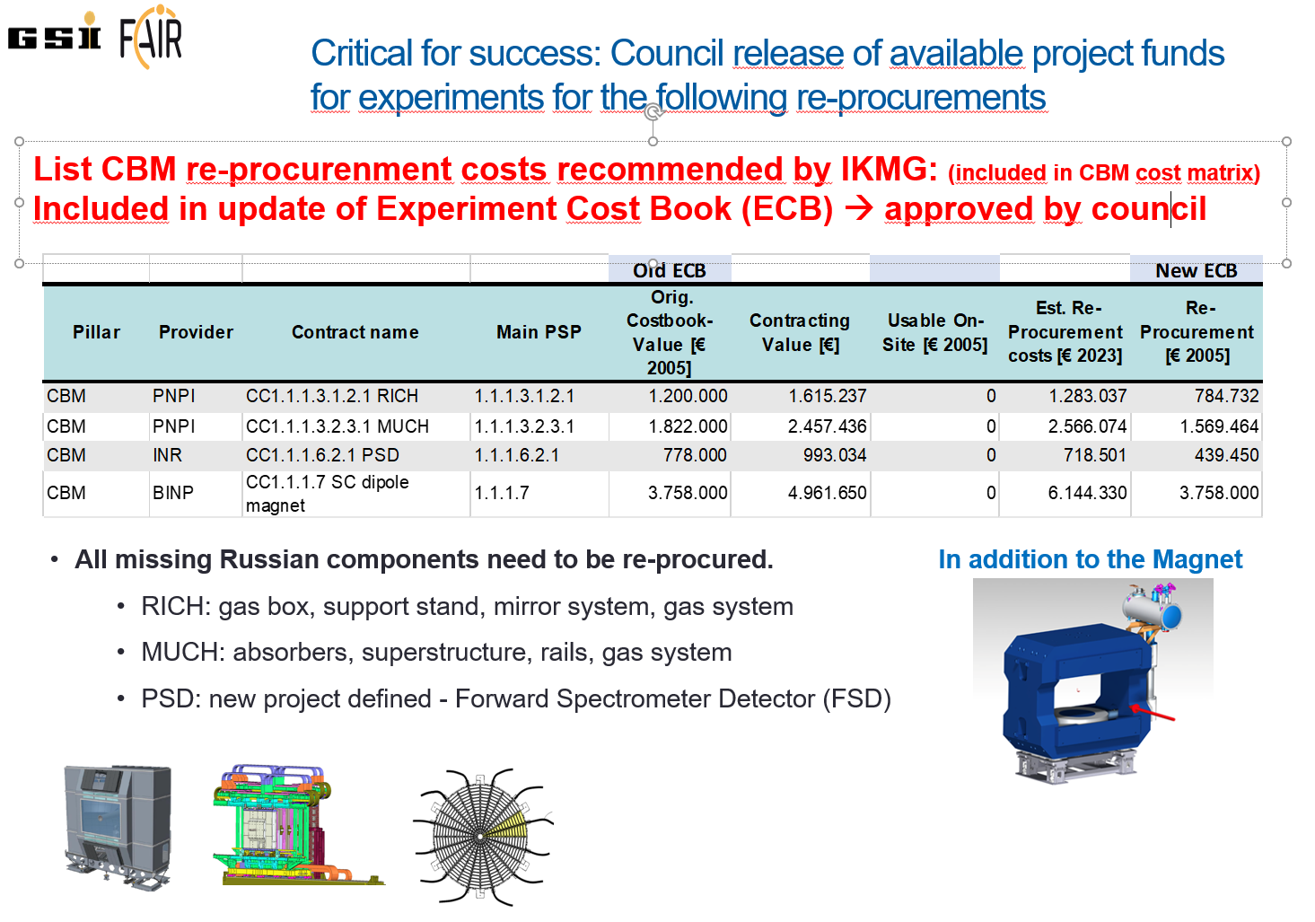
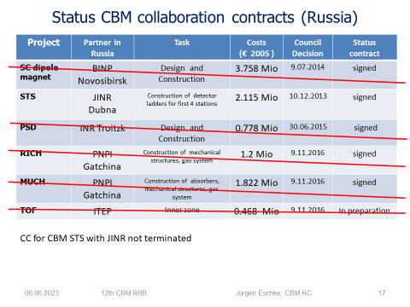
Termination of In-Kind contracts with Russia
Decision of FAIR Shareholders (council) executed on 06.10.2022 by FAIR management
to terminate all collaboration contracts with Russian institutions.
Collaboration Contracts (CC) for the accelerator In-Kind components have been terminated.
But also all Collaboration Contracts (CC) with Russian Institutions for In-Kind components for the NUSTAR, APPA, PANDA and CBM have been terminated.
For CBM four important Collaboration Contracts have been terminated.
The termination of the CCs is a prerequisite to procure these items from alternative vendors or receive them from other In-Kind partners.

Slide 6
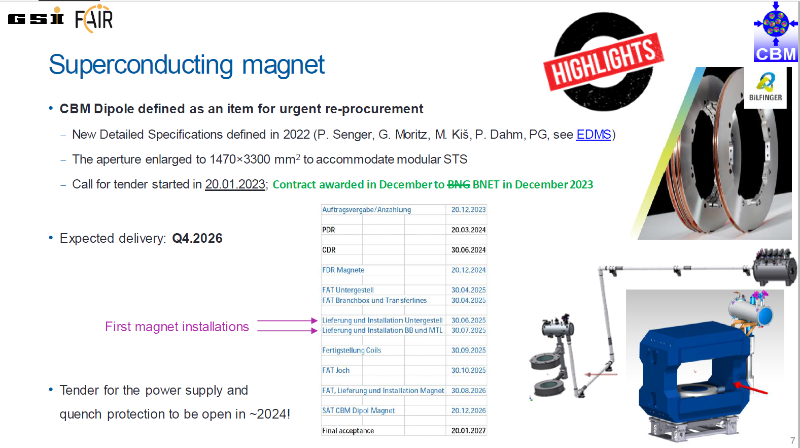
Re-procurement CBM Magnet – experiment project funds released by council

Slide 7
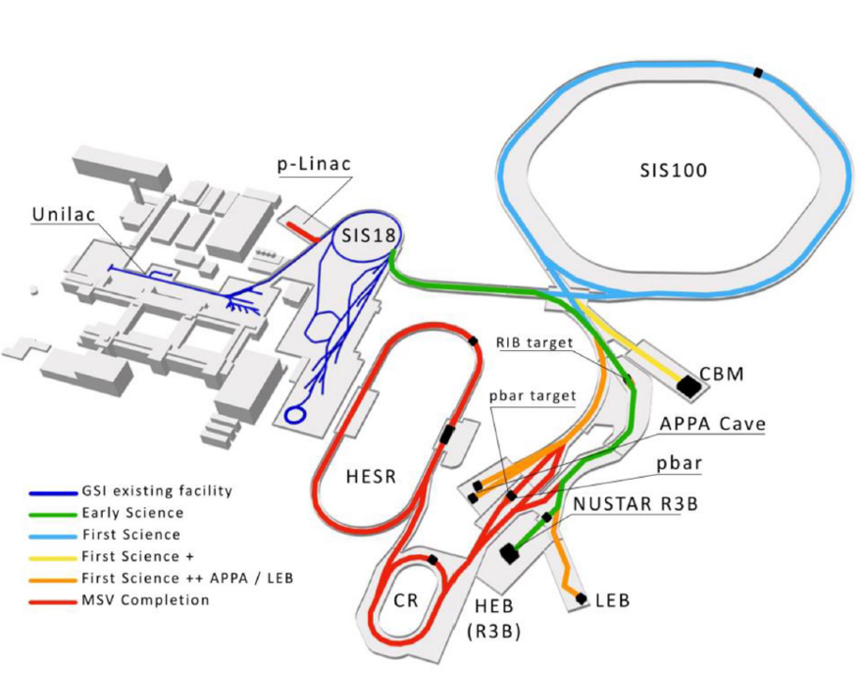
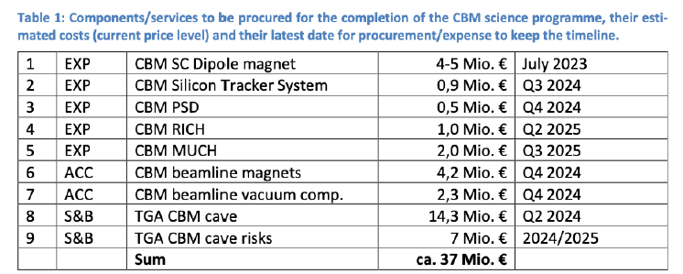
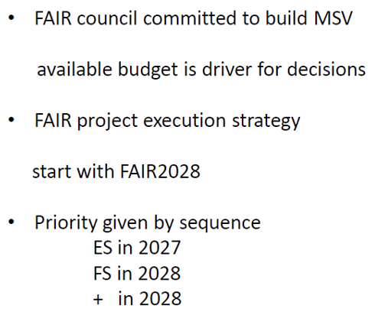
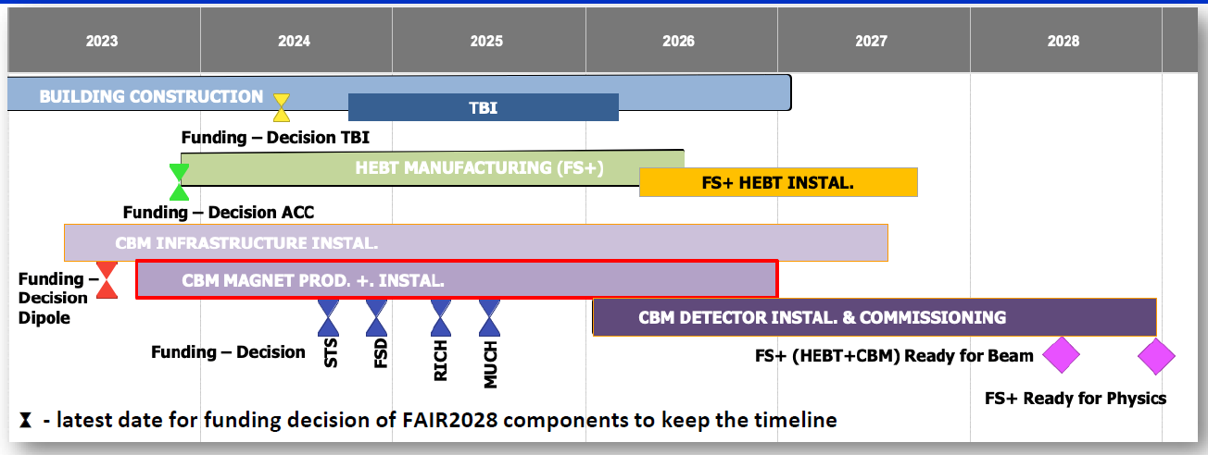
Additional Costs for FS+

Slide 8
Responsibilities for re-procurement for
RICH, MUCH and for building FSD
CBM RICH mechanical structures and gas system
The Wuppertal and Giessen groups have started to prepare the finalization of the engineering design of the RICH mechanical structures, which can be built by a company, if the FAIR council gives the green light for the release of FAIR project funds for experiments.
CBM MUCH mechanical structures/absorbers and gas system
VECC in India is prepared to take over the responsibility for the MUCH mechanical structures, which can be built by a company, if the FAIR council gives the green light for the release of the FAIR project funds for experiments.
new Forward Spectator Detector (FSD) (ex PSD)
CTU, Prague in the Czech Republic has taken over the preparations for the construction of the new Forward Spectator Detector (FSD). CTU is working on the concept and design and will provide additional CZ funds for the construction of the FSD. NPI, Rez is also contributing. Recently the Univ. Bochum and the GSI-FFN group joined the FSD team. However, for the construction of the FSD additional funds are required.

Slide 9
Country funding (in 2022 prices [M€]) CBM day 1 setup 11th RRB 23.02.2022
and CBM phase 1 setup (CBM start version)
Update of costs and funding matrix required without Russian In-Kind contributions (cancellation of In-Kind Contracts) and due to termination of Russian (plus JINR) membership in CBM Collaboration

Slide 10
Experiment funding CBM day 1 setup 13th RRB 16.05.2024 (in 2005 and 2024 prices [k€])
and CBM phase 1 setup (CBM start version@SIS100)

Slide 11
Funding CBM day-1 setup 16 May 2024
Estimated re-procurement costs [2024 EUROS]
Magnet: 5,13 M€
Forward Spectator Detector (ex PSD): 0,74 M€
RICH mechanics, gassystem: 1,32 M€
MUCH absorbers, mechanics: 2,63 M€
total cost: 35,27 M€ (2005 EURO)
secured: 29,73 M€
EoI: 3,22 M€
t.b.a. 2,31 M€
84,3 % secured funding
Common Fund: 22% t.b.a by collaboration due to
termination of membership of Russian Institutes
plus cost increase due to inflation
re-procurement
[2005 prices]
k€

Slide 12
Country funding (in 2024 prices [M€]) CBM day 1 setup 13th RRB 16.05.2024
and CBM phase 1 setup (CBM start version)

Slide 13
Country funding (in 2005 prices [M€]) CBM day 1 setup 13th RRB 16.05.2024
and CBM phase 1 setup (CBM start version)

Slide 14
CBM Cost Matrix &
HADES Cost Matrix (16.05.2024)
please consult distributed
cost matrix for all details!

Slide 15
Status CBM in-kind contracts
Project | Partner Institution | Task | Costs k€ 2005 | Council decision | Status In-Kind contract
STS | AGH, Crakow, Poland | Design and Construction of STS-XYTER chip | 572 | 30.06.2015 | Signed
STS STS STS | JU, Crakow JU, Crakow GSI, Germany | Sensors and QA Front End Boards, test procedures for STS-XYTER chip and FEE STS system | 707 261 4630 | 28.06.2016 28.06.2016 28.06.2016 | Signed Signed Signed
HADES | JU, Crakow, Poland | HADES ECAL Mechanical frame | 200 | 30.06.2015 | Signed (frame delivered and installed in HADES cave)
STS & DAQ | WUT, Warsaw, Poland | DAQ Data Processing Boards (DPBs) & Data Acquisition and Controls (DAQ) | 260 200 | 30.06.2015 06.07.2023 | Joint IKC In preparation
TOF | IFIN-HH, Bukarest, Romania | RPC chambers | 748 | 30.06.2015 28.06.2016 | In preparation
TOF TRD | GSI, Germany IFIN-HH, Bukarest | FEE TRD Chambers | 740 752 | 28.06.2016 29.4.2019 | In preparation In preparation
MUCH | BOSE, Kolkata VECC +12 Indian Institutes | GEM chambers and FEE | 3790 | 10.12.2015 | Signed
15

Slide 16
Funding CBM day-1 setup 16 May 2024
Estimated re-procurement costs [2024 EUROS]
Magnet: 5,13 M€
Forward Spectator Detector (ex PSD): 0,74 M€
RICH mechanics, gassystem: 1,32 M€
MUCH absorbers, mechanics: 2,63 M€
total cost: 35,27 M€ (2005 EURO)
secured: 29,73 M€
EoI: 3,22 M€
t.b.a. 2,31 M€
84,3 % secured funding
How to close the funding gap ?
depends on council decision on FS+
and green light for re-procurement for RICH, FSD and MUCH
Agree on Amendment Construction MoU to compensate
missing Common Fund contribution from Russia
plus for cost increase due to inflation (next talk)
Look for additional partner
new CBM members Bochum and GSI FFN group √,
Hiroshima (√) joined the CBM collaboration in September 2023
US groups are interested in CBM….
Try to construct more cost effective, look for further synergies
Further funding applications
Common Fund: 22% t.b.a by collaboration due to
termination of membership of Russian Institutes
plus cost increase due to inflation
re-procurement
[2005 prices]
k€

Slide 17
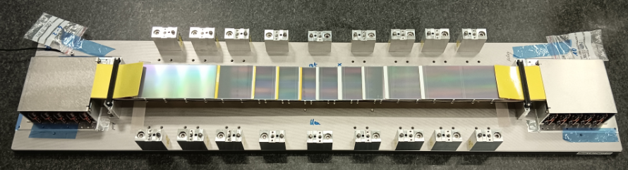
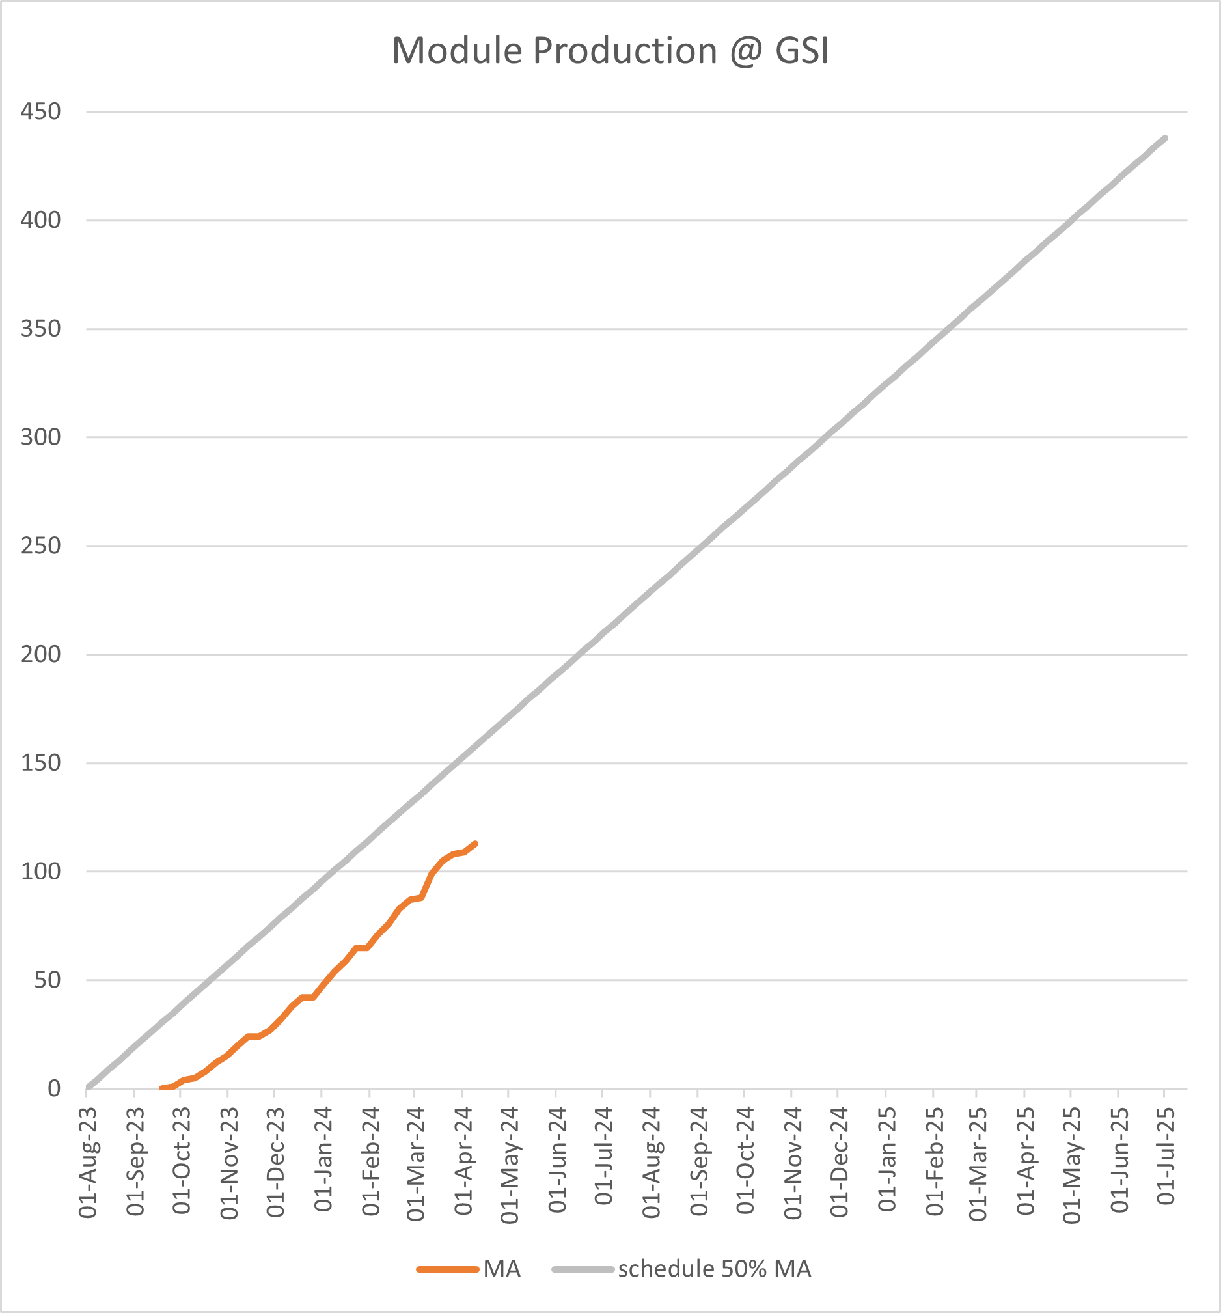
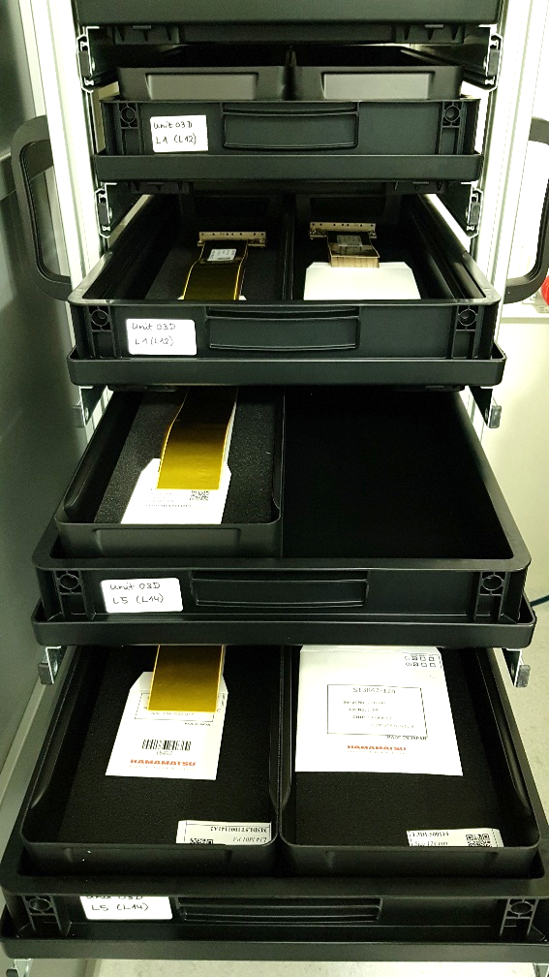
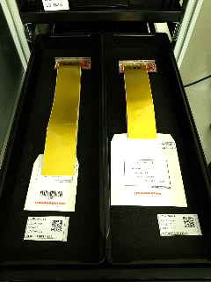
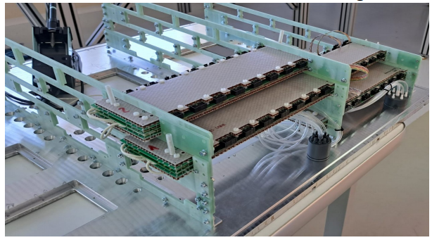
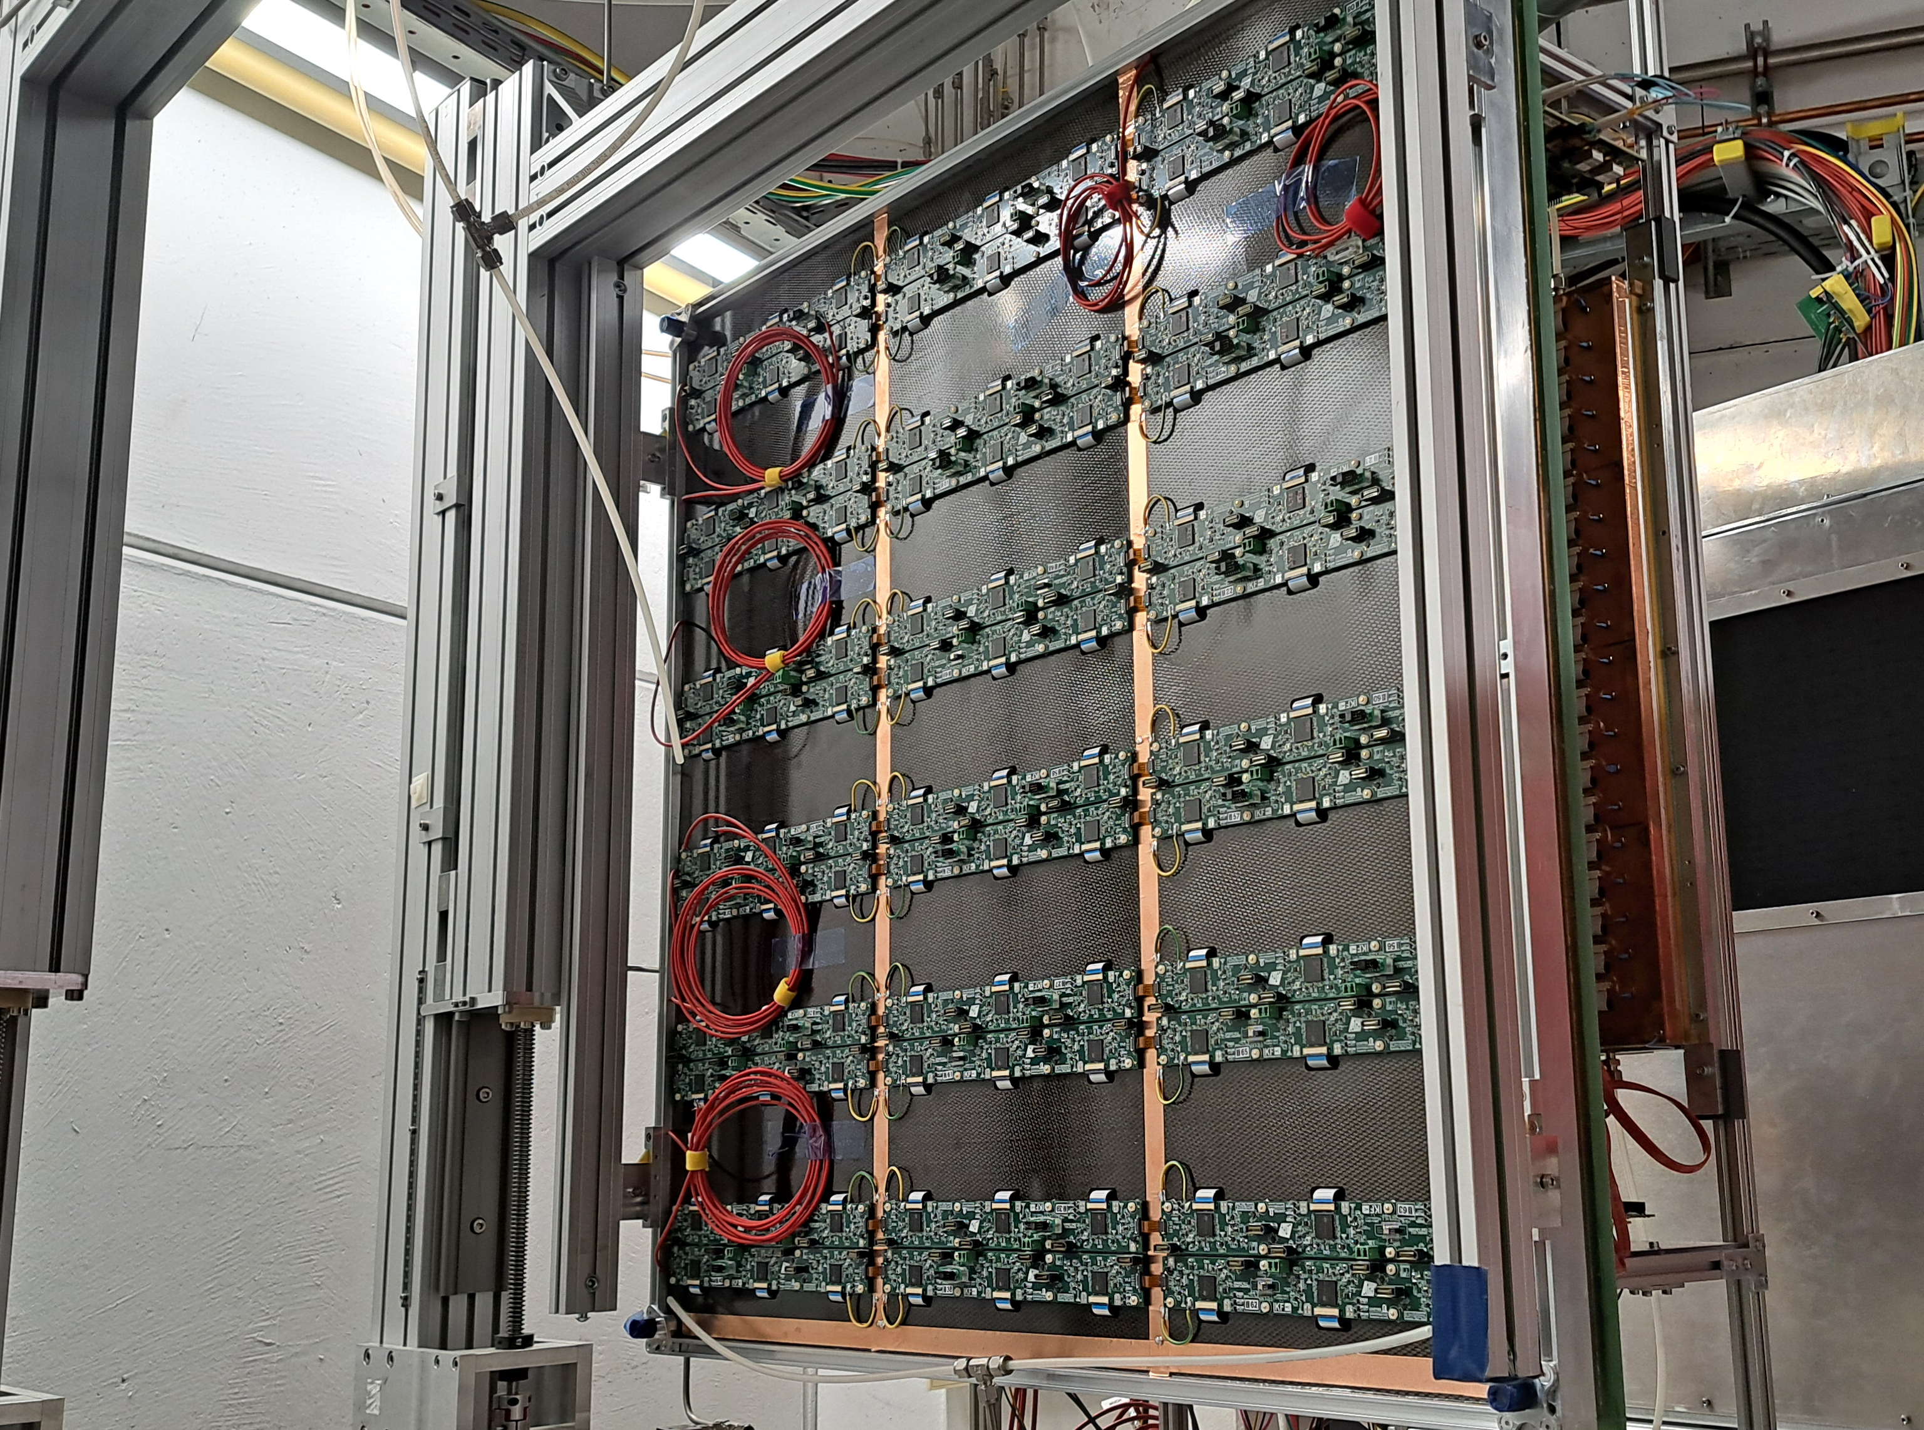
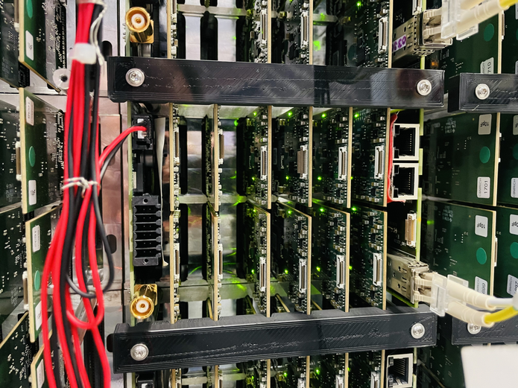
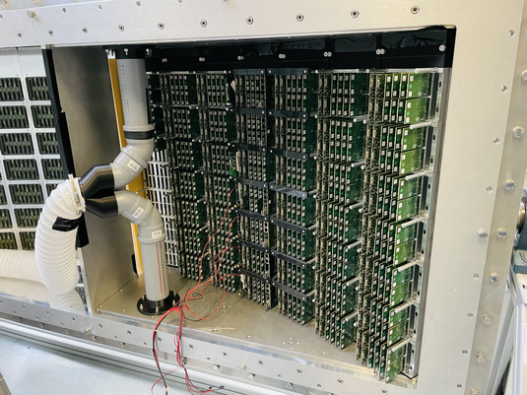
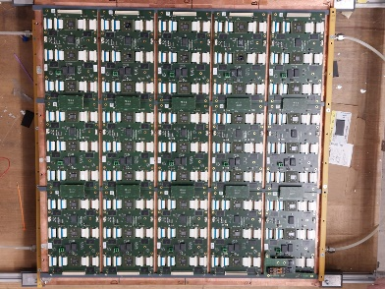
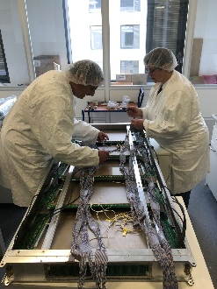
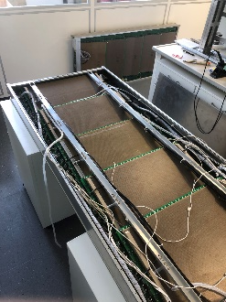
CBM system mass production
STS module production, Ladder pre-production
Module production at GSI
STS module production
  > 100 modules assembled
  Ladder assembly ongoing (first 3 ladders ready!)
  PRR in Spring 2024
RICH
  1 of 2 photo cameras ready!
  50% FEE produced!
TOF
  Counter pre-production concluded. PRR in May/June
  Module pre-production ongoing
TRD
  First pre-production modules of 1D and 2D options ready!
throughput matches
project plan
25% of GSI production
50% of RICH FEE and CAMERAs ready!
TRD pre-production modules
TOF modules pre-production

Slide 18
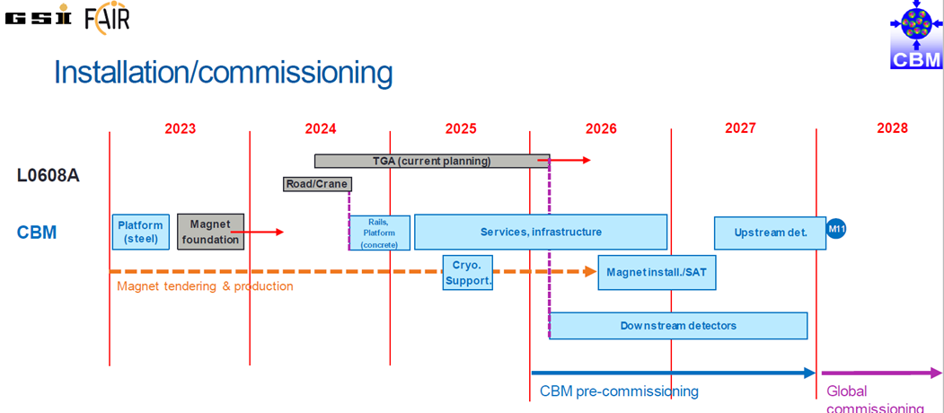
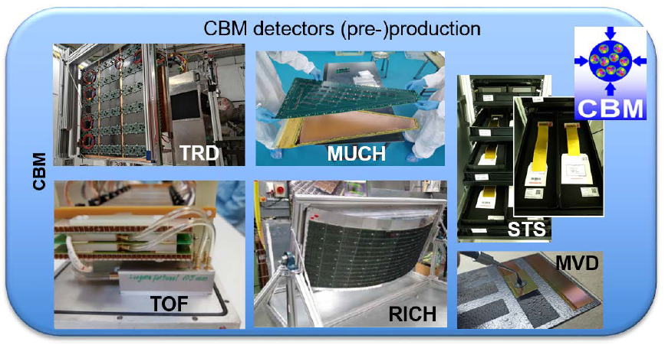
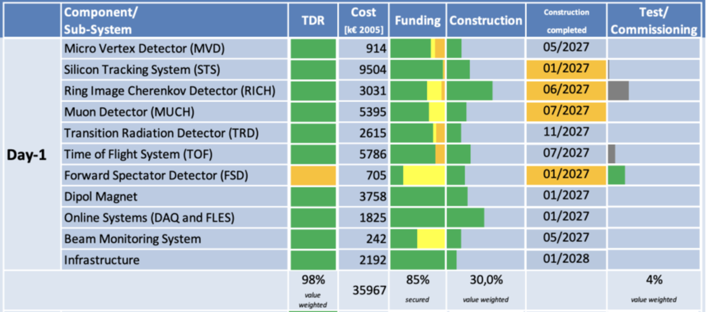
CBM construction timeline and progress
CBM has started
the mass production
of detectors
to be completed
until end of 2027
March 2024

Slide 19
Summary CBM Costs and Funding
- The CBM collaboration has define the “day 1“ setup, which will be operational, when the SIS100 beam will be switched on.
The total cost of the CBM day 1 version (35,27 M€ in 2005 prices)
(-0,7M€) compared to the RRB12.
- Czech Technical University received additional funding (164 T€ - 2024 prices) for the construction of the new Forward Spectator Detector (PSP 1.1.1.6.2.3).
- The CBM Collaboration is preparing the re-procurement of the missing Russian In-Kind contributions
- The CBM collaboration has implemented a Common Fund for covering the costs of the common infrastructure of 3,68 M€ (2024 prices).
Missing contributions of Russian institutions of 22% need to be compensated plus cost increase due to inflation.
(Amendment to CBM Construction MoU – next presentation)
The CBM day 1 setup has 84,3% secured funding
(secured funding will increase after expected council decisions)
The CBM start version (including ECAL and the full bandwidth of the DAQ/FLES) has 77,4% secured funding

Slide 20

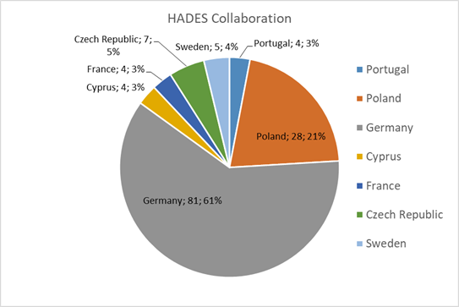
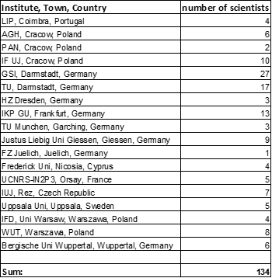
HADES Timeline
Upgrade phase, preparation for SIS18 (FAIR phase 0))
  2022: - RICH UV photo-detector – ready
    - Forward detector – ready
    - ECAL 5 sectors - ready
    - MDC readout upgrade – in progress
    - T0 prototype LGAD based
  2023: - ECAL last sector ready
  - improved target
  - MDC FEE Upgrade
  - T0 LGAD+ASIC based Upgrade
  2024: - setup for Carbon beam run,
  time-zero detector with segmented diamond counter,
  all 6 sectors of ECAL in operation
2022-2028?… (experiment campaign at SIS18 - FAIR phase 0)
  we plan three long runs, e.g.:
    - Au+Au Beam Energy Scan (200-400-600-800 MeV)
    𝜋+(CH₂)_{n}/LH₂: baryon em transition form factors,
    baryonic resonances with strangeness
    p+A/p+p: strangeness/vector mesons in medium
~2030… on (HADES at SIS100)
  Transfer spectrometer to new experimental hall
  Cold matter physics (p+A)
  Exclusive measurements (p+p)
  Ag+Ag system at 4.5 GeV beam energy
HADES collaboration has also terminated the membership of institutions in Russia (this includes JINR) in the collaboration
HADES collaboration has 134 members (May 2024)
Notes:
XB

Slide 21
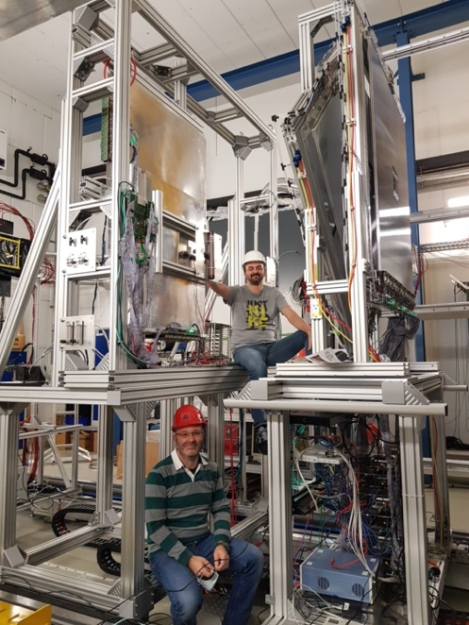
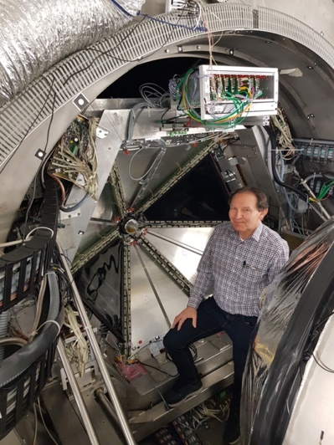
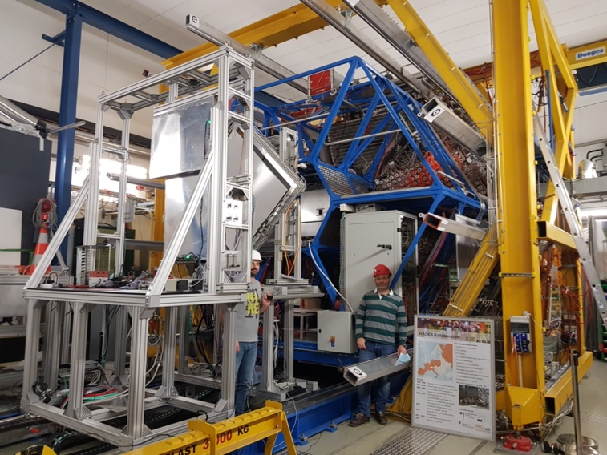
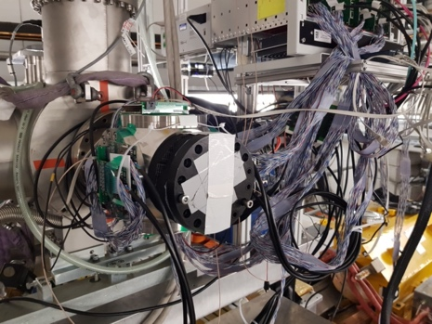
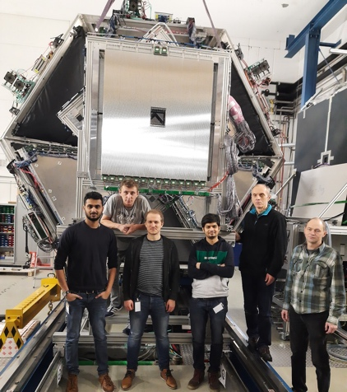
The upgraded HADES detector (five new detector systems)
Improved physics performance through instrumentation of the very forward hemisphere using FAIR technology.
In particular important for the Hyperon Program.
iTOF
TransFAIR, Jülich
APD read-out
Enhances trigger purity
Forward RPC
LIP Coimbra
Based on R&D for neuLAND
TRB3 read-out
STS2
Jagiellonian Univ.
PANDA straw technology
PANDA PASTTREC FEE chip
STS1
TransFAIR, Jülich
PANDA straw technology
PANDA PASTTREC FEE chip
T0
GSI, TU Darmstadt
LGAD technology
In-beam detector

Slide 22

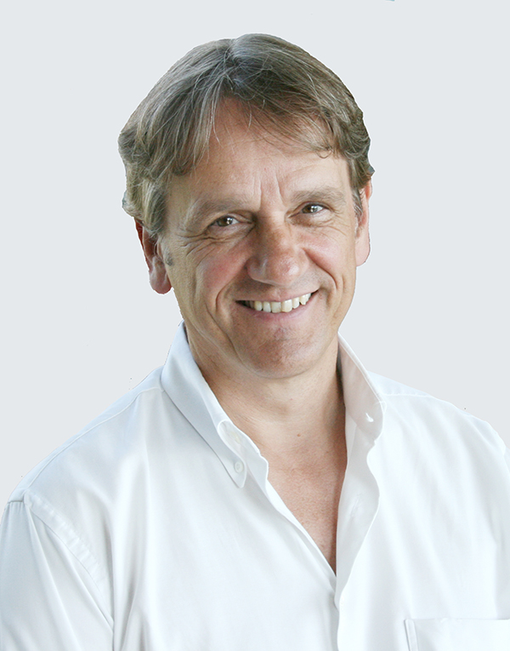
HADES members
The HADES Phase-0 activity has attracted new members with own funding
Polish initiative to increase participation in HADES
(coordinated by Prof. Salabura)
  Institute of Nuclear Physics, Polish Academy of Sciences, Cracow (5)
  AGH University of Science and Technology, Cracow (6)
  University of Warsaw - Institute of Experimental Physics (3)
  Warsaw Techical University (8)
New Czech group: Department of Experimental Physics of Faculty of Science,
Palacky University, Olomouc (3)
FZJülich/Bochum (Prof. Ritmans groups) – now GSI FFN (10)
Swedish PANDA colleagues (through PANDA.HADES MoU,
coord. Prof Schönning)
  Department of Physics and Astronomy, Uppsala University (5)
  University of Stockholm
The HADES spokesperson Prof. Joachim Stroth (Goethe University Frankfurt)
and Pavel Tlusty (deputy) have been re-elected for another period of three years in April 2024
during the collaboration meeting HADES-XLVI.

Slide 23
HADES upgrade costs
The costs of the HADES experiment at SIS18 (FAIR phase 0) amount to 1,17 M€ (2005 prices). The funding is almost assured (91,9% secured funding).
The costs of the HADES experiment at SIS100 (FAIR phase 1) amount to 2,67 M€ (2005 prices). The
level of secured funding amounts to 82,1 % at this time.

Slide 24
HADES upgrade for
FAIR Phase 0 (SIS18) & FAIR Phase 1 (SIS100)
There are additionally secured contribution by NPI, Czech Republic of 195T€ (2024 prices) for the PMTs for the HADES ECAL and 40,5T€ (2024 prices) from TU Darmstadt for the HADES beam monitoring system.
Notes:
one can edit/change the numbers is table
numbers seems to be OK.

Slide 25
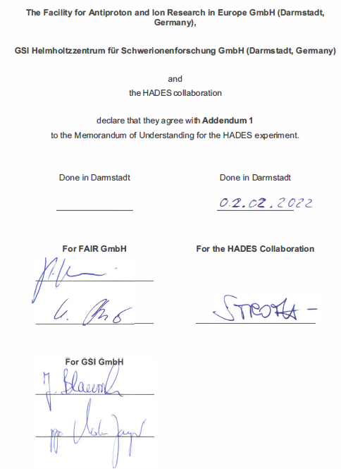
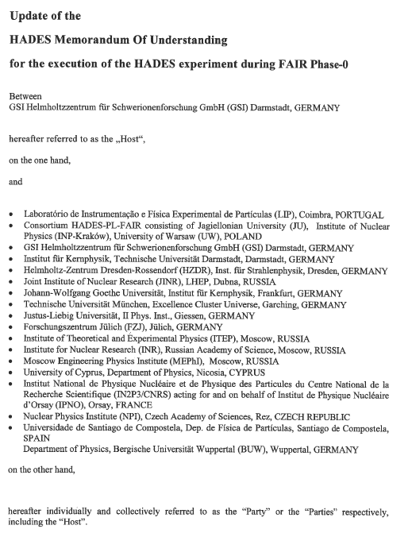
HADES MoUs
Addendum 1 of the “Update HADES Memorandum Of Understanding
for the execution of the HADES experiment during FAIR Phase-0”
FAIR GmbH and GSI Helmholtzzentrum GmbH jointly
representing the Host Laboratories of the FAIR
project certify by signing Addendum 1
to the present MoU for the HADES experiment the following:
1. The upgraded HADES detector is a FAIR experiment at SIS18 and at SIS100.
2. The HADES collaboration operating the HADES experiment is part of the
C.B.M. research pillar of the FAIR science programme.
3. The financial resources for the upgrade of the HADES experiment, including the contributions of
the FAIR shareholders and from other countries, are monitored by the FAIR Resource Review Board.
4. FAIR GmbH and GSI are appreciating the efforts of the HADES collaboration to produce physics
data from the data taking at SIS18 and later at SIS100.
5. A separate Construction MoU like for other FAIR collaboration is not required, since the upgrade
of the HADES experiment is almost completed.
6. For the operation phase of FAIR the present MoU will be superseded by a
Maintenance & Operation MoU for the HADES experiment.
MoU
1999
2009
2012
update MoU
2018
Addendum 1
2022
Addendum 2
extension until 2030
(in preparation)
HADES M&O MoU
2030

Slide 26
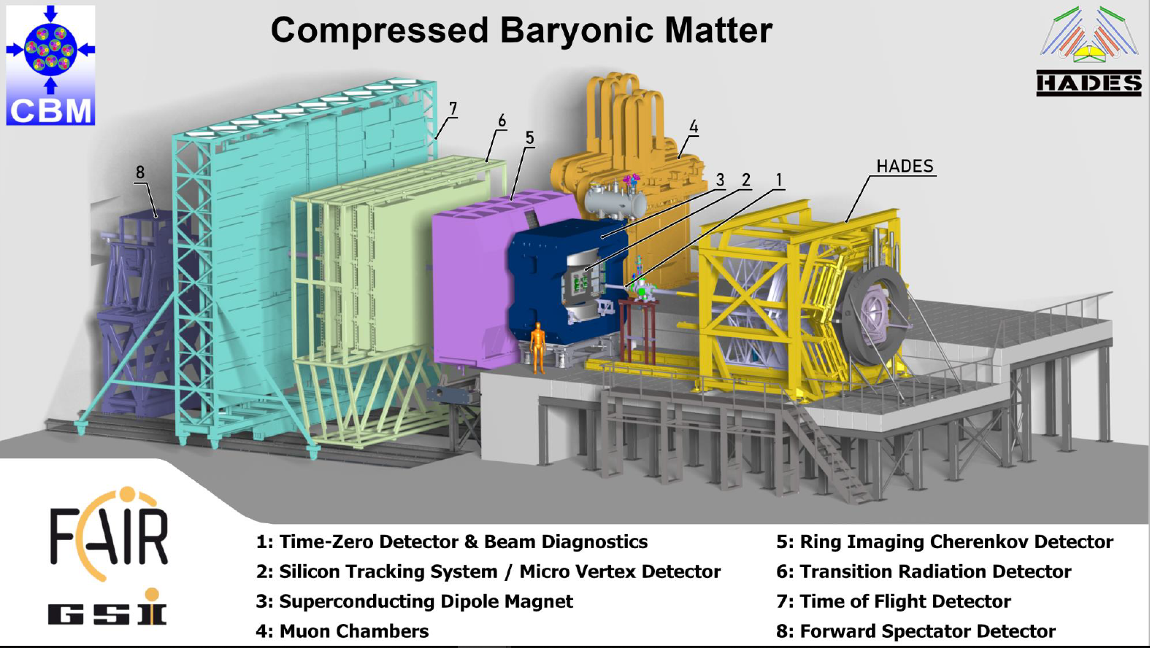
Thank you for your attention !

