Slide 1

Amendment Construction MoU and update Construction Common Fund for the CBM experiment
13th CBM Resource Review Board meeting
16th May 2024
Report CBM Resource Coordinator
Jürgen Eschke
FSD
---

Slide 2

RRB process → Construction MoU → M&O MoU
1st meeting of FAIR RRBs
04 – 05 July 2013
2012 2013 ------------------------------------------------------------------2020 2024 2027
RRB process → signing CBM C-MoU Amendment M&O MoU
Content presentation
Status Signing C-MoU
updated Construction timeline CBM
Construction Common Fund / Status payments
new Spending profile Common Infrastructure/Procurements for Common Infrastructure
CBM proposal for Amendment to C-MoU on Common Fund
ECE/ECSG evaluation of Amendment
Outlook CBM Maintenance & Operation MoU

Slide 3
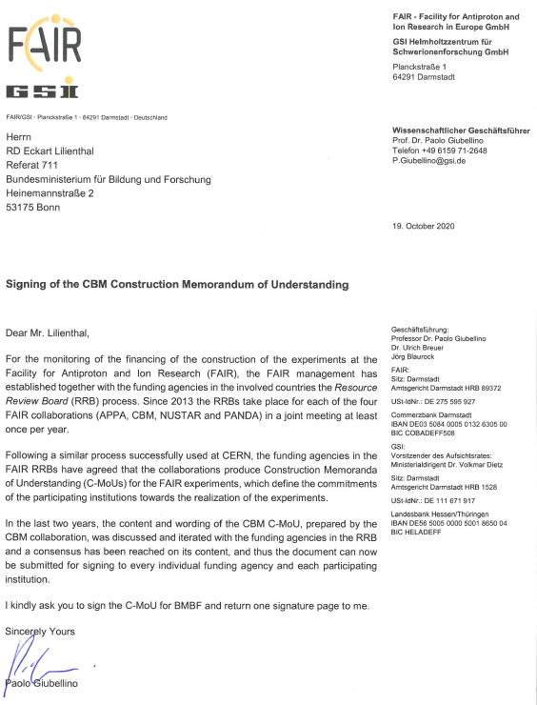
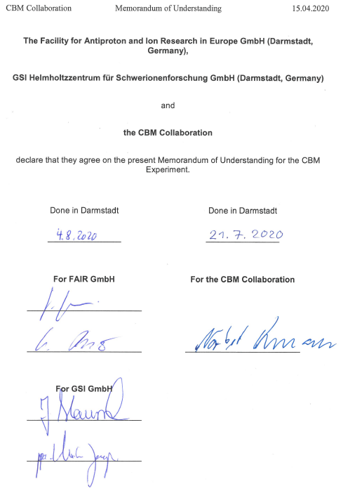
Status CBM Construction MoU
The CBM C-MoU was evaluated by the ECSG/ECE (18.3.20)
  recommendation to RRB to agree on start of signing
Final submission to Funding Agencies in RRBs in April 2020
Final ok for signing of Funding Agencies in 24 June 2020
Signing of C-MoU by FAIR, GSI
and CBM spokesperson in August 2020
Start of distribution to Ministries and
Funding Agencies and to the
CBM full member institutions
in October 2020

Slide 4
Status CBM Construction MoU signatures from Funding Agencies
and CBM member institutions 16.05.2024
Country | Funding agency | Signature received
China | Central China Normal University (CCNU) | √
China | Tsinghua University (THU) | √
China | University of Science & Technology (USTC) | √
Czech Republic | Ministry of Education, Youth and Sports (MSMT) | √
Germany | Bundesministerium für Bildung und Forschung (BMBF) | √
Germany | GSI Helmholtzzentrum GmbH | √
Hungary | WIGNER RCP | √
India | Department of Science & Technology (DST)
Korea | Pusan National University | √
Poland | Ministry of Higher Education in Poland | expected
Romania | Atomic Physics Institute (AFI) for Ministry of Research, Innovation and Digitalization | √
Russian Federation | ROSATOM
Russian Federation | National Research Centre Kurchatov Institute
International Organisation | Joint Institute for Nuclear Research (JINR) | √
Ukraine | NASU / State Agency of Ukraine | expected
The majority
of the funding agencies
and of the
CBM member institutions
have signed the
CBM Construction MoU
already!
clarification with ministry
in India
causes delay in signing
of CBM C-MoU
no signing of CBM C-MoU,
since membership of
Russian Institutions (plus JINR)
is terminated
4

Slide 5
Status CBM Construction MoU signatures from CBM member institutions 16.05.2024
membership
in CBM
Collaboration
terminated
Signatures of Indian and Polish
CBM member institutes expected after
clarification with ministries in India and Poland
on additional funding for FAIR construction
expected
5

Slide 6
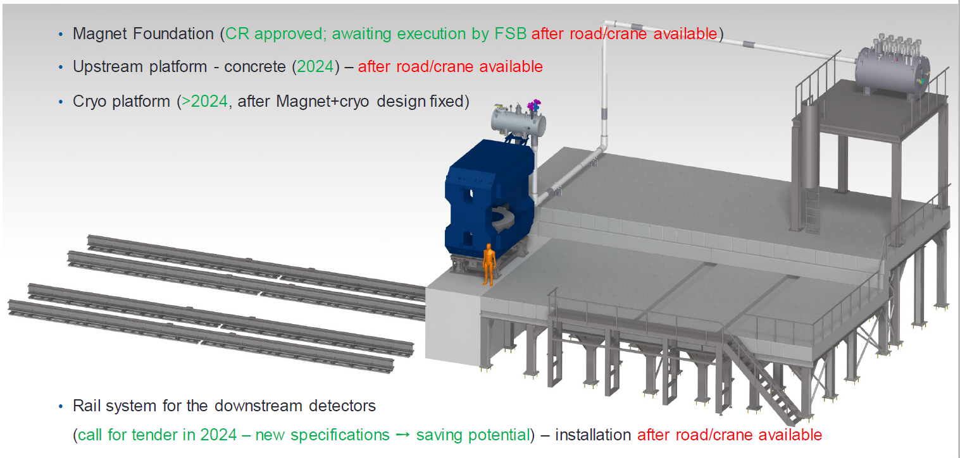
CBM building & cave
Costs for common infrastructure procurements
Common infrastructure installations in CBM cave

Slide 7
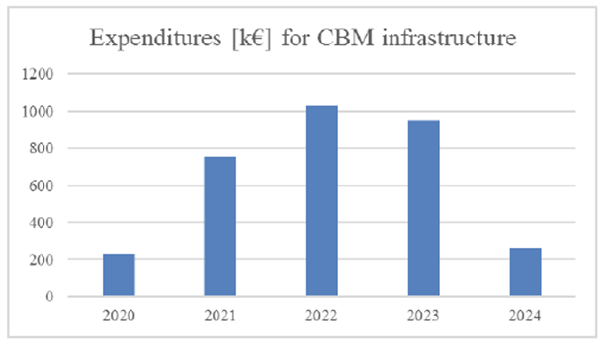
CBM Common (cave) infrastructure
The Experiment Cost Scrutiny Group (ECSG) has performed a Cost Assessment of the Common Infrastructure of the CBM Experiment.
by ECSG performed
expenditures as in C-MoU
meanwhile updated

Slide 8
CBM Common Fund (C-MoU 2020)
Breakdown of the annual contributions to the CBM Common Fund for the
member institutes of the CBM collaboration (CBM data base 13th November 2019 is bases for calculation of due amounts):
2020: 1000€ /PhD holder
2021: 3265€ /PhD holder
2022: 4469€ /PhD holder
2023: 4184€ /PhD holder
2024: 1130€ /PhD holder
in total per PhD holder:
14049 €
2810 €
per year on average
→ flexible payment
possibilities included in
final C-MoU text

Slide 9
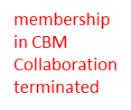
Status payments into CBM Construction Common Fund
Due ammount 2810€ per year per PhD-Holder
payment request
in preparation
Total amount collected so far:
1,527 Million Euro
9

Slide 10
Amendment to CBM C-MoU required
There are three reasons, why an amendment to the CBM Construction MoU is necessary. All of them are a consequence of Russia‘s war against Ukraine.
1. The termination of the CBM collaboration contracts with Russian In-kind providers (cancellation of Russian In-kind contributions to CBM experiment) by the FAIR council, requires a substantial update of the CBM cost and funding matrix, which defines who takes over the responsibility and funding of these items.
2. The re-procurement of missing (Russian) In-Kind contributions causes a delay of the construction timeline of the FAIR project and of the CBM experiment.
→ duration of the C MoU has to be extended
3. A compensation for the missing financial contributions from Russian institutes to CBM Common Fund has to be regulated. The additional costs for the procurement of the CBM infrastructure caused by inflation have to be compensated as well.

Slide 11
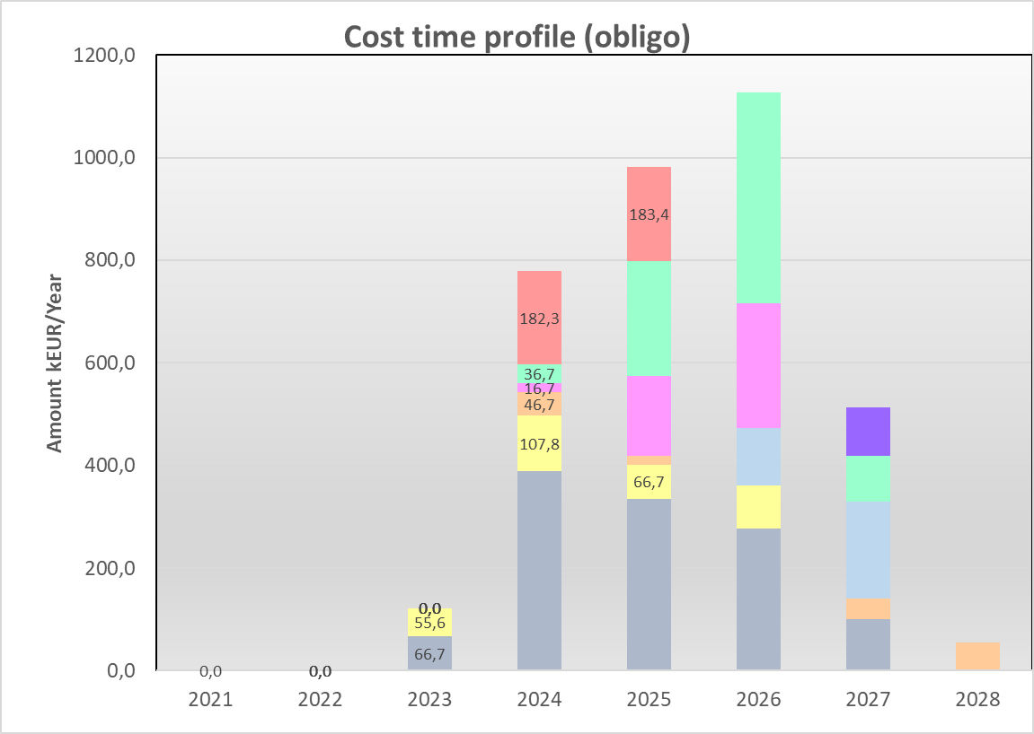
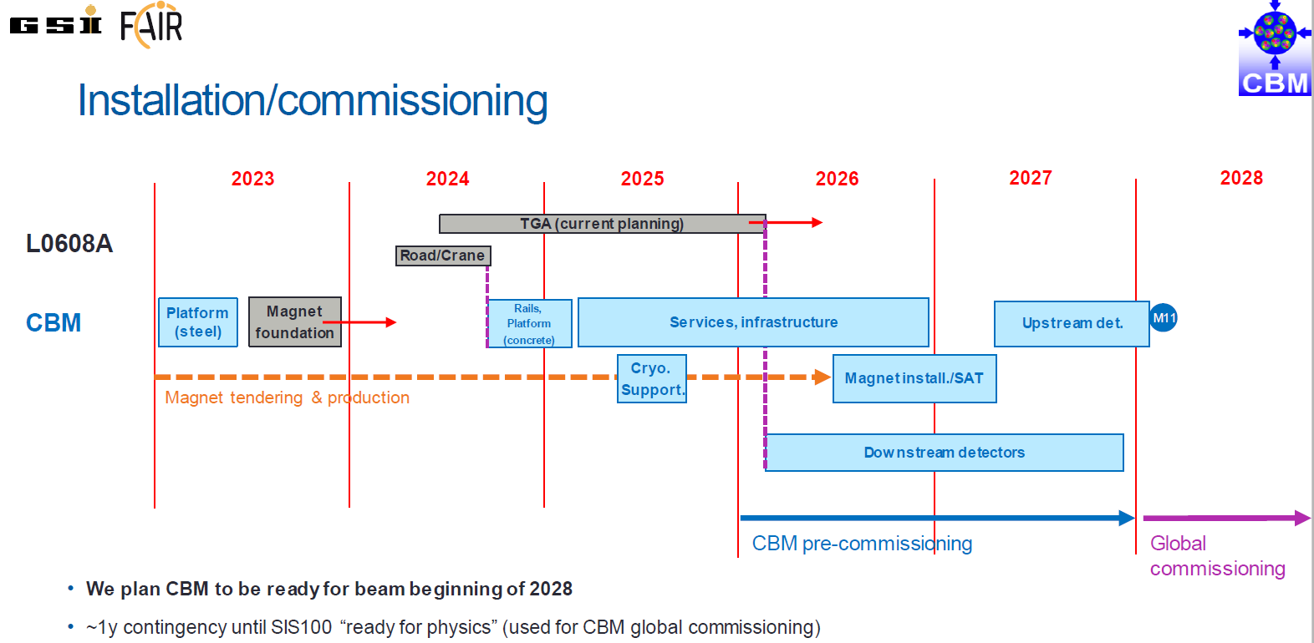
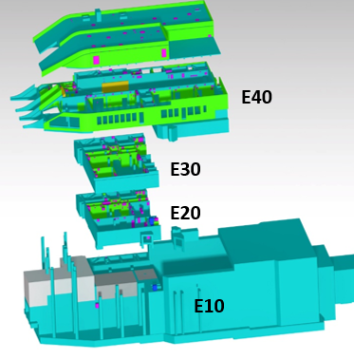
updated spending profile for CBM Common (cave) Infrastructure
CBM installation – timeline re-baselining (2023)
*(C-MoU: 3,23 M€ (2019 prices) - escalated amount (2024 prices) 3,68 MEURO
2023 prices

Slide 12
updated spending profile for CBM Common (cave) Infrastructure
*(C-MoU: 3,23 M€ (2019 prices) - escalated amount (2024 prices) 3,68 MEURO
*[k€]
updated spending profile for CBM common infrastructure
presented to ECE/ECSG in November 2023 and April 2024
2023 prices
escalated amount (2024 prices) 3,68 MEURO

Slide 13
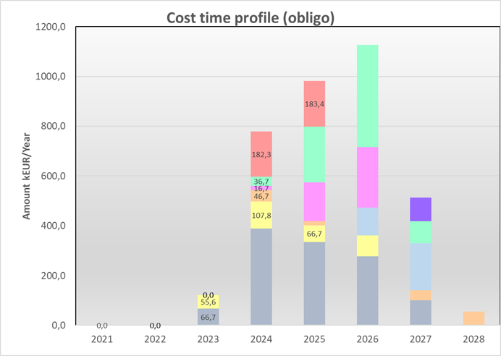
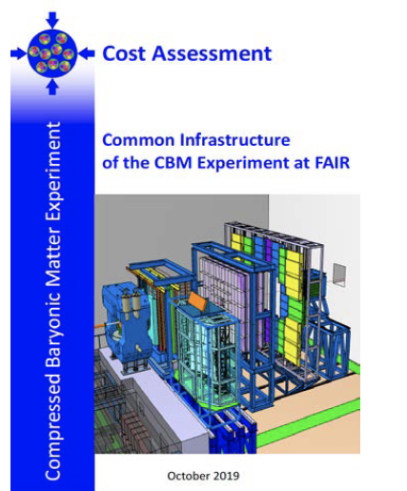
Common Fund procurements
CBM Common Fund (CF) was established for
the financing of the
CBM common infrastructure
(evaluated by ECSG and ECE)
1.53 M€ collected to date (Critical for success: sufficient budget for CF procurements)
~22% Russian contribution to Common Fund (0,711 M€) to be accommodated by other institution
Compensation for cost increase due to inflation (~0,349 M€)
→ 1,06 M€ in addition needed !

Slide 14
update CBM Common Fund (Amendment C-MoU)
Due to the termination of the membership of the institutions in Russia contributions to the Common Fund of 0,711 M€ (~22%) are not covered at present. The CBM Collaboration Board has endorsed at its meeting in March 2023 the strategy to collect the annual due amounts per institute as defined in the CBM Construction MoU for 2 additional years, since the construction period will be about 2 years longer, as anticipated in the signed C-MoU. This procedure would assure that the annual contributions per CBM member institute remain unchanged. Only the transition of the construction phase to the operation phase of the CBM experiment will be shifted by about 2 years.
The annual due amount per PhD holder to the Common Fund in the CBM construction phase will be 2810 EURO. The annual due amount per PhD holder in the operation phase of CBM has to be determined. The M&O costs will be subject of the CBM Maintenance and Operations (M&O) MoU. Moreover, 0,349M€ compensation for inflation have to be collected.
old timeline
construction phase
Construction MoU
operation phase
M&O MoU
2020 2025 2028 2030
new timeline
(2023)
construction phase
Construction MoU
operation phase
M&O MoU
update Common Fund regulated in Amendment:
Annual due amount per PhD holder in construction phase
of 2810 EURO also to be collected in 2025 and 2026!

Slide 15
update CBM Construction Common Fund (Amendment C-MoU)
due amounts per institute in the years 2025 and 2026 for closing of funding gap

Slide 16
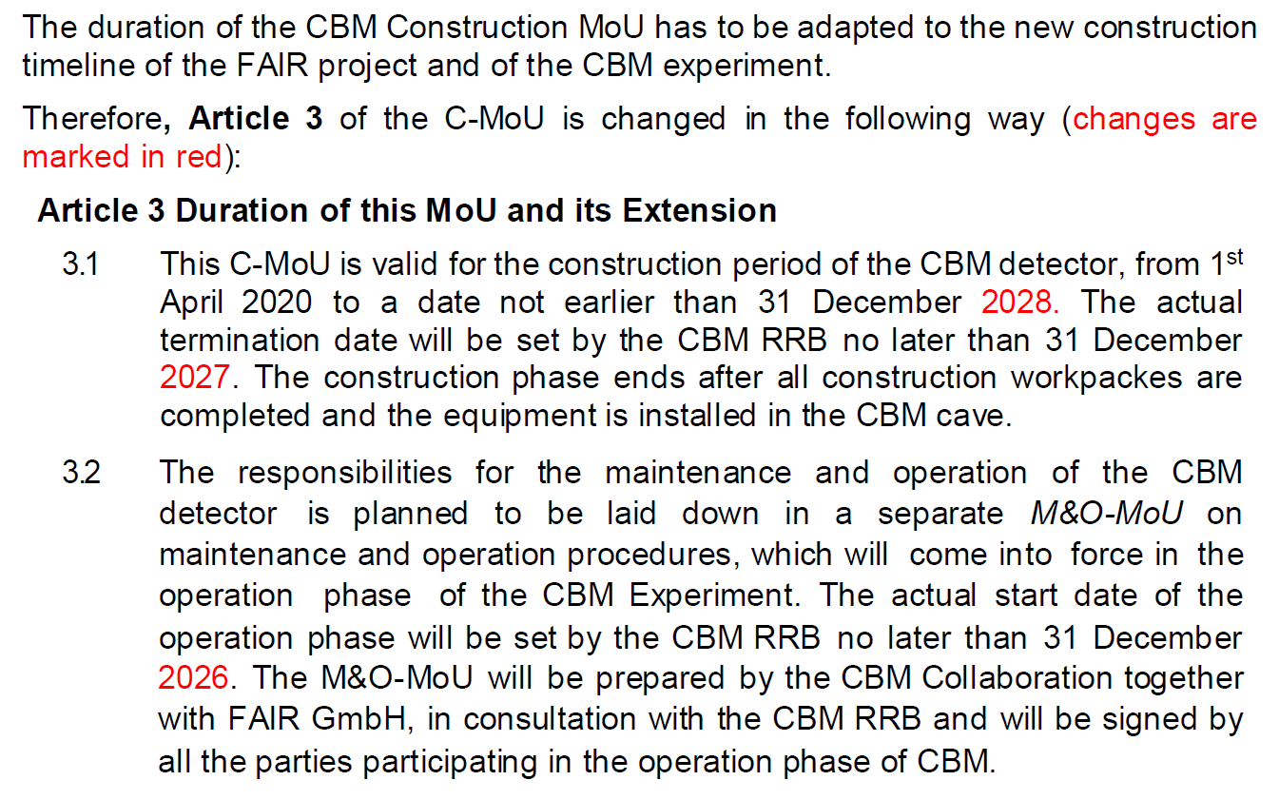
Content of Amendment to CBM Construction MoU
Extention of duration of CBM C-MoU

Slide 17
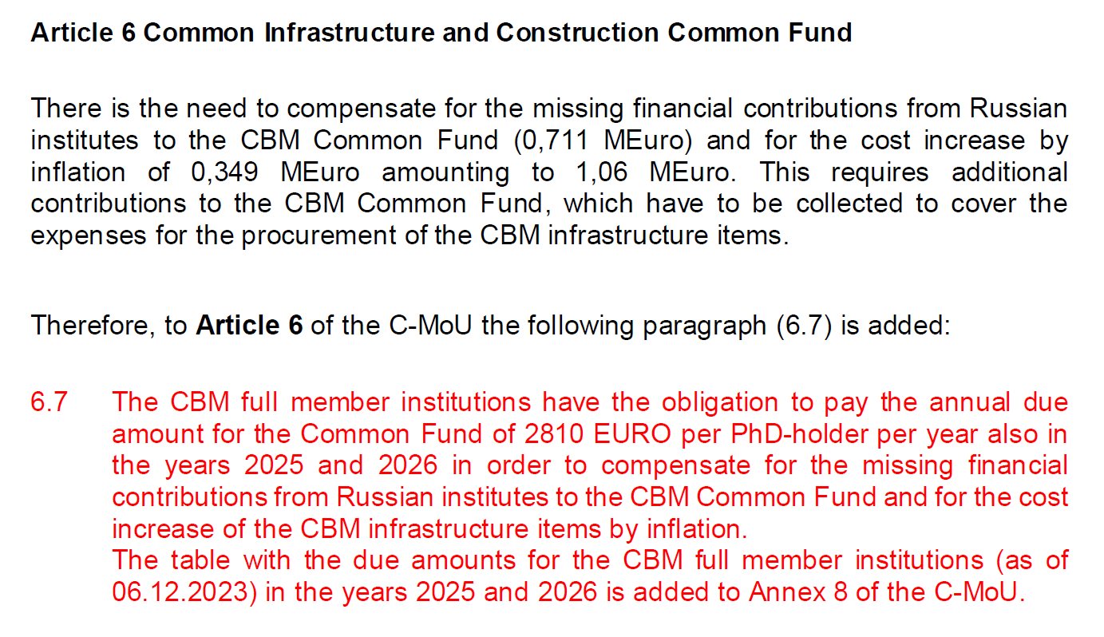
Content of Amendment to CBM Construction MoU
Additional contributions
to CBM Common Fund

Slide 18
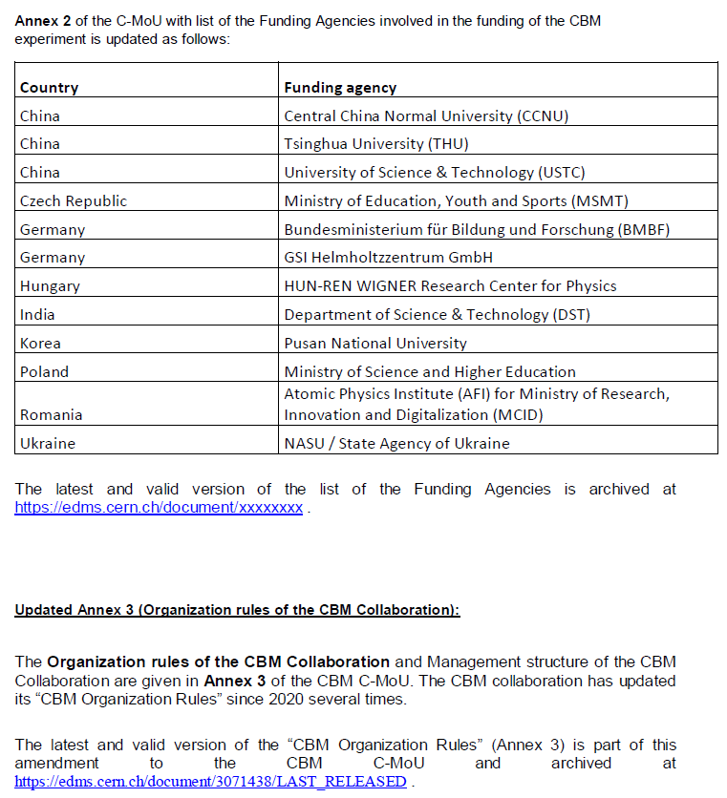
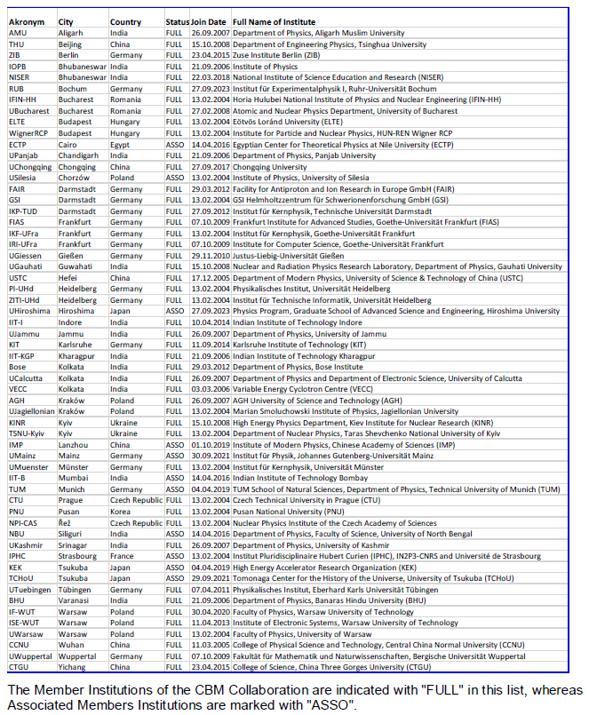
Content of Amendment to CBM Construction MoU
Changes in the Annexes of the C-MoU
The CBM Collaboration Board has decided on April 4th, 2023 to terminate the membership of institutions in Russia (this includes JINR) in the CBM collaboration. The CBM Collaboration Data Base was updated accordingly. The list of member institutes and of the funding agencies is updated in this amendment. of the C-MoU with list of the member institutes of the CBM collaboration is updated s follows:

Slide 19
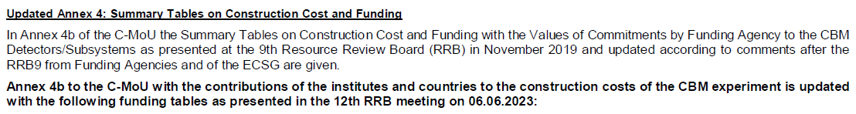
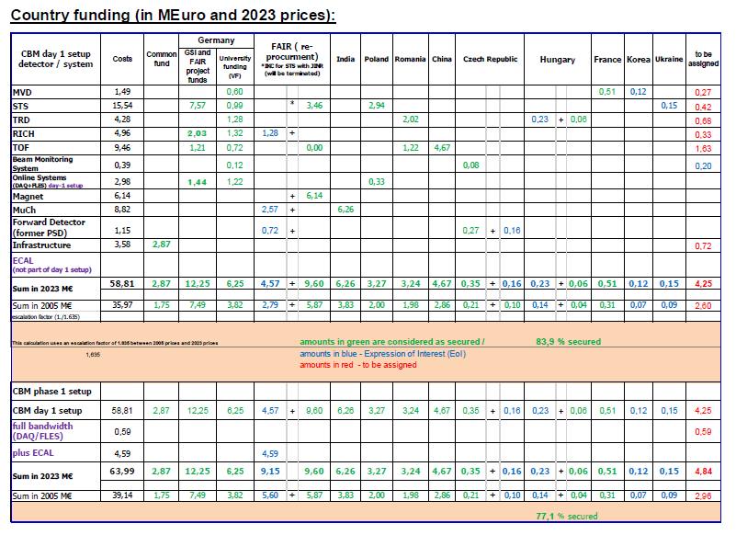
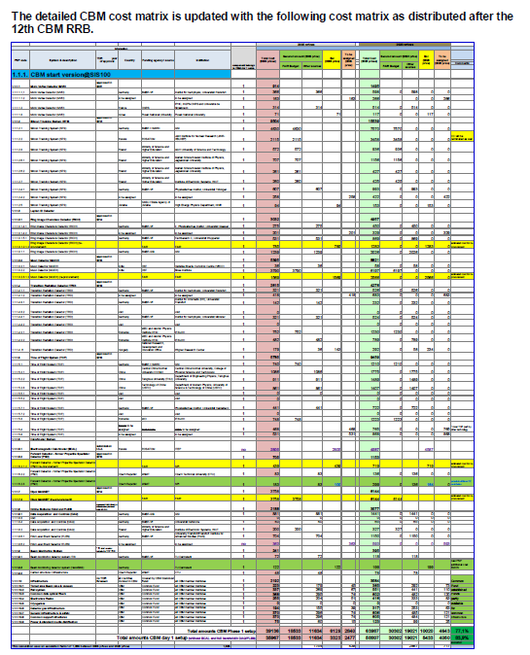
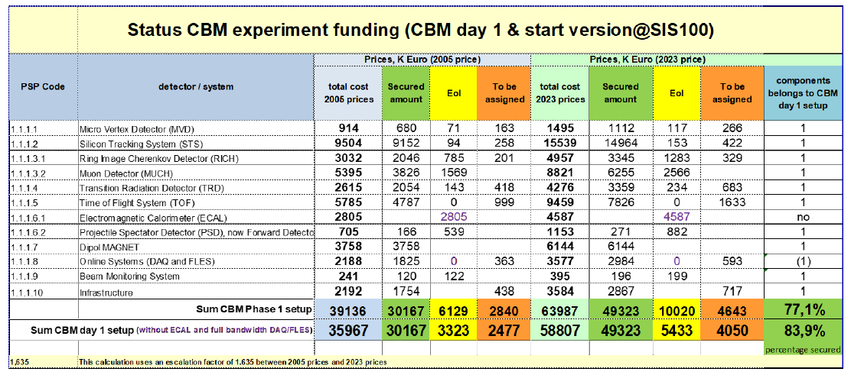
Content of Amendment to CBM Construction MoU
Changes in the Annexes of the C-MoU

Slide 20
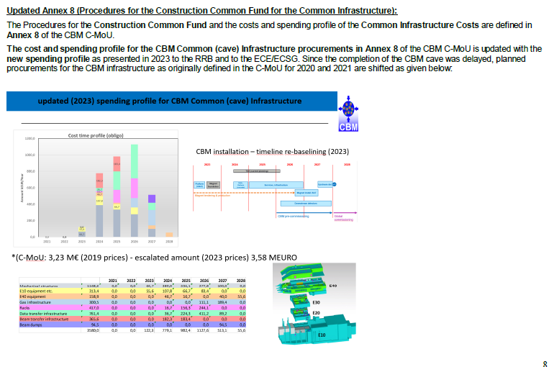
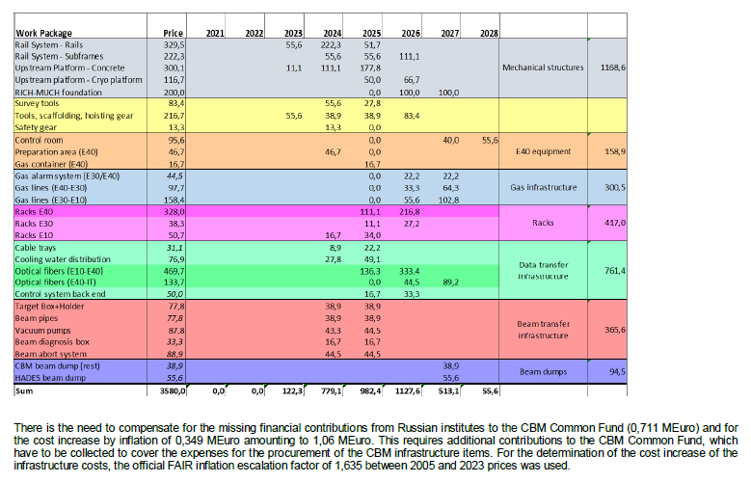
Content of Amendment to CBM Construction MoU
Changes in the Annexes of the C-MoU

Slide 21
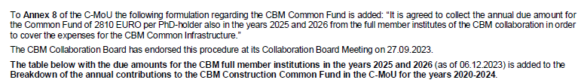
Content of Amendment to CBM Construction MoU
Changes in the Annexes of the C-MoU

Slide 22
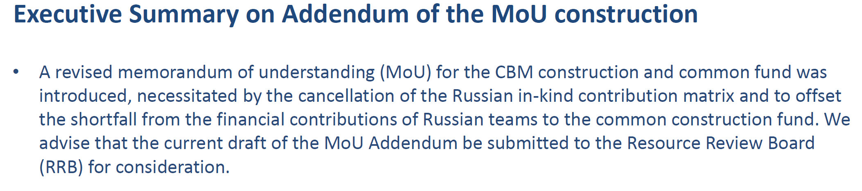
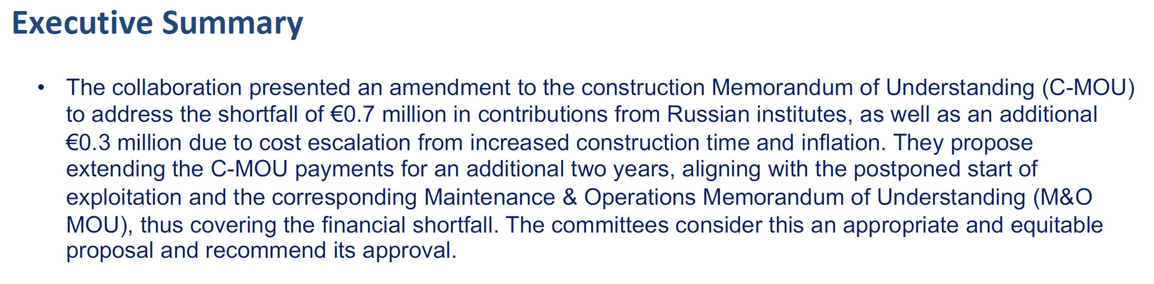
ECE/ECSG recommendations regarding Amendment to CBM C-Mou
ECE/ECSG November 2023:
ECE/ECSG April 2024:

Slide 23
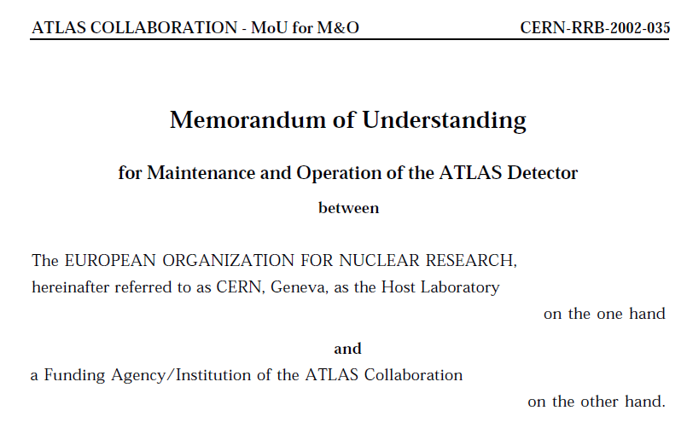
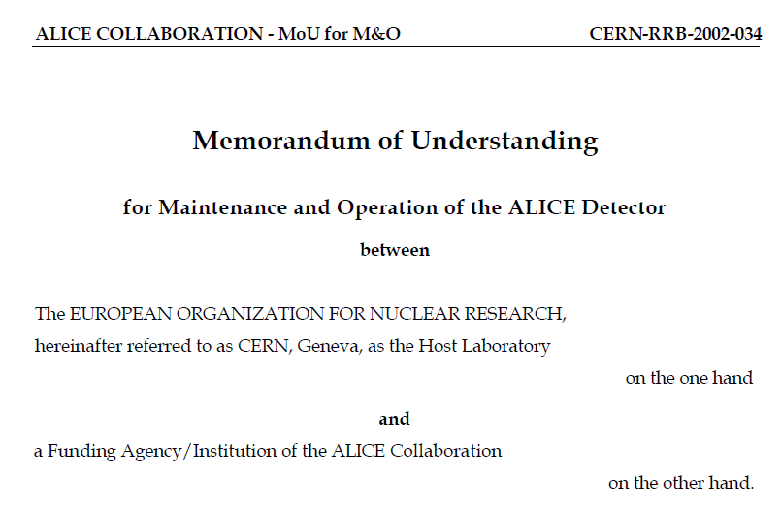
examples CERN: ATLAS and ALICE COLLABORATIONs - MoUs for M&O
Article 7 : Maintenance and OperationCategories
7.1 The M&O expenses can be divided into the following three categories :
7.1.1 Category A. M&O expenses that are shared by the entire Collaboration (cf. Article 6.3.1 above). Annex 9 lists the headings under which Category A
costs are categorised.
7.1.2 Category B. M&O expenses that are borne by part of the Collaboration, i.e. by single Institutes or groups of Institutes, and their Funding Agencies (cf. Article 6.3.2 above). The headings in this category are defined with
reference to the distribution of responsibilities amongst the various
Institutes for the construction of the ATLAS Detector as given in Annex 8.
Annex 10 lists the headings under which Category B costs are
categorised and the Institutes concerned.
It is agreed that an Institute having responsibility under a Category B
heading will contribute to providing the necessary financial, scientific and
technical support, as well as replacement or spare parts, for normal
operation of that equipment and for the routine maintenance needed to
keep it in good working order. If problems arise that require major
modifications, responsibility will lie with the Collaboration as a whole.
The Collaboration will propose on a case-by-case basis the events to which
this provision will apply. The proposal will be submitted for approval to
the next RRB meeting, which will also be asked to approve the provision
of the necessary resources.
7.1.3 Category C. General maintenance and operation expenses that are
provided to the Collaboration by CERN, acting in its role as Host
Laboratory. Subject to the General Conditions for Experiments Performed
at CERN (Annex 3), these are more precisely described in the list given in
Annex 11.
Article 6 : Responsibilities of the Institutes for the Maintenance and Operation
of the ALICE Detector, and of CERN as Host Laboratory
6.1 Responsibility for the M&O of the ALICE detector rests jointly with the Collaboration as a whole and with CERN as Host Laboratory,
within the General Conditions for Experiments Performed at CERN.
It is a fundamental principle that each Institute within the Collaboration shall participate
in both maintenance and operation and contribute a fair and equitable share of common costs.
6.2 It is also a fundamental principle that an Institute, which has contributed a component of
equipment, will also contribute to the necessary scientific and technical manpower support to
operate that component and maintain it in good working order.
CBM has started to discuss the
M&O MoU
and will present a first draft
at one of next CBM RRB meetings
23

Slide 24
CBM RRB action item
draft resolution:
“The CBM RRB has no objections to proceed with the signing of the presented draft of the Amendment to the CBM Construction MoU by the funding agencies and the CBM member institutes.”
24

Slide 25
Thank you for your attention!

Slide 26
CBM Construction Team Accounts
CBM Construction Team Accounts are set up at FAIR GmbH with the same principle as the CBM Common Fund
Purpose:
CBM Construction Team Accounts are needed in the construction/installation phase.
Visiting teams of the CBM member institutes need to be able to withdraw items from the GSI stores, or to purchase equipment via the GSI/FAIR procurement department.
The purchased items become part of the CBM experiment (with PSP code) and are owned by FAIR GmbH
Status:
Until now CBM Construction Team Accounts for several CBM member institutes have been established at FAIR GmbH. The following CBM groups have opened CBM Construction Team Account and transferred
Several hundred thousand EUR to FAIR GmbH, which are available for procurements:
procurement for GU Frankfurt on Mimosis Sensor for MVD and for Univ. Tübingen for
the STS are done
26

