Slide 1
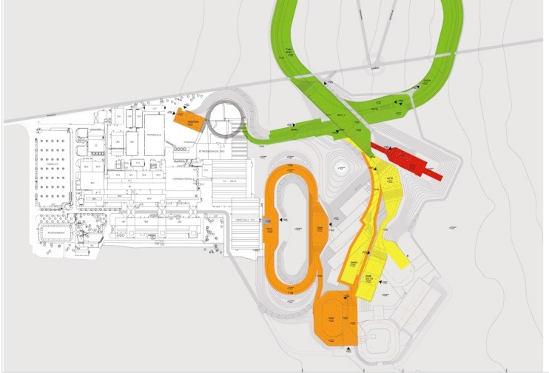
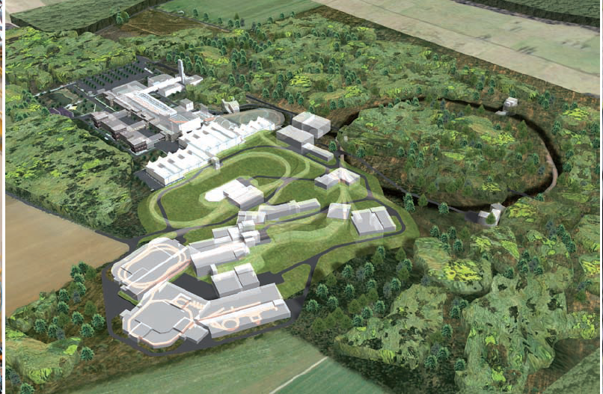
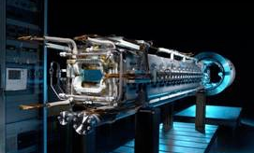

BIOMAT Status Report
RRB-13 Meeting
May 16-17, 2024
Radek Pleskac
BIOMAT technical and resources coordinator

Slide 2

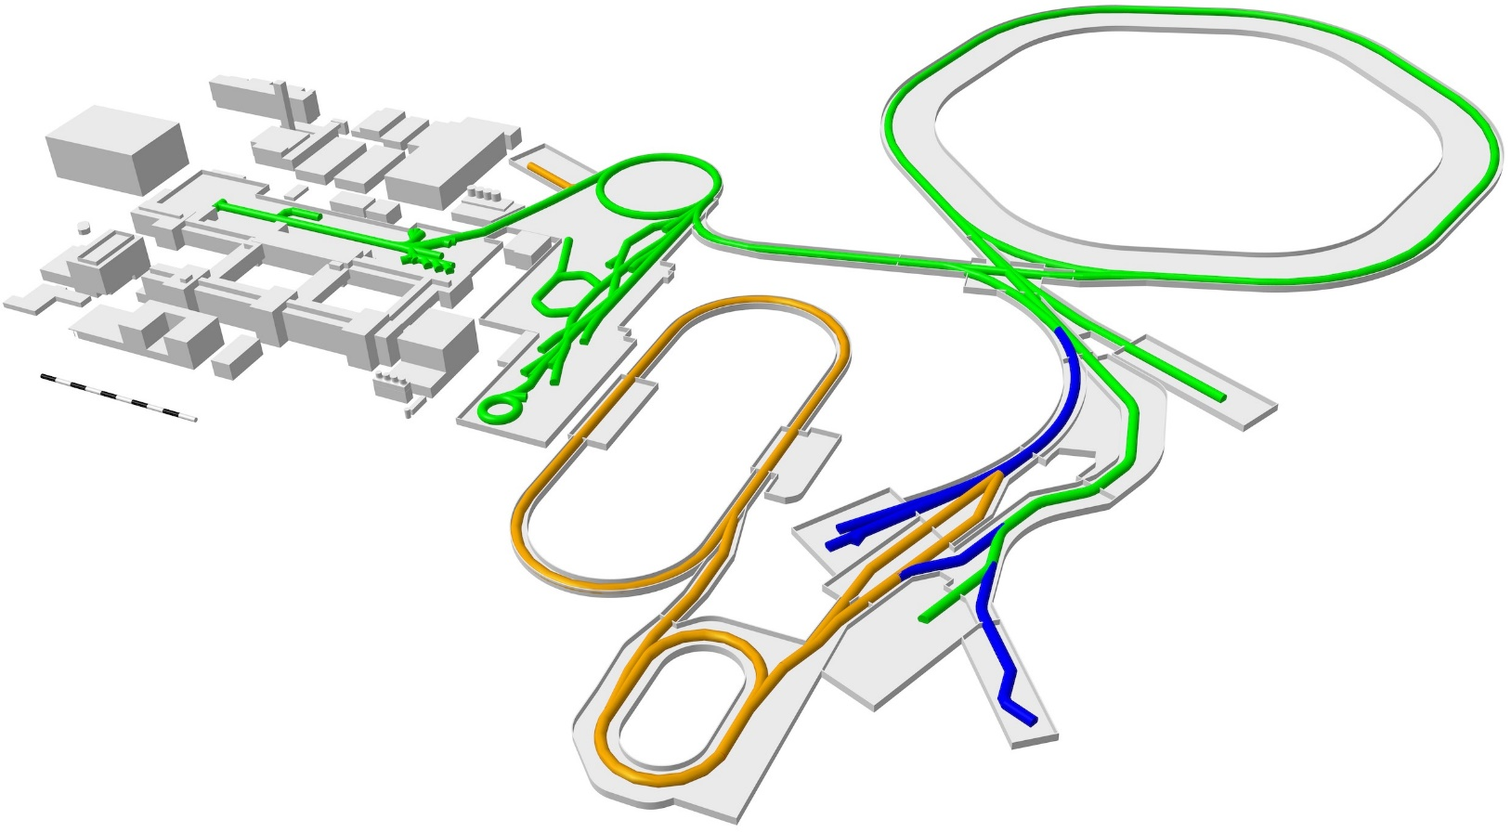
available facilities
BIOMAT fully involved in FAIR Phase-0:
  UNILAC (BIO, MAT)
  CRYRING (Swedish in-kind, MAT)
  Cave A (BIO, MAT), Cave M (BIO) from SIS18
Worldwide unique experimental capabilities:
  Biophysics with heavy-ion beams for space and medical applications
  Materials research: from ion-track nanotechnology to materials under extreme conditions
SIS100
M-branch
X0
X6
cave M
CBM
cave A
CRYRING
FAIR Phase 0
Continuation of BIOMAT experiments in existing facility
Super-FRS
NUSTAR
HEB
ES/FS/FS+
BIOMAT investigate options for further experiments at green lines
FS++
BIOMAT experiments in future APPA cave

Slide 3
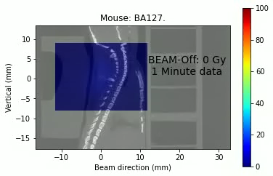
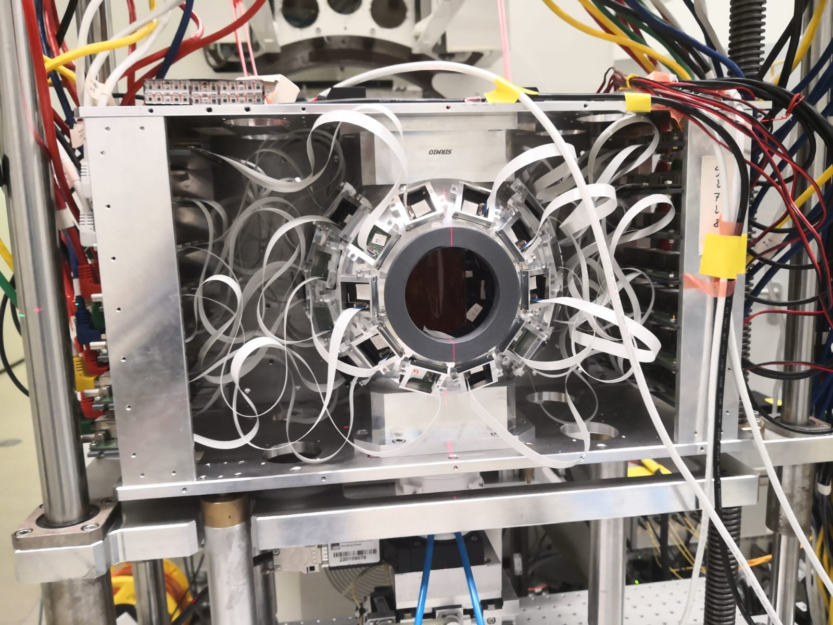
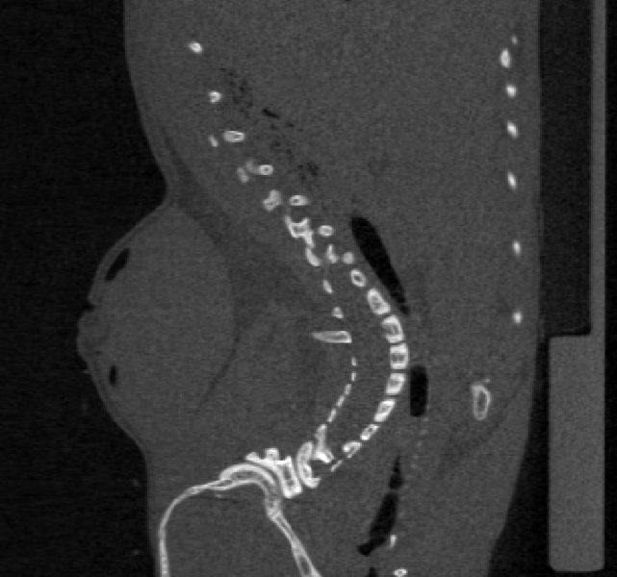



Updates from FAIR Phase-0 (February 2024)
Universal CTV
PTV ¹²C
10 mm
16-17 mm
6 mm
4 mm
PTV ¹¹C
GTV
CTV
BIOMAT Work Package
1.3.5.10 „γ-PET hybrid detector“
The LMU PET detector installed in Cave M and a video showing the accumulation of β⁺ activity in a tumour on the neck of a mouse, close to the spinal cord (organ at risk) following irradiation with ¹¹C

Slide 4
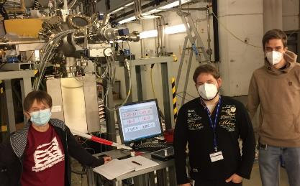
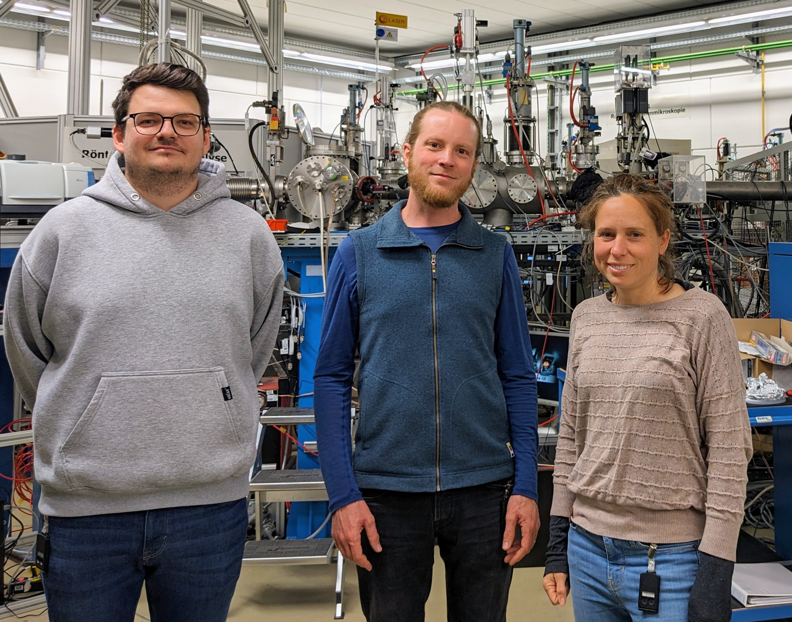
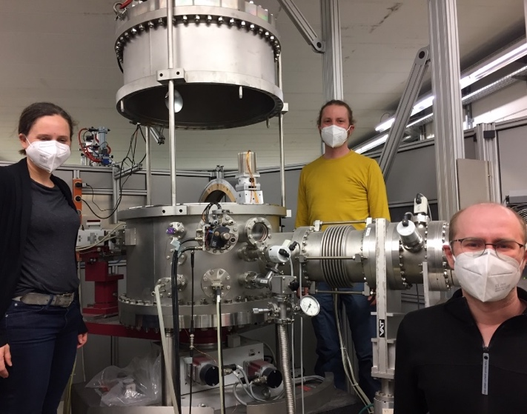
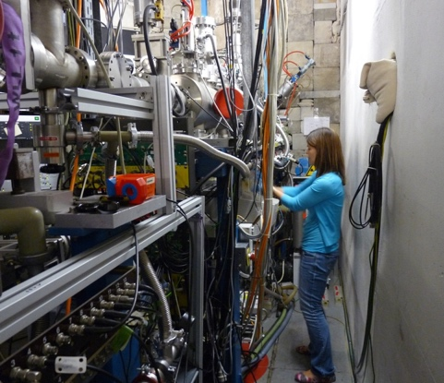
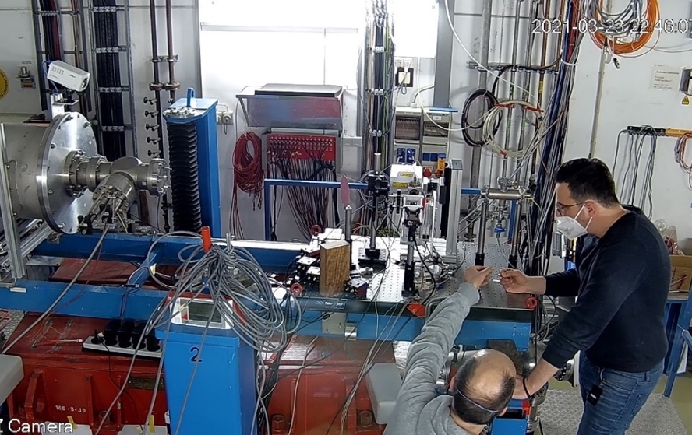
Beamtime 2024
CRYRING
MAT station
UNILAC
M-branch
UNILAC
X0
SIS18
Cave A
March (Au)
Feb-June (Ar, Fe, Au, and U)
June (U)
~55 % of the ~300 shifts granted for 2024/2025 allocated in 2024 (> 50 days operation)
parallel operation of M-branch and X0 is essential and very efficient
~ 40 user groups of the MAT collaboration are being served in 2024
various ion species, energies, fluxes (single ion to > 1e9 i/cm²s)

Slide 5


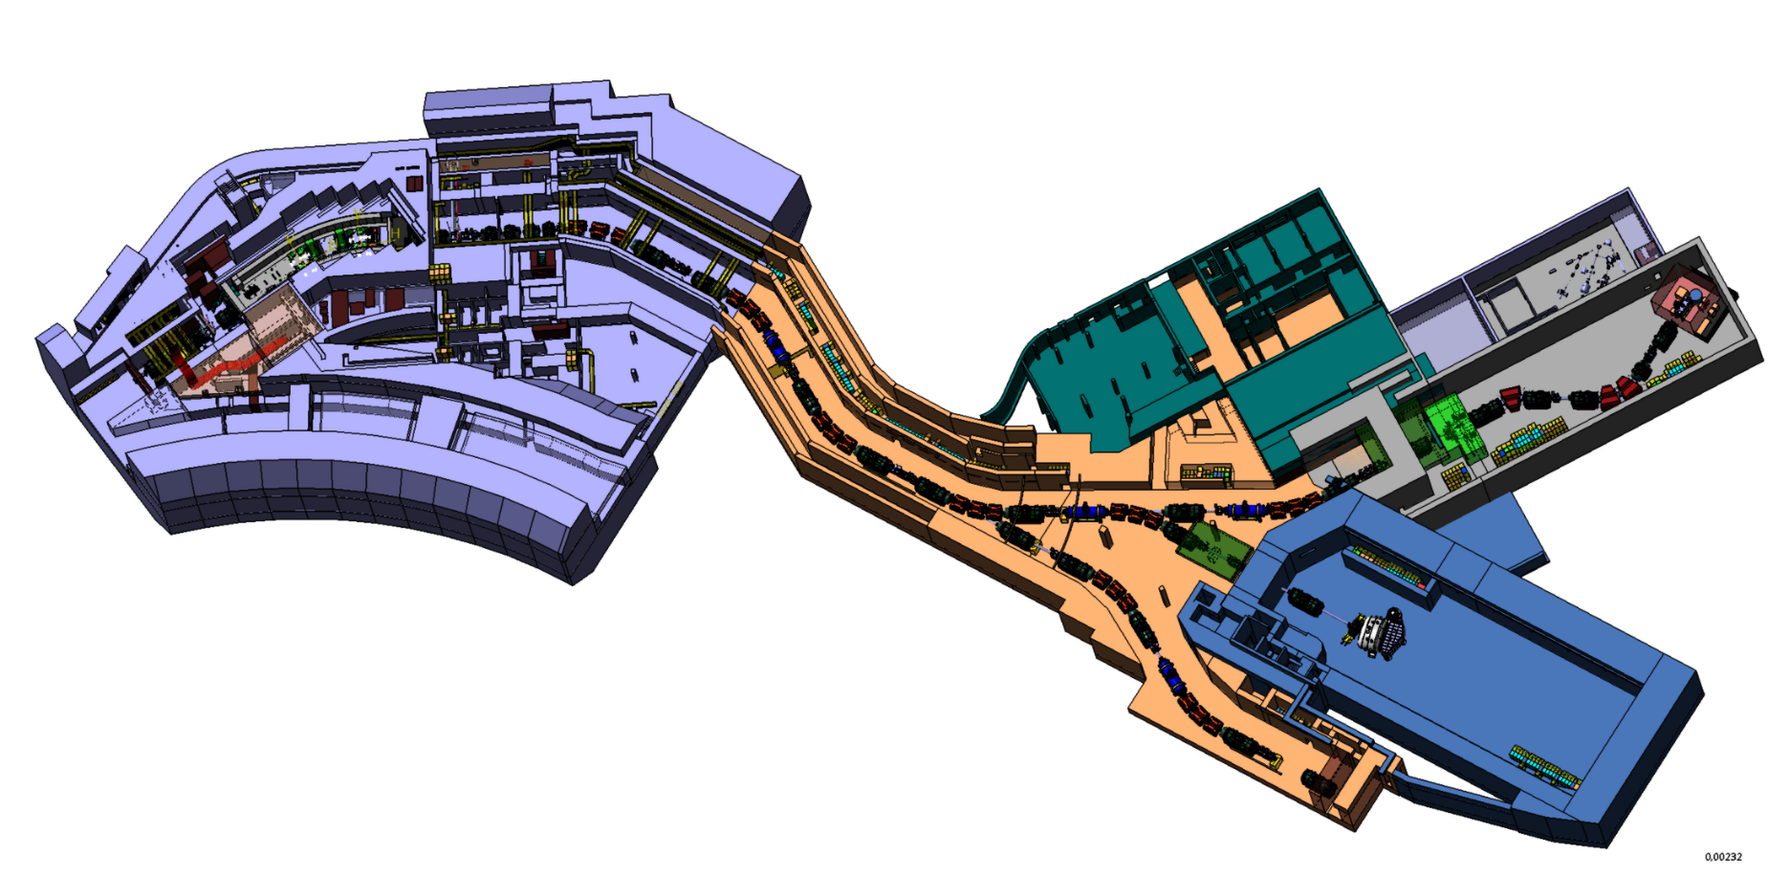



in ES-FS in S-FRS ring branch
BIOMAT

Slide 6
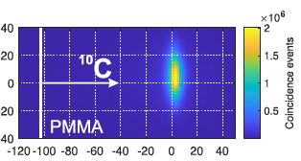
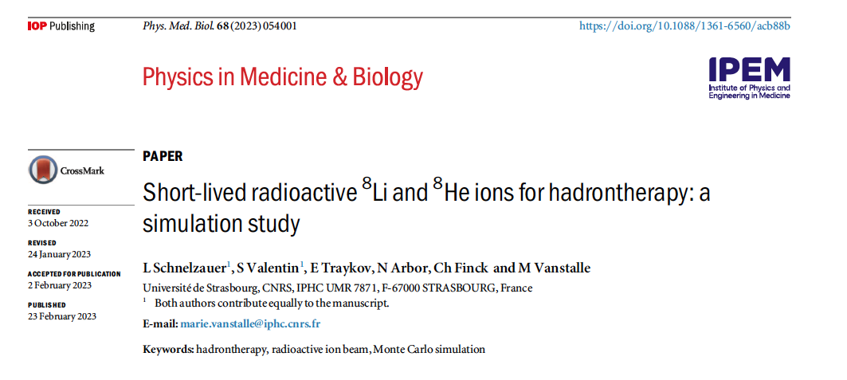
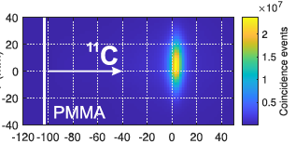
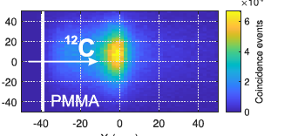
in S-FRS: science case
BARB results show that ¹⁰C would provide the best range resolution, but its intensity at FRS-Cave M is too low for experiments
Recently, collaborators form the University of Strasbourg published a simulation on potential enhancement of biological effects using short-lived ⁸Li or ⁸He-ions
0.04 mm
0.7 mm
1.4 mm
4 spills, 19 s (Kostyleva et al., Phys. Med. Biol. 2023)
Synergy with NuSTAR tetraneutron experiment

Slide 7

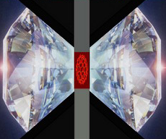
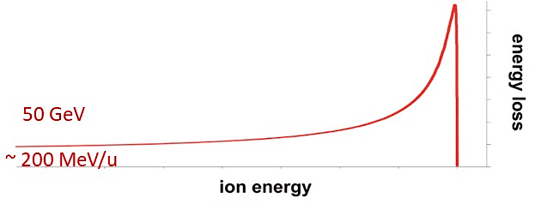




in S-FRS: science case
Materials under extreme conditions
Setup for irradiation of DACs
(diamond anvil cells)
Raman spectrometer
beam
collimator
250 µm aperture
High pressure
Ion Irradiation
200-500 MeV/u ions
Temperature
goniometer
Advantages for MAT:
high flux beam available
access to SIS-18 and SIS-100
slow and fast extraction
beam focus ~few mm for 200-600 MeV/u U ions
sufficient space available
Beam stops in sample
Funded by:

Slide 8
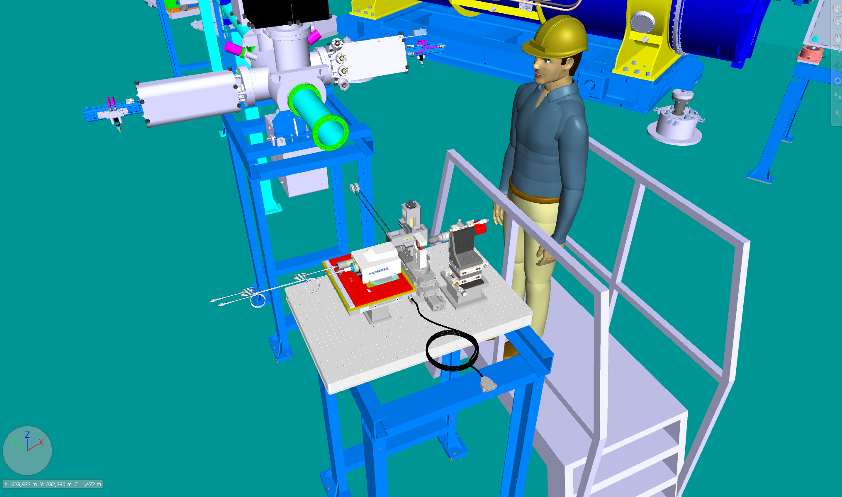
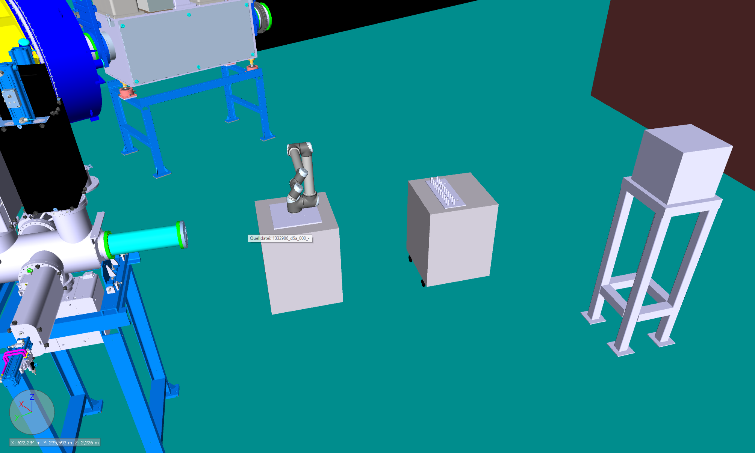
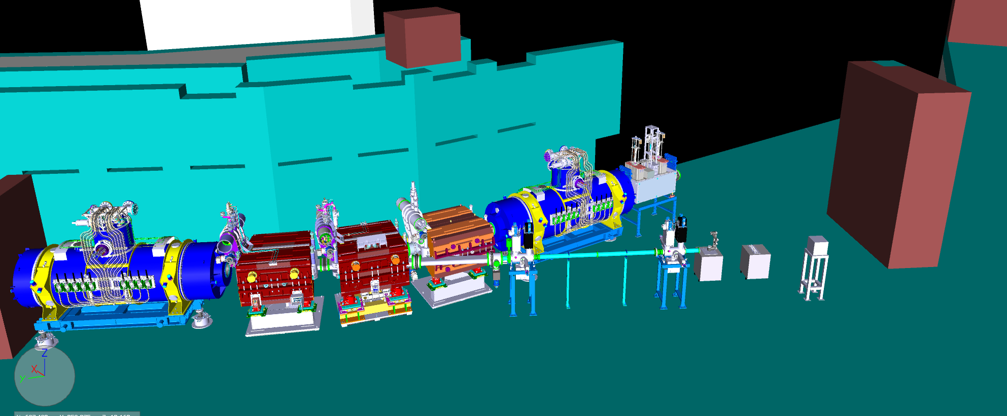
in S-FRS: setup
Robotic arm with magazine
BIOMAT setup:
Beamline with 2 diagnostic chambers (originally planned for APPA)
BIO and MAT irradiation setups
Beam dump
BIOMAT
  The science case was presented in a detailed form to ECE and JSC in 2023 and 2024
(MAT)
„High-pressure“
(BIO)
„Radiactive beams“

Slide 9
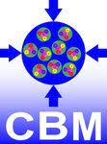
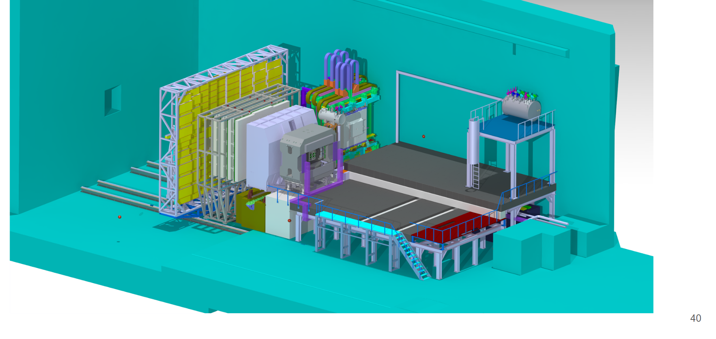



in FS+ in CBM cave
BIOMAT

Slide 10
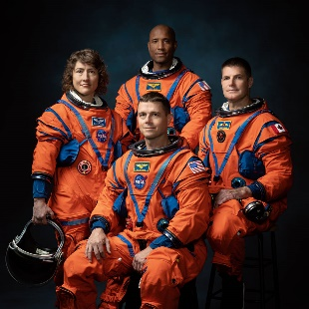
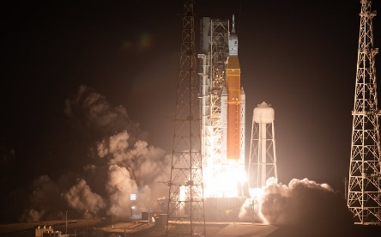
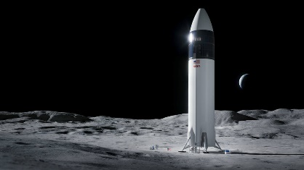

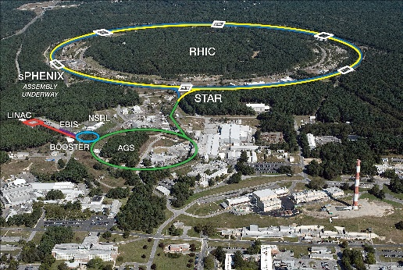

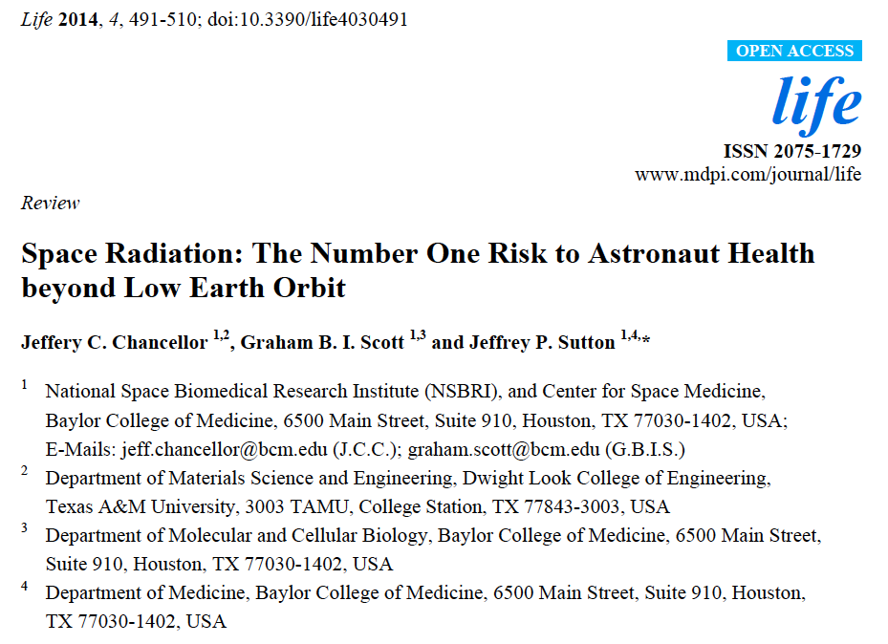

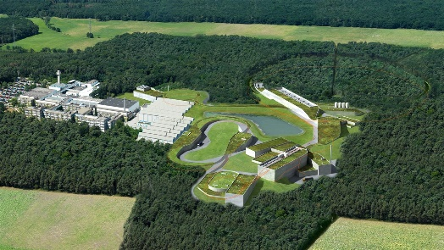
in CBM: science case

Slide 11
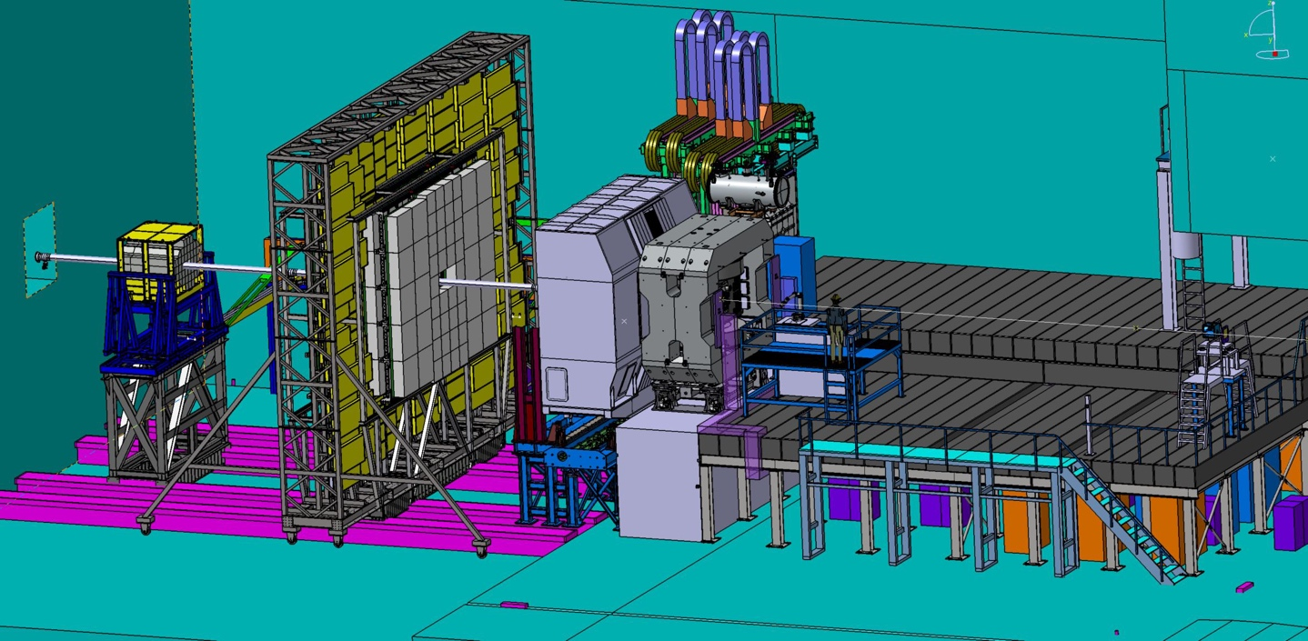
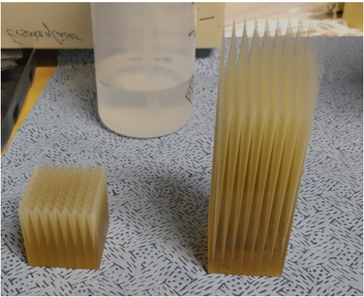
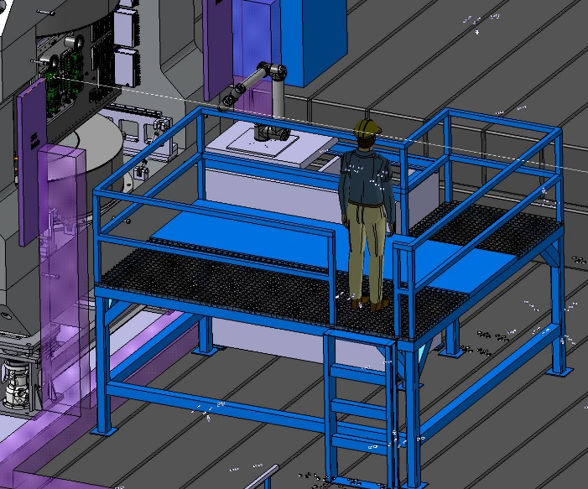
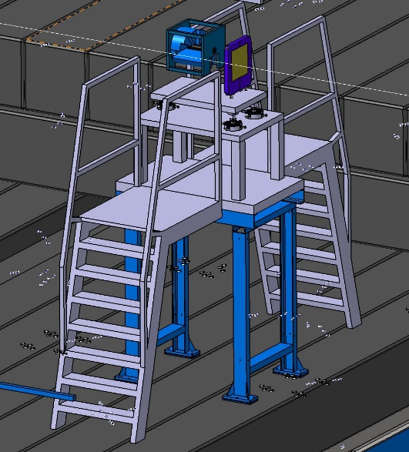
in CBM: setup
Irradiated targets
BIO
  the science case was presented in a detailed form to ECE and JSC in 2023 and 2024
MAT
CBM is a backup option in case the facility at the ring branch cannot be realized
GCR simulator

Slide 12
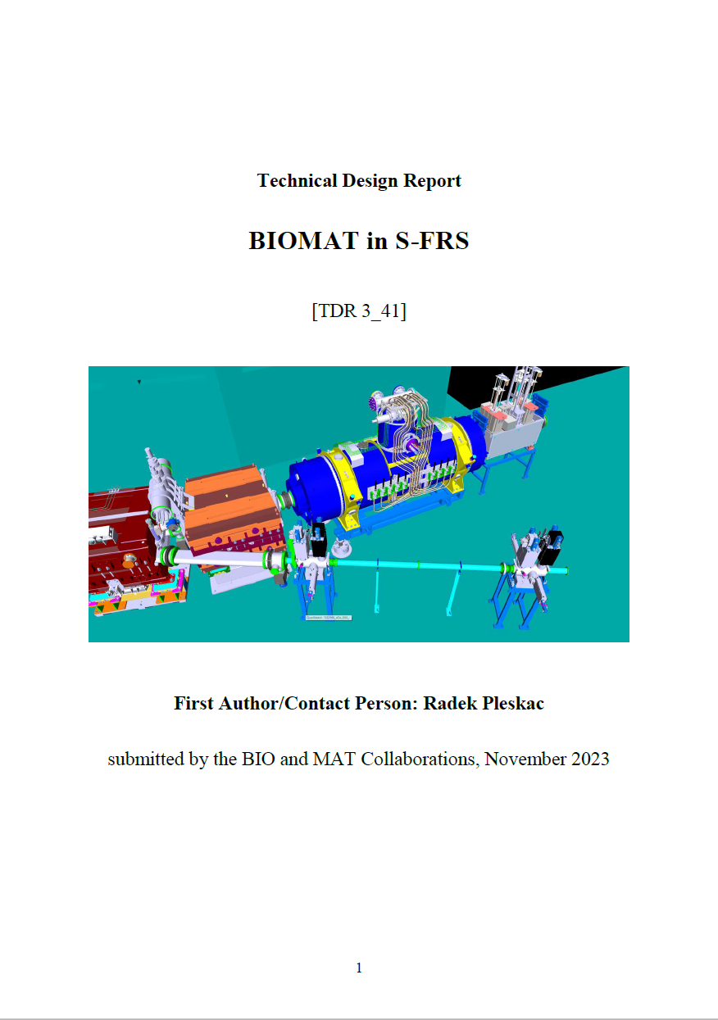
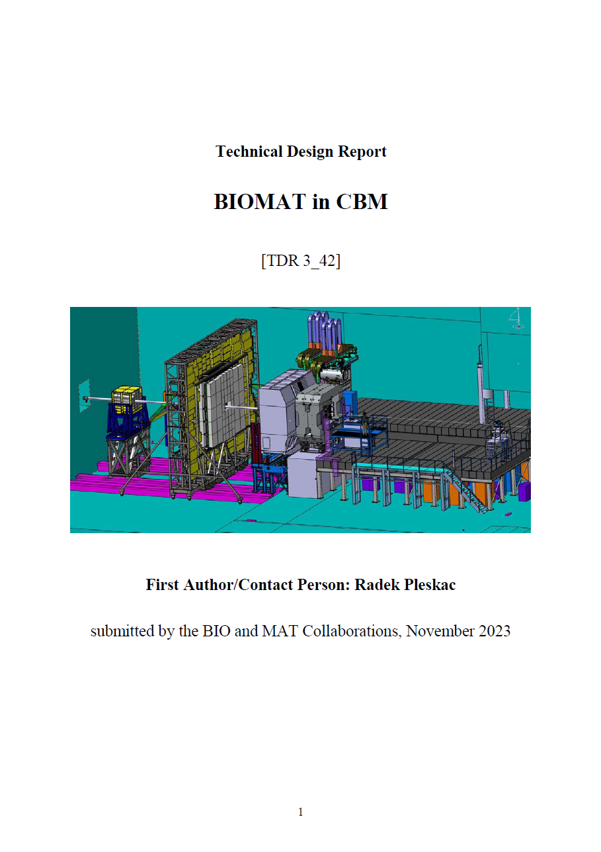
TDRs for ES/FS/FS+ submitted to ECE
TDRs submitted to ECE in November 2023
First evaluation received in April 2024
Positively evaluated by ECE and recommended for approval

Slide 13
Developments since the last RRB12
Major milestones and further steps
        BIO and MAT collaborations are focused on the preparation and run of irradiation experiments during the 2024 beam time block and further in 2025 and 2026
        BIOMAT developed a scenario to temporarily implement part of its APPA cave equipment and program at the S-FRS ring branch and CBM cave
Construction and testing and FAIR Phase-0
          (BIO) for the first time worldwide the simultaneous acceleration of a beam with two ion species within one bunch (¹²C⁶⁺ and ⁴He²⁺), including the transport through the entire accelerator and the delivery to the experimental cave, was successfully demonstrated.
          (BIO) final test of the galactic cosmic ray (GCR) simulator (funded by ESA) was performed in April 2024. The test used ⁵⁶Fe-ions at 1 GeV/n. Starting in 2025, the facility will be offered to all external users of the ESA-sponsored space radiation research program (IBER; www.gsi.de/IBER).
          (MAT) high-pressure irradiation platform is in the process of being further developed in terms of beam collimation, control systems and dosimetry

Slide 14
Developments since the last RRB12
Contracts
        BIOMAT has no running contracts for in-kind contributions
Technical design reports
        already mentioned before
Funding
          BIO collaboration secured additional funding through a new ERC grant (CoG 2024, PI Christian Graeff, GSI).
          A first experimental test for the new ERC grant has been completed during the engineering run in 2023
          BIO department leads a new Marie Cutie ITN network including 28 partners (4 M€ in total) on upright radiotherapy
          MAT collaboration secured additional funds for investigations in FAIR-Phase-0 through a new research group, ‘Transient Sieves’, in the framework of a Deutsche Forschungsgemeinschaft (DFG) funding program.
          The group brings together researchers from GSI and the TU Darmstadt. The goal is to develop a new concept for material separation, based on e.g. ac-controlled track-etched pores that change their selectivity as the material passes through, with possible future applications for filtering antibiotic residues from wastewater

Slide 15
Developments since the last RRB12
News from collaborations
        The 3rd ESA-FAIR Summer School was held in July and August 2023. Half of the school took place at ESOC with lectures and visits to the center, followed by hand-on activities at GSI. 16 students completed the school, which is funded by ESA
        Dr. Gregorio Laucirica has been awarded a EU MSCA postdoctoral fellowship hosted by MAT to conduct the project NanoBioSens, developing a promising combination of single track-etched nanochannels and electrochemical sensing

Slide 16
Funding table Day-1 experiment
PSP | System | Estimate (k€, 2005) | Secured (k€, 2005) | EoI(k€, 2005) | TbA (k€, 2005)
1.3.5.2 | Target handling | 148 | 148 | 0 | 0
1.3.5.3 | Multi-purpose target chamber | 198 | 198 | 0 | 0
1.3.5.4 | High-pressure equipment | 222 | 222 | 0 | 0
1.3.5.6 | BioLab equipment | 277 | 150 | 128 | 0
1.3.5.7 | Control room | 115 | 115 | 0 | 0
1.3.5.8 | Beamline instrumentation | 317 | 317 | 0 | 0
1.3.5.9 | Cosmic ray simulator | 331 | 331 | 0 | 0
1.3.5.10 | γ-PET hybrid detector | 264 | 264 | 0 | 0
 | Total | 1.872 | 1.744 | 128 | 0
Day-1
1.9 M€

Slide 17
Funding table MSV
PSP | System | Estimate (k€, 2005) | Secured (k€, 2005) | EoI (k€, 2005) | TbA (k€, 2005)
1.3.5.1 | Scanner system | 713 | 0 | 278 | 434
1.3.5.2 | Target handling | 148 | 148 | 0 | 0
1.3.5.3 | Multi-purpose target chamber | 198 | 198 | 0 | 0
1.3.5.4 | High-pressure equipment | 396 | 222 | 0 | 174
1.3.5.5 | X-ray machine | 158 | 0 | 0 | 158
1.3.5.6 | BioLab equipment | 277 | 150 | 128 | 0
1.3.5.7 | Control room | 198 | 115 | 83 | 0
1.3.5.8 | Beamline instrumentation | 317 | 317 | 0 | 0
1.3.5.9 | Cosmic ray simulator | 331 | 331 | 0 | 0
1.3.5.10 | γ-PET hybrid detector | 264 | 264 | 0 | 0
 | Total | 2.999 | 1.744 | 489 | 766
MSV
3.0 M€

Slide 18


Funding by copuntry
 | Funding by Country: Secured | EoI (k€, 2005 prices)
 | Germany |  | Czech Republic
Day-1 setup (1.823 k€) | 1.744 | 128 | - | -
Upgrade to MSV (1.128 k€) | - | 83 | - | 278 *
Grand total for MSV (2.951 k€) | 1.744 | 211 | 0 | 278 *
*
The Czech contribution was postponed to the third funding period of the FAIR-CZ project.
German contributions include funding for infrastructure by EU-ERC and ESA-ESTEC.
Secured
1.744 k€
EoI
489 k€

Slide 19
Evolution of funding
Day-1 setup cost: 1.9 M€, 93% covered by secured funding
The introduction of a Common Fund to pay for common infrastructure items is not suitable for BIOMAT
Scientific Review 2022
(ES/FS/FS+/FS++/MSV)
Funding for MSV
Funding Day-1

Slide 20
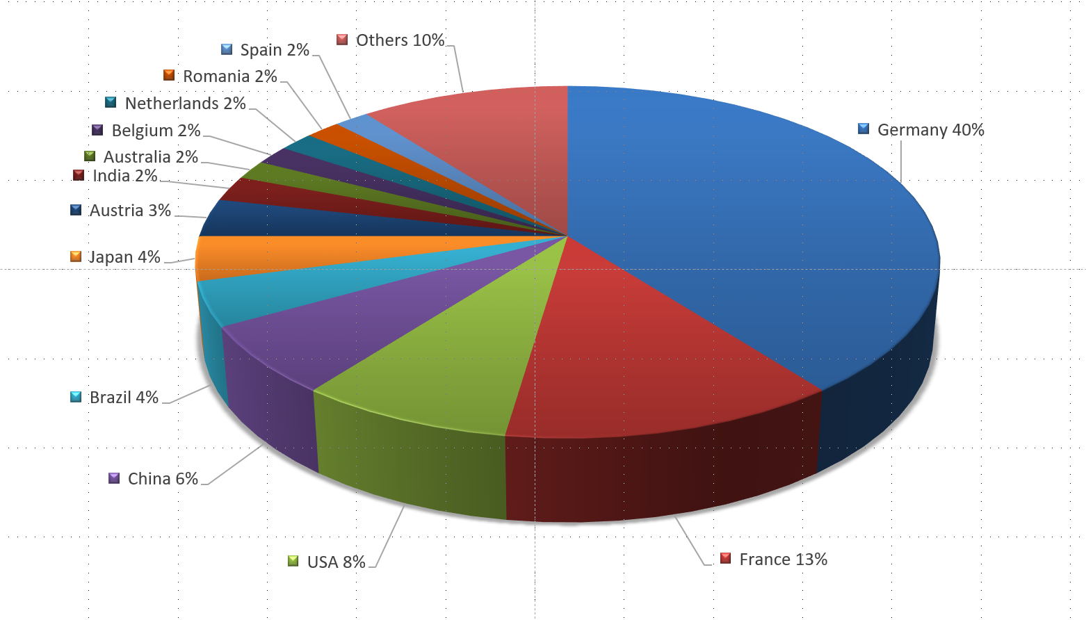
Materials Research Collaboration
Number of members: 172
(May 2024)
26 countries
(Russia excluded)

Slide 21
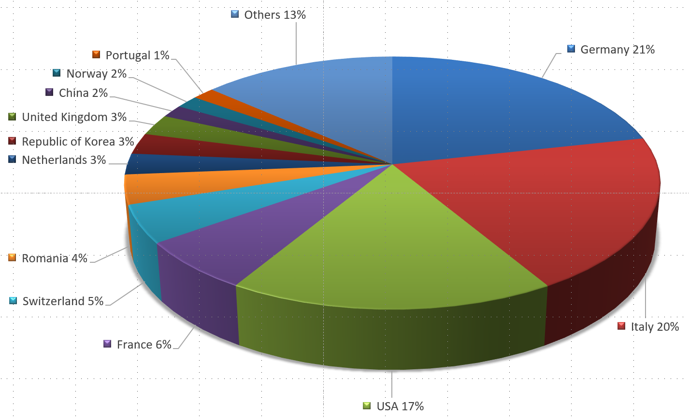

International Biophysics Collaboration
Number of members: 186
(May 2024)
26 countries (Russia excluded)

Slide 22
Conclusions
All BIOMAT activities need to continue the exploitation of the current GSI facilities in FAIR-phase-0 and beyond FAIR2028.
BIOMAT science in FAIR Phase-0 continues to get outstanding results and to attract large external funding (2 ERC grants and 1 MC-ITN)
BIOMAT is planning new stations in S-FRS ring branch and CBM cave to get experimental results already in the initial FAIR phase, before FS++, and has submitted 2 new TDRs to ECE.
Both TDRs have been positively evaluated and recommended for approval
BIOMAT program in S-FRS and CBM cave does not require any additional financial resources comparted to APPA cave. Implementation of both setups has a minimal impact on additional infrastructure costs.

Slide 23
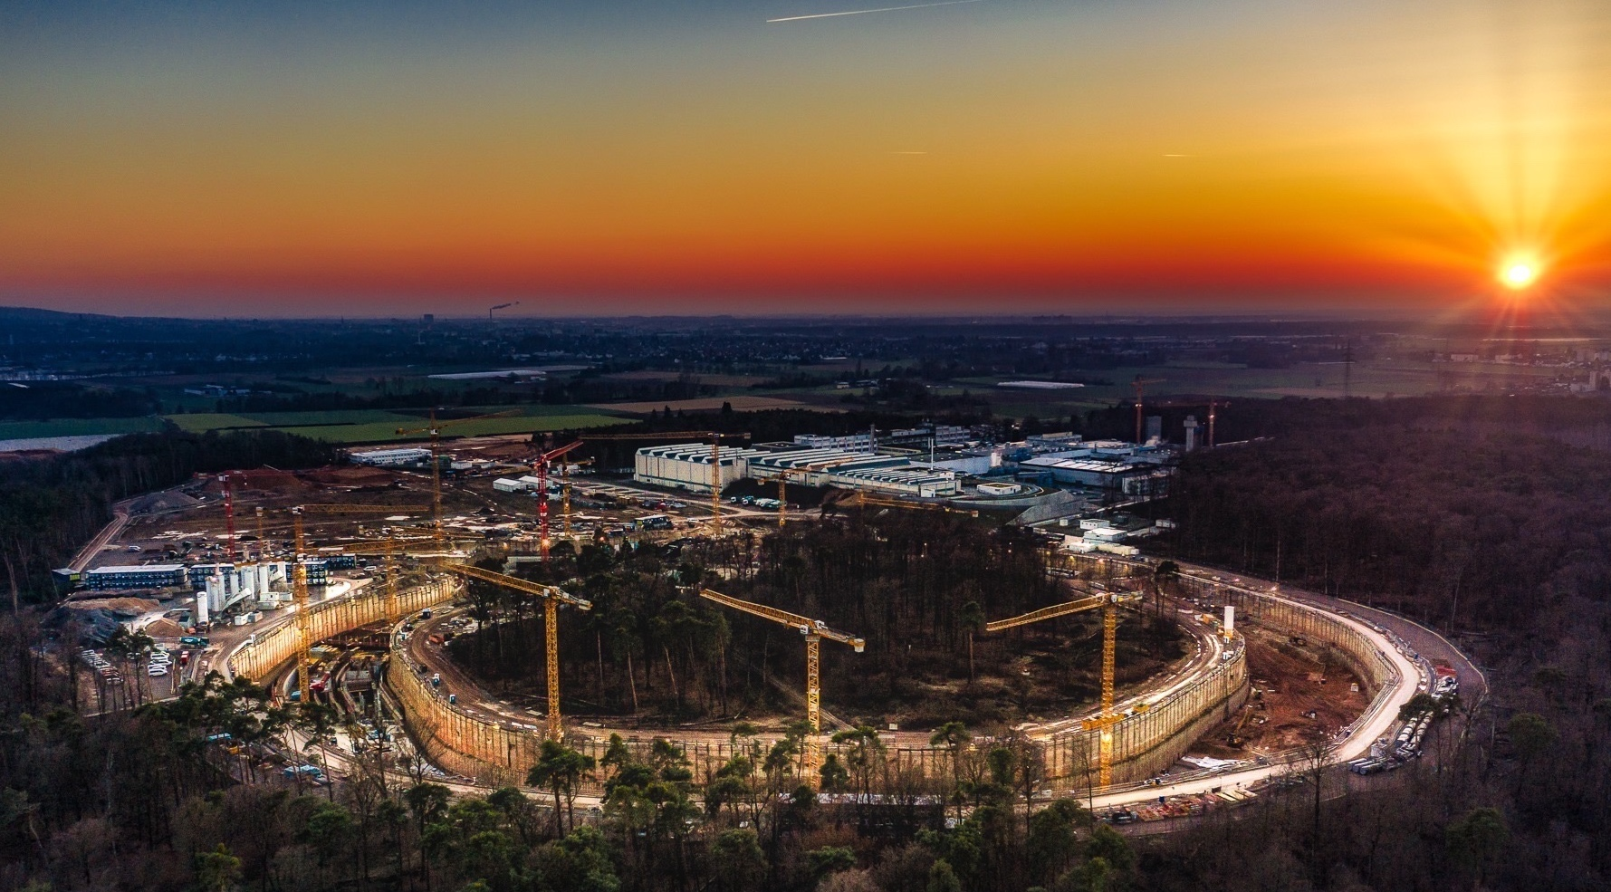
Thank you for your attention!
Photo: C. Betz

Slide 24
Backup slides

Slide 25
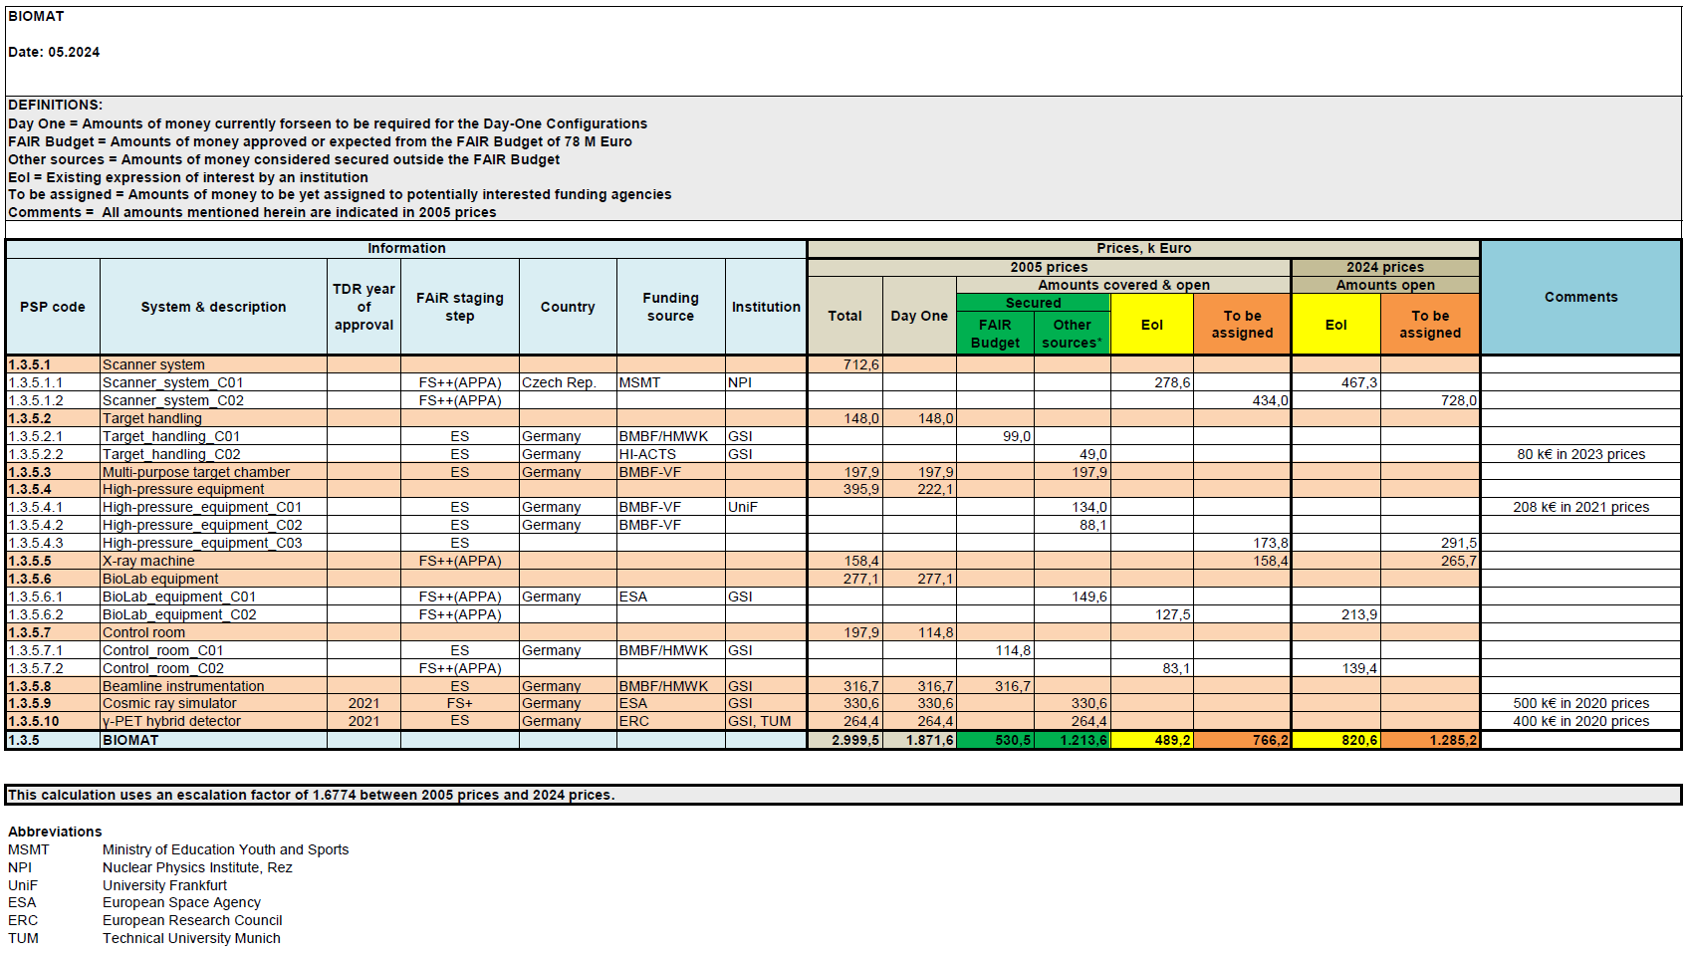
full cost matrix

Slide 26
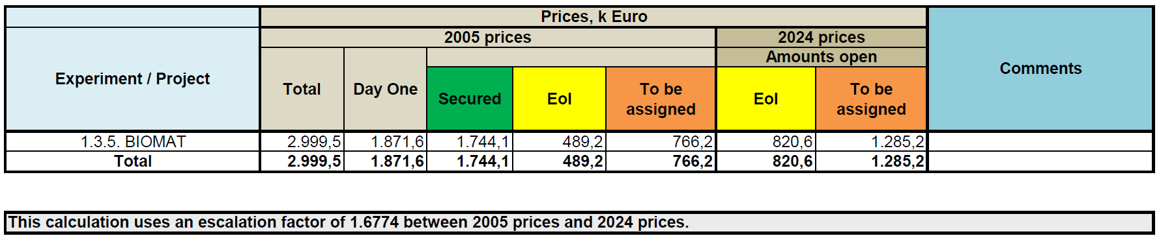
funding per experiment

Slide 27
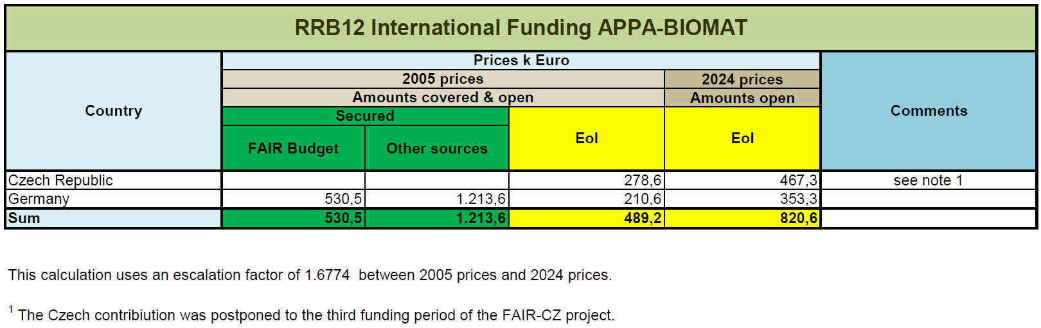
funding by country

Slide 28
Biophysics in FAIR Phase-0
Space radiation protection
Particle therapy
      1998 2022
ESA reference facility for ground-based space radiation protection studies
Current ESA-supported programs ongoing: IBER/IRES/ROSSINI/GCRsim
ESA/FAIR Summer School in Darmstadt
EU programs: RADNEXT-HEARTS
First European center to treat patients with high energy ¹²C-ions (440 patients treated on site)
Now extensive research program in particle therapy covering from nuclear physics to molecular biology
Work supported by BMBF, EU (INSPIRE, HITRI, ERC AdG), NIH

Slide 29
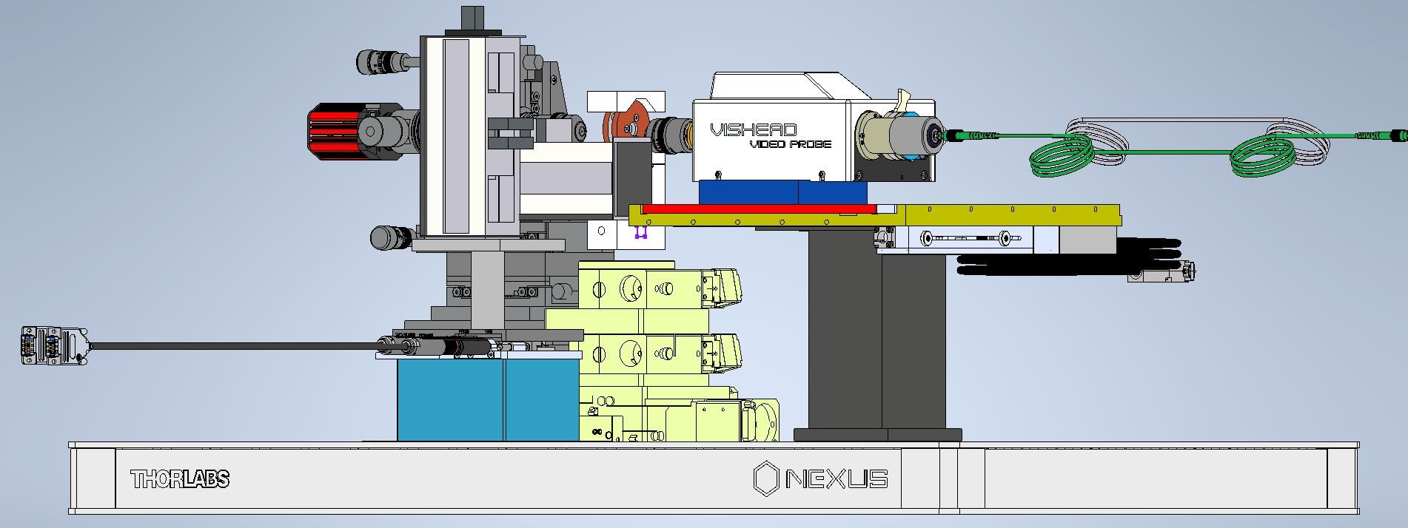
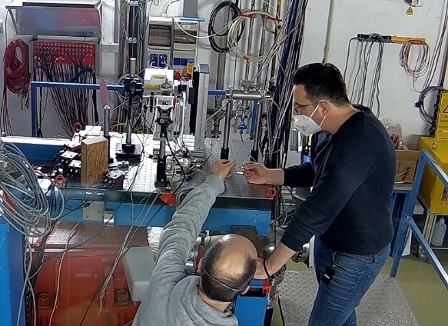
High-pressure irradiation setup I
Collimator
Camera
DAC
Raman Head
Optical fibers to spectrometer
Ion beam
Motorized axes
Mobile setup
Laser table (1 x 1 m)
Prototype setup with online Raman spectroscopy ready
Total space: ~ 2 x 3 m²
Further developments in 2023-2025 (collimation, automatic sample exchange system, remote control of motors …)
Ready for APPA-Cave and FAIR day-1 exp

Slide 30
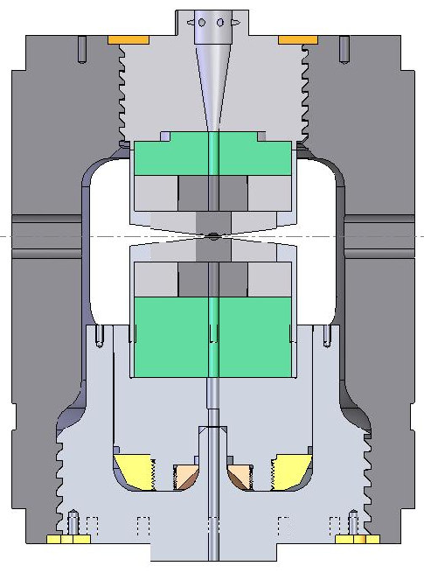
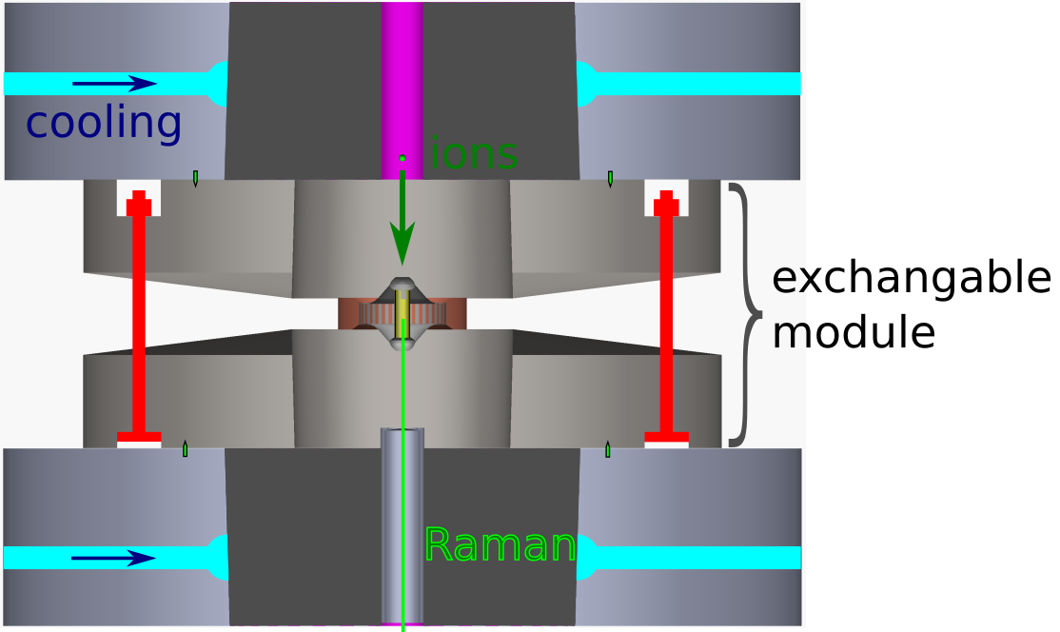
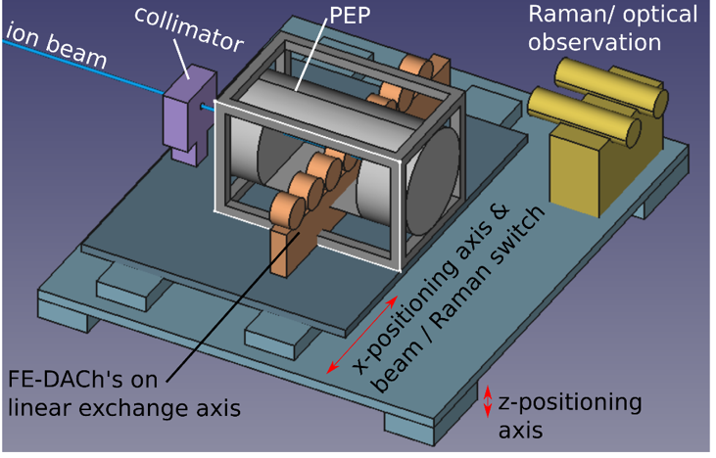

High-pressure irradiation setup II
Paris-Edinburg Cell (PEC)
Sample size ~ mm²
Pressure up to ~12 Gpa
T_{max} ~ 600 °C
Exchange magazine and positioning platform
Automatized exchange of inner pressure cell
Irradiation and in-situ analysis of up to 12 samples
2023-2025: design, collimation, positioning and cooling systems,…
Prof. L. Tacjmanova, Cionoiu, Glasmacher, Blum, Faller

Slide 31
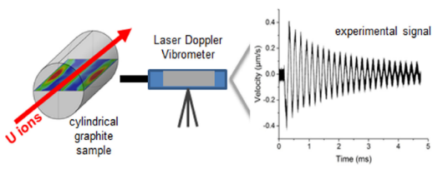





Multi-purpose target chamber for radiation hardness
Applications:
High-power accelerators:
(targets, collimators and beam dumps)
High temperature reactors
Space materials
Multi-purpose chamber:
Radiation resistant carbon fiber composite windows
Remote-controlled sample exchange system
In-situ analysis techniques
Space: 2 x 1 m²
APPA cave or intermediate locations:
Fast extraction of high-intensity pulsed beams (intensities up to 10¹¹ pps)
High energy – larger volumes of radiation damaged and thermally excited material
New facility to study dynamic response of beam-facing materials on site
Monitoring of ion-pulse induced stress waves
Shock and Vibration (2021) 8884447

Slide 32
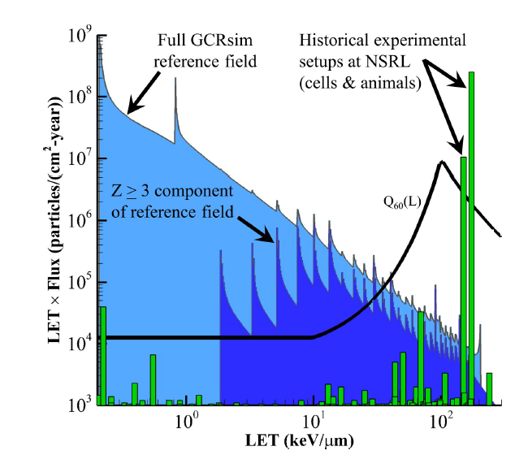
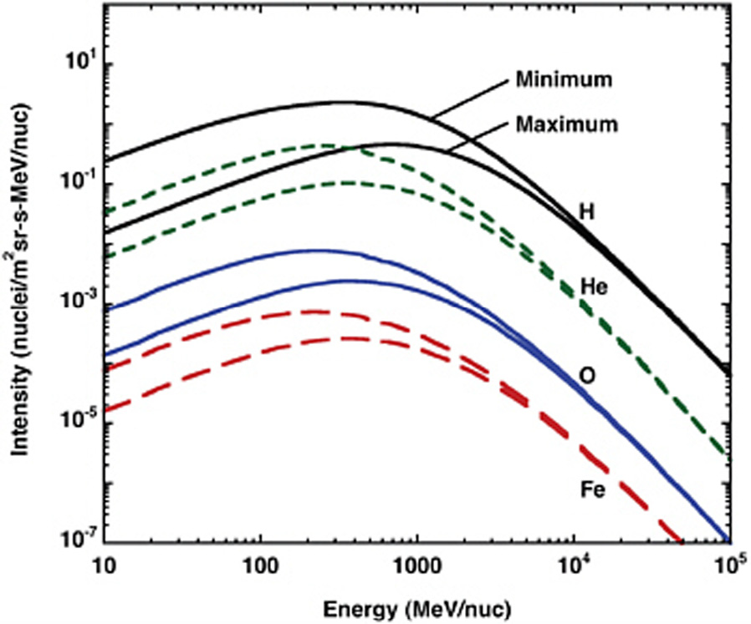
at CBM: science case
CUTOFF
1 GeV/n

Slide 33


Cosmic rays simulator (WP 1.3.5.9)
CUTOFF 1 GeV/n @SIS18
10 GeV/n @SIS100
MAT: CBM is a backup option in case the facility at the ring branch cannot be realized

