Slide 1
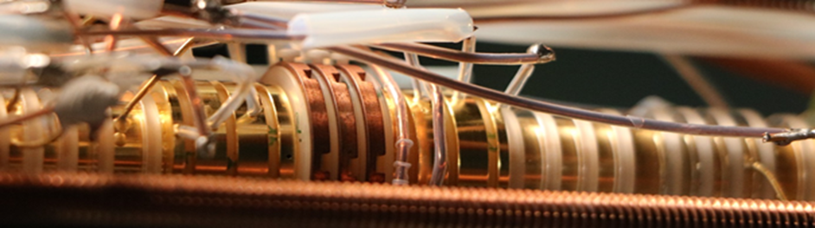


High-precision mass measurements of light ion species
DPG Spring Meeting 2024
Sangeetha Sasidharan

Slide 2
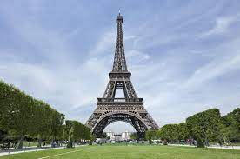
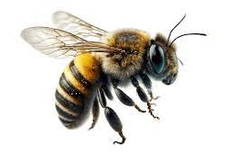
High-precision Mass Spectrometry
Field | δm/m | δE
General chemistry | ≤ 10⁻⁵ | 1 MeV
Nuclear Structure Physics | ≤ 10⁻⁶ | 100 keV
Astrophysics | ≤ 10⁻⁷ | 10 keV
Weak interaction studies | ≤ 10⁻⁹ | 100 eV
Metrology, Fundamental constants, Neutrino physics | ≤ 10⁻¹⁰ | eV – meV
CPT tests, QED in HCI | ≤ 10⁻¹¹ | meV, eV - meV
Short lived nuclides /
Online facilities
Stable nuclides /
Offline setups
Bee (60mg) on Eiffel tower (7300000Kg)
Relative mass precision of 10⁻⁹ and below can be reached by Penning-trap mass spectrometry
Focus: Simple and stable atomic systems

Slide 3
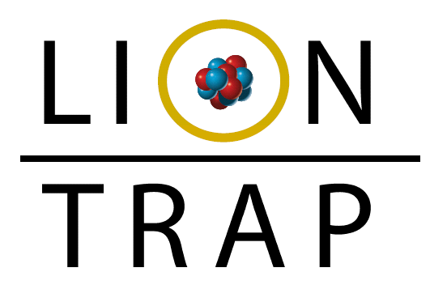
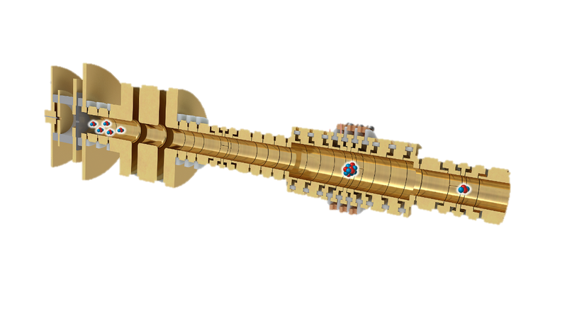

LIONTRAP
Acronym for Light ION TRAP experiment situated in Mainz.
High precision Penning-trap mass spectrometer for light ions
Precision goal: $\frac{\text{δm}}{\text{m}} \text{< }{\text{10}}^{\text{−}11}$
Measure directly in atomic mass units, $u=\frac{1}{12}m\left( ^{12}C\right)$
Specialized trap : Measuring light ions is difficult because of relatively small signals and high relativistic shifts

Slide 4
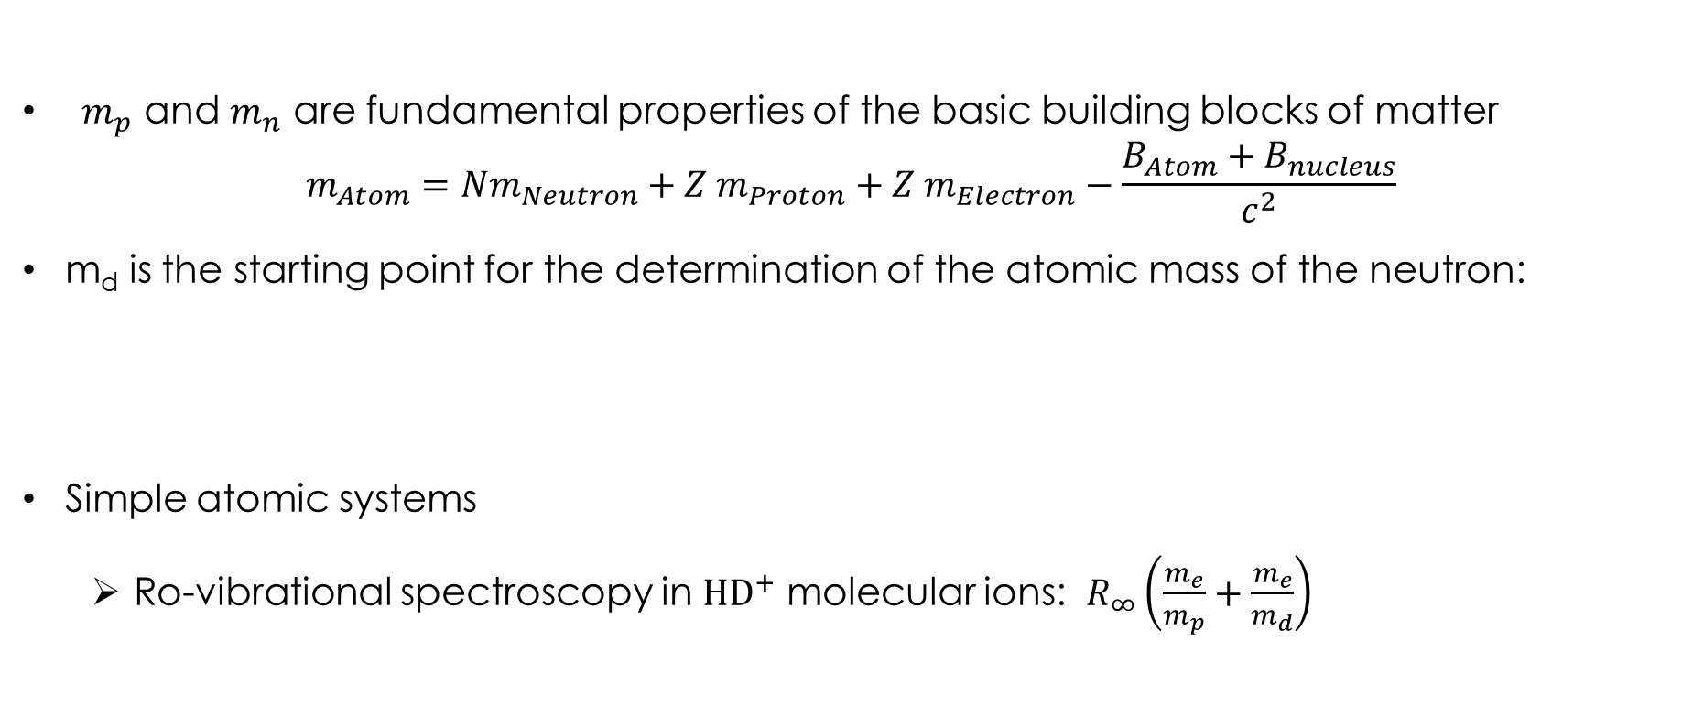


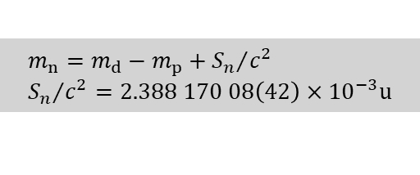
Light Ion Masses for Fundamental Physics
p
d
T
$${}_{}^{3}He$$
$$α$$
${ m}_{p}$ and $m_{n}$ are fundamental properties of the basic building blocks of matter
$$m_{Atom}=Nm_{Neutron}+Z m_{Proton}+Z m_{Electron}−\frac{B_{Atom}+B_{nucleus}}{c^{2}}$$
m_{d} is the starting point for the determination of the atomic mass of the neutron:
Simple atomic systems
  Ro-vibrational spectroscopy in ${HD}^{+}$ molecular ions: $R_{∞}\left(\frac{m_{e}}{m_{p}}+\frac{m_{e}}{m_{d}}\right)$
$$m_{n}=m_{d}−m_{p}+{S_{n}}/{c^{2}} \\ {S_{n}}/{c^{2}=2.388 170 08\left(42\right)×{10}^{−3}u}$$
M.S. Dewey et al. Phys. Rev. C73, 044303 (2006)
S. Rau et al. Nature 585, 43–47 (2020)
Notes:
1:00
Einzig stabile Hadron / leichteste Baryon
Ungefähr 1 % der Masse des Protons kommt von den Massen der Valenzquarks, der Rest stammt von der Bewegungs- und Bindungsenergie zwischen Quarks und den Gluonen.
Correlation coefficient: r(mp,Rinf)=-0.0058 (siehe: https://physics.nist.gov/cgi-bin/cuu/CCValue?ryd|ShowSecond=rydberg+constant&First=mpu) -> Ungenauigkeit von Rinf müsste Faktor 180 mal schrumpfen, dann wäre Unsicherheit durch 1E-10 Protonmasse (VanDyck) dominierend und verbesserte Elektronenmasse wird benötigt.
Erklärung r: Wenn sich mp um ein Sigma (delta_mp) verschieben würde, dann würde sich Rinf um r*delta_Rinf verschieben
CPT-Test (siehe: https://www.nature.com/articles/nature14861): Messe R==(q/m)_antiproton/(q/m)_hydrogen-anion und vergleiche zu R, wo CPT als richtig angenommen, dann: R_theo=(1+2*me/mp+polarizability shift/mp-electron binding energy/mp-electron affinity of hydrogen) und hier ist Unsicherheit von R_theo=2E-13. Und Unsicherheit von R_exp=69E-12. Damit müsste Experiment um Faktor 345 verbessert werden, damit verbesserte Protonmasse benötigt wird.

Slide 5
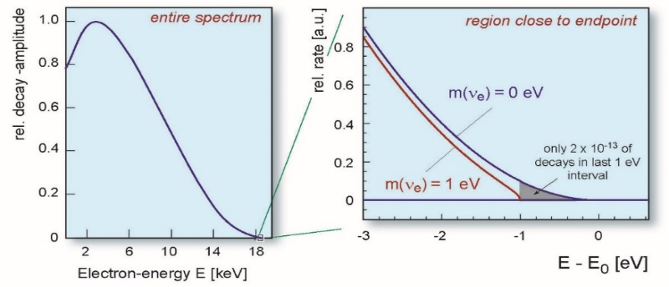
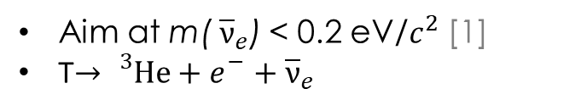
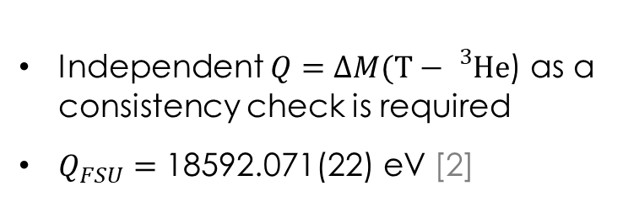
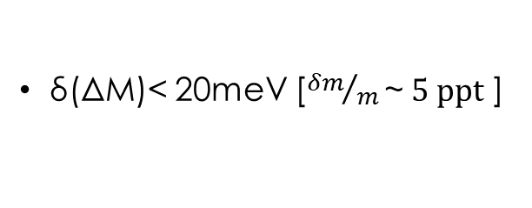
Light Ion Masses for Neutrino physics
KATRIN experiment
Aim at m(${ \overline{ν}}_{e}$) < 0.2 eV/$c^{2}$ [1]
T$→{}_{}^{3}{He}+e_{}^{−}+{\overline{ν}}_{e}$
Independent $Q=∆M(T−{}_{}^{3}{He}$) as a consistency check is required
$Q_{FSU}=\text{18592.071(22) }\text{eV}$ [2]
δ(ΔM)< 20meV [${δm}/m\text{\sim } 5 ppt$ ]
[1] The KATRIN collab., Nat. Phys., 18, 160 (2022)
[2] M. Restrepo et al., Phys. Rev. Lett. 131, 243002 (2023)
From: http://www.katrin.kit.edu

Slide 6
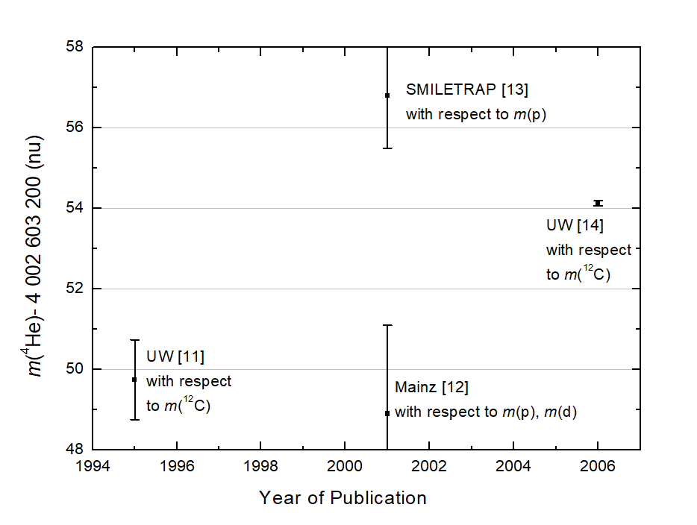
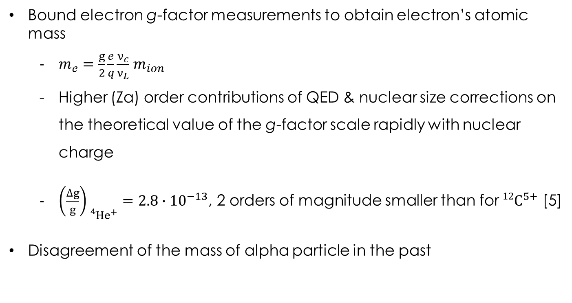
Light Ion Mass for Mass of electron
Bound electron g-factor measurements to obtain electron’s atomic mass
  $m_{e}=\frac{g}{2}\frac{e}{q}\frac{ν_{c}}{ν_{L}}$ $m_{ion}$
  Higher (Zα) order contributions of QED & nuclear size corrections on the theoretical value of the g-factor scale rapidly with nuclear charge
  ${\left(\frac{∆g}{g}\right)}_{{}_{}^{4}He^{+}}=2.8∙{10}^{−13}$, 2 orders of magnitude smaller than for $12C^{5+}$ [5]
Disagreement of the mass of alpha particle in the past
[3]
[4]
[1]
[2]
[1] R.S. Van Dyck Jr et al., Phys. Scripta A T59, 134 (1995)
[2] Brunner. S et al., Eur. Phys. J. D 15, 181 (2001)
[3] T. Fritioff et al., Eur. Phys. J. D 15, 141-143 (2001)
[4] R. S. Van Dyck et al., Int. J. Mass Spectrom., 251,(2006)
[5] A. Czarnecki, Phys. Rev. Lett. 120, 043203 (2018)

Slide 7
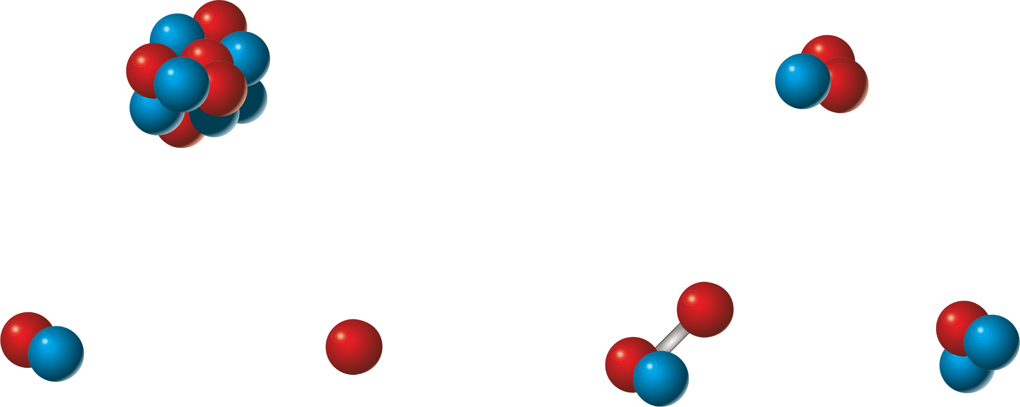
Puzzle of Light Ion Masses
R.S. Van Dyck et al. @ UW
E. Myers et al. @ FSU
[2]
¹²C
³He
m(H) + m(D) − m(³He) Vs m(HD) − m(³He)
[3]
4.4 σ
790(180) pu
Deviation
[2]
[1]
[3]
D
H
HD
T
+ Molecular Binding Energy [4]
+ Binding Energy [4]
[3] E. Myers et al., PRL 114, 013003 (2015)
[1] R. S. Van Dyck Jr. et al., AIP Conf. Proc. 457, 101 (1999)
[4] Yan et al., PRA 67, 062504 (2003)
[2] S. L. Zafonte et al., Metrologia 52, 280 (2015)

Slide 8
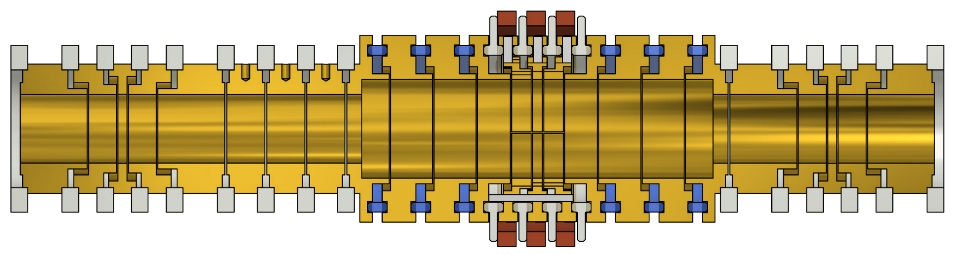
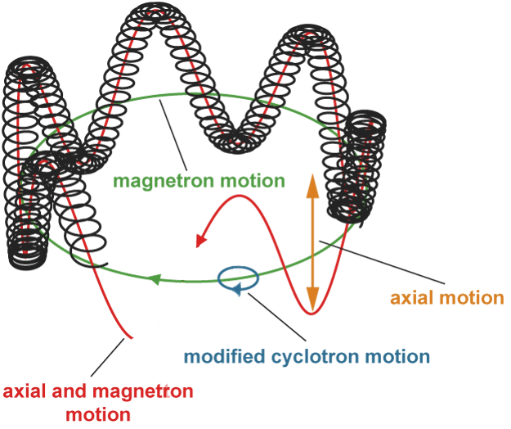

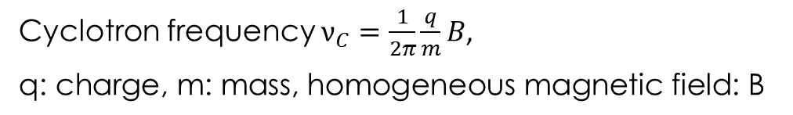



Measurement Tool
Ion stored in a Penning trap:
  homogenous static magnetic field
  electrostatic quadrupole potential for trapping
Helium:
$$ν_{+}\sim 28MHz$$
$$ν_{z}\sim 468kHz$$
$$ν_{−}\sim 4kHz$$
Deuteron:
$$ν_{+}\sim 28MHz$$
$$ν_{z}\sim 460kHz$$
$$ν_{−}\sim 4kHz$$
B-field
Cyclotron frequency $ν_{C}=\frac{1}{2π}\frac{q}{m}B$,
$$\text{q}\text{: }\text{charge}\text{, }\text{m}\text{: }\text{mass}\text{, }\text{homogeneous} \text{magnetic} \text{field}\text{:} \text{B}$$
U_{UC2} ~ -6 V
U_{UC1} ~ -7 V
U_{R} ~ -8 V
U_{LC1} ~ -7 V
U_{LC2} ~ -6 V
Ion
Cyclotron frequency via invariance theorem [1]:
$$ν_{c}=\sqrt{{ν_{+}}^{2}+{ν_{z}}^{2}+{ν_{−}}^{2}}$$
$$v_{c}≈v_{+} ≫v_{z}≫v_{−}$$
$v_{+}$needs to be measured most precisely
1cm
[1] L.S. Brown & G. Gabrielse, PRA 25, 2423 (1982)

Slide 9
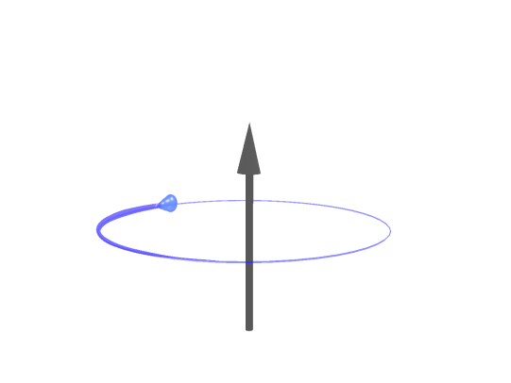
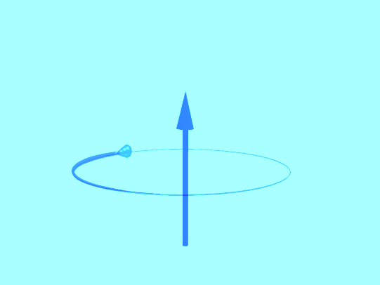


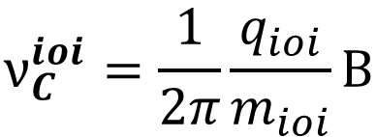
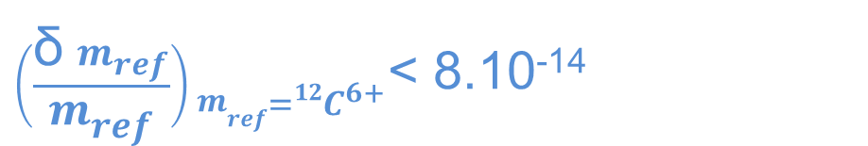
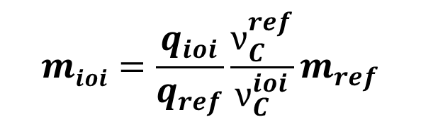
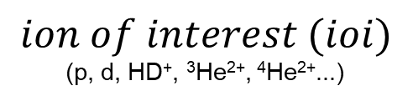

Basic Measurement Principle
Direct measurement of the atomic mass of the ion :
B
B
$$ion of interest (ioi)$$
(p, d, HD⁺, ³He²⁺, ⁴He²⁺...)
¹²C^{q+}
$$ν_{C}^{ioi}=\frac{1}{2π}\frac{q_{ioi}}{m_{ioi}}B$$
$$ν_{C}^{ref}=\frac{1}{2π}\frac{q_{ref}}{m_{ref}}B$$
$$mioi=\frac{q_{ioi}}{q_{ref}}\frac{ν_{C}^{ref}}{ν_{C}^{ioi}}m_{ref}$$
$\left(\frac{\text{δ} m_{ref}}{m_{ref}}\right)m_{ref={12C}^{6+}}$˂ 8.10⁻¹⁴
$$R$$

Slide 10
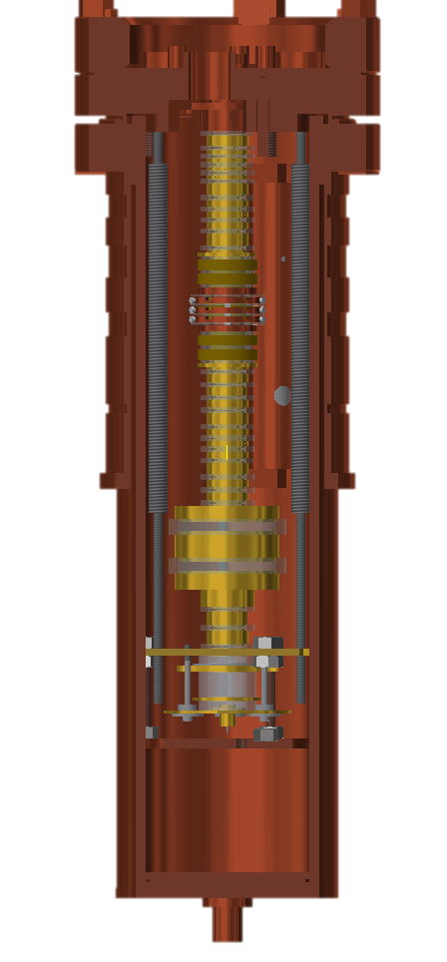
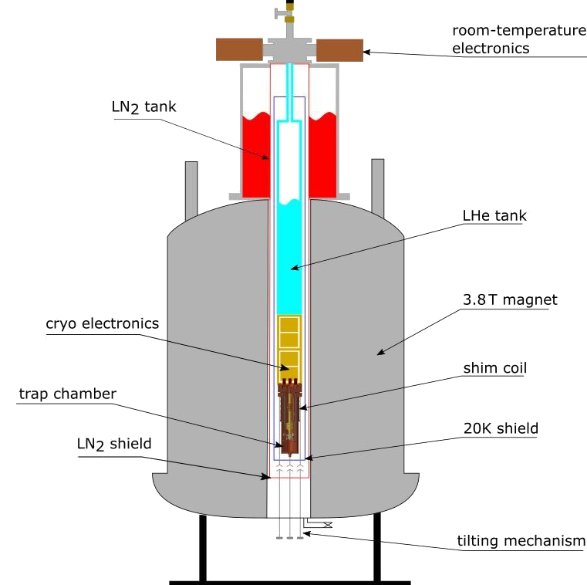
Setup
Offline experiment
Liquid helium temperature
Hermetically sealed
trap chamber, Ultra-high vacuum (Pressure < 10⁻¹⁶ mbar)
Storage time of several months!
In situ ion creation
using miniature
EBIT/S
ST1
PT
ST2
2.3 m
MT
mEBIS
Notes:
-6:40

Slide 11

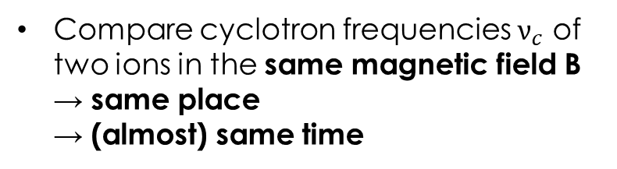

Measurement Procedure
measurement of induced image currents ($\sim fA$) on trap electrodes
$$ioi$$
¹²C⁶⁺
superconducting
tank circuit
ultra low noise
cryogenic amplifiers
Storage
Trap 2 (ST2)
Precision Trap
(PT)
Storage
Trap 1 (ST1)
A
Compare cyclotron frequencies $ν_{c}$ of two ions in the same magnetic field B
→ same place
→ (almost) same time
Fourier transformation
Detected signal (dBV_{rms}/√Hz)
Detected signal (dBV_{rms}/√Hz)
ν-460800 (Hz)
ν-460838 (Hz)
Eg Dip signal of a single deuteron
Notes:
-6:40

Slide 12
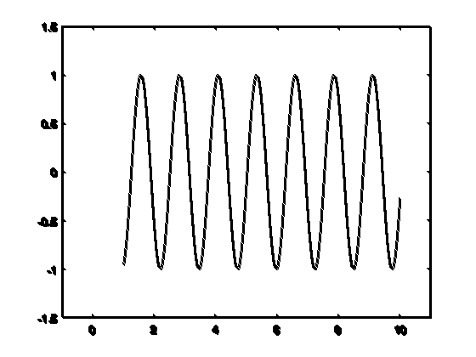

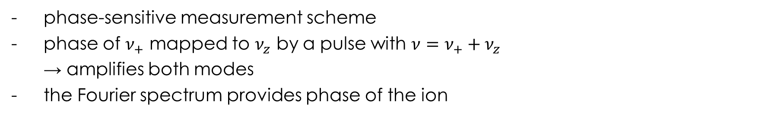


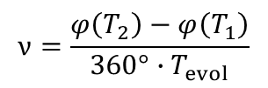
Phase-Sensitive Detection Method
S. Sturm et al., PRL 107, 143003 (2011)
phase-sensitive measurement scheme
phase of $ν_{+}$ mapped to $ν_{z}$ by a pulse with $ν=ν_{+}+ν_{z}$
→ amplifies both modes
the Fourier spectrum provides phase of the ion
$$ν=\frac{φ\left(T_{2}\right)−φ\left(T_{1}\right)}{360°∙T_{evol}}$$
Electrode
    Advantages:
    -Linear scaling with Measurement Time
    -No lineshape model needed
    BUT: at (small) excited radius
$$φ(T_{1})$$
$$φ(T_{2})$$
Dipolar excitation
$$T_{evol}=T_{2}−T_{1}$$

Slide 13
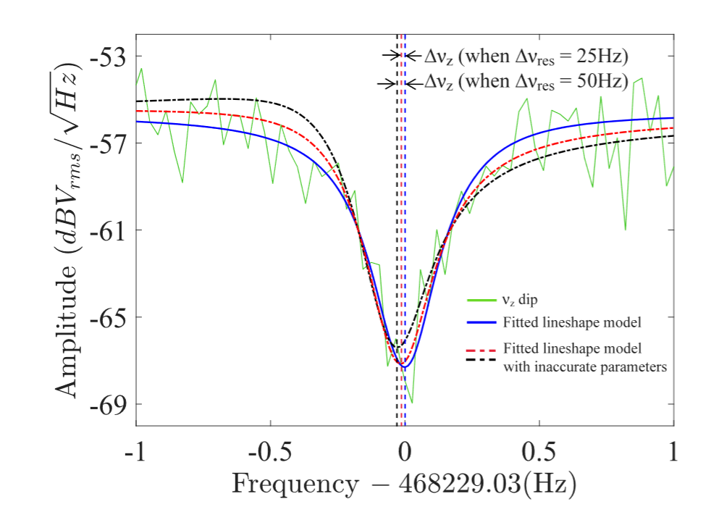
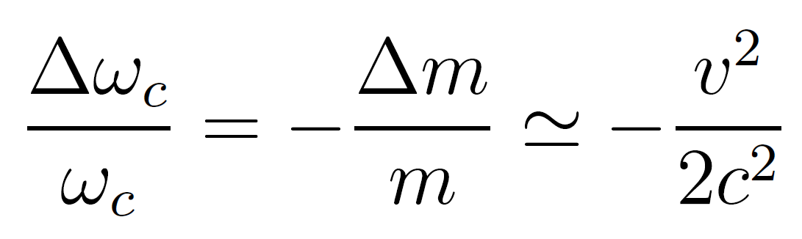
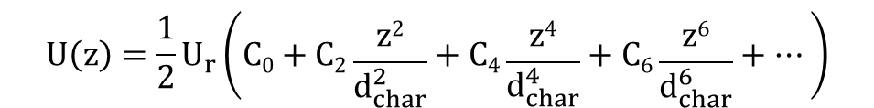
Systematic Uncertainties
Field Imperfections:
Interaction of ion:
Ultra harmonic doubly compensated
With the electrodes:
Image charge effect dominantly shifts radial frequencies
Simulated and measured to a relative uncertainty of 4%
Electric field anharmonicity:
$$U\left(z\right)=\frac{1}{2}U_{r}\left(C0+C2\frac{z2}{d_{char}^{2}}+C4\frac{z4}{d_{char}^{4}}+C6\frac{z6}{d_{char}^{6}}+…\right)$$
Magnetic inhomogeneity :
Superconducting B₂ shim coil
B(z)=B₀+B₁z+B₂z²+…
<B>=B₀+B₂<z₀²>/2
With the detection system:
Special relativistic:
Shifts are large for lighter ions
Finite temperature of the ion → finite thermal radius
Electronic feedback cooling
An axial dip spectrum of ⁴He²⁺

Slide 14
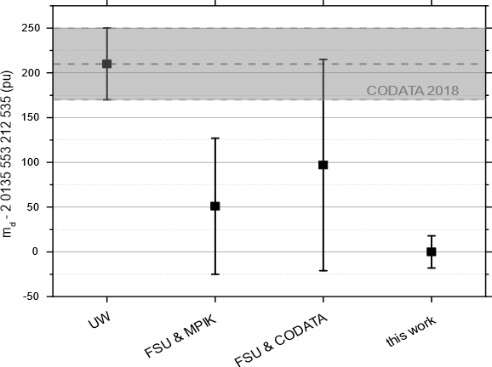
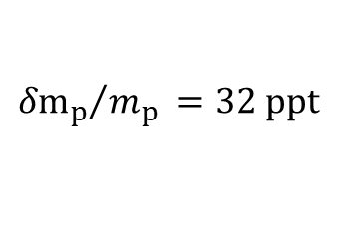
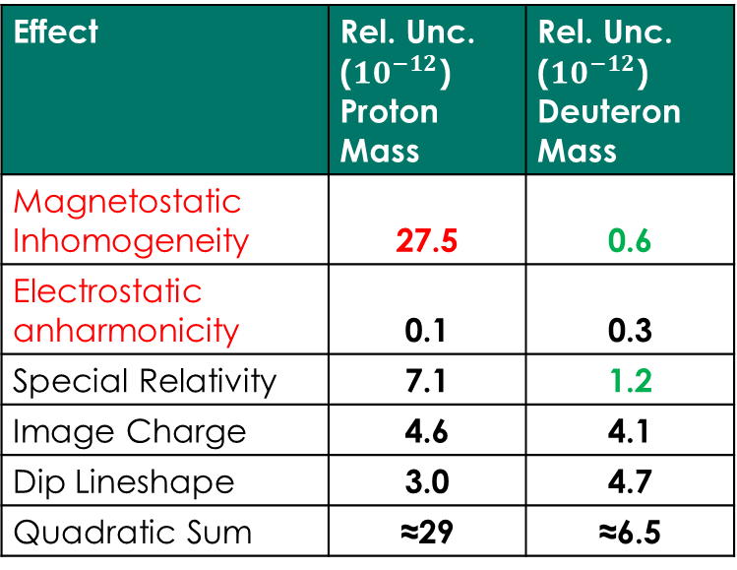
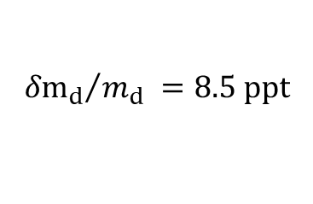


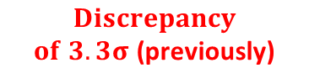
Results of Previous Measurements
Proton mass:
m_{p} $=$ 1.007 276 466 583 $\text{(1}\text{5}\text{)}\text{stat}\text{(}\text{29}\text{)}\text{sys}$ (32) _{tot} u,
$${{δm}_{p}}/{m_{p}} =32 ppt$$
F. Heiße et al., PRL 119, 033001 (2017)
Deuteron mass:
m_{d} = 2.013 553 212 535 (11)_{stat} (13)_{sys} (17)_{tot} u,
$${{δm}_{d}}/{m_{d}} =8.5 ppt$$
S. Rau et al. Nature 585, 43–47 (2020)
Systematics
Proton mass:
Deuteron mass:
Effect | Rel. Unc. (${10}^{−12}$) Proton Mass | Rel. Unc. (${10}^{−12}$) Deuteron Mass
Magnetostatic Inhomogeneity | 27.5 | 0.6
Electrostatic anharmonicity | 0.1 | 0.3
Special Relativity | 7.1 | 1.2
Image Charge | 4.6 | 4.1
Dip Lineshape | 3.0 | 4.7
Quadratic Sum | ≈29 | ≈6.5
B₂-shim coil
*FSU: measurement of $\frac{m_{d}}{m_{p}}$
$$Discrepancy$$
$of 3.3σ$ (previously)
$$Discrepancy$$
$$of 5σ$$

Slide 15

Puzzle of Light Ion Masses
R.S. Van Dyck et al. @ UW
E. Myers et al. @ FSU
[2]
¹²C
³He
m(H) + m(D) − m(³He) Vs m(HD) − m(³He)
4.4 σ
790(180) pu
Deviation
[3]
[2]
[1]
[3]
D
H
HD
T
+ Molecular Binding Energy [4]
+ Binding Energy [4]
[3] E. Myers et al., PRL 114, 013003 (2015)
[1] R. S. Van Dyck Jr. et al., AIP Conf. Proc. 457, 101 (1999)
[4] Yan et al., PRA 67, 062504 (2003)
[2] S. L. Zafonte et al., Metrologia 52, 280 (2015)

Slide 16
Puzzle of Light Ion Masses
R.S. Van Dyck et al. @ UW
E. Myers et al. @ FSU
[2]
¹²C
³He
m(H) + m(D) − m(³He) Vs m(HD) − m(³He)
3.5 σ
560(160) pu
Deviation
[3]
[2]
[1]
Our Measurement
[3]
D
H
HD
T
+ Molecular Binding Energy [4]
+ Binding Energy [4]
[3] E. Myers et al., PRL 114, 013003 (2015)
[1] F. Heiße et al., PRL 119, 033001 (2017)
[4] Yan et al., PRA 67, 062504 (2003)
[2] S. L. Zafonte et al., Metrologia 52, 280 (2015)
Notes:
-230 nu
056(16) nu

Slide 17
Puzzle of Light Ion Masses
R.S. Van Dyck et al. @ UW
E. Myers et al. @ FSU
[2]
¹²C
³He
m(H) + m(D) − m(³He) Vs m(HD) − m(³He)
4.8 σ
484(97) pu
Deviation
New Measurement
[5]
[2]
[1]
Our Measurement
[3]
D
H
HD
T
+ Molecular Binding Energy [4]
+ Binding Energy [4]
[3] E. Myers et al., PRL 114, 013003 (2015)
[1] F. Heiße et al., PRL 119, 033001 (2017)
[4] Korobov et al., PRL. 118, 233001 (2017)
[2] S. L. Zafonte et al., Metrologia 52, 280 (2015)
[5] S. Hamzeloui et al, PRA 96, 060501 (2017)
Notes:
0.47(10) nu

Slide 18
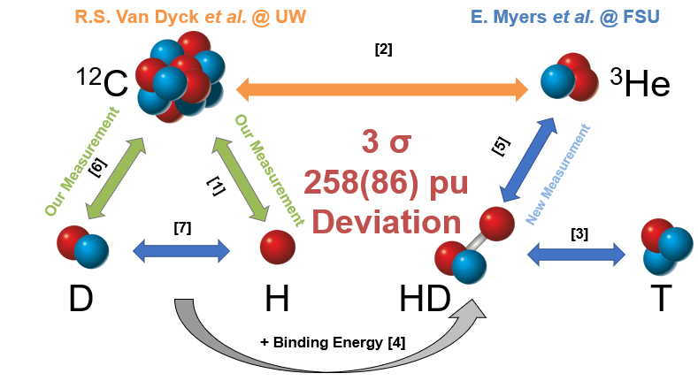
Puzzle of Light Ion Masses
m(H) + m(D) − m(³He) Vs m(HD) − m(³He)
255(84)
Motivation for ³He mass measurement!!
+ Molecular Binding Energy [4]
[1] F. Heiße et al., PRL 119, 033001 (2017)
[5] S. Hamzeloui et al, PRA 96, 060501 (2017)
[2] S. L. Zafonte et al., Metrologia 52, 280 (2015)
[6] S. Rau et al., Nature 585, 43–47 (2020)
[3] E. Myers et al., PRL 114, 013003 (2015)
[7] D. J. Fink, E. Myers, PRL 127, 243001 (2021)
[4] V. Korobov et al., PRL. 118, 233001 (2017)

Slide 19
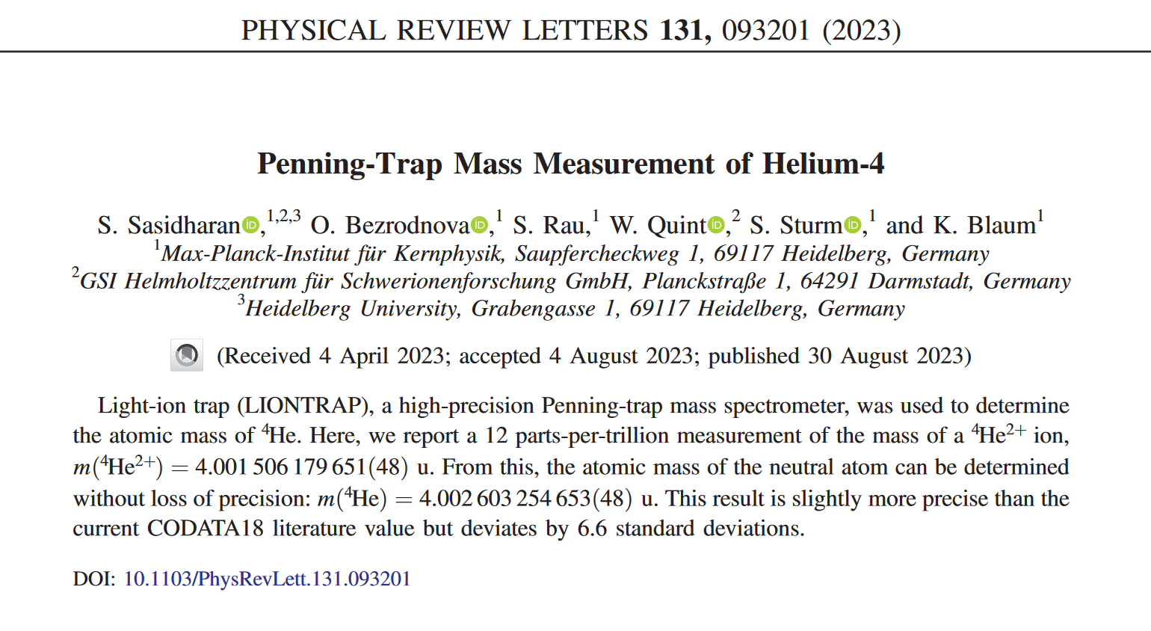
Latest Published Results: Helium-4 Mass

Slide 20
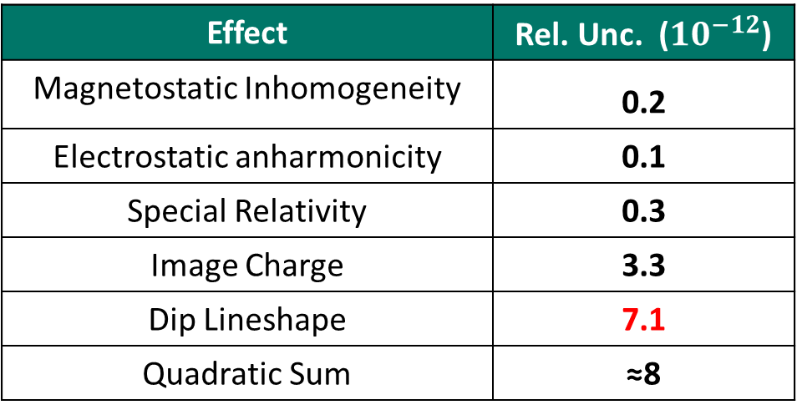

Error Budget Helium-4
Systematic Error
Effect | Rel. Unc. (${10}^{−12}$)
Magnetostatic Inhomogeneity | 0.2
Electrostatic anharmonicity | 0.1
Special Relativity | 0.3
Image Charge | 3.3
Dip Lineshape | 7.1
Quadratic Sum | ≈8
m(⁴He²⁺) = 4.001 506 179 651(36)_{stat}(31)_{sys}(48)_{tot} u.
The total relative uncertainty is 12ppt .
Statistical Error
$${ δR_{0}}/{R_{0}}≈9×{10}^{−12}$$
Notes:
2:20
Wire Radius:
Acetylenflamme mit Schutzgas

Slide 21
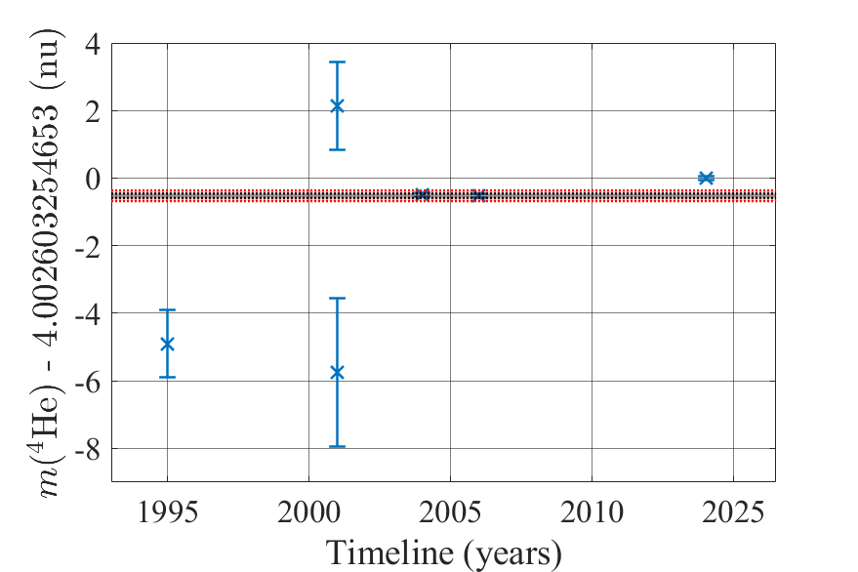
Results – Discrepancy
SMILETRAP
wrt m(p)
[3]
LIONTRAP wrt m(¹²C)
[5]
CODATA18 [6]
UW
wrt m(¹²C)
[4]
Mainz
wrt m(p), m(d)
UW
wrt m(¹²C)
[2]
[1]
[1] R.S. Van Dyck Jr et al., Phys. Scripta A T59, 134 (1995)
[2] Brunner. S et al., Eur. Phys. J. D 15, 181 (2001)
[3] T. Fritioff et al., Eur. Phys. J. D 15, 141-143 (2001)
[4] R. S. Van Dyck et al., Int. J. Mass Spectrom., 251,(2006)
[5] S. Sasidharan et al., PRL 131, 093201 (2023)
[6] E. Tiesinga et al., Rev. Mod. Phys. 93 (2021)

Slide 22
${}_{}^{3}{He} \text{M}\text{ass}$ - Last Piece in the Light Ion Mass Puzzle?
m(H) + m(D) − m(³He) Vs m(HD) − m(³He)
255(84)
Motivation for ³He mass measurement!!
+ Molecular Binding Energy [4]
[1] F. Heiße et al., PRL 119, 033001 (2017)
[5] S. Hamzeloui et al, PRA 96, 060501 (2017)
[2] S. L. Zafonte et al., Metrologia 52, 280 (2015)
[6] S. Rau et al., Nature 585, 43–47 (2020)
[3] E. Myers et al., PRL 114, 013003 (2015)
[7] D. J. Fink, E. Myers, PRL 127, 243001 (2021)
[4] V. Korobov et al., PRL. 118, 233001 (2017)

Slide 23
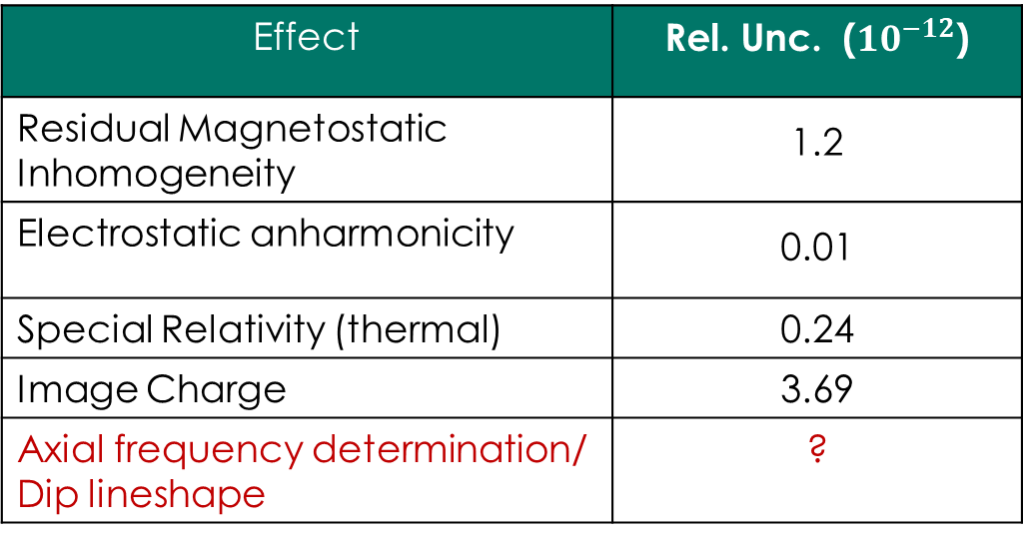

Estimated Error Budget
Statistical Error
$${ δR_{0}}/{R_{0}}≈9×{10}^{−12}$$
Systematic Error
Effect | Rel. Unc. (${10}^{−12}$)
Residual Magnetostatic Inhomogeneity | 1.2
Electrostatic anharmonicity | 0.01
Special Relativity (thermal) | 0.24
Image Charge | 3.69
Axial frequency determination/ Dip lineshape | ?
Preliminary
Improved hardware

Slide 24
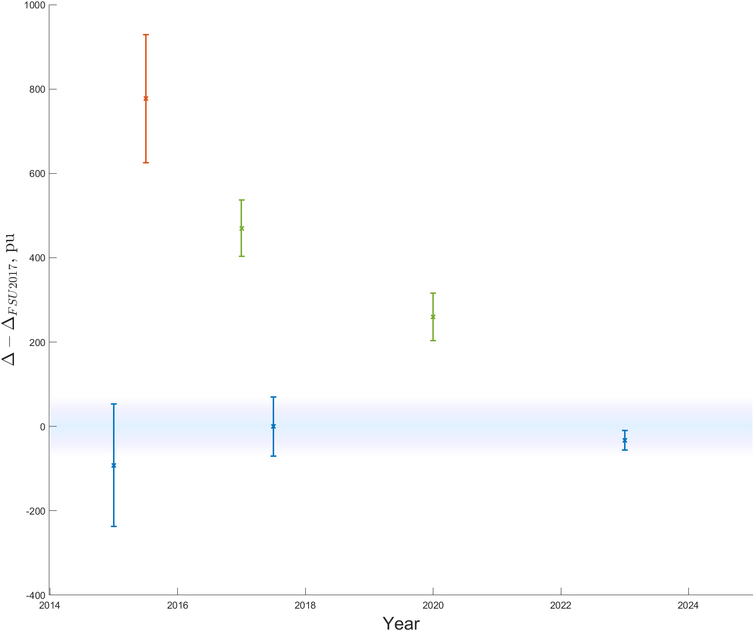
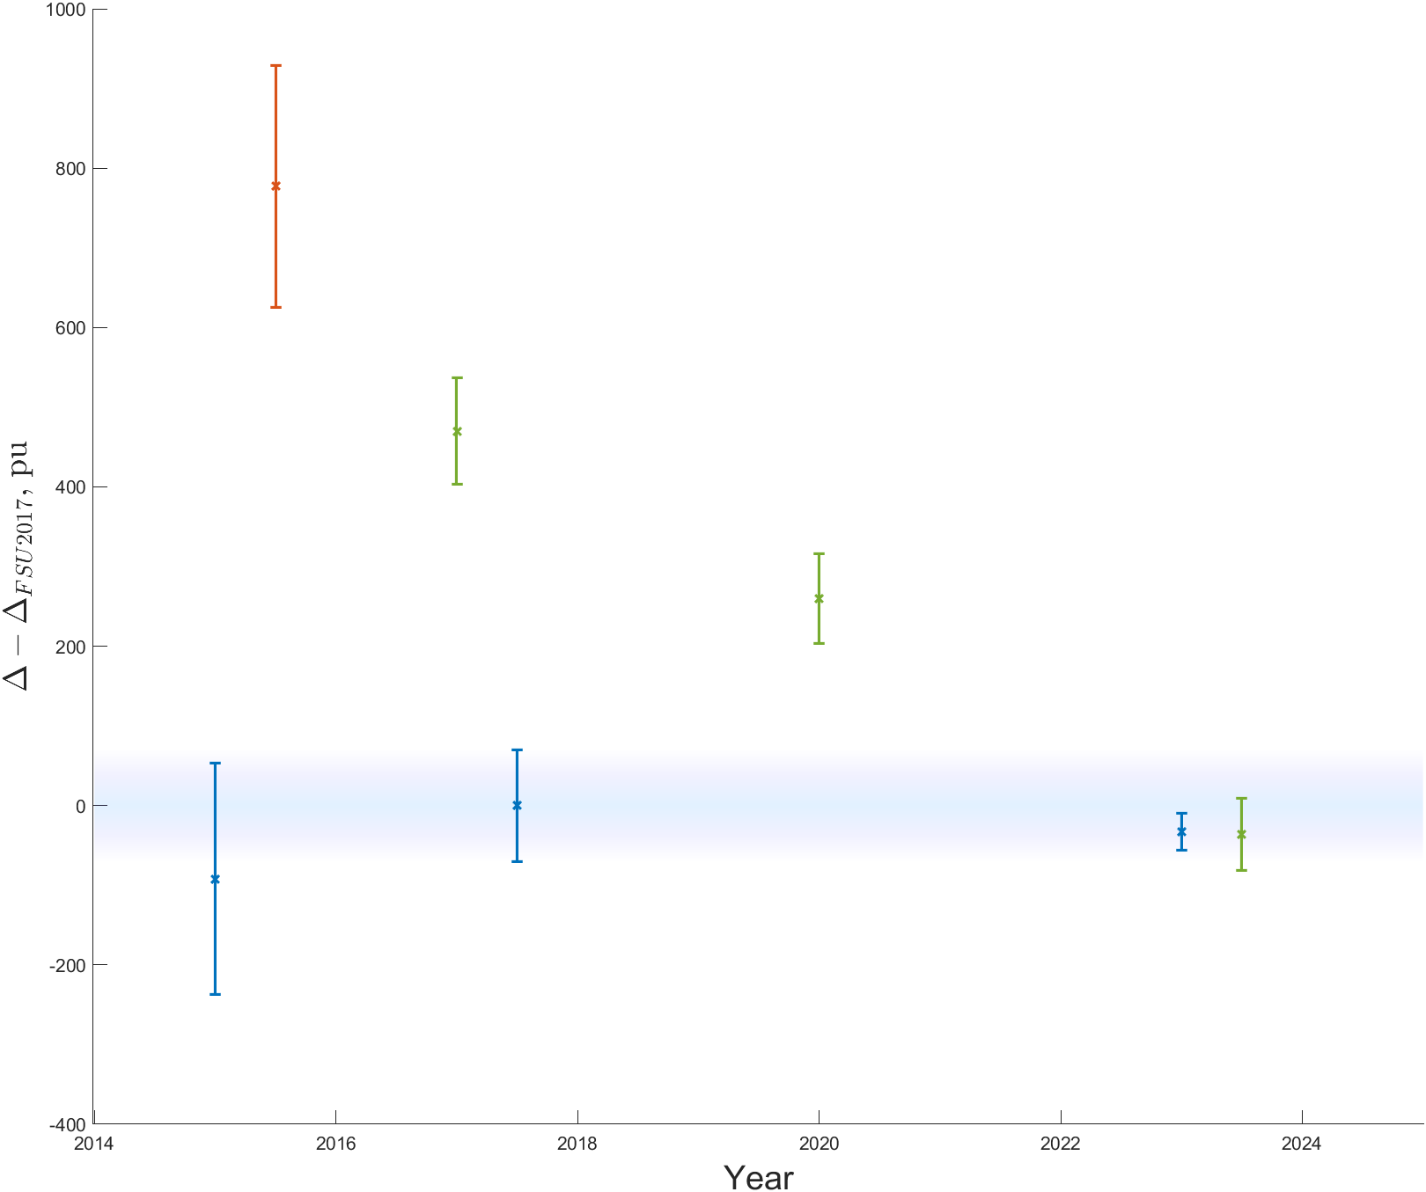

${}_{}^{3}{He} \text{M}\text{ass}$ - Last Piece in the Light Ion Mass Puzzle?
UW1999+UW2015
$$∆=m_{d}+m_{p}−m_{3He}$$
Preliminary
UW2015+MPIK2017
m(H) + m(D) − m(³He) Vs m(HD) − m(³He)
5σ
UW2015+MPIK2017+MPIK2020
FSU2015
FSU2017
MPIK2024
Prelim!
stat only
+ Molecular Binding Energy [4]
FSU2023
stat only!
[1] F. Heiße et al., PRL 119, 033001 (2017)
[2] S. L. Zafonte et al., Metrologia 52, 280 (2015)
[3] E. Myers et al., PRL 114, 013003 (2015)
[4] V. Korobov et al., PRL. 118, 233001 (2017)
[5] S. Hamzeloui et al, PRA 96, 060501 (2017)
[6] S. Rau et al., Nature 585, 43–47 (2020)
[7] D. J. Fink, E. Myers, PRL 127, 243001 (2021)

Slide 25

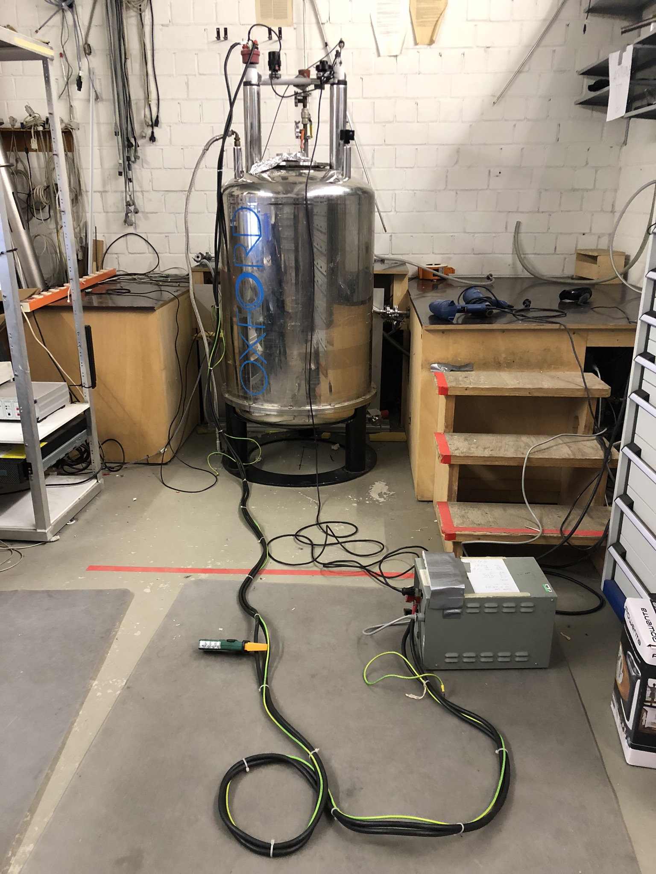
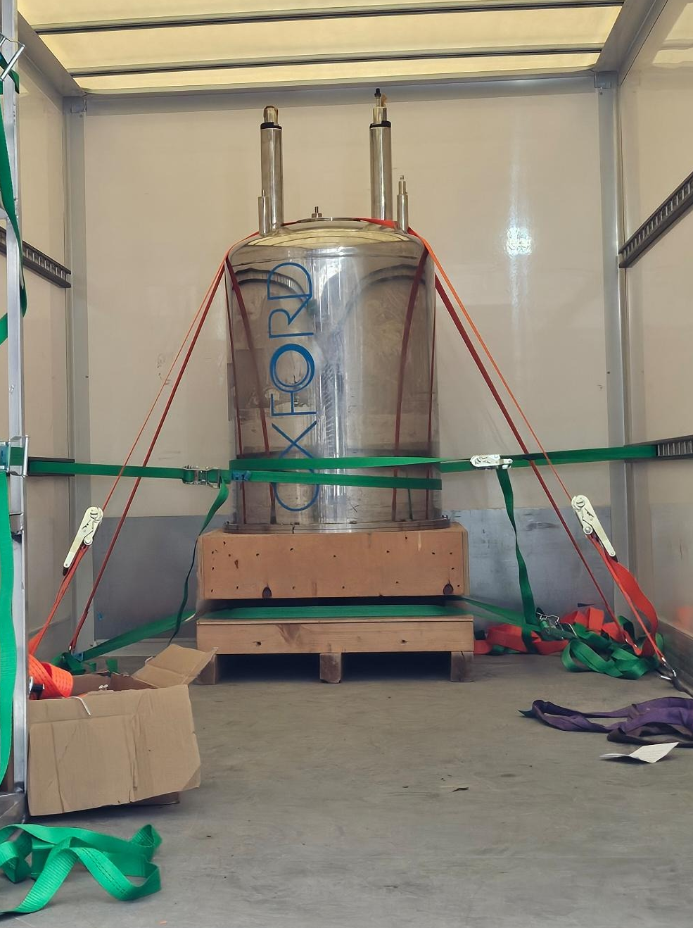


Summary
Proton mass measurement
Deuteron mass measurement
Alpha particle mass measurement
Helion mass measurement
Light Ion mass puzzle solved,
hopefully!
Future
The magnet is moving to MPIK

Slide 26

Acknowledgement
Work Group: | Sangeetha Sasidharan^{1,2}, Olesia Bezrodnova¹, Wolfgang Quint², Sven Sturm¹ and Klaus Blaum¹
¹Division of Stored and Cooled Ions at MPIK, Heidelberg
²Atomic Physics Division at GSI Helmholtzzentrum, Darmstadt
Former members: Sascha Rau, Fabian Heisse, Florian Koehler-Langes
Funding:
Thank you for your attention!

