Slide 1
Due to the data policy of the COLLAPS collaboration, some presented values that have not been published yet were removed or replaced with placeholder values.

Slide 2
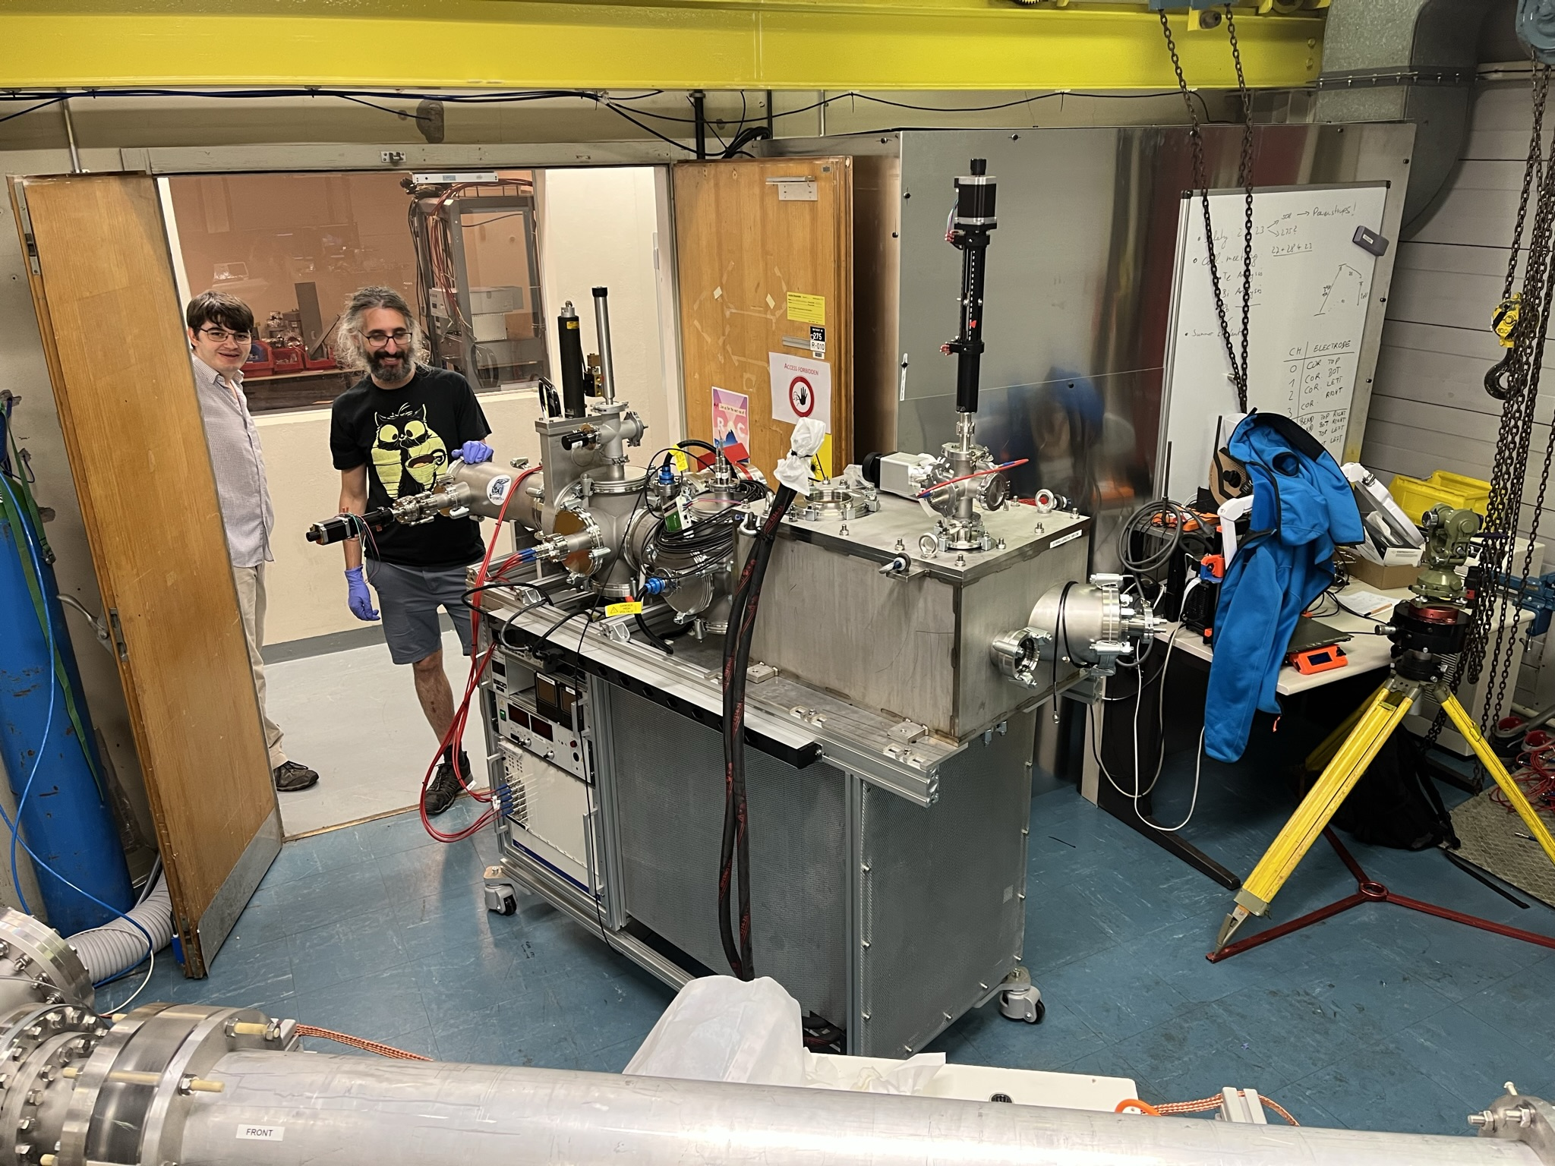
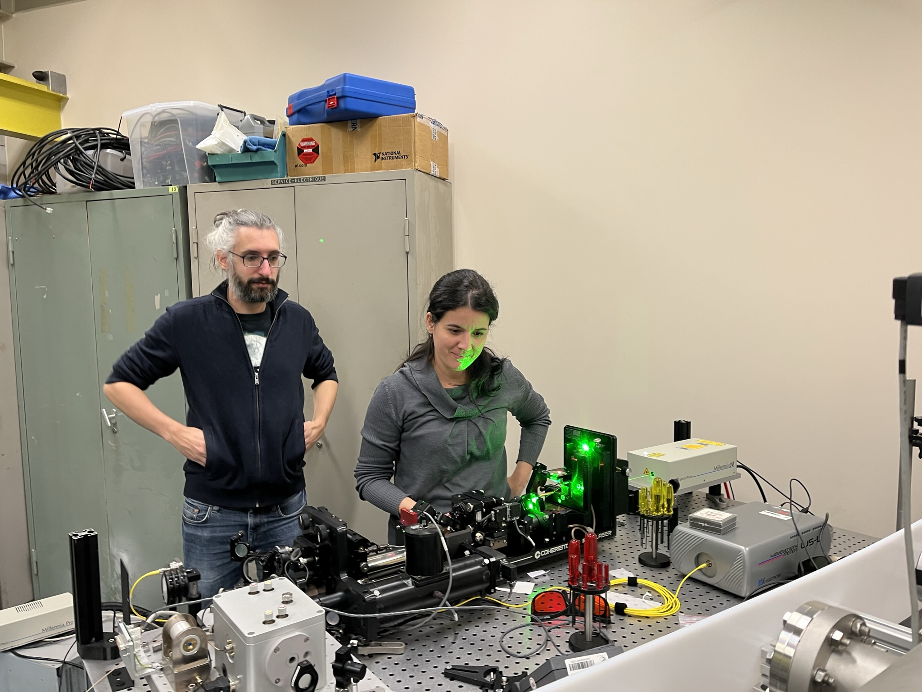
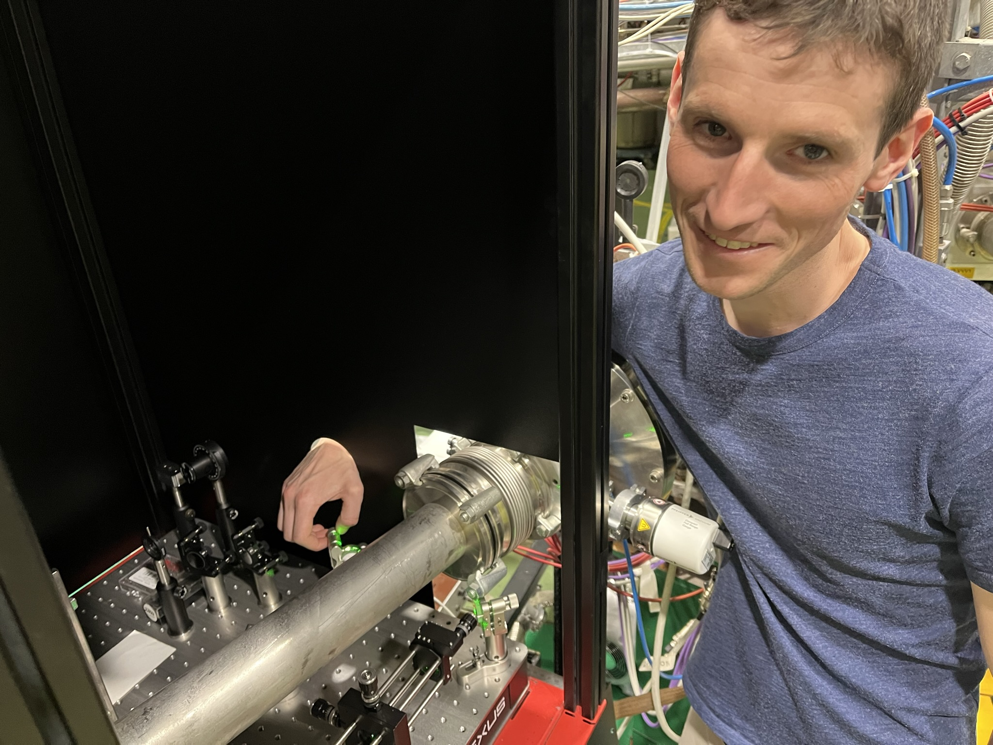
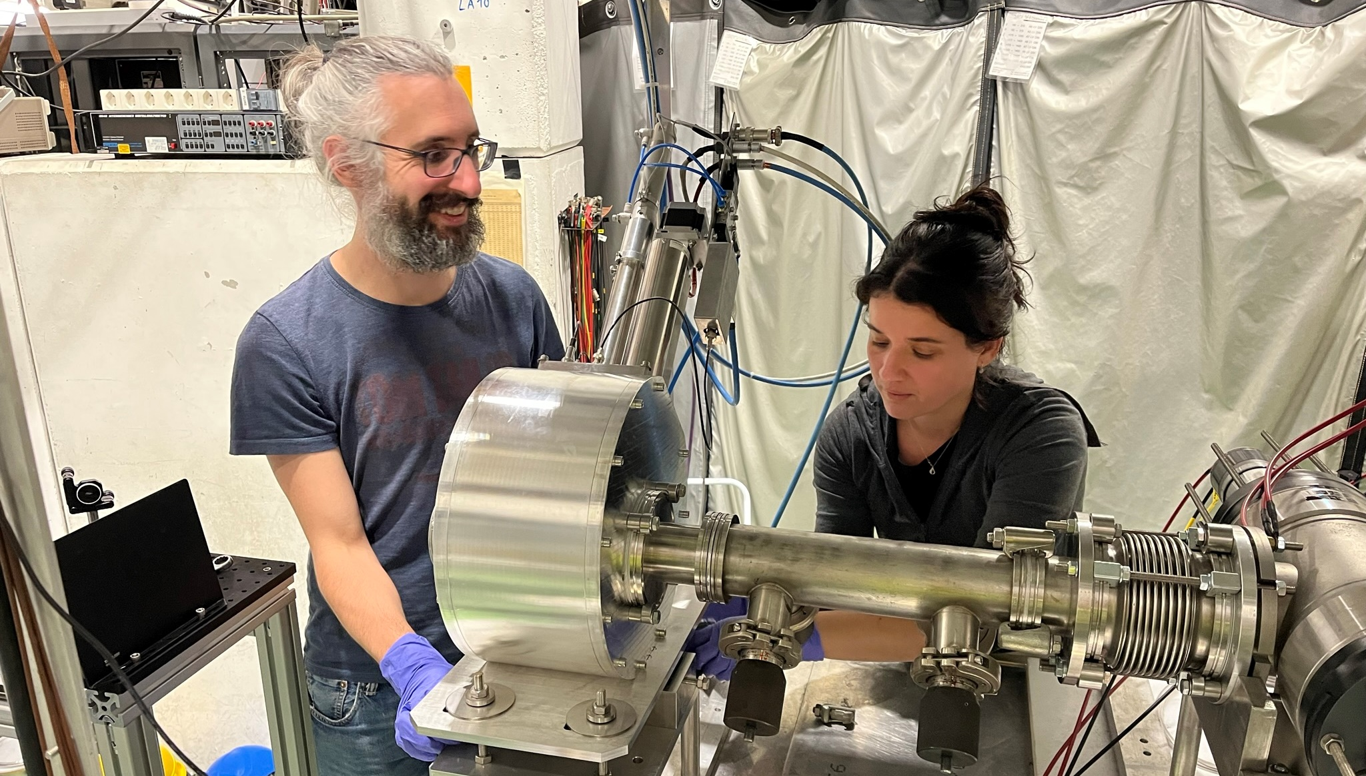
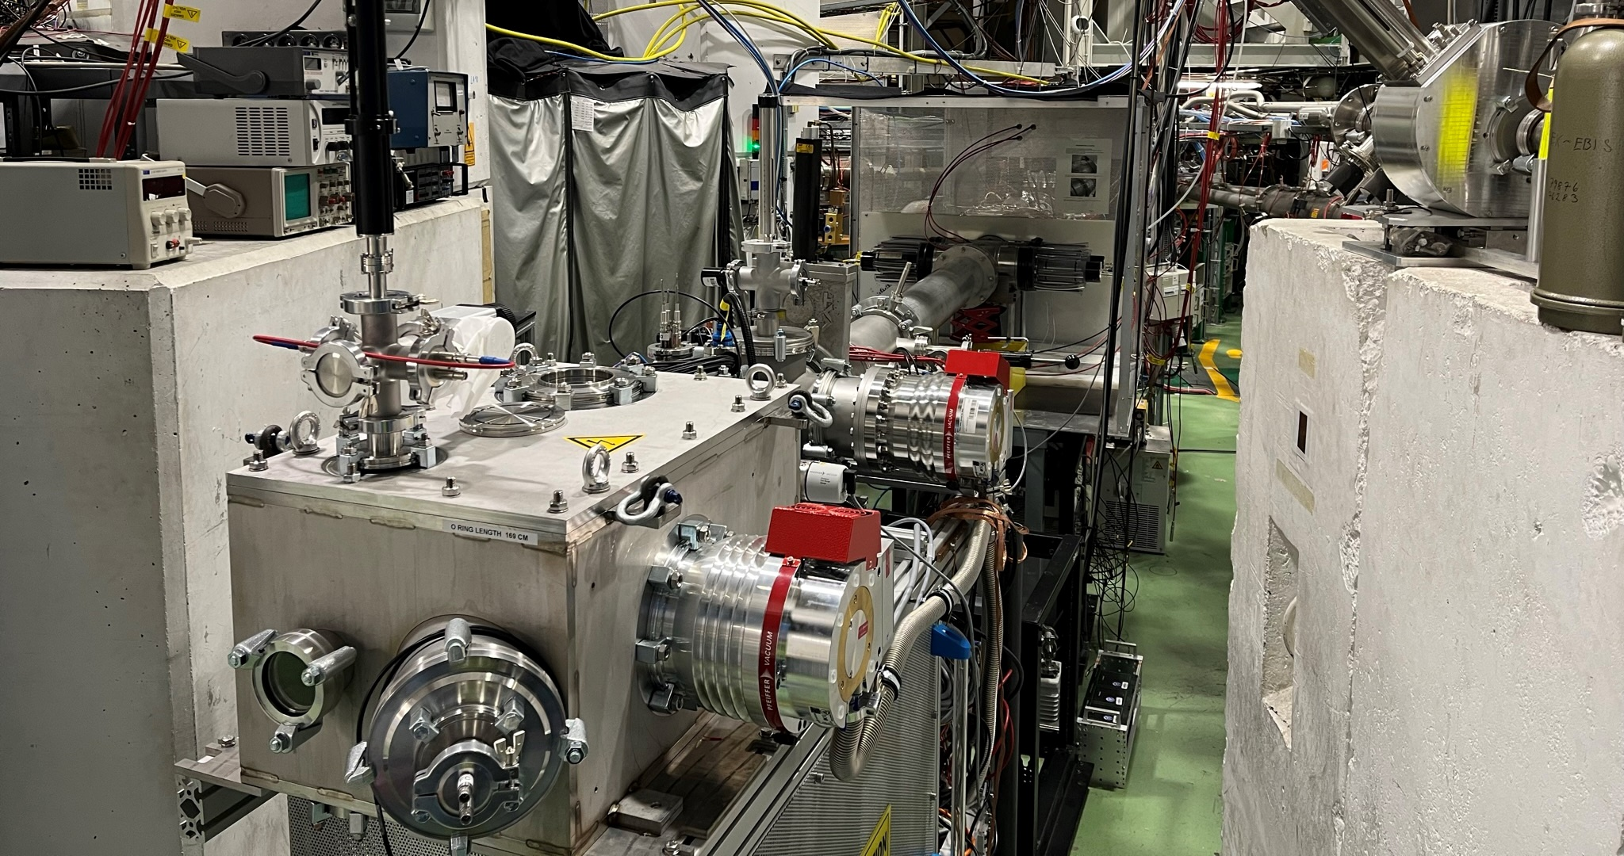
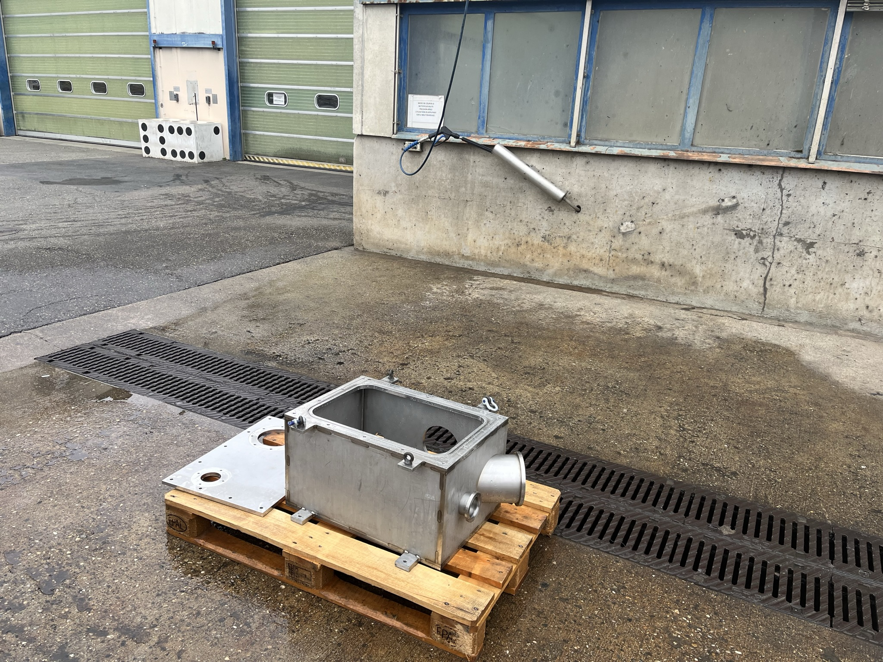
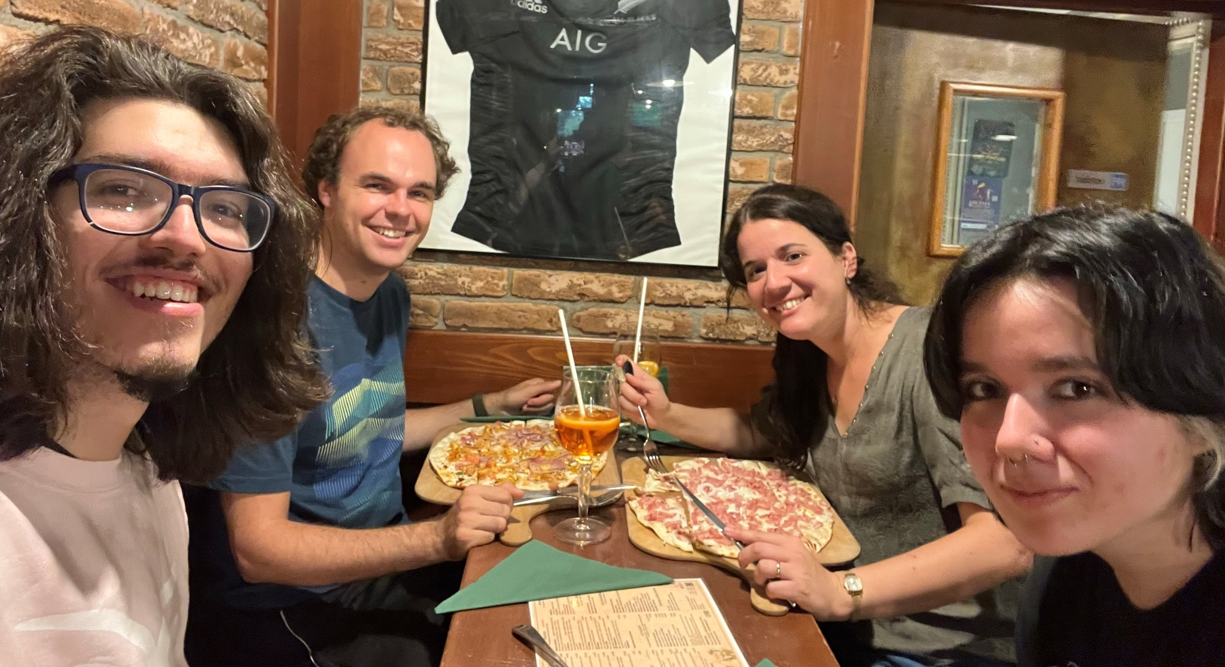
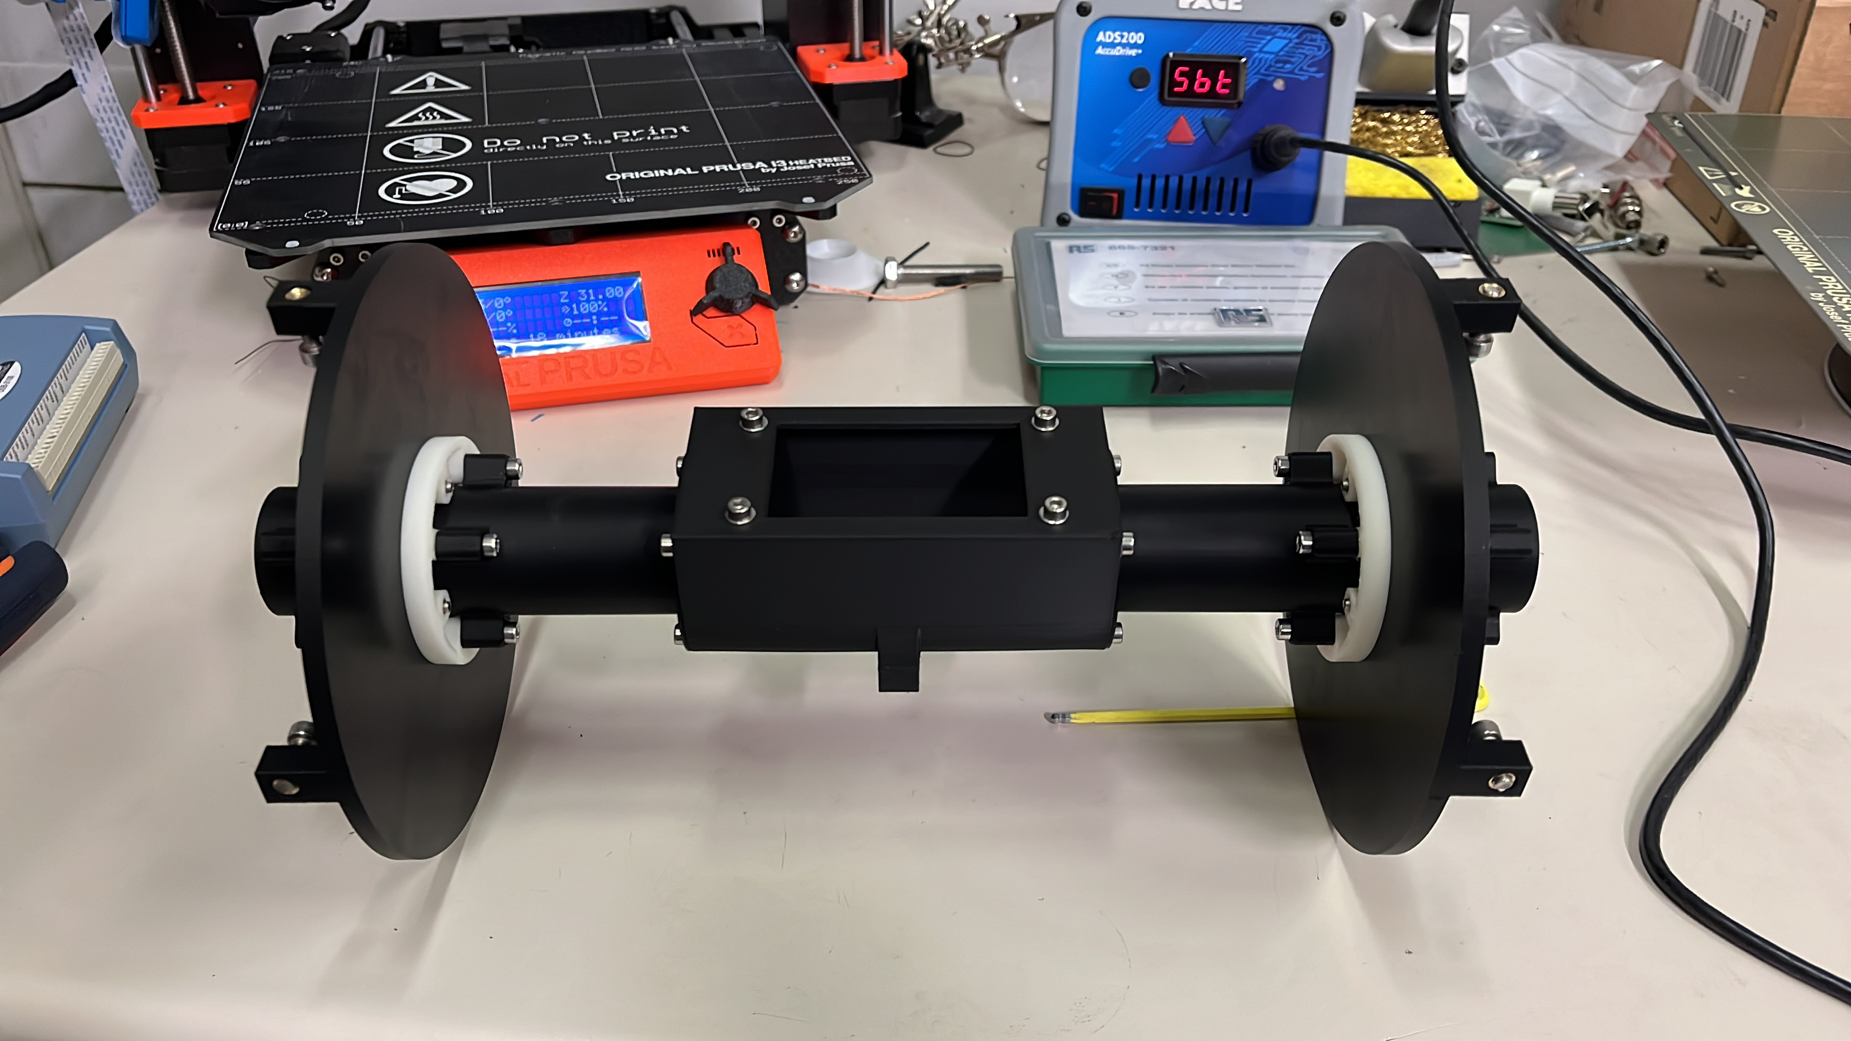
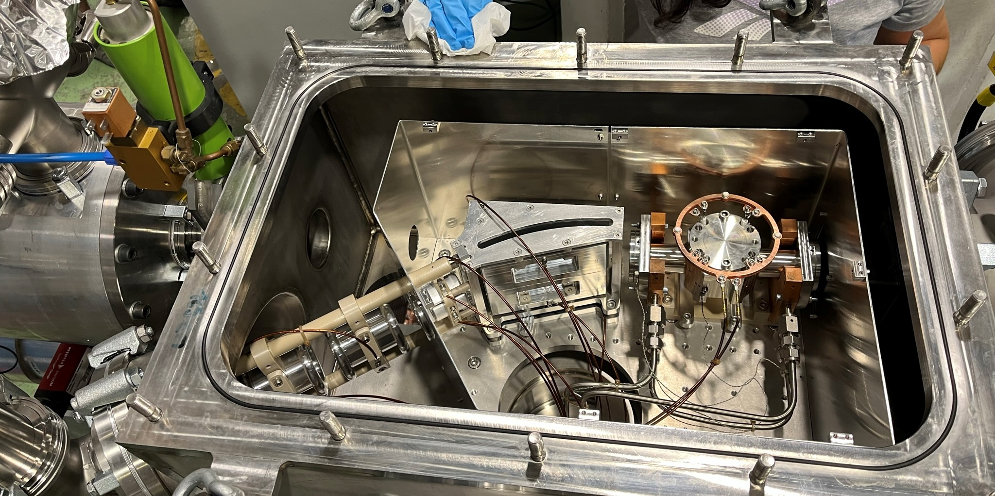
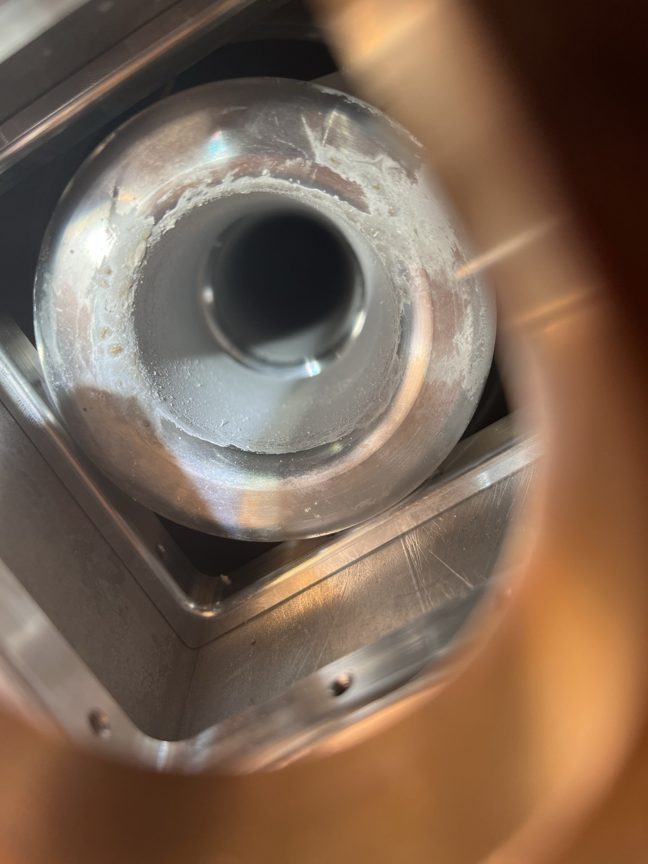
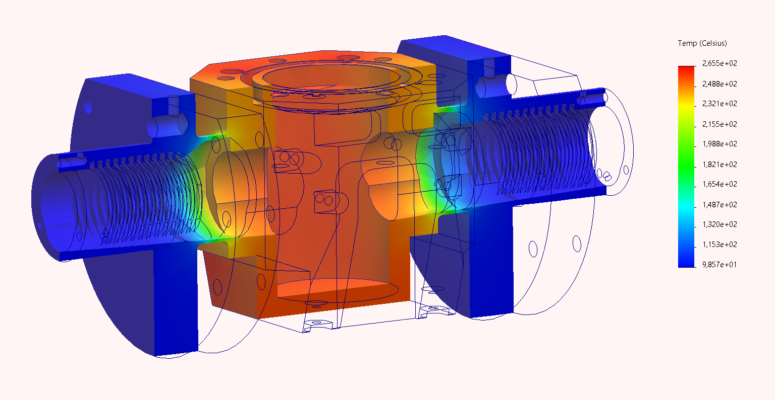
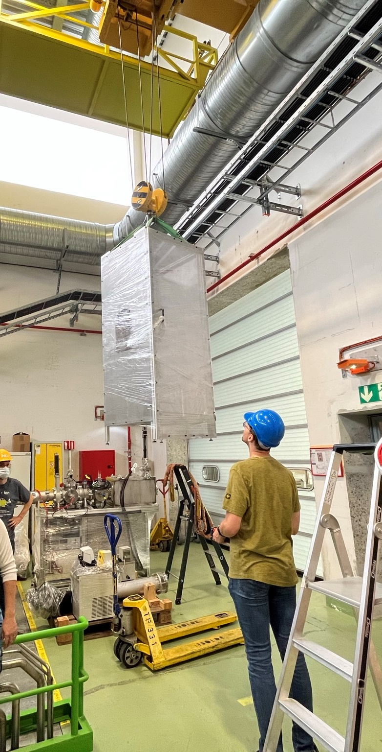
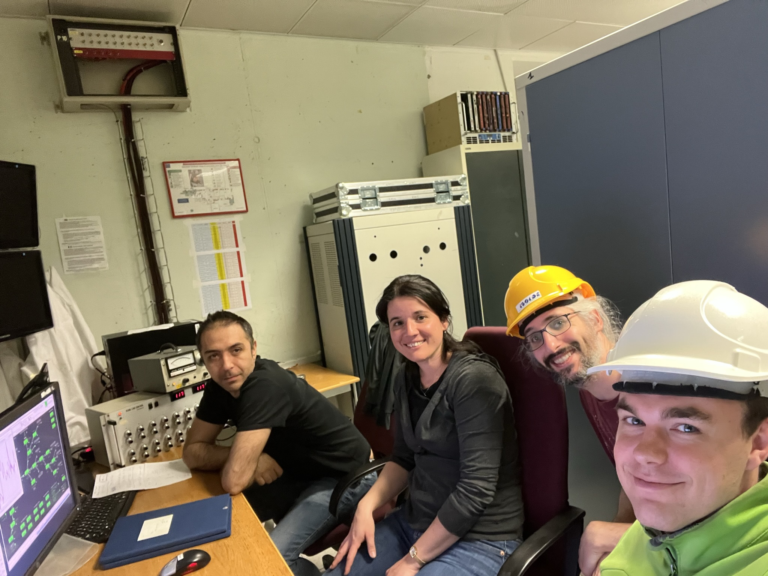
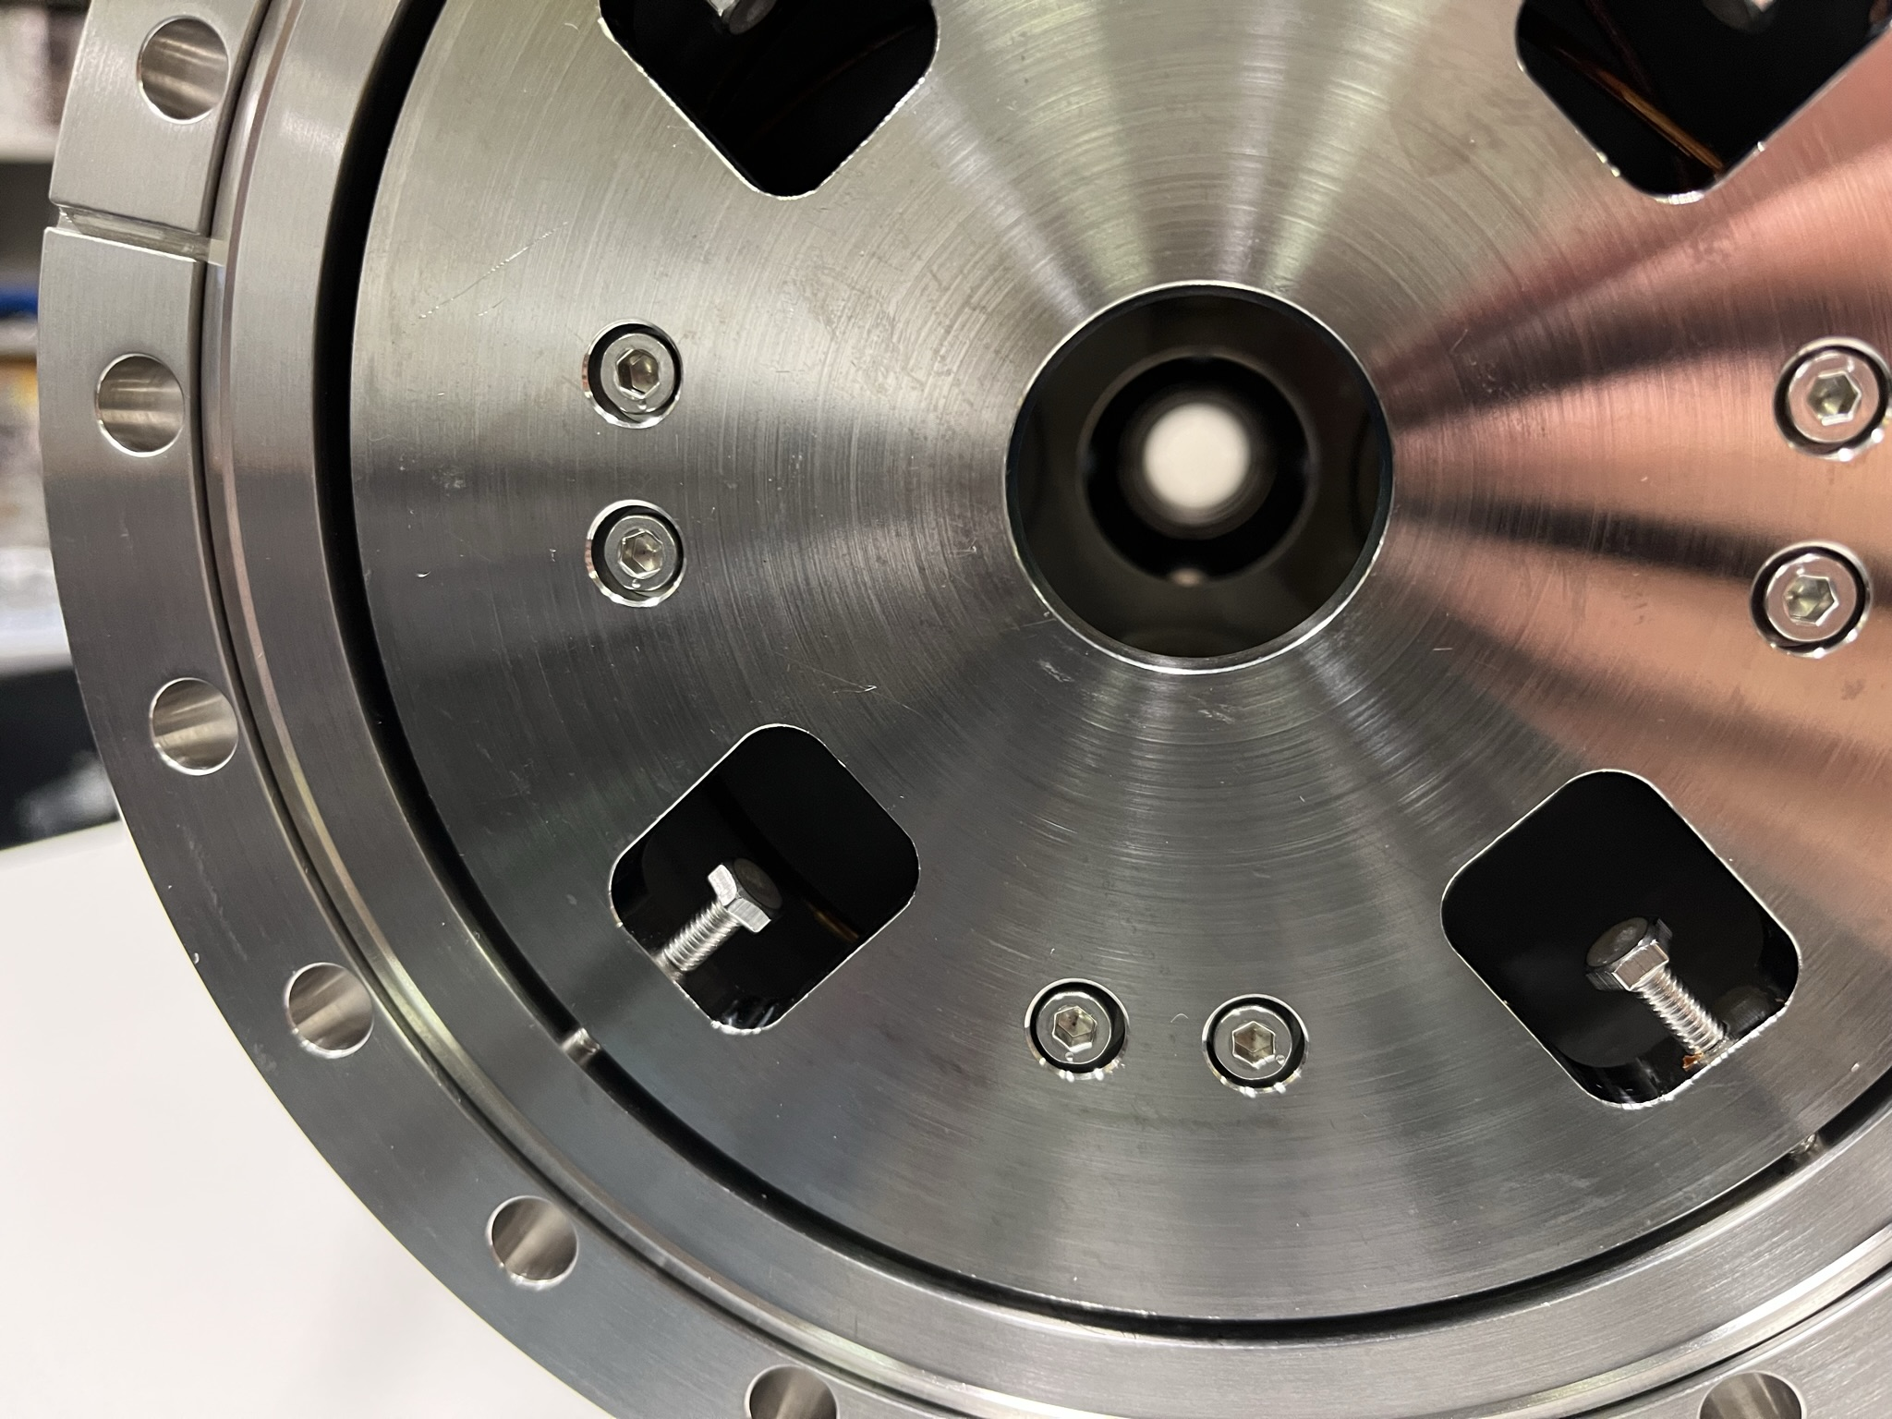
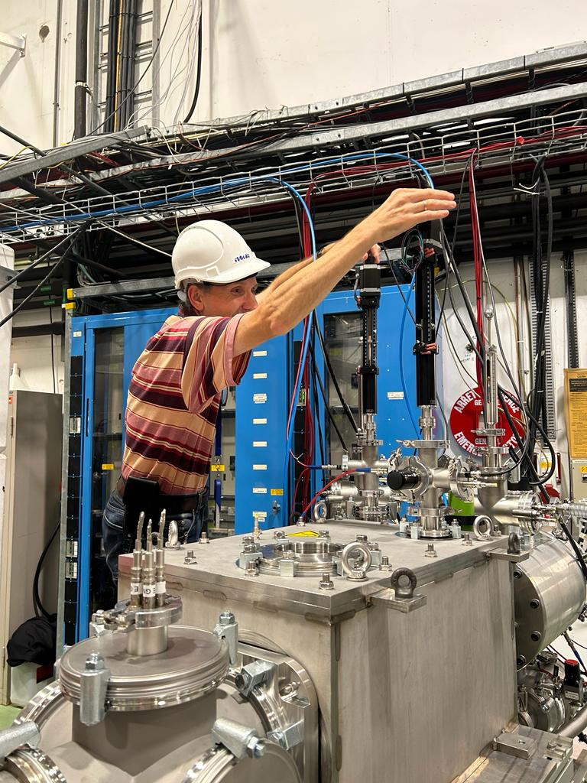
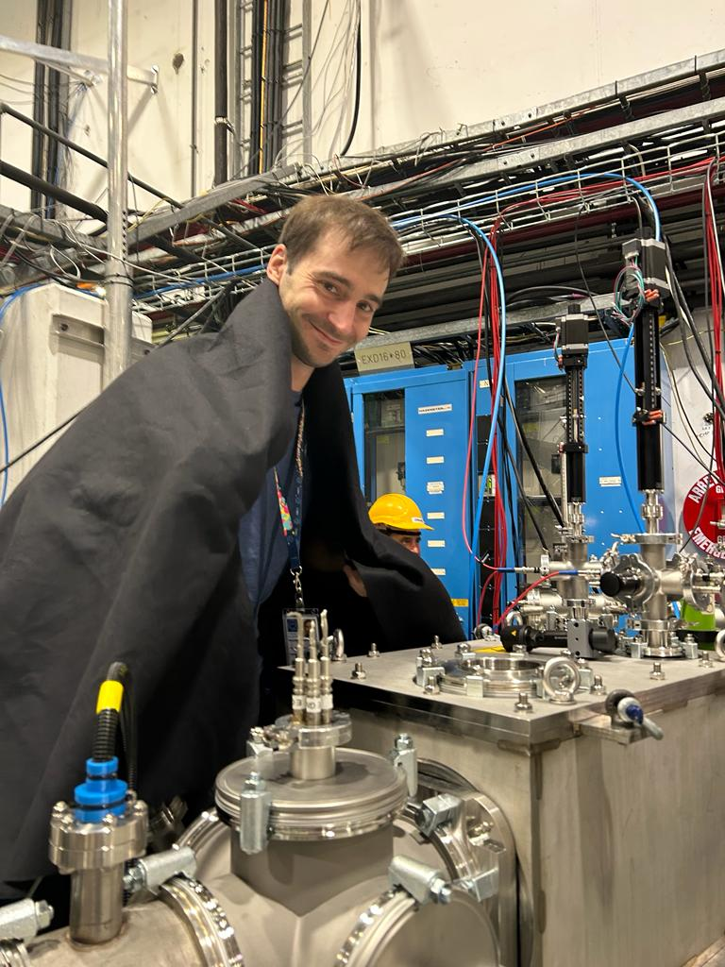
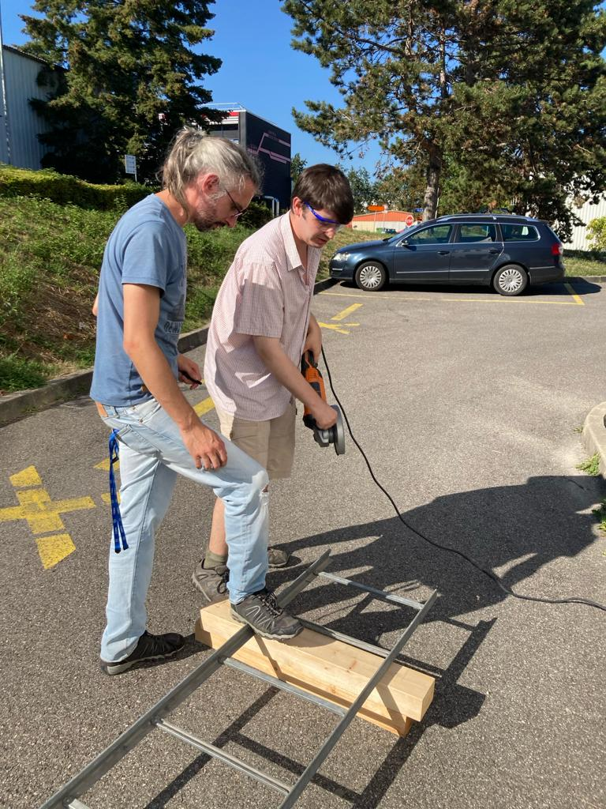
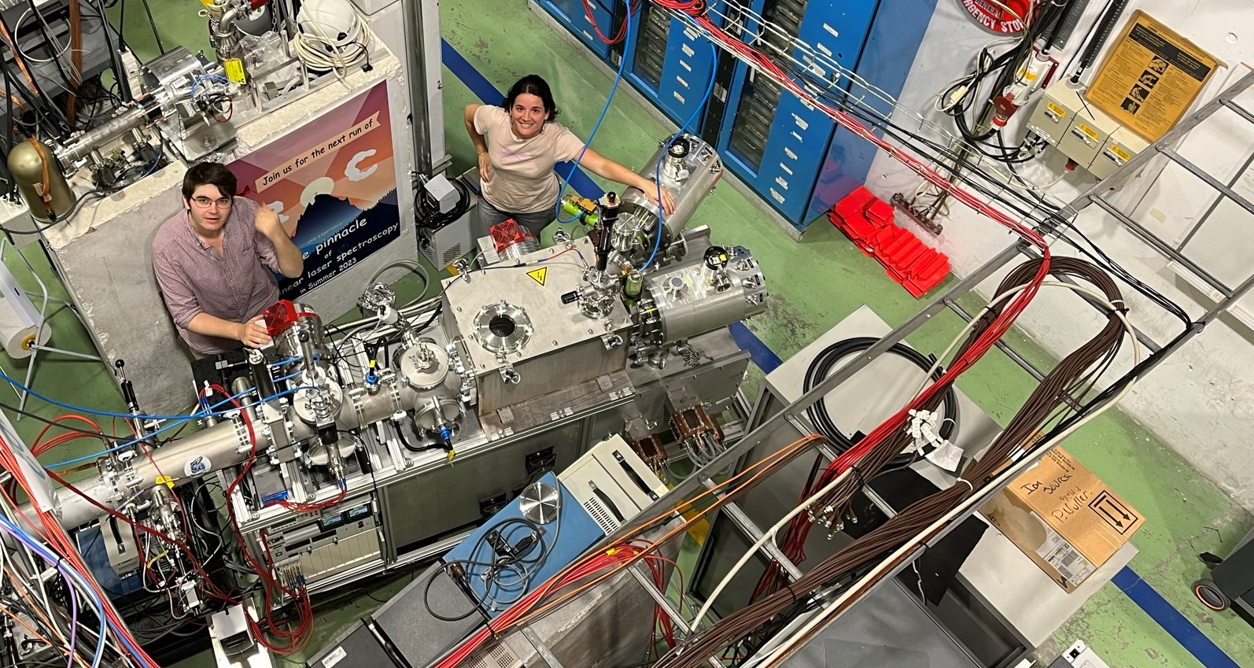
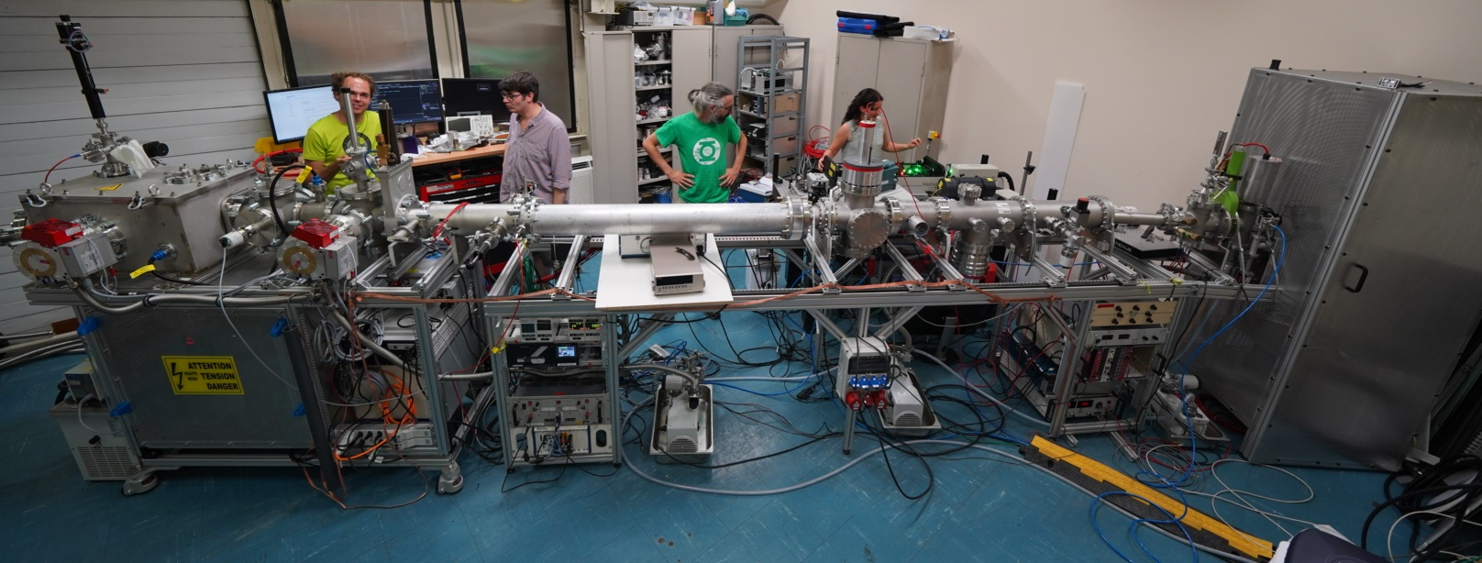
First laser spectroscopy measurements of ⁵³Ca
and the prospects of measuring ⁵⁴Ca
Tim Lellinger for the COLLAPS collaboration

Slide 3
Nuclear observables from laser spectroscopy
Bohr
(electron)
spin-orbit
QED
hyperfine structure
hyperfine structure → “nuclear signature”
number of peaks → spin
splitting of the peaks
magnetic dipole moment
electric quadrupole moment
F = 2
n = 2
2p_{3/2}
F = 1
2p_{3/2}
F = 1
2s_{1/2}
F = 0
2s_{1/2} 2p_{1/2}
F = 1
2p_{1/2}
F = 0
F = 1
fluorescence (a.u.)
n = 1
1s_{1/2}
1s_{1/2}
F = 0
x1000
frequency (GHz)

Slide 4
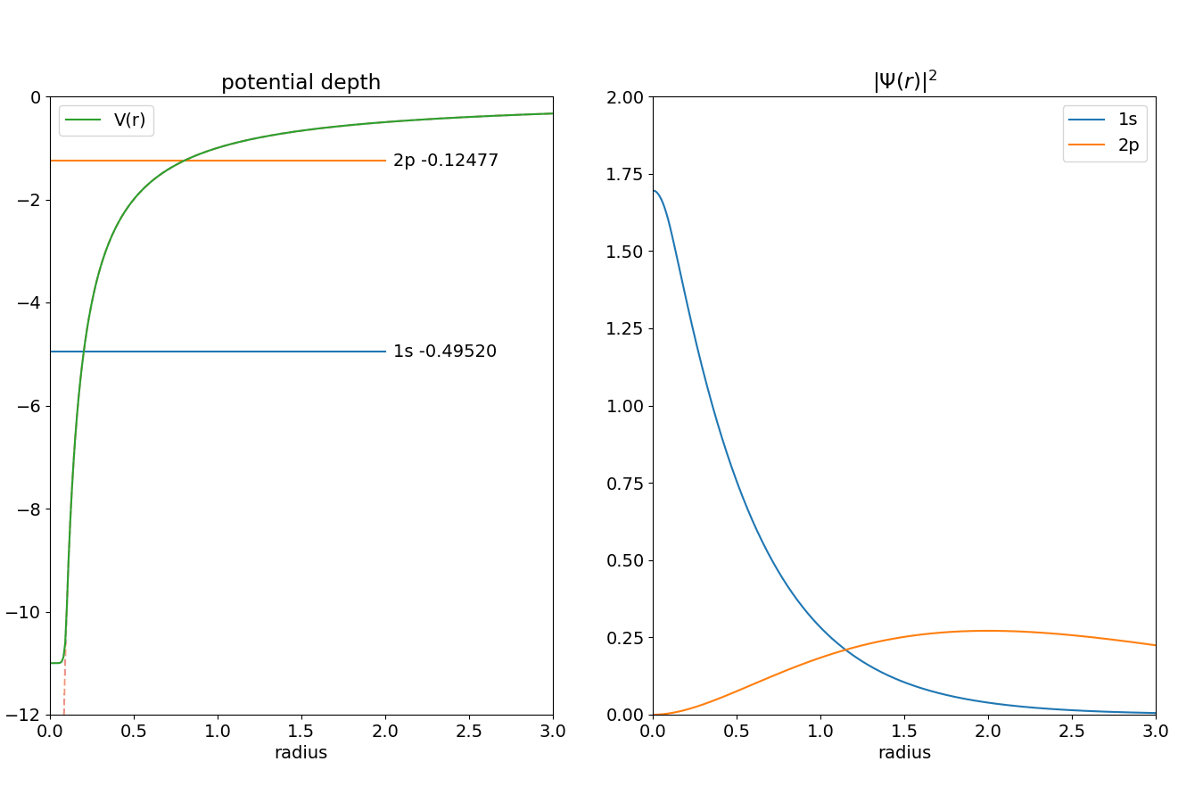
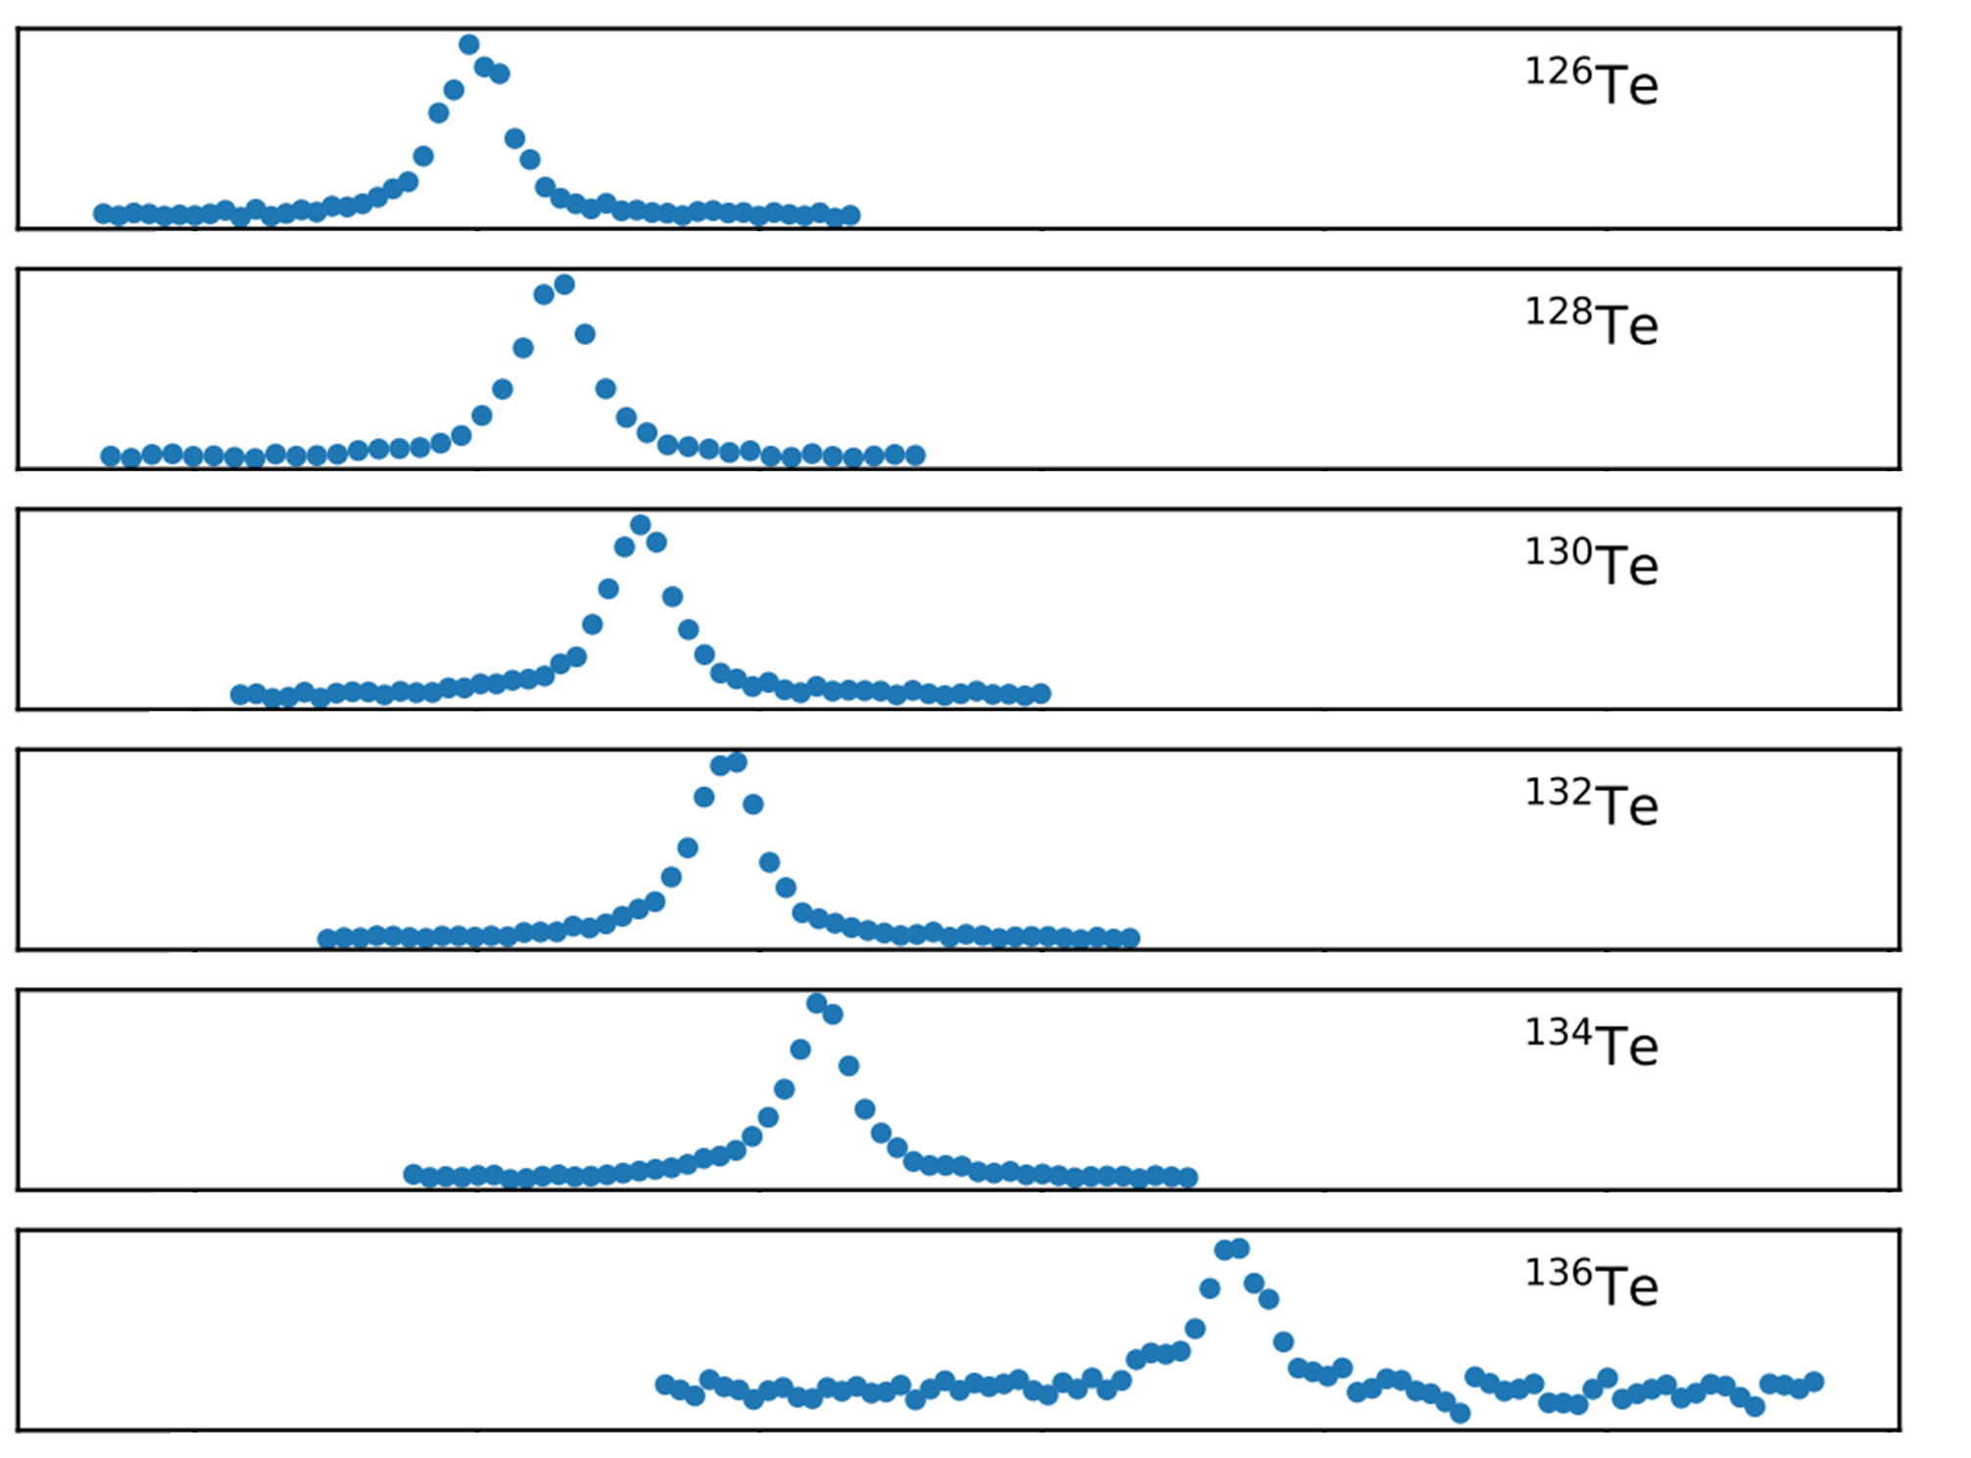
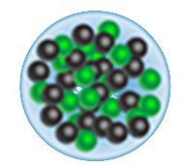
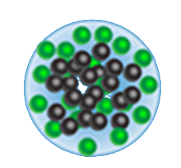
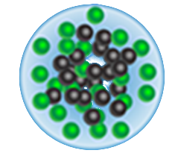
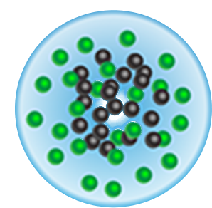
Nuclear observables from laser spectroscopy
$${δν}^{126,132}$$
electron orbitals respond differently to charge distribution of nucleus
Measure difference in charge radius from shift in resonance
All observables: Purely based on atomic physics, no nuclear theory input needed!

Slide 5
Measuring neutron rich calcium
Measure Ca across N = 32 shell (?) gap (^{53,54}Ca)
Experimental challenges for laser spectroscopy of ⁵³Ca, ⁵⁴Ca :
lifetime of 461 ms, 107 ms
yield of 20 ions/s, 2 ions/s at ISOLDE/CERN
From https://upload.wikimedia.org/wikipedia/commons/9/9d/NuclideMap.svg

Slide 6
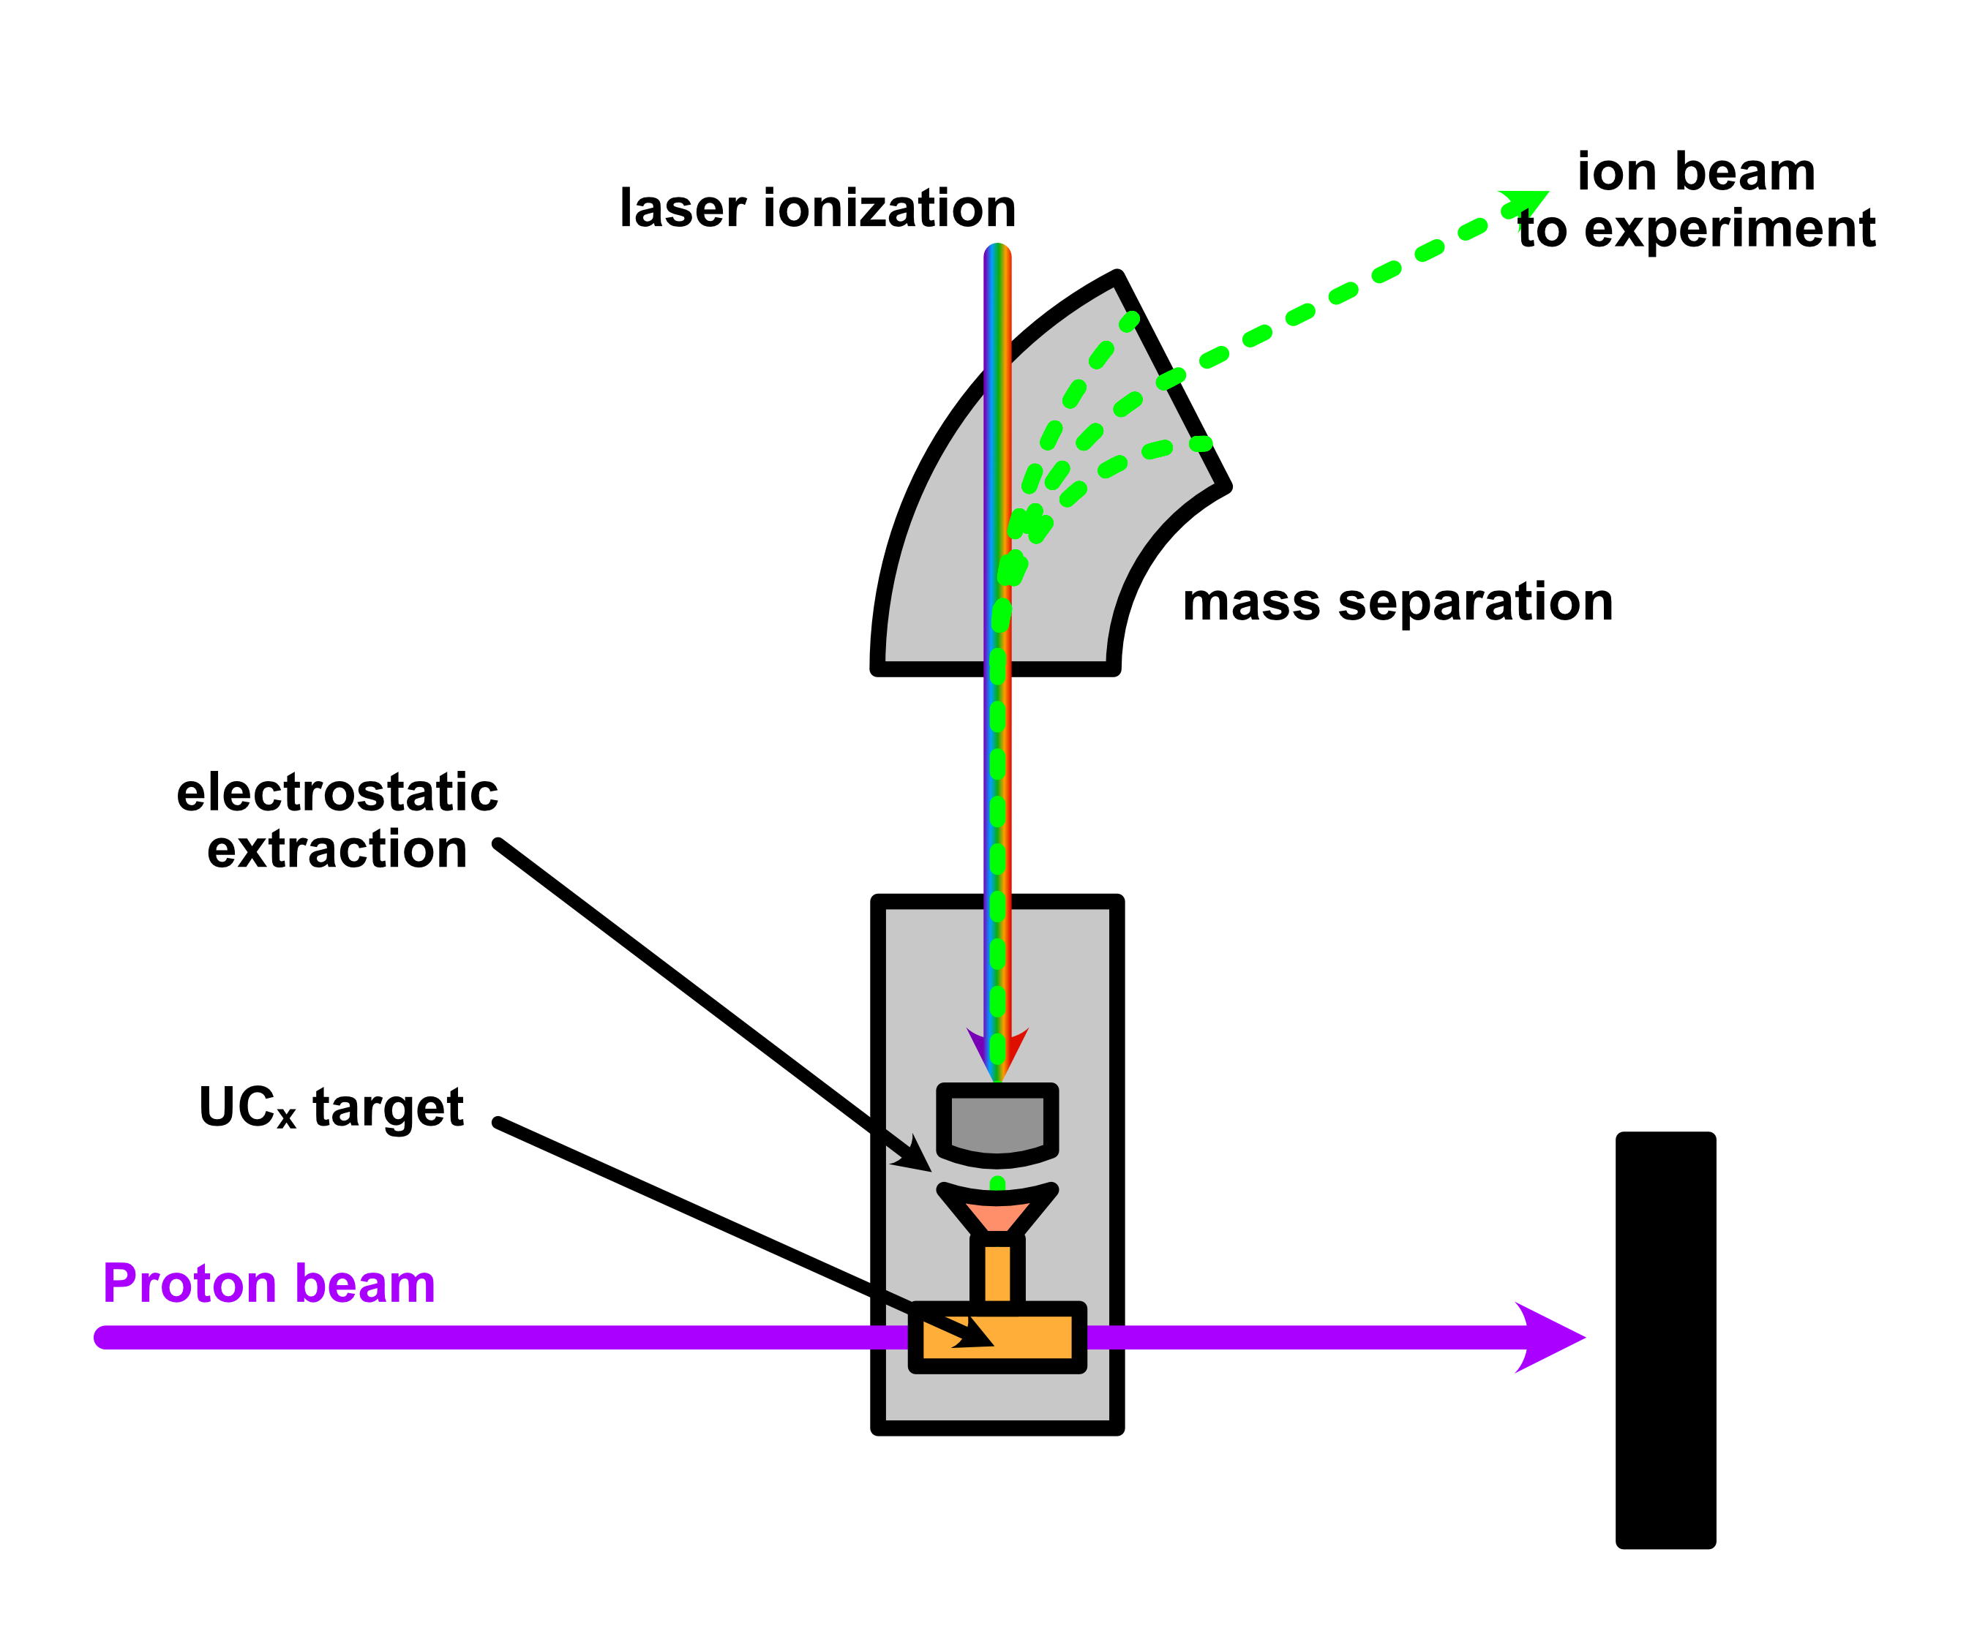
Radioactive Isotopes at ISOLDE/CERN
ISOLDE radioactive calcium ion beam production
bombard UC_{x} target with 1.4 GeV protons
(neutral) fragments are laser ionized by RILIS
ions are extracted with ≈ 30 keV beam energy
magnetic mass separation
ISOLDE @ CERN
operational since 1967
located since 1992 at the PS BOOSTER
Two target stations + separators, various target types, ion sources, etc.

Slide 7
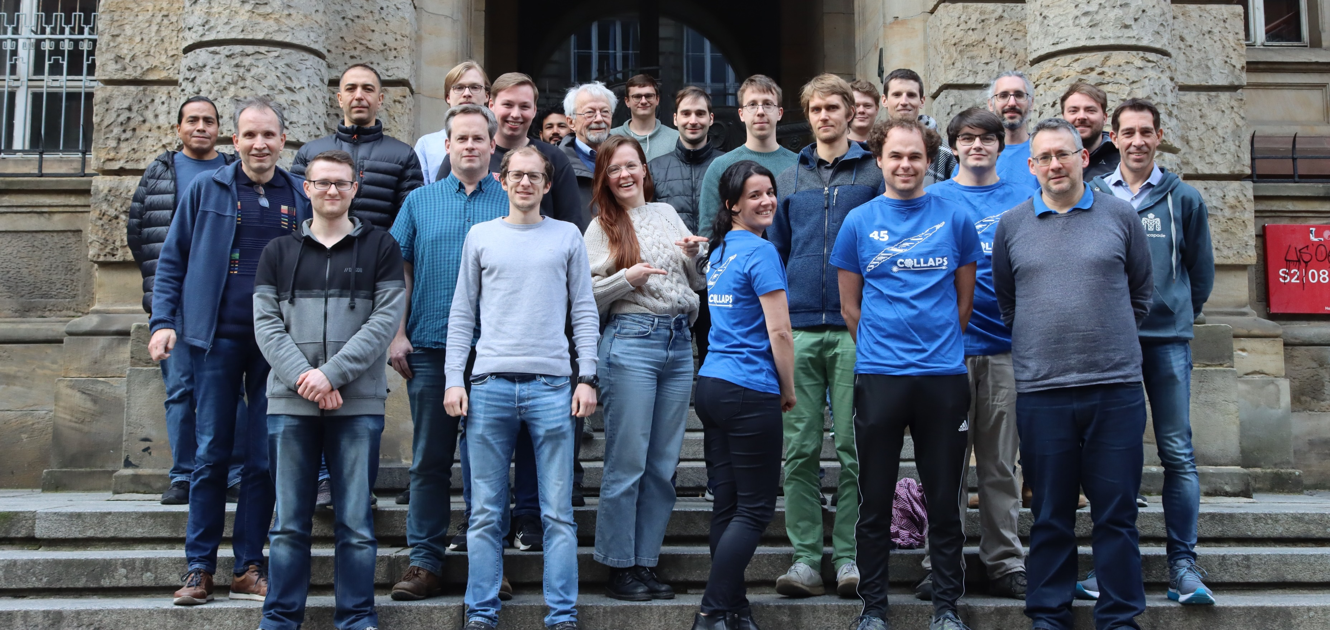
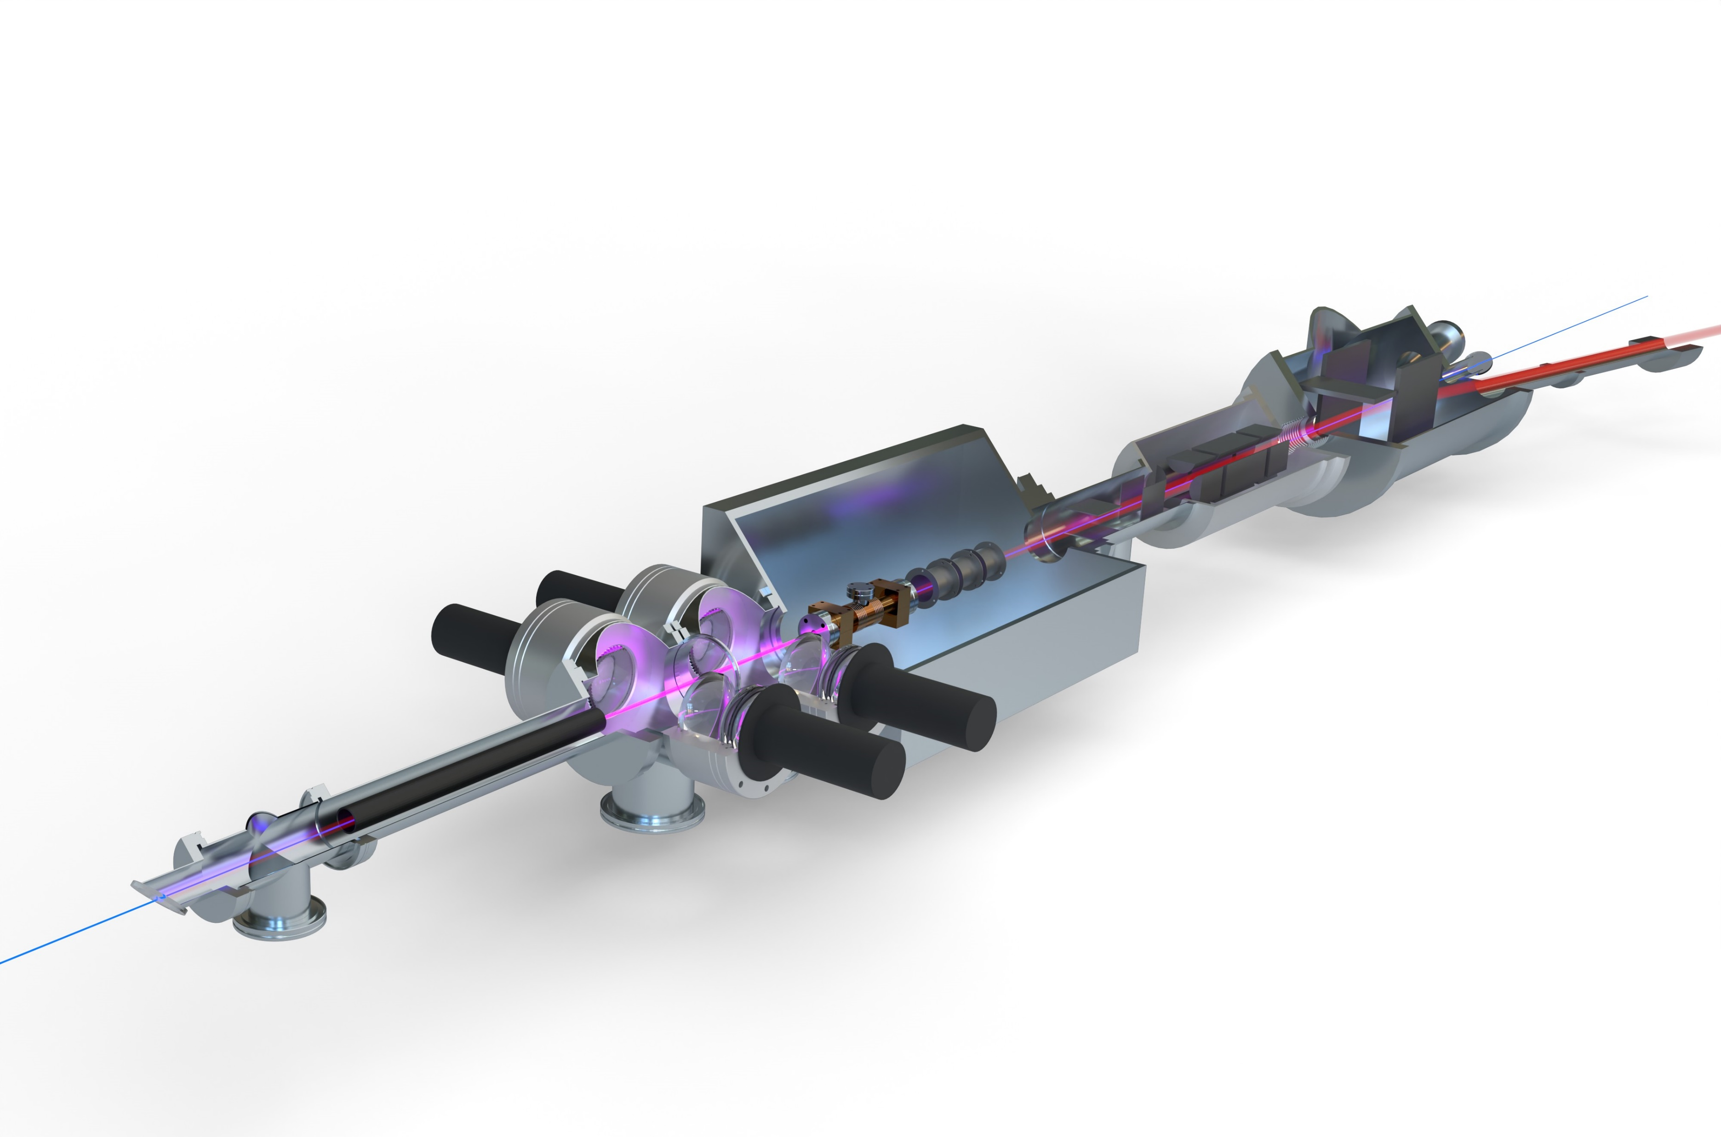
The COLLAPS experiment
Advantages:
collinear geometry → no doppler broadening, limited mostly by natural linewidth
only needs a single narrowband CW laser
insensitive to isobaric contamination
Disadvantages:
Limited by photon detection efficiency and laser stray light
Need more specialized detection setups for very rare cases like ^{53,54}Ca
ROC (radioactive detection after optical pumping and state selective charge exchange)
Collinear laser spectroscopy (CLS) on radioactive isotopes
operating since 45 years…
Measurement principle:
Overlap laser beam and ion bunch collinearly
Focus ion bunch into optical detection
Scan beam energy → scan transition frequency
(opt.) neutralize ion bunch via charge exchange
Measure fluorescence in optical detection
Ion beam correction & focus
laser beam
optical detection
ISCOOL
bunches
laser-ion overlap
charge exchange & beam energy scanning

Slide 8
The ROC method
Relevant Ca II level scheme
Idea: Exploit electronic structure of Ca II
Use laser to excite S→P transition
If laser on resonance, electron will be permanently “pumped” to D-states
Then: detect electronic state change to find out if laser was on resonance
High efficiency because of particle detection while still retaining the advantages of CLS
P_{3/2}
𝜈 = 393 nm
D_{J}
forbidden
S_{1/2}

Slide 9
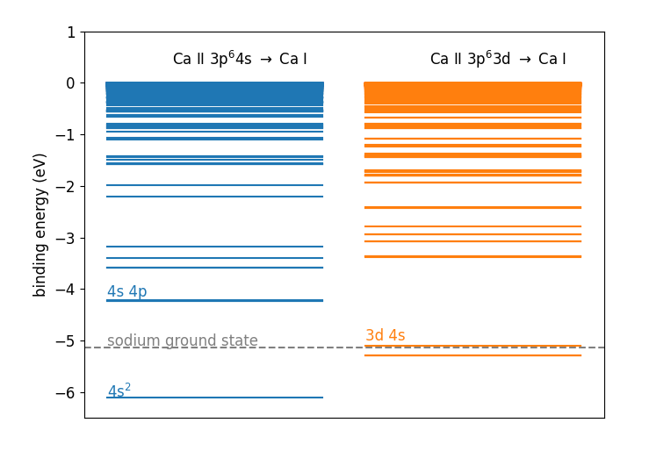
Charge exchange as an electronic state detector
Reaction: Ca II + Na I → Ca I + Na II + ΔE
→ Possible final states in Ca I depend on initial ionic state!
P_{3/2}
𝜈 = 393 nm
D_{J}
forbidden
3d-state is “quasi-resonant” with the sodium ground state!
➔ will have a higher reaction cross section
S_{1/2}

Slide 10
Charge exchange as an electronic state detector
Minimal ROC setup
ISOLDE beam
laser interaction region
deflector
residual ions
particle
detectors
Laser beam
neutralized beam
charge
exchange cell
deflector

Slide 11
Charge exchange as an electronic state detector
laser interaction region
deflector
residual ions
ISOLDE beam
neutralized beam
Laser beam
Na charge
exchange cell
deflector
deflector
Improvements:
Additional deflector so that the laser beam doesn’t hit the neutral particle detector
Move to decay detection to eliminate stable beam contamination

Slide 12
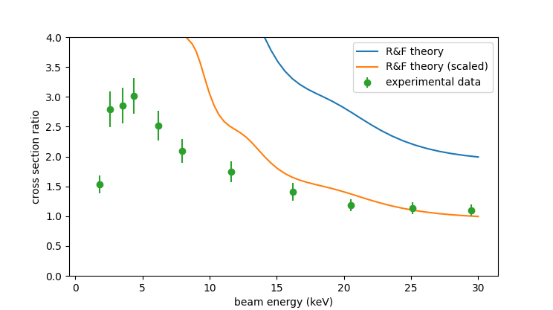
Charge exchange as an electronic state detector
All components
HV cage
laser interaction region
deflector
residual ions
ISOLDE beam
decelerator
neutralized beam
Laser beam
Na charge
exchange cell
deflector
deflector
Charge exchange cross section only different at low beam energies!
Decelerate the beam, then perform charge exchange at 4 keV
CEC needs to be on HV platform!
HV section also needs to be short, since neutralized beam can’t be refocussed
➔ Principal engineering challenge of the technique

Slide 13
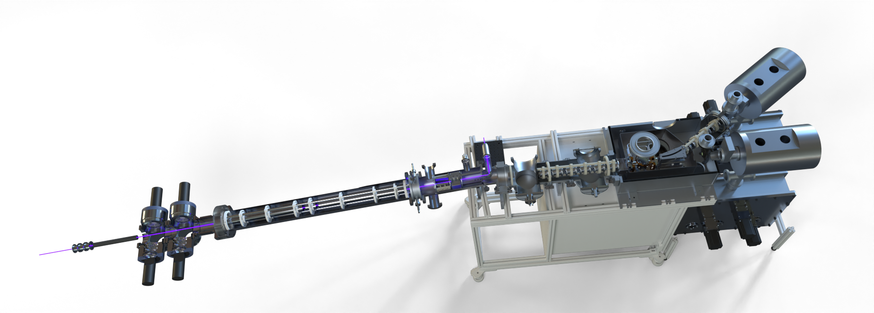
Real setup and beamtime summary
β-detection
Took ISOLDE beam from 27th of September to 2nd of October
Went well considering it is a brand-new setup
new ion optics
new beam diagnostics
new data acquisition
new tape stations
etc…
Some problems with the CEC/HV limited the sensitivity
Measured ⁵²Ca as a “sanity check” (≈ 200 ions/s)
Then measured ⁵³Ca (≈ 20 ions/s)
accelerator
charge exchange
optical interaction
HV cage
5° bender
decelerator
35° bender
COLLAPS OD

Slide 14
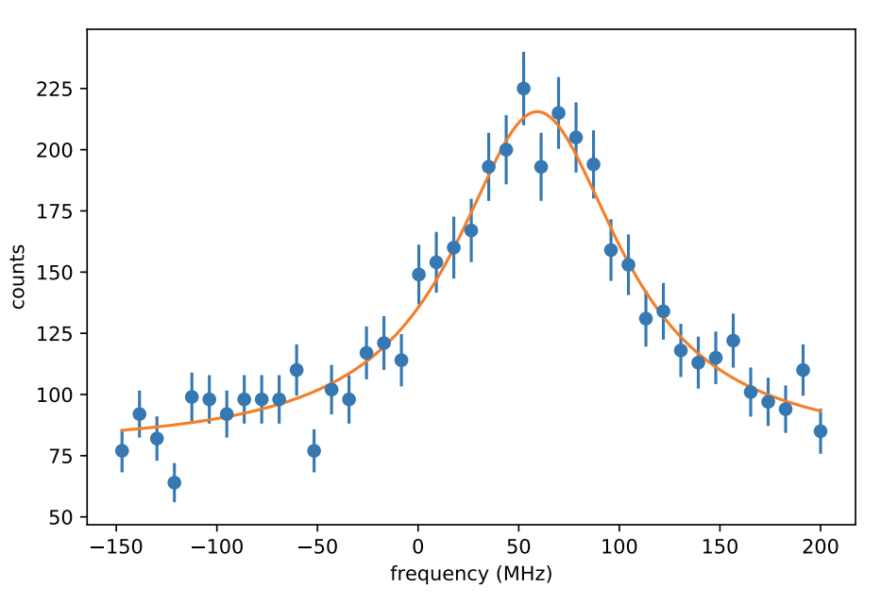
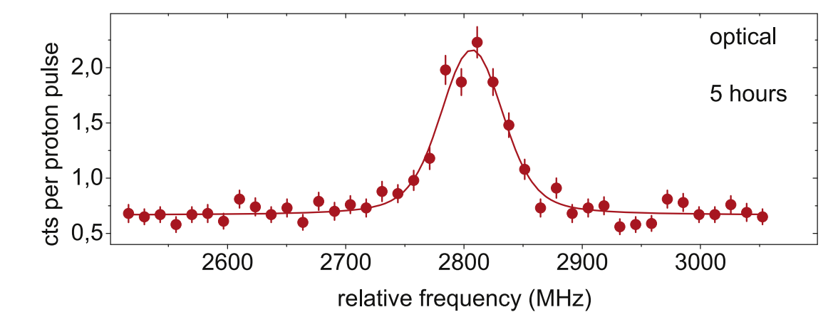
⁵²Ca – the most exotic test case
≈ 200 ions/s yield
statistics of about 40 minutes
100 MHz linewidth
R F Garcia Ruiz et al, Development of a sensitive setup for laser spectroscopy studies of very exotic calcium isotopes
Isotope shift consistent with previous COLLAPS measurement
Reduced measurement time by 8x compared to fluorescence detection!

Slide 15
⁵³Ca: ROC with hyperfine splitting
Population transfer not only to the D-states but also between the lower hyperfine states!
No efficient population transfer possible
Solution: Sequential multi-step pumping
Split up optical interaction region
P_{3/2}
F = 2
F = 1
D_{J}
𝜈 = 393 nm
S_{1/2}
F = 1
F = 0
F = 0,1 → F = 1
F = 1 → F = 2

Slide 16
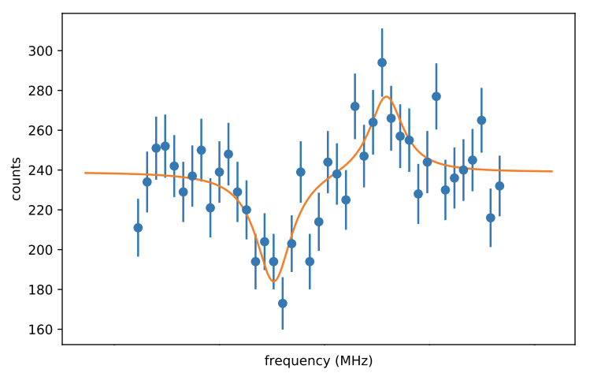
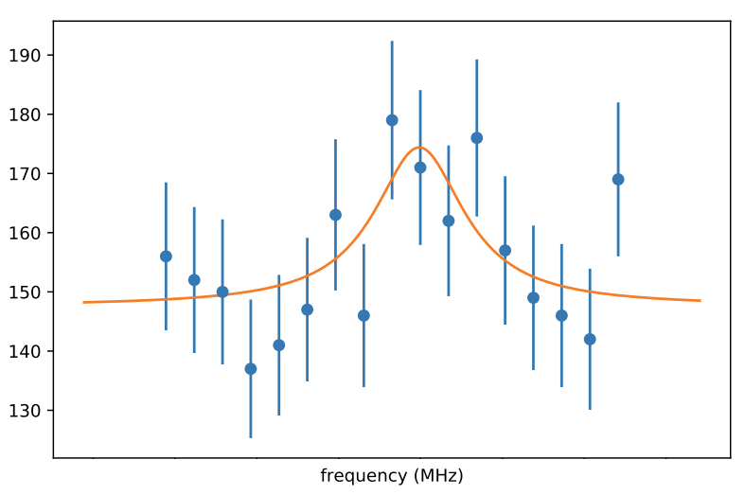
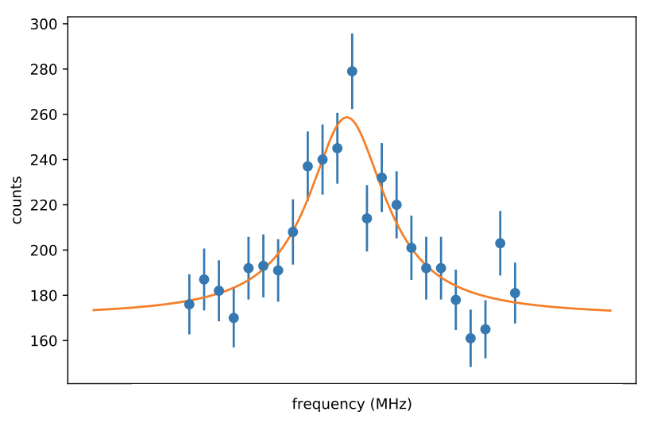
⁵³Ca: ROC with hyperfine splitting
F = 0 → F = 1
F = 1 → F = 2
F = 1 → F = 2
P_{3/2}
F = 2
F = 1
D_{J}
S_{1/2}
F = 1
F = 1 → F = 1
F = 0
Optical interaction region configuration
F = 1 → F = 2
F = 0 → F = 1
F = 1 → F = 2
(fixed on resonance)
F = 1 → F = 2
F = 1 → F = 1

Slide 17
⁵³Ca – spin and magnetic moment
This plot contained unpublished data and was therefore removed
unambiguous spin assignment I = ½
determine mag. moment from hyperfine splitting
Excellent theory prediction (deviated <5%)*
single-particle like? In between ⁴¹Ca and ⁴⁹Ca…
* https://arxiv.org/pdf/2311.14383.pdf

Slide 18
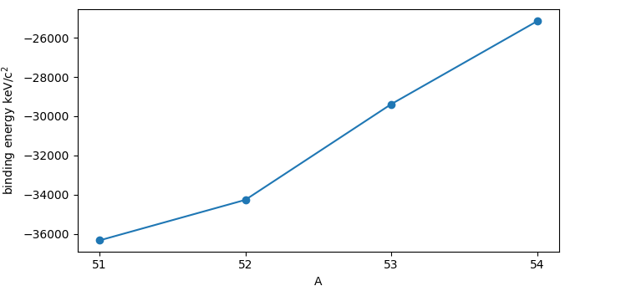
⁵³Ca – charge radius
comparison: binding energy
This plot contained unpublished data and was therefore removed
⁵²Ca was “unexpectedly large”
Seems to flatten out compared to ^{51,52}Ca
Could also be large odd-even staggering
See N = 20 vs. N = 28
Need ⁵⁴Ca to make conclusions
With data from:
R. F. Garcia Ruiz et al., Unexpectedly large charge radii of neutron-rich calcium isotopes
Á. Koszorús et al., Charge radii of exotic potassium isotopes challenge nuclear theory and the magic character of N = 32
H. Heylen et al. Changes in nuclear structure along the Mn isotopic chain studied via charge radii
F. Wienholz et al. Masses of exotic calcium isotopes pin down nuclear forces

Slide 19
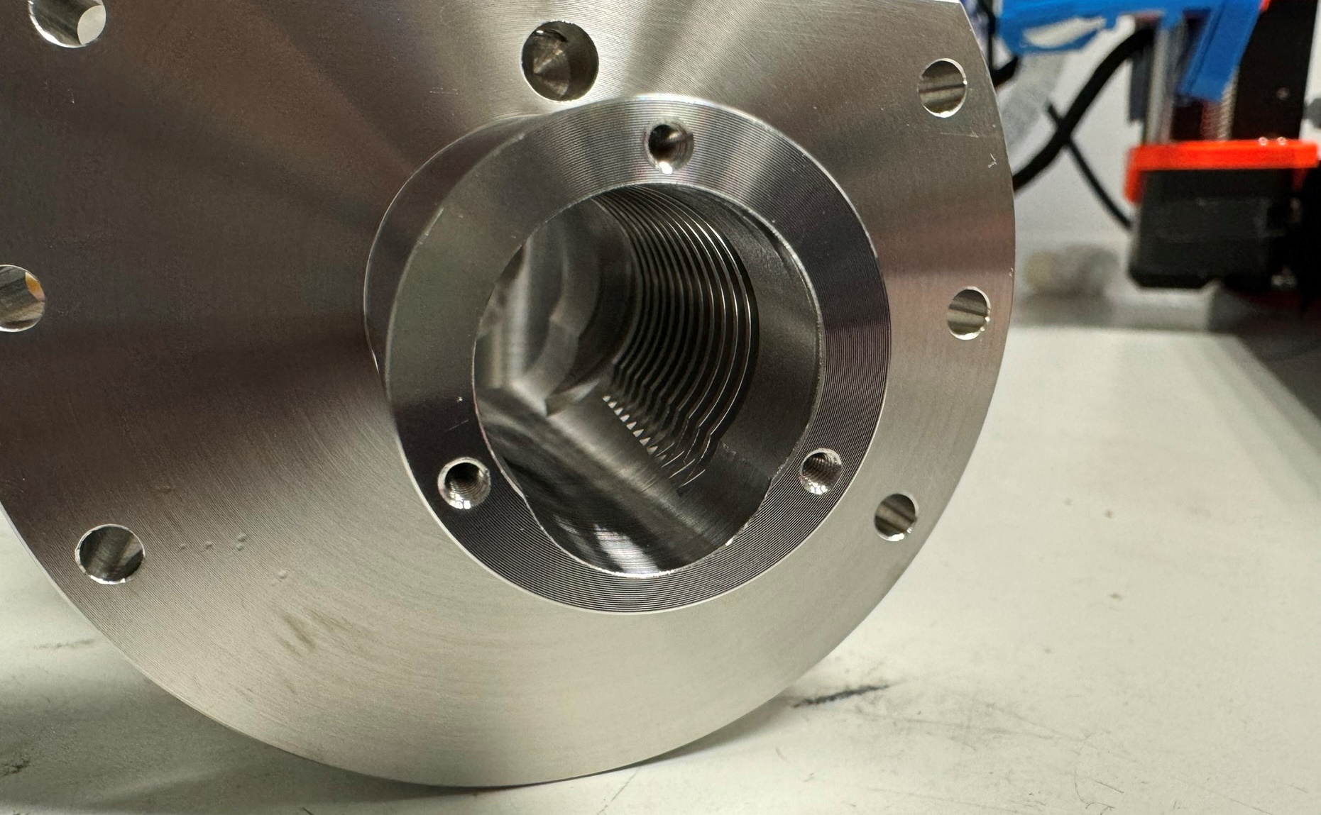
Prospects of measuring ⁵⁴Ca and future
new CEC design
Priority one: fix CEC & HV problems
…already some ideas, currently in testing
measure ⁵⁴Ca hopefully later this year!
Post ⁵⁴Ca:
Sr, Ba, Ra are all straightforward → ⁷⁶Sr
Other elements need more work/testing

Slide 20
Thank you
Advertisement:
Laser spectroscopy in the ruthenium isotopic chain, Wednesday 16:15, HK 42.3
Collinear Laser Spectroscopy of ¹⁵⁵ ⁻ ¹⁷⁵Tm+, Wednesday 17:00, HK 42.6
Transition frequency measurements in ⁴⁶⁻⁵⁰Ti+ of astrophysical interest at COALA, Thursday 17:00 HK 62.5
Posters HK 72.28, HK 72.48, HK 72.55 about technical developments at the COALA beamline
Plenary talk about laser spectroscopy of radioactive isotopes on Friday, 09:00

Slide 21
Leftover slides – proceed at own risk

Slide 22
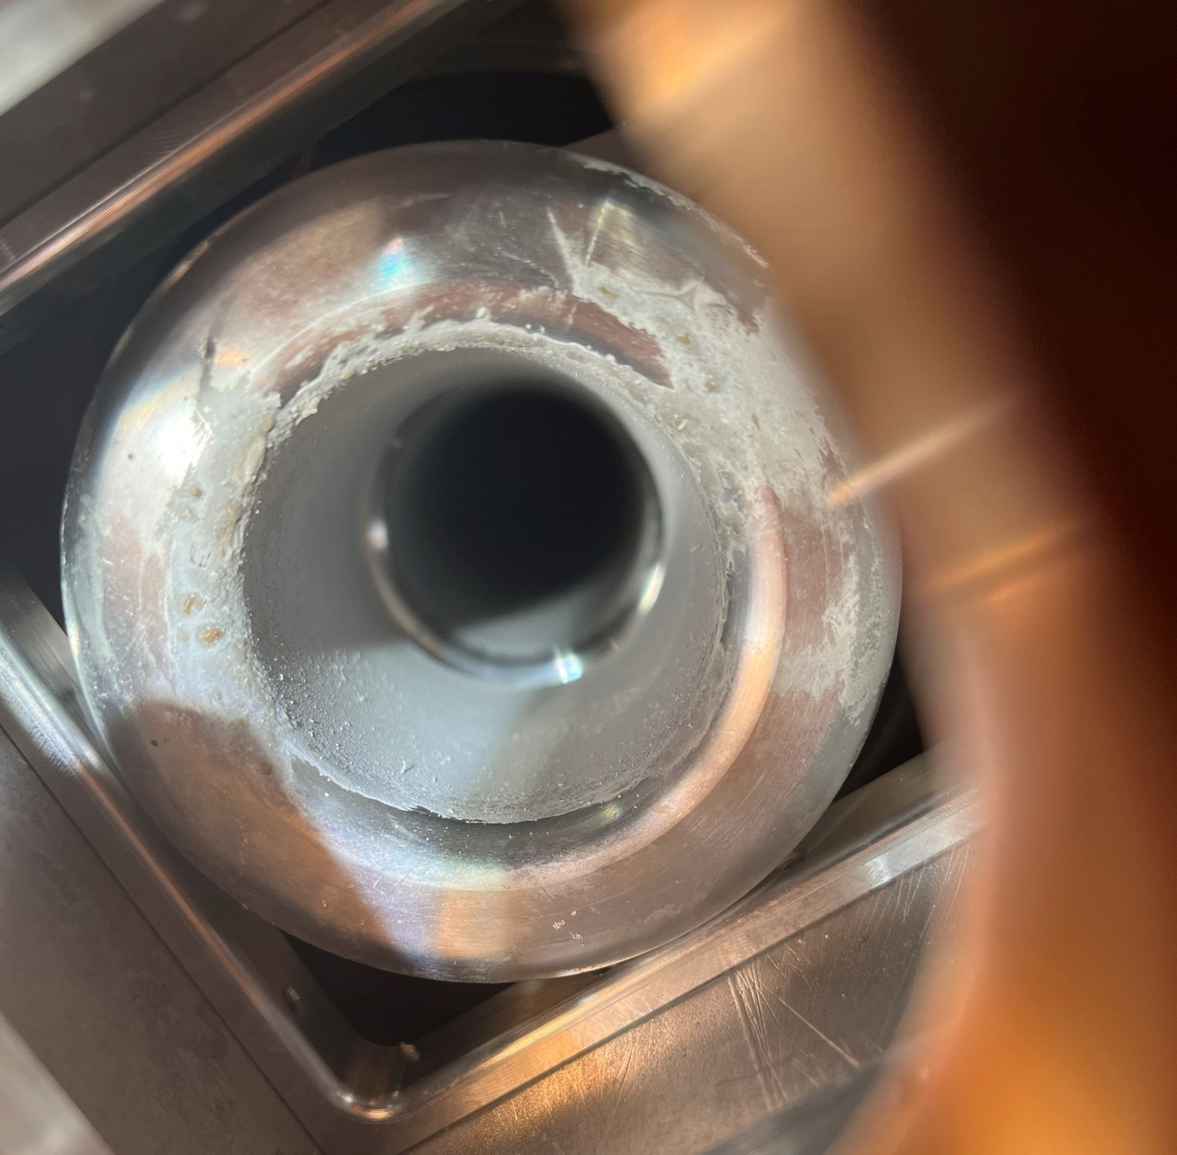
CEC troubles

