Slide 1
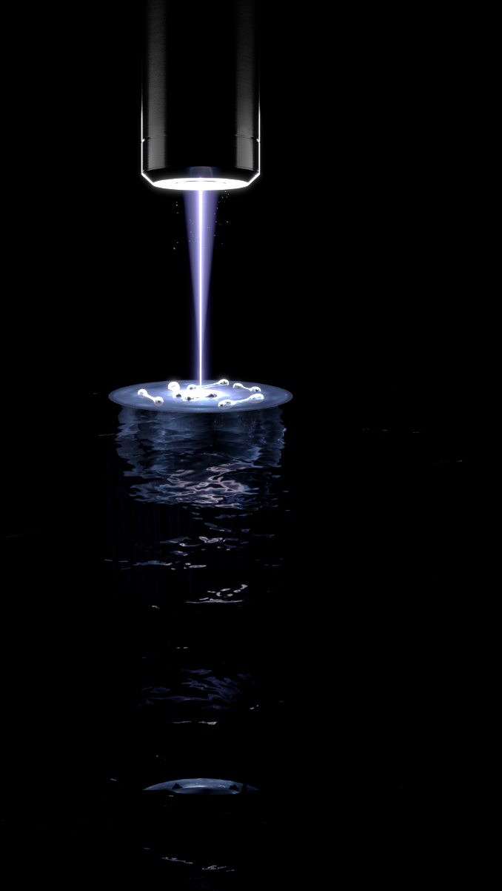

Observing the emergence of elliptic flow
Sandra Brandstetter
Selim Jochim Group
Art by Jonas Ahlstedt / Lund Bioimaging Centre (LIBC)

Slide 2

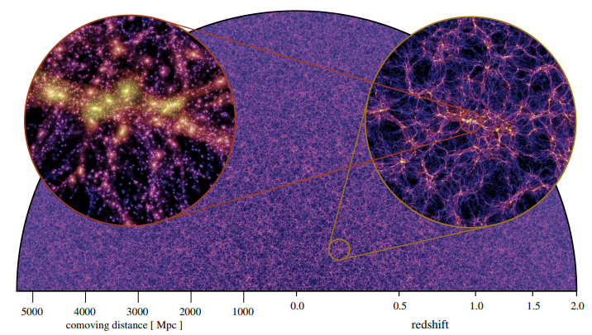
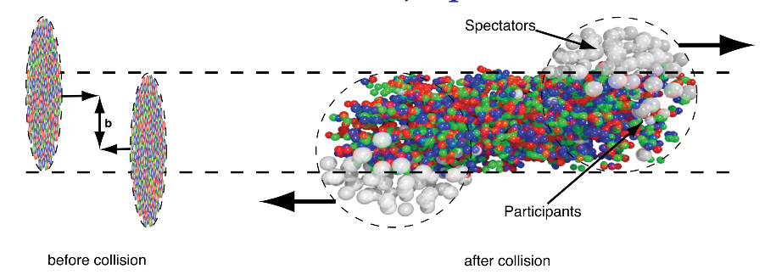
What is a fluid?
Size
R. Snellings, New Journal of Physics 13 (2011) 055008
https://arxiv.org/abs/2210.10059
Continuous medium
Separation of scales

Slide 3
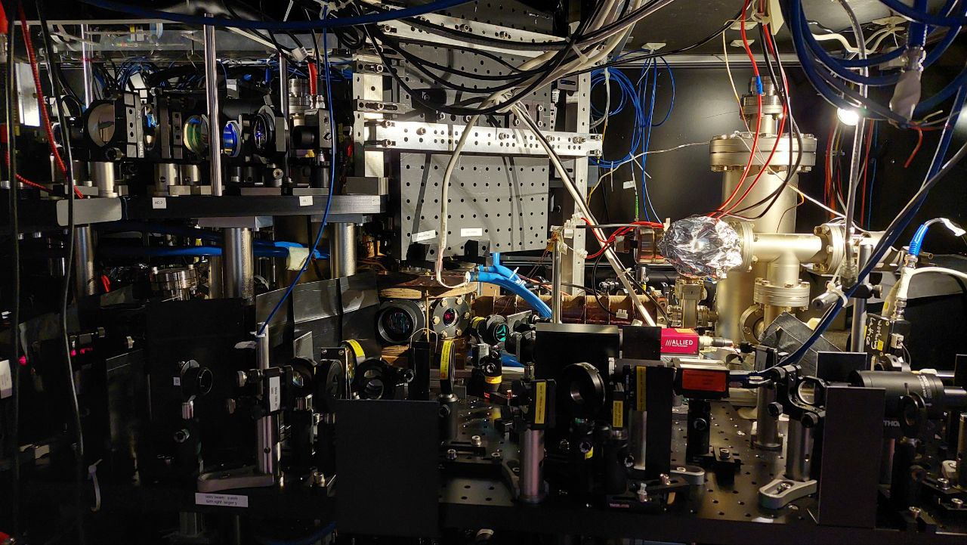
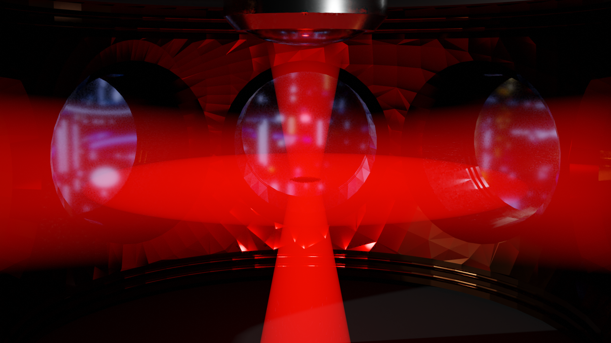
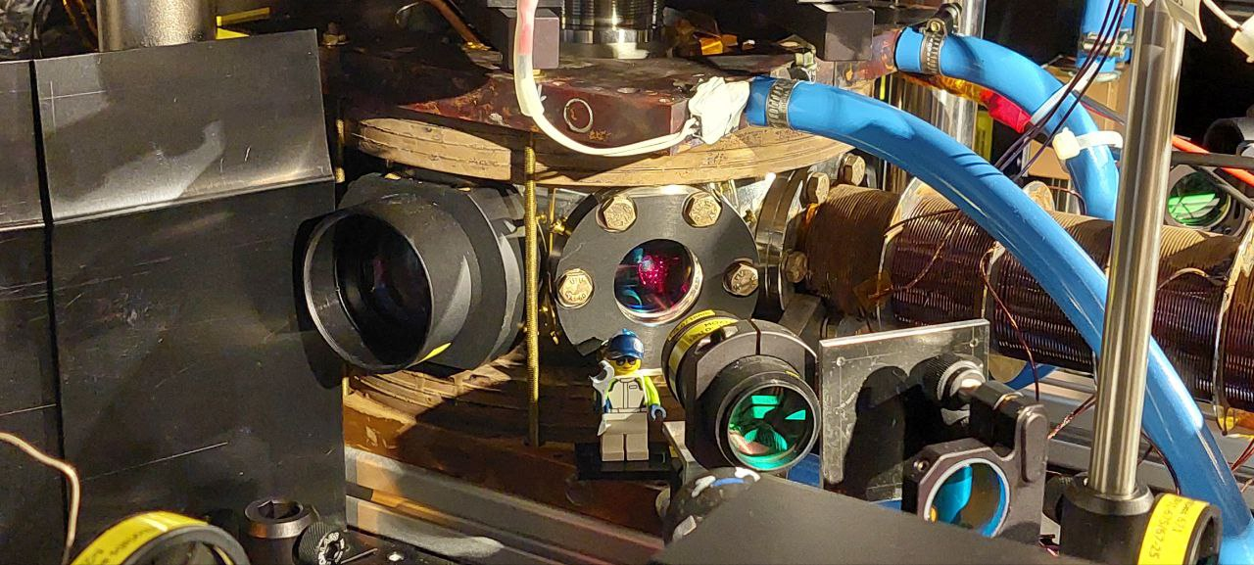
.
Tweezer
2D trap
Notes:
Normal experimental cycle – Oven ZSL MOT ODT -
Start out with equal mixture of 2 spin states of Li 6 – confined in 2 D geometry
Sheet for 2D + tweezer – radial control
Tweezer – 2D sheet, white color

Slide 4
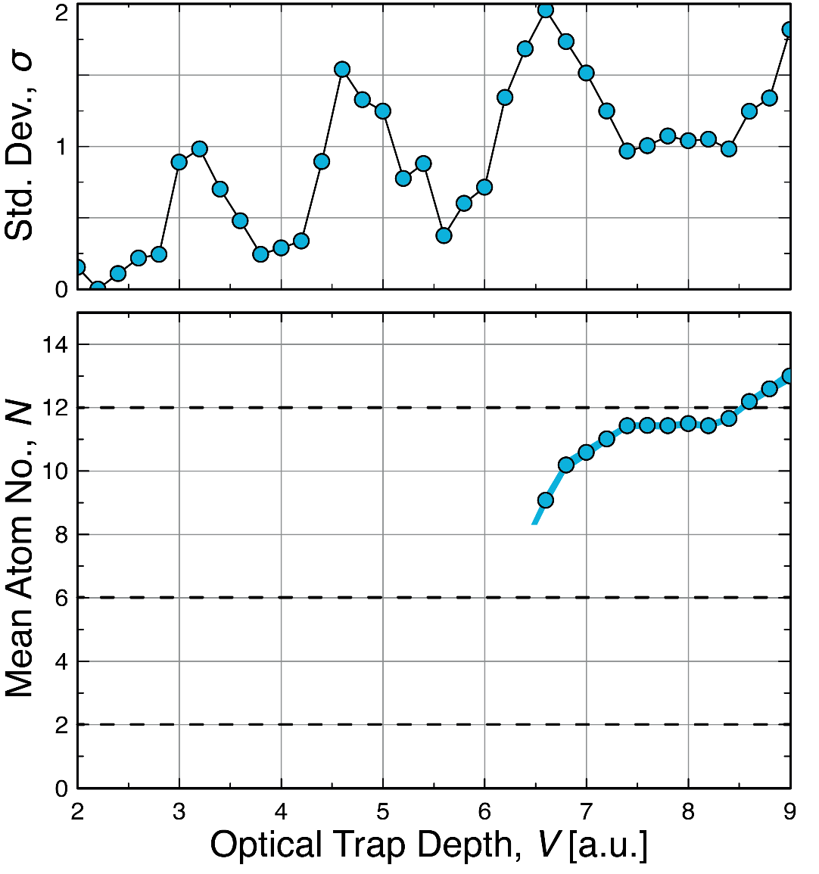
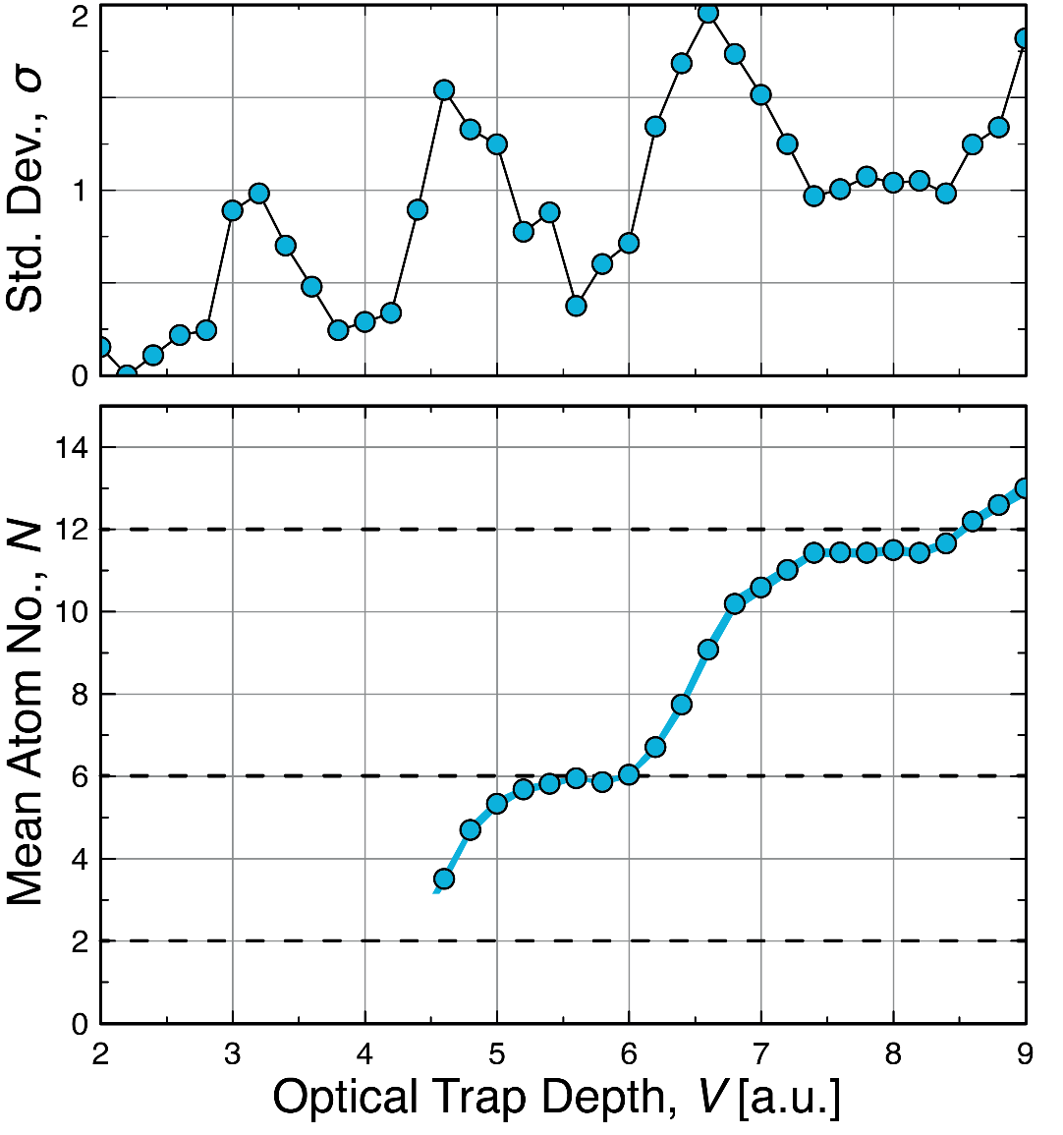
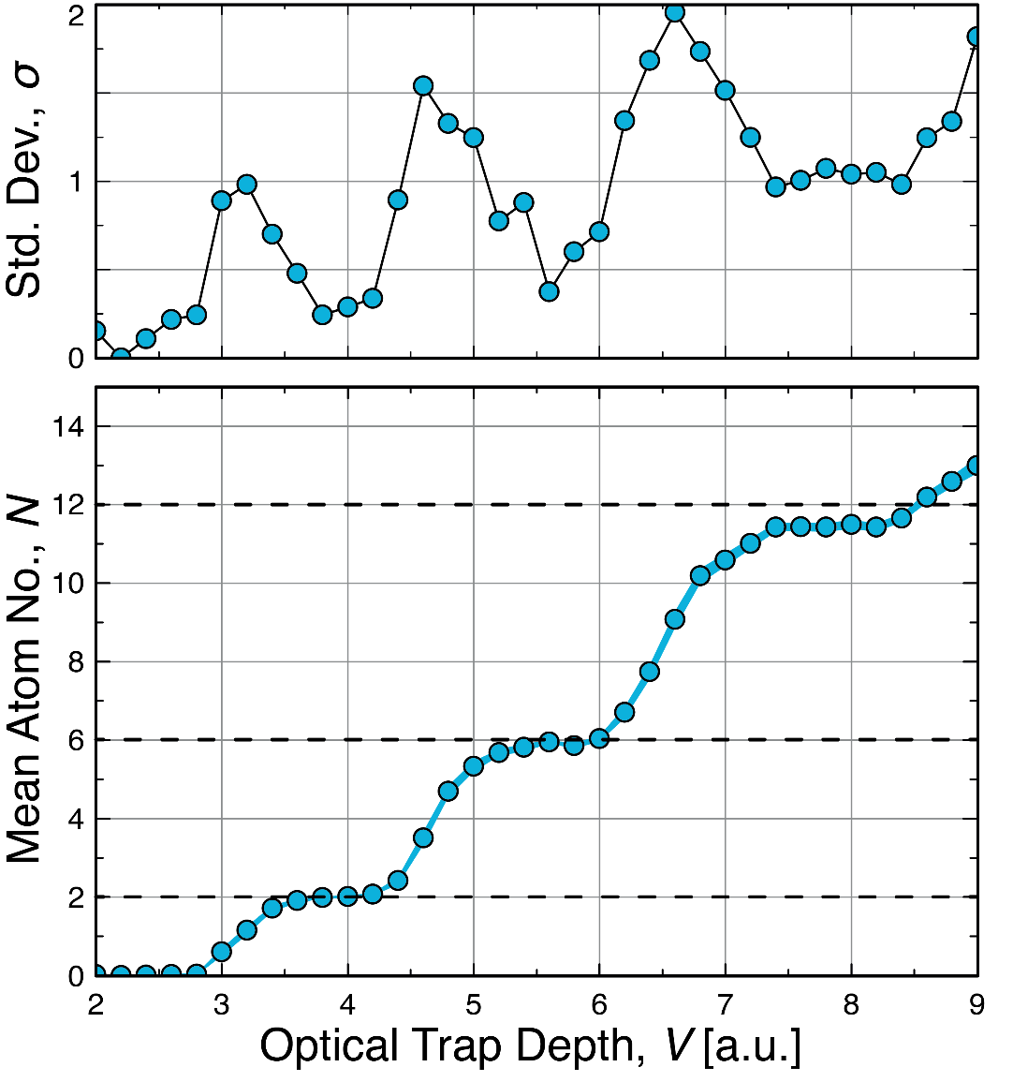
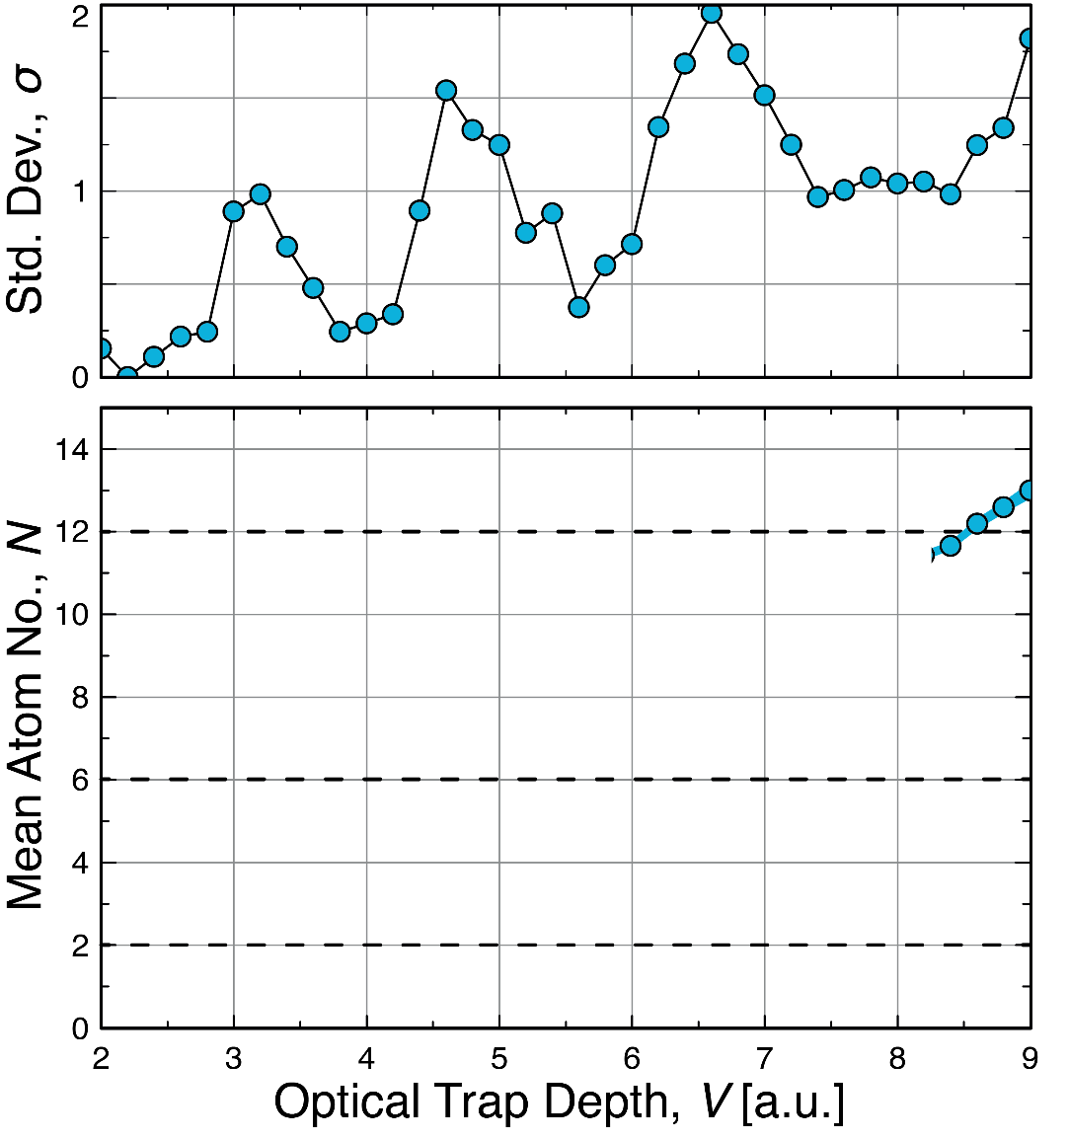


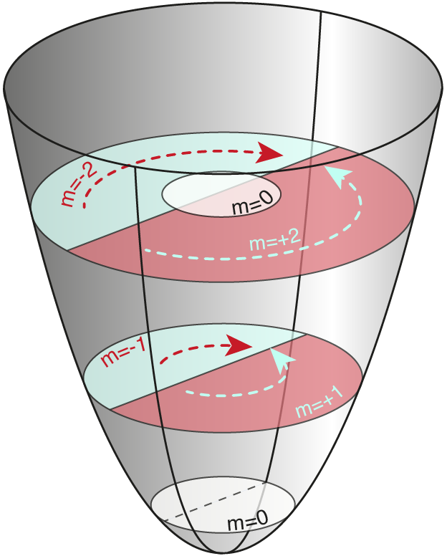
Deterministic Preparation in 2D
Number states
Reduced confinement to ‘spill out’ atoms
Bayha, L et al. Nature 587, 583–587 (2020)
Notes:
Prepare Number states – repeatability – basically T = 0K (dont think about temperature)
Fundamental ingredients – Pauli – fixed number of particles remain trapped
Key word!

Slide 5

Introducing Interactions
Binding Energy
Contact interactions between up and down
Tuneable via magnetic field
In 2D: two particle bound state at any attraction
Binding energy used to characterize system.
$$E_{B}=\frac{ℏ}{2ma_{2D}^{2}}$$

Slide 6
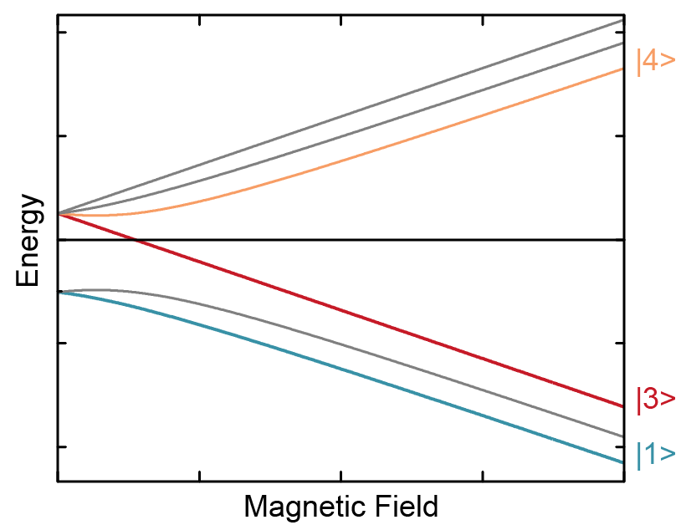
Interaction switch off
Fast interaction switch off
Raman induced spin flip
M. Holten et al., Nature 606, 287–291 (2022)

Slide 7
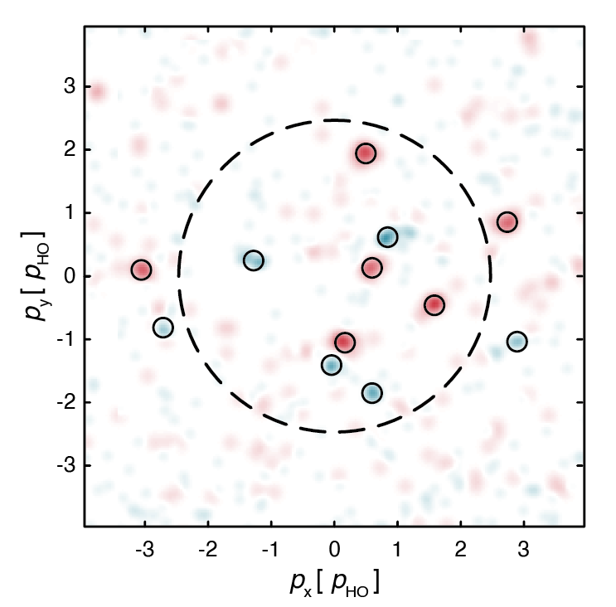
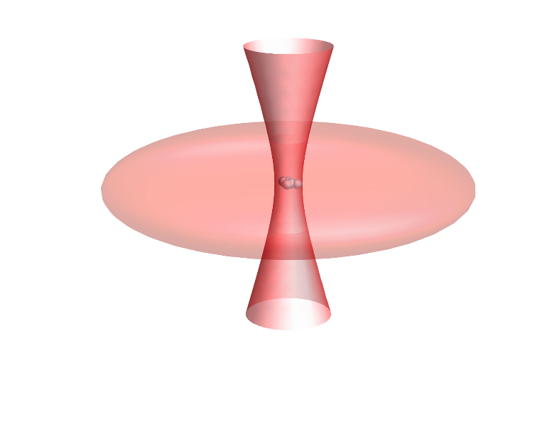
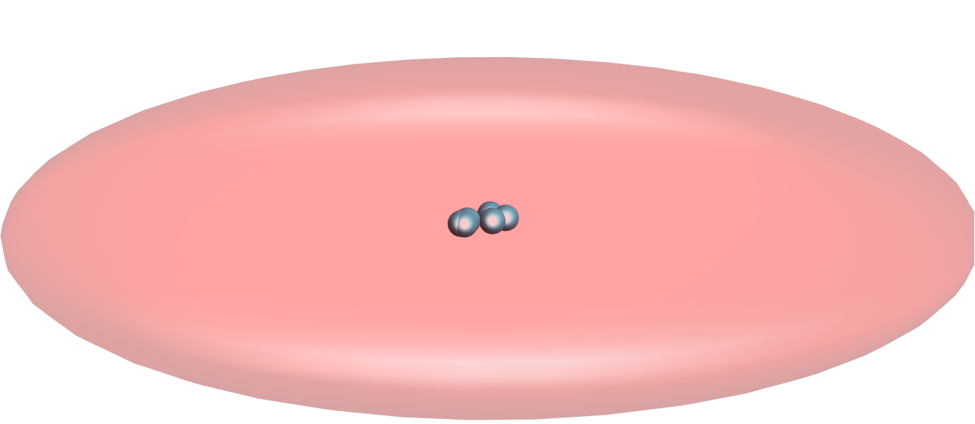
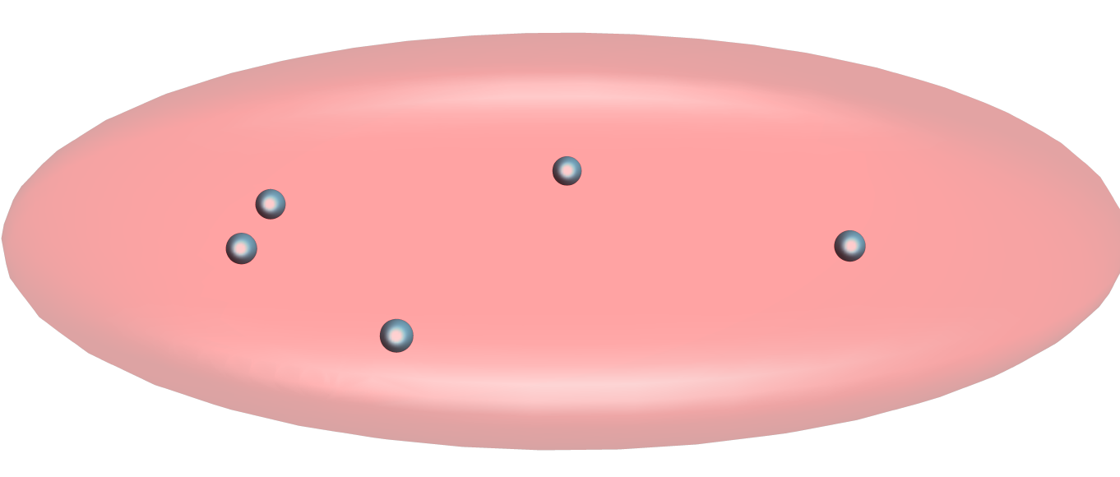
Microscopy – momentum space
x
x
x
Spin Resolved Momentum Distribution
y
p(t_{int})
0
t_{int}
t_{int}+t_{exp}
t
M. Holten et al., Nature 606, 287–291 (2022)

Slide 8
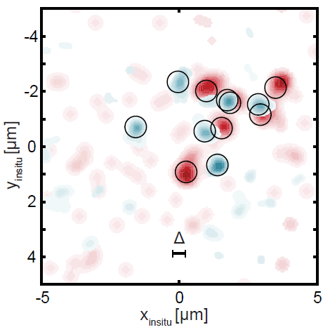
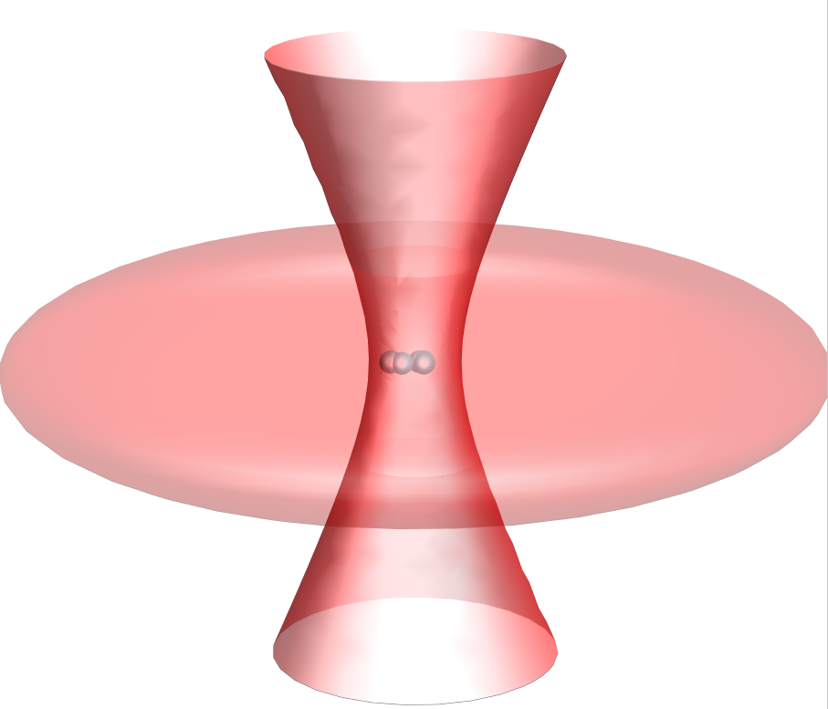
Microscopy – real space
x
x
x
x
y
x(t_{int})
0
t_{int}
t_{int}+T₁/4
t_{int}+T₁/4+t_{exp}
t
[1] Asteria et al. “Quantum gas magnifier for sub-lattice-resolved imaging of three-dimensional quantum systems“. Nature 599, 571–575 (2021)
[2] Murthy et al. “Matter-wave Fourier optics with a strongly interacting two-dimensional Fermi gas”. Phys. Rev. A 90 (2014), 043611
[3] Murthy et al. “Direct imaging of the order parameter of an atomic superfluid using matterwave optics”. Arxiv Preprint (2019). arXiv:1911.10824

Slide 9
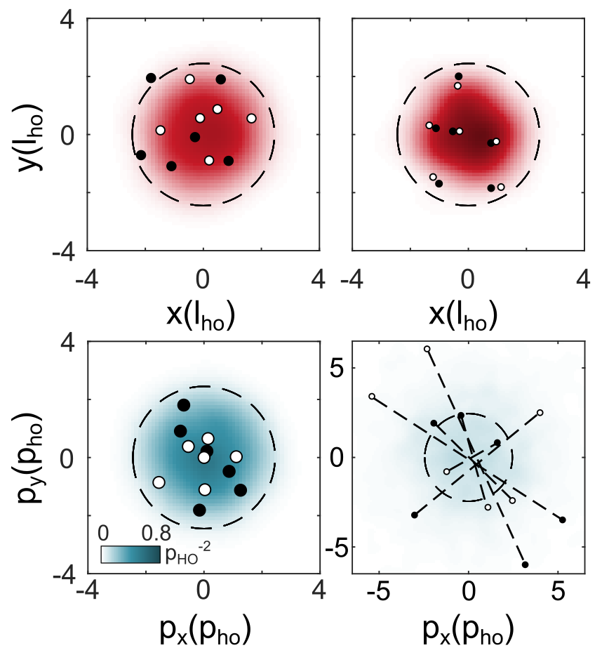

Microscopy of molecules
Non-interacting
Strongly interacting
Momentum space:
Holten et al. Nature 606, 287–291 (2022)

Slide 10
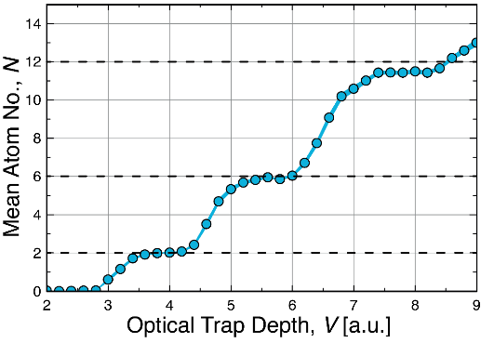
Toolbox
Number states
Tuneable interactions
Instantaneous
switch off
Closed + open shell
BCS side of crossover
Momentum Distribution
Real Space Distribution
Atom number counting

Slide 11
Do 10 particles behave like a fluid?
Art by Jonas Ahlstedt / Lund Bioimaging Centre (LIBC)
Notes:
Classical hydro picture
Elliptic expansion
Interactions – larger forces in direction of larger density

Slide 12
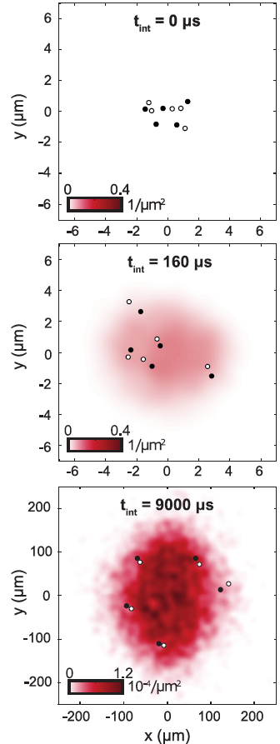
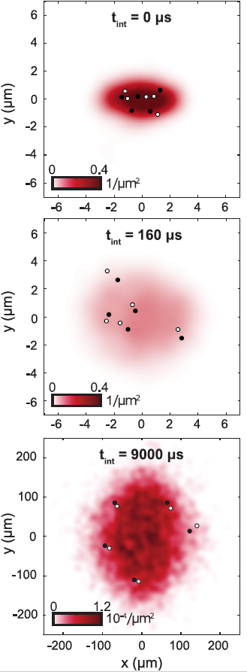
Elliptic flow of 10 particles
Prepare in elliptic trap
5+5 atoms
Strongly interacting
To Understand:
Origin of collectivity
Role of entanglement
Pair formation & scale invariance
≈1000 samples reveal density
Brandstetter, Lunt et al. arxiv: 2308.09699
Notes:
A little bit of intuitive theory

Slide 13
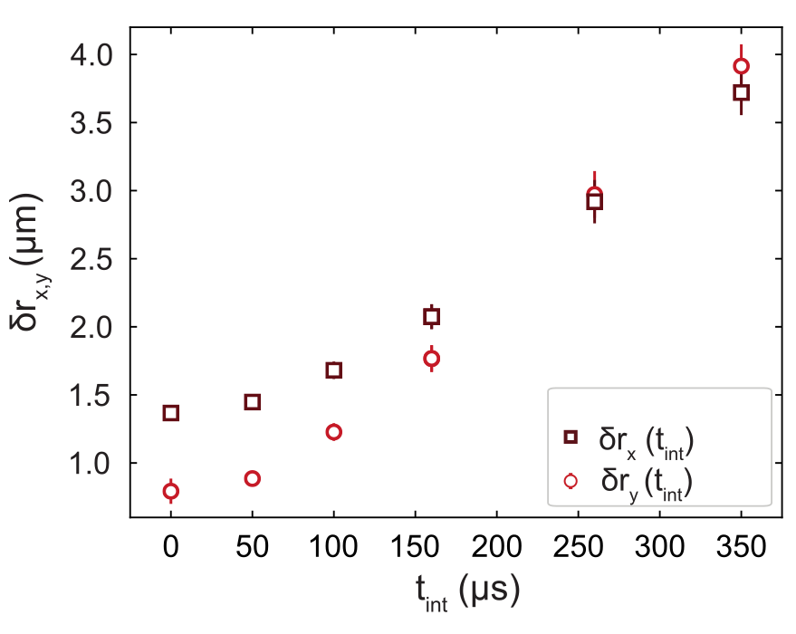
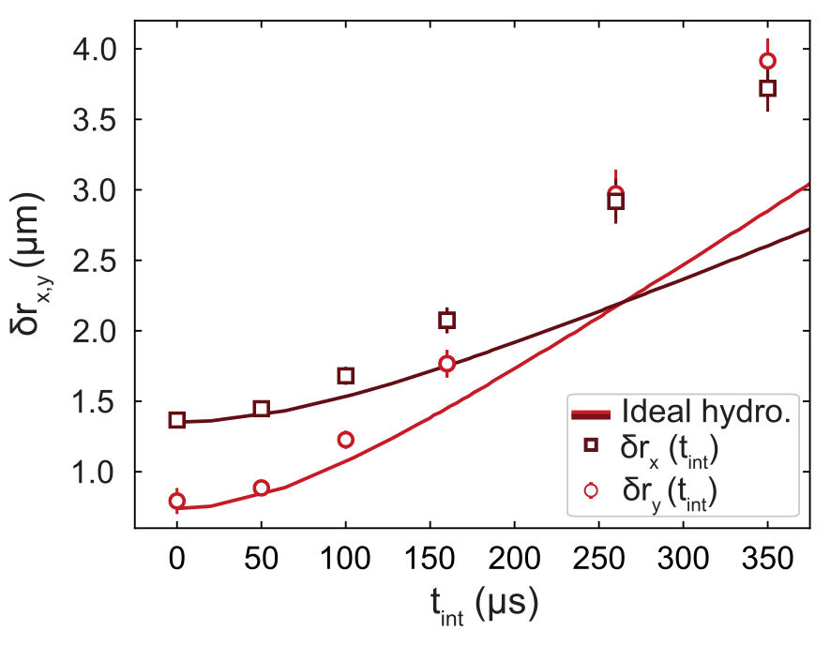
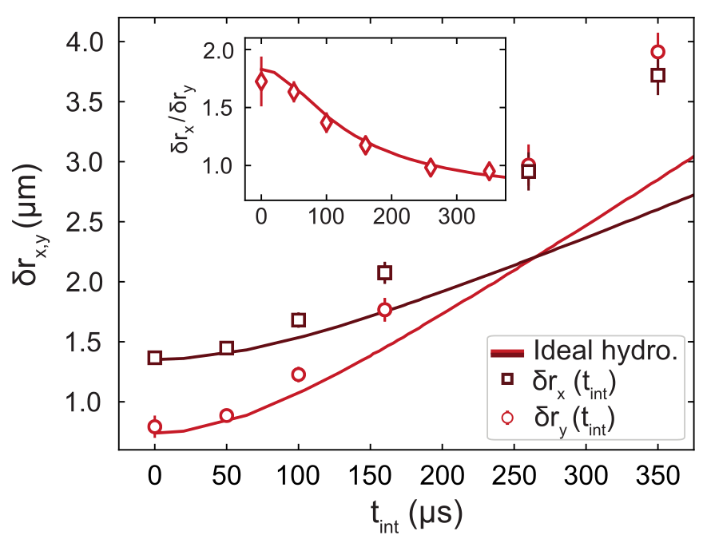
Real space evolution
To Understand:
Origin of collectivity
Role of entanglement
Pair formation & scale invariance
Deviation from many body limit
Brandstetter, Lunt et al. arxiv: 2308.09699
Notes:
Breath
Expalin axis

Slide 14
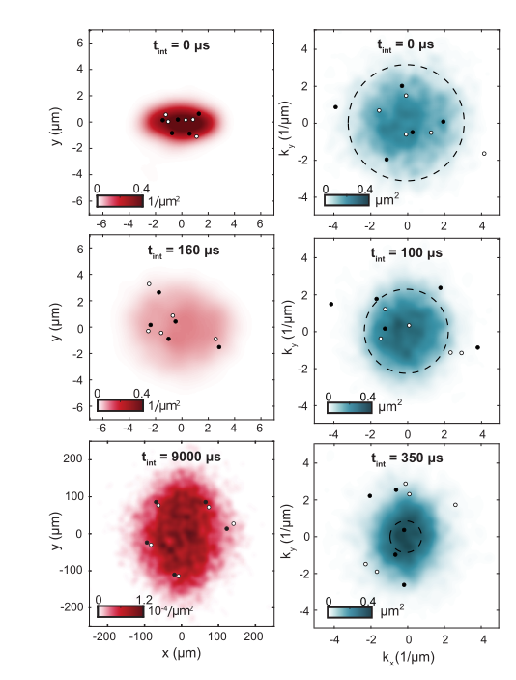
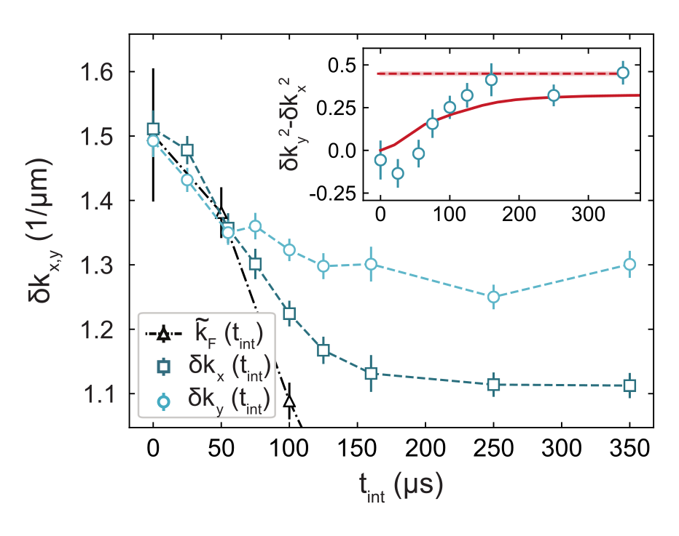
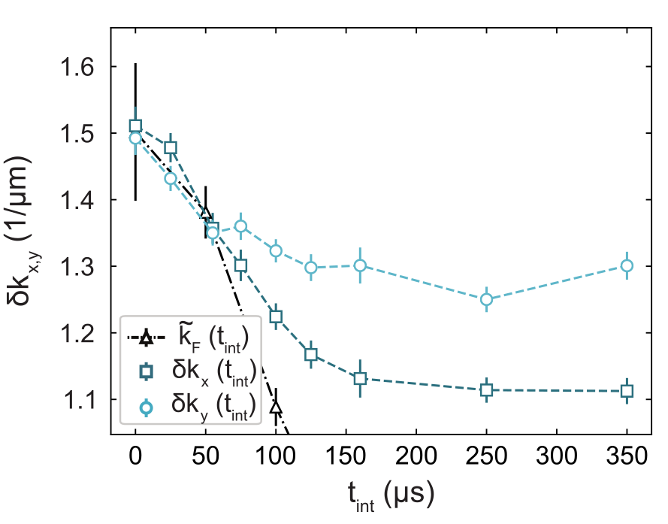
Momentum evolution
Brandstetter, Lunt et al. arxiv: 2308.09699
Notes:
Breath
Redistribution of momenta from strongly confined to weakly confined direction
Decrease: we measure RMS momenta, NOT something like a velocity field – includes fluctuations – decrease as gas expands in x – mechanism unclear
Gas accelerates – momentum space size shrinks
RMS MOMENTUM
Very strong indication for quantum hydro – not thermal!

Slide 15
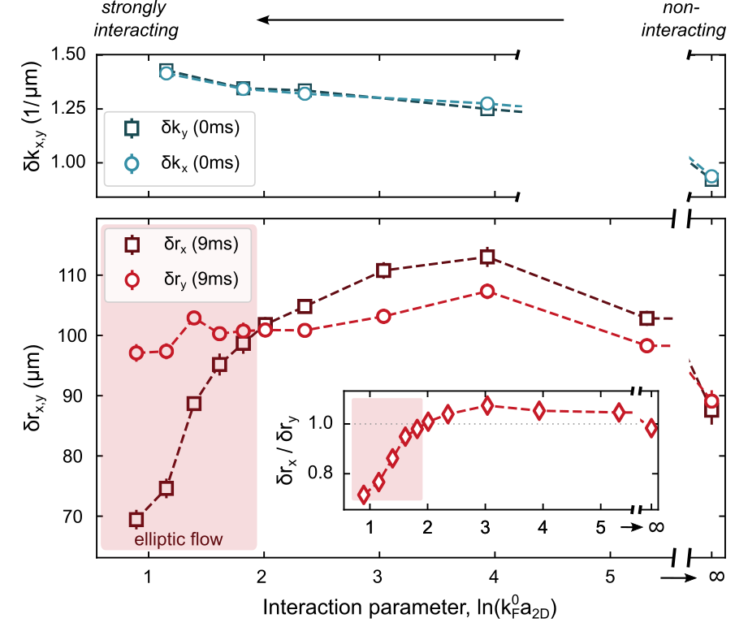
Tuning the interaction strength
Symmetric insitu momenta
Higher interaction strength → stronger ellipticity
Below critical interaction strength
  No inversion
  Initial ellipticity maintained
  Mean field effect
Brandstetter, Lunt et al. arxiv: 2308.09699
Notes:
EB (EF)

Slide 16
Tuning the interaction strength
To Understand:
Origin of collectivity
Role of entanglement
Pair formation & scale invariance
Deviation from many body limit
Weakly interacting regime
Brandstetter, Lunt et al. arxiv: 2308.09699
Notes:
EB (EF)

Slide 17
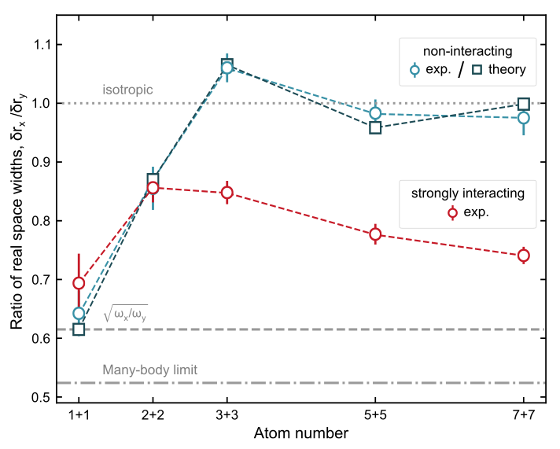
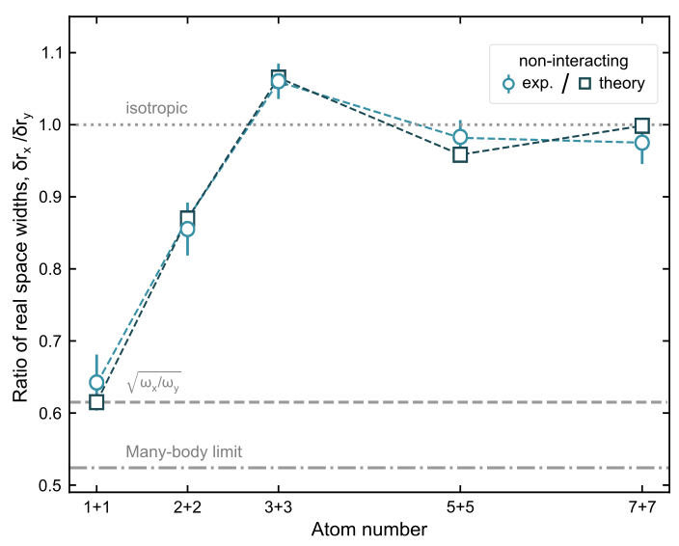
Atom number dependence
Noninteracting:
Higher N → formation of round fermi surface
Comparison to analytic solution of |ψ(p_{x},p_{y})|²
Interacting:
Higher N → stronger ellipticity
Inversion requires interactions
Brandstetter, Lunt et al. arxiv: 2308.09699
Notes:
Breath!
New axis
1+1 -> effectively molecule
Trivial single particle quantum system changes aspect ratio – not necesseraly signature
Few particle behaviour first only 5+5 – stress that 1 is round

Slide 18
Outlook
Image reconstruction
Detector Bias
New tools from heavy ion community?
Pair formation during interacting expansion
Role in collectivity
Freeze out radius - HBT
To Understand:
Origin of collectivity
Role of entanglement
Pair formation & scale invariance
Deviation from many body limit
Weakly interacting regime

Slide 19
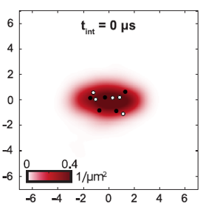
Outlook
Image reconstruction
Detector Bias
New tools from heavy ion community?
Pair formation during interacting expansion
Role in collectivity
Freeze out radius - HBT
To Understand:
Origin of collectivity
Role of entanglement
Pair formation & scale invariance
Turn on interactions during the expansion?
Deviation from many body limit
Weakly interacting regime

Slide 20
Outlook
Image reconstruction
Detector Bias
New tools from heavy ion community?
To Understand:
Origin of collectivity
Role of entanglement
Role of scale invariance
Freeze out radius - HBT
Pair formation & scale invariance
Deviation from many body limit
Weakly interacting regime

Slide 21
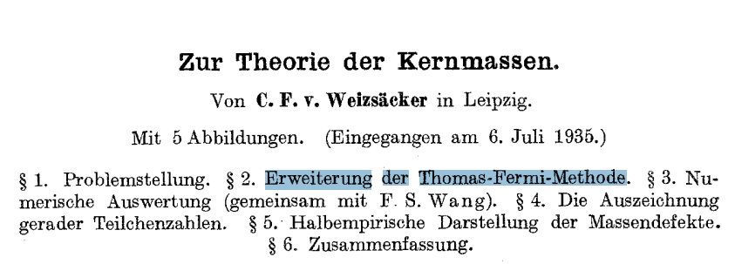
Outlook
To Understand:
Origin of collectivity
Role of entanglement
Pair formation & scale invariance
Deviation from many body limit
Weakly interacting regime

Slide 22
Outlook
Image reconstruction
Detector Bias
New tools from heavy ion community?
Pair formation during interacting expansion
Role in collectivity
Freeze out radius - HBT
To Understand:
Origin of collectivity
Role of entanglement
Pair formation & scale invariance
Deviation from many body limit
Weakly interacting regime

Slide 23

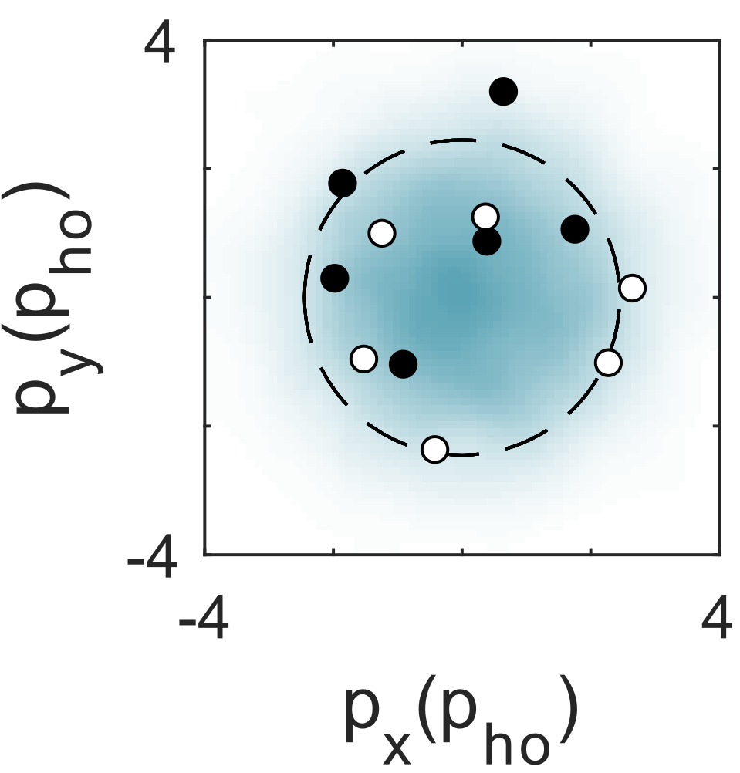
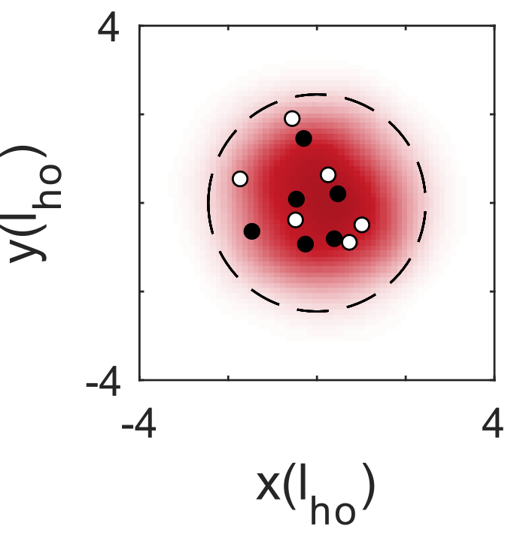

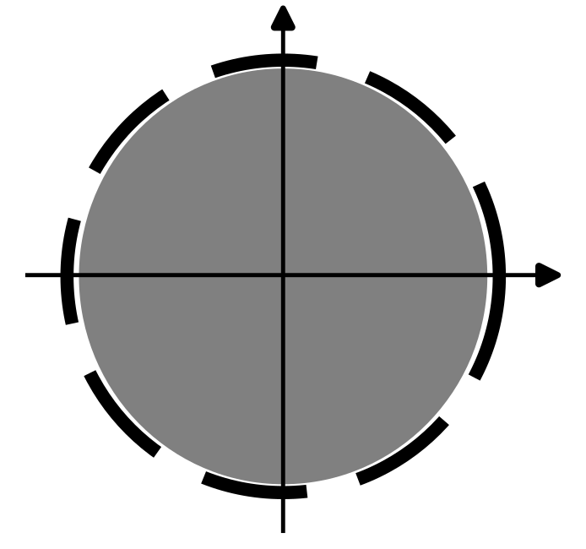
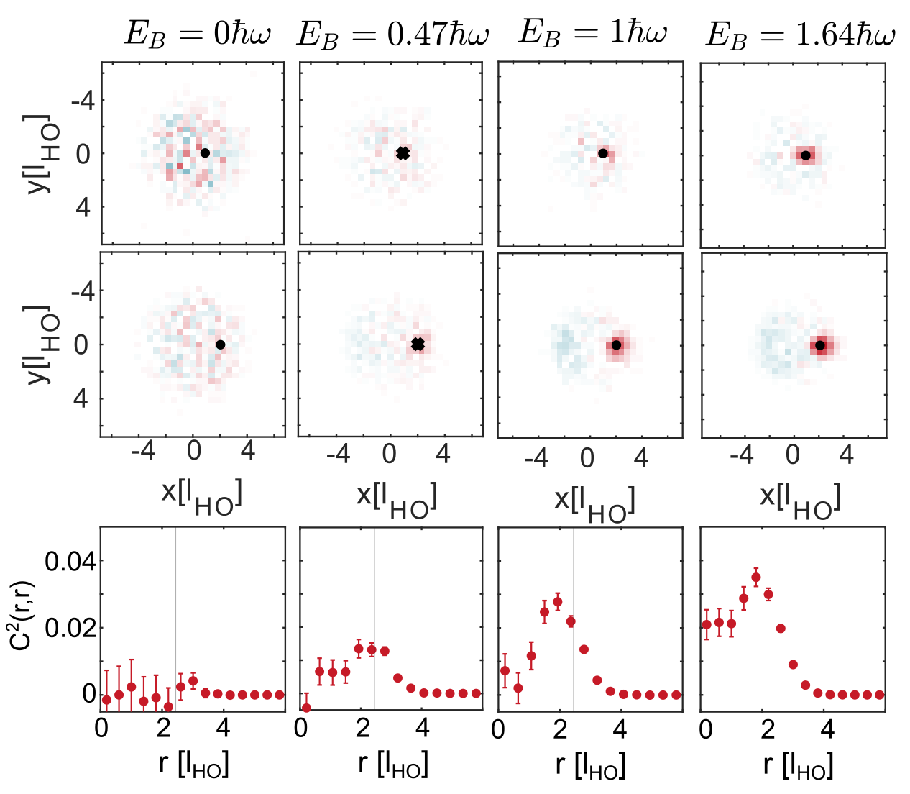
Other cool new stuff
Pauli blocking and pairing in real space?
k_{f}
Preliminary

Slide 24
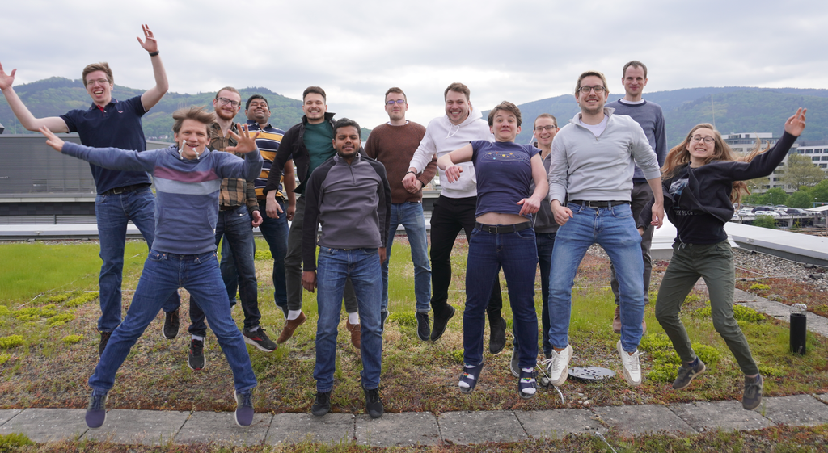







Thank you for your attention!
Maciej Gałka
Tobias
Hammel
Maximilian
Kaiser
Philipp Lunt
Carl Heintze
Suraj Iyer
Jonas
Herkel
Johanna Schulz
Jan Ricken
Paul Hill
Keerthan
Subramanian
Selim
Jochim
Gerhard Zürn
Johannes Reiter
Want to join?
jochim@uni-heidelberg.de

Slide 25

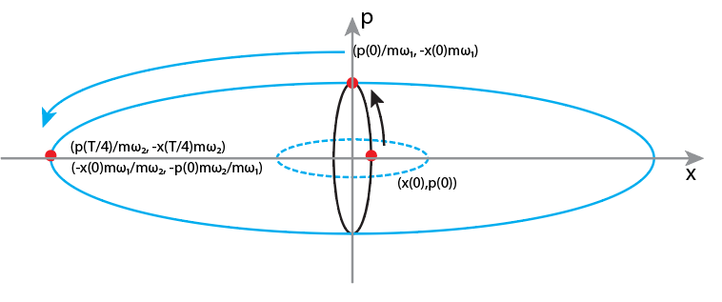
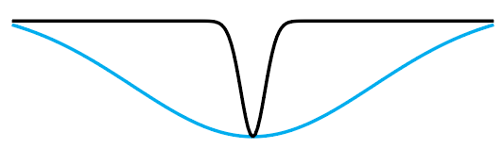
Scheme
A T/4 – propagation in a harmonic trap corresponds to a Fourier transform:
Use two subsequent Fourier transforms - magnification
I Svarchuk et al., PRL 89, 270404 (2002)
A. H. van Amerongen et al., PRL100, 09040 (2008)
S. Tung et al., PRL 105, 230408 (2010)
T. Jacqmin et al., PRA 86, 043626 (2012)
Asteria et al., Nature 599, 571 (2021)
Murthy et al., arXiv:1911.10824
Murthy et al., Phys. Rev. A 90 (2014), 043611

Slide 26
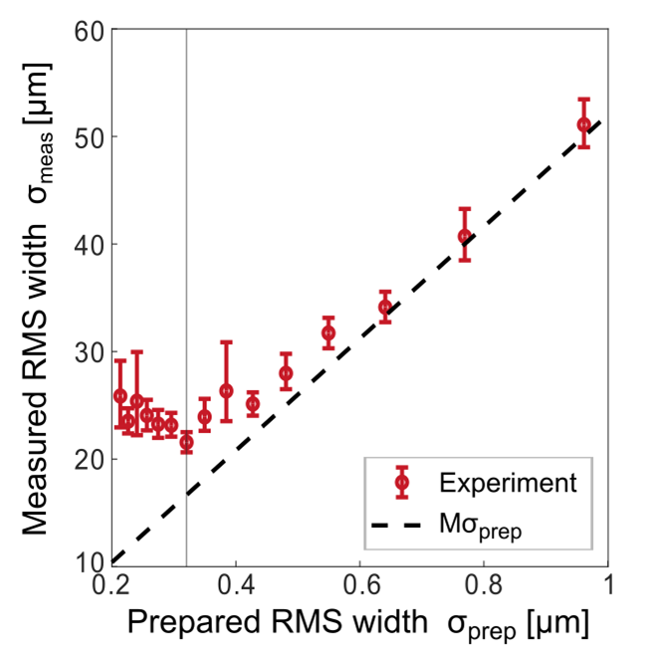
Performance
Resolution: ≈ 300nm
Notes:
Prepared width vs observed width
Avoid long discussion about abberations!

Slide 27
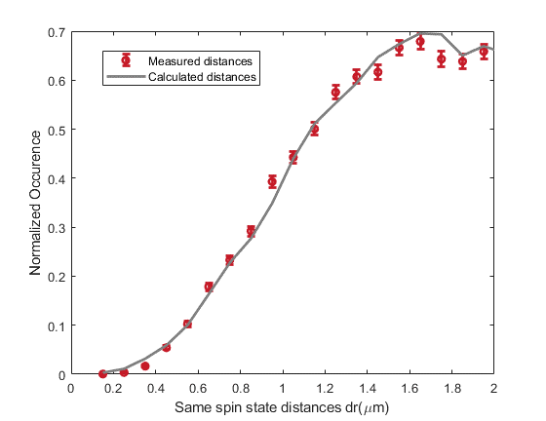
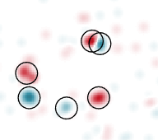
Performance
Resolution: ≈ 300nm
Detection hole < Pauli hole
1
y (l_{HO})
0
-1
-1
0
1
x (l_{HO})
Notes:
Challenge: distinguish individual atoms – sketch – we can distinguish individual atoms

Slide 28
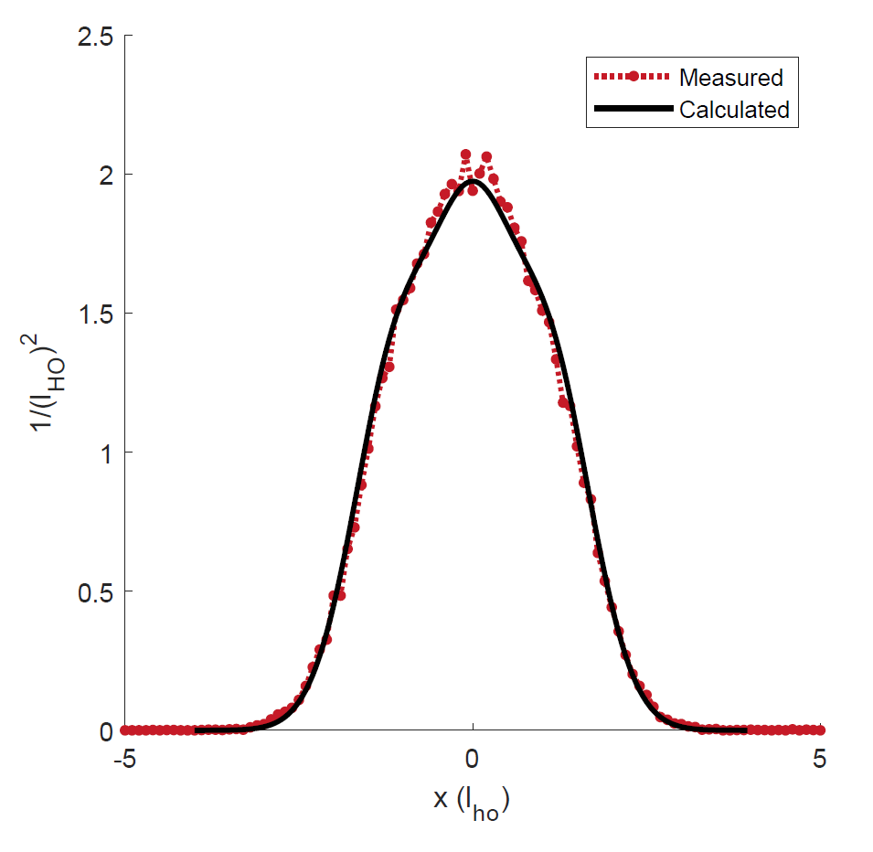
Performance
Resolution: ≈ 300nm
Detection hole < Pauli hole
Deviation from calculated energy:
  3+3 atoms: 1%
  6+6 atoms: 4%
Notes:
3 spin up + 3 spin down atoms
Remove guide to the eye
Main point: precise!

Slide 29
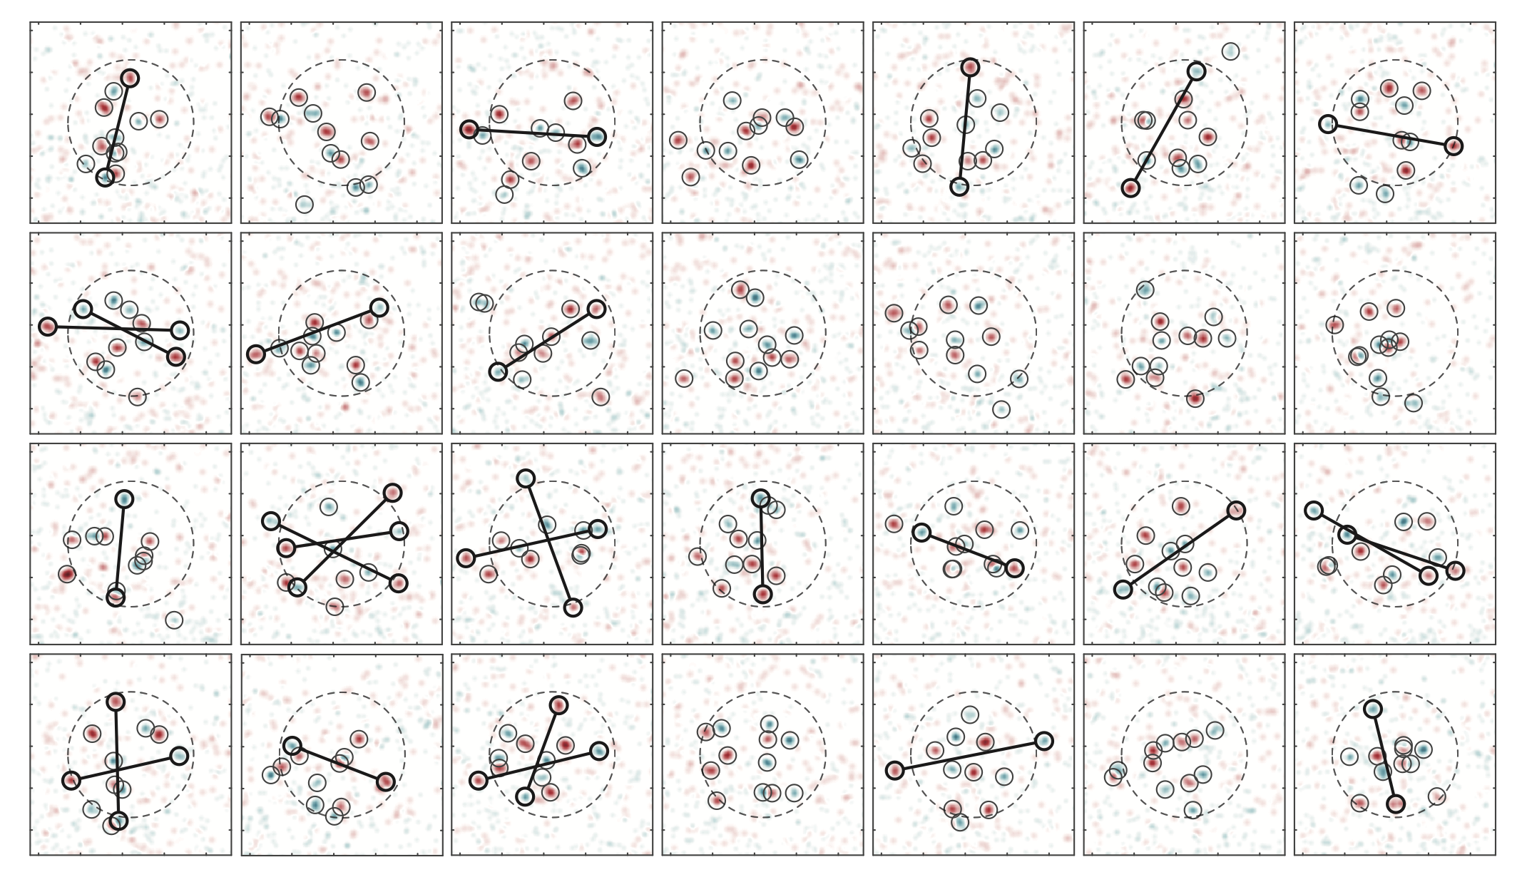
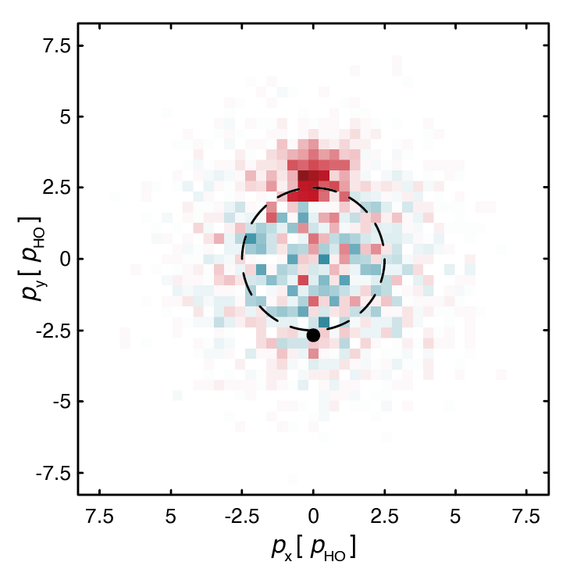
$$𝒞^{\left(2\right)}\left(p_{↑},p_{↓} \right)=<n\left(p_{↑}\right)n\left(p_{↓}\right)>− <n\left(p_{↑}\right)><n\left(p_{↓}\right)>$$
Holten et al. Nature 606, 287–291 (2022)
Notes:
Snapshot of the many particle wavefunction on momentum – all same state, but different snapshots

Slide 30
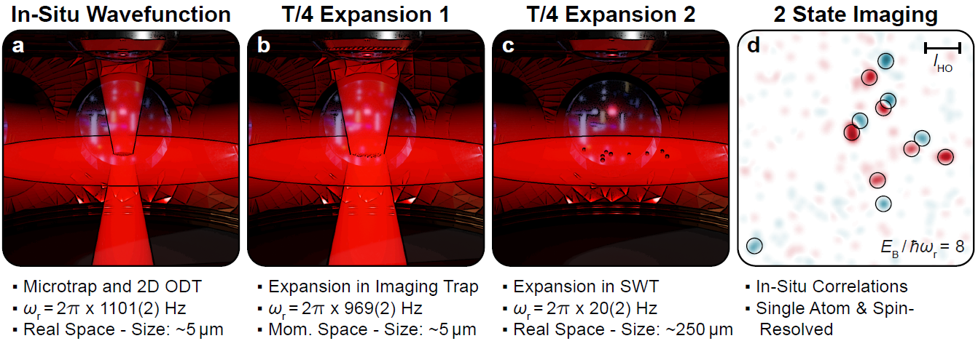
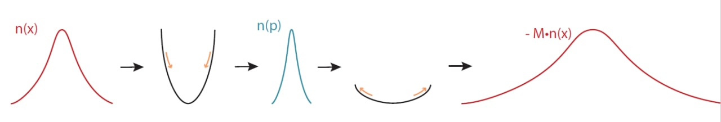

Scheme
[1] Asteria et al. “Quantum gas magnifier for sub-lattice-resolved imaging of three-dimensional quantum systems“. Nature 599, 571–575 (2021)
[2] Murthy et al. “Matter-wave Fourier optics with a strongly interacting two-dimensional Fermi gas”. Phys. Rev. A 90 (2014), 043611
[3] Murthy et al. “Direct imaging of the order parameter of an atomic superfluid using matterwave optics”. Arxiv Preprint (2019). arXiv:1911.10824
Notes:
Needed?
Every shot – projection on position of momentum – C&P Freiburg slide

Slide 31
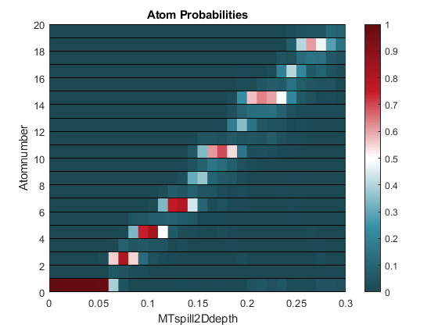
Shell structure anisotropic trap
ħω_{y}= 3∙ħω_{x}
E
ħω_{x}

Slide 32
Interaction Switchoff
Use 2 Lasers for Raman transition from |3> to |4>
Interactions are switched off in 370ns
Jump magnetic field to optimal value
Apply radiofrequency pulses to transfer |1> first to |2> and finally to |3>
Image all atoms in |3>
Transfer second spin state back from |4> to |3>
Image all atoms in |3>

Slide 33
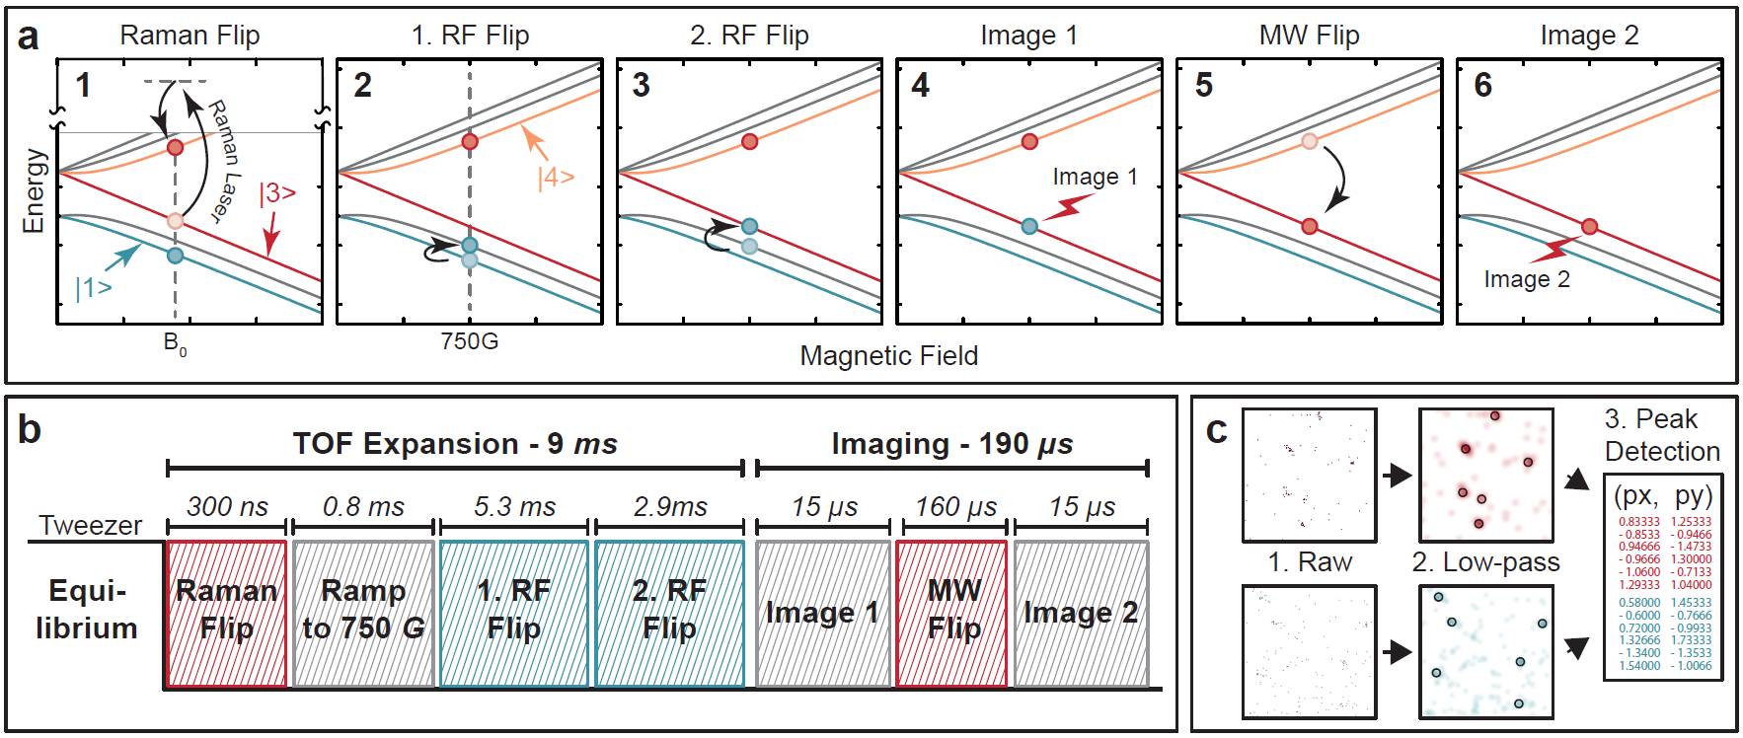
Imaging Sequence

Slide 34

Single-particle detection
Free-space fluorescence imaging:
25 photons/atom
no confining potentials
only resonant light
Light-sheet imaging of Rb: Bücker et al., NJP 11 103039 (2009)
Our work: Bergschneider, Klinkhamer, et al. Phys. Rev. A 97, 063613 (2018)
Notes:
emphasize few photon regime, low background

Slide 35

20 μs exposure
EMCCD camera
background 0.003 photons/pixel
10 μm
Notes:
transition
how many pixels, only 4 brigt ones

Slide 36

20 μs exposure
10 μm

Slide 37


Slide 38

Single-particle detection in free space
Notes:
17 cm width 8 down 10 left

Slide 39


Two State Imaging
Time-of-flight in the non-interacting state to map momentum on position space
Two spin sensitive images in fast succession to obtain full momentum distribution.
Spin Resolved Momentum Distribution
M. Holten et al., Nature 606, 287–291 (2022)

Slide 40

Single Atom Imaging Fidelity

Slide 41


Distribution Fermi gas
Real space:
Momentum space:
Intuitive explanation: asymmetry of trap deforms equipotential lines in x (E_{pot}), but not in p (E_{kin})

Slide 43
Default Text Boxes
Default Caption
Default Text
Default Reference

Slide 44


Symbols

