Slide 1

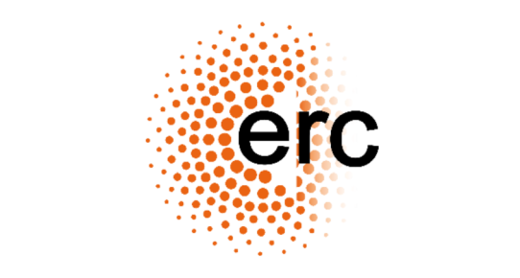




Ultracold ⁶Li-⁵³Cr:
from resonantly-interacting fermions to paramagnetic bosonic molecules
Matteo Zaccanti
CNR-INO & LENS
zaccanti@lens.unifi.it
Young Researchers

Slide 2
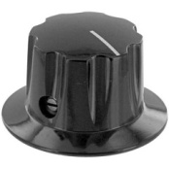
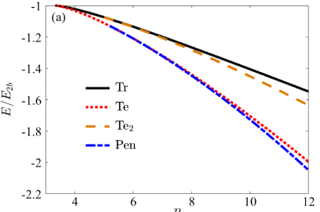
Heteronuclear Fermi mixtures: why?
Rich few-body physics & novel (stable!) cluster states
M/m ≠ 1
PRA 86, 062703 (2012)
Efimov, Nucl. Phys. A 210, 157 (1973)
Kartavstsev&Malykh, J. Phys. B 40, 1429 (2007)
Levinsen et al, Phys. Rev. Lett. 103, 153202 (2009)
Levinsen&Petrov, EPJD 65, 67 (2011)
Blume, Rep. Prog. Phys. 75, 046401 (2012)
Naidon&Endo, Rep. Prog. Phys. 80, 056001 (2017)
… … …
M/m
PRL 118, 083002 (2017)
R*/a
PRL 129, 073401 (2022)
3D
2D
Trimer
Tetramer
Pentamer
M/m
M/m

Slide 3
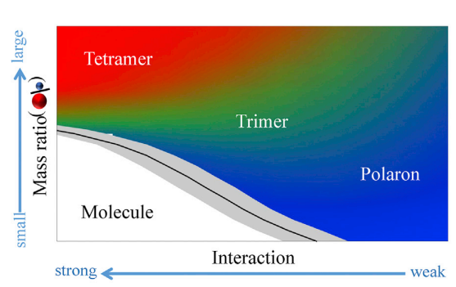
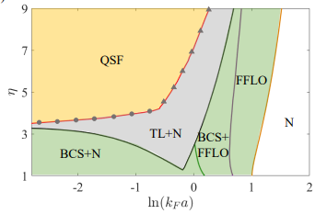
Heteronuclear Fermi mixtures: why?
Novel impurity problems (light impurity)
M/m ≠ 1
PRL 110, 165302 (2013)
Cell Reports Physical Science 3, 100993 (2022)
Trimer
3D
M_{F}/m_{i}
2D
Polaron
Dimer
1/(k_{F} a)
Novel superfluid/normal states beyond pairing
Adapted from PRL 131, 193401 (2023)
Strong similarities with
exciton-electron matter
in TMD materials
2D
M_{maj} /m_{min}

Slide 4
The special case of ⁶Li-⁵³Cr
PRL 118, 083002 (2017)
M_{Cr}/m_{Li}=8.8
trimer
8.17
8.86
tetramer
pentamer
For 3D & zero-range interaction (R*=0):
M_{Cr}/m_{Li} 7% above the critical value for a (fermionic) trimer to exist
M_{Cr}/m_{Li} <1% below the critical value for a (bosonic) tetramer to exist
Robust to finite-range corrections (R*≠0) in quasi-2D
Unique system to explore ultracold fermionic matter with
non-perturbative (elastic) few-body effects
N_{Cr}/N_{Li}
1
2
3

Slide 5
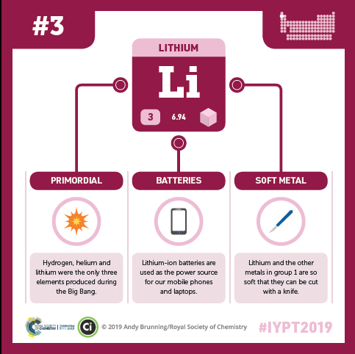
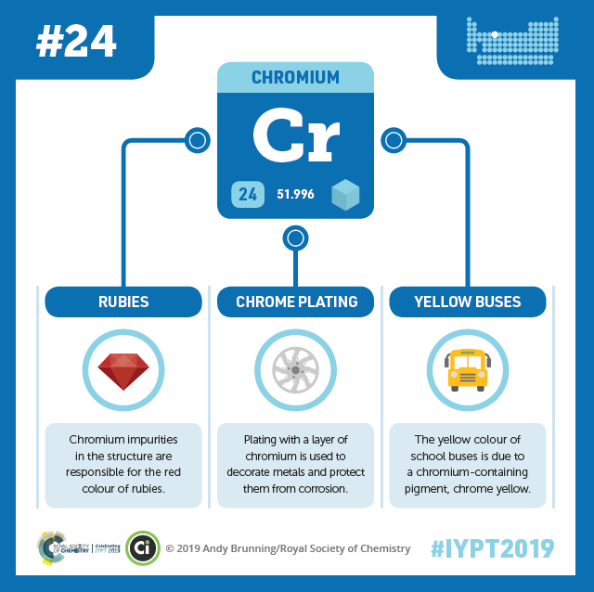
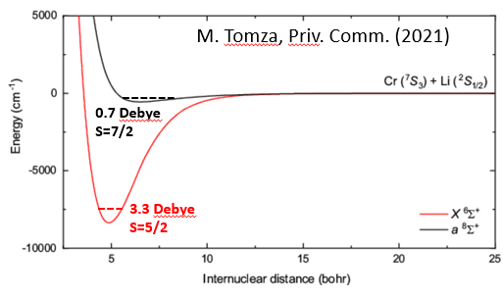

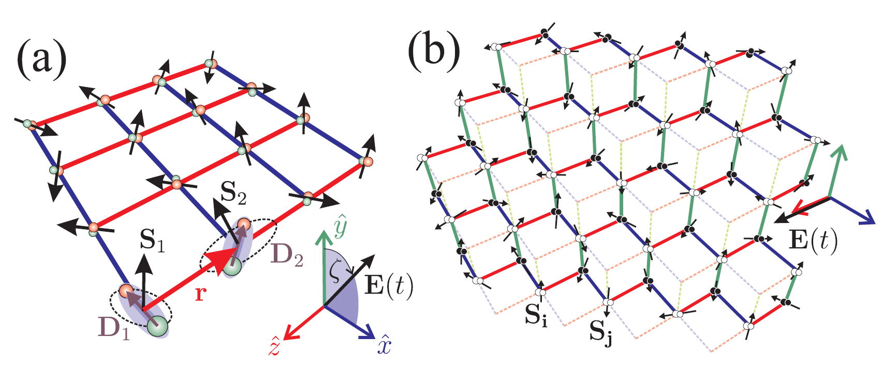
The special case of ⁶Li-⁵³Cr
Alkali
Transition metal
S_{m}
+
=
d_{e}
Not a bi-alkali mixture!
S=1/2
S=3
LiCr ground state molecules
Both large electric and magnetic dipole moment
M. Tomza, Priv. Comm. (2022)
Nature Physics 2,341 (2006)
Ultracold paramagnetic polar molecules
Quantum info/computation
quantum simulation
quantum chemistry
precision measurements
PRL 88, 067901 (2002); Chem. Rev. 112, 5012 (2012); Nat. Phys. 13, 13 (2017); PRX 10, 041005 (2020) ….

Slide 6
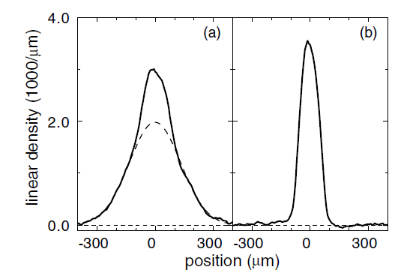
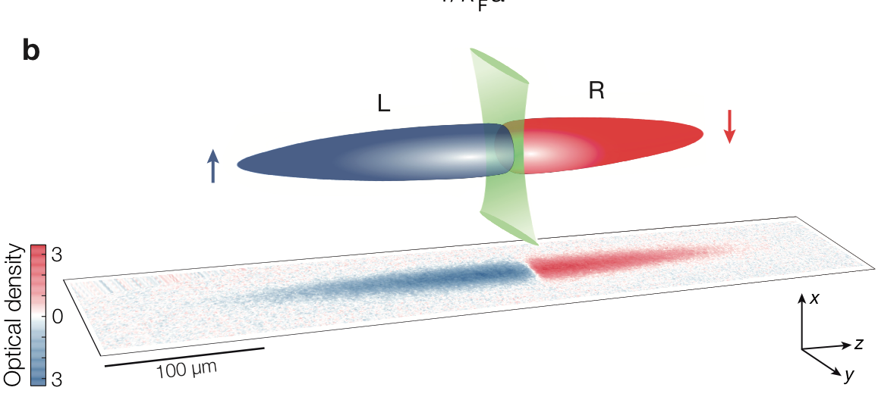

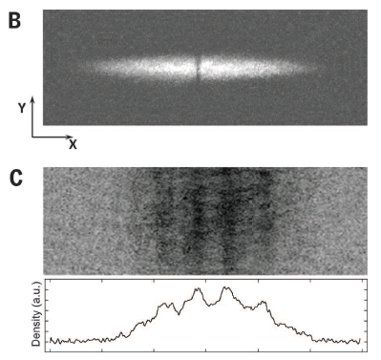
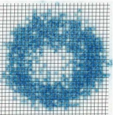
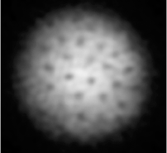

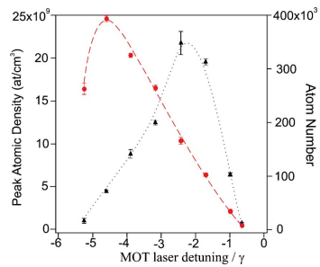
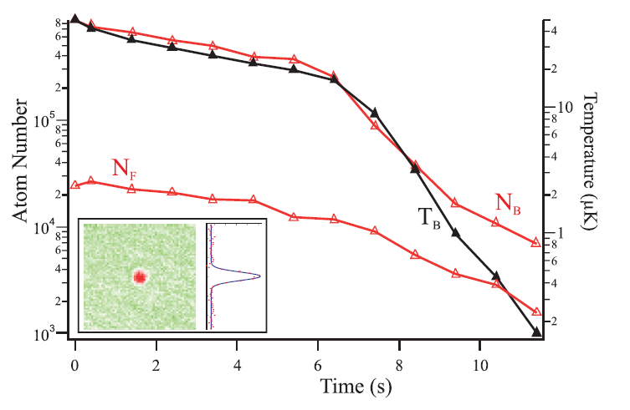
Li-Cr in practice: a challenging experimental task
Combine a widely explored alkali atom…
⁶Li
MIT, Paris, Innsbruck, Zurich, Heidelberg, Swinburne, Florence, Harvard, Hamburg, Yale …
… with an almost unexplored transition metal element
PRA 73, 053406 (2006)
PRA 91, 011603(R) (2015)
4·10⁵@ 100 μK
1000@ T/T_{F}=1
⁵³Cr
Paris Nord

Slide 7
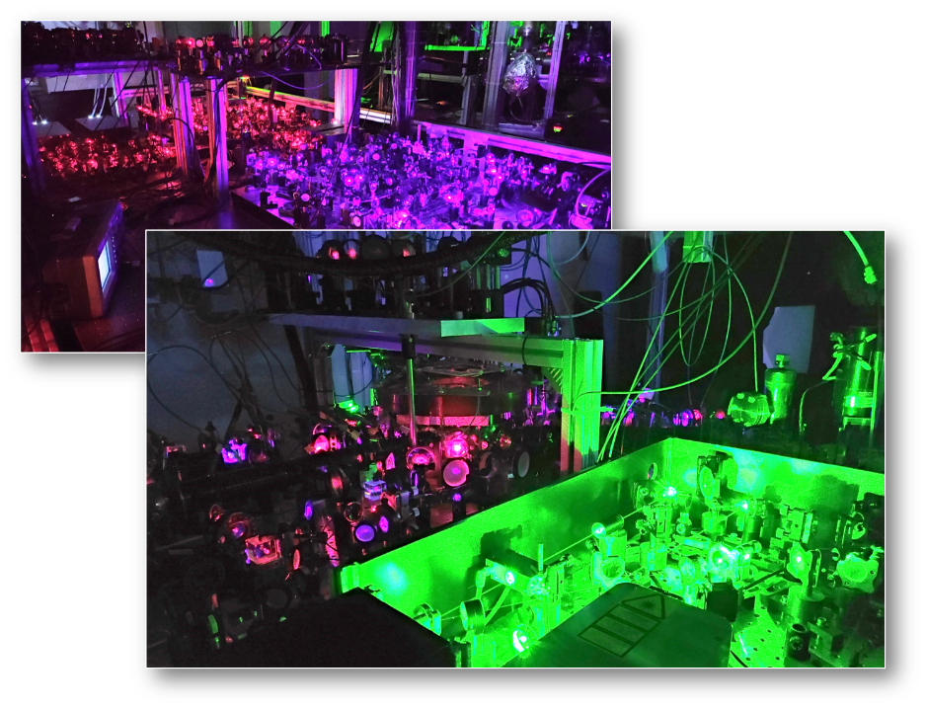
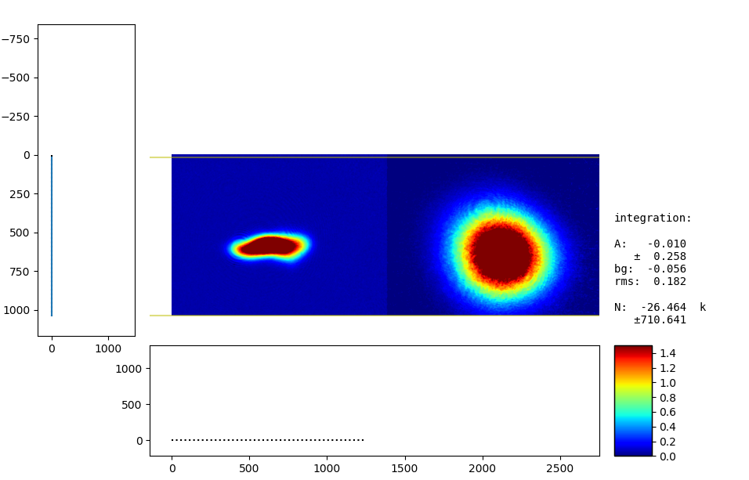
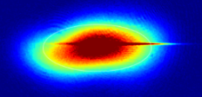
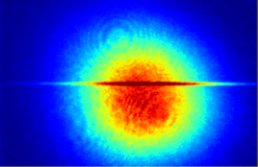
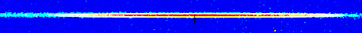
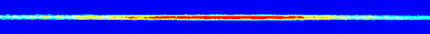
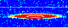
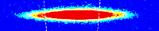
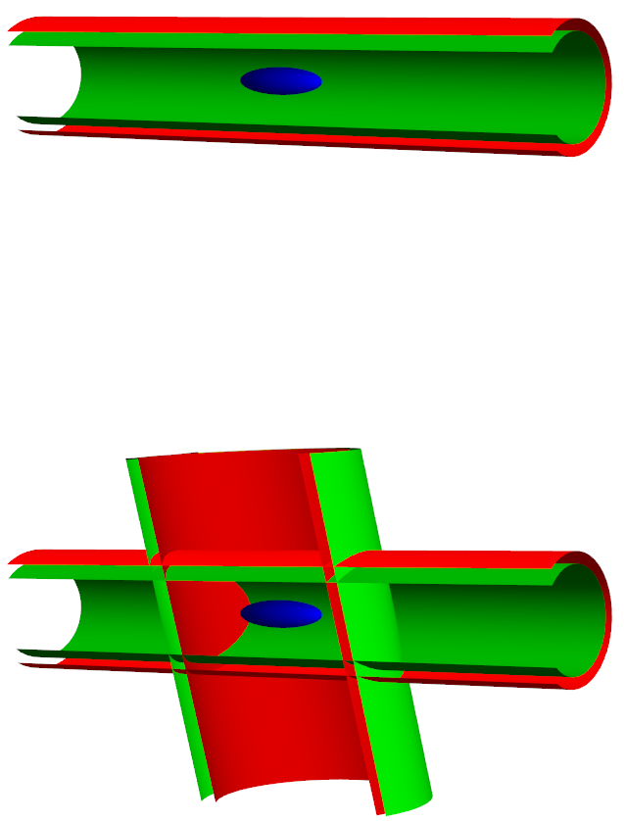
Production of Li-Cr Fermi mixtures
Our strategy: all-optical procedure (similar to the one for ⁶Li-⁴⁰K in Innsbruck, see PRA 81, 043637 (2010))
Li MOT loading
Cr MOT loading
BODT loading
(1070 & 532 nm)
Evaporative cooling (Li) Sympathetic cooling (Cr)
6 + 2 s
6 ms
4.8 s
time
Within 13 seconds:
double-degenerate
Fermi mixtures of
3x10⁵ Li + 10⁵ Cr
both at T/T_{F}~0.25
Details in: Optics Express 27, 27215 (2019); PRA 101, 063602 (2020); PRA 106, 053318 (2022)

Slide 8
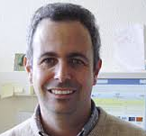
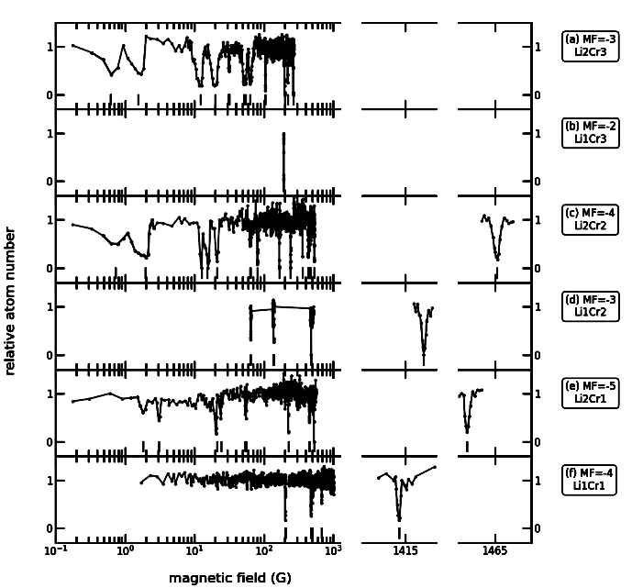
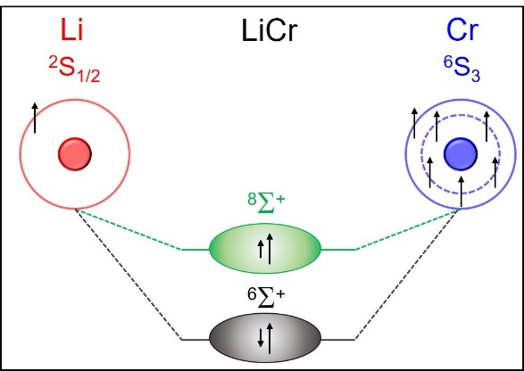
Li-Cr scattering & Feshbach resonances
Loss spectroscopy: results
>50 resonances found
Spectrum is not chaotic!
a_{5/2}=15.53(7) a₀
a_{7/2}=41.48(3) a₀
C₆=920(6) a.u.
Despite Cr complex structure: 2 channels only, as for bi-alkalis
Unambiguous assignment, quantum-collisional model built for all Li-Cr isotopic pairs (A. Simoni)
Ciamei et al, Phys. Rev. Lett. 129, 093402 (2022).

Slide 9
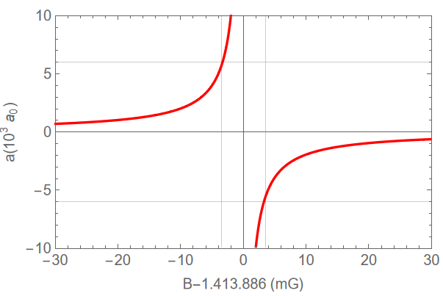
Li-Cr scattering & Feshbach resonances
Wide (ΔB>20 G) p-wave resonances at low field (0…80 G),
one immune to 2-body losses
(Stable?) p-wave resonant
Li-Cr Fermi mixtures possible!
Broadest s-wave resonances are narrow
(ΔB ~0.5 G, R*~6000a₀):
similar to Li-K mixtures, but at x10 higher fields
(>1400 G)
R*/|a|<1
Can we exploit them really ?

Slide 10
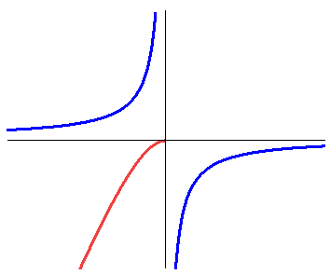
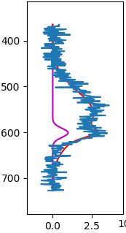
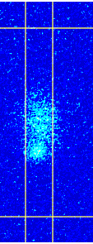
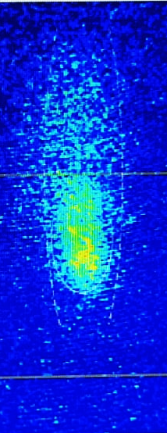
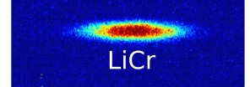

LiCr Feshbach dimers
Magneto-association + detection schemes
B-field ramp
(i) Stern-Gerlach
(B=B₀+b’z)
(ii) RF cleaning pulse
(e.g. on lithium)
Li|2 + Cr|1
- $\frac{|μ|b}{M}$
ν_{RF} ~76.9 MHz
Li|1 + Cr|1
Li
ε_{b}
Li|1Cr|1
LiCr
g

Slide 11
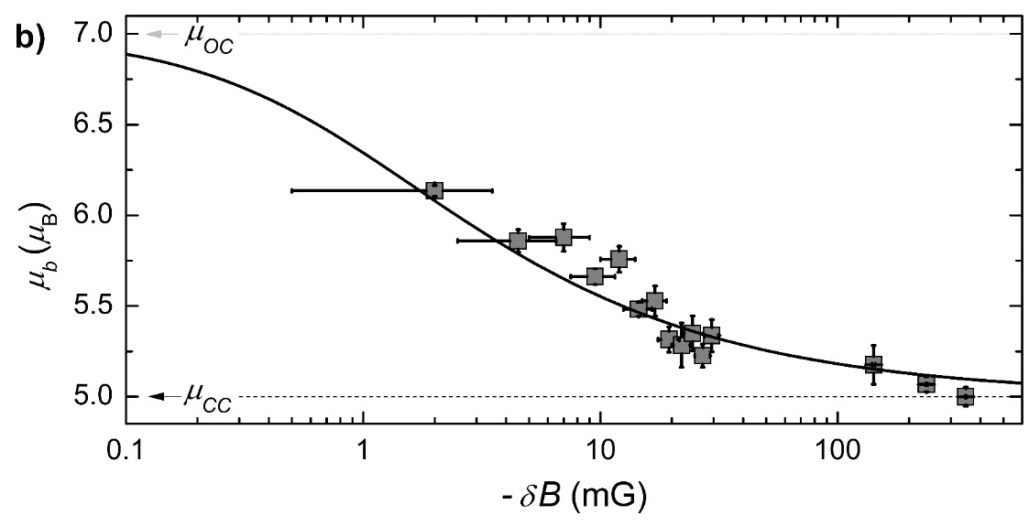
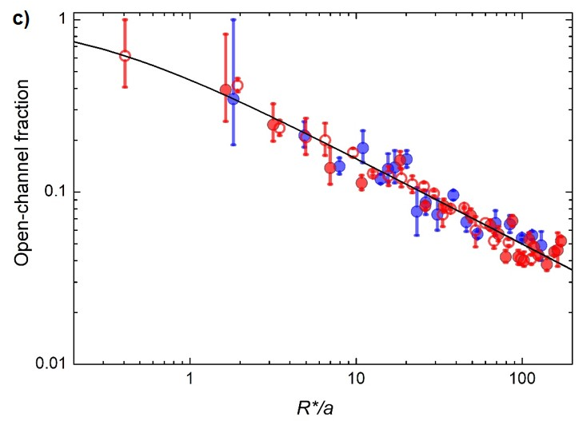


LiCr Feshbach dimers: summary
>50k dimers formed @ T <200 nK and PSD >0.1 !
0.5
LiCr time-of-flight (ms)
10.5
Paramagnetic nature confirmed; quantum-state control experimentally achieved
$${{ μ}_{b}= μ}_{OC}OC+μ_{CC}(1−OC)$$
$$OC=1/\sqrt{1+4R^{∗}/a}$$
Collisional stability explored: lifetime of pure dimer samples >0.2 s !
For details: Finelli et al, arXiv:2402.08337 (2024)

Slide 12
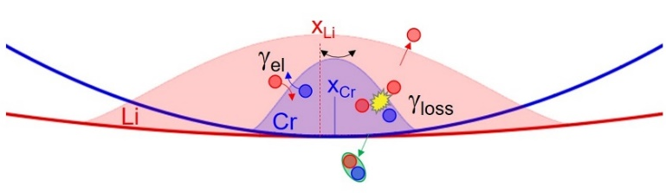
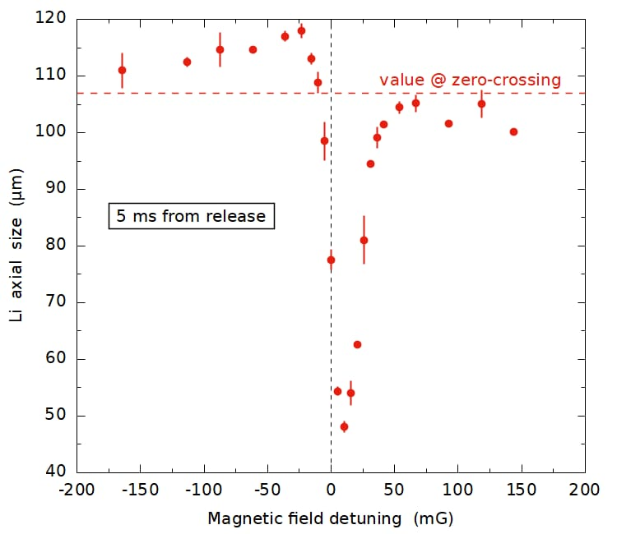
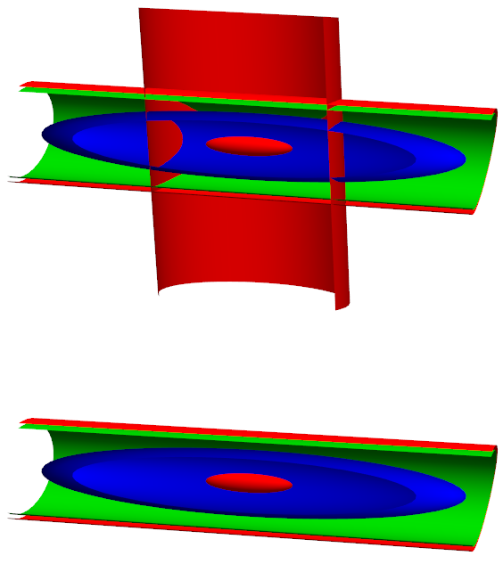
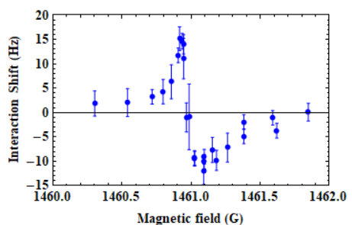
Strongly-interacting Li-Cr mixtures: an overview
Collisional hydrodynamics from in-trap coupled oscillations
For details: Finelli et al, arXiv:2402.08337 (2024)
Spin transport/diffusion: Li in a Cr Fermi gas
ONGOING
Radio-frequency spectroscopy of Li in Cr and vice-versa
ONGOING
Magnetic-field stability: < 5 mG over 100s of ms
Extreme (1 Hz) sensitivity to interaction shifts

Slide 13
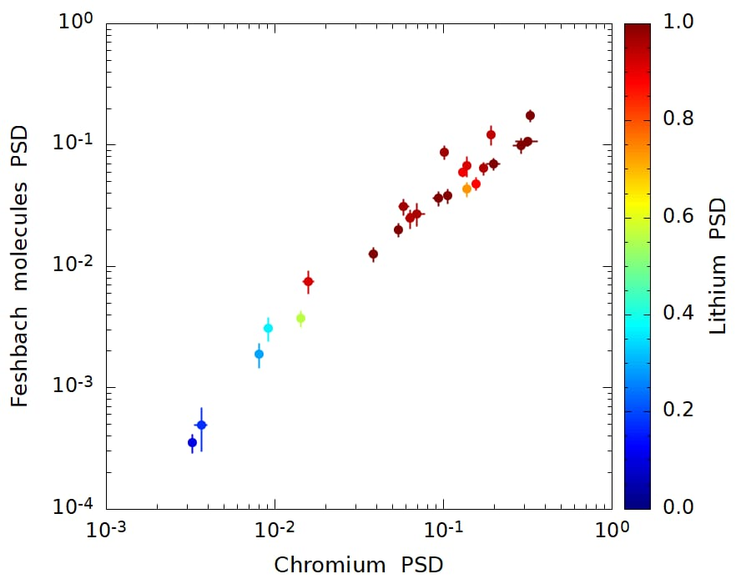
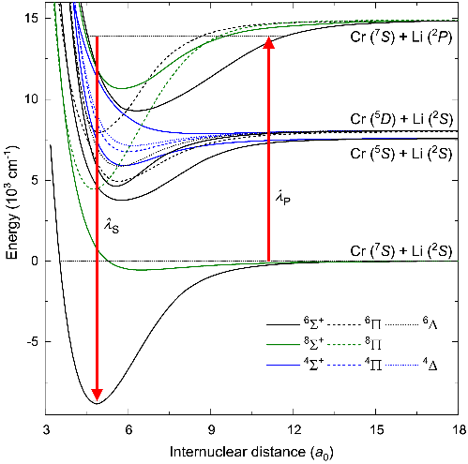
Outlook
Bose Einstein condensate of LiCr Feshbach dimers ?
Few-body clusters (quasi-2D)
R. Liu & X. Cui preliminary
Optical spectroscopy on LiCr & STIRAP to LiCr ground state
Collaboration with M. Tomza, see arXiv:2402.08337 (2024)
Explore p-wave Feshbach resonances

Slide 14
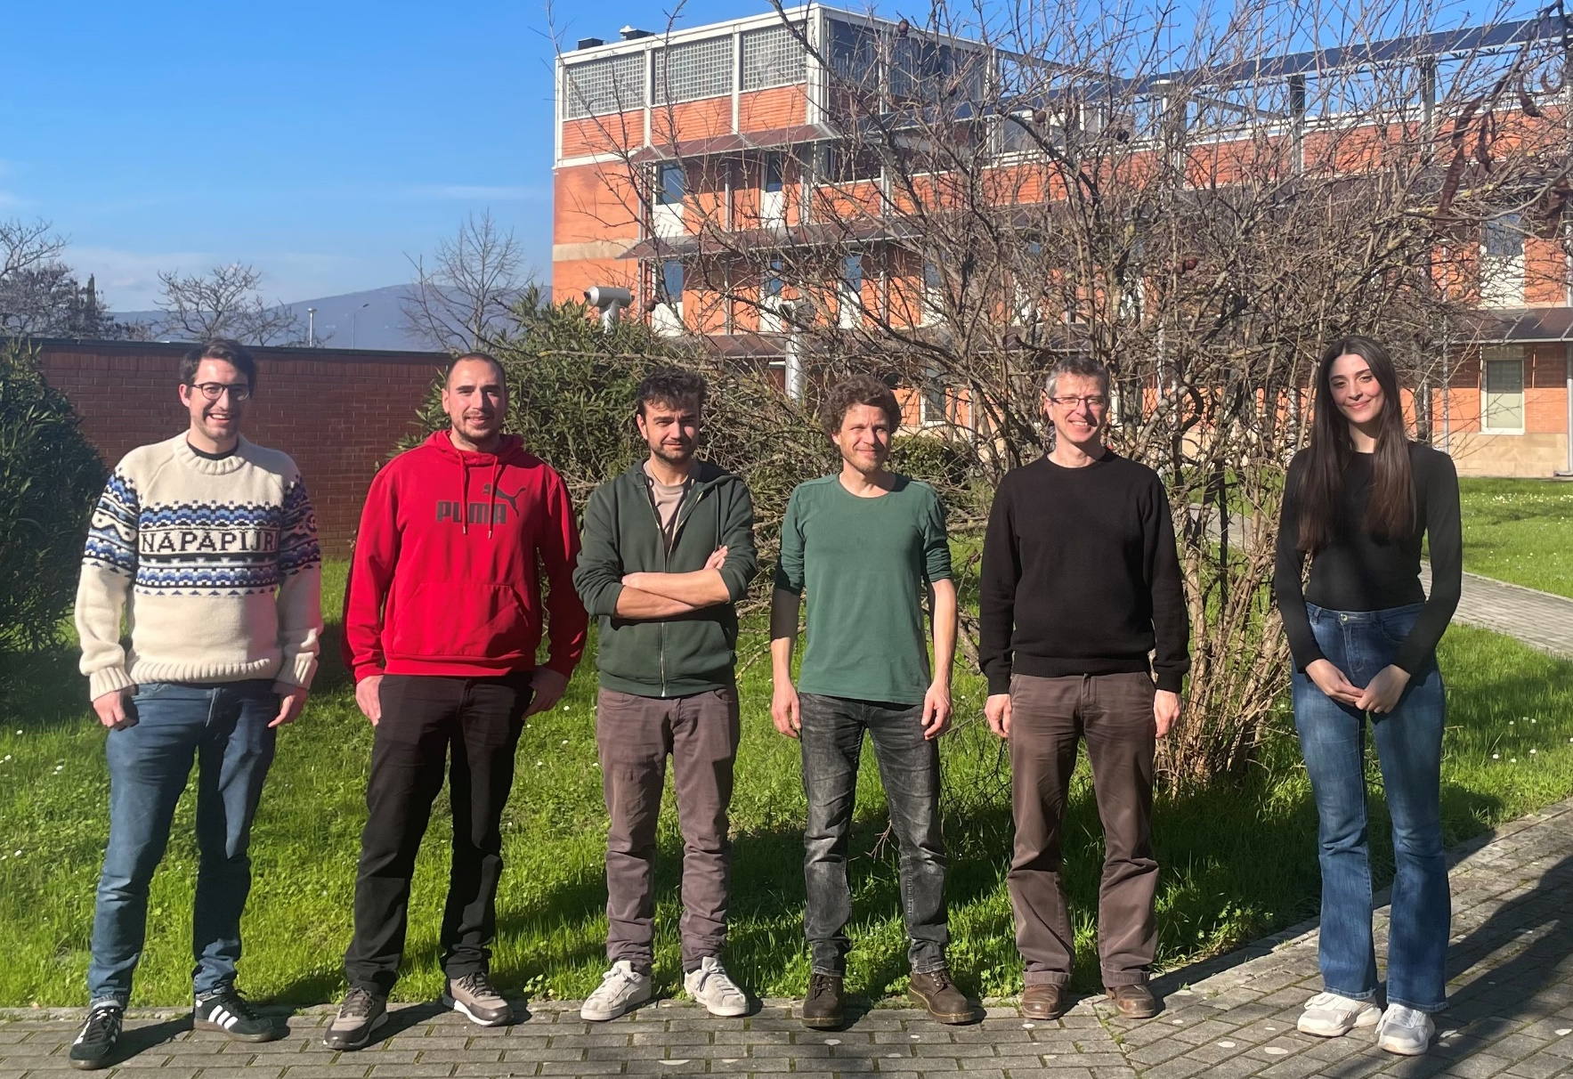


Thanks !
Alessio Ciamei
(CNR researcher)
Beatrice Restivo
(PhD student)
Max Schemmer
(CNR researcher)
Stefano Finelli
(PhD student)
Andreas Trenkwalder
(CNR researcher)
€€€
Young Researchers

