Slide 1
Storage Rings for Quantum Computing
V.S. Morozov, SNS, NSD, Oak Ridge National Lab, Oak Ridge, TN
M. Grau, Old Dominion University, Norfolk, VA
R. Suleiman, Thomas Jefferson National Accelerator Facility, Newport News, VA
Roadmap for Future Accelerators Meeting
Goethe University Frankfurt, Frankfurt am Main, Germany, September 2-3, 2024

Slide 2
Outline
Current state and challenges of quantum computing
Spin-transparent storage ring as a solution to key quantum computing challenges
Qubit selection
Schematic of storage-ring-based quantum computing system
Storage ring design
Spin coherence time in a spin-transparent storage ring
Constraints on background fields
Qubit manipulation and measurement
Beam parameter constraints
Concept verification by a small prototype
Summary and other applications

Slide 3
Quantum Computing
Promising technology relying on fundamental principle of quantum mechanics such as qubit entanglement lacking classical analogs
Simulation of a wide variety of quantum systems including nanomaterials, quantum chemistry, quantum optics, and quantum field theories
Integer factorization and its impact on cryptography
Fast search algorithms
Machine learning tasks
Two of the greatest challenges
Quantum coherence time Polarized accelerator beam analogy: loss of transverse beam polarization component
Scalability Ability to increase the number of qubits without exponential increase in cost of resources

Slide 4
Current State of Art
Search for technology that can provide long coherence times for large, scalable systems of qubits is underway
 | Neutral Atoms | SC Qubits | Trapped Ions | Photonics
Number of Qubits | 280 | 127 | 32 | 216
Coherence Time | 1.5 s | 1 ms | 5500 s | -
Measurement Fidelity | 0.998 | 0.999 | 0.9993 | 0.98
Gate (Operation) Time | 200 µs | 4 ns | 1.6 µs | -
One-Qubit Gate Fidelity | 0.999 | 0.9992 | 0.999999 | 0.986
Two-Qubit Gate Fidelity | 0.993 | 0.995 | 0.997 | 0.93

Slide 5
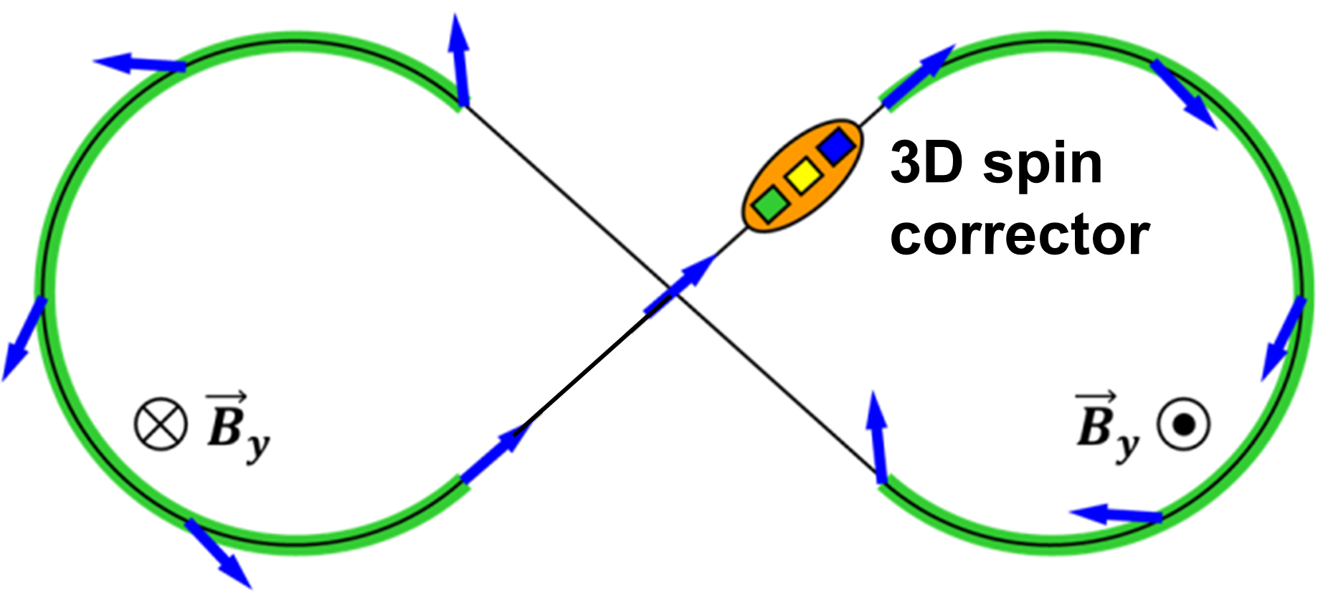
Spin Transparent Ring Concept
Storage ring with degenerate spin motion
Spin transformation in one turn around the ring is a unit operator, i.e., no net spin rotation
Can be understood as spin-echo effect
Figure-8 topology is most natural example
Straightforward concept: spin rotation in one arc is compensated by the spin rotation in the second arc
No first-order spin chromaticity, compensation is energy independent
Originally proposed for polarized storage rings
Well-understood theory for magnetic rings
https://doi.org/10.1103/PhysRevLett.124.194801
https://doi.org/10.3390/sym13030398
$${\vec{B}}_{z}$$
$${\vec{B}}_{z}$$

Slide 6
Reaching Spin Transparency in Real Ring
Imperfections such as dipole roll and quad misalignment lead to closed orbit excursion and break spin degeneracy in a real-world ring
Error effect is rather weak, spin sensitivity to errors can be described through the spin response function based on the linear optics
Closed orbit excursion leads to coherent spin rotation, the same for all particles
Effect of imperfections can be experimentally measured and compensated by a local 3D spin rotator consisting of weak magnets, e.g., a sequence of alternating dipole and solenoids can provide a rotation about an arbitrary axis cancelling the error effect
Higher-order incoherent spin rotations result from betatron and synchrotron motion and set a fundamental limit on the spin coherence time

Slide 7
Benefits on Spin Transparent Ring Approach
Large number of qubits that can be stored in ring
Long quantum coherence times of over an hour
Lack of strict thermal constraints by using spin quantum properties only and not relying on quantum effects of particle motion and inter-qubit interaction
Can also be used as a quantum sensor or part of quantum memory

Slide 8
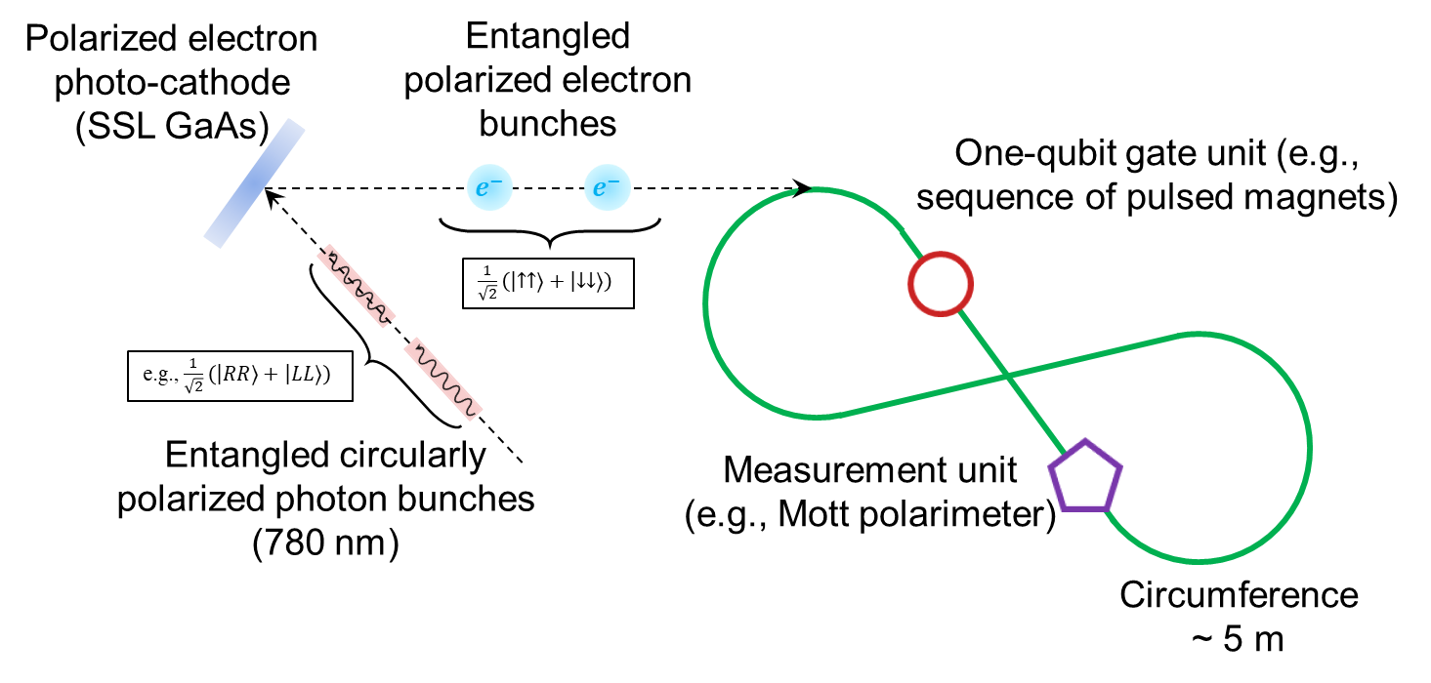
Original Idea
Too many questions
Selection of entangled electrons out of all produced electrons
Entanglement of bunches as macroscopic objects
Qubit initialization, entanglement and readout
Avoid these questions by resorting to a combination of proven technologies as much as possible
¹⁷¹Yb⁺
Ion trap
Ion cooling
State preparation
Entanglement as Two Qubit gate
Storage ring
Application of Single Qubit gates
Final state readout

Slide 9
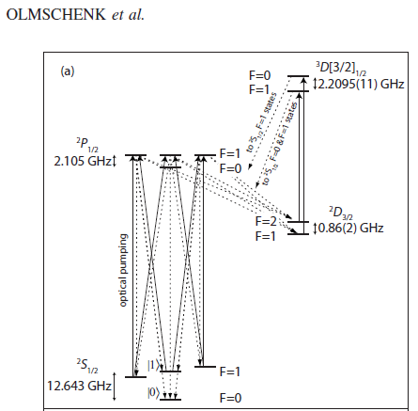
Qubit Selection
¹⁷¹Yb⁺ is an attractive choice
Nuclear spin ½
Reasonable ionization and transition energies
Observational stability
First-order Zeeman insensitive
Extensive existing ion trap experience
Outermost S shell of ¹⁷¹Yb⁺ encodes states of qubit
$\left|0\right\rangle ≡{}_{}^{2}{S_{1/2}|F=0, m_{F}=0⟩}$
$\left|1\right\rangle ≡{}_{}^{2}{S_{1/2}|F=1, m_{F}=0⟩}$

Slide 10
Beam Lifetime
Dominated by charge-exchange interaction of ions with residual gas ${{}_{}^{171}{Yb}}^{+}+H_{2} →{}_{}^{171}{Yb}+H_{2}^{+}$
One-electron capture cross sections nearly independent of ion energy below 100 keV https://doi.org/10.1109/TNS.1976.4328382
Assuming our ion parameters, charge exchange cross section of $\sim 7.5⋅{10}^{−16}$ cm², and a vacuum pressure of $\sim {10}^{−12}$ Torr, stored beam lifetime $τ≃3800 \text{s}$

Slide 11
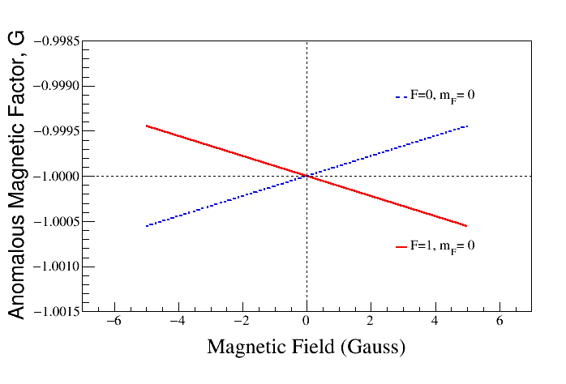
Spin Transparency with Ions
For elementary particles, the spin rotation of a reference particle in a magnetic spin-transparent ring is zero $φ_{y}=\oint{Gγ dθ}=Gγ\oint{dθ}=\frac{eGγ}{p}\oint{B_{y}ds}=0$ because the anomalous magnetic moment $G$ is a constant and there is no net bending angle
Ion is a compound particle, the effective $G$ of the $\left|1\right\rangle$ state depends on the external field in a way such that $G\left(B\right)≠G\left(−B\right)$ The spin transparency condition may be violated.
Choose electric ring design because $G\left(E\right)=G\left(−E\right)$ when
$$φ_{y}=\frac{eγ}{p}\oint{G\left(B_{y}\right) B_{y}ds}≠0$$
$$φ_{y}=−\oint{\frac{1−γ^{2}β^{2}G\left(E_{x}\right)}{γ}\frac{eE_{x}}{pβc}ds}=0$$
$$\oint{E_{x}ds}=0 \left(\text{zero} \text{net} \text{bend}\right) \text{and}$$
$$\oint{G\left(\left|E_{x}\right|\right)E_{x}ds}=0 \text{(}\text{symmetry} \text{of} E_{x} \text{as} \text{function} \text{of} s)$$

Slide 12
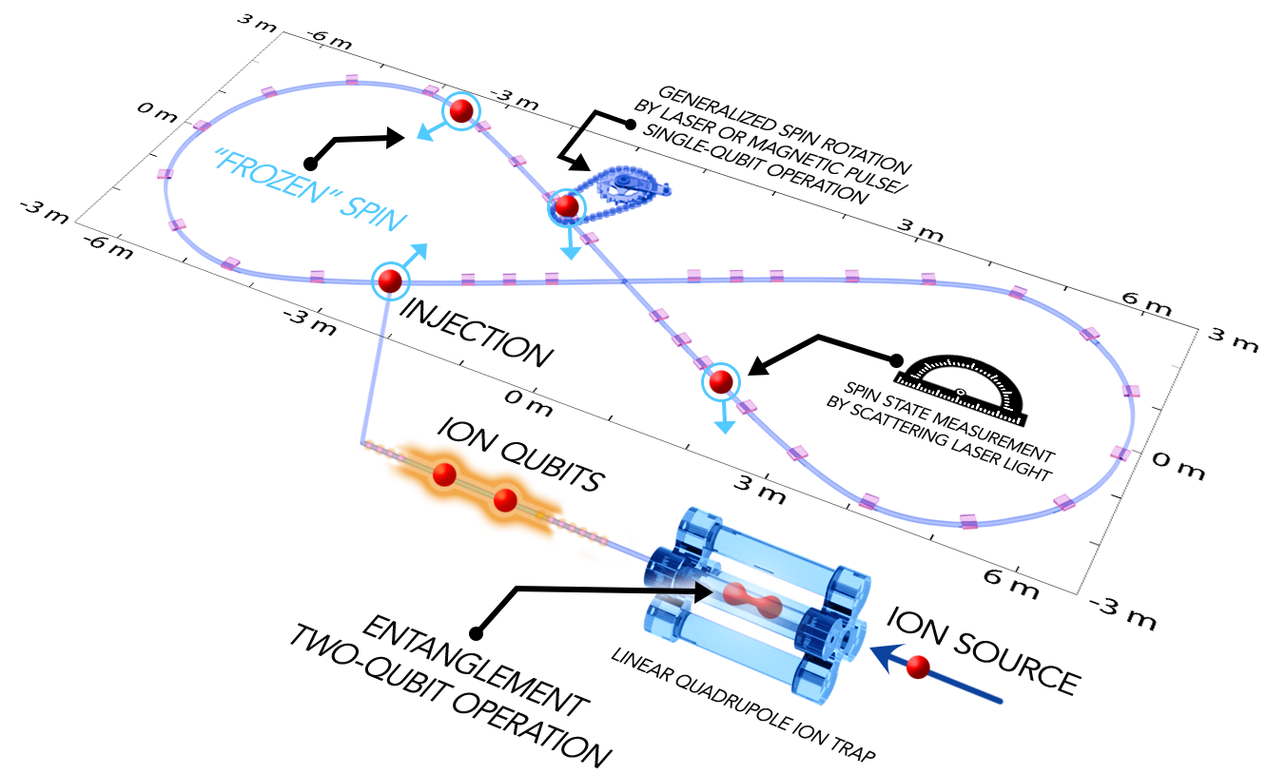
Storage-Ring-Based Quantum Computing System Schematic
Simplest scenario
Ion qubits entangled pairwise in an ion trap (two-qubit gate)
One qubit injected into spin-transparent ring
Remaining qubit entangled with subsequent qubit in the ion trap
Process continues to fill the ring and replace spent qubits
Single-qubit gates applied to stored ions
Final state detected

Slide 13
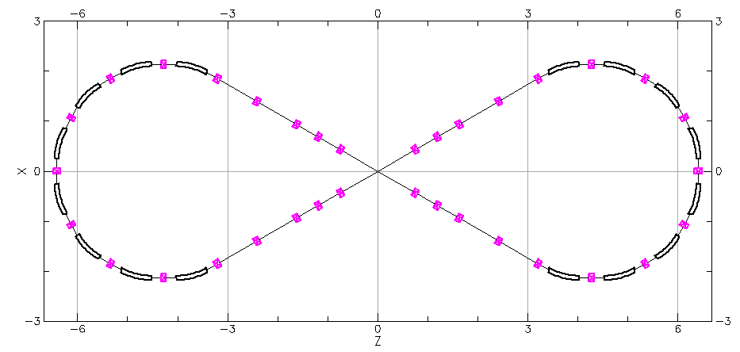
Quantum Computation with “Pitstops”
Ions are selectively kicked out of ring and brought to rest in ion trap
Ions are laser-cool, entangling gates are applied and ions are re-injected back into ring
Ion trap
Entanglement
…
Selected Q-bits

Slide 14
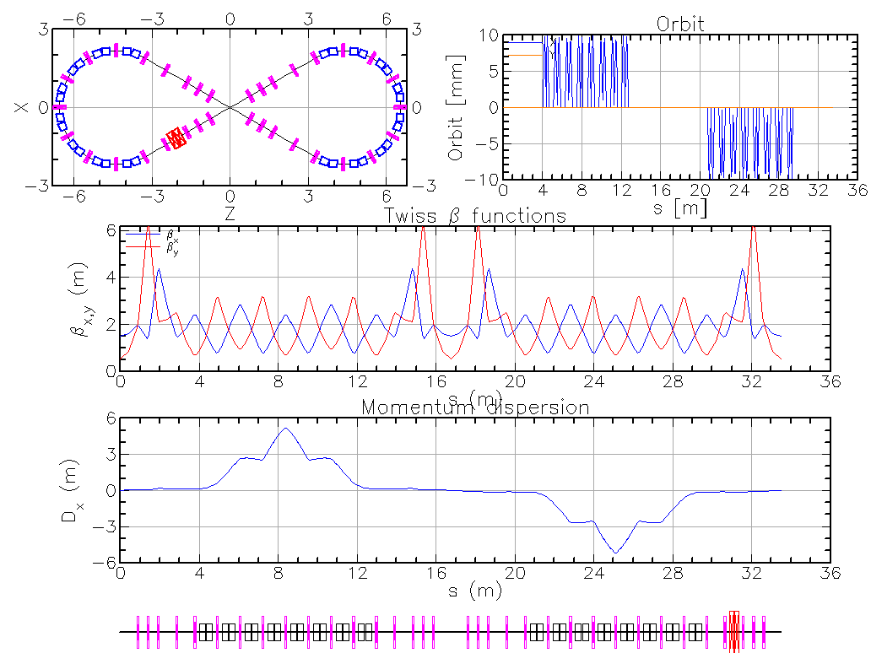
Example Ring Design and Parameters
Circumference is determined by the number of qubits
Inter-qubit separation determined by kicker requirements
Ion | ¹⁷¹Yb⁺
Kinetic energy, $T$ | 10 keV
Relativistic, $β$ | $3.54×{10}^{−4}$
Momentum offset, $Δp/p$ | $<{10}^{−4}$
Angular offset $θ$ | $<{10}^{−4}$
Ring circumference, $L$ | 33.5 m
Circulation frequency, $f_{c}$ | 3.17 kHz
Qubit separation, $Δt$ / $Δz$ | 95.7 ns/ 1 cm
Electric bending field | 17.3 kV/m
10 mrad integrated kicker field | 200 V
Number of qubits | $3,300$
Spin coherence time | $>3$ hours

Slide 15
Spin Coherence Time
Net accumulated spin rotation during storage $Δt_{store}$of ~3 hours must be small $ν_{s}≪\frac{1}{N_{turns}}=\frac{1}{f_{c} Δt_{store}}≃3⋅{10}^{−8}$
Lab-frame electric field acts on the spin through its Lorentz transformation into magnetic field in ion’s rest frame
Electric field’s spin effect suppressed due to low $β$
Spin tracking in an electron ring is not trivial, using PTC method in Bmad
Further work needed but initial analysis shows nearly negligible effect of realistic electric field errors
The coherence time is probably limited by background magnetic fields
Setting a limit on background magnetic field requires simultaneous analysis of both its direct spin effect and its indirect spin effect through orbit excursion, which cannot be easily estimated by analytic tools

Slide 16
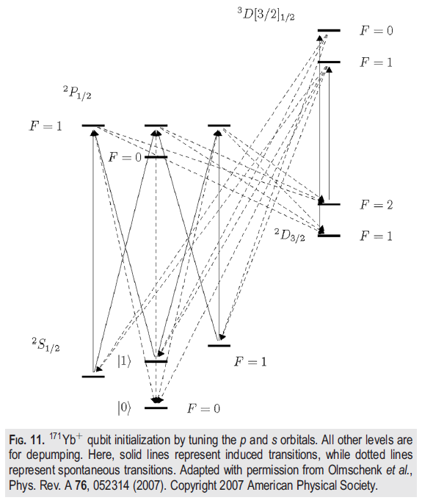
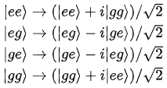
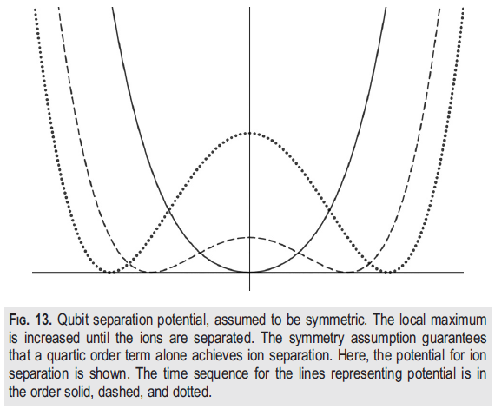
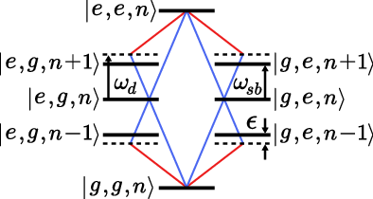
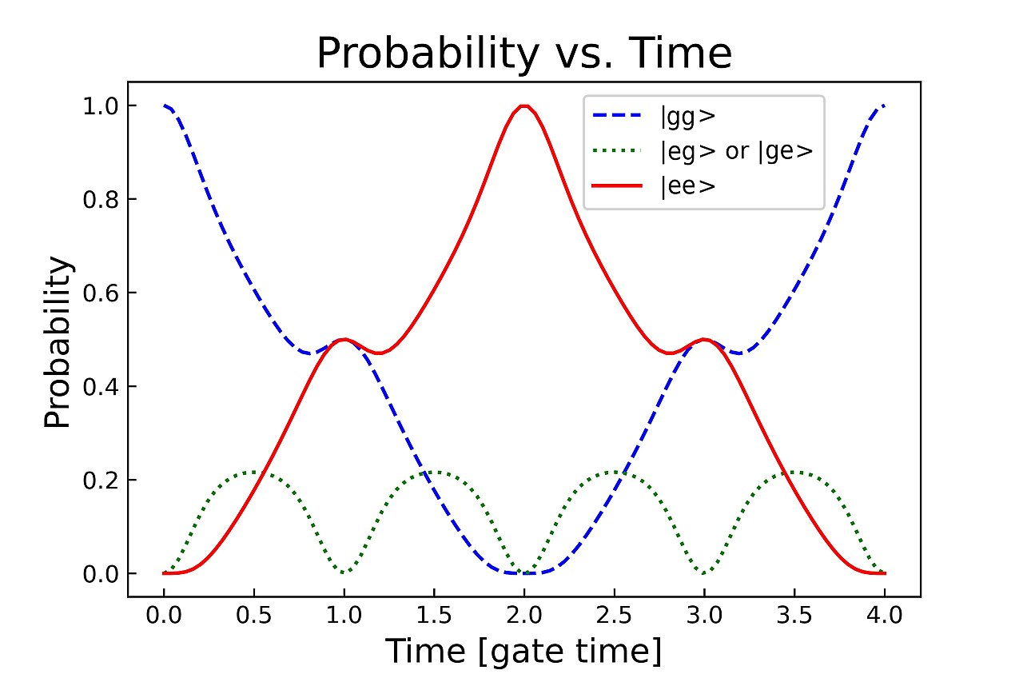
State Preparation in Ion Trap
Relying on existing technology
State initialization to $|0⟩$
Ion entanglement (Mølmer-Sørenson Two-Qubit gate), requires cooling to resolve vibrational modes
Qubit separation with quartic potential
G.N. Nop, D. Paudyal, and J.D.H. Smith, AVS Quantum Sci. 1 December 2021; 3 (4): 044101.
F. Martínez-García et al., arXiv:2112.05447
https://en.wikipedia.org/wiki/Mølmer-Sørensen_gate

Slide 17
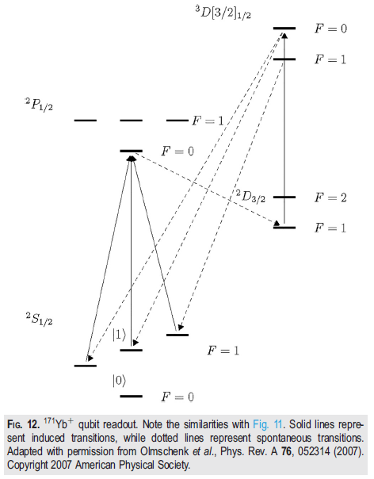
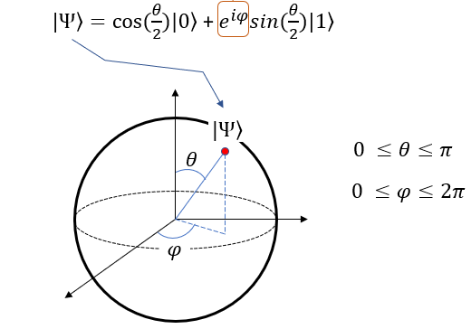
State Manipulation and Readout in Ring
Single-Qubit gates boil down to rotations about the different axes of the Bloch sphere, e.g., Pauli-X, Y, Z gates, rotations about the respective axes by $π$
Rotations can be implemented using pulsed magnetic fields
Naïve calculation treating an ion as a simple particle gives a required solenoid field of $>1 T⋅m$ to flip the spin about the Z axis; however, at this strength, one may have to account for an ion being a compound particle
For simplicity, consider using atomic physics techniques such as laser pulses to induce Rabi rotations of qubits
Readout through fluorescent techniques
These gates together with the two-qubit gate form a universal gate set
G.N. Nop, D. Paudyal, and J.D.H. Smith, AVS Quantum Sci. 1 December 2021; 3 (4): 044101.
https://www.sharetechnote.com/html/QC/QuantumComputing_BlochSphere.html

Slide 18
Constraints on Transverse and Longitudinal Momentum Offsets
Spin motion in a spin-transparent ring is independent of the particle action to first order
No need for cold beams
Limitations on the transverse and longitudinal momentum offsets comes from the incoherent Doppler shift of the laser frequency $f_{lab}$ of ~810 THz (370 nm) in the ion’s rest frame $f_{ion}=γ\left(1−β\cos{θ_{lab}}\right) f_{lab}$
Frequency shift must be less than the transition line’s natural with $Δf_{Nat}$ of ~20 MHz
Head-on illumination $f_{ion}=γ\left(1−β\cos\left(π+θ_{ion}\right)\right) f_{lab}=γ\left(1+(β_{0}+Δβ_{∥})\cos{θ_{ion}}\right) f_{lab}$ $\frac{Δf_{ion}}{f_{lab}}=\frac{1}{f_{lab}}\sqrt{{\left(\frac{∂f_{ion}}{∂β}\right)}^{2}Δβ_{∥}^{2}+{\left(\frac{∂f_{ion}}{∂θ_{ion}}\right)}^{2}θ_{ion}^{2}}≃\frac{γ}{1−β}Δβ_{∥}<\frac{Δf_{Nat}}{f_{lab}}$ $\frac{Δp}{p}=\frac{γ^{2}}{β}Δβ_{∥}<\frac{1−β}{β}γ\frac{Δf_{Nat}}{f_{lab}}≃\frac{1}{ β}\frac{Δf_{Nat}}{f_{lab}}≃7⋅{10}^{−5}$
Transverse illumination $f_{ion}=γ\left(1−β\cos\left(\frac{π}{2}−θ_{ion}\right)\right) f_{lab}=γ\left(1−(β_{0}+Δβ_{∥})\sin{θ_{ion}}\right) f_{lab}$ $σ_{θ}<\frac{1}{γβ}\frac{Δf_{Nat}}{f_{lab}}≃\frac{1}{β}\frac{Δf_{Nat}}{f_{lab}}≃7⋅{10}^{−5}$
It may be possible to relax these requirements by a laser frequency sweep, the fundamental limit is hyperfine splitting of ~12.6 GHz

Slide 19
Expected Performance
Further analysis needed to refine the storage ring’s parameters
 | Storage Ring (projected) | Neutral Atoms | SC Qubits | Trapped Ions | Photonics
Number of Qubits | 10-10⁵ | 280 | 127 | 32 | 216
Coherence Time | ~3 hours | 1.5 s | 1 ms | 5500 s | -
Measurement Fidelity | > 0.99 | 0.998 | 0.999 | 0.9993 | 0.98
Gate (Operation) Time | ~10 ns | 200 µs | 4 ns | 1.6 µs | -
One-Qubit Gate Fidelity | > 0.99 | 0.999 | 0.9992 | 0.999999 | 0.986
Two-Qubit Gate Fidelity | TBD | 0.993 | 0.995 | 0.997 | 0.93

Slide 20
Small-Scale Prototype
The ring circumference is determined by the number of stored qubits, not the electric field strength limitation
One may consider a demonstration experiment with the ring size significantly scaled down, say, by a factor of ~10
Circumference of a few meters
Accommodates several hundred qubits
Modest electric fields of $<200$ kV/m
Reasonable cost
Test key concepts and questions

Slide 21
Summary and Conclusions
Interdisciplinary combination of accelerator and ion trap technologies may potentially open a new avenue in quantum computing
Spin-transparent storage ring concept may offer a solution to the key quantum computing challenges by providing the following features
Large, straightforwardly scalable numbers of qubits
Long qubit spin coherence and storage times of hours
Conventional-emittance beams (no need for ultra-cold beams) in the storage ring
The scheme relies on well-understood technologies
Initial evaluation provides rather modest parameters
The concept can be tested using a small-scale, inexpensive prototype
Spin-transparent storage rings may offer other exciting applications
Measurement of EDMs of free electron and proton R. Suleiman et al., Phys.Lett.B 843 (2023) 138058, doi:10.1016/j.physletb.2023.138058
Search for axions R. Suleiman et al., JACoW IPAC2024, WEAN2 (2024), doi:10.18429/JACoW-IPAC2024-WEAN2

