Slide 1
1
Other Science Applications of FCC-ee
Frank Zimmermann
i.FAST “Accelerator Roadmap” Brainstorm Workshop “iBiF24”, Frankfurt, 2 September 2024

Slide 2
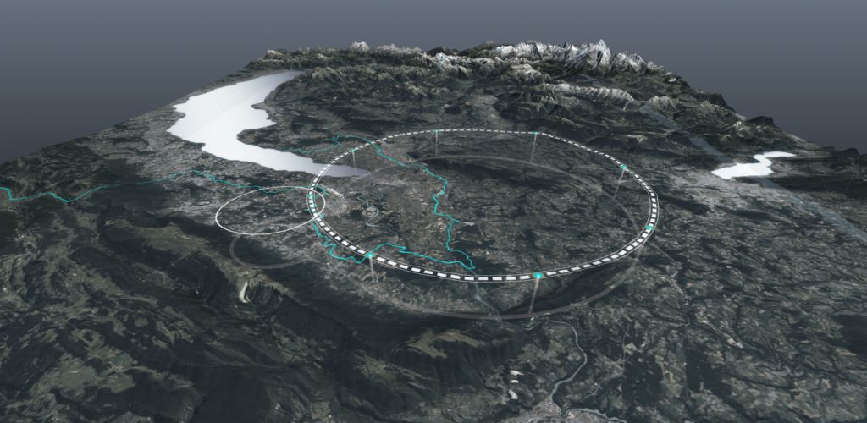
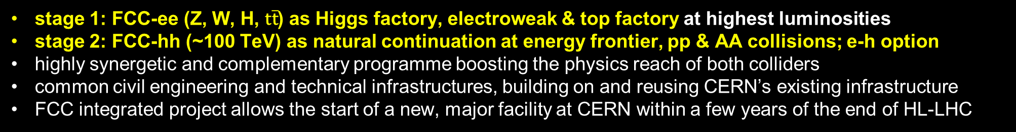
Future Circular Collider - long-term program maximizing physics opportunities
r
stage 1: FCC-ee (Z, W, H, $\text{t}\overline{\text{t}}$) as Higgs factory, electroweak & top factory at highest luminosities
stage 2: FCC-hh (~100 TeV) as natural continuation at energy frontier, pp & AA collisions; e-h option
highly synergetic and complementary programme boosting the physics reach of both colliders
common civil engineering and technical infrastructures, building on and reusing CERN’s existing infrastructure
FCC integrated project allows the start of a new, major facility at CERN within a few years of the end of HL-LHC
Documented in M. Benedikt, F. Zimmermann, M. Doser, S. Casalbuoni, 10.5281/zenodo.7675663

Slide 3

FCC-ee Main Machine Parameters
Parameter | Z | WW | H (ZH) | ttbar
beam energy [GeV] | 45.6 | 80 | 120 | 182.5
beam current [mA] | 1270 | 137 | 26.7 | 4.9
number bunches/beam | 11200 | 1780 | 440 | 60
bunch intensity [10¹¹] | 2.14 | 1.45 | 1.15 | 1.55
SR energy loss / turn [GeV] | 0.0394 | 0.374 | 1.89 | 10.4
total RF voltage 400/800 MHz [GV] | 0.120/0 | 1.0/0 | 2.1/0 | 2.1/9.4
long. damping time [turns] | 1158 | 215 | 64 | 18
horizontal beta* [m] | 0.11 | 0.2 | 0.24 | 1.0
vertical beta* [mm] | 0.7 | 1.0 | 1.0 | 1.6
horizontal geometric emittance [nm] | 0.71 | 2.17 | 0.71 | 1.59
vertical geom. emittance [pm] | 1.9 | 2.2 | 1.4 | 1.6
horizontal rms IP spot size [μm] | 9 | 21 | 13 | 40
vertical rms IP spot size [nm] | 36 | 47 | 40 | 51
beam-beam parameter ξ_{x} / ξ_{y} | 0.002/0.0973 | 0.013/0.128 | 0.010/0.088 | 0.073/0.134
rms bunch length with SR / BS [mm] | 5.6 / 15.5 | 3.5 / 5.4 | 3.4 / 4.7 | 1.8 / 2.2
luminosity per IP [10³⁴ cm⁻²s⁻¹] | 140 | 20 | ≥5.0 | 1.25
total integrated luminosity / IP / year [ab⁻¹/yr] | 17 | 2.4 | 0.6 | 0.15
beam lifetime rad Bhabha + BS [min] | 15 | 12 | 12 | 11
Design and parameters
dominated by the
choice to allow for
50 MW synchrotron
radiation per beam.
4 years
5 x 10¹² Z
LEP x 10⁵
2 years
> 10⁸ WW
LEP x 10⁴
3 years
2 x 10⁶ H
5 years
2 x 10⁶ tt pairs
x 10-50 improvements on all EW observables
up to x 10 improvement on Higgs coupling (model-indep.) measurements over HL-LHC
x10 Belle II statistics for b, c, τ
indirect discovery potential up to ~ 70 TeV
direct discovery potential for feebly-interacting particles over 5-100 GeV mass range
Up to 4 interaction points → robustness,
statistics, possibility of specialised detectors
to maximise physics output
F. Gianotti

Slide 4
FCC-hh Main Machine Parameters
parameter | FCC-hh | HL-LHC | LHC
collision energy cms [TeV] | 84 - 120 | 14 | 14
dipole field [T] | 14 - 20 | 8.33 | 8.33
circumference [km] | 90.7 | 26.7 | 26.7
arc length [km] | 76.9 | 22.5
beam current [A] | 0.5 | 1.1 | 0.58
bunch intensity [10¹¹] | 1 | 2.2 | 1.15
bunch spacing [ns] | 25 | 25 | 25
synchr. rad. power / ring [kW] | 1100 - 4570 | 7.3 | 3.6
SR power / length [W/m/ap.] | 14 - 58 | 0.33 | 0.17
long. emit. damping time [h] | 0.77 – 0.26 | 12.9 | 12.9
peak luminosity [10³⁴ cm⁻²s⁻¹] | ~30 | 5 (lev.) | 1
events/bunch crossing | ~1000 | 132 | 27
stored energy/beam [GJ] | 6.3 – 9.2 | 0.7 | 0.36
Integrated luminosity/main IP [fb⁻¹] | 20000 | 3000 | 300
With FCC-hh after FCC-ee: significantly
more time for high-field magnet R&D
aiming at highest possible energies
Formidable challenges:
high-field superconducting magnets: 14 - 20 T
power load in arcs from synchrotron radiation: 4 MW → cryogenics, vacuum
stored beam energy: ~ 9 GJ → machine protection
pile-up in the detectors: ~1000 events/xing
energy consumption: 4 TWh/year → R&D on cryo, HTS, beam current, …
Formidable physics reach, including:
Direct discovery potential up to ~ 40 TeV
Measurement of Higgs self to ~ 5% and ttH to ~ 1%
High-precision and model-indep (with FCC-ee input)
measurements of rare Higgs decays (𝛄𝛄, Z𝛄, µµ)
Final word about WIMP dark matter
F. Gianotti

Slide 5
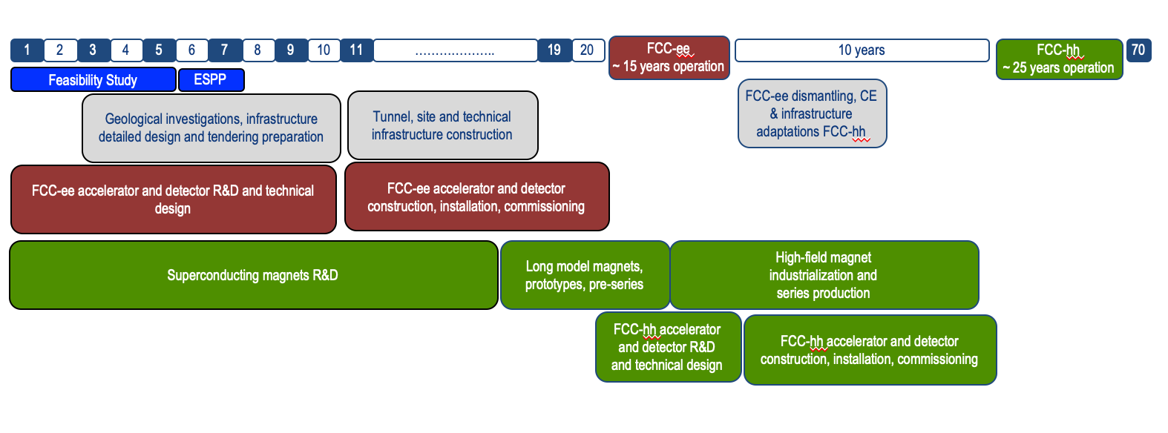
FCC integrated program – “accelerated” schedule
FCC Conceptual Design Study started in 2014 leading to CDR in 2018
2021- 25:
Feasibility Study
2027/2028:
Project Approval by CERN Council
2032:
Start of construction
2041:
HL-LHC ends
2045:
Operation of FCC-ee
2070:
Operation of FCC-hh
“Realistic” schedule taking into account:
past experience in building colliders at CERN
approval timeline: ESPP, Council decision
that HL-LHC will run until 2041
Can be further accelerated if more resources become available

Slide 6




Timeline till start of construction
2024
2025
2026
2027
2028
2029
2030
2031
2032
2033
Feasibility Study
Pre-TDR Phase
TDR Phase
Construction →→→
FS Report
cost update
ESPPU
2025/26
pre TDR
cost update
TDR
cost update
Project
Decision
accelerator design, technical infrastructure design, R&D, towards TDR
engineering design →
Environmental Impact study & Authorization Process
Phase 1 Site Investigations
Phase 2 Site Investigations
CE Concept Design update
CE Tender Design
Construction Design
Start construction
Detector EOI submissions
FC³ formation, call for CDRs
Detector CDRs submitted to FC³

Slide 7

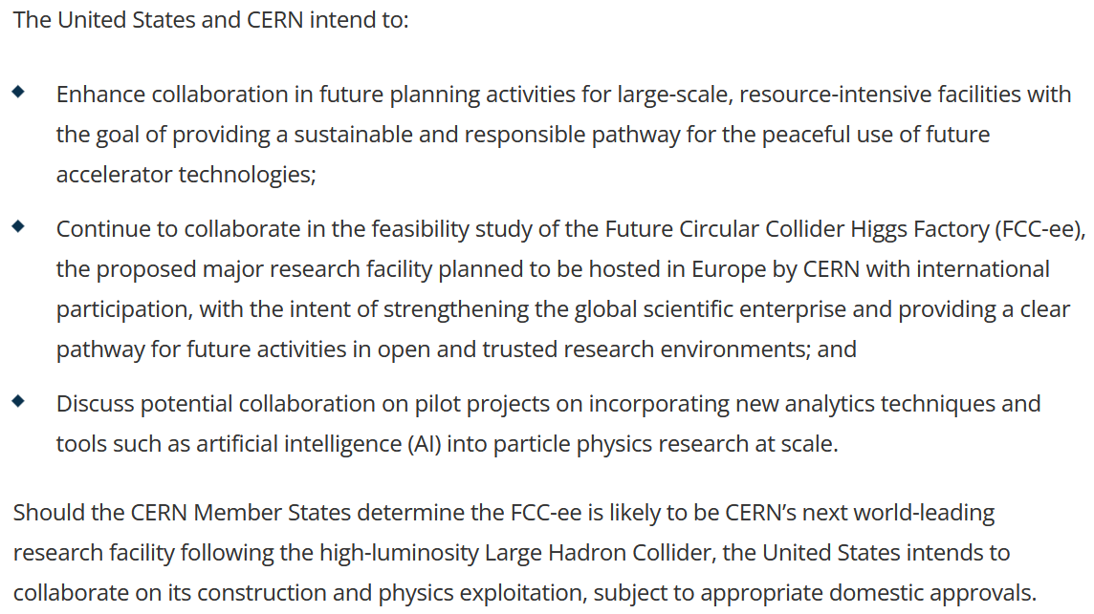
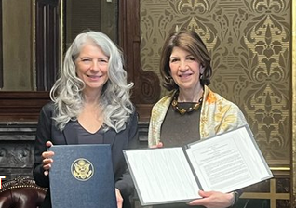
Progress on international collaboration
26 April 2024
White House Office of Science and Technology Policy Principal Deputy U.S. Chief Technology Officer Deirdre Mulligan signed for the United States while Director-General Fabiola Gianotti signed for CERN.

Slide 8
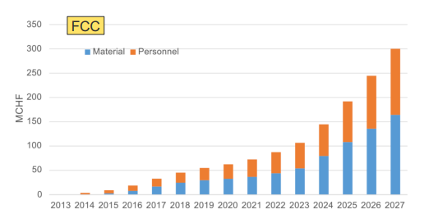
Recent decisions by CERN Council
February 2024: special Council meeting: successful Mid-Term Review; all objectives met, lots of praise & positive feedback, recommendations & guidance
March 2024: ESPPU schedule 2025/2026 approved with input by March 2025, conclusions mid 2026; compatible with “accelerated” FCC schedule
June 2024: approval of modified CERN Medium Term Plan (MTP), including more resources for FCC-FS completion and for FCC pre-TDR phase
Additional expenses in June 2024 MTP to prepare for CERN’s future
Future Circular Collider (FCC)
Additional resources for the Feasibility Study → 13 MCHF (until March 2025, when final report will be submitted)
Funding for “pre-TDR phase” → 82 MCHF (April 2025-end 2027)
Superconducting radiofrequency technology (SRF)
Ramp up R&D for future accelerators (until now 2.3 MCHF/year) → 9.7 MCHF (2025-2027)
cumulative FCC funding up to
end pre-TDR phase
w/o HFM & SRF

Slide 9
History: studies of other FCC science applications
14 May 2013 brainstorming meeting on LHC as a light source organized by Herman Winick.
Attendees: Yunhai Cai, Alan Fisher, Bob Hettel, Claudio Pellegrini, Tom Rabedeau, John Seeman, Jim Sebek, Gennady Stupakov, Kai Tian. “Herman Winick Winick called this meeting after having discussions with Albert Hofmann and Frank Zimmermann, who pointed out that LHC provided soft x-ray beams that might exceed the performance of existing electron storage ring light sources, and that this might be extended to harder x-rays from future proton rings”; Followed by discussion on HE-LHC, VHE-LHC (FCC-hh) & TLEP (FCC-ee) as light sources.
Brainstorming in July 2020 on R1 outside terasse (covid!): Michael Benedikt, Sara Casalbuoni (EU-XFEL, remote), Michael Doser, Frank Zimmermann; identified 7 applications: 1.1 FCC-LS : The world’s most powerful light source for very hard X-rays 1.2 FCC-CBS: 3-5 orders of magnitude more flux and higher photon energy than ELI-NP; 2.1 Positron source for material research; 2.2 Testbed for LEMMA muon collider; 2.3 Plasma acceleration of positrons; 2.4 Non-perturbative QED Experiments – proving the boiling of the QED vacuum ; 2.5 Positronium-based GeV photon source – a speculative proposal ; Documented in M. Benedikt, F. Zimmermann, M. Doser, S. Casalbuoni: 10.5281/zenodo.7675663
Other FCC Science Initiative (also in view of ESU), kick off brainstorm 23 August 2024. In person: Gianluigi Arduini, Hannes Bartosik, Michael Benedikt, Christoph Grojean, Patrick Janot, Yannis Papaphilippou, Guy Wilkinson, Frank Zimmermann; Remote: Emanuele Bagnaschi , Giovanni Cantatore, Sara Casalbuoni, David d’Enterria, Armin Ilg, Richard Jacobsson, Joerg Jaeckel, Witek Krasny, Sakura Pascarelli, Benjamin Rienäcker, Ivo Schulthess, Alessandro Variola, Matthew Wing; https://indico.cern.ch/event/1442918/
Recent communications: Atoosa Meseck on Compton source; Marco Calviani & Charlotte Duchemin on use of beamstrahlung photons and on radionuclide production Witek Krasny – comprehensive notes from, and comments on, the kickoff meeting

Slide 10
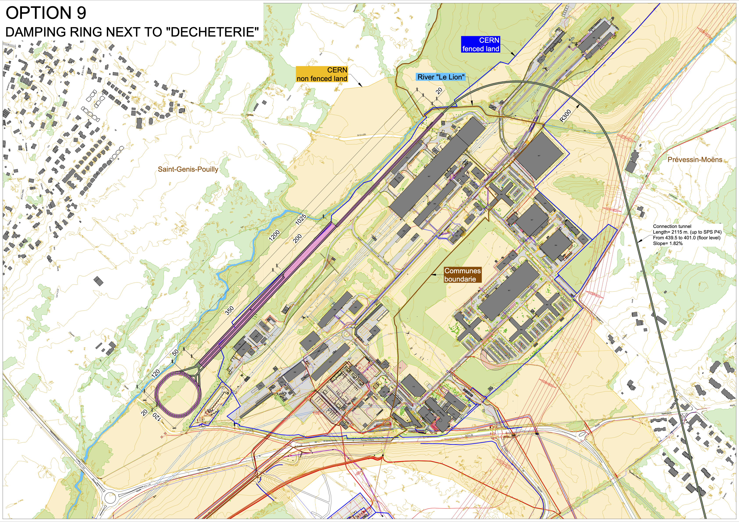
FCC-ee injector complex
Latest proposal: injector complex on the the Prevessin site with damping ring next to the “decheterie”
High energy linac next to North Area and Beam Dump Facility
Connection tunnel (2.1 km) to reach BA4 of the SPS, for transfer to the booster
Injector complex up to 20 GeV (booster injection energy)
Electron linac up to 2.86 GeV
Positron target at 2.86 GeV and positron linac to reach again 2.86 GeV
Damping ring for both e+ and e- at 2.86 GeV
High energy linac to reach 20 GeV
H. Bartosik, T. Watson, P. Craievich

Slide 11
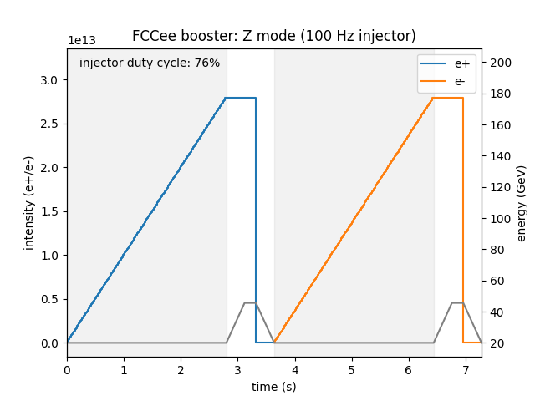
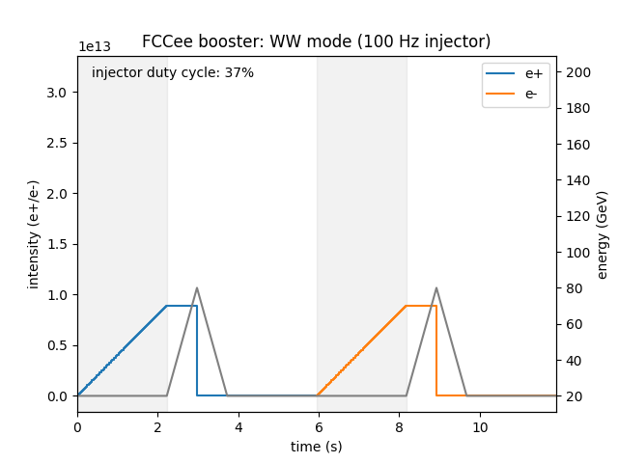
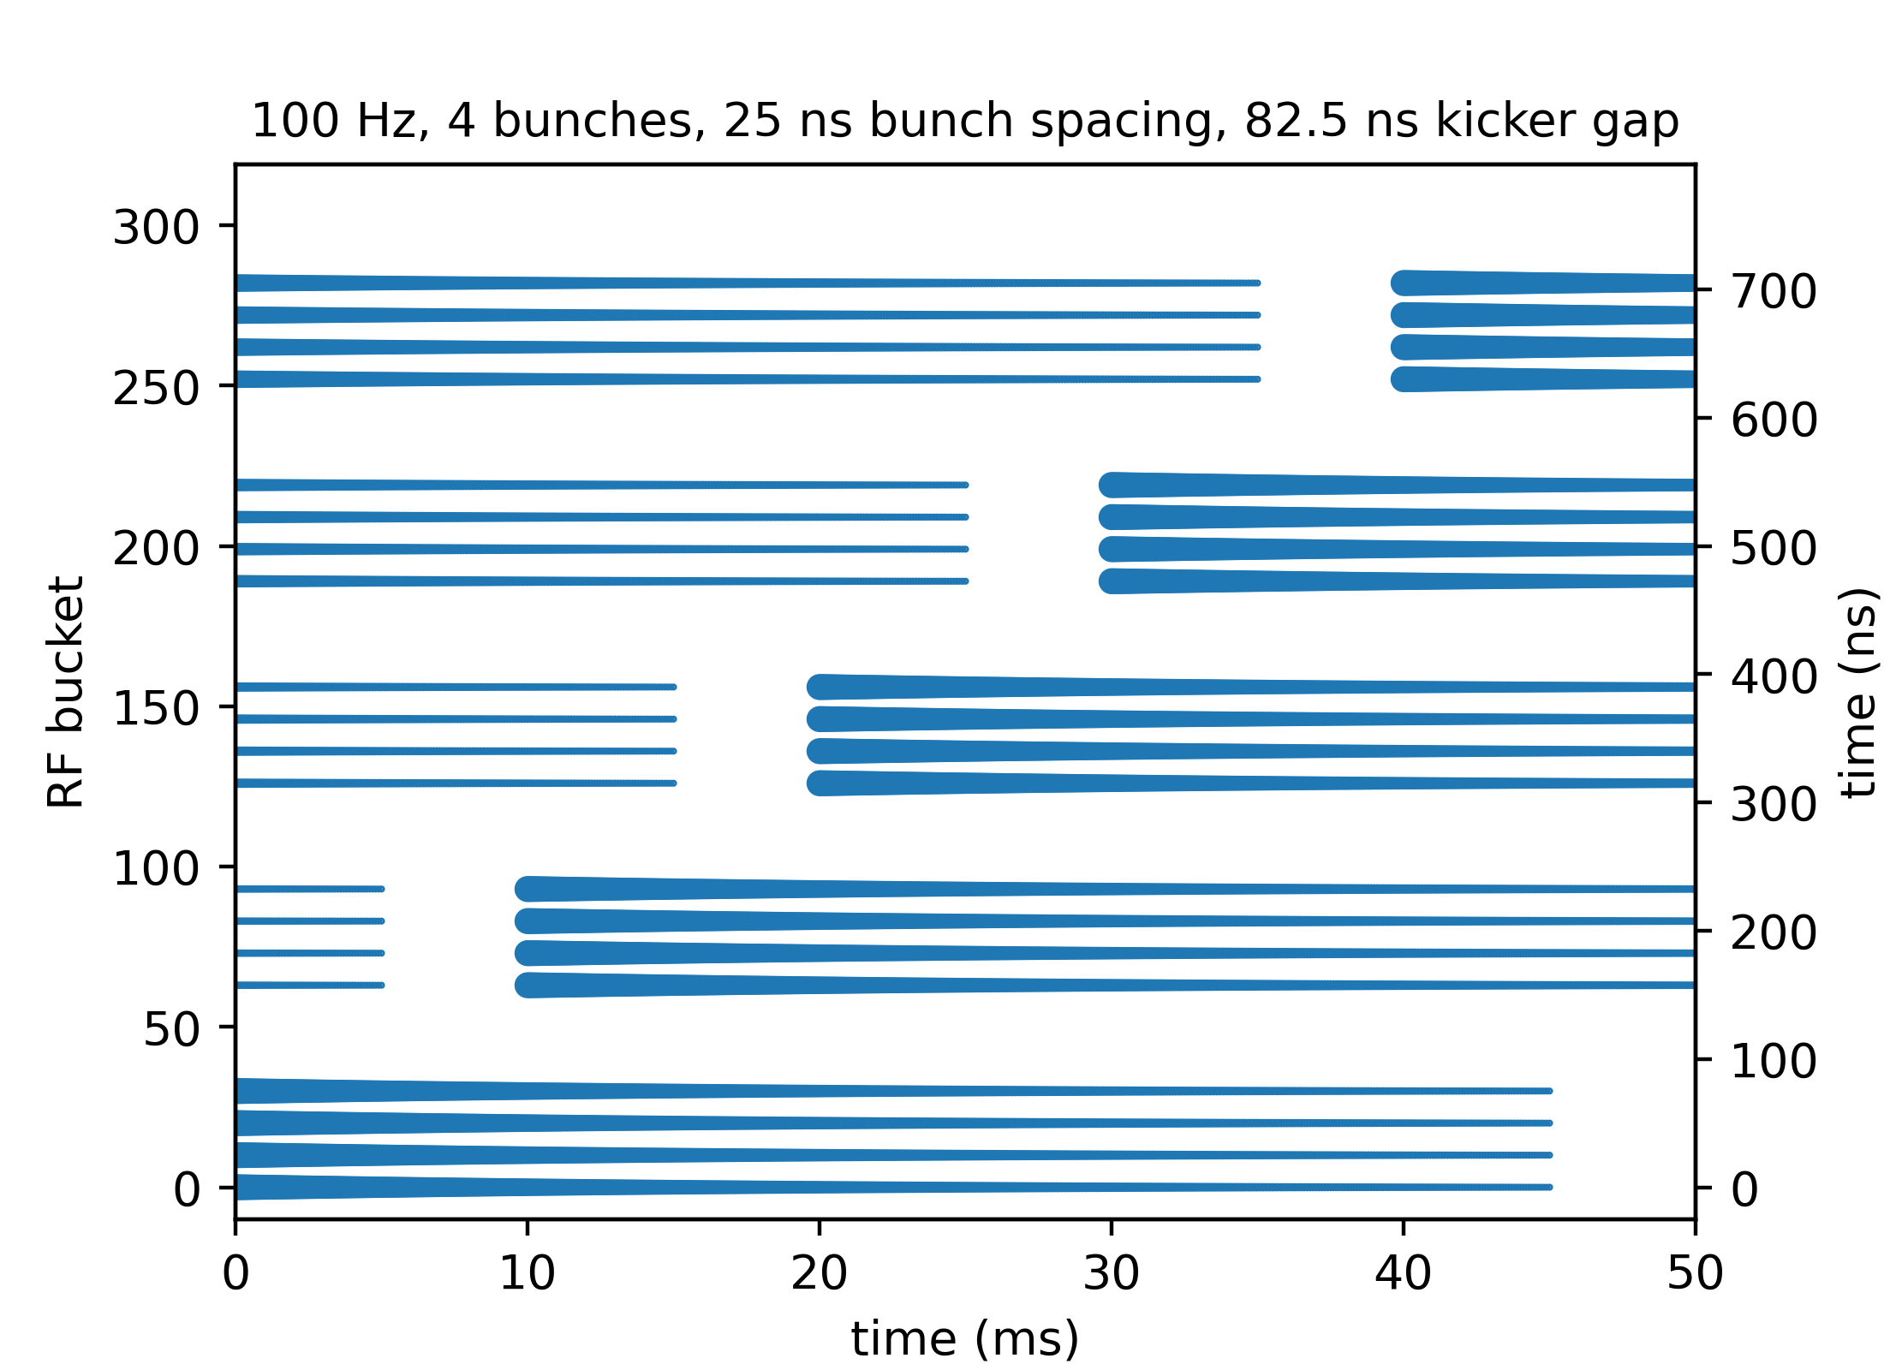
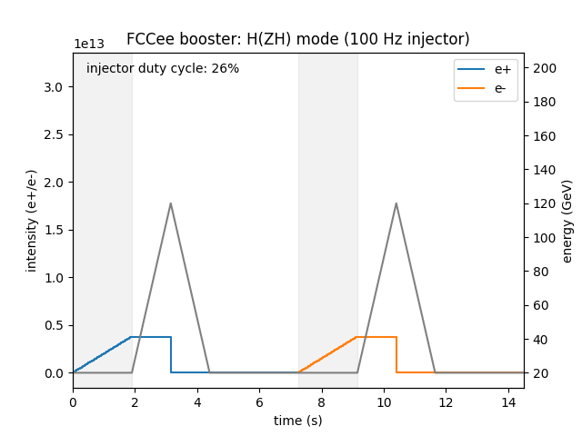
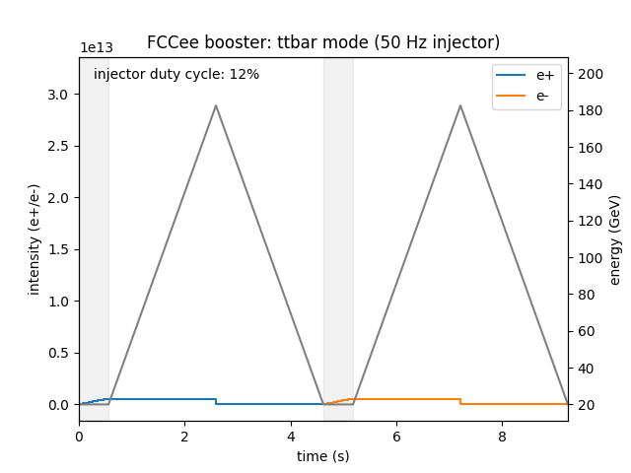
FCC-ee injector operation mode
Continuous re-filling scheme
  Staggered injection at 100 Hz
  4 bunches with 25 ns bunch spacing per injection
  Storage for ~42.5 ms (4x transverse damping times)
  Staggered extraction
Once the booster is filled with the required number of e⁺(e⁻) bunches, the injector switches to e⁻(e⁺) operation
H. Bartosik
The required duty cycle for FCC- ee
filling depends on the operating mode
  76% for Z
  Only 12% for ttbar
  Other modes are in between
During the ramping of the booster, the injectors could serve other users with e⁺ or e⁻ beams

Slide 12
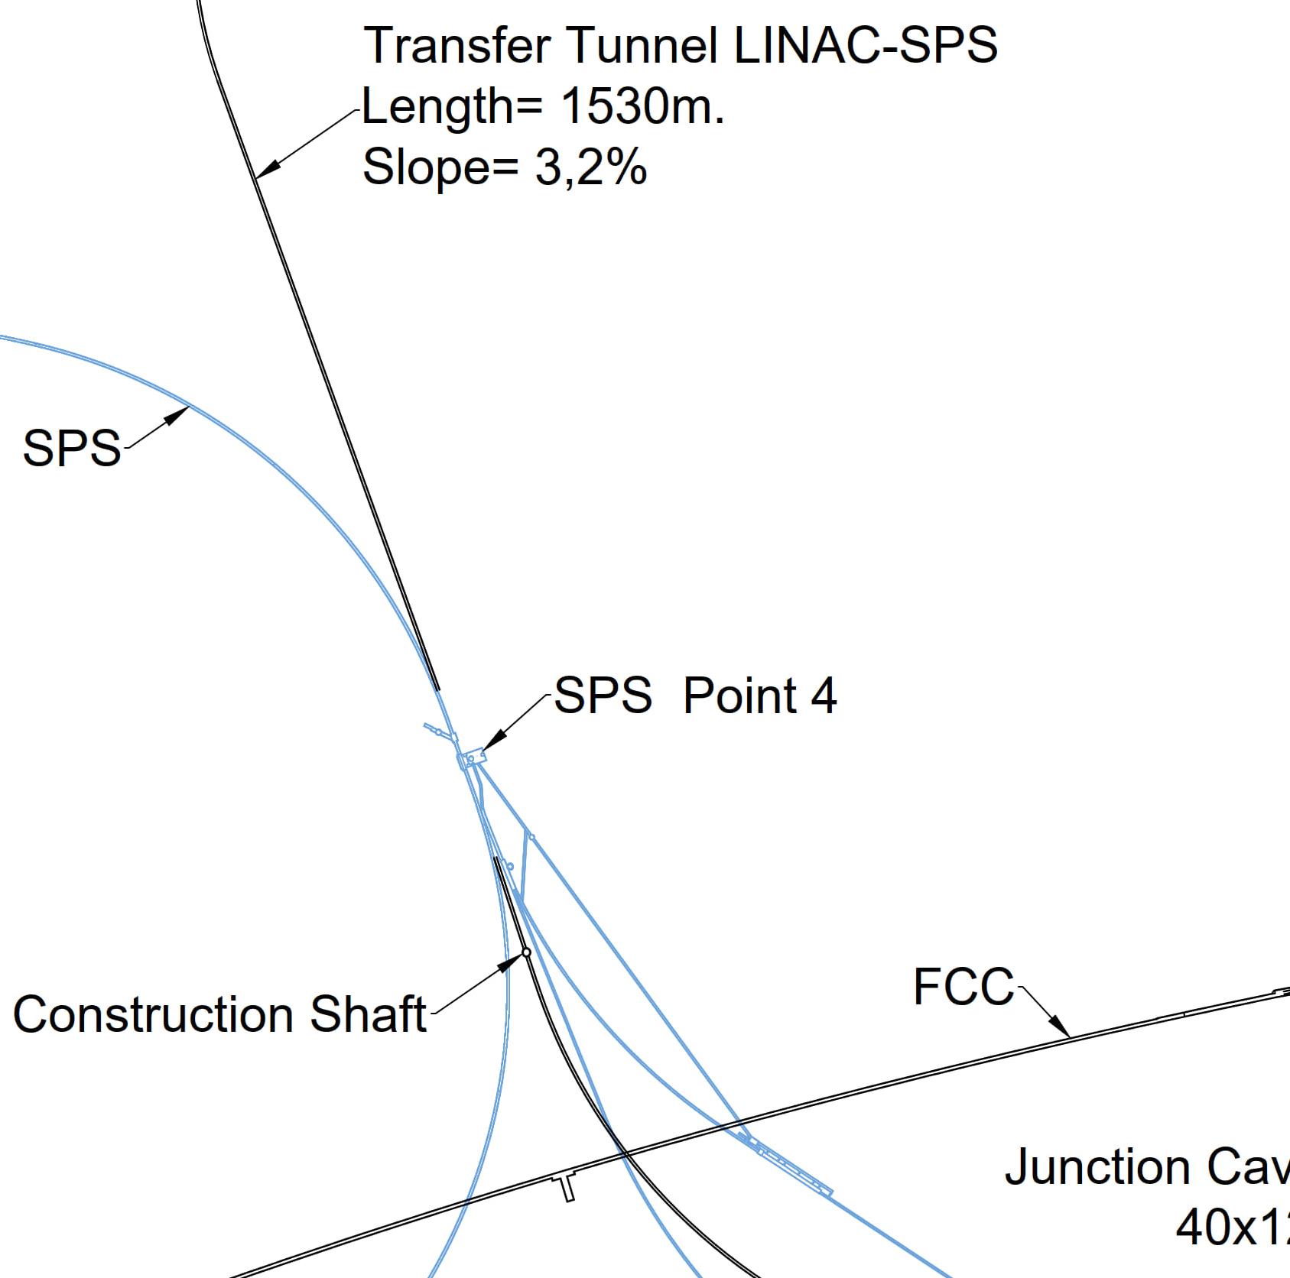
Other applications of FCC-ee injectors
H. Bartosik
FCC-ee injector beams (including also the damping ring) could be used for:
  R&D for accelerator components and beam diagnostics for FCC-ee or the injector itself
  Irradiation facility (e.g. for testing electronics components)
  Medical research
  Use synchrotron light from damping ring at 2.86 GeV to test coatings, photon desorption
  Plasma wakefield acceleration test facilities
  Neutron source with e- beam from injector linac
FCC-ee injector complex of interest for AWAKE! FCC-ee beam line passes through SPS BA4, i.e. the SPS extraction point of protons for the plasma wakefield acceleration experiment AWAKE. Unique opportunity to perform proton driven plasma wakefield acceleration of 20 GeV electrons and positrons
  Lepton beam parameters fit extremely well
  Also electron driven plasma wakefield acceleration experiments
  Unique possibility of positron acceleration
Proton beam line, experimental facility as well as lepton injection area and tunnel to the experiment exists. Would only require ~800 m transfer line for e+/e- in TT40/41 tunnel
M. Calviani
AWAKE

Slide 13
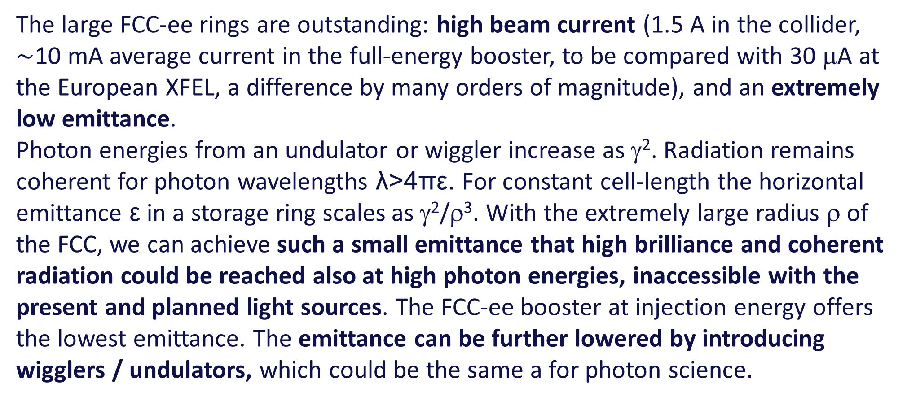
Photon Science: FCC-LS – motivation
The large FCC-ee rings are outstanding: high beam current (1.5 A in the collider, $\sim$10 mA average current in the full-energy booster, to be compared with 30 μA at the European XFEL, a difference by many orders of magnitude), and an extremely low emittance.
Photon energies from an undulator or wiggler increase as γ². Radiation remains coherent for photon wavelengths λ>4πε. For constant cell-length the horizontal emittance ε in a storage ring scales as γ²/ρ³. With the extremely large radius ρ of the FCC, we can achieve such a small emittance that high brilliance and coherent radiation could be reached also at high photon energies, inaccessible with the present and planned light sources. The FCC-ee booster at injection energy offers the lowest emittance. The emittance can be further lowered by introducing wigglers / undulators, which could be the same a for photon science.

Slide 14
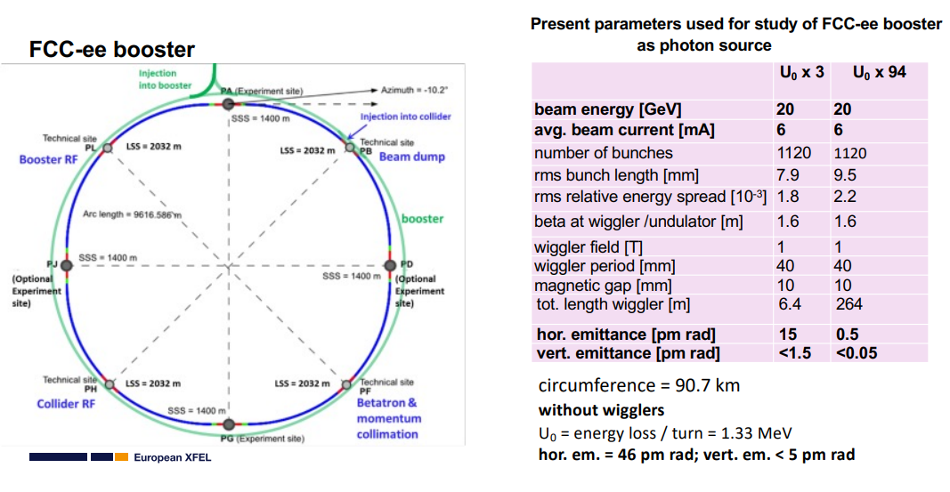
Photon Science: FCC-LS – Opportunities with the booster
S. Casalbuoni

Slide 15
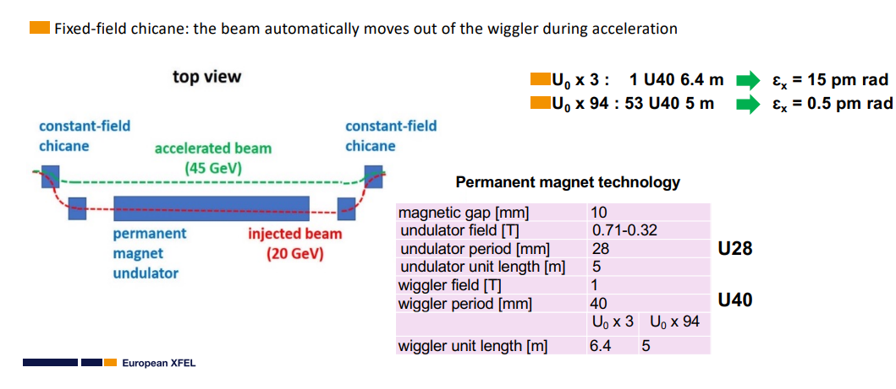
Using the FCC-ee Booster ring as a Photon Source
S. Casalbuoni

Slide 16
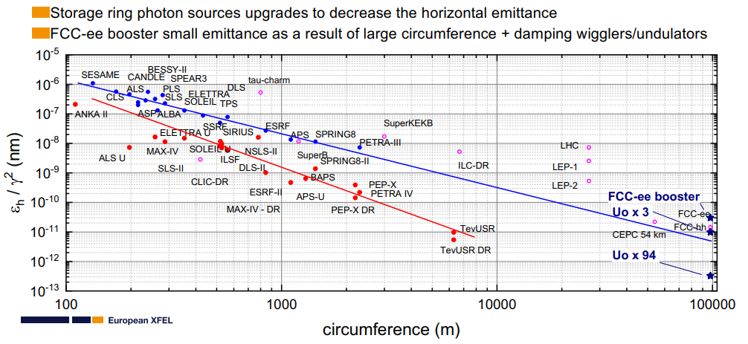
Horizontal emittance versus circumference
S. Casalbuoni

Slide 17
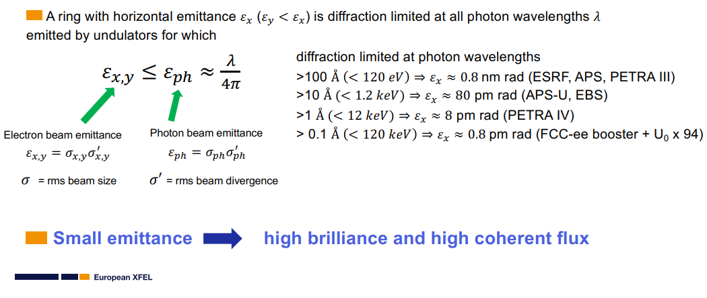
Diffraction limited storage ring (DLSR)
S. Casalbuoni

Slide 18
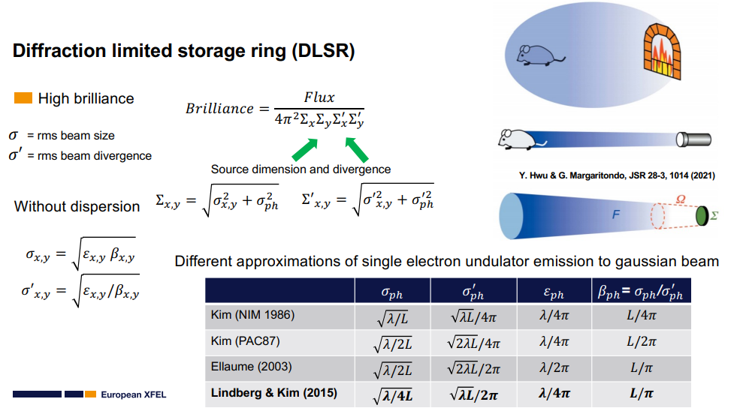
Diffraction limit
S. Casalbuoni

Slide 19
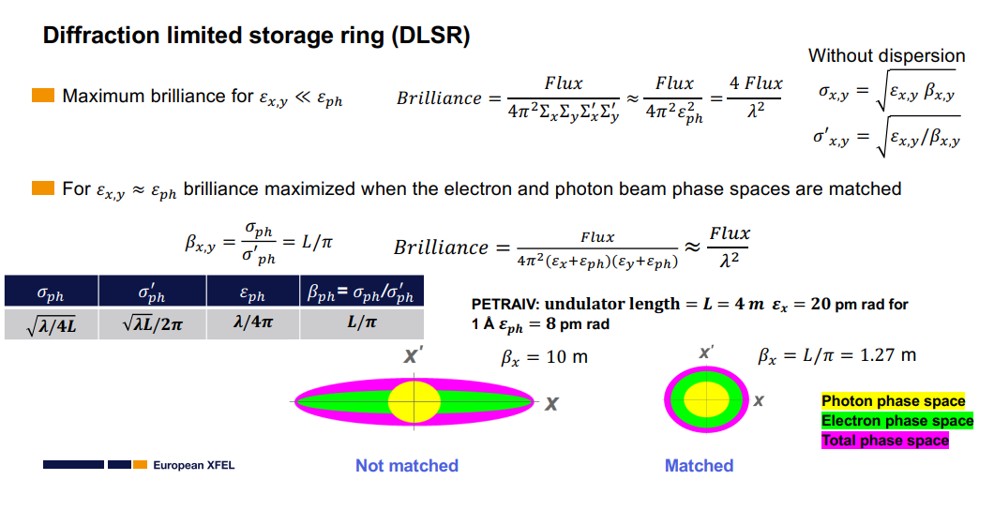
Diffraction limit – matching e⁻ and photon beams
S. Casalbuoni

Slide 20
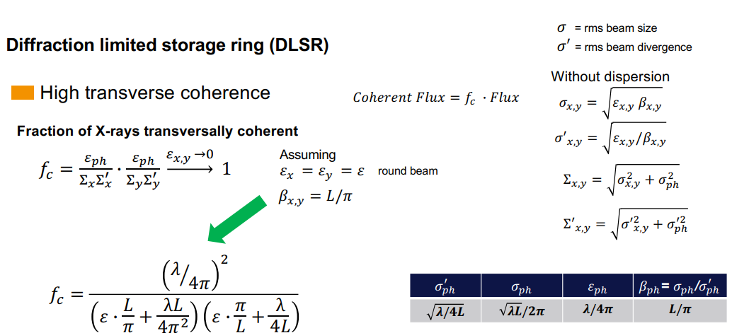
Diffraction limited radiation: High transverse coherence
S. Casalbuoni

Slide 21
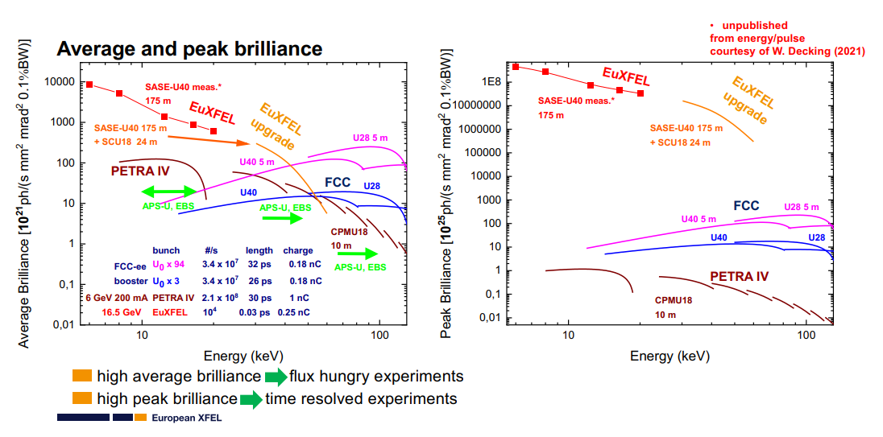
Average and peak brilliance
S. Casalbuoni

Slide 22
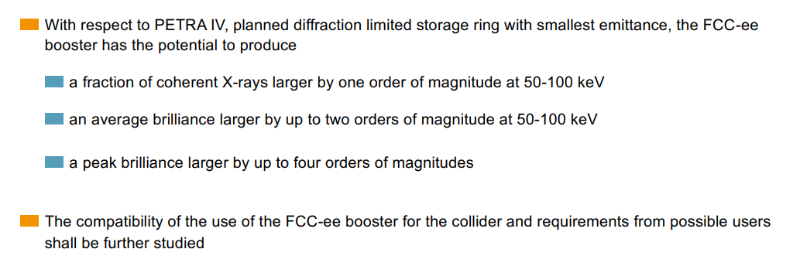
FCC-LS | preliminary conclusions for coherent 50-100 keV photons
S. Casalbuoni

Slide 23
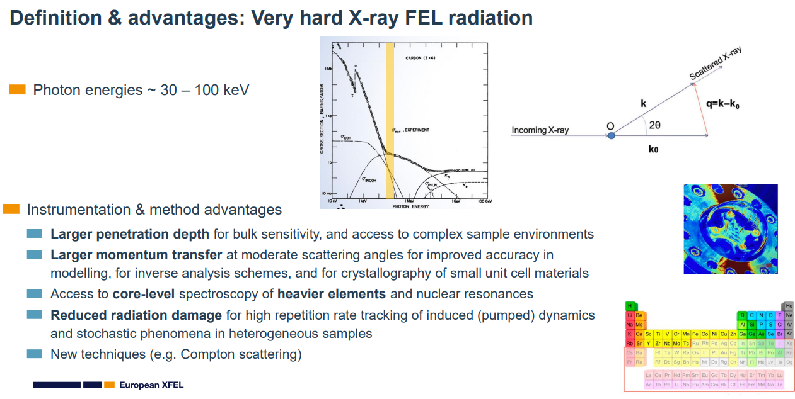
FCC-LS | 30-100 keV photon opportunities
S. Pascarelli

Slide 24
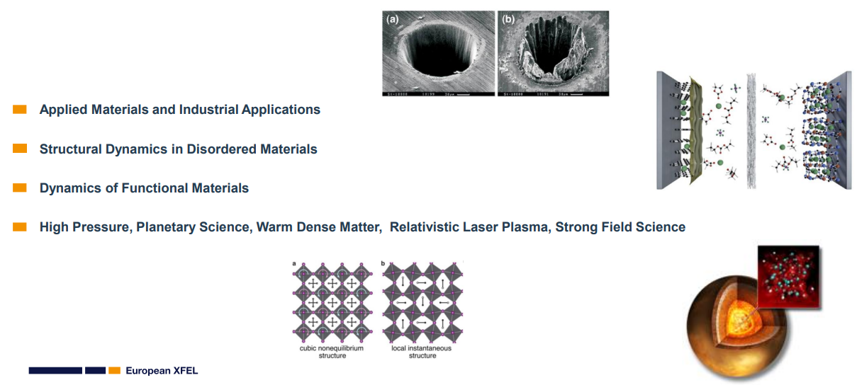
FCC-LS | applications of hard x-rays
S. Pascarelli

Slide 25
Hard coherent X-ray applications – in a nutshell
S. Pascarelli
A lot of exciting new science
Wide range of science questions, out of experimental reach today, from catalysis to the steel industry, from planetary to strong field science…
Very hard XFEL radiation @ EuXFEL
A tool to understand how materials behave under a large range of conditions
Key for providing a 'reality check' on theoretical models & rational path towards development of new materials
Attraction of new (wider) XFEL user communities, in particular in:
    Chemistry
    Materials science
    Extreme Fields science

Slide 26
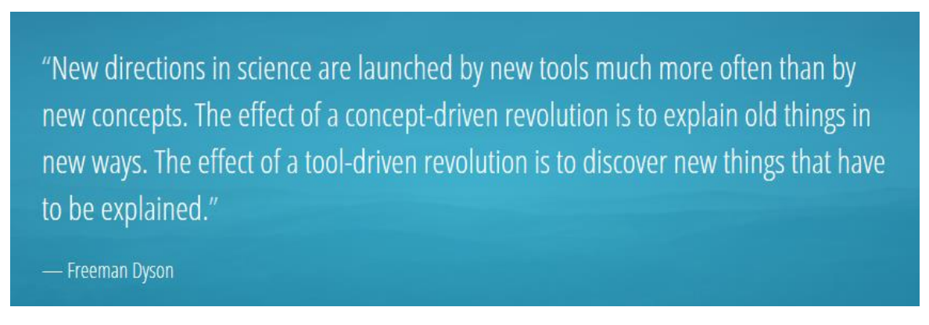
Tool-driven revolution
S. Pascarelli

Slide 27
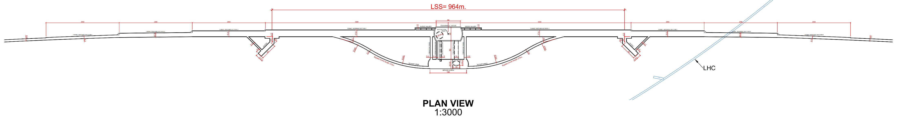
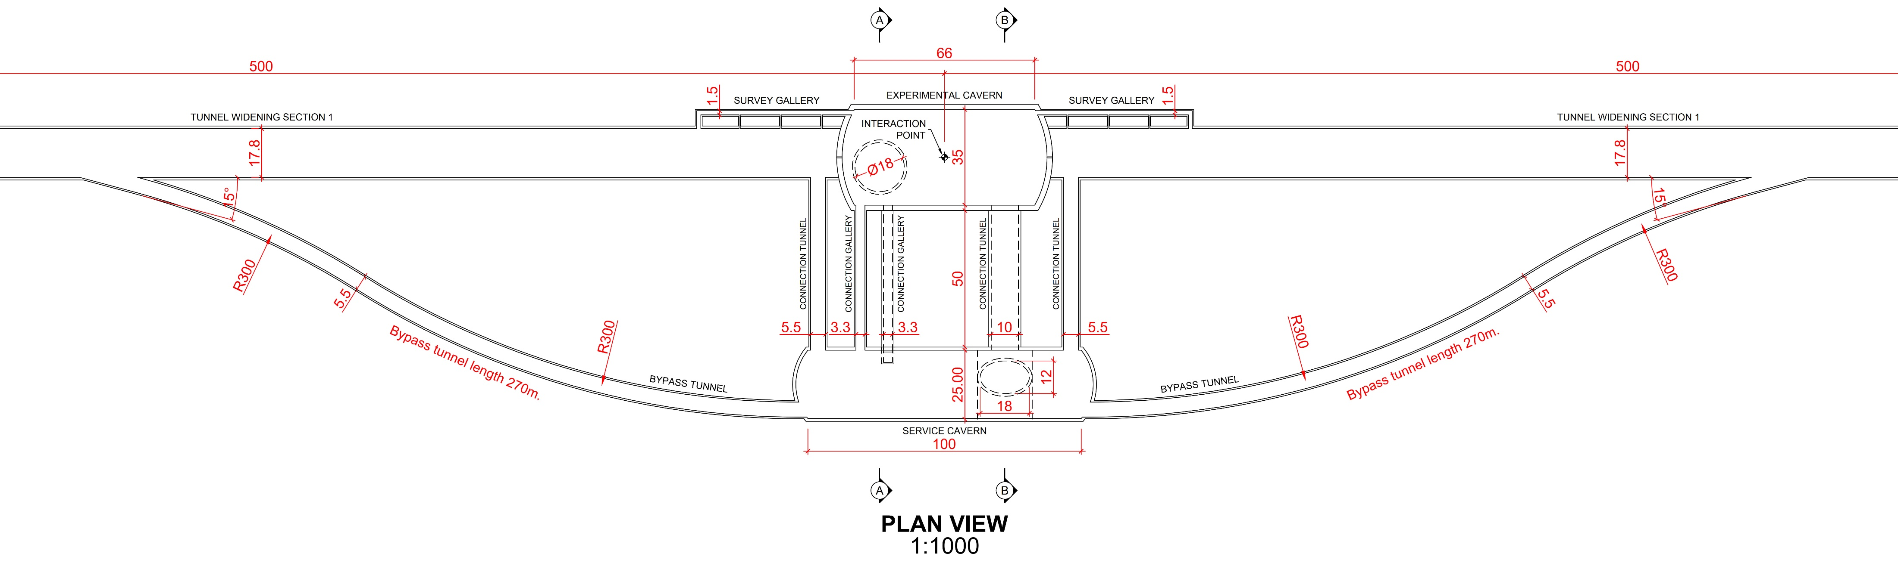
How & where can we integrate the FCC photon beam lines ?
Option: around the four e⁺e⁻ collision points
booster is separated to bypass the experimental detector
large underground infrastructure for FCC-hh
wide tunnel
T. Watson

Slide 28
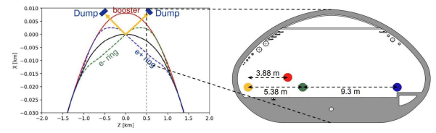
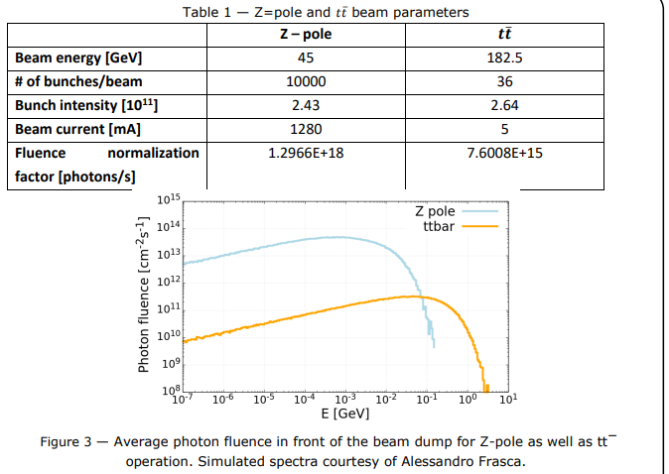
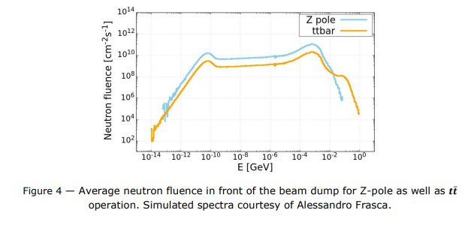
FCC-BS | beamstrahlung photon source
A. Frasca
C. Duchemin, M. Calviani

Slide 29
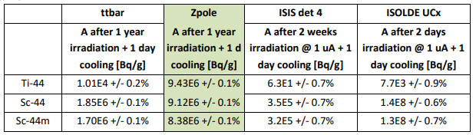
FCC-BS | radionuclide production: example Ti-44
Ti-44 is a radionuclide of long half-life (60 years) that decays into the ground state of Sc-44 (4 h half-life).
Sc-44 is of medical interest for diagnosis but still not sufficiently studied due to its short half-life that makes its production and supply challenging. The possibility of producing Ti-44 as generator of Sc-44 is an alternative solution. Ti-44 could stay at the laboratory and Sc-44 be “milked” from the generator every time one needs to use it, especially because secular equilibrium is reached very fast after 24 hours.
At present the use of Ti-44 as generator of Sc-44 activities is very limited due to the low activity of the generators available. “Generators with clinical amounts of activity (100 MBq or higher) still need to be explored.” This activity is difficult to achieve in cyclotron due to time of operation/irradiation that would be necessary. The following Table shows the activity that could be achieve at FCC and at ISOLDE, considering that a sample could stay for irradiation about 1 year at FCC but only between 2 days and 2 weeks at ISOLDE due to its mode of operation.
C. Duchemin, M. Calviani

Slide 30
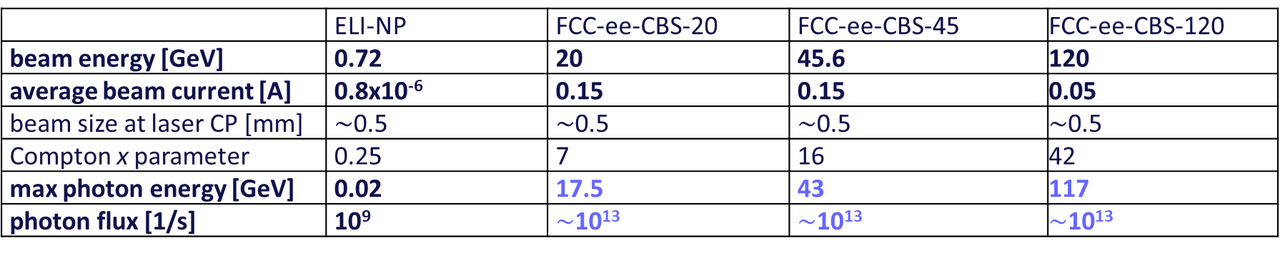
FCC-CBS: 1000-100000x more flux & higher energy than ELI-NP
Comparison of ELI-NP and FCC-ee Compton Backscattering Source (FCC-ee-CBS), assuming Yb:YAG laser (2.3 eV)
 | ELI-NP | FCC-ee-CBS-20 | FCC-ee-CBS-45 | FCC-ee-CBS-120
beam energy [GeV] | 0.72 | 20 | 45.6 | 120
average beam current [A] | 0.8x10⁻⁶ | 0.15 | 0.15 | 0.05
beam size at laser CP [mm] | $\sim$0.5 | $\sim$0.5 | $\sim$0.5 | $\sim$0.5
Compton x parameter | 0.25 | 7 | 16 | 42
max photon energy [GeV] | 0.02 | 17.5 | 43 | 117
photon flux [1/s] | 10⁹ | $\sim$10¹³ | $\sim$10¹³ | $\sim$10¹³
The photon energies are 1000 times higher, the photon flux exceed ELI-NP’s by about a factor 10,000. To achieve this rate the laser beam recirculator system of ELI-NP would need to be modified or, possibly, be replaced by an optical cavity, suitable for cw operation.
CBS beam dynamics – which regime ? tests at Thom-X?

Slide 31
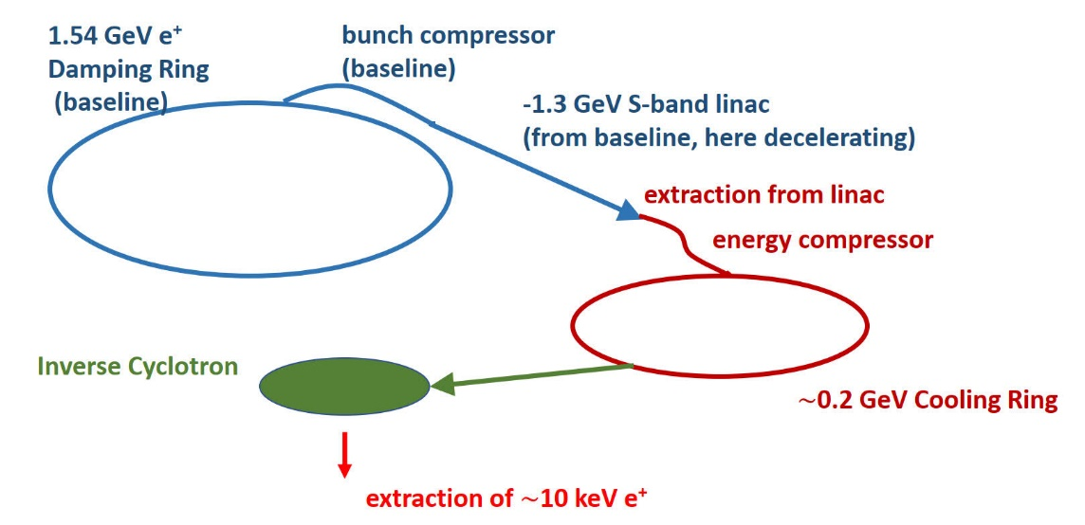
Positron source for material research
The availability of one of the world’s most powerful positron sources, delivering high-flux positrons a of a few 10¹² e+/second, in an energy range from a few 100 MeV to 20 GeV, could offer numerous other applications.
Layout of high-intensity cold positron source fed from the FCC-ee e⁺ damping ring, passing through the bunch compressor and part of the baseline S-band linac. After extraction from the linac, and energy-spread compression. low-energy cooling ring and a small (1 metre) inverse cyclotron are added to provide a high-flux low-energy low-emittance positron beam.
e.g. C. Hugenschmidt, Positrons in Surface Physics, https://arxiv.org/pdf/1611.04430

Slide 32
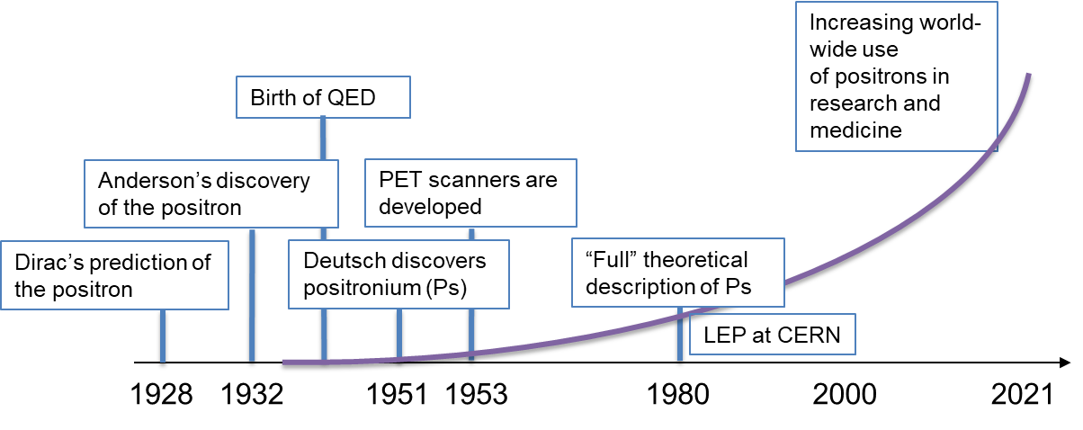


Positron research at a glance
Low energy positron/positronium physics
Precision QED studies (Ps spectroscopy)
Fundamental symmetry tests (annihilation channels)
Material studies (defect studies)
e⁺ with
MeV energy
e⁺ with
eV energy
Isotope sources ($β^{+}$- decay)
Moderator
Continuous slow e⁺ beam
Pair production with:
Nuclear reactor-based sources
Accelerator-based sources
$$ε≈{10}^{−3}$$
B. Rienäcker

Slide 33



Areas of FCC-ee e⁺ impact
Applications of slow positrons
Defect studies
Surface and dislocation probing
Electronic structures
Trapping, cooling, remoderation, bunching
e⁺ beam
$$ε≈{ 10}^{−1}…{ 10}^{−?}$$
$$ε≈{ 10}^{−1}$$
Conversion into positronium (Ps)
Experiments with slow Ps
Precision tests of QED
Fundamental symm. (CPT, WEP)
BEC with Ps
Porosimetry
$$ε≈{ 10}^{−1}$$
Efforts towards the first Bose-Einstein condensation of Ps
When a Ps-BEC annihilates, a coherent burst of gamma rays is emitted.
A proposed way to build a 511 keV gamma ray laser!
Tests of fundamental symmetries and BSM searches
New precision QED measurements feasible, with colder Ps sources
Positrons are non-destructive nanoprobes in material sciences
Possible use case: Ultra-high density monolithic 3D ICs
→ Depth-resolved defect analysis with positrons
B. Rienäcker

Slide 34
FCC-ee e⁺ Take Home Message
Material Science: non-destructive nanoprobes
=> possibly beam time for global partners in industry and academia?
Positrons
Next generation Ps sources with
high intensity,
low energy and
higher density
Better measurement efficiency (results/time)
Higher data quality (less systematics)
A new intense low-energy e+ beam from FCC-ee
Unlocking exciting new possibilities (e.g. Ps-BEC, precision QED, BSM )
More antihydrogen for AEgIS <3
B. Rienäcker

Slide 35
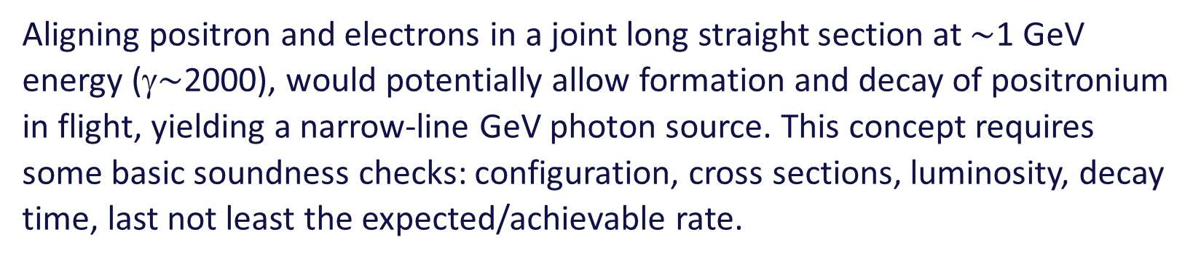
Positronium-based GeV photon source – a speculative proposal
Aligning positron and electrons in a joint long straight section at $\sim$1 GeV energy (γ$\sim$2000), would potentially allow formation and decay of positronium in flight, yielding a narrow-line GeV photon source. This concept requires some basic soundness checks: configuration, cross sections, luminosity, decay time, last not least the expected/achievable rate.
M. Doser

Slide 36
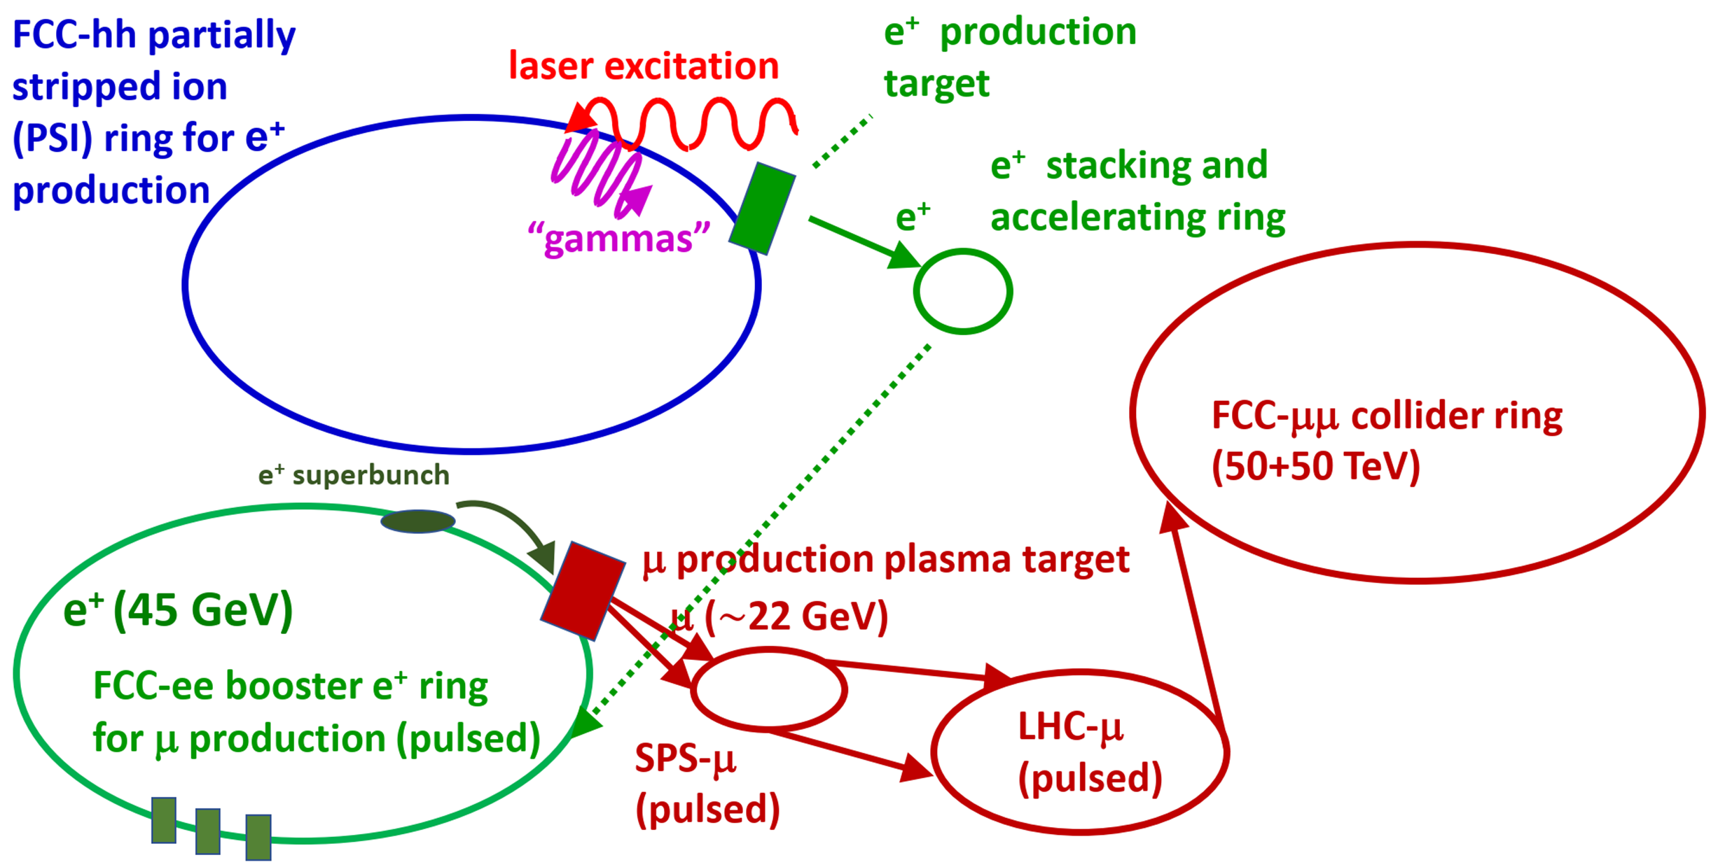
Testbed for LEMMA muon collider
FCC-ee would allow many important proof-of-principle tests for the LEMMM based muon collider. For example, 45 GeV positrons extracted from the booster would be by far the best conceivable platform for carrying out demonstration experiments and beam tests for the LEMMA low-emittance muon-beam production scheme. Various targets and accumulation schemes could be studied. The emittance of the generated muons could be characterized.
Farmer et al., Muon Collider based on Gamma Factory, FCC-ee and Plasma Target, IPAC’22

Slide 37
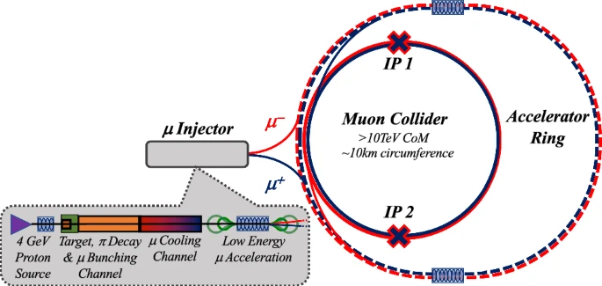
FCC as muon accelerator ring to feed muon collider in LHC tunnel
FCC-ee tunnel could
host muon accelerator
ring
LHC tunnel can host
~30 TeV CoM muon collider
C. Accettura et al.
EPJC, vol 83, 864 (2023)

Slide 38
Non-perturbative QED Experiments – boiling the QED vacuum
The FCC-ee injector complex can generate high rates of high-energy photons either by sending bunches from the linac against a target via bremsstrahlung, as in the proposed LUXE experiment [5], or, via laser Compton backscattering off bunches in the booster. These high-energy photons are then collided with low energy photons from a laser and pairs of electrons and positrons are created via the Schwinger process. The intensity of the laser is varied, e.g., between 5 × 10¹⁸ W/cm² and 1 × 10²⁰ W/cm² (parameters from LUXE) and the rate of electron/positron pairs is measured as function of this intensity, The rate should be proportional to E² e (−E_{S}/E) where E is the electric field of the laser.
Comparison of FCC-ee QED explorer configurations and the European XFEL’s LUXE proposal.
 | LUXE [5] | FCC-ee linac | FCC-ee booster
Beam energy [GeV] | 14 (17) | 20 | 20 or 45.6
Conversion | bremsstrahlung | bremsstrahlung | laser Compton (See Table 2)
Bunch charge [nC] | 0.25 (1) | 3 | 3 (only fraction converted to γ)
Number of bunches | 1 | 2 or 4 | up to 16,000
Repetition rate [Hz] | 1 (10) | 200 | 3,000
Rms spot size [μm] | 5 | 3 (1 cm β) | 30

Slide 39
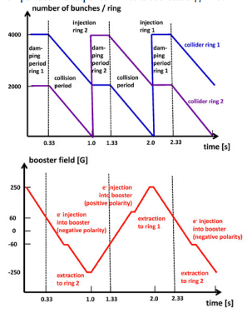
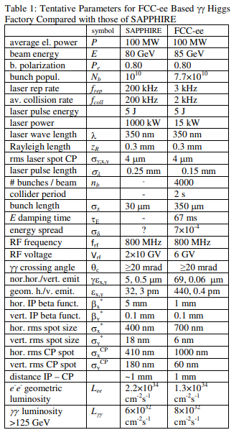
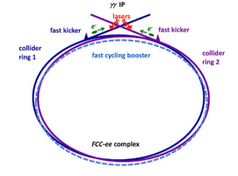
γγ collider based on FCC-ee
Schematic γγ collider based on filling the two FCC-ee collider rings with e⁻ bunches and extracting one bunch per beam and per turn into a dedicated γγ line.
R. Aleksan, A. Apyan, Y. Papaphilippou,
F. Zimmermann, IPAC2015
Cycle pattern for two collider rings (top) and for the booster (bottom).

Slide 40
References
M. Altarelli et al. (Eds.), XFEL: The European X-Ray Free-Electron Laser.Technical Design Report, Preprint DESY 2006-097, DESY, Hamburg, 2006 (see also http://xfel.desy.de).
E.A. Schneidmiller and M.V. Yurkov,”Photon Beam Properties at the European XFEL”, DESY-11-152; TESLA-FEL 2011-01
C. G. Schroer et al., PETRA IV Conceptual Design Report, https://bib-pubdb1.desy.de/record/426140/files/DESY-PETRAIV-Conceptual-Design-Report.pdf
T. Tanaka and H. Kitamura, “SPECTRA: a synchrotron radiation calculation code”, Journal of Synchrotron Radiation 8, 1221 (2001)
F. Burkart et al., “LUXE — A QED Experiment at the European XFEL,” 10th Int. Particle Accelerator Conf. IPAC2019, Melbourne, Australia JACoW Publishing ISBN: 978-3-95450-208-0 doi:10.18429/JACoW-IPAC2019-TUPRB008
C. Hugenschmidt, Positrons in Surface Physics (2016), https://arxiv.org/pdf/1611.04430
M. Benedikt, S. Casalbuoni, M. Doser, F. Zimmermann, First thoughts on the synergetic use of the FCC-ee collider and its injector complex for photon science and other applications, 10.5281/zenodo.7675663.
S. Casalbuoni and F. Zimmermann, FCC-ee booster as ultimate storage ring photon source, FCC Week 2021
R. Aleksan, A. Apyan, Y. Papaphilippou, F. Zimmermann, Scenarios for Circular Gamma-Gamma Higgs Factories, Proc. IPAC2015, Richmond (2015) 2156

Slide 41
Proposed next steps
3 working groups
photon science (light source, CBS)
- S. Casalbuoni, F. Zimmermann, +
HEP applications (QED, dark sector, )
- G. Arduini + ?
e⁺ applications (surface science, Ps BEC, 511 keV X-ray laser )
- B. Rienäcker, M. Doser
in person status & wrap-up meeting at CERN, 28+29 Nov. 2024

Slide 42


Slide 43
backup slides

Slide 44
Past studies
brainstorming in July 2020
  Michael Benedikt, Sara Casalbuoni (EU-XFEL), Michael Doser, Frank Zimmermann
1. Photon science
1.1 FCC-LS : The world’s most powerful light source for very hard X-rays
1.2 FCC-CBS: 3-5 orders of magnitude more flux and higher photon energy than ELI-NP
2. Other applications
2.1 Positron source for material research
2.2 Testbed for LEMMA muon collider
2.3 Plasma acceleration of positrons
2.4 Non-perturbative QED Experiments – proving the boiling of the QED vacuum
2.5 Positronium-based GeV photon source – a speculative proposal
Documented in M. Benedikt, F. Zimmermann, M. Doser, S. Casalbuoni, 10.5281/zenodo.7675663

Slide 45
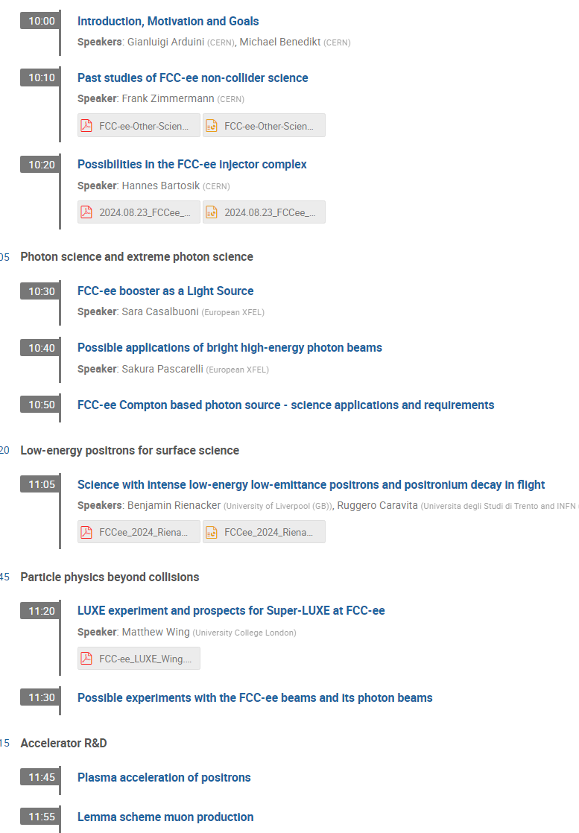
New initiative for ESU | kick off brainstorm 23 August 2024
In person: Gianluigi Arduini, Hannes Bartosik, Michael Benedikt, Christoph Grojean, Patrick Janot, Yannis Papaphilippou, Guy Wilkinson, Frank Zimmermann
Remote: Emanuele Bagnaschi , Giovanni Cantatore, Sara Casalbuoni, David d’Enterria, Armin Ilg, Richard Jacobsson, Joerg Jaeckel, Witek Krasny, Sakura Pascarelli, Benjamin Rienäcker, Ivo Schulthess, Alessandro Variola, Matthew Wing
https://indico.cern.ch/event/1442918/

Slide 46
questions & highlights
could linac emittance be improved ?
applications for 30-100 keV photons plenty and more to come
inertial fusion materials, semiconductors, solar cells, quantum technology
underground infrastructure?
CBS beam dynamics – which regime ? tests at Thom-X?
e⁺ source
Ps-BEC annihilation : 511 keV Gamma ray laser !
non-destructive nanoprobes in material science
ultrahigh density monolithic 3D ICs
moderator instead of inverse cyclotron, lose two orders, starting 10-50 MeV
Super-LUXE: nonlinear QED, ALPs

Slide 47
I. Applied Materials and Industrial Applications
S. Pascarelli
Real time control of irreversible processes at relevant timescales, across length scales
Examples : - crack propagation in semiconductors - plastic deformation or martensitic phase transformation in metals - switching of domains in ferroelectrics - flux lattices in superconductors - fuel instabilities in inertial fusion - biomineralization in bones - flow in geomaterials - 3D printing
Technical limitations :
Lack of diagnostics with sufficient bulk sensitivity, spatial and temporal resolution
Materials for planetary security and spacecraft protection against debris
Design and manufacture more sustainable, lighter, and longer lifetime materials and structures
Real time control of processes in additive manufacturing, laser peening, cavitation
Operando and industrial scale catalysts for cleaner energy production, pollution control
  Steel production: improve energy efficiency and lowering CO2 emission
  Penetration of reactor walls for operando investigations
  Sub-ns structural changes on surfaces and nanoparticles

Slide 48
II. Matter at extreme conditions of Pressure, Temperature, Fields
S. Pascarelli
High Pressure, Planetary Science and Geology, Electron Dynamics, Warm Dense Matter, Relativistic Laser Plasma, Strong Field Science
Structure and chemistry at extreme P/T conditions: geoscience (planetary interiors, formation), new materials
Inertial Confinement Fusion diagnostics of implosion symmetry, convergent geometries
High Z materials in High Energy Density Physics (atomic physics, warm dense matter): Collisional-radiative behavior of plasmas, non-LTE, ionization dynamics and radiation transport in stellar atmospheres
Strong-Field Science: Trident process to test models for dark matter; high photon energy to reduce e- beam energy required for threshold

Slide 49
III. Dynamics in disordered materials, tailor-made functional materials & innovative devices
enhanced performance
  light-emitting devices, solar cells
  quantum technology materials
  stronger magnets
lower energy consumption during operation
  non-volatile memory concepts
  photo-switches
efficiency-optimized and sustainable synthesis
  increased efficiency of catalytic processes e.g. for green H₂
  fully controlled solidification e.g. freeze-in of liquid melts
use of non-toxic and abundant elements
  rare-earth-free magnetic materials
  Technical limitations:
  limited Q-range: resolutions obtainable on sub-ps timescale (out-of-equilibrium) too coarse for any detailed structure determination ; ultra-fast Pair Distribution Function (PDF) methods non existing
S. Pascarelli

Slide 50
Plasma acceleration of positrons
Plasma acceleration of positron is not yet a fully solved problem. The positrons from the FCC injector complex could be used for acceleration-tests in AWAKE-like experiments or for tests with positrons for other novel acceleration schemes, e.g. acceleration of positrons in crystals.
e.g.
Gevy J. Cao, et al., Phys. Rev. Accel. Beams 27, 034801 (2024)

Slide 51
FCC-ee booster as DLS
S. Casalbuoni
With respect to PETRA IV, planned diffraction limited storage ring with smallest emittance, the FCC-ee booster has the potential to produce
  a fraction of coherent X-rays larger by one order of magnitude at 50-100 keV
  an average brilliance larger by up to two orders of magnitude at 50-100 keV
  a peak brilliance larger by up to four orders of magnitudes
high average brilliance flux hungry experiments
high peak brilliance time resolved experiments

Slide 52
Communications regarding other applications
Atoosa Meseck - on Compton source
Marco Calviani & Charlotte Duchemin – on use of beamstrahlung photons and on radionuclide production
Witek Krasny – comprehensive notes from, and comments on, the kickoff meeting

Slide 53
Possible work plan
need to update all to new parameters (booster intensity, DR energy)
on FCC side focus on light source and Compton source applications,
perhaps also e+ for material research
PBC looking after QED vacuum boiling & also positronium scheme?
Other science applications?

Slide 54
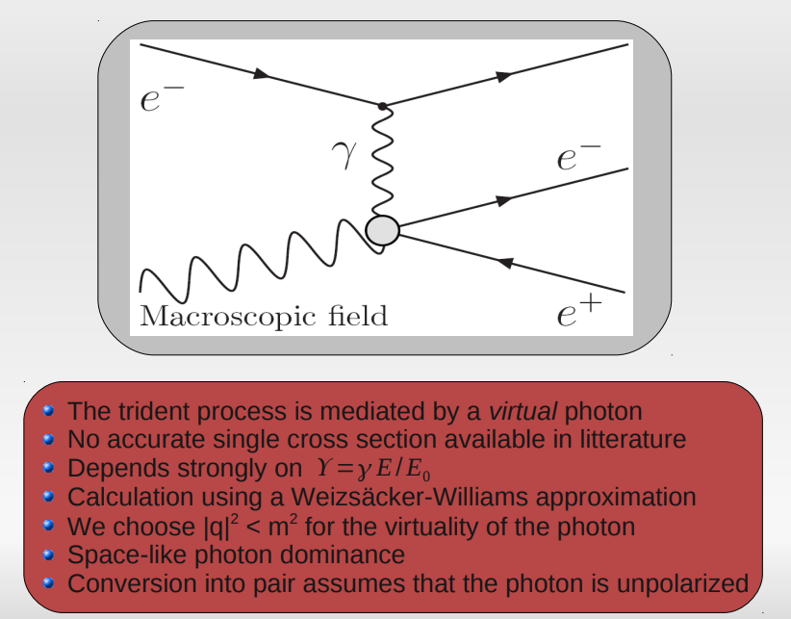
The Trident process
J. Esberg

