Slide 1
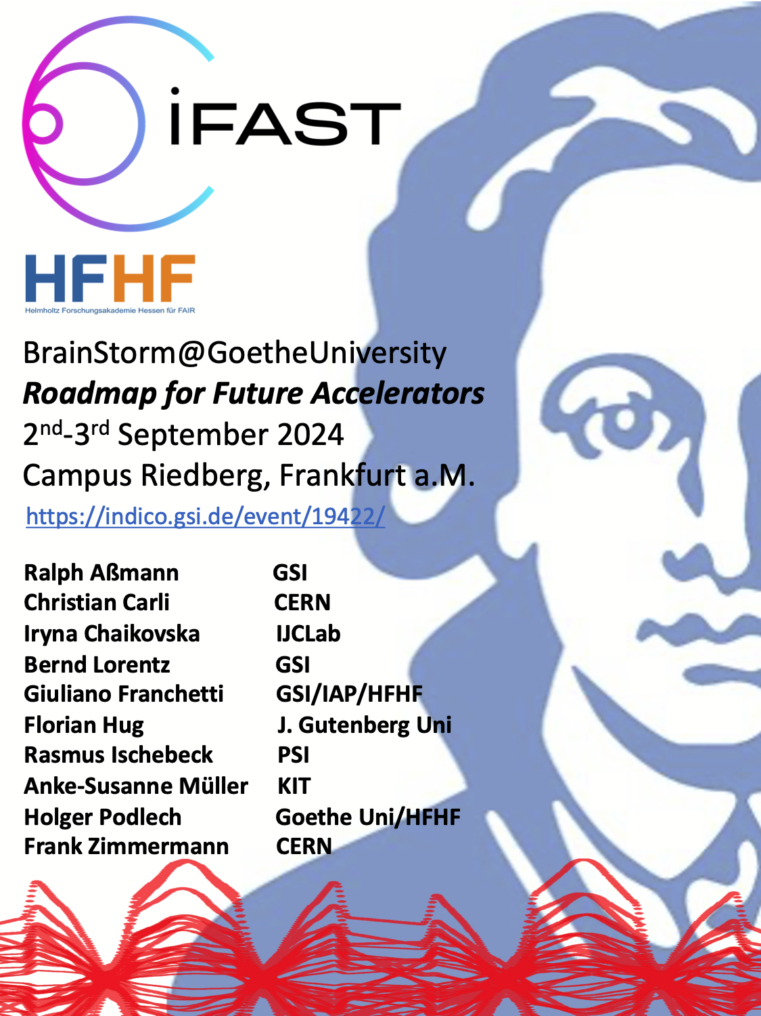
Role of EU networks for the future accelerator R&D and outlook
Maurizio Vretenar CERN
I.FAST Coordinator

Slide 2
Outline
Accelerator R&D landscape, EU impact, challenges
EU support to accelerator R&D: past, present, future
Horizon Europe (2025-28): instruments, calls, IFAST2
Trends and expectations for FP10 (2028-34)

Slide 3
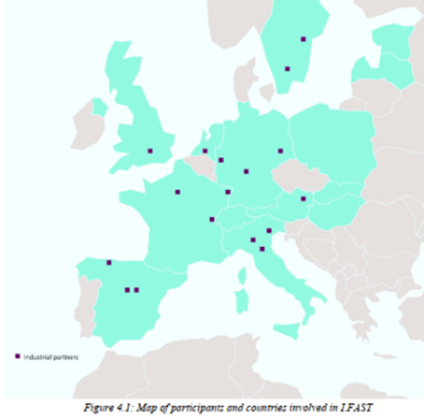
The European accelerator R&D landscape
Development of accelerator technologies is a particular challenge in the fragmented European accelerator environment.
> 100 entities (research laboratories, universities, industry) active in research development and production of accelerator technologies, across 23 EU countries and UK.
CERN stands up as a reference – but CERN’s contribution is focused on the CERN institutional projects, with limited space for long-term low TRL R&D.
An impactful R&D can be only achieved via collaborations, including academia-industry.
The European Commission Programmes can play a strategic role in setting up and supporting collaborations and co-innovation with industry.
The iFAST EU Project for accelerator R&D includes 48 partners (8 accelerator laboratories, 12 national research centres, 12 universities, 16 industrial partners (11 SMEs) - from 15 European Countries.

Slide 4
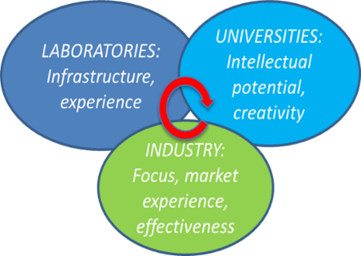
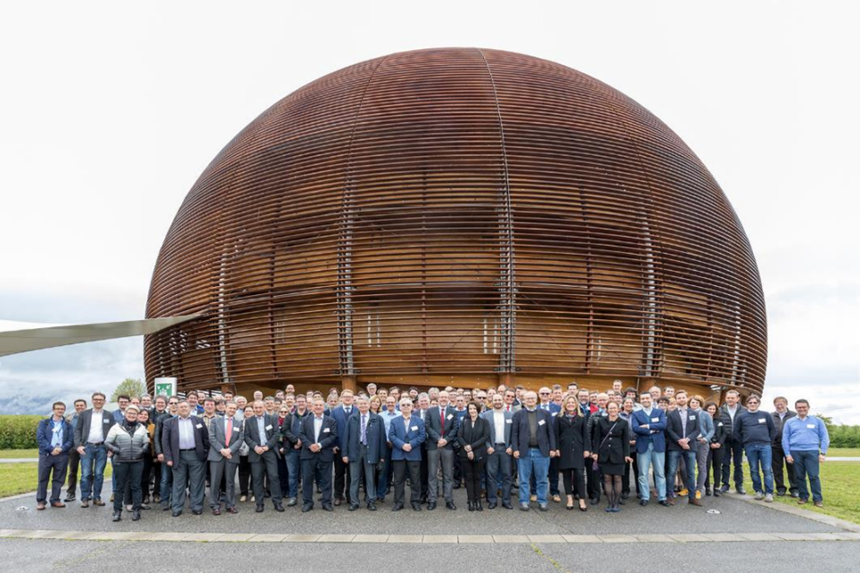
EU projects: opportunities and challenges
EU-supported projects for accelerator technologies are co-funded actions based on a large multinational community of laboratories, universities and industry, to develop specific R&D topics.
Opportunities:
Help to make people meet and to build trust.
Provides a well-defined framework to establish collaborations.
The reputation of being in an EU project helps leveraging additional funding.
Encourages co-funding schemes.
Challenges:
Administration, paperwork.
IP management.
Collaboration with competing industrial partners.
Limited funding.
Still far from final designs/products (low TRL).
A successful model for our community, that we must support / expand

Slide 5
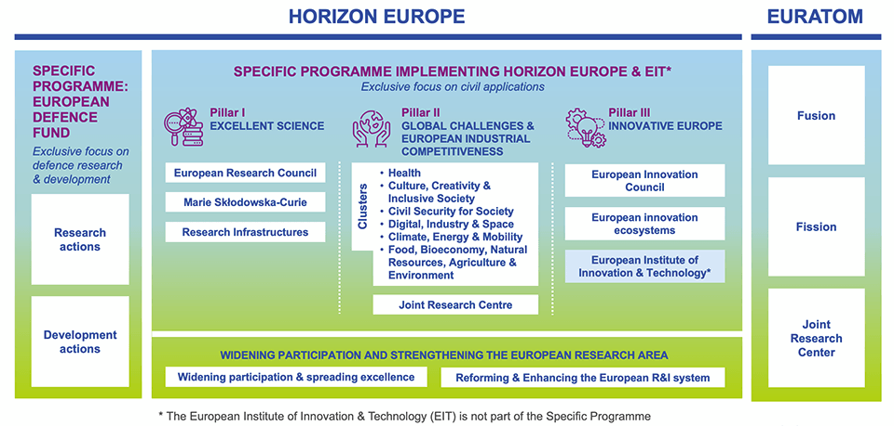
European instruments to support accelerator R&D
European Commission runs Framework Programmes for Research and Innovation, as the ongoing Horizon Europe (2021-27, €95.5 billion). Very successful but overcommitted - from 2024 UK is joining back, with a contribution of €2.43 billion per year (nearly compensating the “war tax”).
R&D for particle accelerators is mostly supported, together with access and technologies for Research Infrastructures, via the Research Infrastructures part of Pillar I (excellent science): pool resources to build and operate larger, more complex and performant accelerators. Level of ~6 M€/year.

Slide 6
General accelerator R&D in the European Programmes
CARE 01/2004 – 12/2008
5 years, 15.2 M€ EC contribution
Design of new infrastructures and development of specific technology (higher TRL).
Support to multiple R&D topics (lower TRL) within large multi-national collaborations: four Integrating Activities and one innovation pilot have received 53 M€ EC funding in 20 years, with >50 M€ co-funding from partners.
FP6
EuCARD 04/2009 – 03/2013
4 years, 10.0 M€ EC contribution
FP7
Integrating Activities
EuCARD-2 05/2013 – 04/2017
4 years, 8.0 M€ EC contribution
Integrating Activities and Innovation Pilot: Development of cross-boundary technology subjects, not directly followed by large laboratories, with added value coming from collaboration and sharing of resources.
ARIES 05/2017 – 04/2022
5 years, 10.0 M€ EC contribution
H2020
Innovation Pilot
I.FAST 05/2021 – 04/2025
4 years, 10.0 M€ EU contribution
I.FAST = Innovation Fostering in Accelerator Science and Technology
In parallel with Integrating Activities / Inn. Pilot, several Design Studies for development of new Research Infrastructure designs

Slide 7
Present situation
2023/24
+ EuPRAXIA Preparatory Phase

Slide 8
Present instruments (Horizon Europe)
Horizon Europe will run for 3 more years, with the calls related to Research Infrastructures defined by 2 Work Programmes, WP 25 (in preparation, to be announced around end of year waiting for new Commission), and WP 26/27.
Type of calls:
INFRA-TECH: main instrument, development of technologies for IA. Currently of 2 types: a) general (10 M€), b) to reduce environmental impact (5 M€).
INFRA-DEV: a) Research Infrastructure concept development (3 M€), b) Preparatory phase for ESFRI projects.
INFRA-SERV: Access to RIs (amount depending on topic).
The TIARA (Test Infrastructure and Accelerator Research Area collaboration board is the instrument set up by the accelerator community to coordinate proposals (prioritize subjects, avoid overlaps) and to support (advise, support letters) preparation and submission.
Coordinator: J.M. Perez, Chair: E. Nappi, Sci. Secr.: M. Vretenar

Slide 9
General trends for future proposals
Discussions and meetings between TIARA and the RI Unit of the EC (DG-RTD). Some general trends can be identified:
More top-down: future projects must be coherent with the priorities of the commission and of the community – less space for “blue sky” accelerator research.
Accelerators are recognized as a critical technology, key component of European “big science”.
Competition for funding is increasing, future calls will be increasingly competitive.
There is no pressure on merging communities, but within a community is important to show the integration of roadmaps from different partners.
Participation of industry (co-innovation) is an asset for our community and remains important for future projects.

Slide 10
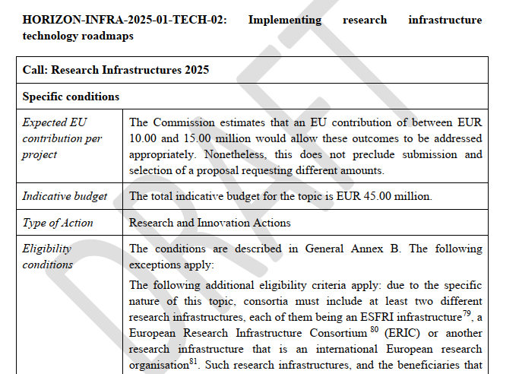
A new project after I.FAST
Following our discussions with the EC, in the draft Work Programme 25 in preparation is included a call:
Budget 10-15M
Space to approve 3 proposals
Deadline for application: 18 September 2025
Possible competitors: photon science (LEAPS), detectors (AIDA), astronomy/astrophysics.
Still to go through final round of comments in October, budget can still change (but only in the negative direction…).

Slide 11
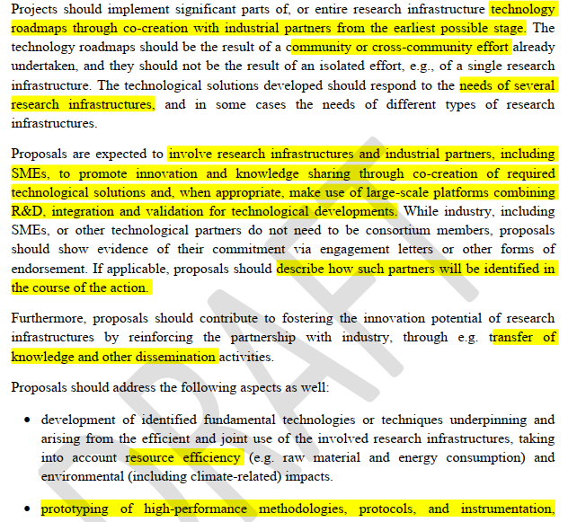
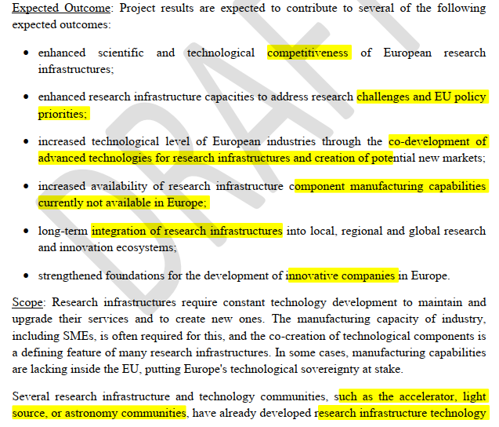
EC requirements

Slide 12
Strategy for I.FAST2
Coordinate the accelerator R&D Roadmaps for particle physics (ESPP), photon science (LEAPS), nuclear physics (?), neutron science (LENS?) and applications (Industry Forum). A common workshop in March/April 2025 organised by TIARA?
Identify common critical topics for R&D and impact that will constitute the “top-down” part of the proposal (directly inviting partners to form collaborations): TIARA with input from other communities (ad-hoc committee?).
Define criteria and selection procedure for the bottom-up part of the proposal (to be coordinated by TIARA, as was for I.FAST).
Preparation time for a good proposal is 1 year, we need to start now!

Slide 13
Possible priority themes for I.FAST2
Technology topics:
SC thin films: time to converge on the construction of a prototype Nb3Sn cavity in collaboration with industry.
Additive manufacturing of copper RF structures (high duty, RFQ, couplers, etc.).
Compact high-current SC linac for applications (with industry? Competition?).
HTS magnets for colliders (and applications).
Something for synchrotron light sources?
Some breakthrough with industry for PWFA/LWFA/DLA ?
Community topics:
Future accelerators.
Sustainability guidelines (LTA’s, etc.).
Training and outreach on accelerators (CBI?).
Coordination of plasma community?
Technology transfer topics:
Support to accelerator start-ups.
Any suggestion?

Slide 14
Other “proposed proposals”
Energy efficiency: preparing a reconversion of the EuMAHTS proposal on HTS magnets that was not successful in 2023, for submission in September 2025 of the part related to energy saving (5M instead of 10M).
Design studies: alternative designs for high-energy physics are usually well considered by the evaluators (e.g. muon collider) – for September 2025 there are discussions on submitting a proposal based on the HALHF linear collider design.

Slide 15
FP10
Priorities for the European Commission
International collaboration
Coordination of instruments (structural funds, etc.)
Priorities for Research Infrastructure
Support to “Big Science” technologies that have a strong impact on science, industry and society.
New access model.
Transitioning to integrated long-term planning and implementation of joint technology research, interacting with preparatory action for common technology development.
Exploration of applications of RI innovations outside the scientific market, via proof-of-concept support (but not beyond proof-of-concept!).
Priorities for TIARA:
Program based on long-range JRAs, complemented with smaller dimension, targeted actions to reply to specific technological RIs needs in accelerator technologies.

Slide 16
Thank you for your attention

