Slide 1
We present today a new study for the housing of STT electronics, cables, gas pipes.
First of all we will remind some numbers:
STT channels and layout: numbers and nomenclature;
electronics cards;
number and types of signal cables, gas pipes, HV cables, etc...
The aim is to make everybody aware of the status and to agree upon solutions.

Slide 2
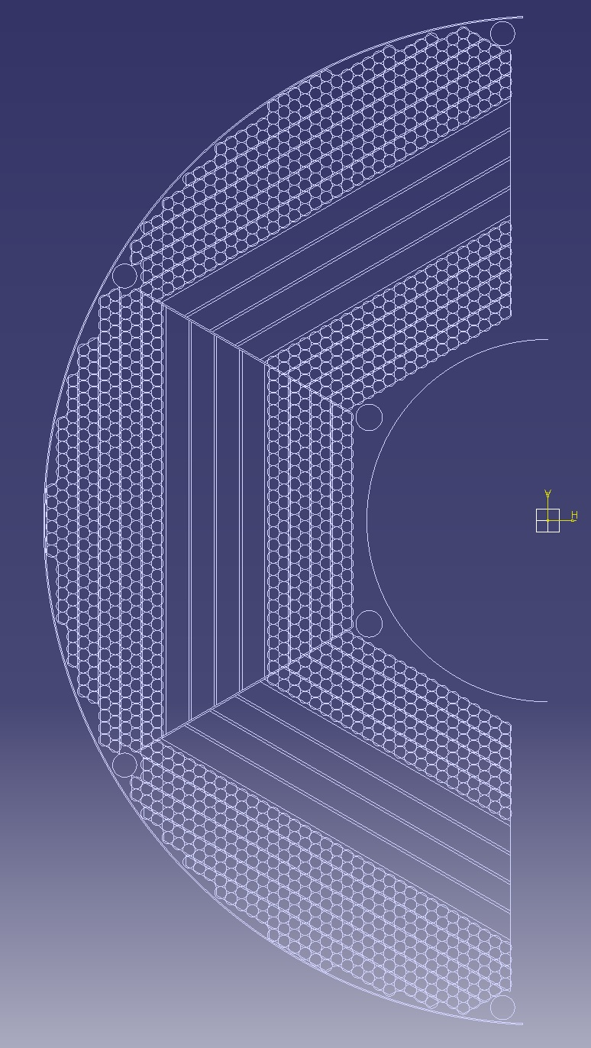
LNF/SPAS -12/10/2012
N.5 OUTER STRAW MODULES:
-13° MODULE 24+17+6= 47 STRAWS
-12° MODULE 32+29= 61 STRAWS
-11° MODULE 35+34= 69 STRAWS
-10° MODULE 35+35= 70 STRAWS
-9° MODULE 34+35= 69 STRAWS
SECTOR “A”
316
N.4 SKEWED STRAW MODULES:
-8° MODULE 30+31= 61 STRAWS
-7° MODULE 28+29= 57 STRAWS
-6° MODULE 26+27= 53 STRAWS
-5° MODULE 24+25= 49 STRAWS
220
N.5 OUTER STRAW MODULES:
-13° MODULE 24+17+6= 47 STRAWS
-12° MODULE 30+29= 59 STRAWS
-11° MODULE 38+37= 75 STRAWS
-10° MODULE 38+37= 75 STRAWS
-9° MODULE 36+37= 73 STRAWS
N.4 INNER STRAW MODULES:
-4° MODULE 22+23= 43 STRAWS
-3° MODULE 20+21= 41 STRAWS
-2° MODULE 18+19= 37 STRAWS
-1° MODULE 16+17= 33 STRAWS
154
329
N.4 SKEWED STRAW MODULES:
-8° MODULE 32+33= 65 STRAWS
-7° MODULE 30+31= 61 STRAWS
-6° MODULE 28+29= 57 STRAWS
-5° MODULE 26+27= 53 STRAWS
TOT. 690
SECTOR “B”
236
N.4 INNER STRAW MODULES:
-4° MODULE 24+25= 49 STRAWS
-3° MODULE 22+23= 45 STRAWS
-2° MODULE 20+21= 41 STRAWS
-1° MODULE 18+19= 37STRAWS
TOT. 690
N.4 INNER STRAW MODULES:
-1° MODULE 16+17= 33 STRAWS
-2° MODULE 18+19= 37 STRAWS
-3° MODULE 20+21= 41 STRAWS
-4° MODULE 22+23= 43 STRAWS
172
154
TOT. 737
N.4 SKEWED STRAW MODULES:
-5° MODULE 24+25= 49 STRAWS
-6° MODULE 26+27= 53 STRAWS
-7° MODULE 28+29= 57 STRAWS
-8° MODULE 30+31= 61 STRAWS
220
N.5 OUTER STRAW MODULES:
-9° MODULE 34+35= 69 STRAWS
-10° MODULE 35+35= 70 STRAWS
-11° MODULE 35+34= 69 STRAWS
-12° MODULE 32+29= 61 STRAWS
-13° MODULE 24+17+6= 47 STRAWS
TOT. STRAWS 2117
SECTOR “C”
316

Slide 3
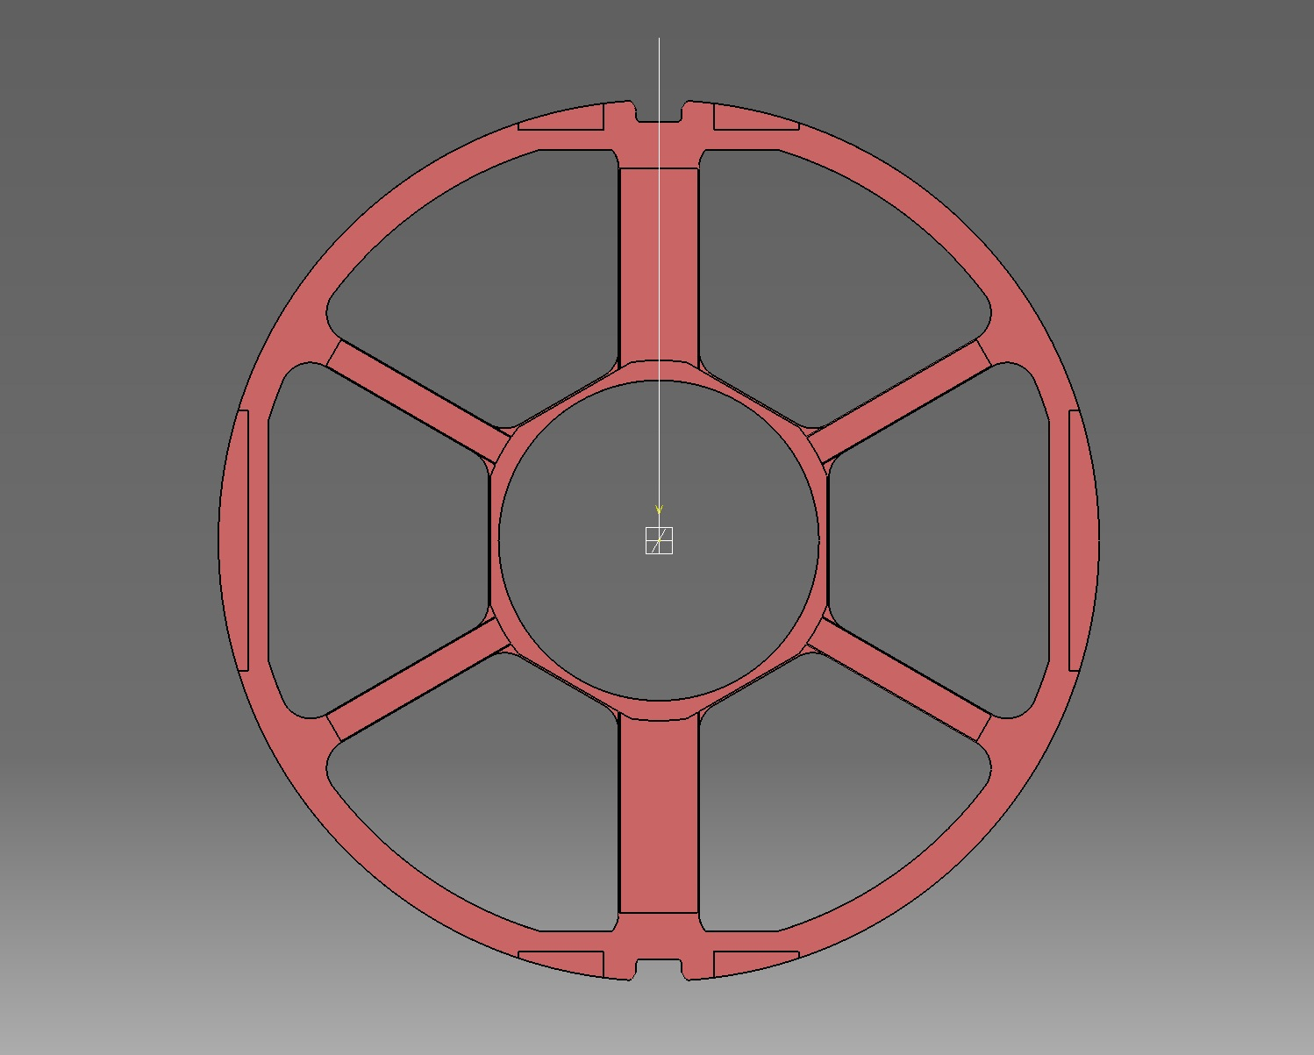
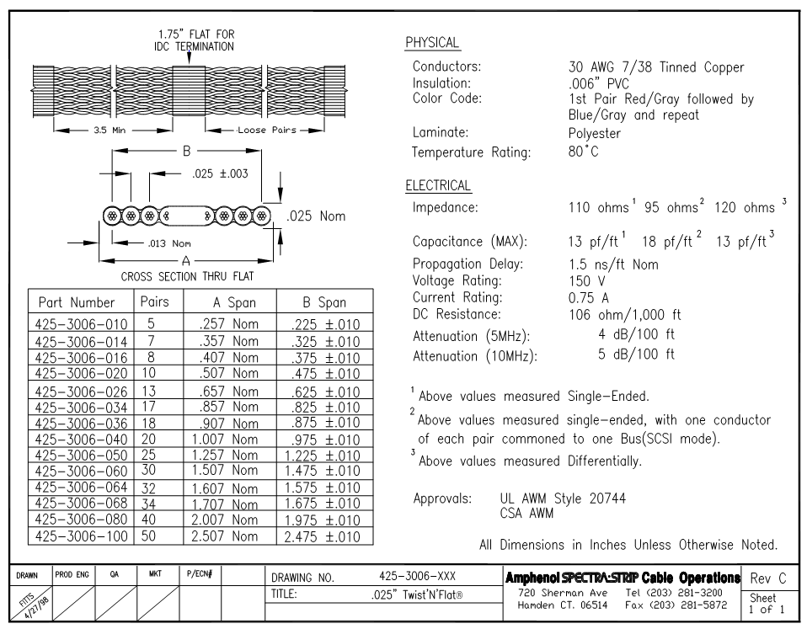
PATHWAYS OF FLAT CABLES BUNCHES
-The encumbrance of the connectors has not been considered!
6
- Flat cable cross section 28,6mm^2/each
- Total: 28,6x85 = 2431mm^2
13
4
Weight: 0.059 kg/m
8
7
3
7
4
7
13
15
15
4
4
4
85 Flates
(2890 Ch.)
13
8
8
4
4
4
0,65mm
13
15
14
6
4
7
3
44mm
7
8
4
13
6

Slide 4
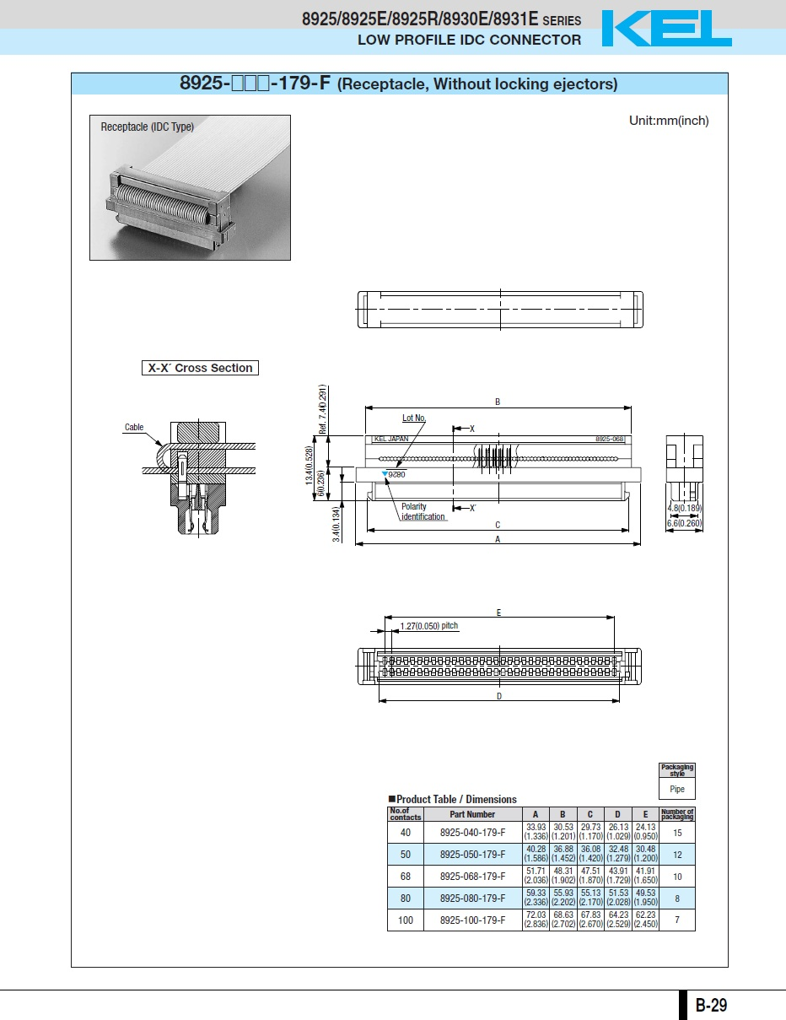
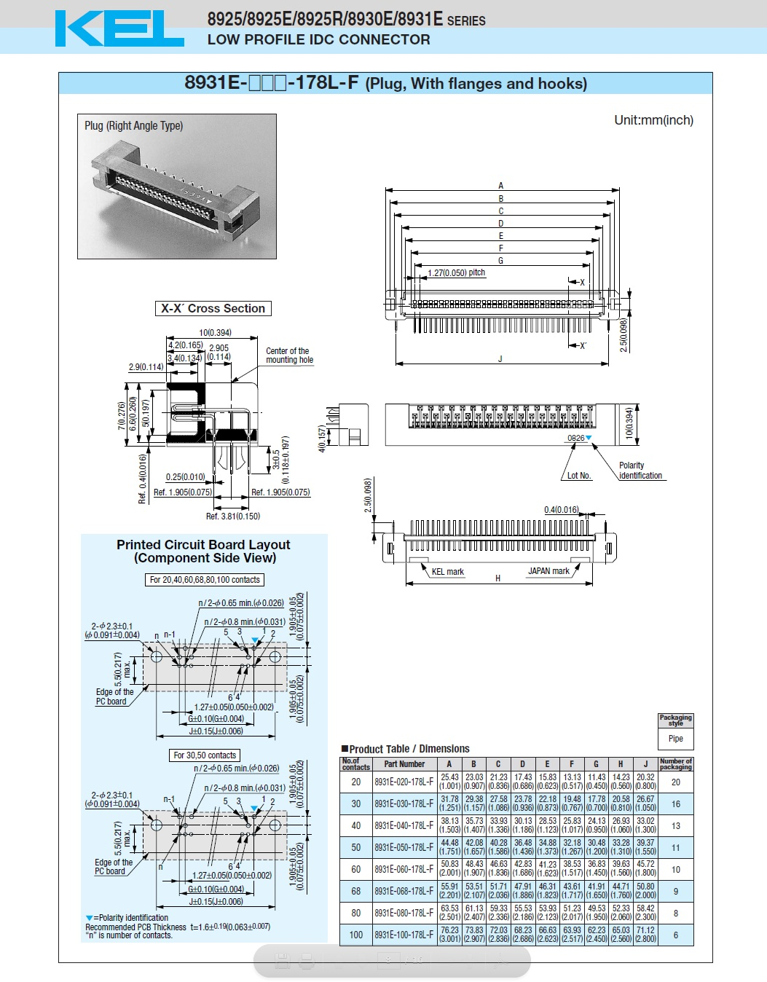
Approx. weight of connector: 5g / Each
FLAT CABLE CONNECTOR
ELECTRONIC CARD CONNECTOR
56mm
10mm
7mm
13,5mm
52mm
6,6mm
E_Card

Slide 5
PATHWAYS OF HV CABLES AND GAS PIPES
12 Gas Pipes
20 HV Cables
- The encumbrance of the connectors has not been considered!
4 Gas Pipes
(From the Forward Side)
8 Gas Pipes
(From the Forward Side)
13 HV Cables
13
7
HV CABLE DIMENSIONS
- Cross Section 8,1mm^2/each
- Total: 8,1x20 = 162mm^2 (Each Pathway)
- Weight: 0,0162 Kg/m
13 HV Cables
6
8 Gas Pipes
(From the Forward Side)
13 HV Cables
13
GAS PIPE DIMENSIONS
4Gas Pipes
(From the Forward Side)
- Cross Section 28,26mm^2/each
- Total: 28,26x12 = 340mm^2 (Each Pathway)
Weight: 0.016 kg/m
12 Gas Pipes
20 HV Cables

Slide 6
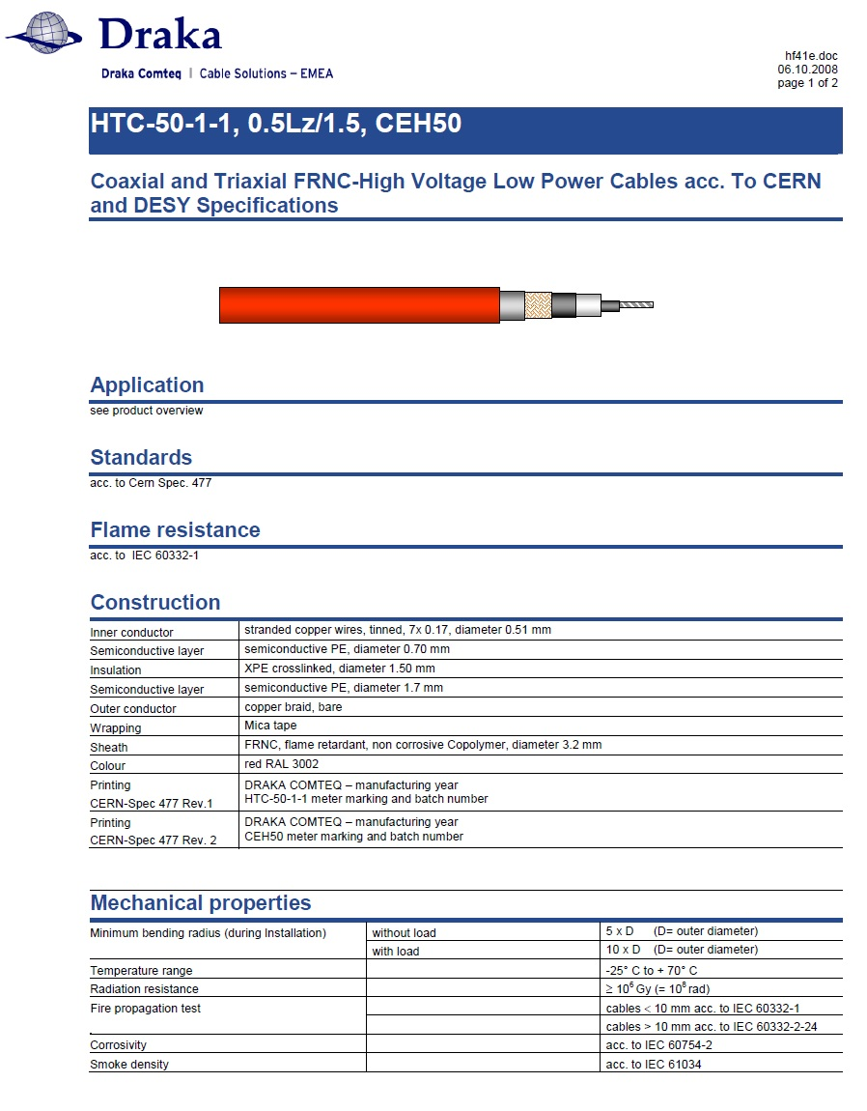
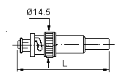
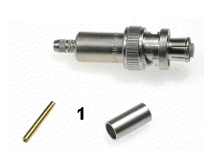
Weight: 0,0162Kg/m
Out diam.: 3.2 mm
L = 50mm
Thinner cables exist, but we have only 40...

Slide 7
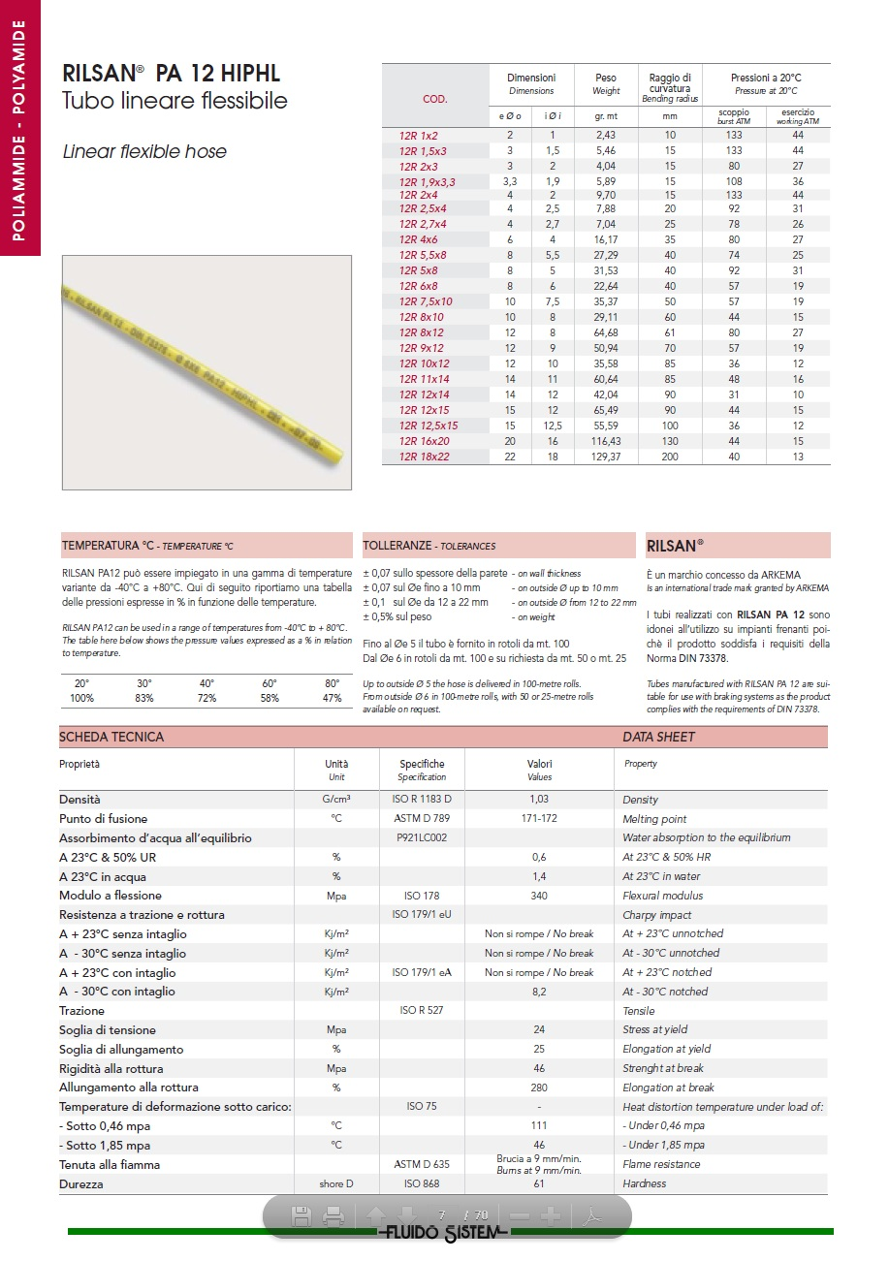
Weight: 0,0162Kg/m
Outer diam: 6 mm

Slide 8
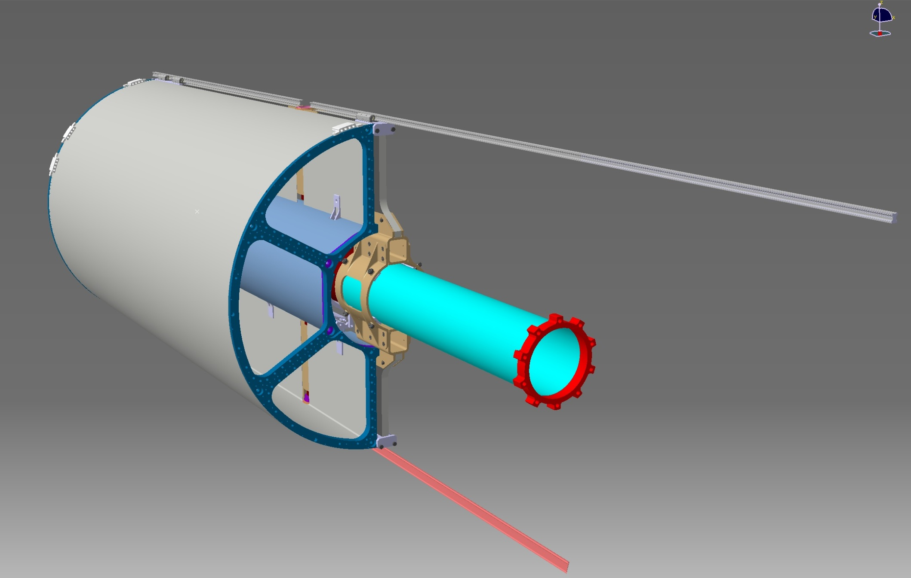
Mounting sequence: step 1
The ST modules are mounted in the
mechanical frame.
Each chamber is attached to the Central Support Frame

Slide 9
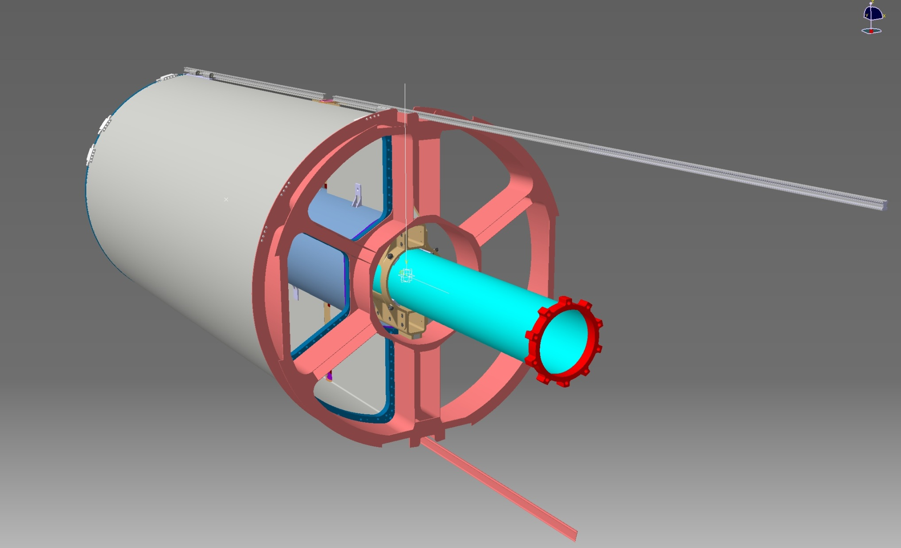
Mounting sequence: step 2
An independent mechanical frame (material can be aluminum) is inserted and connected with the ST Tracker.
Its duty is to support electronics and route cables and other services outside in the backward region.
Notes:
Area laterale 6092 mm2

Slide 10
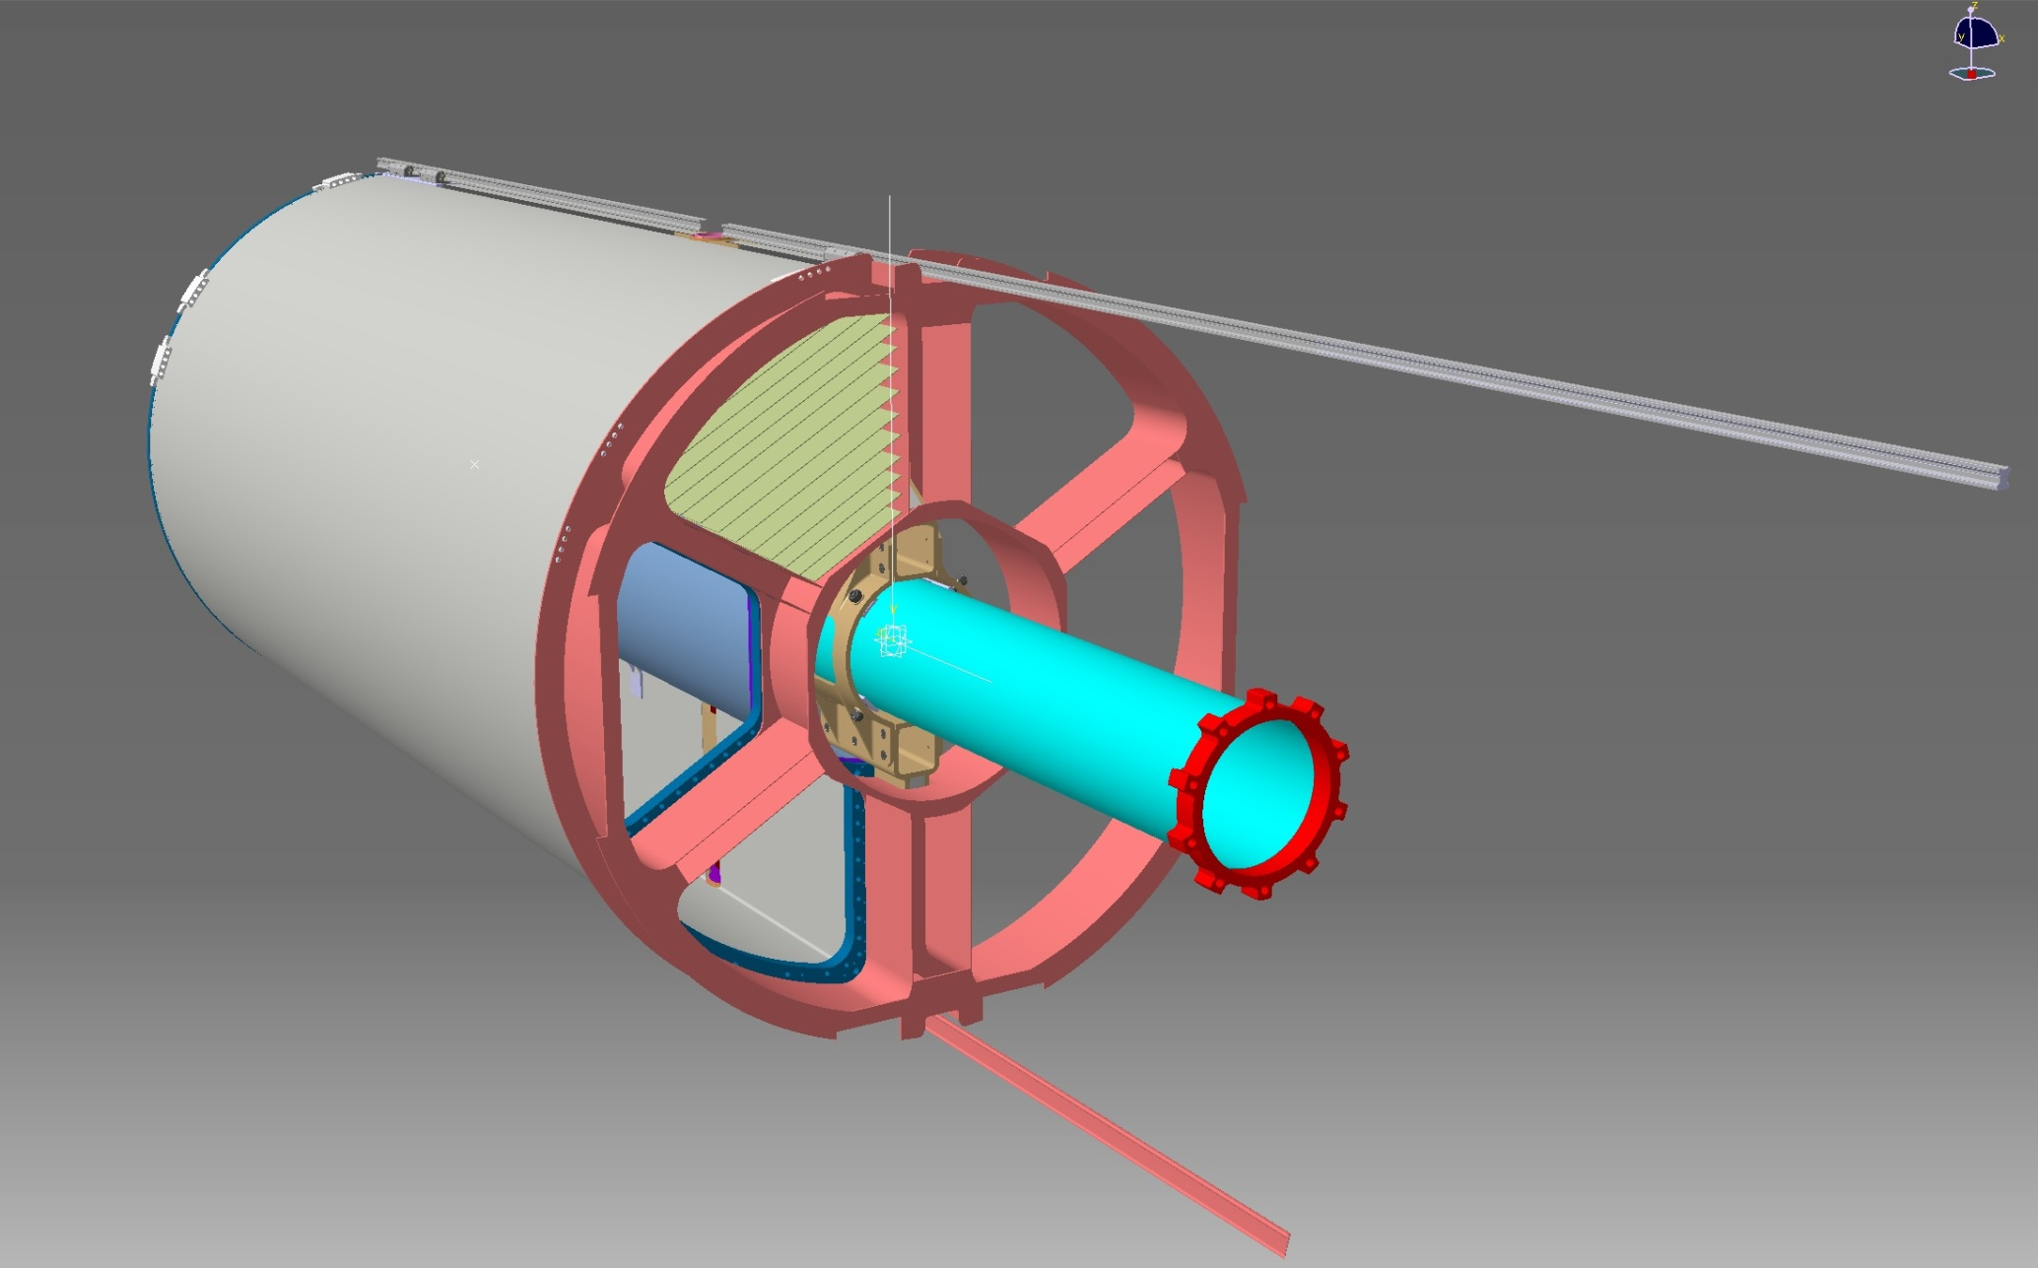
Mounting sequence: step 2
- Electronics cards: one plane for each double-layers
One of the advantages of this solution is that the weight of the electronics is decupled from the detector.
The length of the straws is the maximum possible inside the mechanical frame.
The connections between the electronics and the straw tubes should be made with flexible wires.

Slide 11
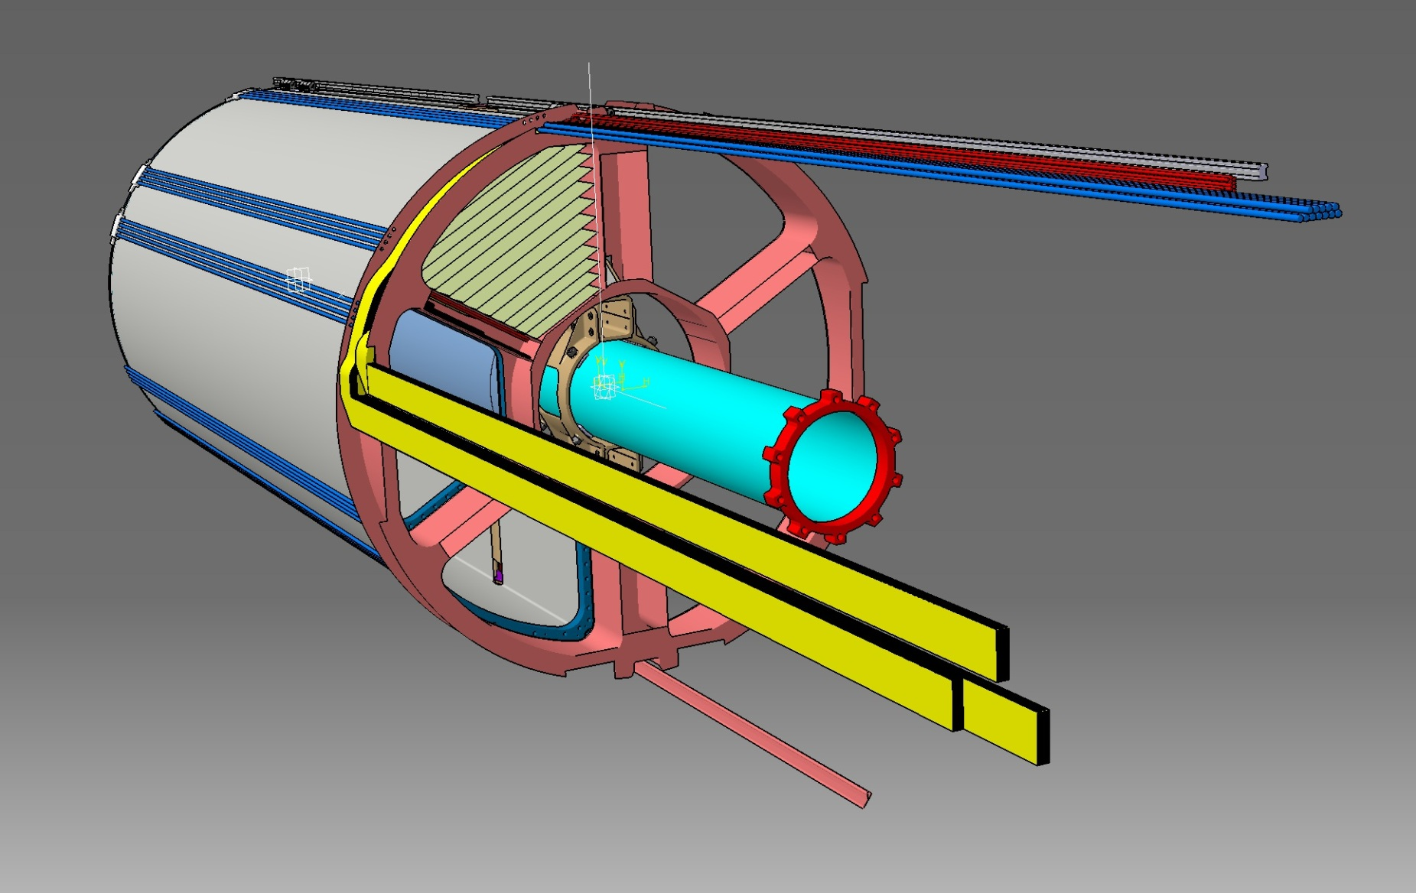
Mounting sequence: step 3
- Four areas have been left for the STT services
Signals cables, HV cables, gas pipes etc.. are connected and routed in the 4 available zones.

Slide 12
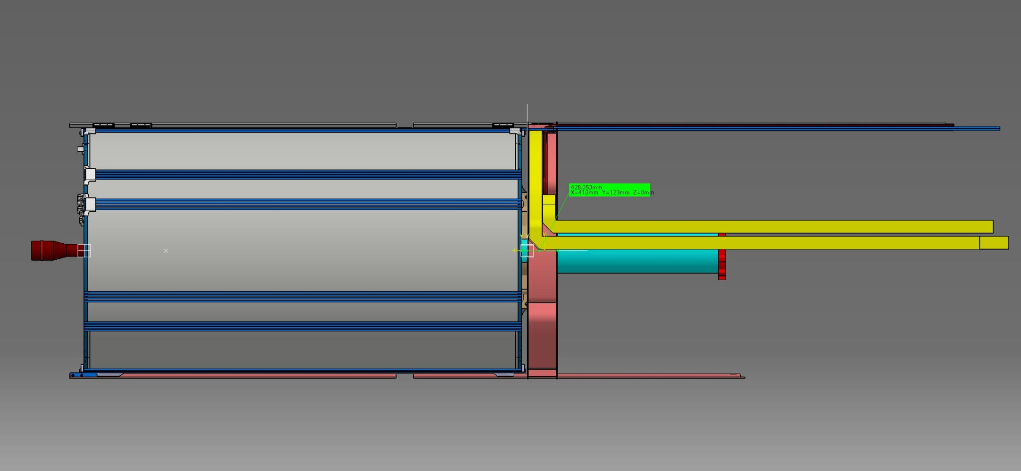
Side view of STT detector after cables and gas pipes mounting
- Forward region
- Backward region
123 mm
Gas distribution is done in the forward region, then gas pipe have to run along the external surface of the detector to reach gas-manifolds

Slide 13
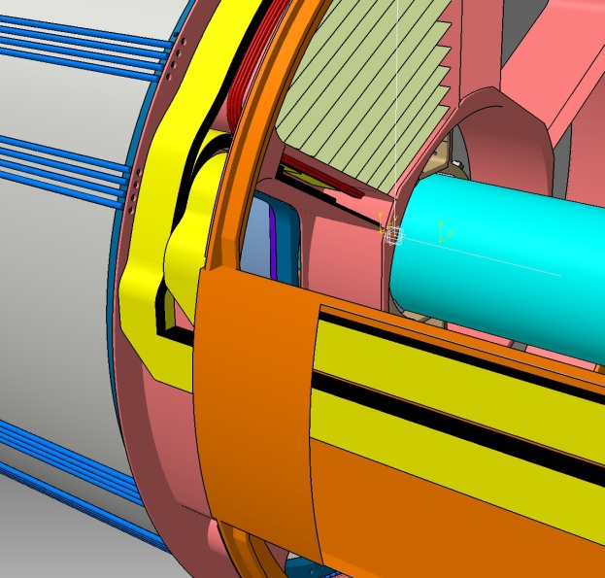
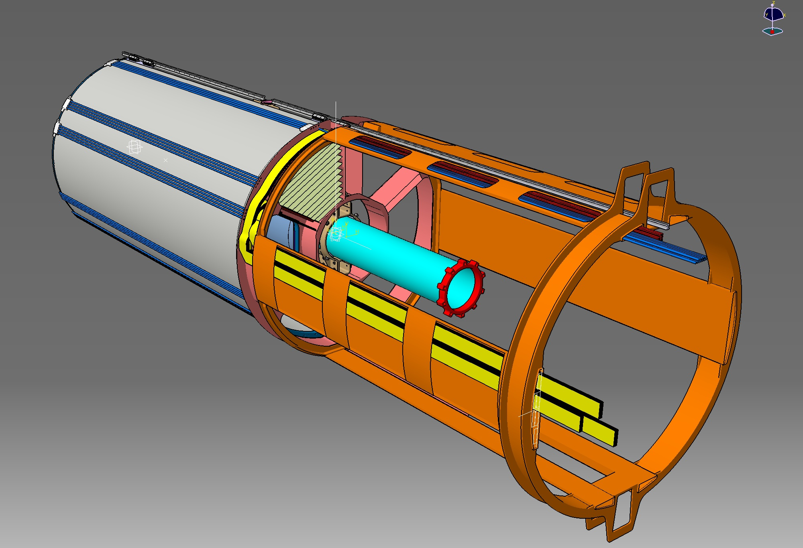
Mounting sequence: step 4
Cable are attached to the routing system.
Left and right boxes are filled with signal cables.
Top and bottom space is for HV-cables, gas pipes and other services.
NB: Where the flats
bent, their thickness double.
A test on a prototype is mandatory.
The cable routing system is attached to the STT rails. It drives the cables outside of the PANDA magnet in a tidy way.

Slide 14
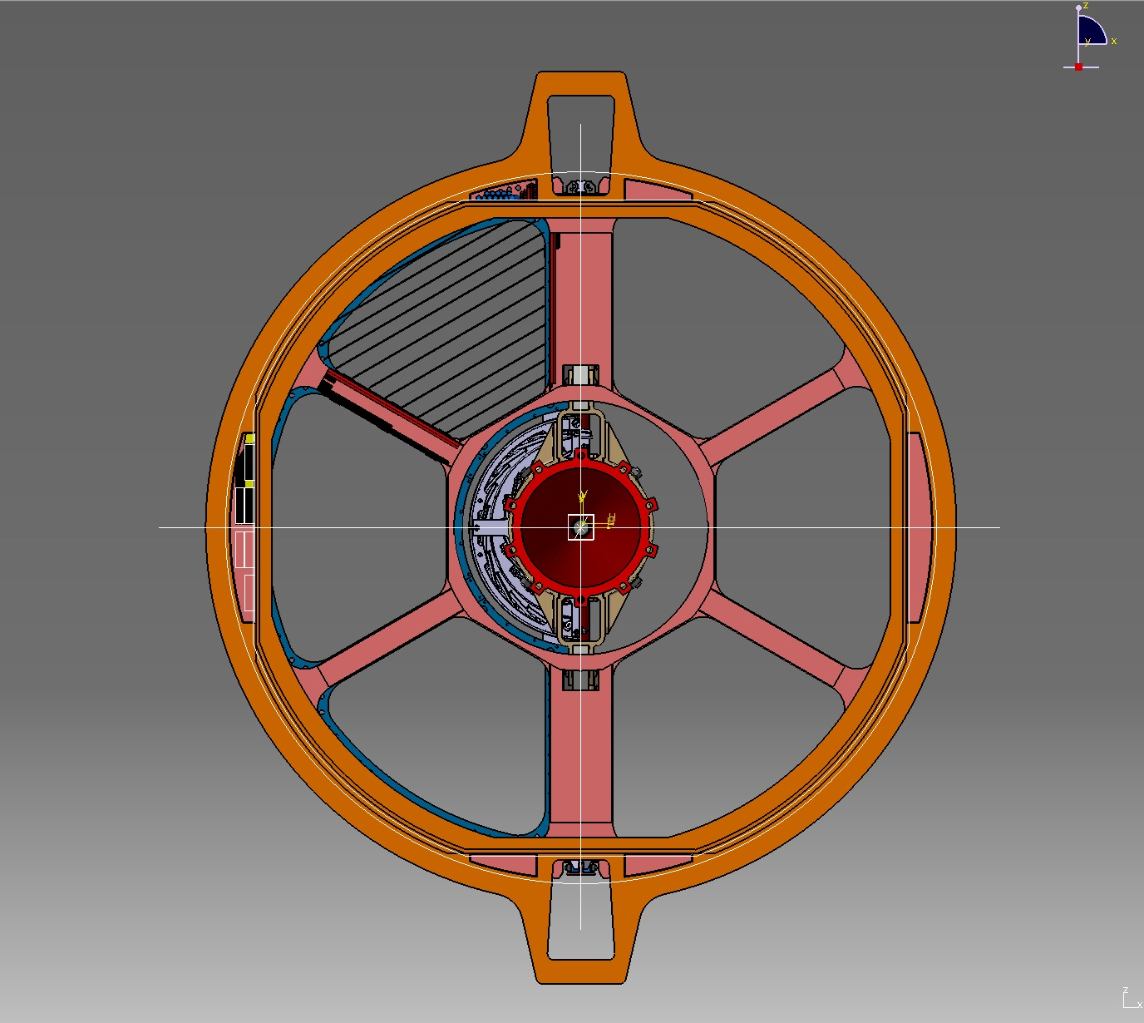
1600mm^2
6000mm^2

Slide 15
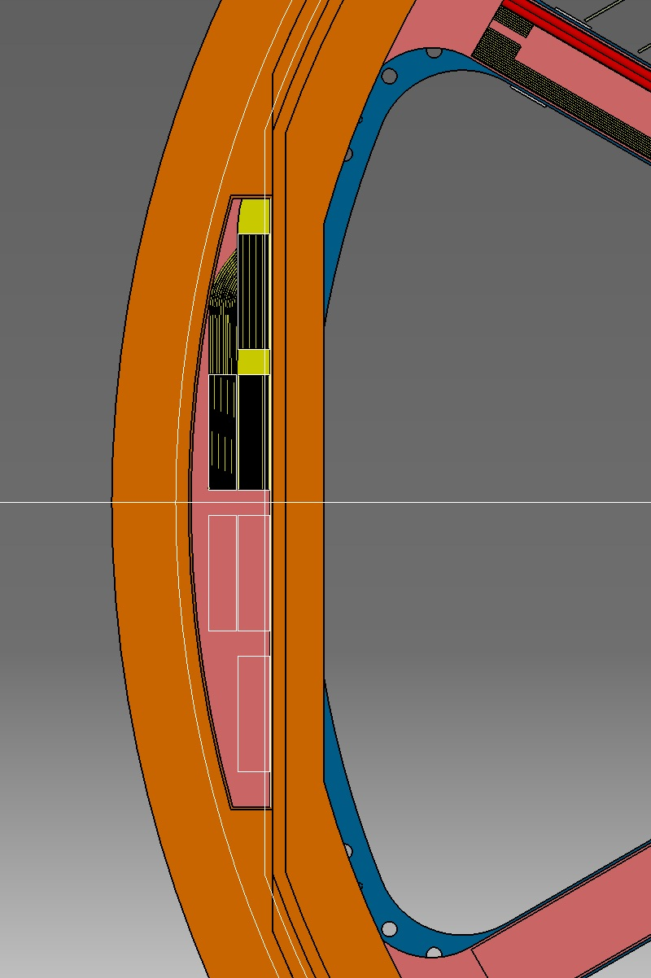
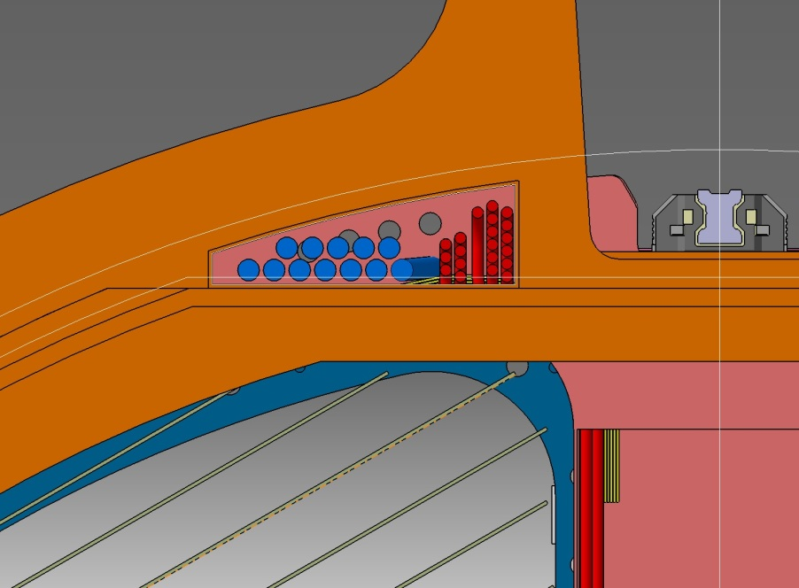
DIRC inner radius: 448mm
-20 hv Cables
-12 Gas Pipes
DIRC inner radius: 448mm
STT Cable housing: 443mm
85 Flates
(2890 Ch.)
EMC-BW: 413mm
STT Cable housing: 410mm
STT Cable housing: 410mm
ADDITIONAL SPACE NEEDED: 10mm
EMC-BW: 413mm

