Slide 1
Radiochemistry Diagnostics at NIF
EMMI-JINA Workshop
EMMI, GSI
10/13/2012
Dawn Shaughnessy for the Radiochemistry Diagnostics Group

Slide 2
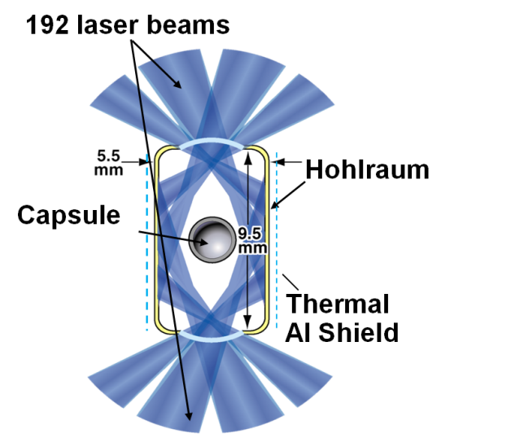
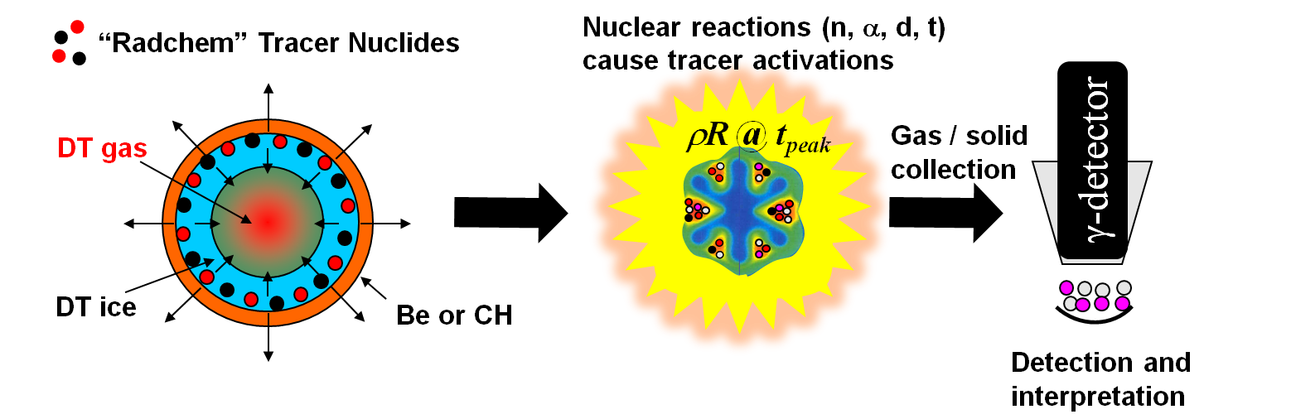
Radiochemistry on NIF can be used both for diagnostics and measuring nuclear data
Tracer atoms are loaded into the capsule ablator or on the hohlraum
~ 10¹⁵ atoms
with target foils
Longest range – probes remaining shell.
  ¹²⁴Xe + n → ¹²³Xe + 2n
  E_{th} = 10.6 MeV 1.6 barn (14.5 MeV)
  ¹²⁴Xe + n → ¹²⁵Xe + γ
  low E_{th} 0.01 barn (1 MeV) 0.002 barn (5 MeV)
Intermediate range – probes inner shell.
  ¹²⁷I + d → ¹²⁷Xe + 2n, ⁷⁹Br(d,2n)⁷⁹Kr
  E_{th} = 4.2 MeV 0.4 barn (10 MeV)
Neutron flux at peak burn creates >10⁶ atoms of reaction products from 10¹⁵ target atoms

Slide 3
A sample NIF capsule with xenon doping for gas collection
CH ablator
CH
CH
6 μm
1x10¹⁵ atoms Xe-124
DT ice
DT
1x10¹⁵ atoms I-127
For charged particle mix diagnostic reactions there must be a sample recovery tracer
For neutron reactions the detector can be its own tracer
In Be capsules, Xe is introduced via the sputtering gas; in CH capsules Xe is ion implanted
Xe doping via ion implantation has been demonstrated
DT

Slide 4
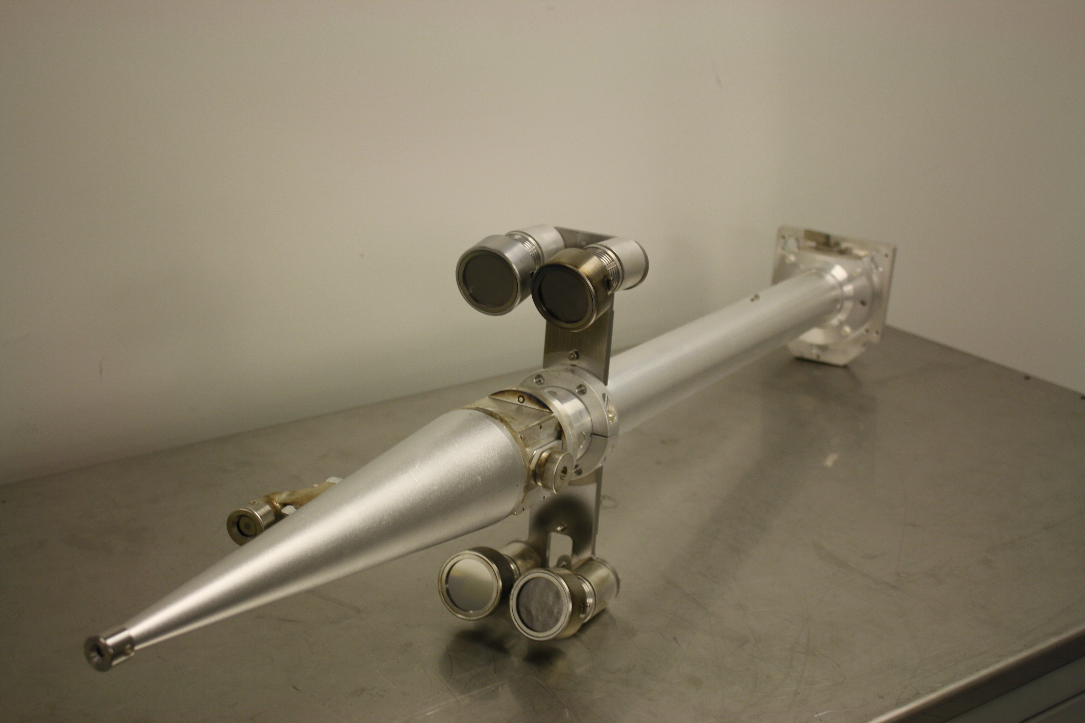
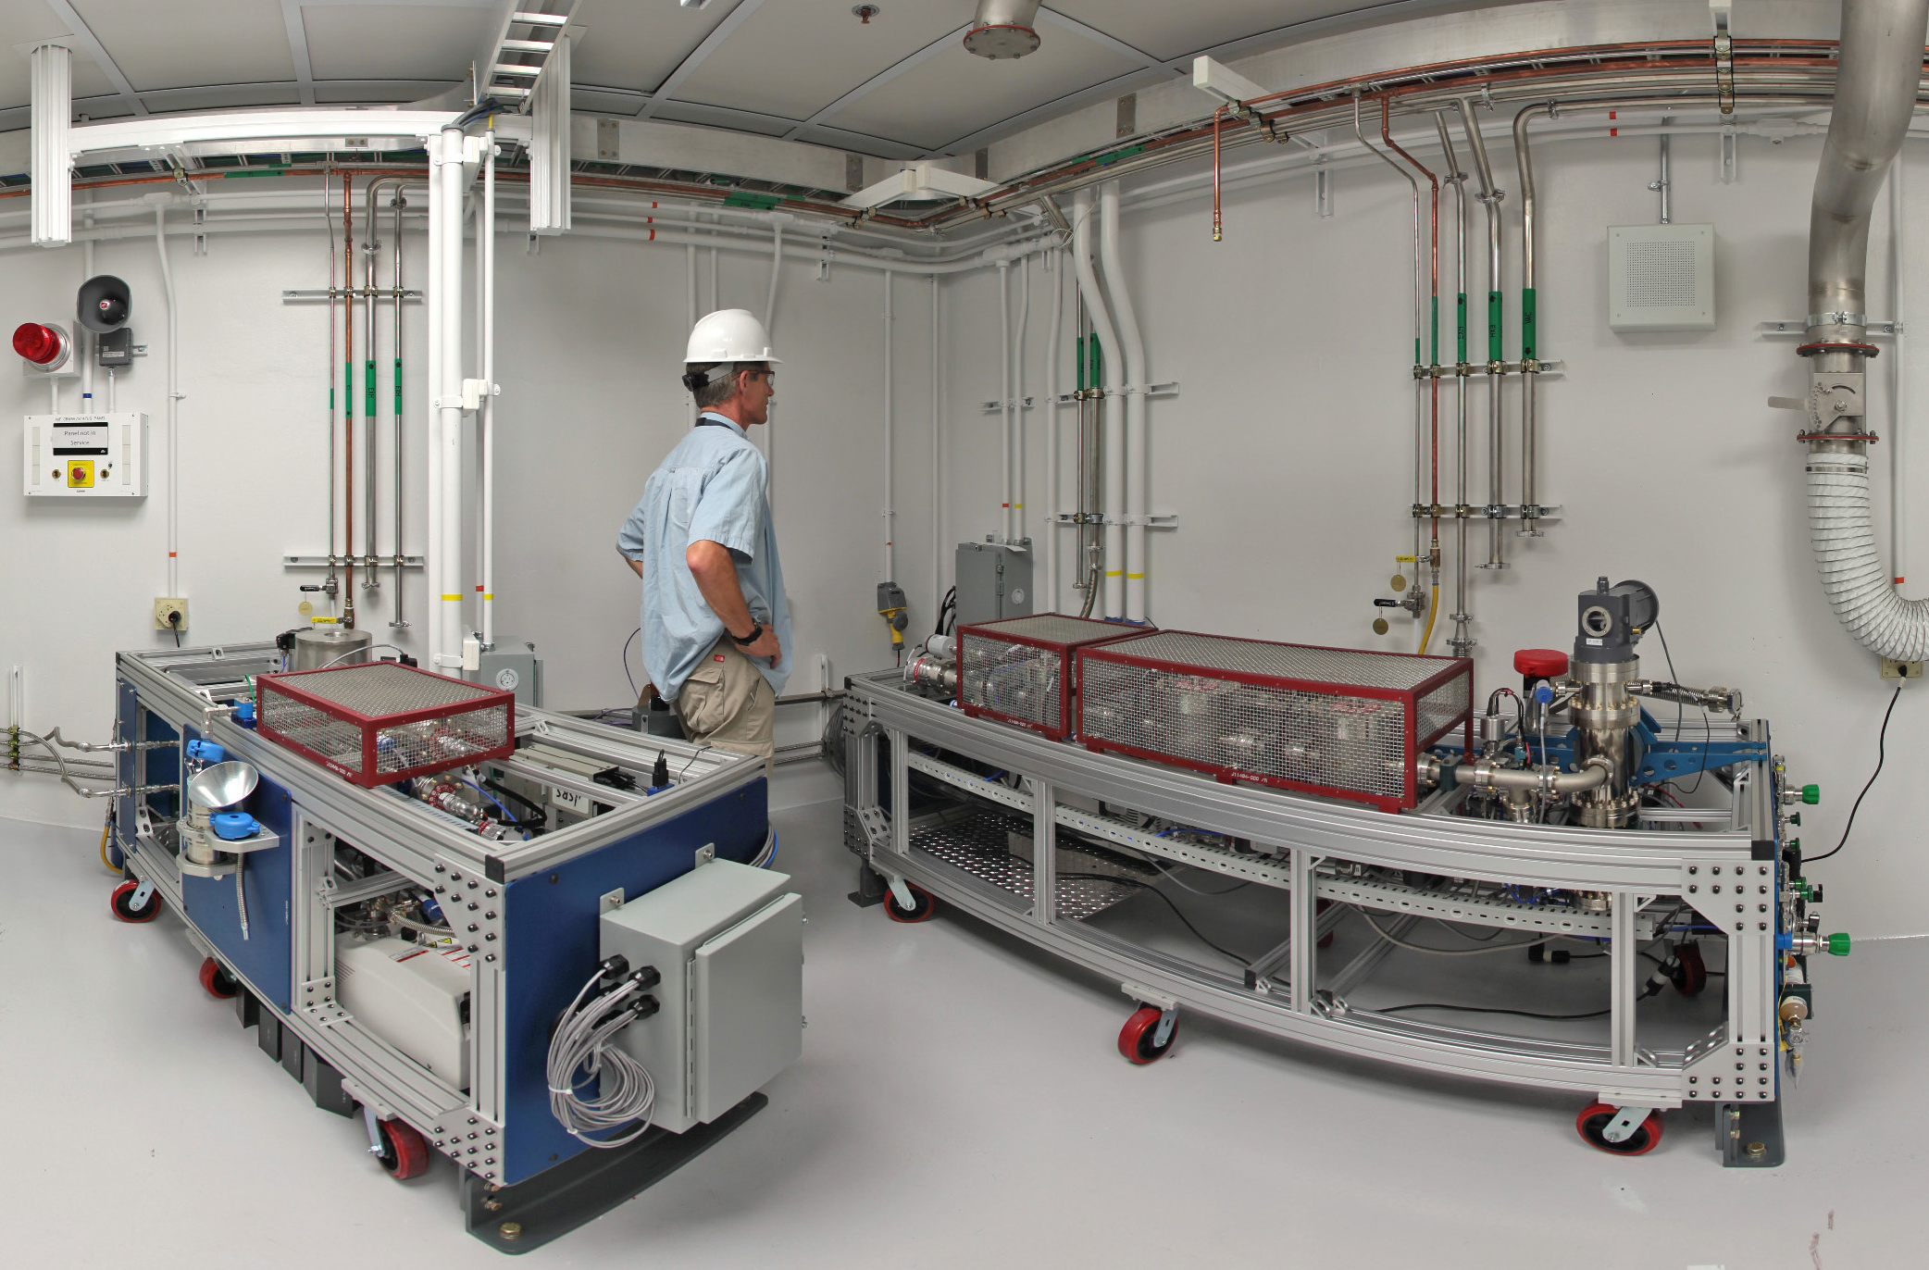
Both gaseous and solid debris collection have been developed at NIF
10 m diameter NIF chamber
Diagnostic Insertion Manipulator (DIM)
nose cone with Solid RadioChemistry (SRC) collectors
Polar DIM
(0,0)
Equatorial DIM
(90,78)
50 cm
Sold RadioChemistry (SRC) Detectors (metal foil or graphite) are removed
post-shot & gamma counted
Radiochemical Analysis of Gaseous
Samples (RAGS)
Gas load from the chamber is pumped to the RAGS apparatus and collected in a removable bottle for gamma counting

Slide 5

Radioactive Analysis of Gaseous Samples (RAGS) gaseous collection
Gas Pre-cleaner System
NIF
Cryo Prefilter
Target
LaBr
NIF
chamber
Chamber
LaBr
3
Getter
(600m
)
Turbos
He flush
Getter
Noble
T
T
Getter
RGA
Gas
Puff
T
System
Getter
He flush
Xenon Cryogenic
Fractionation & Detector
System
Getter
LaBr
Getter
LaBr
Tritium Processing System
Cryo Collector
Abort Tank
RGA
Removable Trap
G
e
r
m
a
n
i
u
m
d
e
t
e
c
t
o
r
C
r
y
o
T
r
a
p
RGA
Ge detector
Noble Gas Mass Spectrometer

Slide 6
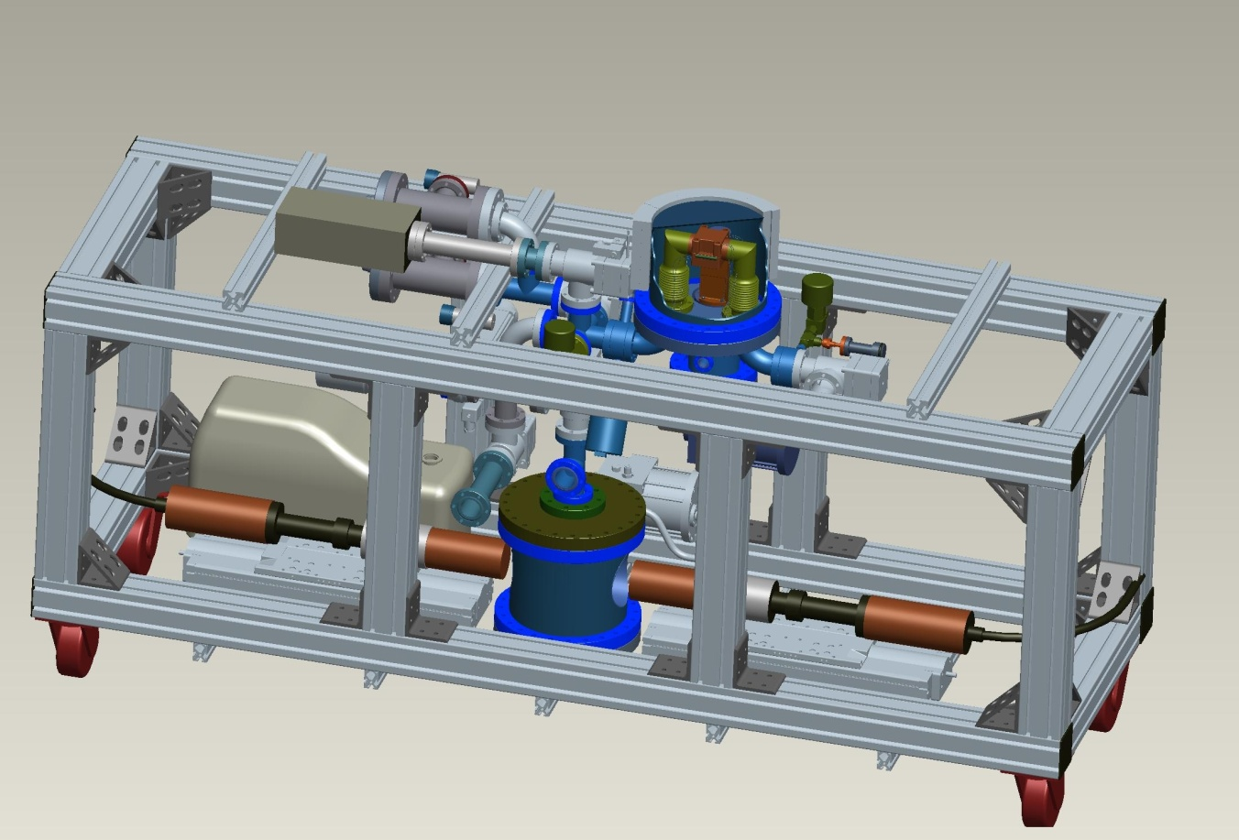
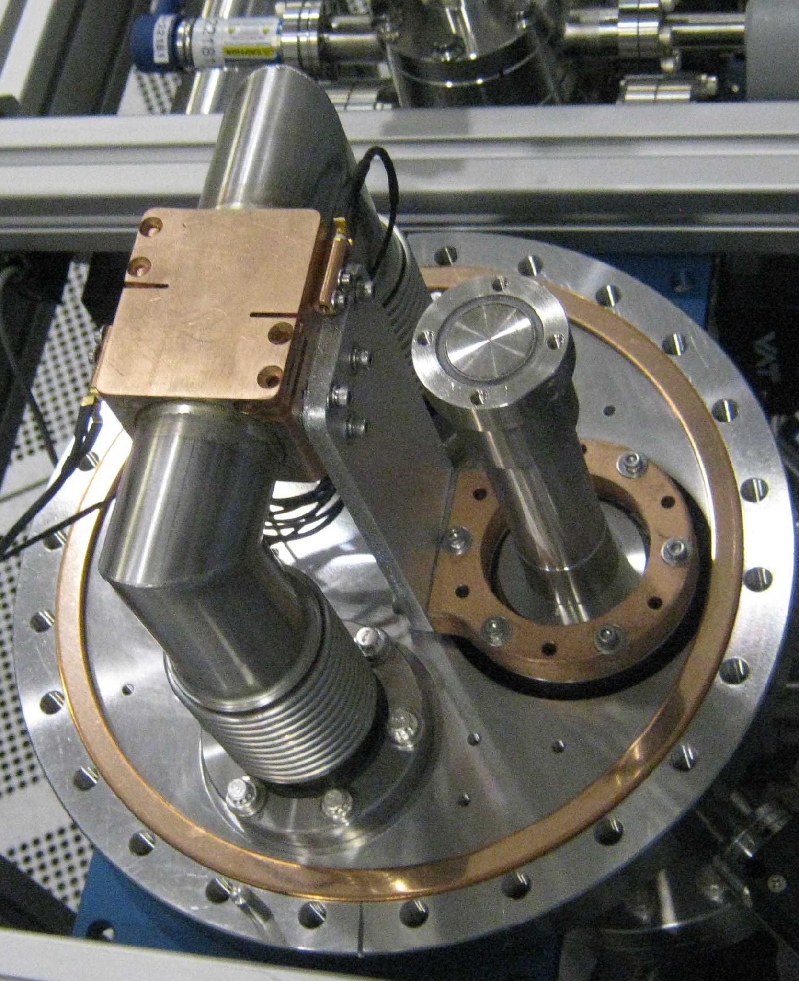
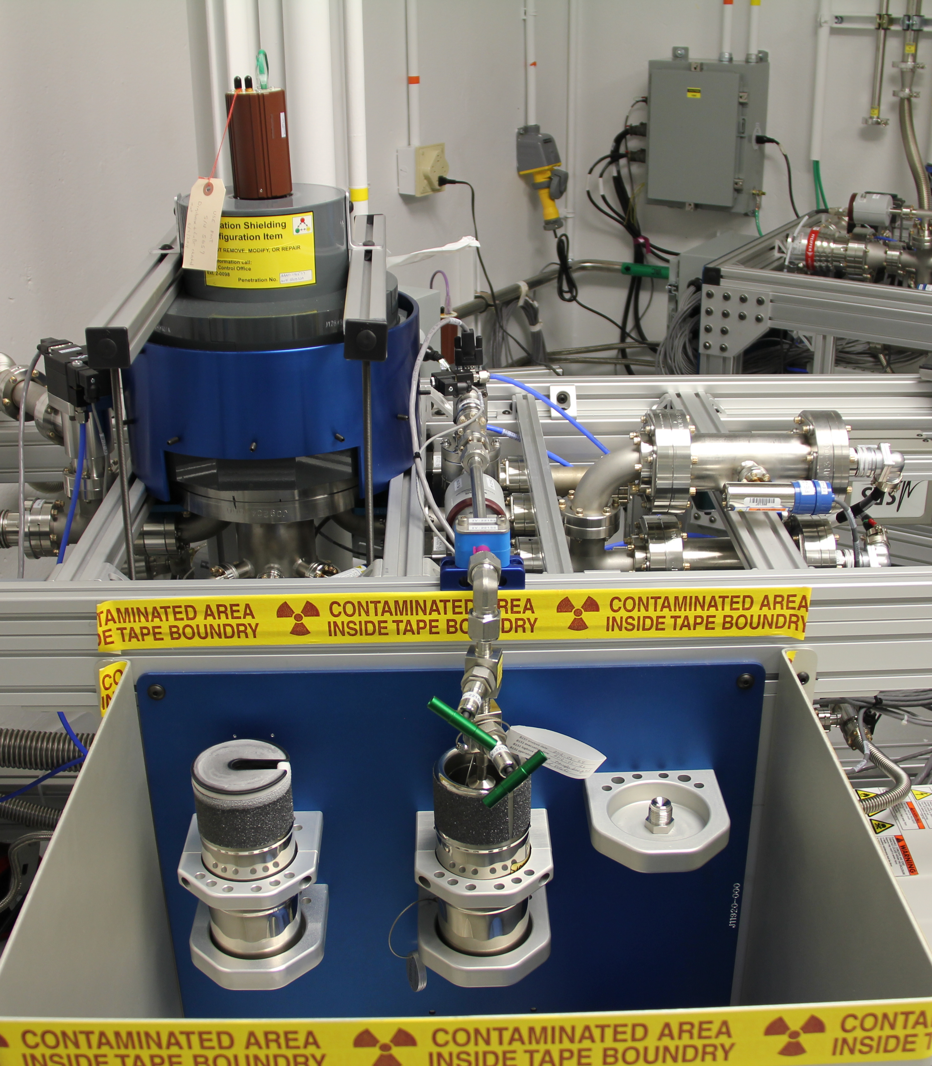
Xenon collection and detection cart
From pre-cleaner
Cu foam cryo head
Future cryo head with 2 coincident Ge detectors for in situ counting
Sample removal bottle for decay counting and noble gas mass spectrometry

Slide 7
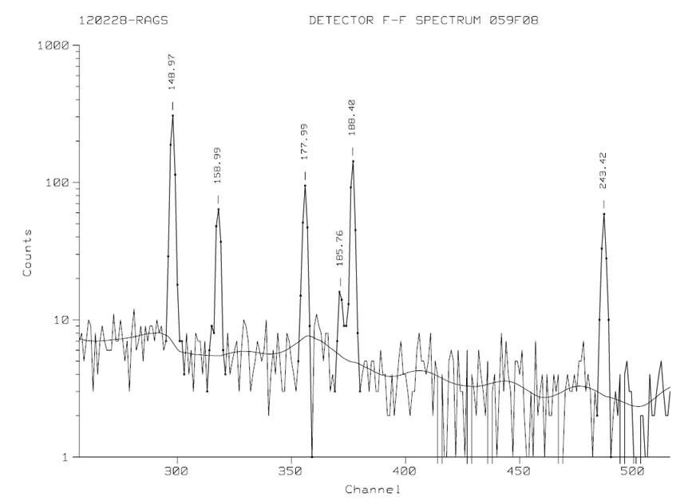
First RAGS xenon collection and gamma spectroscopy data
NIF shot N120228-001-999 (Exploding Pusher)
^{123g}Xe
t_{1/2}=2.1 h
Production Ratios
^{124,126,128}Xe(n,2n)^{123,125,127}Xe
N_{Xe-125} / N_{Xe-123} = 1.22 ± 0.05
N_{Xe-127} / N_{Xe-123} = 1.24 ± 0.17
Normalized to 124:126:128 = 1:1:1
by scaling counting atom ratio with the target isotope fractions and assuming small n,γ contributions vs n,2n
Estimated atoms @Tzero *
N_{Xe-123} ≈ N_{Xe-125} = 2.1E6
N_{Xe-127} ≈ 2E5
Minimum ~ factor of 2 lower
Maximum – not known
^{125g}Xe
t_{1/2}=16.9 h
^{123g}I
t_{1/2}=13.3 h
* Used 65% collection efficiency Target Chamber to RAGS Xe sample bottle
Gamma ray spectrum collected 4.5-5.5 hr post-shot on Germanium detector

Slide 8
Solid Radiochemistry (SRC) was developed by analyzing samples from various locations in the chamber
Polar Diagnostic Insertion Module (DIM)
Disposable Debris Shield (DDS) + Final Optics Assembly
Chamber diameter is ~10 meters. Most of our samples were 1 to 5 cm in diameter.
DDS
7 m
50 cm
Equatorial DIM
Equatorial DIM
25-50 cm
8-10 cm
Al Shields: covered Neutron Activation Diagnostic
Ta Collimators: part of x-ray diagnostic assembly
Glass DDS: covered the final optics assembly
Metal Disks: WRF housing
Glass Debris Catchers: mounted throughout the chamber
DDS
DDS
Drawing Not to Scale, Side View
8

Slide 9
Structural contaminants and Au debris from the hohlraum were identified on all analyzed materials
40 µm
40 µm
Unique elemental signature – usually incorporated with Si and Cu
These sub-micron Au features contribute little in terms of mass collection but may be of interest in terms of chemical/geometric fractionation.
1 μm

Slide 10
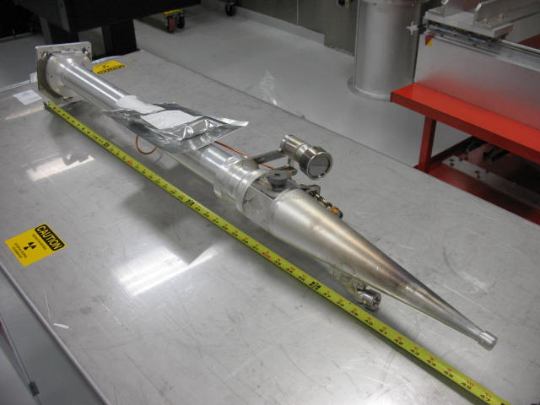
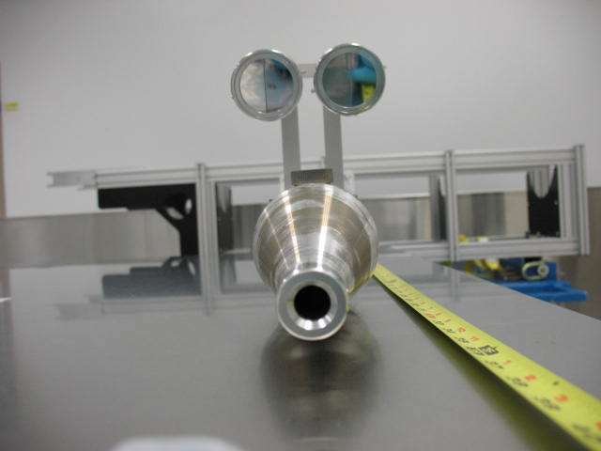
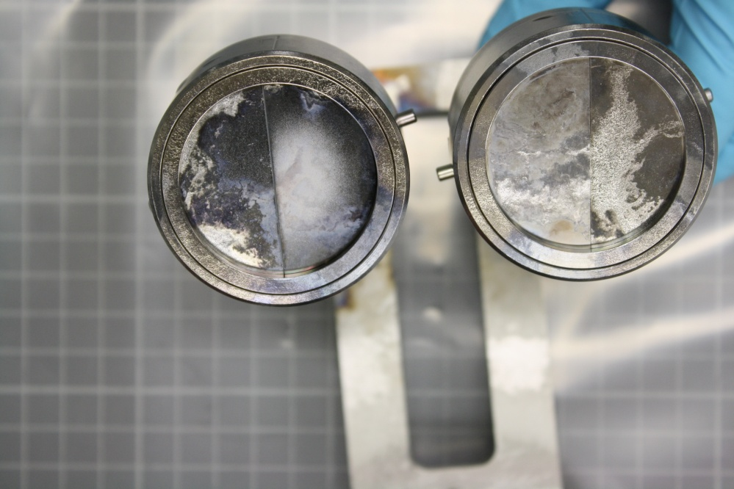
Several materials were fielded as shot ride-alongs to test their feasibility as collectors
Nb, Ta, V, Mo, Ti, Ag and graphite foil (Diameter 5 cm) were fielded using existing wedge range filter mounts that attach to the DIMs
Similar shots with plastic shell Ge-doped capsules, Au hohlraum, laser energy from 940 – 1300 kJ, 50 cm from TCC
Samples were evaluated for morphology changes, Au collection, Ge collection, surface melt, ablation depth, etc.
DIM Snout
Preshot assembly
Postshot assembly
Nb / Ta
V / Mo
Sample
50 cm from TCC
963 kJ TCC energy

Slide 11
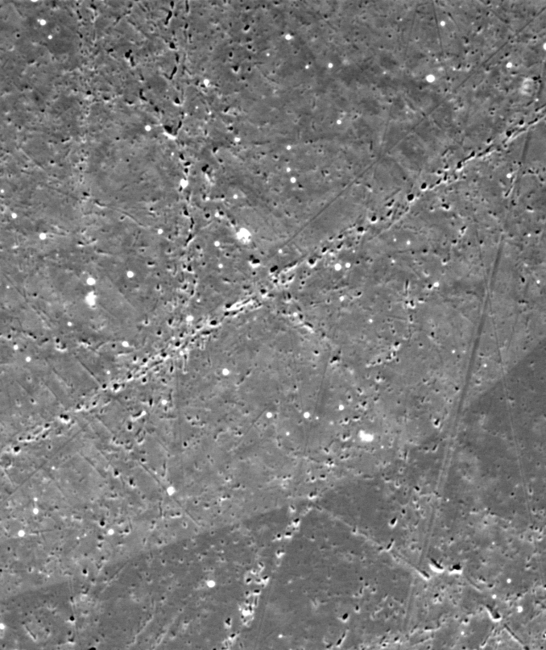
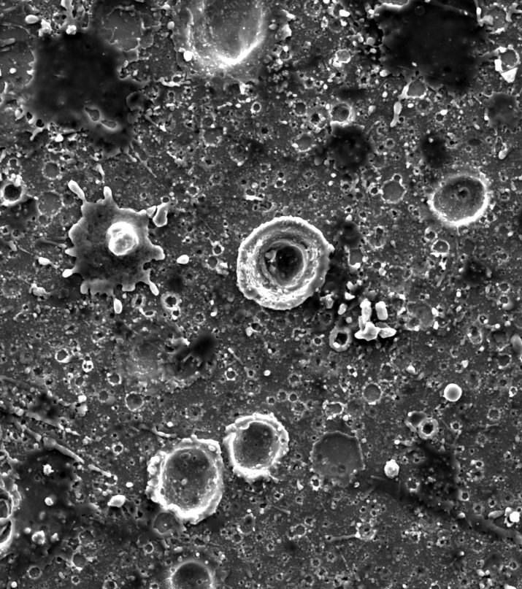
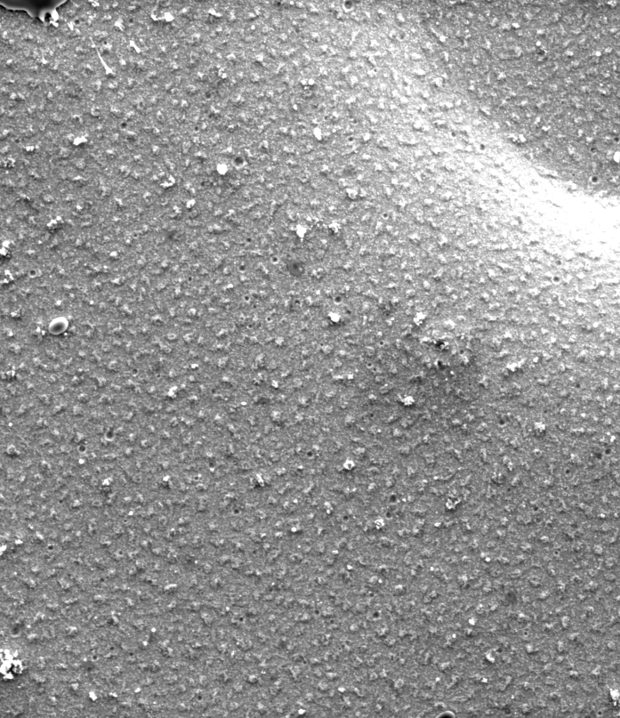
Surface morphology of pre-shot and post-shot disks indicate that the debris wind is not homogenous
Niobium
10 µm
Pre-shot
Post-shot (0-0, Polar)
Post-shot (90-78, Equator)
The polar sample has a high density of craters and large splats.
The equatorial sample has less craters, which are smaller in diameter, and less large debris splats. There is a high density of very small (< 1µm) features on the disks.

Slide 12
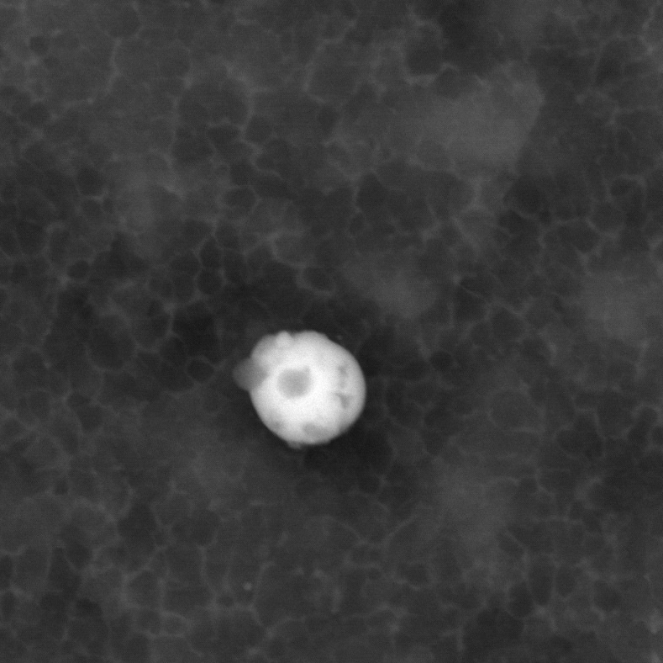
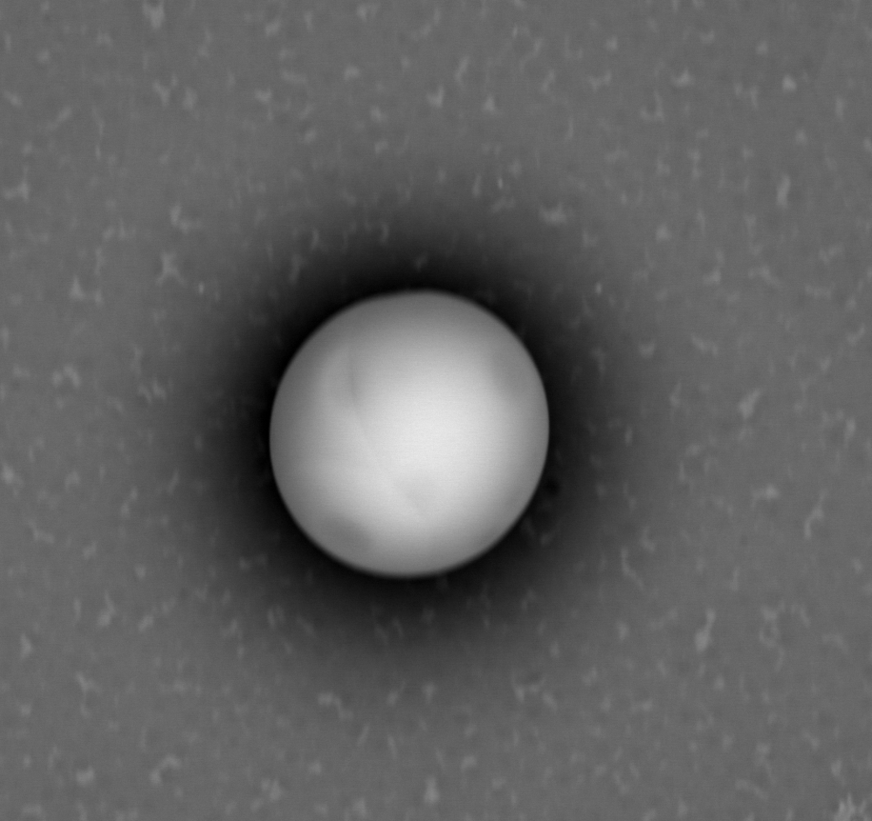
Most of the Au target debris << 1 μm in diameter. Debris condensation needs to be modeled.
100 nm
4 μm
Darker particulates on the sphere are Al/Si
Notice the small Au features surrounding the sphere.

Slide 13
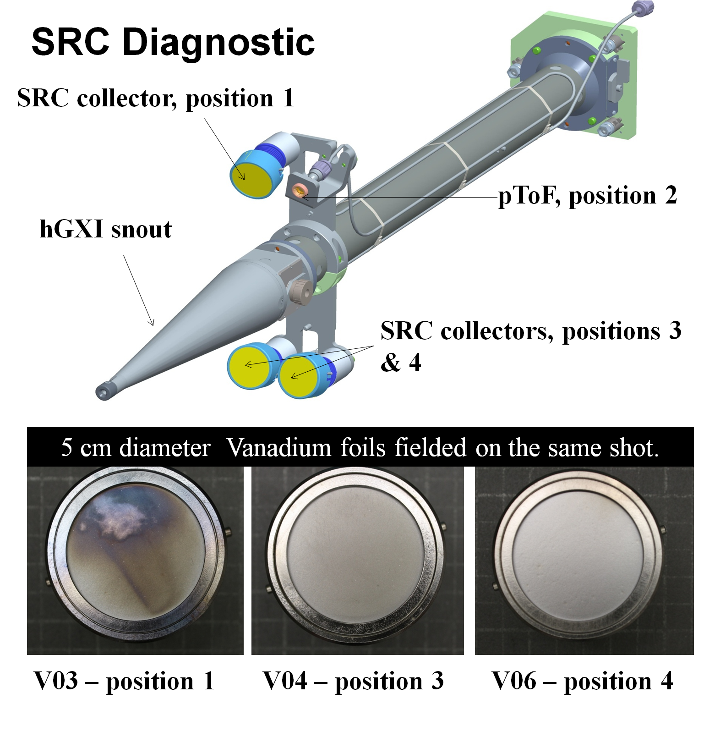
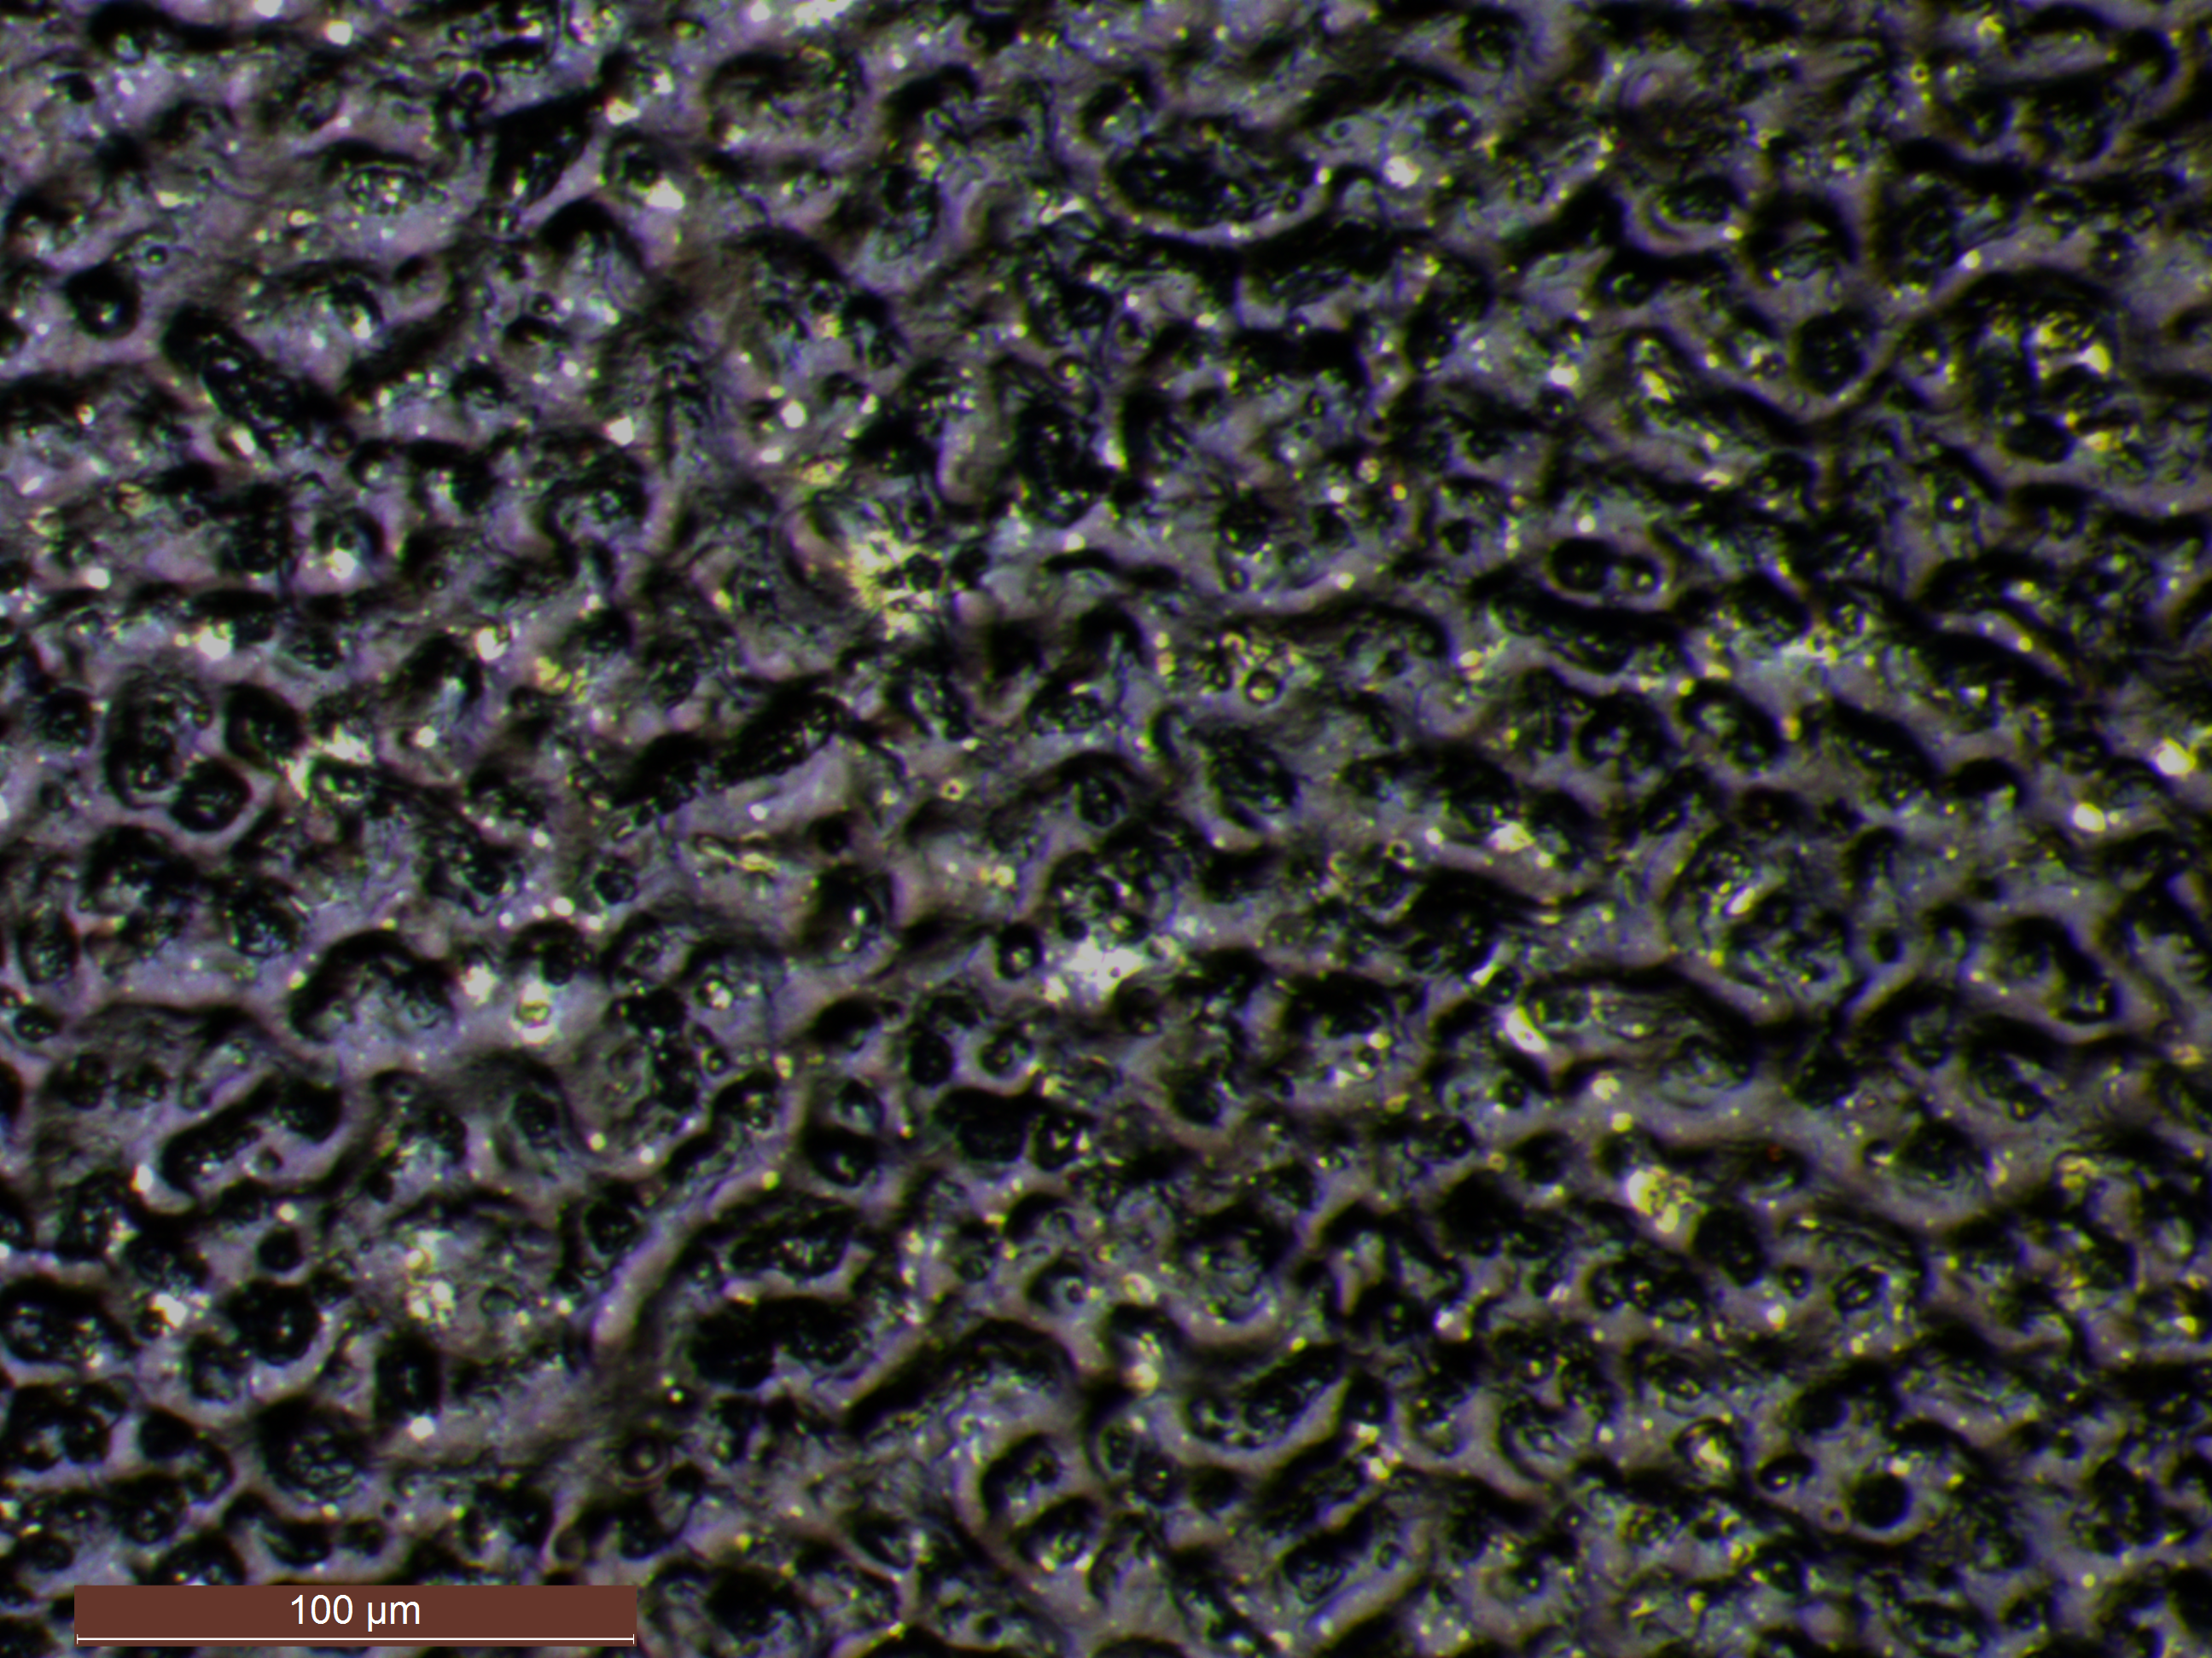
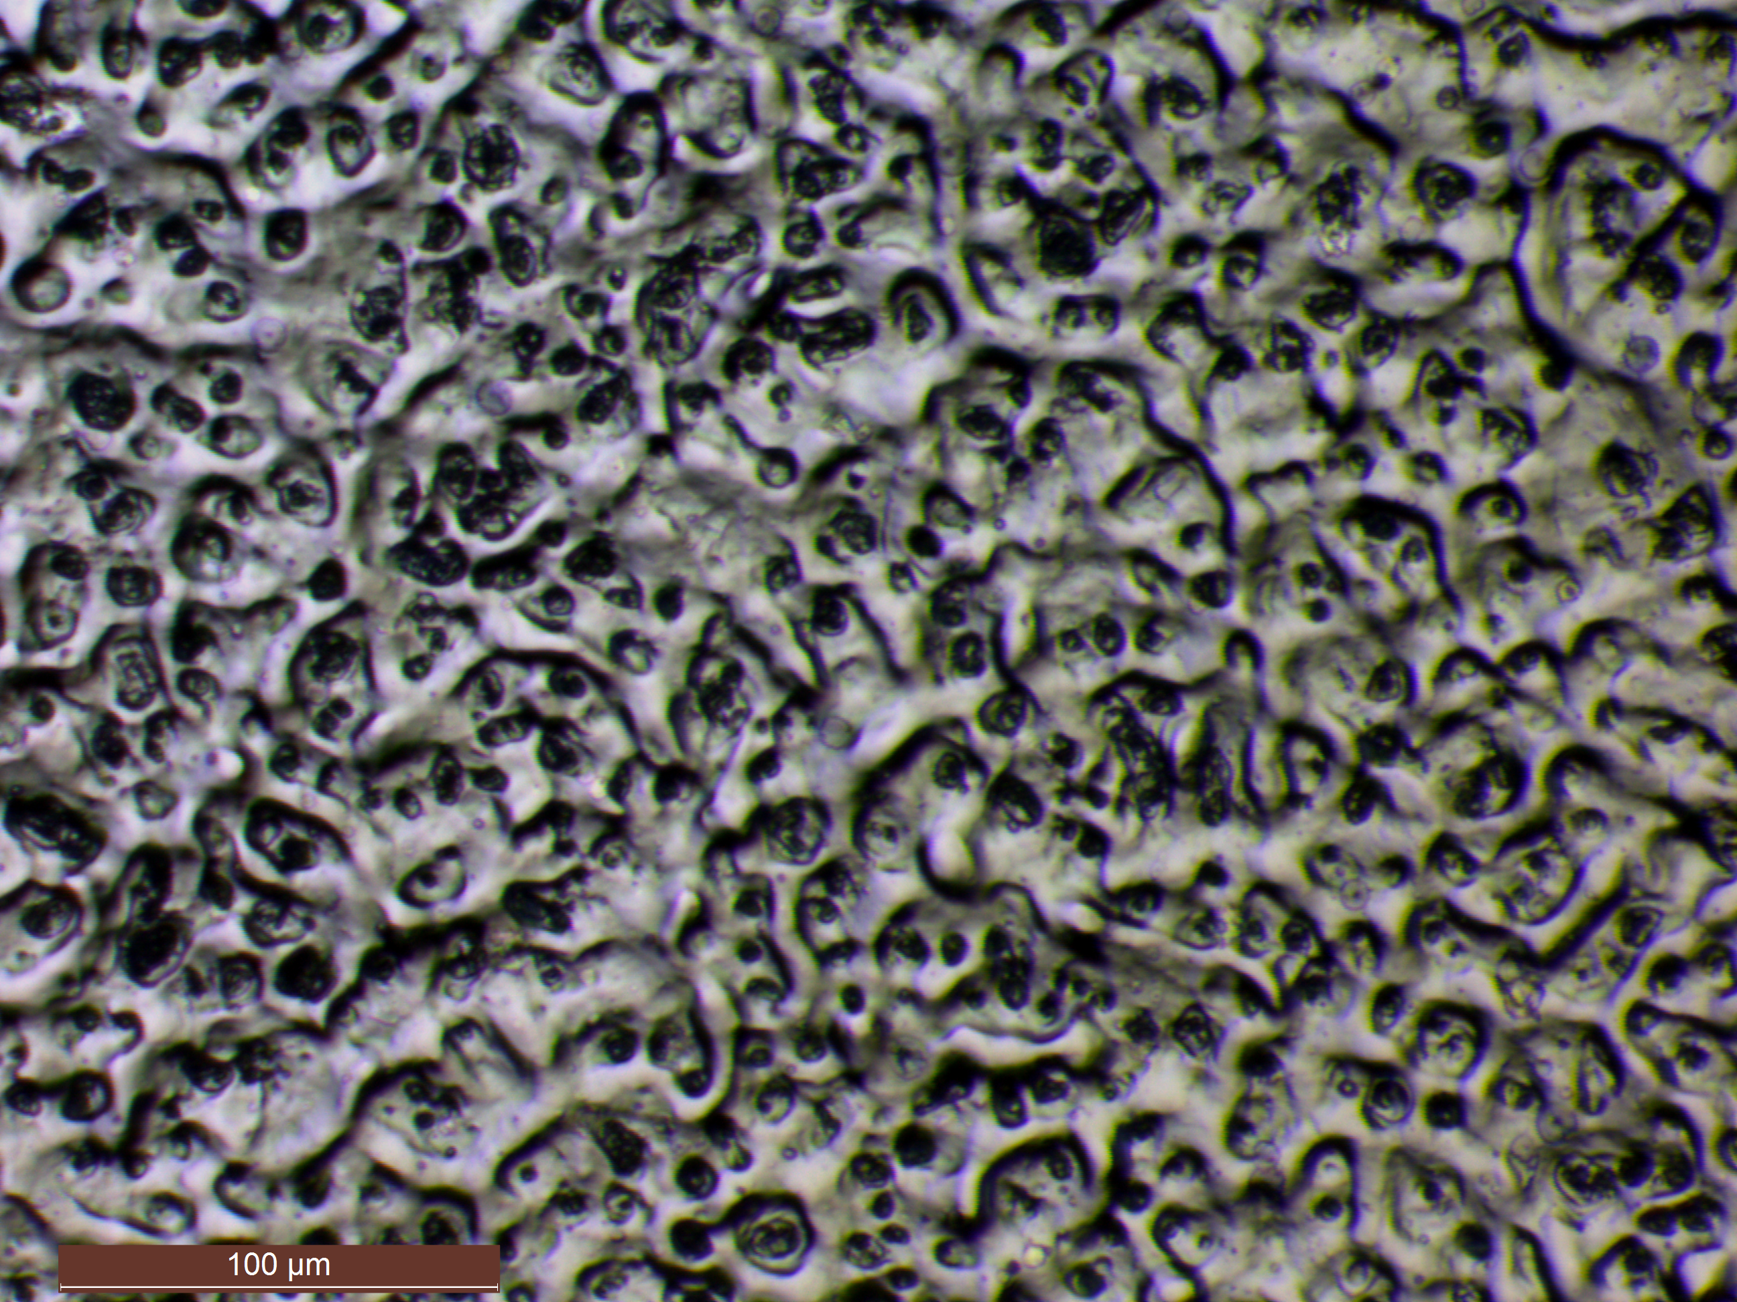
Post-shot photos of collectors fielded on the new 4-mount bracket show differences in debris distribution
Distance between collector mid-point
Pos1, Pos 2 | 6.2 cm
Pos1, Pos 3 | 30 cm
Position 1 shows more gold debris than position 4

Slide 14
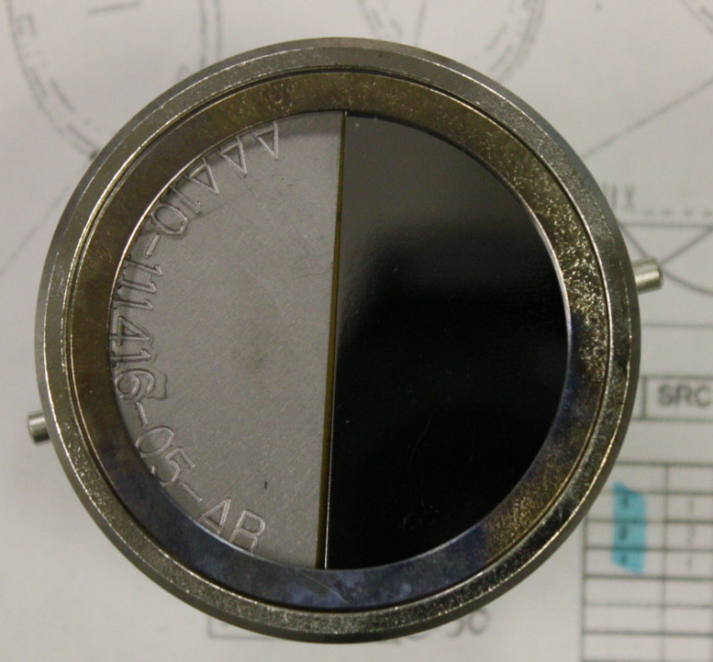
First activated solid debris samples collected from NIF – 11/04/11
Experiment – determine surface finish effects on collection
Measurement of neutron activated Au from the hohlraum
Tantalum - polished
Stainless steel retaining ring
¹⁸¹Ta(n,2n) and ¹⁸¹Ta(n,γ)¹⁸²Ta (collector self-activation)
¹⁹⁷Au(n,2n)¹⁹⁶Au and ¹⁹⁷Au(n,γ)¹⁹⁸Au
(hohlraum debris)
Tantalum - unpolished
5 cm diameter
Sample ¹⁹⁶Au (from n,2n on ¹⁹⁷Au) ¹⁹⁸Au (from n,γ on ¹⁹⁷Au)
Polished Ta (3.28±0.06)E06 (1.50±0.06)E04
Unpolished Ta (1.72±0.04)E06 (7.00±6.00)E03
198/196Au Ratio (polished Ta): (4.28±1.71)E-03
182/180Ta Ratio (polished Ta): (7.97±0.04)E-02
Ta/Au Ratio: 18.61±7.53

Slide 15
The gamma spectra from the first SRC collectors showed activated Ta and Au debris from the hohlraum
¹⁸⁰Ta (8 hr)
¹⁹⁶Au (6.2 d)
These spectra show both ¹⁸¹Ta(n,2n) (collector) and ¹⁹⁷Au(n,2n) (hohlraum debris) activation
Gamma lines from ¹⁸¹Ta(n,γ)¹⁸²Ta and ¹⁹⁷Au(n,γ)¹⁹⁸Au neutron capture were also present in the data
We regularly observe various neutron reactions on the collector material and from collected debris

Slide 16
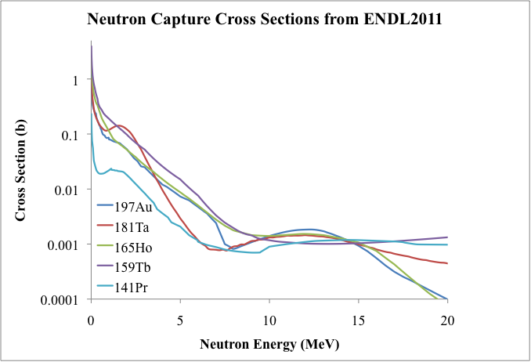
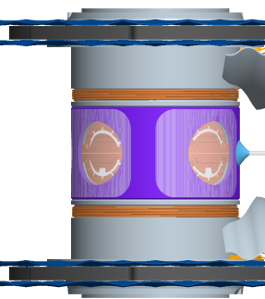
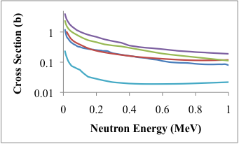
The gold SRC results open the door to hohlraum-mounted σ(n,γ) / Φ_{n} measurements
10-50% of 4π
0.2-1.0 g
(≈1.5-7.5 M_{Au})
(n,γ) cross sections in the keV energy range are unknown and very difficult to model – SRC results show that the hohlraum could be used as a target for studying these reactions
These experiments can ride-along on other NIF shots and could be fielded regularly
Challenges include mounting fouls on the hohlraum; need for higher collection efficiency (collectors currently face the diagnostic windows)

Slide 17
Summary
Collection of gas and solid debris has been established at NIF as a diagnostic
Radiochemical data from RAGS collection shows the possibility of measuring short-lived gaseous species
Solid debris radiochemistry shows that activation and neutron capture products are produced during a NIF shot
Nuclear reaction data can be measured using RAGS and SRC – increased SRC collection efficiency and capsule fabrication development are needed

