Slide 1
ICAP’24
14th International Computational Accelerator Physics Conference

Slide 2
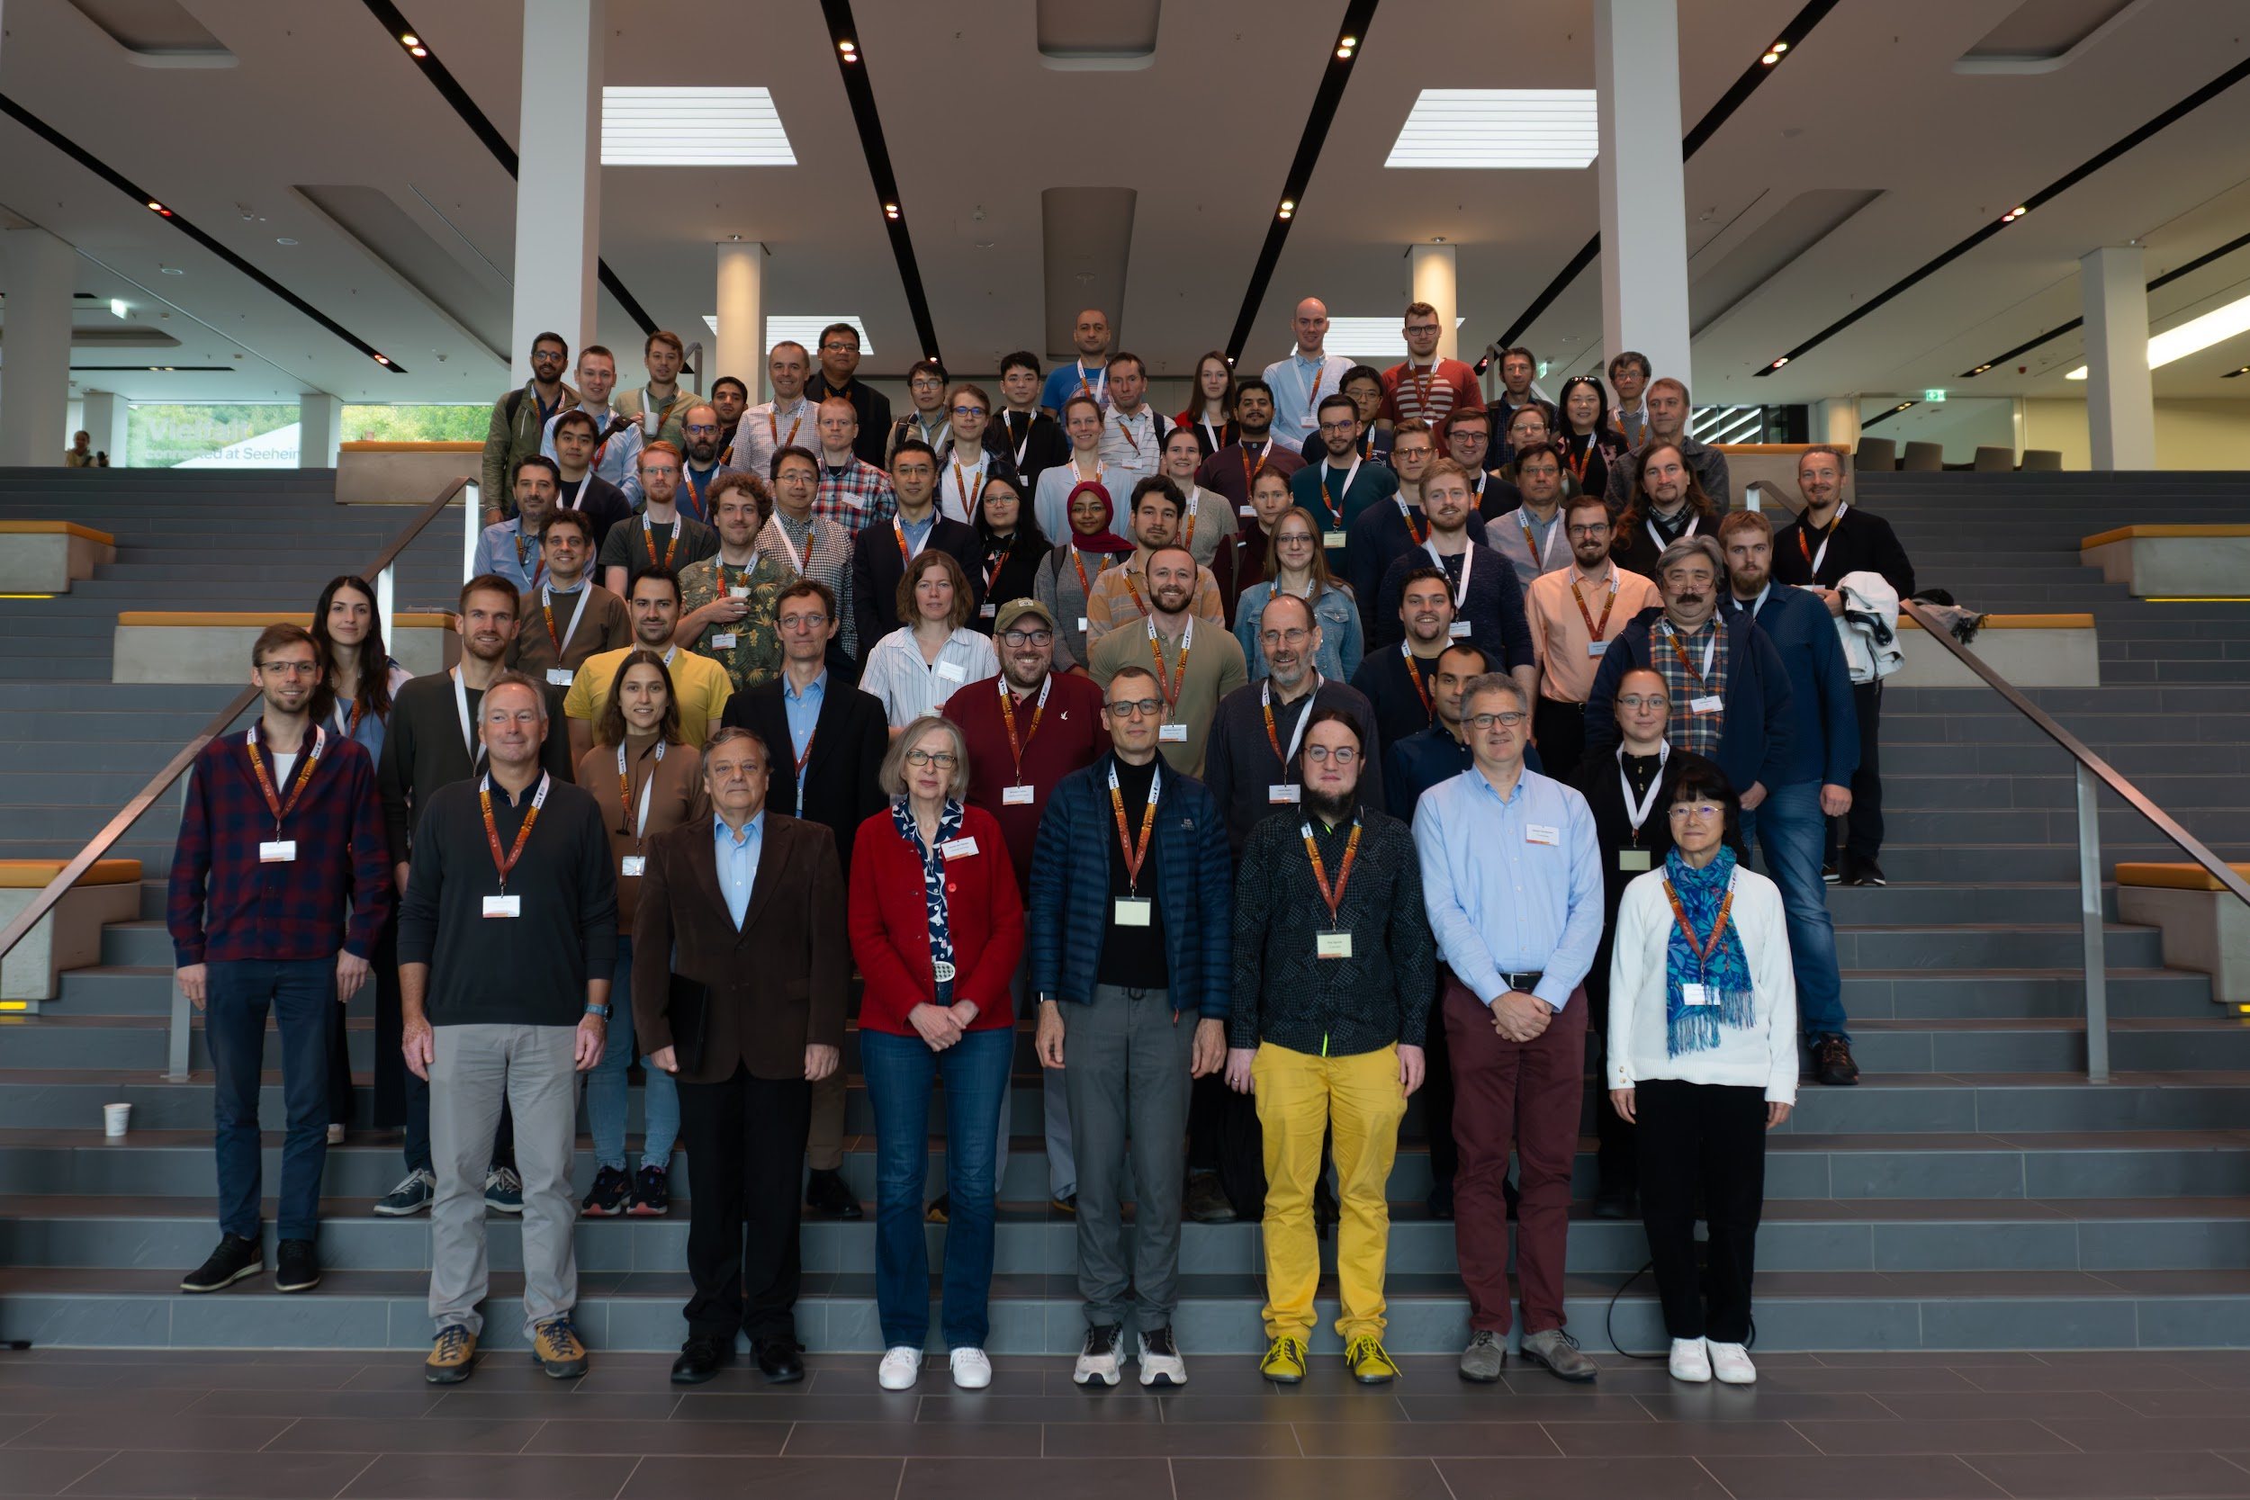
Participants

Slide 3
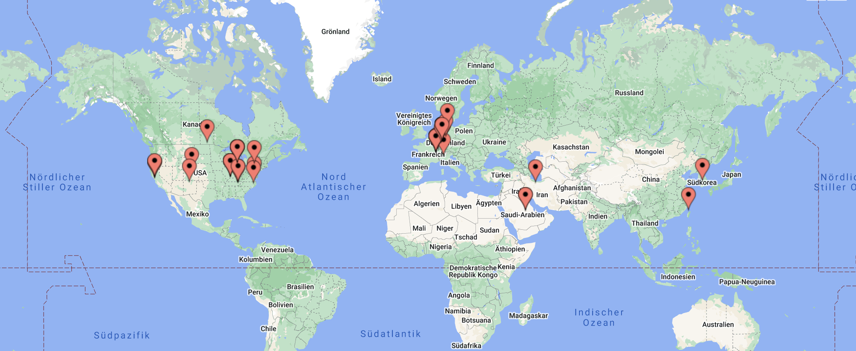
Regional distribution

Slide 4
Proceedings / arXiv
Deadline: 1st of December
Cooking recipe at icap24.de
Index submission will be created afterwards

Slide 5
Sponsors / Support
Institute for Accelerator Science and Electromagnetic Fields (TEMF)

Slide 6
ICAP’27 in Taiwan

