Slide 1
ICAP’24
14th International Computational Accelerator Physics Conference

Slide 2
Previous conferences
La Jolla, USA (1988), Los Alamos, USA (1990), Pleasanton, USA (1993), Williamsburg, USA (1996), Monterey, USA (1998), Darmstadt, Germany (2000), East Lansing, USA (2002), St. Petersburg, Russia (2004), Chamonix, France (2006), San Francisco, USA (2009), Rostock-Warnemünde, Germany (2012), Shanghai, China (2015), and Key West, USA (2018)
Usually every three years (during virus-free times).

Slide 3
Welcome to Seeheim (2024) !
Local Organizing Team
Oliver Boine-Frankenheim, TU Darmstadt / GSI (Conference Co-Chair)
Herbert De Gersem, TU Darmstadt (Conference Co-Chair)
Thilo Egenolf, TU Darmstadt (LOC chair)

Slide 4
Topics
A-1 Project Needs and Challenges (1)
A-2 Modeling of Current and Future Machines (4)
B-1 Light Sources and FELs (6)
B-2 Plasma, Laser, Dielectric and Other Acceleration Schemes (4)
C-1 Magnet Design and Measurements (3)
C-2 Electromagnetic Field Computations (9)
D-1 Beam Dynamics Simulations (10)
D-2 Dynamics -- Spin, Precision, Space Charge (3)
E-1 Multi-Physics Modeling and Applications (1)
E-2 Surrogates and Machine Learning, Optimisation, Control (10)
F-1 Code Development, Status and Comparison with Measurements (9)
F-2 Parallel Computing and Emerging Technologies (0)

Slide 5
The schedule
Wednesday:
Opening, Session (Main), Sessions (Main + Seminar room)
Thursday (National holiday):
Sessions (Main + Seminar room)
Discussion on joint software developments (Seminar room, David Sagan)
Friday:
Sessions (Main + Seminar room), Excursions in the afternoon
Saturday:
Session (Main), End of conference after lunch
http://www.icap24.de

Slide 6
Presentation details
Invited and contributed oral presentations (30 min or 20 min incl. questions)
Please upload your presentation at www.icap24.de (timetable) no later than the day before.
Please contact your session chair and/or session host !

Slide 7
Proceedings
arXiv will be used to publish the conference proceedings of ICAP’24. Submission of a proceedings paper is optional. An index of all submitted proceedings papers will be available on the ICAP’ 24 web site and also submitted to arXiv after the paper submission deadline (Dec. 1st).

Slide 8
Social events
Lunch and dinner on Wednesday, Thursday, Friday, Saturday (lunch only) included in fee.
Individual options in the evenings:
Bars in the LH center, “walk”/taxi to Seeheim, taxi to Bensheim, Darmstadt,...
Friday afternoon (details see web site):
GSI/FAIR tour (Sabrina), Weinheim city tour (Daniel), castle walk (Victoria), eMTB tour (Oliver)

Slide 9
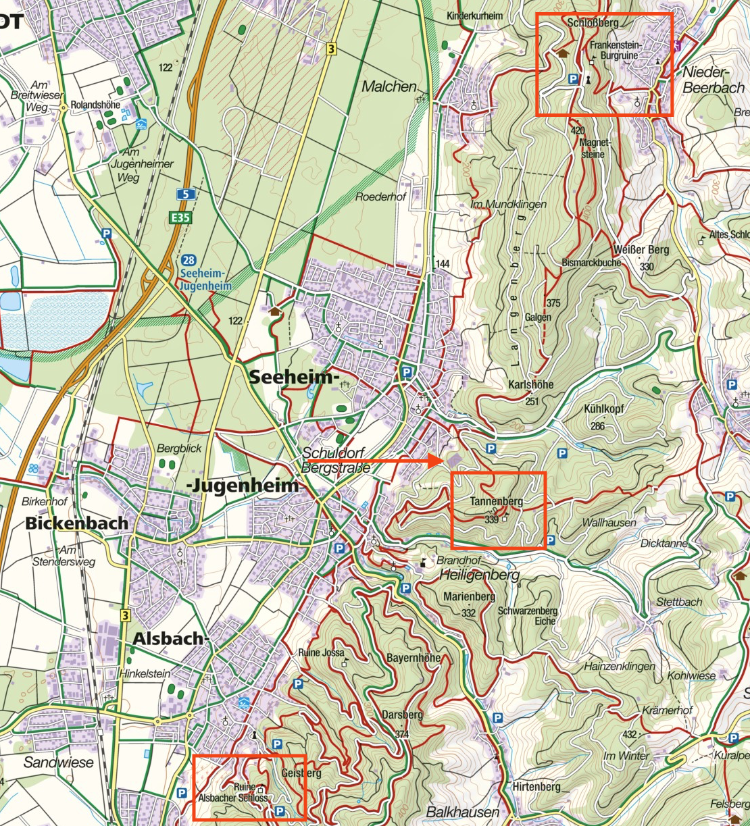
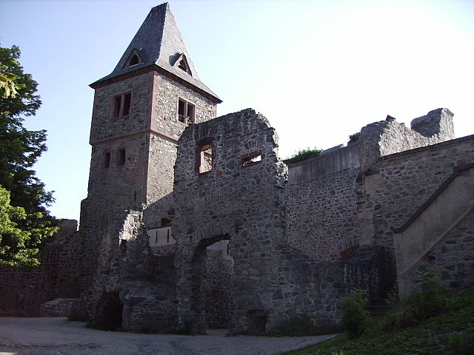
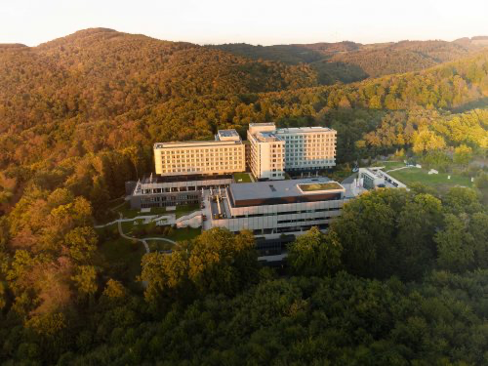
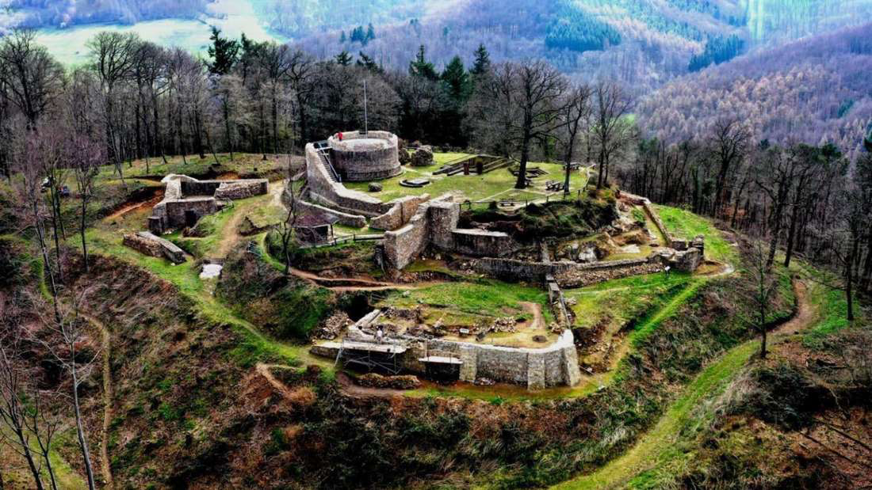
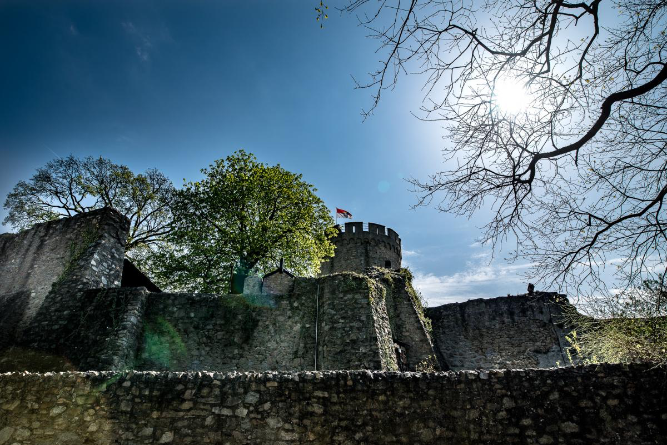
Lufthansa center/castle
Frankenstein castle
Alsbach castle
Tannenberg castle

Slide 10
Sponsors
Institute for Accelerator Science and Electromagnetic Fields (TEMF)

