Slide 1
SciBmad & Community Collaboration
David Sagan, Matt Signorelli
14th International Computational Accelerator Physics Conference
Germany, October 2-5, 2024

Slide 2
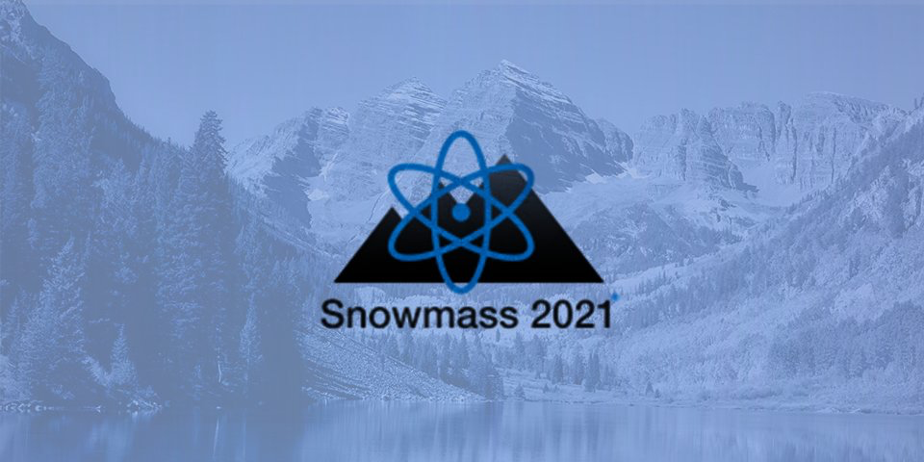
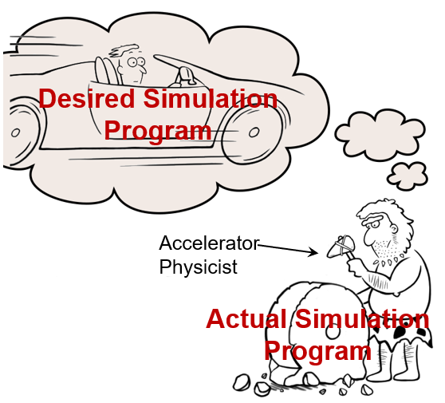
Importance of Collaboration
The disorganized state of accelerator physics simulation development has been recognized by the 2021 US High-Energy Physics community Snowmass white paper:
“The development of beam and accelerator physics codes has often been largely uncoordinated. This comes at a great cost, is not desirable and may not be tenable. Due to developers retiring or moving on to other projects, numerous simulation programs have been completely abandoned or are seldom used. This has resulted in a collection of codes that are not interoperable, use different I/O formats and quite often duplicate some physics functionalities using the exact same underlying algorithms.”

Slide 3
Graveyard of Accelerator Simulation Programs
programs that are no longer or seldom used:
TRACE-3D
ALIGN
BETA
COMFORT
DESIGN
DIMAD
GUINEA-PIG
HARMON
LEGO
LIAR
Etc. Etc...
MAGIC
MARYLIE
PATRICIA
PETROS
RACETRACK
SYNCH
TRACY
TRANSPORT
TURTLE
UAL
How many man-years of effort went into these programs?

Slide 4
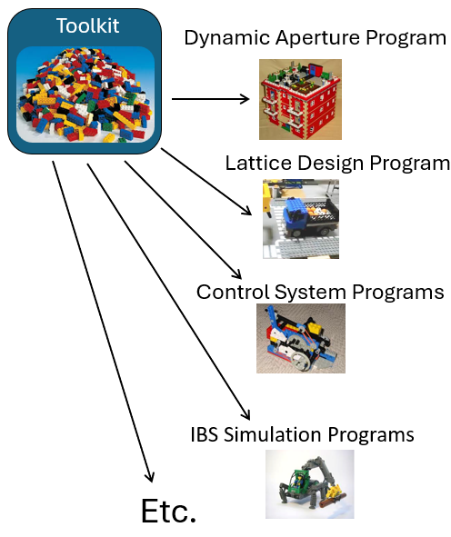
SciBmad Vision
The goal of SciBmad is to create an ecosystem of packages for accelerator simulation which is interoperable with the wider Julia package ecosystem and has connections to useful non-Julia packages.
Python Ecosystem
PyTorch
Xopt
Xsuite
Cheetah
... Etc...
Julia Ecosystem
SciBmad Ecosystem
AcceleratorLattice.jl
NonlinearNormalForm.jl
BeamTracking.jl
GTPSA.jl
AtomicAndPhysicalConstants.jl
... Etc...
Other accelerator simulation packages
Autodiff libraries
Optimizers
Integrators
Plotting
Machine Learning
... Etc...
Other
MAD-NG
... Etc...

Slide 5
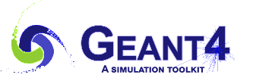
Potential Impact
SciBmad along other connected packages has the potential to have a huge impact on accelerator simulation efforts:
Saving countless hours of development time, and
Resulting in better simulations.
The potential of this ecosystem of packages is similar to that of Geant4. The versatility of the Geant4 toolkit for the simulation of particle passage through matter has resulted in Geant4 having a large impact not only in the field of particle physics, but in other domains as well — including nuclear physics, astrophysics and space science, biomedical physics, and archaeology. Geant4’s main reference has achieved more than 16,000 citations in the Web of Science, making it the most cited publication in particle and field physics, nuclear physics, and other fields.
--- “Geant4: A game changer in high energy physics and related applicative fields”, T. Basaglia, et. al.

Slide 6
SciBmad & Community Collaboration
Areas of collaboration:
Interest in helping develop SciBmad
Interest in using SciBmad
Interest in interoperability with your code.
Interest in developing tools and data interchange standards (EG: OpenPMD) [Also:17:10 today, Seminar room]

Slide 7
Thank You & Discussion...

