Slide 1
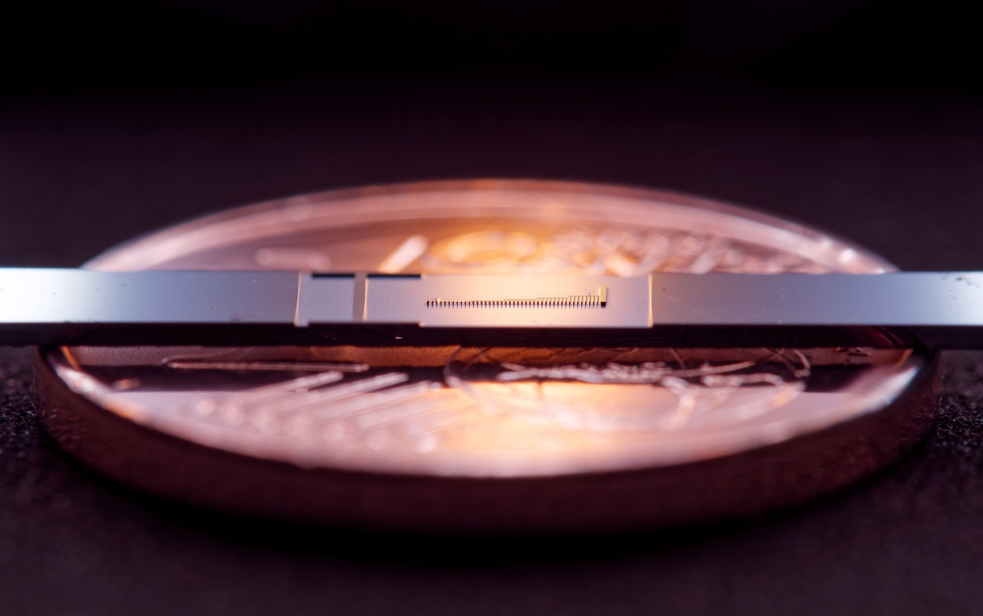
Gradient descent-based optimization of the acceleration field in sub-relativistic dielectric laser accelerators using the adjoint method
M. Konrad, U. Haeusler, C. Neureuter, R. Shiloh, P. Hommelhoff
Friedrich-Alexander-University Erlangen-Nürnberg (FAU)
manuel.l.konrad@fau.de

Slide 2
Contents
Working principles of dielectric laser acceleration (DLA)
Experimental Results
Optimization of DLAs
  Step by step optimization
  Inverse design applied to DLAs
  Adjoint method for efficient gradient calculation
Optimization of sub-relativistic DLAs

Slide 3
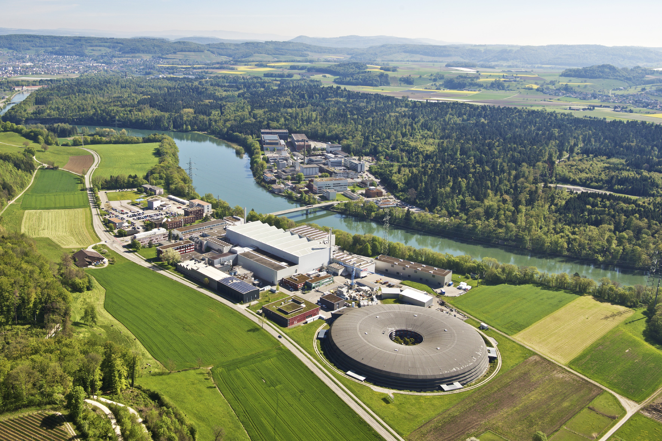
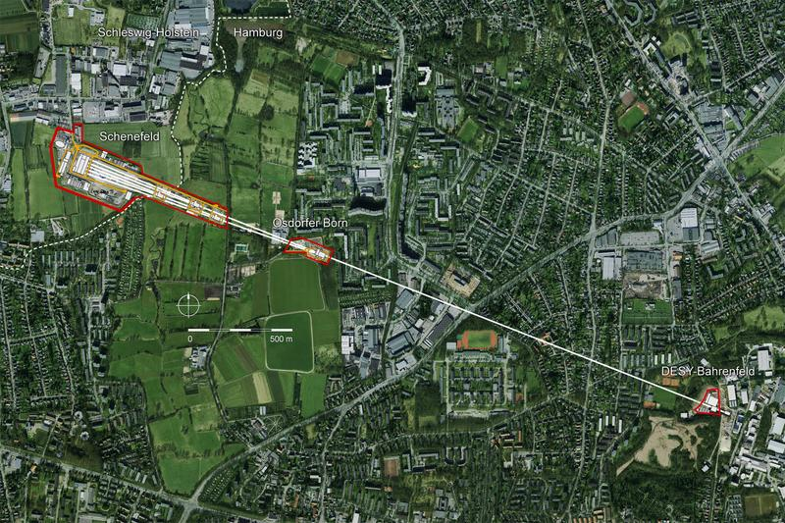
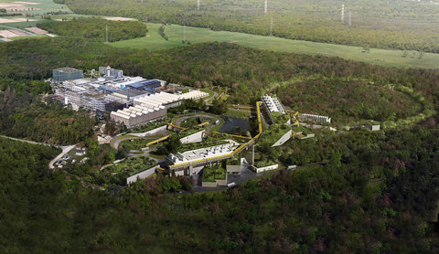

Particle accelerator concepts
Image credits: D. Fehrenz, GSI/FAIR
UNILAC (120m)
SIS18 (216m)
For electrons!
XFEL, DESY (3.4 km)
Image credits: Desy Photon Line
Swiss Light Source, PSI (300 m)
Koichi Shimoda, Appl. Opt. 1, 33-35 (1962)
Lohmann, A., IBM Tech. Note 5, 169–182 (1962)
Mizuno et al., Nature 328, 45 (1987)
Image credits: Paul Scherrer Institut
Image credits: S.Kraus, J.Litzel | Laserphysics | FAU Erlangen

Slide 4
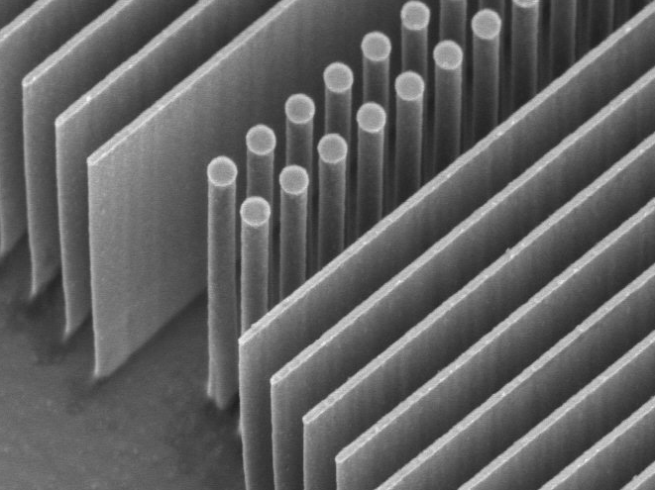
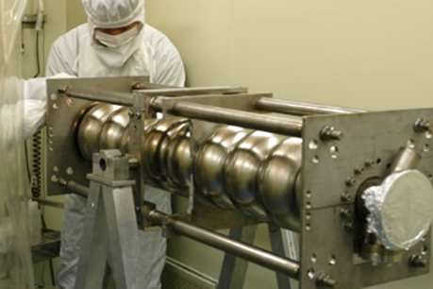
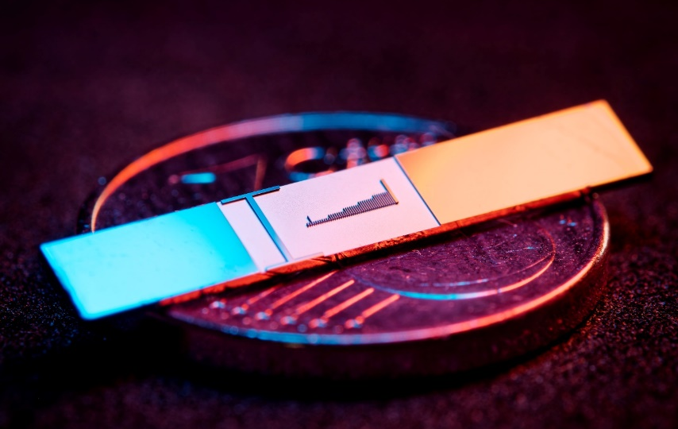
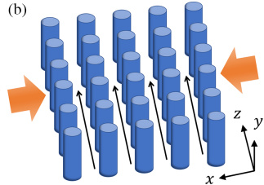

Why dielectric-based laser accelerators?
$$\text{1 }\text{μm}$$
Fermilab
Dielectric materials and optical frequencies
Higher damage threshold than metallic cavities
Higher gradients and smaller, minituarized structures
Much stricter requirements on beam properties
Lower current
per channel
Laser
Laser
DLA
f=150 THz (λ=2 μm)
τ=6.6 fs
RR ~ kHz-MHz
>3 GV/m fields
Gradient >1 GeV/m
Physical aperture: ~200 nm
Emittance <100 pm rad (norm)
fA-pA
(in single channel, many are possible soon)
RF
f=3 GHz
τ=333 ps
RR ~ Hz-kHz
<200 MV/m
25-50 MeV/m
~1cm
1 μm ~ 1 mm rad
nA-μA and larger
Multi-channel DLA:
Zhao et al., Photonics Research 8 10,
1586-1598 (2020)
S-band
https://indico.cern.ch/event/448486/contributions/1108454/attachments/1189017/1725317/Lecture13CavitiesIII_2015.pdf

Slide 5
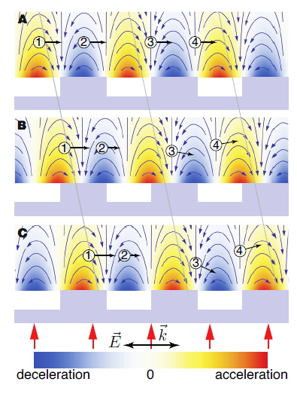
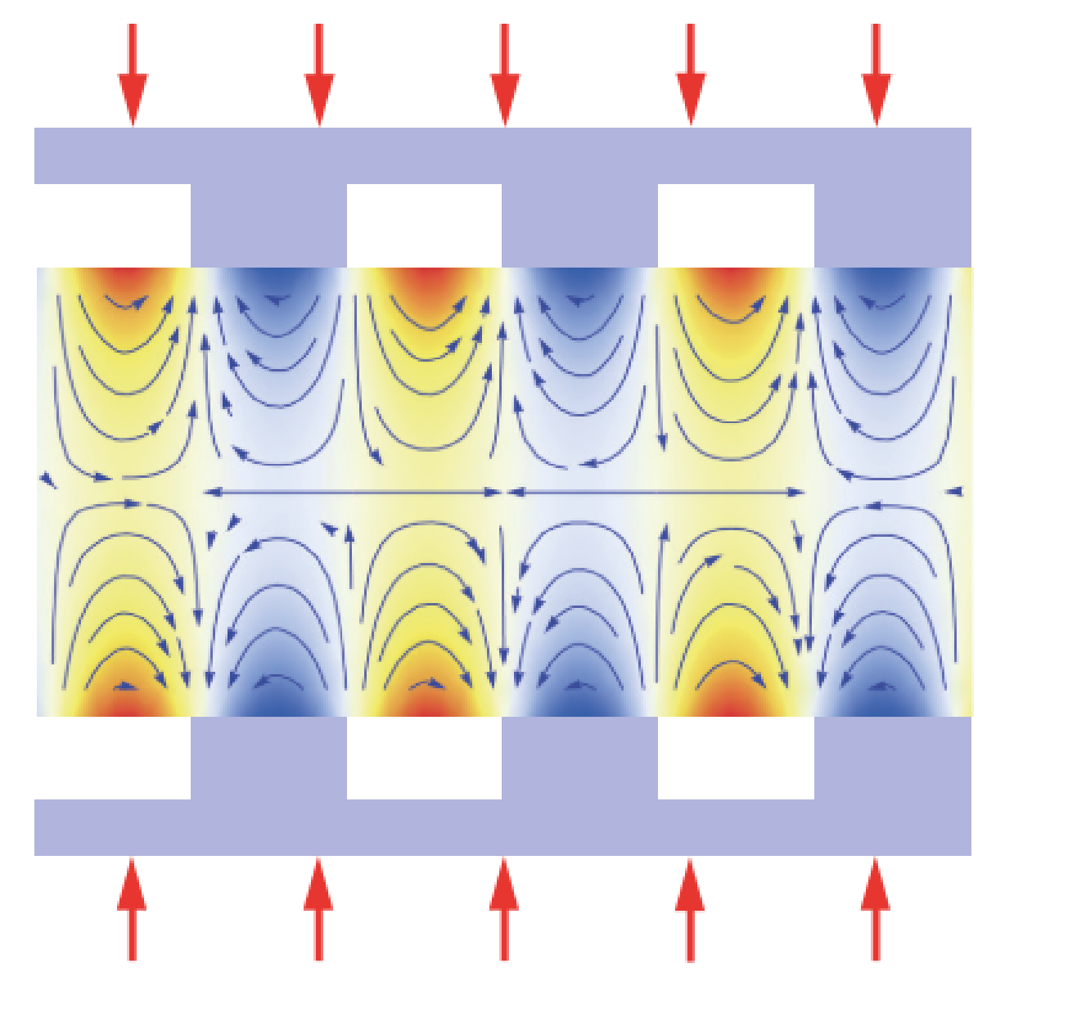
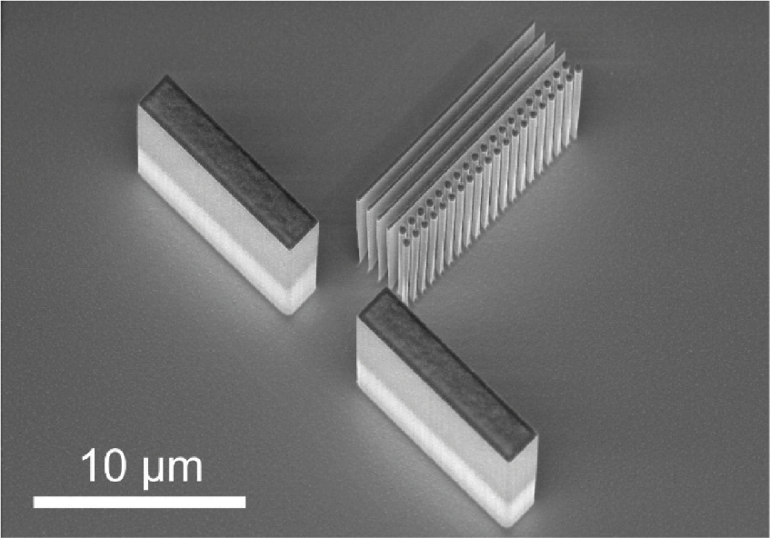
DLA basics
Single sided grating unstable
-> use dual sided grating
-> stable channel in the center
Gratings hard to align
-> dual pillar structure etched
-> from silicon
Breuer, J., and Hommelhoff, P. Phys. Rev. Lett. 111, 134803 (2013).

Slide 6
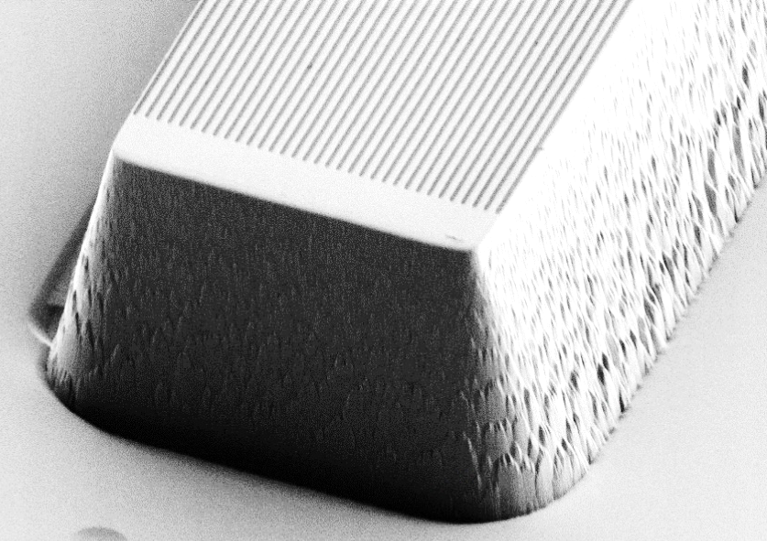







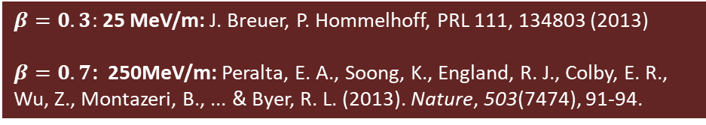
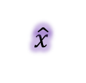


Operation principle
Synchronicity condition:
$$β=Λ_{p}/λm$$
Depending on particles position:
Acceleration
Deceleration
Deflection
1
2
3
4
1
2
$$Λ_{p}$$
3
4
$$\hat{y}$$
TM-polarized
$$\hat{x}$$
$$\hat{y}$$
Goal: generate a mode that allows momentum transfer from laser field to electrons
Use first order effect (efficient!)
Second order effects too power costly
$$\hat{z}$$
$$\hat{x}$$
4
~620nm
$$\hat{z}$$
1
2
3
$$Λ_{p}$$
First spatial harmonic
$$λ$$
Proof of concept:
0
$β=0.3:$ 25 MeV/m: J. Breuer, P. Hommelhoff, PRL 111, 134803 (2013)
$β=0.7$: 250MeV/m: Peralta, E. A., Soong, K., England, R. J., Colby, E. R., Wu, Z., Montazeri, B., ... & Byer, R. L. (2013). Nature, 503(7474), 91-94.
Deceleration
Acceleration

Slide 7
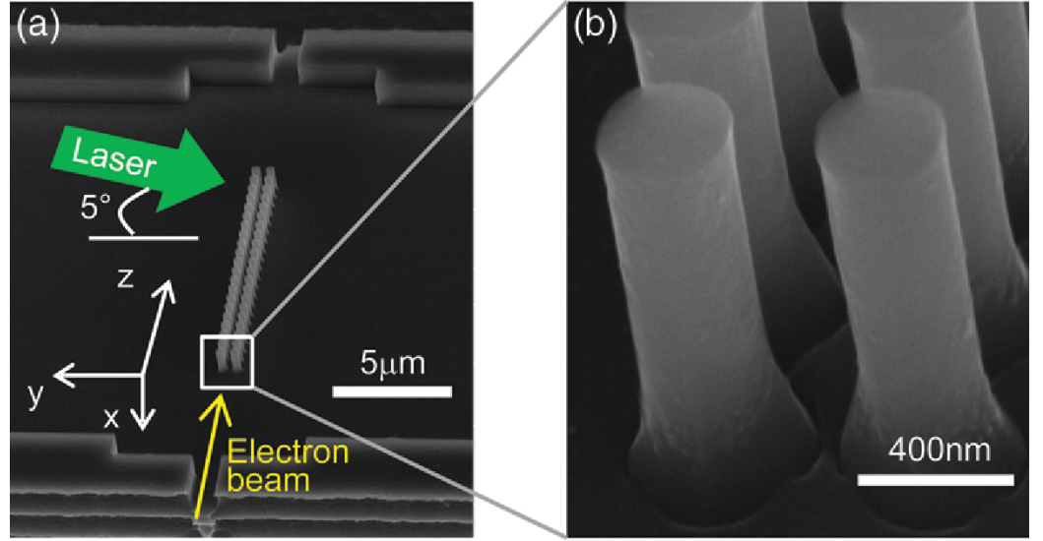
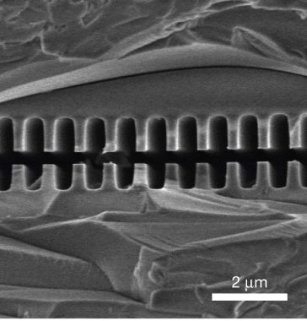
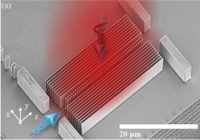
2015
Silicon pillar structures
2021
2013
Top illumination
Bonded silica gratings
Leedle, et al. CLEO, pp. FM3M-7 (2018)
Leedle, et al. Opt. Lett. 40, 4344-4347 (2018)
Yousefi et al., Opt. Lett. 44, 1520-1523 (2019)
Fishman et al., Nature Comm 14, 3687 (2023)
Black et al., PRAB 23, 114001 (2020)
Peralta et al. Nature 503, 91–94 (2013)
Koyama, K., et al. IPAC (2014)
Wei et al., Appl. Optics 56(29) (2017)
Wie et al., Physics of Plasmas 24.7 (2017)
Cesar et al., NIMA 909, 252-256 (2018)
Cesar et al., Optics Expr., 26(22), (2018)
Crisp et al., arXiv:2310.12384 (2023)
Chen et al., Proposal (1989)
Shiloh, et al., Opt. Express 29, 14403-14411 (2021)

Slide 8
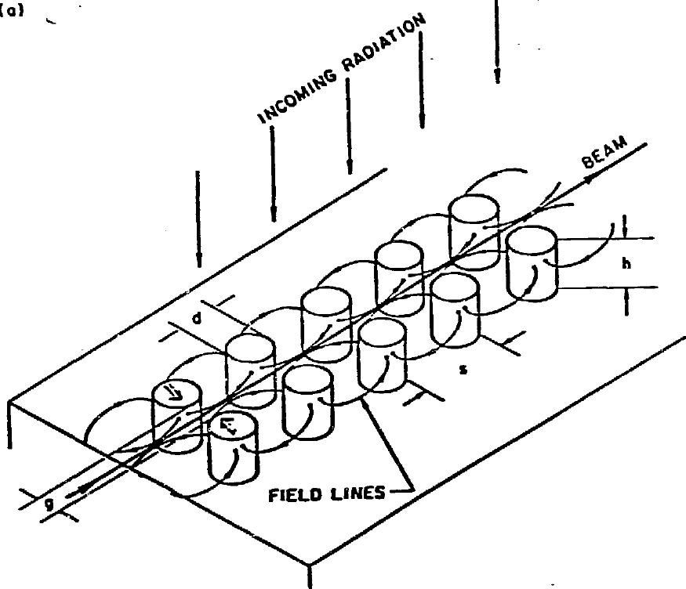
2015
Silicon pillar structures
2021
2013
Top illumination
Bonded silica gratings
Leedle, et al. CLEO, pp. FM3M-7 (2018)
Leedle, et al. Opt. Lett. 40, 4344-4347 (2018)
Yousefi et al., Opt. Lett. 44, 1520-1523 (2019)
Fishman et al., Nature Comm 14, 3687 (2023)
Black et al., PRAB 23, 114001 (2020)
Peralta et al. Nature 503, 91–94 (2013)
Koyama, K., et al. IPAC (2014)
Wei et al., Appl. Optics 56(29) (2017)
Wie et al., Physics of Plasmas 24.7 (2017)
Cesar et al., NIMA 909, 252-256 (2018)
Cesar et al., Optics Expr., 26(22), (2018)
Crisp et al., arXiv:2310.12384 (2023)
Chen et al., Proposal (1989)
Shiloh, et al., Opt. Express 29, 14403-14411 (2021)

Slide 9
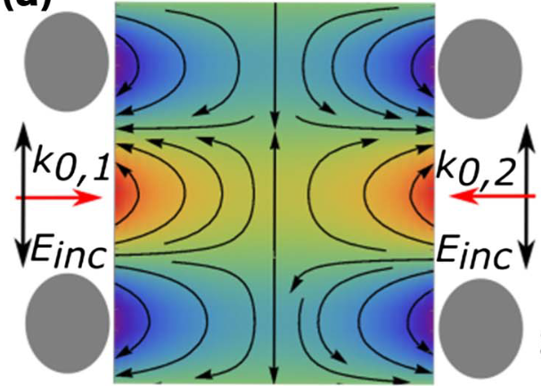

Red (accelerating) and blue (decelerating)
2015
e⁻
E_{z}
x
Silicon pillar structures
2021
2013
Top illumination
y
z
Bonded silica gratings
Laser
Laser
Laser
Laser
Side illumination
Leedle, et al. CLEO, pp. FM3M-7 (2018)
Leedle, et al. Opt. Lett. 40, 4344-4347 (2018)
Yousefi et al., Opt. Lett. 44, 1520-1523 (2019)
Fishman et al., Nature Comm 14, 3687 (2023)
Black et al., PRAB 23, 114001 (2020)
Peralta et al. Nature 503, 91–94 (2013)
Koyama, K., et al. IPAC (2014)
Wie et al., Physics of Plasmas 24.7 (2017)
Cesar et al., NIMA 909, 252-256 (2018)
Cesar et al., Optics Expr., 26(22), (2018)
Crisp et al., arXiv:2310.12384 (2023)
For reviews, see for example:
R. J. England et al., Rev. Mod. Phys. 86, 1337 (2014),
R. Shiloh et al., Adv. Opt. Phot. 14, 862 (2022)

Slide 10
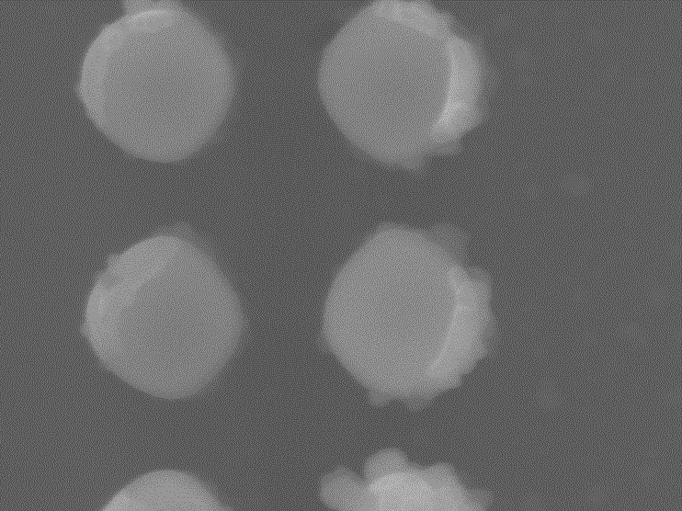
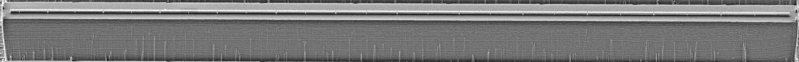
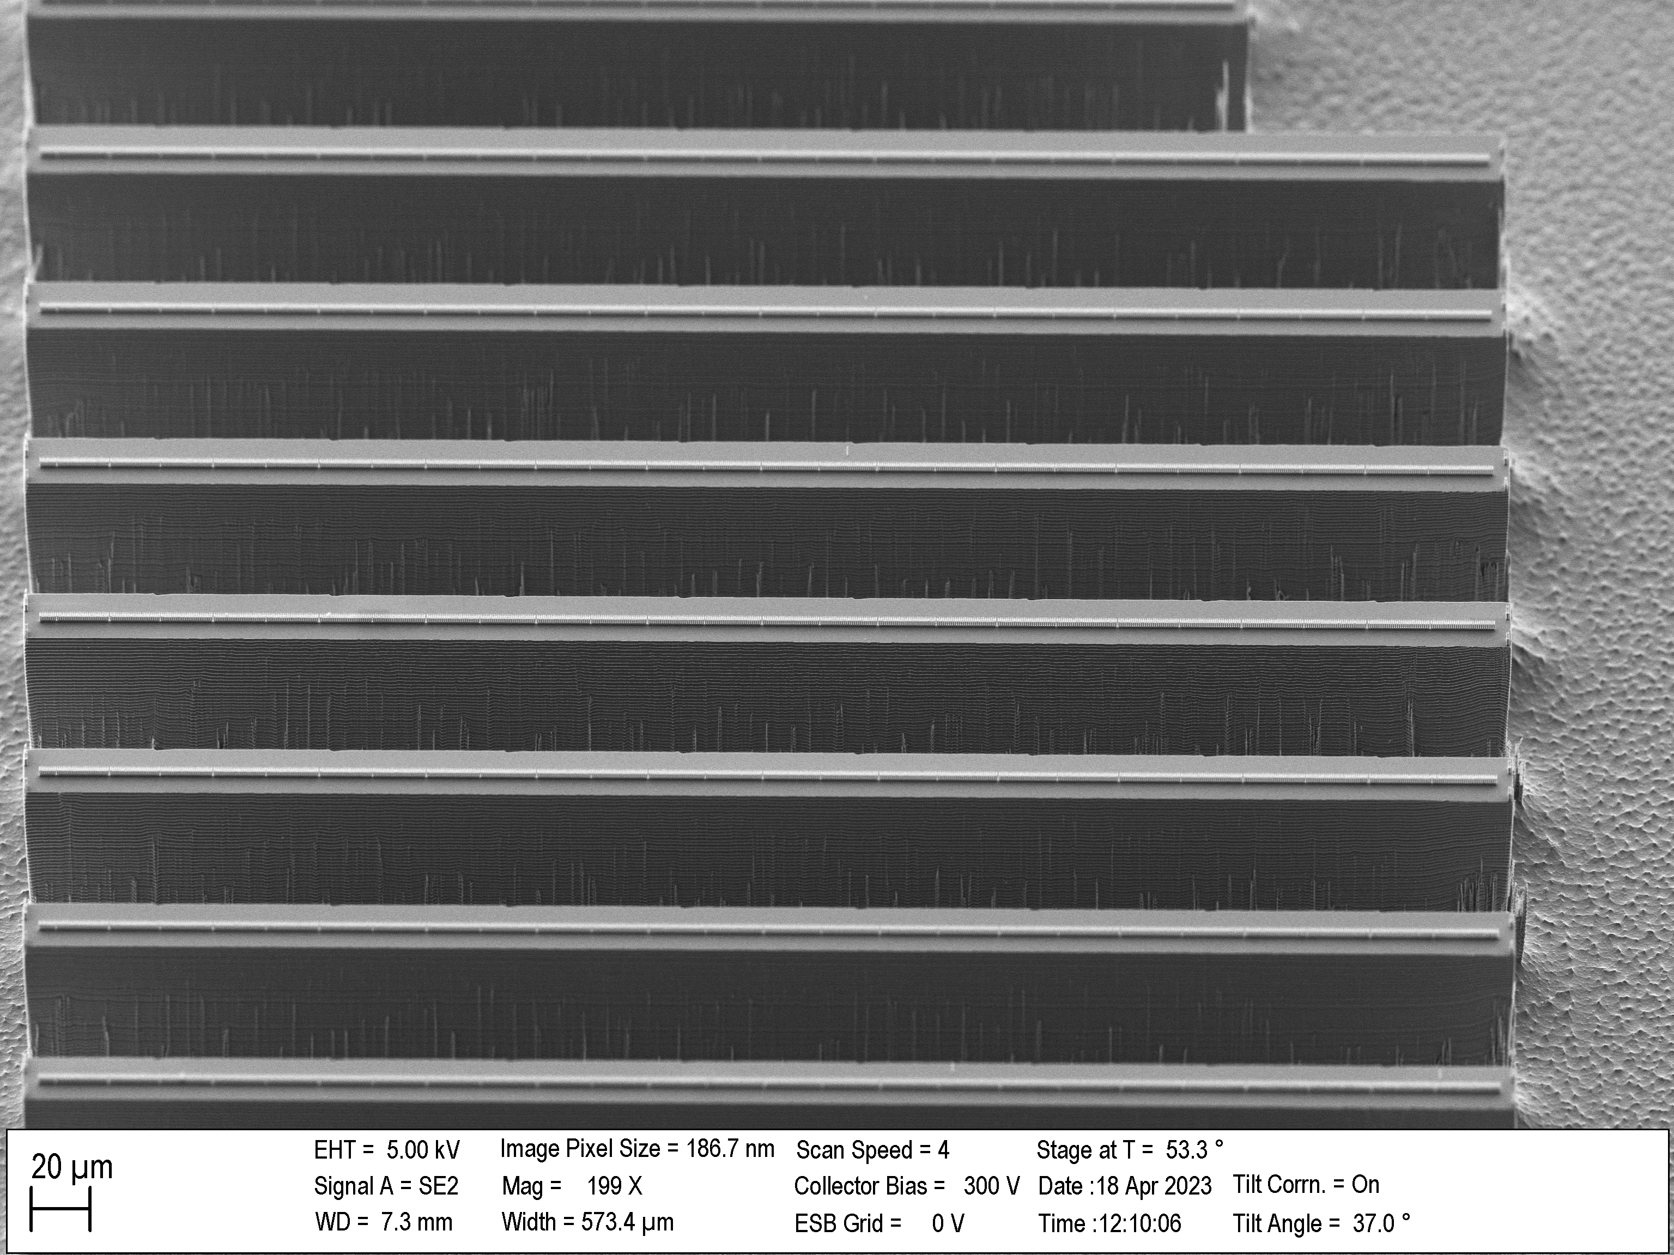




Acceleration structures
Top view
225nm
500 µm long, made of 733 pillar pairs
Tapered periodicity: from 619 nm to 717 nm due to starting energy of 28.4 keV
Pillar radii: 240nm x 225nm, 225nm wide channel
Macro-cells: from 5 µm to 22.5 µm (total of 26 segments)
Average design gradient: 22.7 MeV/m
Peak electric optical field: 600 MV/m (2.2 µJ pulse energy and 360 mW average power)
Laser pulse front tilting required in experiment
139 – 237nm
480nm
450nm
$$\text{20}\text{0}\text{n}\text{m}$$
2$μm$ pillar height
$$\text{50 }\text{μm}$$
$$\text{50 }\text{μm}$$

Slide 11
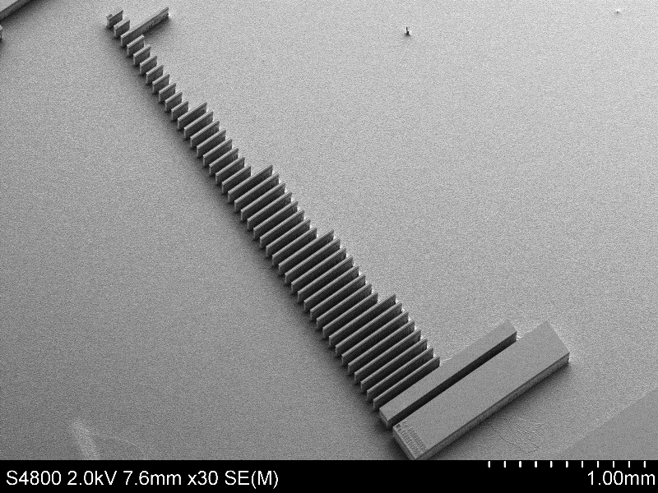
1mm

Slide 12
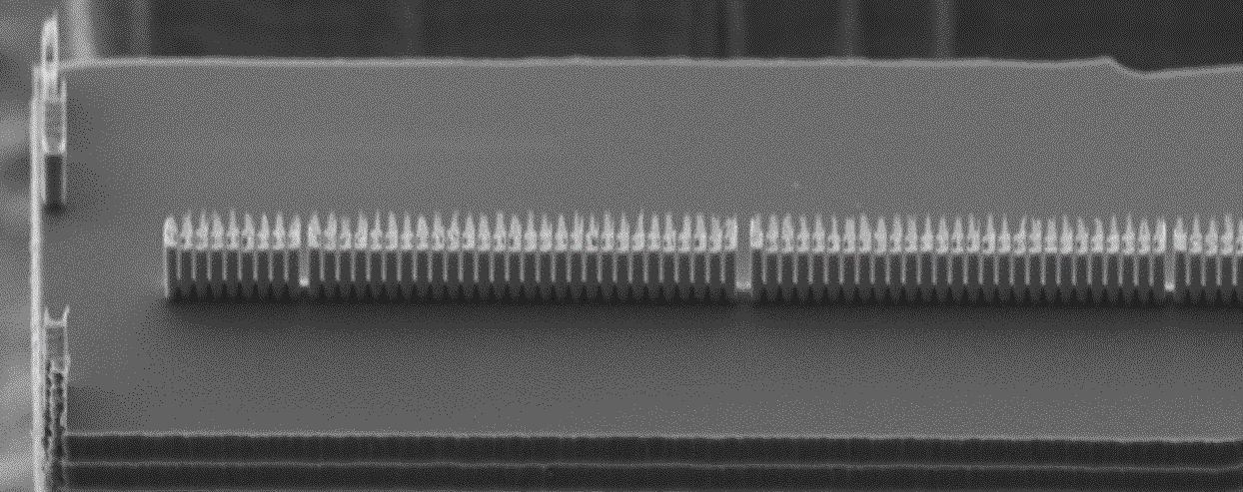




Laser
e-
Previous generation accelerating structure
2µm
200 $μm$
300 $μm$
400 $μm$
E_{Peak} = 600MV/m - 700MV/m
Design gradient: 22.7MeV/m
500 $μm$
1mm
11

Slide 13
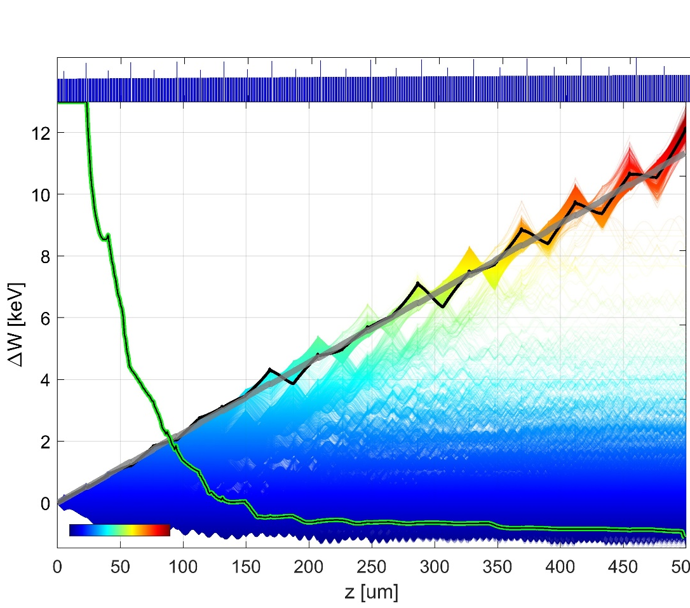
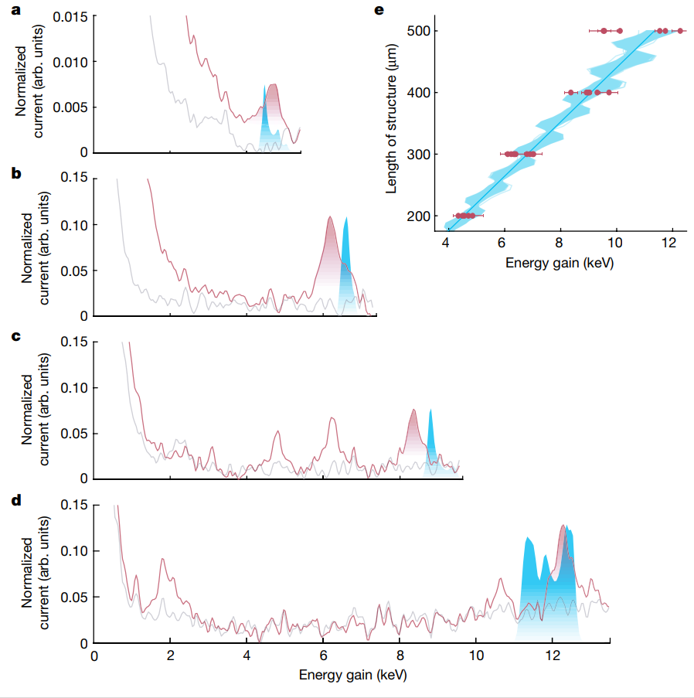
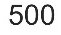




Simulation
Pillar distance
200$μ$m
1
11.9 keV
8.8 keV
Energy gain (keV)
6.6 keV
% of survived particles
0.5
300$μ$m
4.5 keV
Laser on
Laser off
Simulation
Energy
0
400$μ$m
Maximum energy gain 12.3 keV
Total energy of 40.7 keV
43% energy gain
500$μ$m
Similar results from Stanford/Darmstadt team:
Broaddus, Egenolf, …, Byer, Leedle, Solgaard, Phys. Rev. Lett. 132, 085001 (2024)
T. Chlouba*, R. Shiloh*, S. Kraus*, L. Brückner*, J. Litzel, P. Hommelhoff, Nature, 622, 476 (2023)

Slide 14
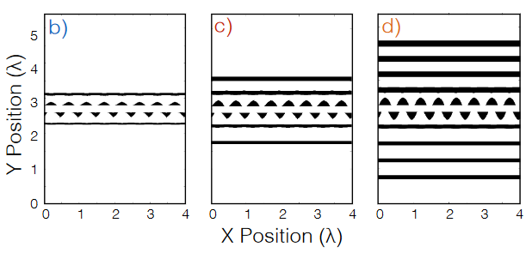
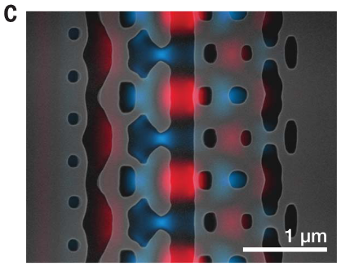
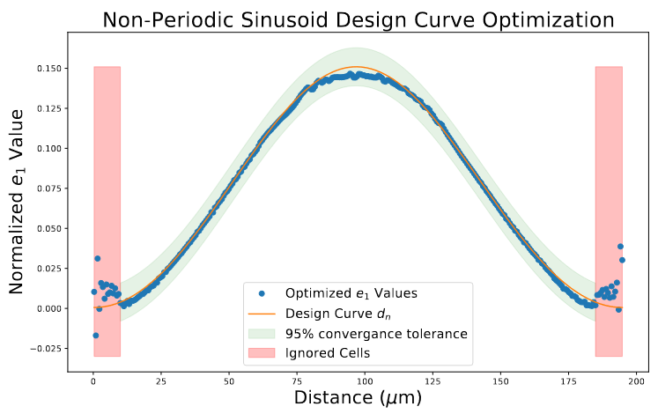
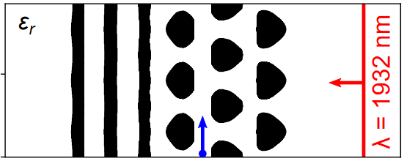
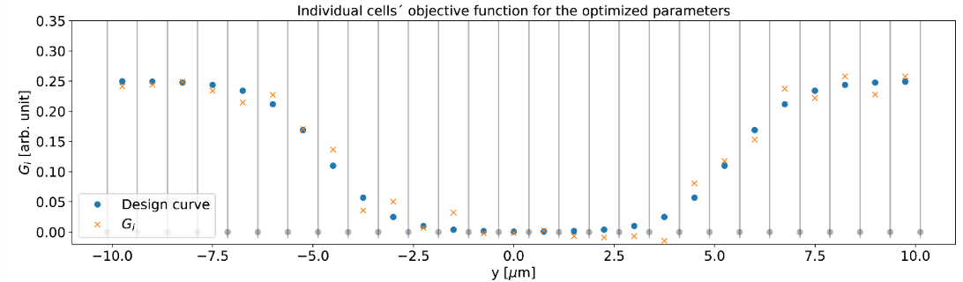
Inverse design in the past and goals of Thesis
Built upon:
Existing code from my Bachelor’s Thesis (Basic inverse design implementation)
Christian Neureuter’s Master’s Thesis (Inverse design of non-periodic structures)
Inverse design of single unit cells:
Inverse design of non-periodic structures:
Hughes et al. Opt. Express 25, 15414-15427 (2017)
Urs Haeusler, Master’s Thesis
Sapra et al. Science 367, 79-83 (2020)
Christian Neureuter, Master‘s Thesis
Initial Goal:
Implement particle tracking into the optimization routine
Design non-periodic large scale accelerators
Inverse design of multiple unit cells:
Manuel Konrad, Bachelor‘s Thesis
Notes:
But after rewriting the code (due to the need to clean up and due to needing

Slide 15
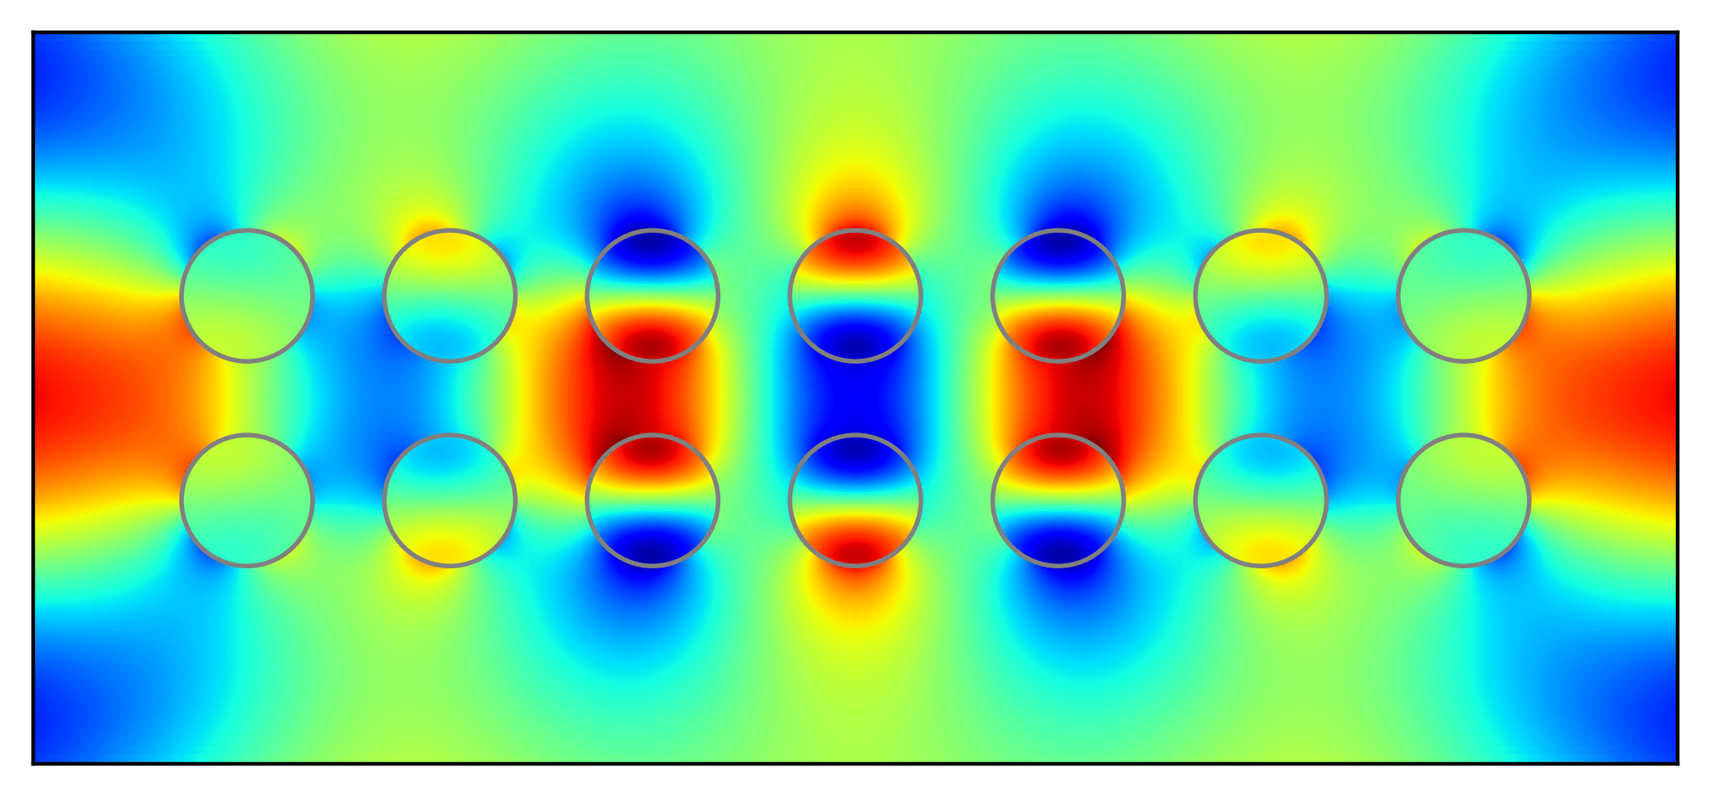

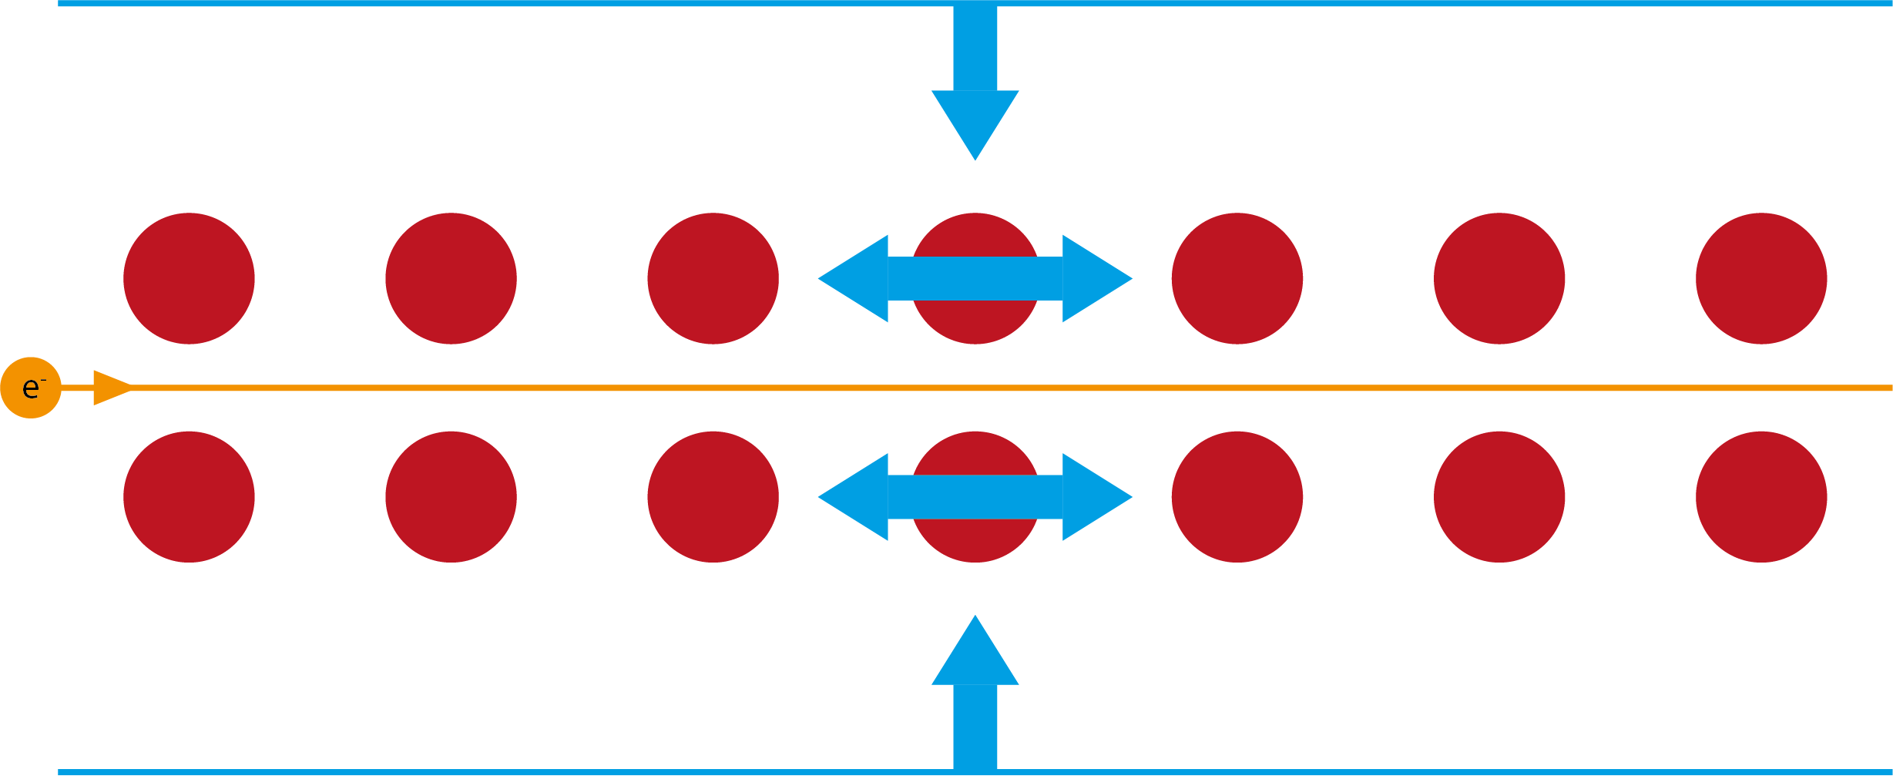
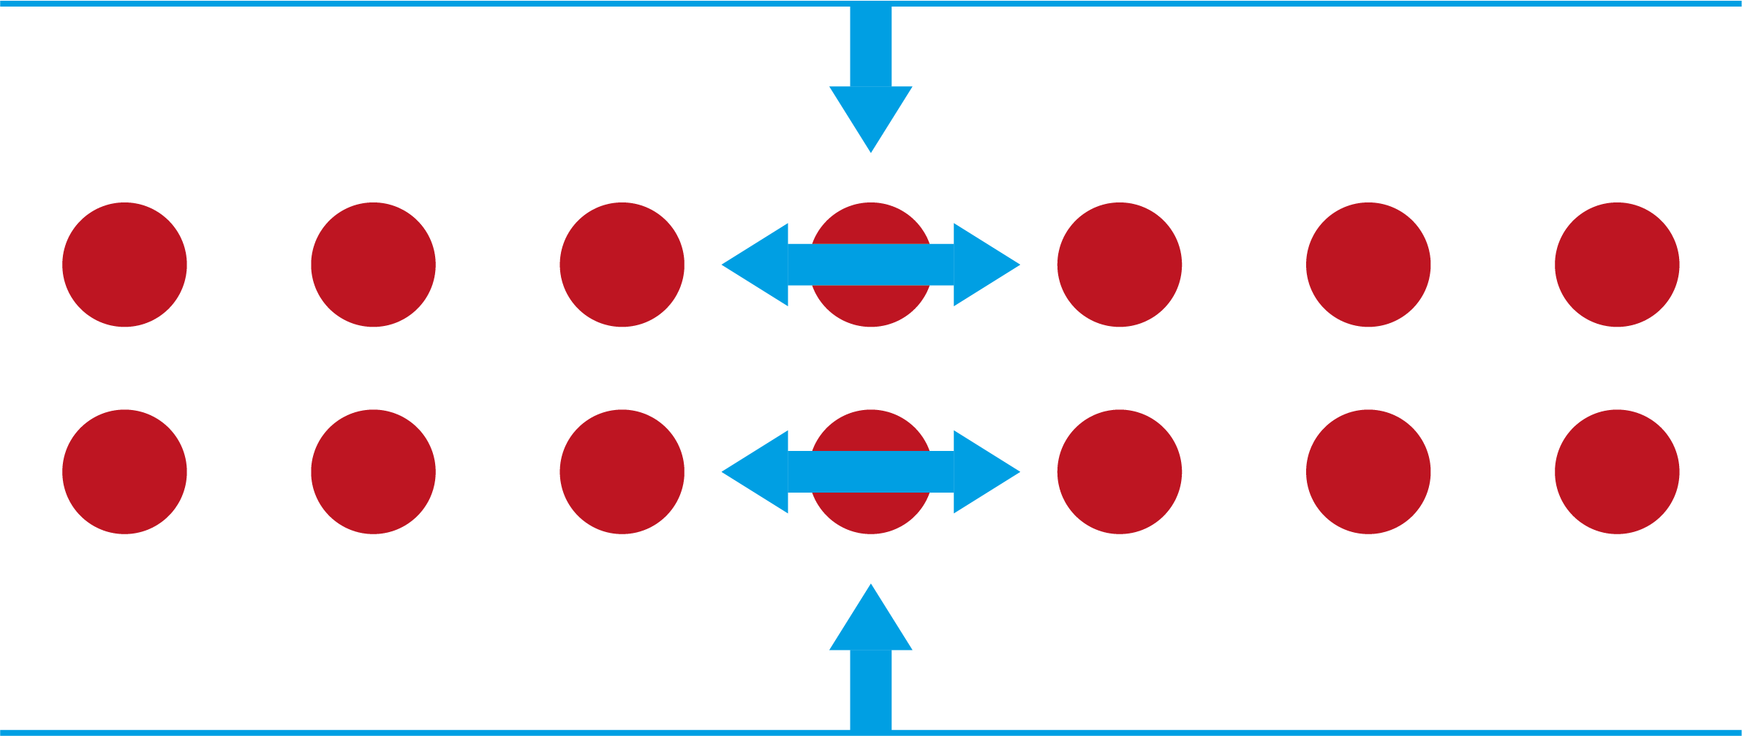

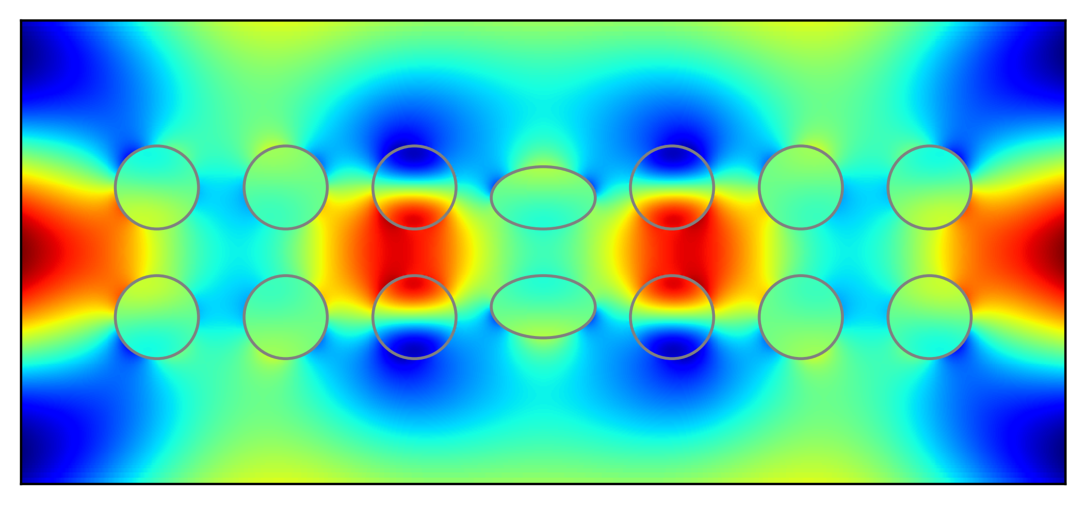

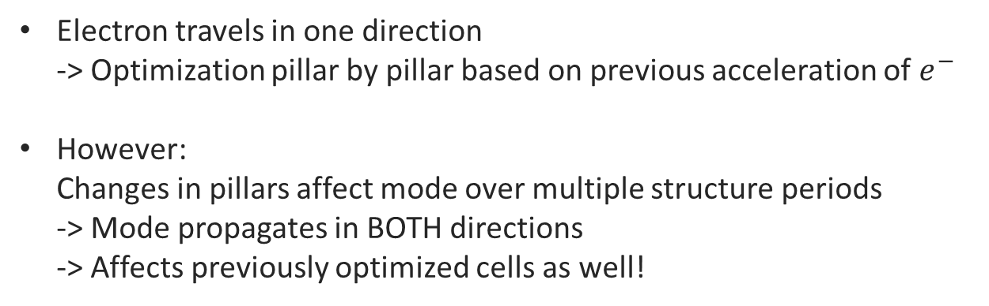
Step by step optimization
Electron travels in one direction
-> Optimization pillar by pillar based on previous acceleration of $e^{−}$
However:
Changes in pillars affect mode over multiple structure periods
-> Mode propagates in BOTH directions
-> Affects previously optimized cells as well!

Slide 16
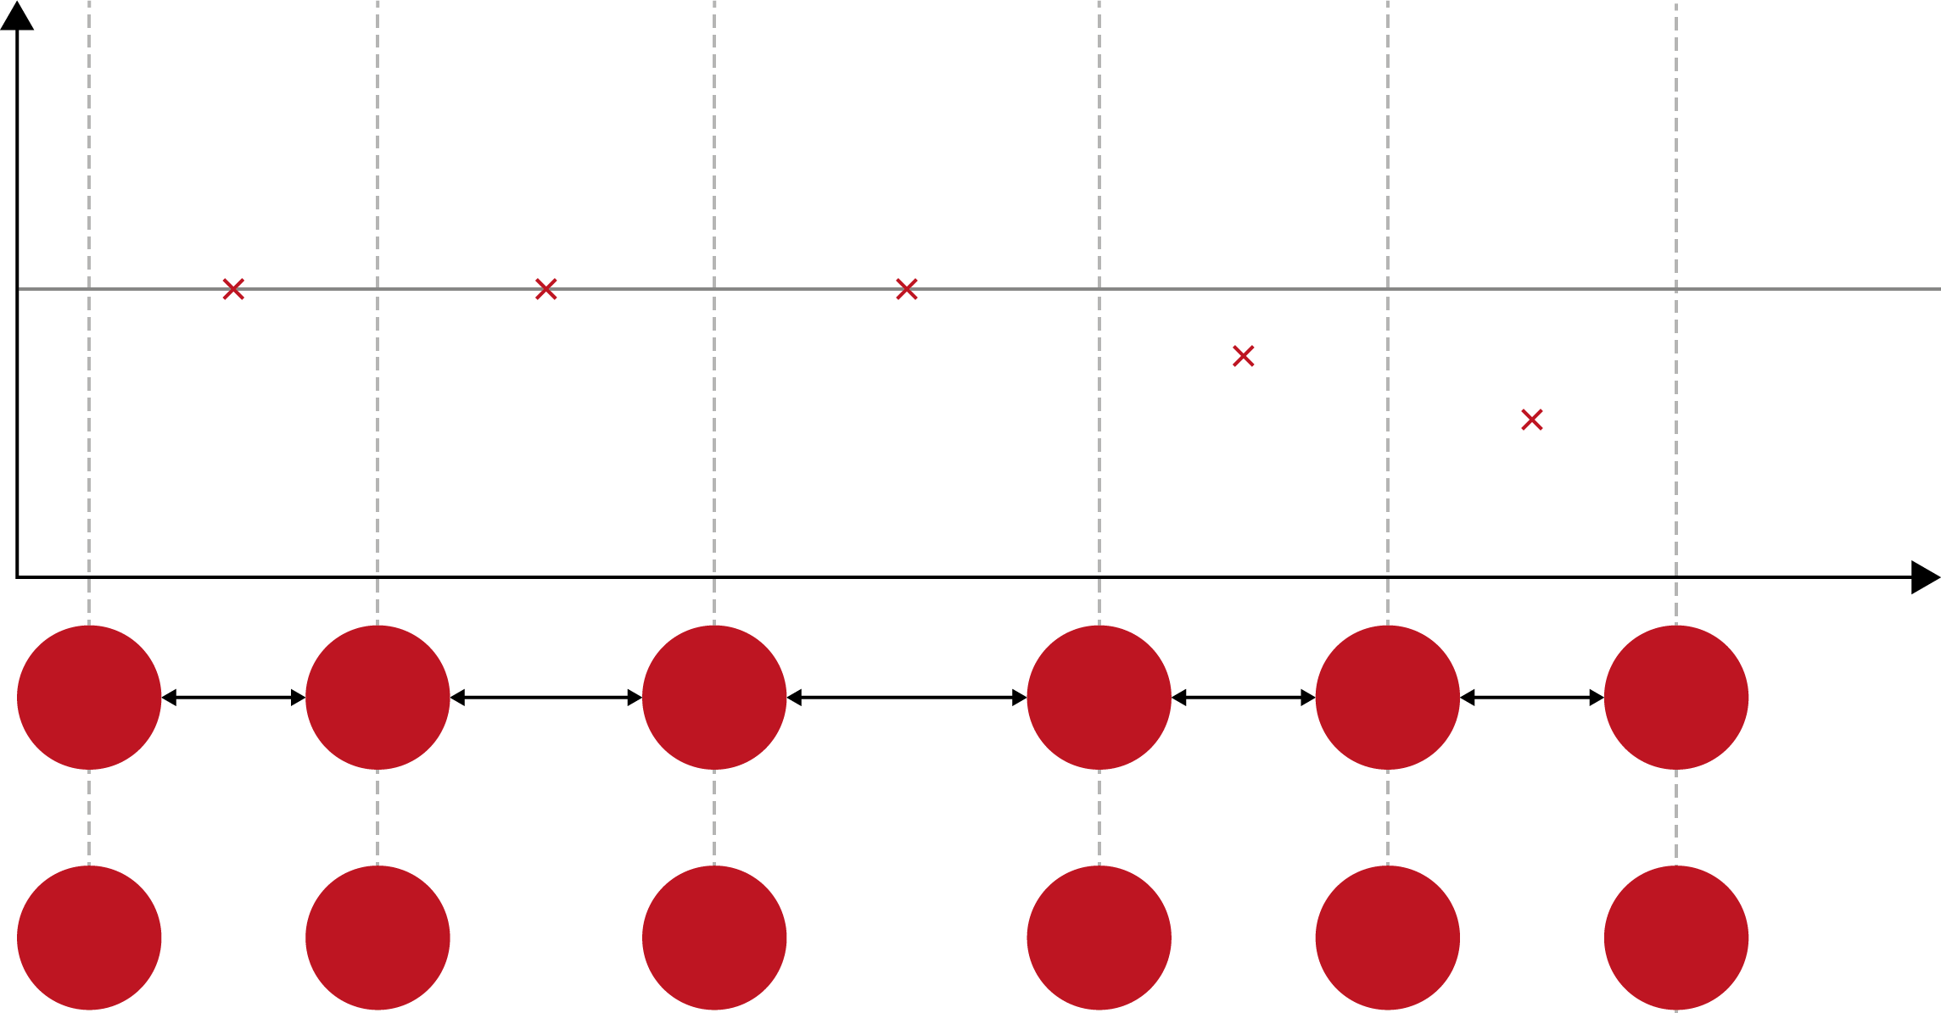
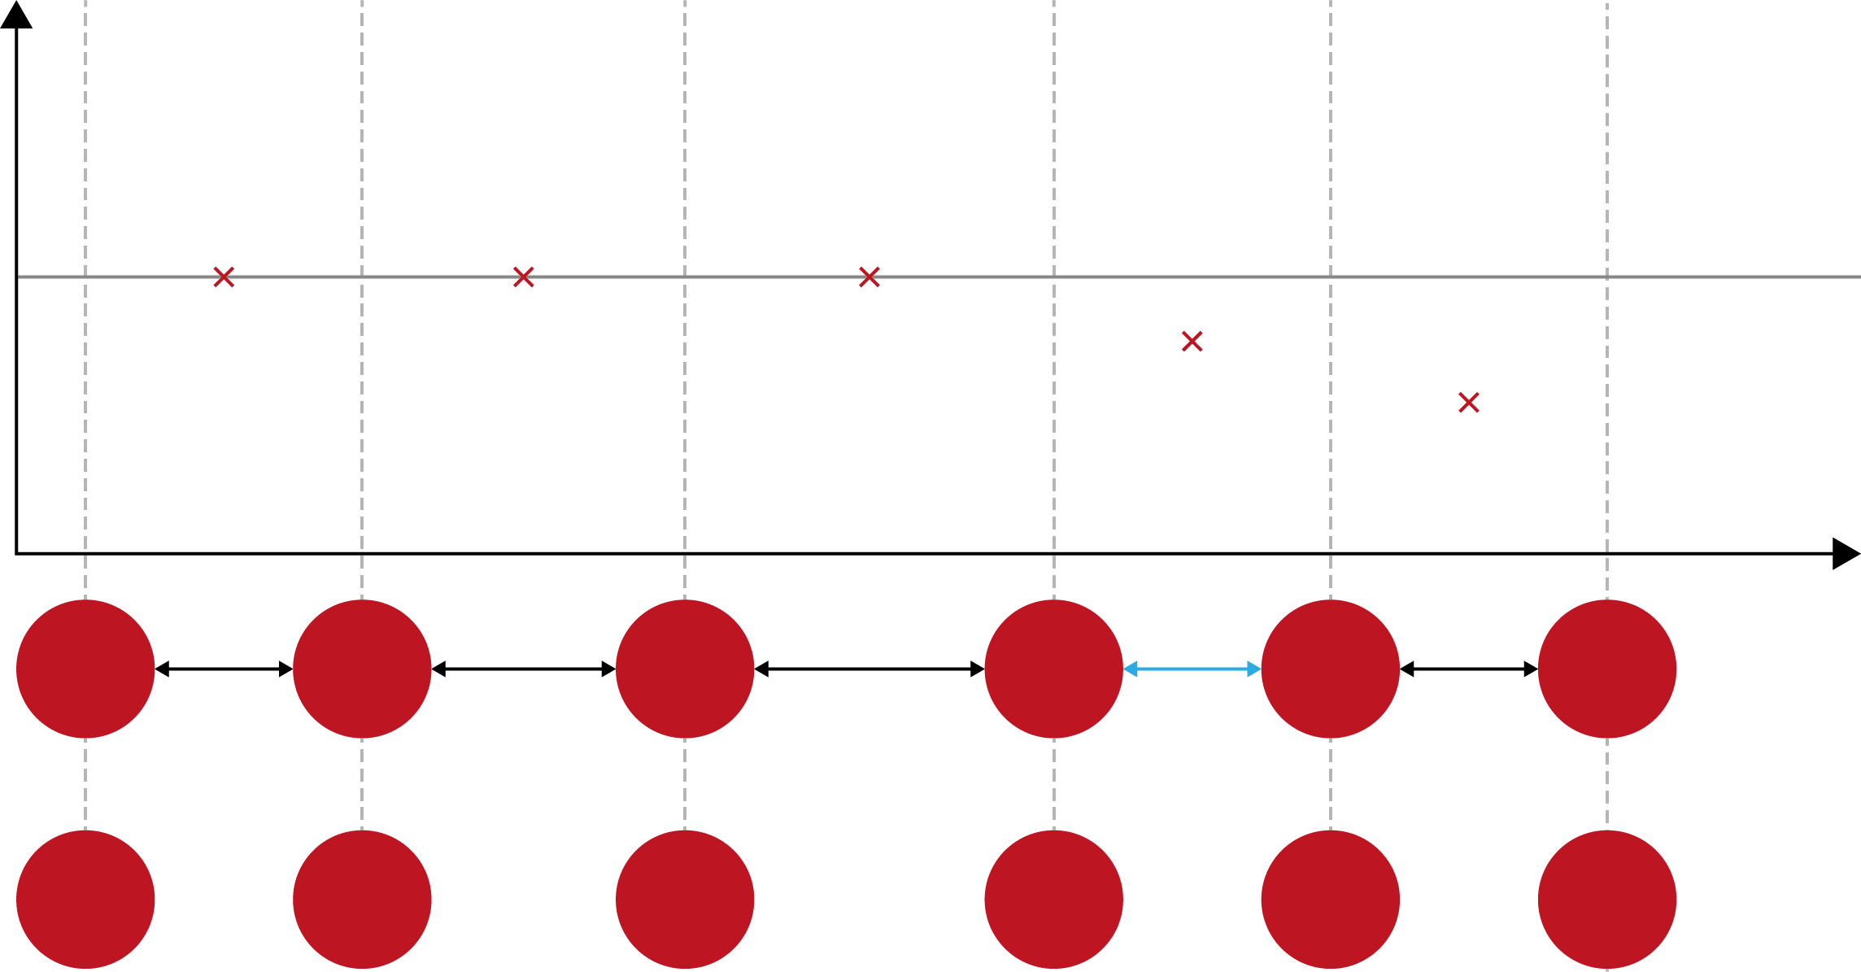
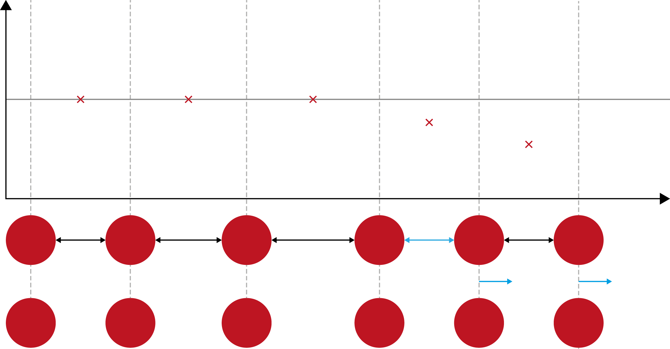
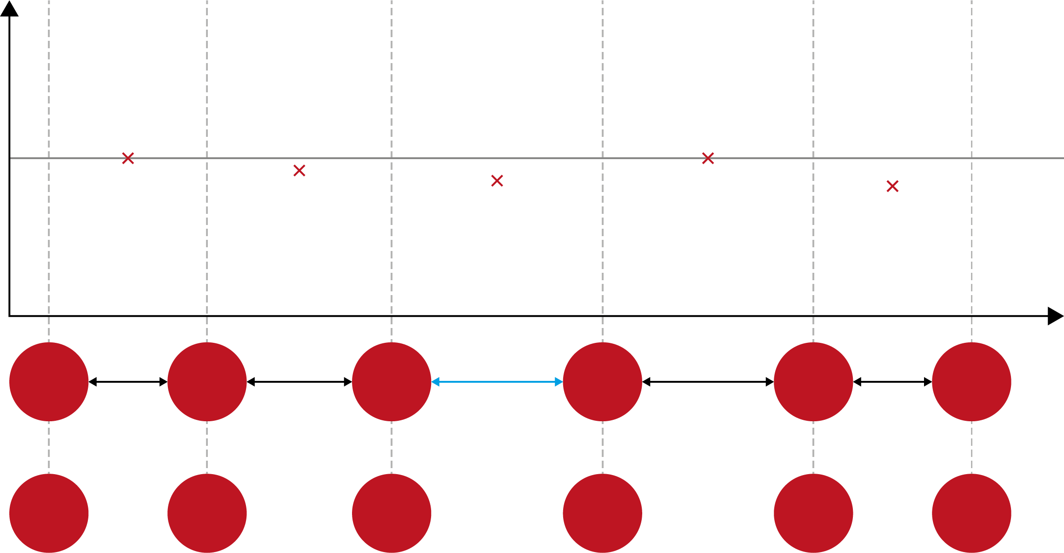

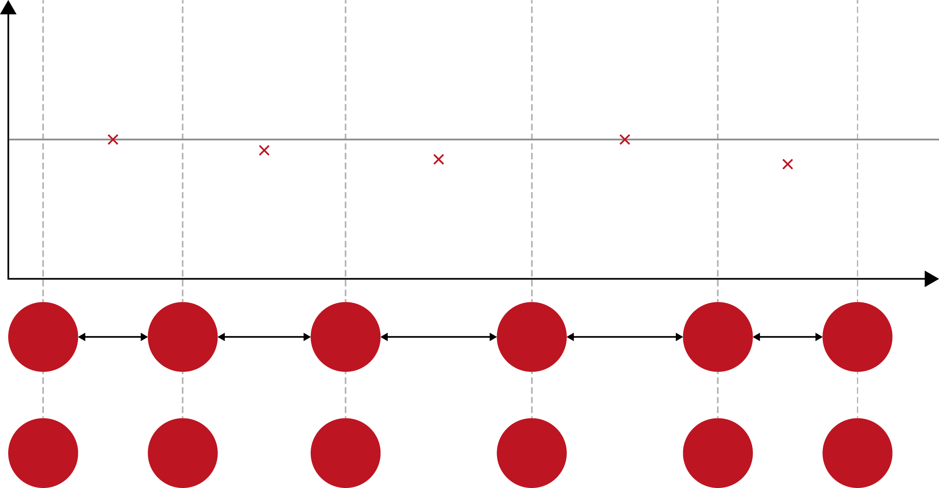
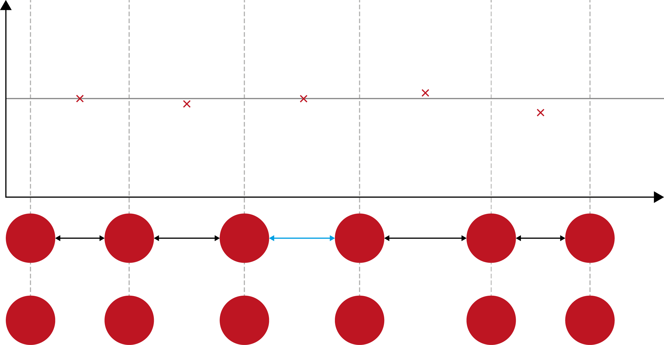
Step by step optimization
Next cell again off
Already optimized
Parameters: Distance between pillars
Goal function
Iterative approach will only result in an approximation of the design
Susceptible to dephasing problems if structure does not follow the design exactly
Pillar position

Slide 17
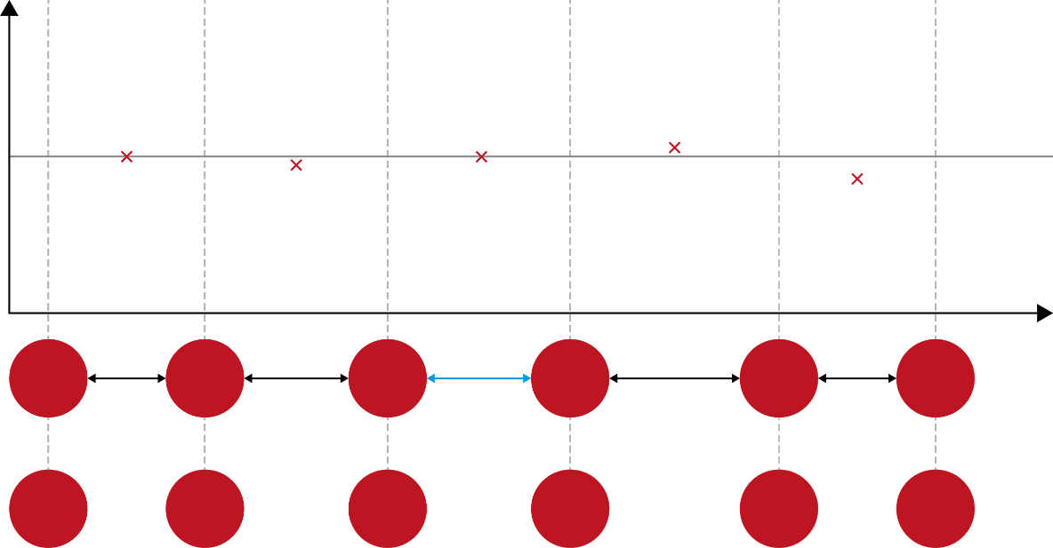
Step by step optimization
Need to know response of whole system to parameter change
Optimize all pillars/parameters at the same time
-> Gradient descent
-> Inverse design
Iterative approach will only result in an approximation the design
Susceptible to dephasing problems if structure does not follow the design exactly
Instead:

Slide 18
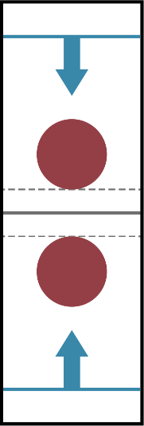
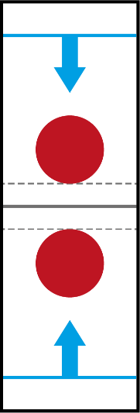
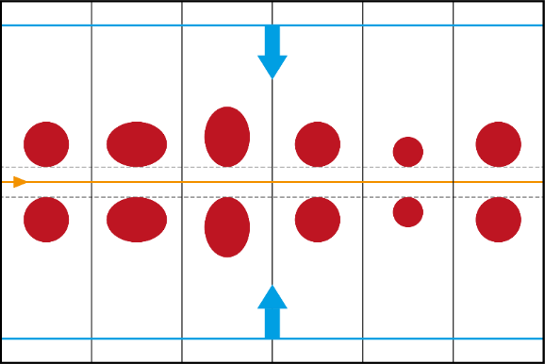
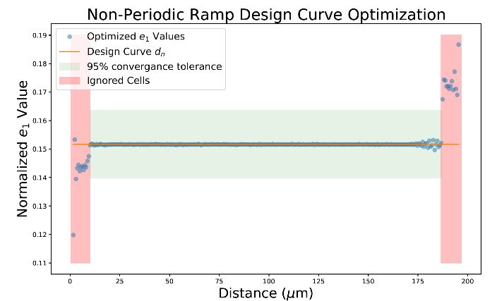
Inverse design of DLAs
Built upon:
Existing code from my Bachelor’s Thesis (Basic inverse design implementation)
Christian Neureuter’s Master’s Thesis (Inverse design of non-periodic structures)
Inverse design of DLAs in Literature:
Mostly used to create complex patterns
Repetition of single periodic
unit cells
Only one unit cell optimized
-> Dephasing in long structures
-> Equivalent to single repeating pillar
-> Not suited for sub-relativistic DLAs
Hughes et al. Opt. Express 25, 15414-15427 (2017)
Sapra et al. Science 367, 79-83 (2020)
Inverse design of multi-pillar cells:
Inverse design of non-periodic structures:
Extended structures
Concatenation of different unit cells
All unit cells optimized in the same step
-> But: still periodic (Repetition of
-> block of unit cells)
Extended structures
Not periodic: Open ends
-> Can change periodicity along
-> the structure
-> Suited for sub-relativistic DLAs
Extended structures
Concatenation of different unit cells
All unit cells optimized in the same step
-> Can change periodicity along the structure
-> Equivalent to single repeating pillar
Notes:
But after rewriting the code (due to the need to clean up and due to needing

Slide 19
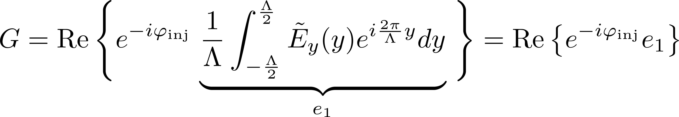
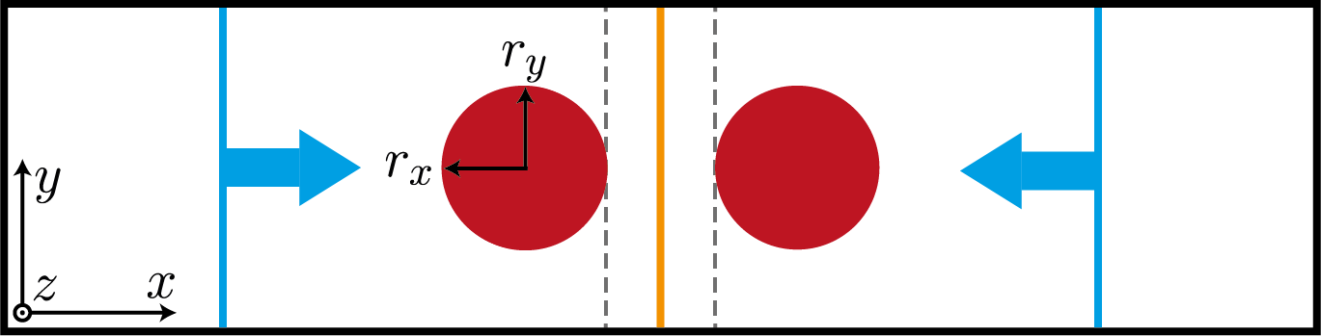




Inverse design of DLAs
Computational design via optimizing a structure for a certain objective function
Objective function: Acceleration gradient inside the structure
with
: Injection phase
Wanted: efficient way to calculate the gradient of the objective function for some parameter vector
Parameters: Pillar dimensions in x and y direction
Laser coming from the side
(side illumination)
Field evaluated here

Slide 20







Adjoint method
Maxwell’s equations in frequency domain:
On a grid:
Gradient of G:
with
Define second simulation with source term
-> Only one additional simulation necessary to calculate complete gradient!
Forward simulation
Source term
Contains structure
Electric field
Finite difference
Adjoint simulation

Slide 21
Inverse design of DLAs
Built upon:
Existing code from my Bachelor’s Thesis (Basic inverse design implementation)
Christian Neureuter’s Master’s Thesis (Inverse design of non-periodic structures)
Inverse design of DLAs in Literature:
Mostly used to create complex patterns
Repetition of single periodic
unit cells
Only one unit cell optimized
-> Dephasing in long structures
-> Equivalent to single repeating pillar
-> Not suited for sub-relativistic DLAs
Hughes et al. Opt. Express 25, 15414-15427 (2017)
Sapra et al. Science 367, 79-83 (2020)
Inverse design of multi-pillar cells:
Inverse design of non-periodic structures:
Extended structures
Concatenation of different unit cells
All unit cells optimized in the same step
-> But: still periodic (Repetition of
-> block of unit cells)
Extended structures
Not periodic: Open ends
-> Can change periodicity along
-> the structure
-> Suited for sub-relativistic DLAs
Extended structures
Concatenation of different unit cells
All unit cells optimized in the same step
-> Can change periodicity along the structure
-> Equivalent to single repeating pillar
Notes:
But after rewriting the code (due to the need to clean up and due to needing

Slide 22




Multi-pillar optimization
Side illuminated, dual pillar structures
Constant channel width of 225 nm
Optimization parameters:
and of each pillar pair
Spacing between pillars chosen according to the synchronicity condition:

Slide 23


Multi-pillar optimization
For multiple pillars:
Acceleration should follow design curve
Gradient:
Objective function
of cell n
Design curve value
assigned to cell n
Gradient of the objective function of
cell n for each parameter in the parameter vector

Slide 24






Forward simulation
Adjoint simulation
Python process
Lumerical FDTD process
Optimizer: SciPy’s SLSQP
Optimization result

Slide 25







Difficulty of designing DLAs II
Goal function
Pillar position

Slide 26

Optimization Results – Periodic structure
27 pillar pairs
(54 parameters)
Periodic
Arbitrary design curve
-> prove of concept
Optimization successful
after ~ 100 Simulations
Deviations below 1%

Slide 27
Inverse design of DLAs
Built upon:
Existing code from my Bachelor’s Thesis (Basic inverse design implementation)
Christian Neureuter’s Master’s Thesis (Inverse design of non-periodic structures)
Inverse design of DLAs in Literature:
Mostly used to create complex patterns
Repetition of single periodic
unit cells
Only one unit cell optimized
-> Dephasing in long structures
-> Equivalent to single repeating pillar
-> Not suited for sub-relativistic DLAs
Hughes et al. Opt. Express 25, 15414-15427 (2017)
Sapra et al. Science 367, 79-83 (2020)
Inverse design of multi-pillar cells:
Inverse design of non-periodic structures:
Extended structures
Concatenation of different unit cells
All unit cells optimized in the same step
-> But: still periodic (Repetition of
-> block of unit cells)
Extended structures
Not periodic: Open ends
-> Can change periodicity along
-> the structure
-> Suited for sub-relativistic DLAs
Extended structures
Concatenation of different unit cells
All unit cells optimized in the same step
-> Can change periodicity along the structure
-> Equivalent to single repeating pillar
Notes:
But after rewriting the code (due to the need to clean up and due to needing

Slide 28

Optimization Results – Non-periodic structure
300 pillar pairs
(600 parameters)
First and last 15 pillars ignored
Non-periodic
-> tapered structure (period
increases over length of structure)
Sloped design curve
-> generally higher acceleration
-> gradients possible for higher
-> energies
Optimization successful only
away from the edges
C. Neureuter‘s Master‘s thesis

Slide 29



Conclusion and Outlook
Current status:
  Can efficiently optimize multi-pillar macro-cells
  Struggle with edge effects in the non-periodic case
Future work:
  Implement deflecting/focusing forces
  Particle tracking instead of evaluating first harmonic
  Implement alternating phase focusing
  Move to more complex structures -> more parameters
$$\text{50 }\text{μm}$$
$$\text{50 }\text{μm}$$

Slide 30
Thank you for your attention!

Slide 31








Backup: Calculation of
From Maxwell’s equations
Apply chain rule:
Calculation of using finite difference methods:
The gradient of the structure matrix becomes
For every parameter, one additional finite difference calculation is necessary
-> Calculation effort can be neglected for single pillar case
Permittivity distribution
not analytical
d)
b)
c)
Vector of individual

Slide 32








Backup: Adjoint source
Derivative of the multi-pillar objective function
Corresponding source:
Error: Prefactor not applied to
source -> flat source profile
Prefactor only applied after the simulation
Source term of adjoint simulation
if y inside cell
if y outside cell

