Slide 1
Fast Surrogate models for dielectric laser accelerator diagnostics
Thilo Egenolf, Oliver Boine-Frankenheim
Joint research project with Luca Genovese and Huseyin Cankaya (DESY / UHH Hamburg)

Slide 2
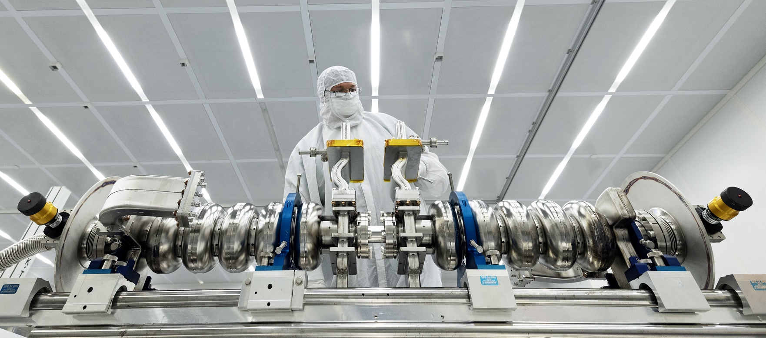
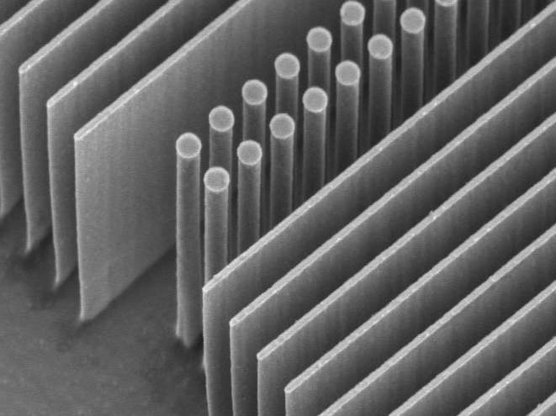
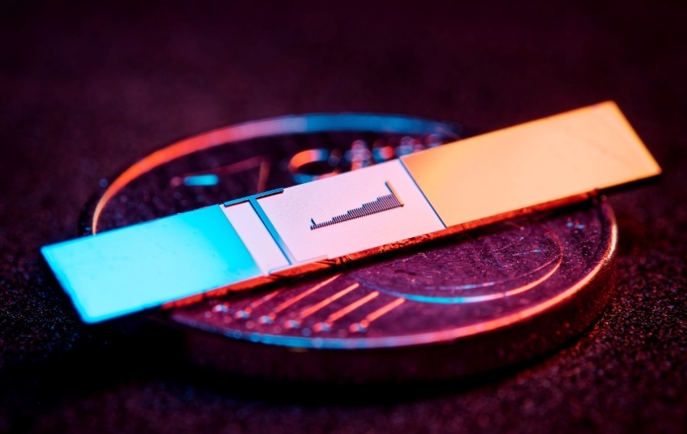
Why dielectric-based laser accelerators?
SRF Test Lab at Jefferson Lab
Frequencies
Damage threshold
Acceleration gradient
Beam quality
f = 3 GHz
τ = 333 ps
Repetition rate ~ Hz-kHz
<200 MV/m fields
25-50 MeV/m
Emittance
1 μm ~ 1 mm rad
Metal
Dielectric
$$\text{1 }\text{μm}$$
f = 150 THz (λ=2 μm)
τ = 6.6 fs
Repetition rate
~ kHz-MHz
>3 GV/m fields
>1 GeV/m
Emittance
<100 pm rad
FAU Erlangen

Slide 3
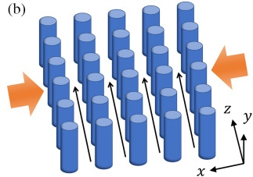
Why (not) dielectric-based laser accelerators?
Small structures
▼
Small physical aperture ~ 1 µm
Strict requirements on beam properties and electron source
Low current
per DLA (channel) ~ 1 fA – 1pA
Multichannel DLA
Zhao et al., Photonics Research 8 (10), 1586-1598 (2020)
High repetition rate
~ 1 MHz
＆

Slide 4
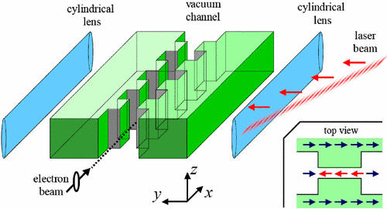
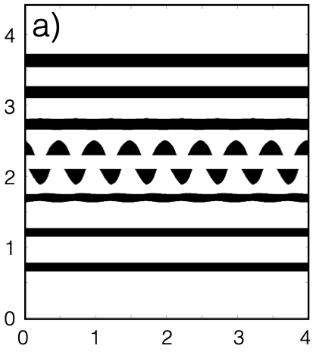
DLA in Theory
Proof of principle: K. Shimoda, Applieds Optics 1 (1), 33-35 (1962) T. Plettner et al., Phys. Rev. ST AB 9, 111301 (2006)
Structure design and optimization: T. Hughes et al., Optics Express 25 (13), 15414-15427 (2017) U. Niedermayer, T. Egenolf et al., PRAB 20, 111302 (2017) → Next talk by Manuel Konrad (FAU Erlangen)
Guiding by Alternating Phase Focusing: U. Niedermayer, T. Egenolf et al., PRL 121, 214801 (2018) U. Niedermayer, T. Egenolf et al., PRL 125, 164801 (2020)
T. Plettner et al., Phys. Rev. ST AB 9, 111301 (2006)
T. Hughes et al., Optical Express 25 (13), 15414-15427 (2017)
R. Shiloh et al., Nature 597, 498 (2021)

Slide 5
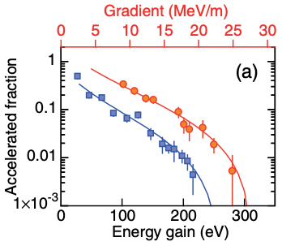
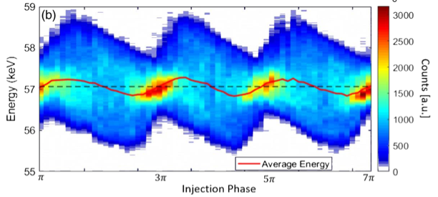
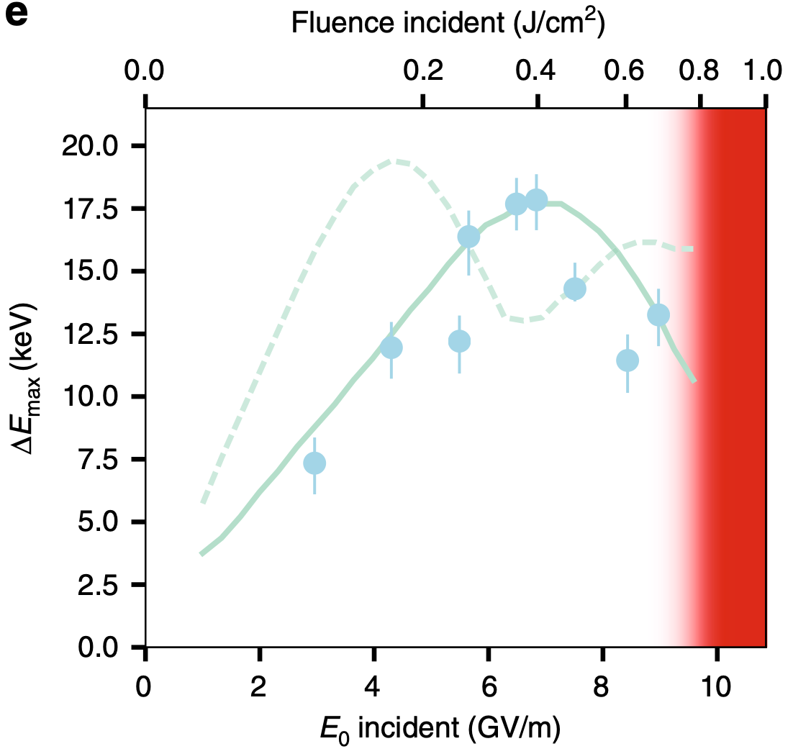
Experiments catching up
Proof of principle: J. Breuer, P. Hommelhoff, PRL 111, 134803 (2013) E. A. Peralta et al., Nature 503(7474), 91-94 (2013)
Acceleration at subrelativistic energies: D. S. Black et al., PRL 123, 264802 (2019) N. Schönenberger et al., PRL 123, 264803 (2019)
Acceleration at relativistic energies: K. Wootton et al., Opt. Lett. 41 (12), 2696-2699 (2016) D. Cesar et al., Communications Physics 1, 46 (2018)
J. Breuer, P. Hommelhoff, PRL 111, 134803 (2013)
D.S. Black et al., PRL 123, 264802 (2019)
D. Cesar et al., Communications Physics 1, 46 (2018)

Slide 6
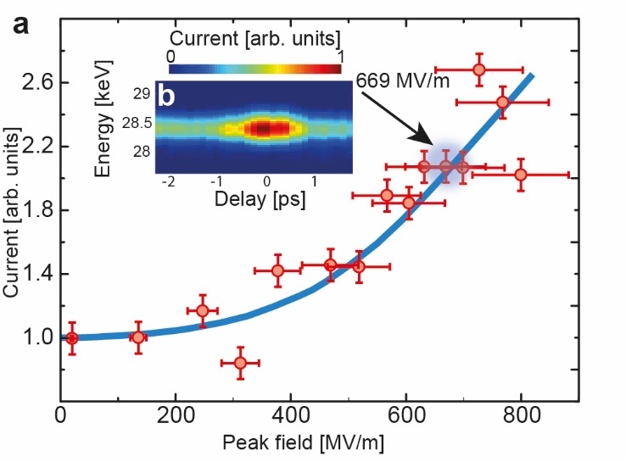
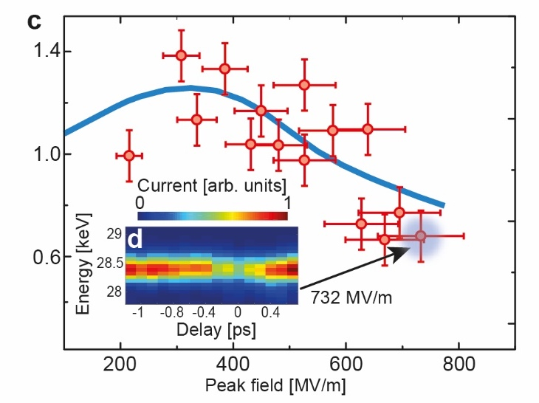
APF at dla: proof of principle
Overfocusing
Guiding
2.7 larger electron current at optimal transport field strength (~700 MV/m)
Overfocusing effect (>400 MV/m)
Different structure geometry with larger macrocells
R. Shiloh et al., Nature 597, 498 (2021)

Slide 7
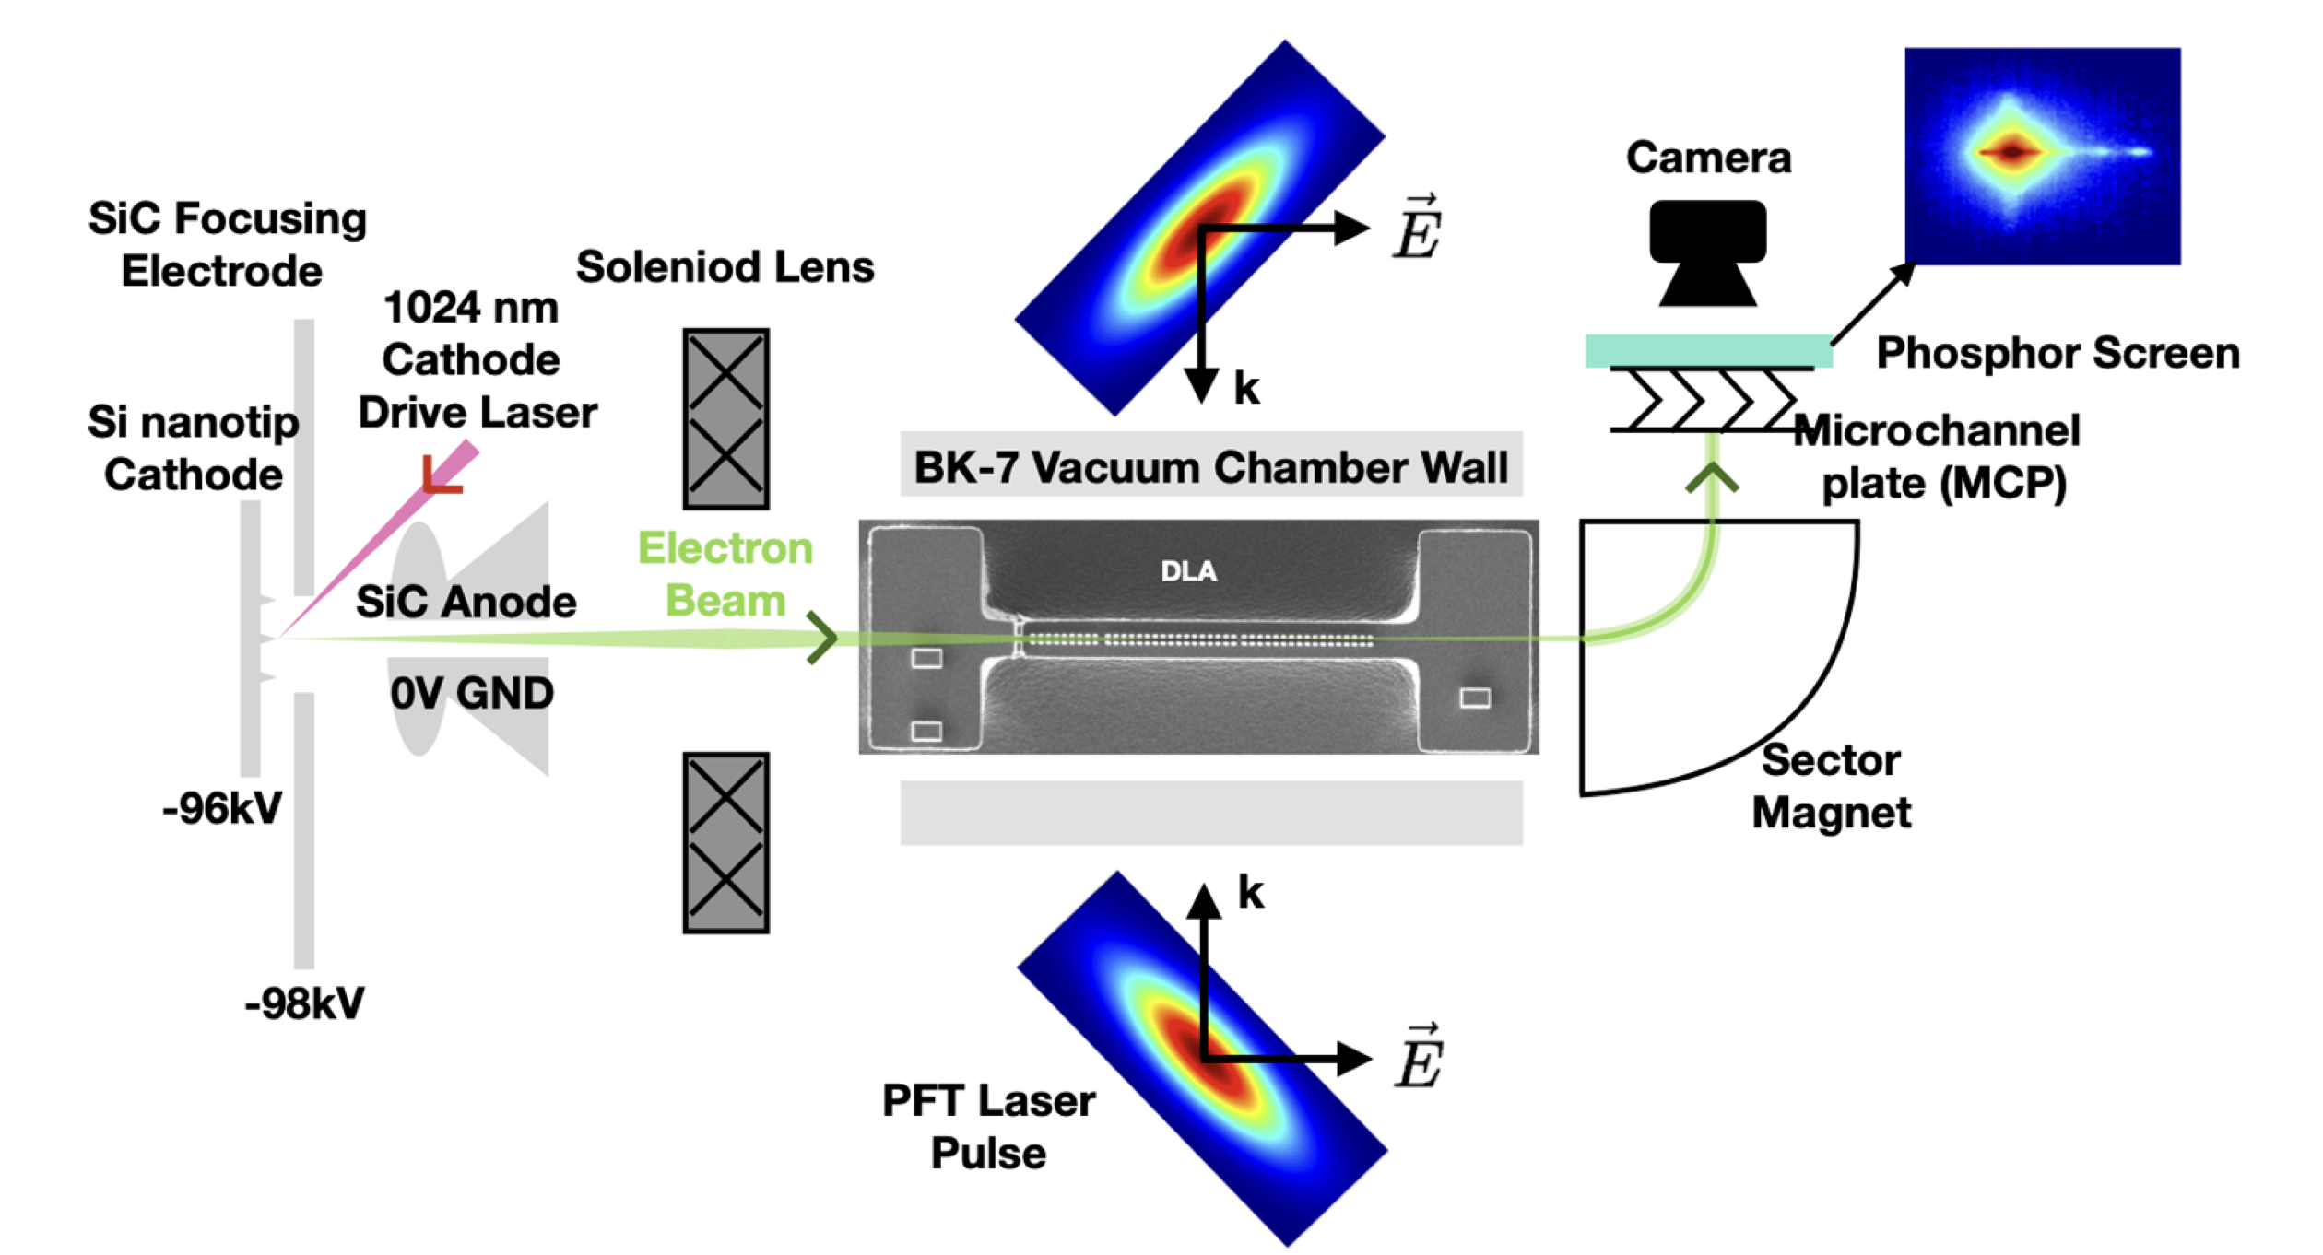
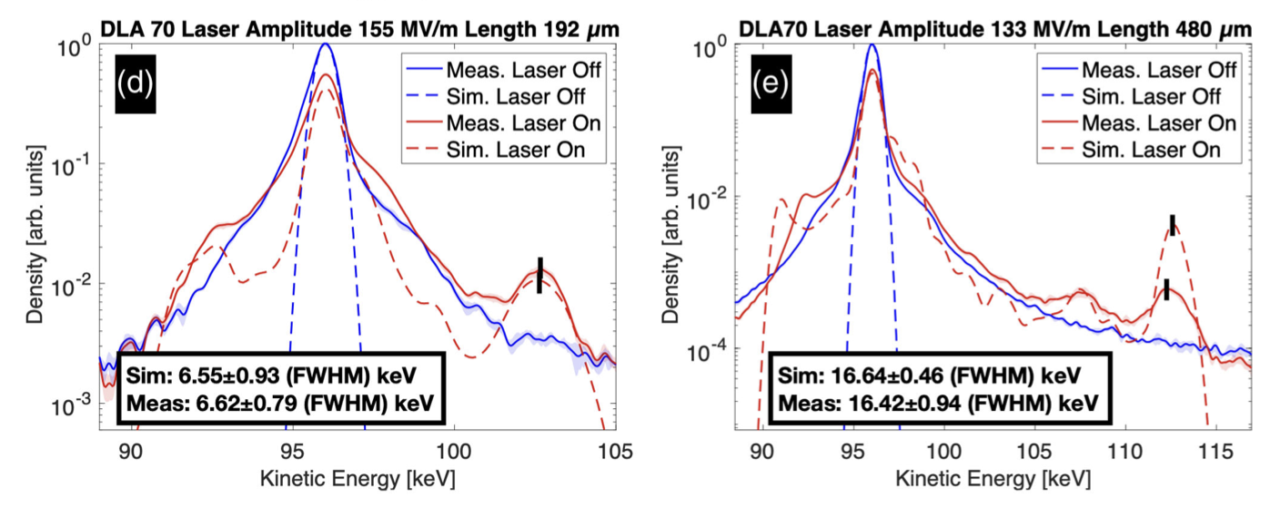
APF at dla: guiding and acceleration
P. Broaddus, T. Egenolf et al., PRL 132, 085001 (2024)

Slide 8
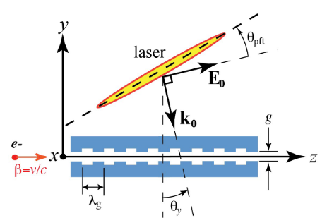
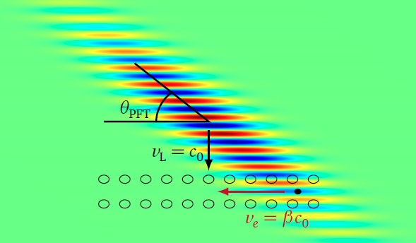
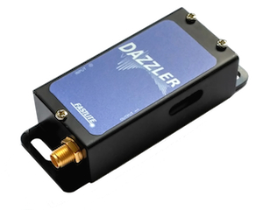
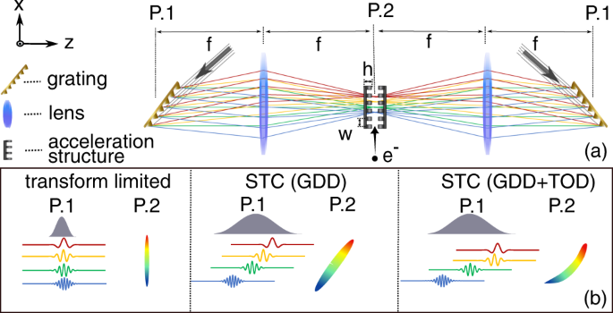
complicated optics: Pulse front tilt
Acousto-optic programmable diffractive filter (AOPDF)
D. Cesar et al., Optics Express, vol. 26, 29216, 2018
D. Cesar, PhD Thesis, UCLA, 2019
L. Wang et al., Commun Phys 5, 175 (2022)

Slide 9
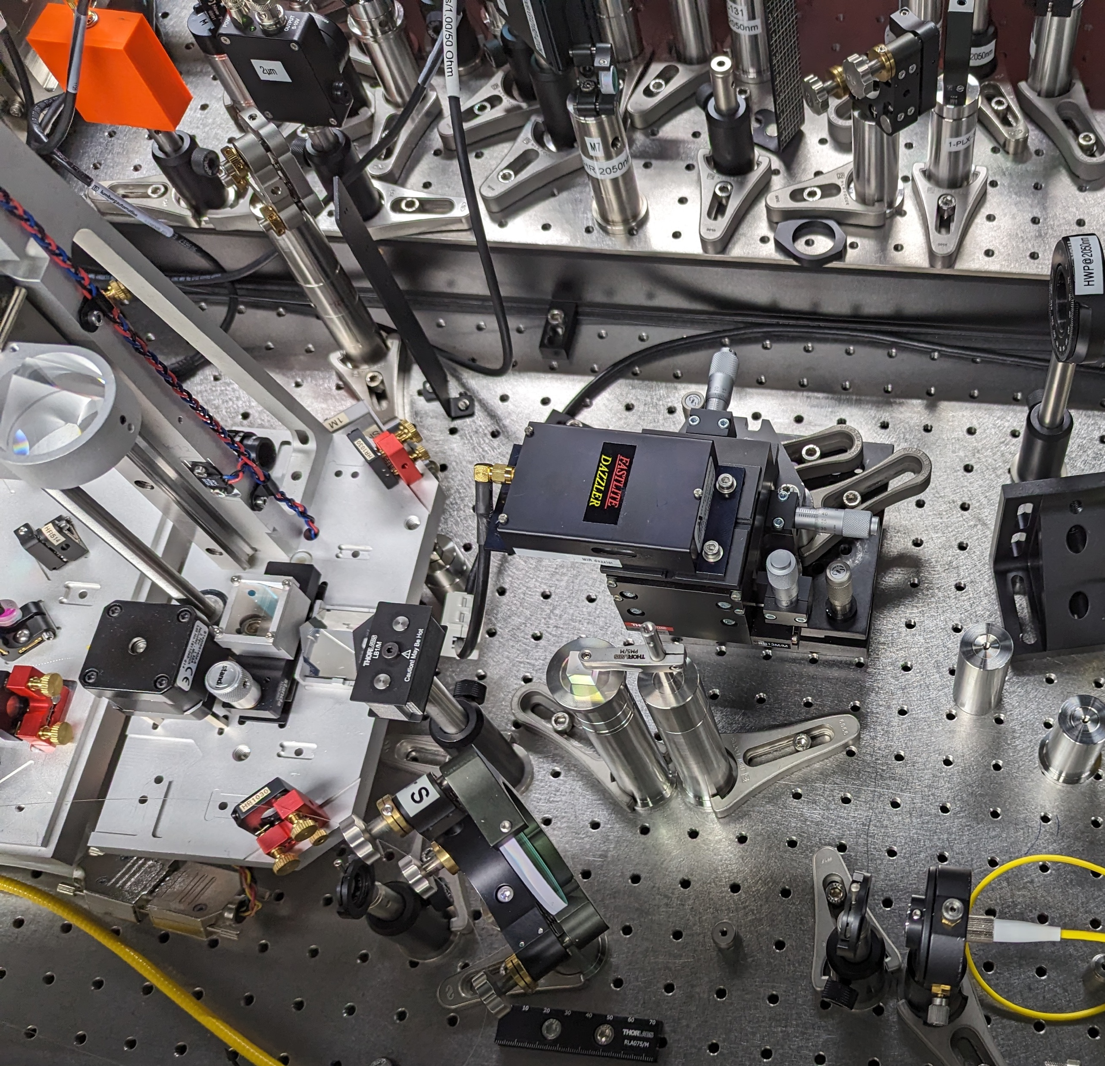
Pulse front tilt
Acousto-optic programmable diffractive filter (AOPDF)
D. Cesar et al., Optics Express, vol. 26, 29216, 2018
D. Cesar, PhD Thesis, UCLA, 2019
L. Genovese (DESY / UHH)
L. Wang et al., Commun Phys 5, 175 (2022)

Slide 10
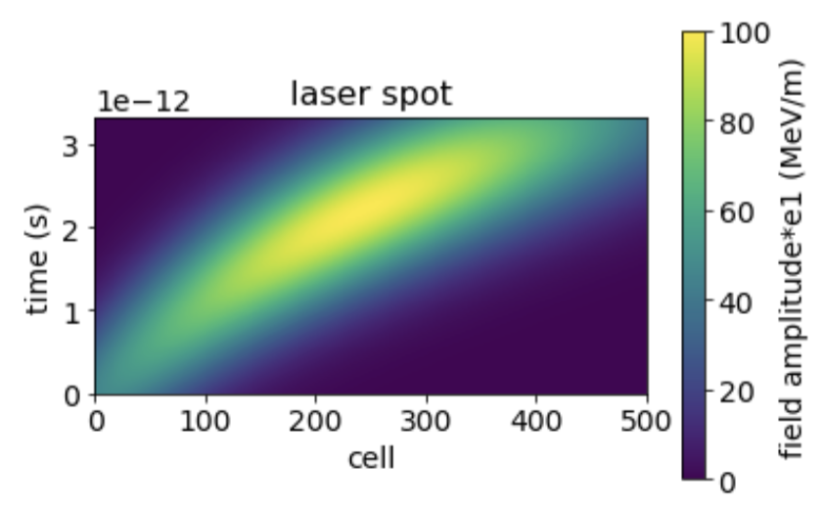
Pulse front tilt
How does the laser pulse looks like at the interaction point?
Dependencies: longitudinal coordinate along structure, time
Assumption: Gaussian function
Gaussian in z (coordinate along structure) with $µ_{z}$ and $σ_{z}$
Gaussian in time (longitudinal coordinate in phase space) with $µ_{t}(z)$ and $σ_{t}(z)$

Slide 11
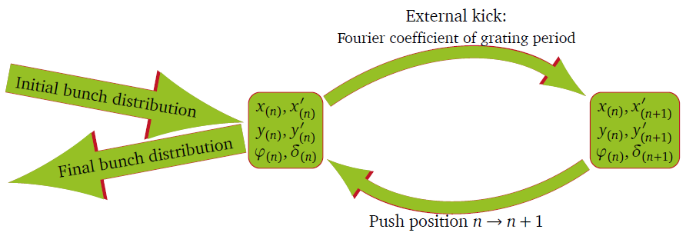
DLAtrack6D
$${\left.\left(\begin{matrix}\begin{matrix}x \\ x^{′} \\ y\end{matrix} \\ \begin{matrix}y^{′} \\ φ \\ δ\end{matrix}\end{matrix}\right.\right)}^{(n+1)}={\left.\left(\begin{matrix}\begin{matrix}x \\ Ax^{′}+Δx^{′}\left(x,y,φ\right) \\ y\end{matrix} \\ \begin{matrix}Ay^{′}+Δy^{′}\left(x,y,φ\right) \\ φ \\ δ+Δδ\left(x,y,φ,φ_{0}\right)\end{matrix}\end{matrix}\right.\right)}^{(n)}+{\left.\left(\begin{matrix}\begin{matrix}λ_{z}x′(x,y,φ) \\ 0 \\ λ_{z}y′(x,y,φ)\end{matrix} \\ \begin{matrix}0 \\ −\frac{2π}{β^{2}γ^{2}}δ(x,y,φ) \\ 0\end{matrix}\end{matrix}\right.\right)}^{(n+1)}$$
Symplectic tracking code
Kicks by ${\underline{e}}_{1}\left.\left(x,y\right.\right)={\underline{e}}_{1}^{0}\cosh\left.\left(\frac{ωy}{βγc_{0}}\right.\right)$
Transverse kicks by Panofsky-Wenzel theorem
with $A^{(n)}=\frac{{\left(βγ\right)}^{\left(n+1\right)}}{{\left(βγ\right)}^{(n)}}$
Updates:
Python version: GUI and command line tool
Tracking parallelized on CPU
Arbitrary laser pulse shape (pulse front tilt)
Laser wavelength change during tracking (chirp)
U. Niedermayer, T. Egenolf, O. Boine-Frankenheim, Phys. Rev. Accel. Beams 20, 111302 (2017)

Slide 12
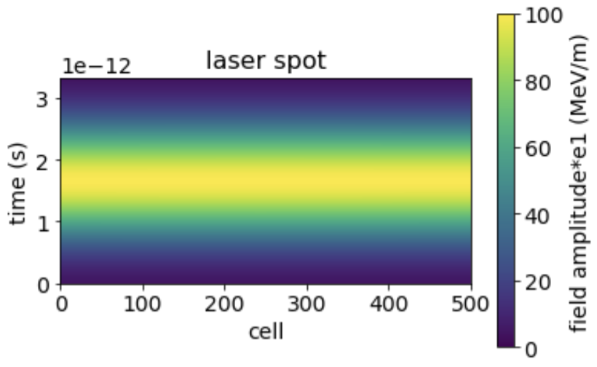
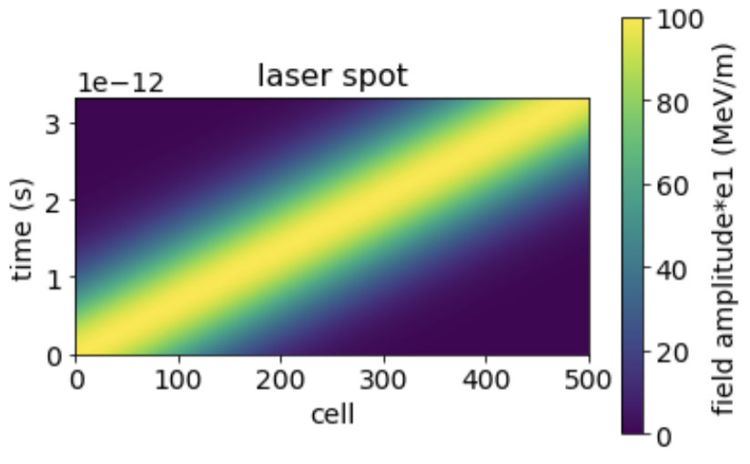
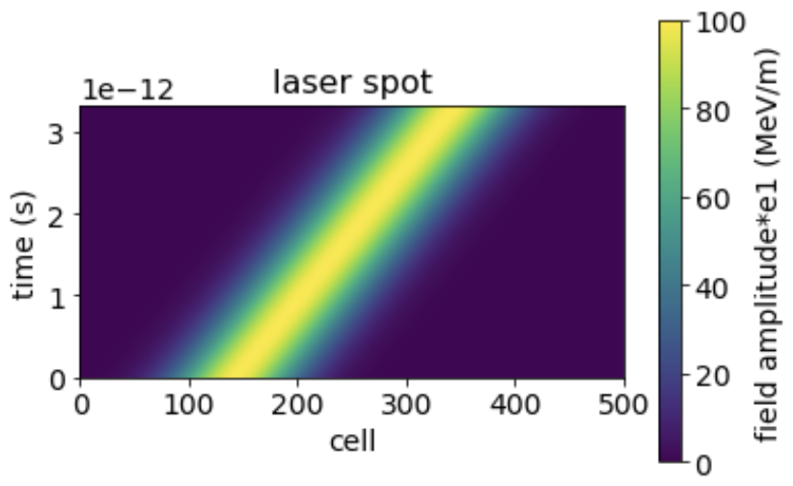
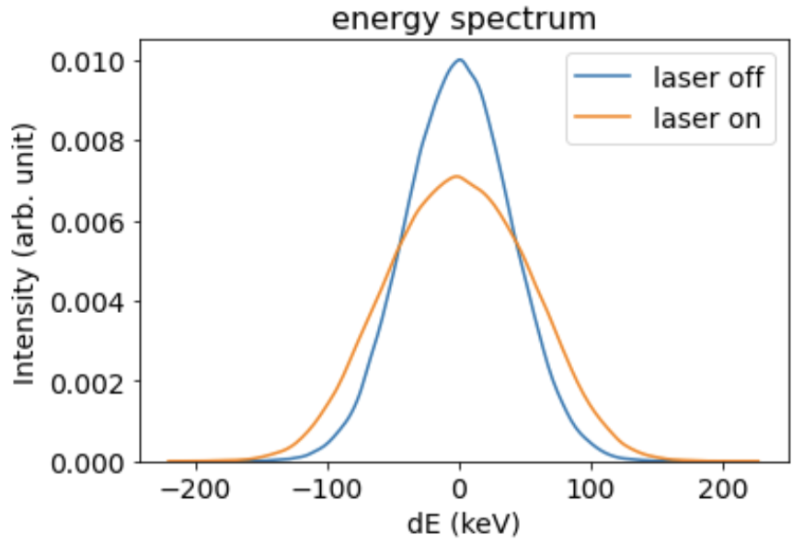
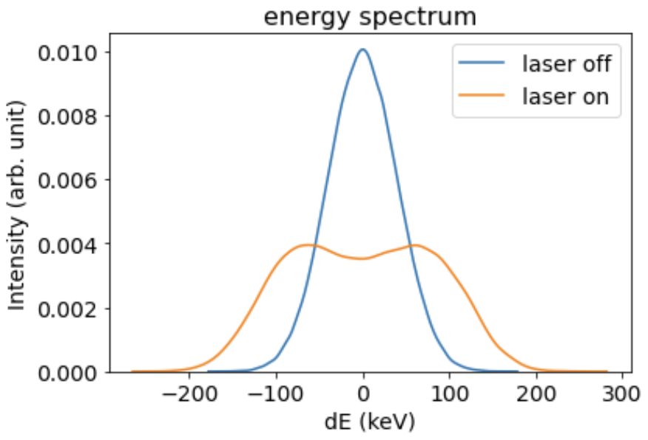
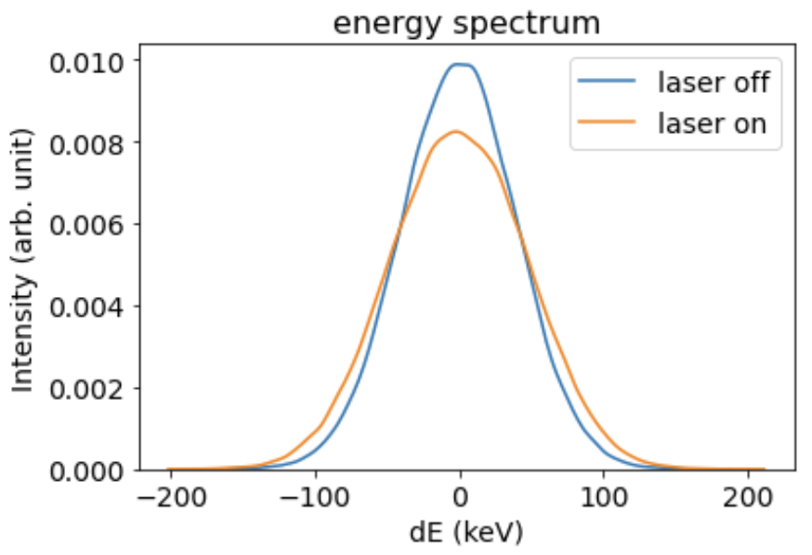
DLAtrack6D
Examples: Various PFT angles

Slide 13
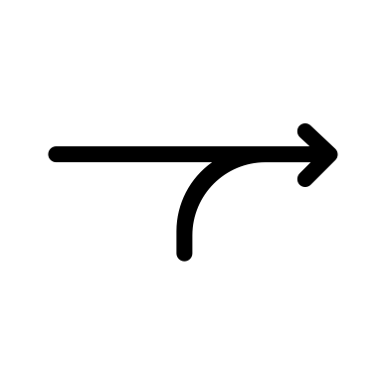
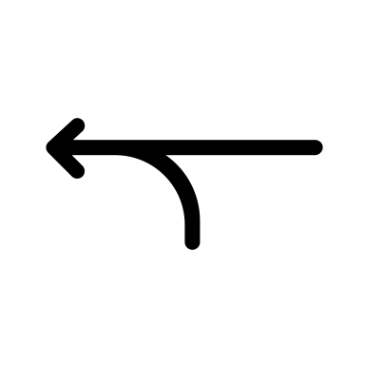
DLA experiment – inverse problem
Simulations
Initial electron bunch distribution
Laser pulse shape
Tracking
Final electron bunch distribution
(Energy spectrum)
Grating parameters
Experiments
Initial electron bunch distribution
Laser pulse shape
Reconstruction
Energy spectrum
Additional diagnostics
Grating parameters

Slide 14
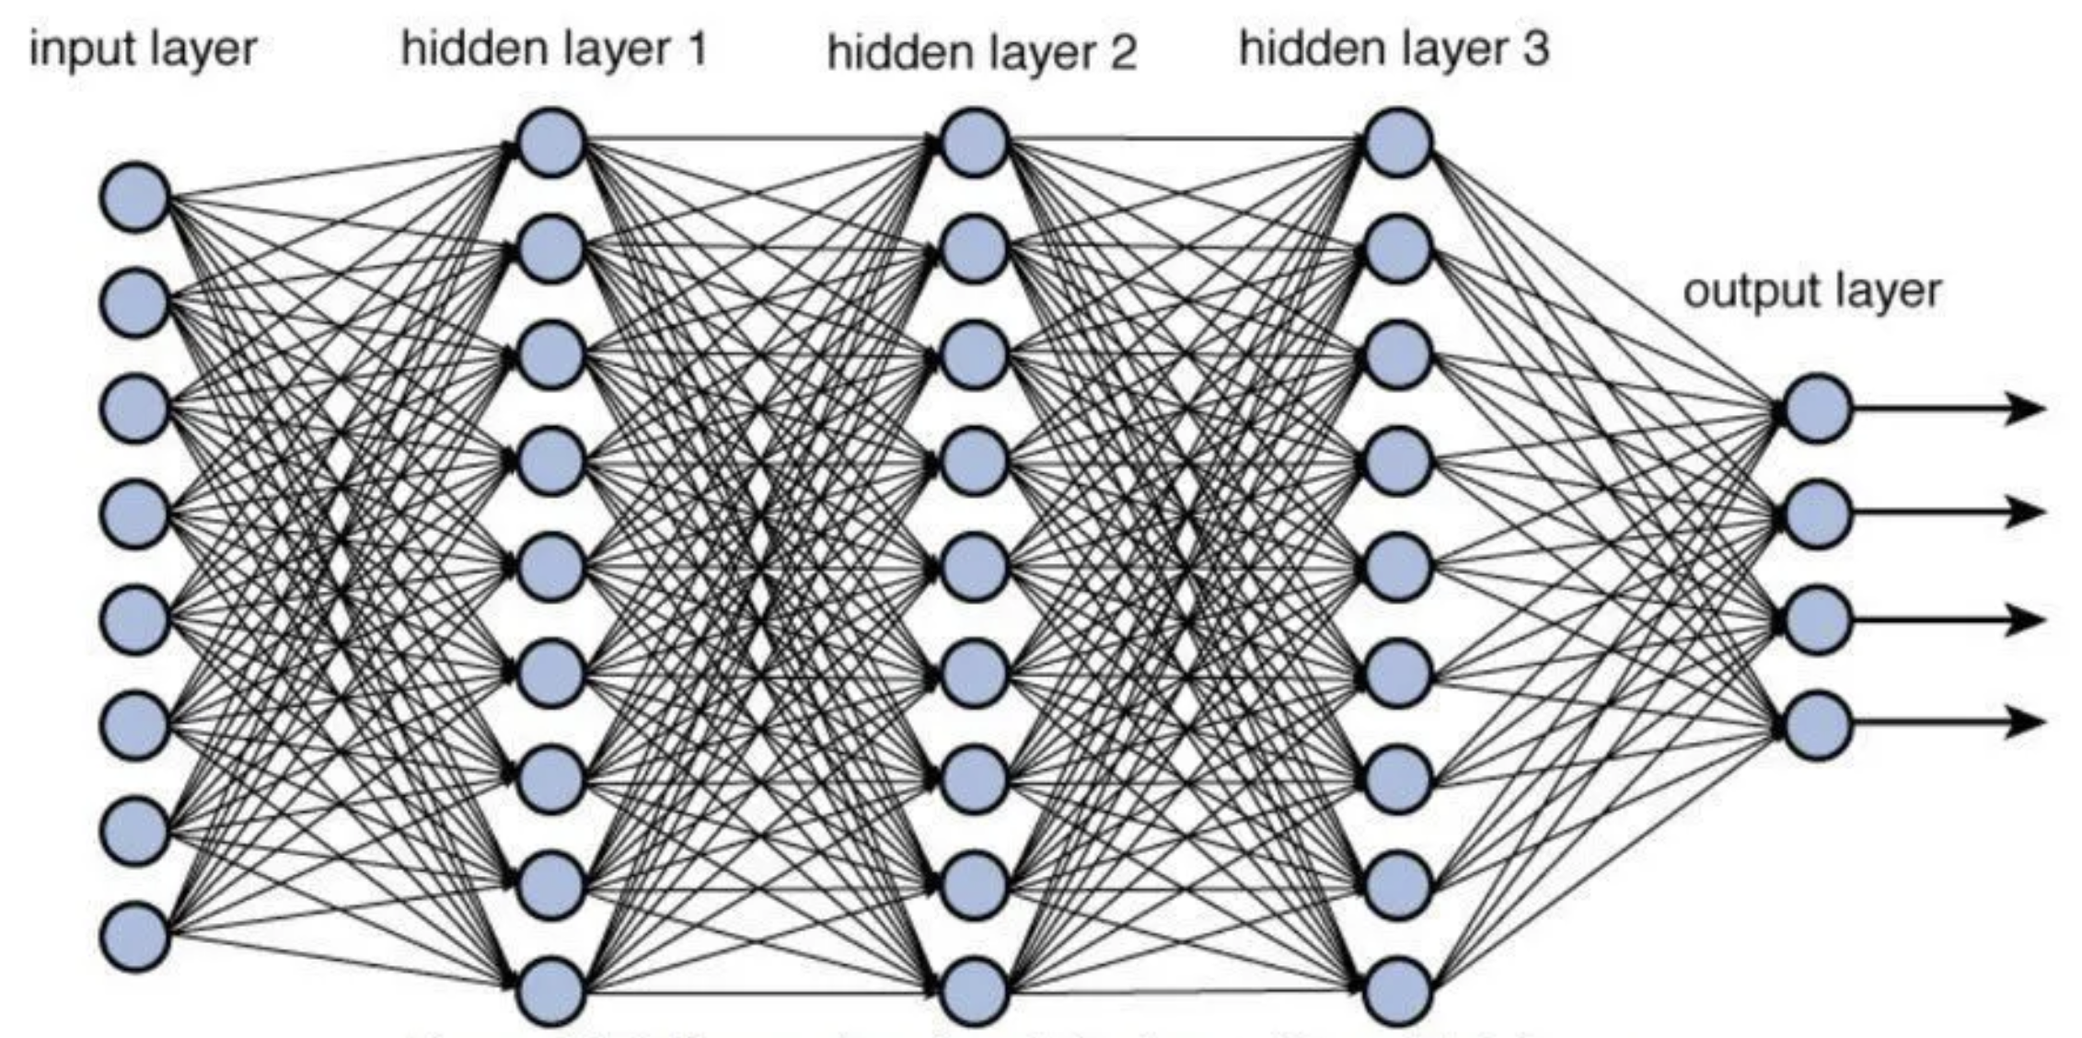
Reconstruction by deep neural nets
1
2
3
$$x=(x_{1},x_{2},…)$$
3
$$y=(y_{1},y_{2},…)$$
$=w_{1}∗ +{ w}_{2}∗ +{ w}_{3} ∗ +…$
1
2

Slide 15
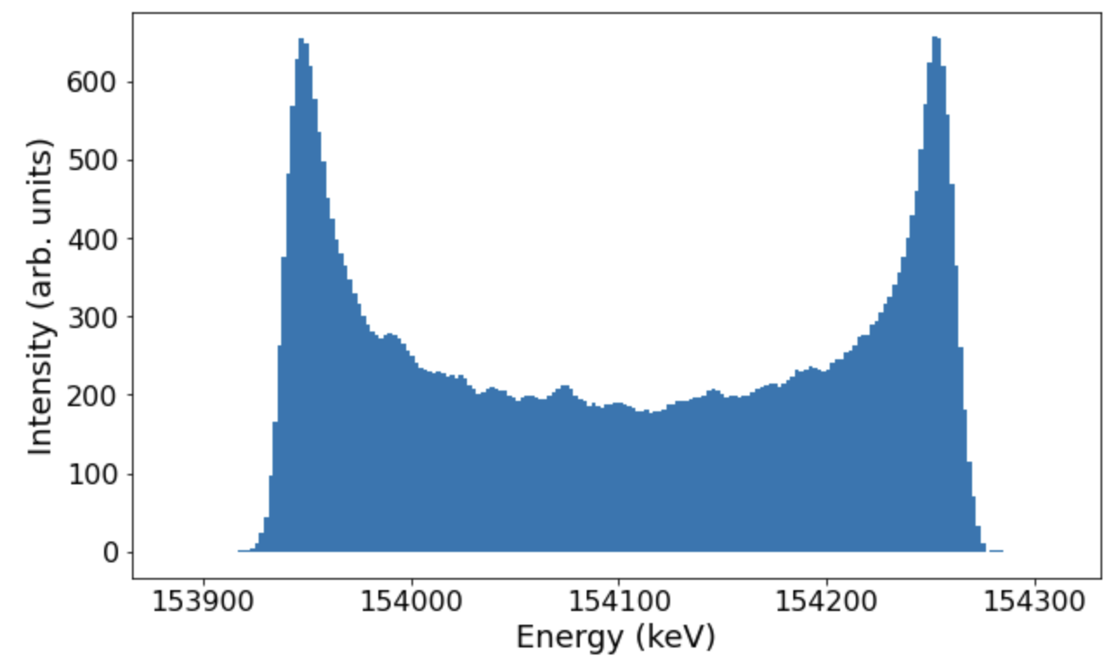
Trained neural net
Input: Binned energy spectrum of electrons after DLA interaction (~200 bins)
Net
3 layers fully connected (200 neurons → 200 neurons → <=5 neurons (till now)
ReLU activation function
Loss function: mean absolute error (parameters normalized→ percentage error)
Output: Experimental parameters (input of tracking simulations)
Dense
200 neurons ReLU activation
Dense
200 neurons ReLU activation
Dense
<=5 neurons ReLU activation
Experimental parameters

Slide 16
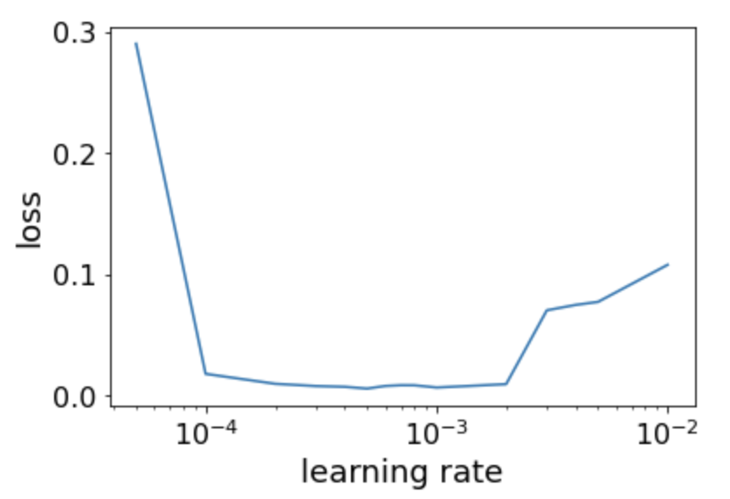
Trained neural net
Implemented using pyTorch
Trained with simulation data created by DLAtrack6D

Slide 17
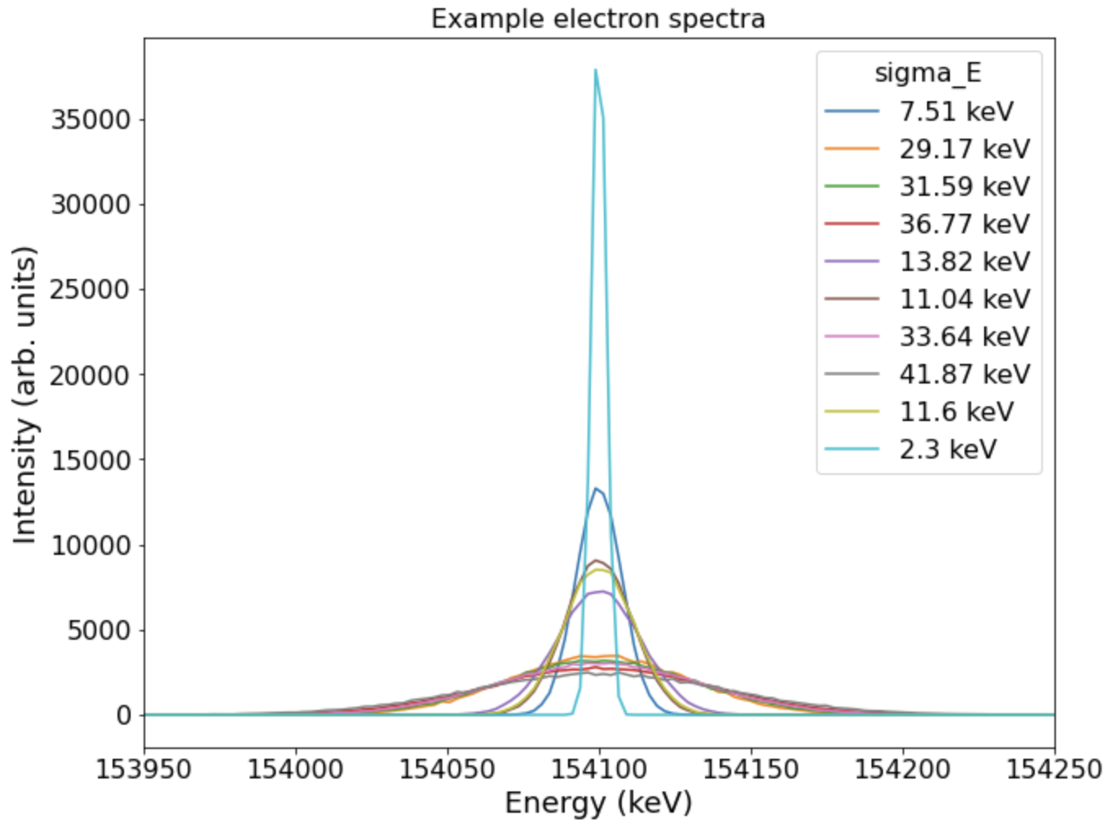
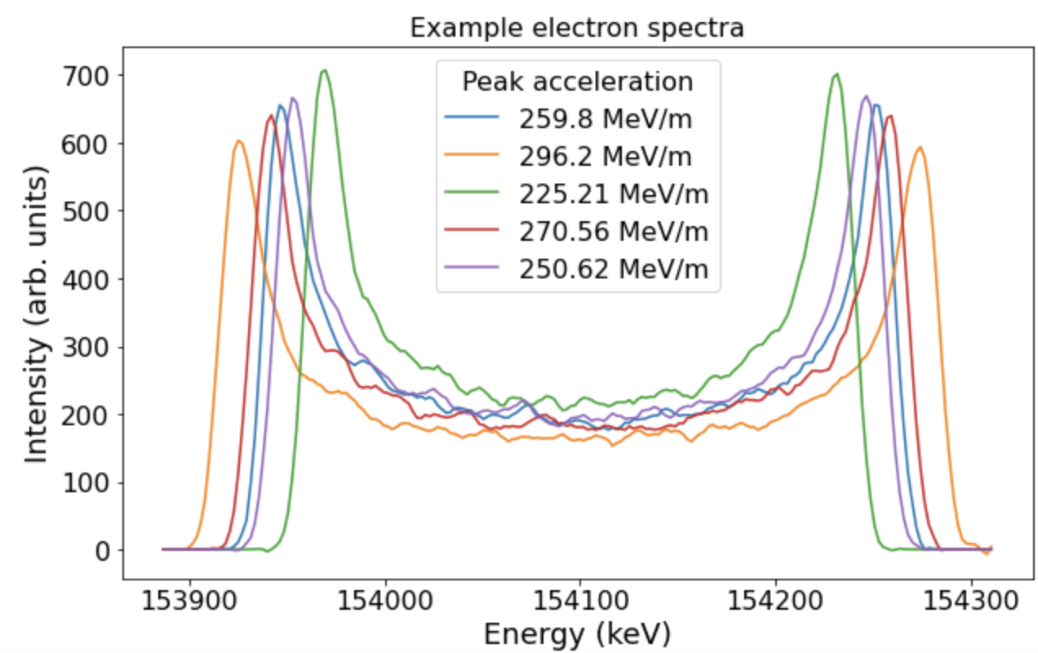
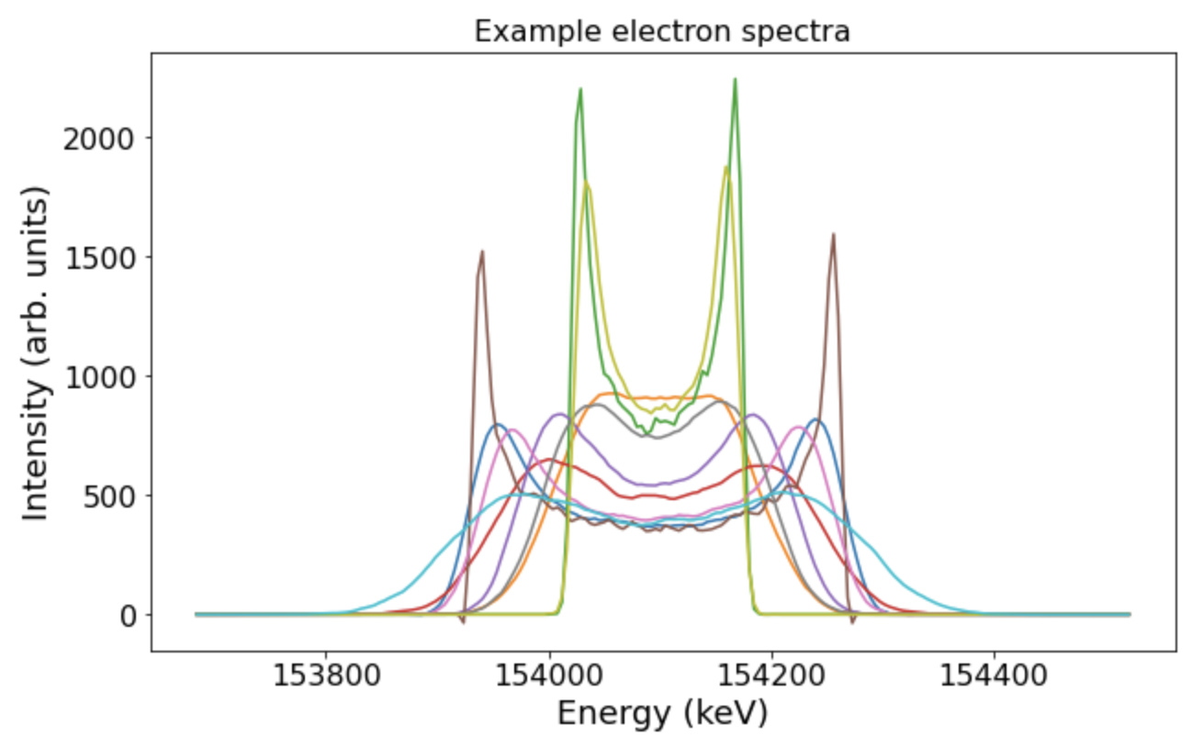
(Trivial) test examples
Peak width of energy spectrum
Laser amplitude
Both together
➔ below 1% error in training and validation datasets for all three examples

Slide 20
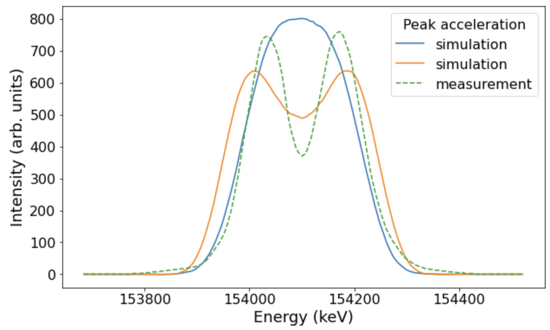
Reconstruction vs experiment
Simple model with two free parameters: energy width of electron bunch and laser amplitude
DLA period << electron bunch length << laser pulse
BUT
Reconstruction failed
Tracking

Slide 21
Reconstruction vs experiment
Possible explanations:
Substructures in electron bunch (TDC measurements required)
Missmatch between laser wavelength (2.052µm mean) and DLA period length (2.05µm)
Laser pulse chirp (wavelength change)
Different laser pulse shape (more parameters needed)

Slide 22
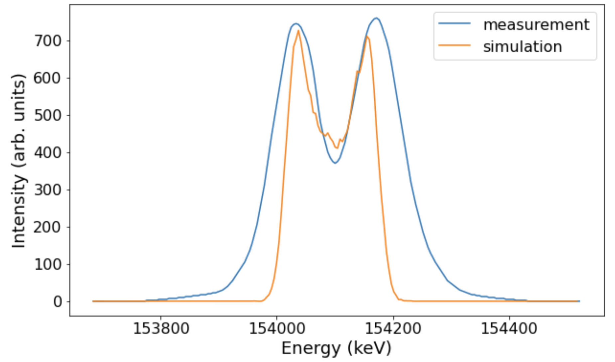
Reconstruction vs experiment
Model with 5 free parameters for laser pulse ($σ_{z},μ_{z},σ_{y},μ_{y}$ and laser amplitude)
Missmatch between laser wavelength and DLA period length of 20 nm included → phase shift
Much better agreement: higher laser amplitude but shorter laser pulse (interaction only in a fraction of the grating)
Has to be further investigated but maybe rotation of laser spot (1mm x 50µm) during experiment

Slide 23
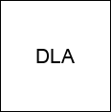
Goal: Control and optimization
Spectrum
Optimizer
Reconstructed
Parameters
Neural Net

Slide 24
Conclusions
Guiding and acceleration in DLA shown in theory and experiments
Electron accelerator
Longer structures and special laser pulse shapes complicate experiments
Diagnostics required but not possible everywhere
Reconstruction with neural nets
Trivial examples with only a few parameters work well
Models with more parameters are under development
First validation with experimental data is done, more data needed
Thank you for your attention!

Slide 25
DLA operation principle
Depending on particles position:
Acceleration
Deceleration
Deflection
1
2
3
4
1
2
3
4
Synchronicity condition:
Goal: generate a mode that allows momentum transfer from laser field to electrons
$β=Λ_{p}/(λm$)
1
4
2
3
$$Λ_{p}$$
First spatial harmonic
Proof of concept experiments in 2013:
$$λ$$
$β=0.3:$ 25 MeV/m: J. Breuer, P. Hommelhoff, PRL 111, 134803 (2013)
$β=0.7$: 250 MeV/m: E. A. Peralta et al. (2013). Nature, 503(7474), 91-94.
Deceleration
0
Acceleration

Slide 26
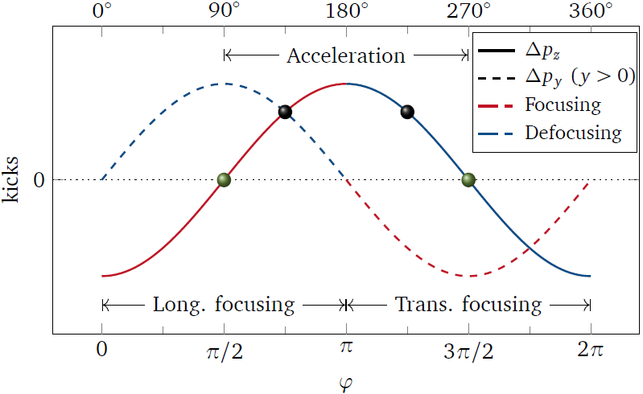
Guiding? Alternating phase focusing!
$$\frac{π}{2}≤φ_{0}<π$$
$$π<φ_{0}≤\frac{3π}{2}$$
$$\frac{π}{2}≤φ_{0}<π$$
Longitudinal focusing
Transverse defocusing
Longitudinal defocusing
Transverse focusing
Longitudinal focusing
Transverse defocusing
U. Niedermayer, T. Egenolf, O. Boine-Frankenheim, P. Hommelhoff, PRL 121, 214801(2018)
R. Shiloh et al., Nature 597, 498 (2021)

Slide 27
APF at dla: guiding and acceleration
Synchronicity condition:
$$β=Λ_{p}/(λm)$$
Chirped gratings: change of period length along grating

Slide 28
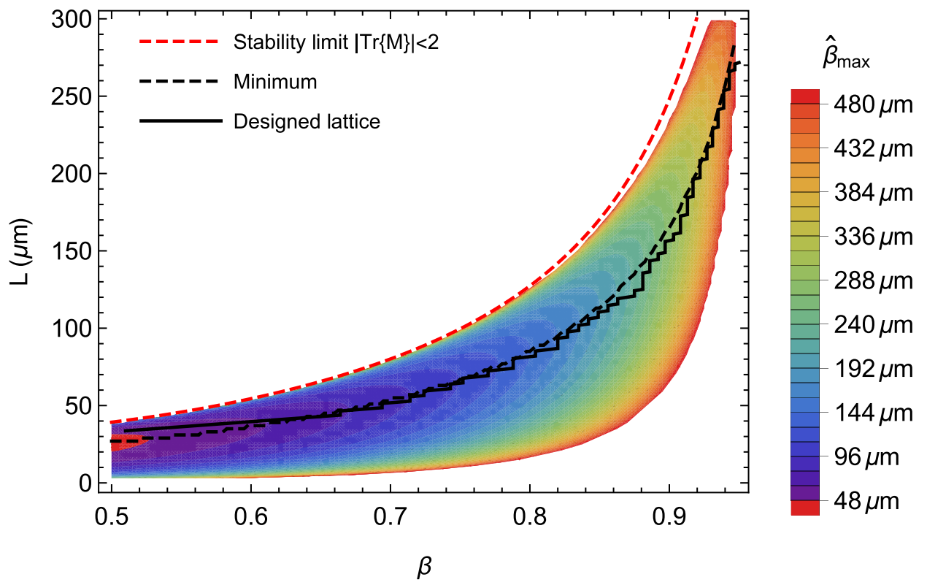
APF at dla: guiding and acceleration
Synchronicity condition:
$$Δz^{(n+1)}=\frac{q\left|e_{1}\right|λ^{2}\cos\left(φ_{s}^{\left(n\right)}\right)}{{γ^{\left(n\right)}}^{3}m_{e}c^{2}}$$
$$β^{\left(n+1\right)}=β^{\left(n\right)}+{Δz^{\left(n+1\right)}}/λ$$
$$β=Λ_{p}/(λm)$$
Chirped gratings: change of period length along grating
(velocity in c)
U. Niedermayer, T. Egenolf, O. Boine-Frankenheim, and P. Hommelhoff
PRL 121, 214801 (2018)
Proof of concept experiments recently published:
T. Chlouba, R. Shiloh, S. Kraus, L. Brückner, J. Litzel, P. Hommelhoff, Nature, 622, 476 (2023)
P. Broaddus, T. Egenolf et al., PRL 132, 085001 (2024)

