Slide 1
Simulation study of nanostructured copper photocathodes
This work is funded by the German Ministry of Research (BMBF) under contract 005K2022
Margarita Bulgacheva¹, Erion Gjonaj¹, Dmitry Bazyl²
¹ TEMF, Technische Universität Darmstadt, Darmstadt, Germany
² Deutsches Elektronen-Synchrotron, Hamburg, Germany

Slide 2
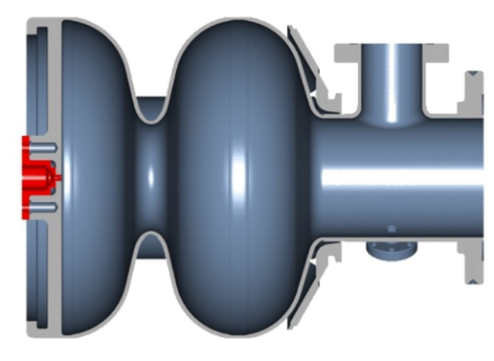
Introduction
A Continuous Wave (CW) electron source is necessary for the future operation of the CW and High-Duty-Cycle EuXFEL.
DESY is currently developing a 1.6-cell superconducting radio-frequency (SRF) gun cavity, designed to operate at 1.3 GHz.
This gun can only be used with metal photocathodes due to construction (no load lock system).
It is necessary to design a copper photocathode with increased Quantum Efficiency (QE).
D. Bazyl, et al. “CW Operation of the European XFEL: SC-Gun Injector Optimization, S2E Calculations and SASE Performance.” (2021)
D. Bazyl, “Nanostructured photocathode RnD for CW photoinjector at DESY”, Deutsches Elektronen-Synchrotron (DESY), unpublished.

Slide 3
Short theory of plasmonics
Periodic structure
+
Laser pulse
laser
Array of nanoholes

Slide 4
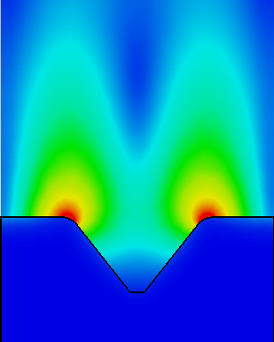
Short theory of plasmonics
Periodic structure
Surface Plasmon Polariton (SPP) modes
+
Laser pulse
laser
Array of nanoholes
Single nanohole
E-field

Slide 5
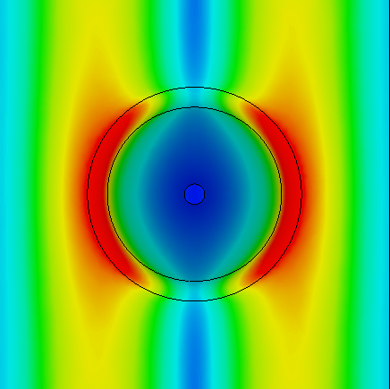
Short theory of plasmonics
Periodic structure
Surface Plasmon Polariton (SPP) modes
Increased local absorption
+
Laser pulse
laser
Array of nanoholes
Single nanohole
E-field
Single nanohole

Slide 6
Short theory of plasmonics
Periodic structure
Surface Plasmon Polariton (SPP) modes
Increased local absorption
+
Laser pulse
Increased quantum efficiency (QE)

Slide 7
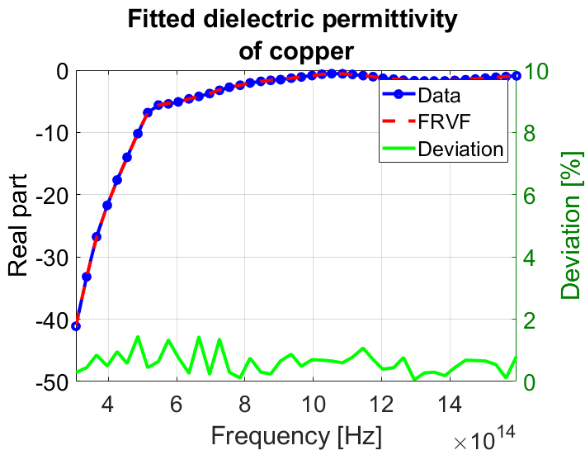
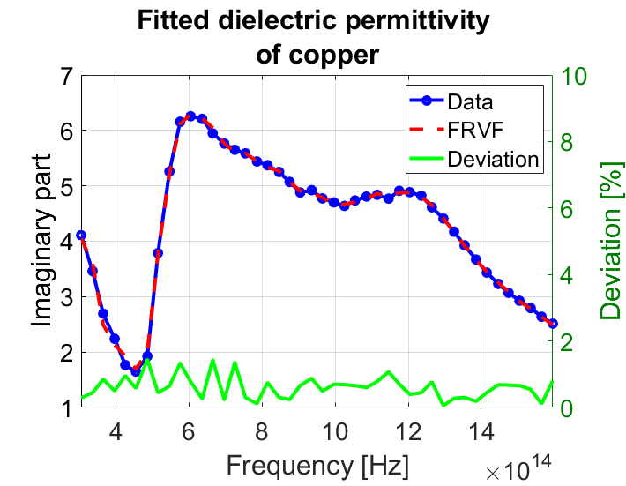
Dispersion modeling
Reflectance R(ω) depends on the complex, frequency dependent permittivity of the cathode material.
New dispersion model for accurate simulation of the reflectance spectra:
44 data points [Johnson & Christy] 1000 data points
Fast relaxed vector fitting
(passive – no energy growth)
Notes:
?

Slide 8
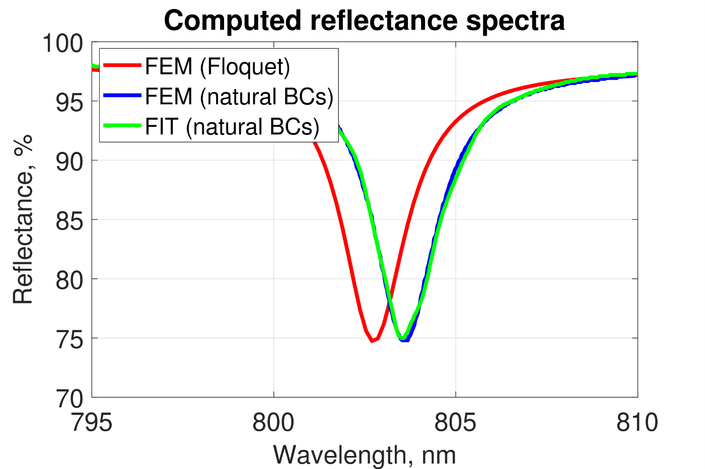
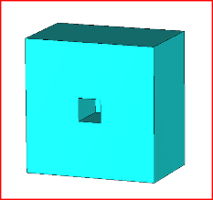
Simulation methods and accuracy estimation
3 different simulation models:
• FEM solver, Floquet (periodic) boundaries
• FEM solver, natural (E+H) boundaries
• FIT solver, natural (E+H) boundaries

Slide 9
Simulation methods and accuracy estimation
3 different simulation models:
• FEM solver, Floquet (periodic) boundaries
• FEM solver, natural (E+H) boundaries
• FIT solver, natural (E+H) boundaries
Results deviation:
• Minimum reflectance < 0.5%
• SPP resonance frequency < 0.02%

Slide 10
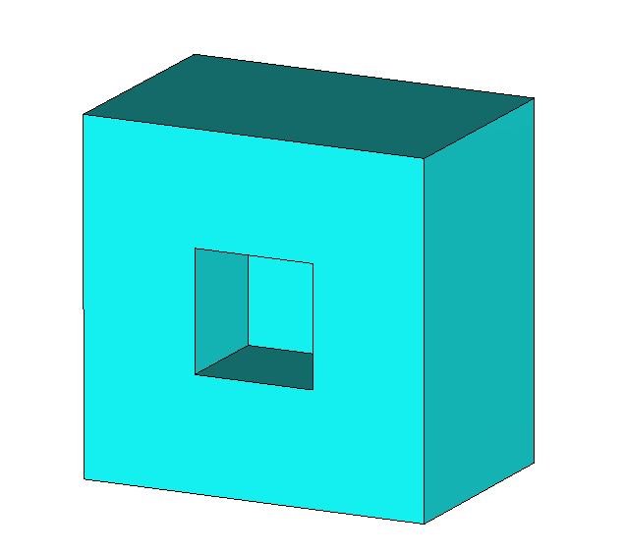
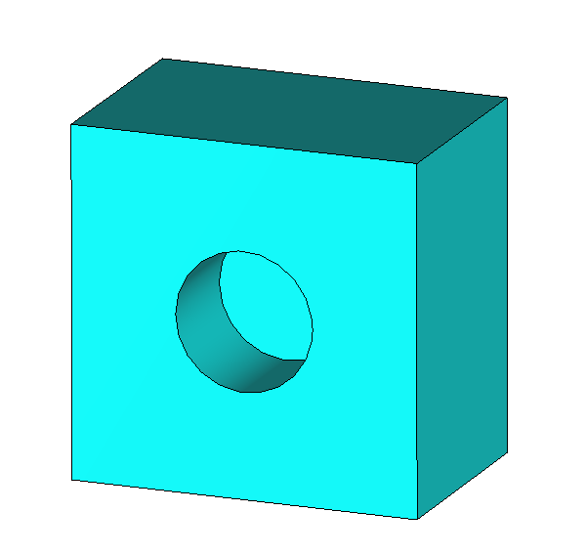
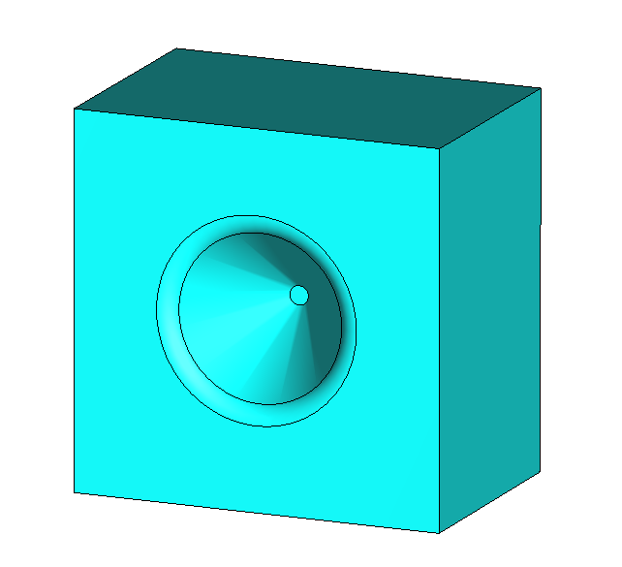
Geometrical optimization results
Shapes considered for optimization:
Optimized geometrical parameters
Parameter | Square | Round | Cone
Periodicity, nm | 751 | 756 | 768
Nanohole width, nm | 260 | 300 | 372
Nanohole depth, nm | 240 | 240 | 210
Reflectance, % | 1 | 0.26 | 0.14

Slide 11
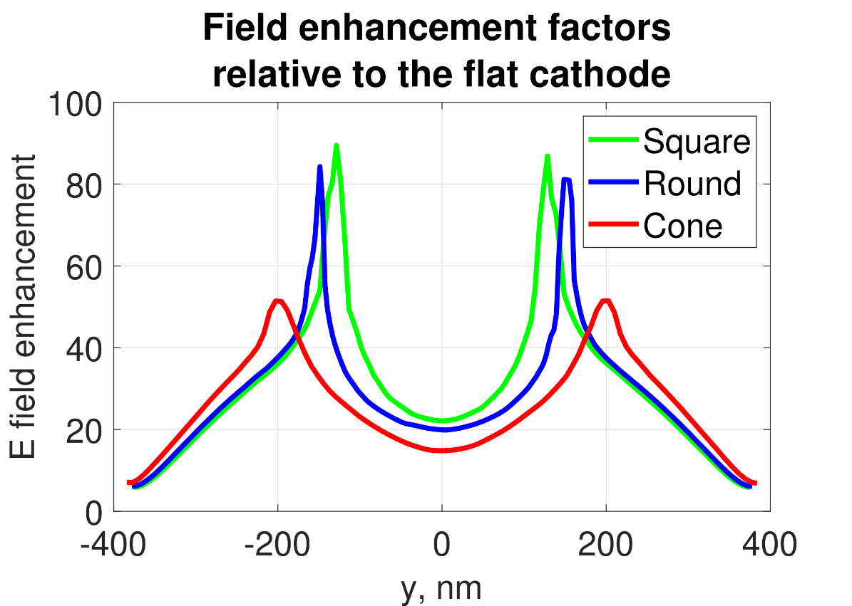
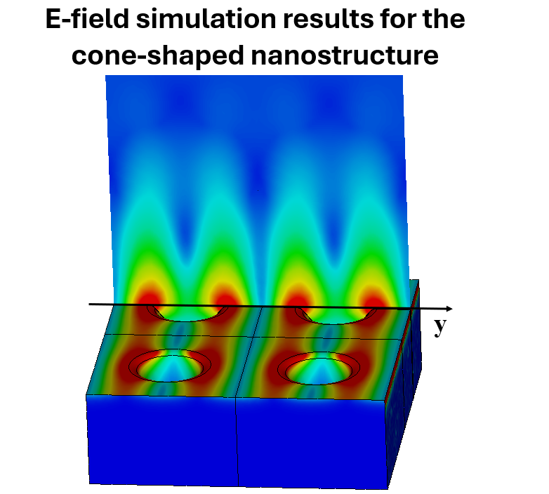
Local field enhancement
Electric field peaks may impact the transverse emittance of the electron beam.
Conical-type nanoholes yield the most uniform field, while achieving the same reflectance level.

Slide 12
Effect of geometrical imperfections
Perfect array profile, σ = 0%
Notes:
?

Slide 13
Effect of geometrical imperfections
Perfect array profile, σ = 0%
Imperfect array profile, σ = 20%
Notes:
?

Slide 14
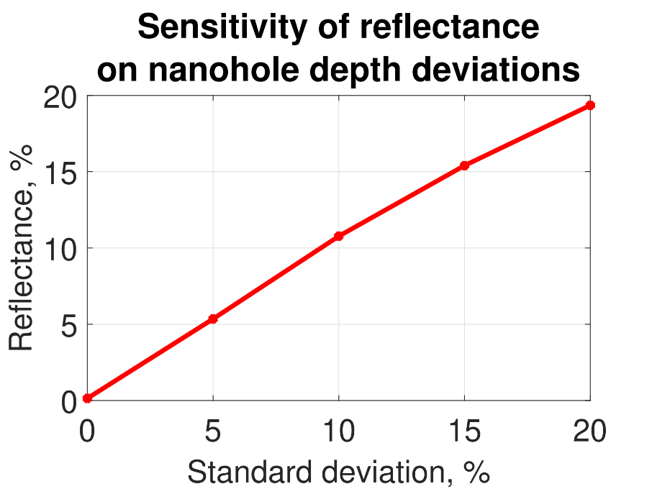
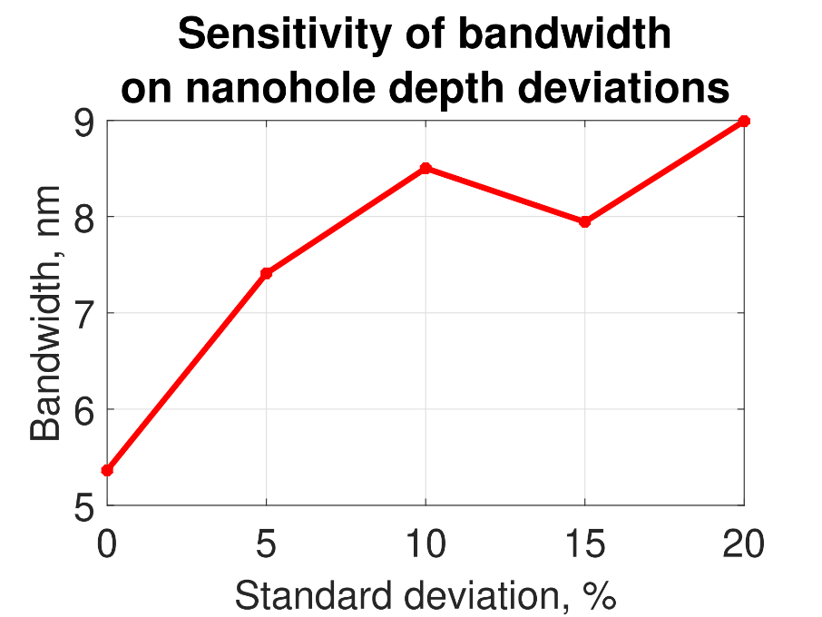
Effect of geometrical imperfections
Perfect array profile, σ = 0%
Imperfect array profile, σ = 20%
Notes:
?

Slide 15
Beam dynamics
How to simulate photoemission from structured cathodes?
Most beam dynamics codes are suitable only for flat cathodes

Slide 16
Beam dynamics
How to simulate photoemission from structured cathodes?
Most beam dynamics codes are suitable only for flat cathodes
CST simulation allows to use non-flat cathode geometry

Slide 17
Beam dynamics
How to simulate photoemission from structured cathodes?
Most beam dynamics codes are suitable only for flat cathodes
No photoemission in Particle-in-Cell solver
CST simulation allows to use non-flat cathode geometry

Slide 18
Beam dynamics
How to simulate photoemission from structured cathodes?
Most beam dynamics codes are suitable only for flat cathodes
No photoemission in Particle-in-Cell solver
CST simulation allows to use non-flat cathode geometry
Optically induced emission model in Tracking solver

Slide 19
Beam dynamics
How to simulate photoemission from structured cathodes?
Most beam dynamics codes are suitable only for flat cathodes
How to generate time dependent optically emitted bunch distribution?
No photoemission in Particle-in-Cell solver
CST simulation allows to use non-flat cathode geometry
Optically induced emission model in Tracking solver

Slide 20
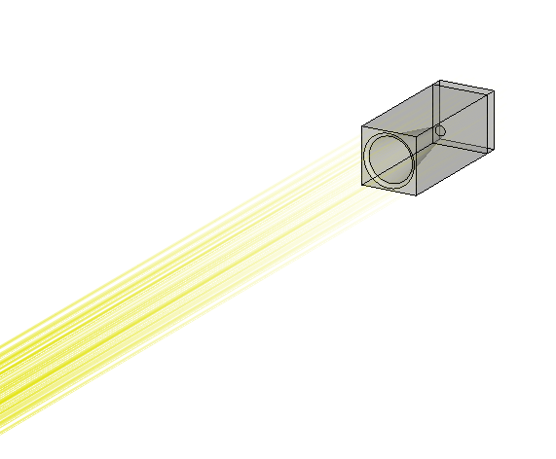
Beam dynamics in the cathode vicinity
Optically induced emission model (given QE):
Sample structure (single nano-cone)
Use light source with given wavelength and power

Slide 21
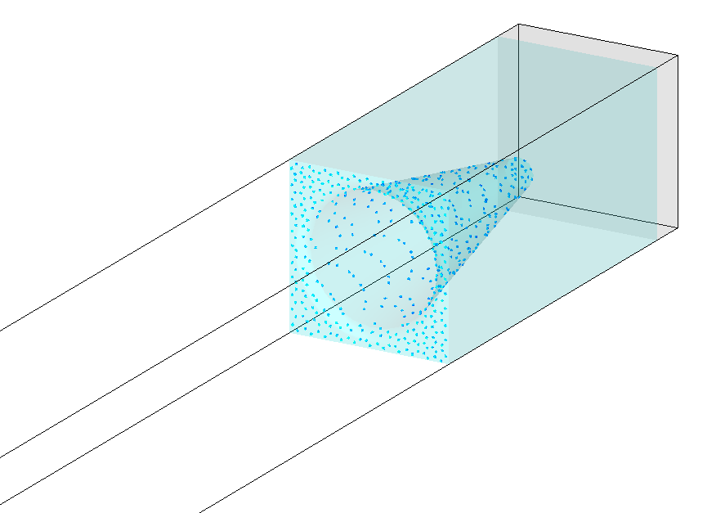
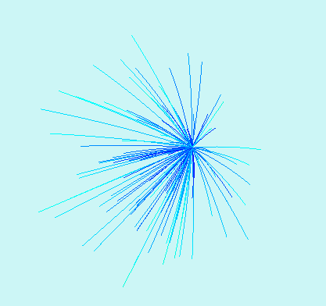
Beam dynamics in the cathode vicinity
Optically induced emission model (given QE):
Sample structure (single nano-cone)
Use light source with given wavelength and power
Get sample distribution on the cathode
Get emission angle distribution at the cathode
Get emission current for given power

Slide 22
Beam dynamics in the cathode vicinity
Optically induced emission model (given QE):
Sample structure (single nano-cone)
Use light source with given wavelength and power
Get sample distribution on the cathode
Get emission angle distribution at the cathode
Get emission current for given power
Construct temporal current profile according to the laser pulse
Import particle data into E-static PIC solver as a particle interface

Slide 23
Beam dynamics flat vs structured
Single nano-cone simulation, no space charge
Periodic boundary conditions
Flat cathode
Structured cathode

Slide 24
Beam dynamics flat vs structured (short bunch)
Single nano-cone simulation, no space charge
Periodic boundary conditions
1000 times shorter bunch (0.18 ps)
Flat cathode
Structured cathode

Slide 25
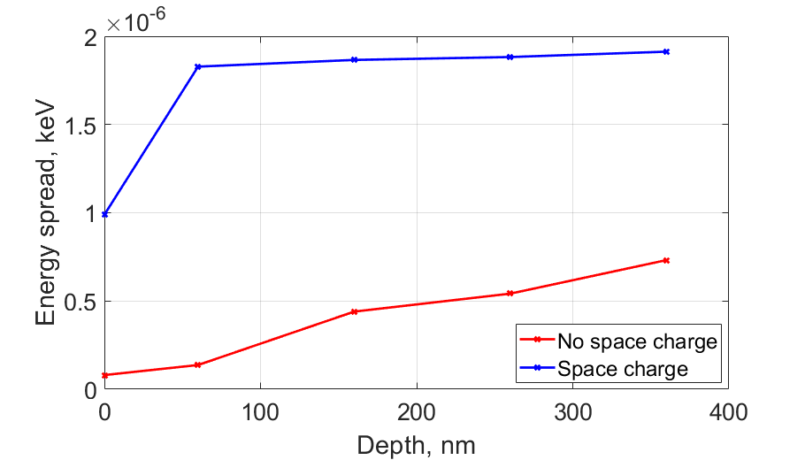
energy spread FOR A SINGLE NANO-CONE
Accelerating gradient is constant (≈50 MV/m)
Energy spread grows with the increase of the nanohole depth
Effect is more prominent with space charge simulation

Slide 26
results
New dispersion model for accurate simulation based on Johnson & Christy data
Optimized cathodes for different nanohole geometries
Implemented optically induced emission model
Calculated preliminary beam dynamics for a single nano-cone
Estimated the effect of nano-cone depth on beam dynamics

