Slide 1
Integration of magnetic measurement data in magnetic field simulations by BEM-based discrepancy modeling
Chair: Mariusz Wozniak
Melvin Liebsch (CERN)
Stephan Russenschuck (CERN)
Matthias Bonora (CERN)
Luisa F. Fleig (CERN, TU Darmstadt)
Jens Kaeske (CERN, KIT Karlsruhe)

Slide 2
Agenda
Learning from data through the lens of models is a way to exploit structure in an otherwise intractable problem [1]
The lifecycle of the accelerator magnet
Hybrid modeling (Newton to Kepler)
Calibrated models
Delta models
Integration in the life cycle management
Conclusion
[1] K. Wilcox, Predictive data science for physical systems – from model reduction to scientific machine learning. ICIAM – international congress on industrial and applied mathematics. 2019

Slide 3
Agenda
Learning from data through the lens of models is a way to exploit structure in an otherwise intractable problem [1]
The lifecycle of the accelerator magnet
Hybrid modeling (Newton to Kepler)
Calibrated models
Delta models
Integration in the life cycle management
Conclusion
[1] K. Wilcox, Predictive data science for physical systems – from model reduction to scientific machine learning. ICIAM – international congress on industrial and applied mathematics. 2019

Slide 4
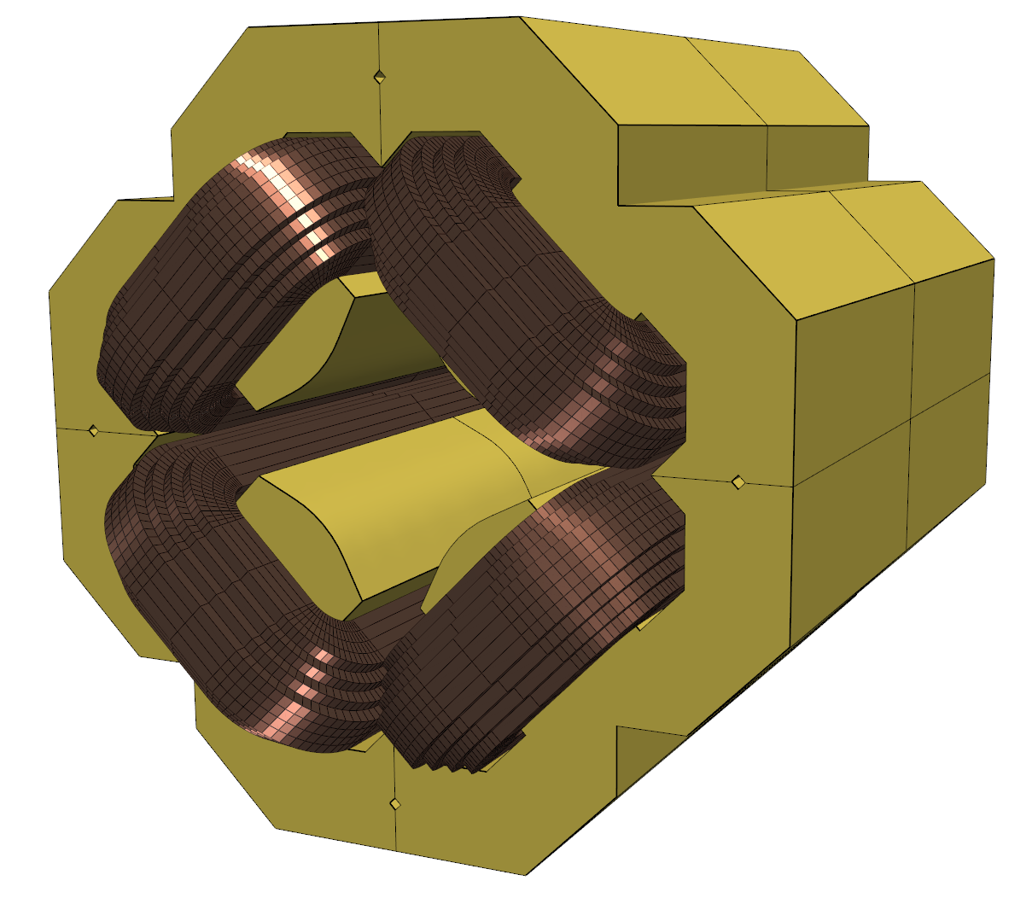
Accelerator magnet life cycle
Magnet operation
Virtual prototyping
State observation
Prediction
Maintenance
Specs
Coupled multi-physics optimization
Integration in virtual environment
Multiscale modeling
Digital twin
Meas.
Report
Simulation
Data
Prototype manufacturing/testing
Series manufacturing
Calibrating material properties
Optimal experimental design
Quality assurance
Fault detection and correction procedures
Magnet alignment data
Magnet transfer function
Test
Report
Design
Report
CAD
Drawings
Communication frequency
Principles of systems modeling
slow
fast
Product life cycle
Document based information exchange
Data management services: EDMS, EAM, NORMA, PLM
Development life cycle
Communication frequency depends on the application
Document-based → Model-based

Slide 5
Challenges
Digital representation
a.k.a. numerical system model
Complex (non-linear) dynamic system
Interplay of iron saturation, hysteresis and eddy currents
Superconductor magnetization
Temperature effects
Computational costs
A complete 3D magnet simulation does not allow for fast predictions
Tough requirements for machine operation
Field stability at 1 unit in 100 000
Field quality at 1 unit in 10 000
data
1st principles
Measurement data needs to be integrated in the numerical model to enable accurate predictions
Hybrid models integrate first principle and data driven models in a joint architecture

Slide 6
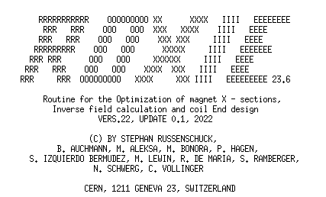
The field simulation software ROXIE
Routine for the Optimization of Magnet X-sections, Inverse Field Computation and Coil End Design
Developed for the design of the superconducting magnets for the LHC
The standard tool for the design of cos(θ) magnets
Features the calculation of 3D fields and iron magnetization
Based on the coupling of boundary and finite elements (BEM-FEM), see [4]
ROXIE default output
[4] S. Russenschuck, “ROXIE: Routine for the optimization of magnet X-sections, inverse field computation and coil end design.,” in 1st International ROXIE Users Meeting and Workshop, Geneva, Switzerland, CERN Yellow Reports: Conference Proceedings, 3 1998.

Slide 7
Agenda
Learning from data through the lens of models is a way to exploit structure in an otherwise intractable problem [1]
The lifecycle of the accelerator magnet
Hybrid modeling (Newton to Kepler)
Calibrated models
Delta models
Integration in the life cycle management
Conclusion
[1] K. Wilcox, Predictive data science for physical systems – from model reduction to scientific machine learning. ICIAM – international congress on industrial and applied mathematics. 2019

Slide 8
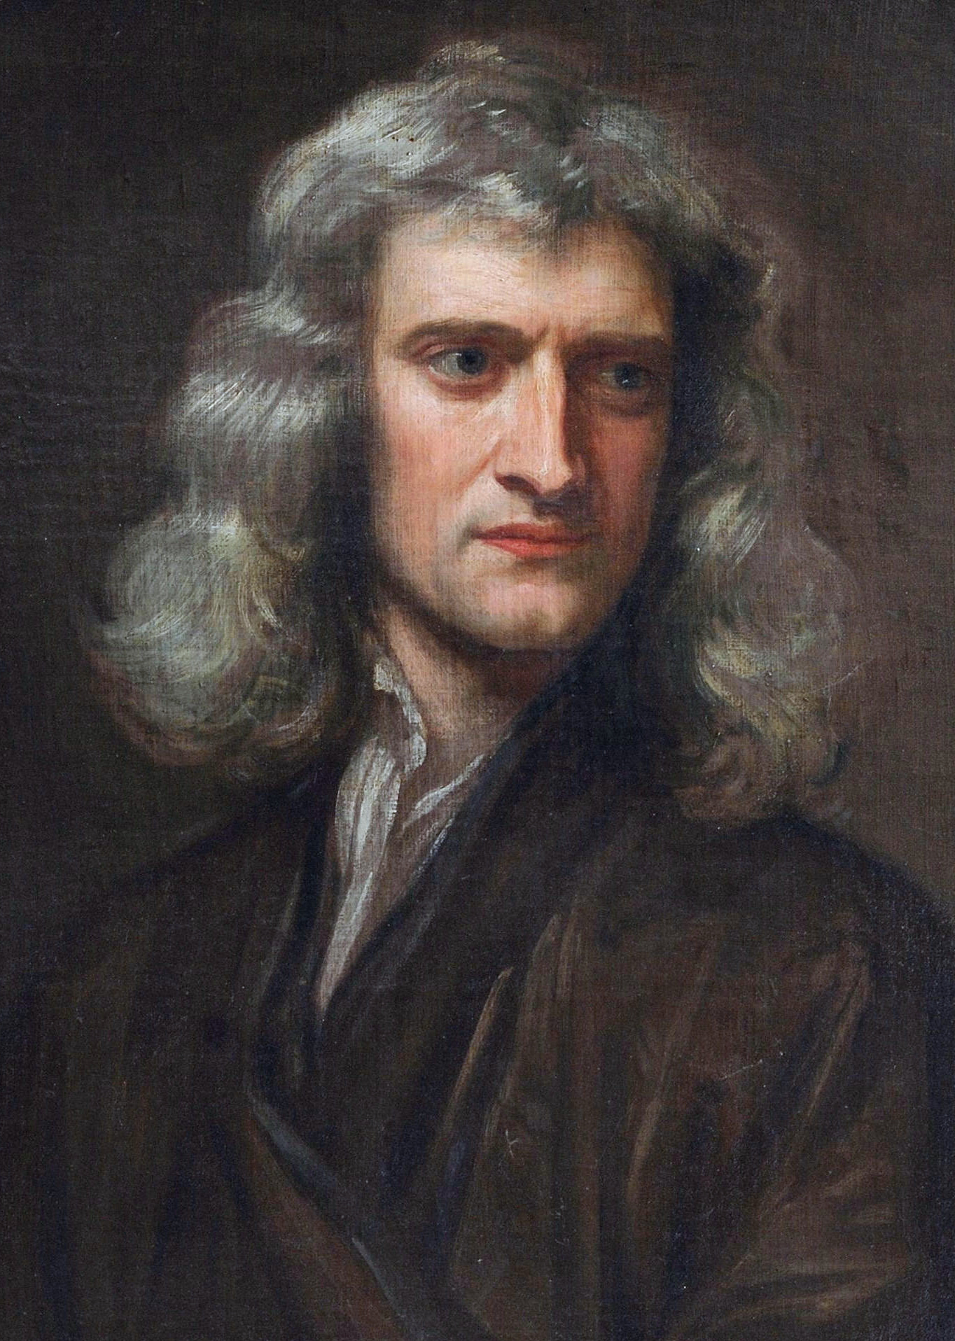
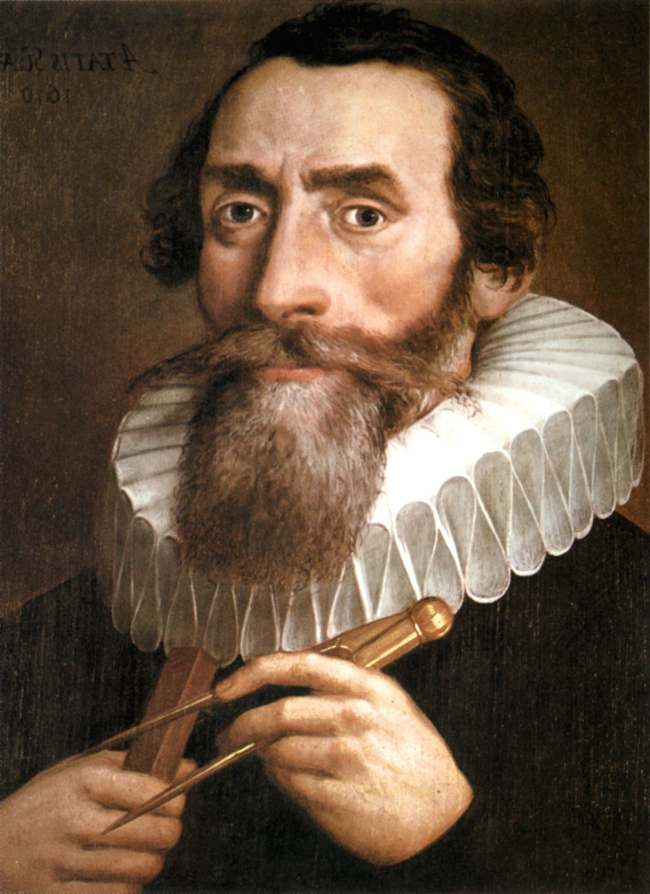
Hybrid modeling [5]
1st principle modeling
P
D
Machine learning (ML)
physics
measurements
“Newtonian paradigm”
“Keplerian paradigm”
Model calibration
Delta models
ML models
D
P
D
D
P
https://commons.wikimedia.org/wiki/File:Sir_Isaac_Newton_by_Sir_Godfrey_Kneller,_Bt.jpg
https://de.wikipedia.org/wiki/Johannes_Kepler#/media/Datei:Portrait_Confused_With_Johannes_Kepler_1610.jpg
[5] Rudolph M., Kurz S. and Rakitsch B. Hybrid modeling design patterns, Journal of Mathematics in Industry, 2024, DOI: 10.1186/s13362-024-00141-0

Slide 9
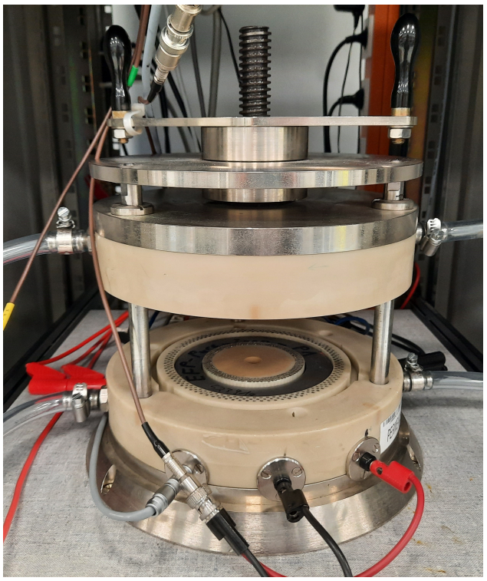
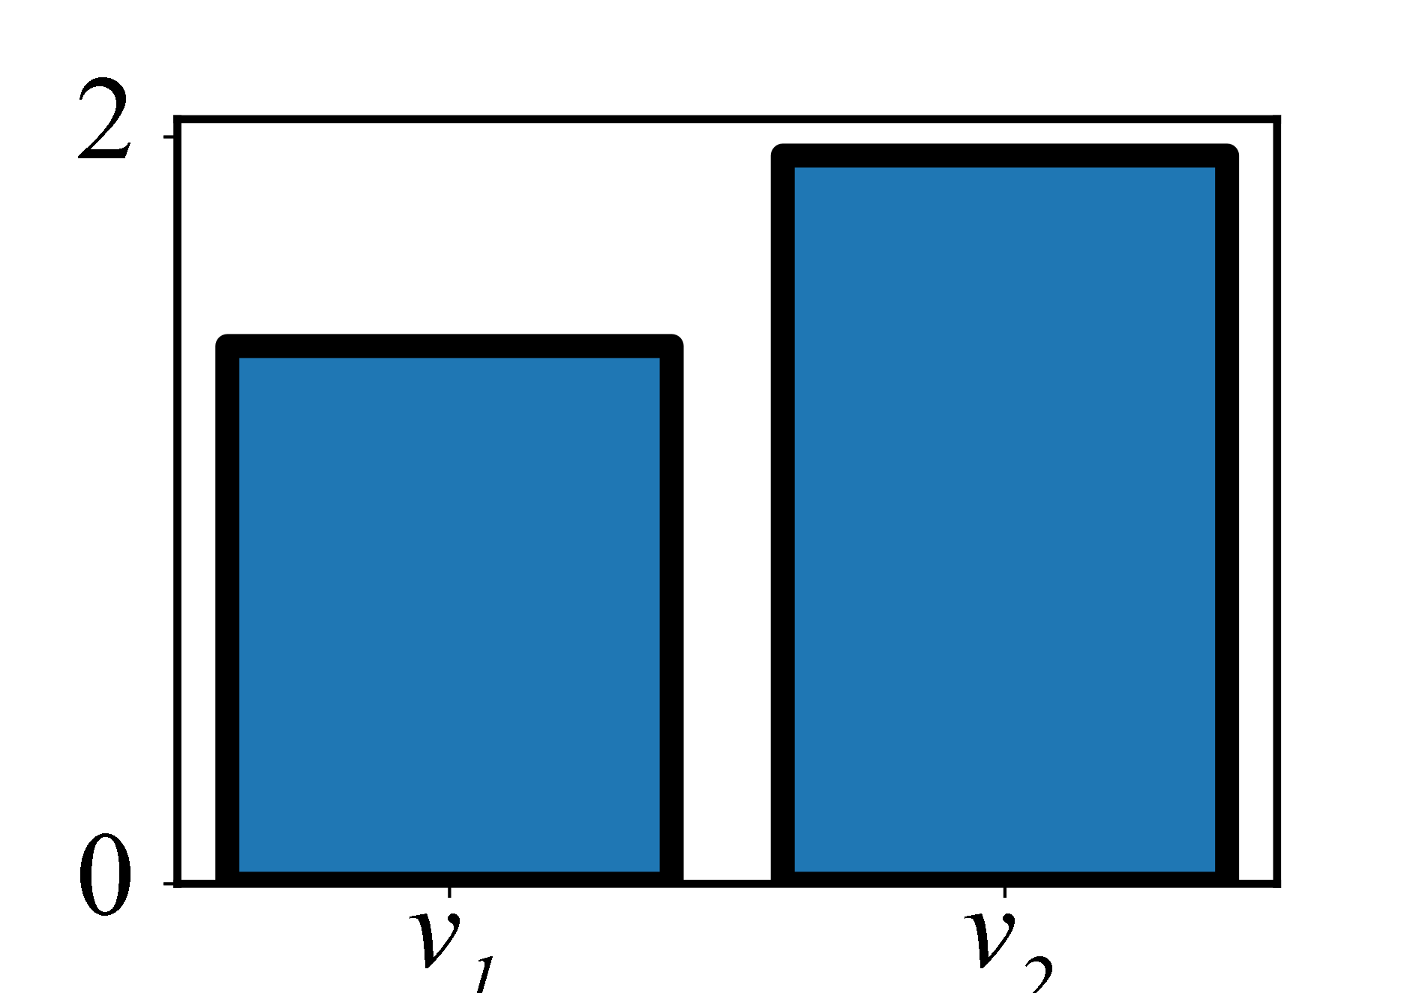
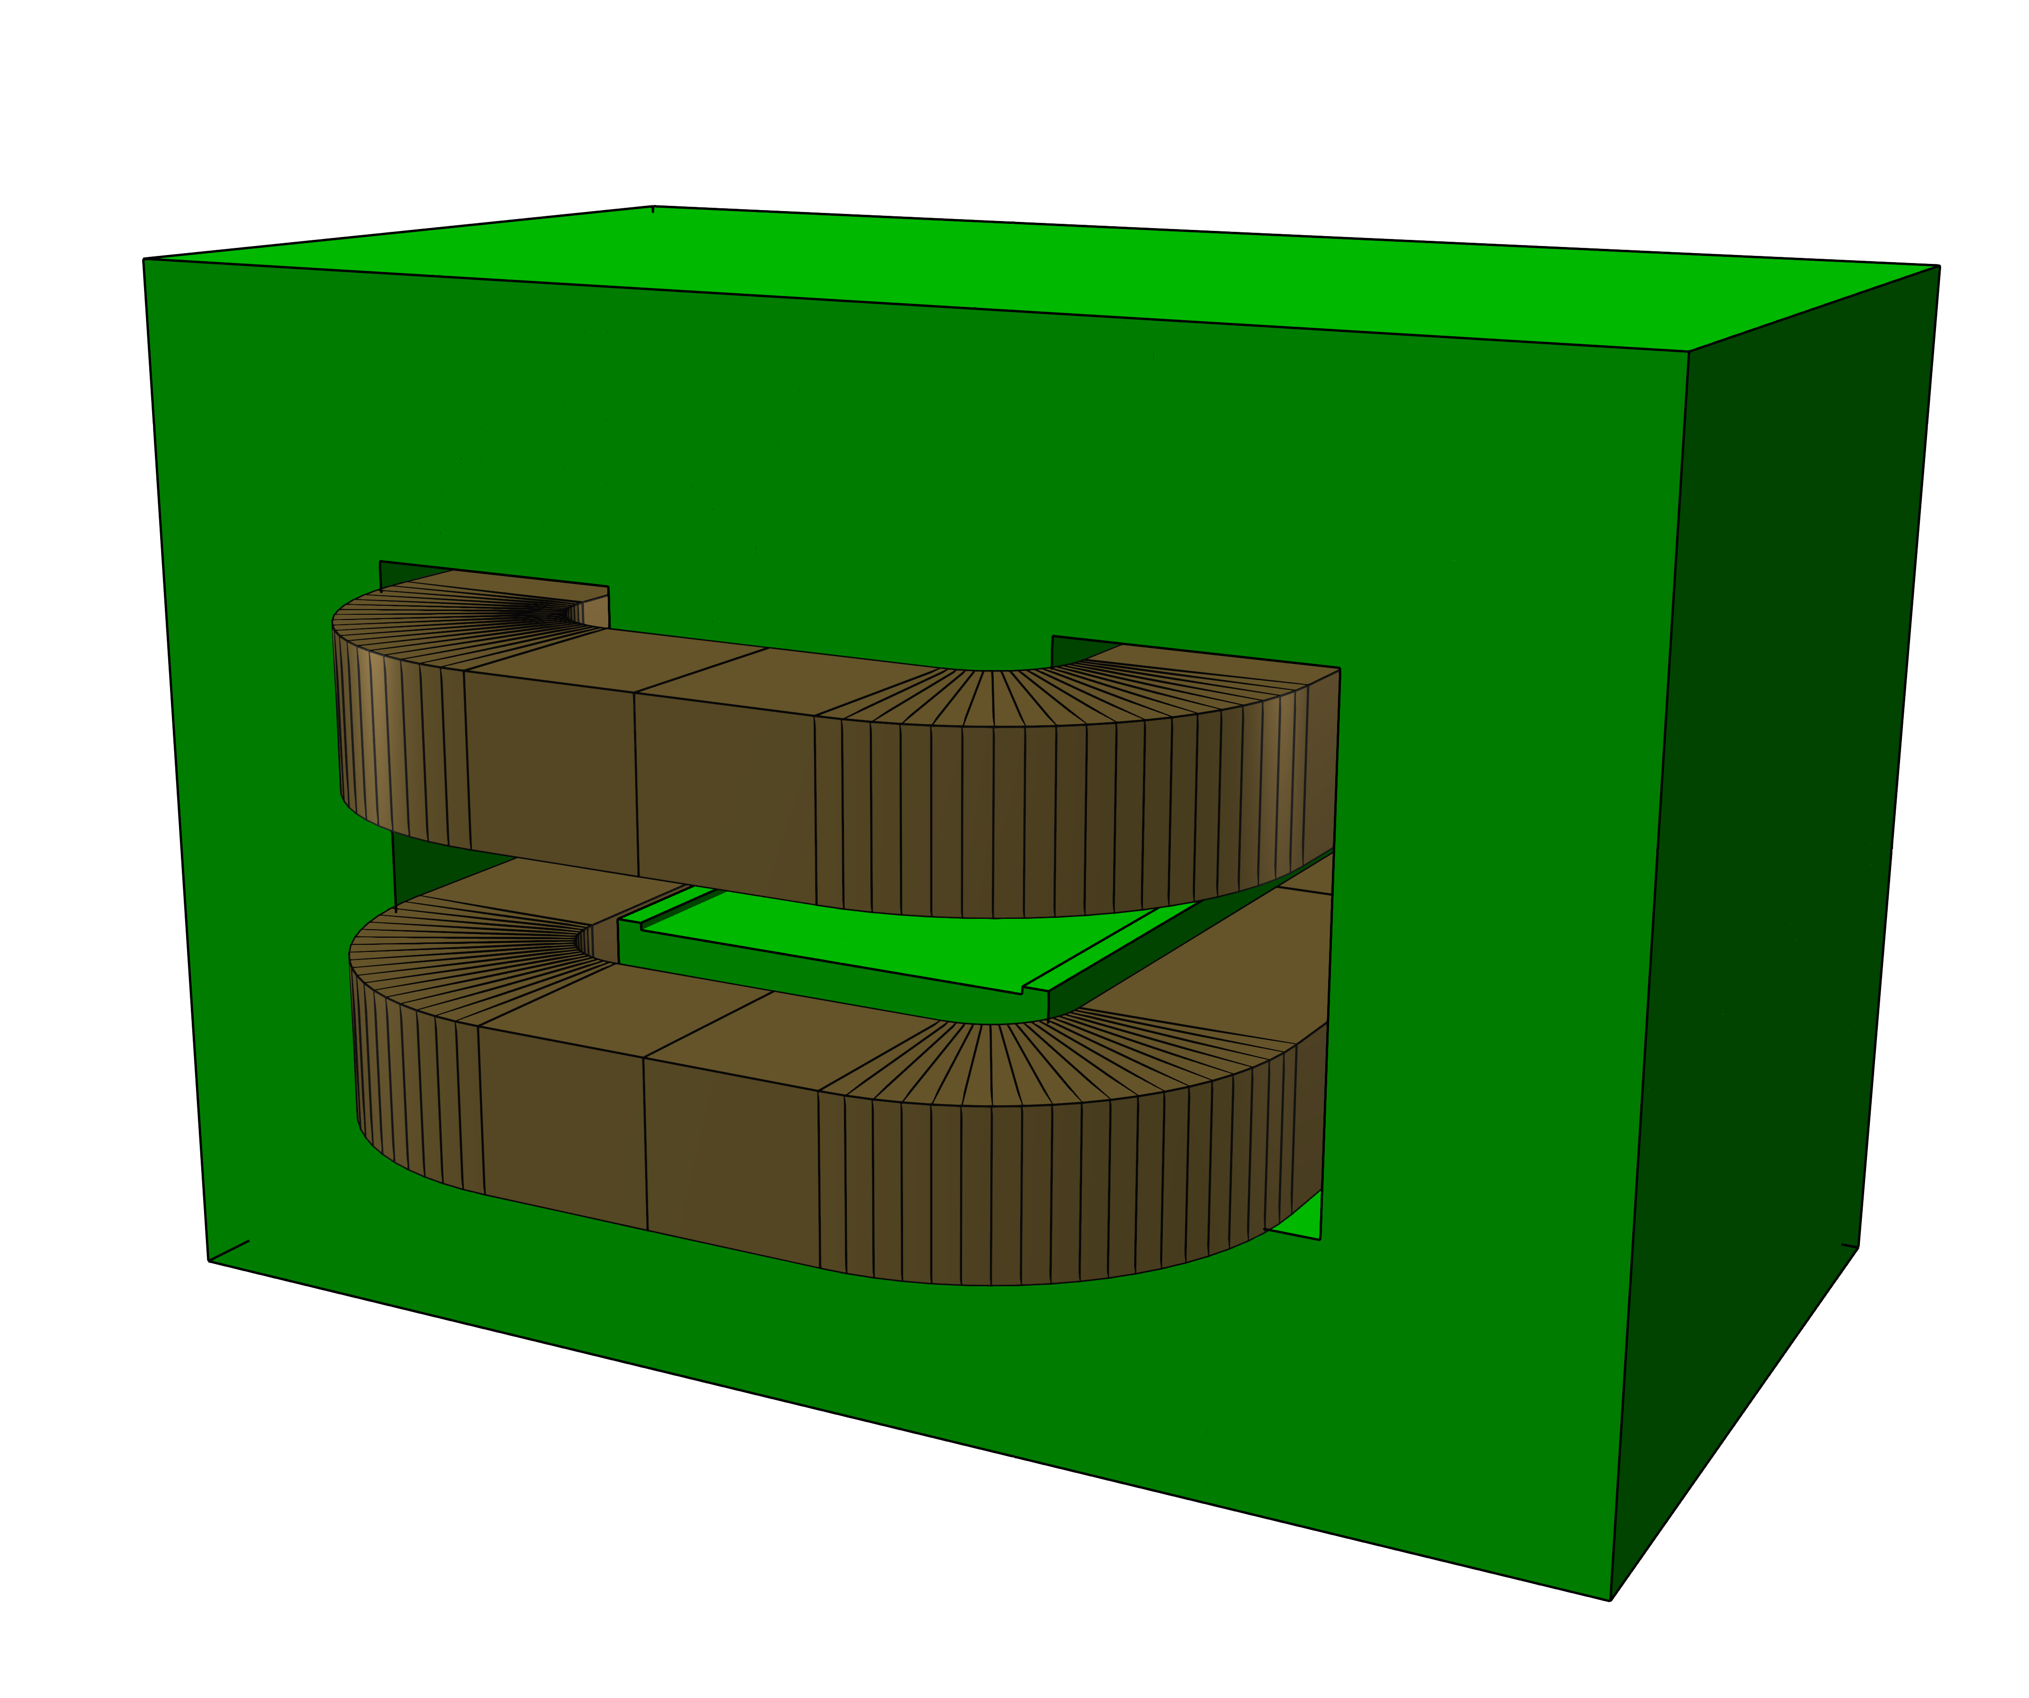
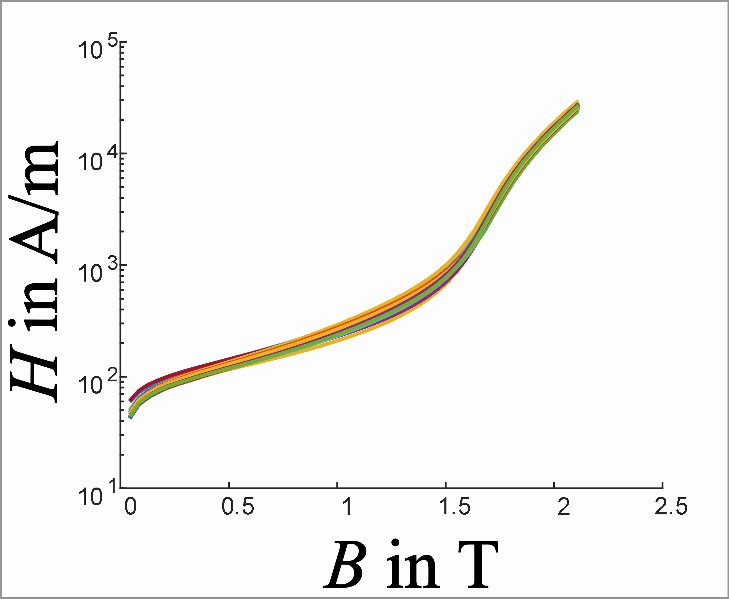
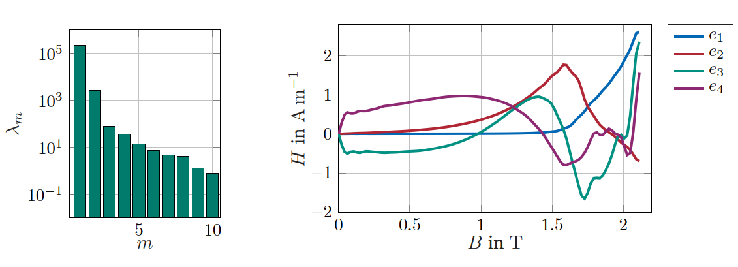
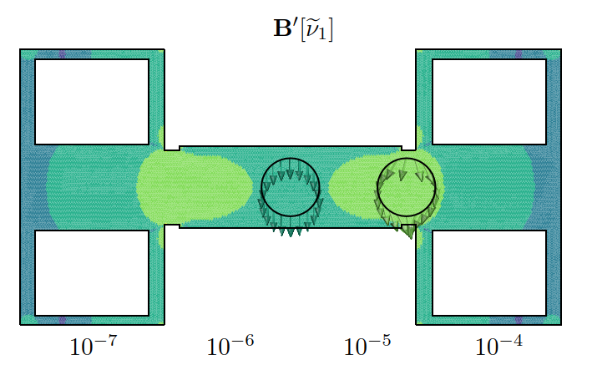
Model calibration [6]
D
Magnet manufacturing QA
P
Calibration test campaign
Material Specimen
Permeameter
Resulting parameters
Digital twin
H(B)-curve
Design of a test campaign
Design of experiment (DOE)
optimal sensor placement
Pattern recognition (KLE)
[6] L. Fleig, M. Liebsch, S. Russenschuck and S. Schöps, "Identification of B(H) Curves Using the Karhunen Loève Expansion," in IEEE Access, vol. 12, pp. 59441-59449, 2024, doi: 10.1109/ACCESS.2024.3393348

Slide 10
Delta models
$$Γ_{ia}$$
$$Ω_{c}$$
P
D
The discrepancy between measurement and simulation may not vanish after magnet calibration
The discrepancy drives the delta model
The delta model may be used to understand the origin of the discrepancy
The predictions of the updated model are matching our observations
ROXIE boundary integral equation for field evaluation
$$A\left(r\right)=\int_{Γ_{ia}}{\underset{\begin{aligned}MVP \\ ROXIE \\ BEM−FEM\end{aligned}}{\underbrace{A(r′)}}} ∂_{n} u^{∗}\left(r, r^{′}\right) dr^{′}−\int_{Γ_{ia}}{\underset{\begin{aligned}normal \\ derivative \\ ROXIE \\ BEM−FEM\end{aligned}}{\underbrace{∂_{n}A\left(r^{′}\right)}}} u^{∗}\left(r, r^{′}\right) dr^{′}$$
Data driven update
$$+\int_{Ω_{c}}{\underset{\begin{aligned}Current \\ density in \\ coil domain\end{aligned}}{\underbrace{J(r′)}}} u^{∗}\left(r, r^{′}\right) dr^{′}$$
$$+\int_{Γ_{ia}}{\underset{\begin{aligned}ficticious \\ sources\end{aligned}}{\underbrace{{curl}_{Γ_{ai}} v}}} u^{∗}\left(r, r^{′}\right) dr^{′}$$
$$u^{∗}$$ | Greens function | $$Δ u^{∗}(r, r′)=δ(r−r′)$$

Slide 11
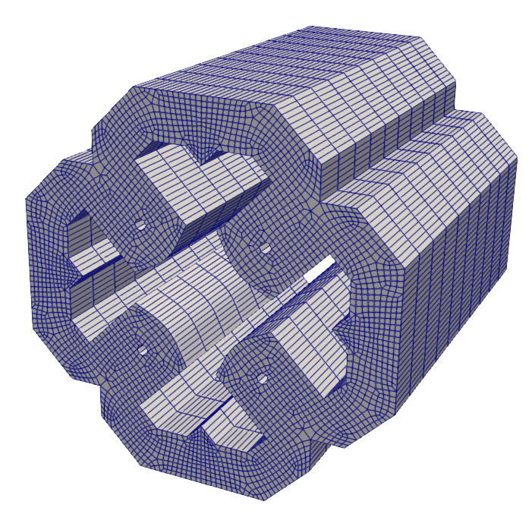
Delta models - Data driven model update
P
D
Boundary mesh
Minimum energy solution
minimize $E\left(v\right)$
subject to: $H\left(v\right)=y−\tilde{y}$
Discretized on boundary mesh
minimize $\frac{1}{2}v^{T}W v$
subject to: $H v=y−\tilde{y}$
$$E(⋅)$$ | Energy functional
$$W$$ | Energy matrix
$$H(⋅)$$ | Observation operator
$$H$$ | Observation matrix
$$y$$ | Measurement data
$$\tilde{y}$$ | Predicted measurements
Model update is obtained by quadratic programming
We use the python software for convex optimization “cvxopt”

Slide 12
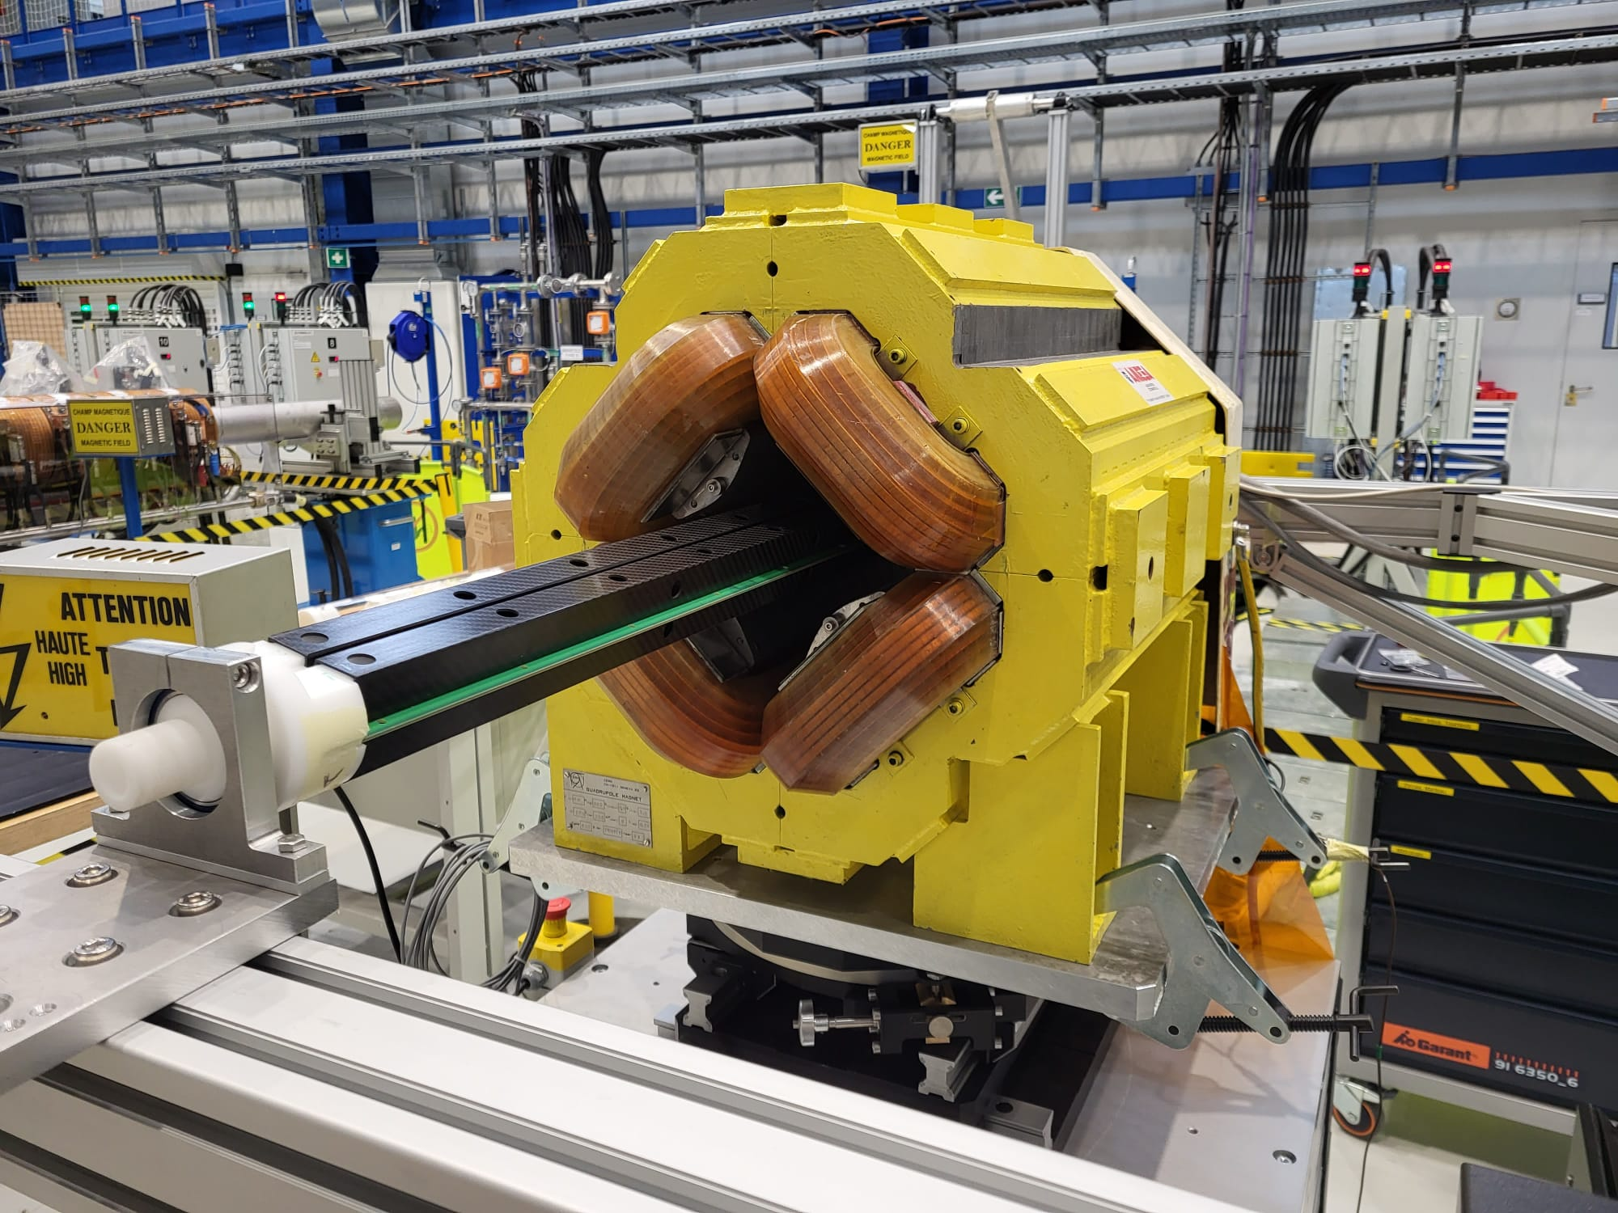
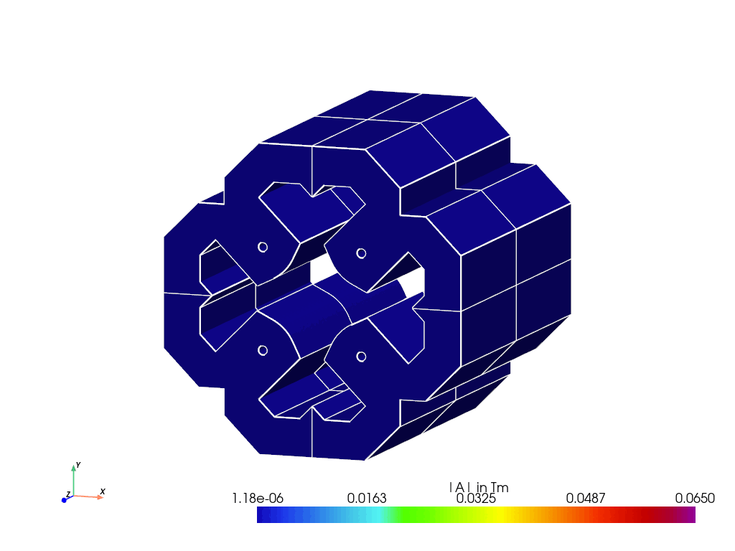
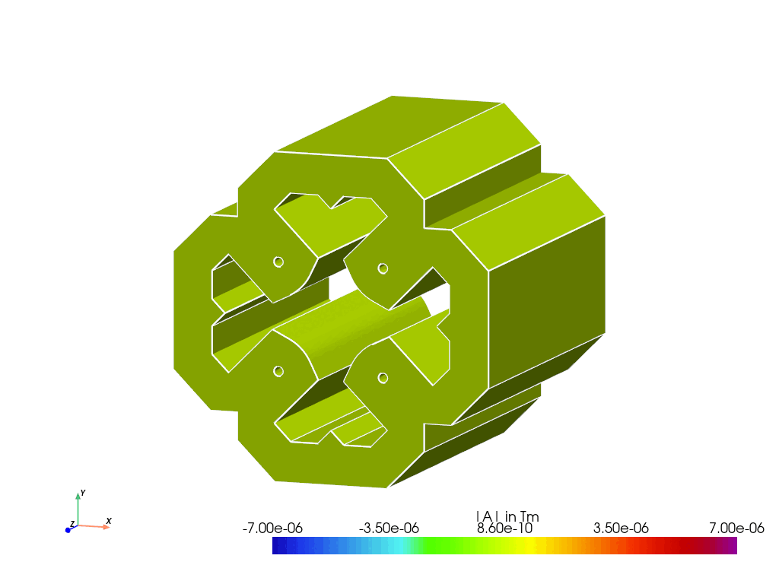
Example integrated field measurement
P
D
Quadrupole magnet on test bench
Rotating coil measurement system

Slide 13
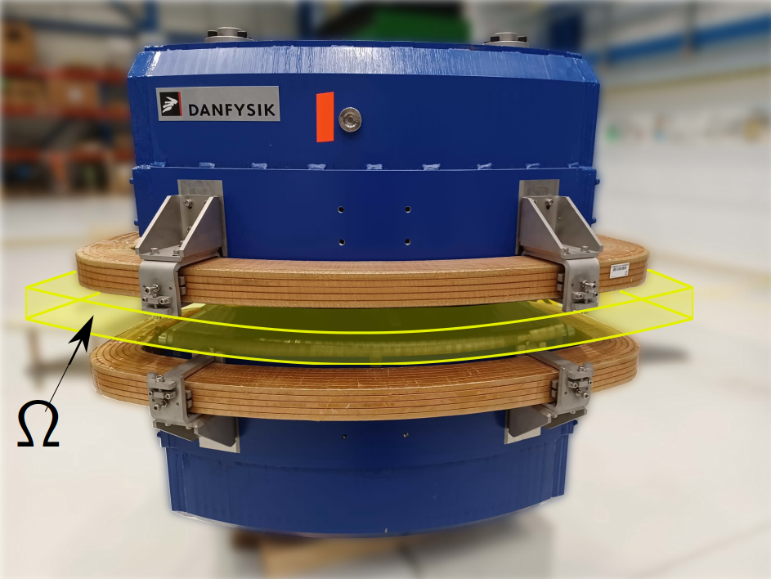
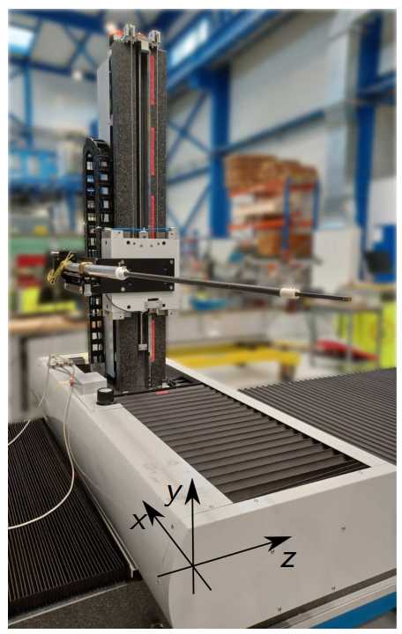
Example 3D field mapping [7]
Curved dipole magnet on test bench
Model update ($v_{0}→v_{1}$) by means of a linear Kálmán filter
$$Q_{1}={\left(H^{T}R^{−1}H+Q_{0}^{−1}\right)}^{−1}$$
$$\left(H^{T}R^{−1}H+Q_{0}^{−1}\right) v_{1}=H^{T}R^{−1}y+Q_{0}^{−1}v_{0}$$
$$Q_{0}$$ | Prior covariance matrix
$$Q_{1}$$ | Posterior covariance matrix
$$H$$ | Observation matrix
$$R$$ | Measurement covariance matrix
$$y$$ | Measurement data
[7] Liebsch, Melvin, Russenschuck, Stephan and Kurz, Stefan. "BEM-Based Magnetic Field Reconstruction by Ensemble Kálmán Filtering" Computational Methods in Applied Mathematics, vol. 23, no. 2, 2023, pp. 405-424. https://doi.org/10.1515/cmam-2022-0121

Slide 14
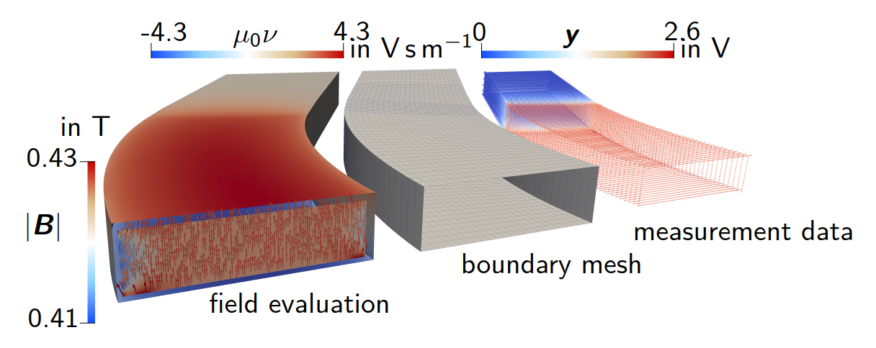
Example 3D field mapping [7]
Curved dipole magnet on test bench
Measurement data, boundary mesh and model update
[7] Liebsch, Melvin, Russenschuck, Stephan and Kurz, Stefan. "BEM-Based Magnetic Field Reconstruction by Ensemble Kálmán Filtering" Computational Methods in Applied Mathematics, vol. 23, no. 2, 2023, pp. 405-424. https://doi.org/10.1515/cmam-2022-0121

Slide 15
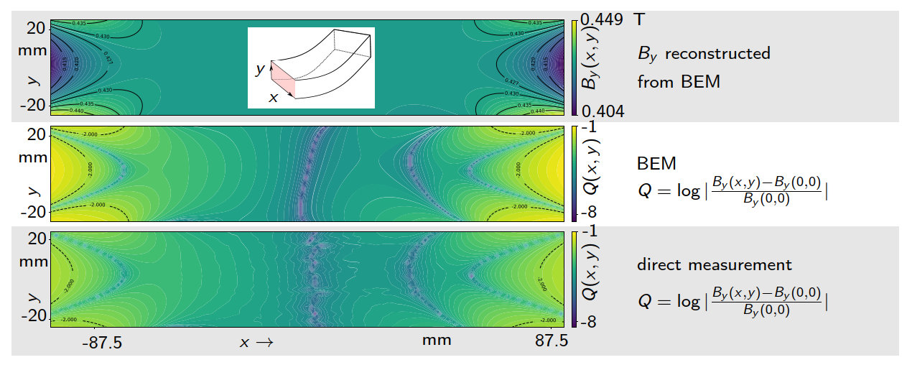
Example 3D field mapping [7]
Curved dipole magnet on test bench
Validating the field evaluation
[7] Liebsch, Melvin, Russenschuck, Stephan and Kurz, Stefan. "BEM-Based Magnetic Field Reconstruction by Ensemble Kálmán Filtering" Computational Methods in Applied Mathematics, vol. 23, no. 2, 2023, pp. 405-424. https://doi.org/10.1515/cmam-2022-0121

Slide 16
Agenda
Learning from data through the lens of models is a way to exploit structure in an otherwise intractable problem [1]
The lifecycle of the accelerator magnet
Hybrid modeling (Newton to Kepler)
Calibrated models
Delta models
Integration in the life cycle management
Conclusion
[1] K. Wilcox, Predictive data science for physical systems – from model reduction to scientific machine learning. ICIAM – international congress on industrial and applied mathematics. 2019

Slide 17
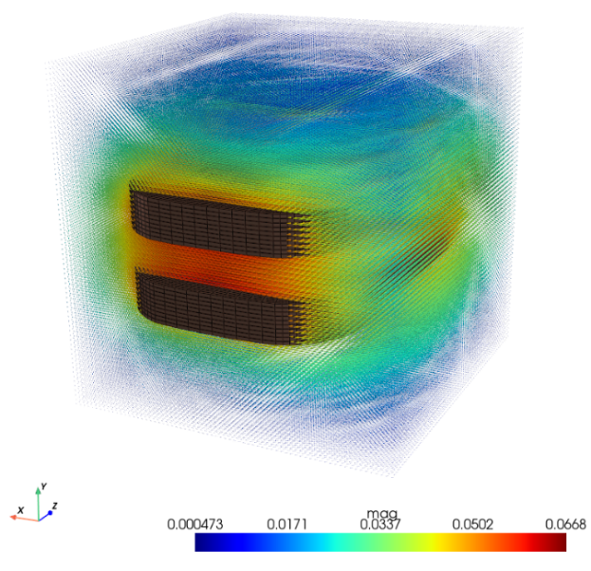
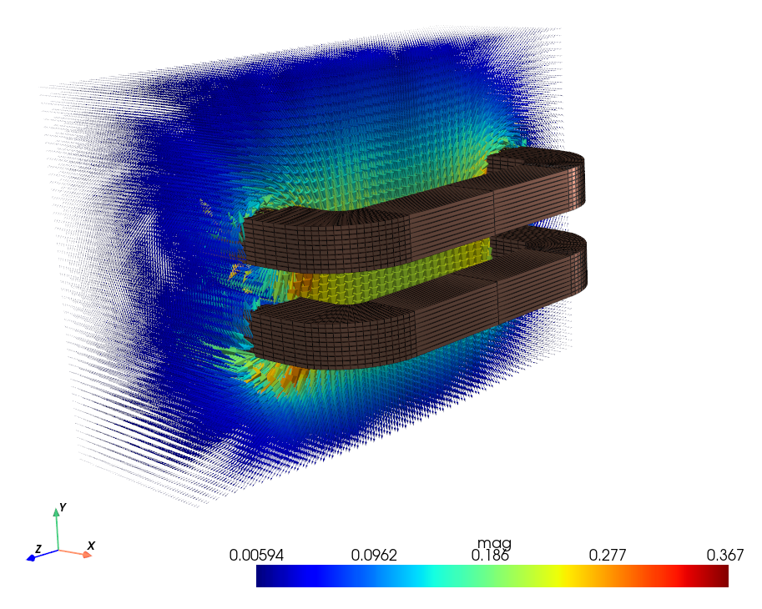
The ROXIE evaluator
The ROXIE evaluator is python package for the advanced post-processing and reverse engineering
We make extensive use of GMSH for mesh operations and shape functions
Performant C++ extensions are used for the BEM matrix assembly
The C++ code leverages on
vectorization (EigenC++)
parallelization (OpenMPI)
It features a Multi Level Fast Multipole Method (MLFMM) for accelerated field evaluation
The poetry packaging manager is used for platform independence and dependency tracking
https://github.com/MelvinLie/roxie_evaluator

Slide 18
Integration
All systems models must be:
Exchangeable
Versioned
Integratable
Application specific software for ROXIE
ROXIE API
ROXIE evaluator
The goal is to integrate our models in pyMBSE [8], a python toolbox for the self-contained multi model execution
Model-Based Systems Engineering
Model-Based Systems Engineering
Design Software
Numerical Models
Magnets & Devices
Transducers & instrumentation
Measurement Models
DAQ & Analysis Software
Design Software
Physical Objects
System Models
Gen. $n−1$
Application Specific Software
Gen. $n$
[8] PyMBSE User Documentation, Accessed: Oct. 03, 2024. [Online]. Available: https://chart-magnum.github.io/pymbse-docs/intro.html

Slide 19
Agenda
Learning from data through the lens of models is a way to exploit structure in an otherwise intractable problem [1]
The lifecycle of the accelerator magnet
Hybrid modeling (Newton to Kepler)
Calibrated models
Delta models
Integration in the life cycle management
Conclusion
[1] K. Wilcox, Predictive data science for physical systems – from model reduction to scientific machine learning. ICIAM – international congress on industrial and applied mathematics. 2019

Slide 20
Conclusion
We use hybrid modeling to integrate magnetic measurement data in numerical field simulations
Model calibration techniques alone are sometimes not sufficient to find a match between measurements and simulations
Delta models are used to compensate for discrepancies
They can provide an indication of the cause of the differences
Our post-processing techniques leverage on boundary integral equations
We follow the principles of model-based systems engineering to integrate the numerical models and simulation data in the development and product lifecycle

Slide 21
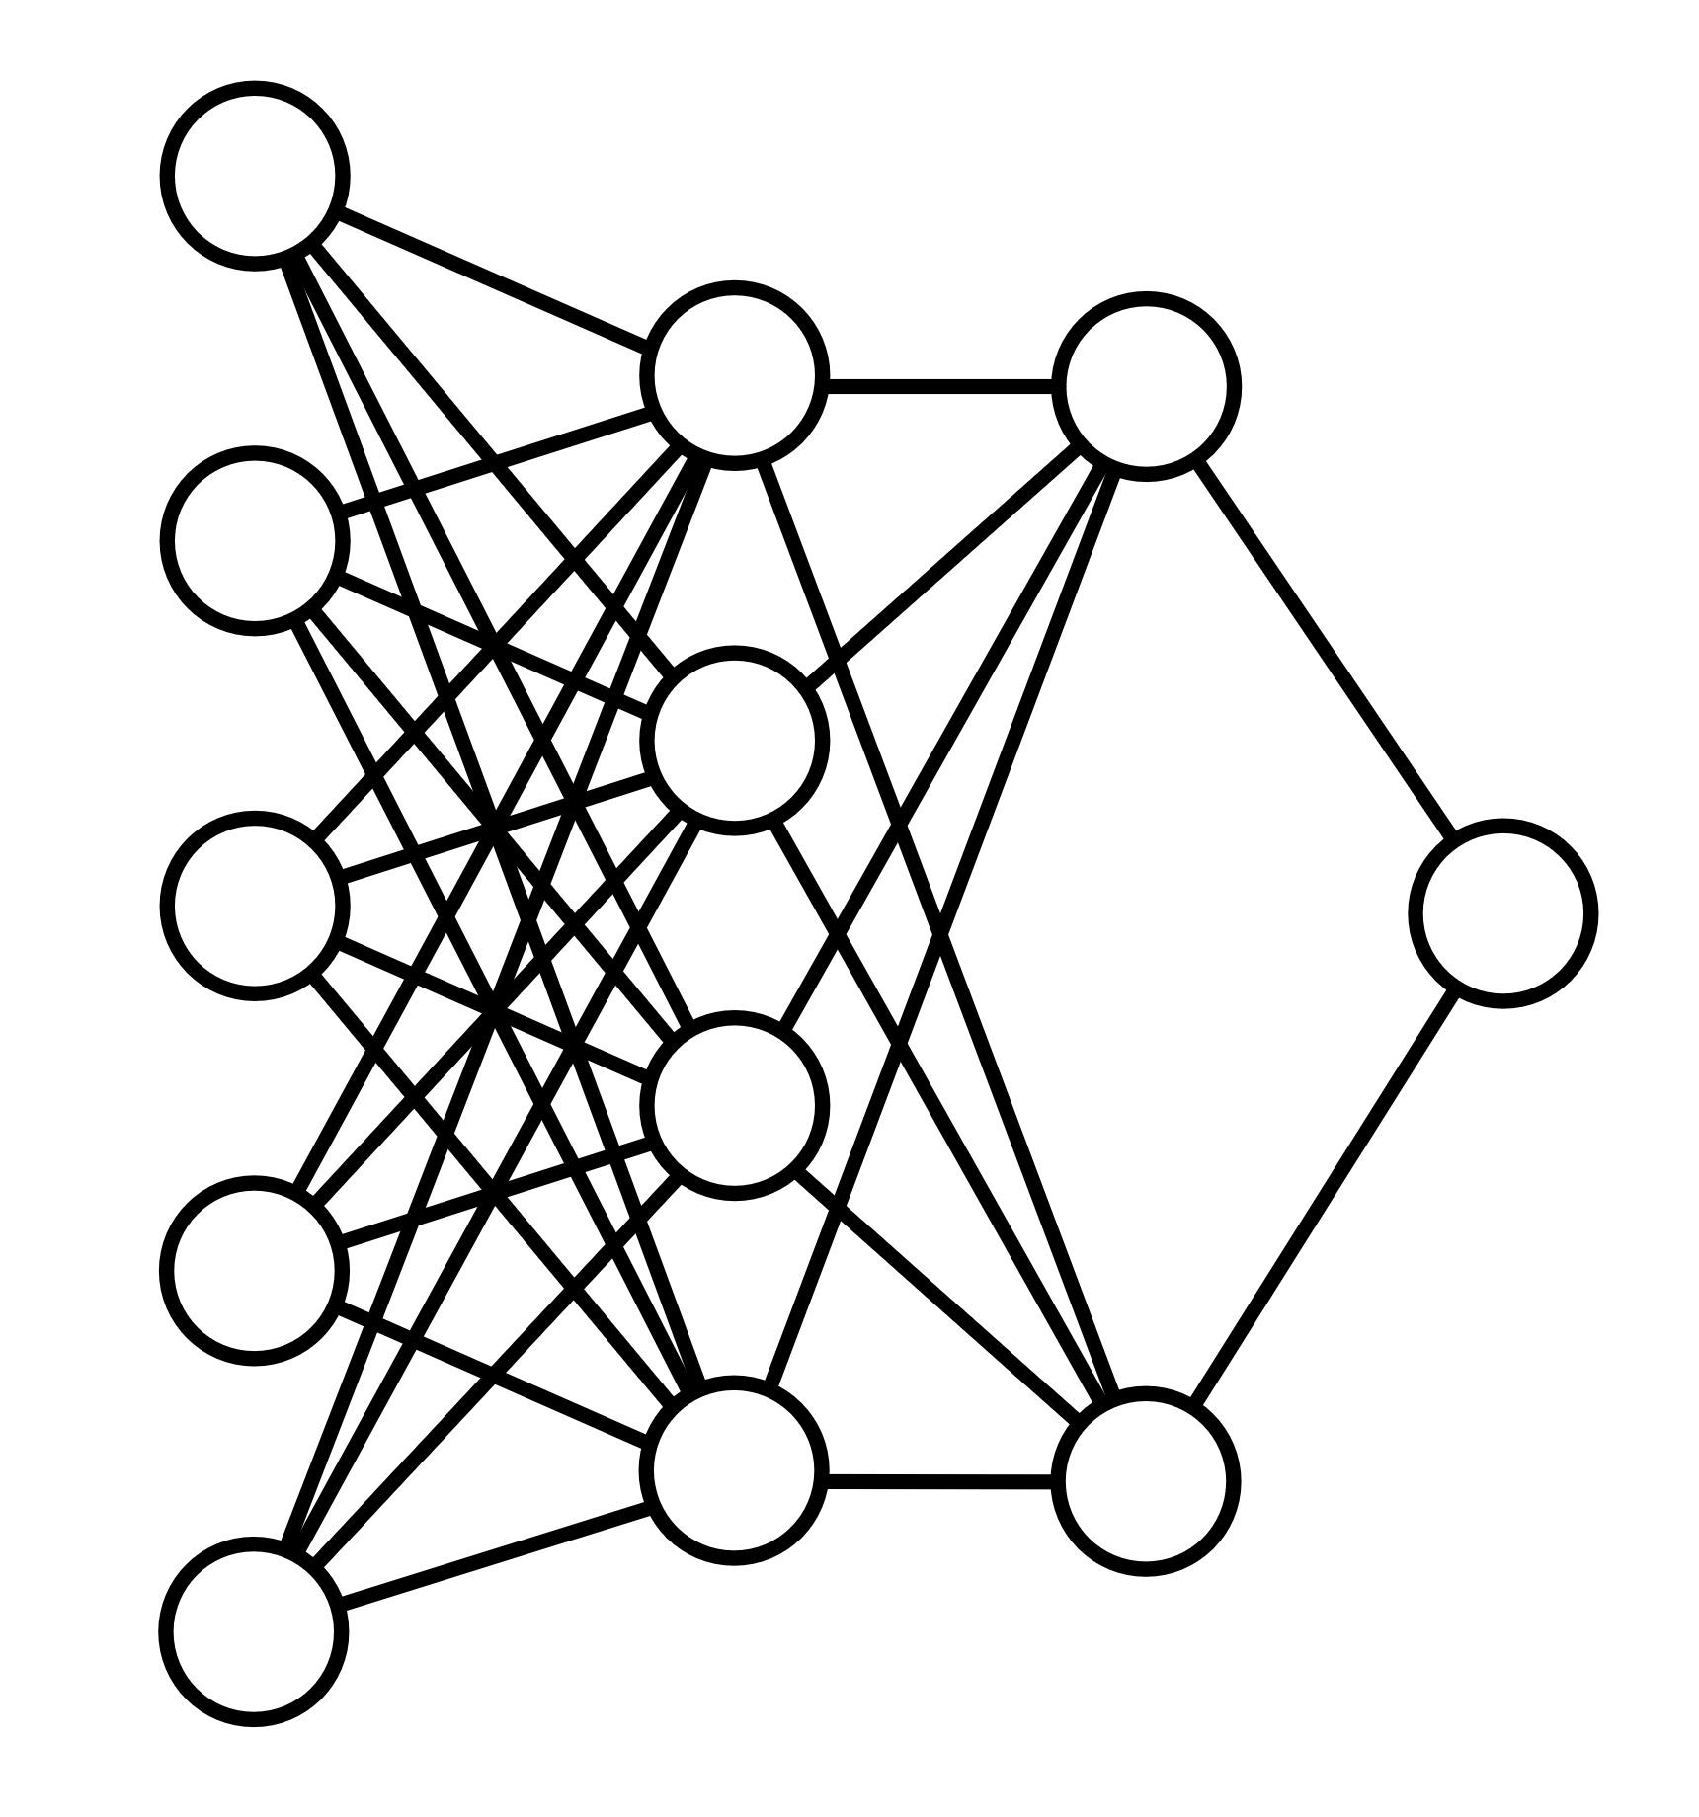
Magnet operation
Digital twin
Magnet operation
State observation
Prediction
Maintenance
Requires rapid information exchange
Model order reduction (MOR) [5]
$$\dot{x}\left(t\right)=A x\left(t\right)+B u\left(t\right)$$
High fidelity model
Machine learning models*
D
$$\left\{I_{t}\right\}, t<τ$$
$$\dot{x}$$
$$A$$
$$x$$
$$B$$
$$u$$
$$\left\{\hat{B_{t}}\right\}, t<τ$$
=
+
Example: Hysteresis compensation for SPS dipole magnets
Neural network-based Time series modeling B(I)
Currently developed with SPS training data
$$\left\{I_{t}\right\}, t≥τ$$
Reduced order model (ROM)
$$\dot{\hat{x}}$$
=
$$\hat{A}$$
$$\hat{x}$$
+
$$\hat{B}$$
$$u$$
$x$: State vector, $u$: Input vector, $\hat{x}$: ROM state
$$\left\{\hat{B_{t}}\right\}, t≥τ$$
*Example provided by A. Lu (PhD, BE-CSS-DSB)
[5] Sorti, S., Petrone, C., Russenschuck, S., Braghin, F.: Data-driven simulation of transient ﬁelds in air-coil magnets for accelerators, Nuclear Instruments and Methods in Physics Research Section A, 2021

Slide 22
Delta models – Example
$$Γ_{ia}$$
Quadrupole magnet on test bench
ROXIE boundary integral equation for field evaluation
$$A\left(r\right)=\int_{Γ_{ia}}{\underset{\begin{aligned}MVP \\ ROXIE \\ BEM−FEM\end{aligned}}{\underbrace{A(r′)}}} ∂_{n} u^{∗}\left(r, r^{′}\right) dr^{′}−\int_{Γ_{ia}}{\underset{\begin{aligned}normal \\ derivative \\ ROXIE \\ BEM−FEM\end{aligned}}{\underbrace{∂_{n}A\left(r^{′}\right)}}} u^{∗}\left(r, r^{′}\right) dr^{′}$$
$$+\int_{Γ_{ia}}{\underset{\begin{aligned}model \\ discrepancy\end{aligned}}{\underbrace{{curl}_{Γ_{ai}} v}}} u^{∗}\left(r, r^{′}\right) dr^{′}$$
Data driven update
Rotating coil measurement system
$$u^{∗}$$ | Greens function | $$Δ u^{∗}(r, r′)=δ(r−r′)$$

Slide 23
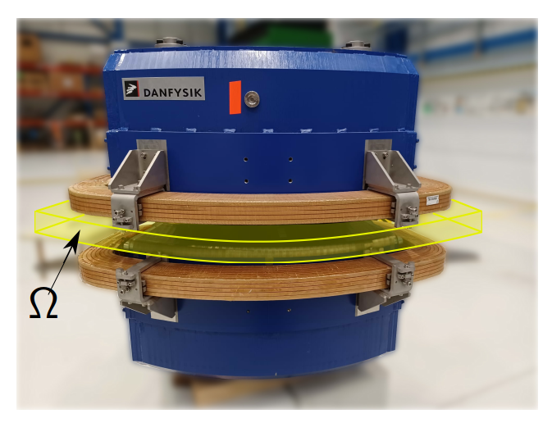
Delta models – BEM-based field reconstruction
The representation formula
$$φ_{m}\left(r\right)=\underset{single layer potential}{\underbrace{\int_{∂Ω}{g\left(r^{′}\right){ u}^{∗}\left(r, r^{′}\right) dr^{′}}}} −\underset{double layer potential}{\underbrace{\int_{∂Ω}{u\left(r^{′}\right){ u}^{∗}\left(r, r^{′}\right) dr^{′} }}}$$
$$u$$ | Dirichlet data | „boundary potential“
$$g$$ | Neumann data | „normal flux“
$$u^{∗}$$ | Greens function | $$Δu^{∗}(r, r′)=δ(r−r′)$$
Magnetostatics in $Ω$
→ Dirichlet and Neumann data are linearly dependent!
→ Problem must be formulated in $u$ or $g$!
$$div B=0$$ | $$curl H=0$$
Magnetic scalar potential | $$H=−μ_{0} grad φ_{m}$$

Slide 24
Delta models
P
D
The discrepancy between measurement and simulation may not vanish after magnet calibration
The discrepancy drives the delta model
The delta model may be used to understand the origin of the discrepancy
The predictions of the updated model are matching our observations

Slide 25
What is in ROXIE?
Main ingredients:
Reduced vector potential formulation
→ Simplifies conductor modeling and mesh generation (line currents)
BEM-FEM coupling
→ No mesh for air/vacuum domain
→ Smoothing property towards approximation errors
Second order method
→ High accuracy FEM approximation
Main drawback:
Non-local BEM interactions
→ Loss of sparsity. Low rank approximations are needed for eﬀicient
computations (e.g. ACA, FMM).

Slide 26
Example integrated field measurement
P
D
Quadrupole magnet on test bench
Rotating coil measurement system

Slide 27
The digital twin [2]
Physical object
a.k.a. accelerator magnet
Communication channel
Digital representation
a.k.a. numerical system model
Data
Measurements
and inputs
Geometry
model
Thermal
model
Information
Prediction
State observation
Electromagnetic
model
Mechanical
model
[3]
The digital twin requires multi-physical modeling
[2] Piascik, R., et al., Technology Area 12: Materials, Structures, Mechanical Systems, and Manufacturing Road Map. 2010, NASA Office of Chief Technologist.
[3] M. Maciejewski, B. Auchmann, D. M. Araujo, G. Vallone, J. Leuthold and J. Smajic, "Model-Based System Engineering Framework for Superconducting Accelerator Magnet Design," in IEEE Transactions on Applied Superconductivity, vol. 33, no. 5, pp. 1-5, Aug. 2023, Art no. 4003105, doi: 10.1109/TASC.2023.3249647

