Slide 1
JuTrack, a Julia Package for Auto- Differentiation Application in Accelerator Modeling and Tracking
Jinyu Wan, Helena Alamprese, Joshua Keeney, Christian Ratcliff, Yue Hao, Michigan State University
Ji Qiang, Lawrence Berkeley National Laboratory

Slide 2
Outline
Revisit of Auto Differentiation
JuTrack package
Benchmark and Preliminary Applications
Optimization
NL Dynamics
Self-Fields

Slide 3
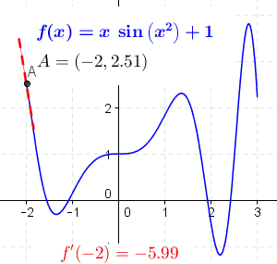
Derivatives
Derivative is a linear operator that transforms f to f’.
Basic relations:
Fast evaluation of function ‘s derivative has wide applications
Linearity: ${\left(af\left(x\right)+bg\left(x\right)\right)}^{′}=af^{′}\left(x\right)+bg′(x)$
$$f⋅dg$$
$$f⋅g$$
Product Rule: ${\left(f\left(x\right)g\left(x\right)\right)}^{′}=g(x)f^{′}\left(x\right)+f\left(x\right)g′(x)$
$$g⋅df$$
Chain Rule: ${\left(f∘g\left(x\right)\right)}^{′}=\left(f^{′}∘g\left(x\right)\right)⋅g′(x)$
Trend prediction
Function optimization
Function approximation
Parameter Sensitivity
Newton ‘s method
Hermite Interpolation
Jacobian for Nonlinear BD
Gradient Descent based
Rational Approximations?

Slide 4
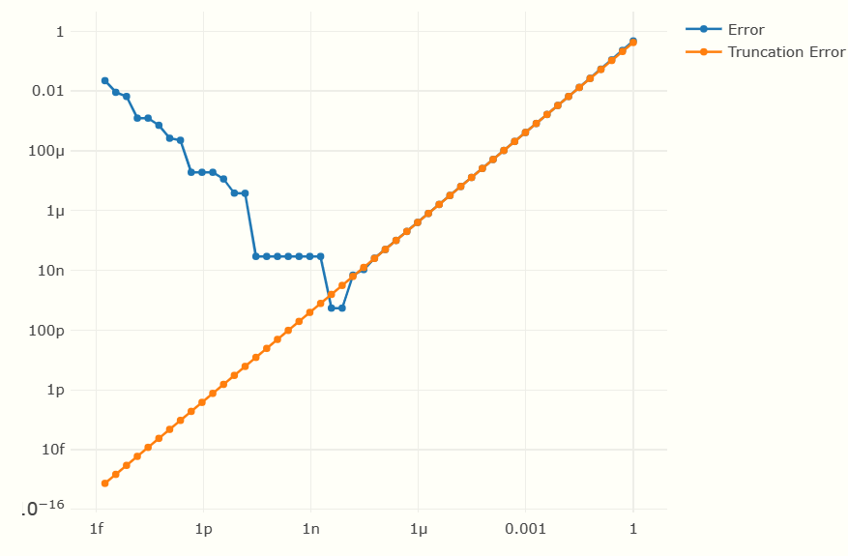
Methods for Obtaining Derivatives
Symbolic differentiation
Complex combination of expressions
Examples: Mathematica, Sympy (Python)
Maybe impractical for a complex system.
Numerical Differentiation
Approximation, depend on stepsize
Round-off errors and truncation errors can
be significant in ill-conditioned problems
$$\frac{∂f(x)}{∂x_{i}}≈\frac{f\left(x+hI_{i}\right)−f\left(x\right)}{h}$$

Slide 5
Auto-Differentiation
Method | Feature
Symbolic differentiation (SD) | Exact expression and most informative; excessive expression
Numerical differentiation (ND) | Work with black-box functions; Numerical error, step size dependence
Auto Differentiation (AD) | SD in algorithm/compiler, precise derivatives; Separate algorithm needed.
Auto-differentiation (AD) decompose calculations into elementary steps and use chain rule for the function compositions.
Consider $y=f_{n}∘f_{n−1}∘⋯∘f_{1}(x)$
with $v_{i}=f_{i}\left(v_{i−1}\right);v_{0}=x;v_{n}=y$
$$\frac{∂y}{∂x}=\frac{∂f_{n}(v_{n−1})}{∂v_{n−1}}\frac{∂f_{n−1}(v_{n−2})}{∂v_{n−2}}⋯\frac{∂f_{1}(v_{0})}{∂v_{0}}$$
Reverse Differentiation
Forward Differentiation

Slide 6
Forward AD
Accelerator community is familiar with the Forward AD(FAD) since the Differential algebra or Truncated Power Series has been introduced.
The process can be illustrated as dual number $<x, x^{′}>$ for first derivative of 1-D functions, with const $c$ as $<c, 0>$ and variable as $<x_{0}, 1>$
More efficient when output dimension is much larger than that of input.
Can be extended to multi-variable $<x, x_{1}^{′},x_{2}^{′},⋯>$ and high orders.
$$<x_{1}, x_{1}^{′}>±<x_{2}, x_{2}^{′}> = <x_{1}±x_{2}, x_{1}^{′}±x_{2}^{′}>$$
$$<x_{1}, x_{1}^{′}>×<x_{2}, x_{2}^{′}> = <x_{1}x_{2}, x_{1}^{′}x_{2}+x_{1}x_{2}^{′}>$$
$$<x_{1}, x_{1}^{′}>÷<x_{2}, x_{2}^{′}> = <\frac{x_{1}}{x_{2}}, \frac{x_{1}^{′}x_{2}−x_{1}x_{2}^{′}}{x_{2}^{2}}>$$
$$f\left(<x, x^{′}>\right)=<f\left(x\right), x^{′}f^{′}\left(x\right)>$$

Slide 7
FAD example
$$y=f(x_{1}, x_{2})=\left[\sin\left(\frac{x_{1}}{x_{2}}\right)+\frac{x_{1}}{x_{2}}−exp\left(x_{2}\right)\right]\left[\frac{x_{1}}{x_{2}}−exp(x_{2})\right]$$
Intermediate Vars. | Expressions | Values | Derivatives with respect to $x_{1}$
$$v_{−1}$$ | $x_{1}$, $<1.5, 1, 0>$ | 1.5 | 1.0
$$v_{0}$$ | $x_{2}$, $<0.5, 0, 1>$ | 0.5 | 0.0
$$v_{1}$$ | $$v_{−1}/v_{0}$$ | 3.0 | 2.0
$$v_{2}$$ | $${sin(v}_{1})$$ | 0.1411 | -1.98
$$v_{3}$$ | $${exp(v}_{0})$$ | 1.6487 | 0.0
$$v_{4}$$ | $$v_{1}−v_{3}$$ | 1.3513 | 2.0
$$v_{5}$$ | $$v_{2}+v_{4}$$ | 1.4924 | 0.02
$$v_{6}$$ | $$v_{5}v_{4}$$ | 2.0167 | 3.0118

Slide 8
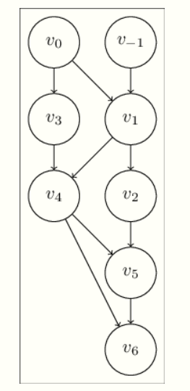
Reverse AD
Reverse AD (RAD) calculate the derivatives from the outer functions, which is the same order with calculation by hand, a reversed direction of function evaluation.
Main workhorse of ML using NN (Backpropagation)
More efficient when input dimension is much larger.
$$y=f_{n}∘f_{n−1}∘⋯∘f_{1}(x)$$
Value evaluation
$$\frac{∂y}{∂x}=\frac{∂f_{n}(v_{n−1})}{∂v_{n−1}}\frac{∂f_{n−1}(v_{n−2})}{∂v_{n−2}}⋯\frac{∂f_{1}(v_{0})}{∂v_{0}}$$
Reverse Differentiation
Adjoints from
Wengert list [1964]

Slide 9
RAD example
$$y=f(x_{1}, x_{2})=\left[\sin\left(\frac{x_{1}}{x_{2}}\right)+\frac{x_{1}}{x_{2}}−exp\left(x_{2}\right)\right]\left[\frac{x_{1}}{x_{2}}−exp(x_{2})\right]$$
Intermediate Vars. | Expressions | Values | Adjoints
$$v_{−1}$$ | $$x_{1}$$ | 1.5 | 3.0118
$$v_{0}$$ | $$x_{2}$$ | 0.5 | -13.7239
$$v_{1}$$ | $$v_{−1}/v_{0}$$ | 3.0 | 1.5059
$$v_{2}$$ | $${sin⁡(v}_{1})$$ | 0.1411 | 1.3513
$$v_{3}$$ | $${exp⁡(v}_{0})$$ | 1.6487 | -2.8437
$$v_{4}$$ | $$v_{1}−v_{3}$$ | 1.3513 | 2.8437
$$v_{5}$$ | $$v_{2}+v_{4}$$ | 1.4924 | 1.3513
$$v_{6}$$ | $$v_{5}v_{4}$$ | 2.0167 | 1.0
Adjoints from
Wengert list [1964]

Slide 10
AD in Accelerators
TPSA implemented in many widely used code such as MADX-PTC and BMAD. It is a forward-AD with $M$ dimensions and $N$ orders.
Each variable is represented by $(N+M)!/N!M!$ Vector
Almost impossible to include large number tuning parameters
The new implementation GTPSA (@Laurent), allows different maximum order for different variables. Recently, a Julia interface (@ Matt) was developed.
Other general AD tools
C++: Stan, Enzyme and CppAD …
Python: PyTorch, mygrad+numpy, TensorFlow …
Julia: Zygote.jl, Enzyme.jl and GTPSA.jl …

Slide 11
JuTrack
JuTrack, an AD enabled beam dynamics tool. The goal is to make simulation results and Truncated Power Series Algebra (TPSA) coefficients differentiable w.r.t. the design parameters of the accelerator.
Physics code (Lattice, Collective Effects)
6-D symplectic tracking with dynamics coordinate, $x, p_{x}, y,p_{y}, z, δ$
and design parameters, $p_{1}, p_{2}, ⋯,p_{n}$
6-D Truncate Power Series, $Ο(N)$
$$f\left(x, p_{x}, y,p_{y}, z, δ\right)=f_{0}+f_{11}x+f_{12}p_{x}+⋯+f_{16}δ+⋯$$
$+f_{N1}x^{N}+f_{N2}x^{N−1}p_{x}+⋯f_{Nm}δ^{N}$
Coefficients, $f_{0}, f_{11},f_{12},⋯,f_{Nm}$
TPSA package
AD
Simulation results, $R_{1}, R_{2}, ⋯, R_{L}$
AD makes $dR/dp$ and $df/dp$ possible!

Slide 12
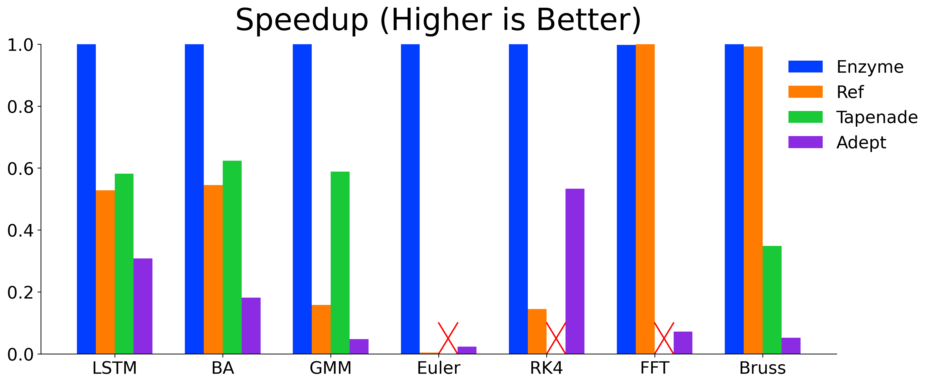
JuTrack (cont’d)
We have chosen Julia + TPSA + AD (Enzyme) modules to implement.
Julia (released in 2012) is a high-level, high-performance programming language designed for technical computing.
Performance:
Julia’s just-in-time (JIT) compilation using the LLVM framework allows it to approach or match the speed of C for many tasks
Ease of use:
Dynamic type with option of explicitly type declaration, e.g., f(x, y), f(x::Int64, y::Float64) and f(x::Int64, y) are all acceptable.
Multiple Dispatch. Allows functions to behave differently based on the type of arguments. E.g., track(ele::Quad) and track(ele::Bend)
Readable Syntax. Easy to understand
Enzyme is a powerful tool designed to perform AD of programs, specifically targeting the LLVM compiler infrastructure, such as C, C++, Rust, and Julia.
In many AD tools, the process of differentiating code occurs at a high level, before the code is optimized by the compiler.
Enzyme makes it much faster by working at LLVM level.

Slide 13
JuTrack Status
Beam and lattice module
create various accelerator elements and build lattice
create beam with specific type of particles
calculate optics and coupling (based on Edward Teng’s parameterization)
Truncated power series algebra (TPSA) module
create TPS of arbitrary order
do arithmetic of TPS, include + - * / sin exp log sqrt pow sinh
Tracking module
symplectic integration for elements in particle accelerator.
calculation of collective effects (still under development)
parallel computing using multi-threading feature of Julia

Slide 14
Modeling of Collective Effects
Space Charge and Beam-Beam Effects
Soft Gaussian Model, Bassetti-Ershkin Formula with customized derivatives.
Self-consistent approach, Grid-less kick [J. Qiang, PRAB 20, 014203 (2017)] :
Wake field, from the convolution of the Green functions.
$$Δp_{y}+iΔp_{x}∼w\left[\frac{x+iy}{\sqrt{2\left(σ_{x}^{2}−σ_{y}^{2}\right)}}\right]−e^{−\frac{x^{2}}{2σ_{x}^{2}}−\frac{y^{2}}{2σ_{y}^{2}}}w\left[\frac{\frac{xσ_{y}}{σ_{x}}+\frac{iyσ_{x}}{σ_{y}}}{\sqrt{2\left(σ_{x}^{2}−σ_{y}^{2}\right)}}\right]$$
The Faddeeva function $w\left(z\right)$ has its derivative: $\frac{dw\left(z\right)}{dz}=\frac{2i}{\sqrt{π}}−2zw(z)$
$$Dp_{xi}\left(τ\right)=Dp_{xi}\left(0\right)−Dτ\frac{K}{2}\sum_{l=1}^{N_{l}}{\sum_{m=1}^{N_{m}}{Dφ^{lm}α_{l}\cos\left(α_{l}Dx_{i}\right)\sin\left(β_{m}Dy_{i}\right)}}$$
where
$$Dφ^{lm}=4π\frac{4}{ab}\frac{1}{N_{p}}\sum_{j=1}^{N_{p}}{\frac{1}{γ_{lm}^{2}}}\sin\left(α_{l}Dx_{j}\right)\sin\left(β_{m}Dy_{j}\right)$$
$$Dp_{yi}\left(τ\right)=Dp_{yi}\left(0\right)−Dτ\frac{K}{2}\sum_{l=1}^{N_{l}}{\sum_{m=1}^{N_{m}}{Dφ^{lm}β_{m}\sin\left(α_{l}Dx_{i}\right)\cos\left(β_{m}Dy_{i}\right)}}$$

Slide 15
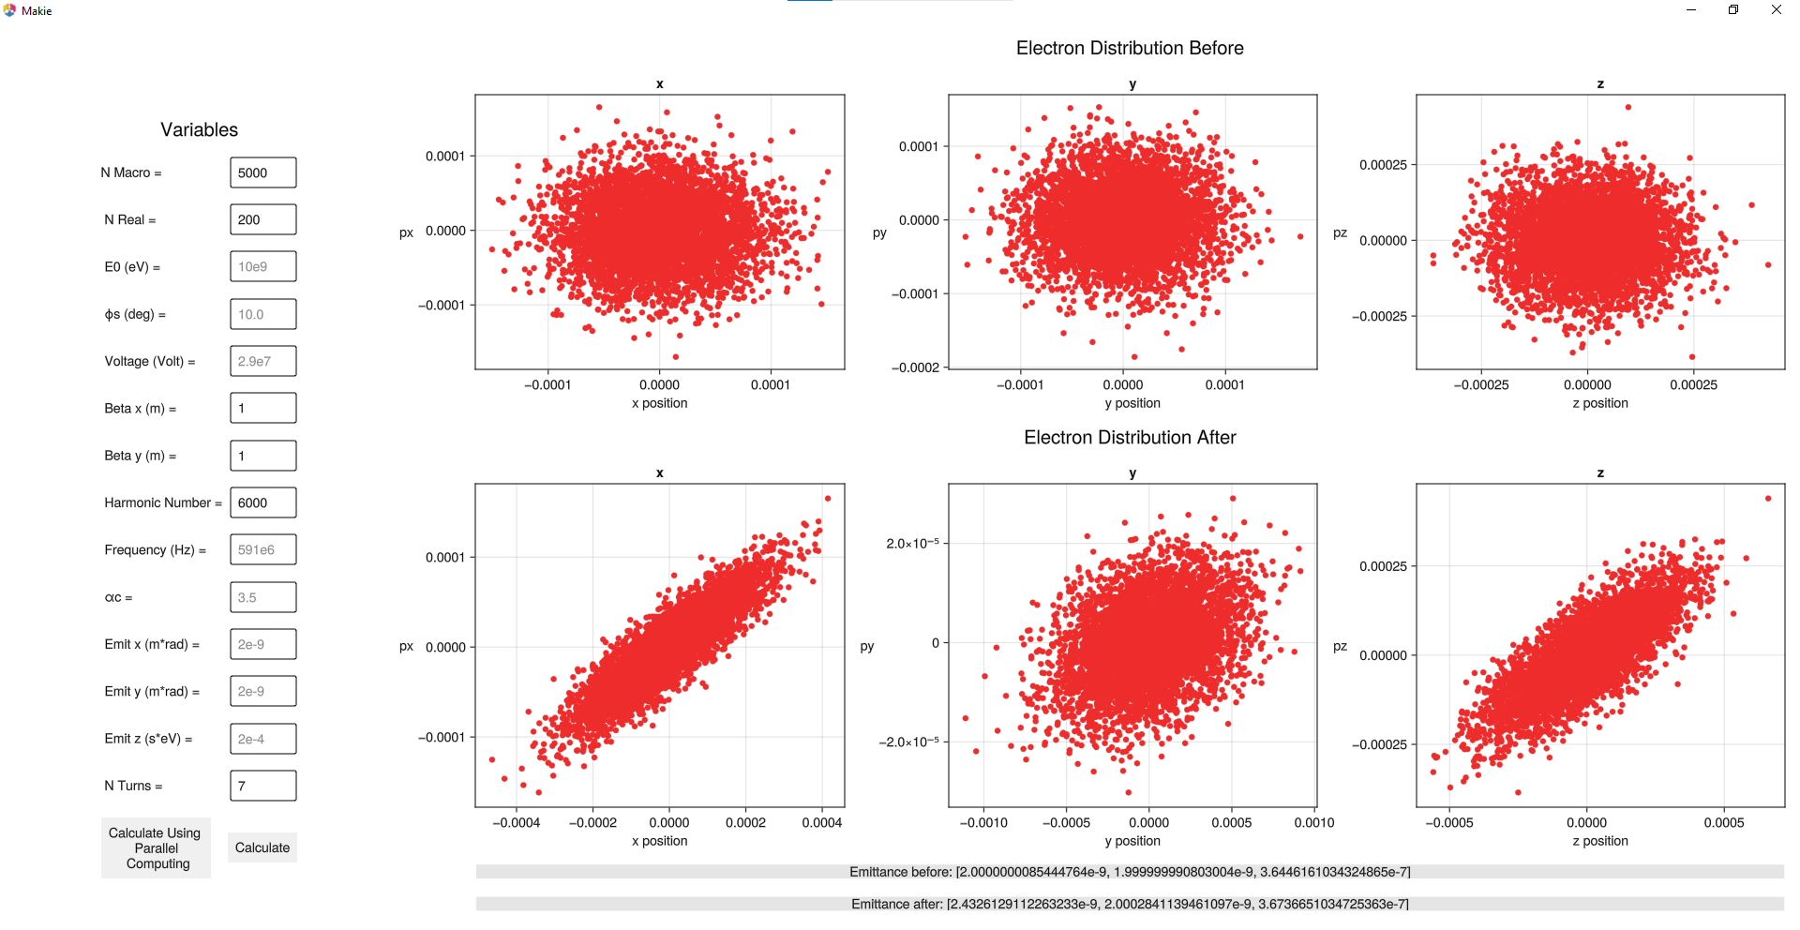
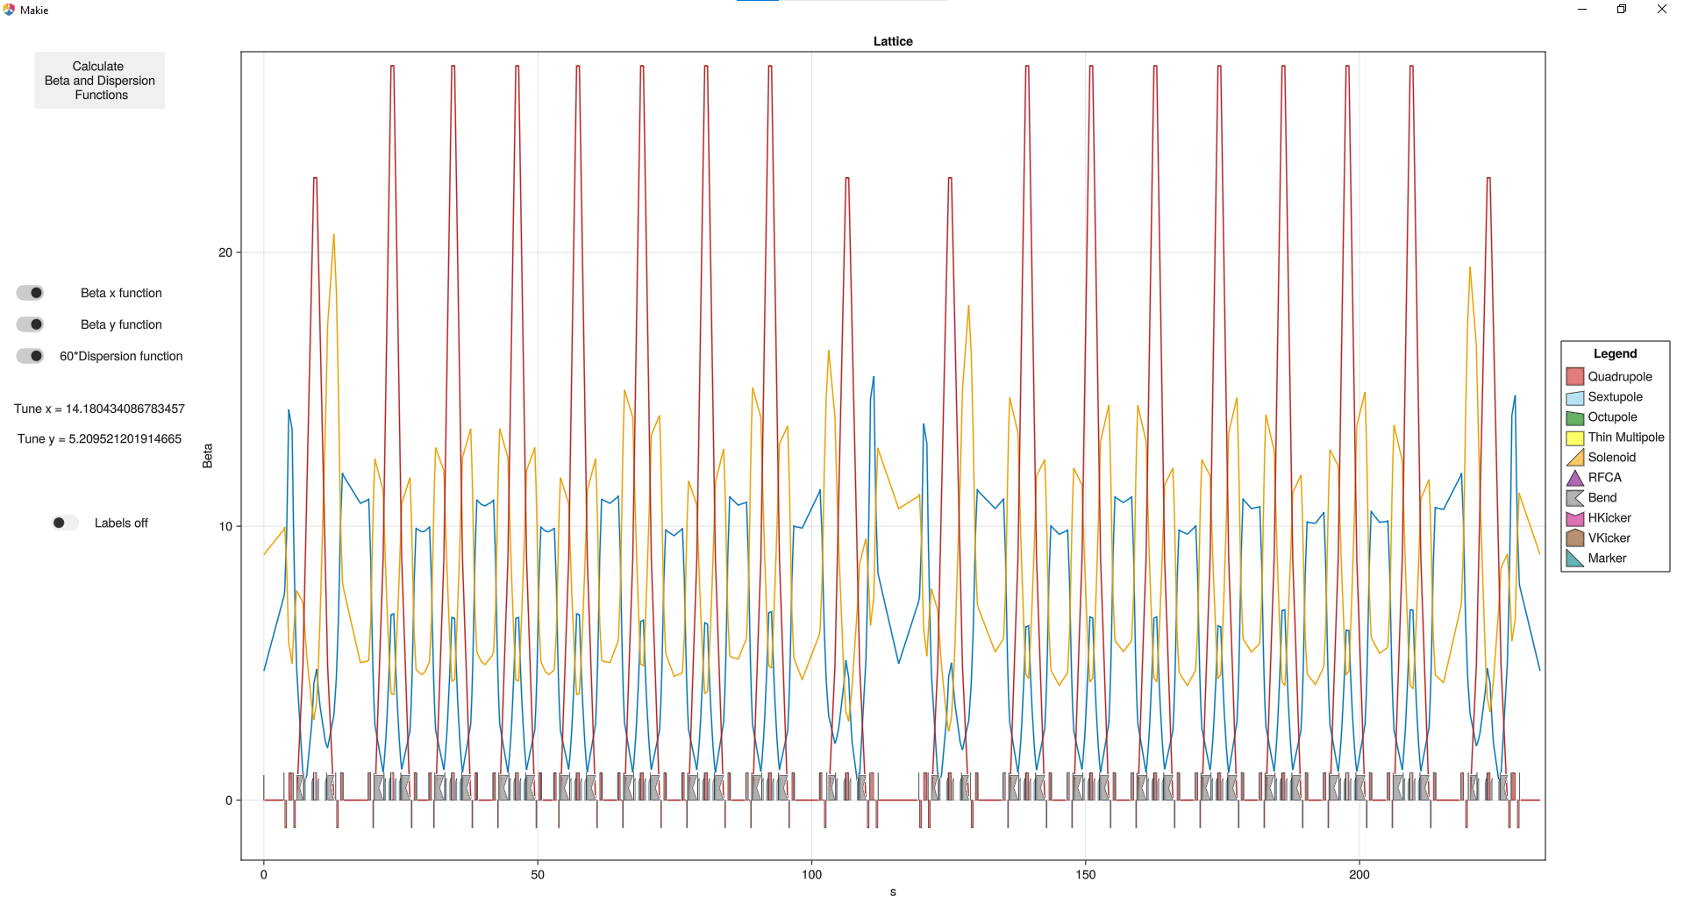
JuTrack GUI
Optics Display
Beam Tracking

Slide 16
Example of AD Particle Tracking
For a FODO cell with two parameters (k1 and k2), the tracking results and its derivatives can be expressed as
function f(k1, k2)
xin = [0.001 0.0001 0.0 0.0 0.0 0.0]
beam = Beam(xin) D1 = DRIFT("D1", 0.5)
Q1 = KQUAD("Q1", 1.0, k1, 0)
D2 = DRIFT("D2", 0.5)
Q2 = KQUAD("Q2", 1.0, k2, 0)
seq = [Q1, D1, Q2, D2]
linepass!(seq, xin)
return beam.r
end
k1 = 1.0
K2 = -1.0
Grad = jacobian(Forward, f, [k1, k2], Val(2))
 | $d$x | $$dp_{x}$$ | $d$y | $$dp_{y}$$ | $d$z | $$dδ$$
$$dk_{1}$$ | -0.0031362 | -0.0020738 | 0.0 | 0.0 | 2.54465e-6 | 0.0
$$dk_{2}$$ | 8.37936e-5 | 0.00014908 | 0.0 | 0.0 | -8.04511e-8 | 0.0

Slide 17
Example of TPSA
Instead of a specific initial condition, we track the TPSA wrt origin and use k1 and k2 as the parameter
TPS coefficients for x:
[0.0, 0.8142086540076545, 0.6148743649232753, 0.0, 0.0, 0.0, 0.0, 0.0, 0.0, 0.0, 0.0, 6.77177969053929, 0.0, 0.0, 0.0, 0.0, 3.777328658722505, 0.0, 0.0, 0.0, 0.0, 0.0, 0.0, 0.0, 0.0, 0.0, 0.0, 0.0]
derivatives of the coeffecients w.r.t. k1 and k2:
w.r.t. k1, [-0.0, -0.7066709784430745, -0.27861605201268735, -0.0, -0.0, -0.0, -0.0, -0.0, -0.0, -0.0, -0.0, -2.2561205078968287, -0.0, -0.0, -0.0, -0.0, -0.4931722737026719, -0.0, -0.0, -0.0, -0.0, -0.0, -0.0, -0.0, -0.0, -0.0, -0.0, -0.0],
w.r.t. k2, [0.0, -4.445896312934257, -2.614025589841921, 0.0, 0.0, 0.0, 0.0, 0.0, 0.0, 0.0, 0.0, 7.313226768999287, 0.0, 0.0, 0.0, 0.0, 5.576041849897743, 0.0, 0.0, 0.0, 0.0, 0.0, 0.0, 0.0, 0.0, 0.0, 0.0, 0.0]
function f(k1, k2)
x = CTPS(0.0, 1, 6, 2)
px = CTPS(0.0, 2, 6, 2)
y = CTPS(0.0, 3, 6, 2)
py = CTPS(0.0, 4, 6, 2) delta = CTPS(0.0, 5, 6, 2)
z = CTPS(0.0, 6, 6, 2)
xin = [x,px,y,py,z,delta]
D1 = DRIFT("D1", 0.5)
Q1 = KQUAD("Q1", 1.0, k1, 0)
D2 = DRIFT("D2", 0.5)
Q2 = KQUAD("Q2", 1.0, k2, 0)
seq = [Q1, D1, Q2, D2]
track!(seq, xin)
return xin[1].map
end

Slide 18
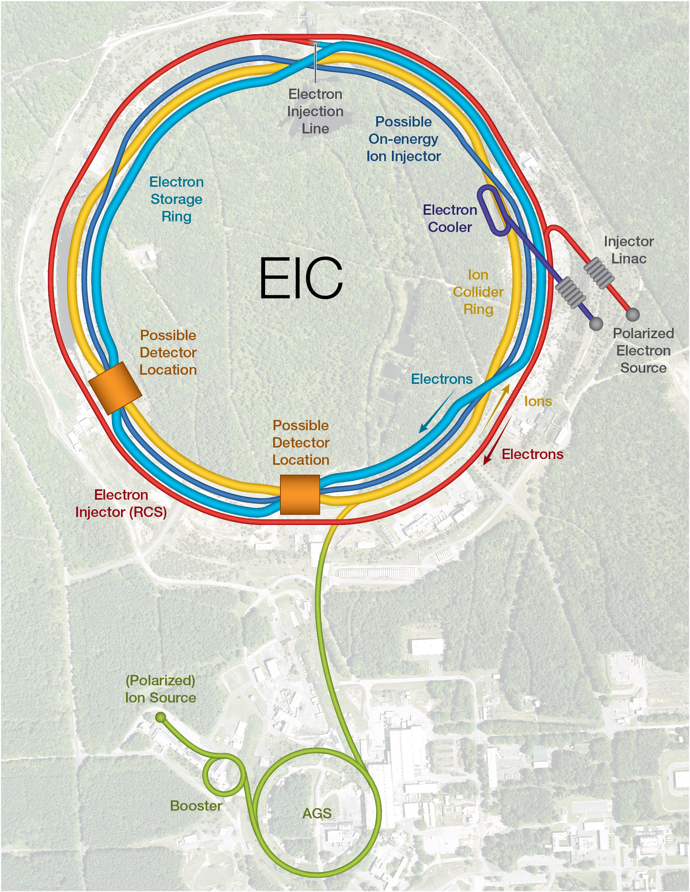
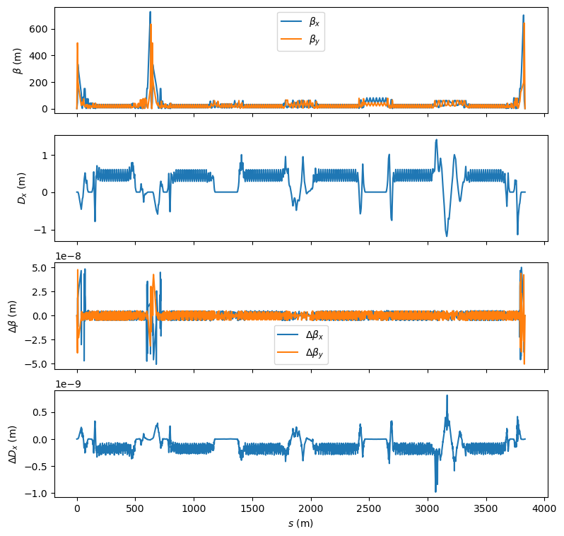
A real-life example
EIC is an ongoing project of US DOE which adds a new electron ring and its injector to the existing RHIC complex.
We reads in the current ESR lattice of MADX.
The calculated optics agrees well with MADX
MADX Tune: 50.0800, 46.1400
JuTrack Tune: 50.0800, 46.1398

Slide 19
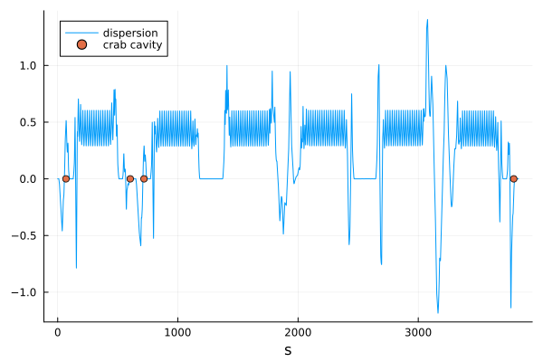
Application in Optimization
In local scheme of crab-crossing, the phase advance between two crab cavities should be $nπ$.
Method: optimize 7 quadrupoles located between CC4 and CC1 (Their original strength is 0)
Do a simple gradient descent optimization:
$k_{new}=k_{old}−step∗g,$
$$step=1e^{−5}$$
${φ_{23}=φ}_{3}−φ_{2} =$2.0000 $π$
$φ_{41}=φ_{1}+φ_{1turn}−φ_{4} =$2.0272 $π$

Slide 20
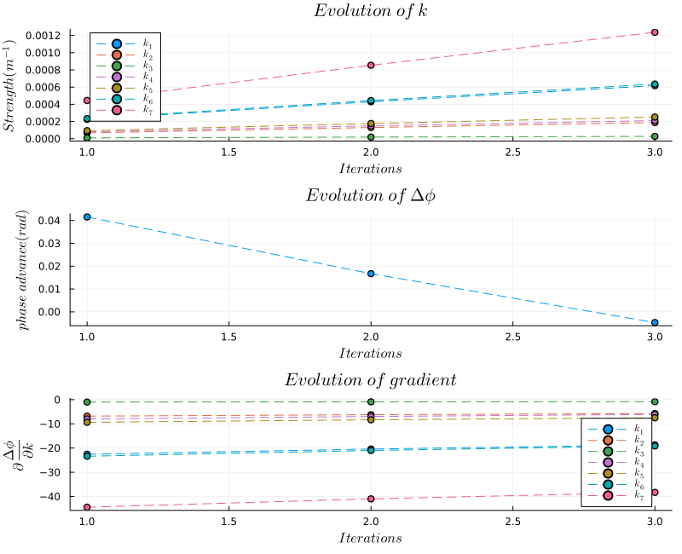
Simplified phase adv. matching
Optimization goal: $∆φ=phase advance −2π$
The phase advance is optimized within 3 steps.
More work is needed to use the existing optimizer which support constrains.

Slide 21
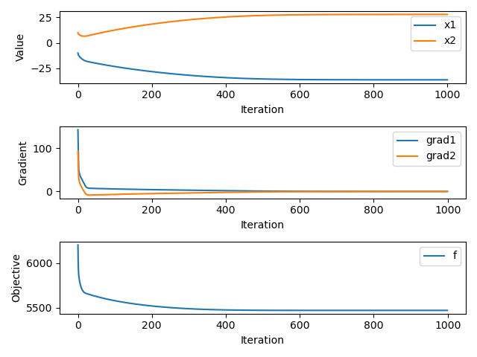
Application in Nonlinear Optimization
The nonlinear DA indicators are used for optimizing DA.
We use SPEAR3 lattice as an example to show gradient based optimization of 3rd order Nonlinear Driving terms using two sextupole families.
Use $h\left(k_{2SF},k_{2SD}\right)={h_{30000}+h}_{21000}+h_{10110}+h_{10200}+h_{10020}$ as a test.
Here we only tested a basic gradient descent algorithm. Reach minimum in 400 iterations. The function may be trapped in a local minimum.

Slide 22
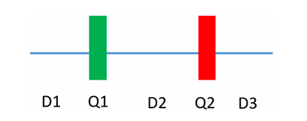
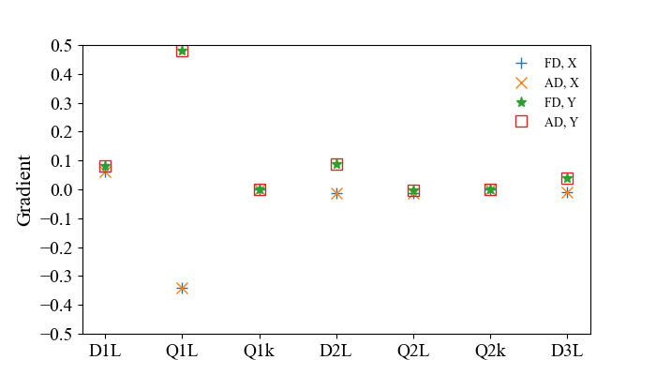
Application in Self-Fields
Evaluate/Benchmark the self-consistent space charge using the grid-less symplectic method. Calculate derivative of final emittance (normalized by the initial emittance) with respect to the design parameters.
4-D Gaussian distribution
Specie: proton
Normalized emittance: 1mm
Current: 200 A
Energy: 1 GeV
Number of slices:
4 4 8 4 4
Space charge kick occurs in the middle of each slice
AD: derivatives calculated with auto differentiation
FD: derivatives estimated with finite difference approximation.
Results also agree with the Ji Qiang’s earlier work.

Slide 23
Summary
JuTrack is an on-going project for Auto-Differentiation enabled accelerator design and beam dynamics code.
JuTrack adopts the flexibility and high-performance Julia language and the modules from the community.
The code can be applied in
Optimization of lattice
Nonlinear Beam dynamics
Dynamics of self fields and more …
We plan to test alternative TPSA/AD packages. We are looking forward to any form of collaboration on code developments and broader range of applications.

