Slide 1
REALISTIC UNDULATORS FOR INTENSE GAMMA-RAY BEAMS AT FUTURE COLLIDERS
Ayash Alrashdi
King Abdul-Aziz City for Science and Technology (KACST)

Slide 2
Outline
Introduction.
HUSR Software Spectra.
Produce realistic undulator magnetic field.
Electron Trajectory Inside ILC Helical Undulator.
Energy spectrum from ideal and realistic undulator field maps.
Additional applications using the ILC gamma-ray beam.
Conclusion.

Slide 3
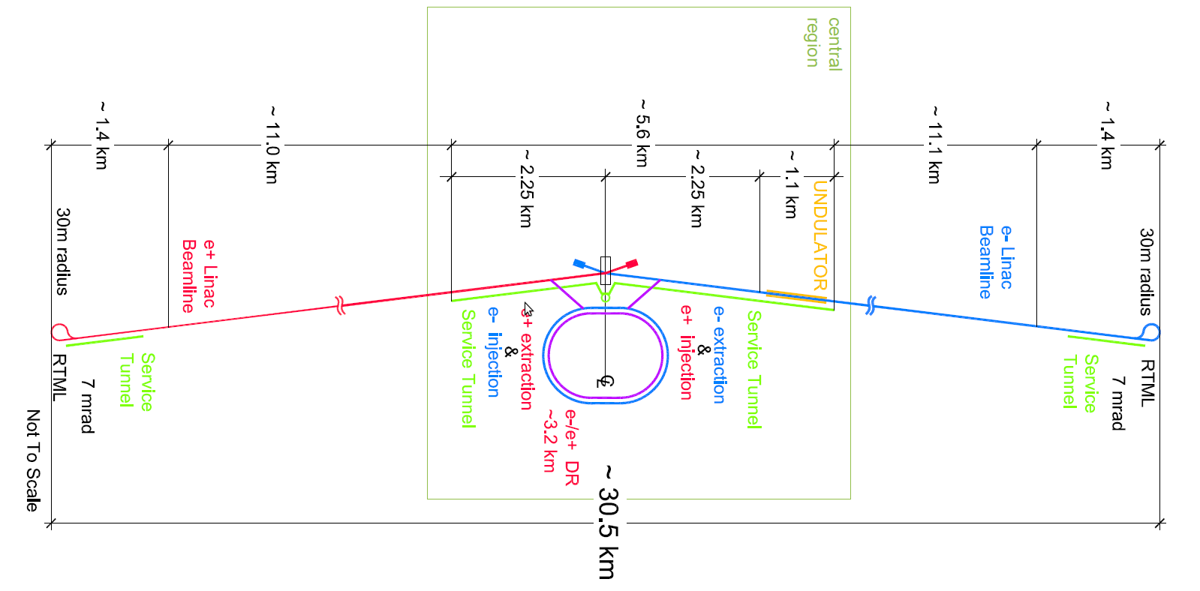
Introduction
Required photon flux (approximately 10¹⁶ photon/s) for high-luminosity electron positron colliders such as the ILC.
The TDR parameters for the baseline positron source at 150 GeV are assumed throughout this talk.
3.9x10¹⁴ e⁺/s

Slide 4
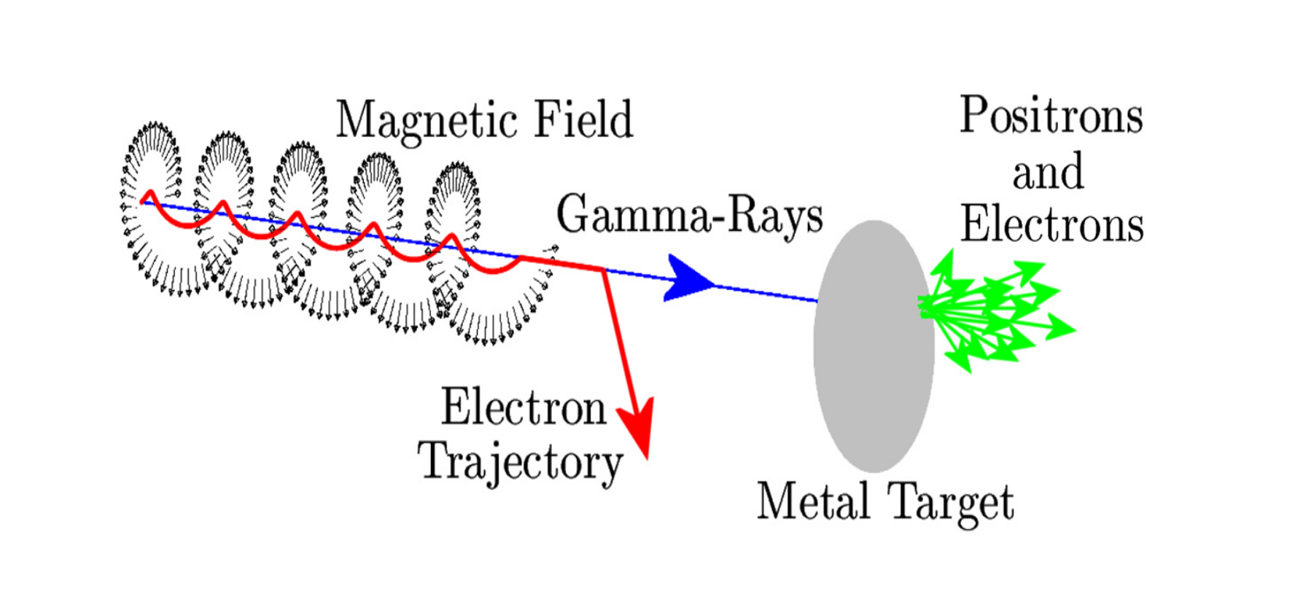
Introduction
Layout of the method of producing polarised positrons from high energy electrons passing through helical undulator

Slide 5
SIMULATING UNDULATOR PHOTON SPECTRA
HUSR developed at Cockcroft Institute by David Newton.
HUSR simulates a photon spectrum from an arbitrary magnetic field map.
Using different arbitrary maps is possible in HUSR e.g. include errors in the magnet, tapering, etc.

Slide 6
Bench marking HUSR energy spectra with Kincaid energy spectra.

Slide 7
Produce realistic undulator magnetic field.
Code were developed to produced a realistic undulator field map from any measured field map.
Errors were introduced in the simulated magnetic field map based on the measured magnetic field of the ILC prototype undulator.
We compared the discrete Fourier Transform of the x-projection of the magnetic field within the undulator for the measured data and simulated data to tune the error parameters used in the model.

Slide 8
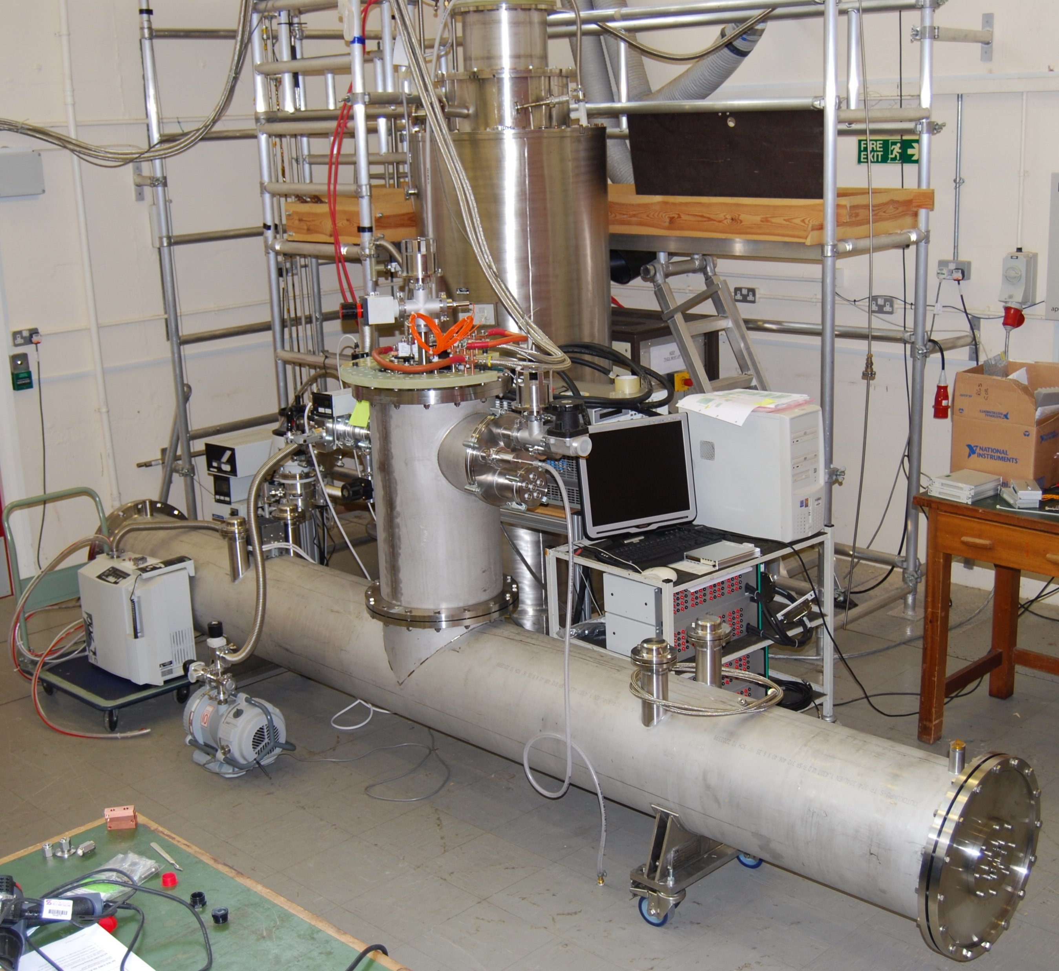
Prototype for the helical undulator

Slide 9
Produce realistic undulator magnetic field.
Discrete Fourier transform of the x-projection and y-projection of the magnetic field in the undulator.
Design Period
X-projection Measured
Y-projection Measured
Simulated

Slide 10
Electron Trajectory Inside ILC Helical Undulator.
HUSR were used with a measured map from the ILC helical undulator prototype constructed some years ago.
This map were used inside the HUSR software to calculate the trajectory of an electron inside this map and the resulting photon spectra.
We have generated many simulated field maps and used them to explore deviations in the electron trajectory and the impact on the spectrum.

Slide 11
Electron Trajectory Inside ILC Helical Undulator.
Electron Trajectory from Ideal Map
Electron Trajectory from Simulated Map
Electron Trajectory from Measured Map

Slide 12
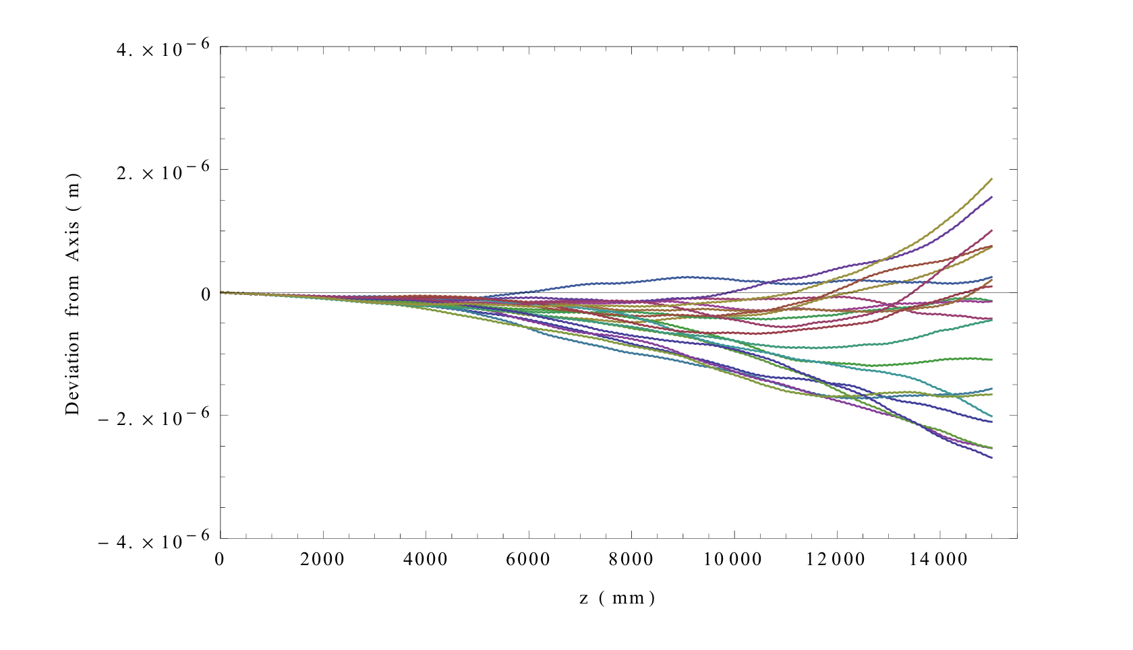
Electron Trajectory Inside ILC Helical Undulator.
To investigate a representative sample of possible trajectories of the electron inside the undulator, 20 simulated different modules were used.
X axis
Y axis

Slide 13
Electron Trajectory Inside ILC Helical Undulator.
Electron Trajectory from Simulated Map
Electron Trajectory from Measured Map
Electron Trajectory from Ideal Map

Slide 14
Energy spectrum from ideal and realistic undulator field maps.
Energy spectrum were investigated to see the effects of using the measured and simulated field maps and compared them to the ideal.

Slide 15
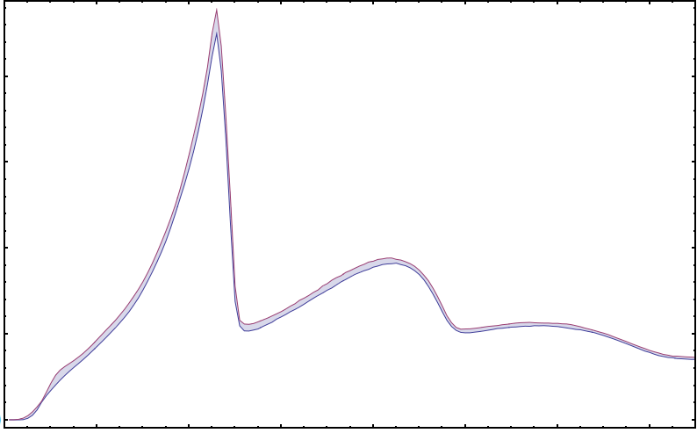
Energy spectrum from ideal and realistic undulator field maps.
Measured energy spectrum compared to energy spectrum from one representative example of the 20 simulated filed maps.
Spread of gamma-ray spectra from the simulated field maps.
Flux (A.U.)

Slide 16
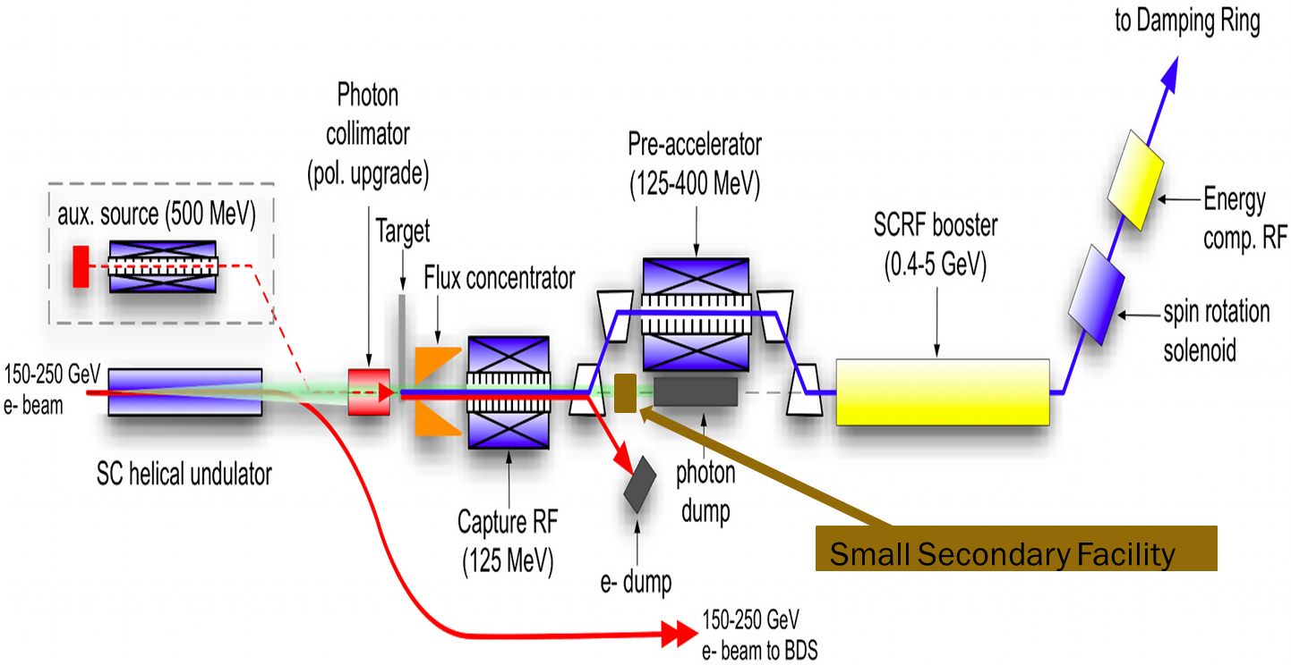
Additional applications using the ILC gamma-ray beam
Only 7% or less of the ILC gamma-ray beam will be used to produce positrons, therefore, possibility of using the ILC gamma-ray for additional applications e.g. nuclear physics were considered.
A possible design for the ILC positron source with secondary experimental station.

Slide 17
Additional applications using the ILC gamma-ray beam
We adapted the HUSR software to automatically detect the positions of the observation points which give spectra in accordance with the users requirements.
Method
We designed the required spectra (from user).
We select those observation points which has a spectra which lies fully underneath the designed spectra or exactly equal to the designed spectra.
Based on the results we can decide which collimator shape would give the required spectra.

Slide 18
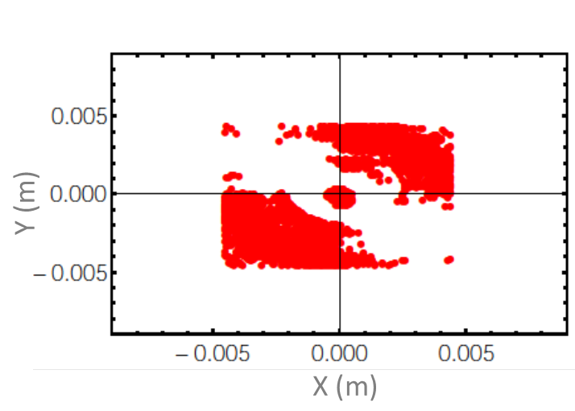
Additional applications using the ILC gamma-ray beam
Two techniques were developed to automatically define the collimator shape which give the required energy spectra from the users.
Flux (A.U.)
Flux (A.U.)

Slide 19
Additional applications using the ILC gamma-ray beam
The flux of the peak
corresponding to 8x10¹³ photon/s
Current Gamma-Ray Sources:
HIGS (10⁸ photon/s, Bandwidth 5%-10%) at Duke University , USA.
ELI-NP is being designed (8x10⁸ photon/s, Bandwidth 0.5%).
Flux (A.U.)

Slide 20
Conclusion
Good agreement between the simulated field map with errors introduced and the measured field map.
By evaluating the spectrum using a numerical code with a high accuracy and realistic simulated data we hope to turn this initial study into a detaild investigation.
From this work suggests a drop in positron yield of ∼ 7% compared to the ideal case.
This reduction could be compensated for by optimising the beam trajectory through the undulator or if required increasing the undulator length to approximately 160 m.
Based on the initial results, we believe there is a good chance that the spent ILC gamma-ray beam could be put to good use.

Slide 21
Thank you

